Slide 1
Microservice-based Full Stack Application For Employee Time Clocking
Name: Salal Shahid Candidate Number: 384089 Supervisor Name: Dr. Oluwole Ajala Date: October 14th, 2024

Slide 2
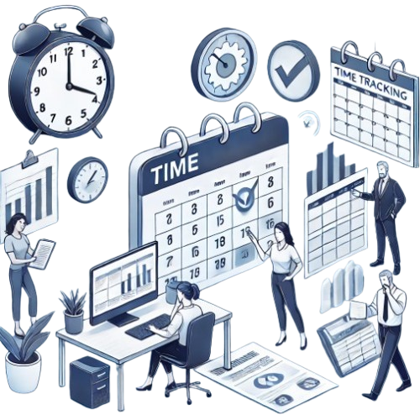
Introduction
Problem Statement
Aims
Objectives
Inefficiency
Error-Prone
Lack of Scalability
Paper-Based Limited Visibility:
Scalability
Microservice-Based Architecture
Automation
Clock In/Out Functionality
Project-Specific Hours: Detailed Reports
Security and Ease of Use
Design and Implement Microservices
Develop a Responsive Frontend
Implement Secure Authentication:
Generate Customizable Reports
Notes:
Problem statement:
In today's fast-paced digital environment, traditional time-tracking systems face several challenges. They are often inefficient, error-prone, and difficult to scale. Businesses relying on manual entries or outdated systems experience payroll inaccuracies, project management difficulties, and limited insight into employee productivity.
Aims:
The aim of my project was to develop a scalable, automated solution to these challenges by creating a microservice-based time-tracking application. This system automates employee time monitoring, making it easy for employees to clock in and out, assign their work hours to specific tasks or projects, and generate comprehensive reports.
Objectives
To achieve this, I set out the following objectives:
Design and implement four independent microservices for handling core business operations like user administration, time logging, project management, and notifications.
Develop a responsive and user-friendly frontend using React, ensuring the interface is intuitive and easy to navigate.
Implement secure JWT-based authentication to ensure data security and control access based on roles.
Finally, provide a customizable reporting feature to generate detailed reports for managers, offering valuable insights into employee performance and project progress.

Slide 3
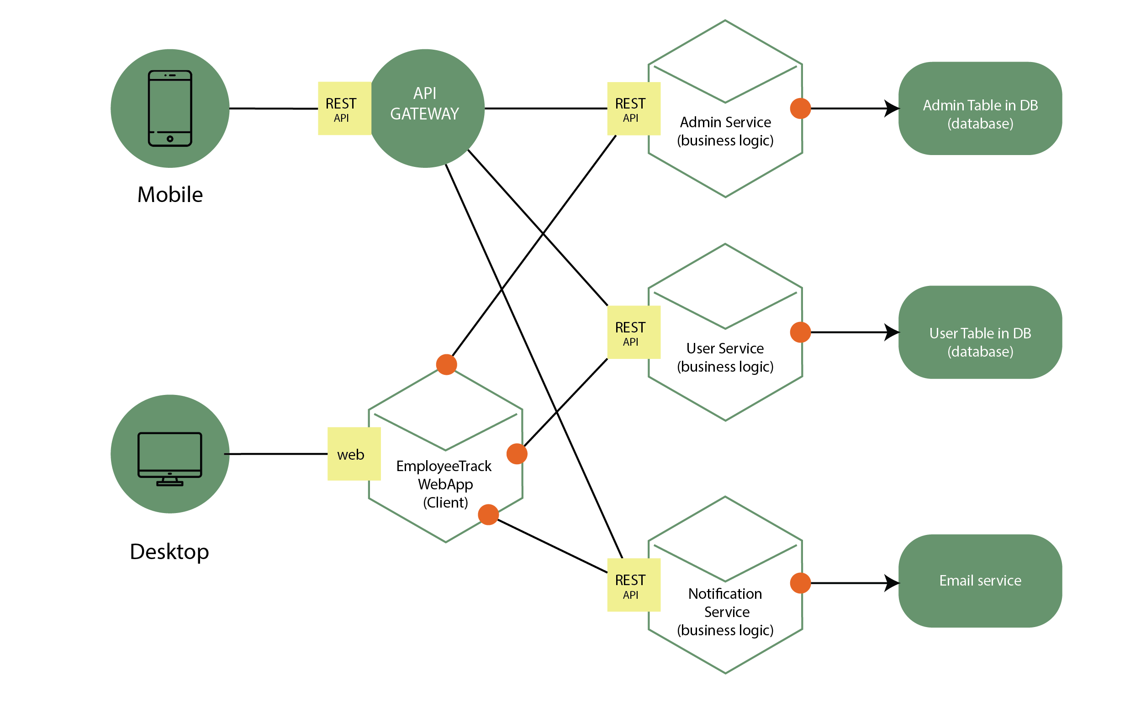
Background Overview
Need for Efficient Time Tracking
Microservices Architecture
Modern businesses require efficient time-tracking systems to enhance productivity, reduce errors, and optimize project management. Traditional monolithic systems struggle with scalability and maintenance, leading to higher operational costs and reduced efficiency.
Modularity: Independent services (e.g., user management, time tracking) simplify maintenance and scaling.
Scalability: Services can be scaled individually, allowing the system to grow with business needs.
Flexibility: Services can be updated or replaced independently, improving adaptability to new requirements.
Key Benefits of Microservices
Improved Performance: Smaller, isolated services reduce overhead and improve responsiveness.
Fault Tolerance: Failures in one service do not crash the entire system, improving system reliability.
Technology Flexibility: Each service can use the best-suited technology stack for its function.
Notes:
1: Need for Efficient Time Tracking:
As businesses grow, the complexity of managing employee work hours increases. Traditional systems, such as manual time entries or paper-based systems, are no longer sufficient to meet the demands of modern workplaces. These systems are prone to errors, inefficient, and difficult to scale, which affects the overall productivity and accuracy of tracking employee hours.
2: Microservices architecture:
To address these challenges, I chose to implement a microservice-based architecture. Microservices allow us to break down the system into smaller, independent services. Each service, whether it's for time logging, user administration, or notifications, can operate and scale independently. This brings several benefits:
Modularity: Each service is focused on a specific function, which makes maintenance easier.
Scalability: We can scale individual services depending on business needs without affecting the rest of the system.
Flexibility: As new features or services are required, they can be added or updated without disrupting the entire application.
3. Why microservices were chosen:
Microservices were chosen over monolithic architectures because they provide improved performance, fault tolerance, and the flexibility to use the best technology for each service. This ensures that the system remains responsive, reliable, and easy to manage as it scales
Improved Performance: Each service can be optimized for its specific function, leading to better overall performance. For instance, the time logging service can be designed to handle large numbers of requests efficiently without impacting other parts of the system.
Fault Tolerance: If one microservice (such as notifications) fails, it doesn’t crash the entire system. The other services continue to operate independently, ensuring that the system remains stable.
Flexibility: Different technologies can be used for different services. For example, the backend can use Django, while the frontend uses React. This allows for a more flexible and future-proof system, as each service can evolve independently.

Slide 4
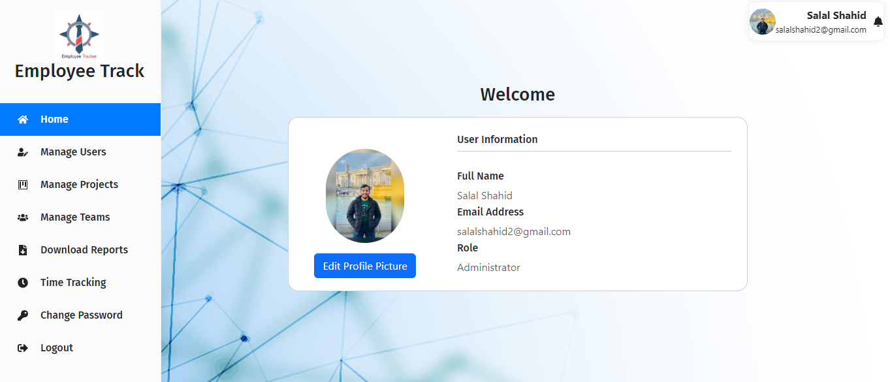
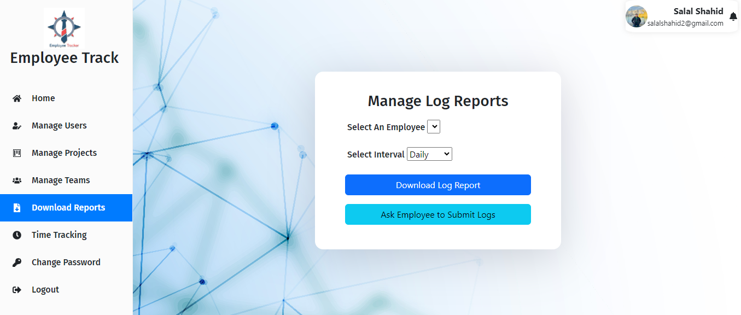
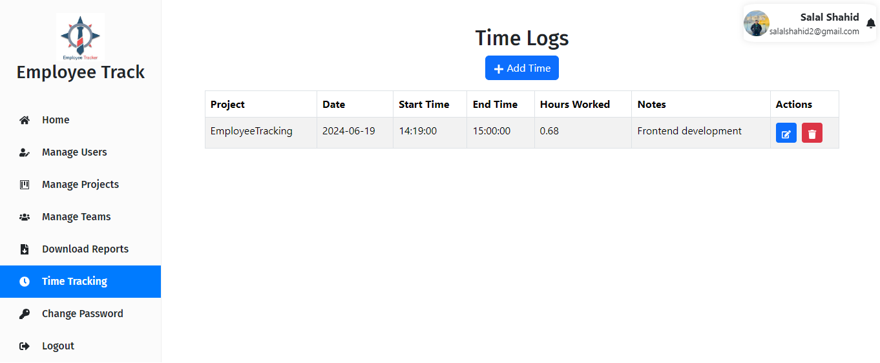
Project Delieverables
Main Features of the Application
Time Logging Service
Project Management Service
Notification Service
Reporting and Analytics
Notes:
The main deliverables of this project focus on providing an automated, scalable solution for employee time tracking and project management. The system consists of several core components:
Time Logging Service: The Time Logging Service allows employees to clock in and out, log their breaks, and assign their working hours to specific projects. This ensures that all time entries are accurate and linked to the correct project, avoiding any discrepancies in time tracking
Project Management Service: The Project Management Service enables managers to create and assign projects to employees. This feature provides an easy way for managers to track project-specific time logs, monitor progress, and ensure that resources are allocated effectively.Notification Service:The Notification Service is event-driven and ensures that both employees and managers are kept informed. It sends notifications like reminders for missing time logs or updates on project completion via email or push notifications, ensuring that everyone stays on track.
Reporting and Analytics: Lastly, the system includes a Reporting and Analytics feature that allows managers to generate detailed, customizable reports. These reports provide insights into employee performance, project efficiency, and overall time usage, helping to make data-driven decisions.
Introduce the image: As you can see from this screenshot of the system's user interface, the Employee Track application offers a clean, user-friendly experience. The sidebar on the left provides easy access to features like time tracking, project management, and report downloads, making it straightforward for both employees and managers to use the system.

Slide 5
High-Level Design
System Components
API Gateway:
Web Application (Frontend)
Microservices (Backend)
Database (MongoDB Atlas)
Data Flow
Notes:
The system is designed using a microservice-based architecture to ensure modularity, scalability, and flexibility. The key components of the system communicate through an API gateway, which serves as the central point of interaction between the frontend and backend services.
API Gateway:The API Gateway routes all requests coming from the frontend to the appropriate backend microservices. This simplifies the interaction between the client and the backend by acting as a unified interface for all the services.
Web Application:The Web Application or frontend, built using React.js, offers a responsive and intuitive user interface. It allows users to log in, track their working hours, manage projects, and generate reports. The web client communicates with the backend services through REST APIs, ensuring seamless data flow.
Microservices (Backend):On the backend, each microservice handles a specific task:
Admin Service: Manages user roles, permissions, and administrative tasks.
User Service: Handles user registration, authentication (JWT-based), and profile management.
Time Logging Service: Manages time entries, allowing users to clock in and out, and track project-specific hours.
Notification Service: Sends automated reminders and updates based on key system events.
Reporting Service: Generates customizable reports for managers, providing detailed insights.
Database: All data is stored in MongoDB Atlas, which offers a scalable cloud-based solution for storing user profiles, time logs, project data, and notifications. The database structure is optimized for performance, ensuring that data retrieval is fast and efficient, even with large datasets.
Data flow: The data flow starts when a user interacts with the web application. The API Gateway forwards their request to the relevant service, such as logging time or generating reports. Each microservice performs its task and stores or retrieves data from the MongoDB Atlas database.

Slide 6
Implementation
1: Backend (Django Framework)
JWT Authentication
Time Logging and Project Management Services
2: Frontend (React.js)
3: Database (MongoDB Atlas)
4: Notification Service
5: Security
Notes:
Backend technologies
For the backend, I used the Django framework, a Python-based web framework known for its security and scalability. Django handles all the core business logic, including managing time logs, user authentication, and administrative tasks. To ensure secure access to the system, I implemented JWT-based authentication. This method allows us to authenticate users with a JSON Web Token (JWT), which ensures that only authorized users can access the application and perform their tasks.
Frontend technologies: On the frontend, I used React.js, which offers a responsive and interactive user interface. React’s component-based architecture allowed me to build a modular UI that is easy to update and maintain. Key functionalities, such as clocking in/out, managing projects, and generating reports, are all handled through React's dynamic features.
Database choice: For data storage, I used MongoDB Atlas, a cloud-based NoSQL database. MongoDB is highly scalable, which makes it ideal for handling large datasets like time logs and user data. The cloud-hosted solution ensures that the system can handle high traffic loads efficiently without compromising performance.
Notification Service: The Notification Service is event-driven, meaning it triggers alerts based on user actions. For example, if an employee forgets to log their time, the system automatically sends a reminder email. This keeps employees and managers informed in real time and helps ensure that time-tracking data is accurate and up to date.
Security Measures: Data security is paramount in this system. The entire application uses HTTPS to encrypt data in transit, and MongoDB ensures that data is encrypted at rest. JWT tokens provide secure access control, preventing unauthorized users from accessing the application.

Slide 7
Project Evaluation and Key Findings
Achievements:
Scalability
Security
User-Friendly Interface
Customizable Reports
Challenges:
Notification Frequency
Large Datasets
Integration Complexity
Notes:
Achievements:
This project achieved several key milestones:
Scalability: By using a microservices architecture and MongoDB Atlas for cloud storage, the system can easily scale to handle more users and larger datasets without affecting performance.
Security: The implementation of JWT-based authentication and encrypted data storage ensures that all user data remains secure. The use of HTTPS also ensures data security during transmission.
User-Friendly Interface: The frontend, built using React, provides a responsive and intuitive interface, making it easy for both employees and managers to use the system effectively.
Challenges: However, there were also some challenges:
Notification Overload: During testing, we realized that too many notifications could overwhelm users. We had to adjust the frequency of notifications to ensure they were helpful and not intrusive.
Handling Large Datasets: As the amount of time logs and project data increased, ensuring fast performance became a challenge. Optimizing the database queries and scaling MongoDB Atlas was necessary to keep the system responsive.Testing Results:Testing of the system yielded positive results
Functionality: The core features of the system, including time logging, project management, and reporting, passed functionality tests.
Performance: Under load, the system maintained good performance, even with larger datasets. MongoDB Atlas allowed for seamless scaling, and the React frontend remained responsive
Key Findings:
Overall, the system provides a robust solution for employee time tracking and project management. It addresses key pain points such as security, scalability, and usability, though improvements can be made in notification management and performance optimization.

Slide 8
Conclusion and Future Work
Conclusion
The project successfully developed a scalable and secure microservice-based time-tracking application.
The system automates employee time logging, project management, and report generation, providing a user-friendly interface with robust backend services.
Scalability and security were the key strengths, achieved through modular microservices, JWT-based authentication, and MongoDB’s scalable data storage.
Future Work
Mobile Application Development
Predictive Analytics
Advanced Role-Based Access Control (RBAC)
Real-Time Collaboration Features
Integration with Third-Party Tools
Notes:
Conclusion:
In conclusion, this project successfully developed a scalable, secure, and user-friendly solution for employee time tracking and project management. The use of microservices architecture, a responsive React frontend, and MongoDB Atlas as the cloud database ensured that the system could handle a growing number of users and large datasets efficiently.The system addresses the key challenges of traditional time-tracking systems by providing automation, real-time notifications, and detailed reporting features, all while ensuring data security with JWT-based authentication and HTTPS.
Future Work:
While the project met its core objectives, there are several areas for future improvements and enhancements:
Mobile Application Development:
One of the next logical steps is to develop a dedicated mobile app using React Native. This will allow users to manage their time logs and projects on the go, further enhancing accessibility and convenience.
Predictive Analytics:
Integrating machine learning algorithms into the system could provide predictive insights into employee performance, helping managers make more informed decisions based on historical data.
Advanced Role-Based Access Control (RBAC):
Implementing finer-grained role-based access control (RBAC) will allow for more precise permissions, ensuring that users only have access to the specific parts of the system relevant to their role.
Real-Time Collaboration:
Adding features like real-time collaboration, where employees can communicate and share progress on tasks within the platform, would make the system even more robust and efficient for project management.
Third-Party Tool Integration:
Future versions of the system could benefit from integration with third-party tools such as Slack or Google Calendar, allowing for better communication and scheduling within teams.Call to Action:This concludes my presentation. Thank you for your time and attention. I’m happy to answer any questions you may have.

