Slide 1
Managing Memory Globally in Workstation and PC Clusters
Hank Levy
Dept. of Computer Science and Engineering
University of Washington

Slide 2
People
Anna Karlin
Geoff Voelker
Mike Feeley (Univ. of British Columbia)
Chandu Thekkath (DEC Systems Research Center)
Tracy Kimbrel (IBM, Yorktown)
Jeff Chase (Duke)

Slide 3
Talk Outline
Introduction
GMS: The Global Memory System
  The Global Algorithm
  GMS Implementation and Performance
Prefetching in a Global Memory System
Conclusions

Slide 4
Basic Idea: Global Resource Management
Networks are getting very fast (e.g., Myrinet)
Clusters of computers could act (more) like a tightly-coupled multiprocessor than a LAN
“Local” resources could be globally shared and managed:
  processors
  disks
  memory
Challenge: develop algorithms and implementations for cluster-wide management

Slide 5


Workstation cluster memory
Idle memory
File server
zzzz
Shared data
Workstations
  large memories
Networks
  high-bandwidth switch-based

Slide 6
Cluster Memory: a Global Resource
Opportunity
  read from remote memory instead of disk
  use idle network memory to extend local data caches
  read shared data from other nodes
  a remote page read will be 40 - 50 times faster than a local disk read at 1GB/sec networks!
Issues for managing cluster memory
  how to manage the use of “idle memory” in cluster
  finding shared data on the cluster
  extending the benefit to
    I/O-bound and memory-constrained programs

Slide 7
Previous Work: Use of Remote Memory
For virtual-memory paging
  use memory of idle node as backing store
    Apollo DOMAIN 83, Comer & Griffoen 90, Felten & Zahorjan 91, Schilit & Duchamp 91, Markatos & Dramitinos 96
For client-server databases
  satisfy server-cache misses from remote client copies
    Franklin et al. 92
For caching in a network filesystem
  read from remote clients and use idle memory
    Dahlin et al. 94

Slide 8
Global Memory Service
Global (cluster-wide) page-management policy
  node memories house both local and global pages
  global information used to approximate global LRU
  manage cluster memory as a global resource
Integrated with lowest level of OS
  tightly integrated with VM and file-buffer cache
  use for paging, mapped files, read()/write() files, etc.
Full implementation in Digital Unix

Slide 9
Talk outline
Introduction
GMS: The Global Memory System
  The Global Algorithm
  GMS Implementation and Performance
Prefetching in a Global Memory System
Conclusions

Slide 10
Key Objectives for Algorithm
Put global pages on nodes with idle memory
Avoid burdening nodes that have no idle memory
Maintain pages that are most likely to be reused
Globally choose best victim page for replacement

Slide 11
GMS Algorithm Highlights
Node P
Node Q
Node R
Local
Memory
Global
Global-memory size changes dynamically
Local pages may be replicated on multiple nodes
Each global page is unique

Slide 12
The GMS Algorithm:
Handling a Global-Memory Hit
If P has a global page:
Node P
Node Q
Local
Memory
* fault
desired page
Global
Nodes P and Q swap pages
  P’s global memory shrinks

Slide 13
The GMS Algorithm:
Handling a global memory Hit
If P has only local pages:
Node P
Node Q
Local
Memory
* fault
desired page
LRU page
Nodes P and Q swap pages
  a local page on P becomes a global page on Q

Slide 14
The GMS Algorithm:
Handling a Global-Memory Miss
If page not found in any memory in network:
Node P
Disk
Local
Memory
desired page
* fault
Node Q
(or discard)
Global
least-valuable page
Replace “least-valuable” page (on node Q)
  Q’s global cache may grow; P’s may shrink

Slide 15
Maintaining Global Information
A key to GMS is its use of global information to implement its global replacement algorithm
Issues
  cannot know exact location of the “globally best” page
  must make decisions without global coordination
  must avoid overloading one “idle” node
  scheme must have low overhead

Slide 16
Picking the “best” pages
time is divided into epochs (5 or 10 seconds)
each epoch, nodes send page-age information to a coordinator
coord. assigns weights to nodes s.t. nodes with more old pages have higher weights
on replacement, we pick the target node randomly with probability proportional to the weights
over the period, this approximates our (global LRU) algorithm

Slide 17
Approximating Global LRU
Nodes:
Pages in global-LRU order:
M globally-oldest pages:
After M replacements have occurred
  we should have replaced the M globally-oldest pages
M is an chosen as an estimate of the number of replacements over the next epoch

Slide 18
Talk outline
Introduction
GMS: The Global Memory System
  The Global Algorithm
  GMS Implementation and Performance
Prefetching in a Global Memory System
Conclusions

Slide 19
Implementing GMS in Digital Unix
free
free
VM
File Cache
GMS
Free Pages
write
read/free
free
read
Disk/NFS
Remote GMS
Physical Memory
VM
File Cache
GMS
Free

Slide 20
GMS Data Structures
Every page is identified by a cluster-wide UID
  UID is 128-bit ID of the file block backing a page
  IP node address, disk partition, inode number, page offset
Page Frame Directory (PFD): per-node structure for every page (local or global) on that node
Global Cache Directory (GCD): network-wide structure used to locate IP address for a node housing a page. Each node stores a portion of the GCD
Page Ownership Directory (POD): maps UID to the node storing the GCD entry for the page.

Slide 21
Locating a page
GCD
UID
UID
PFD
POD
miss
UID
node b
Hit
node c
node a
miss

Slide 22
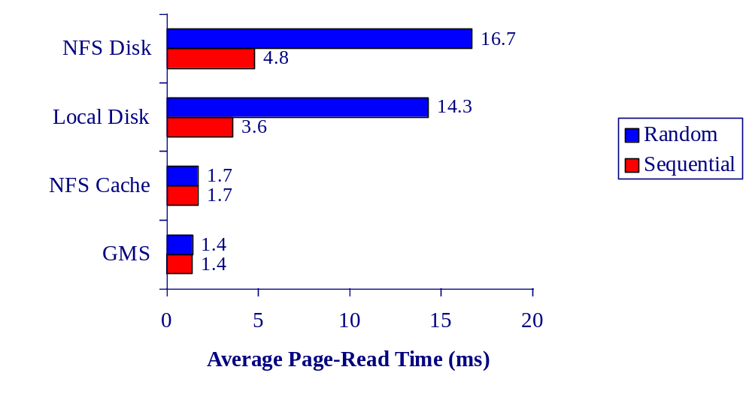
GMS Remote-Read Time
Environment
  266 Mhz DEC Alpha workstations on 155 Mb/s AN2 network

Slide 23
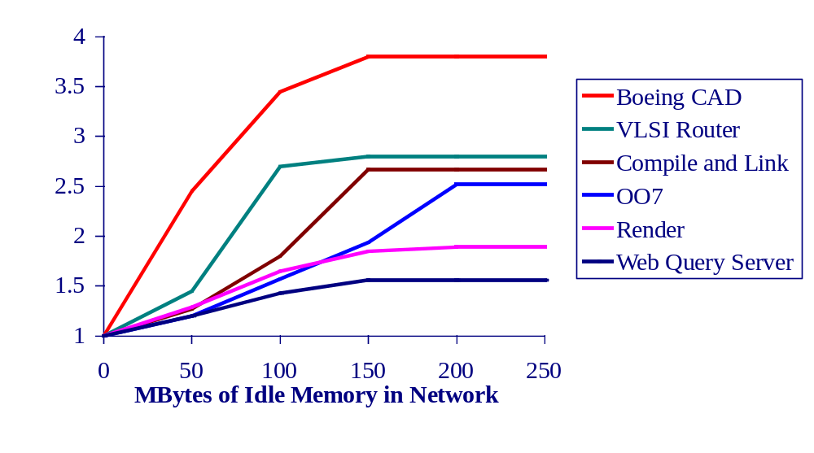
Application Speedup with GMS
Experiment
  application running on one node
  seven other nodes are idle

Slide 24
GMS Summary
Implemented in Digital Unix
Uses a probabilistic distributed replacement algorithm.
Performance on 155Mb/sec ATM
  remote-memory read 2.5 to 10 times faster than disk
  program speedup between 1.5 and 3.5
Analysis
  global information is needed when idleness is unevenly distributed
  GMS is resilient to changes in idleness distribution

Slide 25
Talk Outline
Introduction
GMS: The Global Memory System
  The Global Algorithm
  GMS Implementation and Performance
Prefetching in a Global Memory System
Conclusions

Slide 26
Background
Much current research looks at prefetching to reduce I/O latency (mainly for file access)
  [R. H. Patterson et al., Kimbrel et al., Mowry et al.]
Global memory systems reduce I/O latency by transferring data over high-speed networks.
  [Feeley et al., Dahlin et al.]
Some systems use parallel disks or striping to improve I/O performance.
  [Hartman & Ousterhout, D. Patterson et al.]

Slide 27
PMS
Prefetching global MemorySystem
Basic idea: combine the advantages of global memory and prefetching
Basic goals of PMS:
  Reduce disk I/O by maintaining in the cluster’s memory the set of pages that will be referenced nearest in the future
  Reduce stalls by bringing each page to the node that will reference it in advance of the access

Slide 28


PMS: Three Prefetching Options
1. Disk to local memory prefetch
Prefetch data
Hi

Slide 29
PMS: Three Prefetching Options
1. Disk to local memory prefetch
Prefetch data
Prefetch request
2. Global memory to local memory prefetch
Hi

Slide 30
PMS: Three Prefetching Options
1. Disk to local memory prefetch
Prefetch data
Prefetch request
2. Global memory to local memory prefetch
3. (Remote) disk to global memory prefetch
Hi

Slide 31
Conventional Disk Prefetching
Prefetch m
from disk
Prefetch n
from disk
F_{D}
F_{D}
m
n
time

Slide 32
Global Prefetching
Prefetch m
from disk
Prefetch n
from disk
F_{D}
F_{D}
m
n
Prefetch m from B
Request node B
to prefetch m
Request node B
to prefetch n
Prefetch n from B
F_{D}
F_{D}
F_{G}
F_{G}
m
n
time

Slide 33
Global Prefetching: multiple nodes
Prefetch m
from disk
Prefetch n
from disk
F_{D}
F_{D}
m
n
Prefetch m from B
Request node B
to prefetch m
Request node B
to prefetch n
Prefetch n from B
F_{D}
F_{D}
F_{G}
F_{G}
m
n
time
Prefetch m from B
Request B
to prefetch m
Prefetch n from C
Request C
to prefetch n
F_{G}
F_{G}
m
n
time
F_{D}

Slide 34
PMS Algorithm
Algorithm trades off:
  benefit of acquiring a buffer for prefetch, vs.cost of evicting cached data in a current buffer
Two-tier algorithm:
  delay prefetching into local memory as long as possible
  aggressively prefetch from disk into global memory (without doing harm)

Slide 35
PMS Hybrid Prefetching Algorithm
Local prefetching (conservative)
  use Forestall algorithm (Kimbrel et al.)
  prefetch just early enough to avoid stalling
  we compute a prefetch predicate, which when true, causes a page to be prefetched from global memory or local disk
Global prefetching (aggressive)
  use Aggressive algorithm (Cao et al.)
  prefetch a page from disk to global when that page will be referenced before a cluster resident page

Slide 36
PMS Implementation
PMS extends GMS with new prefetch operations
Applications pass hints to the kernel through a special system call
At various events, the kernel evaluates the prefetch predicate and decides whether to issue prefetch requests
We assume a network-wide shared file system
Currently, target nodes are selected round-robin
There is a threshold on the number of outstanding global prefetch requests a node can issue

Slide 37
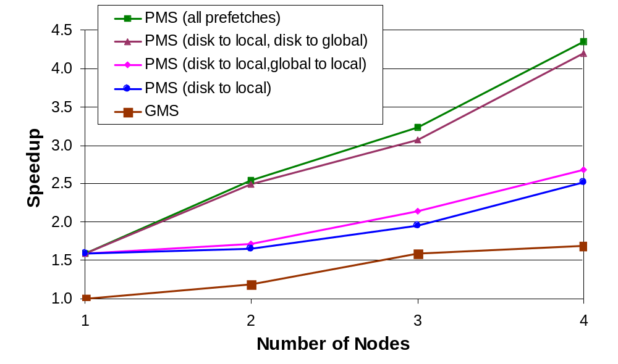
Performance of Render application

Slide 38
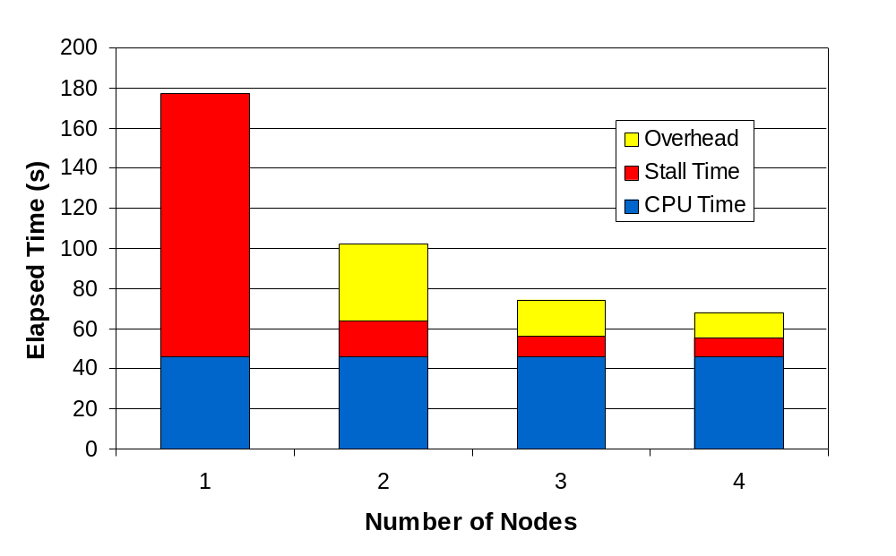
Execution time detail for Render

Slide 39
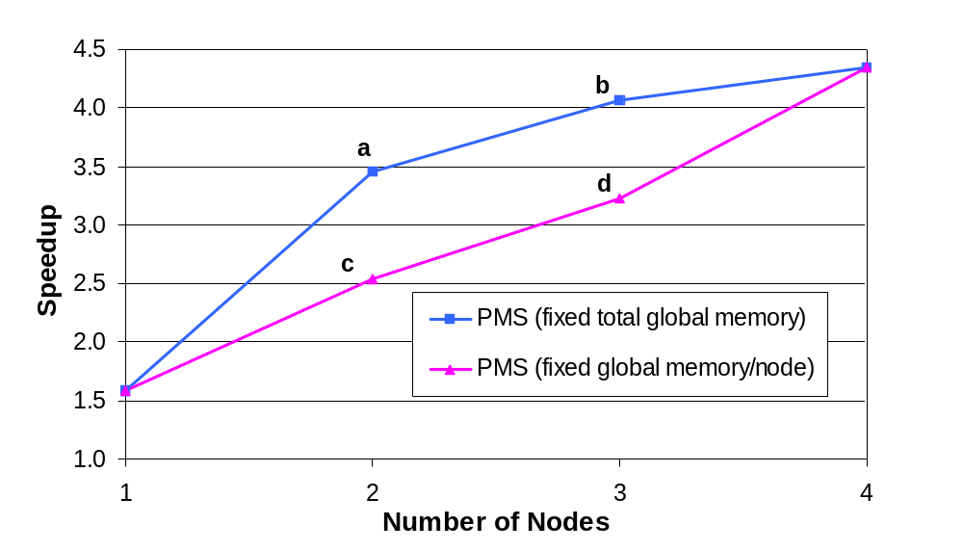
Impact of memory vs. nodes
96MB total
32MB/node

Slide 40
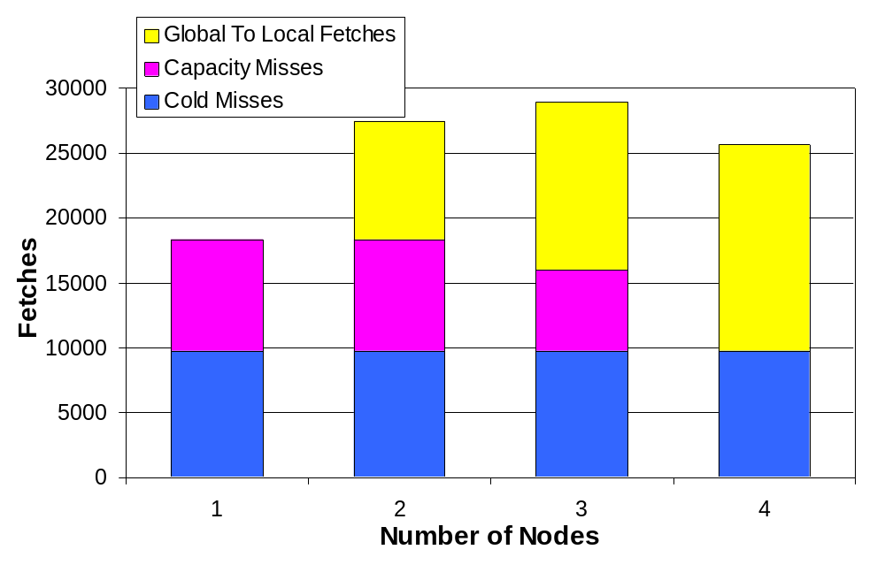
Cold and capacity misses for Render

Slide 41
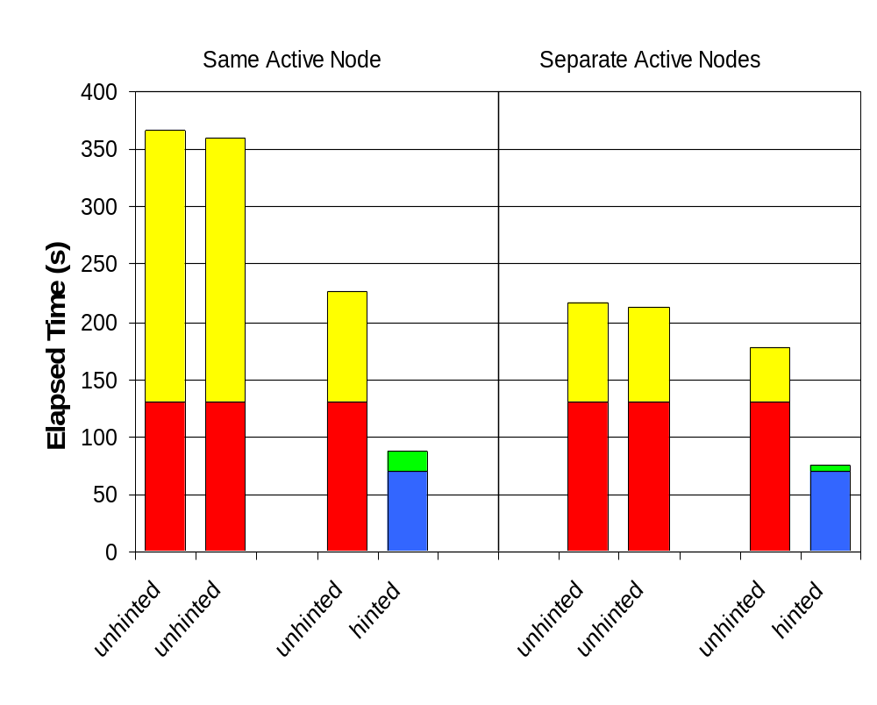
Competition with unhinted processes

Slide 42
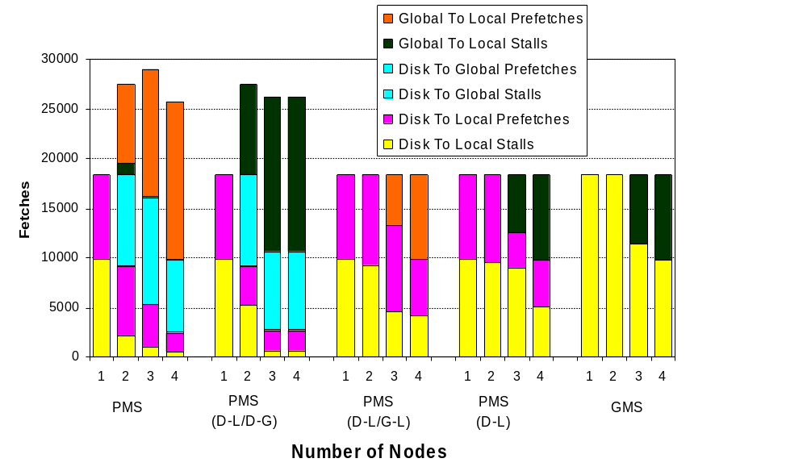
Prefetch and Stall Breakdown

Slide 43
Lots of Open Issues for PMS
Resource allocation among competing applications.
Interaction between prefetching and caching.
Matching level of I/O parallelism to workload.
Impact of prefetching on global nodes.
How aggressive should prefetching be?
Can we do speculative prefetching?
Will the overhead outweigh the benefits?
Details of the implementation.

Slide 44
PMS Summary
PMS uses CPUs, memories, disks, and buses of lightly-loaded cluster nodes, to improve the performance of I/O- or memory-bound applications.
Status: prototype is operational, experiments in progress, performance potential looks quite good

Slide 45
Talk Outline
Introduction
GMS: The Global Memory System
  The Global Algorithm
  GMS Implementation and Performance
Prefetching in a Global Memory System
Conclusions

Slide 46
Conclusions
Global Memory Service (GMS)
  uses global age information to approximate global LRU
  implemented in Digital Unix
  application speedup between 1.5 and 3.5
Can use global knowledge to efficiently meet objectives
  puts global pages on nodes with idle memory
  avoids burdening nodes that have no idle memory
  maintains pages that are most likely to be reused
Prefetching can be used effectively to reduce I/O stall time
High-speed networks change distributed systems
  managed “local” resources globally
  similar to tightly-coupled multiprocessor

Slide 47
References
Feeley et al., Implementing Global Memory Management in a Workstation Cluster, Proc. of the 15th ACM Symp. on Operating Systems Principles, Dec. 1995.
Jamrozik et al., Reducing Network Latency Using Subpages in a Global Memory Environment, Proc. of the 7th ACM Symp. on Arch. Support for Prog. Lang. and Operating Systems, Oct. 1996.
Voelker et al., Managing Server Load in Global Memory Systems, Proc. of the 1997 ACM Sigmetrics Conf. on Performance Measurement, Modeling, and Evaluation.
http://www.cs.washington.edu/homes/levy/gms

