Slide 1
Remote Procedure Calls (RPC)
Presenter: Benyah Shaparenko
CS 614, 2/24/2004

Slide 2
“Implementing RPC”
Andrew Birrell and Bruce Nelson
Theory of RPC was thought out
Implementation details were sketchy
Goal: Show that RPC can make distributed computation easy, efficient, powerful, and secure

Slide 3
Motivation
Procedure calls are well-understood
Why not use procedural calls to model distributed behavior?
Basic Goals
  Simple semantics: easy to understand
  Efficiency: procedures relatively efficient
  Generality: procedures well known

Slide 4
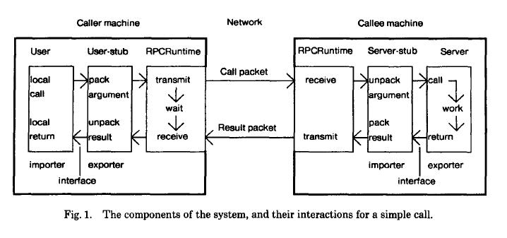
How RPC Works (Diagram)

Slide 5
Binding
Naming + Location
  Naming: what machine to bind to?
  Location: where is the machine?
    Uses a Grapevine database
Exporter: makes interface available
  Gives a dispatcher method
  Interface info maintained in RPCRuntime

Slide 6
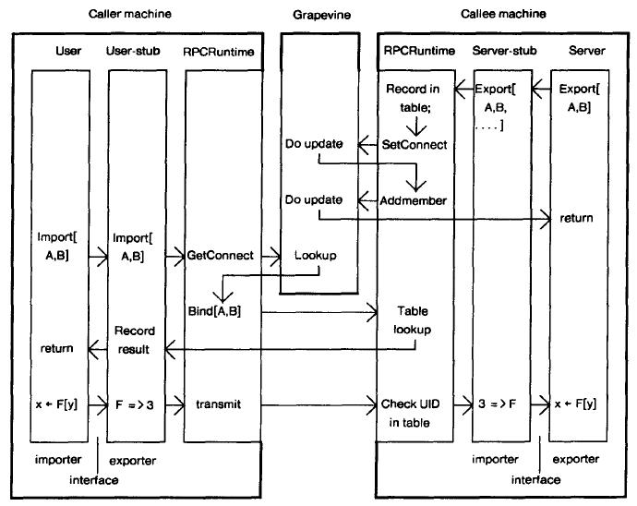

Slide 7
Notes on Binding
Exporting machine is stateless
  Bindings broken if server crashes
Can call only procedures server exports
Binding types
  Decision about instance made dynamically
  Specify type, but dynamically pick instance
  Specify type and instance at compile time

Slide 8
Packet-Level Transport
Specifically designed protocol for RPC
Minimize latency, state information
Behavior
  If call returns, procedure executed exactly once
  If call doesn’t return, executed at most once

Slide 9
Simple Case
Arguments/results fit in a single packet
Machine transmits till packet received
  I.e. until either Ack, or a response packet
Call identifier (machine identifier, pid)
  Caller knows response for current call
  Callee can eliminate duplicates
Callee’s state: table for last call ID rec’d

Slide 10
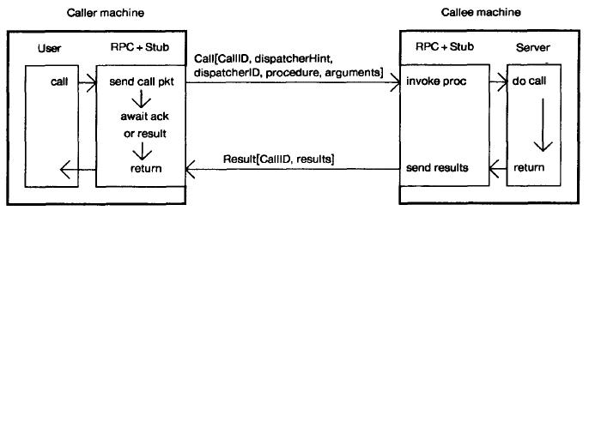
Simple Case Diagram

Slide 11
Simple Case (cont.)
Idle connections have no state info
No pinging to maintain connections
No explicit connection termination
Caller machine must have unique call identifier even if restarted
Conversation identifier: distinguishes incarnations of calling machine

Slide 12
Complicated Call
Caller sends probes until gets response
  Callee must respond to probe
Alternative: generate Ack automatically
  Not good because of extra overhead
With multiple packets, send packets one after another (using seq. no.)
  only last one requests Ack message

Slide 13
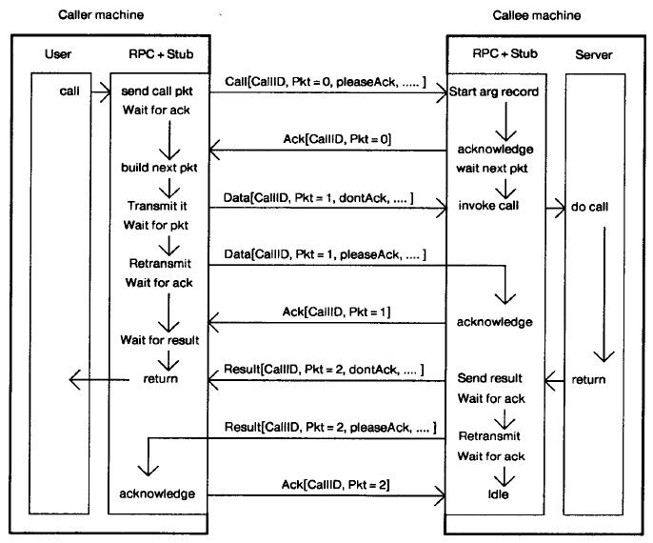

Slide 14
Exception Handling
Signals: the exceptions
Imitates local procedure exceptions
Callee machine can only use exceptions supported in exported interface
“Call Failed” exception: communication failure or difficulty

Slide 15
Processes
Process creation is expensive
So, idle processes just wait for requests
Packets have source/destination pid’s
  Source is caller’s pid
  Destination is callee’s pid, but if busy or no longer in system, can be given to another process in callee’s system

Slide 16
Other Optimization
RPC communication in RPCRuntime bypasses software layers
  Justified since authors consider RPC to be the dominant communication protocol
Security
  Grapevine is used for authentication

Slide 17
Environment
Cedar programming environment
Dorados
  Call/return < 10 microseconds
  24-bit virtual address space (16-bit words)
  80 MB disk
  No assembly language
3 Mb/sec Ethernet (some 10 Mb/sec)

Slide 18
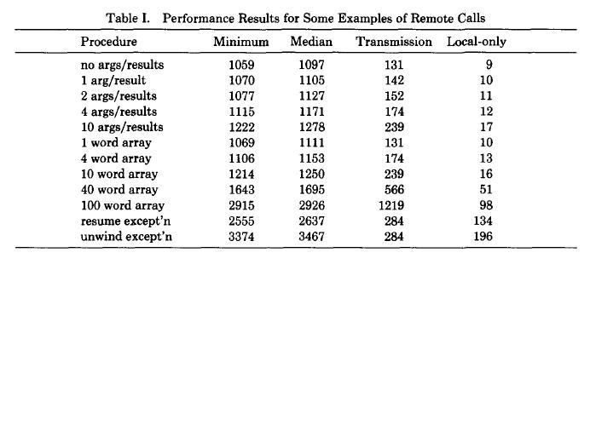
Performance Chart

Slide 19
Performance Explanations
Elapsed times accurate to within 10% and averaged over 12000 calls
For small packets, RPC overhead dominates
For large packets, data transmission times dominate
The time not from the local call is due to the RPC overhead

Slide 20
Performance cont.
Handles simple calls that are frequent really well
With more complicated calls, the performance doesn’t scale so well
RPC more expensive for sending large amounts of data than other procedures since RPC sends more packets

Slide 21
Performance cont.
Able to achieve transfer rate equal to a byte stream implementation if various parallel processes are interleaved
Exporting/Importing costs unmeasured

Slide 22
RPCRuntime Recap
Goal: implement RPC efficiently
Hope is to make possible applications that couldn’t previously make use of distributed computing
In general, strong performance numbers

Slide 23
“Performance of Firefly RPC”
Michael Schroeder and Michael Burrows
RPC gained relatively wide acceptance
See just how well RPC performs
Analyze where latency creeps into RPC
Note: Firefly designed by Andrew Birrell

Slide 24
RPC Implementation on Firefly
RPC is primary communication paradigm in Firefly
  Used for inter-machine communication
  Also used for communication within a machine (not optimized… come to the next class to see how to do this)
Stubs automatically generated
Uses Modula2+ code

Slide 25
Firefly System
5 MicroVAX II CPUs (1 MIPS each)
16 MB shared memory, coherent cache
One processor attached to Qbus
10 Mb/s Ethernet
Nub: system kernel

Slide 26
Standard Measurements
Null procedure
  No arguments and no results
  Measures base latency of RPC mechanism
MaxResult, MaxArg procedures
  Measures throughput when sending the maximum size allowable in a packet (1514 bytes)

Slide 27
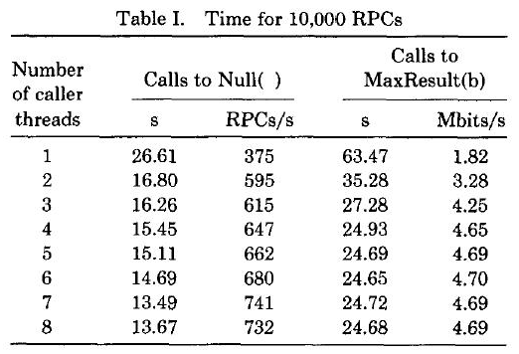
Latency and Throughput

Slide 28
Latency and Throughput
The base latency of RPC is 2.66 ms
7 threads can do 741 calls/sec
Latency for Max is 6.35 ms
4 threads can achieve 4.65 Mb/sec
  Data transfer rate in application since data transfers use RPC

Slide 29
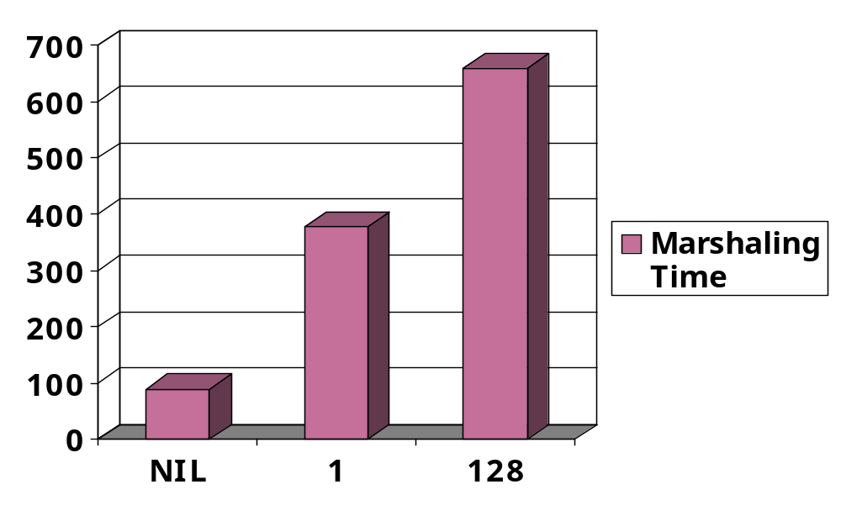
Marshaling Time
As expected, scales linearly with size and number of arguments/results
  Except when library code is called…

Slide 30
Analysis of Performance
Steps in fast path (95% of RPCs)
  Caller: obtains buffer, marshals arguments, transmits packet and waits (Transporter)
  Server: unmarshals arguments, calls server procedure, marshals results, sends results
  Client: Unmarshals results, free packet

Slide 31
Transporter
Fill in RPC header in call packet
Sender fills in other headers
Send packet on Ethernet (queue it, read it from memory, send it from CPU 0)
Packet-arrival interrupt on server
Wake server thread
Do work, return results (send+receive)

Slide 32
Reducing Latency
Custom assignment statements to marshal
Wake up correct thread from the interrupt routine
  OS doesn’t demultiplex incoming packet
    For Null(), going through OS takes 4.5 ms
  Thread wakeups are expensive
Maintain a packet buffer
  Implicitly Ack by just sending next packet

Slide 33
Reducing Latency
RPC packet buffers live in memory shared by everyone
  Security can be an issue (except for single-user computers, or trusted kernels)
RPC call table also shared by everyone
  Interrupt handler can waken threads from user address spaces

Slide 34
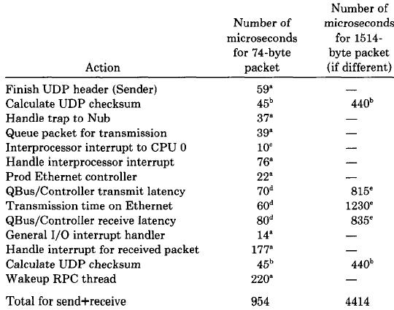

Slide 35
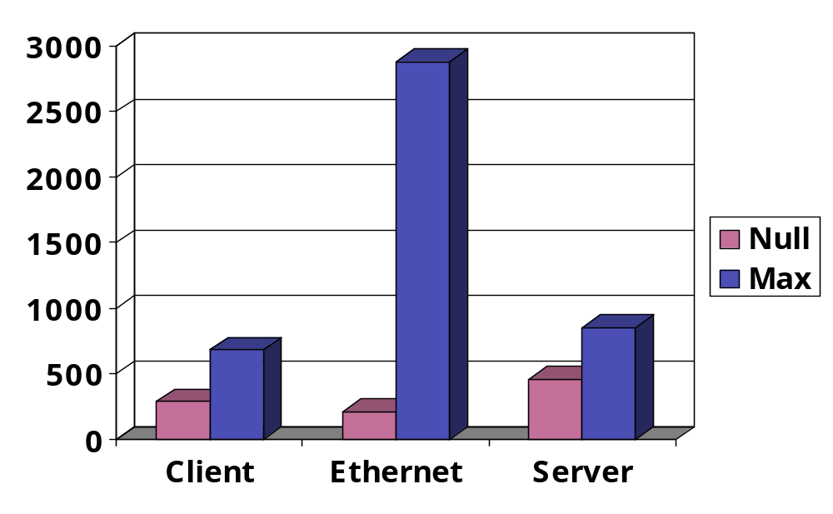
Understanding Performance
For small packets software costs prevail
For large, transmission time is largest

Slide 36
Understanding Performance
The most expensive are waking up the thread, and the interrupt handler
20% of RPC overhead time is spent in calls and returns

Slide 37
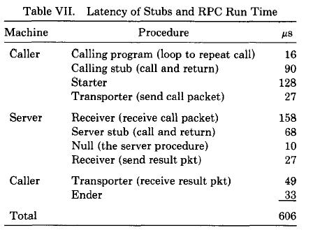
Latency of RPC Overheads

Slide 38
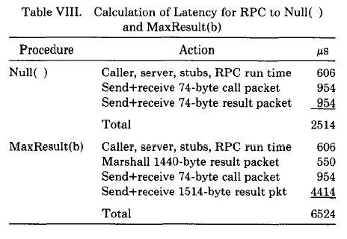
Latency for Null and Max

Slide 39
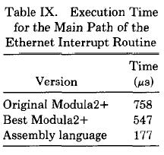
Improvements
Write fast path code in assembly not Modula2+
  Firefly RPC speeds up by a factor of 3
  Application behavior unchanged

Slide 40
Improvements (cont.)
Different Network Controller
  Maximize overlap between Ethernet/QBus
  300 microsec saved on Null, 1800 on Max
Faster Network
  10X speedup gives 4-18% speedup
Faster CPUs
  3X speedup gives 52% speedup (Null) and 36% (Max)

Slide 41
Improvements (cont.)
Omit UDP Checksums
  Save 7-16%, but what if Ethernet errors?
Redesign RPC Protocol
  Rewrite packet header, hash function
Omit IP/UDP Layering
  Direct use of Ethernet, need kernel access
Busy Wait: save wakeup time
Recode RPC Runtime Routines
  Rewrite in machine code (~3X speedup)

Slide 42
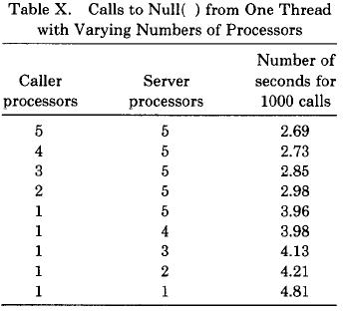
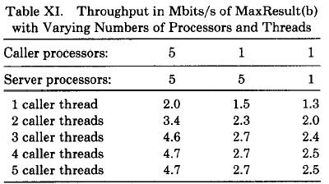
Effect of Processors Table

Slide 43
Effect of Processors
Problem: 20ms latency for uniprocessor
  Uniprocessor has to wait for dropped packet to be resent
Solution: take 100 microsecond penalty on multiprocessor for reasonable uniprocessor performance

Slide 44
Effect of Processors (cont.)
Sharp increase in uniprocessor latency
Firefly RPC implementation of fast path is only for a multiprocessor
Locks conflicts with uniprocessor
Possible solution: streaming packets

Slide 45
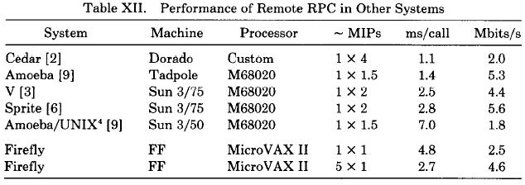
Comparisons Table

Slide 46
Comparisons
Comparisons all made for Null()
10 Mb/s Ethernet, except Cedar 3 Mb/s
Single-threaded, or else multi-threaded single packet calls
Hard to find which is really fastest
  Different architectures vary so widely
  Possible favorites: Amoeba, Cedar
  ~100 times slower than local

