Slide 1
Journaling Vs. Soft Updates: Asynchronous Meta-data Protection in File Systems
Margo I. Seltzer, Gregory R. Ganger, M. Kirk McKusick, Keith A. Smith, Craig A. N. Soules, Christopher A. Stein
Presented By:
Abhijit Deodhar

Slide 2
Overview
Key Points
Approaches
  Soft updates
  Journaling
Comparison
Evaluation

Slide 3
Key Points
Meta-data integrity
Journaling systems record metadata operations on an auxiliary log
Soft updates uses ordered writes

Slide 4
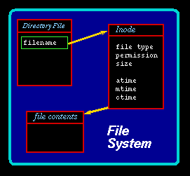
FFS Organization
Source: http://owen.sj.ca.us/rkowen/howto/robj/images/inode.png

Slide 5
Meta-data Integrity
    Old directory will contain link to new file
Meta-data operations modify the structure of the file system
  Creating, deleting or renaming files
Why is it important?
  Suppose you delete a file and subsequently crash
    Privacy compromise ?
File system recovery must be possible

Slide 6
Update Dependency Rules
Never point to a structure before it has been initialized. (inode < direntry)
Never reuse a resource before nullifying all previous pointers to it.(inode ptr to data blk < blk realloc)
Never reset the last pointer to a live resource before a new pointer has been set. (File rename)

Slide 7
Deleting a File
Directory block
i-node-1
abc
def
i-node-2
ghi
i-node-3
Assume we want to delete file “def”

Slide 8
Deleting a File
Directory block
i-node-1
abc
?
def
ghi
i-node-3
Cannot delete i-node before directory entry “def”

Slide 9
Deleting a File
Correct sequence is
  Write to disk directory block containing deleted directory entry “def”
  Write to disk i-node block containing deleted i-node
Leaves the file system in a consistent state

Slide 10
Creating a File
Directory block
i-node-1
abc
ghi
i-node-3
Assume we want to create new file “tuv”

Slide 11
Creating a File
Directory block
i-node-1
abc
ghi
i-node-3
tuv
?
Cannot write directory entry “tuv” before i-node

Slide 12
Creating a File
Correct sequence is
  Write to disk i-node block containing new i-node
  Write to disk directory block containing new directory entry
Leaves the file system in a consistent state

Slide 13
Synchronous Updates
FFS
  Guarantees durability
  Meta-data operations done through blocking writes
Problems
  Increases cost of updates
  Impacts file system performance
  Recovery requires full file system scan

Slide 14
Soft Updates
Delayed writes (write-back cache)
Dependency information
  Block level vs. Pointer level
Advantage – faster file system recovery after crash
Overhead - extra write
When to write to disk?

Slide 15
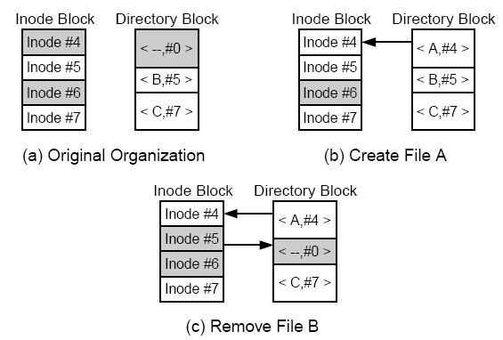
Cyclic Dependency
Source: Soft Updates: A solution to the metadata update problem in File Systems - Ganger

Slide 16
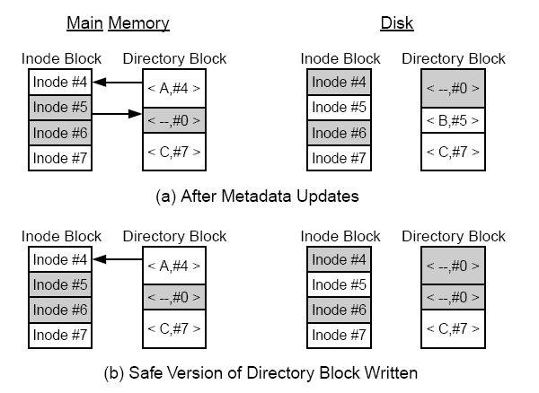
Undo/redo Operations
Undo
Free(B)

Slide 17
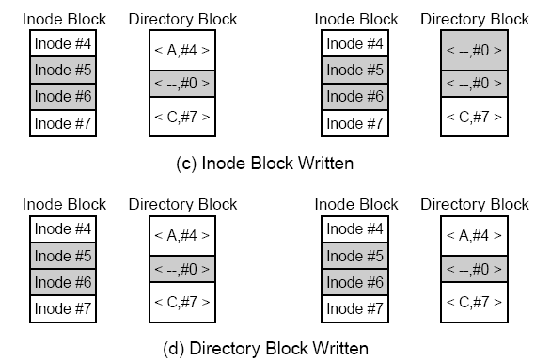
Undo/redo Operation Cont.
Redo
Create(A)

Slide 18
Journaling File Systems
LFFS-file
  Write-ahead logging (WAL)
    Flush meta data to persistent storage before data
  Circular buffer
    Size of log proportional to amount of changing meta-data (usually KB)
  Log space reclamation
    Periodic syncer daemon
  Forced checkpoints

Slide 19
Journaling File Systems
LFFS-wafs
  Auxiliary file system
  Flexibility
    Log on a separate high speed disk to reduce contention
  Asynchronous logs for performance

Slide 20
Structure of Journal
Contains three types of data blocks
  Metadata: entire contents of a single block of filesystem metadata as updated by the transaction
  Descriptor: describe other journal metadata blocks (where they really live on disk)
  Header: contain head and tail of the journal, sequence number, the journal is a circular structure

Slide 21
LFFS Recovery
Superblock has address of last checkpoint
  LFFS-file has frequent checkpoints
  LFFS-wafs much less frequent checkpoints
First recover the log
Read the log from logical end (backward pass) and undo all aborted operations
Do forward pass and reapply all updates that have not yet been written to disk

Slide 22
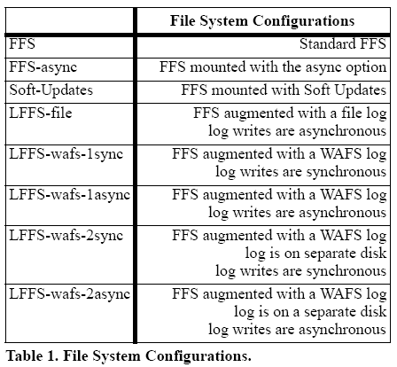
File System Configurations

Slide 23
System Comparison
Semantics
  Durability
  Status of file system after a reboot
  Guarantees about the data in files
  Ability to provide atomicity

Slide 24
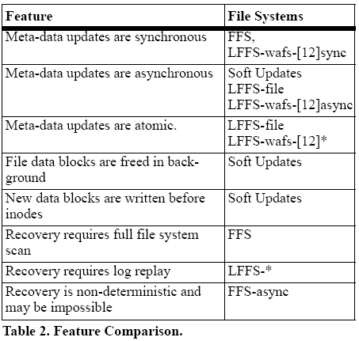
Feature Comparison

Slide 25
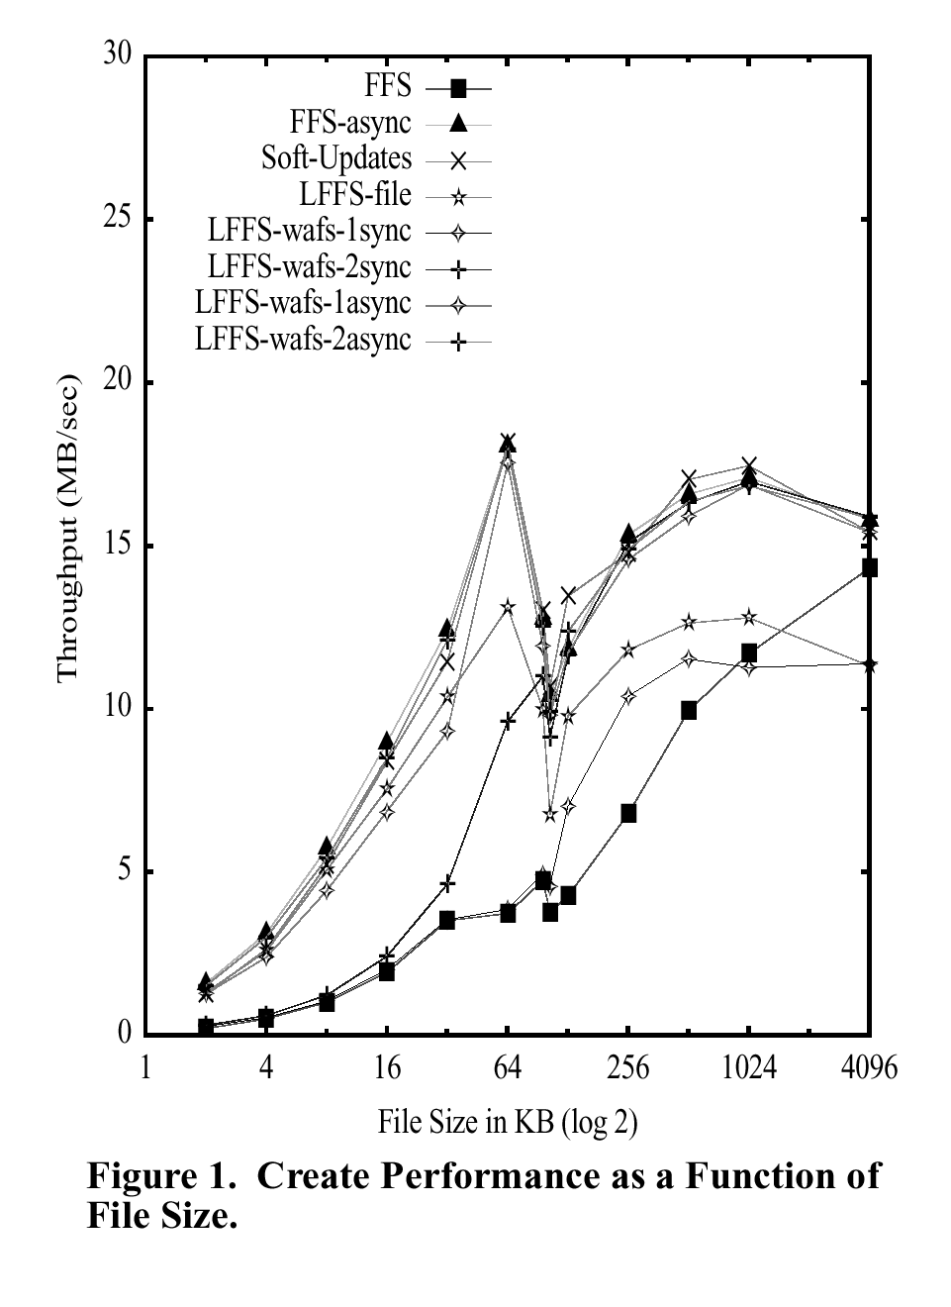
Microbenchmark
Results
clustering
indirect block
Create Performance
Drops in all curves.

Slide 26
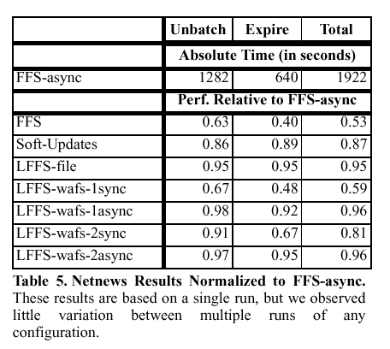
Macrobenchmark Results
-Large data set exceeds cache
-Dependency rollbacks hit

Slide 27
Results Summary
Soft updates excels in meta-data intensive microbenchmarks
  Background deletes
  No disk I/O for 0-length file create/delete
Macrobenchmark results are ambiguous

Slide 28
Evaluation
Soft-updates – just another way of doing meta-data updates.
Difficult to implement on FS which implements directories as b-tree / hashes.
Updates may proceed out of order.
  Eg. Create /dir1/a and then /dir2/b.
Better parallelism due to fine-grained meta-data updates.

Slide 29
Evaluation
Journaling widely adopted in industry (ext3, VxFS, JFS)
Journaling alone is not sufficient to “solve” the meta-data update problem
  Cannot realize its full potential when synchronous semantics are required
Which method to choose -
  Depends heavily on your file system design goals

Slide 30

Questions

Slide 31
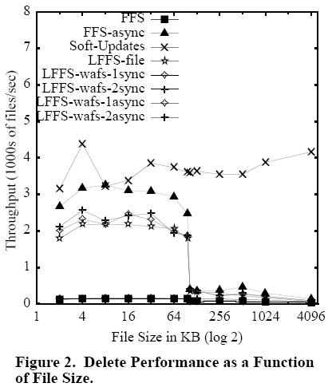
Delete Performance
Background deletes.

Slide 32
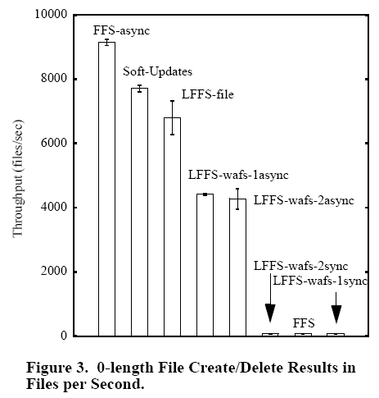
0-length File Create/delete
Best case
Asynchronous
No disk IO

Slide 33
Approaches
Soft Updates
Journaling
Hardware techniques
  NVRAM
  MRAM
Log-structured file systems (LFS)

