Slide 1
VMM – a Brief History
Virtual Machine Monitor: a software-abstraction layer that partitions the HW into one or more virtual machines
1960s: used for multiplexing the scarce general purpose computing platforms among multiple applications
1980s: multitasking OSes + low HW costs
  Rendered VMMs obsolete
  Consequently, no hardware support for virtualization in the CPU architectures of the time (e.g., x86)

Slide 2
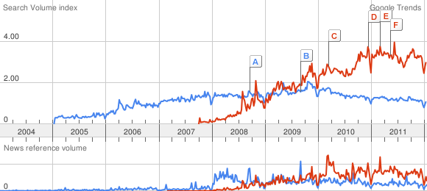
And now…
Compared to “cloud computing” (in red)

Slide 3
Why this revival?
Virtual Machine Monitor: a software-abstraction layer that partition the HW into one or more virtual machines
1960s: used for multiplexing the scarce general purpose computing platforms among multiple applications
1980s: multitasking OSes + low cost hardware
  Rendered VMMs obsolete
2000s: multitasking OSes + low cost hardware
  Revived VMMs

Slide 4
Cause and Solution
Increased OS functionality:
  More capable OSes:
    Fragile and vulnerable
Low cost hardware:
  Proliferation of machines:
    Underused
    With high space and management overhead
Solution: back to one application per machine
  Per virtual machine
  This time: VMM as a means of multiplexing hardware for server consolidation
    Solution for security and reliability

Slide 5
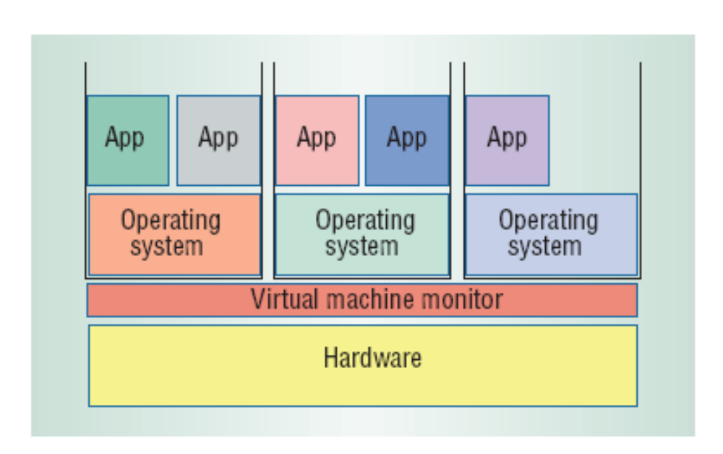
VMM: Decoupling the HW and the OS by a layer of indirection
Uniform view of underlying HW,
  so virtual machines can run on any hardware
Complete encapsulation of a virtual machine’s software state,
  so migration is much easier
Total mediation of all interactions between the virtual machine and the underlying HW,
  thus allowing strong isolation between VMs

Slide 6
Big Picture (and Terminology)
Virtual Machine
Guest OS

Slide 7
Xen
(Original slides by Kishore Ramachandran adapted by Anda Iamnitchi)

Slide 8
Key points
Goal: extensibility and flexibility akin with Exokernel/Micro-kernel goals
Main difference: granularity of operating systems rather than applications
  running several commodity operating systems on the same hardware simultaneously without sacrificing performance or functionality
Why?
  Application mobility
  Server consolidation
  Co-located hosting facilities
  Distributed web services
  Secure computing platforms

Slide 9
Possible Virtualization Approaches
Standard OS (such as Linux, Windows)
  Meta services (such as grid) for users to install files and run processes
  Administration, accountability, and performance isolation become hard
Retrofit performance isolation into OSs
  Accounting resource usage correctly can be an issue unless done at the lowest level and very fine granularity (e.g., Exokernel)
Xen approach
  Multiplex physical resource at OS granularity

Slide 10
Full Virtualization
Make hw completely invisible to the OS
Virtual hardware identical to real one
  Relies on hosted OS trapping to the VMM for privileged instructions
  Pros: run unmodified OS binary on top
  Cons:
    supervisor instructions can fail silently in some hardware platforms (e.g. x86)
      Solution in VMware: Dynamically rewrite portions of the hosted OS to insert traps
    need for hosted OS to see real resources: real time, page coloring tricks for optimizing performance, etc…

Slide 11
Paravirtualization
Presents a virtual machine abstraction similar but not identical to the underlying hardware
  Pros:
    allows strong resource isolation on uncooperative hardware (x86)
    enables optimizing guest OS performance and correctness
  Cons:
    Need to modify the guest OS

Slide 12
(More) Background
ABI, signals, interrupts, system calls
  ABI defines the machine as seen by process
The non-virtualizable x86 architecture
  Visibility of privileged state: the guest can observe it has been deprivileged when reads its code segment selector
  Lack of traps when privileged instructions run at unprivileged level: instructions fail silently

Slide 13
Xen Principles
Support for unmodified application binaries
Support for multi-application OS
  Complex server configuration within a single OS instance
Use paravirtualization in order to support uncooperative architectures such as x86
Enable guest OSes to optimize performance and correctness

Slide 14
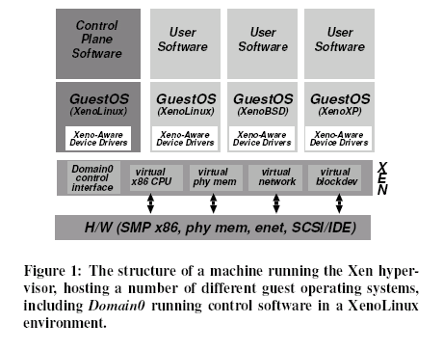

Slide 15
Challenges
CPU virtualization
  …
Memory virtualization
  …
I/O virtualization
  …

Slide 16
Xen: Memory Management
What would make memory virtualization easy
  Software TLB
  Tagged TLB =>no TLB flush on context switch
    Tag identifies a different address space
  X86 does not have either
Xen approach
  Guest OS responsible for allocating and managing hardware page tables
  Every guest OS has its own address space
  Xen occupies top 64MB of every address space. Why?
    To save moving between address spaces (hypervisor calls), no TLB flush
    Xen code and its data structures
    Cost?

Slide 17
x86 Memory Management
Segments
  CS (code); SS (stack); DS, ES, FS, GS (all data)
  Base address and limit checking
Segment base added to CPU address is the linear 32-bit virtual address
4KB pages (12-bit offsets)
  2-level page table
    Top 10 bits of address: page table
    Next 10 bits of address: page table entry

Slide 18
Physical Memory
At domain creation, hardware pages “reserved”
Domain can increase/decrease its quota
Xen does not guarantee that the hardware pages are contiguous
Guest OS can maintain its own mapping of “contiguous” “physical memory” mapped to the “hardware pages”

Slide 19
Creating a new Page Table by Guest OS
  (every process has its own page table)
  allocate and initialize a page and registers it with Xen to serve as the new page table
  all subsequent updates to this page via Xen
  can batch updates to reduce the cost of entering and exiting Xen
Segmentation by guest OS virtualized similarly

Slide 20
Virtual Address Translation
Xen solution
  Physical memory is not contiguous for guest OS
    Fundamental shift from the traditional view of the HW
  Register guest OS PT directly with MMU
  Guest OS has read only access to the PT
    All modifications to the PT via Xen
    Why?
  Type associated with a page frame
    PD, PT, LDT, GDT, RW (terminology specific to x86 architecture)
    All except RW: read-only access to the page for guest OS
    Guest OS can retask a page only when ref count is 0

Slide 21
Xen: CPU Virtualization
Four privilege levels in x86
  Ring 0: originally for OS (now Xen)
  Ring 1: originally not used (now guest OS)
  Ring 3: originally for applications (now applications of the guest OS)
  Ring 2: originally not used (now for shared libraries for supporting user processes in Ring 3)
Privileged instructions
  Validated and executed in Xen (e.g., installing a new PT)
Exceptions
  Registered with Xen once. Accepted (validated) if don’t require to execute exception handlers in ring 0.
  Called directly without Xen intervention
  All syscalls from apps to guest OS handled this way (and executed in ring 1)
Page fault handlers are special
  Faulting address can be read only in ring 0
  Xen reads the faulting address and passes it via stack to the OS handler in ring 1

Slide 22
CPU Scheduling
Bounded Virtual Time (BVT) scheduling algorithm [Duda & Cheriton, SOSP 99]
  BVT guarantees fairness over a window of time
  Keeps track of CPU time allocated to each guest OS.
    The guest OS uses its own scheduling techniques for its processes.

Slide 23
Time and Timers
Guest OSs have access to
  Real time (cycle counter accuracy for real time tasks in guest OSs)
  Virtual time (enables time slicing within the guest OS)
  Wall clock time (real time + domain changeable offset)
    Time zones, particular settings (e.g., 5 minutes fast)
Guest OS maintain their own internal timer queues and use a pair of Xen timers (real and virtual)

Slide 24
Xen: Device I/O Virtualization
Set of clean and simple device abstractions
Allows buffers to be passed directly to/from guest OS to I/O devices via shared memory with Xen
I/O rings implement event delivery mechanism for sending asynchronous notifications to the guest OS

Slide 25
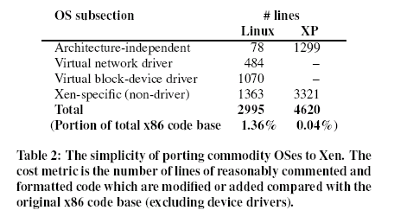

Slide 26
Details of subsystem virtualization
Control transfer
  Between the guest OS and Xen
  E.g., page table updates and creation
Data transfer
  Passing data between Xen and the OS
  E.g., the fault address
These are used in the virtualization of all the subsystems

Slide 27
Control Transfer
Hypercalls from guest OS to Xen
  E.g., (set of) page table updates
Events for notification from Xen to guest OS
  E.g., data arrival on network; virtual disk transfer complete
Events may be deferred by a guest OS (similar to disabling interrupts)
Hypercalls can be aggregated to save on control transfers between guest OS and Xen

Slide 28
Data transfer – I/O rings
Resource management and accountability
  CPU time
    Demultiplex data to the domains quickly upon interrupt
    Account computation time for managing buffers to the appropriate domain
  Memory buffers
    Relevant domains provide memory for I/O to Xen
      Protection guaranteed between different guest OSs
    Xen pins page frames during I/O transfer
      Used to defer interruptions on data transfers
    One I/O ring for each device for each guest OS: e.g., one for writing data to the disk; one for sending network packets; one for receiving network packets; etc.

Slide 29
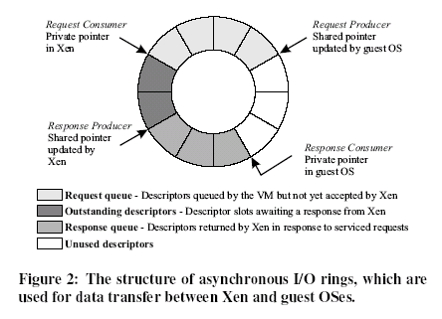
I/O descriptors indirectly reference the actual memory buffers

Slide 30
Each request: unique ID from guest OS
Response: use this unique ID
Network packets
  Represented by a set of requests
  Responses to these signal packet reception
Disk requests
  May be reordered for performance (e.g., elevator)
No copying between Xen and the guest OS (therefore, no performance penalties)
Domain may queue up multiple entries before invoking a hypercall request
Ditto for responses from Xen
I/O rings in memory shared by Xen and guest OS

Slide 31
Network
Each guest OS has two I/O rings for network
  One for receive and one for transmit
  Each ring is a contiguous region of memory
Transmit
  Queue descriptor on the transmit ring
    Points to the buffer in guest OS space
    Page pinned till transmission complete
  Round robin packet scheduler across domains
Receive
  Network packets written in the receive ring of the destination guest OS
  Xen makes an upcall to the guest OS
No copying!

Slide 32
Disk
Batches of requests from competing domain taken and scheduled
Since Xen has knowledge of disk layout, requests may be reordered
No copying into Xen
“Reoder barrier” to prevent reordering (may be necessary for higher level semantics such as write ahead log)
  It will overwrite the order of the circular I/O memory buffer

Slide 33
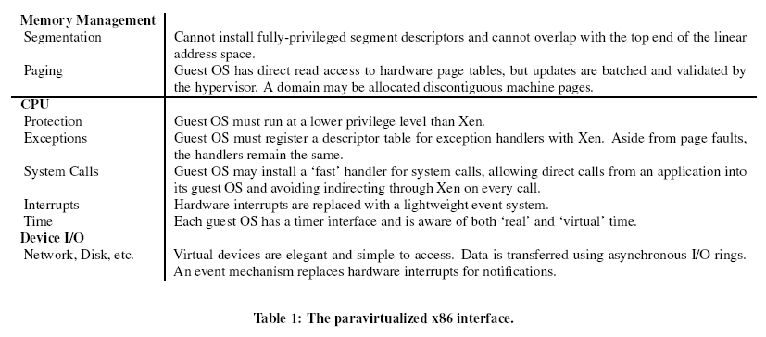

Slide 34
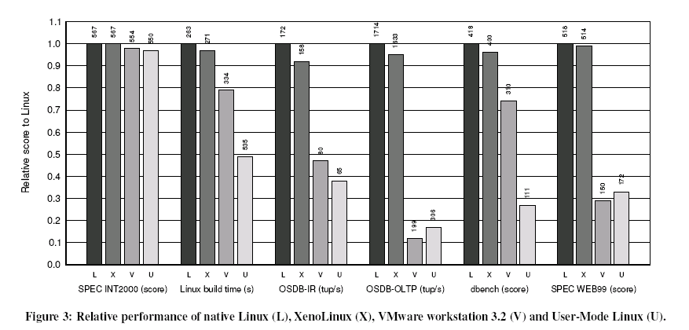
Performance

