Slide 1
Using MtConnect Data

Slide 2
Iteration1
Adapter was set so that the only data received by the agent(mtConnect server was PathPosition)
Used request
okuma-matata:5000/sample?from=60915?count=100000
Sampling rate from adapter was 100ms
Adapter was only outputting pat postion information
Request pulled position information from the buffer
Example used was HardMoldy_design
Example Workplan was Boeing Profiling
Moldy.stpnc was generated by extending the hardmoldy sample and adding a new workplan
A single workstep was added
For each point in the sample file apt->GotoXYZ was called

Slide 3
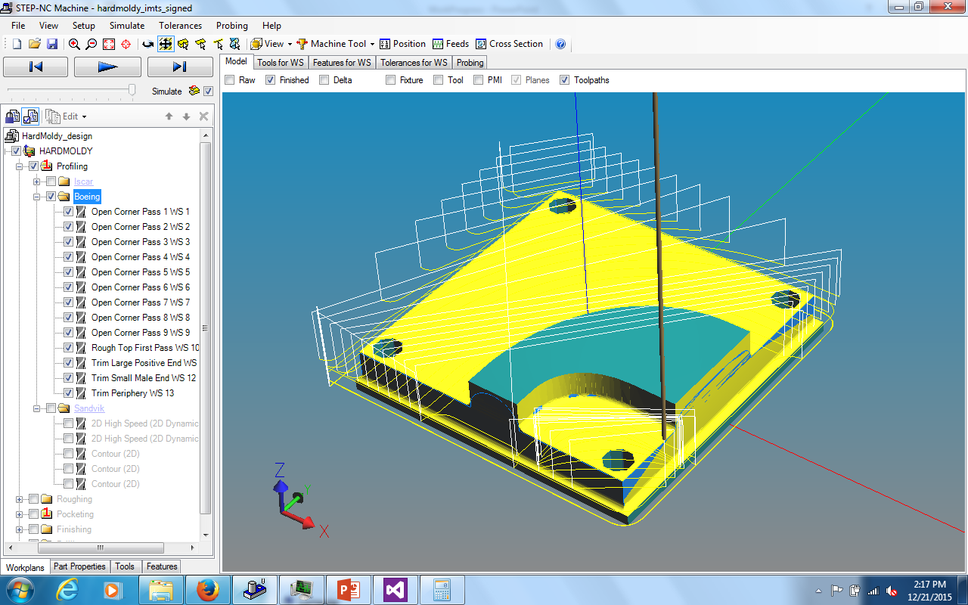
Results-Original Boeing Profile

Slide 4
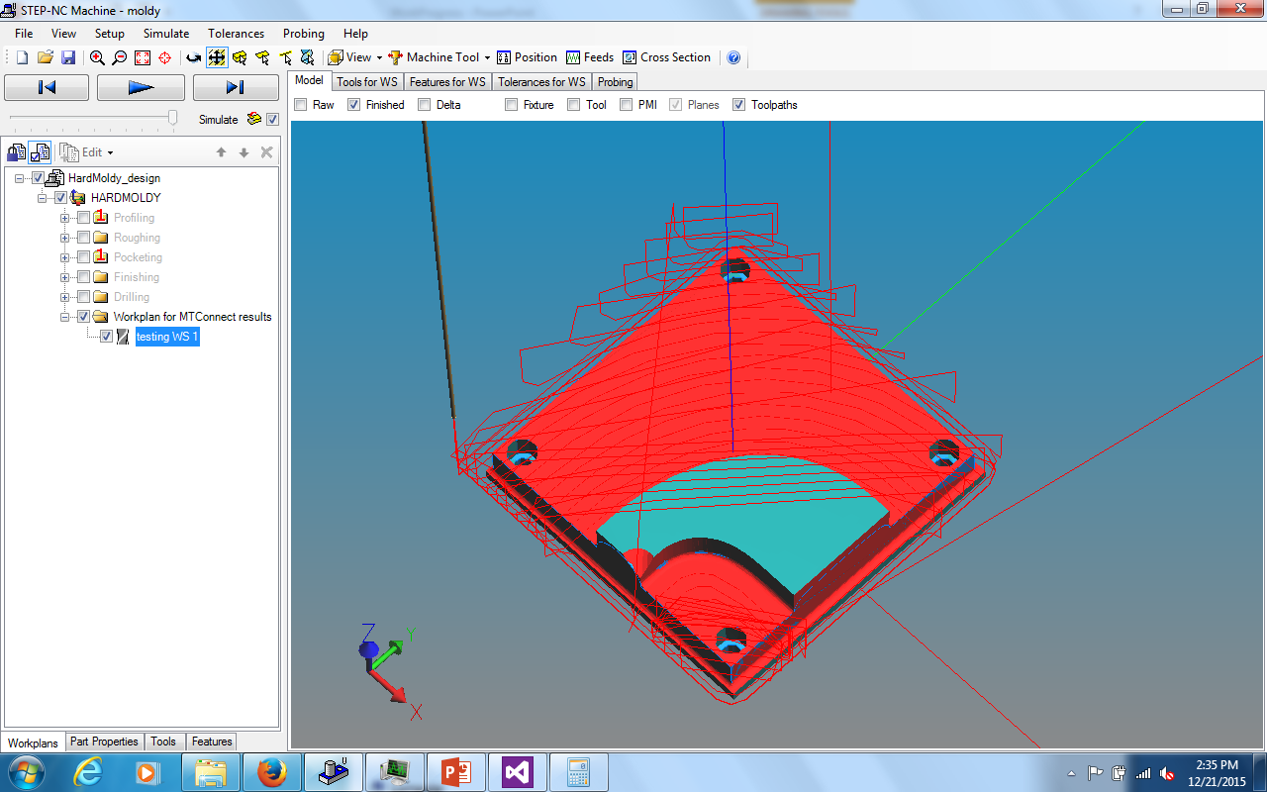
Part Generated via MtConnect Path Position Data

Slide 5
Observations/Notes
The extreme tool path positions far away form the part are due to sampling before the boeing Profile began to execute on the Okuma Machine
Simulated part will jump Diagonally during rapids as opposed to going up vertically first(Due to sampling rate)
This behavior causes the unusual cut in the simulated model
This failure to perform rapids properly occurs many times as seen by the diagonal tool paths in the simulated part

Slide 6
Possible Solutions
Increase Sampling rate-May exceed buffer so will need to have information pushed to from the MtConnect server to application every 100000 pts
Determine from MtConnect data when a rapid will occur (determine what stepnc command you are at) and use that to determine when a rapid is occurring
Constantly calculate the current movement vector of the tool, if the distance between two consecutive points(loc1 and loc2) is faster than the feed Threshold*rate*AverageSamplingTime, -> intervene and have next goto location be alpha*vector+location1 then have the following goto location be loc2

Slide 7
Iteration 2 increased Sampling rate
Increased the sampling rate to 1ms according to adapter settings
Actually closer to 8ms

Slide 8
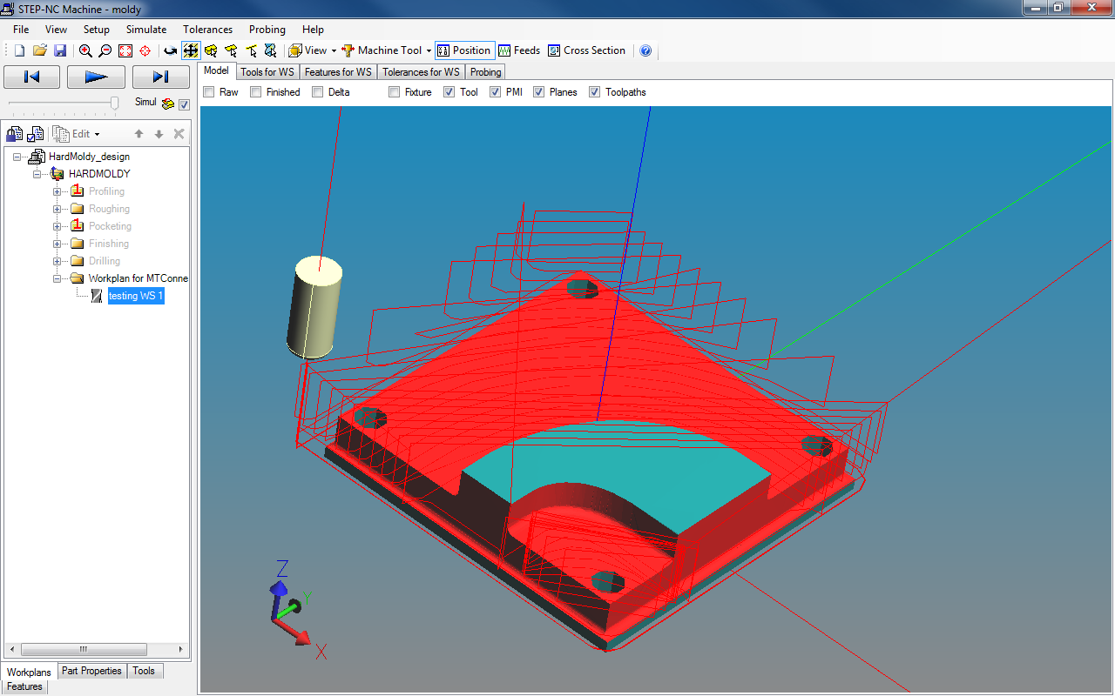

Slide 9
Observation
Good Quality

Slide 10
Possible alterations
Have adapter send other data values to mt connect(current line # etc) and see if there is a significant difference
Determine minimum sampling rate needed for a given feed rate and tolerance

Slide 11
Iteration 3
10ms according to the adapter

Slide 12
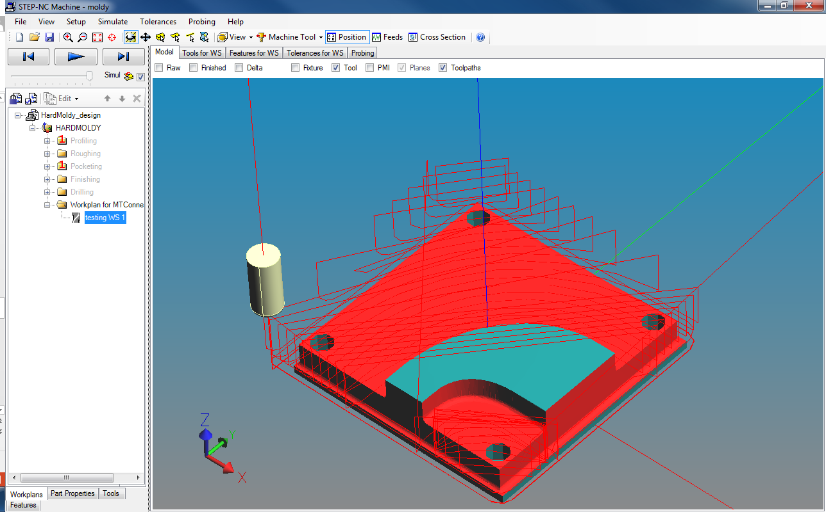

Slide 13
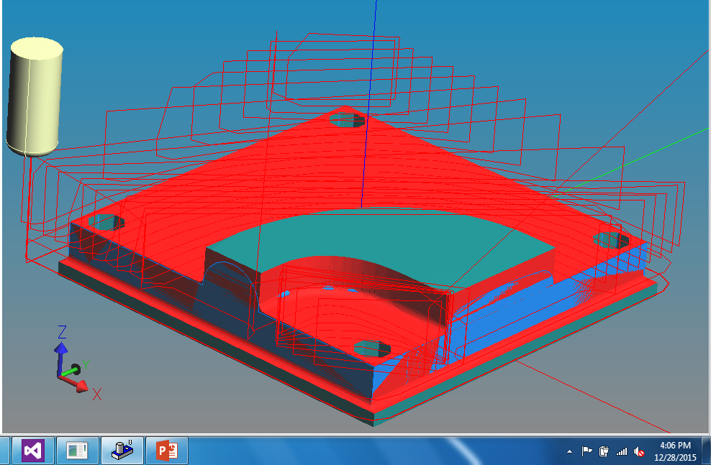
Iteration4
50ms interval

Slide 14
Iteration 5
200ms

Slide 15
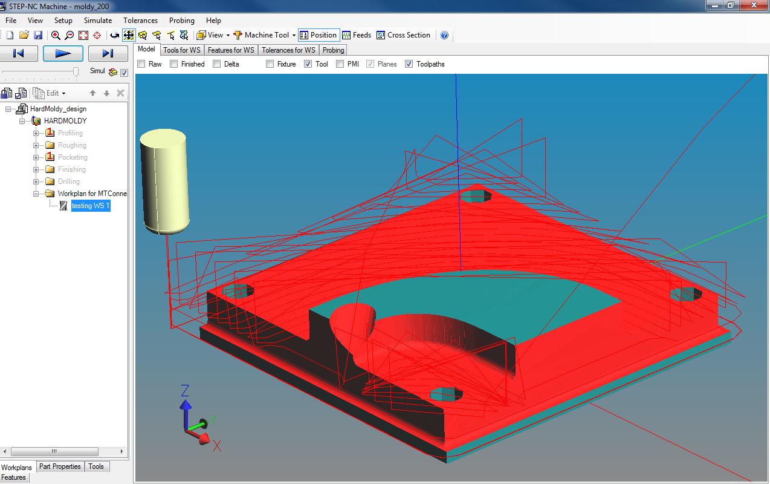

Slide 16
Patched #2
Algorithm
Get a list of all Rapid paths in the original stpnc file
For all consecutive path position samples
Compute speed of tool movement form xml
If tool is moving faster than max feed rate
Use rapid path from stpnc file and ignore all sample positions with speed>max feed rate
Correlate rapid path in sample positions with stpnc via chronological order
Else
Goto to next coordinate

Slide 17
Notes
Max feed was hardcoded
Mtconnect data was trimmend to start of program
Manually set units to inches
Manually selecting correct tool
Chronological order used to correlate rapid tool paths
Used trimmed 100ms data

Slide 18
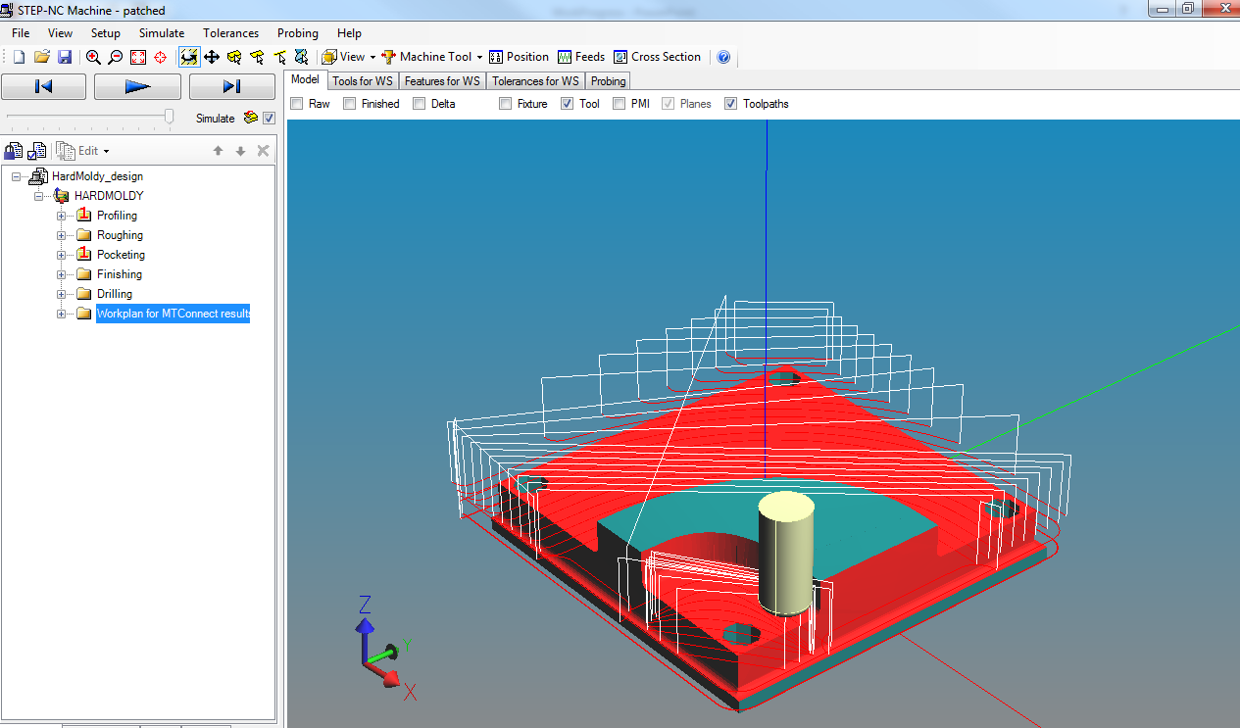

Slide 19
Patched 3 200ms

Slide 20
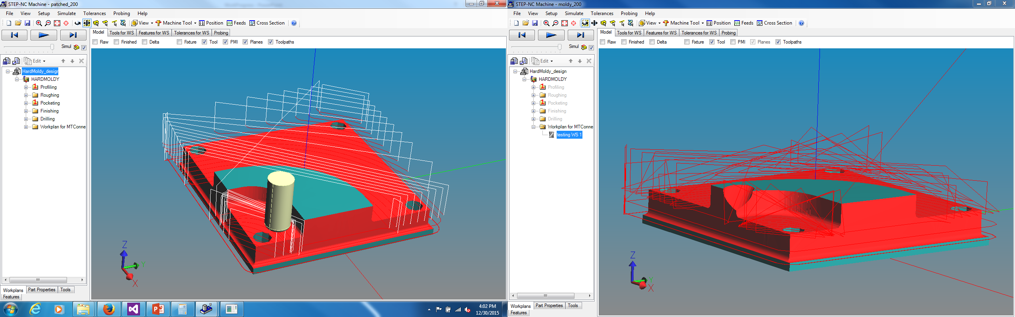
Patch vs raw mtconnect data

Slide 21
Observations
Uses chronological order of rapids in stpnc to correlate rapids in stpnc to sampled position data
Intermediate tool path positions during Rapids may vary between machine so matching actual rapid paths with the rapid path in stpnc may be difficult
Could match start and end point of a rapid path
Must have a tolerance for position error due to sampling rates and machine tolerance
Due to close tool paths very similar paths may match if the tolerance is large enough

