Slide 1
Data Science Capstone project
<SALAMI, Olatunde Stephen>
<August 9, 2021>

Slide 2

Outline
Executive Summary
Introduction
Methodology
Results
Conclusion
Appendix

Slide 3

Executive Summary
Summary of methodologies:
SpaceX’s Falcon9 rocket launch trip is advertised as 165 million on their website, this is at 3x lesser than there contemporaries. The low pricing from SpaceX is because they can reuse the first stage, which often depends on a successful falcon9 landing.
In this report, I collected, processed, and analysed historic Falcon9 rocket launches, then predicted using Machine Learning approach, the possible outcome from the first launch.
Summary of all results:
A successful rocket launch is depended on many factors such as payload mass, orbit type, launch sites, etc.
Advancement in the technology is aiding improved research, thus contributing to closing the knowledge gap, thus improving the success rate year on year.

Slide 4

Introduction
Project background and context
Falcon9 is part of the falcon rocket family. It is designed and operated by private manufacturer SpaceX. They are mainly used for space exploration such as; cargo delivery, crewed flights to the International Space Station (ISS), etc. (Wikipedia).
Since June 2010, rockets from the falcon9 family have been launched 126 times, with 124 full mission successes, one partial failure and one total loss of spacecraft (Wikipedia), hence they have a good record of launches.
The landing performed on Falcon9 after there launches is usually controlled, hence there high success landing rate. This allows for of reusability, and thus low fare pricing compared to there competitors.
Problems to be answered
For other manufacturers to stand a chance against SpaceX, historical falcon9 launch data was analyzed for key questions such as:
What are the principal factors for a successful landing?
What factors are associated with failure landing?
If known, Information on a possible successful rocket landing can be used by other rocket companies to bid against SpaceX’s rocket launch pricing.

Slide 5

Methodology
Data collection methodology:
Describes how data were collected
Performed data wrangling
Describe how data were processed
Performed exploratory data analysis (EDA) using visualization and SQL
Performed interactive visual analytics using Folium and Plotly Dash
Performed predictive analysis using classification models
How to build, tune, evaluate classification models

Slide 6
Methodology

Slide 7
Data collection
How data sets was collected.
Data used for this analysis was collected using two different approaches:
Through REST API request made directly to the SpaceX API
Web scraping the Wikipedia page for relevant Falcon9 historical launch table
Here’s a Github link to the complete notebook of the data collection

Slide 8

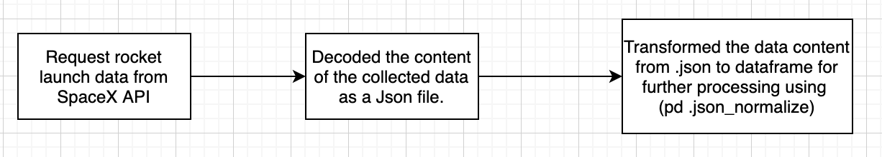
Data collection – REST API
Initiated a request to SpaceX API
Then converted the response content into a pandas dataframe for Cleaning, and further processes
Below is a flowchart of the collected process.
Here’s a Github link to the complete notebook of the data collection

Slide 9
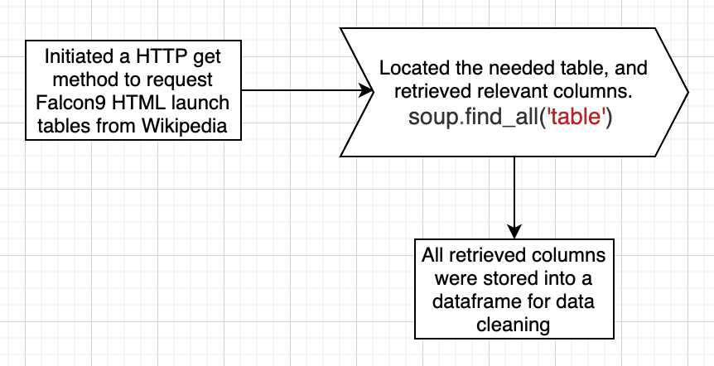


Data collection – Web scraping
A flowchart of web scraping process.
The webscraping was done using BeautifulSoup (a python package)
Extracted a falcon9 launch record HTML table from Wikipedia
Parsed the table and converted it to a dataframe.
Here’s a Github link to the complete notebook for the webscraping

Slide 10
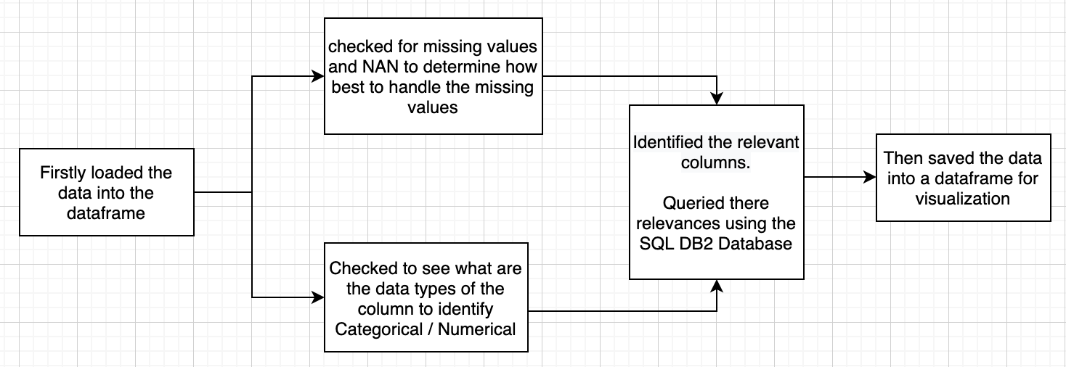
Data wrangling
The objective of the data wrangling was to:-
* Understand the dataset * Data cleaning, and identifying patterns in the dataset
* Determine the labels for training the machine learning model.
Here’s a flowchart of the processes
Here’s a Github link to the complete notebook for the data wrangling

Slide 11
EDA with SQL
Summary of some performed SQL queries using bullet points
Displayed the number of unique lunch sites on the space mission
Queried the average payload mass carried by Booster version F9 V1.1
Queried for the first successful landing outcome
Also queried for the total number of successful outcomes
Displayed the number of booster which have success in drone ship and have higher payload mass between 4000 and 6000
Here’s a Github link to the complete notebook for the data wrangling

Slide 12
EDA with data visualization
Summary of what charts were plotted and why used those charts
Plotted a catplot to discover the relationship between Flight-Number and Payload Mass, the essence to to observe how these variables would affect launch outcome.
Plotted a chart to relationship between Flight Number and Launch Site, and to establish how launch sites vary with flight numbers.
Also tried to observe if there’s a relationship between payload mass and launch sites.
Then I also plotted a chart to visualize relationship between success rate of each orbit type
Also the relationship between payload mass and orbit type.
Here’s a Github link to the complete notebook for the data wrangling

Slide 13
Build an interactive map with Folium
Summarize what map objects such as markers, circles, lines, etc. you created and added to a folium map
Created and added folium.Circle and folium.Marker for each launch site on the site map, to visualize the relative positions of the key locations
Create a new column in launch_sites dataframe called marker_color to store the marker colors based on the class value
Drew a PolyLine between a launch site and it neighbouring facilities to check for there proximities to public paces.
Here’s a Github link to the complete notebook for the data wrangling

Slide 14
Build a Dashboard with Plotly Dash
Summarize what plots/graphs and interactions you have added to a dashboard
Explain why you added those plots and interactions
Add the GitHub URL of your completed Plotly Dash lab, as an external reference and peer-review purpose

Slide 15
Predictive analysis (Classification)
Summarize how you built, evaluated, improved, and found the best performing classification model
You need present your model development process using key phrases and flowchart
Add the GitHub URL of your completed predictive analysis lab, as an external reference and peer-review purpose

Slide 16
Results
Exploratory data analysis results
Interactive analytics demo in screenshots
Predictive analysis results

Slide 17
EDA with Visualization

Slide 18
Flight Number vs. Launch Site
Show a scatter plot of Flight Number vs. Launch Site
Show the screenshot of the scatter plot with explanations

Slide 19
Payload vs. Launch Site
Show a scatter plot of Payload vs. Launch Site
Show the screenshot of the scatter plot with explanations

Slide 20
Success rate vs. Orbit type
Show a barchart for the success rate of each orbit type
Show the screenshot of the scatter plot with explanations

Slide 21
Flight Number vs. Orbit type
Show a scatter point of Flight number vs. Orbit type
Show the screenshot of the scatter plot with explanations

Slide 22
Payload vs. Orbit type
Show a scatter point of payload vs. orbit type
Show the screenshot of the scatter plot with explanations

Slide 23
Launch success yearly trend
Show a line chart of yearly average success rate
Show the screenshot of the scatter plot with explanations

Slide 24
EDA with SQL

Slide 25
All launch site names
Find the names of the unique launch sites
Present your query result with a short explanation here

Slide 26
Launch site names begin with `CCA`
Find all launch sites begin with `CCA`
Present your query result with a short explanation here

Slide 27
Total payload mass
Calculate the total payload carried by boosters from NASA
Present your query result with a short explanation here

Slide 28
Average payload mass by F9 v1.1
Calculate the average payload mass carried by booster version F9 v1.1
Present your query result with a short explanation here

Slide 29
First successful ground landing date
Find the date when the first successful landing outcome in ground pad
Present your query result with a short explanation here

Slide 30
Successful drone ship landing with payload between 4000 and 6000
List the names of boosters which have success in drone ship and have payload mass greater than 4000 but less than 6000
Present your query result with a short explanation here

Slide 31
Total number of successful and failure mission outcomes
Calculate the total number of successful and failure mission outcomes
Present your query result with a short explanation here

Slide 32
Boosters carried maximum payload
List the names of the booster which have carried the maximum payload mass
Present your query result with a short explanation here

Slide 33
2015 launch records
List the records which will display the month names, failure landing_outcomes in drone ship ,booster versions, launch_site for the months in year 2015
Present your query result with a short explanation here

Slide 34
Rank success count between 2010-06-04 and 2017-03-20
Rank the count of successful landing_outcomes between the date 2010-06-04 and 2017-03-20 in descending order.
Present your query result with a short explanation here

Slide 35
Interactive map with Folium

Slide 36
<Folium map screenshot 1>
Replace <Folium map screenshot 1> title with an appropriate title
Show the screenshot of all launch sites’ location markers on a global map
Explain the important elements and findings on the screenshot

Slide 37
<Folium map screenshot 2>
Replace <Folium map screenshot 2> title with an appropriate title
Show the screenshot of color-labeled launch records on the map
Explain the important elements and findings on the screenshot

Slide 38
<Folium map screenshot 3>
Replace <Folium map screenshot 3> title with an appropriate title
Show the screenshot of a selected launch site to its proximities such as railway, highway, coastline, with distance calculated and displayed
Explain the important elements and findings on the screenshot

Slide 39
Build a Dashboard with Plotly Dash

Slide 40
<Dashboard screenshot 1>
Replace <Dashboard screenshot 1> title with an appropriate title
Show the screenshot of launch success count for all sites, in a piechart
Explain the important elements and findings on the screenshot

Slide 41
<Dashboard screenshot 2>
Replace <Dashboard screenshot 2> title with an appropriate title
Show the screenshot of the piechart for the launch site with highest launch success ratio
Explain the important elements and findings on the screenshot

Slide 42
<Dashboard screenshot 3>
Replace <Dashboard screenshot 3> title with an appropriate title
Show screenshots of Payload vs. Launch Outcome scatter plot for all sites, with different payload selected in the range slider
Explain the important elements and findings on the screenshot

Slide 43
Predictive analysis (Classification)

Slide 44
Classification Accuracy
Visualize all the built model accuracy for all built models, in a barchart
Find which model has the highest classification accuracy

Slide 45
Confusion Matrix
Show the confusion matrix of the best performing model with explanation

Slide 46

CONCLUSION
Point 1
Point 2
Point 3
Point 4
…

Slide 47

APPENDIX
Include any relevant assets like Python code snippets, SQL queries, charts, Notebook outputs, or data sets that you may have created during this project

