Slide 1



FIREWALL USING IPTABLES
PROTECTING OUR DIGITAL WORLD
Christelle Oueiss
Salam Lababidi

Slide 2


TABLE OF CONTENT

Slide 3
TABLE OF CONTENT
1
INTRODUCTION

Slide 4
TABLE OF CONTENT
1
2
INTRODUCTION
HISTORY

Slide 5
TABLE OF CONTENT
1
2
3
INTRODUCTION
HISTORY
WHAT IS A FIREWALL?

Slide 6
TABLE OF CONTENT
1
2
3
INTRODUCTION
HISTORY
WHAT IS A FIREWALL?
4
WHAT IS A FIREWALL WITH IPTABLES?

Slide 7
TABLE OF CONTENT
1
2
3
INTRODUCTION
HISTORY
WHAT IS A FIREWALL?
4
5
WHAT IS A FIREWALL WITH IPTABLES?
REAL WORLD IMPLICATIONS

Slide 8
TABLE OF CONTENT
1
2
3
INTRODUCTION
HISTORY
WHAT IS A FIREWALL?
4
5
6
WHAT IS A FIREWALL WITH IPTABLES?
REAL WORLD IMPLICATIONS
IMPLEMENTATIONS

Slide 9
TABLE OF CONTENT
7
DISCUSSION

Slide 10
TABLE OF CONTENT
7
8
9
DISCUSSION
RECOMMENDATIONS
CONCLUSION

Slide 11
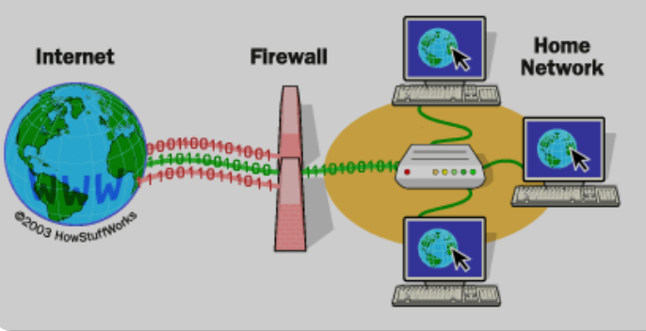
INTRODUCTION

Slide 12
INTRODUCTION
Develop a minimalist, effective firewall using iptables to enhance Linux-based network security.

Slide 13
INTRODUCTION
Develop a minimalist, effective firewall using iptables to enhance Linux-based network security.
Filter traffic to block unauthorized access while allowing trusted connections.

Slide 14
INTRODUCTION
Develop a minimalist, effective firewall using iptables to enhance Linux-based network security.
Filter traffic to block unauthorized access while allowing trusted connections.
Enable essential services like SSH and HTTP.

Slide 15
INTRODUCTION
Develop a minimalist, effective firewall using iptables to enhance Linux-based network security.
Filter traffic to block unauthorized access while allowing trusted connections.
Enable essential services like SSH and HTTP.
Configure rules based on IP addresses , ports, and protocols for precise traffic management.

Slide 16
INTRODUCTION
Develop a minimalist, effective firewall using iptables to enhance Linux-based network security.
Filter traffic to block unauthorized access while allowing trusted connections.
Enable essential services like SSH and HTTP.
Configure rules based on IP addresses , ports, and protocols for precise traffic management.
Understand iptables structure, including chains, tables, and rules.

Slide 17
This project aims to create a robust, adaptable firewall that balances security with accessibility, providing hands-on experience in securing Linux systems against real-world threats.

Slide 18
HISTORY

Slide 19

HISTORY
ORIGINS AND EVOLUTION
Firewalls began in the 1980s as simple packet filters, evolving into stateful inspection and application-layer firewalls for dynamic protection

Slide 20
HISTORY
ORIGINS AND EVOLUTION
Firewalls began in the 1980s as simple packet filters, evolving into stateful inspection and application-layer firewalls for dynamic protection
ROLE OF IPTABLES
Introduced with Linux's Netfilter framework, iptables transformed open-source firewall technology with its flexible, command-line traffic management

Slide 21
HISTORY
ORIGINS AND EVOLUTION
Firewalls began in the 1980s as simple packet filters, evolving into stateful inspection and application-layer firewalls for dynamic protection
ROLE OF IPTABLES
Introduced with Linux's Netfilter framework, iptables transformed open-source firewall technology with its flexible, command-line traffic management
KEY CAPABILITIES
Offers granular control over packet filtering, logging, and NAT, making it a lightweight yet powerful tool for Linux network security.

Slide 22
HISTORY
ORIGINS AND EVOLUTION
Firewalls began in the 1980s as simple packet filters, evolving into stateful inspection and application-layer firewalls for dynamic protection
ROLE OF IPTABLES
Introduced with Linux's Netfilter framework, iptables transformed open-source firewall technology with its flexible, command-line traffic management
KEY CAPABILITIES
Offers granular control over packet filtering, logging, and NAT, making it a lightweight yet powerful tool for Linux network security.
PROJECT FOCUS
Builds on this legacy to craft an effective firewall using iptables, emphasizing modern cybersecurity principles of precision and adaptability.

Slide 23

WHAT IS A FIREWALL ?

Slide 24
WHAT IS A FIREWALL ?
A firewall is a network security device or software tool that monitors and controls incoming and outgoing traffic based on predefined rules

Slide 25
WHAT IS A FIREWALL ?
A firewall is a network security device or software tool that monitors and controls incoming and outgoing traffic based on predefined rules
Acts as a barrier between trusted internal networks and untrusted external networks, preventing unauthorized access while allowing legitimate communication

Slide 26
WHAT IS A FIREWALL ?
A firewall is a network security device or software tool that monitors and controls incoming and outgoing traffic based on predefined rules
Acts as a barrier between trusted internal networks and untrusted external networks, preventing unauthorized access while allowing legitimate communication
Basic Packet Filtering: Inspects data packets based on IP addresses, ports, and protocols.
Advanced Monitoring: Includes stateful inspection and application-layer monitoring to analyze traffic context and behavior

Slide 27
WHAT IS A FIREWALL ?
A firewall is a network security device or software tool that monitors and controls incoming and outgoing traffic based on predefined rules
Acts as a barrier between trusted internal networks and untrusted external networks, preventing unauthorized access while allowing legitimate communication
Basic Packet Filtering: Inspects data packets based on IP addresses, ports, and protocols.
Advanced Monitoring: Includes stateful inspection and application-layer monitoring to analyze traffic context and behavior
Enforces access control policies, filters malicious data, mitigates cyber threats, and ensures the integrity of network communications

Slide 28
WHAT IS A FIREWALL USING IPTABLES?

Slide 29
WHAT IS A FIREWALL USING IPTABLES?
ADVANCED CONTROL
iptables offers granular control, allowing administrators to define specific rules for traffic based on IPs, ports, protocols, and connection states.

Slide 30
WHAT IS A FIREWALL USING IPTABLES?
ADVANCED CONTROL
iptables offers granular control, allowing administrators to define specific rules for traffic based on IPs, ports, protocols, and connection states.
CUSTOM RULE CHAINS
Enables creation of custom rule chains to determine how packets are processed, dropped, or accepted

Slide 31
WHAT IS A FIREWALL USING IPTABLES?
ADVANCED CONTROL
iptables offers granular control, allowing administrators to define specific rules for traffic based on IPs, ports, protocols, and connection states.
CUSTOM RULE CHAINS
Enables creation of custom rule chains to determine how packets are processed, dropped, or accepted
ENHANCED FEATURES
Supports additional functionalities like Network Address Translation (NAT), detailed logging, and dynamic traffic handling

Slide 32
WHAT IS A FIREWALL USING IPTABLES?
ADVANCED CONTROL
iptables offers granular control, allowing administrators to define specific rules for traffic based on IPs, ports, protocols, and connection states.
CUSTOM RULE CHAINS
Enables creation of custom rule chains to determine how packets are processed, dropped, or accepted
ENHANCED FEATURES
Supports additional functionalities like Network Address Translation (NAT), detailed logging, and dynamic traffic handling
PROJECT EXAMPLE
Configures a firewall to block all incoming traffic by default, allowing only essential services like SSH and HTTP, while permitting trusted IPs—demonstrating tailored security with controlled accessibility

Slide 33




IMPLEMENTATION

Slide 34
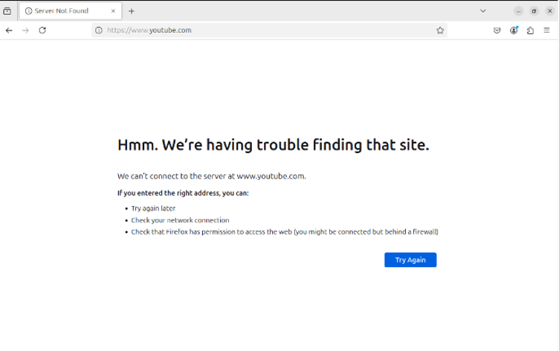
IMPLEMENTATION

Slide 35
REAL LIFE IMPLICATIONS
WANNACRY RANSOMWARE ATTACK (2017)
In May 2017, the WannaCry ransomware attack infected over 230,000 computers in 150+ countries by exploiting a Windows vulnerability (EternalBlue) and spreading through ports 445 and 139.

Slide 36
REAL LIFE IMPLICATIONS
WANNACRY RANSOMWARE ATTACK (2017)
In May 2017, the WannaCry ransomware attack infected over 230,000 computers in 150+ countries by exploiting a Windows vulnerability (EternalBlue) and spreading through ports 445 and 139.
Organizations, including the UK’s NHS, mitigated the attack by quickly configuring firewalls to block these ports, containing the malware's spread and preventing further infections.

Slide 37
REAL LIFE IMPLICATIONS
WANNACRY RANSOMWARE ATTACK (2017)
In May 2017, the WannaCry ransomware attack infected over 230,000 computers in 150+ countries by exploiting a Windows vulnerability (EternalBlue) and spreading through ports 445 and 139.
Organizations, including the UK’s NHS, mitigated the attack by quickly configuring firewalls to block these ports, containing the malware's spread and preventing further infections.
Pre-configured firewalls with restricted access to trusted IPs proved highly effective, underscoring the importance of proactive firewall setups, like those achievable with tools such as `iptables`, in defending against large-scale cyber threats.

Slide 38
RECOMMENDATIONS
INTEGRATION WITH MONITORING TOOLS
Future implementations could include integrating iptables with network monitoring tools, such as Fail2Ban or Suricata, to enable real-time threat detection and automatic response to suspicious activities.

Slide 39
RECOMMENDATIONS
INTEGRATION WITH MONITORING TOOLS
Future implementations could include integrating iptables with network monitoring tools, such as Fail2Ban or Suricata, to enable real-time threat detection and automatic response to suspicious activities.
ENHANCED LOGGING AND ANALYTICS
Incorporating advanced logging mechanisms, such as centralized log management using tools like ELK Stack, can provide deeper insights into traffic patterns and potential threats.

Slide 40
RECOMMENDATIONS
INTEGRATION WITH MONITORING TOOLS
Future implementations could include integrating iptables with network monitoring tools, such as Fail2Ban or Suricata, to enable real-time threat detection and automatic response to suspicious activities.
ENHANCED LOGGING AND ANALYTICS
Incorporating advanced logging mechanisms, such as centralized log management using tools like ELK Stack, can provide deeper insights into traffic patterns and potential threats.
SECURITY HARDENING AND THREAT MODELING
Regularly reviewing and updating firewall rules based on emerging threats, combined with simulated attack scenarios, can enhance the overall security posture of the system.

Slide 41
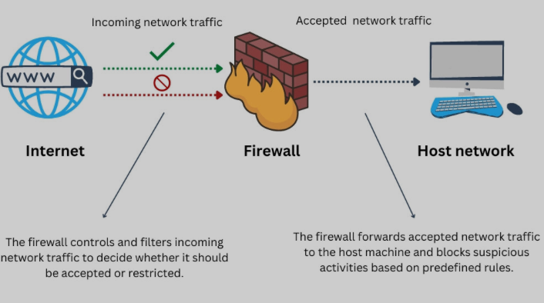
CONSLUSION
Firewalls are an indispensable tool in safeguarding networks from unauthorized access and malicious threats. Through this project, we demonstrated how iptables can be used to design a robust yet straightforward firewall, capable of filtering traffic and securing Linux-based systems. By mastering the configuration of chains, tables, and rules, this project highlights the importance of precise traffic control in achieving an optimal balance between security and functionality. The practical implementation and testing of the firewall underscore its adaptability to real-world challenges, proving its value in protecting systems across diverse environments.

Slide 42
THANK YOU

