Slide 1
PREDICTING DIABETES PREVALENCE
From Neighborhood Health Indicators
A CDC PLACES census-tract analysis to help target public health outreach
Ali Odah
Qossay Shtaiwi
Salam Odeh
Data Wrangler
Analyzer / Visualizer
Modeler
AXSOS Academy — Introduction to Machine Learning — Final Group Project
Notes:
Welcome / intro. Team 3: Ali Odah (Data Wrangler), Qossay Shtaiwi (Analyzer/Visualizer), Salam Odeh (Modeler). Today we're presenting our analysis of CDC PLACES health data, looking at which neighborhood-level health indicators are most strongly associated with diabetes prevalence, and what that means for public health outreach targeting.

Slide 2
The Business Problem
Where should limited public health resources go first?
1
Limited budgets, unlimited need
Public health departments can't run diabetes-prevention programs everywhere at once.
2
A data-driven starting point
Which neighborhood-level health indicators travel most closely with diabetes prevalence?
3
The goal
Use that association to help prioritize where screening, prevention, and outreach go first — not to diagnose individuals.
Business Problem
2
Notes:
Ali presents. Frame the problem in plain terms: this isn't about diagnosing individuals, it's about helping public health teams decide where to focus limited outreach and screening budgets. We're using CDC's PLACES dataset to see which neighborhood health indicators are most closely tied to diabetes prevalence.

Slide 3
The Dataset: CDC PLACES
Local Data for Better Health — Census Tract Data, 2024 release
36,242
40
33
6
Census tracts
(raw export)
Health measures
per tract
States in raw
export
Measure
categories
Six measure categories:
Health Outcomes (diabetes, stroke, arthritis...)
Prevention (checkups, screenings)
Health Risk Behaviors (smoking, inactivity)
Disability (mobility, vision, hearing...)
Health Status (self-rated health, distress)
Social Needs (food & housing insecurity, insurance)
Target variable: Diabetes — % of adults with diagnosed diabetes (crude prevalence), a regression task.
Dataset Overview
3
Notes:
Ali continues. Explain each tract is roughly a neighborhood. Every value is a model-based estimate from CDC, not a hand count — built from BRFSS survey + Census data. We chose Diabetes prevalence as our target because it's a well-understood outcome with plausible predictors already in the dataset.

Slide 4
Our Process: CRISP-DM
Cross-Industry Standard Process for Data Mining, mapped to our three roles
1
2
3
4
5
6
Business
Understanding
Data
Understanding
Data
Preparation
Modeling
Evaluation
Deployment
Whole team
Wrangler +
Analyzer
Data Wrangler
Modeler
Analyzer +
Modeler
Whole team
We treated Evaluation as more than a scoreboard: a deliberate part of this phase was checking why the model performed so well, and being explicit about what that accuracy does and doesn't mean.
CRISP-DM Process
4
Notes:
Ali wraps up his section. We followed CRISP-DM end to end, mapped onto our three roles. Hand off to Qossay for Data Understanding / EDA.

Slide 5
Data Preparation Highlights
Turning 1.29M raw rows into one clean, modeling-ready table
1
Caught a real data bug
2
Reshaped long format to wide
5 junk rows at the end of the export were an appended API error message — removed before anything else.
Pivoted from one row per (tract × measure) to one row per tract, 40 measure columns.
3
Handled missing values deliberately
4
Filtered unstable estimates
Dropped rows missing the target; median-imputed the rest (5–25% missing per column).
Removed 11 tracts with population under 100.
Result: 33,180 census tracts × 48 columns, zero missing values, ready for EDA and modeling.
Data Preparation
5
Notes:
Ali's last slide. Emphasize the junk-row catch — shows real data quality diligence, not just running code blindly. Median imputation was chosen because it's robust to outliers in percentage data. Hand off to Qossay now for EDA.

Slide 6
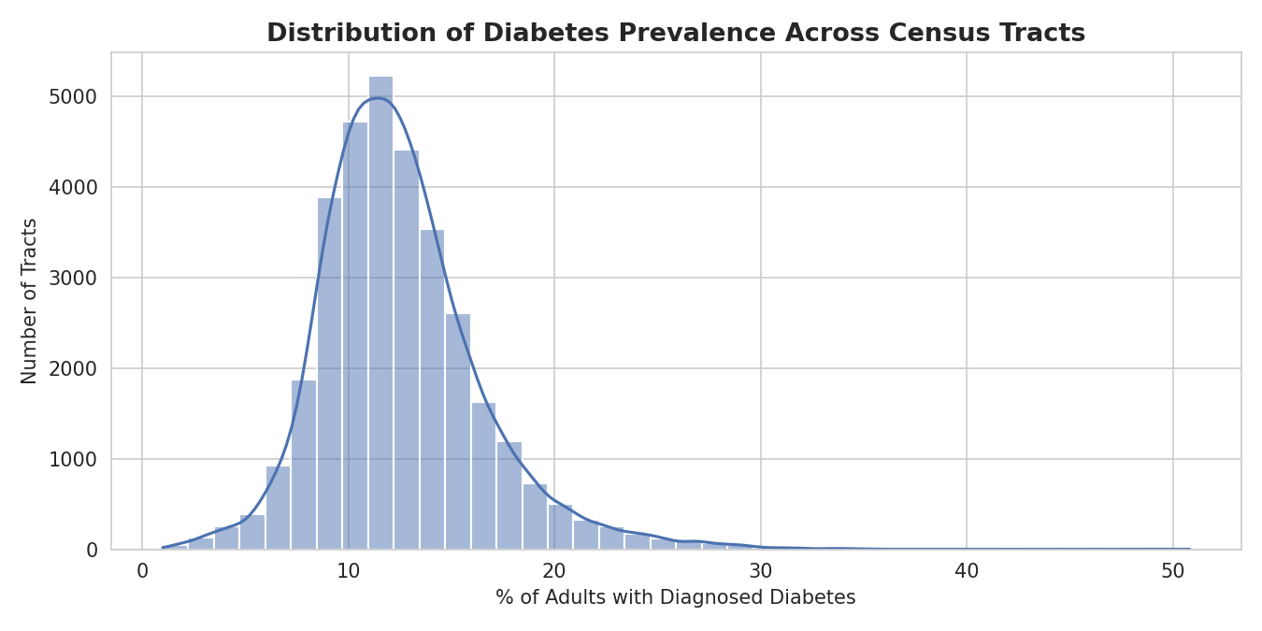
What Are We Predicting?
The distribution of diabetes prevalence across census tracts
12.5%
average tract
prevalence
10–14.5%
middle 50% of
tracts (IQR)
Right-skewed
a tail of high-
prevalence outliers
Exploratory Data Analysis
6
Notes:
Qossay presents. Before looking at predictors, understand the target. Most tracts cluster between 10-14.5%, with a smaller number of high-prevalence outlier tracts pulling the tail up. This right skew is worth remembering when we get to model evaluation.

Slide 7
Strongest Predictors of Diabetes
Correlation of each health measure with diabetes prevalence (top 10)
✓
Disability & mobility measures dominate — r > 0.8 for the top 10
✓
Cardiovascular measures (stroke, blood pressure) cluster right alongside them
✓
These 6 measures (r > 0.8) became our modeler's starting feature set
Exploratory Data Analysis
7
Notes:
Qossay continues. We correlated all 39 other measures against Diabetes. Disability, inactivity, and cardiovascular measures show up strongest — makes medical sense, since these conditions cluster in the same populations.

Slide 8
A Regional Pattern — and a Data Quirk
Average diabetes prevalence by state (highest & lowest 5)
Highest 5 States
Lowest 5 States
Consistent with the well-known U.S. “Diabetes Belt” — Southeastern states highest, Mountain/Northeast states lowest.
Data quirk to flag: the column “Health Insurance” actually measures lack of insurance — easy to misread the direction.
Scope limitation: the raw export covers 33 states, but 12 had zero usable Diabetes values and were dropped — our modeling data reflects 21 states.
Exploratory Data Analysis
8
Notes:
Qossay continues. Point out the Diabetes Belt pattern is a well-documented real phenomenon, good narrative color. Then flag the Health Insurance labeling issue clearly — shows careful reading of the data dictionary, not just running correlations blindly. Also state the 21-state scope limitation explicitly here so the audience doesn't assume national coverage.

Slide 9
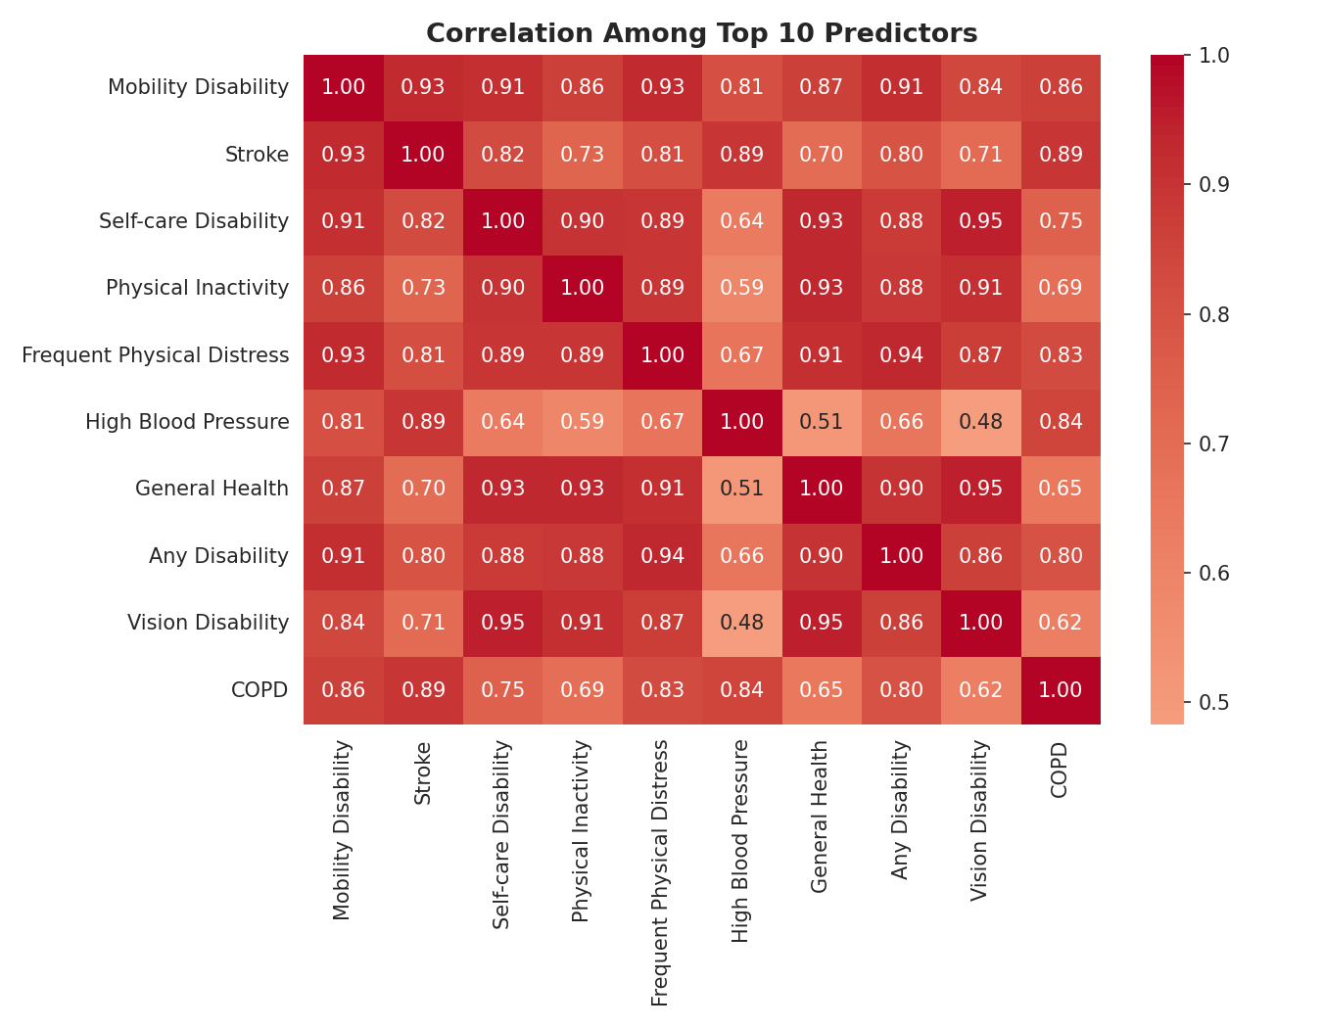
A Complication: Multicollinearity
Several top predictors are highly correlated with each other
!
Mobility Disability & Stroke
r ≈ 0.93 — nearly redundant signals
!
Physical Inactivity & General Health
r ≈ 0.93
✓
What this means
Linear coefficients become unstable when inputs overlap this much
✓
Our recommendation
Favor tree-based models — they handle correlated features more gracefully
Exploratory Data Analysis
9
Notes:
Qossay's last slide. This is the key insight we hand off to Salam: several of the strongest predictors move together so closely that a linear model's individual coefficients become unreliable. This is why we recommend tree-based models. Hand off to Salam for modeling.

Slide 10
Modeling Approach
Three models, same 75/25 train/test split (random_state=42)
1
2
3
Linear Regression
Random Forest
Gradient Boosting
Baseline
Primary candidate
Second comparison
Scaled features. Used as a performance floor and interpretability check — not a production candidate, given the multicollinearity Qossay found.
Chosen because tree-based models tolerate correlated features far better than linear models. Tuned via GridSearchCV.
A second tree-based method, included to confirm Random Forest's advantage wasn't a fluke of one algorithm.
Modeling
10
Notes:
Salam presents. Explain why three models: Linear as an honest floor, Random Forest as the primary bet given the multicollinearity Qossay flagged, Gradient Boosting as a second opinion. All compared fairly on the same split.

Slide 11
Model Comparison Results
Test R² across all four models (higher is better)
Model | RMSE | MAE
Linear Regression | 0.626 | 0.424
Random Forest (Default) | 0.527 | 0.360
Gradient Boosting | 0.657 | 0.469
Random Forest (Tuned) | 0.527 | 0.359
RMSE / MAE in percentage points of diabetes prevalence
Every model exceeds R² = 0.97 — unusually high for real-world data. We traced why (next: Limitations).
Modeling Results
11
Notes:
Salam continues. Random Forest wins, tuning barely changes anything (0.9816 both) — that's a reassuring sign the default wasn't a fluke, not a wasted step. Flag the suspiciously high R2 here to set up the Limitations slide — don't let the audience think we're just celebrating a big number.

Slide 12
What Drives the Model?
Feature importances — tuned Random Forest (top 10)
~80%
of the model's total importance comes from Mobility Disability alone
Frame carefully: this matches the multicollinearity we found — correlated features get treated as redundant. The honest claim is “disability & inactivity indicators are the strongest signal,” not that mobility issues cause diabetes.
Modeling Results
12
Notes:
Salam continues. This matches exactly what Qossay found in correlation — good sign the pipeline is consistent. Be careful with language here: correlation/importance, not causation. Set up transition to Limitations slide.

Slide 13
Limitations & Honest Caveats
We think this section matters as much as the results themselves
!
Ecological correlation, not individual prediction
!
Shared statistical origin inflates R²
Every value is a neighborhood %, not an individual health record.
All 40 PLACES measures come from the same CDC small-area model — likely why every model scores above 0.97.
!
Correlation, not causation
!
Multicollinearity concentrates importance
E.g. Binge Drinking's negative correlation likely reflects population age, not a protective effect.
A cluster of correlated features can make one look disproportionately dominant.
!
Scope limitation
12 of 33 exported states had zero usable Diabetes values — our data reflects 21 states, not the full U.S.
Bottom line: strong neighborhood-level statistical associations — not a validated causal or individual-level diagnostic tool.
Limitations
13
Notes:
Salam's key slide — don't rush this. This is what shows we understand the data, not just that we ran models on it. State each point plainly and confidently; these caveats don't undermine the work, they make it credible.

Slide 14
Business Recommendations
What a public health team could do with this
1
Use disability & cardiovascular indicators as an early screening layer for outreach targeting
2
Treat this as a targeting tool, not a diagnostic one — guides resource allocation, not individual care
3
Pair quantitative targeting with local, on-the-ground context
4
Re-run this analysis as new PLACES releases come out, with full state coverage
Thank You
Questions?
Ali Odah • Qossay Shtaiwi • Salam Odeh
Recommendations & Closing
14
Notes:
Whole team for Q&A. Recap: strong neighborhood-level associations between disability/cardiovascular indicators and diabetes prevalence, usable for outreach targeting with the caveats we outlined. Open the floor for questions — each of us should be ready to speak to any part of the project, not just our own section.

