Slide 1
Low-Altitude Aerial
Object Detection
ARIEL PROJECT
THI · Fraunhofer IVI · THD
Final Project Presentation
Aksakal Berke · Haggag Seifeldin · Rihani Yazan Daniel · Uzun Recep
Group-One · SS26
Notes:
Introduce yourselves. State the project: Low-Altitude Aerial Object Detection for THI-Fraunhofer-THD collaboration. Mention the 15-min structure: intro → dataset → model → results → conclusion.

Slide 2
Presentation Outline
Ariel Project · Group-One
01
Project Overview
02
Dataset & Annotation
Goals, motivation & research gap
4,776 annotations · 10 videos · 4 scenes
03
Model & Training
04
Results & Evaluation
YOLOv8 fine-tuning on custom dataset
mAP, precision, recall, confusion matrix
05
Qualitative Results
06
Conclusion & Next Steps
Detection examples across all scenes
Key findings and future work
Notes:
Walk through the agenda briefly — 30 seconds max.

Slide 3
Project Overview
Low-Altitude Aerial Object Detection (3–9 m)
Research Gap
Detection Classes
Existing datasets (VisDrone, UAVDT) are optimized for >30 m altitude — leading to missed detections and high false positives at low altitudes.
Class 0 — Human
Pedestrians & clusters
Objective
Class 1 — Bicycle
Build a custom annotated dataset for 3–9 m drone footage and fine-tune a YOLO-based detector to achieve reliable detection at ground-level altitudes.
Parked or moving
Pipeline
Class 2 — Vehicle
Data collection → Frame extraction → Manual annotation → YOLO fine-tuning → Evaluation (mAP@0.5 / mAP@0.5:0.95)
SUVs, sedans — top-down
Python · PyTorch · Ultralytics YOLOv8 · Roboflow
Notes:
Explain the gap in existing datasets. VisDrone/UAVDT are >30m altitude — we're building for 3-9m which is a completely different visual challenge. Objects appear much larger, perspective is more top-down.

Slide 4
Dataset Statistics
4,776 annotations · 10 video sequences · 4 distinct scenes · YOLO (.txt) format
4,776
3,642
597
537
Total Annotations
Human (76.2%)
Bicycle (12.5%)
Vehicle (11.2%)
2,227
10
4
~15%
Frames Labeled
Video Sequences
Distinct Scenes
Negative Samples
Notes:
Highlight the class imbalance — Human dominates at 76%. This will affect Bicycle performance in particular. Negative samples at 15% were intentionally kept to teach the model background.

Slide 5
Annotation Methodology
Tool · Process · Labeling Rules
Annotation Tool — Roboflow
Frame Extraction Strategy
Web-based collaborative labeling platform
Parallel annotation across team members
Built-in quality review & version control
Direct YOLO (.txt) export — one file per frame
Source: 30 FPS drone footage
Extract only on significant scene change
Threshold: ≥10% pixel-wise intensity delta
Object enter/exit events also trigger extraction
Labeling Rules
01
02
03
04
Class Naming
Tight Bounding Box
Full Object Extent
Consistency
Strict names: Human / Bicycle / Vehicle. No plurals or variants.
Zero padding. Boxes hug each object edge-to-edge exactly.
Include entire visible object — no gaps or background pixels.
Same rules across all annotators for reliable mAP evaluation.
Notes:
The key insight is consistency — all 4 team members had to follow identical rules so the ground truth is reliable. Inconsistent annotation hurts mAP directly.

Slide 6
Annotation Challenges
Decisions made during labeling and their impact on model quality
👁 Shadows
🔍 Occlusion & Truncation
Rule:
Label physical silhouette only — never include the shadow.
Rule:
Box visible portion only. Label if ≥20% body visible. Skip tiny fragments.
⚡ Mislabeled shadows inflate False Positives and teach wrong spatial extent.
⚡ Guessing hidden parts adds spatial noise and ambiguous samples that harm recall.
📐 Bounding Box Tightness
🔲 Negative Samples (~15%)
Rule:
Zero-padding policy: box must touch each edge. Full object extent captured.
Rule:
Empty frames intentionally kept at ~15% ratio. No bounding boxes in .txt.
⚡ Loose boxes penalize IoU. Inconsistent tightness across annotators hurts mAP.
⚡ Teaches model what background looks like. Without negatives → high False Positive rate.
Notes:
These 4 decisions were the most debated during annotation. Shadows in particular were tricky — at 3-9m altitude the shadows can be 2-3x the size of the person.

Slide 7
Model & Training Setup
YOLOv8n · Google Colab (T4 GPU) · 150 epochs · Early Stopping
Base Model
Epochs
Image Size
Dataset Split
yolov8n.pt
150
640 px
80/10/10
Nano — optimized for edge/drone devices
Early stopping: patience=15 epochs
imgsz=640, batch=16
Train / Validation / Test
train.py
model = YOLO("yolov8n.pt")
model.train(
data="./unified_dataset_80_10_10/data.yaml",
epochs=150, imgsz=640, batch=16,
patience=15, # Early Stopping
box=7.5, cls=1.5, cos_lr=True, # Aerial tuning
project="Ariel_Project", name="drone_model_final")
🚀 Platform: Google Colab (T4 GPU) · ⚡ Inference: 2.3 ms (4.2 ms total) · 📦 Export: ONNX
Notes:
Explain: we used YOLOv8 Nano because it's designed for edge/drone devices. Trained on Google Colab T4 GPU. Early stopping at patience=15 means training auto-stopped when mAP stopped improving. Aerial optimizations: box=7.5 enforces tight bounding boxes, cls=1.5 weights classification correctly, cos_lr gives smooth learning rate decay.

Slide 8
Quantitative Results
231 test images · 501 instances · YOLO val output
91.8%
95.6%
92.6%
85.0%
mAP@0.5
Precision
Recall
mAP@0.5:0.95
all classes
all classes
all classes
stricter threshold
Per-Class Breakdown
Class | Images | Instances | Precision | Recall | mAP@0.5 | mAP@0.5:0.95
All | 231 | 501 | 0.956 | 0.926 | 0.918 | 0.850
Human | 188 | 385 | 0.949 | 0.958 | 0.951 | 0.845
Bicycle | 34 | 55 | 0.918 | 0.818 | 0.807 | 0.713
Vehicle | 61 | 61 | 1.000 | 1.000 | 0.995 | 0.993
F1 Score (all classes): 0.94 · Vehicle achieves perfect 1.0 precision & recall · Bicycle lowest due to class imbalance (597 samples vs 3,642 Human)
Notes:
Key talking points: Vehicle gets perfect 1.0 because it's visually distinct from top-down view. Bicycle struggles most — 597 training samples vs 3,642 Human. Overall 91.8% mAP@0.5 is strong for a custom dataset.

Slide 9
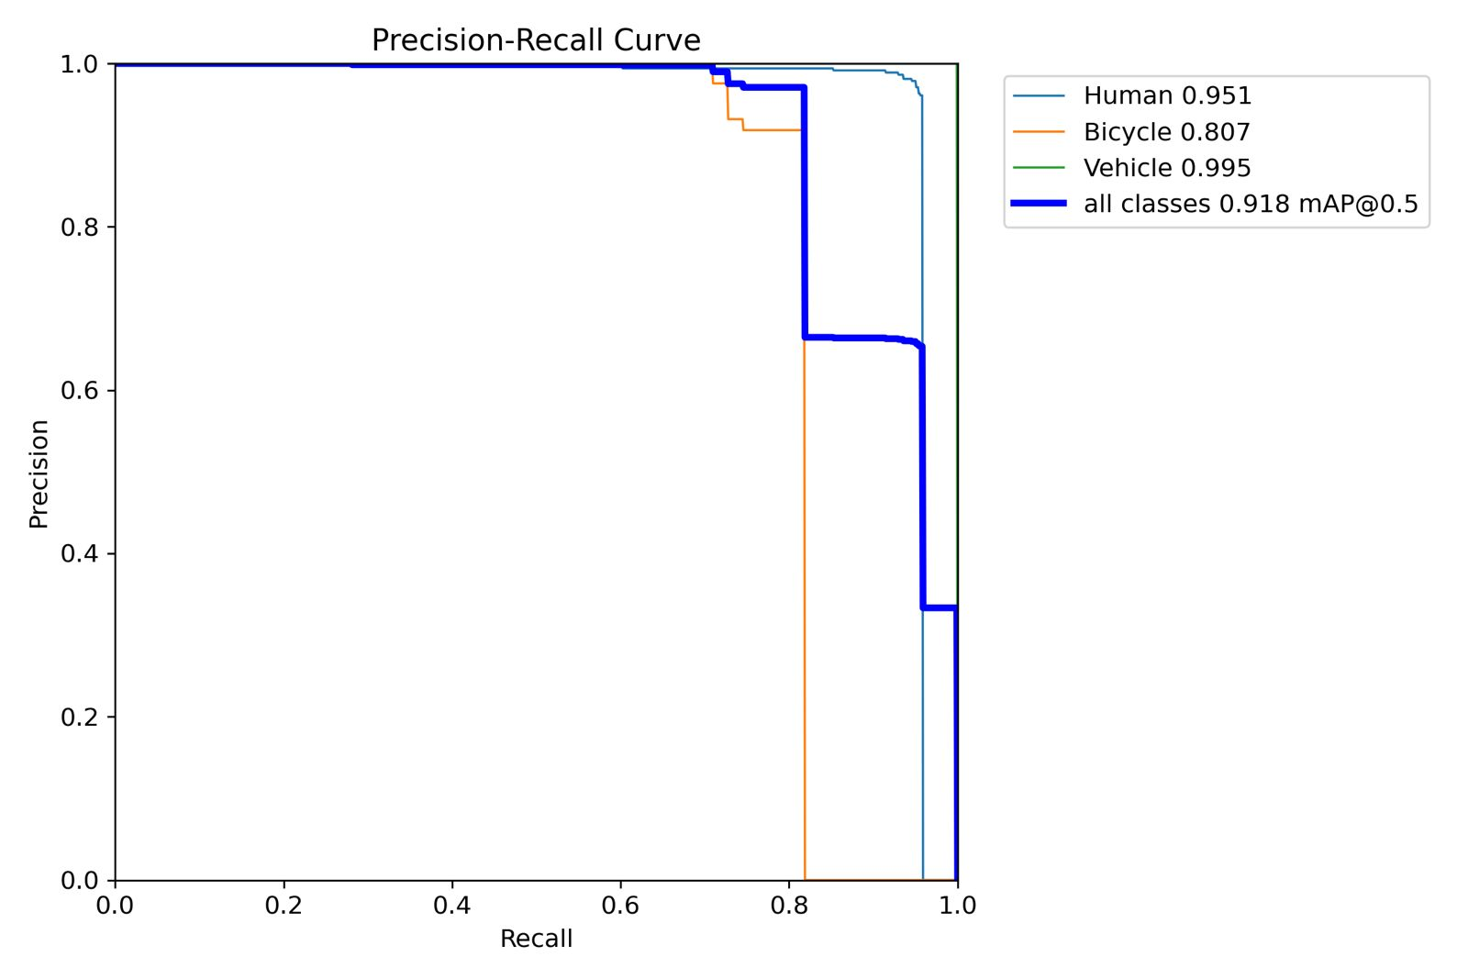
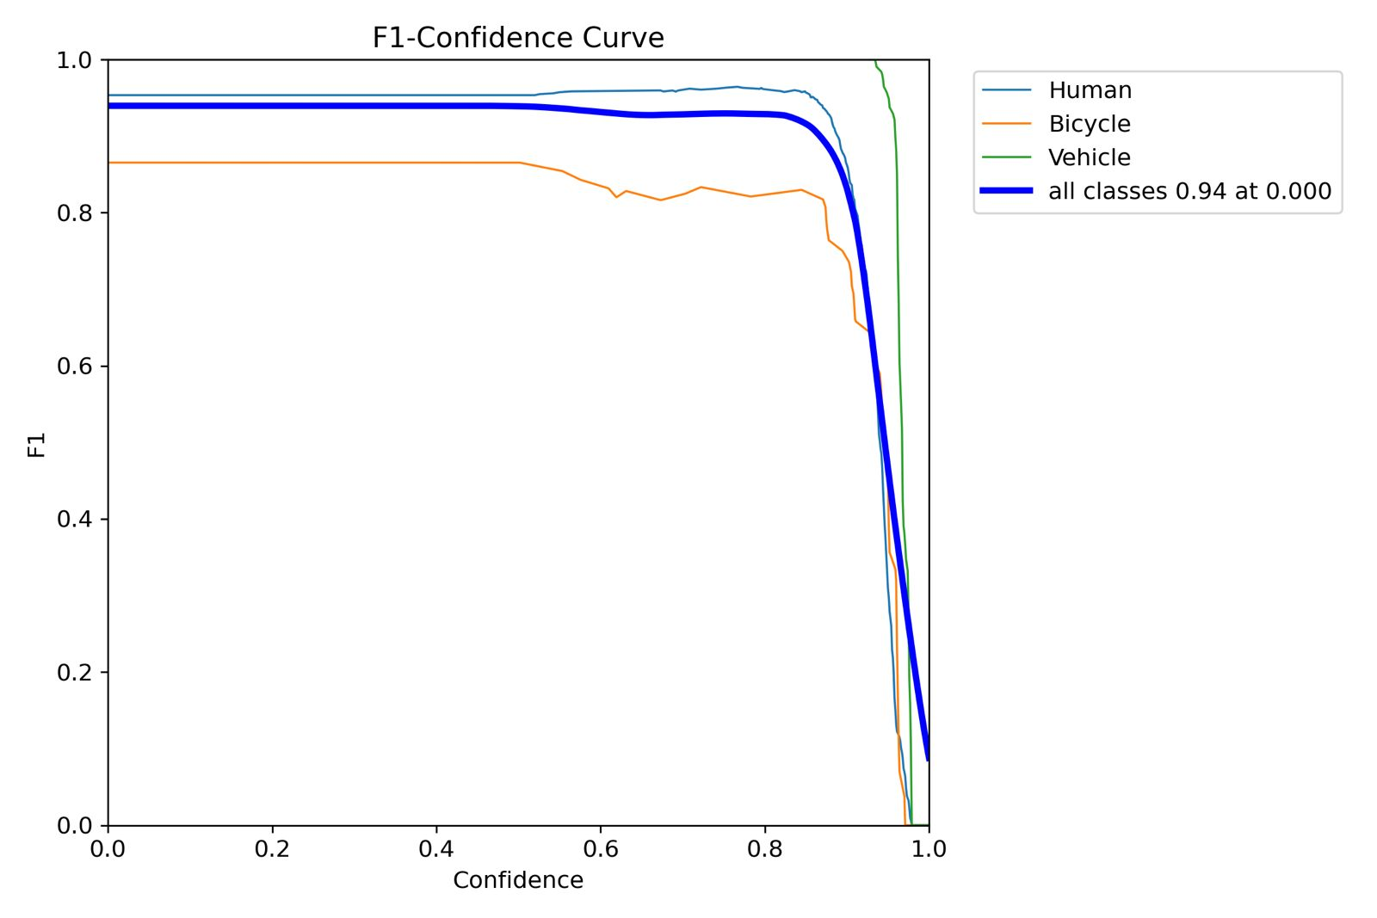
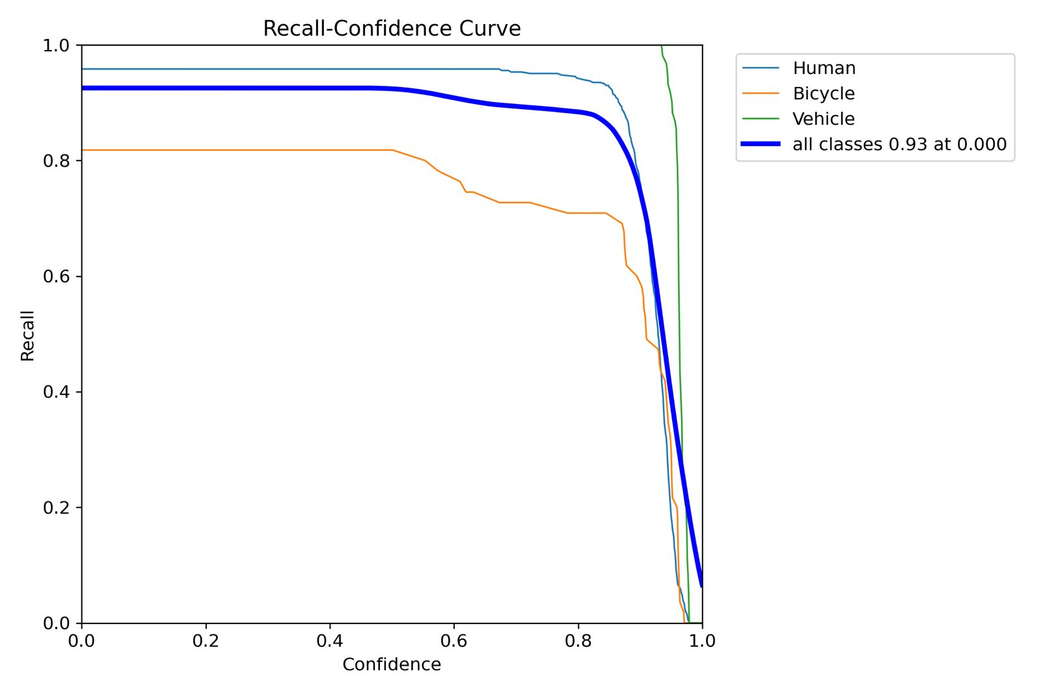
Evaluation Curves
Precision-Recall · F1-Confidence · Recall-Confidence
PR Curve · mAP@0.5: 0.918
F1-Confidence · Best F1: 0.94
Recall-Confidence · Recall: 0.93
Bicycle (orange) consistently lowest across all curves — explained by class imbalance (597 instances vs 3,642 Human). Vehicle (green) achieves near-perfect scores.
Notes:
Point out that all three curves are very flat and high — meaning the model is robust across confidence thresholds. The drop-off happens only at very high confidence (>0.9). Bicycle's lower performance is expected and explained by training data volume.

Slide 10
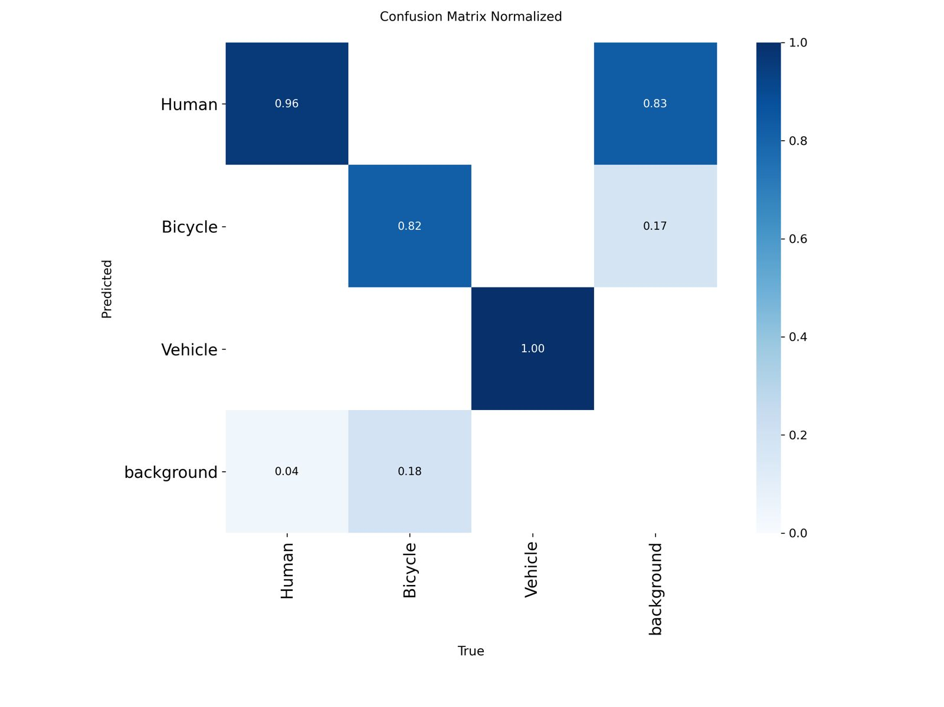
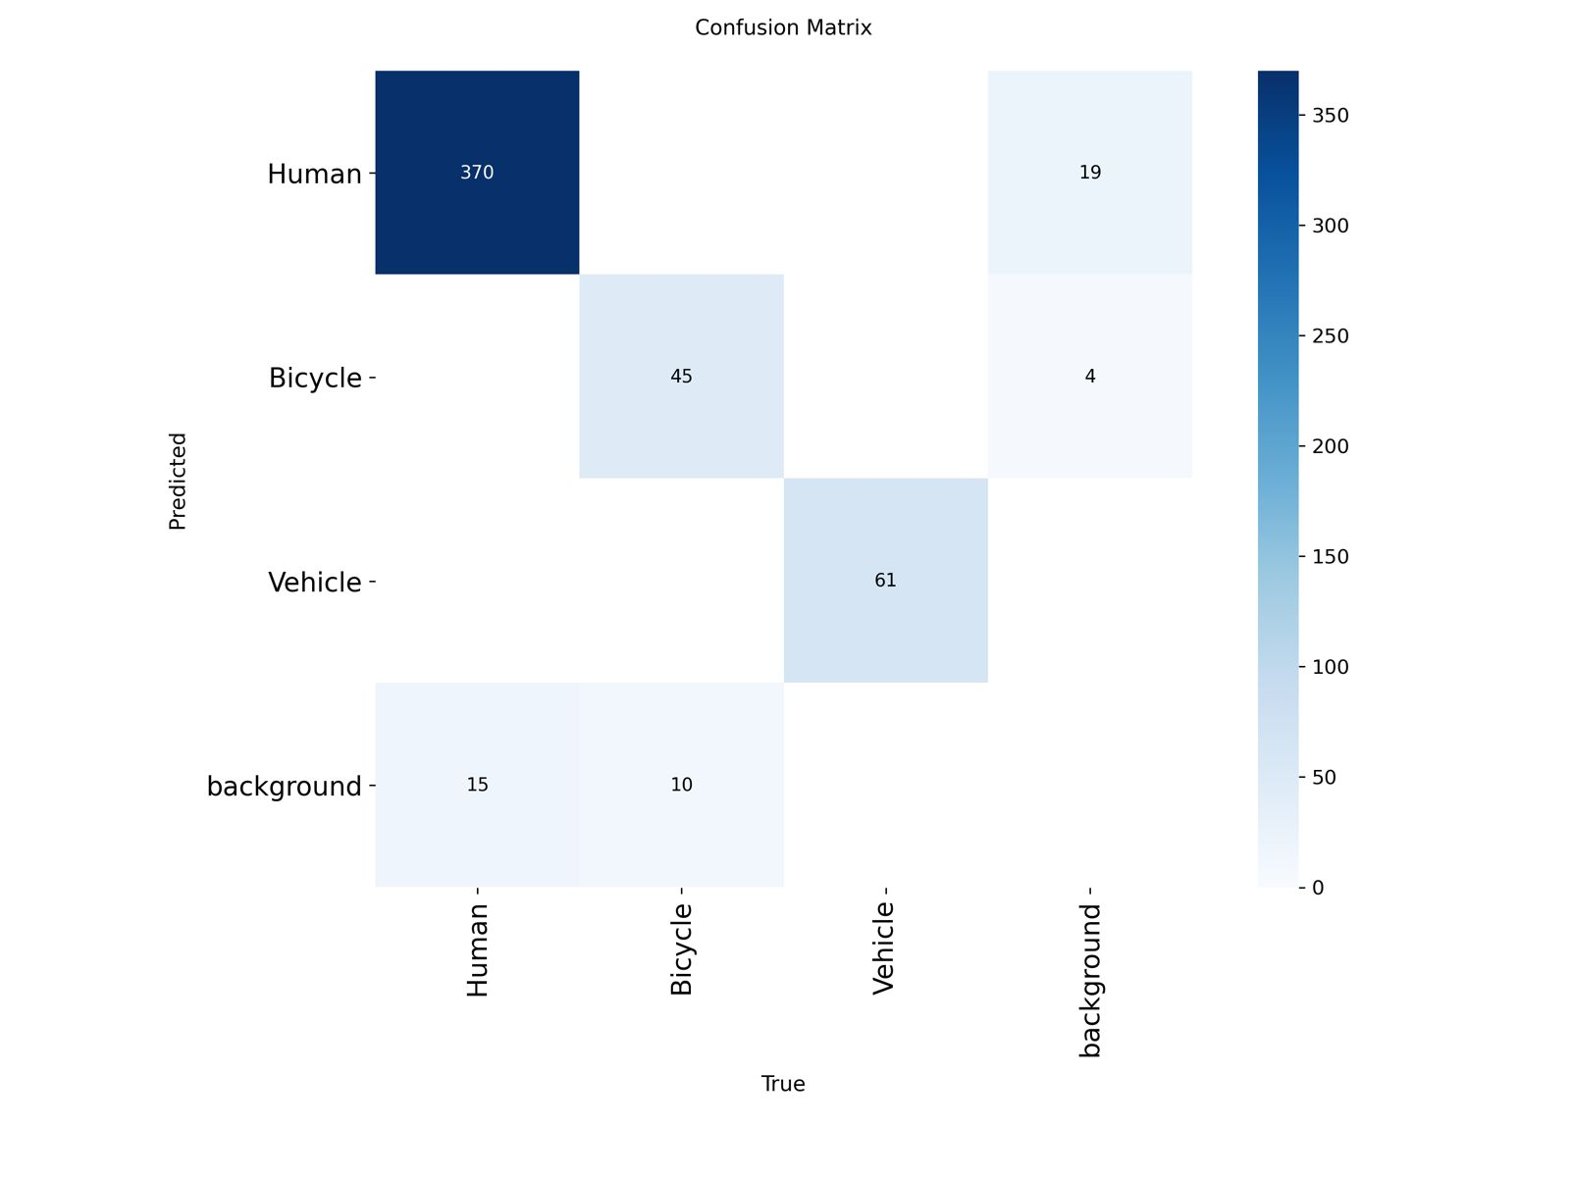
Confusion Matrix Analysis
Raw counts & normalized view
Normalized
Raw Counts
✅ Human: 96% correctly classified
✅ Vehicle: 100% correctly classified
⚠️ Background → Human (83%): main FP edge case
Notes:
The key insight from the confusion matrix: Bicycle's main error is being missed (classified as background) — not being confused with other classes. This means the model knows WHAT a bicycle looks like but sometimes doesn't detect it. Solution: more bicycle training data.

Slide 11
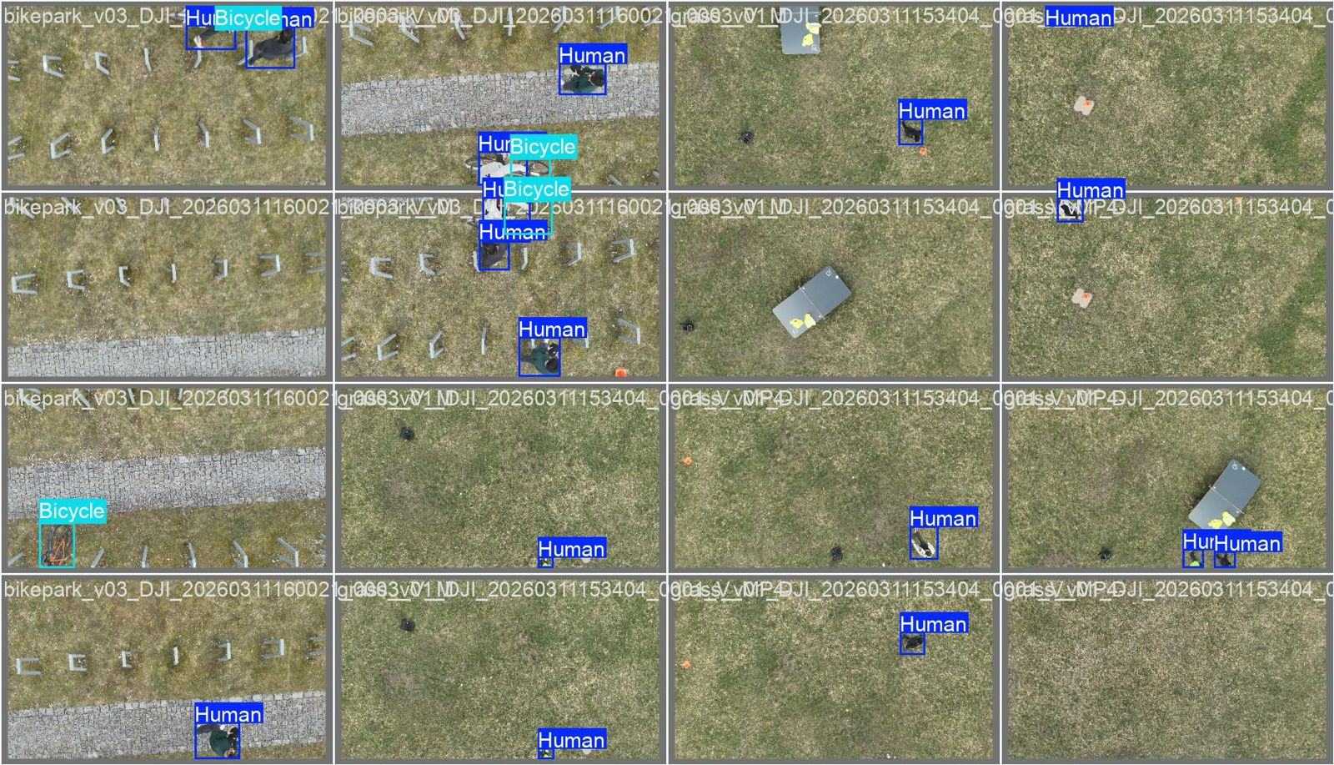
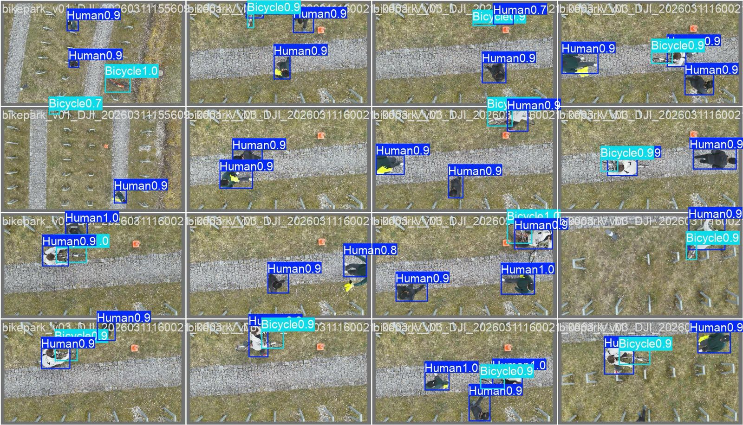
Qualitative Results — Detection Examples
THI_Bikepark · THI_Grass scenes — model predictions with confidence scores
THI_Bikepark — Predictions
THI_Grass + Mixed Scenes
■ Human (navy) · Confidence scores shown on each box
■ Bicycle (cyan) · Confidence scores shown on each box
Notes:
Show these examples and point out: high confidence scores (0.9-1.0) on well-visible objects, correct bounding box tightness, and that the model generalizes across different scenes.

Slide 12
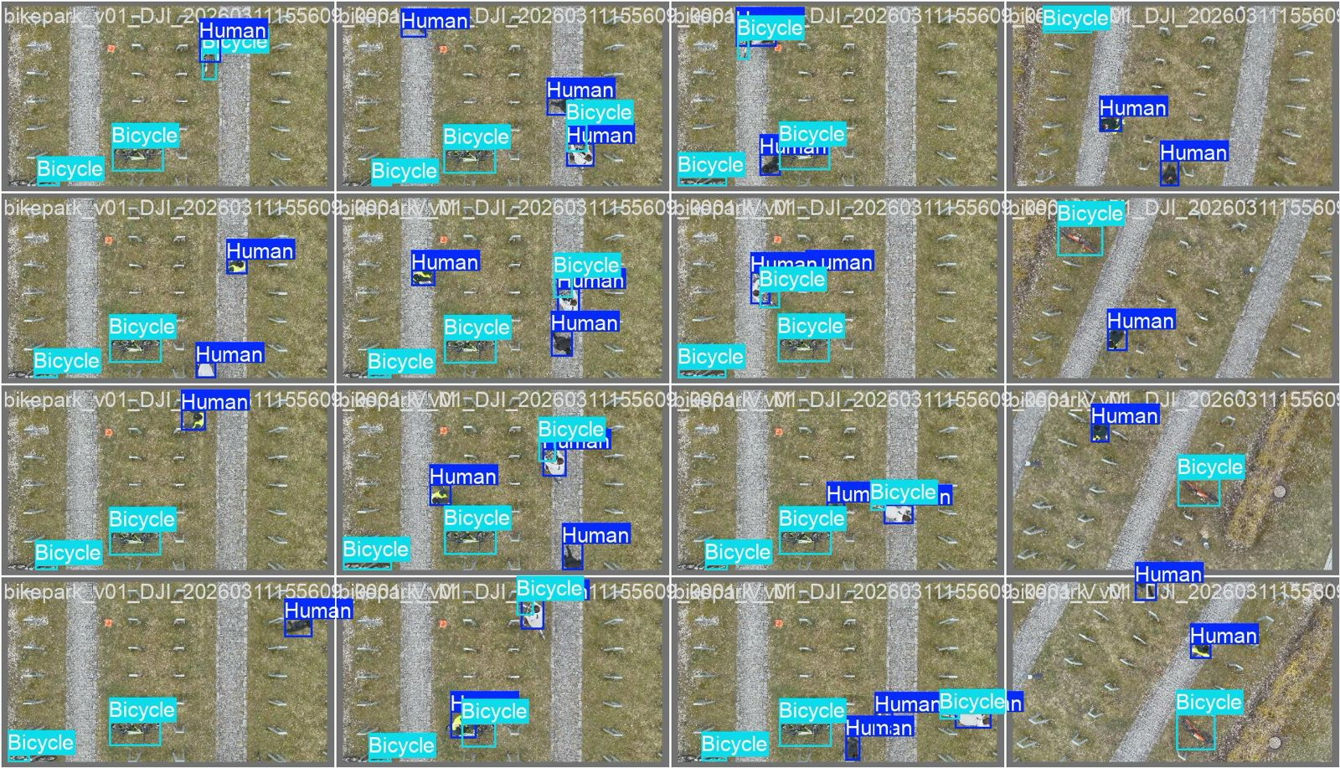
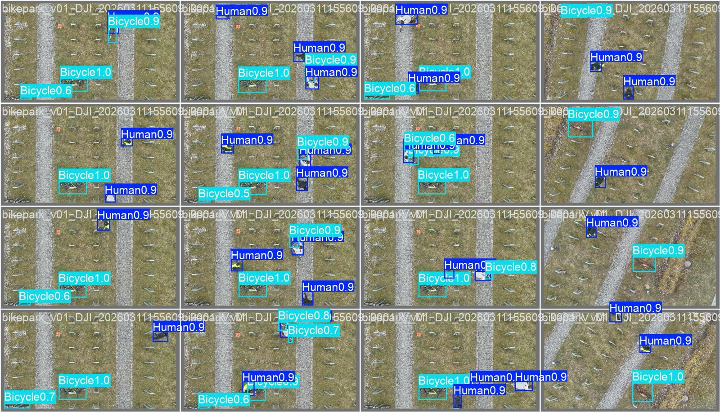
Detection Examples — DK Parking Scene
Ground truth vs. model predictions
Ground Truth Labels
Model Predictions
Model predictions closely match ground truth labels — tight bounding boxes and accurate class assignment across crowded scenes.
Notes:
Compare GT vs predictions side by side. The boxes align very well. This is from DK_parking which has the most annotations (1,757 total).

Slide 13
Conclusion
Ariel Project · Group-One · THI-THD · SS26
✅ Custom dataset: 4,776 annotations across 4 distinct scenes
✅ mAP@0.5 of 91.8% — strong result for custom low-altitude data
✅ Vehicle: perfect 1.0 precision & recall
✅ Human: 96% correctly classified with high confidence
✅ Inference: 2.3 ms (4.2 ms full pipeline) — real-time ready
🔭 Future work: expand negatives to reduce background → Human FPs
Thank you · Questions welcome
Notes:
Summarize: we built a real low-altitude detection pipeline from scratch. The dataset quality was key — 91.8% mAP proves it. Next step is the tracking extension and more bicycle data. Open for Q&A.

