Slide 1
DAA MACRO PROJECT
Visualizing Algorithms with AI
Group 13 | Design and Analysis of Algorithms
Unit I
Project 1
Y.Spoorthy
24wh1a0522
Unit II
Project 6
S.Sneha
24wh1a0521
Unit III
Project 9
T.Navya
24wh1a0513
Unit IV
Project 10
M.Samvrudhi
24wh1a0531
Unit V
Project 13
D.Hasini
24wh1a0539

Slide 2
Unit I – Algorithm Analysis | Project 1
Sorting Complexity Visualizer
Problem and Key Ideas
Algorithm (Pseudocode)
Compare how the running time of Merge Sort and Quick Sort grows as the input size increases (n = 10, 100, 1000).
Merge Sort: O(n log n) in all cases
Quick Sort: O(n log n) average, O(n²) worst case
Goal: see growth rates side by side
MergeSort(A, l, r):
if l < r:
m = (l + r) / 2
MergeSort(A, l, m)
MergeSort(A, m+1, r)
Merge(A, l, m, r)
QuickSort(A, l, r):
if l < r:
p = Partition(A, l, r)
QuickSort(A, l, p-1)
QuickSort(A, p+1, r)
Group 13 | DAA Macro Project

Slide 3
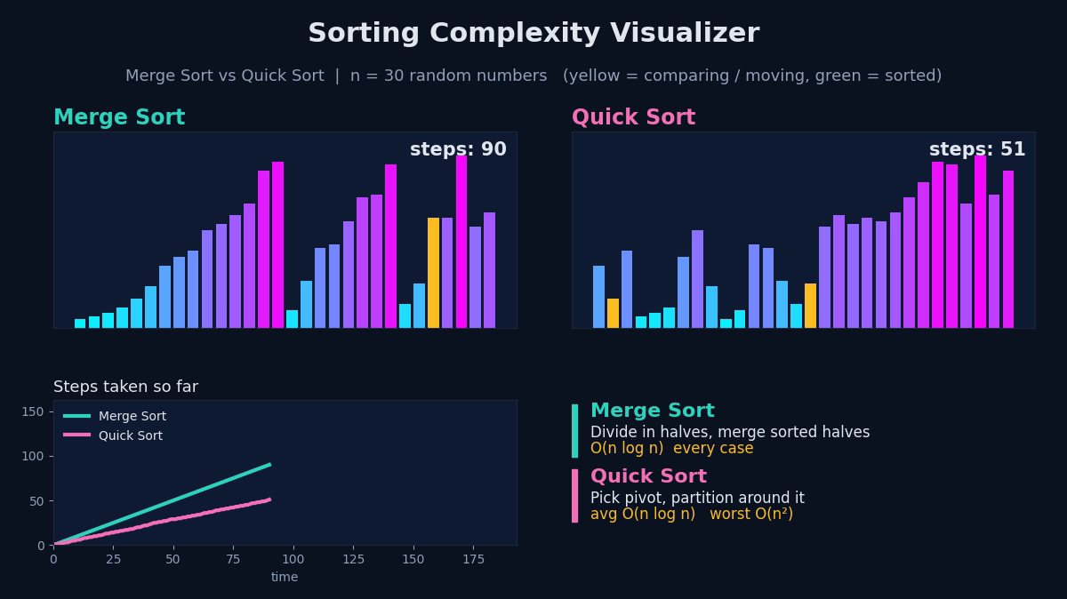
Unit I – Algorithm Analysis | Project 1
Sorting Complexity Visualizer: Prompt and Visualization
Prompt Used
"Generate a graph comparing time complexity of Merge and Quick Sort for n = 10, 100, 1000."
How It Works
Each algorithm is run for the three input sizes and the operation count or time is plotted. The curves show Merge Sort growing steadily as n log n, while Quick Sort matches it on average but can climb sharply in its worst case.
Group 13 | DAA Macro Project

Slide 4
Unit II – Divide and Conquer / Greedy | Project 6
Optimal Merge Pattern Tree
Problem and Key Ideas
Algorithm (Pseudocode)
Merge files of sizes 10, 20, 30 and 40 into one file with the minimum total number of record moves.
Greedy rule: always merge the two smallest files
Uses a min-heap to pick the smallest sizes
Merges: 10+20=30, 30+30=60, 60+40=100 (cost 190)
OptimalMerge(sizes):
H = MinHeap(sizes)
cost = 0
while H.size > 1:
a = H.extractMin()
b = H.extractMin()
cost += a + b
H.insert(a + b)
return cost
Group 13 | DAA Macro Project

Slide 5
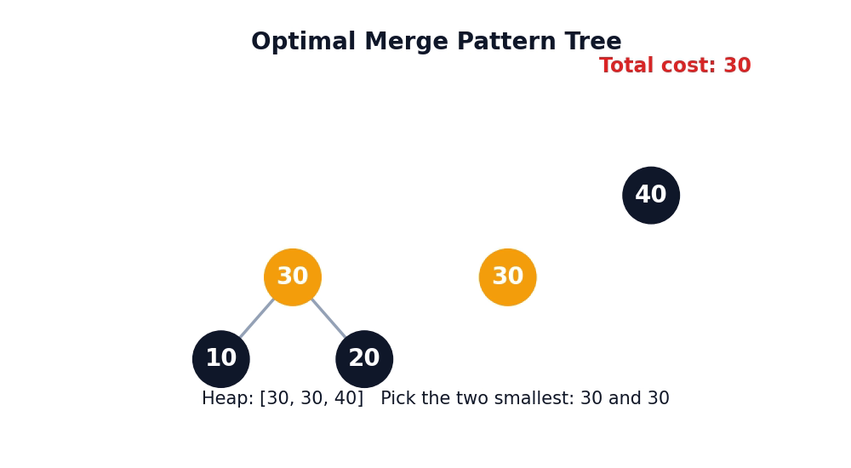
Unit II – Divide and Conquer / Greedy | Project 6
Optimal Merge Pattern Tree: Prompt and Visualization
Prompt Used
"Draw a binary tree showing optimal merge pattern for files of sizes 10, 20, 30, 40."
How It Works
Leaves are the original files and each internal node is a merge, labeled with its combined size. Smaller files sit deeper in the tree, so they are merged more often, which keeps the total cost minimal.
Group 13 | DAA Macro Project

Slide 6
Unit III – Dynamic Programming | Project 9
Knapsack DP Table
Problem and Key Ideas
Algorithm (Pseudocode)
Choose items to maximize total value in a knapsack of capacity 10 with 4 items, where each item is taken whole or not at all (0/1).
State: V[i][w] = best value using first i items, capacity w
Either skip item i or take it if it fits
Answer is stored in V[n][W]
Knapsack(wt[], val[], n, W):
for i = 0..n:
for w = 0..W:
if i == 0 or w == 0:
V[i][w] = 0
else if wt[i] <= w:
V[i][w] = max(V[i-1][w],
val[i] + V[i-1][w-wt[i]])
else:
V[i][w] = V[i-1][w]
return V[n][W]
Group 13 | DAA Macro Project

Slide 7
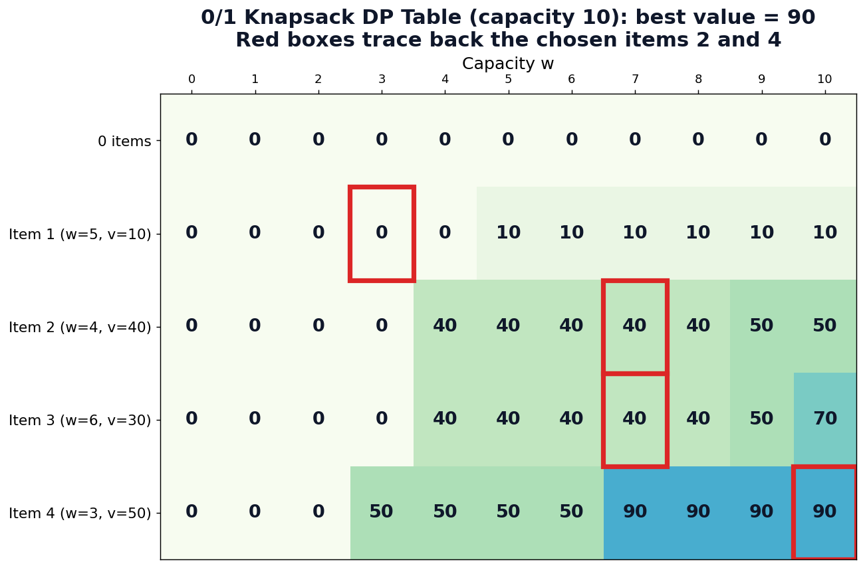
Unit III – Dynamic Programming | Project 9
Knapsack DP Table: Prompt and Visualization
Prompt Used
"Draw a DP table for 0/1 Knapsack with 4 items and capacity 10."
How It Works
Rows are items and columns are capacities 0 to 10. Each cell shows the best value so far, and tracing back from the bottom-right cell reveals which items were included.
Group 13 | DAA Macro Project

Slide 8
Unit IV – Backtracking | Project 10
N-Queens State Space Tree
Problem and Key Ideas
Algorithm (Pseudocode)
Place 4 queens on a 4x4 board so that no two queens attack each other (same row, column or diagonal).
Place one queen per row, trying each column
If a placement is unsafe, backtrack to the previous row
Reaching row N means a valid solution is found
Solve(row):
if row == N:
print solution; return
for col = 0..N-1:
if IsSafe(row, col):
place queen at (row, col)
Solve(row + 1)
remove queen // backtrack
Group 13 | DAA Macro Project

Slide 9
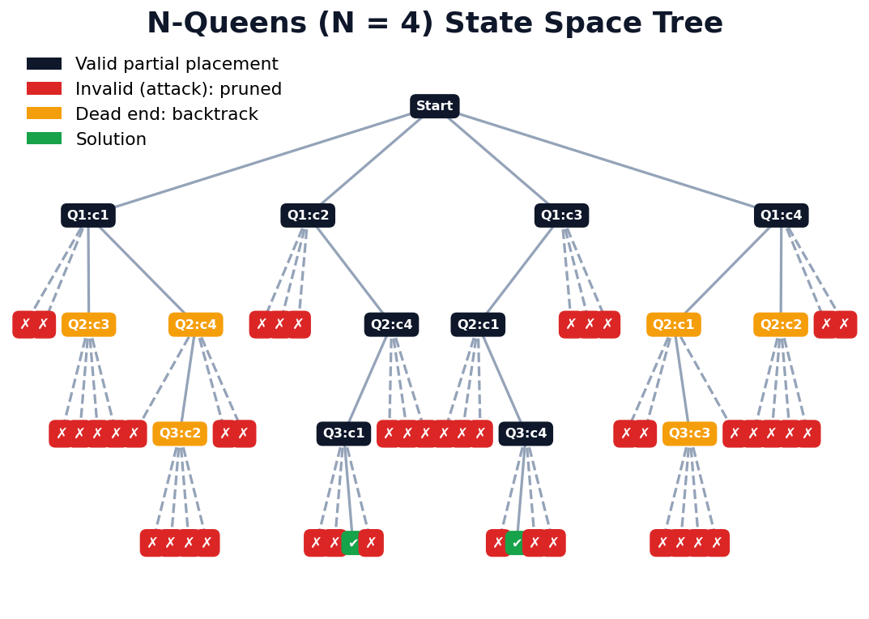
Unit IV – Backtracking | Project 10
N-Queens State Space Tree: Prompt and Visualization
Prompt Used
"Visualize the state space tree for N = 4 queens, marking invalid branches in red."
How It Works
Each node is a partial placement. Valid branches continue downward, while invalid ones are marked red and cut off, showing exactly where the algorithm backtracks before finding a solution.
Group 13 | DAA Macro Project

Slide 10
Unit V – Branch and Bound | Project 13
Knapsack Branch-and-Bound Tree
Problem and Key Ideas
Algorithm (Pseudocode)
Solve 0/1 Knapsack by exploring a tree of include/exclude decisions, cutting off branches that cannot beat the best known solution.
Each node stores weight, value and an upper bound
Bound is computed with a fractional knapsack estimate
Nodes with bound ≤ best value are pruned
BnB(items sorted by value/weight):
Q = priority queue; push root
best = 0
while Q not empty:
u = Q.pop()
if u.bound > best:
take = child(include next item)
if take.weight <= W:
best = max(best, take.value)
if take.bound > best: Q.push(take)
skip = child(exclude next item)
if skip.bound > best: Q.push(skip)
return best
Group 13 | DAA Macro Project

Slide 11
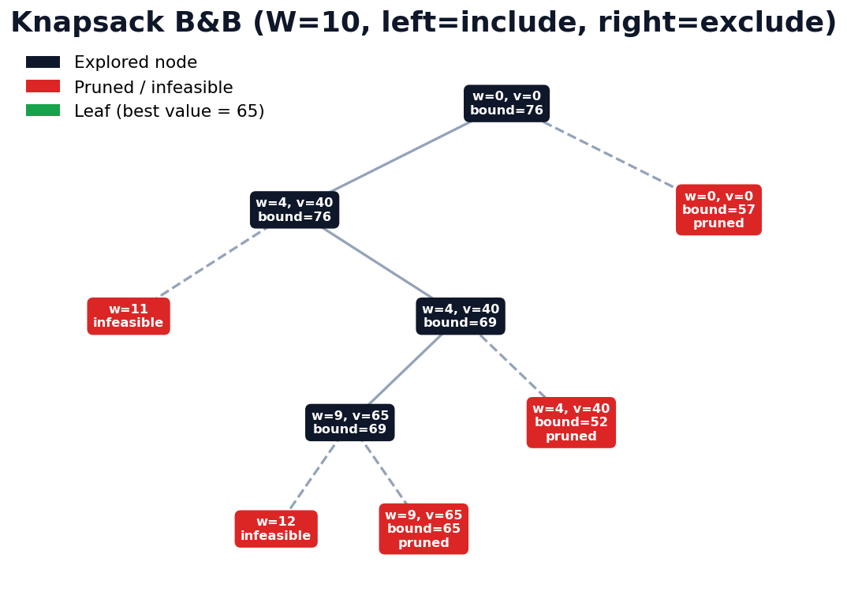
Unit V – Branch and Bound | Project 13
Knapsack Branch-and-Bound Tree: Prompt and Visualization
Prompt Used
"Illustrate bounding and pruning in 0/1 Knapsack using node values."
How It Works
Every node shows its bound value. Branches whose bound falls below the current best are crossed out as pruned, so only promising paths are explored, far fewer than in brute force.
Group 13 | DAA Macro Project

Slide 12
Thank You
Group 13 | Design and Analysis of Algorithms

