Slide 1
Blockchain Technologies & Systems

Slide 2
SEZG569 – Blockchain Technologies & Systems
Lecture No. 01
Dr.Animesh Giri
animesh.giri@wilp.bits-pilani.ac.in

Slide 3
Contents
RL1.1-Elements of Cryptography
RL1.2-Public key cryptographic hashing
CS:
CS1.1.1 Machines that encrypted in the past
CS1.1.2 Modern encryption
CS1.1.3 Hashing
CS 1.1.4 Blocks to Hashes
3

Slide 4
Blockchain Technologies
https://www.youtube.com/watch?v=SSo_EIwHSd4&t=8s

Slide 5
Machines That Encrypted In The Past
Caesar Cipher Wheel
Jefferson Disk Cipher
Enigma Machine
Purple Cipher Machine
Bombe Machine
SIGABA Machine
Lorenz Cipher Machine
Hagelin Cipher Machine
M-209 Converter
Hebern Rotor Machine
Playfair Cipher Device
Vernam Cipher Machine
Kryha Encryption Machine
Typex Machine
Colossus Computer for Codebreaking

Slide 6
Modern encryption
Types of Modern Encryption
1. Symmetric Encryption
In symmetric encryption, the same key is used for both encryption and decryption.
Working
Plaintext → Encryption Algorithm + Secret Key → Ciphertext Ciphertext → Decryption Algorithm + Same Key → Plaintext
Features
Fast processing
Suitable for large data
Requires secure key sharing
Common Algorithms
AES (Advanced Encryption Standard)
DES (Data Encryption Standard)
3DES
Blowfish
Applications
File encryption
Database security
VPNs
Disk encryption

Slide 7
Modern encryption
2. Asymmetric Encryption (Public Key Encryption)
Uses two keys:
Public Key
Private Key
Working
Public key encrypts data
Private key decrypts data
Features
More secure key exchange
Supports digital signatures
Slower than symmetric encryption
Common Algorithms
RSA
ECC (Elliptic Curve Cryptography)
DSA
Applications
SSL/TLS certificates
Secure emails
Digital signatures
Cryptocurrency wallets

Slide 8
Modern encryption
3. Hash Functions
Hashing converts data into a fixed-size digest.
Characteristics
One-way process
Fixed output size
Collision resistant
Common Hash Algorithms
SHA-256
SHA-512
MD5 (outdated)
SHA-1 (deprecated)
Applications
Password storage
Blockchain
Data integrity verification

Slide 9
Techniques to Implement Security Mechanisms
Cryptography: in Greek it means “secret writing”. In the network security it means the science of transforming the messages to make them secure and immune to attacks.
Symmetric-Key Encipherment
Asymmetric (or Public) Key Encipherment
Data Integrity
Mutual Trust
Steganography: in Greek it means “covered writing”. In contrast with cryptography, it means concealing the message itself by covering it with something else. Example:
A letter is written on the paper using onion juice or ammonia salts which would not be visible unless exposed to heat.

Slide 10
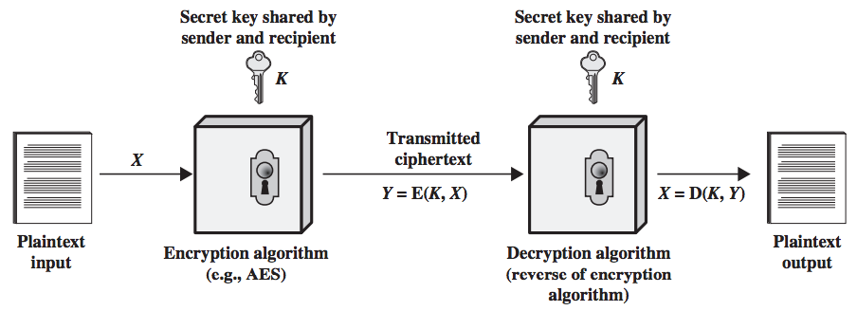
Simplified Model of Conventional Encryption

Slide 11
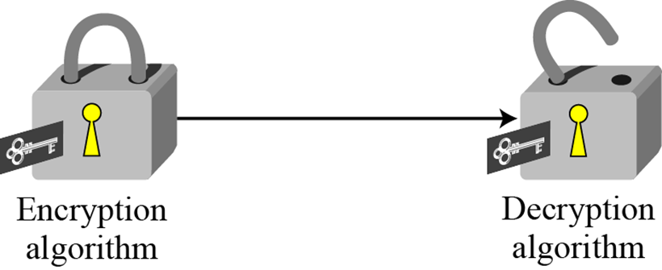
Symmetric-Key Encipherment
Sender encrypts the message using an encryption algorithm and the receiver decrypts the message using a decryption algorithm. Symmetric-Key Encipherment uses a single secret key for both encryption and decryption.
It is analogous to that the sender puts the message in a box and locks the box with a shared key. Receiver opens the box with the same shared key and gets the message.

Slide 12
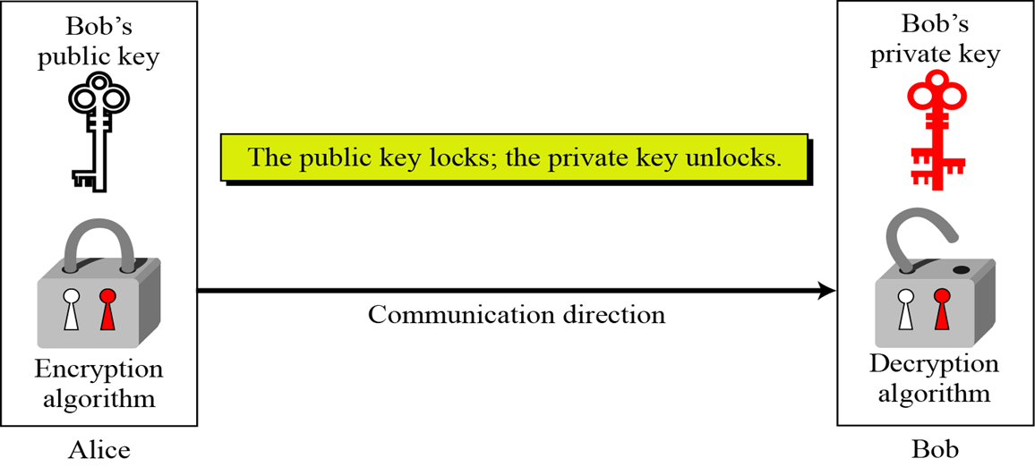
Asymmetric-Key Encipherment
To send a secure message, the sender first encrypts the message using receiver’s public key. To decrypt the message, the receiver uses its own private key.

Slide 13
Dimensions of Cryptographic System
1.Operation
Substitution (replacing plain text with a symbol, number etc.,)
Transposition ( shifting or rearranging position of the texts)
2. Number of Keys
Symmetric (single key for encryption and decryption)
Asymmetric (Different keys for encryption and decryption)
3. Processing Method
Block cipher (encryption in blocks of 128, 256 bytes)
Stream (encryption in one single stroke)

Slide 14
Hash functions
Hash functions are cryptographic algorithms that take an input (or message) and produce a fixed-size string of characters, called a hash value or digest. These functions are designed to be one-way, meaning it should be computationally infeasible to reverse the process and derive the original input from the hash value. Hash functions are used for data integrity verification, password hashing, digital signatures, and various other cryptographic applications. Examples include SHA-256 (Secure Hash Algorithm 256-bit) and MD5 (Message Digest Algorithm 5).

Slide 15
Digital signatures
Digital signatures provide authentication and integrity verification for digital messages or documents. They are created using asymmetric encryption techniques. The sender uses their private key to generate a digital signature, which can be verified by anyone who has access to the sender's public key. If the signature is valid, it confirms that the message was indeed sent by the claimed sender and that it has not been altered in transit.

Slide 16
Key exchange protocols
Key exchange protocols facilitate the secure exchange of cryptographic keys between parties over an insecure communication channel. These protocols ensure that even if intercepted, the exchanged keys cannot be easily deciphered by an attacker. Examples include Diffie-Hellman key exchange and its variants, which are widely used in securing internet communications (e.g., TLS/SSL).

Slide 17
Random Number Generators (RNGs):
Random number generators are crucial cryptographic elements for generating unpredictable and uniformly distributed random numbers used as cryptographic keys, initialization vectors, nonces, and other parameters in cryptographic protocols. High-quality RNGs are essential for the security of cryptographic systems.

Slide 18
Cryptographic protocols
Cryptographic protocols are sets of rules and procedures governing the secure communication and interaction between parties in a distributed system. These protocols often incorporate various cryptographic elements, such as encryption, digital signatures, and key exchange, to achieve specific security objectives. Examples include SSL/TLS for secure web communication, IPSec for secure IP networking, and PGP (Pretty Good Privacy) for email encryption and authentication.

Slide 19
Cryptography & Distributed ledger technology
Security and Immutable Data:
Cryptography plays a central role in ensuring the security and immutability of data stored on a distributed ledger. By utilizing cryptographic hash functions, DLT systems can create unique, fixed-length representations of data known as hashes. These hashes are used to link blocks of data together in a chain, forming a tamper-evident and immutable record of transactions or information. Any attempt to alter the data within a block would result in a change to its hash, which would be immediately detectable, thus preserving the integrity of the ledger.
Public-key Cryptography for Digital Signatures:
Distributed ledger systems often rely on public-key cryptography to provide authentication and authorization mechanisms. Each participant in the network possesses a unique pair of cryptographic keys: a public key, which is freely shared with others, and a private key, which is kept secret. Digital signatures, created using these key pairs, allow participants to cryptographically sign transactions or messages, thereby verifying their authenticity and ensuring that they cannot be tampered with by unauthorized parties.

Slide 20
Cryptography & Distributed ledger technology
Consensus Mechanisms:
Cryptographic algorithms and protocols are also used to establish consensus among network participants regarding the validity of transactions and the ordering of blocks in the ledger. Consensus mechanisms, such as Proof of Work (PoW), Proof of Stake (PoS), and Byzantine Fault Tolerance (BFT), rely on cryptographic puzzles, cryptographic voting, or cryptographic signing to enable decentralized decision-making and prevent malicious actors from manipulating the ledger..
Privacy and Confidentiality:
Cryptography enables DLT systems to implement privacy-enhancing features that protect sensitive information while still maintaining transparency and auditability. Techniques such as zero-knowledge proofs, homomorphic encryption, and ring signatures allow participants to prove the validity of transactions or computations without revealing the underlying data, thus preserving privacy and confidentiality.

Slide 21
Cryptography & Distributed ledger technology
Key Management and Access Control:
Proper key management is essential in distributed ledger systems to prevent unauthorized access and ensure the security of participants' assets and identities. Cryptographic techniques such as hierarchical deterministic wallets, multi-signature schemes, and threshold cryptography are employed to securely generate, store, and distribute cryptographic keys, enabling fine-grained access control and mitigating the risk of key.

Slide 22
Public Key Cryptographic Hashing
Introduction
Public key cryptographic hashing is a security technique used in modern computer systems to ensure data integrity, authentication, and secure communication. It combines the concepts of public key cryptography and cryptographic hash functions.
Hashing converts input data into a fixed-length value called a hash value or digest. Public key cryptography uses two keys:
Public Key → shared openly
Private Key → kept secret
Together, they provide secure authentication and digital security services.

Slide 23
Public Key Cryptographic Hashing
Cryptographic Hash Function
A cryptographic hash function takes any size input and produces a fixed-size output.
Characteristics
Fixed output length
One-way process
Fast computation
Difficult to reverse
Small input changes create different hashes
Collision resistant
Example
Input: “Hello”
Hash Output: 185f8db32271fe25f561a6fc938b2e264306ec304eda518007d1764826381969

Slide 24
Public Key Cryptographic Hashing
Algorithm | Output Size | Status
MD5 | 128-bit | Weak
SHA-1 | 160-bit | Deprecated
SHA-256 | 256-bit | Secure
SHA-512 | 512-bit | Highly Secure

Slide 25
Public Key Cryptographic Hashing
Public Key Cryptography
Public key cryptography uses asymmetric encryption.
Components
Public Key
Private Key
Working
Sender encrypts data using receiver’s public key
Receiver decrypts using private key
Popular Algorithms
RSA
DSA
ECC

Slide 26
Blocks to Hashes
Introduction
In blockchain technology, data is stored in units called blocks. Each block contains transaction details and is converted into a unique digital fingerprint called a hash using cryptographic hash functions. The process of converting blocks into hashes ensures security, integrity, and immutability of blockchain data.

Slide 27
Blocks to Hashes
What is a Block?
A block is a container that stores information in a blockchain network.
Components of a Block
Transaction data
Timestamp
Previous block hash
Nonce value
Current block hash
Each block is connected to the previous block through hash values.

Slide 28
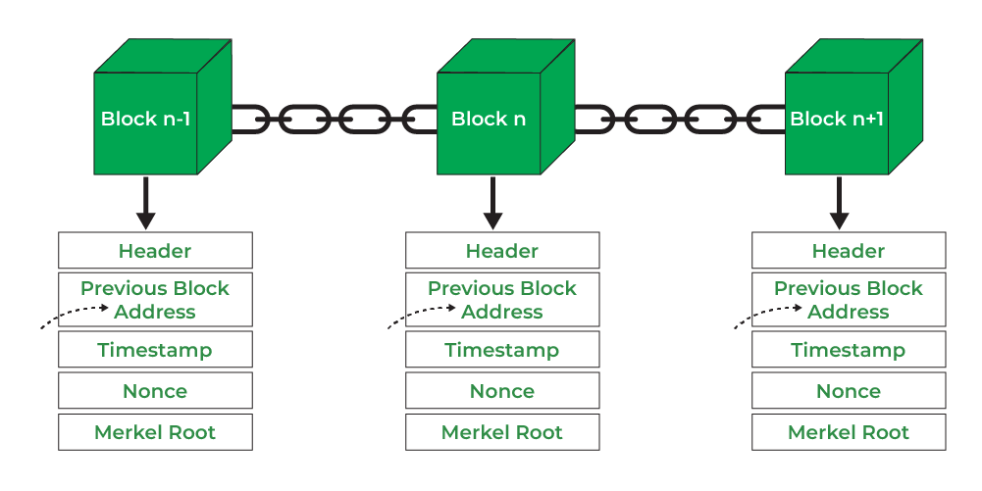
Blocks to Hashes
Process of Converting Blocks to Hashes
Step 1: Create a Block
Transaction records and information are grouped together.
Example Block Data
Sender: A
Receiver: B
Amount: 100
Timestamp
Step 2: Add Previous Hash
The block stores the hash value of the previous block.
This creates a chain structure.
Step 3: Apply Hash Function
A cryptographic hash algorithm such as SHA-256 processes the block data.
Representation: Block Data → SHA-256 → Hash Value
Step 4: Generate Unique Hash
A fixed-length hash is generated.

Slide 29
Blocks to Hashes
Blockchain Linking Through Hashes
Each block contains:
Its own hash
Previous block’s hash
Structure
Genesis Block → Hash A Block 2 → Hash B + Previous Hash A Block 3 → Hash C + Previous Hash B
This linking secures the blockchain.

Slide 30
Hashing Function Online Demo
https://10015.io/tools/md5-encrypt-decrypt

Slide 31
Hashing Function Online Demo
https://10015.io/tools/md5-encrypt-decrypt
https://emn178.github.io/online-tools/sha256.html

Slide 32


