Slide 1
Blockchain Technologies & Systems

Slide 2
SEZG569 – Blockchain Technologies & Systems
Lecture No. 02
Dr.Animesh Giri
animesh.giri@wilp.bits-pilani.ac.in

Slide 3
Previous Session
RL1.1-Elements of Cryptography
RL1.2-Public key cryptographic hashing
CS:
CS1.1.1 Machines that encrypted in the past
CS1.1.2 Modern encryption
CS1.1.3 Hashing
CS 1.1.4 Blocks to Hashes
3

Slide 4
Contents
RL2.1
Centralized Vs Decentralized computing ledger transactions and trade
RL2.2
Distributed ledger technology. Peer to peer technology.
CS2.1
Distributed consensus and Fault tolerance mechanisms,
Validation services for permissioned blockchains,
From Byzantine consensus to Blockchains
4

Slide 5
Blockchain Technologies
https://www.youtube.com/watch?v=SSo_EIwHSd4&t=8s

Slide 6
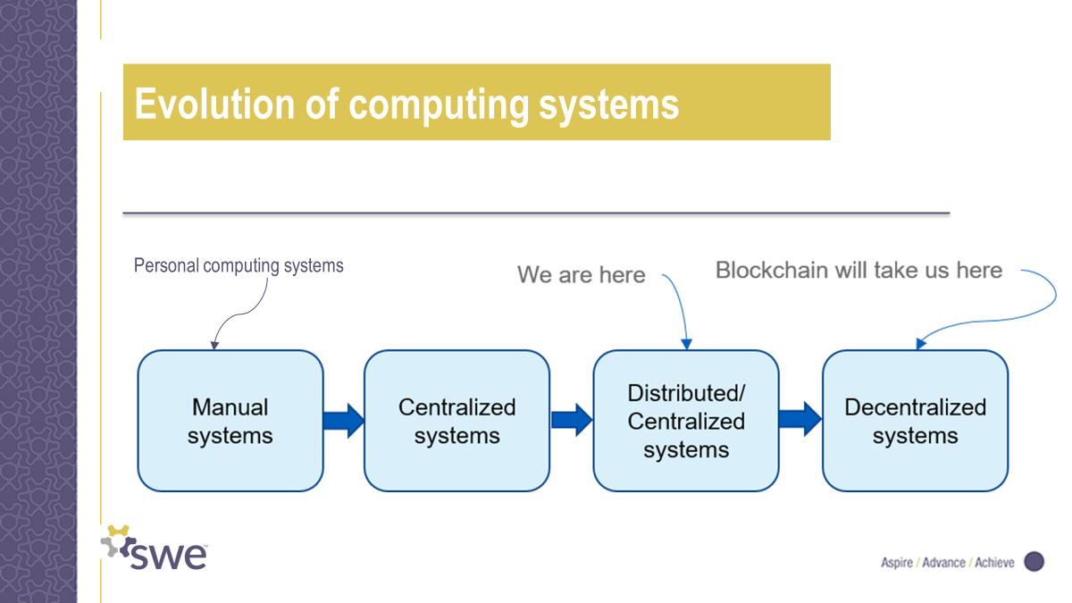
Evolution of Computing Systems

Slide 7
Centralized Network
A centralized network is a system where a single authority or server controls and manages the flow of information and resources. Here’s a straightforward explanation:
Single Control Point: In a centralized network, there is one central point, often a server or mainframe, that governs the entire network.
Communication Flow: All communication between devices, like computers or users, goes through this central point. It acts as a mediator, receiving requests and sending back responses.
Data Storage: The central authority stores data and information. When users or devices need data, they request it from the central point, and it provides the necessary information.
Decision-Making: Decisions, such as access permissions or resource allocation, are made centrally. The central authority has the ultimate say in how resources are used or shared.
Dependency: The entire network relies on the central authority. If it fails or experiences issues, the entire network may be affected.

Slide 8
Decentralized Network
Multiple Nodes: In a decentralized network, there isn’t a single central authority. Instead, multiple nodes or participants in the network have equal status.
Peer-to-Peer Communication: Nodes communicate directly with each other without the need for a central server. Each node can send and receive information independently.
Data Distribution: Data is distributed across multiple nodes. Instead of being stored in one central location, it’s spread out, often using a technology called distributed ledger or Blockchain.
Redundancy and Resilience: Since data is stored across many nodes, the network is more resilient. If one node fails, the data can still be retrieved from other nodes, enhancing reliability.
Decision-Making: Decisions are often made through a consensus mechanism involving multiple nodes. This ensures that no single entity has complete control, promoting fairness.
Example: Cryptocurrencies like Bitcoin operate on a decentralized network. Each user’s computer, known as a node, contributes to the overall functioning of the network by validating and recording transactions.
Autonomy: Nodes in a decentralized network have a degree of autonomy. They can operate independently, making the network less vulnerable to a single point of failure.

Slide 9
Centralized Vs Decentralized Networks:
Control:
Centralized Network: In a centralized network, control lies in the hands of a central authority, such as a government, organization, or individual. This entity has the power to make decisions, enforce rules, and manage the entire network.
Decentralized Network: Decentralized networks distribute control across multiple nodes or participants. No single entity has absolute authority, and decisions may be made collectively or through consensus mechanisms.
Decision-Making:
Centralized Network: Decisions are typically top-down, coming from the central authority. Participants follow these decisions without much input in the process.
Decentralized Network: Decision-making is more democratic and distributed. Participants, or nodes, often have a say in the decision-making process, and changes may require consensus among a majority or all participants.

Slide 10
Centralized Vs Decentralized Networks:
Reliability:
Centralized Network: Reliability in centralized systems is dependent on the robustness of the central authority. If it fails or faces a disruption, the entire network may be affected.
Decentralized Network: Decentralization often leads to increased reliability. Since functions are distributed, the failure of one node or a few nodes doesn’t cripple the entire network.
Scalability:
Centralized Network: Scaling can be challenging in centralized systems because all activities are funneled through a single point. As the system grows, this central point may become a bottleneck.
Decentralized Network: Decentralized networks often exhibit better scalability. Additional nodes can be added to the network without relying on a single point to handle all transactions, making them more adaptable to growth.

Slide 11
Centralized Vs Decentralized Networks:
Security:
Centralized Network: Centralized systems are vulnerable to a single point of failure. If the central authority is compromised, the entire network may be at risk.
Decentralized Network: The distributed nature of decentralized networks enhances security. Even if one node is compromised, it doesn’t jeopardize the integrity of the entire system, making them more resilient to attacks.
Examples:
Centralized Network: Traditional banking systems are a classic example of a centralized network, where a central bank oversees and controls financial transactions.
Decentralized Network: Cryptocurrencies, like Bitcoin, operate on decentralized principles. Transactions are verified by a network of nodes rather than a central authority.

Slide 12
Centralized Vs Decentralized Networks:
The Involvement of Third Parties:
Centralized Network: In a centralized network, the participation of third parties or specific intermediaries is essential to facilitate effective communication among different nodes. These mediators play a crucial role in ensuring coordination.
Decentralized Network: In contrast, significant decentralized networks eliminate the need for intermediaries. Each independent node can communicate directly with others on the Blockchain network, streamlining the process.
Transparency:
Centralized Network: Centralized networks tend to be less transparent since all information and data are stored in a single central location, limiting visibility.
Decentralized Network: Decentralization, particularly through Distributed Ledger Technology (DLT), significantly enhances transparency. Information is distributed across nodes, providing a more open and accessible record.

Slide 13
Centralized Vs Decentralized Networks:
Security:
Centralized Network: Traditional centralized networks are more vulnerable to attacks because hackers can target the central storage, gaining access to a wealth of information.
Decentralized Network: Decentralized networks offer heightened security. Even if a specific node is compromised, the overall integrity remains intact because other nodes remain unaffected.
Scalability:
Centralized Network: Scaling conventional centralized networks is relatively straightforward by adding extra servers.
Decentralized Network: Scaling decentralized networks proves more challenging as each node must be capable of handling additional traffic. This decentralization aspect adds complexity to scaling efforts.
Exchange Fees:
Centralized Network: Centralized networks, often involving multiple intermediaries like financial service providers and banks, tend to have higher fees.
Decentralized Network: Decentralized networks do not involve these intermediary factors, leading to lower fees for transactions and exchanges.

Slide 14
Advantages of Centralized Networks:
Efficiency: Centralized networks can be more efficient in terms of decision-making and resource allocation since there is a single point of control.
Simplicity: Managing and operating a centralized system is often simpler and requires less coordination compared to decentralized systems.
Control: A central authority in a centralized network has direct control over rules, policies, and operations, enabling streamlined governance.
Scalability: Adding resources and scaling up is usually more straightforward in centralized networks, making them suitable for applications with predictable growth.
Security: Centralized systems can implement stringent security measures at the central point, protecting sensitive data from unauthorized access.

Slide 15
Advantages of Decentralized Networks:
Resilience: Decentralized networks are more resilient to failures and attacks. Even if one node fails or is compromised, the network can continue to operate.
Transparency: Decentralized systems, especially those using distributed ledger technology, provide a high level of transparency as information is distributed across nodes.
Security: The distributed nature of decentralized networks enhances security. An attack on one node doesn’t compromise the entire system.
Autonomy: Participants in decentralized networks have greater autonomy and control over their own nodes, reducing dependency on a central authority.
Lower Costs: Decentralized networks often have lower operational costs as they eliminate the need for intermediaries, reducing fees associated with transactions.
Inclusivity: Decentralized systems can be more inclusive, allowing anyone to participate without needing approval from a central authority.

Slide 16
Disadvantages of Centralized Networks:
Single Point of Failure: Centralized networks are susceptible to a single point of failure. If the central authority experiences issues or is compromised, the entire network can be affected.
Limited Transparency: Centralized systems may lack transparency since all information is stored in one central location, making it harder for participants to verify or audit the system.
Vulnerability to Attacks: Centralized networks are more vulnerable to targeted attacks, as compromising the central storage could result in the loss or theft of a significant amount of data.
Dependence on Central Authority: Users in a centralized system depend heavily on the decisions and policies of the central authority, limiting individual autonomy.
Scalability Challenges: While centralized networks can be scalable, there may be practical challenges in scaling due to increased traffic or resource demands.

Slide 17
Disadvantages of Decentralized Networks:
Complexity: Decentralized systems can be more complex to manage and coordinate, especially as the number of nodes increases.
Slower Decision-Making: Decision-making in decentralized networks can be slower due to the need for consensus among multiple participants.
Resource Intensive: Some decentralized networks, especially those utilizing Blockchain technology, can be resource-intensive in terms of computing power and energy consumption.
Less Efficiency in Some Cases: In certain scenarios, decentralized networks may be less efficient than centralized alternatives, particularly when quick decision-making is essential.
Learning Curve: Participants in decentralized systems may face a learning curve as they adapt to the distributed nature and new technologies involved.
Regulatory Challenges: Decentralized networks may encounter regulatory challenges, as existing legal frameworks may not be well-suited to these innovative models.

Slide 18
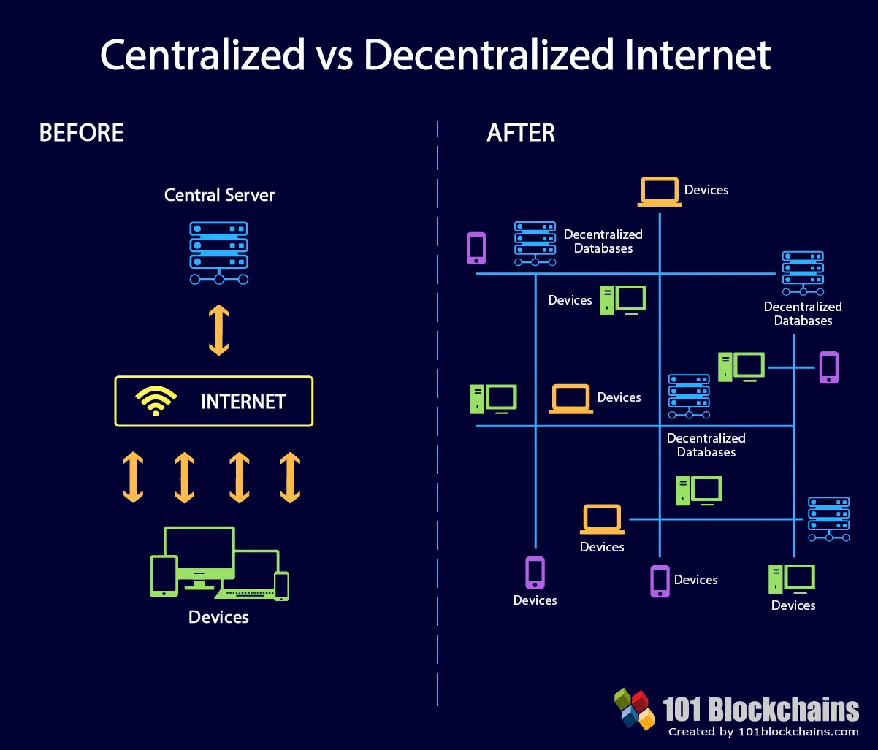

Slide 19
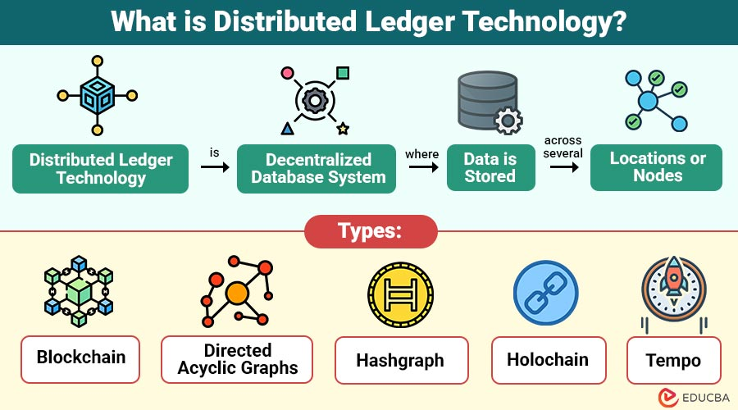
Introduction to Distributed Ledger Technology
What is DLT?
Distributed Ledger Technology (DLT) is a decentralized database shared across multiple computers (nodes).
Every participant maintains a synchronized copy of the ledger.
Transactions are recorded securely and transparently.
Eliminates the need for a central authority.
Key Features
Decentralization
Transparency
Immutability
Security
Fault Tolerance

Slide 20
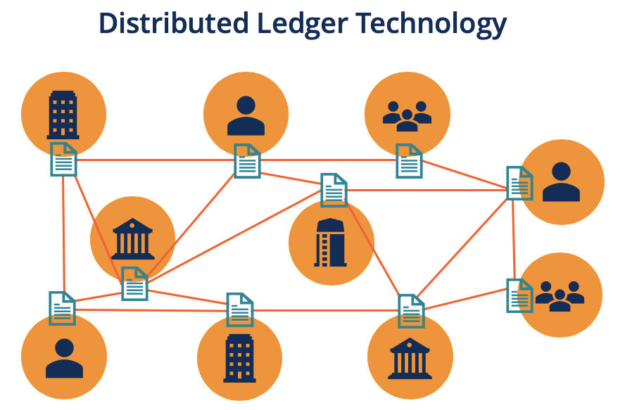
Working of Distributed Ledger Technology
Main Characteristics
Decentralized Control: No central administrator.
Distributed Storage: Data stored on multiple nodes.
Consensus Mechanism: Agreement among participants.
Transparency: All transactions are visible.
Security: Cryptographic protection.
Immutability: Records cannot be altered easily.

Slide 21
Working of Distributed Ledger Technology
Main Characteristics
Decentralized Control: No central administrator.
Distributed Storage: Data stored on multiple nodes.
Consensus Mechanism: Agreement among participants.
Transparency: All transactions are visible.
Security: Cryptographic protection.
Immutability: Records cannot be altered easily.

Slide 22
Applications of DLT
Applications of DLT
Real-World Applications
Banking and Finance
Cryptocurrency Systems
Supply Chain Management
Healthcare Records
Voting Systems
Digital Identity Management
Insurance Industry
Government Services
Advantages
Cost Reduction
Enhanced Security
Improved Efficiency

Slide 23
Introduction to Peer-to-Peer (P2P) Technology
What is Peer-to-Peer Technology?
A network architecture where computers communicate directly with each other.
Every participant acts as both a client and a server.
No central server is required.
Examples
Blockchain Networks
File Sharing Systems
Distributed Computing

Slide 24
Working of Peer-to-Peer Networks
P2P Network Operation
A peer joins the network.
Resources are shared among peers.
Requests are sent directly to other peers.
Data is exchanged without a central server.
Network continues functioning even if some peers fail.
Features
Resource Sharing
Direct Communication
Self-Organization

Slide 25
Types of Peer-to-Peer Networks
1. Pure P2P Network
No centralized server.
All nodes are equal.
2. Hybrid P2P Network
Combination of centralized and decentralized components.
Central server assists in resource discovery.
3. Structured P2P Network
Organized topology.
Efficient data searching.
4. Unstructured P2P Network
Random node connections.
Easy to establish.

Slide 26
Types of Peer-to-Peer Networks
1. Pure P2P Network
No centralized server.
All nodes are equal.
2. Hybrid P2P Network
Combination of centralized and decentralized components.
Central server assists in resource discovery.
3. Structured P2P Network
Organized topology.
Efficient data searching.
4. Unstructured P2P Network
Random node connections.
Easy to establish.

Slide 27
DLT vs P2P Technology
Feature | DLT | P2P
Purpose | Maintain shared ledger | Direct resource sharing
Data Storage | Distributed ledger | Distributed resources
Security | Cryptographic validation | Depends on network
Consensus | Required | Usually not required
Transparency | High | Moderate
Example | Blockchain | BitTorrent

Slide 28
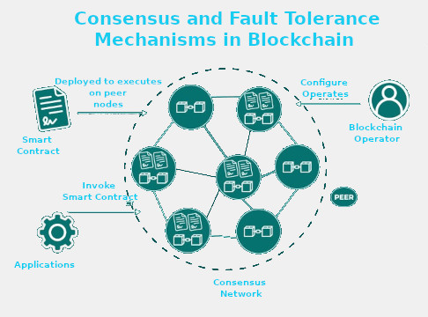
Distributed Consensus and Fault Tolerance Mechanisms
Introduction
What is Consensus?
Consensus is the process through which all nodes in a distributed network agree on a common state of the ledger.
It ensures that all participants have the same version of transaction records.
Consensus is essential in blockchain networks to maintain trust and consistency.
Objectives
Agreement among nodes
Data consistency
Security and trust
Prevention of double spending

Slide 29
Distributed Consensus and Fault Tolerance Mechanisms
Distributed Consensus Mechanisms
Definition
A distributed consensus mechanism is a protocol that allows network participants to agree on the validity of transactions without relying on a central authority.
Key Requirements
Agreement
Validity
Integrity
Fault Tolerance
Availability
Benefits
Eliminates intermediaries
Enhances reliability
Supports decentralization

Slide 30
Distributed Consensus and Fault Tolerance Mechanisms
Types of Consensus Mechanisms
Common Consensus Algorithms
1. Proof of Work (PoW)
Miners solve complex mathematical puzzles.
Used by Bitcoin.
2. Proof of Stake (PoS)
Validators are selected based on stake ownership.
Energy efficient.
3. Practical Byzantine Fault Tolerance (PBFT)
Suitable for permissioned blockchains.
Fast transaction processing.
4. Raft Consensus
Leader-based consensus algorithm.
Used in enterprise blockchain systems.

Slide 31
Distributed Consensus and Fault Tolerance Mechanisms
Byzantine Fault Tolerance (BFT)
What is Byzantine Fault Tolerance?
Ability of a distributed system to operate correctly even when some nodes behave maliciously or fail.
Byzantine Generals Problem
Multiple participants must agree on a strategy.
Some participants may provide false information.
Importance
Prevents fraudulent transactions.
Maintains network integrity.
Ensures trust among participants.

Slide 32
Distributed Consensus and Fault Tolerance Mechanisms
Fault Tolerance Mechanisms
Fault Tolerance in Blockchain
Fault tolerance enables the system to continue functioning despite failures.
Types of Faults
1. Crash Faults
Node stops functioning.
2. Network Faults
Communication interruptions.
3. Byzantine Faults
Nodes send incorrect or malicious data.
Benefits
High Availability
Reliability
Continuous Operation

Slide 33
Distributed Consensus and Fault Tolerance Mechanisms
Practical Byzantine Fault Tolerance (PBFT)
PBFT Working Process
Step 1: Request
Client sends transaction request.
Step 2: Pre-Prepare
Primary node broadcasts proposal.
Step 3: Prepare
Nodes verify transaction and exchange messages.
Step 4: Commit
Nodes agree on transaction.
Step 5: Reply
Transaction is finalized.
Advantages
Fast confirmation
Low energy consumption
Suitable for consortium blockchains

Slide 34
Byzantine consensus in Blockchains
Introduction to Byzantine Consensus
What is Byzantine Consensus?
Byzantine Consensus is a fault-tolerant mechanism that enables distributed systems to reach agreement even when some participants behave incorrectly, maliciously, or unpredictably.
Origin
The concept originates from the Byzantine Generals Problem, proposed by Leslie Lamport, Robert Shostak, and Marshall Pease in 1982.
The Byzantine Generals Problem
Several generals surround a city.
They must agree on a common attack or retreat strategy.
Some generals may be traitors and send conflicting messages.
Loyal generals must still reach a common decision.
Importance in Blockchain
Ensures all nodes agree on the same transaction history.
Prevents fraud and double-spending.
Maintains trust without a central authority.
Enables secure distributed operations.

Slide 35
Byzantine consensus in Blockchains
Byzantine Fault Tolerance (BFT):
Understanding Byzantine Faults
A Byzantine fault occurs when a node behaves arbitrarily, including:
Examples
Sending incorrect transaction information.
Sending conflicting messages to different nodes.
Refusing to participate in consensus.
Acting maliciously due to hacking or insider attacks.
Byzantine Fault Tolerance (BFT)
BFT is the capability of a distributed system to continue functioning correctly despite the presence of faulty or malicious nodes.
Conditions for BFT
Honest nodes must reach agreement.
Invalid transactions must be rejected.
Network should remain operational even with faulty participants.

Slide 36
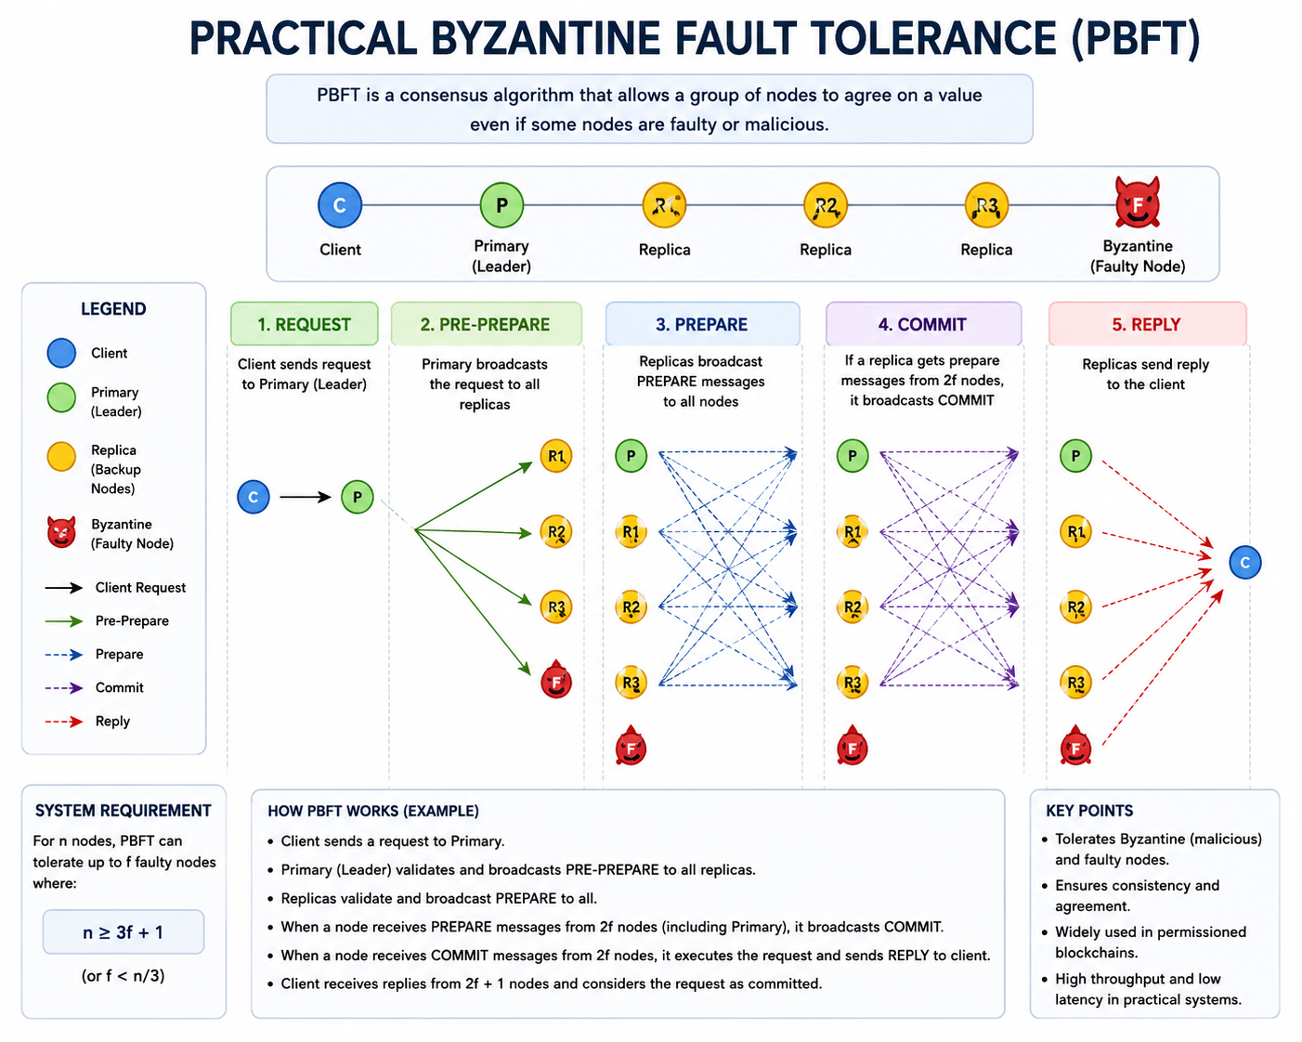
Byzantine consensus in Blockchains
Working of Byzantine Consensus in Blockchains
Consensus Process
Step 1: Transaction Submission
A user submits a transaction to the blockchain network.
Step 2: Transaction Broadcasting
The transaction is distributed to participating nodes.
Step 3: Validation
Nodes verify:
Digital signatures
Account balances
Transaction rules
Smart contract conditions
Step 4: Message Exchange
Nodes communicate with one another to determine transaction validity.
Step 5: Agreement
A sufficient majority of nodes agree on the transaction outcome.
Step 6: Block Commitment
The validated transaction is permanently added to the blockchain ledger.
Outcome
All honest nodes maintain an identical ledger state despite the presence of malicious nodes.

Slide 37
Byzantine consensus in Blockchains
Practical Byzantine Fault Tolerance (PBFT)
PBFT Algorithm
Practical Byzantine Fault Tolerance (PBFT) is one of the most widely used Byzantine consensus algorithms in permissioned blockchains.
PBFT Phases
1. Request Phase
Client sends a transaction request.
2. Pre-Prepare Phase
Primary (leader) node proposes the transaction.
3. Prepare Phase
Replica nodes verify and exchange messages.
4. Commit Phase
Nodes confirm agreement.
5. Reply Phase
Transaction is finalized and result is returned.
Advantages
Fast transaction confirmation.
Low energy consumption.
High throughput.
Suitable for enterprise blockchains.
Applications
Hyperledger Fabric
Tendermint
Quorum

Slide 38
Byzantine consensus in Blockchains
Byzantine Consensus in Modern Blockchains
Benefits
Security
Protects against malicious nodes.
Prevents fraudulent transactions.
Reliability
Continues operating despite failures.
Consistency
All honest nodes maintain the same ledger.
Decentralization
No central authority required.
Challenges
Scalability
Communication overhead increases with network size.
Complexity
Large number of message exchanges required.
Network Latency
Performance may decrease in geographically distributed systems.

Slide 39
Permissioned Blockchains
What is a Permissioned Blockchain?
Blockchain where participants are known and authorized.
Access rights are controlled by an organization or consortium.
Characteristics
Restricted membership
Identity verification
High transaction throughput
Enhanced privacy
Examples
Hyperledger Fabric
R3 Corda
Quorum

Slide 40
Permissioned Blockchains
Validation Services for Permissioned Blockchains
Validation Services
Validation services verify the correctness and authenticity of transactions before adding them to the blockchain.
Functions
Identity Verification
Confirms participant identity.
Transaction Validation
Verifies transaction rules and policies.
Smart Contract Validation
Ensures contract execution correctness.
Access Control
Restricts unauthorized actions.
Endorsement Policies
Requires approval from designated participants.
Benefits
Increased Security
Regulatory Compliance
Improved Trust

Slide 41


