Slide 1
Blockchain Technologies & Systems

Slide 2
SEZG569 – Blockchain Technologies & Systems
Lecture No. 03
Dr.Animesh Giri
animesh.giri@wilp.bits-pilani.ac.in

Slide 3
Contents
RL3.1 | Blockchain overview and structure of a block transaction
RL 3.2 | Consensus Philosophy
RL 3.3 | Adding new block, forking page
RL 3.4 | Blockchain types and properties and Smart contracts
CS3.1
What is a blockchain
What are nodes
What are tokens
3

Slide 4
What We'll Cover Today
01
What is a Blockchain?
Distributed ledgers, immutability, and trust
02
What are Nodes?
Network participants and consensus mechanisms
03
What are Tokens?
Digital assets, cryptocurrencies, and utility
Notes:
Overview of the chapter. Let students know all three concepts are deeply linked — tokens live on blockchains, blockchains need nodes to function.

Slide 5
Blockchain Technologies
https://www.youtube.com/watch?v=SSo_EIwHSd4&t=8s

Slide 6
What is a
Blockchain?
"A blockchain is a type of database that stores information in blocks that are then linked together."
Notes:
Section header. A blockchain is often misunderstood — start by asking students what they think it means before explaining.

Slide 7
What is a Blockchain?
Definition A blockchain is a distributed digital ledger that records transactions across many computers. Each record (block) is linked and secured using cryptography, making data practically impossible to alter retroactively.
📚 Analogy
Think of a blockchain like a shared Google Doc that thousands of people can SEE, but NOBODY can secretly edit.
Every time someone writes a new entry, it gets stamped with a timestamp and linked to the previous entry — like numbered pages in a diary no one can rip out.
Key Properties
🔗
Decentralized
🔒
Immutable
No single owner or controller
Records cannot be changed once added
👁
Transparent
🤝
Trustless
All participants can view the ledger
No need to trust a third party
Notes:
Core definition from Chapter 1. Emphasize the 'chain of blocks' metaphor. Ask: What problems does this solve compared to a regular database?

Slide 8
How a Blockchain Works
Block #1
(Genesis)
Block #2
Block #3
Block #4
Transaction
data
Transaction
data
Transaction
data
Latest
data
Each block contains: Data · Previous block's hash (fingerprint) · Its own hash
1
Transaction Initiated: A user requests a transaction — e.g., sending cryptocurrency or recording a contract.
2
Transaction Broadcast: The transaction is shared with a peer-to-peer network of computers (nodes).
3
Validation: Nodes validate the transaction using consensus algorithms (e.g., Proof of Work, Proof of Stake).
4
Block Created & Added: Validated transactions are combined into a new block, which is permanently added to the chain.
5
Transaction Complete: The transaction is now immutably recorded and visible to all participants.
Notes:
Walk through each step slowly. Draw the chain on the board if helpful. Emphasize: once a block is added, it cannot be changed without invalidating all subsequent blocks.

Slide 9
Types of Blockchains
🌐
Public Blockchain
🏢
Private Blockchain
Open to anyone. Fully decentralized. Examples: Bitcoin, Ethereum. No single authority — anyone can participate, validate, and read.
Access is restricted to invited participants. Often used by enterprises. A central authority controls who participates.
🤝
Consortium Blockchain
⚡
Hybrid Blockchain
Governed by a group of organizations rather than one entity. Balances decentralization and control. Used in finance & supply chain.
Combines private and public elements. Organizations can keep some data private while making other data publicly verifiable.
Notes:
Laurence covers all four types. Key difference: who can READ and WRITE to the chain. Public = most decentralized but slower. Private = faster but centralized.

Slide 10
Blockchain Design

Slide 11
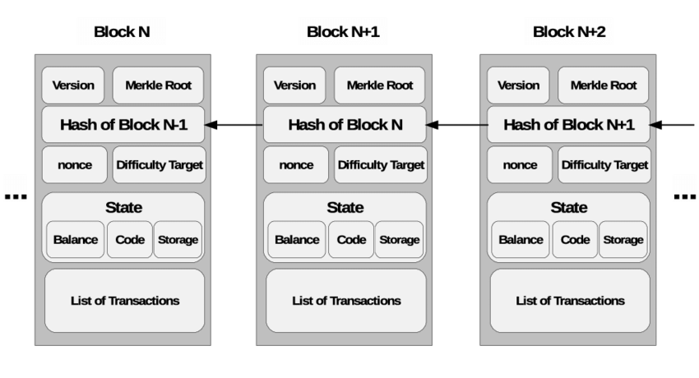
Blockchain Design

Slide 12
Blockchain Design
Blockchain is a technology where multiple parties involved in communication can perform different transactions without third-party intervention. Verification and validation of these transactions are carried out by special kinds of nodes.
Benefits of Blockchain:
It is safer than any other technology.
To avoid possible legal issues, a trusted third party has to supervise the transactions and validate the transactions.
There’s no one central point of attack.
Data cannot be changed or manipulated, it’s immutable.

Slide 13
Blockchain Design
Header: It is used to identify the particular block in the entire blockchain. It handles all blocks in the blockchain. A block header is hashed periodically by miners by changing the nonce value as part of normal mining activity, also Three sets of block metadata are contained in the block header.
Previous Block Address/ Hash: It is used to connect the i+1th block to the i^{th} block using the hash. In short, it is a reference to the hash of the previous (parent) block in the chain.
Timestamp: It is a system verify the data into the block and assigns a time or date of creation for digital documents. The timestamp is a string of characters that uniquely identifies the document or event and indicates when it was created.

Slide 14
Blockchain Design
Nonce: A nonce number which uses only once. It is a central part of the proof of work in the block. It is compared to the live target if it is smaller or equal to the current target. People who mine, test, and eliminate many Nonce per second until they find that Valuable Nonce is valid.
Merkel Root: It is a type of data structure frame of different blocks of data. A Merkle Tree stores all the transactions in a block by producing a digital fingerprint of the entire transaction. It allows the users to verify whether a transaction can be included in a block or not.

Slide 15
Key Characteristics of Blockchain Architecture

Slide 16
Key Characteristics of Blockchain Architecture
Decentralization: In centralized transaction systems, each transaction needs to be validated in the central trusted agency (e.g., the central bank), naturally resulting in cost and the performance jam at the central servers. In contrast to the centralized mode, a third party is not needed in the blockchain. Consensus algorithms in blockchain are used to maintain data stability in a decentralized network.
Persistency: Transactions can be validated quickly and invalid transactions would not be admitted by persons or miners who mining the crypto. It is not possible to delete or roll back transactions once they are included in the blockchain network. Invalid transactions do not carry forward further.
Anonymity: Each user can interact with the blockchain with a generated address, which does not disclose the real identity of the miner. Note that blockchain cannot guarantee perfect privacy preservation due to the permanent thing.

Slide 17
Key Characteristics of Blockchain Architecture
Auditability: Blockchain stores data of users based on the Unspent Transaction Output (UTXO) model.Every transaction has to refer to some previous unspent transactions. Once the current transaction is recorded into the blockchain, the position of those referred unspent transactions switches from unspent to spent. Due to this process, the transactions can be easily tracked and not harmed between transactions.
Transparency: The transparency of blockchain is like cryptocurrency, in bitcoin for tracking every transaction is done by the address. And for security, it hides the person’s identity between and after the transaction. All the transactions are made by the owner of the block associated with the address, this process is transparent and there is no loss for anyone who is involved in this transaction.
Cryptography: The blockchain concept is fully based on security and for that, all the blocks on the blockchain network want to be secure. And for security, it implements cryptography and secures the data using the cipher text and ciphers.

Slide 18
Adding New Block, Forking Page

Slide 19
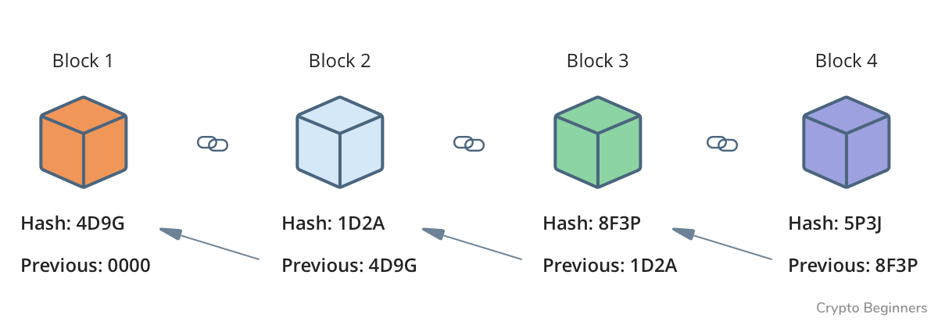
Adding New Block, Forking Page

Slide 20
Adding New Block, Forking Page
Adding a New Block: When a new block is added to the blockchain, it means that a set of transactions has been validated and added to the ledger. The process typically involves the following steps:
a. Transaction Validation: Transactions are broadcasted to the network and validated by nodes according to the consensus mechanism in use (e.g., Proof of Work, Proof of Stake). Valid transactions are grouped together into a block.
b. Block Creation: Miners (in PoW systems) or validators (in PoS systems) compete to solve a cryptographic puzzle that allows them to create a new block containing the validated transactions. This process is known as mining or forging.
c. Block Propagation: Once a miner successfully creates a new block, it is broadcasted to other nodes in the network.

Slide 21
Adding New Block, Forking Page
d. Consensus: Other nodes in the network validate the new block and agree to append it to their copy of the blockchain if it meets the necessary criteria (e.g., valid proof of work, correct transactions).
e. Adding to the Chain: The new block is added to the blockchain, linking it to the previous block in the chain. This process continues as new blocks are added over time, extending the blockchain.

Slide 22
Adding New Block, Forking Page
Forking: Forking occurs when the blockchain splits into two or more branches due to a disagreement among network participants. There are two main types of forks:
a. Soft Fork: A soft fork occurs when a change to the protocol makes previously valid blocks invalid. Nodes that continue to follow the old rules will still recognize the new blocks as valid, but nodes following the new rules will not recognize blocks created using the old rules. Soft forks typically maintain compatibility with older versions of the software.
b. Hard Fork: A hard fork occurs when a change to the protocol makes previously invalid blocks valid. This results in a permanent divergence in the blockchain, with one branch following the old rules and the other branch following the new rules. Hard forks require all nodes to upgrade to the new software to avoid being left on the old chain.
Forks can happen for various reasons, such as protocol upgrades, disagreements over governance or economic incentives, or security vulnerabilities. Resolving forks typically involves community discussion, coordination among developers and miners, and ultimately, network-wide consensus on which branch of the blockchain to follow.

Slide 23
Blockchain properties and Varieties of blockchain page

Slide 24
Blockchain properties
Decentralization
Immutability
Transparency
Security
Anonymity and Pseudonymity
Distributed Ledger
Consensus Mechanism
Smart Contracts

Slide 25
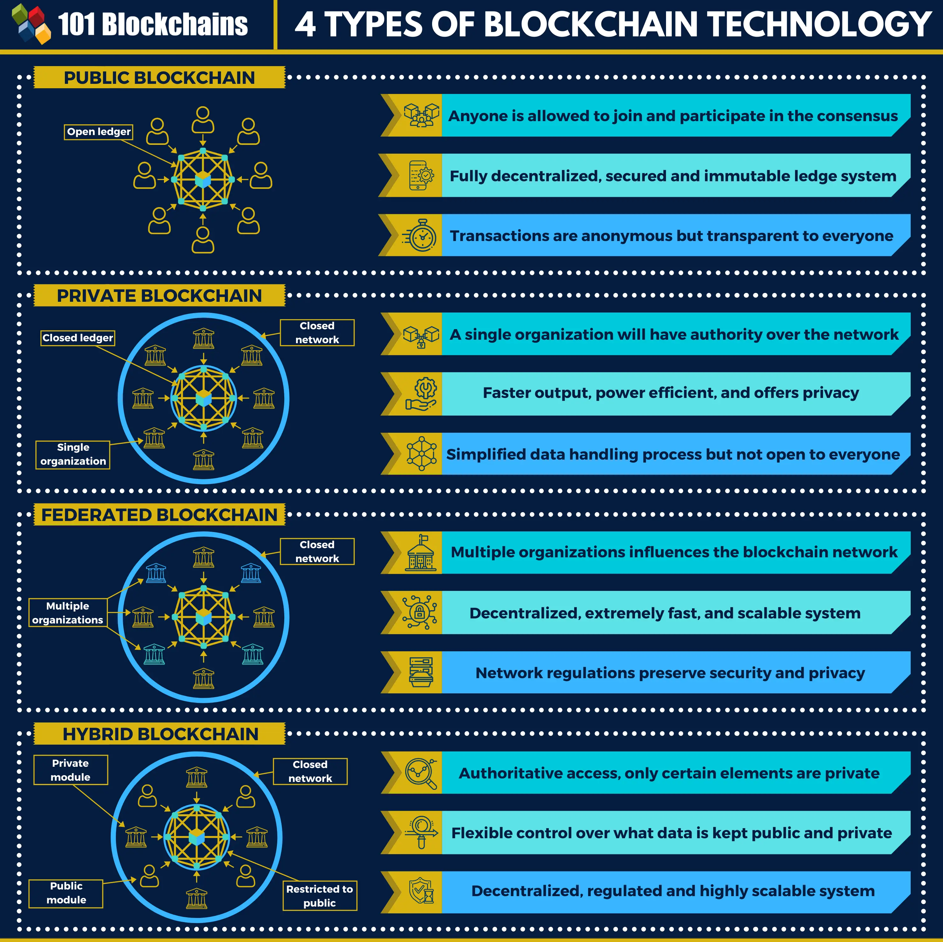
Varieties of blockchain page

Slide 26
Varieties of blockchain page
Public Blockchain: Public blockchains are open networks where anyone can participate, read, write, and validate transactions without permission. Examples include Bitcoin and Ethereum. These blockchains offer high levels of decentralization and transparency but may suffer from scalability and privacy limitations.
Private Blockchain: Private blockchains are permissioned networks where access and participation are restricted to a specific group of participants. These blockchains are often used by enterprises for internal processes and sensitive data management. They offer greater control over access, scalability, and privacy but sacrifice some decentralization.

Slide 27
Varieties of blockchain page
Consortium Blockchain: Consortium blockchains are semi-decentralized networks controlled by a group of trusted entities or organizations. Access and participation are permissioned, but governance is shared among the consortium members. Consortium blockchains are often used in industries where multiple organizations need to collaborate while maintaining certain levels of privacy and control.
Hybrid Blockchain: Hybrid blockchains combine elements of both public and private blockchains. They allow for public accessibility and transparency while also providing private channels for specific transactions or data. Hybrid blockchains offer flexibility and can cater to a wide range of use cases, especially in industries requiring a balance between transparency and privacy.

Slide 28
Varieties of blockchain page
Permissioned Blockchain: Permissioned blockchains require users to obtain permission before participating in the network. They are often used in enterprise settings where strict control over access and governance is necessary. Permissioned blockchains offer increased scalability, efficiency, and privacy compared to public blockchains but may sacrifice decentralization.
Sidechain: Sidechains are independent blockchains that are interoperable with a primary blockchain, often referred to as the mainchain. They allow for the execution of specific tasks or smart contracts off the mainchain, thereby improving scalability and reducing congestion. Sidechains enable experimentation with new features and functionalities without risking the stability of the mainchain.

Slide 29
Varieties of blockchain page
Cross-Chain: Cross-chain technology enables interoperability and communication between different blockchain networks. It allows assets and data to be transferred seamlessly between blockchains, facilitating decentralized exchanges, asset swaps, and multi-chain applications. Cross-chain solutions aim to address the challenge of blockchain fragmentation and siloed ecosystems.

Slide 30
Similarities between Block chain and Linked list and Implementing a blockchain from Linked list

Slide 31
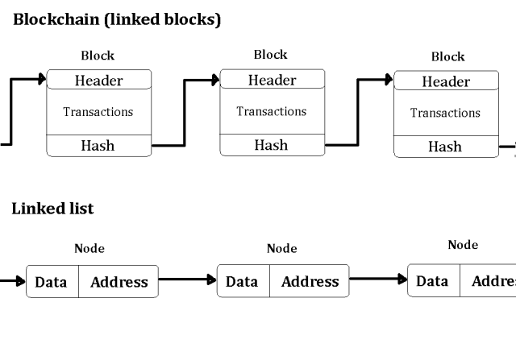
Similarities between Block chain and Linked list and Implementing a blockchain from Linked list

Slide 32
Similarities between Block chain and Linked list & Implementing a blockchain from Linked list
Sequential Data Structure: Both blockchain and linked lists organize data in a sequential manner. In a linked list, each element (node) contains a reference to the next node in the sequence. Similarly, in a blockchain, each block contains a reference (hash) to the previous block, forming a chain of blocks.
Data Integrity: Both blockchain and linked lists ensure data integrity through cryptographic hashing. In a linked list, the integrity of the data structure relies on maintaining the correct references between nodes. In a blockchain, cryptographic hashes are used to link blocks together, ensuring that any tampering with the data is easily detectable.

Slide 33
Similarities between Block chain and Linked list and Implementing a blockchain from Linked list
Insertion and Deletion: Both blockchain and linked lists support insertion and deletion operations. In a linked list, new nodes can be inserted at any position by updating the references of adjacent nodes. Similarly, in a blockchain, new blocks can be added to the chain by referencing the previous block's hash. Deletion operations are less common in blockchain due to its immutable nature.
Traversal: Both blockchain and linked lists support traversal operations to access and iterate through the data structure. In a linked list, traversal involves following the references from one node to the next. Similarly, in a blockchain, nodes can traverse the chain by following the links between blocks.

Slide 34
Designing a Blockchain

Slide 35
Similarities between Block chain and Linked list and Implementing a blockchain from Linked list
Implementing a blockchain using a linked list involves adapting the principles of a linked list to accommodate the unique requirements of a blockchain. Here's a simplified outline of how you might implement a blockchain using a linked list:
Define Block Structure: Create a data structure to represent each block in the blockchain. Each block should contain data (transactions), a timestamp, a nonce (for Proof of Work), and a reference to the previous block's hash.
Create Linked List Nodes: Use a linked list node structure to represent each block in the chain. Each node should contain the block data and a reference to the next node (block) in the chain.

Slide 36
Similarities between Block chain and Linked list and Implementing a blockchain from Linked list
Implement Insertion Operation: Define functions to add new blocks to the blockchain. When adding a new block, calculate its hash and set it as the reference to the previous block's hash. Insert the new block node into the linked list.
Implement Traversal Operation: Define functions to traverse the blockchain by iterating through the linked list nodes. Start from the genesis block (the first block in the chain) and follow the references to subsequent blocks.
Ensure Data Integrity: Use cryptographic hashing to ensure data integrity and chain validity. Verify that each block's hash matches the hash of the previous block, indicating that the chain has not been tampered with.

Slide 37
What are
Nodes?
"Every participant in the blockchain network is called a node."
Notes:
Transition to nodes. Ask: If no one is in charge, who keeps the blockchain running? Nodes!

Slide 38
What are Nodes?
Definition A node is any computer (or device) connected to a blockchain network. Nodes store a copy of the entire blockchain, validate new transactions, and maintain the network's integrity.
N1
N6
N2
Types of Nodes
Full Node Stores a complete copy of the blockchain. The backbone of security.
N5
Node
N3
Light Node Stores only block headers. Used in mobile wallets.
N4
Mining Node Validates and adds new blocks via Proof of Work (in Bitcoin).
Validator Node Used in Proof of Stake systems to approve new transactions.
Notes:
Key insight: because thousands of nodes each hold a copy, there is no single point of failure. If one node goes down, the network keeps running. This is the heart of decentralization.

Slide 39
How Nodes Reach Agreement: Consensus
Since there is no central authority, nodes must agree on which transactions are valid. This is called a consensus mechanism.
⛏
Proof of Work (PoW)
✅ Highly secure
⚠️ Energy-intensive (e.g., Bitcoin)
Nodes (miners) compete to solve complex math puzzles. The winner adds the next block.
🏦
Proof of Stake (PoS)
✅ Energy-efficient
⚠️ Wealthier nodes gain more influence (e.g., Ethereum)
Validators are chosen based on how many tokens they "stake" as collateral.
🗳
Delegated PoS (DPoS)
✅ Fast & democratic
⚠️ Risks of voter apathy
Token holders vote for delegates who validate transactions on their behalf.
Notes:
Analogy for consensus: imagine a classroom vote where everyone must agree before a new rule is written in the class logbook. No one teacher decides alone.

Slide 40
What are
Tokens?
"Tokens represent value, access, or ownership on a blockchain."
Notes:
Transition slide. Before revealing, ask: What do you think a 'token' is? Let students guess — then explain.

Slide 41
What are Tokens?
Definition Tokens are digital units of value created and managed on a blockchain. They can represent currency, ownership rights, access permissions, or almost anything of value.
₿
Ξ
💰
Cryptocurrency
🔑
Utility Token
📜
Security Token
e.g. Bitcoin (BTC)
e.g. Ethereum (ETH)
e.g. Tokenized stocks
Digital money used as a medium of exchange. Not tied to physical assets.
Grants access to a product or service on a blockchain platform.
Represents ownership in a real-world asset; regulated like securities.
🎨
NFT
⚓
Stablecoin
🗳
Governance Token
e.g. CryptoKitties
e.g. USDC, Tether
e.g. Uniswap (UNI)
Non-fungible token — unique, one-of-a-kind digital asset or collectible.
Pegged to a stable asset (like USD) to minimize price volatility.
Grants voting rights in a decentralized organization (DAO).
Notes:
Key distinction: a 'coin' (like Bitcoin) is native to its blockchain. A 'token' (like an ERC-20 token) is built ON TOP of an existing blockchain. Both are types of tokens in common usage.

Slide 42
Coins vs Tokens — What's the Difference?
🪙 Coins
🎟 Tokens
Native to their own blockchain
Primarily used as digital currency
Examples: Bitcoin (BTC), Ether (ETH), Litecoin
Required to pay network transaction fees ("gas")
Cannot exist without their native chain
Built on top of an existing blockchain
Can represent currency, assets, or rights
Examples: USDC, Uniswap (UNI), NFTs
Use the host chain's coin for transaction fees
Far more variety in purpose and design
Notes:
Common student confusion: all coins are tokens, but not all tokens are coins. The word 'token' is umbrella; 'coin' is specific. Analogy: all squares are rectangles, not all rectangles are squares.

Slide 43
How It All Connects
Blockchain, nodes, and tokens work as an inseparable system:
NODES
maintain
& validate
BLOCKCHAIN
live on
& move via
TOKENS
🔗
The blockchain is the shared ledger — the permanent record of all transactions.
💻
Nodes are the computers that host the blockchain and validate every new entry.
🪙
Tokens are the assets that flow through the blockchain, recorded by the nodes.
🔄
Without nodes, the blockchain can't run. Without the blockchain, tokens can't exist.
Notes:
Synthesis slide. Spend time here. Ask: Can you have tokens without a blockchain? (No.) Can you have a blockchain without nodes? (No.) They are interdependent.

Slide 44
Real-World Applications
🏦
Finance
🏥
Healthcare
🚢
Supply Chain
Cross-border payments, DeFi (decentralized finance), digital currencies (CBDCs)
Secure patient records, drug supply chain tracking, clinical trial data integrity
Real-time tracking of goods from manufacturer to consumer; reducing fraud
🗳
Voting
🎮
Gaming & NFTs
📋
Legal / Contracts
Tamper-proof digital voting systems; verifiable, transparent election results
Player-owned in-game assets, verifiable scarcity, NFT marketplaces
Smart contracts: self-executing code that automates agreements without lawyers
Notes:
This slide grounds abstract concepts in reality. Ask students: Which application surprises you the most? Which seems most impactful for society?

Slide 45
Common Misconceptions
MYTH
❌ Blockchain = Bitcoin
TRUTH
✅ Bitcoin is ONE application of blockchain technology. There are thousands of blockchains beyond Bitcoin.
MYTH
❌ Blockchain is completely anonymous
TRUTH
✅ Most blockchains are pseudonymous — transactions are traceable. True anonymity requires specialized techniques.
MYTH
❌ Blockchain is 100% secure and hackable
TRUTH
✅ The blockchain itself is extremely hard to tamper with, but applications built on it (wallets, exchanges) can still be hacked.
MYTH
❌ Blockchain can store any data cheaply
TRUTH
✅ Storing data on-chain is expensive. Most applications store data off-chain and only record a hash (fingerprint) on the blockchain.
Notes:
Busting myths is engaging! Turn this into a quick True/False quiz — read the myth and ask students to vote before revealing the truth.

Slide 46
Key Terms
Block
A collection of validated transactions grouped together and added to the chain.
Hash
A unique cryptographic fingerprint of data; any change to the data changes the hash completely.
Ledger
A record-keeping system that logs all transactions; blockchain is a distributed ledger.
Node
Any computer participating in a blockchain network; stores and validates the chain.
Token
A digital unit of value on a blockchain representing currency, assets, or rights.
Consensus
The mechanism by which all nodes agree on the valid state of the blockchain.
Smart Contract
Self-executing code on a blockchain that automatically enforces agreement terms.
Wallet
Software that stores private keys, allowing users to access and manage their tokens.
Mining
The process of validating transactions and adding blocks via Proof of Work.
DeFi
Decentralized Finance — financial services built on public blockchains without banks.
Notes:
Encourage students to copy these terms into their notes. Can become a flashcard exercise or short quiz in next class.

Slide 47
Key Takeaways
1
A blockchain is a distributed, immutable ledger — a shared record that no single party controls or can secretly alter.
2
Nodes are the computers that keep the blockchain alive. They store copies of all data and validate every transaction through consensus.
3
Tokens are digital units of value — from cryptocurrencies to NFTs — that live on and travel across the blockchain.
4
The three concepts are inseparable: blockchains need nodes to run, and tokens need blockchains to exist.
5
Blockchain has real applications far beyond Bitcoin — finance, healthcare, voting, supply chain, and much more.
Notes:
Wrap-up slide. Ask students to close their notes and recall as many of these points as they can. Then reveal one by one.

Slide 48
Further Reading & Resources
📖 Primary Textbook
Tiana Laurence, Introduction to Blockchain Technology, 1st Edition, Van Haren Publishing
Focus: Chapter 1 — Core Concepts
🔗
Bitcoin Whitepaper (Satoshi Nakamoto) The original 2008 paper that started it all — challenging but foundational reading.
🌐
ethereum.org/en/what-is-ethereum Official Ethereum documentation — great for understanding smart contracts and tokens.
📹
3Blue1Brown — "But how does bitcoin actually work?" YouTube video — the best visual explanation of blockchain cryptography.
📚
CoinMarketCap Alexandria Free educational articles on every blockchain concept at coinmarketcap.com/alexandria
Notes:
Assign the 3Blue1Brown video as home viewing — it dramatically increases comprehension. The Bitcoin whitepaper is optional enrichment for advanced students.

Slide 49


