Slide 1
Blockchain Technologies & Systems

Slide 2
Blockchain Technologies & Systems
Lecture No. 04

Slide 3
Contents
Blockchain Design consequences, properties
Security & Privacy in Blockchain System Page
Performance aspect of blockchain
Blockchain as an Architectural Element
Blockchain as Storage Element
Creating Smart contracts and assessing the security aspect
3

Slide 4
Blockchain Design Paradigm and Patterns
Blockchain design consequences
The Zero state challenge - What you feed is what gets fed !
Reliance on private keys - Everything lost if private lost?
Blockchain security depends on strong encryption and secure key management; if encryption fails, blockchain fails.
Identity, ownership, and lawfulness: Balancing user anonymity with legal and regulatory compliance is a key blockchain design trade-off.
Transparency and Immutability - How would privacy fit within an immutable systems transparent to everyone?
Consensus and impact - How would agreements be taken and its impact?
Enterprise connect - Data validation, interoperability/integration with enterprise tools

Slide 5
Blockchain design goals
01
Governance
Set of rules for overall governance & monitoring
Consensus, Permission(less), Public Vs Private
Lawful support and Enterprise connect
02
Identity
How is identity defined and established?
Digital identity, Anonymous stakes
How identity is used, accessed, protected, revealed
03
Verification & Authentication
How inputs are verified & authentication in ledgers?
Data authentication vs transaction authentication
Legal and territorial aspects if humans involve
04
Access
Definition, granting, execution, revocation of access
Access to regulatory or law agencies, enterprises
Stakeholders stake vs level of access
05
Data ownership
Data storage, changes, ownership, access
Accountability for data misuse/overuse/lawful-use
Ability of owners to control access, storage, changes
06
Security
Key/keypair management, wallet integration
Encryption strength, impact on performance
What if keys are lost?

Slide 6
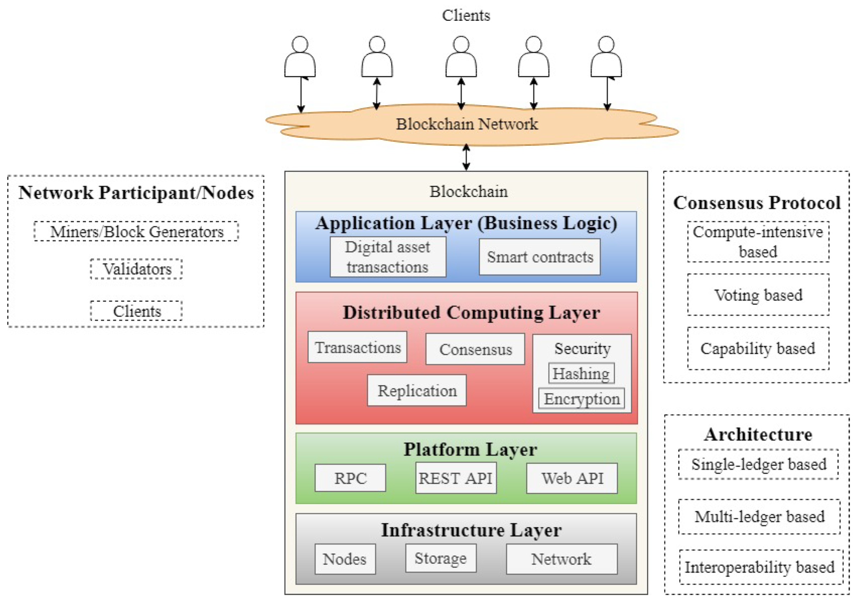
Blockchain reference design
The blockchain architecture is divided into four layers:
infrastructure
platform
distributed computing
application

Slide 7
The infrastructure layer consists of all the hardware components required to run the blockchain, such as nodes, storage, and network facilities.
The nodes are the network participants.
A typical blockchain network has three different types of nodes: simple (also referred to as a light node), full, and mining.
A simple node in the network can just send and receive transactions and does not store a copy of the ledger, neither validate a transaction, whereas a full node does.
Full node: Stores the complete blockchain ledger and validates transactions and blocks to maintain network integrity.
A mining node (also referred to as a block generator) is a full node with the capability of mining, i.e., the process of generating a new block. The storage component stores the ledger of the transaction records.
Infrastructure layer

Slide 8
Platform layer
Provides RPC, Web APIs, and REST APIs for communication.
Enables interaction between blockchain network participants.
Supports application integration with the blockchain network.
Facilitates data exchange and service access across the platform.

Slide 9
Distributed computing layer
Ensures local data access, fault tolerance, immutability, privacy, authenticity, and security of transactions.
Maintains immutability, preventing modification of transaction records once added to the ledger.
Uses a consensus protocol to agree on transaction order, ledger updates, and miner selection.
Provides user authentication (encryption) and data privacy (hashing techniques).

Slide 10
Application layer
The application layer is the business logic for digital asset transactions and the execution of smart contracts.
An application developed on top of a blockchain network can be accessed by the clients using the platform layer.

Slide 11
The layers of the blockchain architecture have the following characteristics.
Decentralization: The transactions in blockchain are processed and validated by the consensus of most network nodes. They are replicated on the nodes in a ledger. This eliminates the need for an intermediary to share and maintain the transactions data.
Immutability: The transactions in blockchain are stored into blocks. Each block in the chain is linked to the previous block using a cryptographic hash function. Any attempt to modify the content of a block will affect the subsequent blocks in the chain. Consequently, a malicious attacker needs to change all the succeeding blocks in the chain to modify a particular block, which is computationally difficult because the chained blocks are replicated over multiple nodes.
Transparency: The ledger is only updated when most of the nodes reach a consensus. Changes in the network are publicly visible ensuring transparency and security.
Traceability: The distributed and transparent nature of blockchain makes it easier to trace any transaction event. Each update in the state of an asset can be traced down back to its origin. This helps in making the network more secure, efficient and transparent.
Trustless: Blockchain allows transaction of assets between unknown parties who do not trust each other. By distributing the ledger across several nodes in the network and updating this ledger via a consensus ensures the validity of transactions in an untrusted environment.

Slide 12
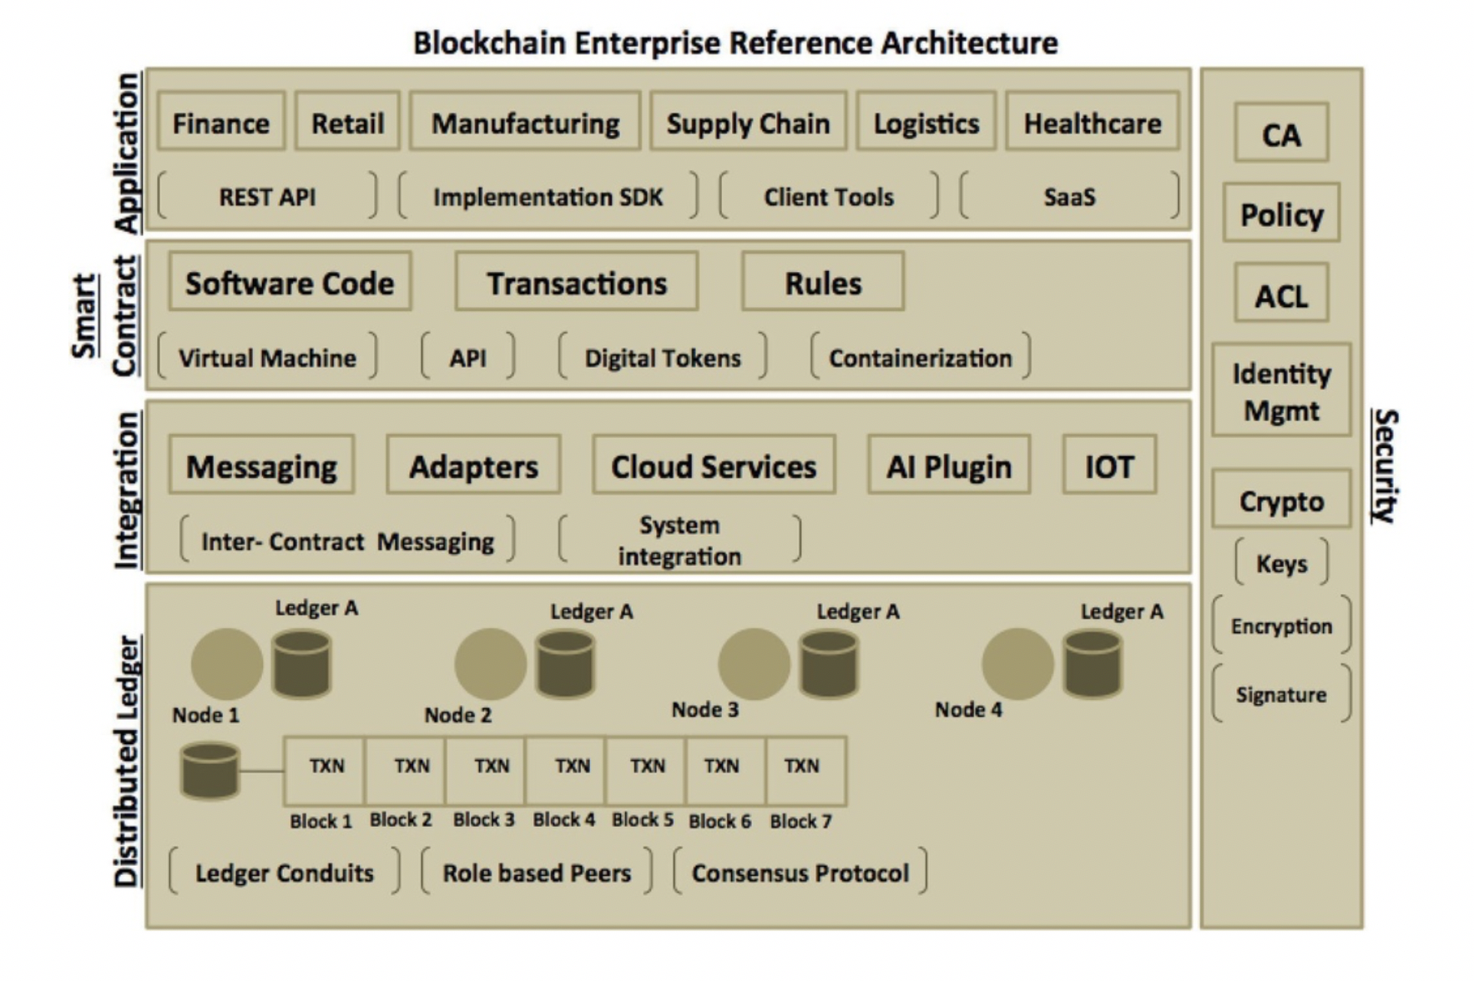

Blockchain Enterprise reference architecture
https://cloudsolutions.academy/how-to/blockchain-reference-architecture/application/

Slide 13
Application
The application layer is where your end user or client application sits.
The client application typically kick starts your business workflow by initiating a transaction. The transactions are executed by the nodes using smart contract.
The client application could be implemented in any software language and can run on a wide variety of operating systems.
The application could use a command line interface (CLI) tool as provided by any blockchain framework implementation or it could use language specific SDK (Software Development Kit) to communicate with nodes on the network.
As the blockchain evolves beyond its traditional image of digital crypto currency based network, we are seeing different types of clients and tools supporting the blockchain framework.
The client application can also listen to various types of events occurring on the blockchain network and perform the necessary actions on those events.
The event may be as simple as providing status update to the application from the network. One can also have a separate dedicated application to monitor the blockchain network.

Slide 14
Smart contract
Smart contract is a software code that represents transactions in the blockchain network.
It is a collection of business rules or conditions that are invoked by the nodes in the blockchain network.
Smart contract can have its own execution runtime or a virtual machine environment.
It can be made to run in a secured context, like a virtualized container.
Smart contract can be implemented in any software languages, the popular being, but not limited to, Java, Python, Go, JavaScript and Scala.
Smart contract can be also written as services and placed in registries so that client can look up for the same in a location independent way.
The registries can be secured, and access can be controlled so that only authorized clients can act upon that contract.
Smart contract itself can be made secured using cryptographic hash algorithms so that it’s content (software code and related metadata) are made confidential.
Smart contract can also be programmed to communicate or broadcast transaction state transitions in the form of events. It could be lifecycle events of the contract itself.
The application client can listen to these events and handle them accordingly.

Slide 15
Integration
In today’s world of disruptive technologies where application integration and communication has become so imperative, no one platform can stand in isolation. Blockchain is no different.
Blockchain network should be able to access any data outside of the network. The data could be part of any external application or system that can provide significant value to the blockchain workflow. Similarly, external system must also be able to communicate with the blockchain network. One approach could be to setup an external event hub, as a medium to exchange data with external systems through event processing.
An external application can listen on to a specific event on the hub and accordingly perform some task. On the other hand, a smart contract can listen to events coming from external systems and accordingly execute the business function. The following section explains some other interesting use cases in the integration scenario:
Artificial Intelligence (AI) Integration
Cloud Integration & IoT Integration

Slide 16
Artificial Intelligence (AI) Integration
• Blockchain provides a decentralized and secure ledger for storing transaction data.
• AI can analyze blockchain data using machine learning and advanced algorithms.
• AI helps in anomaly detection, predictive analysis, and business process optimization.
• AI can reduce transaction costs, improve efficiency, and increase business value.
• The combination of AI and Blockchain enables smarter, autonomous, and more secure systems.

Slide 17
Cloud Integration
• Blockchain architecture can be extended with a cloud-hosted component that provides application integration services such as routing, data transformation, protocol translation, and certificate authority services.
• This component acts as a middleware, offering its capabilities as Blockchain as a Service (BaaS) in the cloud.
• The blockchain implementation can provide adapters to connect the blockchain network with the middleware component, both within and outside the network.
• The blockchain middleware can be hosted in a secure sandboxed environment or a virtualized container, enabling external applications to interact with the blockchain through adapters and valid access certificates.

Slide 18
IoT Integration
• A new wave of integration enables IoT devices and sensors to communicate directly with the blockchain network.
• Different types of IoT devices can inject data into the blockchain, which is then validated by blockchain nodes.
• A standardized middleware can collect device data and perform the necessary data conversion and transformation required by the blockchain network.
• The peers/nodes validate the received data using a consensus algorithm and smart contracts.

Slide 19
Distributed Ledger
• The distributed ledger is the core persistent layer of blockchain, providing a decentralized and distributed database of transaction records.
• Transactions are recorded in chronological order and grouped into hashed blocks.
• The ledger forms a chain of blocks, where each block references the previous block using cryptographic hashes.
• The ledger is shared across all nodes, and each node maintains a copy and independently verifies transactions.
• When nodes agree on the validity of transactions, the network reaches consensus.
• Consensus algorithms define the rules and conditions for validating transactions and updating the ledger.
• Permissionless ledgers are typically used in public blockchains, while permissioned ledgers in private or consortium blockchains provide access control over transactions and data.
Key Components • Ledger Conduits – Mechanisms for transaction propagation and ledger synchronization. • Consensus Algorithms – Protocols used to achieve agreement among network participants.

Slide 20
Ledger Conduits
• Ledger conduits are private channels within a permissioned blockchain network that enable secure transactions between authorized nodes.
• Only authorized members can participate in a conduit, ensuring enhanced privacy and access control.
• Conduits act as small private networks within a larger blockchain network.
• This pattern provides additional security and confidentiality for enterprise blockchain applications.

Slide 21
Consensus Algorithms
The blockchain network typically is governed by anonymous entities or nodes that are not trusted.
The consensus is all about providing the trust factor in the network.
Each node can update the blockchain network with data in the form of transaction that eventually needs to be verified before it can be officially recorded as part of block in the ledger.
There are different consensus algorithms that convey how the block (of transactions) is created and validated, thereby enforcing trust in the network.
Practical Byzantine Fault Tolerance (PBFT)
Proof-Of-Work (PoW)
Proof-Of-Stake (PoS)

Slide 22
Practical Byzantine Fault Tolerance (PBFT)
• A consensus algorithm enables nodes to validate transactions and update the blockchain according to predefined rules.
• The network reaches consensus when a majority of nodes agree on the same result.
• Rogue or malicious nodes that violate the rules are ignored, as their outcomes are not accepted by the network.
• All participating nodes must follow and execute the same set of rules and conditions to achieve a valid and consistent outcome.

Slide 23
Proof-Of-Work (PoW)
• Proof of Work (PoW) is one of the earliest and most widely used consensus algorithms, used in Bitcoin and earlier versions of Ethereum.
• PoW requires significant computational effort to solve complex mathematical or cryptographic puzzles.
• Nodes with higher computing power have a greater chance of solving the puzzle first.
• The first node to achieve the required result earns the right to create the next block and receives a reward.
• PoW typically relies on cryptographic hashing to meet a predefined target and secure the network.

Slide 24
Proof-Of-Stake (PoS)
• Proof of Stake (PoS) was introduced as an alternative to PoW to reduce high energy consumption and computational costs.
• In PoS, the probability of creating a new block depends on a participant’s stake (ownership of cryptocurrency or digital assets).
• Users with a higher stake have a greater chance of being selected to validate transactions and create new blocks.
• PoS replaces the need for powerful computing hardware with economic investment in the network.
• This approach improves energy efficiency while maintaining blockchain security and consensus.

Slide 25
Security
• Security is a key component of blockchain architecture, ensuring safe and reliable transactions.
• Depending on whether the blockchain is permissionless or permissioned, different security and consensus mechanisms are applied.
• In public blockchains, anyone can participate, while in permissioned blockchains, access control restricts participation to authorized entities.
• Every entity in the network must have a defined identity; permissioned systems include organizations, users, and nodes with specific roles.
• Public Key Infrastructure (PKI) is used in permissioned blockchains, where a trusted Certificate Authority (CA) issues cryptographic credentials.
• These credentials include public keys (for verification) and private keys (for signing), establishing a trusted environment.
• Blockchain security systems should support interoperability of different CA systems through a plug-and-play abstraction layer.
• Core security measures include authentication, access control, integrity, confidentiality, and non-repudiation.

Slide 26
Security and Privacy in Blockchain Systems
Security controls in blockchain systems
01
Governance: System rules
Identity and Access Management
Key management, Information Security training
Information security policies and guidelines
02
Applications: Smart contracts
Application Security
Secure code development and checklists
Vulnerability management and 3rd party apps review
03
Data: Onchain data encryption
Encryption and key management
Privacy policies and controls
Off chain data security
04
Transactions: Consensus
Secure algorithms to avoid double spending, censorship
Fork management and maintenance
05
Infra: Networks/systems
Periodic vulnerability assessment and pen testing
Logging and monitoring
Endpoint security and patch management

Slide 27
Security and Privacy in Blockchain Systems
Privacy controls in blockchain systems
Anonymization
Private contracts
Differential privacy
Mixing
Encryption
Removal of Personally Identifiable Information(PII) before and after publishing and transmission
Only programmable contract between concerning nodes contains transactional details
Noise addition and/or data perturbation to make indistinguishable
Combining and merging of transactions to hide original identity
Use of public and private keys identity and privacy
1
2
3
4
5

Slide 28
Security and Privacy in Blockchain Systems
Business attack vector - Bitcoin perspective
Double spending attack
Finney attack
Brute force attack
Vector 76 / one-confirmation attack
Goldfinger attack
Block discarding / selfish mining
Block withholding
Fork after withholding

Slide 29
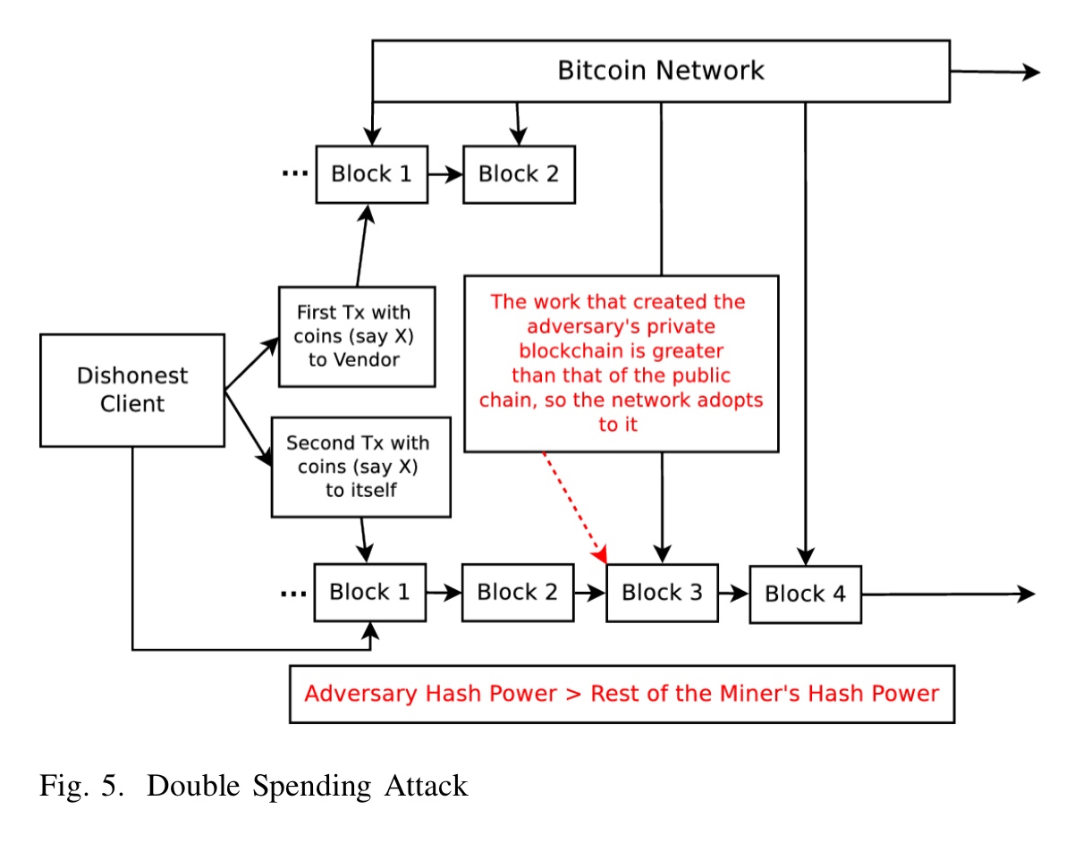
Double spending attack
• A double spending attack occurs when the same bitcoins are used more than once in different transactions.
• The attacker tricks a vendor by showing a confirmed transaction, causing the release of goods or services.
• Meanwhile, a conflicting transaction is broadcast to the network, sending the same coins back to an address controlled by the attacker.
• If this fraudulent transaction is included in the main blockchain branch (fork), the original payment becomes invalid.
• As a result, the attacker ends up with both the goods and the digital coins.

Slide 30
Finney attack
• A Finney attack is a type of double spending attack where the attacker first pre-mines a block containing a transaction that sends coins to an address they control.
• After successfully mining this block, the attacker makes a second transaction paying the same coins to a merchant/vendor.
• The vendor may accept the payment after seeing a valid transaction confirmation.
• The attacker then releases the pre-mined block, creating a competing fork in the blockchain.
• The attack succeeds if the attacker’s fork becomes part of the longest valid chain, making the vendor’s transaction invalid.

Slide 31
Brute force attack
• With high computing power (e.g., a large mining pool), an attacker can pre-mine multiple blocks ahead of the honest network.
• The attacker builds a private chain of blocks containing a conflicting transaction.
• The victim (vendor) sees a valid transaction confirmation and releases goods.
• The attacker then releases the pre-mined chain, which can quickly become the longest chain.
• As a result, the attacker’s chain replaces the honest one, leading to successful double spending.

Slide 32
Vector 76 / one-confirmation attack
• A Vector 76 attack is a form of double spending attack targeting a cryptocurrency exchange instead of a vendor.
• The attacker first creates a pre-mined block containing a fake deposit transaction to the exchange.
• When a new block is announced, the attacker quickly submits a withdrawal transaction for the same funds.
• The attacker then releases the pre-mined block, attempting to create a competing fork in the blockchain.
• If the deposit transaction is invalidated, the exchange may still process the withdrawal, resulting in a financial loss.

Slide 33
Goldfinger attack
• If a miner or mining pool controls around 51% of the total network hashrate, it can perform a 51% attack, gaining majority control over block creation.
• This allows the attacker to double spend coins, reverse transactions, and manipulate the blockchain history.
• When such control is used for profit-driven manipulation, it is called a 51% attack.
• If the intention is to damage or destroy the cryptocurrency/network rather than profit, it is referred to as a Goldfinger attack.
• In both cases, the attacker gains the ability to rewrite parts of the blockchain by outpacing honest miners.

Slide 34
Block discarding / selfish mining
• In a block discarding attack, a dishonest miner or group of miners in a pool withholds newly mined blocks instead of broadcasting them.
• The attackers continue mining on a private chain, while honest miners extend the public chain.
• If the private chain maintains a lead in length, the dishonest miners gain a higher share of rewards, while honest miners waste computational effort.
• When both chains reach a similar length, attackers may release their hidden blocks to compete for the longest chain.
• If the attacker’s chain becomes the longest valid chain, it replaces the public chain, allowing the attackers to win rewards unfairly.

Slide 35
Block withholding
• A block withholding attack is an internal attack within a mining pool, often carried out by a miner infiltrating from a rival pool.
• The attacker submits partial proofs of work (shares) to receive rewards, but deliberately withholds full valid blocks.
• This reduces the mining pool’s overall efficiency and can undermine rival pools or create unfair advantages.
• Such behavior may also be used to gain profit through race-to-publish strategies in certain scenarios.
• The Miners’ Dilemma shows that if multiple pools attack each other this way, they reach a Nash equilibrium, where all parties earn less reward than if they had not attacked.

Slide 36
Fork after withholding
• The Fork After Withholding (FAW) attack is a variation of the block withholding attack that can be executed more frequently and efficiently by mining pools.
• Unlike standard block withholding, FAW allows attackers to strategically release withheld blocks to create a temporary fork in the blockchain.
• This method can be used up to four times more often per pool, making it more profitable than traditional block withholding.
• Currently, there is no known effective defense against FAW attacks.
• FAW can create a feedback loop of increasing mining power concentration, where larger pools gain more advantage, potentially pushing the network toward a 51% dominance scenario.

Slide 37
Performance Aspects in Blockchain Systems
Factors influencing performance in blockchain systems
01
Consensus Mechanism
Algorithm for validation and finalization
Direct impact on scalability
02
Network Latency
Broadcast and response of block addition
Direct impact on scalability
03
Node Infrastructure
Runtime engine and database of right size and scale
Server infra on cloud vs on premise
04
Number of nodes
More the # of nodes, longer is txn confirmation time
Network lag increases as number of nodes increases
05
Smart contract complexity
Validation logic for reads/write to/from ledgers
Complex smart contracts increases latency
06
Transaction payload size
Bigger payload takes longer times for relay & commit
Guidance Is to relay reference instead of full payload
08
Node local storage
Local storage critical for ledger read/writes/IOPS
More delays add further delays due to catchup
08
Transaction pooling
Txn pooling/queueing critical for txn batch pickup
Without pooling longer it takes for larger # of txns

Slide 38
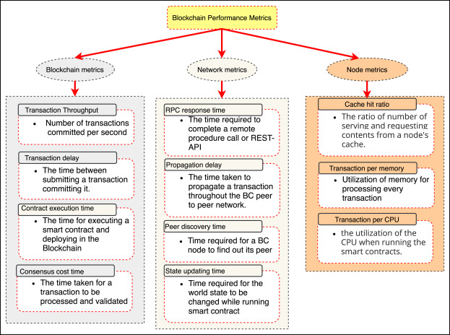
Blockchain performance metrics
© Md.Ashraf Uddin, Andrew Stranieri, Iqbal Gondal, Venki Balasubramanian

Slide 39
Blockchain as an Architectural Element
Software Component View: Blockchain is considered a distributed, network-based software architectural component within a larger system that provides data storage, computation, and communication services under a shared consensus mechanism.
On-chain vs Off-chain Decisions: A key responsibility of system architects is deciding what data and application logic should be placed on-chain (to benefit from decentralization, trust, and immutability) and what should remain off-chain (due to scalability, cost, performance, or privacy constraints).
Functional Roles: Blockchain can serve multiple architectural roles, including a shared data layer, a computation platform via smart contracts, a coordination and trust layer, and a token/asset management mechanism.

Slide 40
Blockchain as an Architectural Element
Replication Across Nodes: Blockchain data and state are replicated across all participating nodes, ensuring high availability and fault tolerance but also increasing storage and computation overhead.
Consensus Dependency: The behavior of the blockchain layer depends on a consensus protocol (e.g., PoW, PoS), which ensures agreement on the system state and directly impacts performance, scalability, and trust.
Trust Distribution: Blockchain shifts trust from a central authority to a distributed network of nodes, enabling trustless or partially trusted environments.
Immutability and Auditability: Once recorded, data becomes tamper-resistant and auditable, making blockchain suitable for systems requiring traceability and provenance

Slide 41
Blockchain as a Storage Element
Data Structure: A blockchain is an ordered, cryptographically linked sequence of blocks, where each block contains a set of transactions and references the previous block using a hash pointer.
Append-Only Nature: Blockchain is logically append-only and tamper-evident, meaning new data can be added but existing data cannot be altered without invalidating the chain and breaking consensus integrity.
Storage Options: Data is stored either:
within transactions (as in Bitcoin-style systems), or
in on-chain state storage (as in Ethereum-style systems using a key–value based contract storage model).

Slide 42
Blockchain as a Storage Element
Global State Replication Cost: Since all full nodes replicate the blockchain, storage is expensive and inefficient for large data, so large datasets are typically stored off-chain with only hashes on-chain.
Data Integrity via Hashing: Integrity is ensured using cryptographic hash functions and Merkle trees, which allow efficient verification of data consistency.
Limited Query Capability: Compared to traditional databases, blockchain storage has limited querying flexibility and performance, which is why external indexing systems are often used.

Slide 43
What is a smart contract?
A "smart contract" is computer code:
embedded in a blockchain or [eventually] other form of decentralized ledger that
incorporates all or part of a written legal agreement and
transfers digital assets or vests rights or is otherwise triggered when a set of pre-defined terms and conditions are satisfied.

Slide 44
What is a smart contract?
Key Points:
The "smart contract“ once written can be self-executing and autonomous, without the need for further action by the parties.
A form of robotics for commercial contracts.

Slide 45
Smart Contract Examples
Smart contracts do not have to be complex and can be used to perform a few simple functions repetitively for a large group of transactions or agreements.
The key to smart contracts is their ability to obtain and handle variable data and to automatically process and act on those variables.

Slide 46
Smart Contract Examples
Example: (a) Green transfers ownership of securities or other digital assets into the blockchain; (b) Blue is required to pay
$5X for the assets on a certain date, but
$8X for the assets if Event A occurs prior to that date.
The smart contract determines whether Event A has occurred, and then self-executes by (i) paying Green $5X or $8X and (ii) transferring ownership of the securities to Blue.

Slide 47
Smart Contract Example: Insurance
Smart automobile insurance policy:
Track driver using sensors.
All data would be continuously and permanently added to the blockchain along with traffic citations and other external data for each policyholder.
The smart policy automatically (i) increases or decreases the premium based on the data and (ii) withdraws payment from the driver’s bank account.

Slide 48
Smart Contract Example: Supply Chain
Increased complexity in the cross-border manufacturing and distributing of goods.
New legal and compliance obligations for supply chain transparency require companies to trace, document and report the source of products and their components.*
*See for example the California Transparency in Supply Chains Act of 2010, California Civil Code Section 1714.43, which focuses on prevention of human trafficking and use of child labor in manufacturing.

Slide 49
Smart Contract Example: Supply Chain
Use of smart contract: Coordination of numerous counterparties; tracking and verification of source of components; supply chain transparency under applicable law.
Bar codes or RFID or IOT devices or other sensors would automatically identify and track each individual component and upload data to the blockchain as its status changes.

Slide 50
Other Smart Contract Use Cases
Stocks: Trading and registration of shares of corporate stock. Several states including Delaware have recently enacted statutes permitting use of blockchain as the official stock ledger.
Financial Instruments: Trading of derivatives or other financial instruments.
Trade Finance: Automated issuance of or substitution for letters of credit, guarantees and trade finance instruments.

Slide 51
Other Smart Contract Use Cases
Clinical Trials: Automated obtaining and tracking of required patient consents; standardization of patient inquiries; and secure sharing of personal medical information across institutions.
Scientific Research: Real-time secure sharing of medical or other scientific research between institutions to avoid the “silo” effect; automated nondisclosure terms to protect patent and other IP rights; automatic release of grant funds.

Slide 52
Building of Smart Contracts
How is a smart contract constructed using a blockchain?

Slide 53
Building of Smart Contracts
There are competing versions of blockchain software, similar to competing versions of computer system software such as Microsoft and Apple.
For example, Bitcoin has its own blockchain system for the issuance and transacting of the Bitcoin cryptocurrency as an alternative to fiat currencies such as dollars and Euros.

Slide 54
Ethereum Blockchain System
The main blockchain software used for smart contracts is Ethereum.
Ethereum is a separate open-source, public, blockchain-based distributed computing platform and operating system.

Slide 55
Ethereum Blockchain System
The difference is that unlike Bitcoin, the Ethereum platform also contains additional critical features:
Smart contract (computer code) functionality permitting self-executing contract terms and conditions to be embedded in the blockchain.
The ability to perform computations
within the blockchain.

Slide 56
Ethereum Blockchain System
The ability to obtain extrinsic or external data from third parties outside of the blockchain using a function called an “oracle”.
The ability to combine this external data with the executable computer code within the blockchain to perform smart contract functions.
Decentralized Applications (Dapps) run on top of the platform to add functions.

Slide 57
Building a Smart Contract: Step 1: Agreement
Two or more parties must negotiate a written legal contract or use a form contract from one of the parties or an affiliation group containing their agreement.
The contract must include specific transactions or other rights and obligations that vest or are executed upon specified sets of conditions.

Slide 58
Building a Smart Contract: Step 2: Conditions
The parties must set:
All of the conditions to be automated under their agreement
All permutations of each of those conditions
The intended result or instruction in each case.

Slide 59
Building a Smart Contract: Step 2: Conditions
The set conditions can be internal to the contract:
The manufacture or shipping or delivery of a product
A schedule of due dates for payments
Expiration of inspection rights or warranties
A form of deliverable or notice by a party.

Slide 60
Building a Smart Contract: Step 2: Conditions
The set conditions can be external to the contract:
Acts or omissions of third parties
Accidents or weather or climate events or other acts of God
Other events of force majeure
Financial or product market triggers
Changes in legal or financial status

Slide 61
Building a Smart Contract: Step 3: Coding
The smart part of a contract requires the writing of a computer program or code which incorporates all of the set conditions and results, so that the contract will automatically be performed when those conditions are triggered.
In Ethereum the main programming language for writing smart contracts is Solidity.

Slide 62
Building a Smart Contract: Step 3: Coding
Key Point:
A smart contract therefore always has two versions: the human language version and the machine code version.

Slide 63


Building a Smart Contract: Step 3: Coding
Written Contract:
Human language
All parts of agreement
Freely modifiable in writing by the parties.
Subject to interpretation
Smart Version:
Machine computer code
Only transactions to be automated
Embedded into blockchain or other ledger
Cannot be changed
- only added to.

Slide 64
Building a Smart Contract: Step 4: Blockchain
The smart contract code is published to the blockchain or other decentralized ledger network by the parties.
The smart contract code is verified and then "written" into a block in the blockchain or other ledger.
The parties are issued public and private keys so they can conduct the transaction on the blockchain.

Slide 65
Building a Smart Contract: Step 5: Execute
Execution of the transaction is triggered:
by a message sent by a party validated by its private key or
by the objective satisfaction of external or other events or conditions coded into the program.
The transaction [such as transfer of funds or title] is automatically performed pursuant to the smart contract code.

Slide 66
Building a Smart Contract: Step 6: Recording
The completed transaction [for example: sale of property; payment of royalties; delivery of shipment] is verified and written into a new block in the chain.
All of the computers [nodes] which are part of the relevant network are then distributed updated copies of the ledger which show that the transaction is completed.

Slide 67
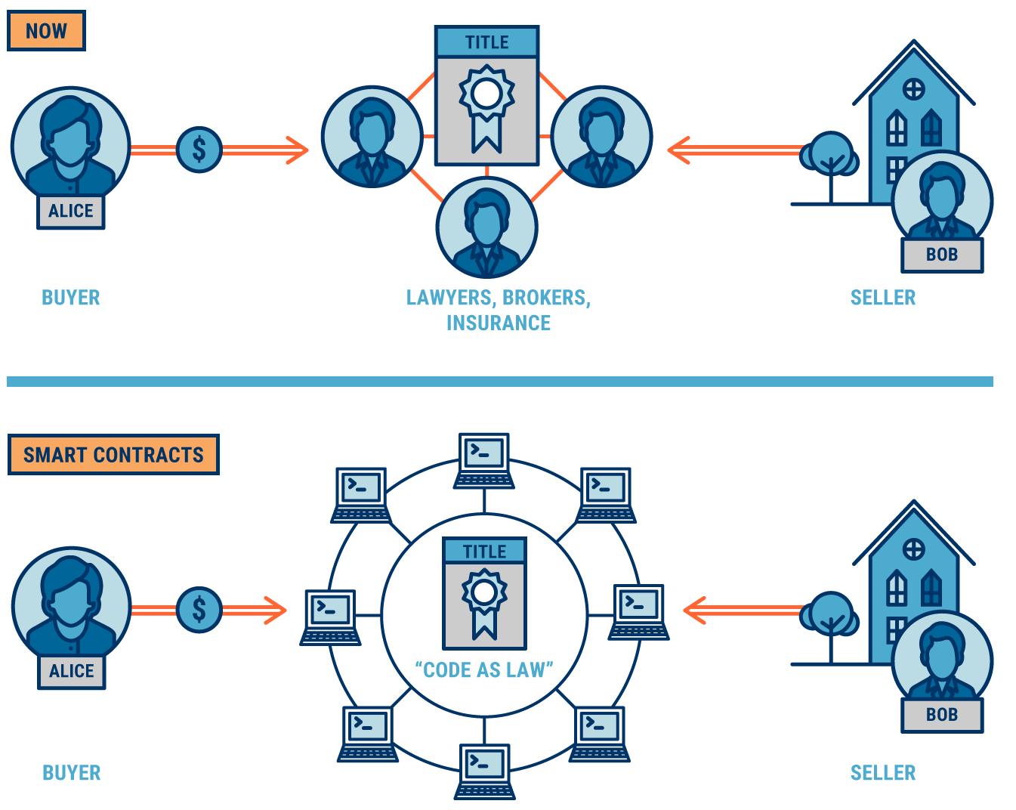
Building a Smart Contract

Slide 68
Building a Smart Contract
A smart contract generally will not be the whole agreement but only those portions of the contract that are highly process-based, can be represented in executable computer code, and can be usefully automated in a manner that is more efficient and easier to scale than human processing.

Slide 69
Building a Smart Contract
In its current stage, better suited to industrial scale or repetitive forms and transactions rather than "one off" agreements.

Slide 70
Anatomy of a Smart Contract
// SPDX-License-Identifier: MIT
pragma solidity ^0.8.0;
contract SimpleStorage {
address public owner;
uint256 private value;
event Updated(uint256 v);
constructor() { owner = msg.sender; }
modifier onlyOwner() {
require(msg.sender == owner);
_;
}
function set(uint256 v) public onlyOwner {
value = v; emit Updated(v);
}
function get() public view
returns (uint256) { return value; }
}
License & pragma — SPDX tag and the compiler-version constraint.
State variables — persistent on-chain storage — the costliest resource.
Visibility — public / external / internal / private control access.
Functions — view/pure (no change) vs state-changing (need a tx + gas).
Modifiers — reusable guard clauses, e.g. onlyOwner for access control.
Events — indexed logs that off-chain apps subscribe to.
Constructor — runs once at deployment to initialise state.

Slide 71
Assessing Smart Contract Security
Smart contracts are immutable after deployment
Security flaws can lead to permanent financial/data loss
Security assessment ensures correctness and trustworthiness
Focus areas include logic, vulnerabilities, and external interactions
Uses multiple methods: code review, testing, and auditing

Slide 72
Key Security Evaluation Areas
Logic correctness: Ensure business rules are implemented properly
State safety: Validate all possible state transitions
Access control: Restrict sensitive functions using roles/permissions
External interactions: Secure calls to other contracts/oracles
Gas safety: Avoid loops or operations causing execution failure

Slide 73
How to Assess Smart-Contract Security
Technique | Purpose | Tools
Manual code audit | Expert review of logic, intent, and business rules | Auditors, SWC / SCSVS checklists
Static analysis | Automated detection of known bug patterns | Slither, Mythril
Fuzzing / property testing | Stress testing with random inputs to verify invariants | Echidna, Foundry (Forge)
Symbolic execution | Explore multiple execution paths to find inputs that break constraints | Manticore, Mythril
Formal verification | Mathematically prove correctness of specified properties | Certora, SMTChecker
Testing & coverage | High-coverage unit and integration testing | Hardhat, Foundry
Runtime monitoring | Detect issues and respond after deployment | Tenderly, Forta, bug bounties

