Slide 1
Blockchain Technologies & Systems

Slide 2
Blockchain Technologies & Systems
Contact Session . 05

Slide 3
Contents
RL 4.4 Blockchain in Software Architecture
RL 4.5 Integrating Blockchain into enterprise applications
RL 4.6 Blockchain and Smart contract vulnerabilities
CS5
• Blockchain as Computational Element
• Blockchain as Communication Mechanism

Slide 4
What will we learn today?
Software Architecture Basics
Blockchain in Software Architectures
Integrating Blockchain into enterprise applications
Blockchain and Smart contract vulnerabilities
Functionality of Blockchain
Data Storage
Computation
Communication
Asset Management

Slide 5
Blockchain in Software Architecture

Slide 6
Software Architecture’s Elements
A software architecture defines the overall structure and organization of a software system.
A software system is not a single monolithic unit; it is composed of multiple interconnected parts.
Dividing the system into smaller units improves modularity, scalability, maintainability, and flexibility.
One split:
Component,
Connector, and
Configuration

Slide 7
Software Component
Software components are the fundamental building blocks for software architecture
A software component is an architectural entity that:
Encapsulates a subset of the system’s functionality and/or data
Restricts access to that subset via an explicitly defined interface
Has explicitly defined dependencies on its required execution context
Components typically provide application-specific services
Notes:
Software components are the elements that encapsulate processing and data in a system’s architecture

Slide 8
Software Connectors
In complex systems interaction may become more important and challenging than the functionality of the individual components
Connector: architectural building block tasked with effecting and regulating interactions among components
Connectors typically provide application-independent interaction facilities
Communication: transfer data
Coordination: transfer control
Facilitation: enable and optimise component’s interactions
Conversion: adjust the interactions between incompatible interfaces

Slide 9
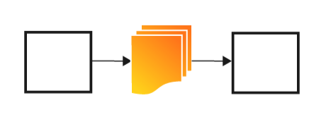
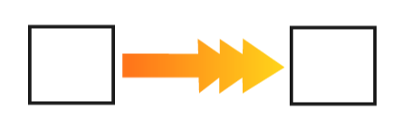
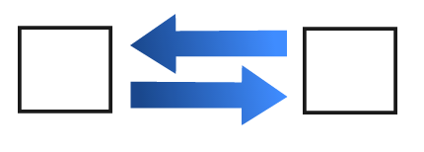
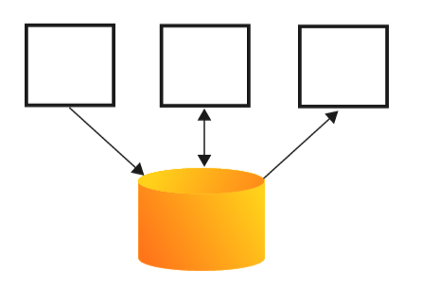
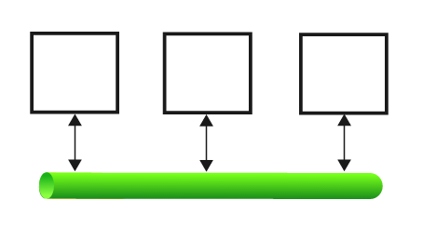
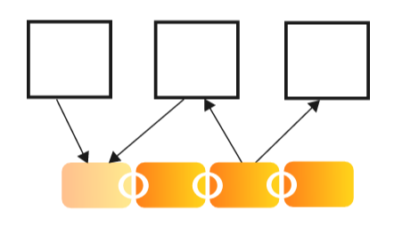
Example Software Connectors
Remote Procedure Call
File Transfer
Stream
Message Bus
Blockchain
Shared Database
→ Blockchain can play the role of a software connector
Notes:
File transferred from a component to another
Stream coming from a component to another
Simple procedure calls
Shared data accesses
Message bus that connect multiple components
Much more sophisticated and complex connectors are possible: blockchain

Slide 10
Software Configuration
Configuration specifies how components and connectors are organized and interact to achieve system functionality.
This architectural approach simplifies system design, development, testing, integration, and future maintenance.
In a blockchain application, Smart Contracts, Ledger, Consensus, and User Applications are components
APIs and peer-to-peer protocols are connectors
The overall blockchain network structure represents the configuration.

Slide 11
Non-Functional Properties
Non-Functional Properties arise from Architectural Design Choices
There are two kinds of requirements:
Functional Requirements
What does the system do, what are the inputs and outputs?
Non-Functional Requirements (a.k.a. Qualities, or -illities)
How does the system do that, i.e., how fast, at what cost, …?
e.g. “Performance” (latency, throughput, … )
e.g. “Security” (confidentiality, integrity, availability, privacy, …)
e.g. Usability, Reliability, Modifiability, …
Notes:
Two kinds of requirements
FR: specify the behavior of system
NFR: specifies criteria that can be used to judge how well the system operates
With a fixed budget and timeframe, there is tradeoffs between non functional properties

Slide 12
Blockchain in Larger Software System
Applications
Applications
Applications
Applications
API
Key Management
Tokens / Currencies
Smart Contracts
Private Data
Key Management
Shared Data Ledger
(meta-data, small data)
Big Data
Key Management
Component
Blockchain
Auxiliary
Database
Notes:
The blockchain stores and shares data, and executes smart contracts.
The blockchain component might also control digital currency or represent other assets.
Due to limitations of privacy and scalability, there are also off-chain auxiliary databases used in the system.
First, private data is stored in an internal database. Second, large data is stored separately, such as in a cloud service.
There is an API layer between the three data storage mechanisms.
Key management is an essential component when working with blockchains. Every participant in a blockchain network has one or more private keys, which are used by the participant to digitally sign its transactions.

Slide 13
Overview of Blockchain in a Software System
Blockchain is one component of a larger enterprise software system.
Users interact with blockchain through applications, not directly.
Multiple applications can share the same blockchain platform.
Applications communicate with blockchain using APIs (Application Programming Interfaces).
Blockchain provides a shared, trusted, and tamper-proof ledger.
Business logic is implemented using Smart Contracts.
Large business data is stored outside the blockchain in external databases.
Together, applications, APIs, blockchain, and databases form a complete enterprise solution.

Slide 14
Blockchain in Larger Software System
The blockchain stores and shares data, and executes smart contracts.
The blockchain component might also control digital currency or represent other assets.
Due to limitations of privacy and scalability, there are also off-chain auxiliary databases used in the system.
First, private data is stored in an internal database. Second, large data is stored separately, such as in a cloud service.
There is an API layer between the three data storage mechanisms.
Key management is an essential component when working with blockchains.
Every participant in a blockchain network has one or more private keys, which are used by the participant to digitally sign its transactions.
Notes:
The blockchain stores and shares data, and executes smart contracts.
The blockchain component might also control digital currency or represent other assets.
Due to limitations of privacy and scalability, there are also off-chain auxiliary databases used in the system.
First, private data is stored in an internal database. Second, large data is stored separately, such as in a cloud service.
There is an API layer between the three data storage mechanisms.
Key management is an essential component when working with blockchains. Every participant in a blockchain network has one or more private keys, which are used by the participant to digitally sign its transactions.

Slide 15
Core Components of the Blockchain Layer
1. Shared Data Ledger
Stores shared and immutable transaction records.
Contains transaction metadata and small amounts of business data.
Every participating organization maintains the same copy.
Prevents unauthorized modification of records.
2. Smart Contracts
Self-executing programs stored on the blockchain.
Automatically enforce business rules.
Eliminate intermediaries and manual processing.
3. Tokens/Currencies
Represent digital assets or cryptocurrencies.
Enable secure transfer of value between participants.
Can also represent ownership of physical or digital assets.

Slide 16
Core Components of the Blockchain Layer
4. Key Management
Generates and manages public/private cryptographic keys.
Ensures secure authentication and digital signatures.
Protects user identity and transaction ownership.
5. Auxiliary Database
Stores
Private business information
Large documents
Images
Videos
Analytics data

Slide 17
Benefits of Architecture for Blockchain applications
Understanding important architectural impacts
Performance and other quality attributes
Security, privacy, scalability, sustainability…
Design trade-offs regarding quality attributes
Making informed architectural decisions
…and documenting them
Rationale to support architectural decisions
Whether to employ a blockchain or some conventional components
Notes:
We can then consider design tradeoffs regarding these quality attributes,
and provide rationales to support architectural decisions about whether to employ a blockchain or some conventional component.

Slide 18
Blockchain as a Software Component
Complex, network-based software component
As a component, blockchain has unique properties and limitations.
Blockchains are complex, network-based software components, which can provide data storage, computation services, and communication services.
Blockchain features can include cryptographically-secure payment, mining, transaction validation, incentive mechanisms, and permission management.
A so-called ‘oracle’ may supply information about the external world to the blockchain, usually by adding that information to the blockchain as data in a transaction.
Features
Cryptographically-secure payment
Mining
Transaction Validation
Incentive mechanism
Permission management
Notes:
As a component, blockchain has unique properties and limitations.
Blockchains are complex, network-based software components, which can provide data storage, computation services, and communication services.
Blockchain features can include cryptographically-secure payment, mining, transaction validation, incentive mechanisms, and permission management.
A so-called ‘oracle’ may supply information about the external world to the blockchain, usually by adding that information to the blockchain as data in a transaction.

Slide 19
Functions blockchain can provide in an application architecture
Architectural Element
Storage Element
Computational Element
Communi-cation Mechanism
Asset Management and Control Mechanism
Blockchain as…

Slide 20
Functions of Blockchain
Computational Element: Executes business logic through smart contracts, enabling automated and tamper-proof processing.
Communication Mechanism: Facilitates secure and trusted information exchange among multiple organizations without relying on a central authority.
Storage Element: Maintains an immutable shared ledger that securely stores transactions and metadata.
Asset Management and Control: Manages digital assets such as cryptocurrencies, tokens, certificates, and ownership records with transparency.
Architectural Element: Integrates with enterprise applications through APIs to improve security, trust, transparency, and decentralization.

Slide 21
Recap: Properties of Blockchain
Blockchain cannot meet the requirements of all usage scenarios
E.g. those that require real-time processing
Fundamental Properties
Immutability from committed transaction
Integrity from cryptographic methods
Transparency from public access
Equal rights from consensus and p2p structure
Limitation
Data privacy
Scalability
Size of the data on blockchain
Transaction processing rate, throughput
Latency of data transmission and commits
Notes:
From software architecture perspective, blockchain is a distributed database with unique properties and limitations.
Cannot meet requirements for all usage scenarios
Data privacy and scalability are the two limitations of public blockchains.
On a public blockchain, there is no privileged users, and every participant can join the network to access all the information on blockchain and can validate new transactions.
the mainstream public blockchain can only handle on average 3-20 transactions per second
mainstream payment services, like VISA, can handle an average of 1,700 transactions per second.

Slide 22
Integrating Blockchain into enterprise applications

Slide 23
In this segment
Integrating blockchain into enterprise applications
Do we need a blockchain at all?
Simple integration
Reference integration of blockchain to enterprise applications

Slide 24
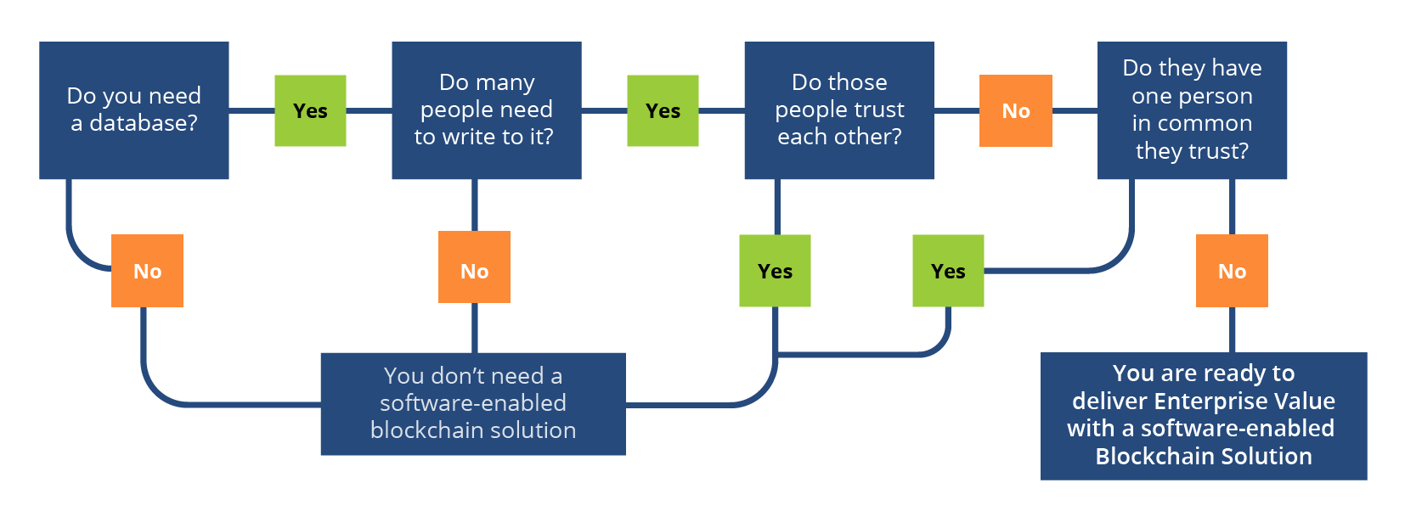
Integrating Blockchains into Enterprise Apps
Blockchain systems reference architecture

Slide 25
Decision Framework
First determine whether the application actually needs a database.
Check whether multiple organizations need to update the same data.
Determine whether these organizations fully trust one another.
If everyone trusts each other, a conventional database is usually sufficient.
If organizations do not trust one another, blockchain becomes valuable.
Blockchain eliminates dependence on a central authority.
Permissioned blockchains are commonly used in enterprise environments.
Use blockchain only when it solves a real trust problem.

Slide 26
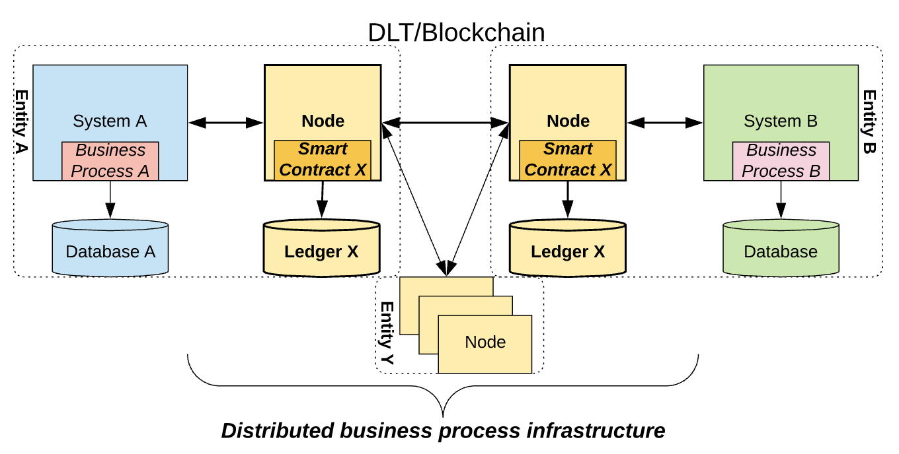
Integrating Blockchains into Enterprise Apps
Simple integration of blockchain to enterprise apps
© Techcrunch

Slide 27
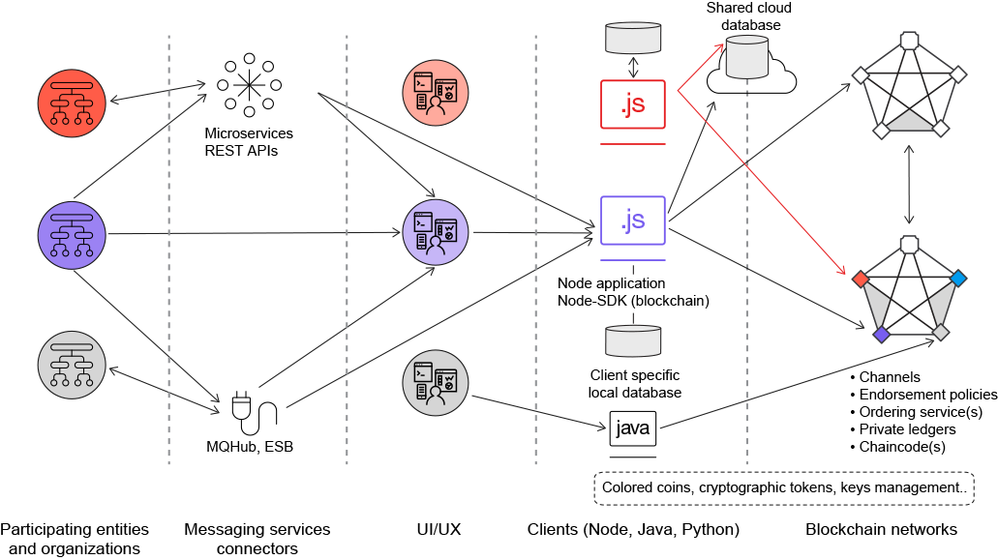
Integrating Blockchains into Enterprise Apps
Reference integration of blockchain to enterprise apps
Middleware
Enterprise DB
Blockchain nodes
© IBM Developer

Slide 28
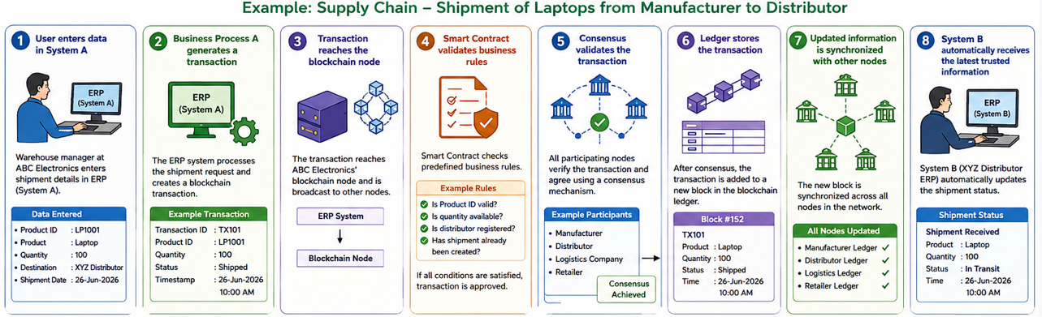
Integration of Blockchain to Enterprise Applications

Slide 29
Blockchain – Smart Contract Vulnerabilities

Slide 30
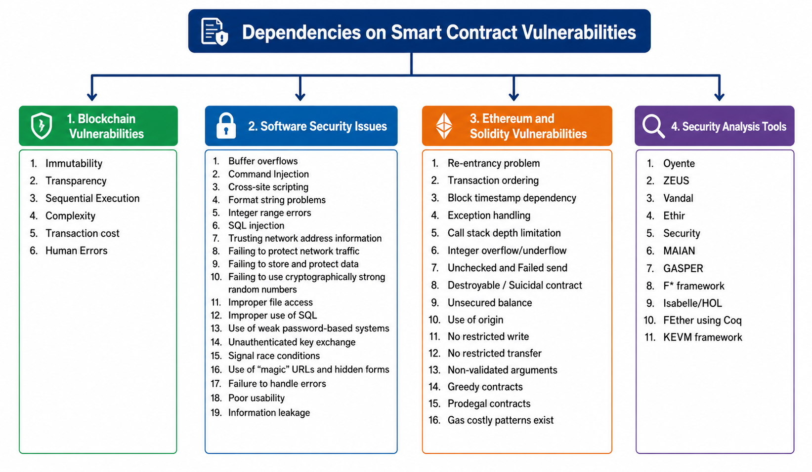
Blockchain and Smart contract vulnerabilities

Slide 31
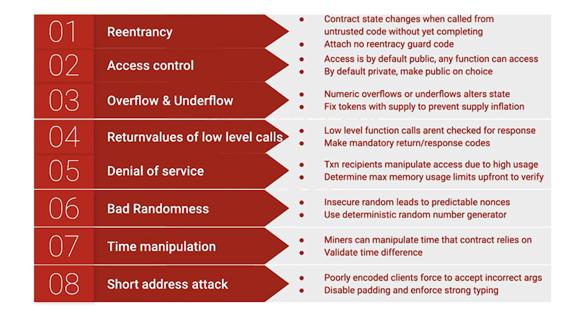
Smart contract vulnerabilities – An Ethereum perspective

Slide 32
Functionality of Blockchain Data Storage Computation Communication Asset Management

Slide 33
Blockchain Functionality
Blockchain as Storage Element
Append only data store – prevent tampering of data
An ordered list of blocks, where each block contains a small (possibly empty) list of transactions.
Each block in is “chained” back to the previous block, by containing a hash of the previous block
Transactions
Information is recorded within the transactions
Update blockchain states
Store code, variables, and results of function call results
Public key and digital signatures are normally used to identify accounts and to ensure integrity and authorization of transactions
Notes:
Lifecycle of transactions
Created by an initiator
Signed with the initiator’s signature which provides authorization to spend the money, create a contract or pass the parameters
Sent to a node which validates the transaction
Invalid transactions are discarded
Valid transaction is propagated to other connected nodes for further validation and send it to their peers until it reaches every node (usually within a few seconds)
When it reaches a miner, it is verified and maybe included in a block
The network reaches a consensus about the latest block to be included into the blockchain using consensus mechanism
The new block is broadcasted to the network by the winning miner
The nodes receiving the new block, verify the block and record it into the blockchain
Users often wait a number of subsequent blocks to be added to the block containing a transaction before viewing the transaction as committed

Slide 34

Blockchain as Storage Element
Blockchain data structure
Linked list with hash pointers
Tamper-proof
Computational constraints
Incentive scheme
Genesis Block
H( )
of previous block
of previous block
of previous block
H()
H()
H( )
Transactions
⁞
Transactions
⁞
Transactions
⁞
Notes:
each block contains a small (possibly empty) list of transactions.
Each block in the data structure is “chained” back to the previous block, by containing a cryptographic hash of the representation of the previous block.
Historical transactions in the blockchain may not be deleted or altered without invalidating this chain of hashes.
Combined with computational constraints and incentive schemes on the creation of blocks, this can in practice prevent tampering and revision of information stored in the block- chain.

Slide 35
Blockchain as Storage Element
Transactions
Transactions represent authorized state transitions
Transactions can record data
Transaction can transfer control of digital assets among participants
Crypto-currencies
Smart contract-based digital assets
State_{n}
Tx
State_{n+1}
Notes:
Cryptocurrencies are one kind of digital asset, but other kinds of digital asset tokens can be implemented on blockchains.
Ethereum digital asset tokens can be represented using smart contracts, which can represent the tokenized asset and store holdings as values of private variables

Slide 36
Representation of Crypto-currency Holdings
Bitcoin
Collection of unspent transaction outputs (UTXO) from all previous transactions to that address
Ethereum
Represented in a global system state
Smart contract has its own storage: key-value data store
Updates to contract variables do not change the historical data
But: transactions update the latest view of those variables in the contract data store
Notes:
There are various representations of cryptocurrency holdings.
In Bitcoin, the holdings of an address comprise the collection of unspent transaction outputs (UTXO) from all previous transactions to that address.
In Ethereum, the holdings of an address are represented in a global system state.
In Ethereum, every smart contract has its own storage which only it can update. Contract storage can be viewed as a flexible key-value data store.
Blockchain are immutable, so the updates to variables in the contract store do not change the data in old blocks. Instead, the transactions only update the latest view of those variables in the contract store.

Slide 37
Storing Arbitrary Data on Blockchain
“Arbitrary”: not structured in a way defined by the protocol
Two ways of storing data on blockchain
Adding data into transaction
Bitcoin
Ethereum
Adding data into contract storage
Smart contract on Ethereum
Smart contracts have an address, which is used to invoke the contract
Smart contract can only directly update its own storage
But can also call other smart contracts, which might update their storage
Note: anything in a transaction will be part of the ledger
Even if you do not store it in a contract variable
Both ways store data through submitting transactions
Amount of cryptocurrency transferred (can be 0)
Additional other data (also optional)

Slide 38
Comparison with Other Data Storage
Comparison with Shared Centralised Database
Comparison with Cloud Storage
Comparison with Peer-to-Peer Data Storage
Comparison with Replicated State Machines

Slide 39
Blockchain vs. Shared DB: Operations
Insert Transaction (Append Only)
Current view of smart contract variable values can mimic database
Analogy: log
Data items get appended
Never deleted or updated
Create
Read
Update
Delete
Notes:
Shared data stores, provide a basic Create/Read- /Update/Delete (CRUD) interface.
A blockchain is an append-only data store and does not support in-place updates, but rather only supports the creation of new transactions.
The current view of smart contract variable values can mimic the behaviour of conventional data stores.
Any changes/updates on contract states are appended to the blockchain as new transactions.
An analogy with this so-called ledger in data stores is the concept of log where data items get appended but never deleted or updated.

Slide 40
Blockchain vs. Shared DB: Consensus
Majority of peers agree on the outcome of transactions
Assumption
No leader
No trustworthy node
Distributed Transactions (2 Phase Commit, Paxos, …)
Synchronization
Notes:
Traditional shared data stores have their own consensus protocols to synchronize replicas in a fully trusted environment, such as 2-Phase Commit and Paxos.
Blockchains also rely on consensus protocols, and private blockchains often use the same protocols as traditional shared data stores.
On public blockchains, the assumptions required for conventional consensus protocols do not hold.
on a public blockchain there may be no master nodes, many thousands of nodes, their number may be unknown number.
Each of these facts violate assumptions required for some conventional consensus algorithms.
Some private blockchains assume that nodes are somewhat trustworthy, but on a public blockchain that assumption is not always reasonable.

Slide 41
Blockchain vs. Shared DB: Replication
Complete replication on every peer (full node)
Leader-Follower
(used to be called “Master-Slave”, but no longer seen as politically correct term)
Multi-Leader

Slide 42
Blockchain vs. Shared DB: Consistency
Transactions validated everywhere
Global rules enforced on the whole blockchain
No extra money created during a normal transaction
Bitcoin coinbase Tx is exception
No money transfer without authorization
Application-specific rules
implemented in smart contracts
Integrity Constraints
Stored procedures
Notes:
Blockchains validate the consistency of transactions by
using global rules implemented in the blockchain platform,
and by using application-specific rules implemented in smart contracts. Global rules on public blockchains include for example, that cryptocurrency transactions do not create money, nor transfer money without authorisation.

Slide 43
Blockchain vs. Cloud
Blockchain | Cloud
No trusted single party | Cloud provider is trusted
Users can monitor or participate themselves as nodes that store the blockchain | Cloud provider store user data and provide access to the data
Data integrity is guaranteed (probabilistically) | Data integrity and access availability may not be guaranteed
No defined SLAs (service-level agreement) provided by public blockchain | Clearly defined SLAs
Notes:
cloud providers are trusted to store data uploaded by users, and to provide access to that data
Users are normally not able influence to how the data is stored. Data integrity and access availability may not be guaranteed.
blockchain there is no need to trust a single entity.
Storage integrity is guaranteed (probabilistically) through the actions of the collective of nodes that operates the blockchain.
Users can monitor that collective, and could even participate themselves as nodes that store the blockchain if desired.
There are no guarantees or defined service-level agreements (SLAs) provided by public block- chains.

Slide 44
Blockchain vs. Peer-to-Peer Data Storage
Peer-to-peer Data Storage allow users to access data that is stored in other computers connected to the same peer-to-peer network
BitTorrent, IPFS (InterPlanetary File System)
Blockchain | Peer-to-Peer Data Storage
Very high read availability All nodes have the same shared copy of the blockchain data | Low read availability for unpopular data
Not suitable for storing large data | Only store or distribute content the user wants to store or distribute
Strong data integrity | Hash pointer, checksum
Notes:
Peer-to- peer systems use various mechanisms to share data with peers and to replicate data across nodes.
Access to data will be possible while users have access to nodes that are active in the blockchain network.

Slide 45
Blockchain vs. Replicated State Machines
 | Blockchain | Replicated State Machines
Fault Tolerance | Use distribution to not depend on any single entity | Replicate state at multiple servers Coordinate service requests from clients
Consensus | Ensure only one among multiple conflicting proposed transaction is included | Decide upon receiving update requests from components Ensure only one client acquires a lock
Voting | large portion of the community to agree to achieve consensus | A quorum of voters with weighted votes
Communi-cation | Transactions are replicated and persisted after it is included | Transmitting state update data among components Information is replicated
Facilitation | Blocks and transactions are totally ordered | Requests are ordered
Notes:
Replicated State Machines is a mechanism to implement fault-tolerant services in a distributed system.
Request/component
Transaction/node
Blockchain is similar to Replicated State machines in the following aspects
To cope with failures, they replicate state at several servers, and coordinate service requests issued by the clients. Similarly, the blockchain uses distribution to not depend on any single entity.
Both uses a consensus that guarantee that only one request or transaction among multiple conflicting ones is responded or approved.
Both using voting mechanism to achieve consensus when a quorum of voters agree to the same result
Both provides replication. replicated state machine transmit state update date among components, which is replicated.
Public blockchains offer no strict guarantees on transaction inclusion, but once transactions are seen as committed, they are replicated and persisted, and are exceedingly unlikely to be removed.
Facilitation. Finally, a replicated state machine totally orders the requests from components. blocks in the blockchain data structure are totally ordered, and so are the transactions within a block.

Slide 46
Functionality of Blockchain Data Storage Computation Communication Asset Management

Slide 47
Blockchain Functionality
Blockchain as a Computational Infrastructure
Architectural decision
Which parts of data and computation should be placed on-chain or kept off-chain?
The amount computational power, data storage space and control of read accesses on a blockchain can be limited
A common practice: store hashed data, meta-data and small-sized public data on-chain and keep large and private data off-chain
Other platforms (e.g. IPFS) can be used for providing a data layer on top of blockchain
Oracles: interacting with the external world
Notes:
40s
blockchain can be a software component offering computational capabilities.
Smart contracts allow us to execute small programs on the blockchain.
Smart contracts on Ethereum can express triggers, conditions and business logic, to enable complex programmable behaviours.
A common simple example of a smart contract-enabled service is escrow, Escrow can be implemented in a smart contract. It can hold funds until the conditions defined in the smart contract have been satisfied.
One of the main kinds of architectural decisions is about which pieces of functionality
should be allocated to which components.
For blockchain-based systems, this includes the key decisions about which parts of the data and computation should be placed on-chain or kept off-chain. Part of an application can be implemented inside the blockchain component using the blockchain ledger and smart contracts.
However the amount of computational power, data storage space, and control of read accesses on a blockchain can be limited.
So, parts of an application implemented outside the blockchain component might host off-line data and application
logic. Blockchain transactions and their effects sit at the interface between on-chain
and off-chain functions.
A common practice is to store hashed data, meta-data, and some small-sized
public data on-chain, and to keep large or private data off-chain. Due to the limited
size of the data store provided by the blockchain, an off-chain data store is necessary
for some applications. There are existing platforms providing a data layer on top of
the blockchains, such as Factom, which stores only the hash of the private data and
small amounts of public data in their own blockchain. Distributed data storage, like
IPFS8, or systems using DHTs (Distributed Hash Tables) are also sometime used in
combination with blockchains to build decentralized applications.
Blockchain computation has a closed-world assumption; smart contracts can usually
only examine state that is stored on the blockchain ledger. So in order to interact
with the external world, oracles are invoked to bring external state into the blockchain.
There are various sorts of oracles: some are like normal users of the blockchain,
and merely record facts about the world as normal transactions on the ledger;
while others are components or nodes within the blockchain platform that can invoke
smart contracts privileged to them. In either case, oracles typically become a
trusted party for this data about the external world.

Slide 48




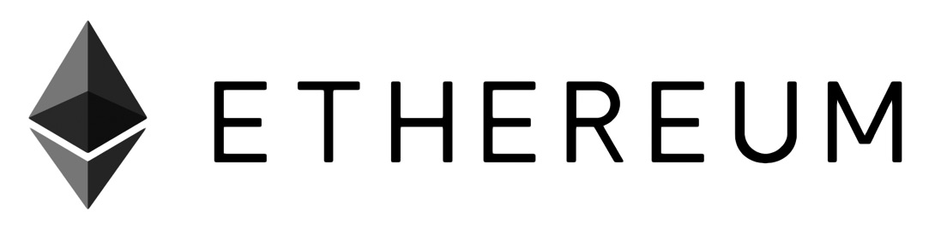

Data and Computational Platform
Blockchain 1st gen. – Cryptocurrency
Blockchain 2nd gen. – crypto-economic State Machine
Smart contract: event-driven program (with state) that runs on a blockchain
Can realize potentially complex business logic
More than simple currency/token-based value transfer
Can take custody over assets on the ledger
Computational result is stored on the public ledger
Notes:
There was very limited native capability for programmable transactions.

Slide 49
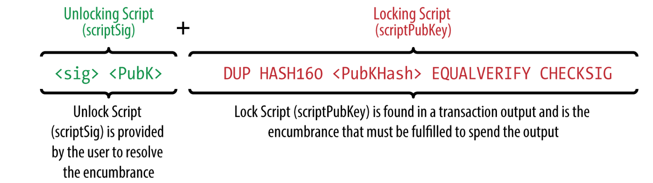
Limited Computational Power of 1st Generation Blockchains
Native smart contracts on Bitcoin do not support complex control flow definition
External services allow end users to build self-executing contracts connected to (but outside) Bitcoin
Executed by external Oracle
Integrity of execution is not guaranteed
Notes:
Native smart contracts on Bitcoin are very simple and do not support complex control flow.
Some external services attempted to address this, to allow end users to build self-executing contracts on the Bitcoin blockchain network
but the blockchain platform does not guarantee the integrity of the execution of these smart contracts
Instead, smart contract execution is performed by external oracles.

Slide 50
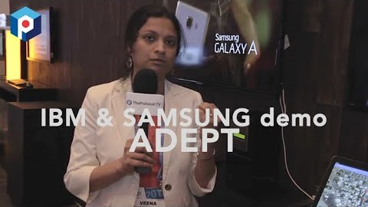
Turing-complete Programming of 2nd Generation Blockchains
Ethereum is a general computational platform
Turing complete programming language
As expressive as any other general-purpose programming language
Practical limitations on computational complexity
E.g. implemented via Gas limit in Ethereum
Video source: https://www.youtube.com/watch?v=U1XOPIqyP7A
Notes:
This kind of capability significantly expands the power of blockchain systems, and increases their range of use and potential for innovation.

Slide 51
Functionality of Blockchain Data Storage Computation Communication Asset Management

Slide 52
Blockchain Functionality
Blockchain as a Communication Mechanism
Transactions that are announced get broadcast across the network
Committing a transaction to the data structure may be required before regarding the transaction as final
…or the receiver can already act based on the announcement
Threshold for viewing a transaction as committed: user-defined

Slide 53
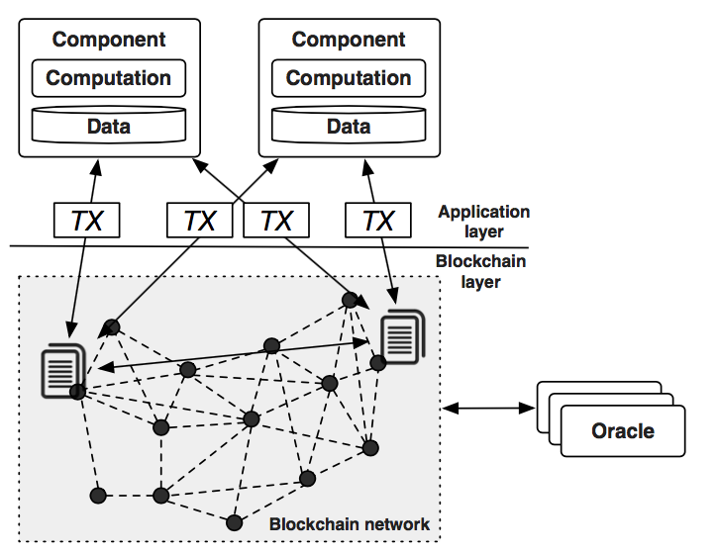
Data Communication
Components on application layer use blockchain as a mediator to transfer data
Sending data to blockchain using transactions
Query blockchain to retrieve data
Blockchain provides data API
Access historical transactions
Filter historical transactions
Local component monitors update from new blocks
…and stores relevant data in a local database or triggers other action
Notes:
The components at the application layer exchange data by sending data to the blockchain using transactions, and query the blockchain data structure to retrieve the data.
Ethereum suggests to cache all transactions to prevent the blockchain network from being stressed by frequent queries.
There can be a component that continuously monitors the updates from new blocks.
This component can store relevant data in a local database or pass it on through proactive API calls to components on the application layer.

Slide 54
Computation Communication 1/2
Components use blockchain to coordinate computation
Submitting transactions to smart contracts to invoke their function
Using oracle to sign transactions depending on external state
Typical control flow
Initiated from externally owned accounts
Transferred among contract accounts
Contract termination
Cannot respond to transactions
Contract code remains on the blockchain
Permanently stored in the creation transaction
External account
Deploy via Transaction
Smart contract
External account
Invoke via Transaction
Smart contract
Run the function with the supplied parameters
Notes:
Typically the control flow of an application is initiated from externally owned accounts and is transferred among contract accounts.
Smart contracts behave like agents that live in the execution environment of the blockchain system and its network.
Contracts are instantiated by submitting transactions with the code of the contracts to the blockchain network
A smart contract defines a set of functions. When invoked in a transaction, the contract runs the function code using the supplied parameter values.
Contracts can also create new contracts, and can terminate themselves.
A contract cannot respond to transactions after termination, but the code of the contract remains on the blockchain, permanently stored in the transaction that created the contract.

Slide 55
Computation Communication 2/2
Oracles facilitate component coordination with external state
Some blockchains have direct support for oracles
Others use oracles as external services
Interacting with blockchain through normal transactions
Validation of transactions can be made depended on external state
Platform-supported oracle can validate and sign transaction
Transaction progress paused until the oracle completes
Oracle can be an external service injecting data into blockchain
Smart contracts use that data to validate transaction, e.g., by requesting latest data from an oracle smart contract
Delay is between the external state changes and time when this is recorded into blockchain
Automated vs. human oracle
Notes:
An oracle facilitates component coordination with external state.
An oracle is a component in a blockchain-based system.

Slide 56
Functionality of Blockchain Data Storage Computation Communication Asset Management

Slide 57
Blockchain Functionality
Blockchain as an Asset Management and Control Mechanism
Cryptocurrency and tokens are virtual assets
Typically, only the owner can control them
More complex models can be implemented, e.g.:
Multi-signature or threshold voting (more than one account controls an asset)
Escrow: smart contract code controls an asset
Highly customizable through smart contracts

Slide 58
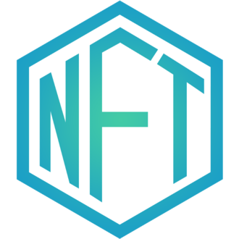
Asset Management and Control Mechanism
Tokenization enables asset management
Represent digital assets or physical assets
Fungible: interchangeable, like cryptocurrencies, 1 liter of gasoline
Non-fungible: Unique and cannot be interchanged, like cryptokitties, artwork and land (NFTs: non-fungible tokens, e.g., "Everydays – The First 5000 Days" sold for US$69.3 million in 2021.)
Tokenization
Starts when an asset under custody is represented using a cryptographic token
The control of this token aligns with the ownership of the asset
The reverse process takes place if the user redeems the token to recover the asset (if possible)
Using smart contract to associate conditions with the transfer of ownership

Slide 59
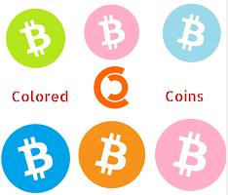
Asset Management and Control Mechanism
Native token of 1st generation blockchains
Cryptocurrency is the native asset
Identity of the cryptocurrency or associated data can represent other assets
Track claims of title over physical assets
Transactions record the transfer of title from one user to another
Limited due to small size of arbitrary data
Bitcoin overlay network: colored coin
Taint a subset of Bitcoin to represent and manage real-world assets
Few attributes can be recorded and few conditions can be checked within blockchain
Smart contract in 2nd generation blockchains
Enable more expressive data structure
Flexibility for tokenizing a wider variety of assets

Slide 60
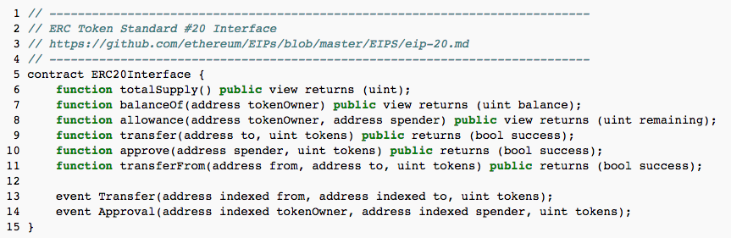
Asset Management and Control Mechanism
Token Standards
ERC-20 for Ethereum-based fungible token
ERC-721 for Ethereum-based non-fungible tokens
Since June 2019 (final): ERC-1155 for both (https://eips.ethereum.org/EIPS/eip-1155)
Notes:
These token standards describe the functions and events that token smart contracts should implement.
The new proposed tokens should follow the standard.
balanceOf: Get the token balance for account “tokenOwner”
Allowance: returns the amount of tokens approved by the owner that can be transferred to the spender’s account
Transfer: Transfer “tokens” from the “from” account to the “to” account
Approve: Token owner can approve for “spender” to transferFrom(…) “tokens” from the token owner’s account

Slide 61


