Slide 1
Python
Salar Mokhtari Laleh
Spring_2022

Slide 2
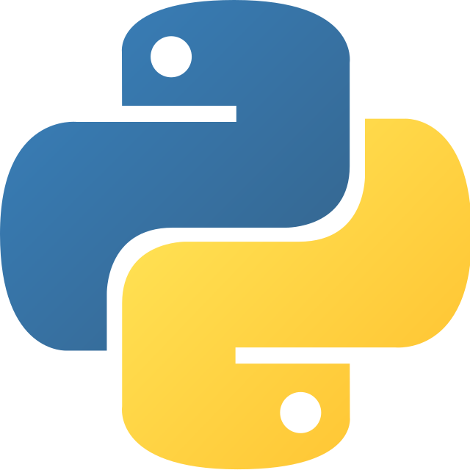

Slide 3
Python
Python has become one of the most popular programming languages in the world in recent years. It's used in everything from machine learning to building websites and software testing. It can be used by developers and non-developers alike.Python, one of the most popular programming languages in the world, has created everything from Netflix’s recommendation algorithm to the software that controls self-driving cars. Python is a general-purpose language, which means it’s designed to be used in a range of applications, including data science, software and web development, automation, and generally getting stuff done.
Let’s take a closer look at what Python is, what it can do, and how you can start learning it.

Slide 4
What is Python?
Python is a computer programming language often used to build websites and software, automate tasks, and conduct data analysis. Python is a general purpose language, meaning it can be used to create a variety of different programs and isn’t specialized for any specific problems. This versatility, along with its beginner-friendliness, has made it one of the most-used programming languages today. A survey conducted by industry analyst firm RedMonk found that it was the most popular programming language among developers in 2020

Slide 5
History
Python was conceived in the late 1980s by Guido van Rossum at Centrum Wiskunde & Informatica (CWI) in the Netherlands as a successor to the ABC programming language, which was inspired by SETL, capable of exception handling and interfacing with the Amoeba operating system.It’s implementation began in December 1989. Van Rossum shouldered sole responsibility for the project, as the lead developer, until 12 July 2018, when he announced his "permanent vacation" from his responsibilities as Python's "benevolent dictator for life", a title the Python community bestowed upon him to reflect his long-term commitment as the project's chief decision-maker.In January 2019, active Python core developers elected a five-member Steering Council to lead the project

Slide 6
Python 2.0 was released on 16 October 2000, with many major new features.Python 3.0, released on 3 December 2008, with many of its major features backported to Python 2.6.x and 2.7.x. Releases of Python 3 include the 2to3 utility, which automates the translation of Python 2 code to Python 3.
Python 2.7's end-of-life was initially set for 2015, then postponed to 2020 out of concern that a large body of existing code could not easily be forward-ported to Python 3. No further security patches or other improvements will be released for it. With Python 2's end-of-life, only Python 3.6.x and later are supported.
Python 3.9.2 and 3.8.8 were expedited as all versions of Python (including 2.7) had security issues leading to possible remote code execution and web cache poisoning.

Slide 7
What is Python used for?
Python is commonly used for developing websites and software, task automation, data analysis, and data visualization. Since it’s relatively easy to learn, Python has been adopted by many non-programmers such as accountants and scientists, for a variety of everyday tasks, like organizing finances.
“Writing programs is a very creative and rewarding activity,” says University of Michigan and Coursera instructor Charles R Severance in his book Python for Everybody. “You can write programs for many reasons, ranging from making your living to solving a difficult data analysis problem to having fun to helping someone else solve a problem.”
Here’s a closer look at some of the common ways Python is used

Slide 8
Data analysis and machine learning
Python has become a staple in data science, allowing data analysts and other professionals to use the language to conduct complex statistical calculations, create data visualizations, build machine learning algorithms, manipulate and analyze data, and complete other data-related tasks.
Python can build a wide range of different data visualizations, like line and bar graphs, pie charts, histograms, and 3D plots. Python also has a number of libraries that enable coders to write programs for data analysis and machine learning more quickly and efficiently, like TensorFlow and Keras.

Slide 9
Web development
Python is often used to develop the back end of a website or application—the parts that a user doesn’t see. Python’s role in web development can include sending data to and from servers, processing data and communicating with databases, URL routing, and ensuring security. Python offers several frameworks for web development. Commonly used ones include Django and Flask.
Some web development jobs that use Python include back end engineers, full stack engineers, Python developers, software engineers, and DevOps engineers.

Slide 10
Automation
or
scripting
If you find yourself performing a task over and over again, you could work more efficiently by automating it with Python. Writing code used to build these automated processes is called scripting. In the coding world, automation can be used to check for errors across multiple files, convert files, execute simple math, and remove duplicates in data.
Python can even be used by relative beginners to automate simple tasks on the computer—such as renaming files, finding and downloading online content or sending emails or texts at desired intervals.

Slide 11
Software testing and prototyping
In software development, Python can aid in tasks like build control, bug tracking, and testing. With Python, software developers can automate testing for new products or features. Some Python tools used for software testing include Green and Requestium.

Slide 12
Why is Python so popular?

Slide 13
Python is popular for a number of reasons. Here’s a deeper look at what makes it so versatile and easy to use for coders.
It has a simple syntax that mimics natural language, so it’s easier to read and understand. This makes it quicker to build projects, and faster to improve on them.
It’s versatile. Python can be used for many different tasks, from web development to machine learning.
It’s beginner friendly, making it popular for entry-level coders.
It’s open source, which means it’s free to use and distribute, even for commercial purposes.
Python’s archive of modules and libraries—bundles of code that third-party users have created to expand Python’s capabilities—is vast and growing.
Python has a large and active community that contributes to Python’s pool of modules and libraries, and acts as a helpful resource for other programmers. The vast support community means that if coders run into a stumbling block, finding a solution is relatively easy; somebody is bound to have run into the same problem before.

Slide 14
Frequently asked questions (FAQ)
Should I learn Python 2 or Python 3?
Python 3 is considered more up-to-date and has overtaken Python 2 in popularity. JetBrains, a software development company, found that 93 percent of surveyed Python users worked with Python 3. Python 2 was sunsetted in January 2020, which means it will no longer be updated with bug fixes, security patches, or new features
How long does it take to learn Python?
Learning the basics of Python can take anywhere from a few weeks to a few months, depending on what you want to learn and how frequently you learn. But since Python has so many uses—and tools to support those uses—you can spend years learning its different applications.

Slide 15
Who uses Python today?
Of the hundreds of programming languages out there, Python remains a popular choice among numerous companies and organizations. Some familiar names that use Python include Google, Meta, Venmo, Spotify, Netflix, and Dropbox.
What types of jobs use Python?
Developer
Data analyst
Data scientist
Ethical hacker/penetration tester
Software engineer
Data journalist
Cloud architect
QA engineer

