Slide 1
>> IN THE NAME OF ALLAH, THE MOST GRACIOUS, THE MOST MERCIFUL <<
DETERMINATION OF OPTIMUM STRUCTURAL DUCTILITY RATIO FROM ENERGY DISSIPATION CAPACITY INDEX USING FINITE‑DIFFERENCE NEWTON ITERATION
THIS PROGRAM WRITTEN BY SALAR DELAVAR GHASHGHAEI (QASHQAI)

Slide 2
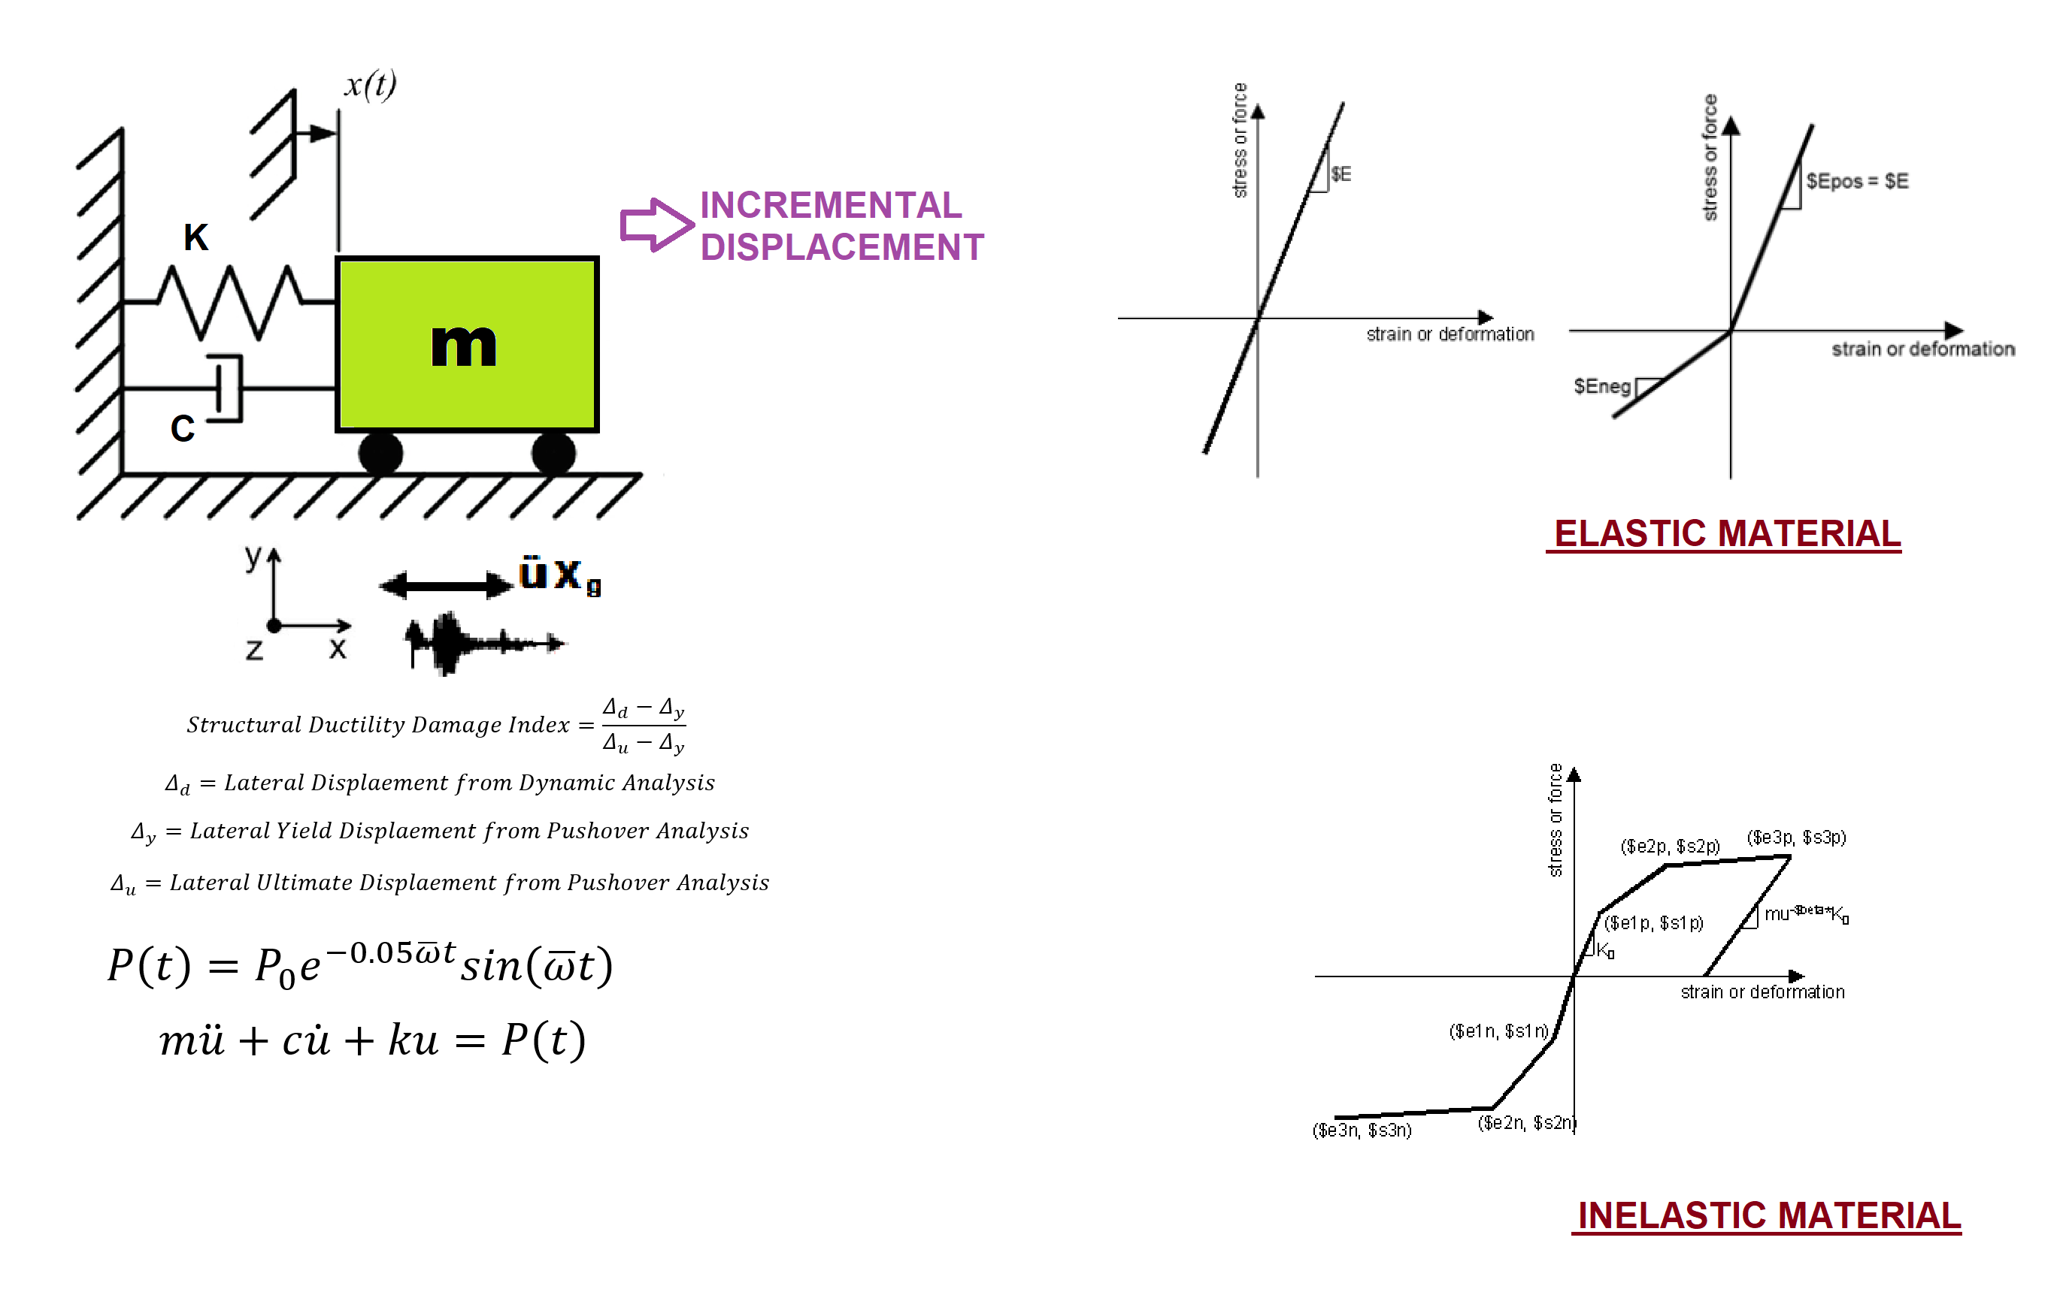

Slide 3
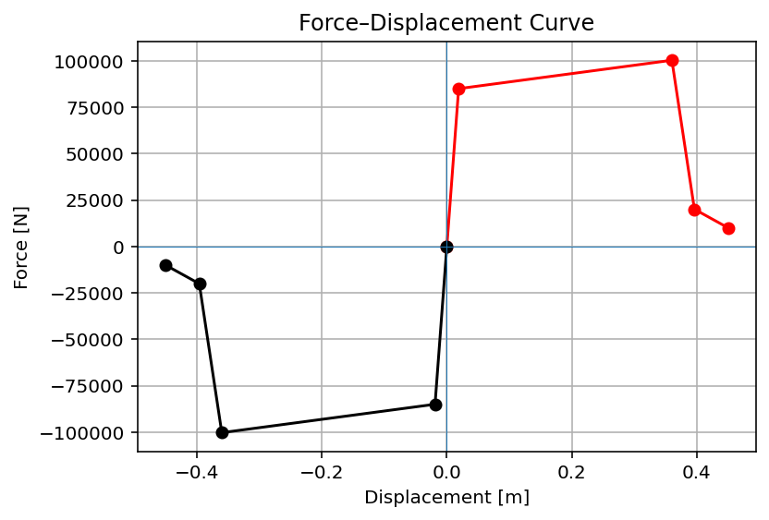

Slide 4
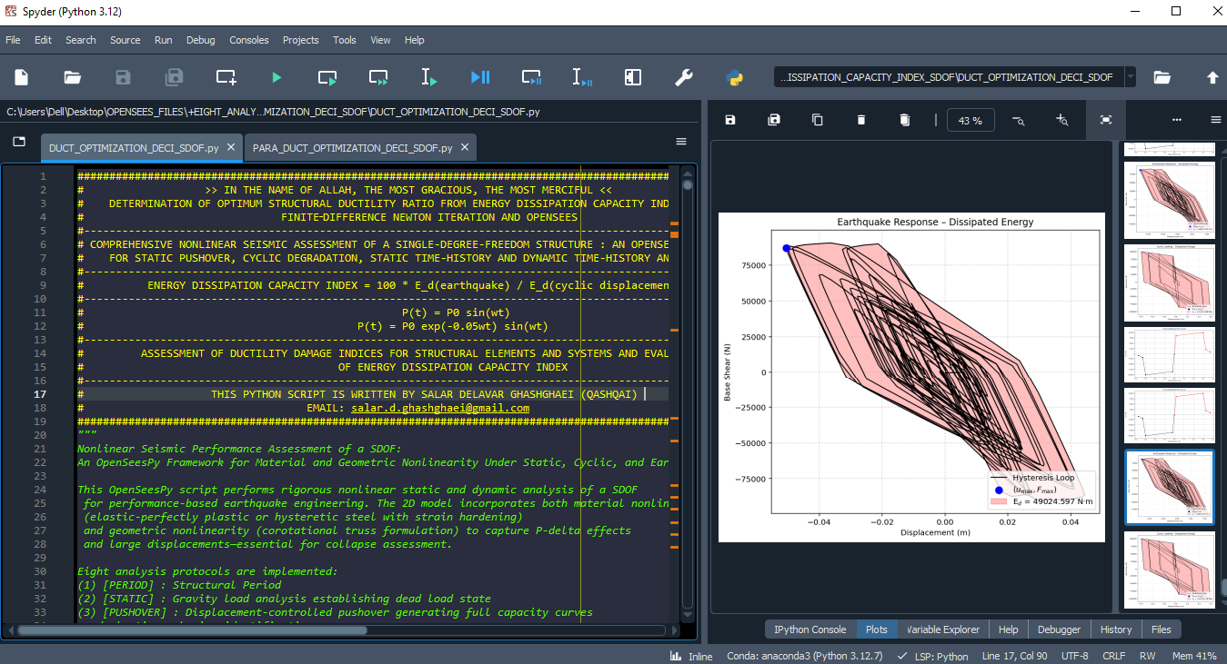

Slide 5
OPTIMIZATION PROBLEM FOR ENERGY DISSIPATION CAPACITY INDEX (EDCI)

Slide 6
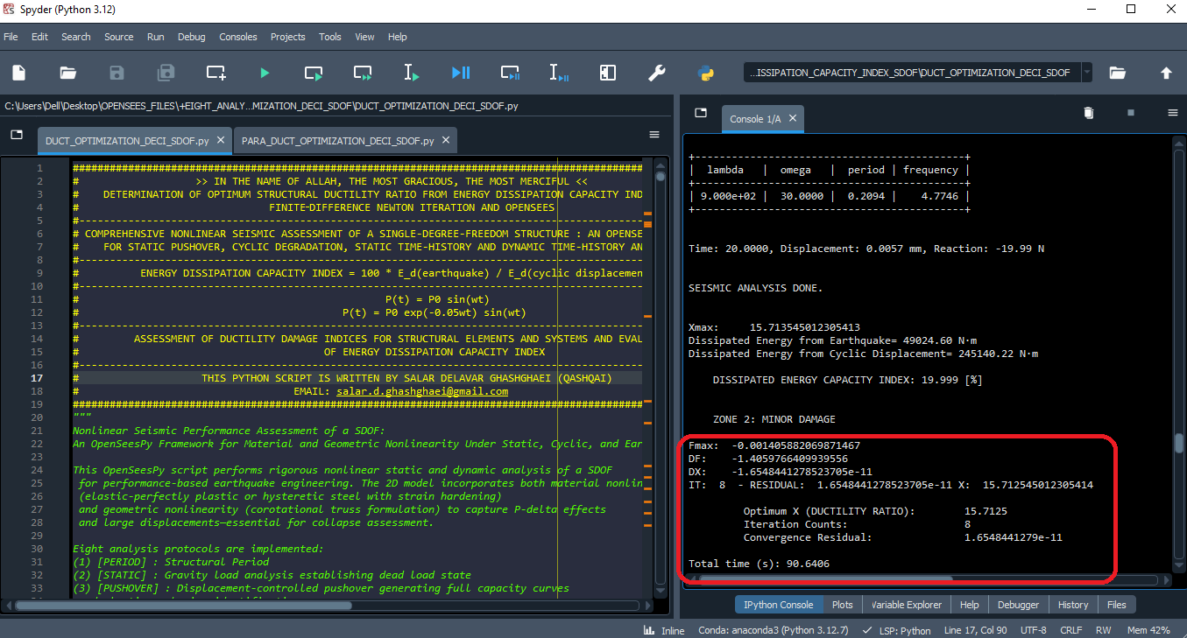

Slide 7
Dissipated Energy from Earthquake= 49024.60 N·m
Dissipated Energy from Cyclic Displacement= 245140.22 N·m
DISSIPATED ENERGY CAPACITY INDEX: 19.999 [%]
ZONE 2: MINOR DAMAGE
Fmax: -0.001405882069871467
DF: -1.4059766409939556
DX: -1.6548441278523705e-11
IT: 8 - RESIDUAL: 1.6548441278523705e-11 X: 15.712545012305414
Optimum X (DUCTILITY RATIO): 15.7125
Iteration Counts: 8
Convergence Residual: 1.6548441279e-11
Total time (s): 90.6406

Slide 8
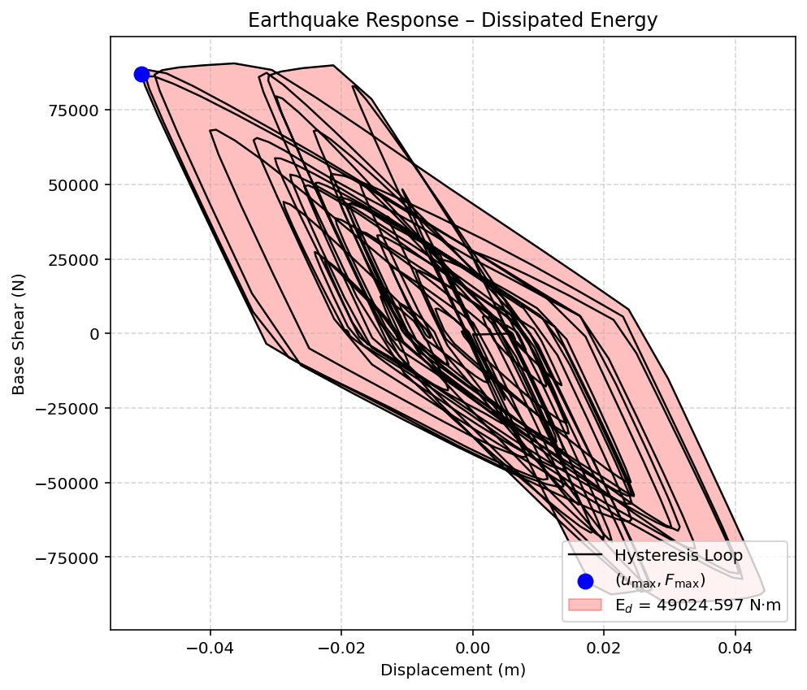

Slide 9
