Slide 1
>> IN THE NAME OF ALLAH, THE MOST GRACIOUS, THE MOST MERCIFUL <<
COMPREHENSIVE NONLINEAR SEISMIC ASSESSMENT OF A SEMI-RIGID CONNECTION AS A SINGLE-DEGREE-OF-FREEDOM (SDOF) STRUCTURE: AN OPENSEES FRAMEWORK FOR STATIC PUSHOVER, CYCLIC DEGRADATION, STATIC TIME-HISTORY AND DYNAMIC TIME-HISTORY ANALYSIS
THIS PROGRAM WRITTEN BY SALAR DELAVAR GHASHGHAEI (QASHQAI)

Slide 2
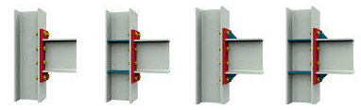
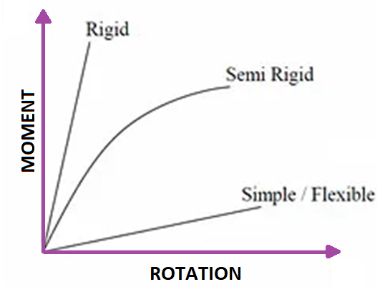

Slide 3
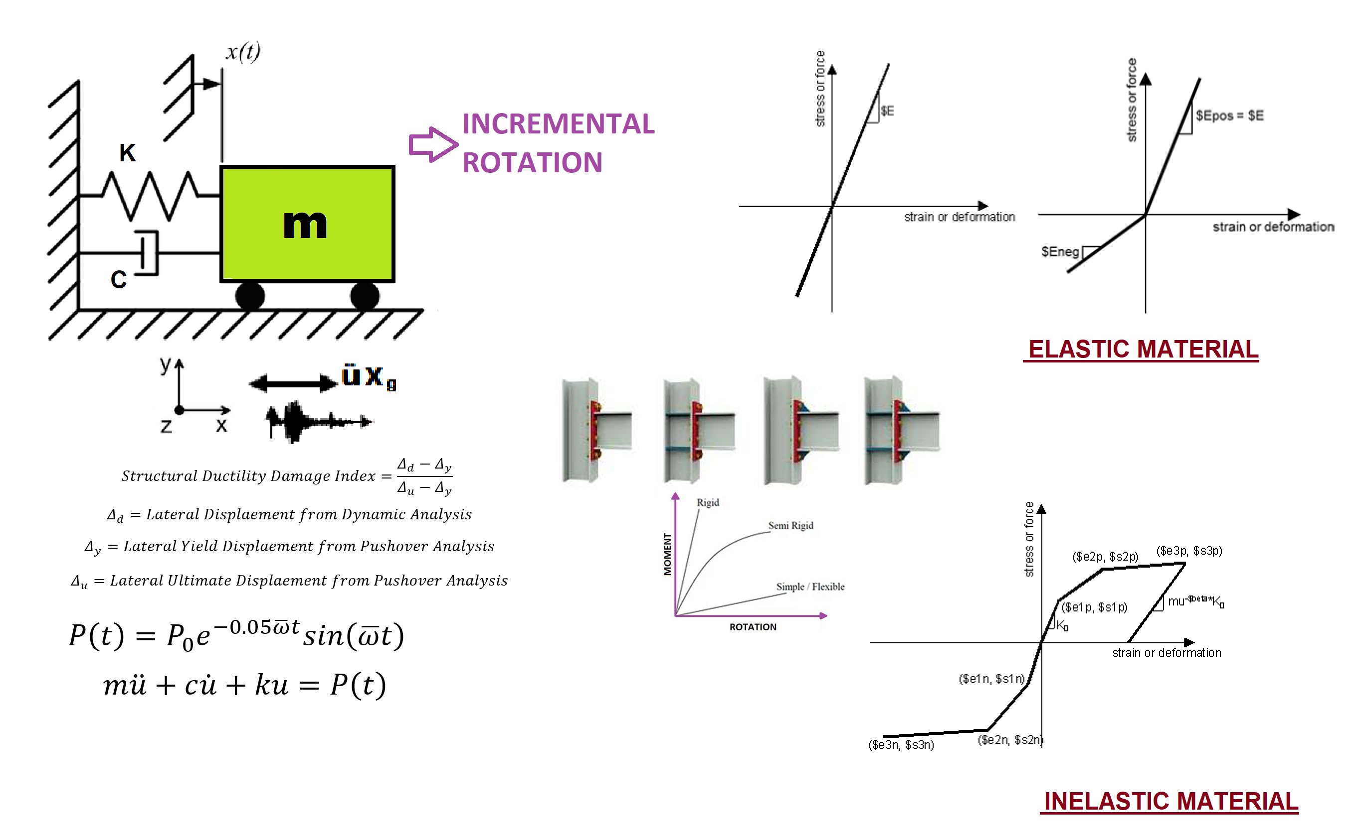

Slide 4
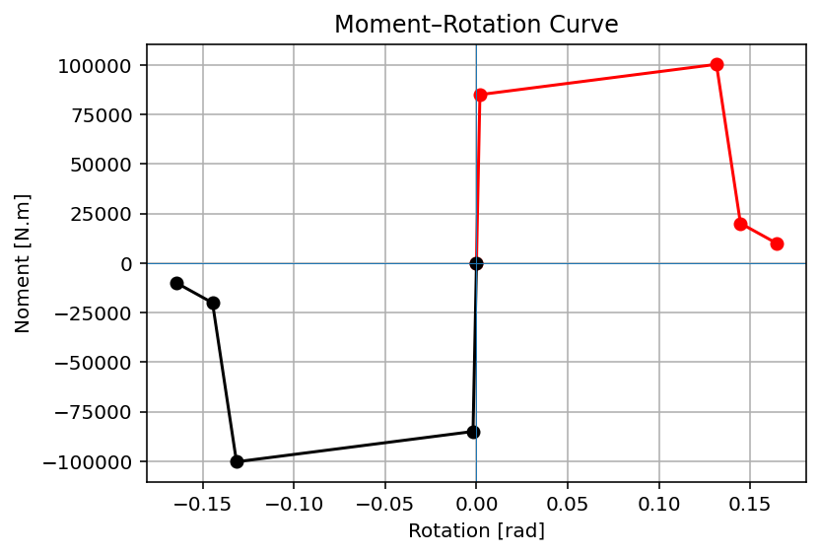

Slide 5
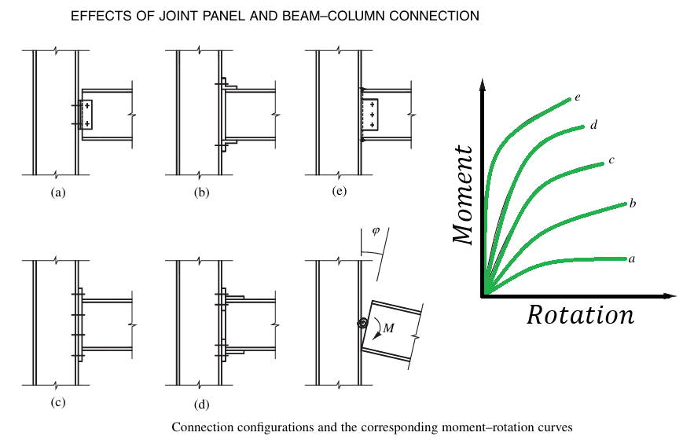

Slide 6
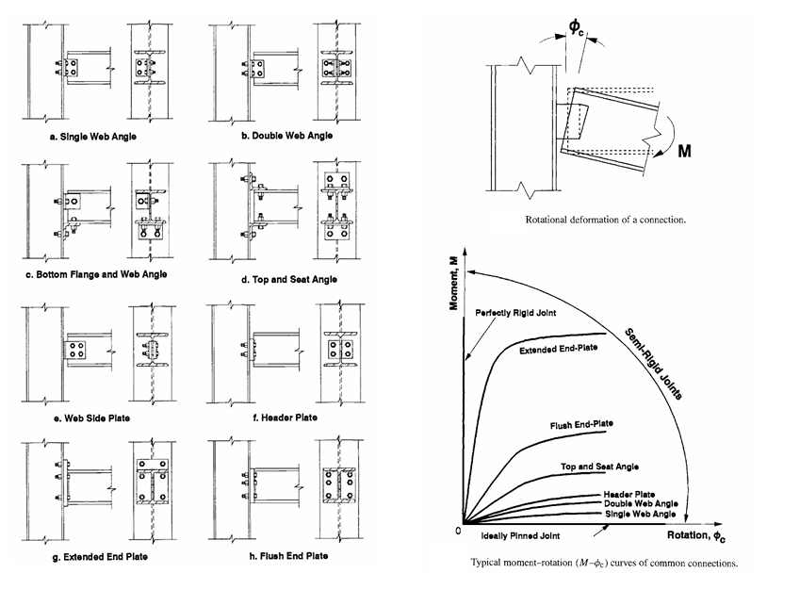

Slide 7
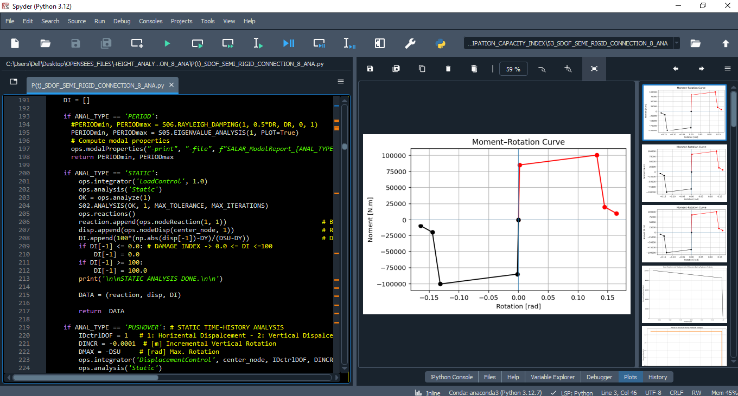

Slide 8
STATIC ANALYSIS

Slide 10
PUSHOVER ANALYSIS

Slide 11
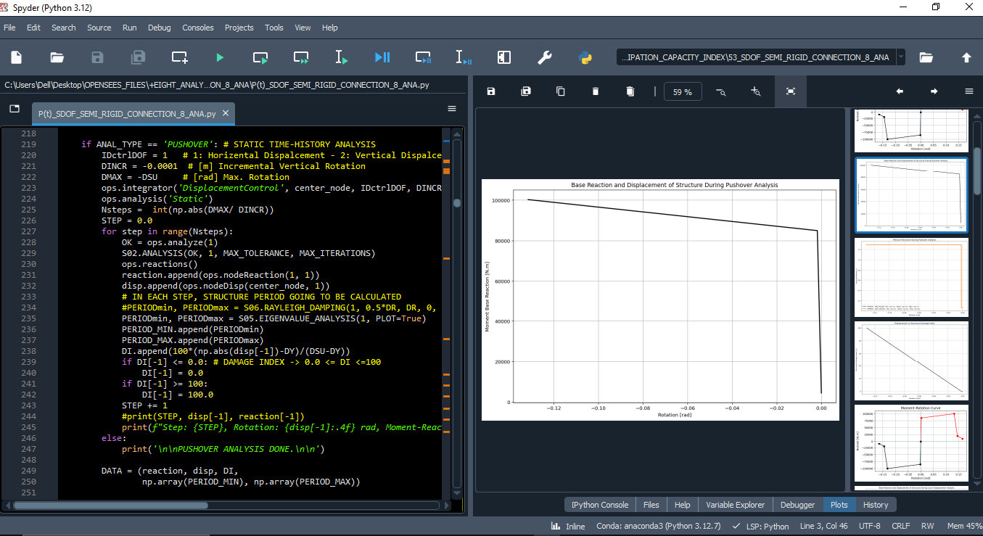

Slide 12
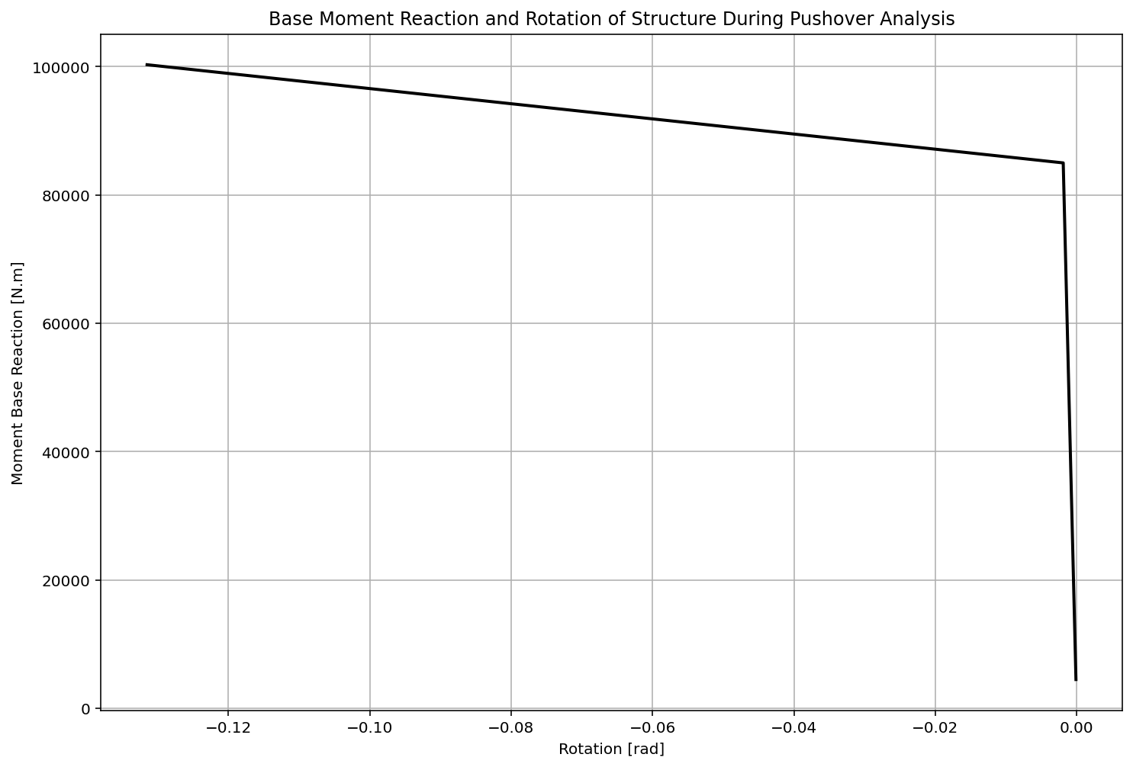

Slide 13
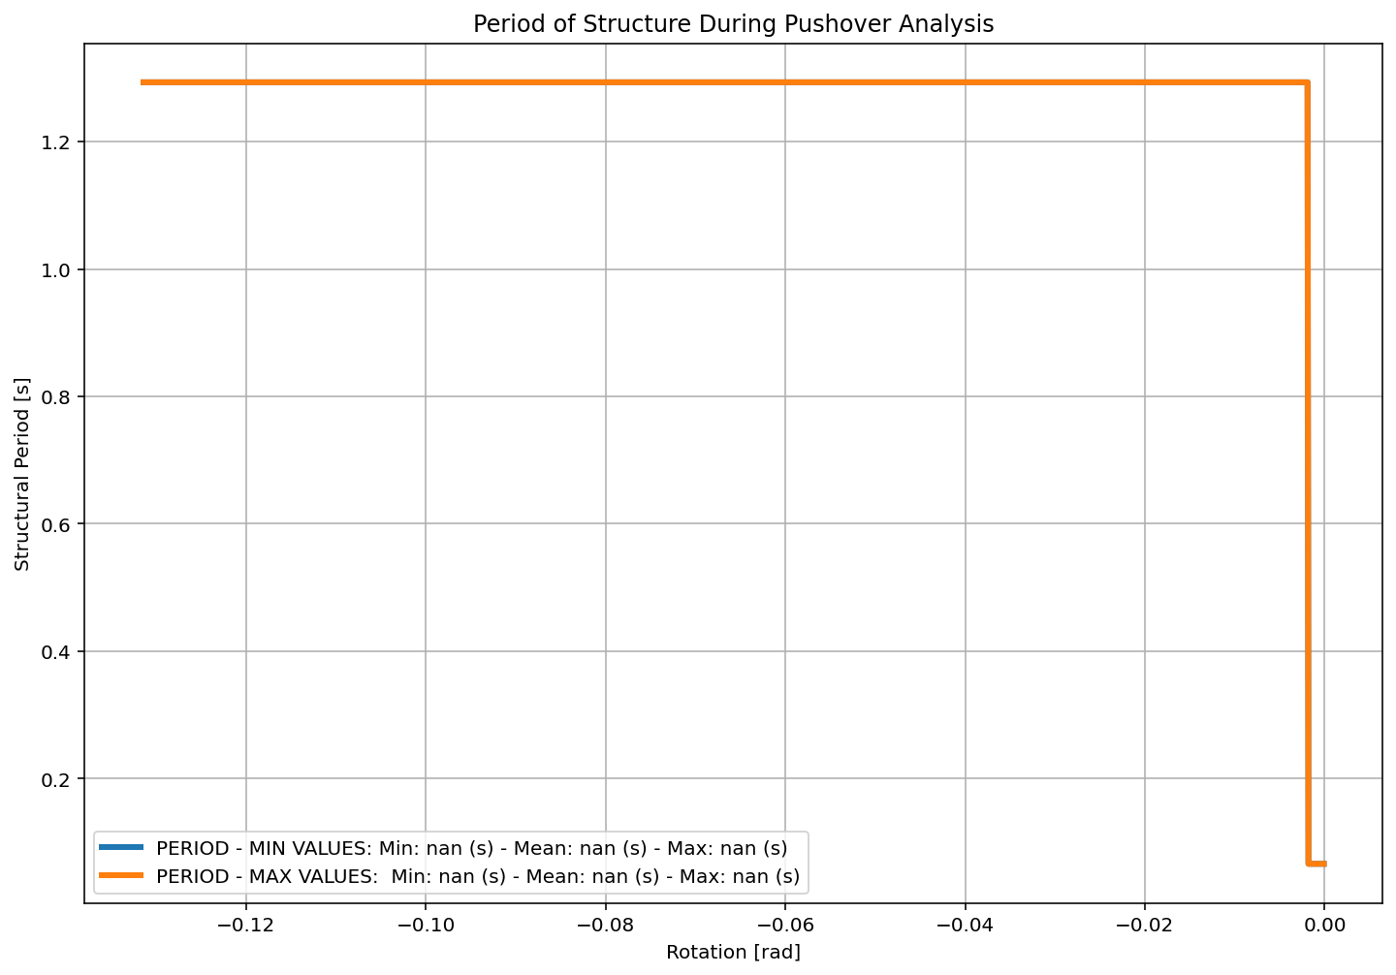

Slide 14
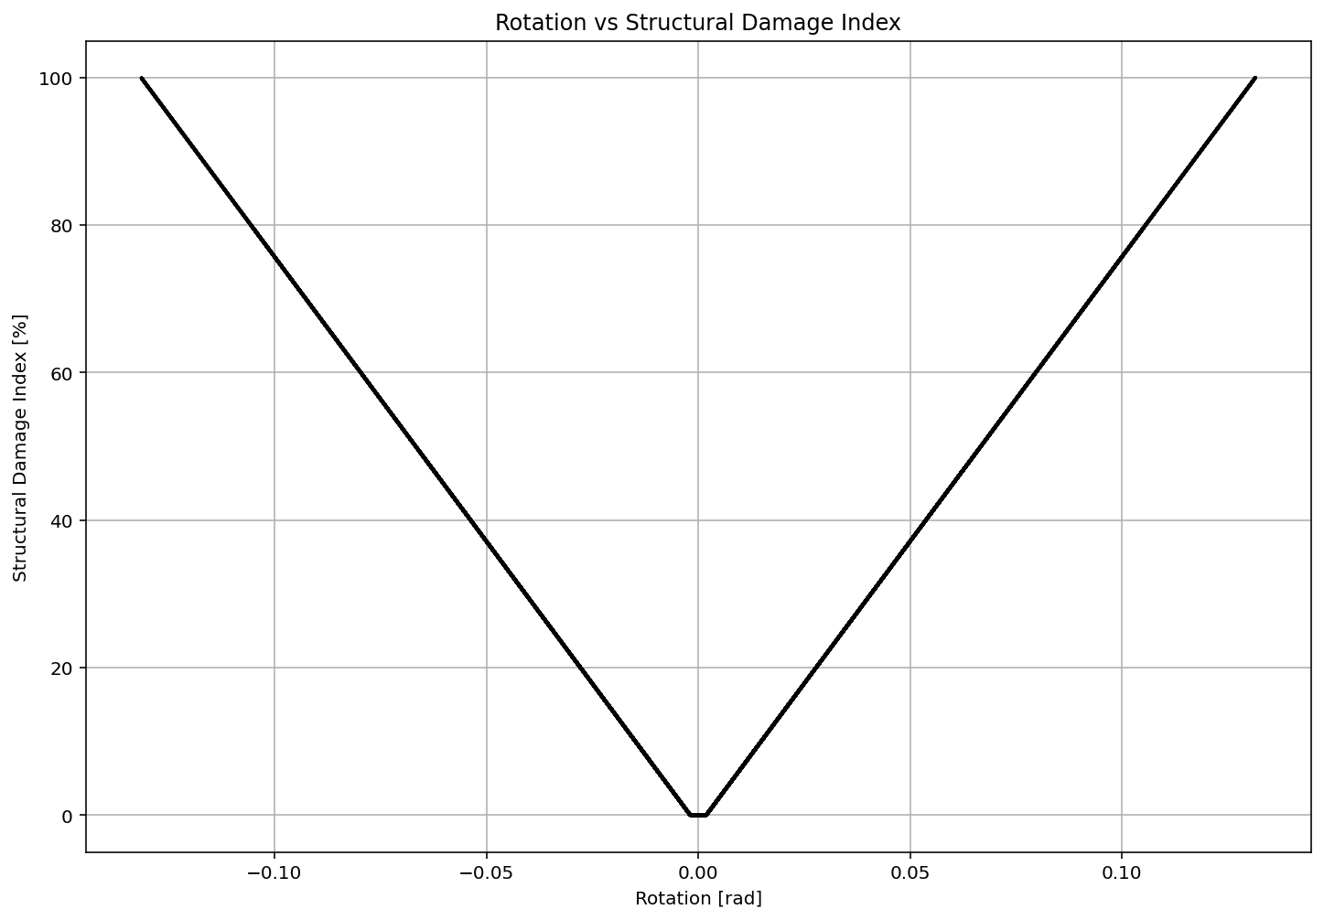

Slide 15
CYCLIC DISPLACEMENT ANALYSIS

Slide 16
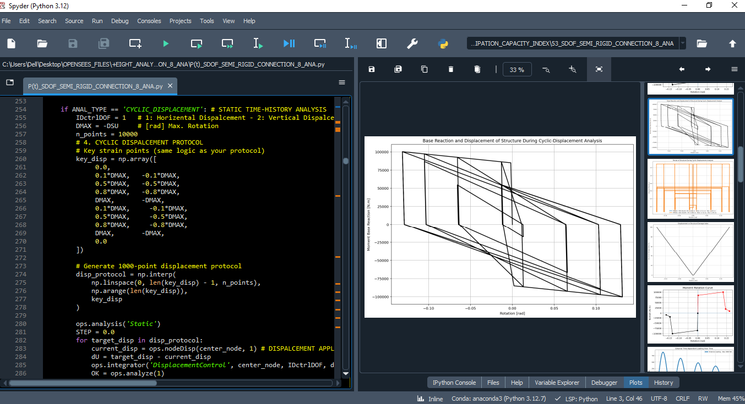

Slide 17
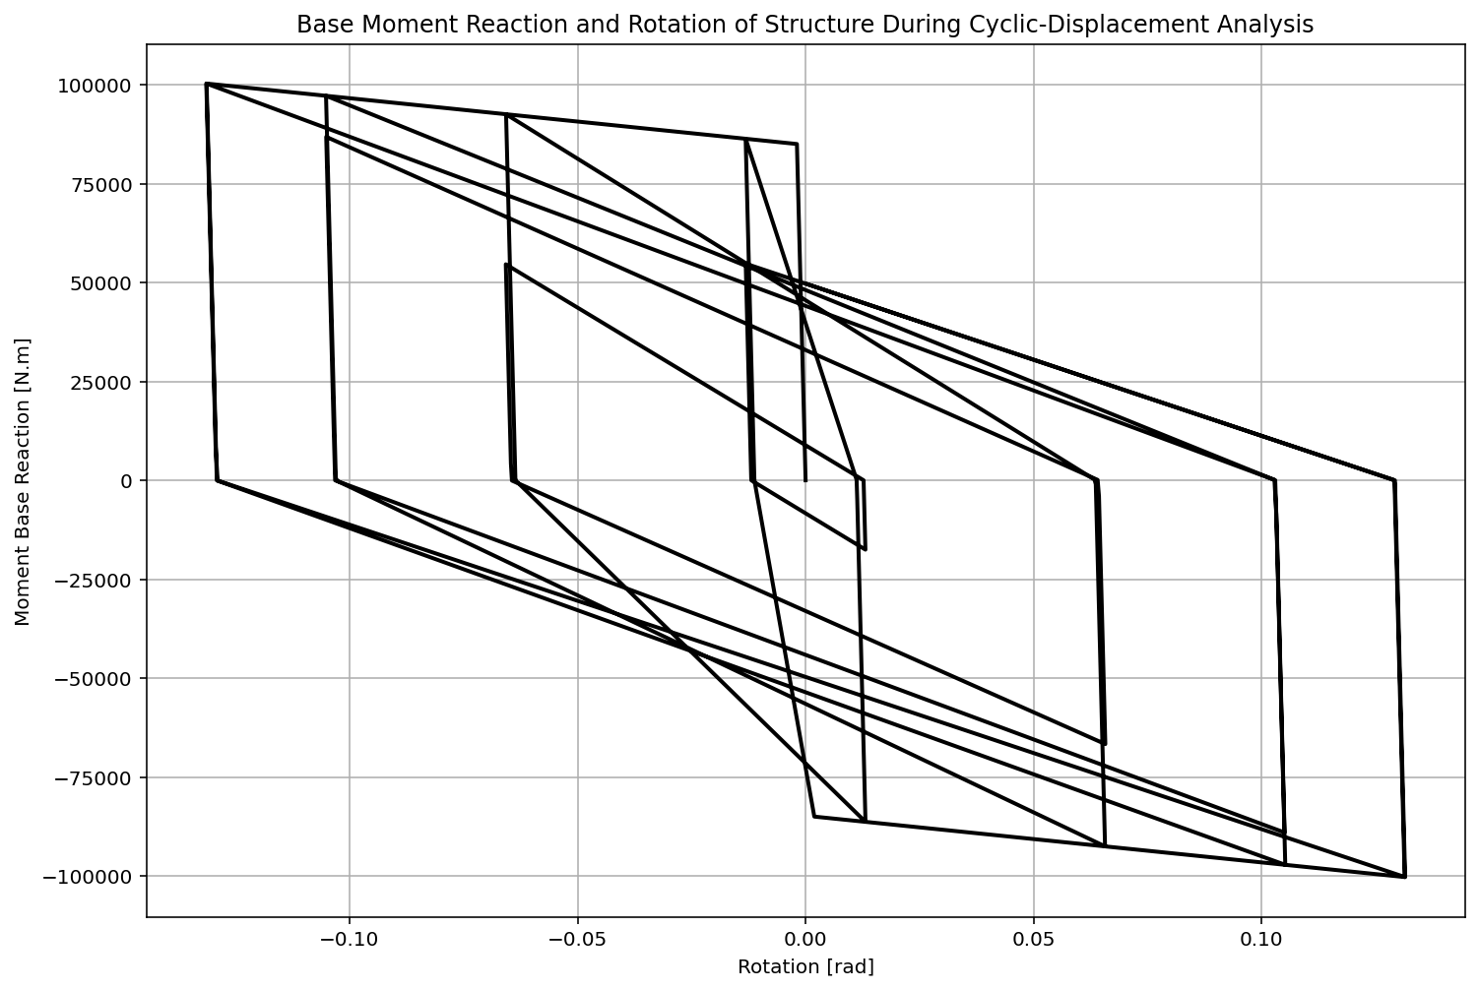

Slide 18
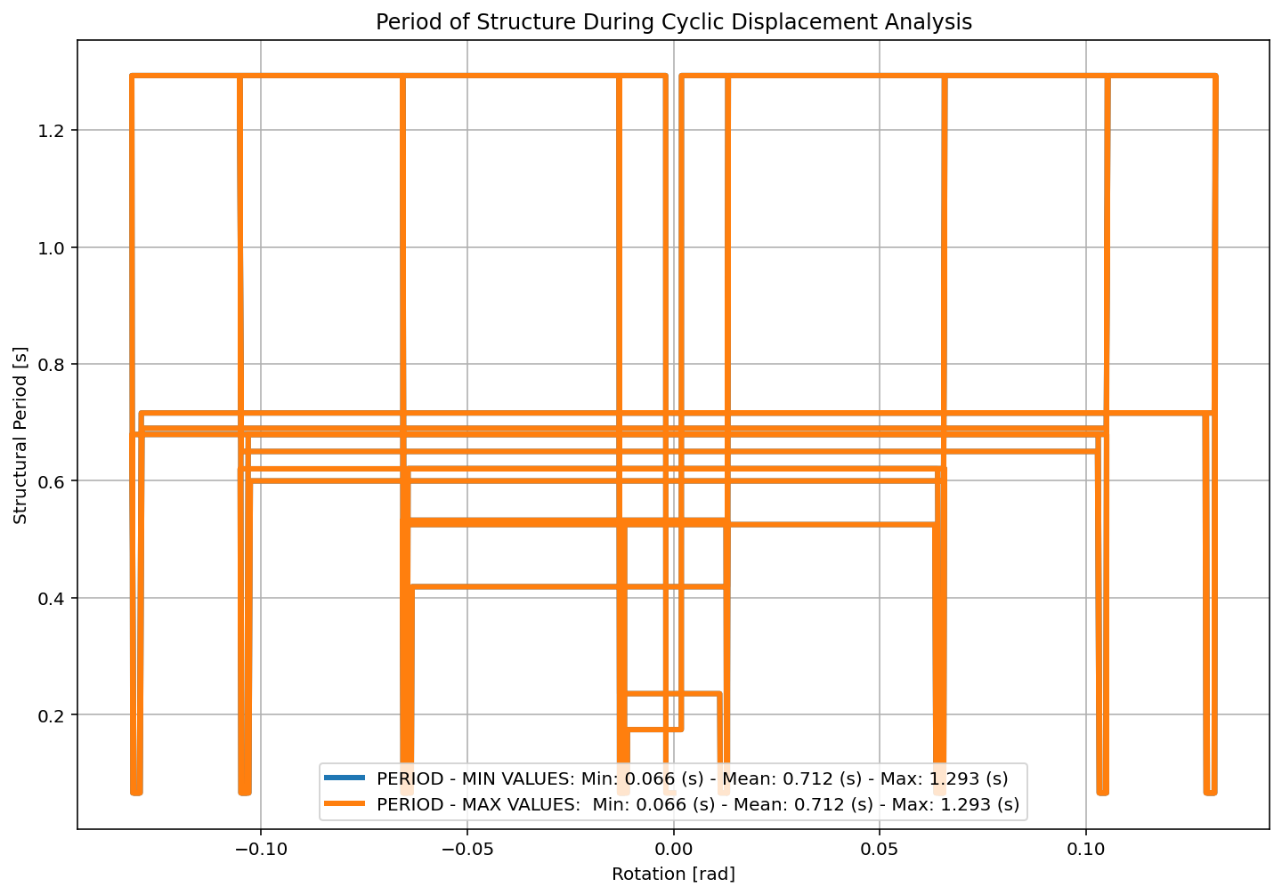

Slide 19
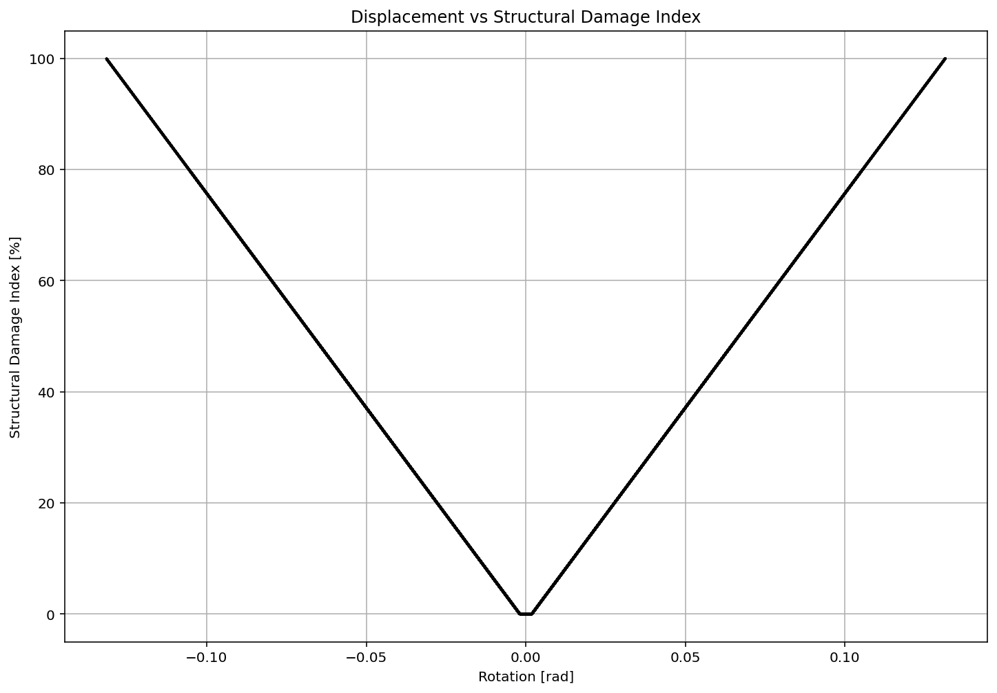

Slide 20
STATIC TIME-HISTORY WITH EXTERNAL TIME-DEPENDENT LOADING ANALYSIS

Slide 21
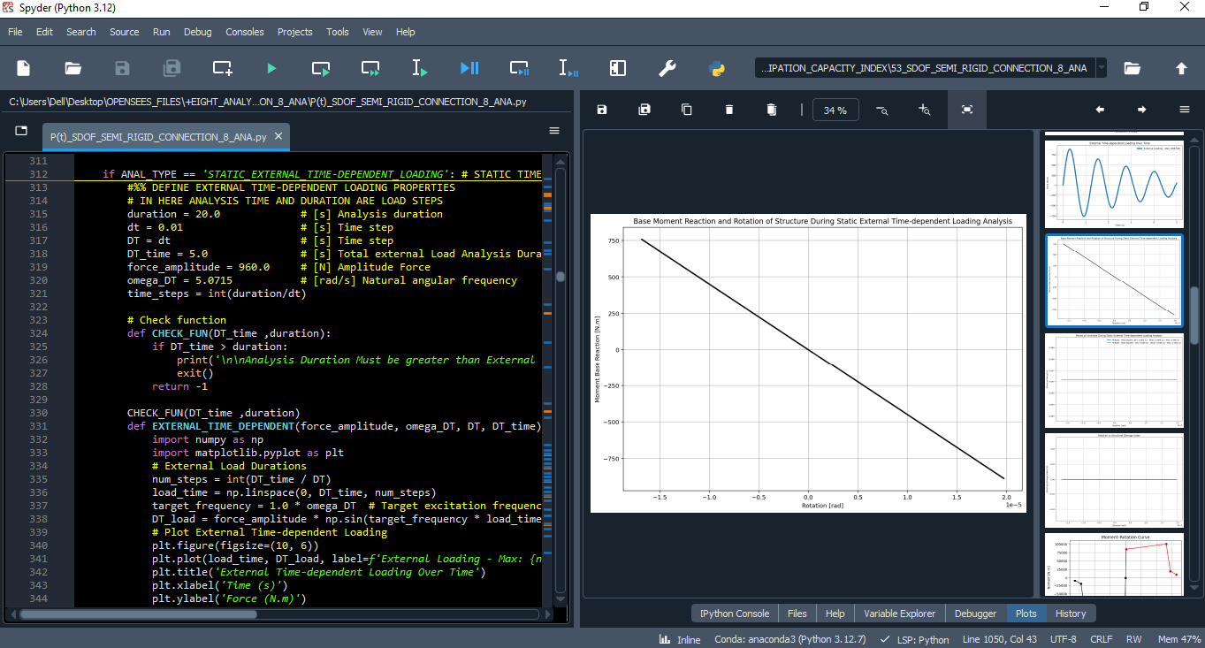

Slide 22
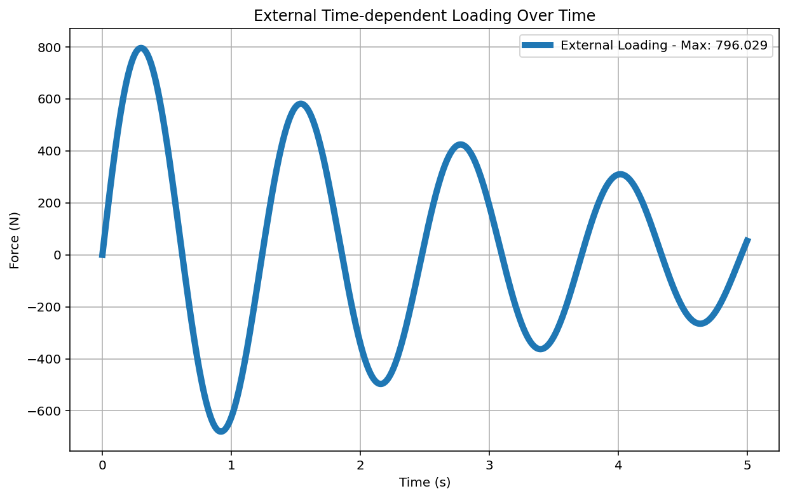

Slide 23
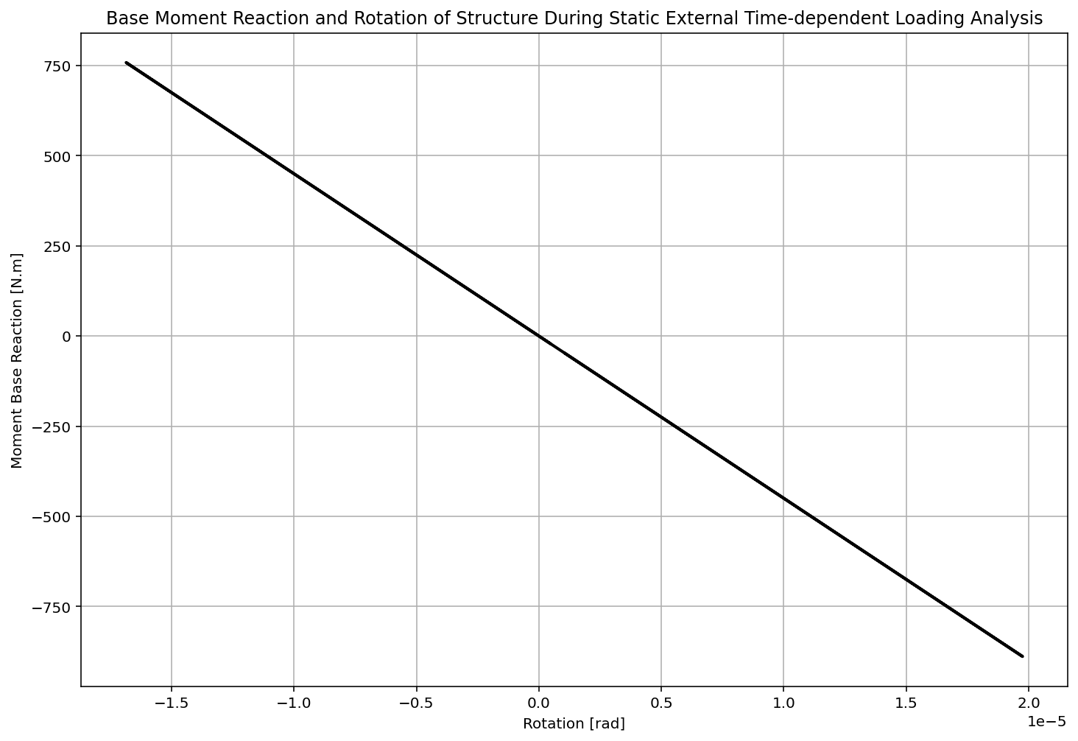

Slide 24
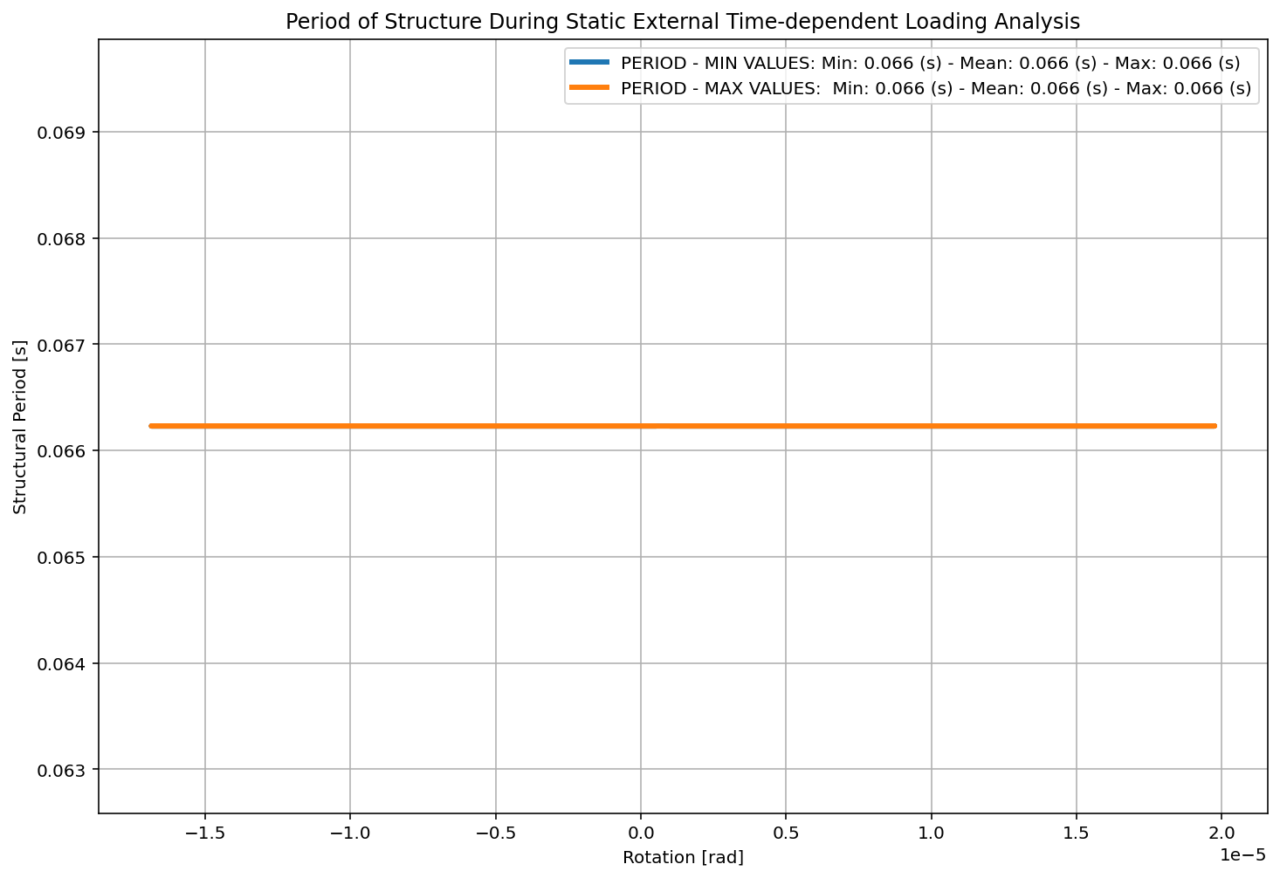

Slide 25
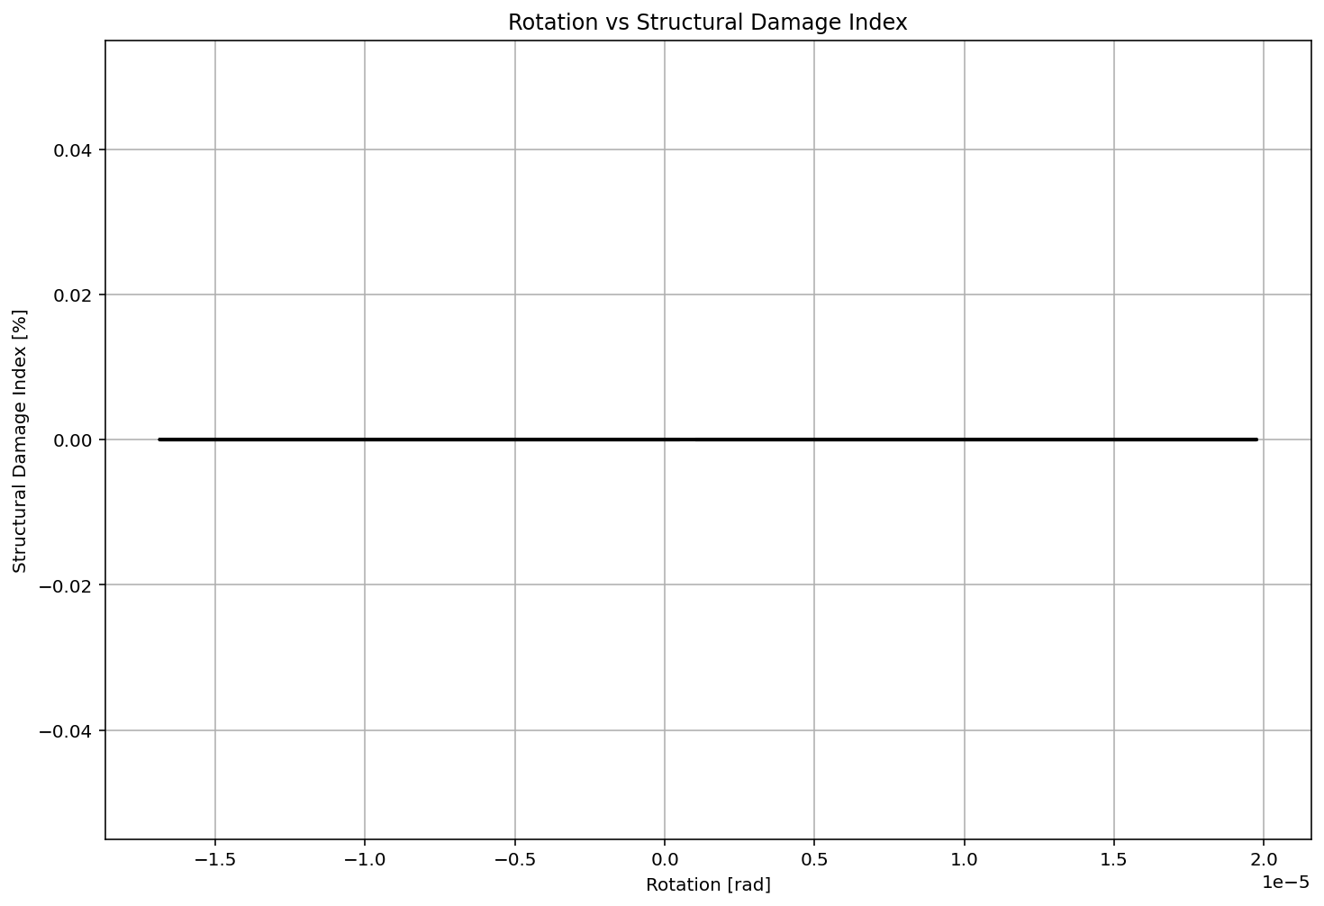

Slide 26
DYNAMIC TIME-HISTORY WITH EXTERNAL TIME-DEPENDENT LOADING ANALYSIS

Slide 27
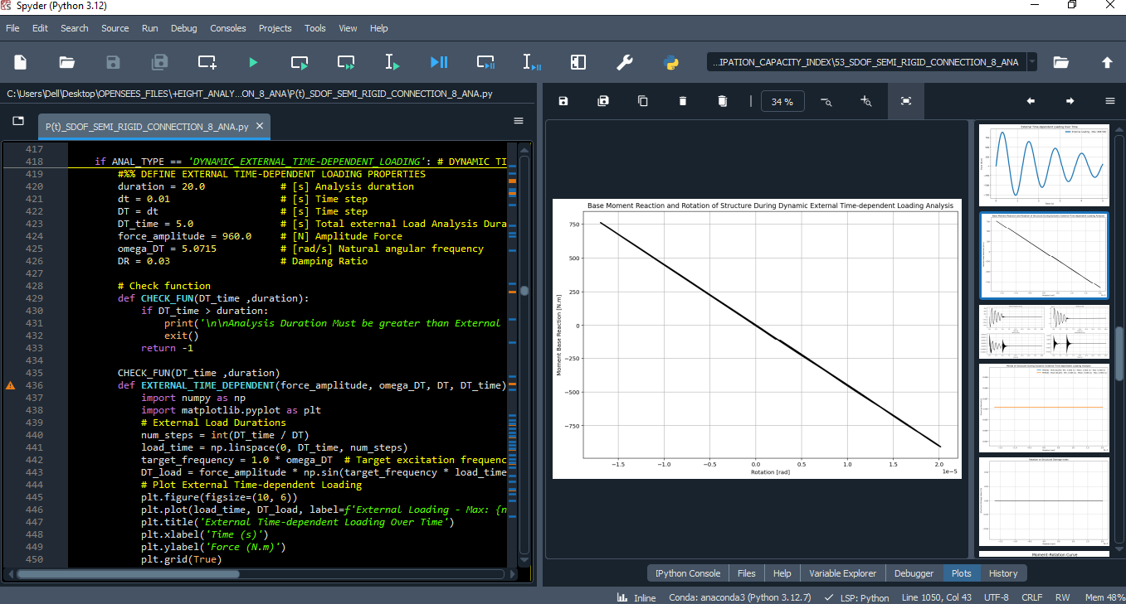

Slide 28
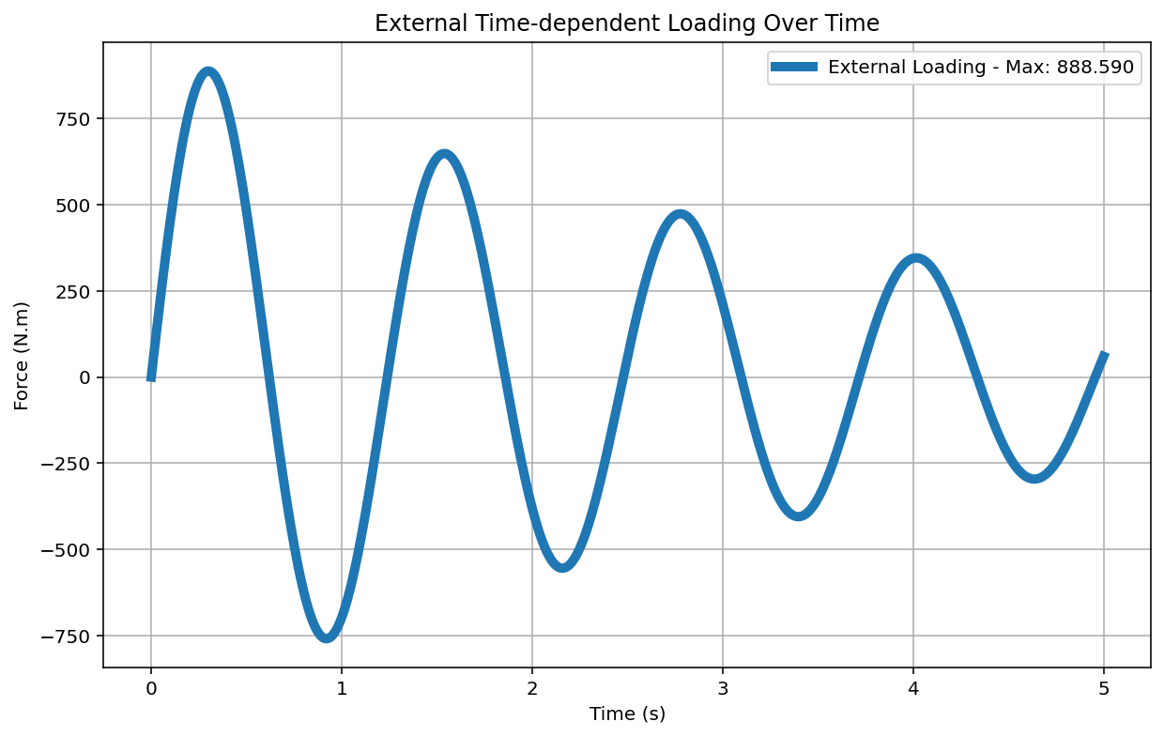

Slide 29
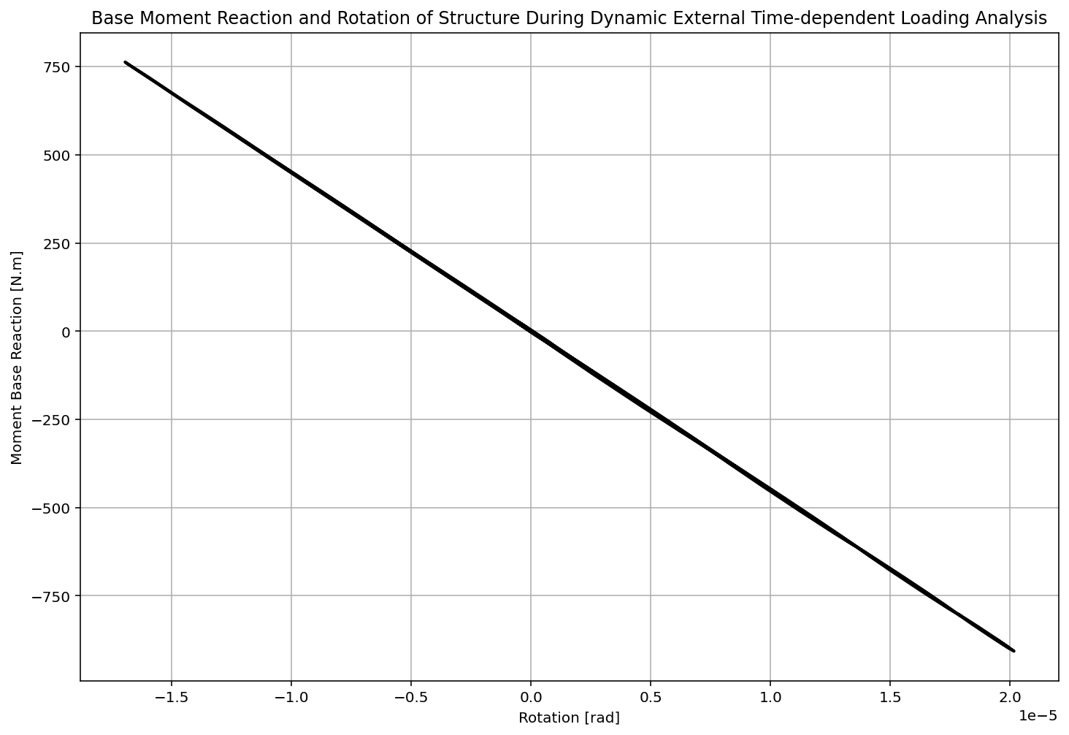

Slide 30
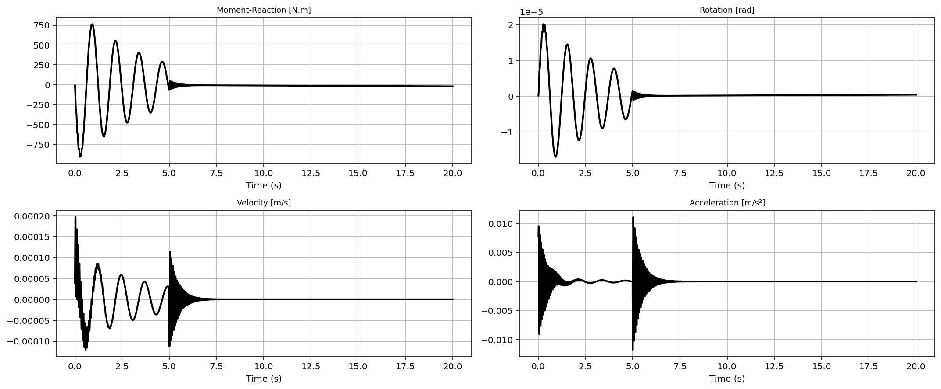

Slide 31
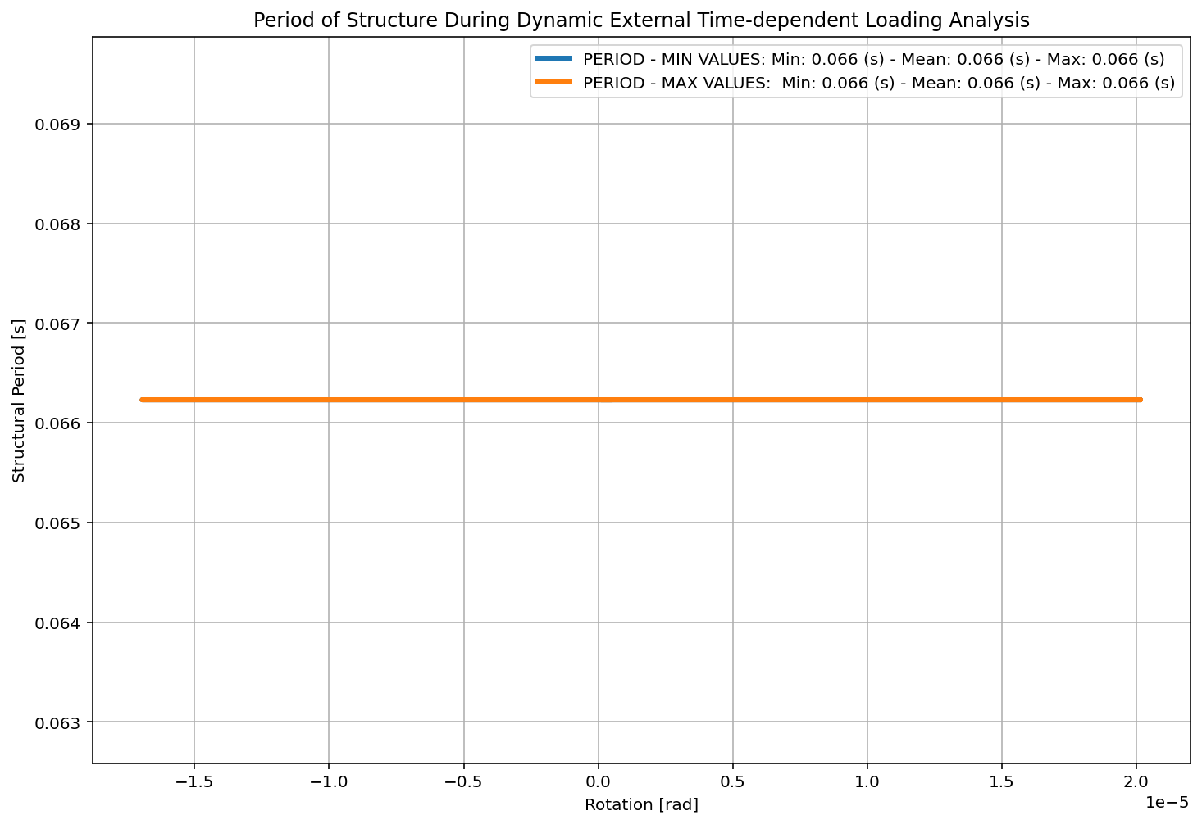

Slide 32


Slide 33
FREE-VIBRATION ANALYSIS

Slide 34
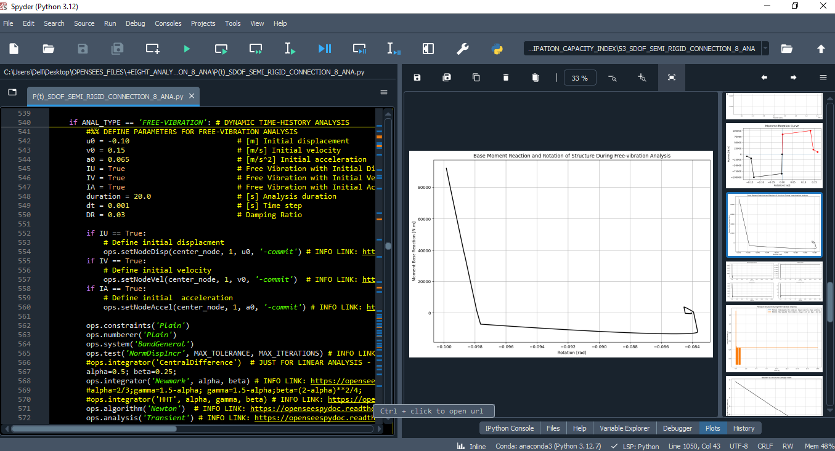

Slide 35
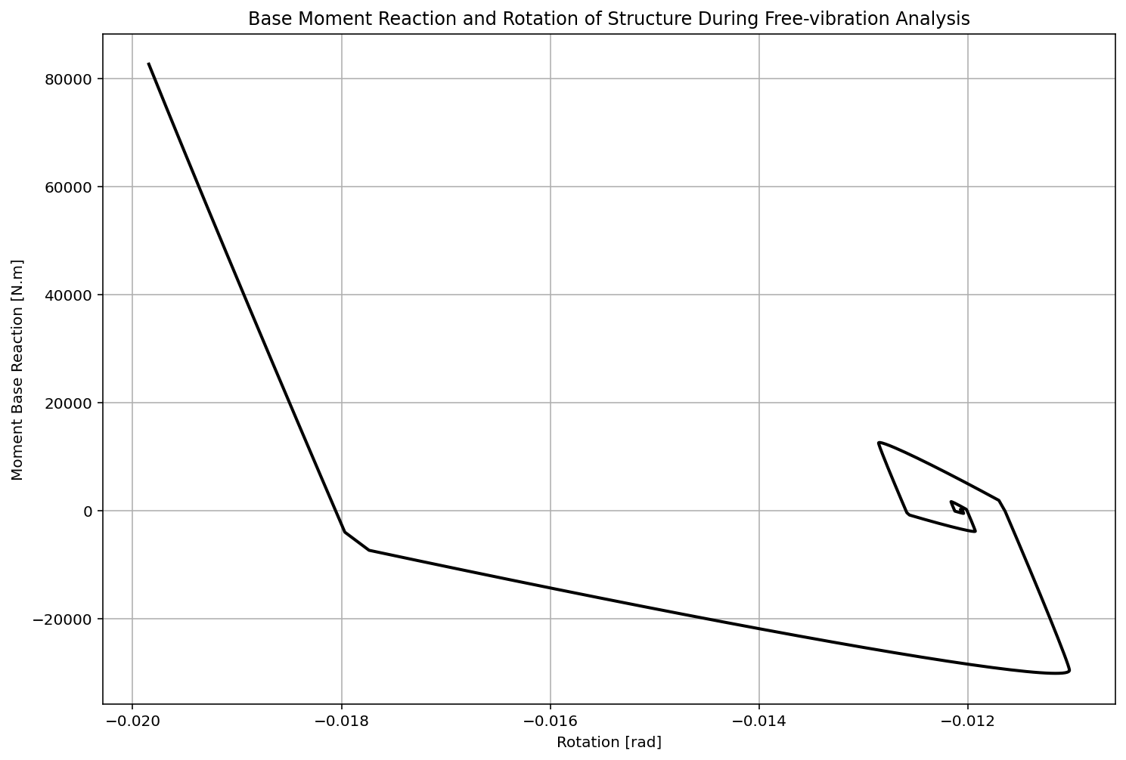

Slide 36
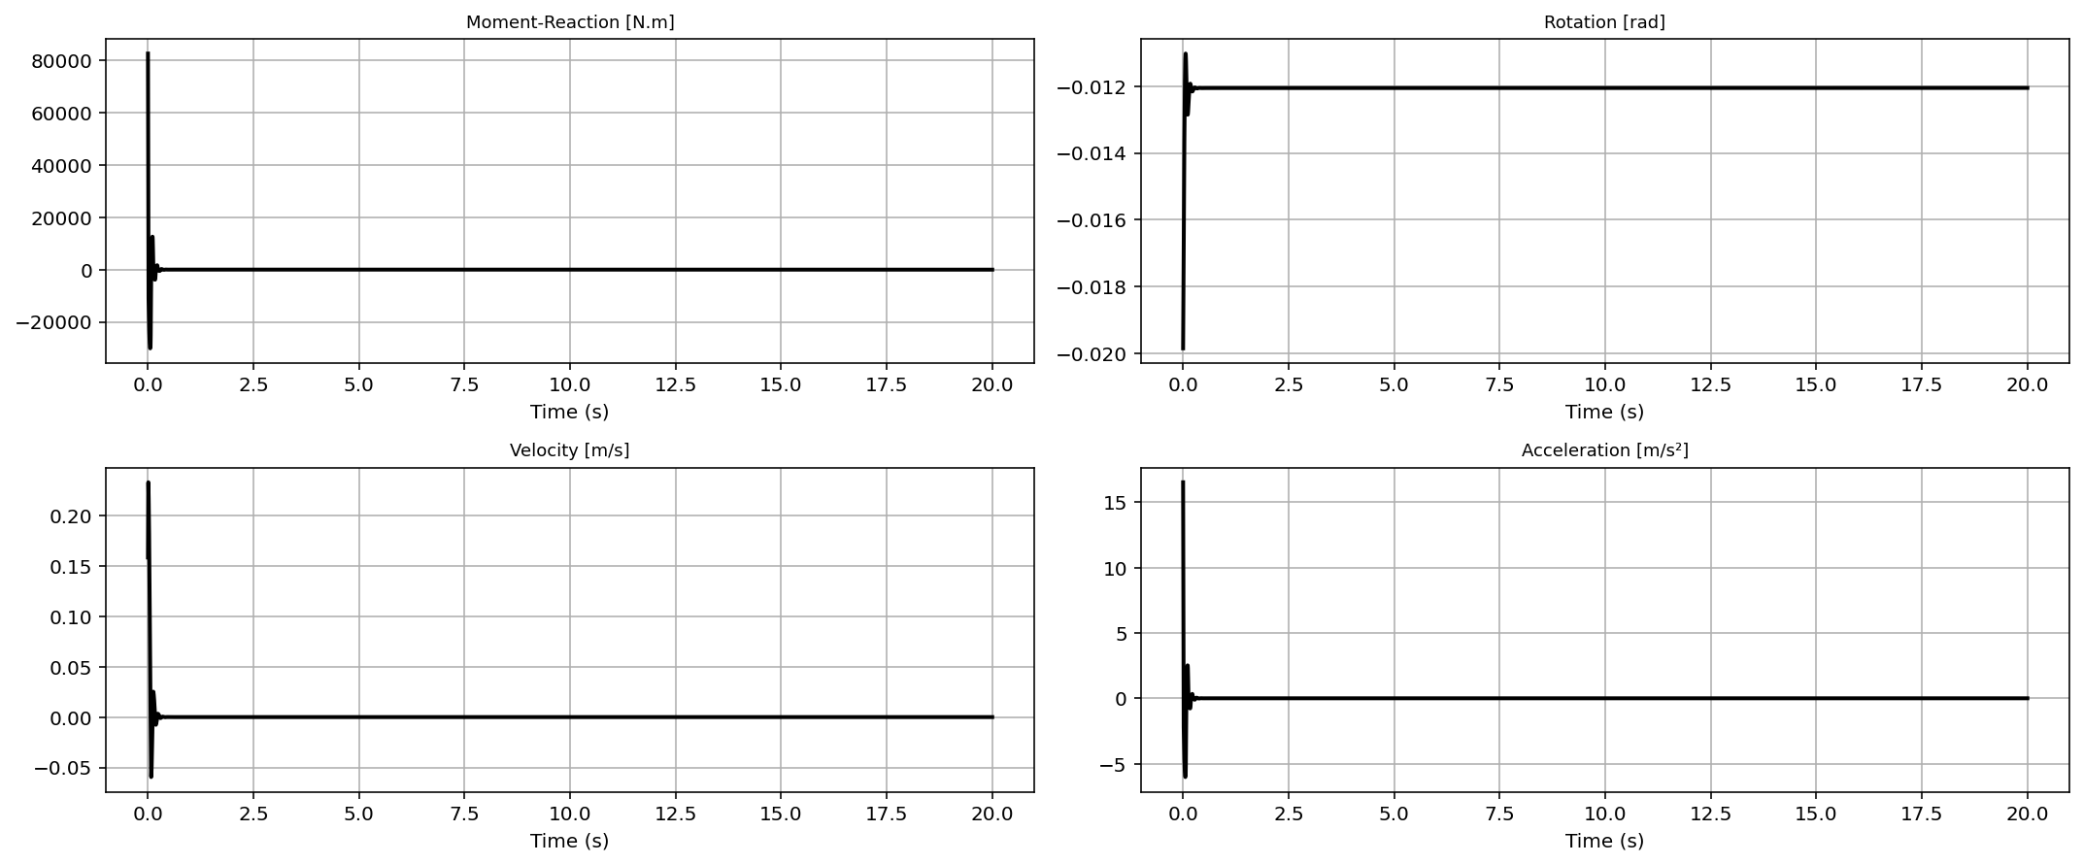

Slide 37
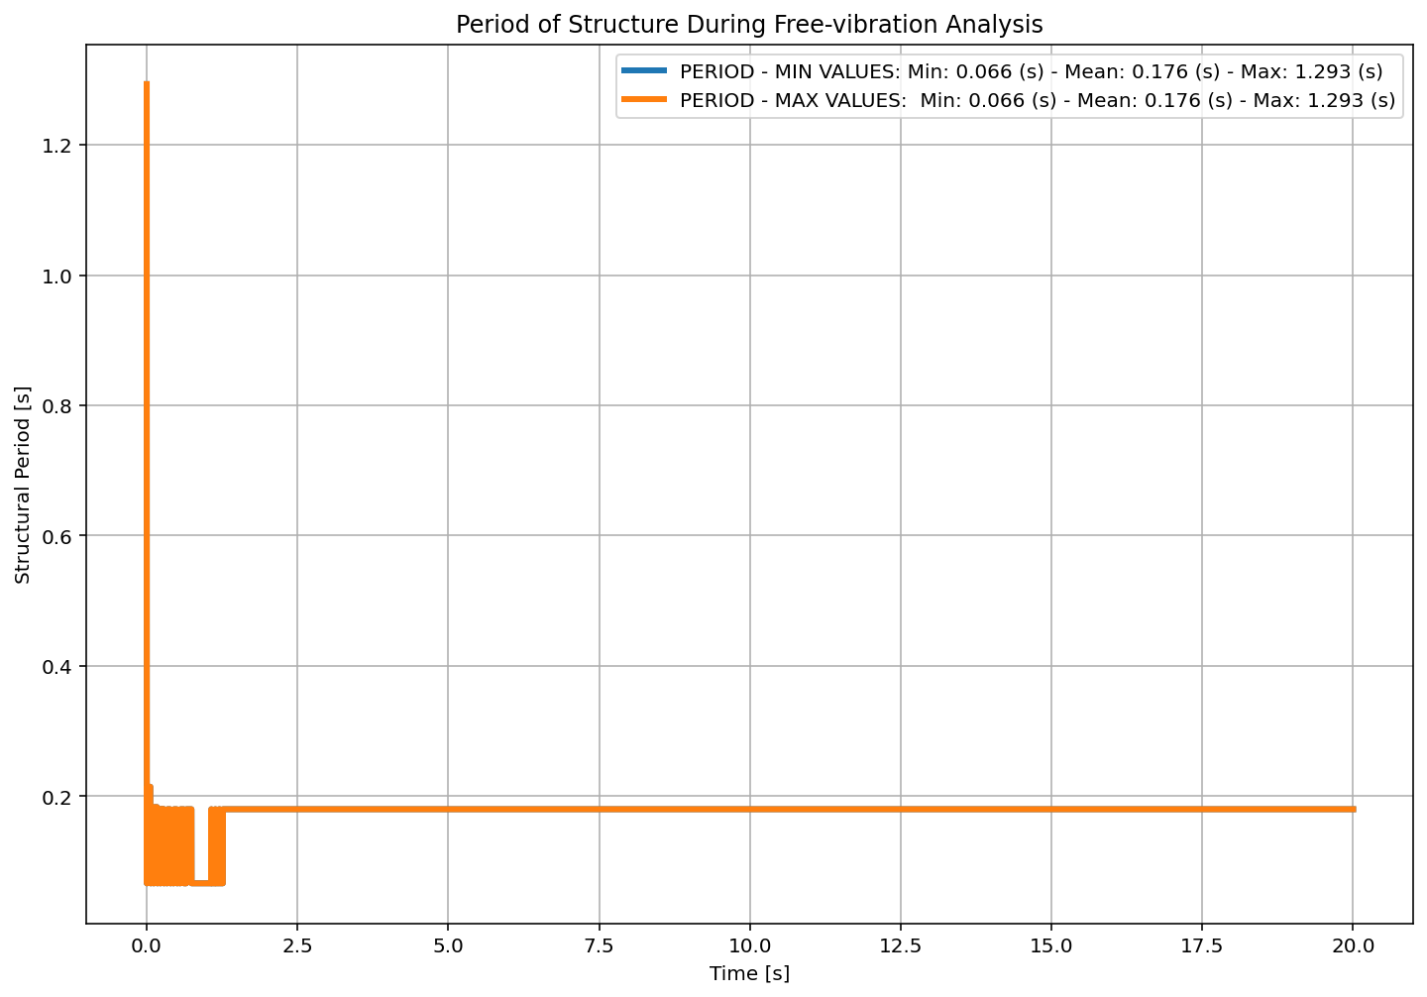

Slide 38
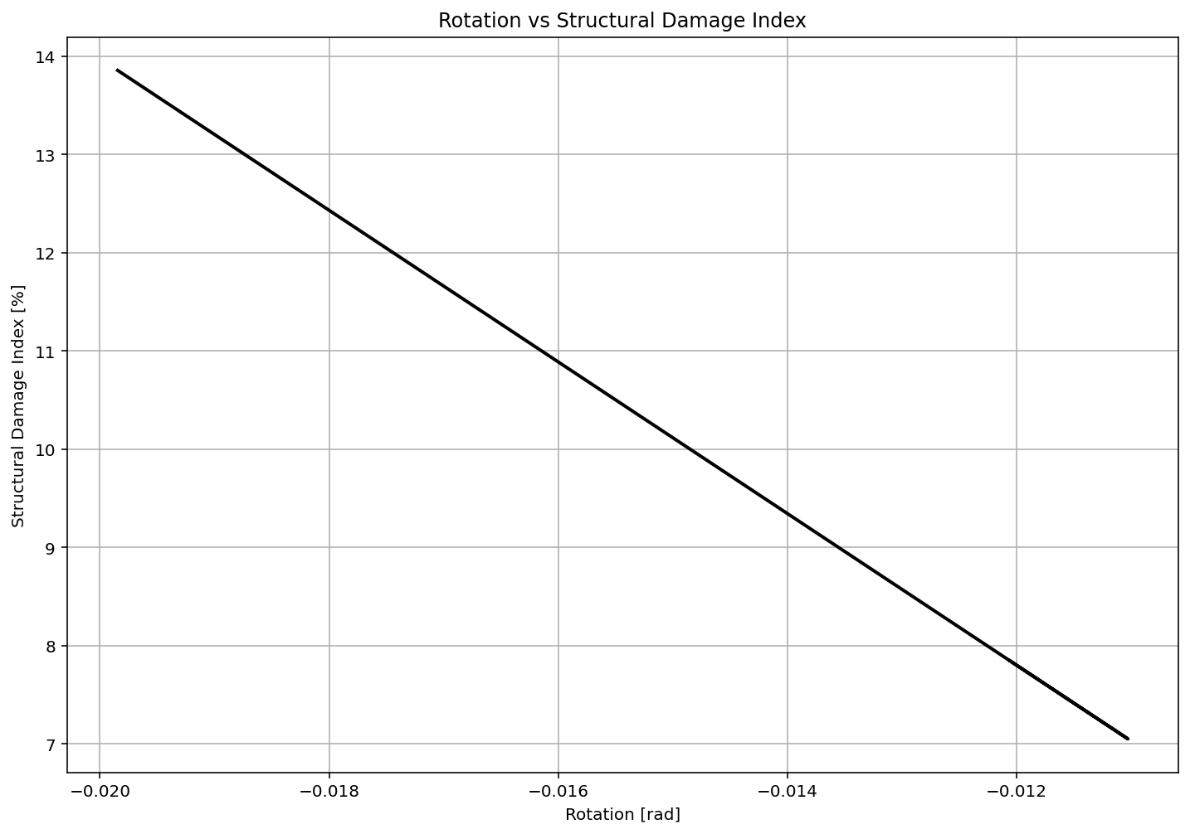

Slide 39
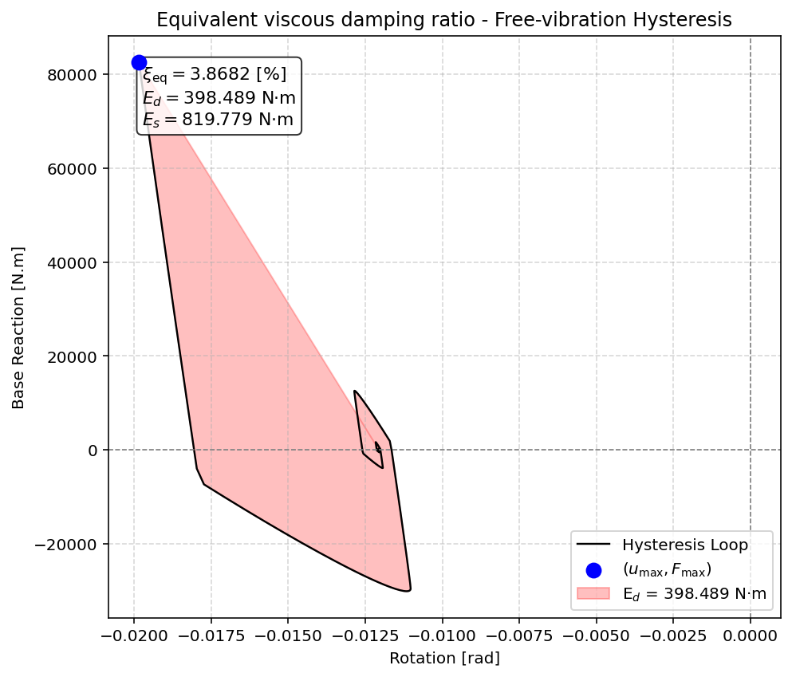

Slide 40
SEISMIC ANALYSIS

Slide 41
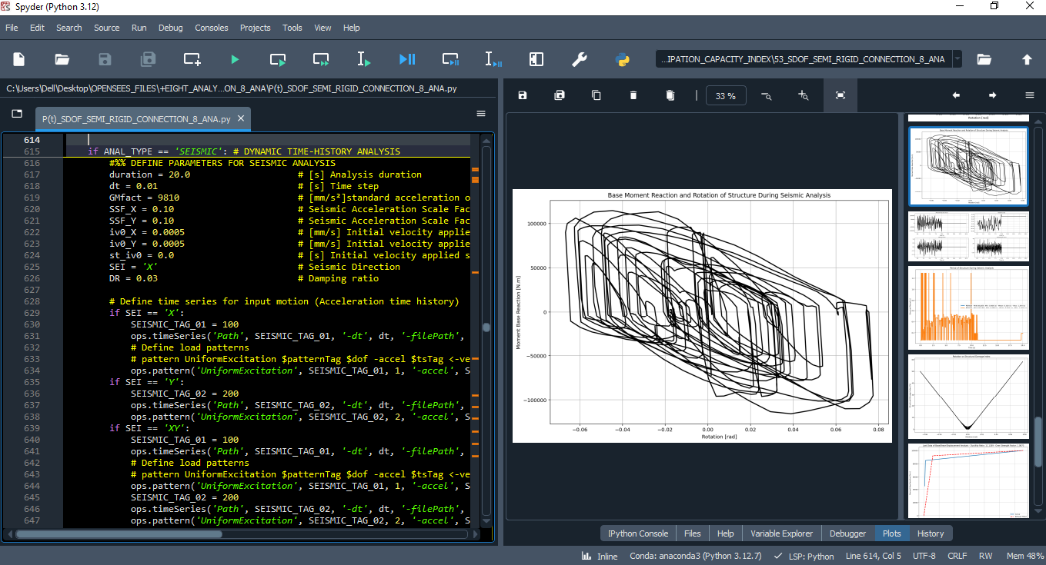

Slide 42
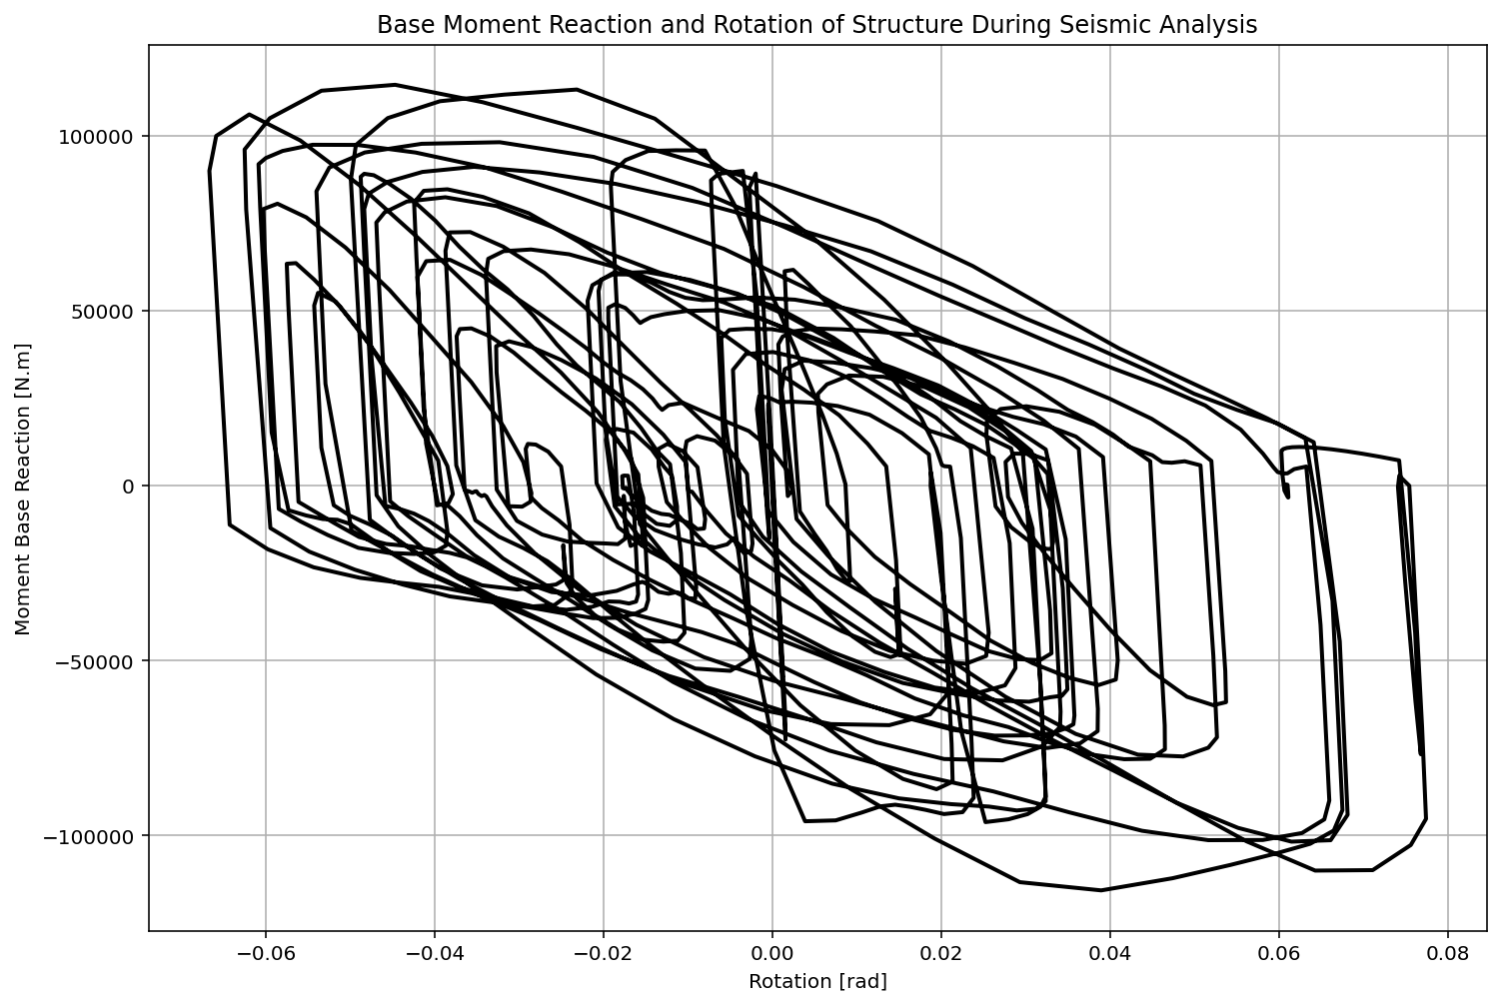

Slide 43
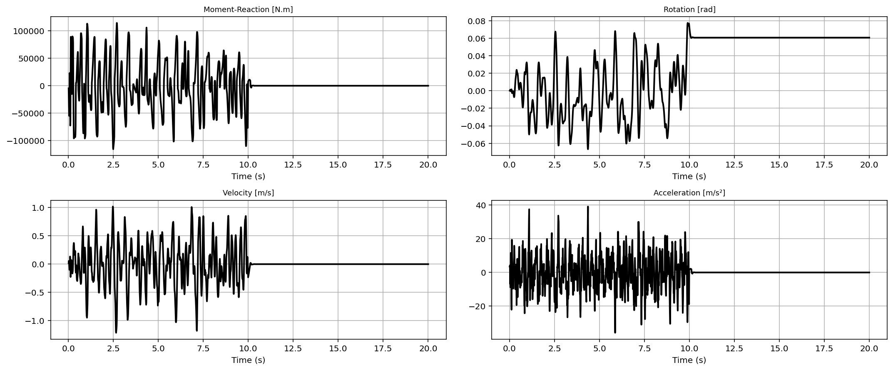

Slide 44
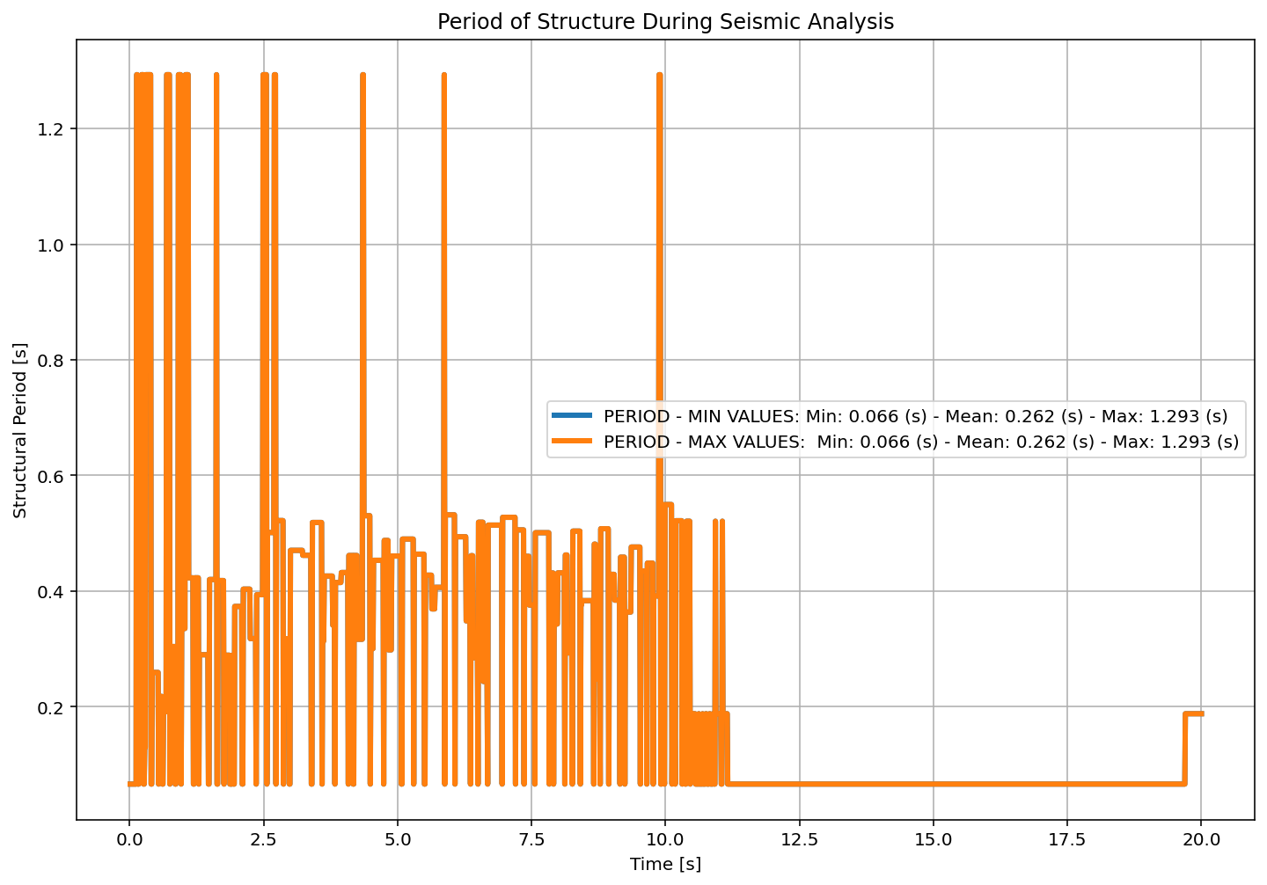

Slide 45
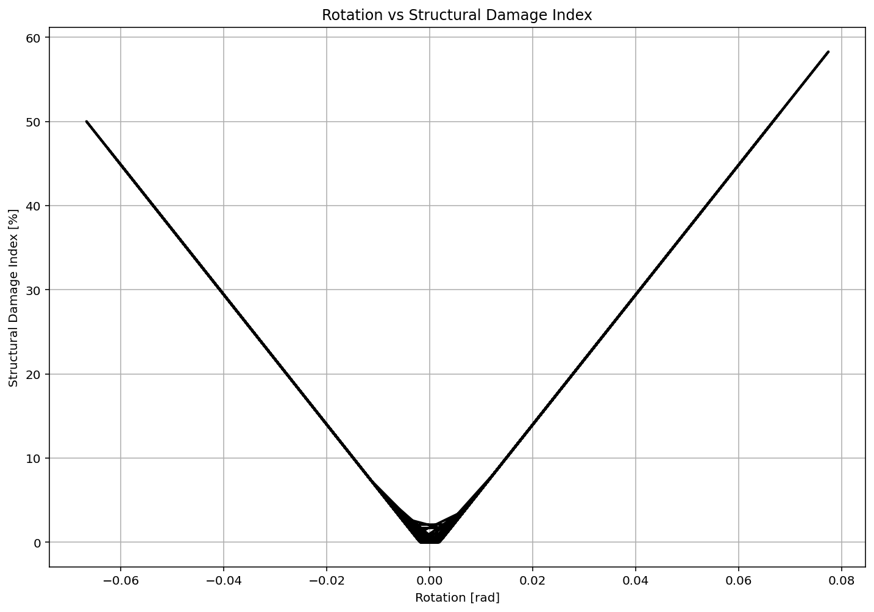

Slide 46
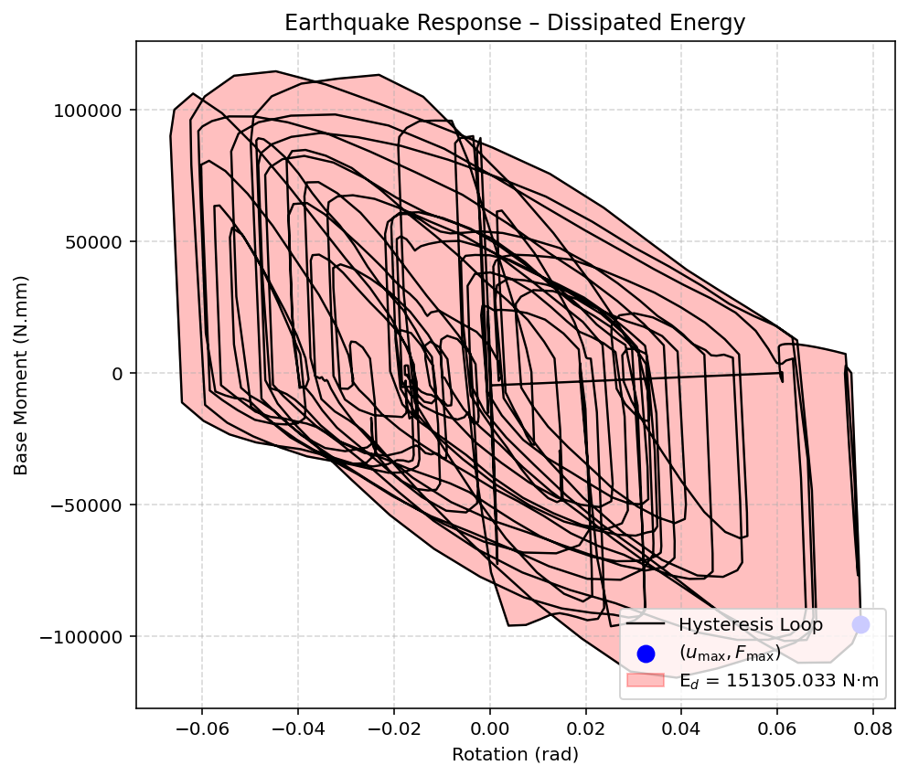

Slide 47
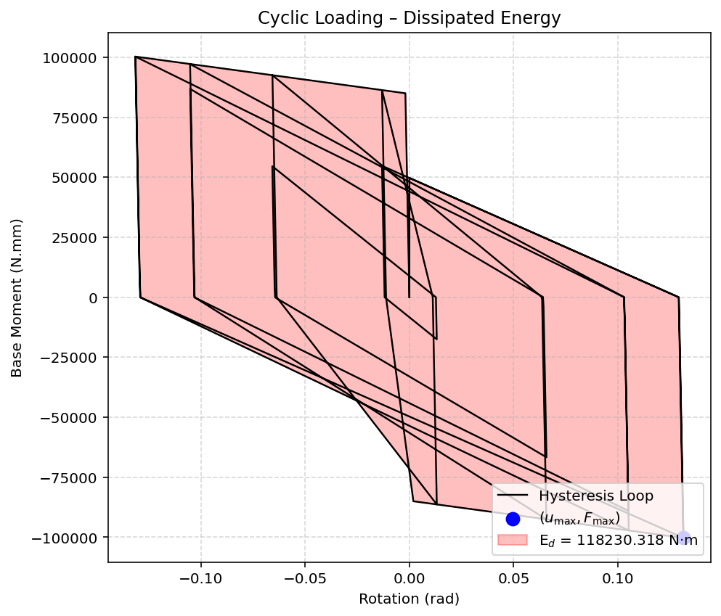

Slide 48
Dissipated Energy from Earthquake= 151305.03 N·m.Rad
Dissipated Energy from Cyclic Rotation= 118230.32 N·m.Rad
FOR EVALUATION OF DISSIPATED ENERGY CAPACITY INDEX:
CHECK THE CYCLIC ROTATION ANALYSIS AND IF IT IS POSSIBLE
INCREASE THE ROTATION.

Slide 49
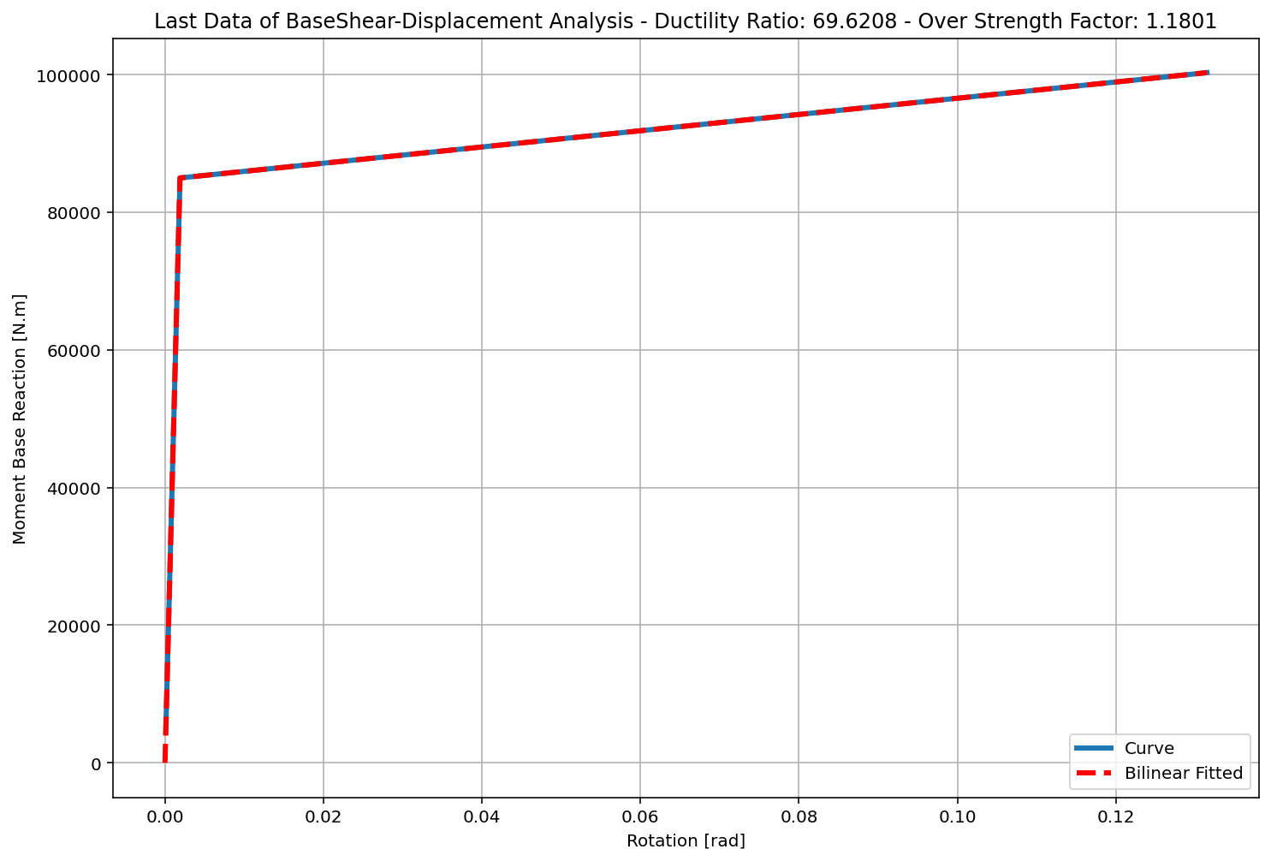

Slide 50
+==========================+
= Analysis curve fitted =
Rotation Base Moment
----------------------------
[[0.00000000e+00 0.00000000e+00]
[1.88880391e-03 8.49961760e+04]
[1.31500000e-01 1.00300000e+05]]
+==========================+
+----------------------------------------------------+
Structure Elastic Stiffness : 45000000.00
Structure Plastic Stiffness : 762737.64
Structure Tangent Stiffness : 118074.86
Structure Ductility Ratio : 69.62
Structure Over Strength Factor: 1.18
+----------------------------------------------------+
Over Strength Coefficient (Ω0): 1.1801
Rotation Ductility Ratio (μ): 69.6208
Ductility Coefficient (Rμ): 69.6208
Structural Behavior Coefficient (R): 82.1562
Structural Ductility Damage Index in X Direction: 58.2884 (%)

Slide 51
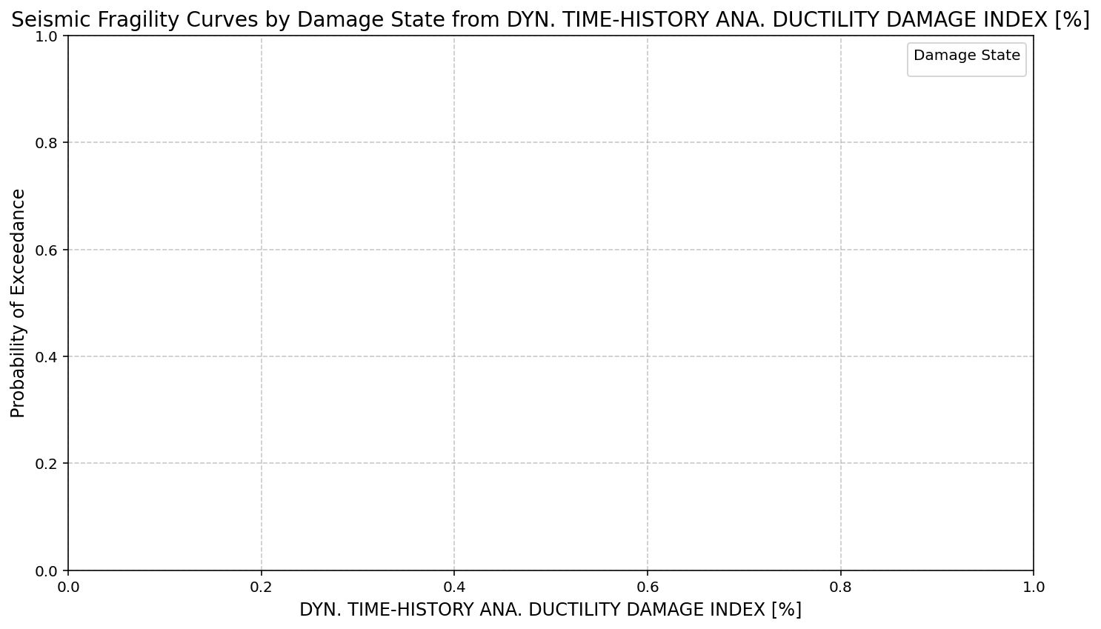

Slide 52
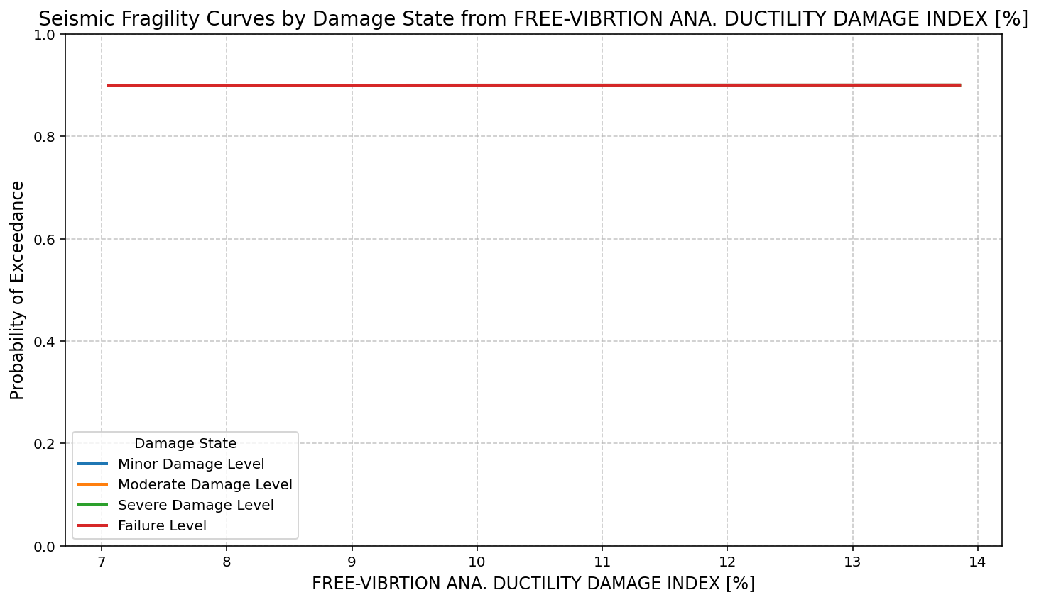

Slide 53
