Slide 1
IN THE NAME OF ALLAH, THE MOST GRACIOUS, THE MOST MERCIFUL
COMPARATIVE ANALYSIS OF AXIAL FORCE–MOMENT (P–M) INTERACTION IN CONFINED REINFORCED CONCRETE WITH PLATE COMPOSITE SECTIONS: EVALUATING STRAIN HARDENING AND ULTIMATE STRAIN CRITERIA USING OPENSEES
WRITTEN BY SALAR DELAVAR GHASHGHAEI (QASHQAI)

Slide 2
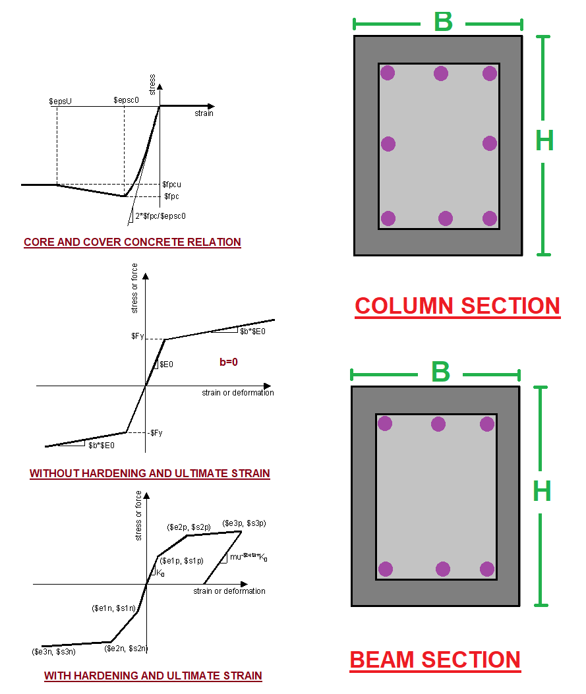
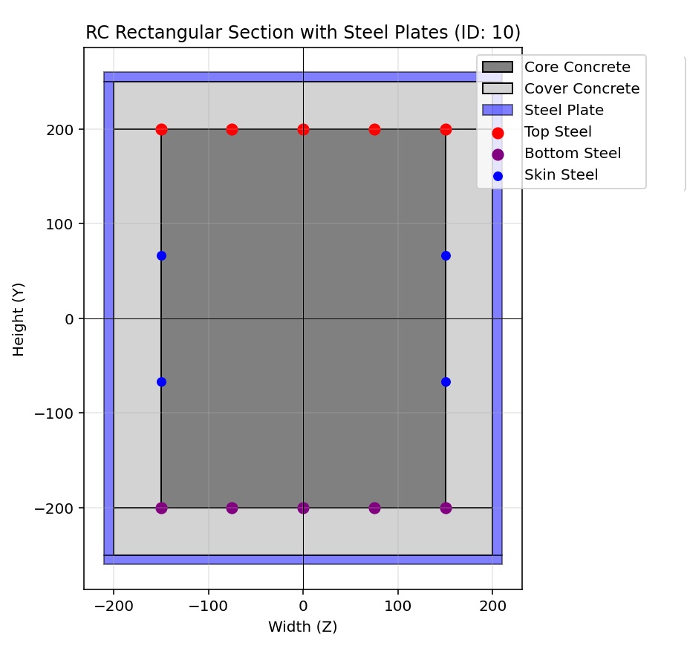

Slide 3
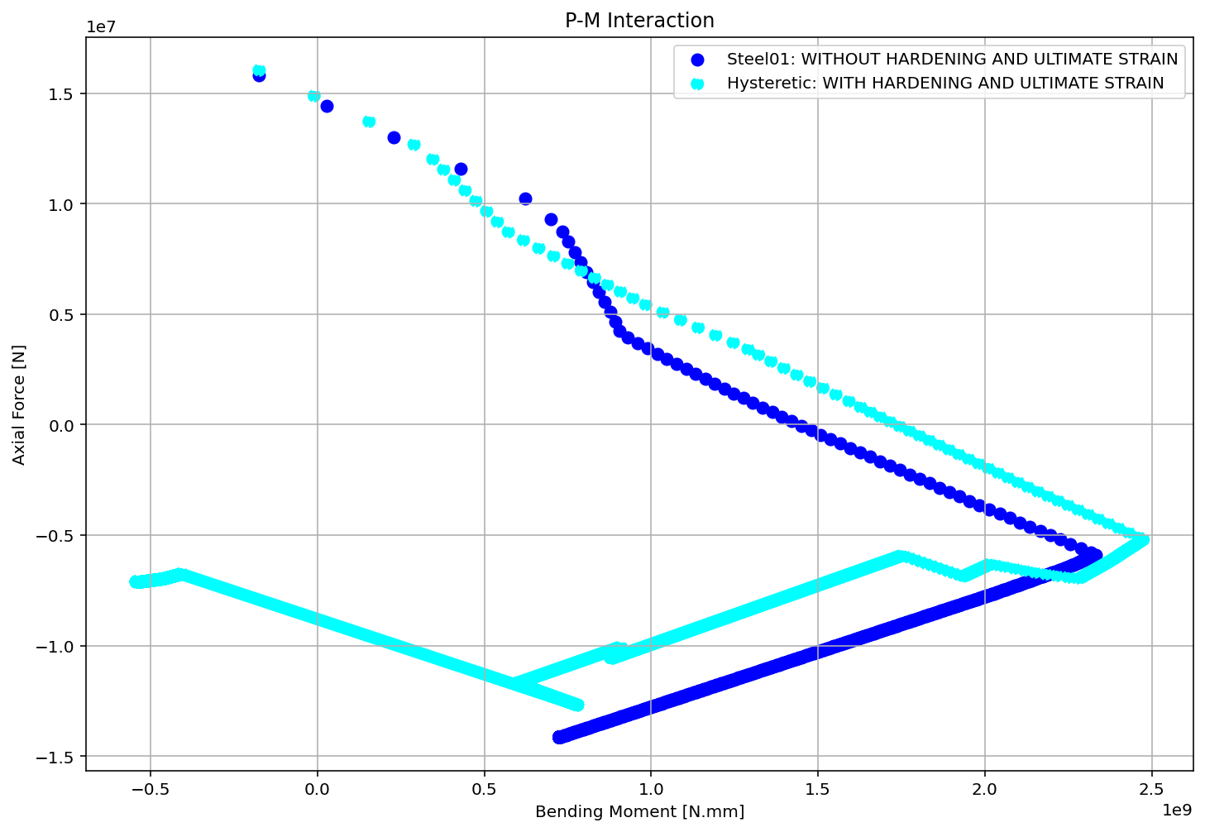

Slide 4
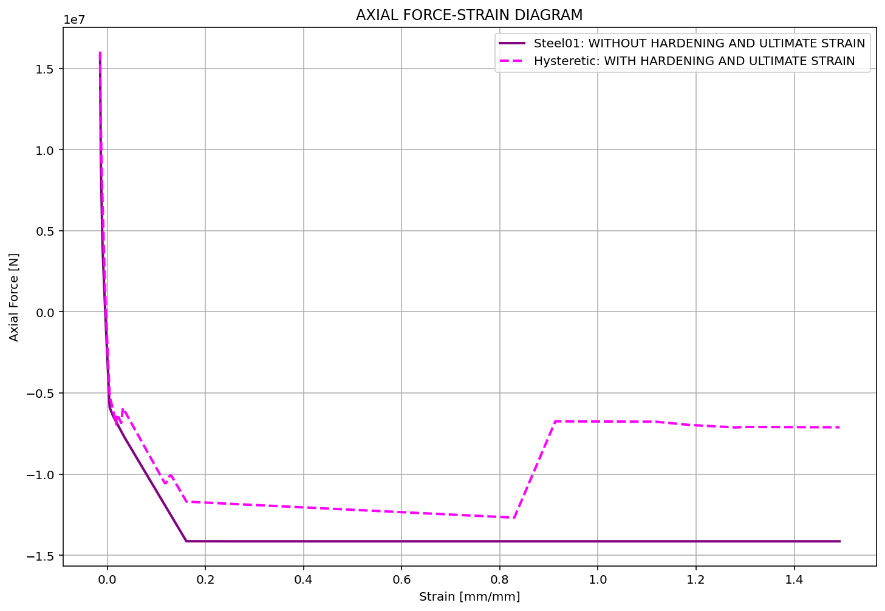

Slide 5
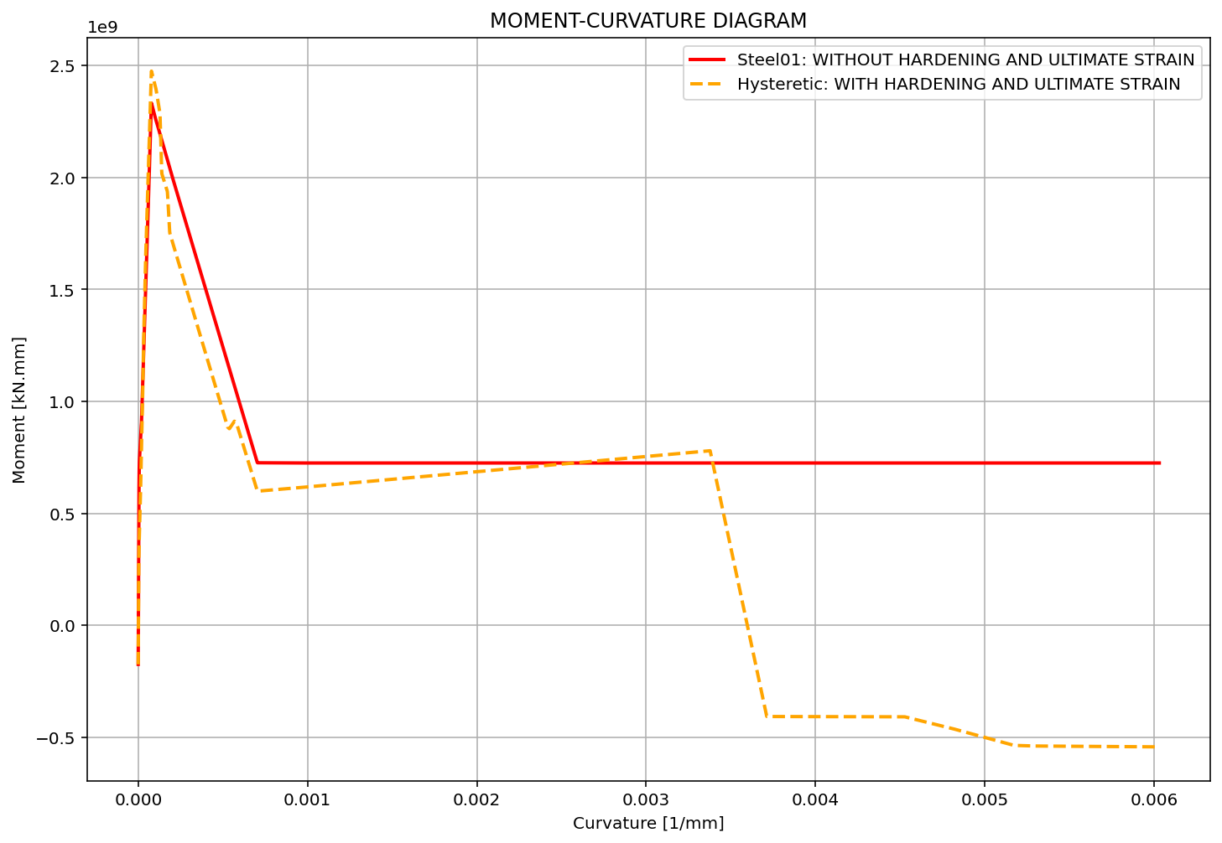

Slide 6
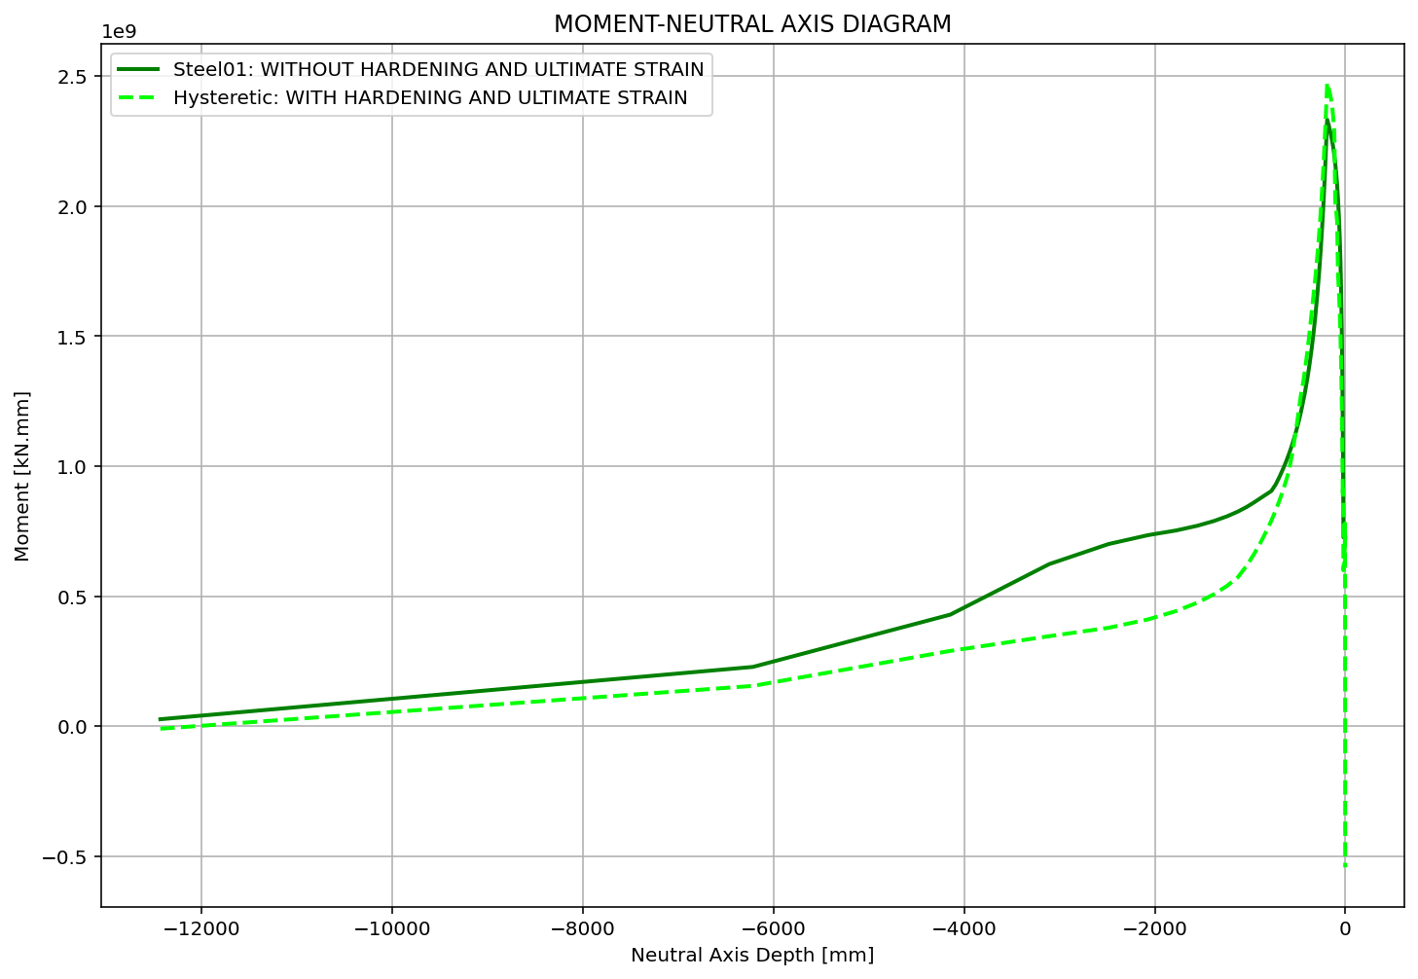

Slide 7
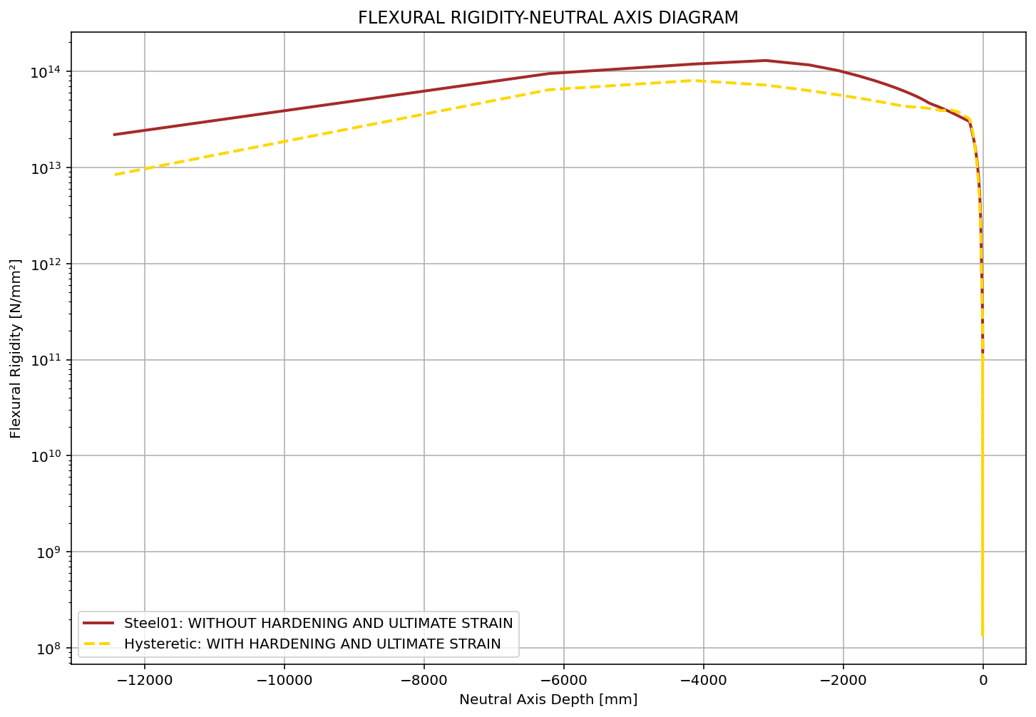

Slide 8
