Slide 1
IN THE NAME OF ALLAH, THE MOST GRACIOUS, THE MOST MERCIFUL
ASSESSMENTS OF THE STRUCTURAL DUCTILITY DAMAGE INDEX OF CONCRETE FRAME USING OPENSEES
WRITTEN BY SALAR DELAVAR GHASHGHAEI (QASHQAI)

Slide 2
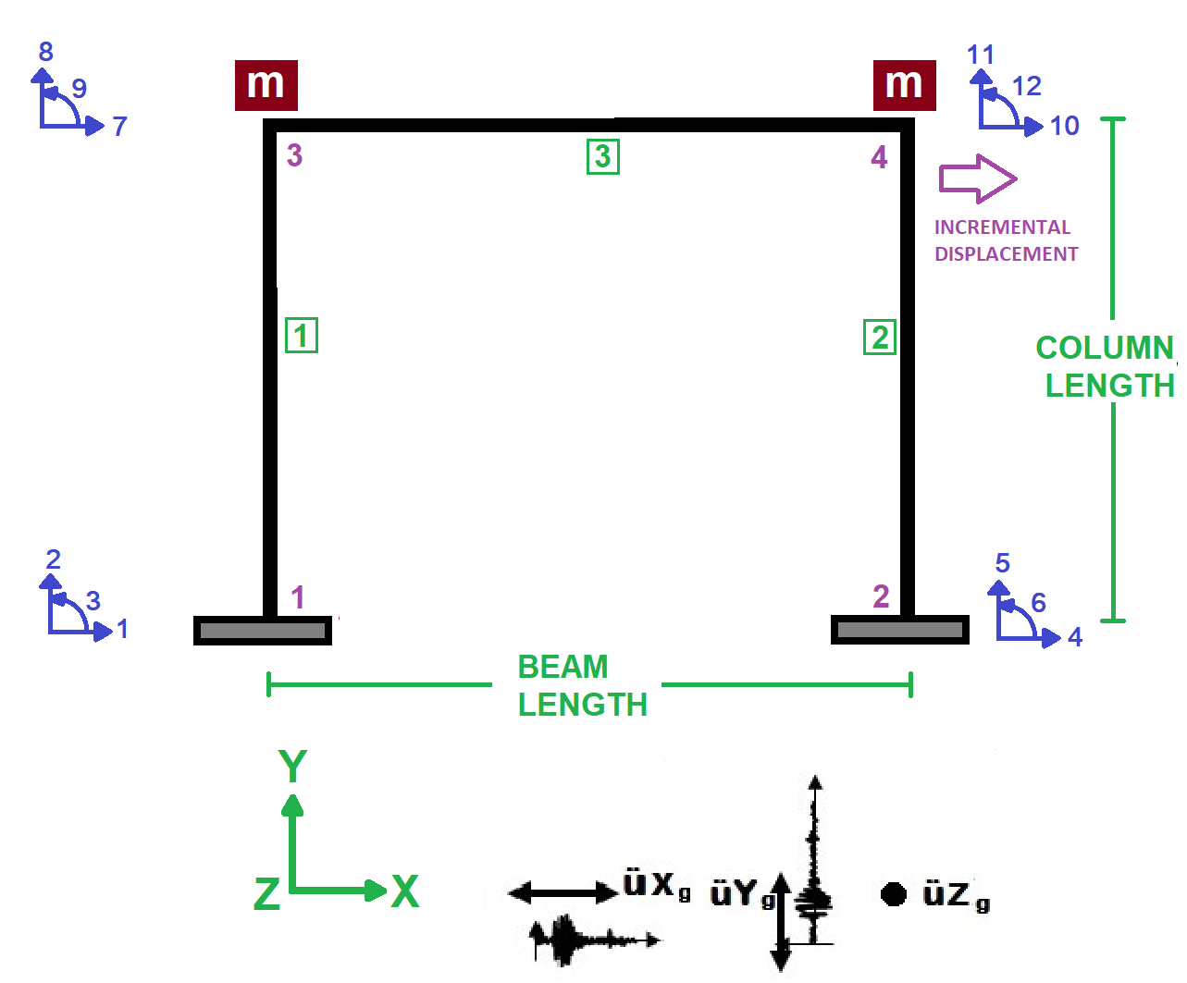

Slide 3
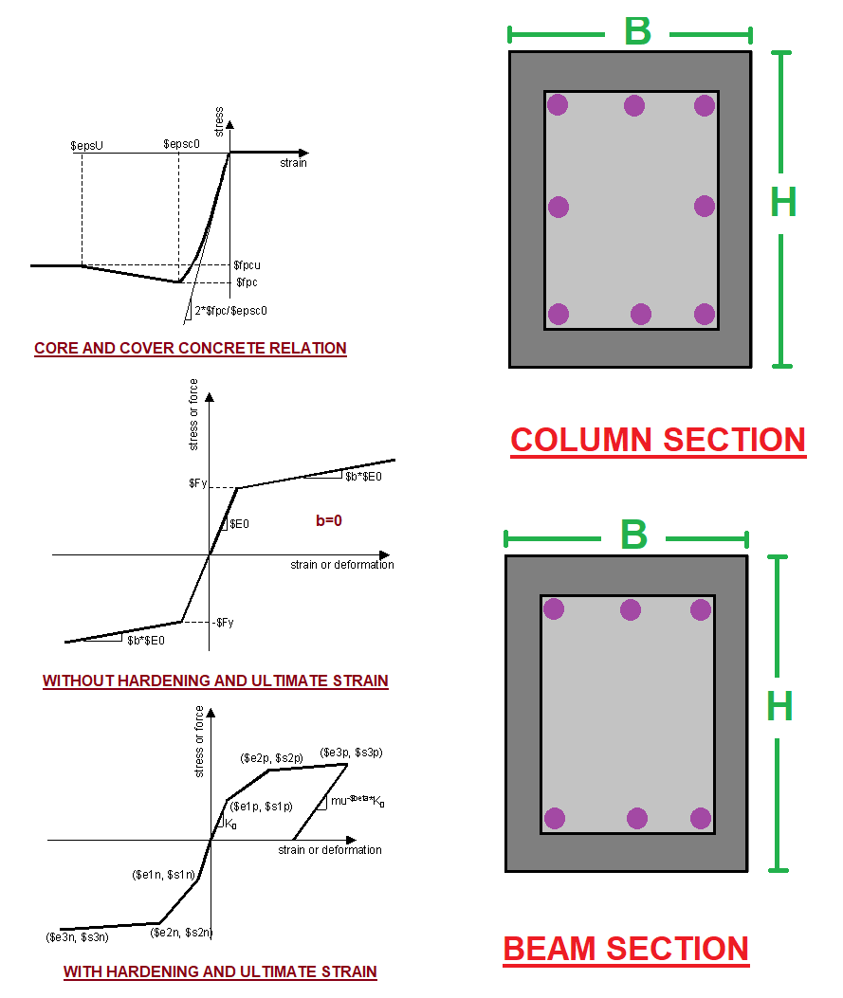

Slide 4
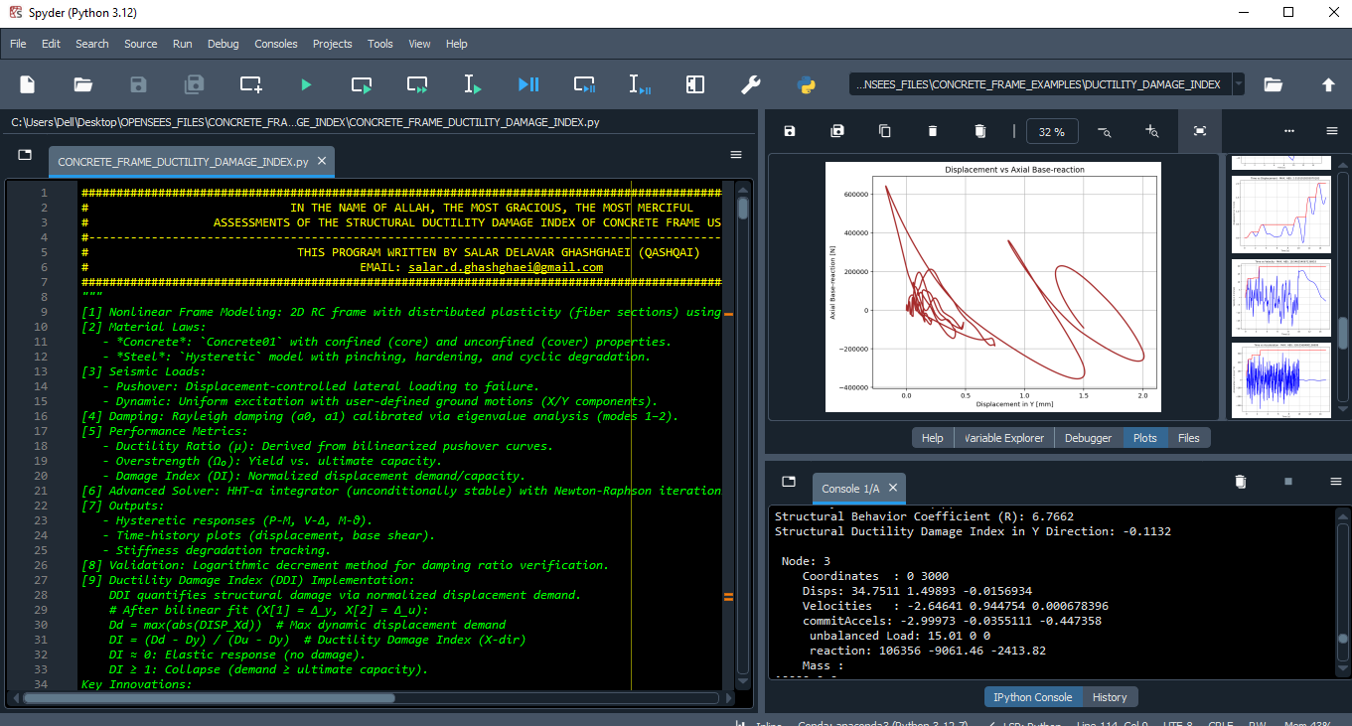

Slide 5
NONLINEAR STATIC ANALYSIS
(PUSHOVER)

Slide 6
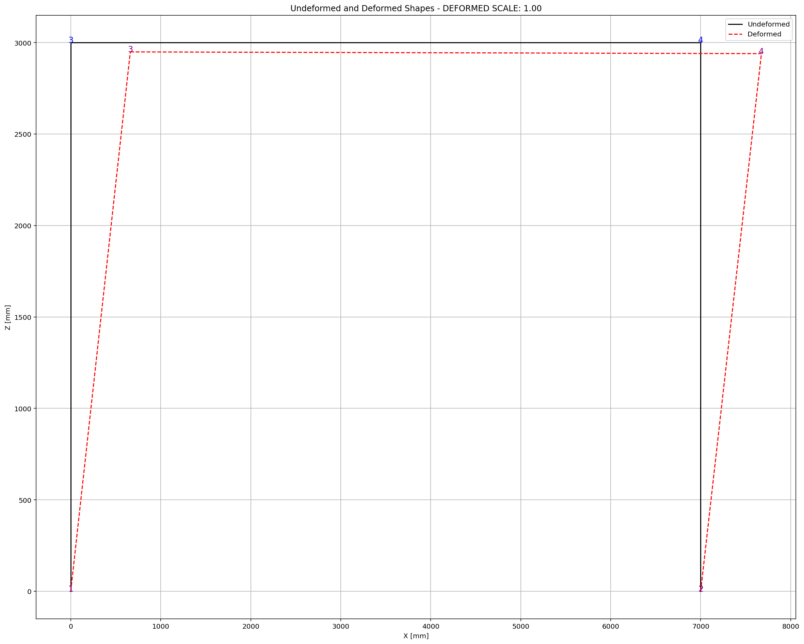

Slide 7
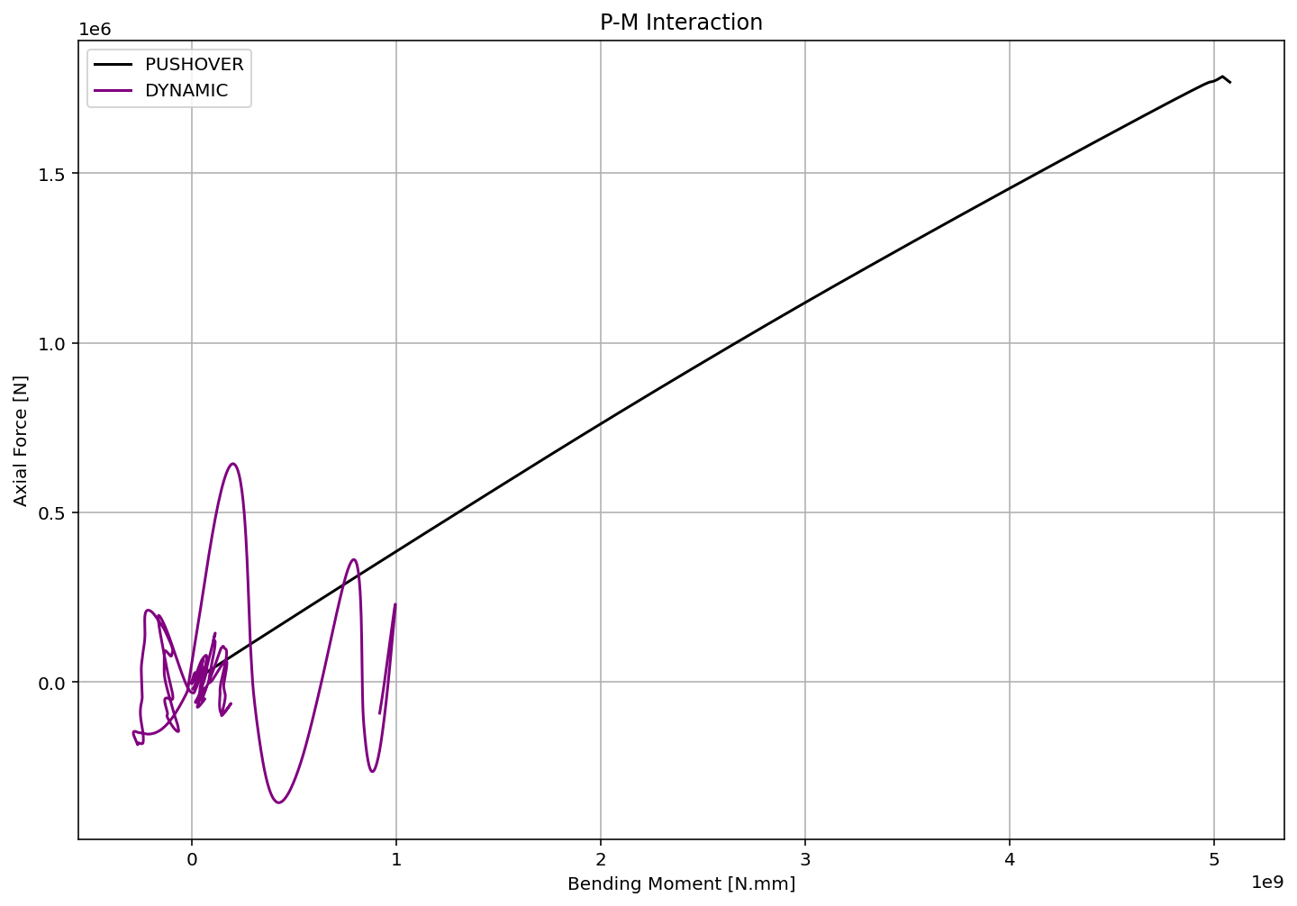

Slide 8
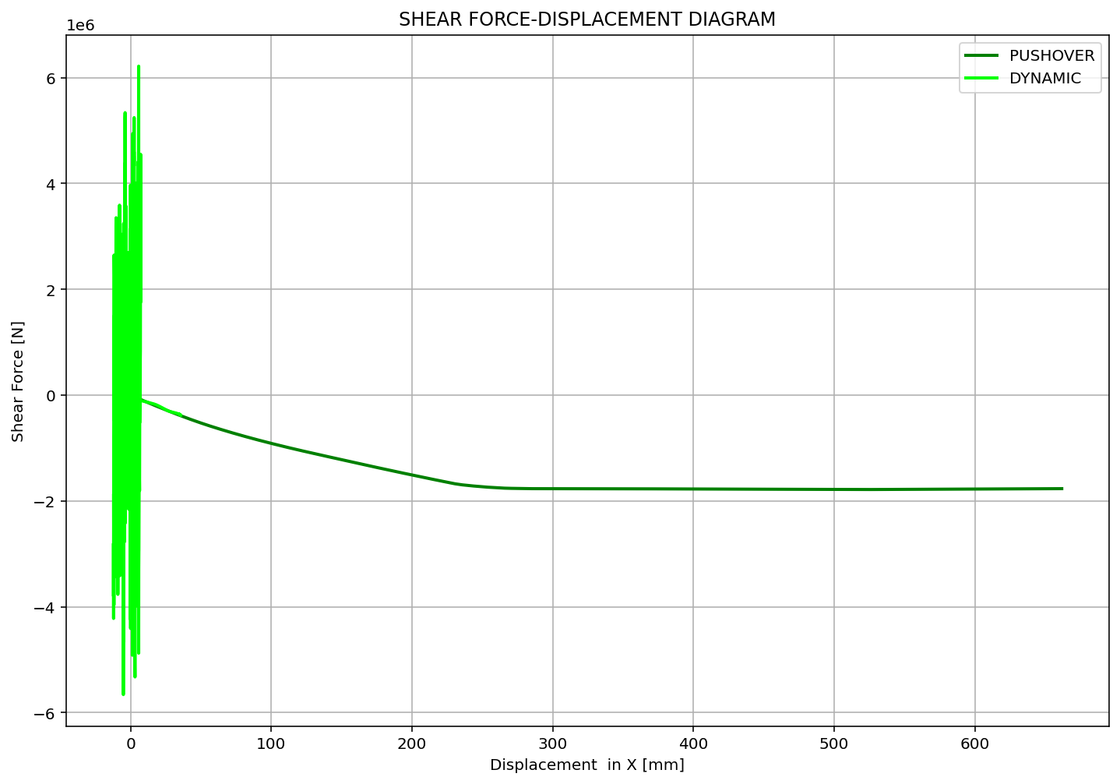

Slide 9
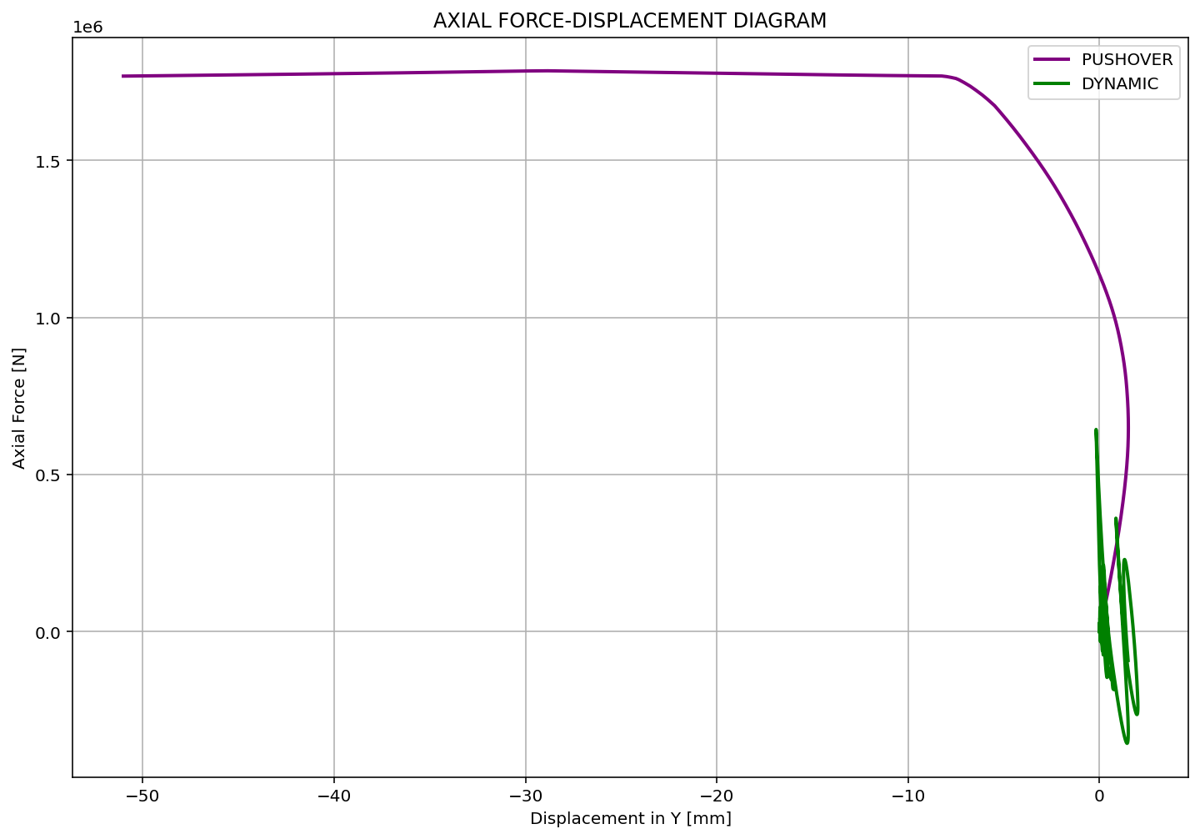

Slide 10
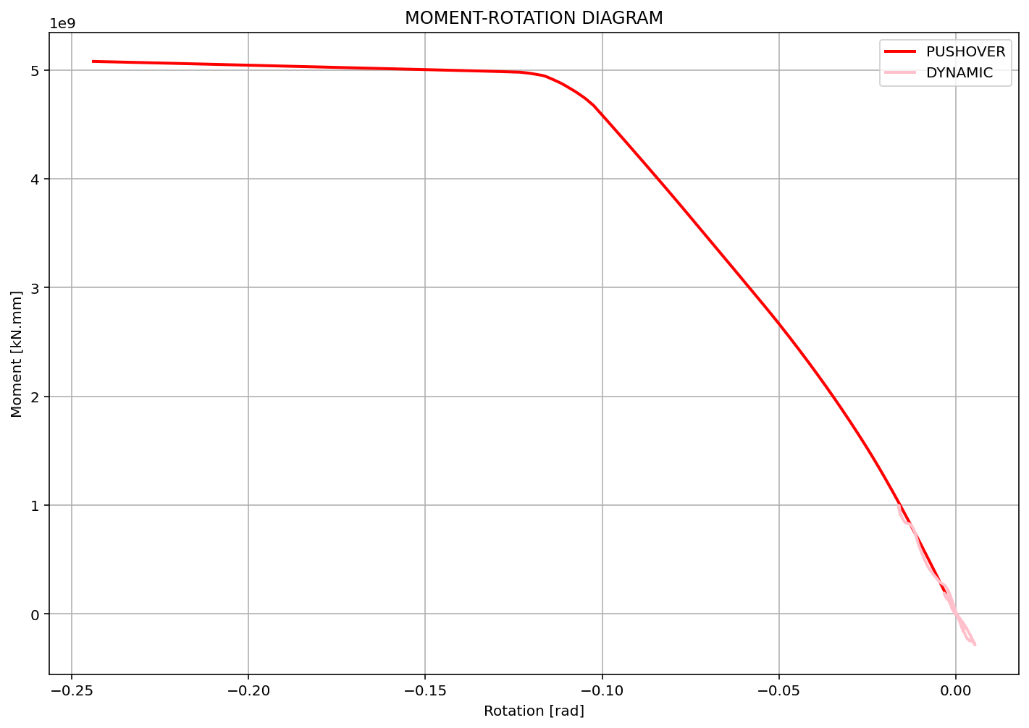

Slide 11
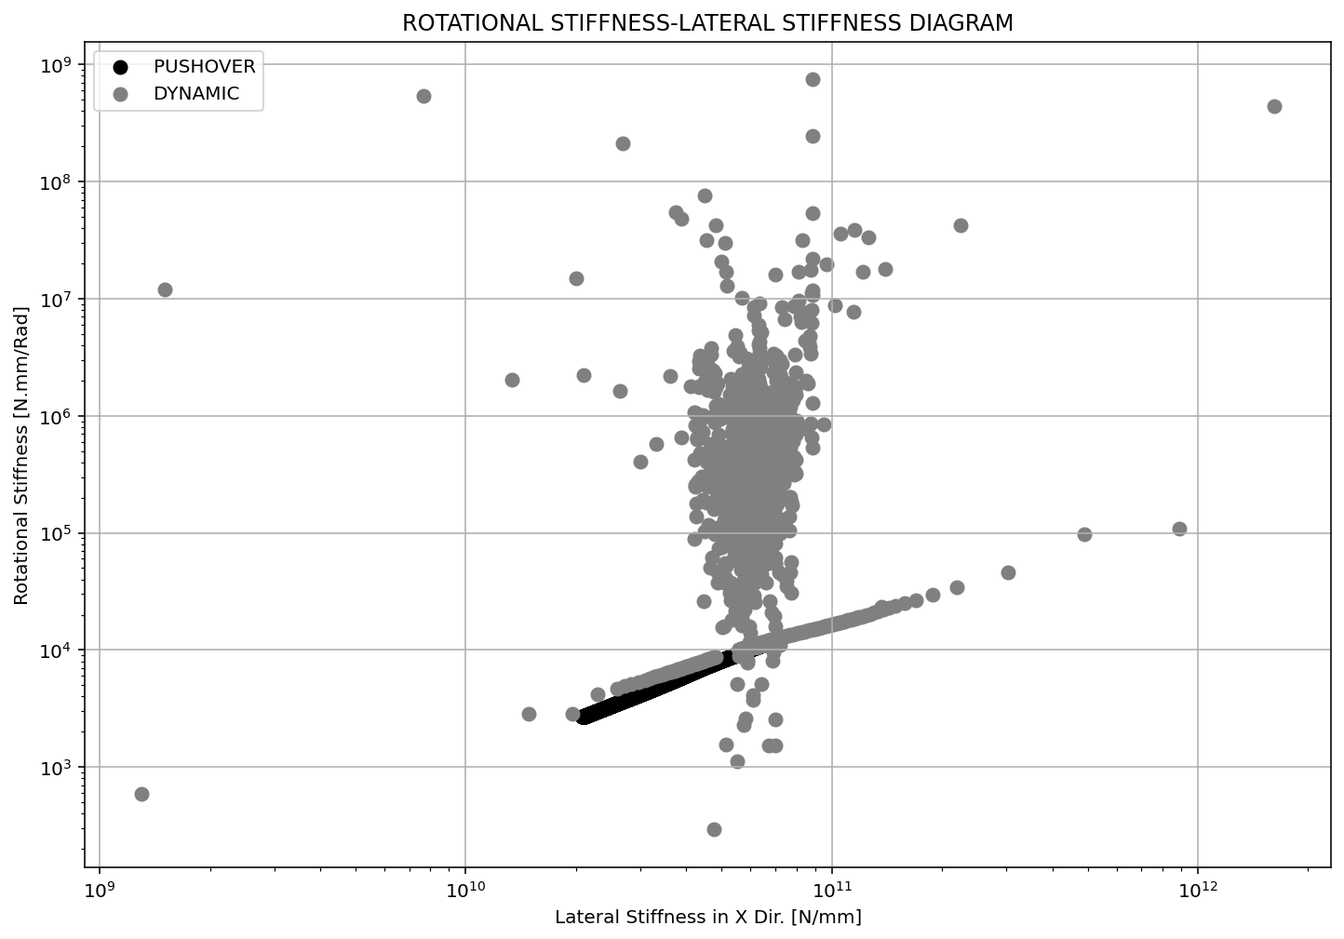

Slide 12
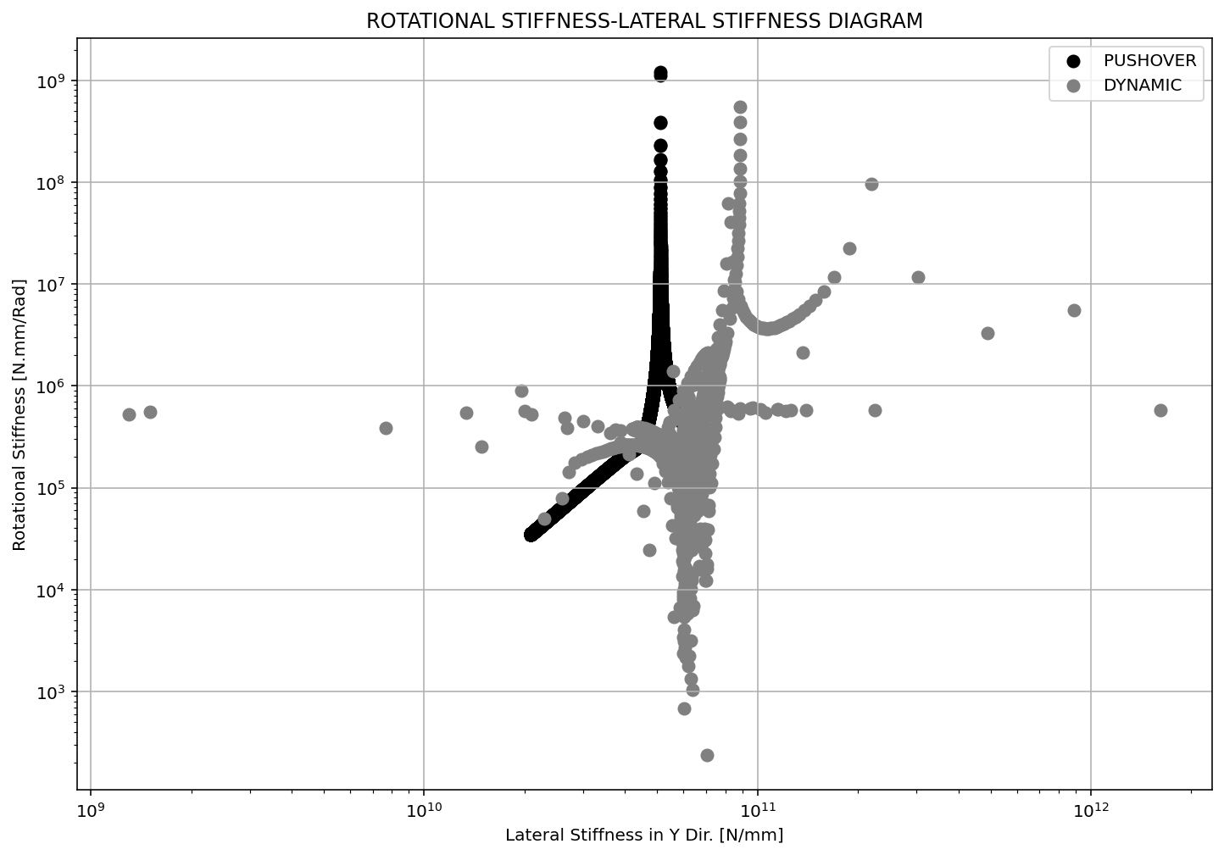

Slide 13
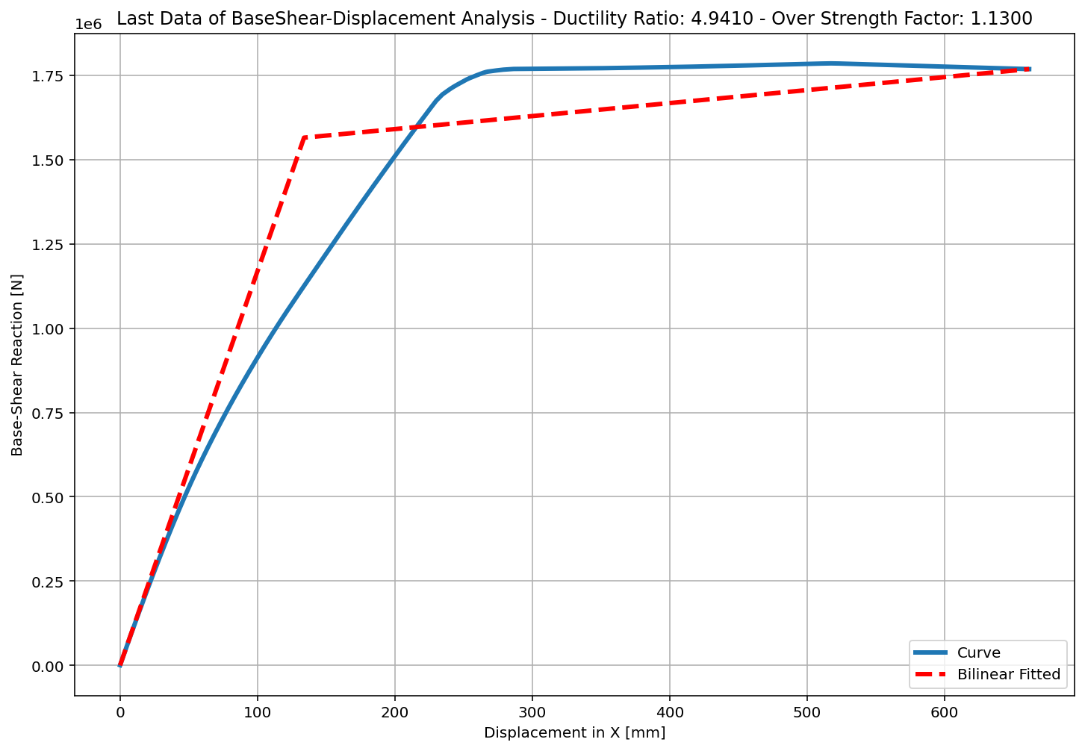
+==========================+
= Analysis curve fitted =
Disp Base Shear
----------------------------
[[0.00000000e+00 0.00000000e+00]
[1.33908963e+02 1.56504883e+06]
[6.61645649e+02 1.76849816e+06]]
+==========================+
+----------------------------------------------------+
Structure Elastic Stiffness : 11687.41
Structure Plastic Stiffness : 2672.88
Structure Tangent Stiffness : 385.51
Structure Ductility Ratio : 4.94
Structure Over Strength Factor: 1.13
+----------------------------------------------------+
Over Strength Coefficient (Ω0): 1.1300
Displacement Ductility Ratio (μ): 4.9410
Ductility Coefficient (Rμ): 4.9410
Structural Behavior Coefficient (R): 5.5833
Structural Ductility Damage Index in X Direction: -0.1859

Slide 14
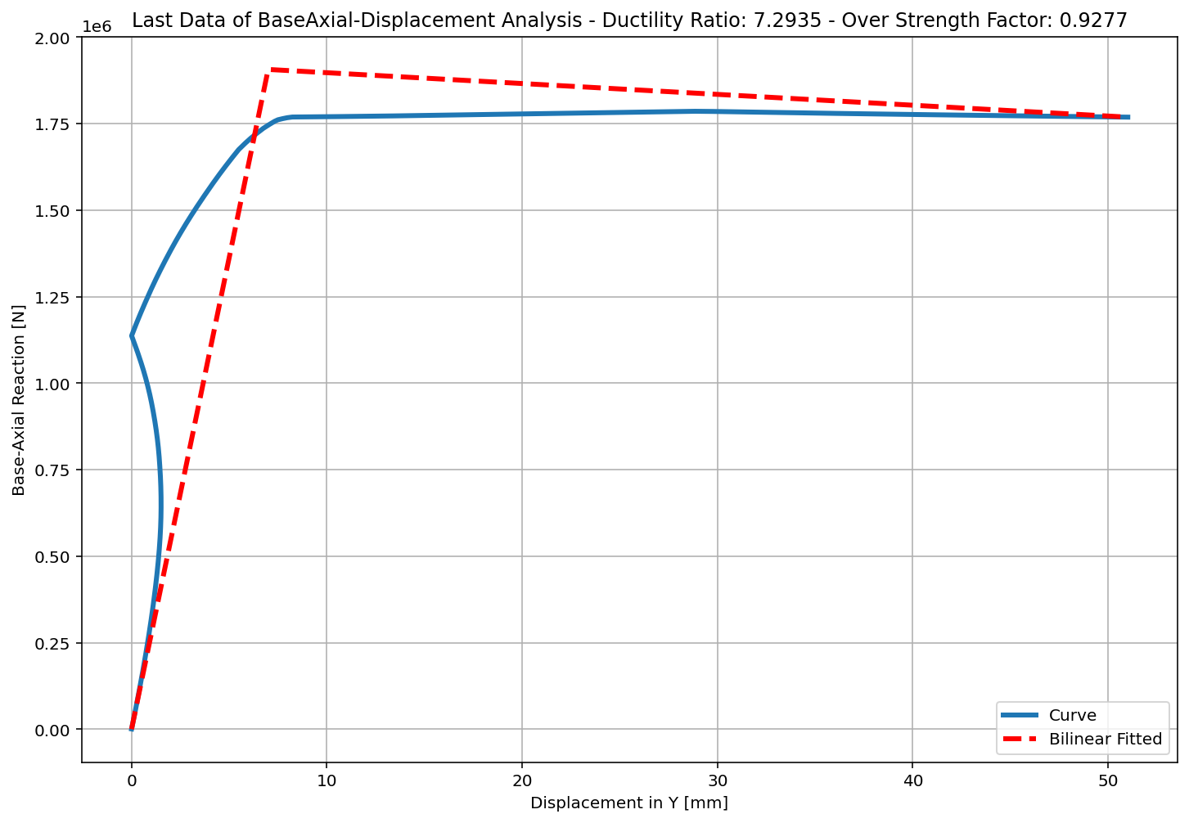
+==========================+
= Analysis curve fitted =
Disp Base Shear
----------------------------
[[0.00000000e+00 0.00000000e+00]
[6.99459041e+00 1.90633034e+06]
[5.10151935e+01 1.76849816e+06]]
+==========================+
+----------------------------------------------------+
Structure Elastic Stiffness : 272543.53
Structure Plastic Stiffness : 34666.11
Structure Tangent Stiffness : -3131.08
Structure Ductility Ratio : 7.29
Structure Over Strength Factor: 0.93
+----------------------------------------------------+
Over Strength Coefficient (Ω0): 0.9277
Displacement Ductility Ratio (μ): 7.2935
Ductility Coefficient (Rμ): 7.2935
Structural Behavior Coefficient (R): 6.7662
Structural Ductility Damage Index in Y Direction: -0.1132

Slide 15
NONLINEAR DYNAMIC ANALYSIS

Slide 16
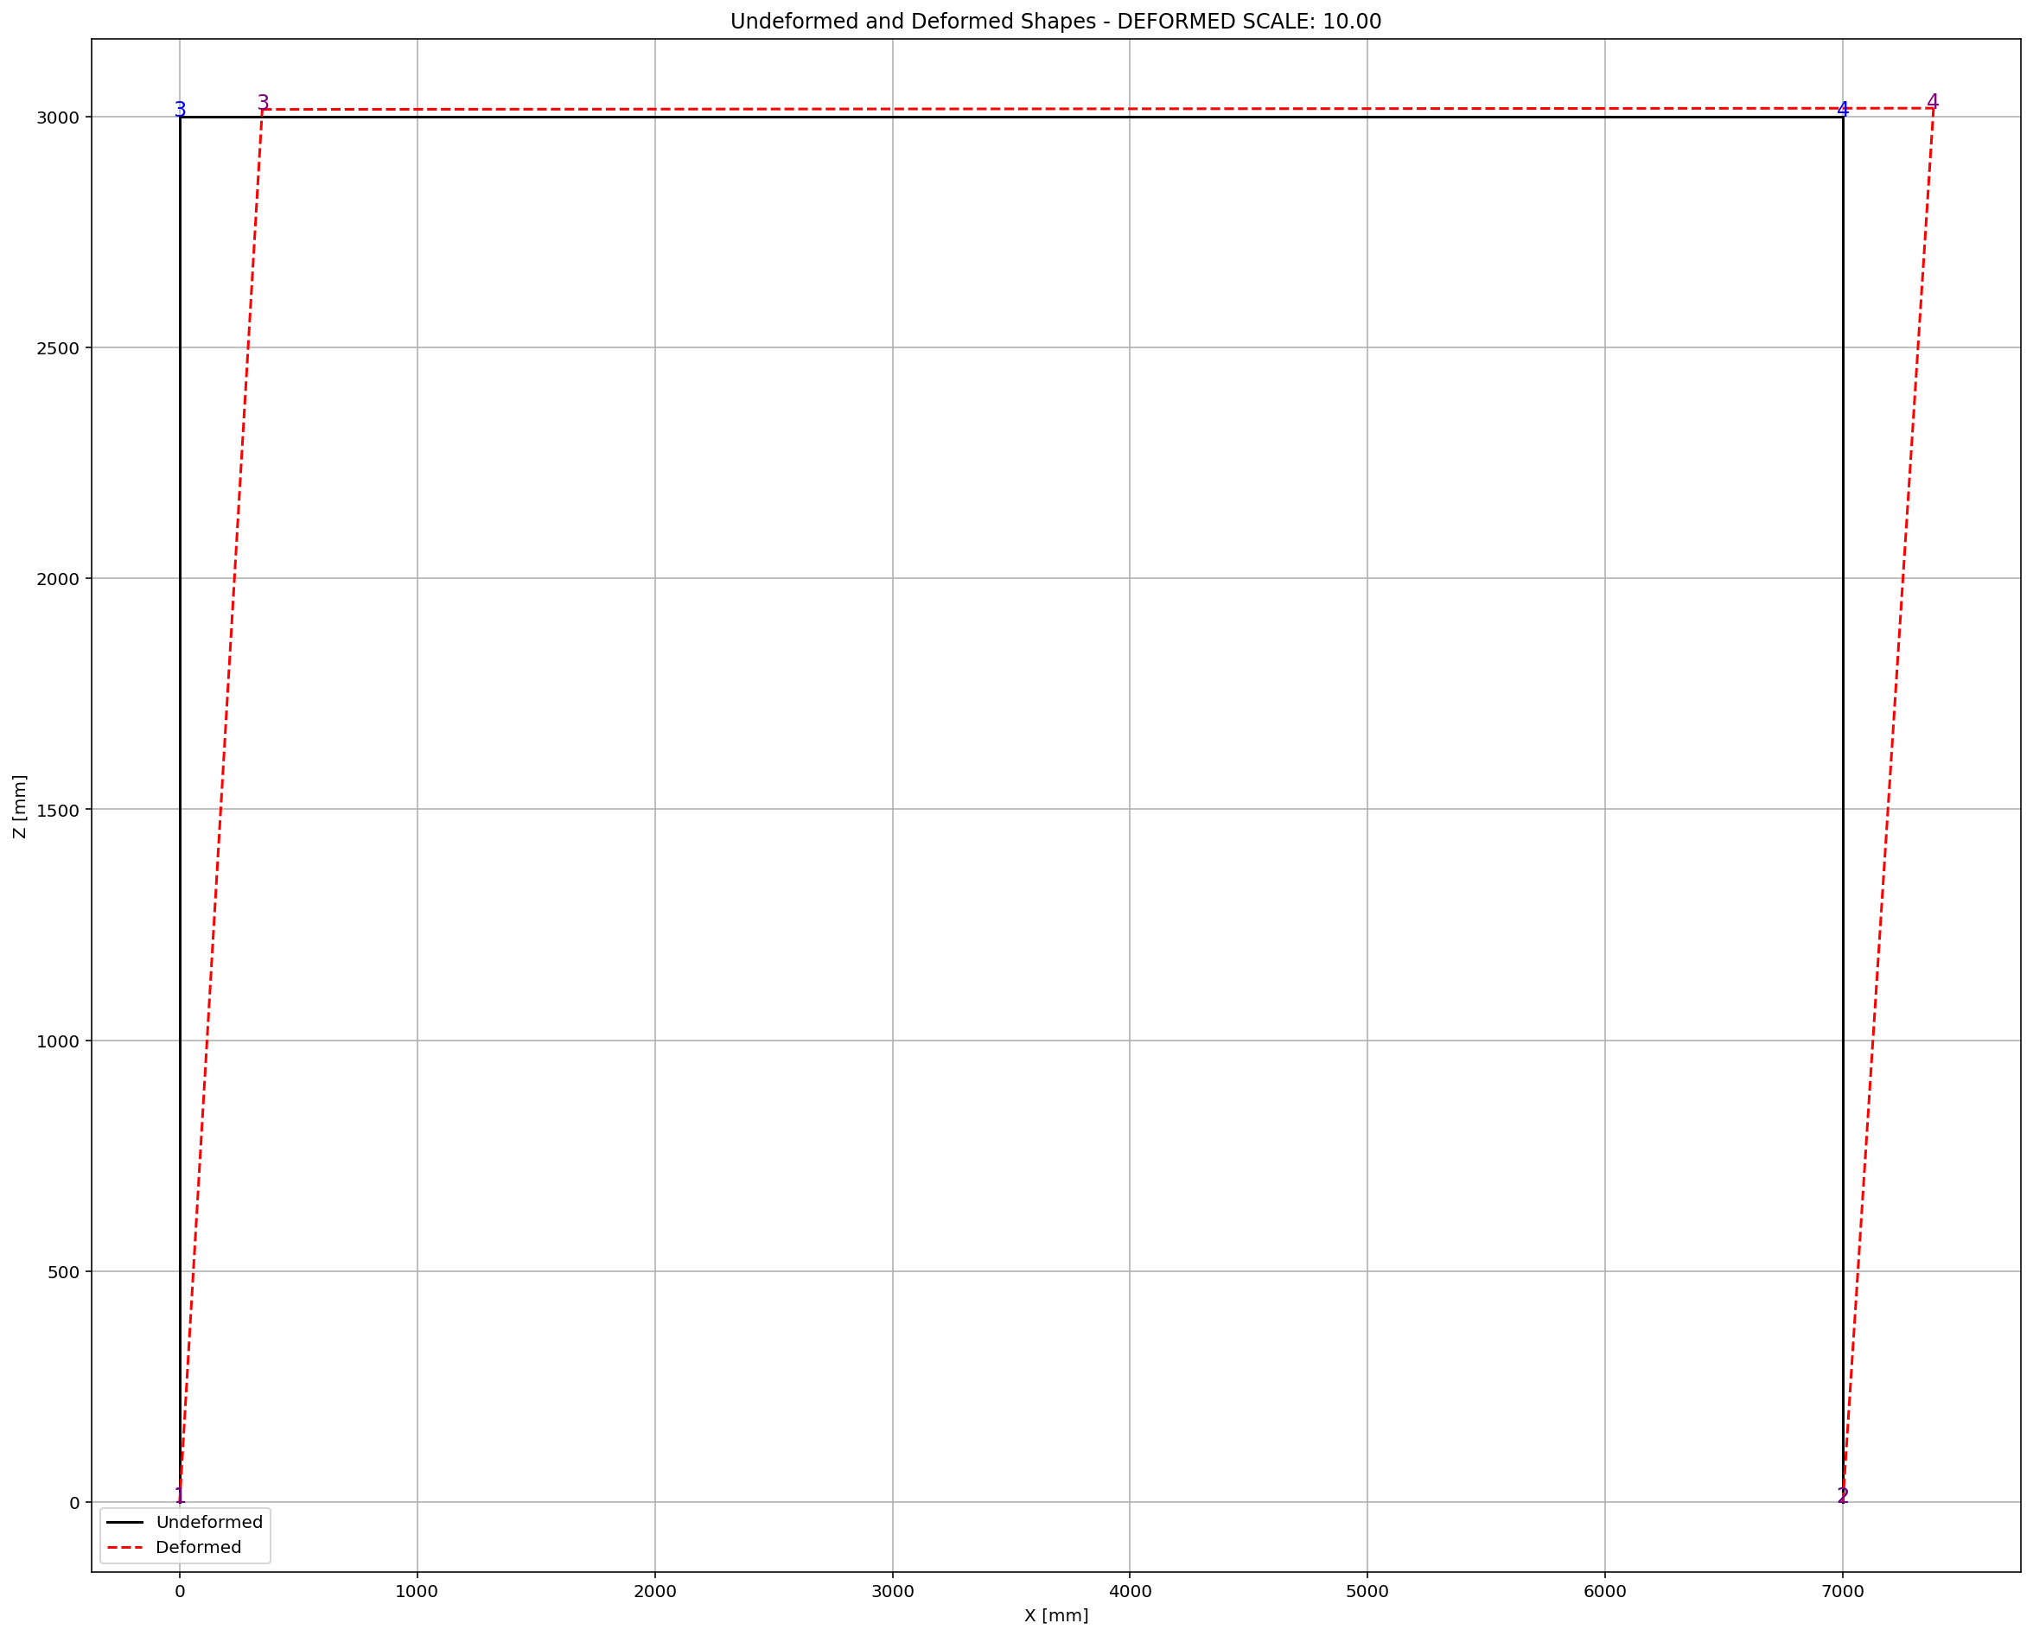

Slide 17
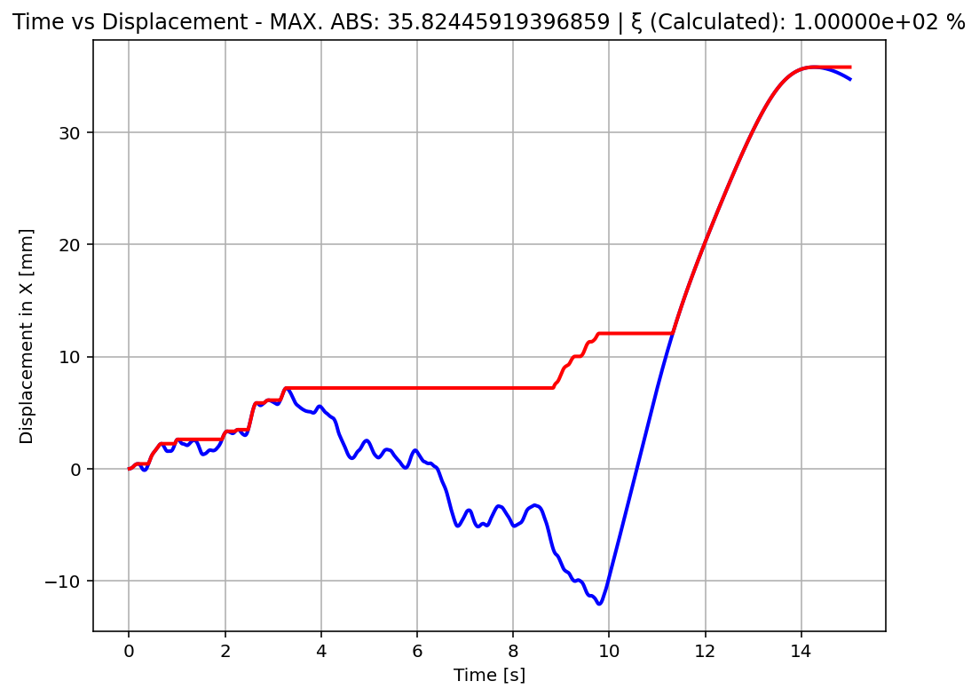

Slide 18
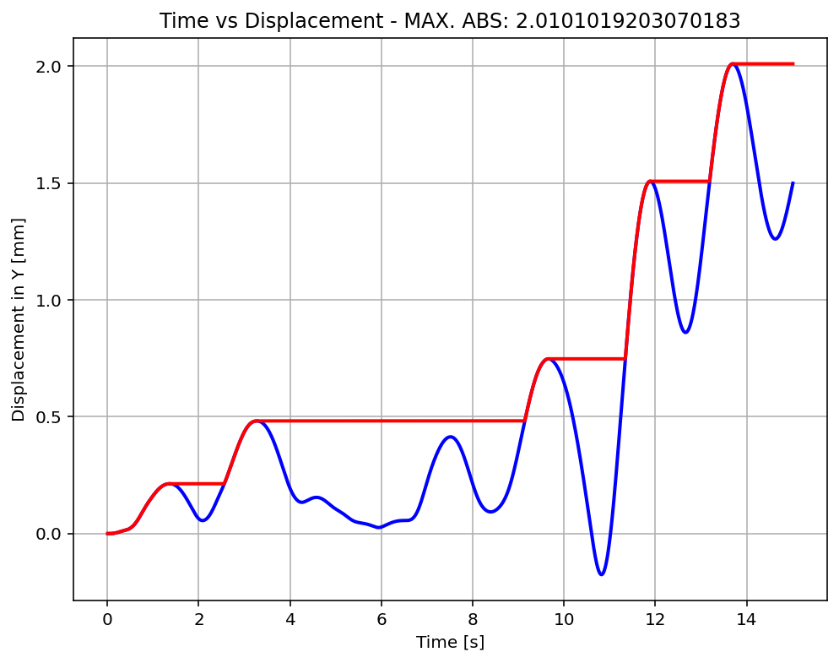

Slide 19
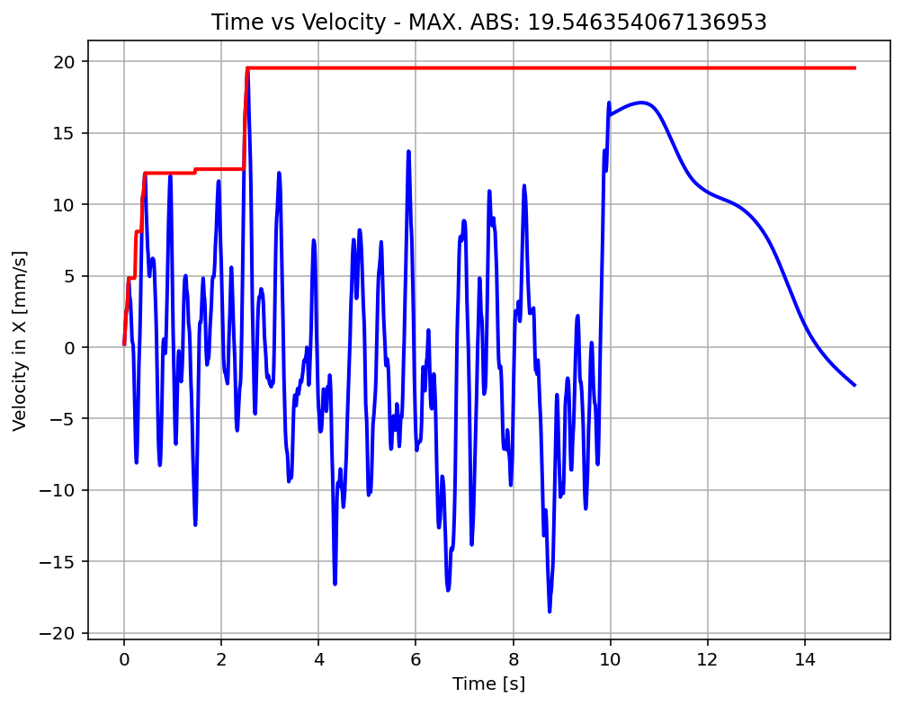

Slide 20
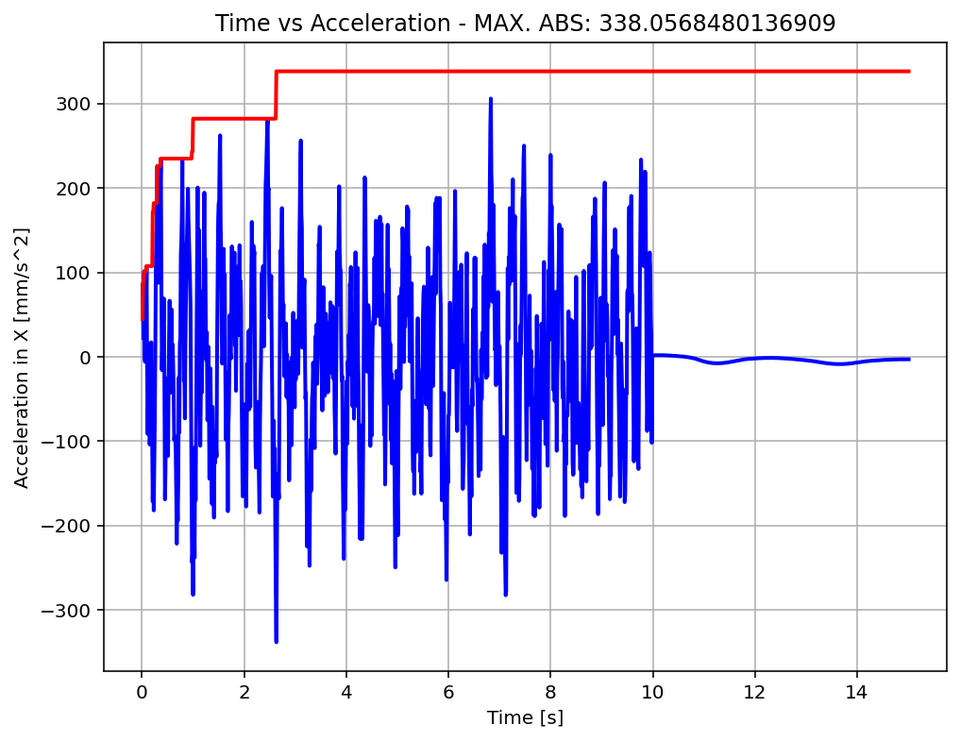

Slide 21
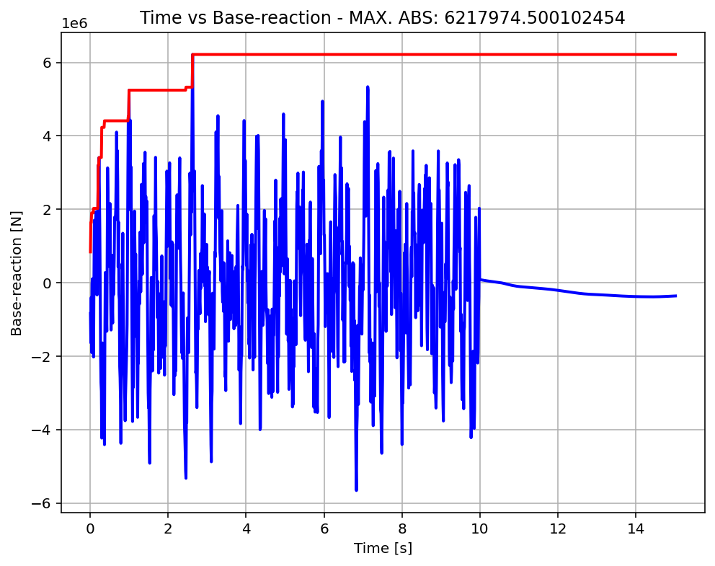

Slide 22
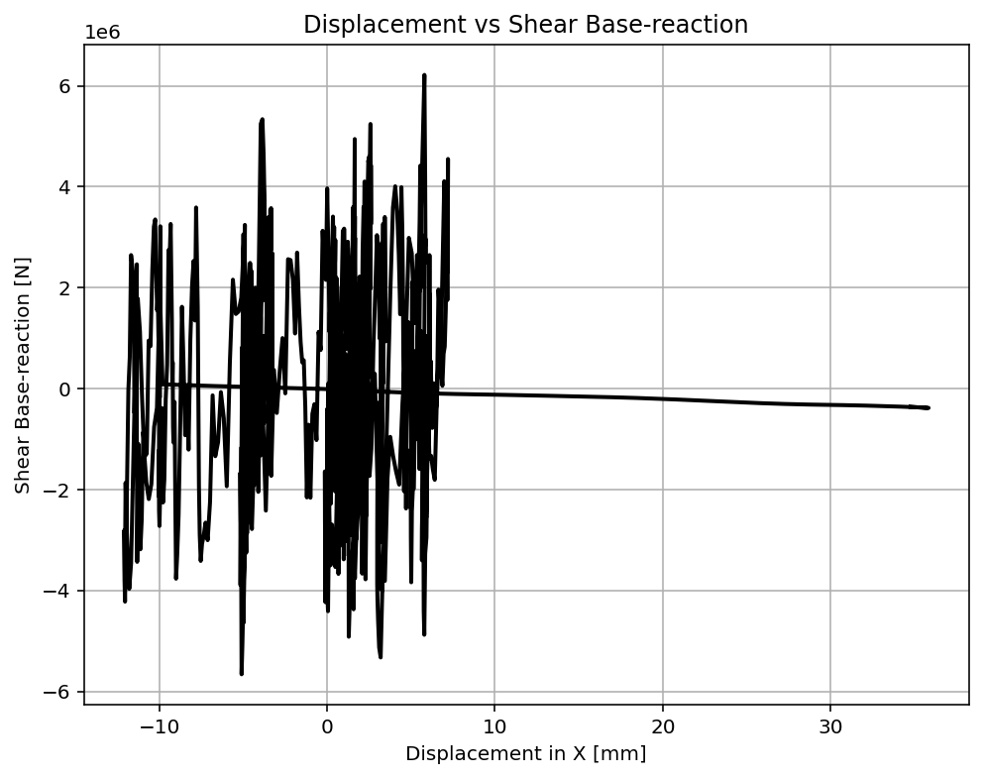

Slide 23
