Slide 1
IN THE NAME OF ALLAH, THE MOST GRACIOUS, THE MOST MERCIFUL
COMPARATIVE STUDY OF ELASTIC AND INELASTIC STRUCTURAL BEHAVIOR THROUGH PUSHOVER DYNAMIC ANALYSIS. HARMONIC IMPACT LOADING ANALYSIS OF CONCRETE FRAME WITH VISCOUS DAMPER USING OPENSEES
WRITTEN BY SALAR DELAVAR GHASHGHAEI (QASHQAI)

Slide 2
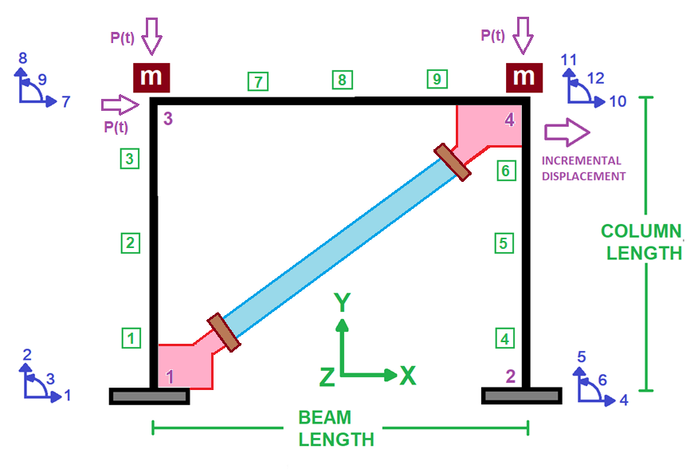

Slide 3
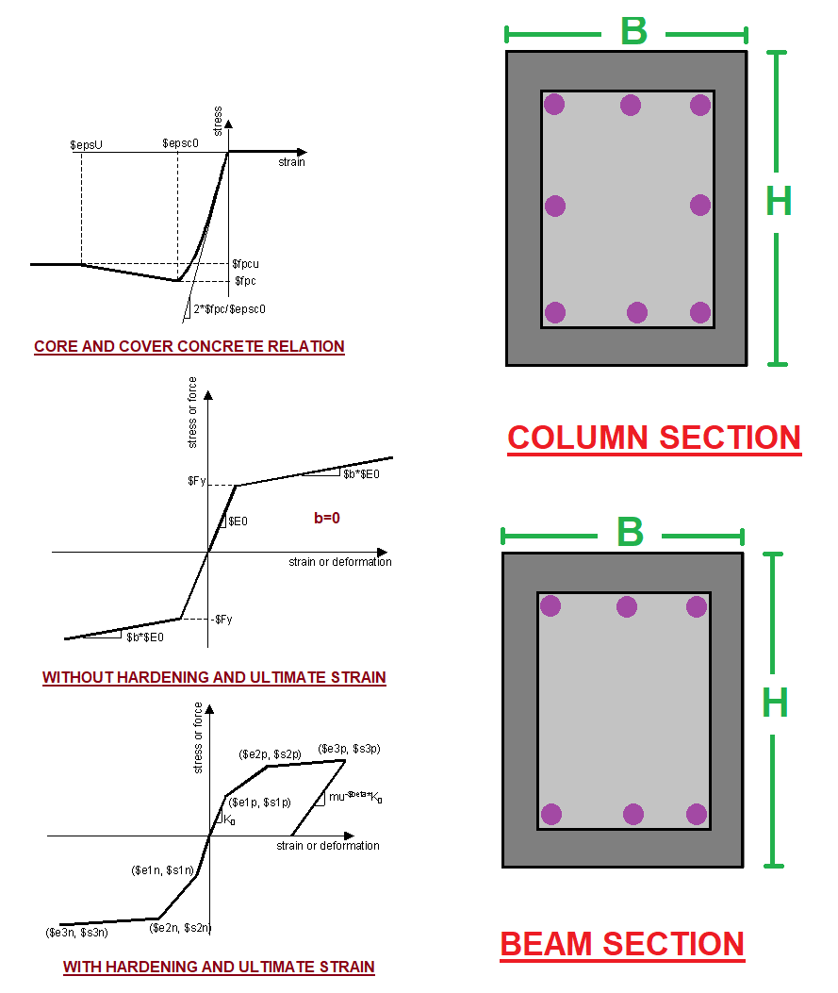

Slide 4
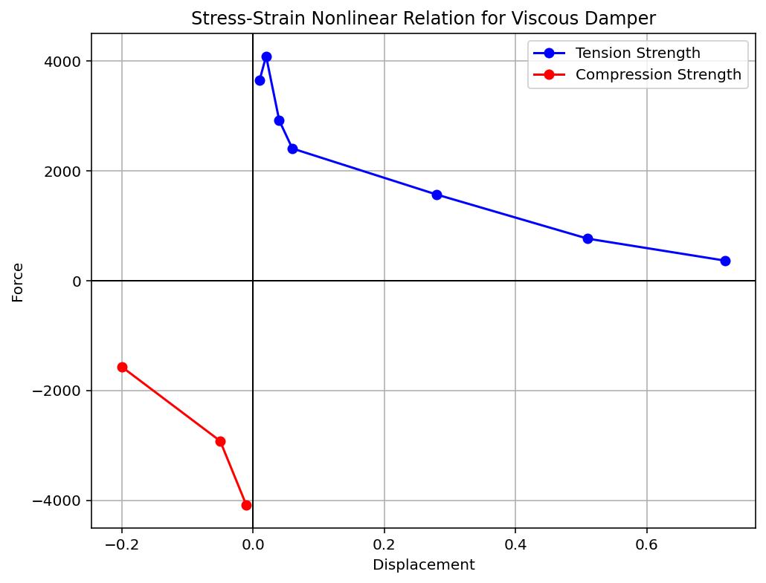

Slide 5
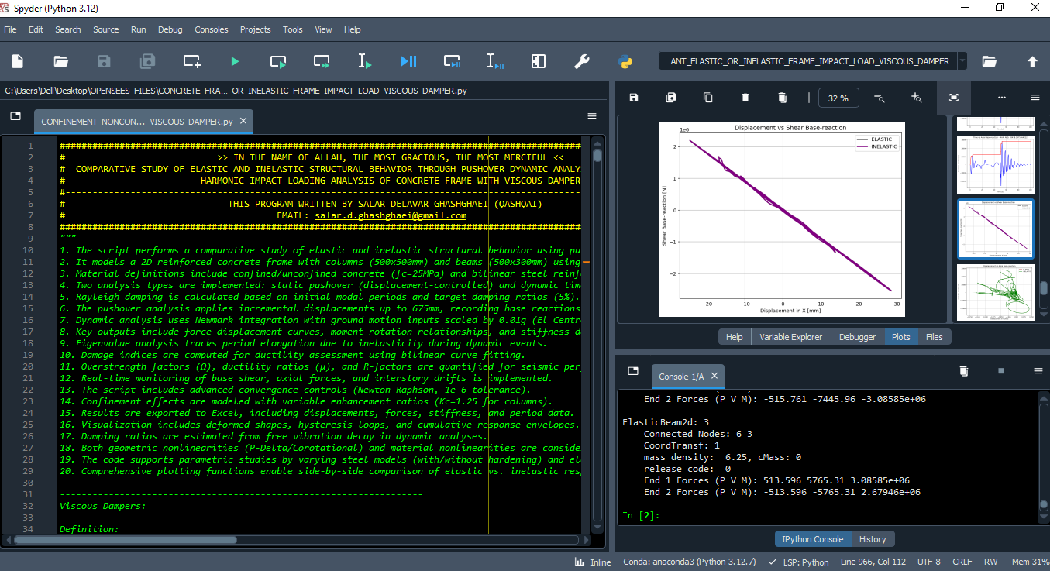

Slide 6
ELASTIC AND INELASTIC STATIC ANALYSIS
(PUSHOVER)

Slide 7
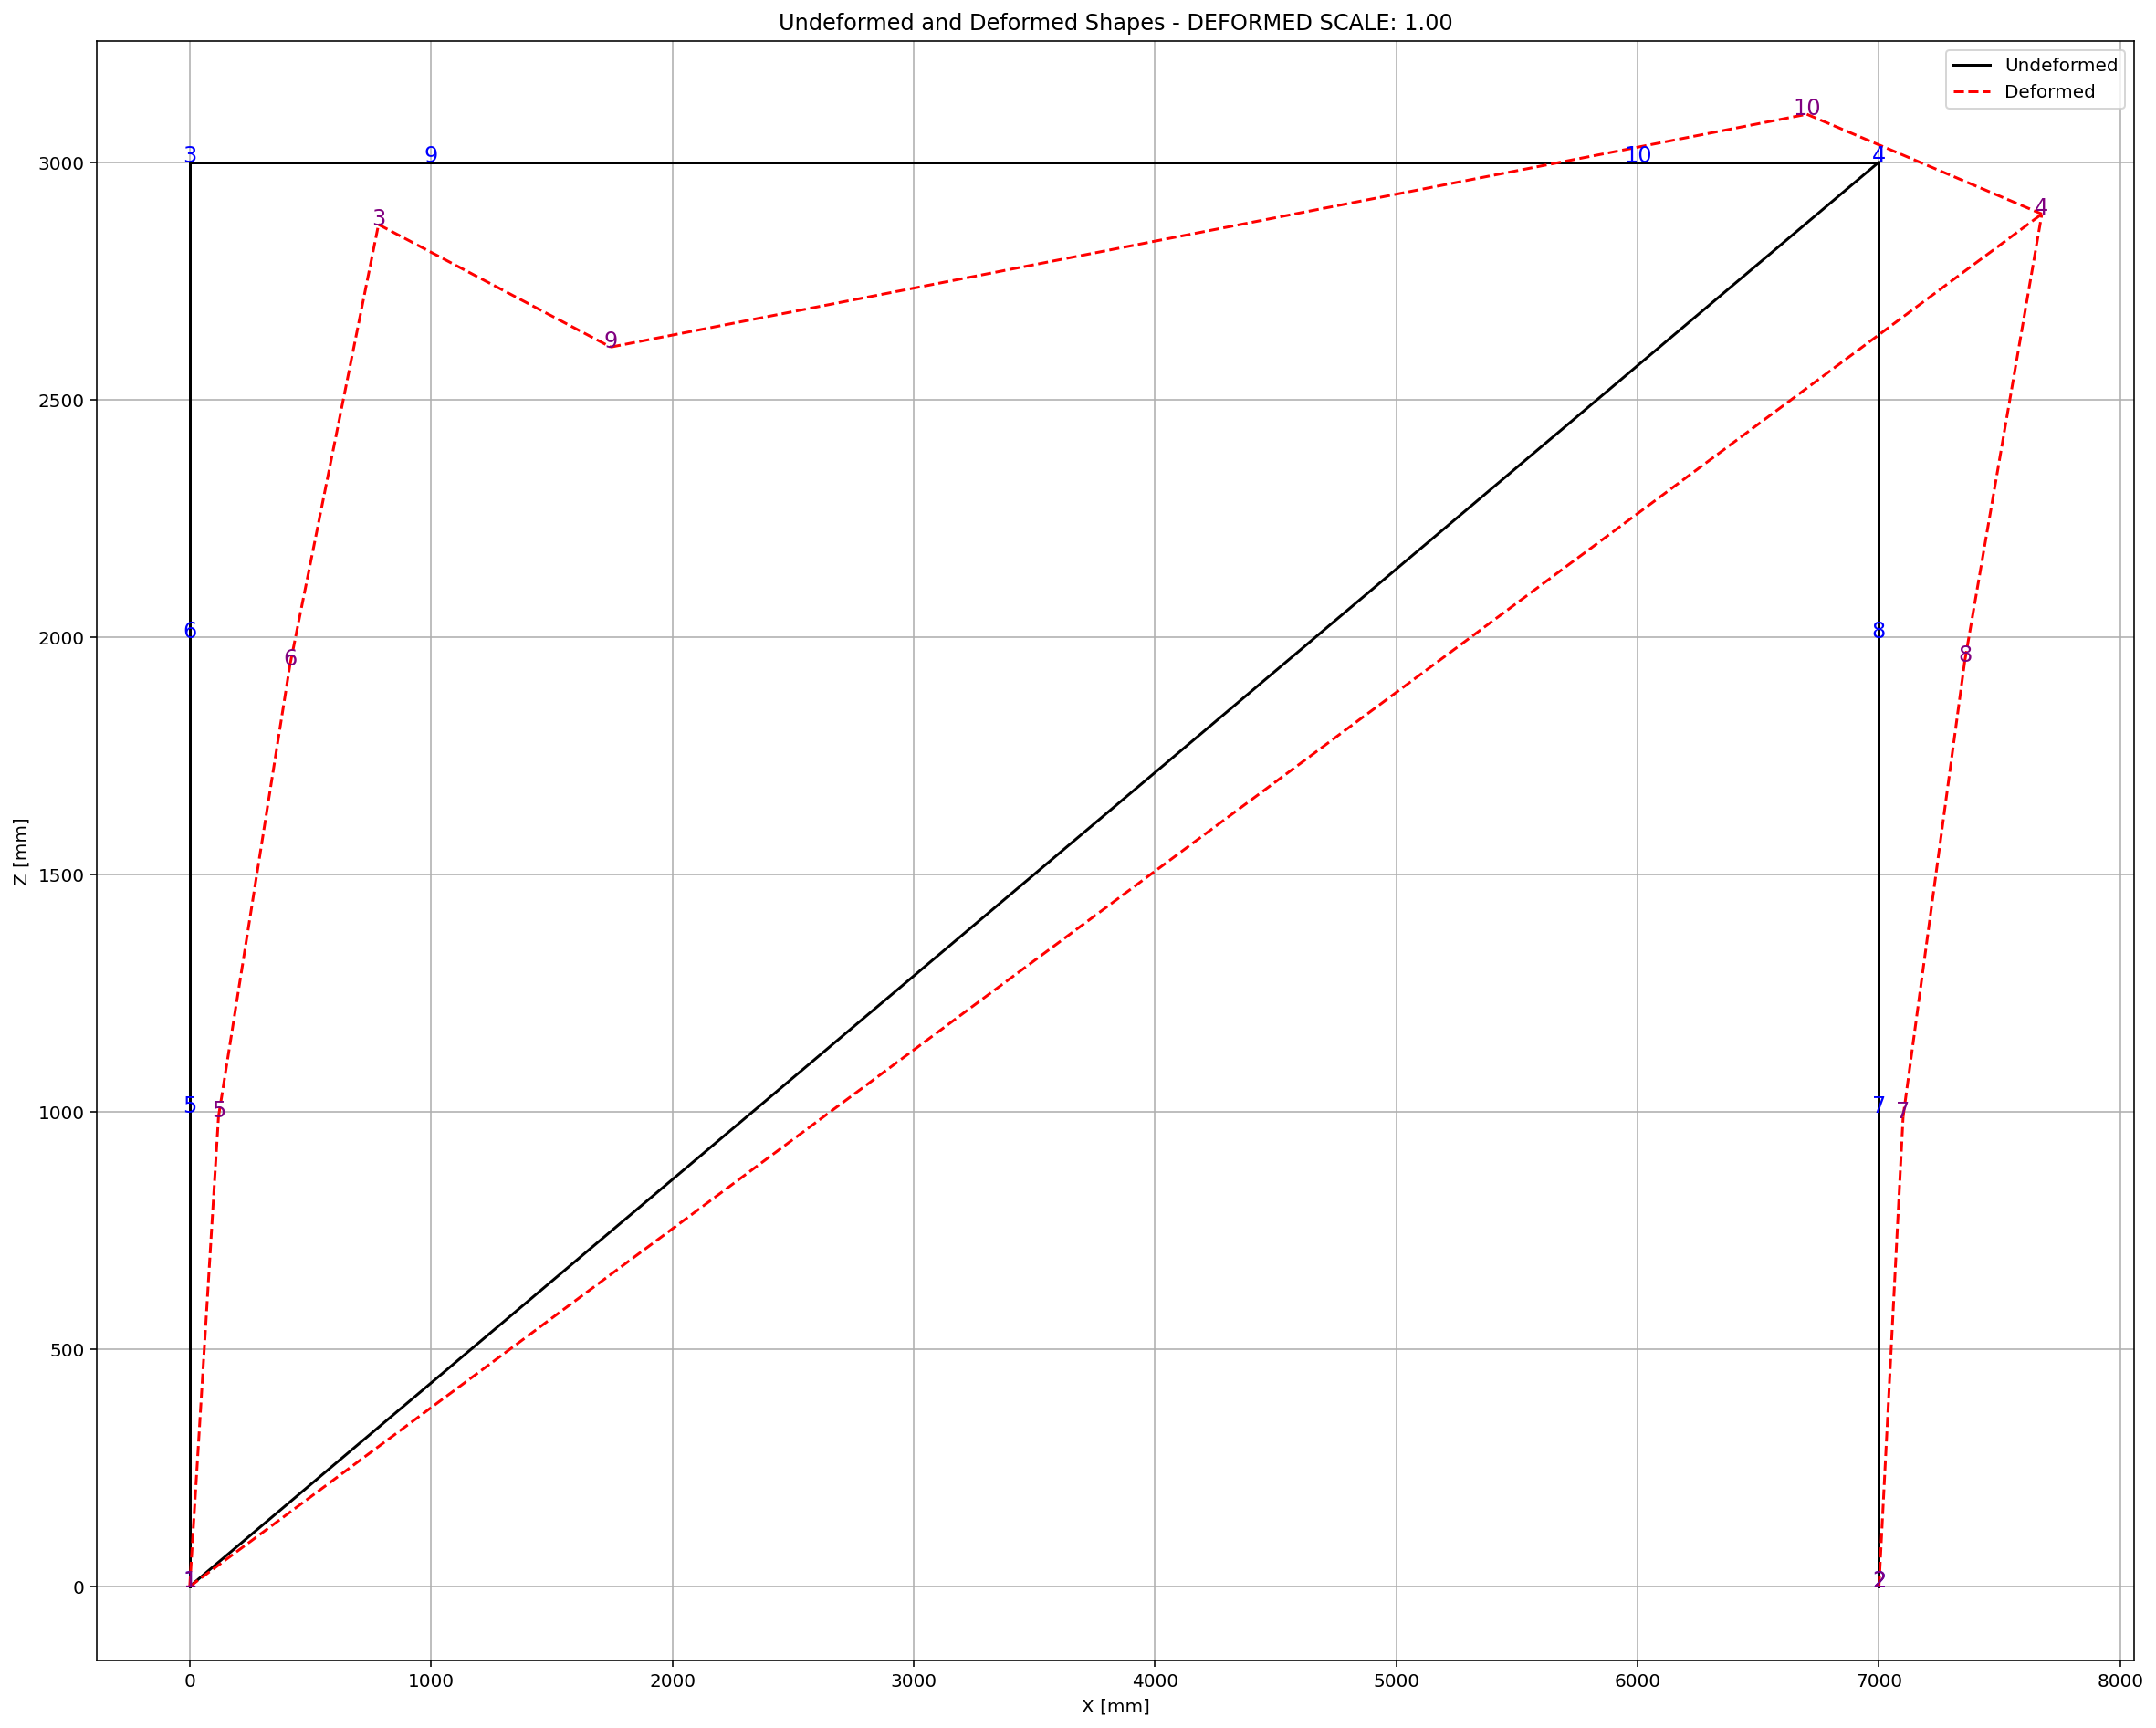

Slide 8
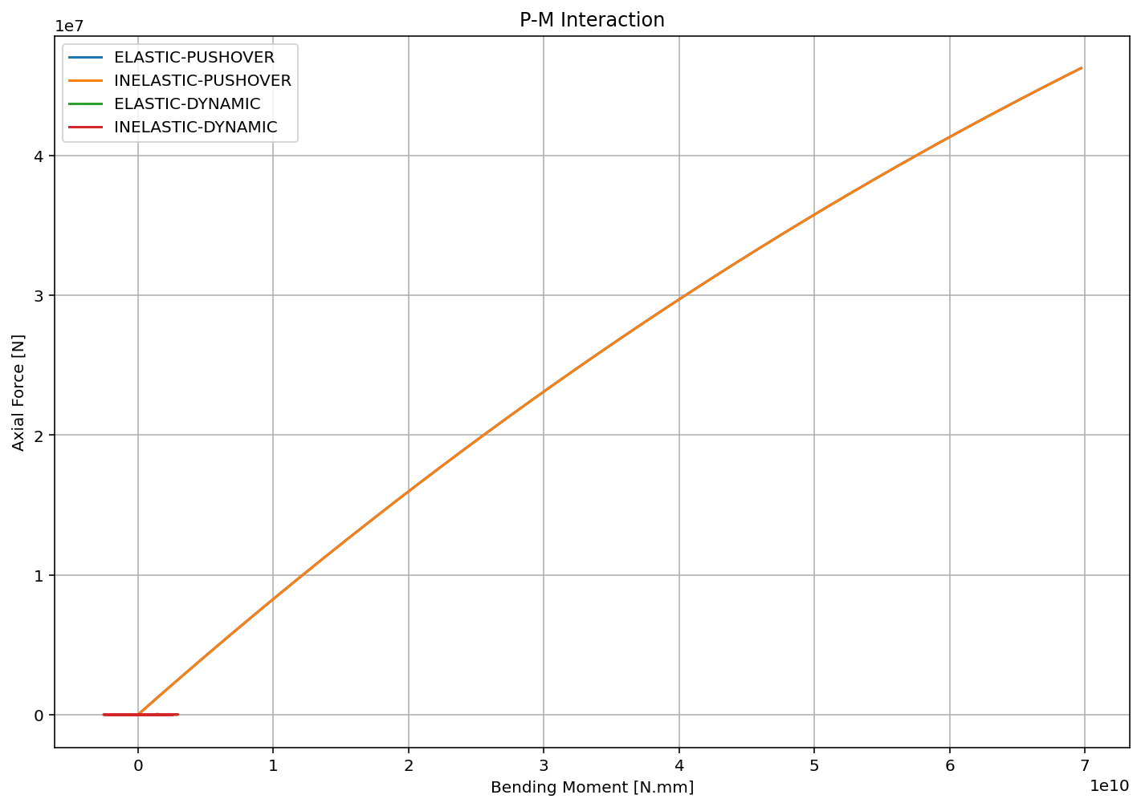

Slide 9
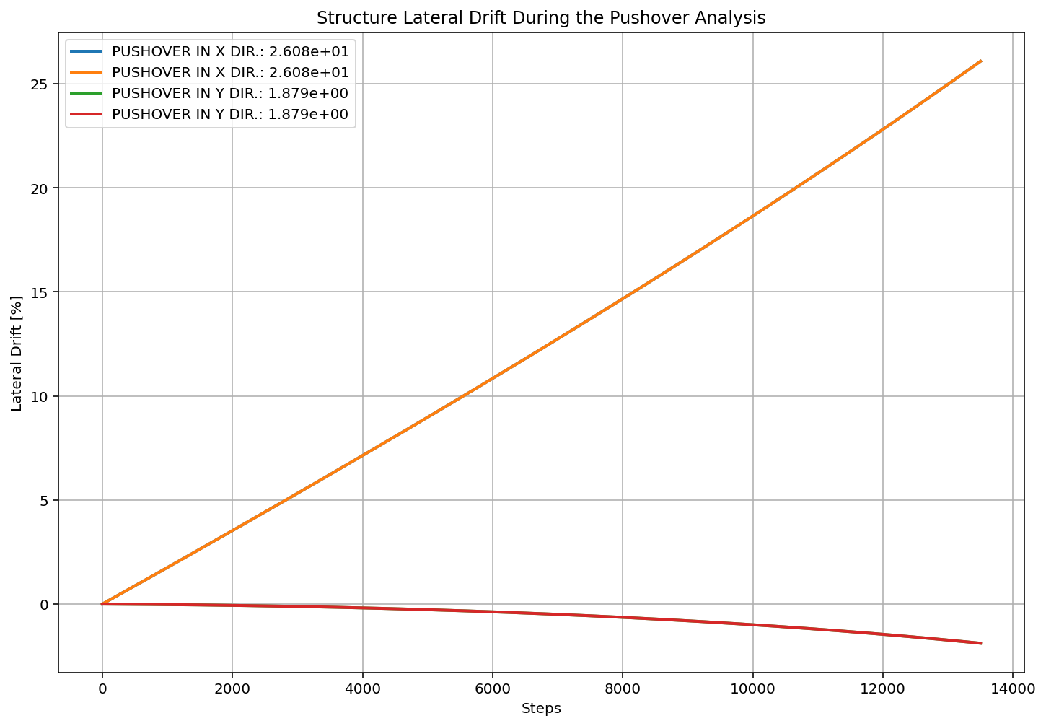

Slide 10
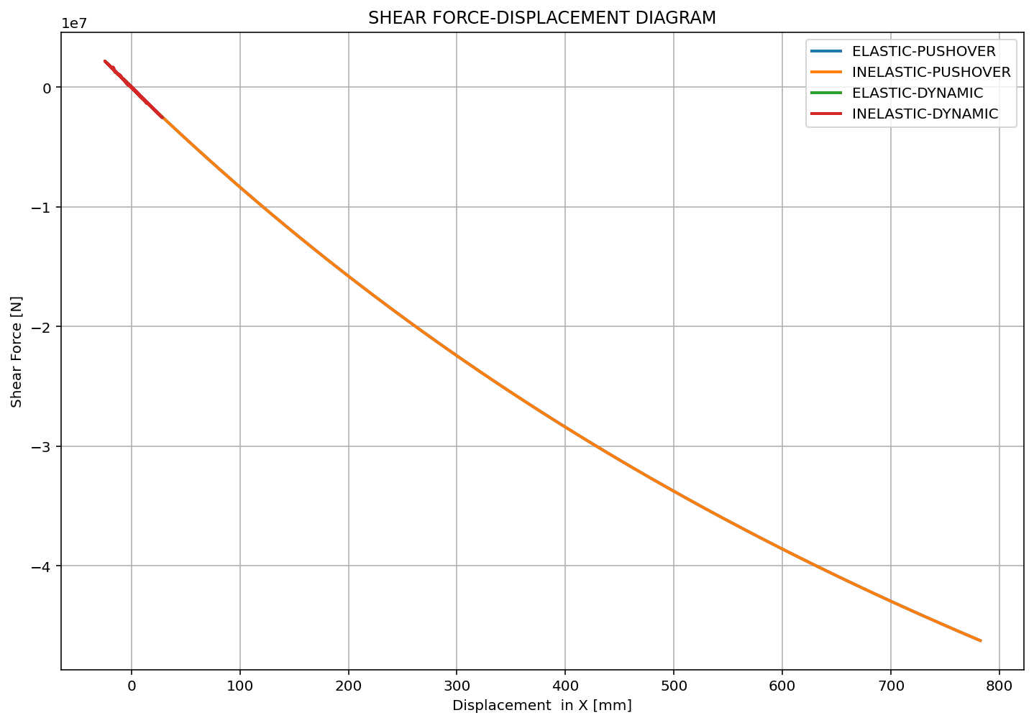

Slide 11
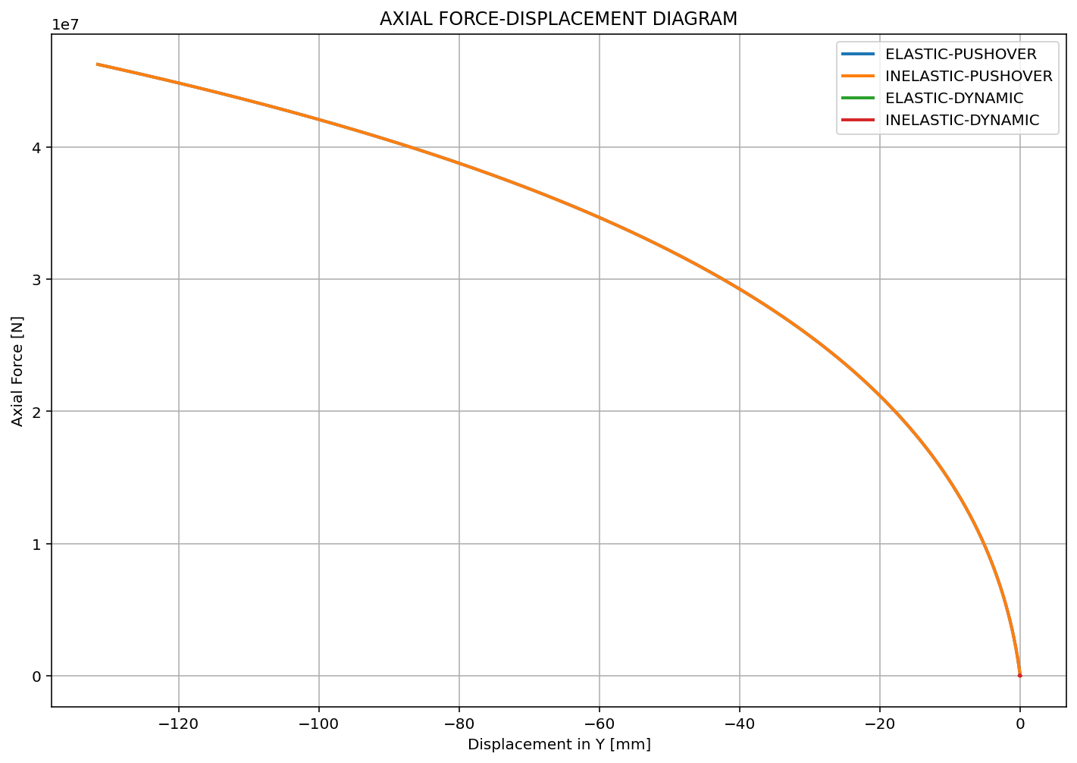

Slide 12
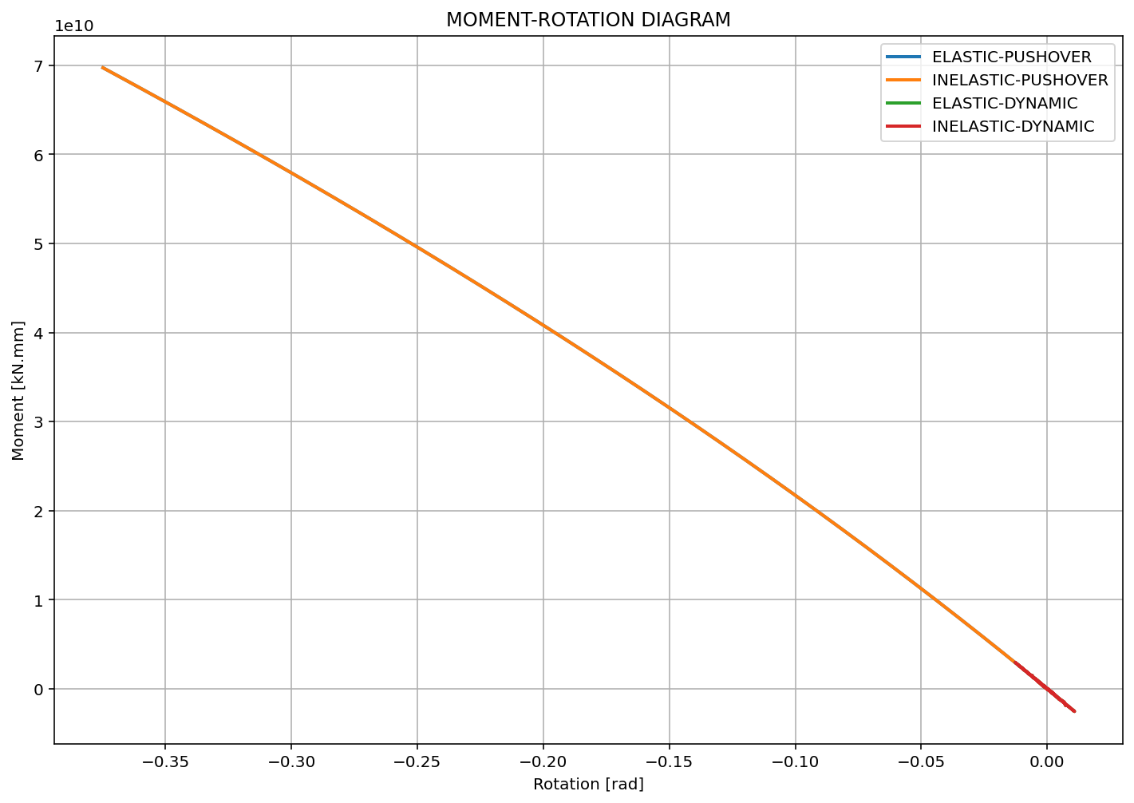

Slide 13
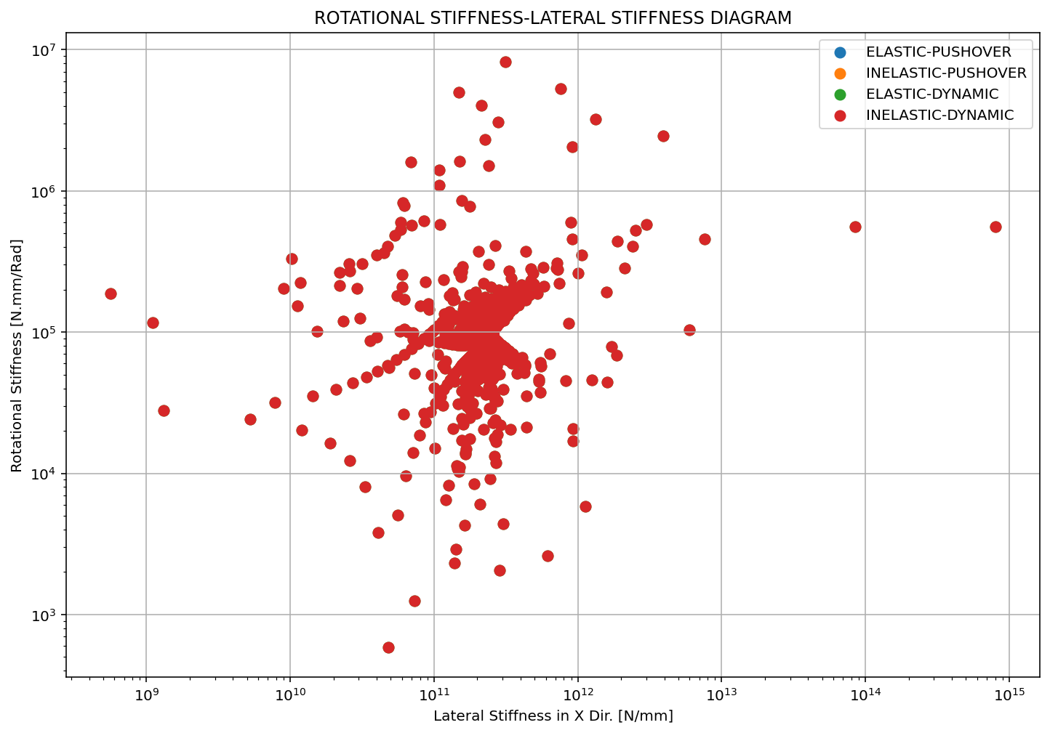

Slide 14
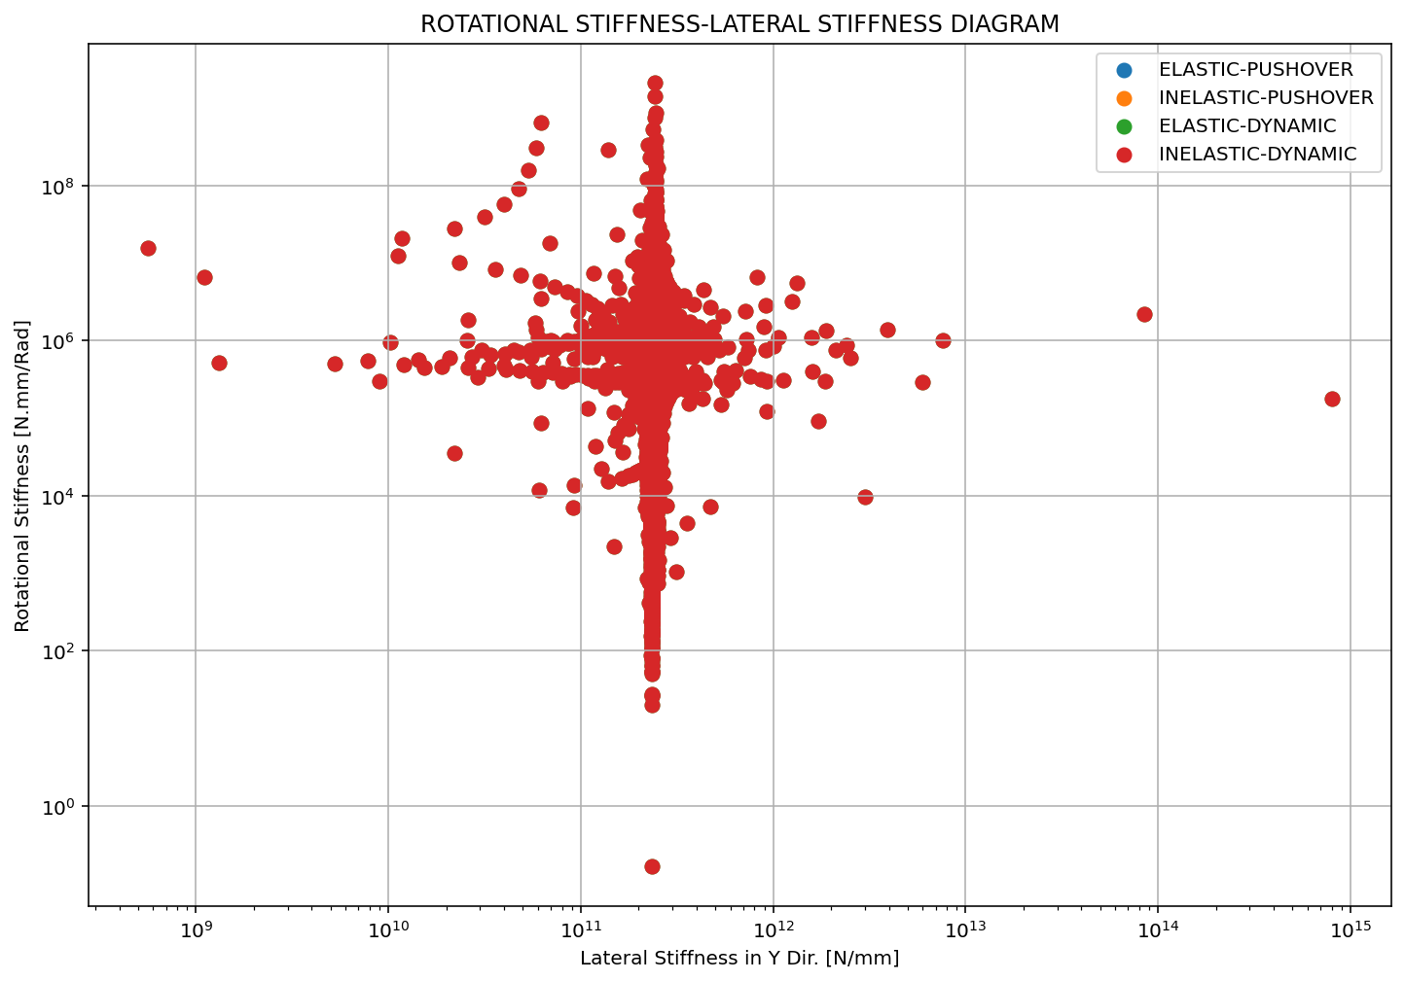

Slide 15
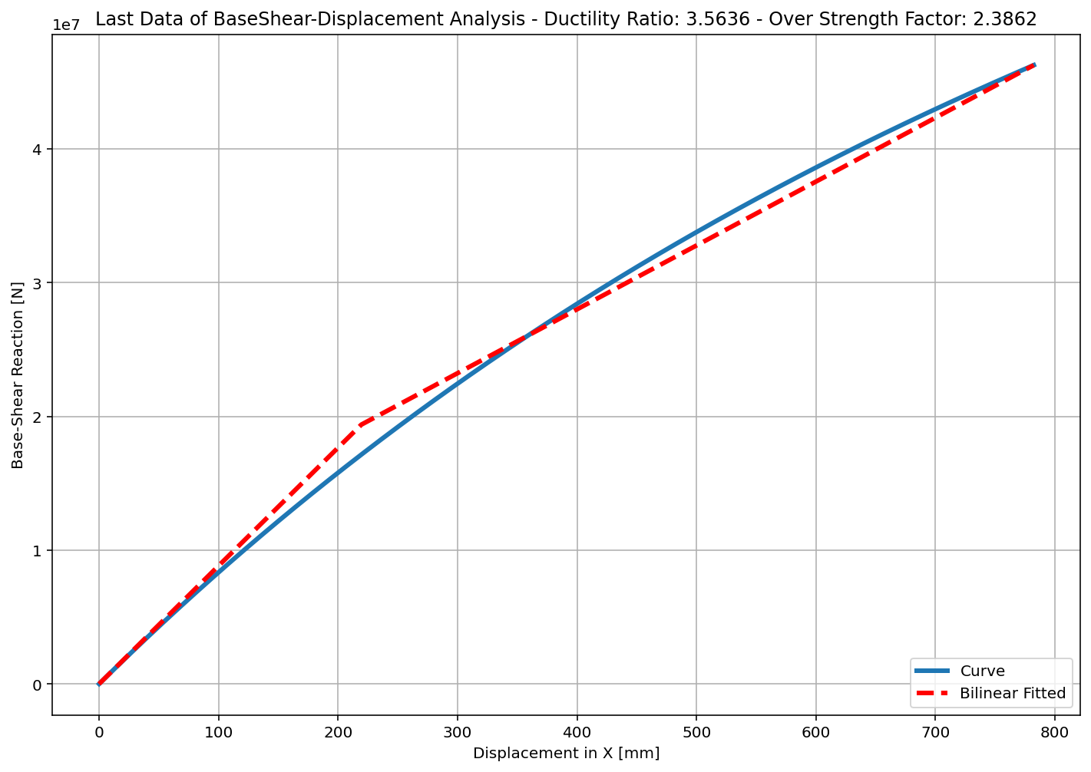
+==========================+
= Analysis curve fitted =
Disp Base Shear
----------------------------
[[0.00000000e+00 0.00000000e+00]
[2.19526346e+02 1.93813588e+07]
[7.82314246e+02 4.62474860e+07]]
+==========================+
+----------------------------------------------------+
Structure Elastic Stiffness : 88287.17
Structure Plastic Stiffness : 59116.25
Structure Tangent Stiffness : 47737.57
Structure Ductility Ratio : 3.56
Structure Over Strength Factor: 2.39
+----------------------------------------------------+
Over Strength Coefficient (Ω0): 2.3862
Displacement Ductility Ratio (μ): 3.5636
Ductility Coefficient (Rμ): 3.5636
Structural Behavior Coefficient (R): 8.5035
Structural Ductility Damage Index in X Direction: -0.3393

Slide 16
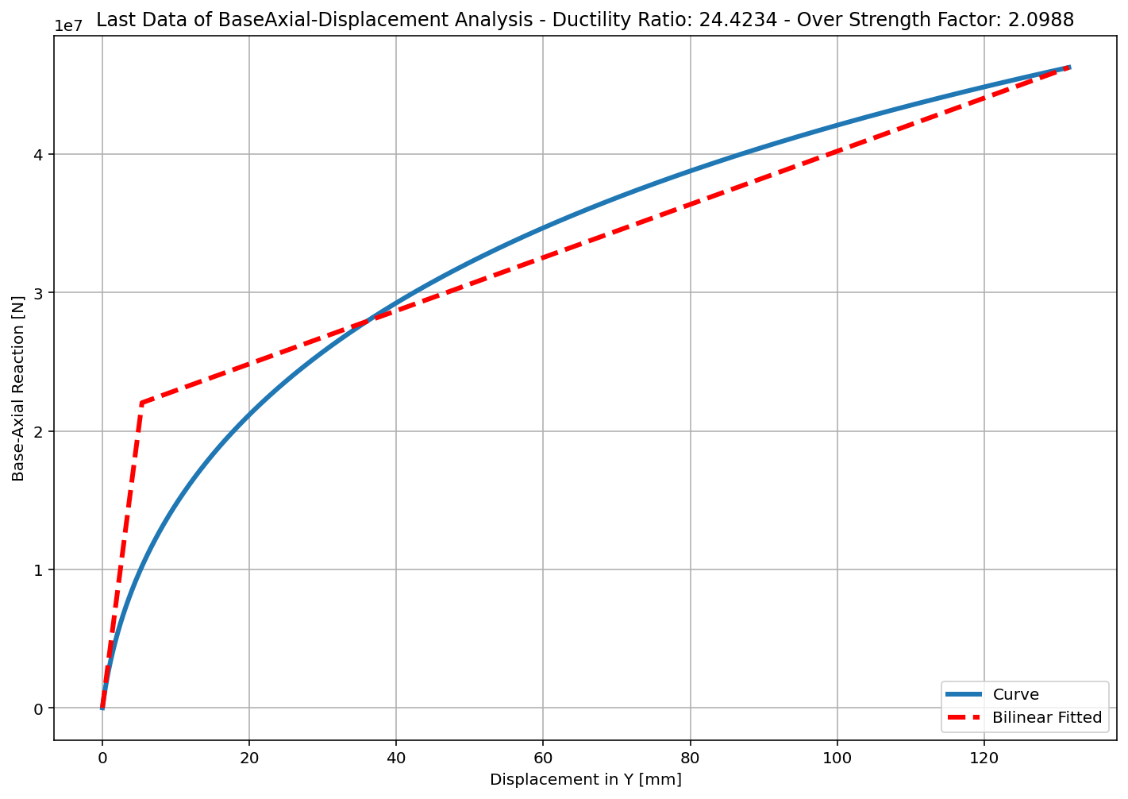
+==========================+
= Analysis curve fitted =
Disp Base Shear
----------------------------
[[0.00000000e+00 0.00000000e+00]
[5.38492101e+00 2.20350353e+07]
[1.31517948e+02 4.62474860e+07]]
+==========================+
+----------------------------------------------------+
Structure Elastic Stiffness : 4091988.59
Structure Plastic Stiffness : 351643.91
Structure Tangent Stiffness : 191959.64
Structure Ductility Ratio : 24.42
Structure Over Strength Factor: 2.10
+----------------------------------------------------+
Over Strength Coefficient (Ω0): 2.0988
Displacement Ductility Ratio (μ): 24.4234
Ductility Coefficient (Rμ): 24.4234
Structural Behavior Coefficient (R): 51.2602
Structural Ductility Damage Index in Y Direction: -0.0415

Slide 17
ELASTIC AND INELASTIC DYNAMIC ANALYSIS

Slide 18
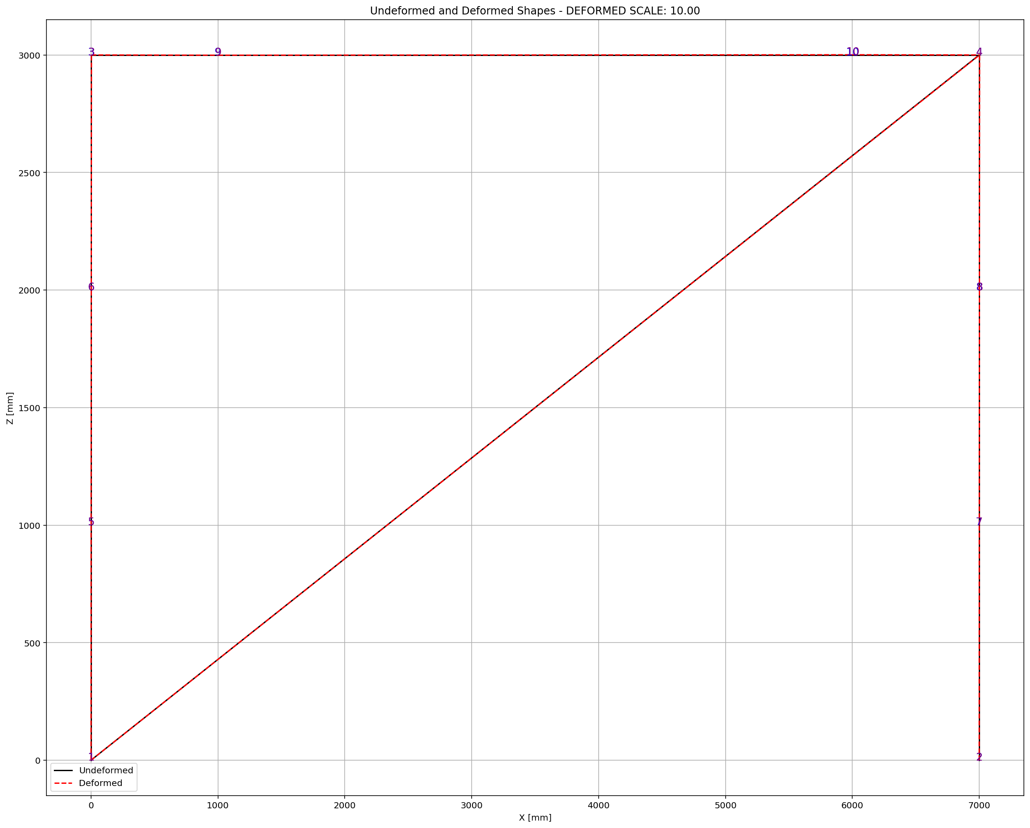

Slide 19
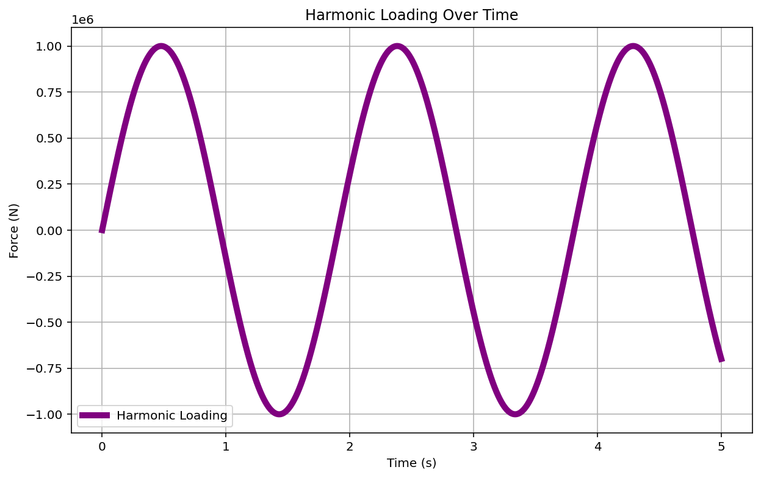

Slide 20
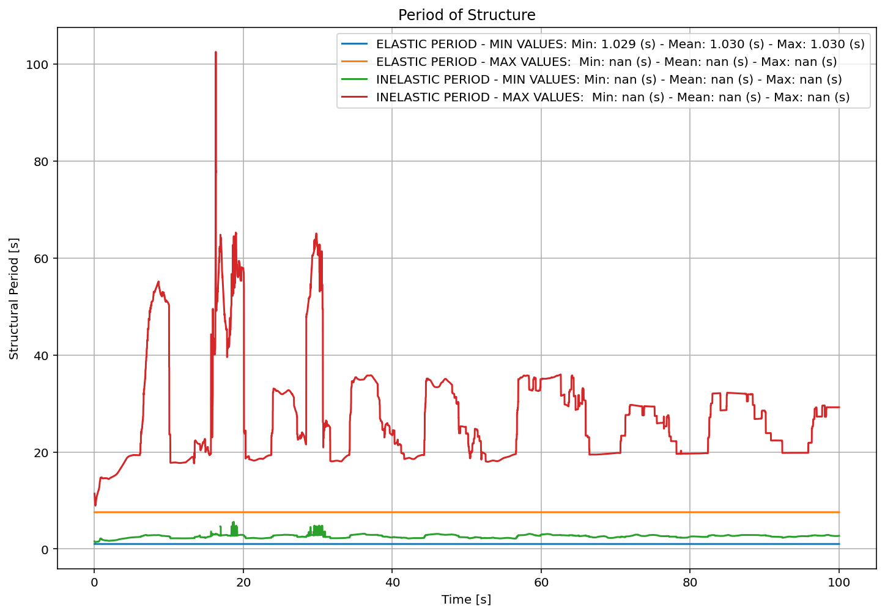

Slide 21
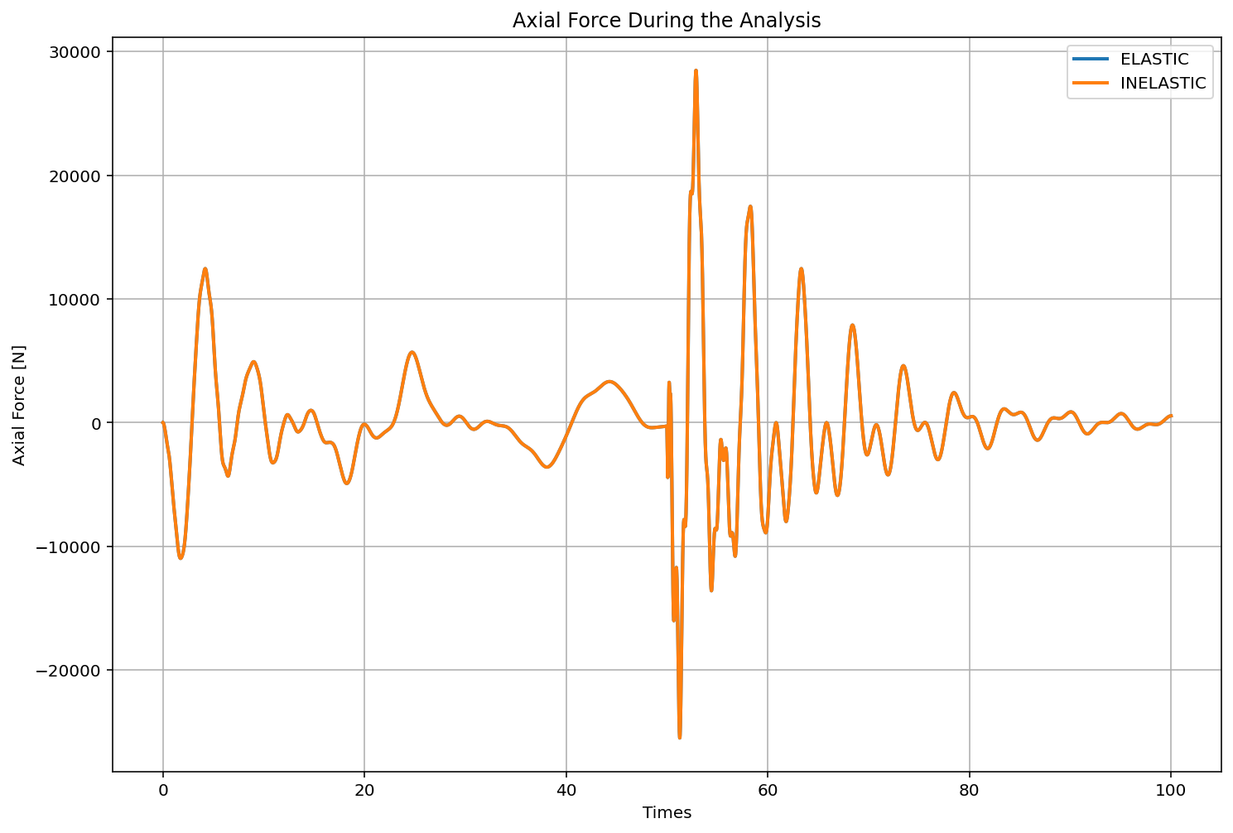

Slide 22
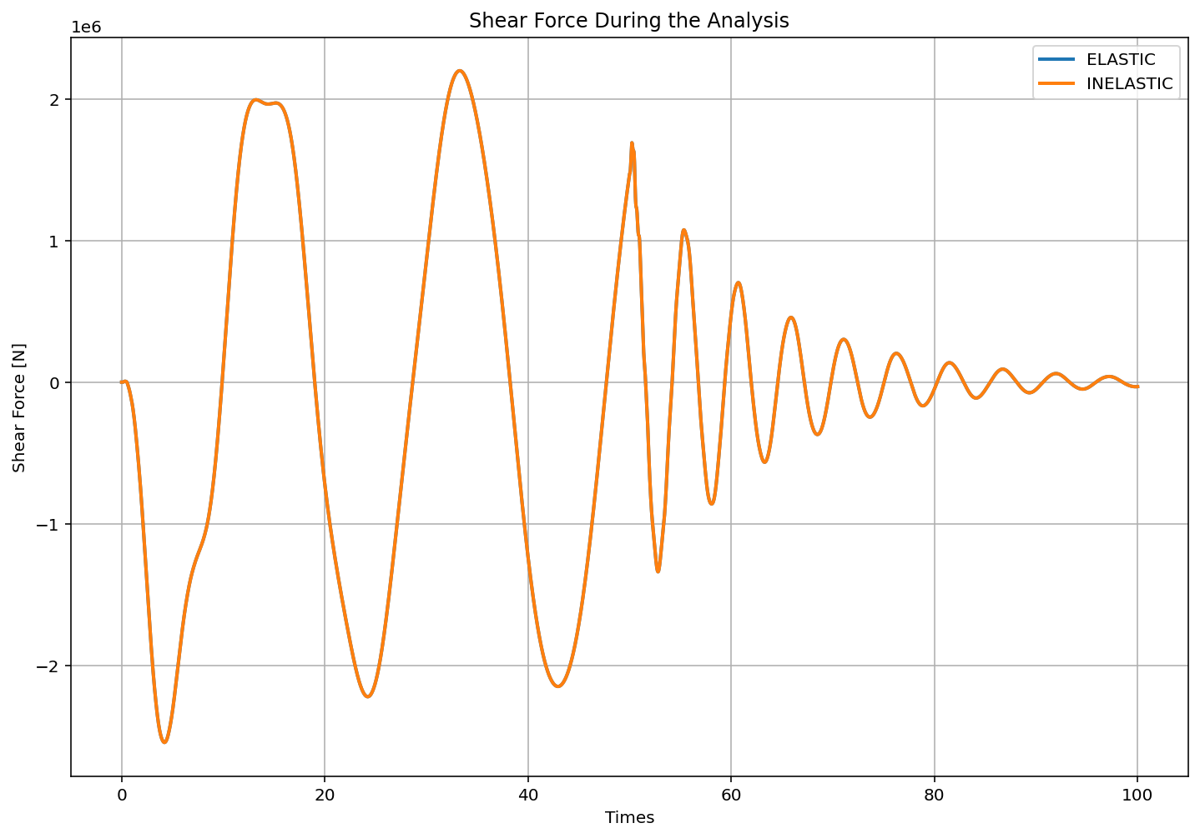

Slide 23
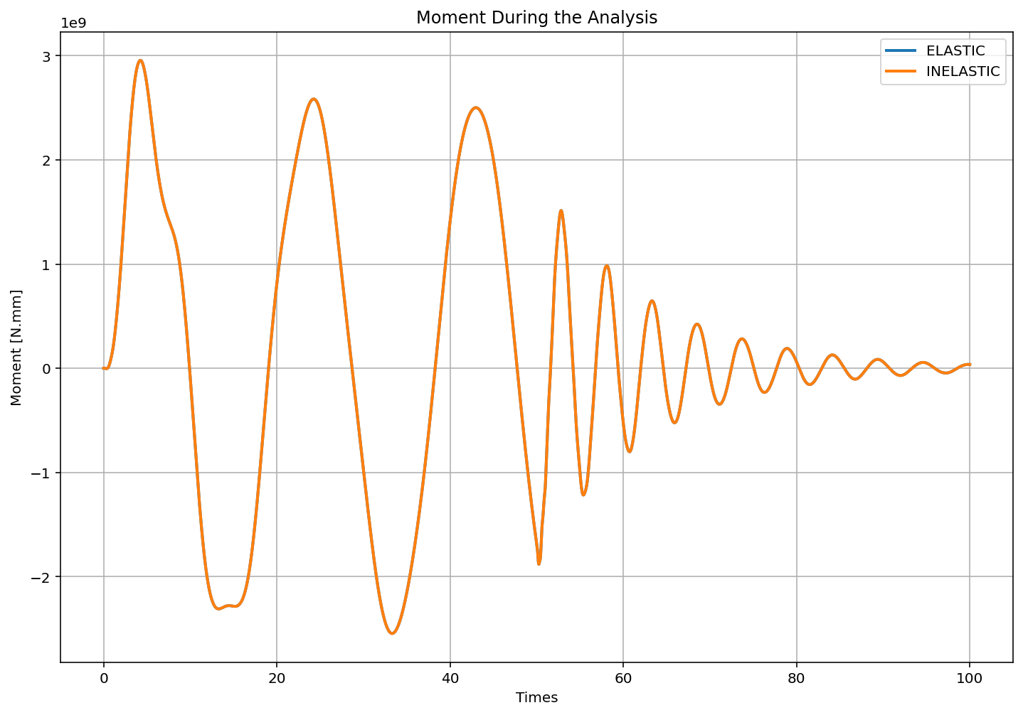

Slide 24
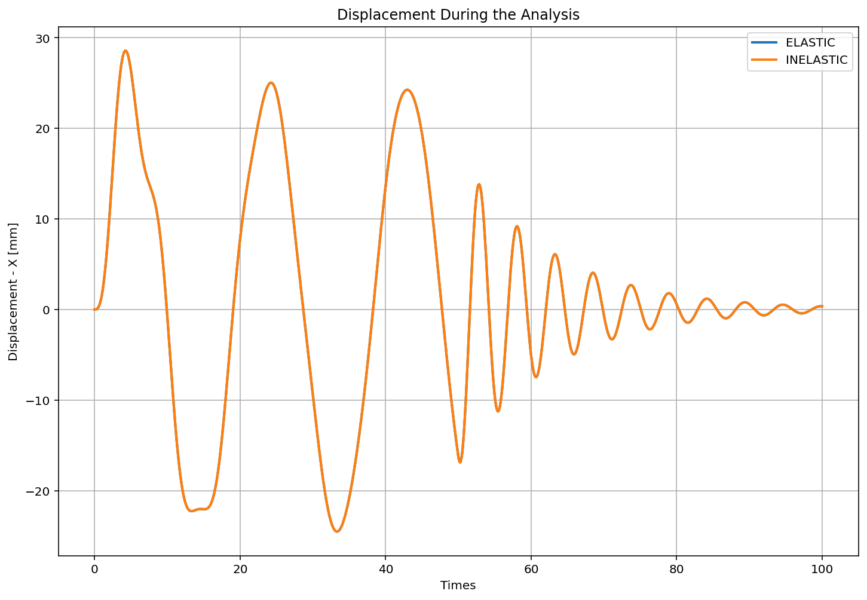

Slide 25
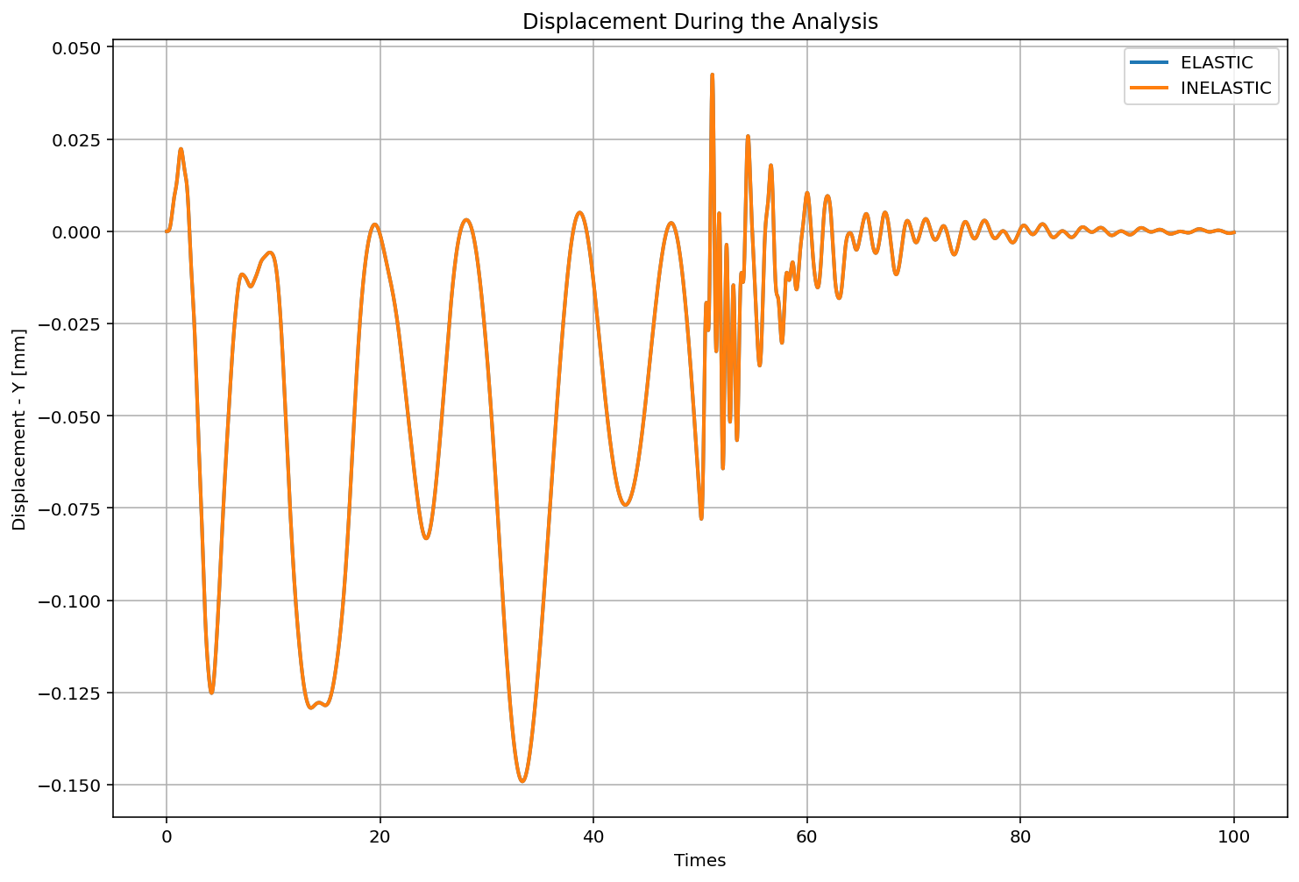

Slide 26
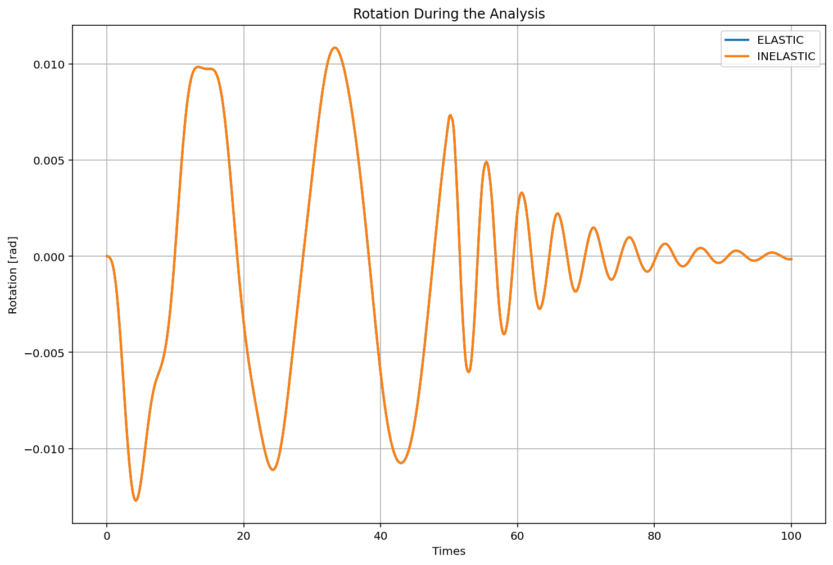

Slide 27
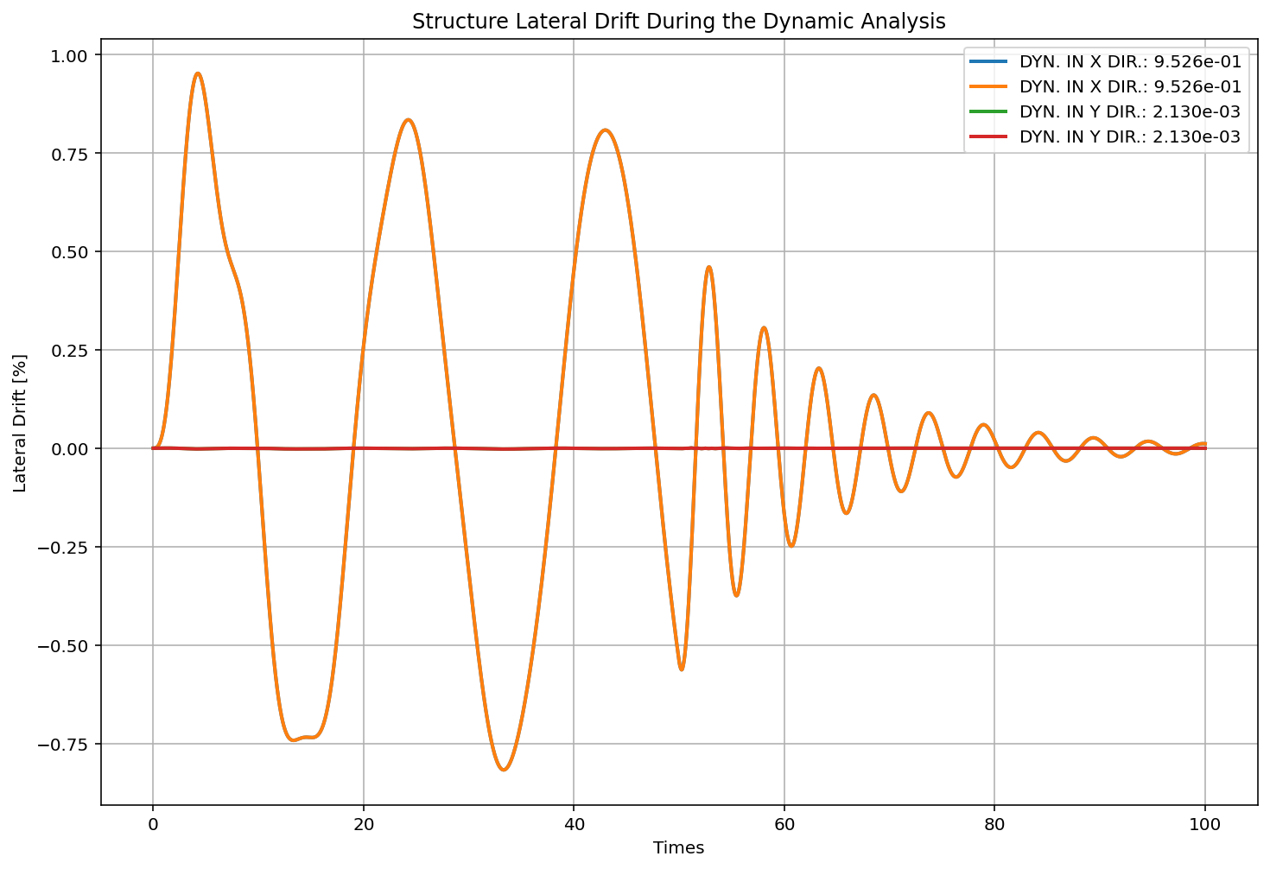

Slide 28
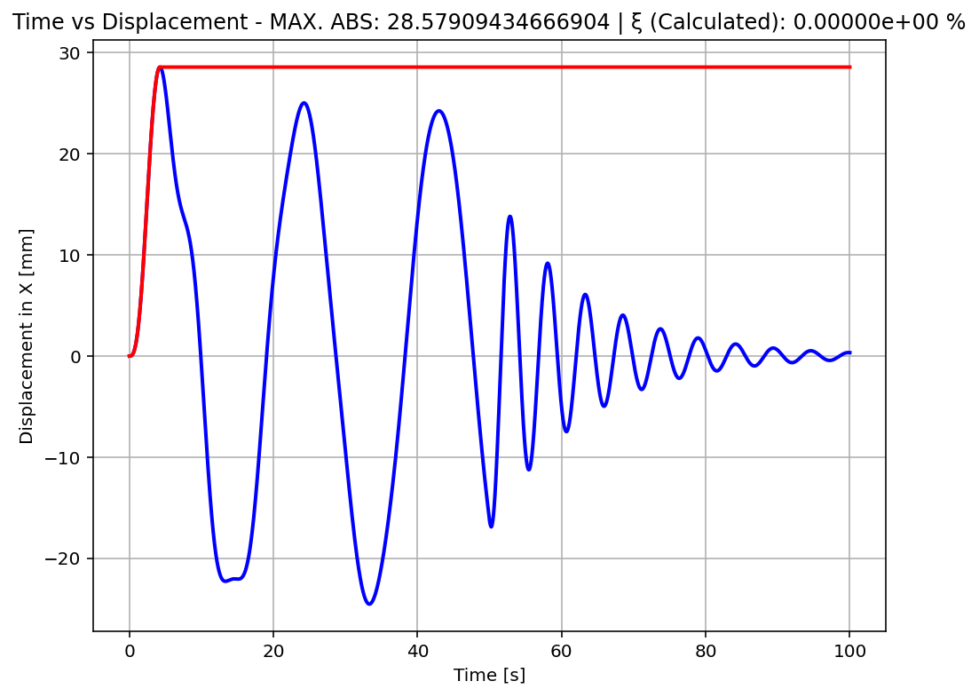

Slide 30
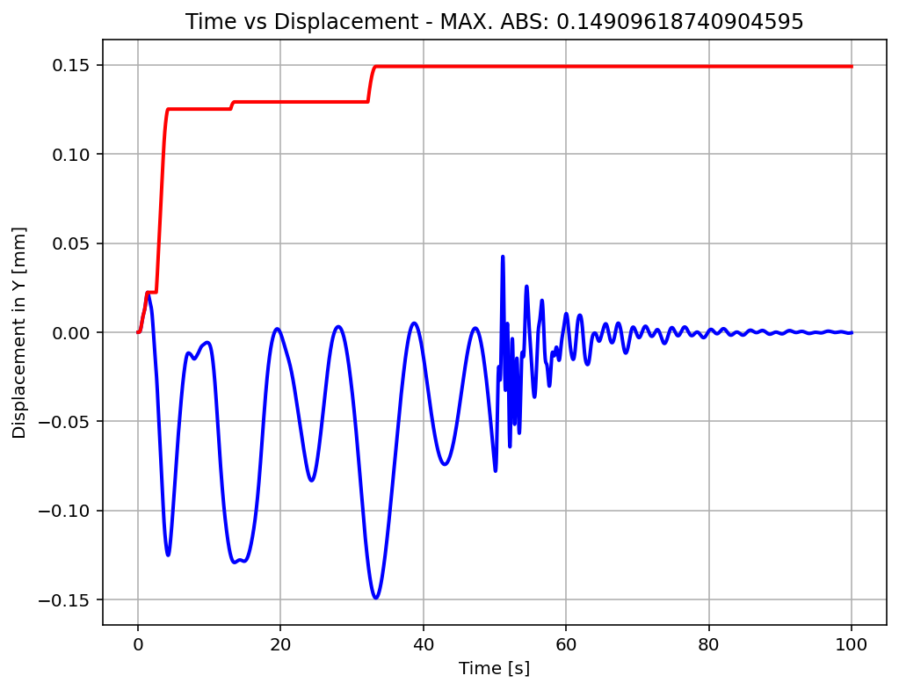

Slide 32
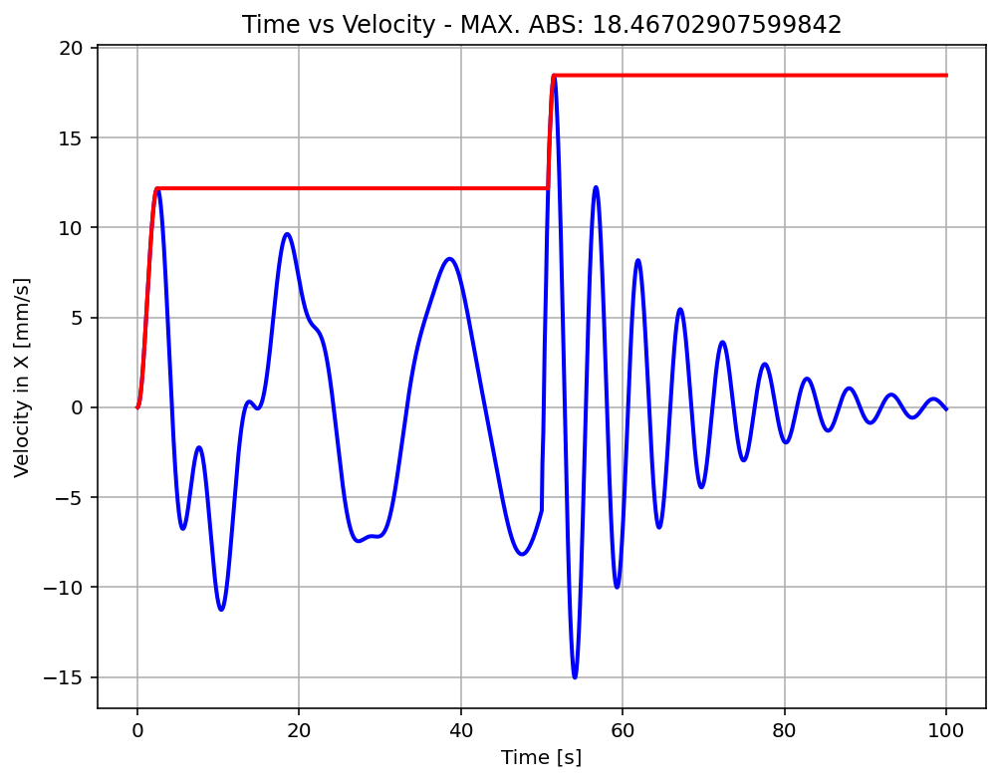

Slide 34
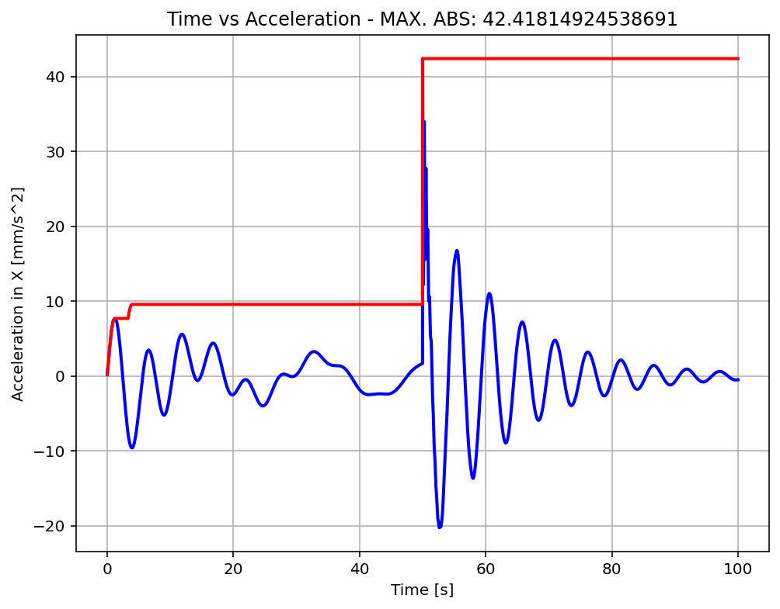

Slide 36
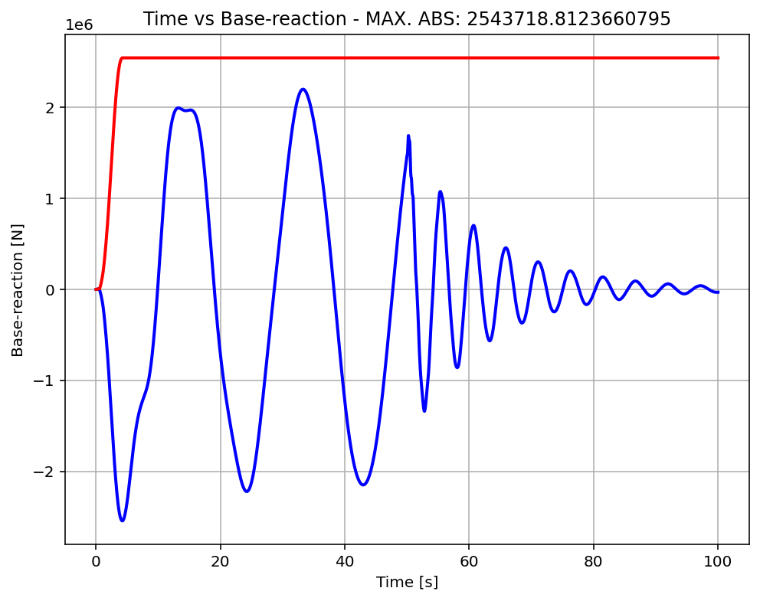

Slide 37
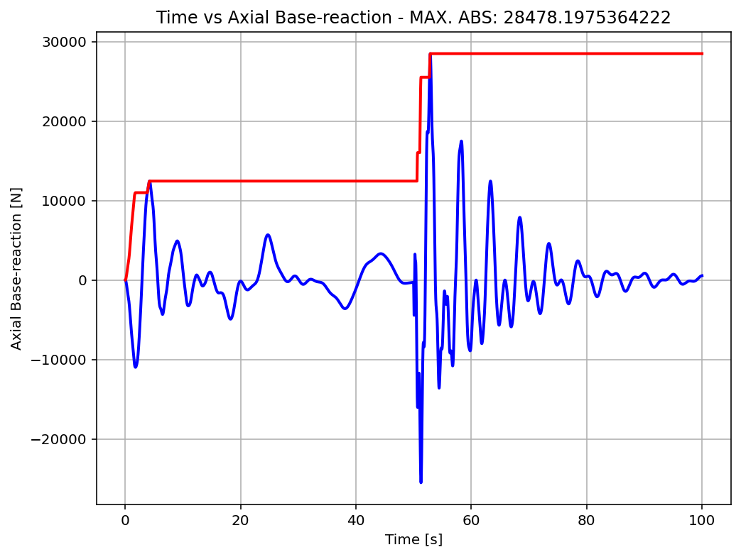

Slide 38
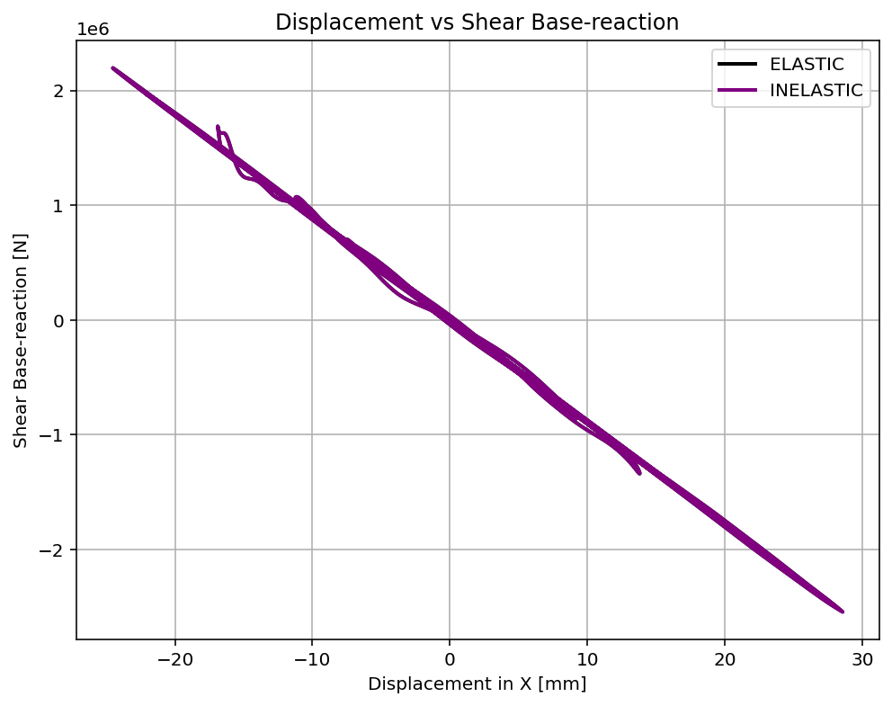

Slide 39
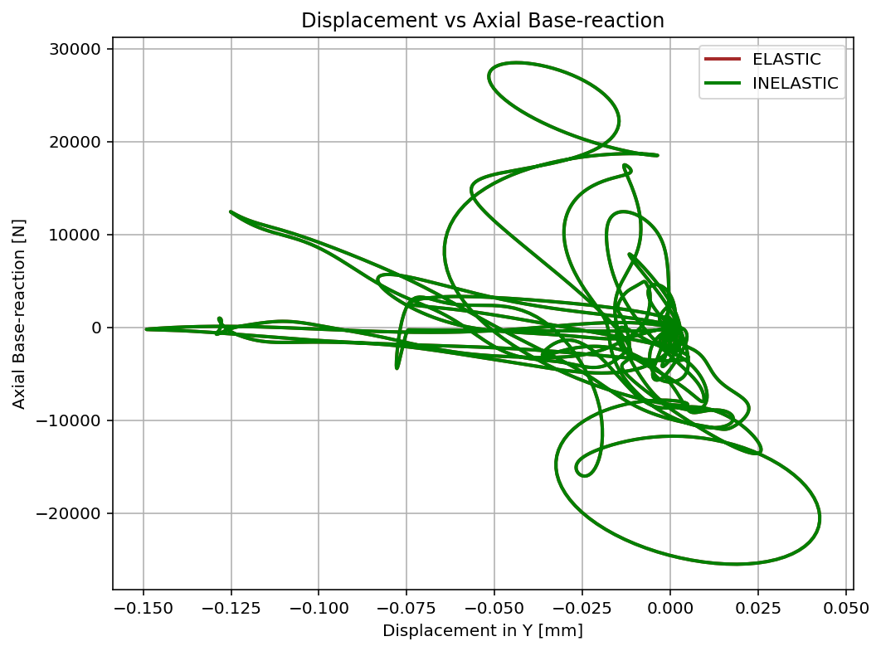

Slide 40
