Slide 1
IN THE NAME OF ALLAH, THE MOST GRACIOUS, THE MOST MERCIFUL
PUSHOVER ANALYSIS WITH INCREMENTAL RECTANGULAR OR TRIANGULAR DISTRIBUTED LOAD OF CONCRETE FRAME. EVALUATING STRAIN HARDENING AND ULTIMATE STRAIN CRITERIA USING OPENSEES
WRITTEN BY SALAR DELAVAR GHASHGHAEI (QASHQAI)

Slide 2
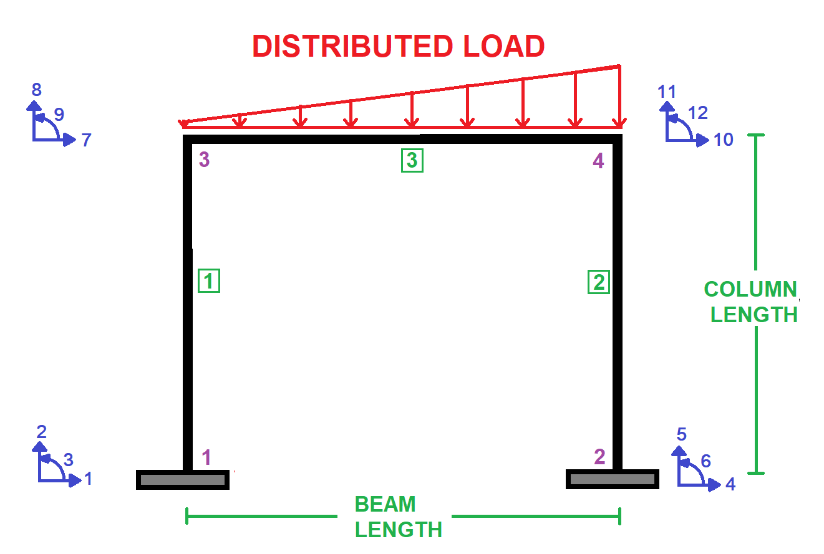

Slide 3
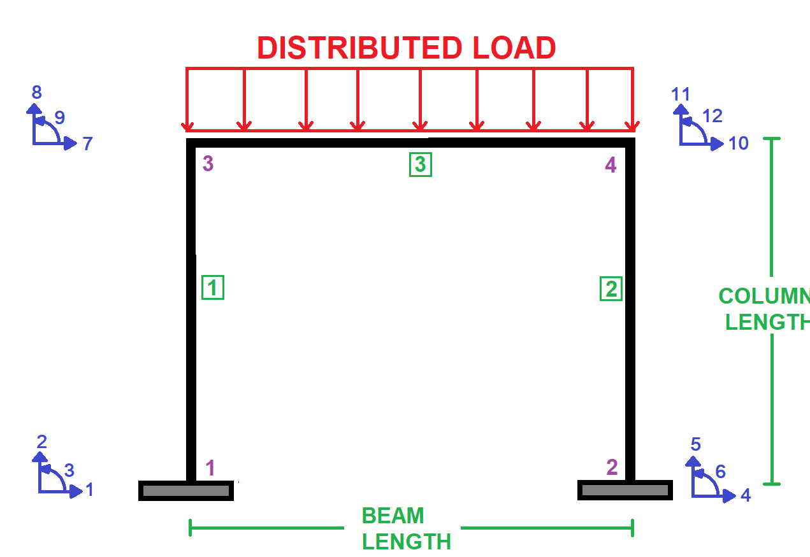

Slide 4
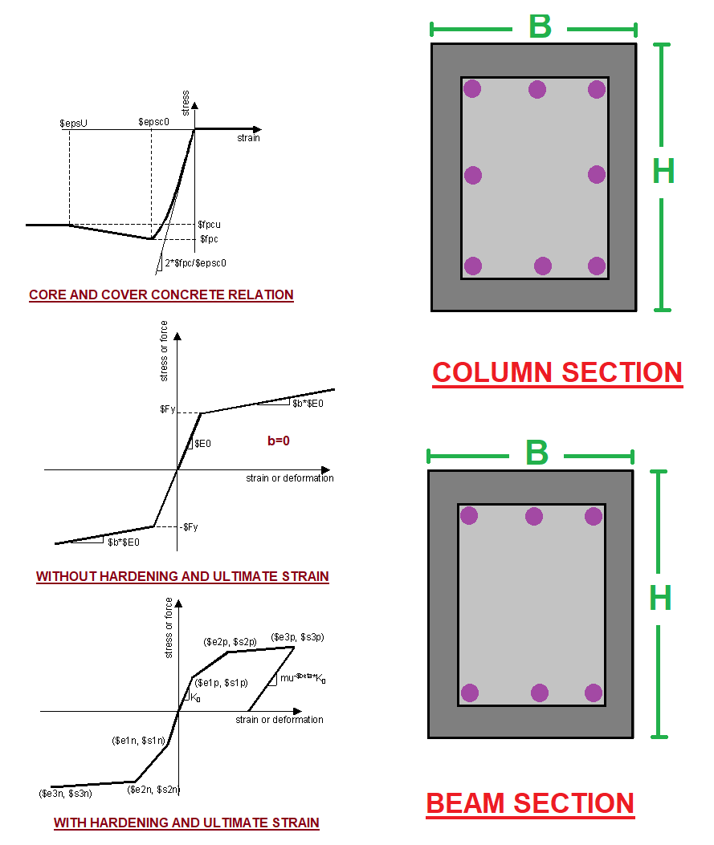

Slide 5
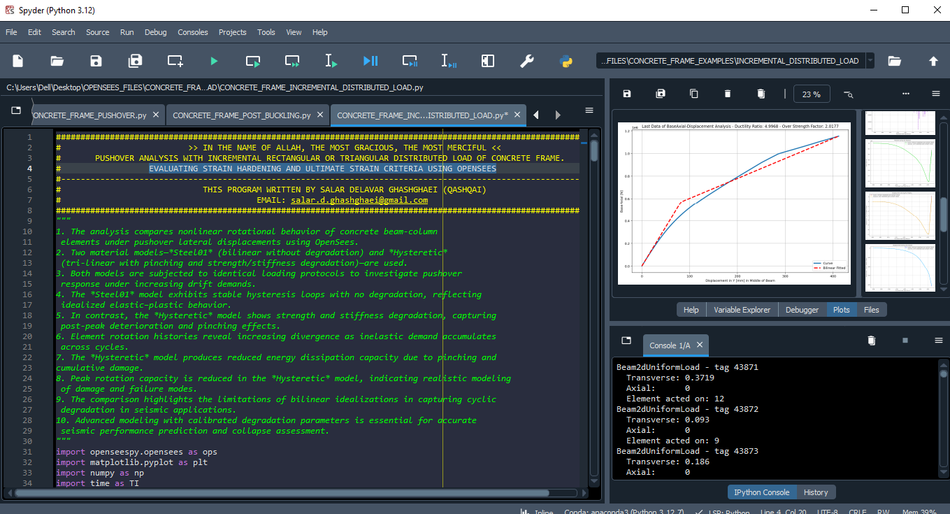

Slide 6
NONLINEAR STATIC ANALYSIS
(PUSHOVER)

Slide 7
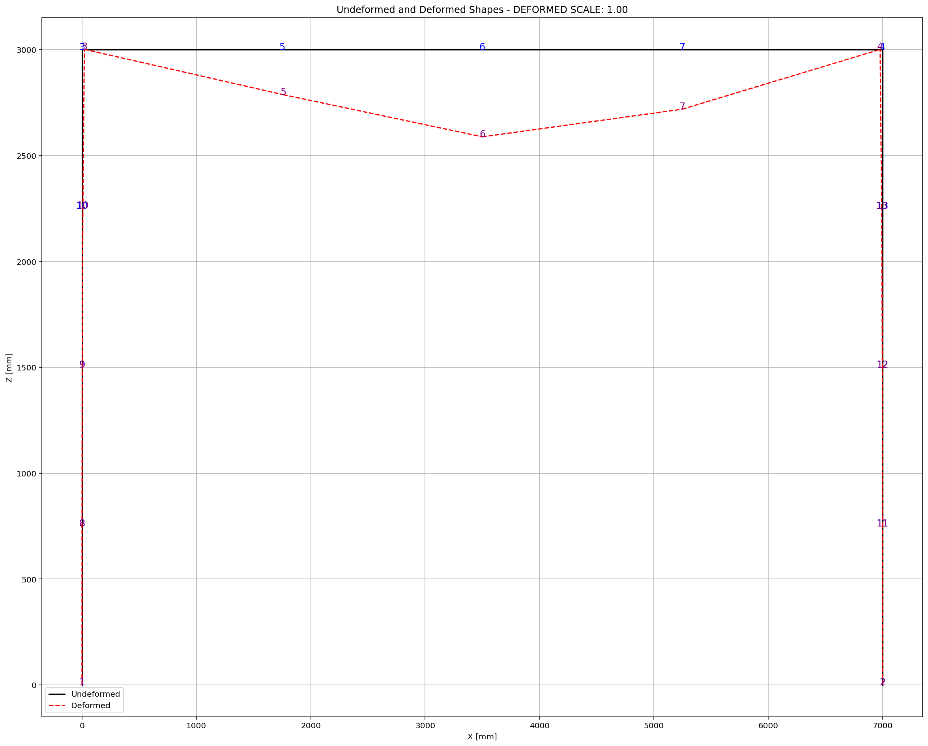

Slide 8
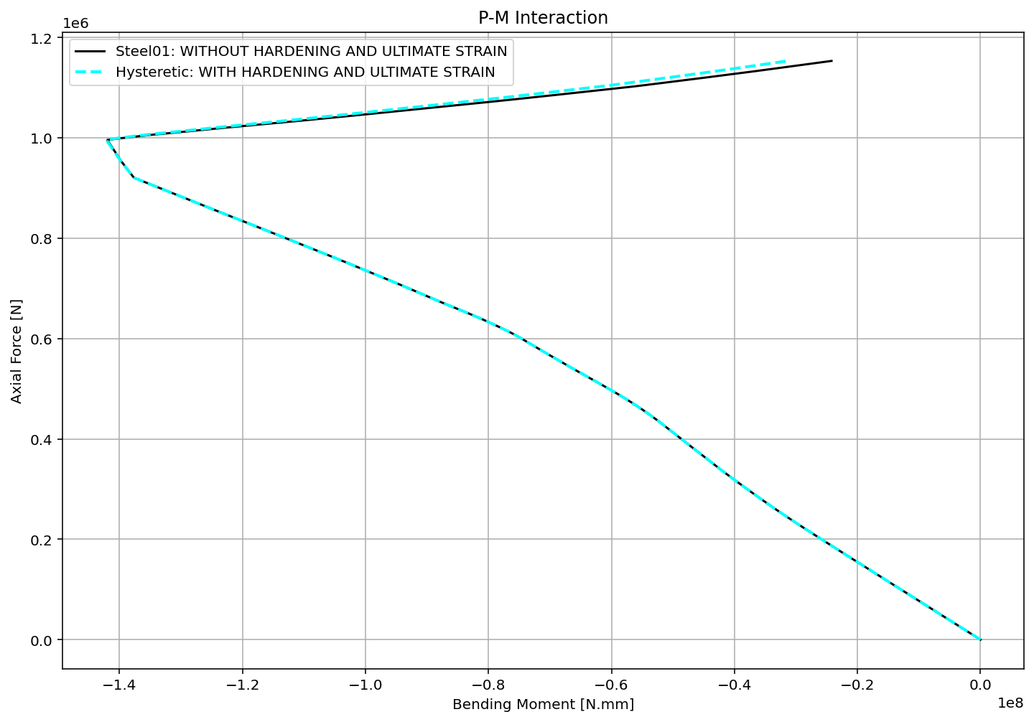

Slide 9
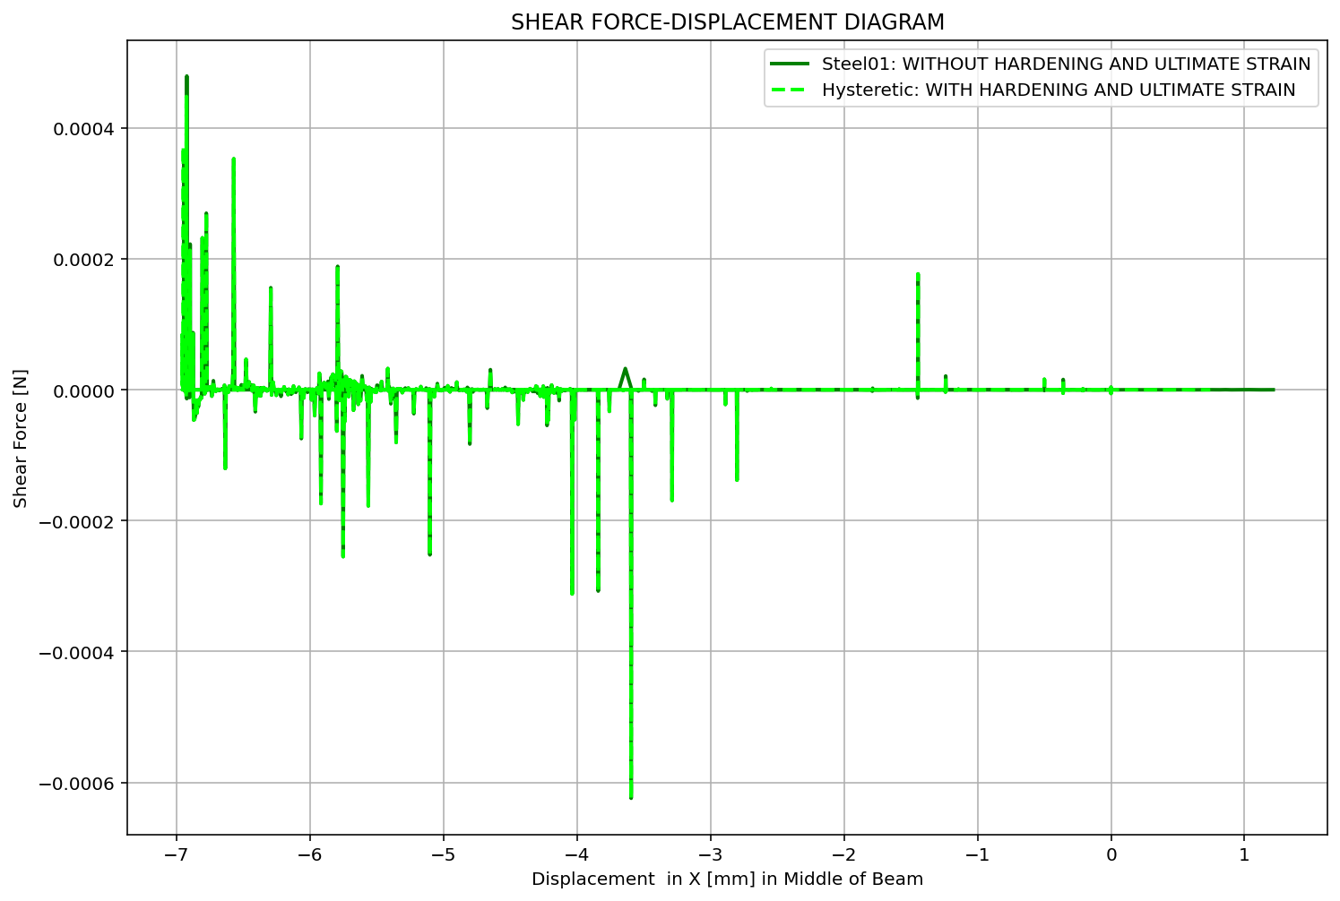

Slide 10
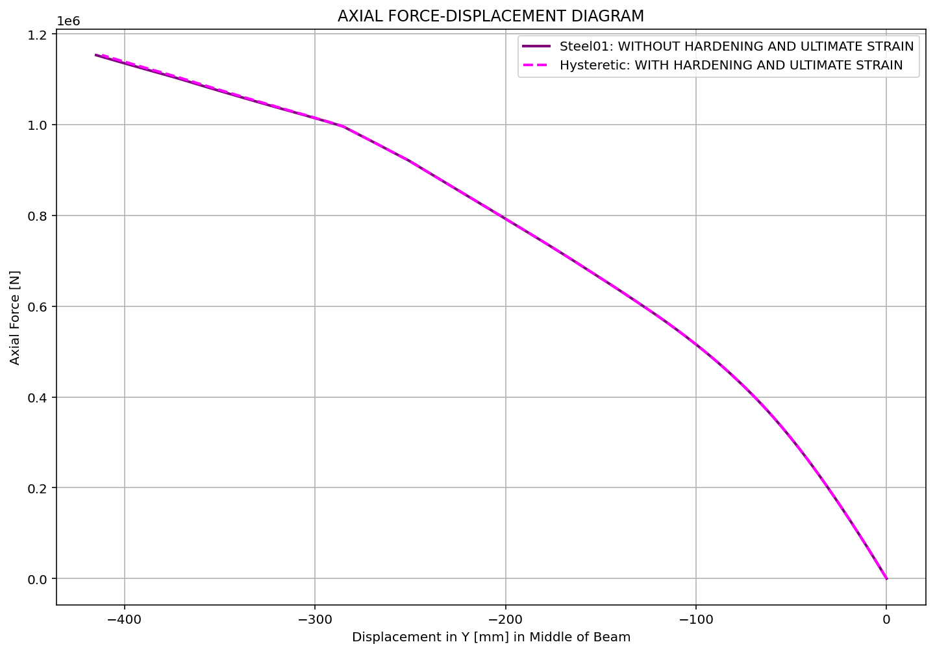

Slide 11
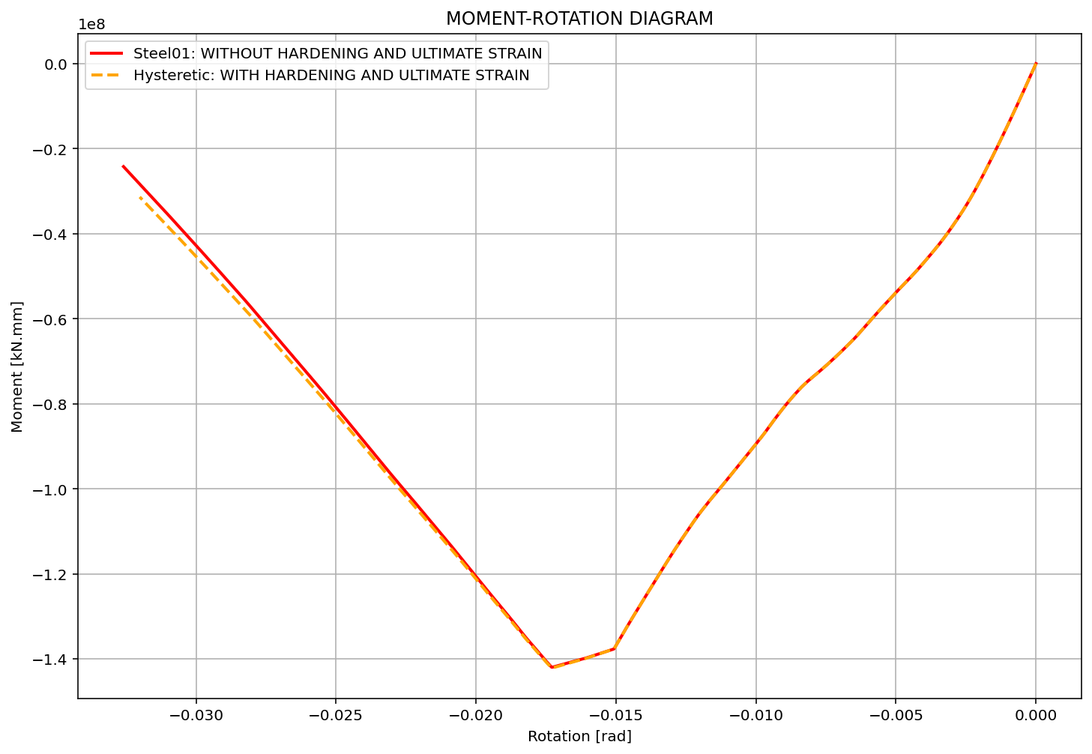

Slide 12
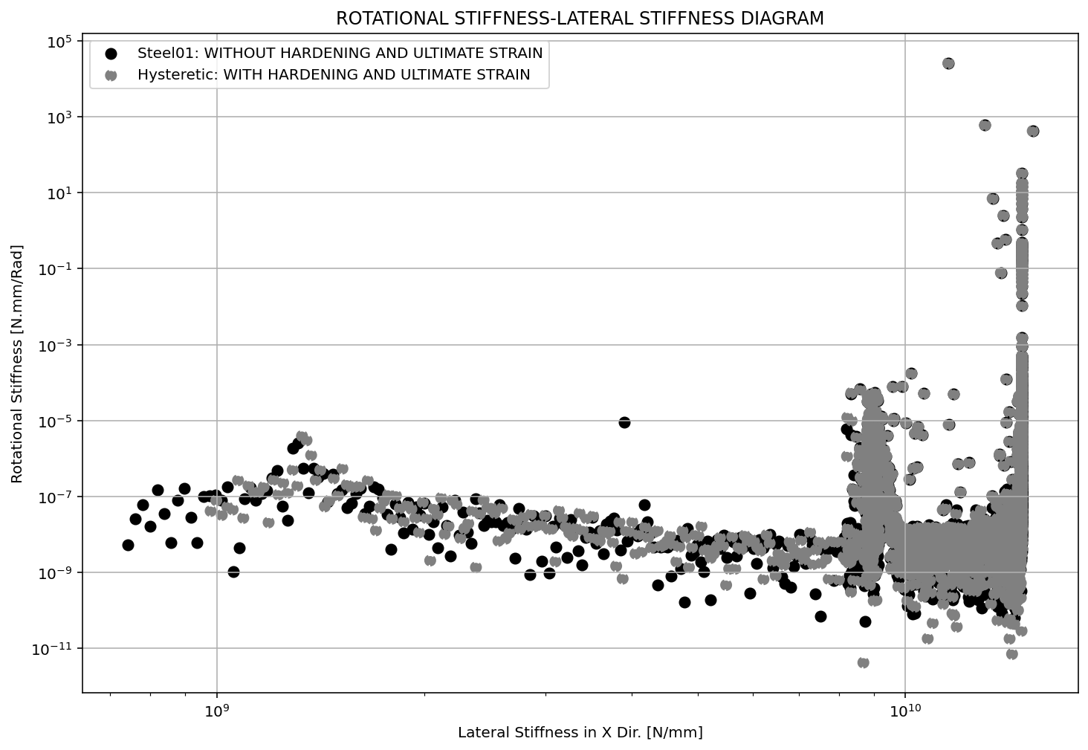

Slide 13
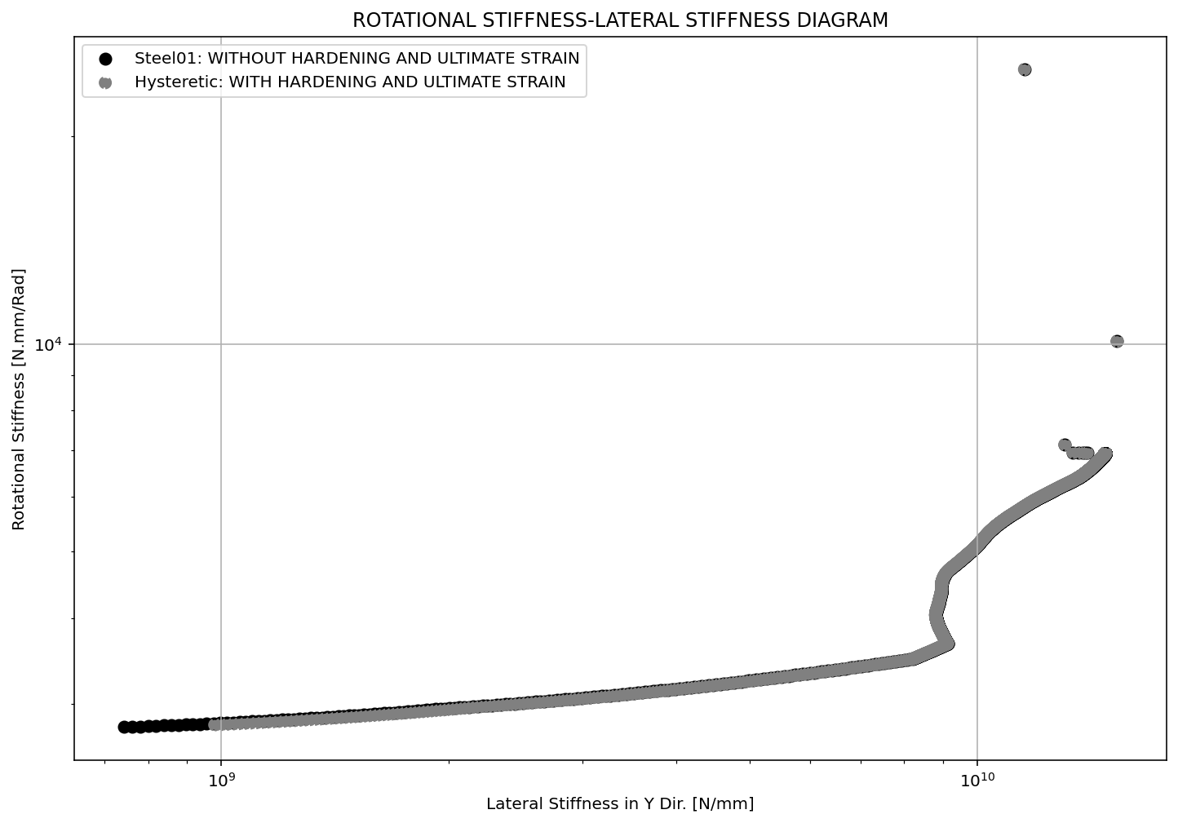

Slide 14
