Slide 1
>> IN THE NAME OF ALLAH, THE MOST GRACIOUS, THE MOST MERCIFUL <<
COMPARATIVE PUSHOVER ANALYSIS OF A SDOF STRUCTURE: ELASTIC VS INELASTIC RESPONSE USING OPENSEES
WRITTEN BY SALAR DELAVAR GHASHGHAEI (QASHQAI)

Slide 2
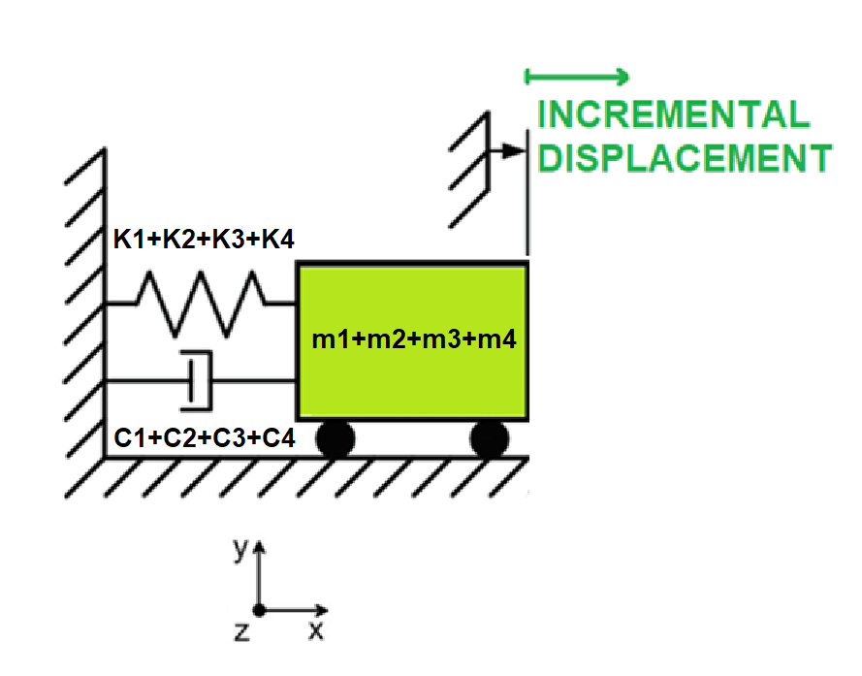

Slide 3
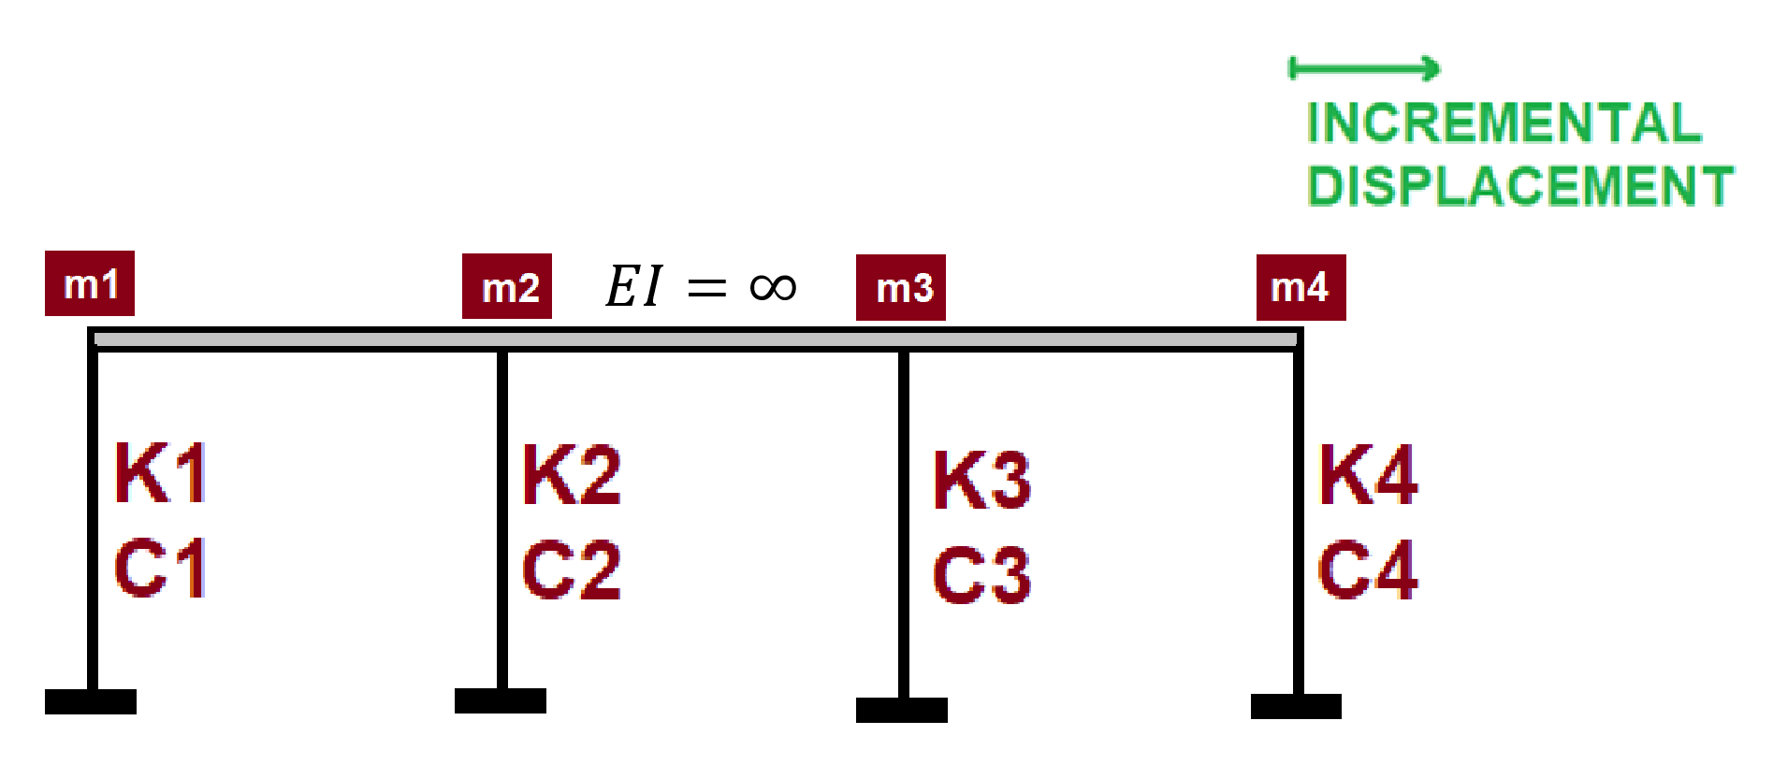

Slide 4
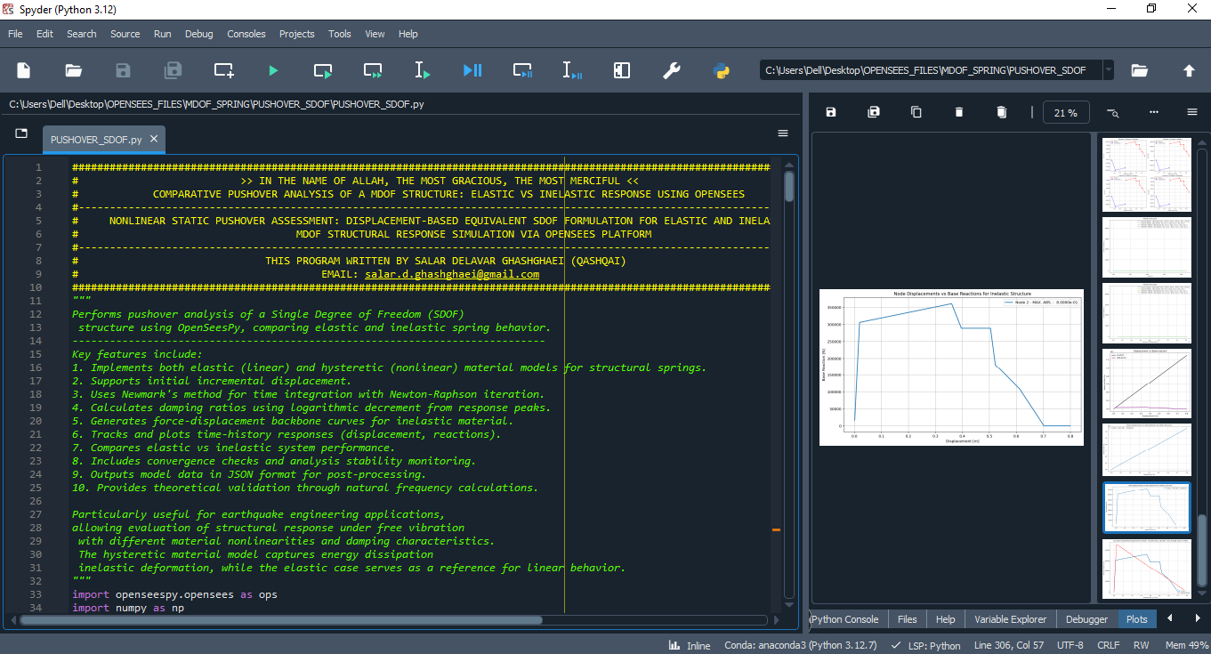

Slide 5
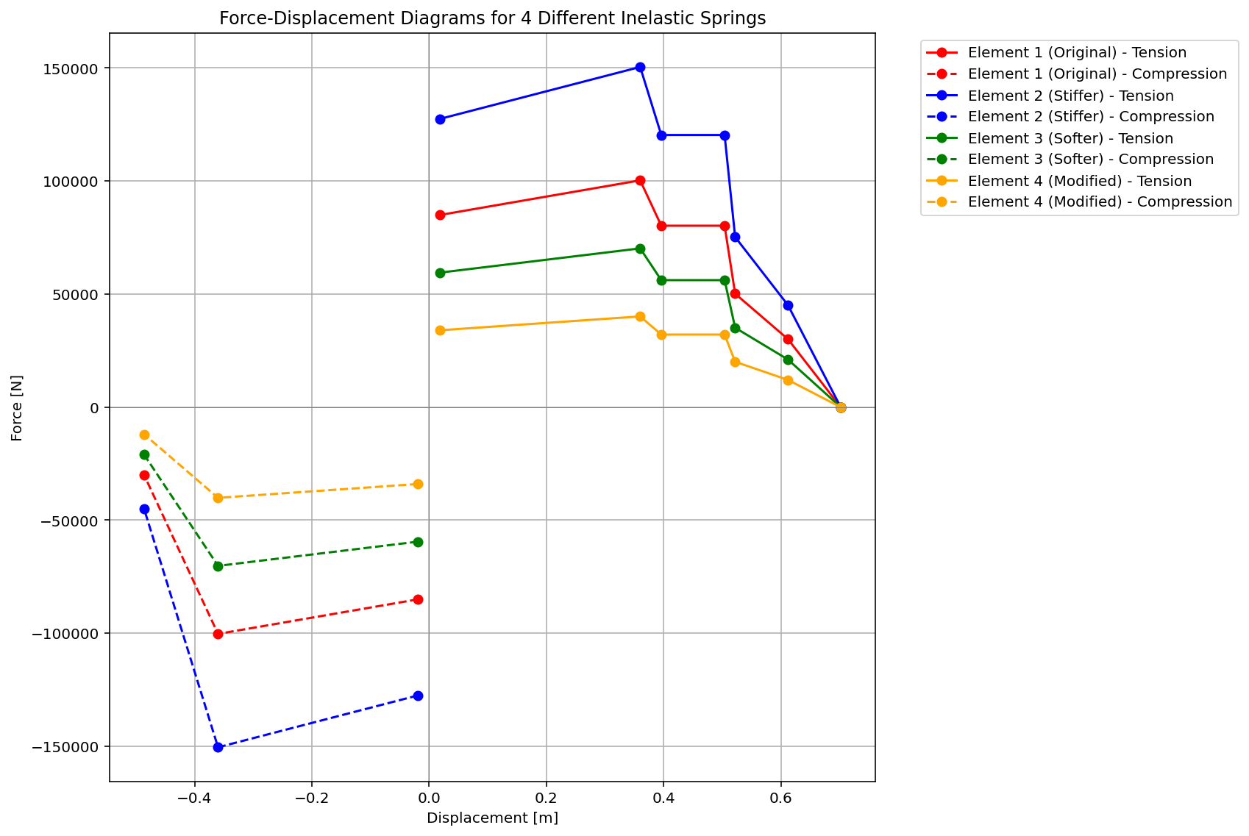

Slide 6
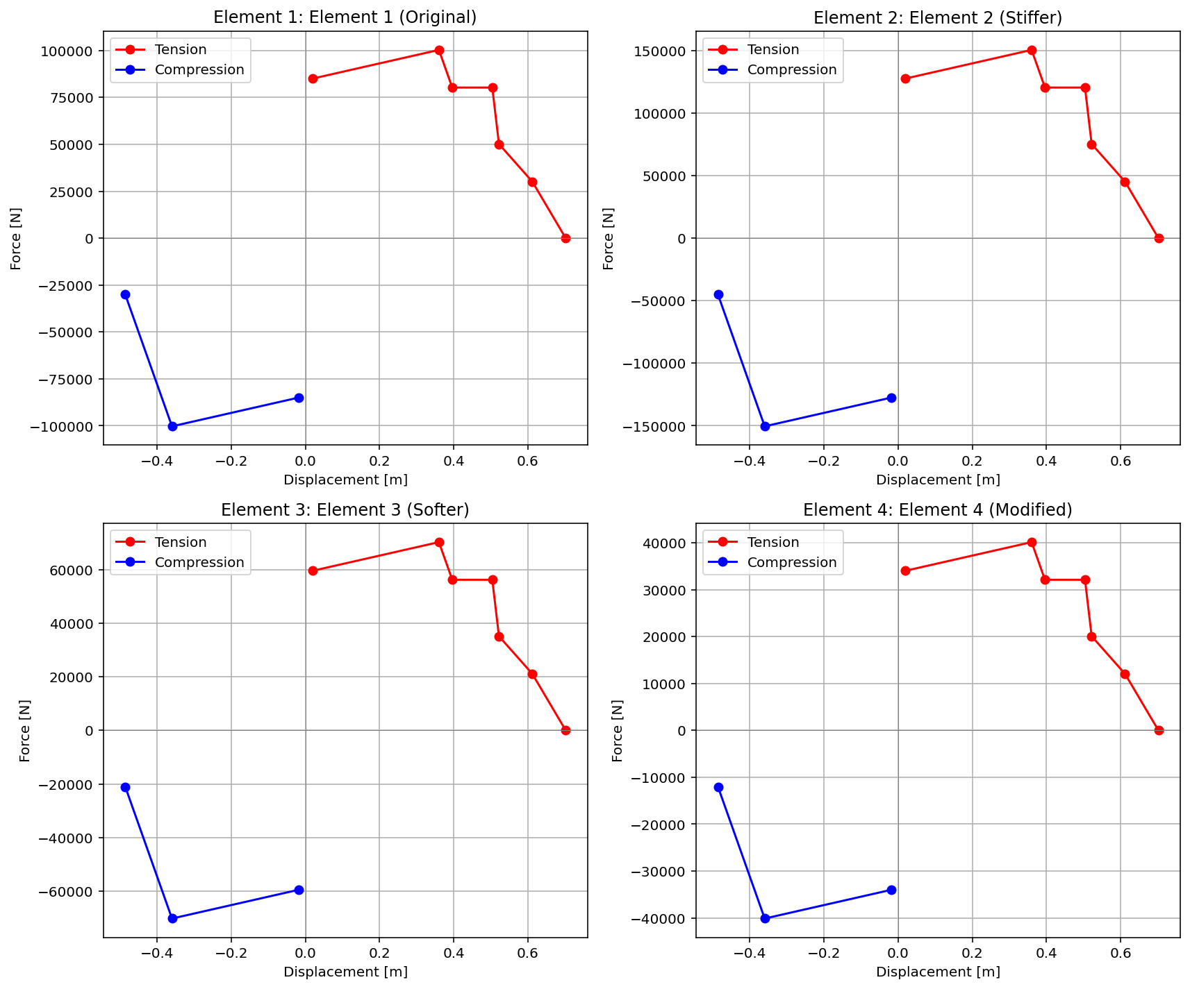

Slide 7
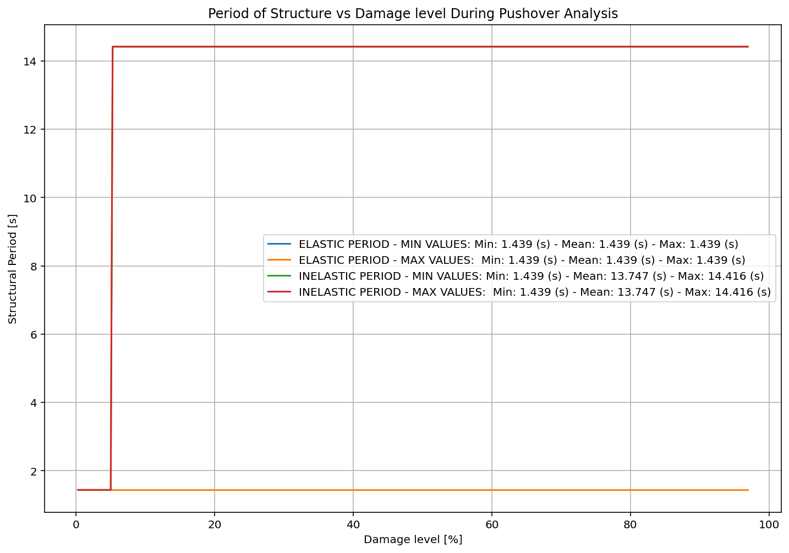

Slide 8
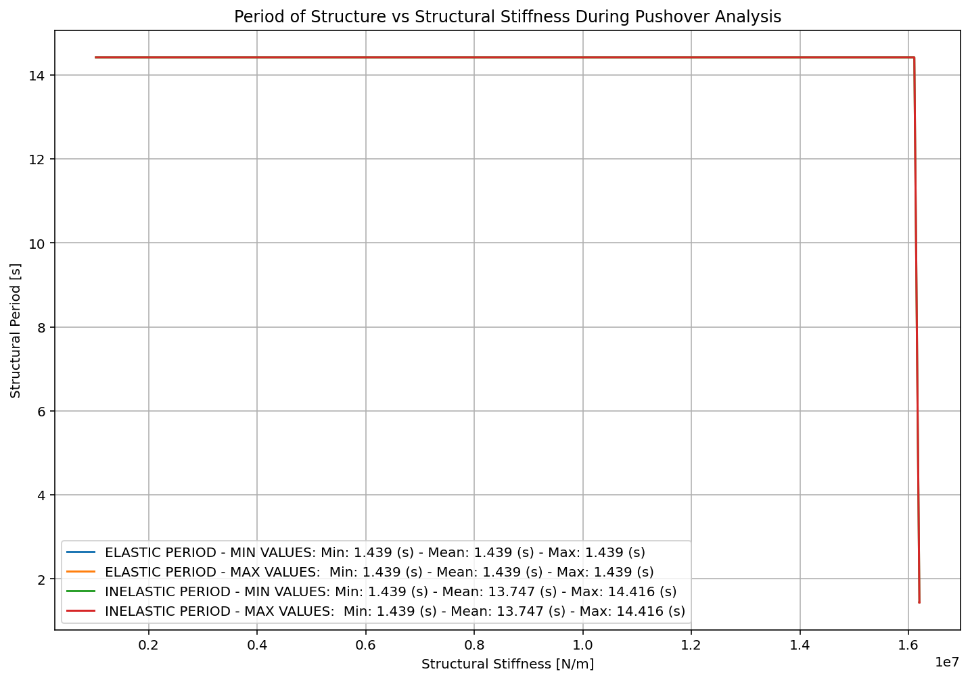

Slide 9
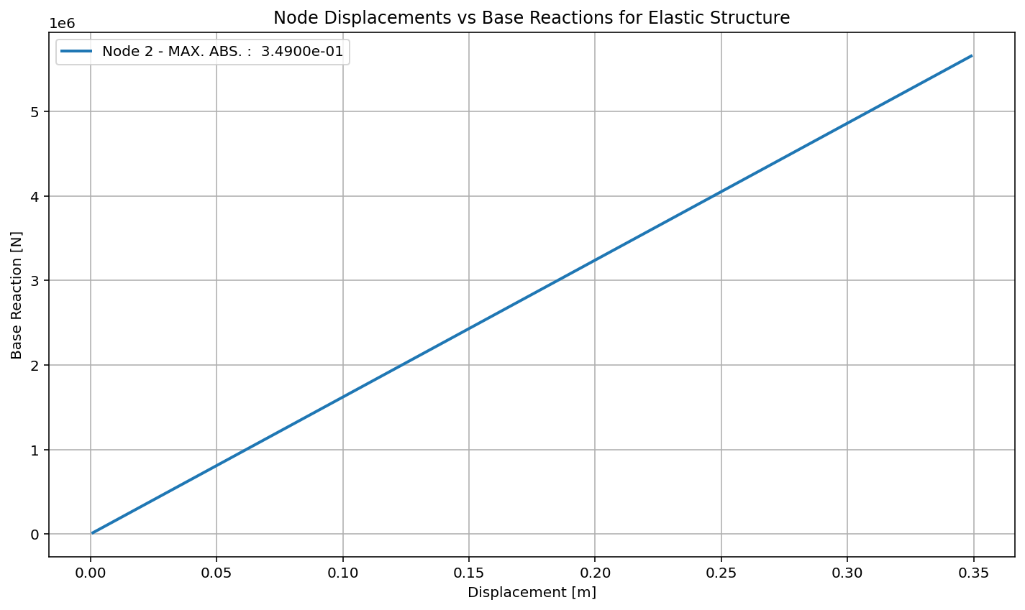

Slide 10
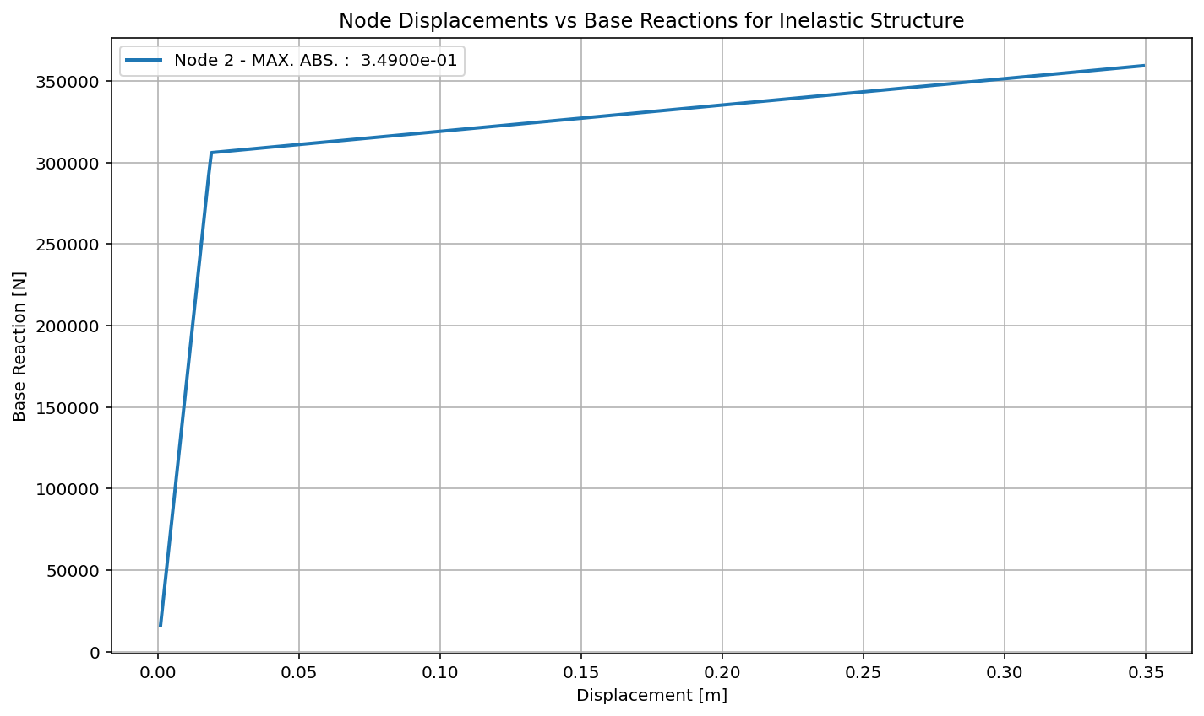

Slide 11
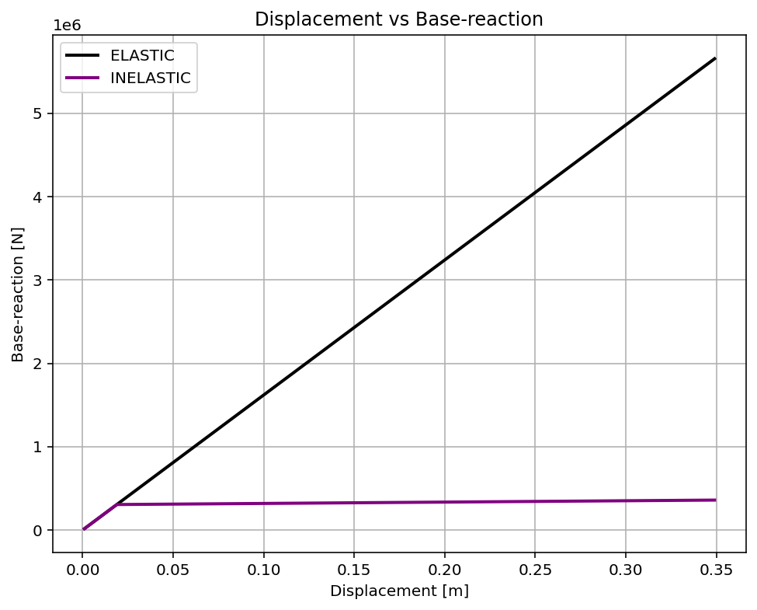

Slide 12
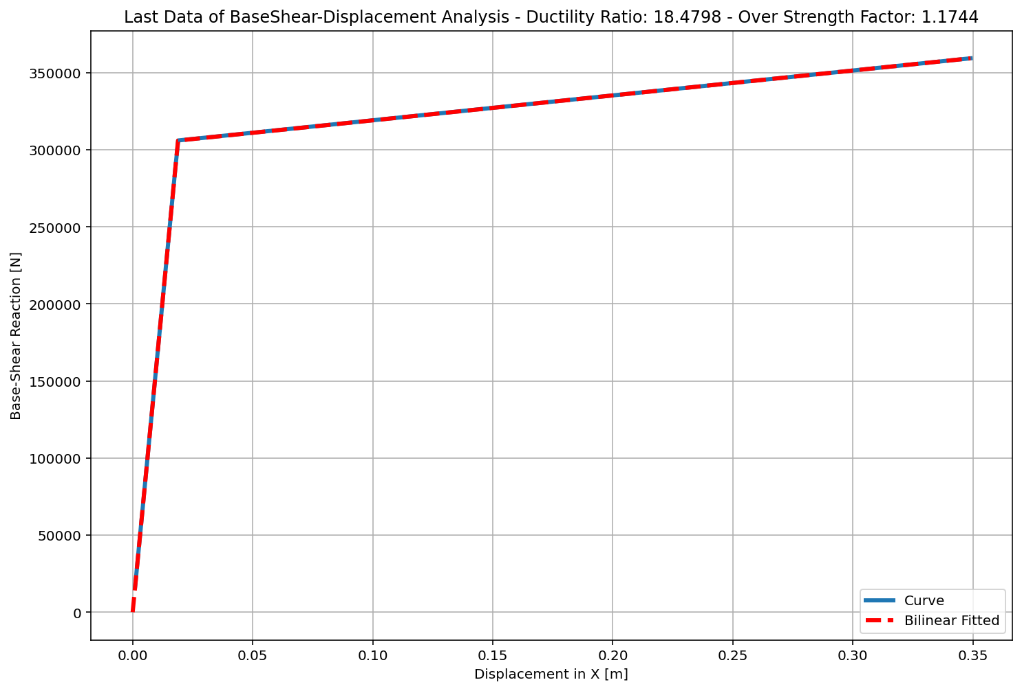
+==========================+
= Analysis curve fitted =
Disp Base Shear
----------------------------
[[0.00000000e+00 0.00000000e+00]
[1.88855299e-02 3.05945585e+05]
[3.49000000e-01 3.59303805e+05]]
+==========================+
+----------------------------------------------------+
Structure Elastic Stiffness : 16200000.00
Structure Plastic Stiffness : 1029523.80
Structure Tangent Stiffness : 161635.51
Structure Ductility Ratio : 18.48
Structure Over Strength Factor: 1.17
+----------------------------------------------------+
Over Strength Coefficient (Ω0): 1.1744
Displacement Ductility Ratio (μ): 18.4798
Ductility Coefficient (Rμ): 18.4798
Structural Behavior Coefficient (R): 21.7027

