Slide 1
>> IN THE NAME OF ALLAH, THE MOST GRACIOUS, THE MOST MERCIFUL <<
COMPREHENSIVE NONLINEAR SEISMIC ASSESSMENT OF A FRAME STRUCTURE: AN OPENSEES FRAMEWORK FOR STATIC PUSHOVER, CYCLIC DEGRADATION, STATIC TIME-HISTORY AND DYNAMIC TIME-HISTORY ANALYSIS
THIS PROGRAM WRITTEN BY SALAR DELAVAR GHASHGHAEI (QASHQAI)

Slide 2
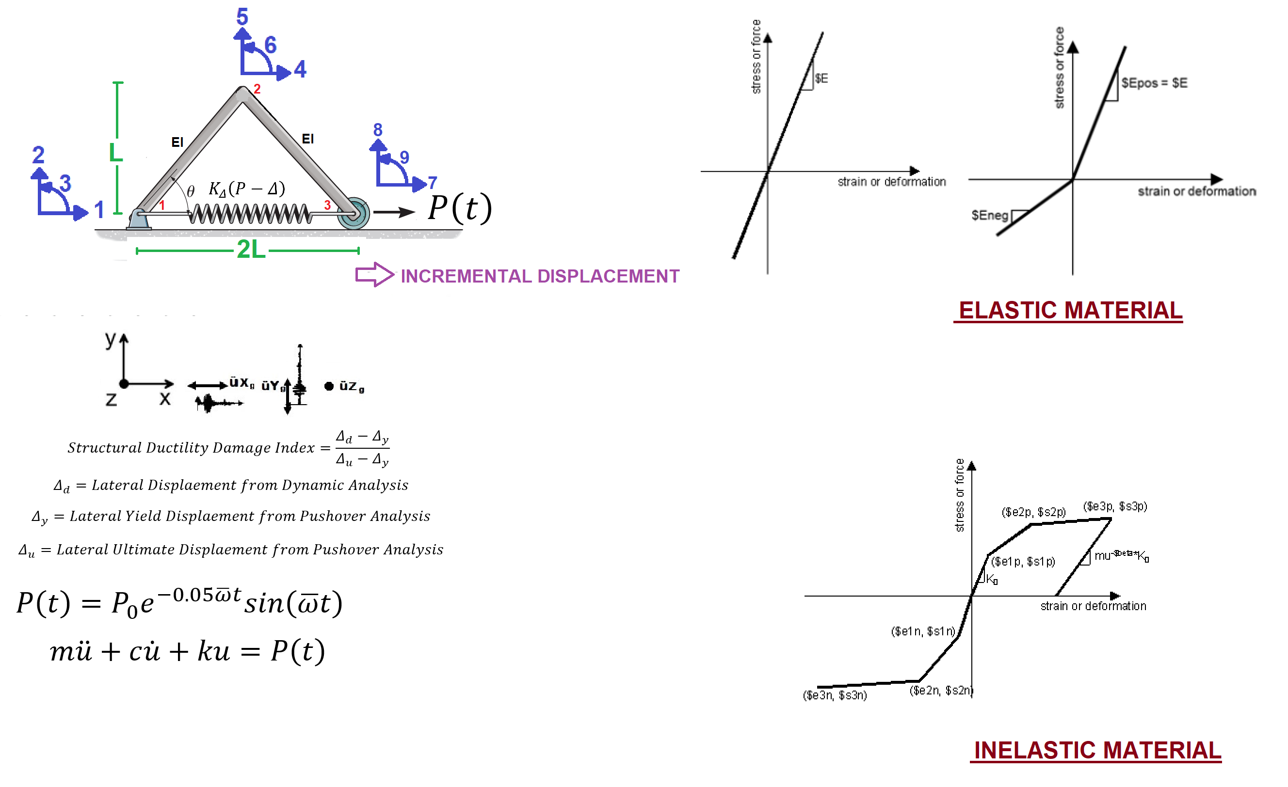

Slide 3
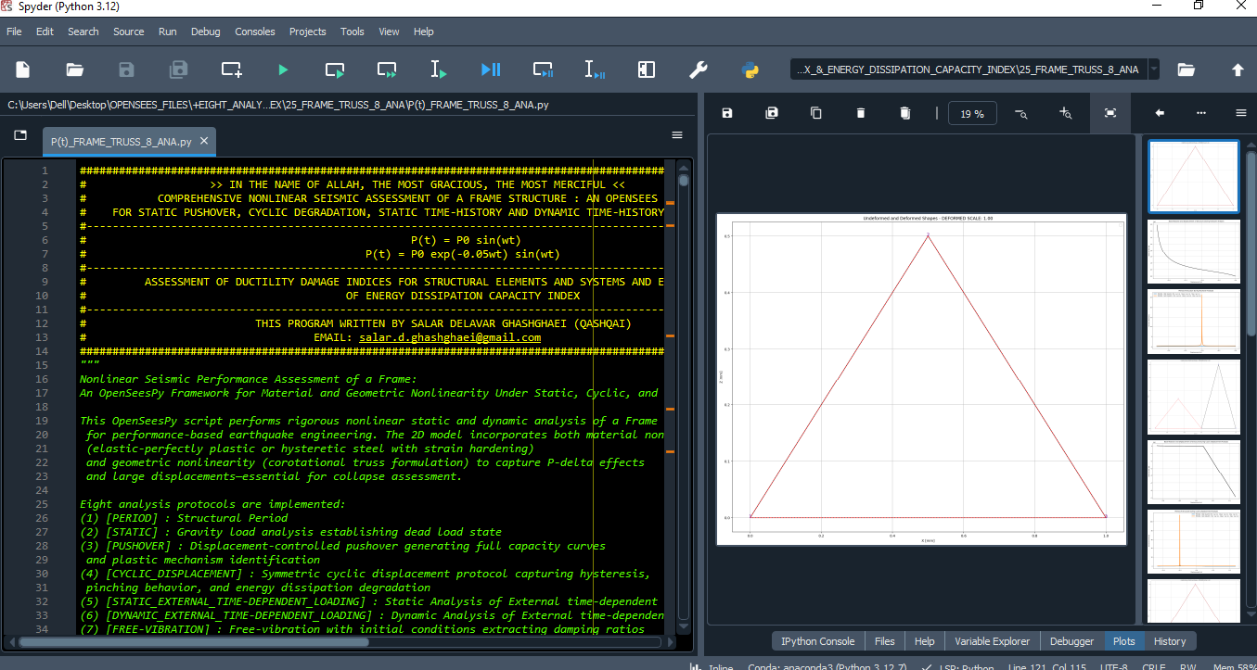

Slide 4
STATIC ANALYSIS

Slide 5
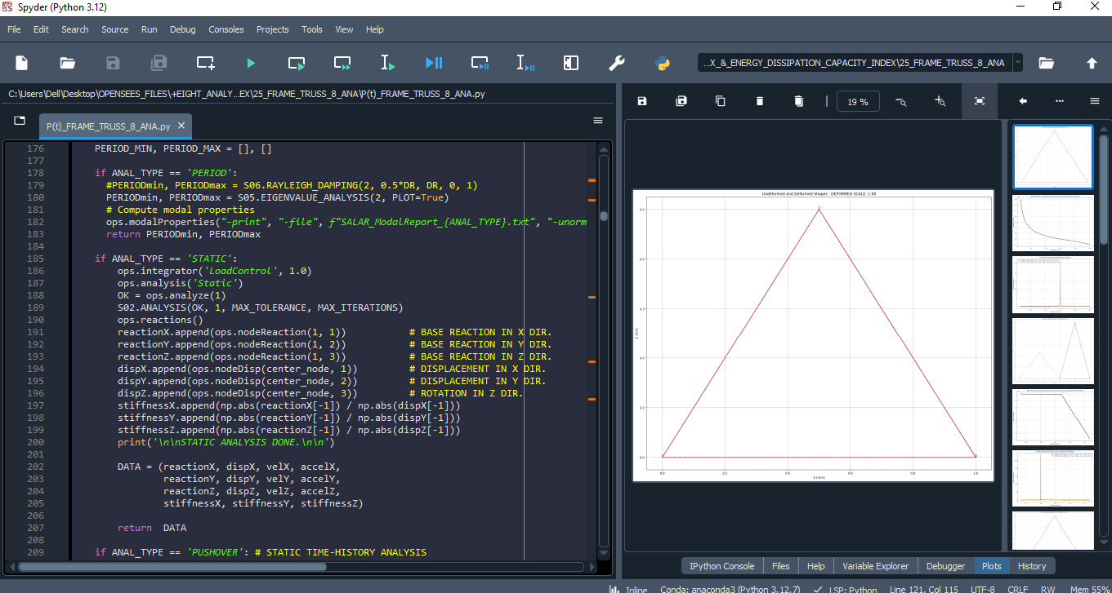

Slide 6
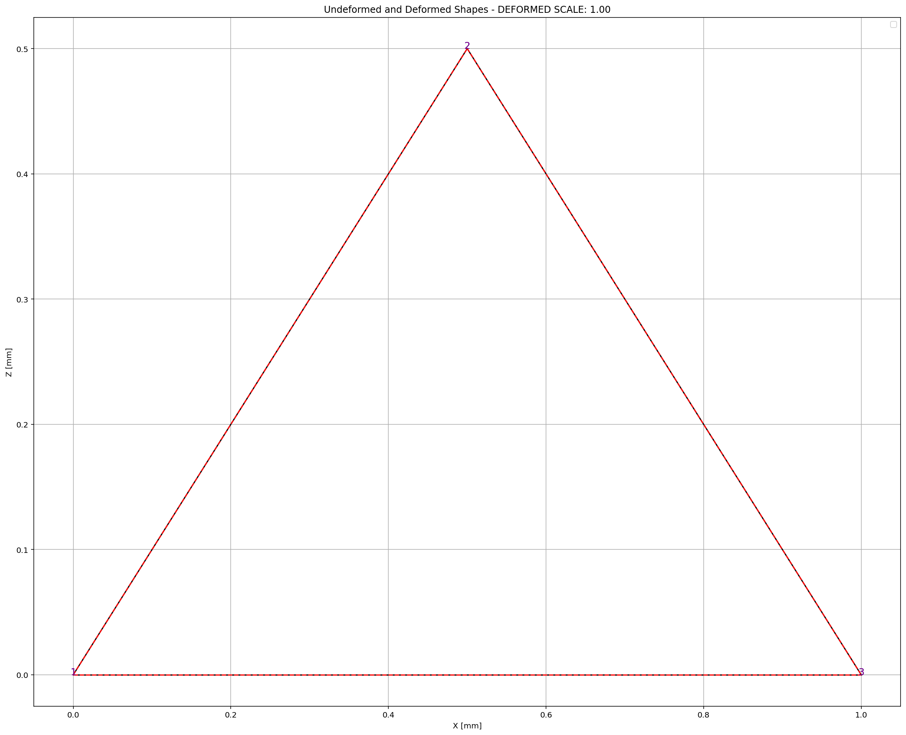

Slide 7
PUSHOVER ANALYSIS

Slide 8
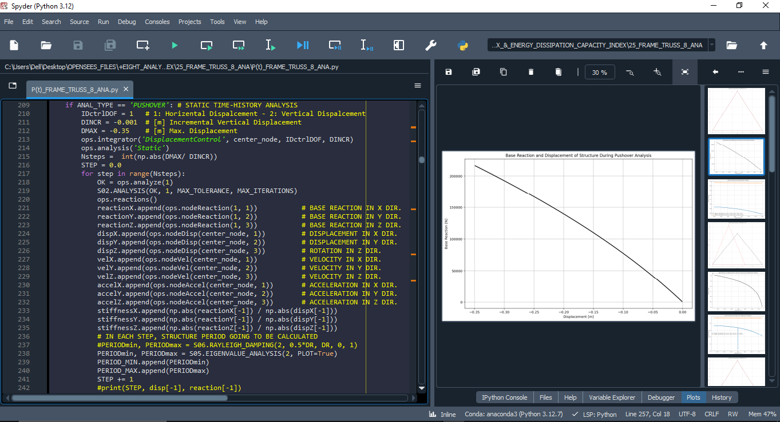

Slide 9
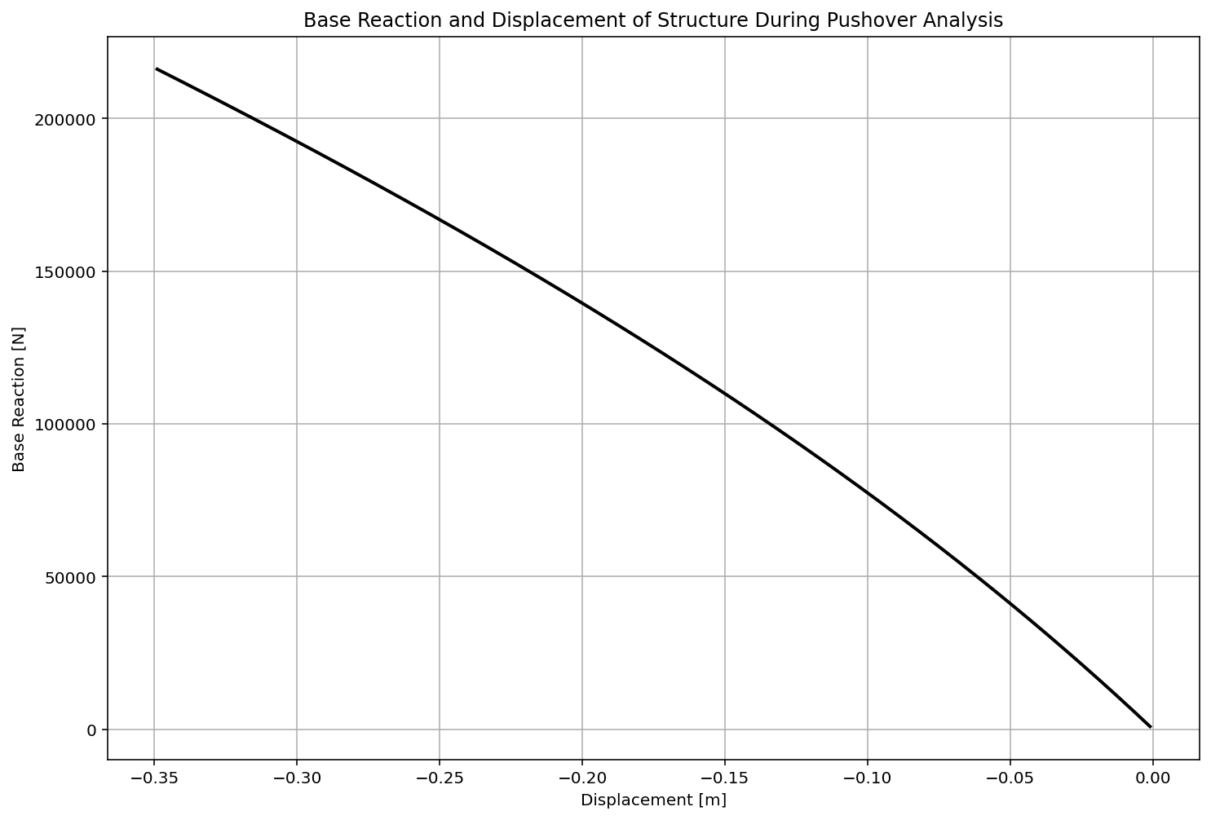

Slide 10
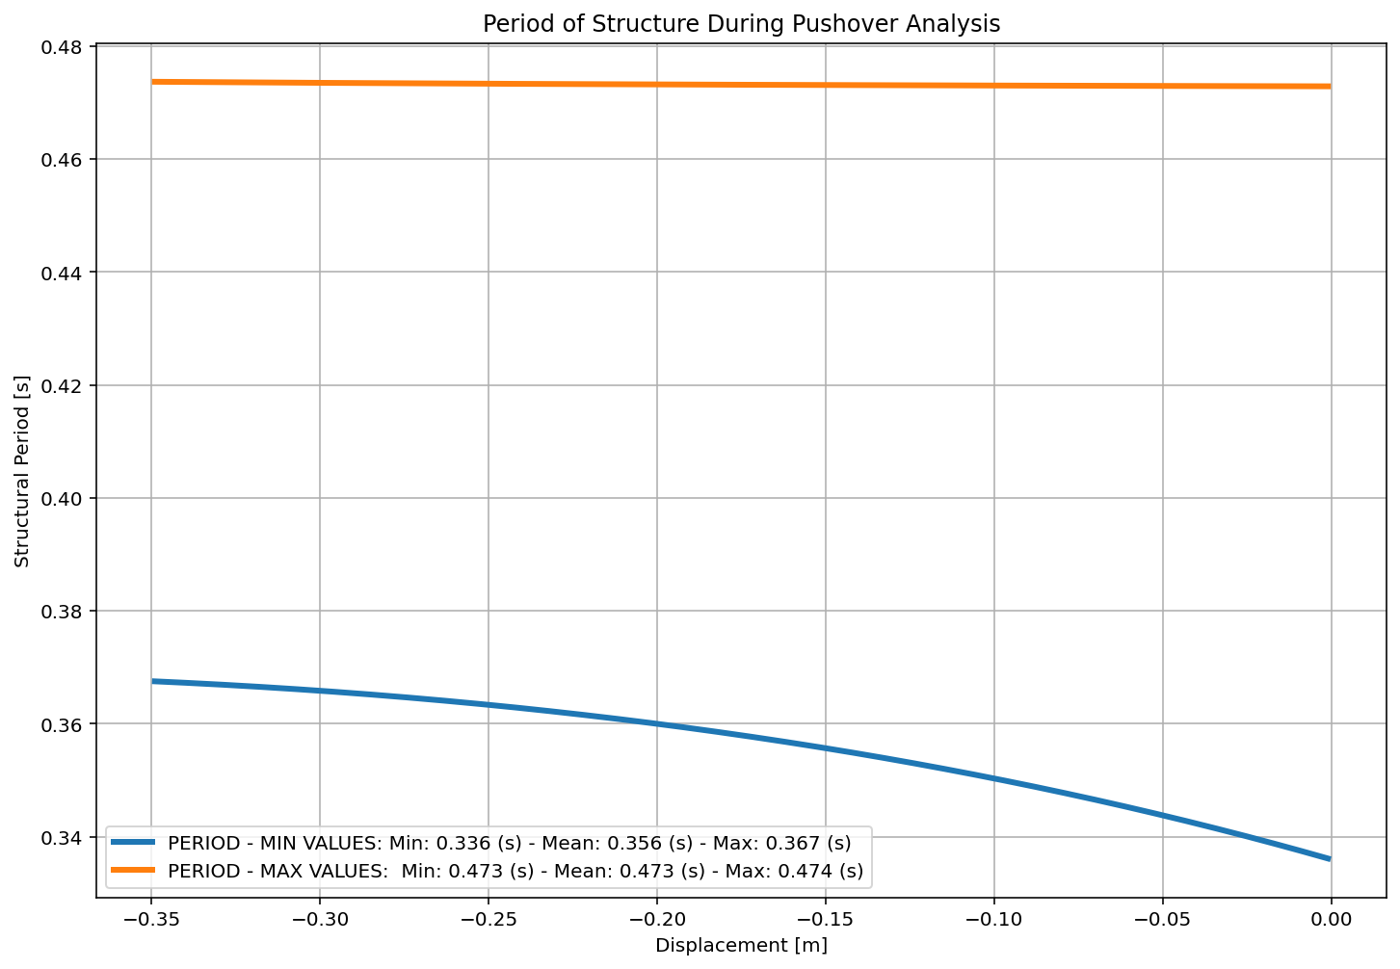

Slide 11
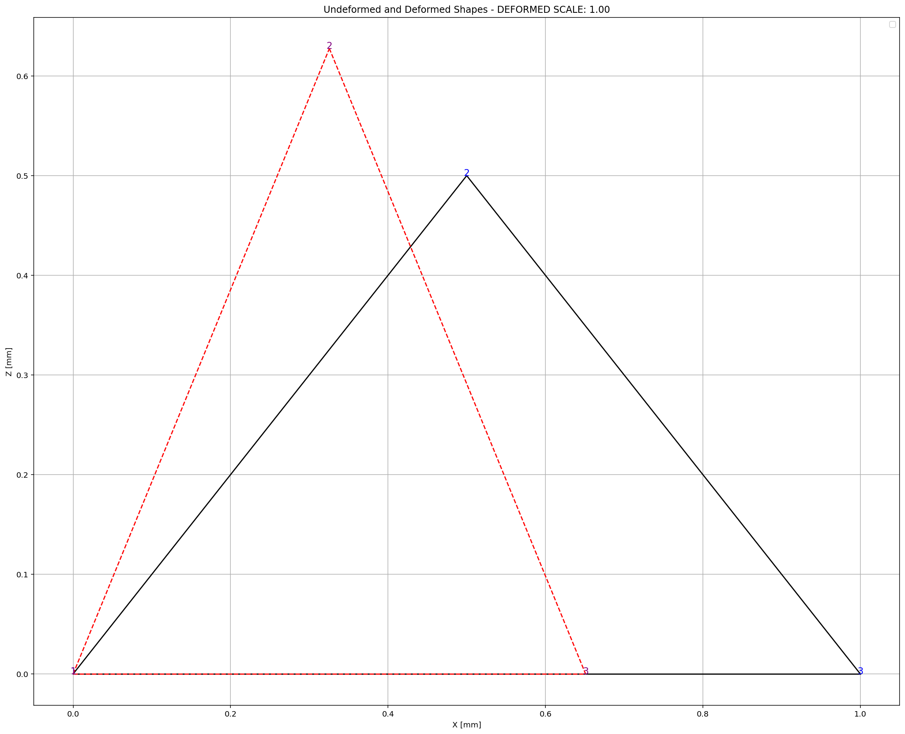

Slide 12
CYCLIC DISPLACEMENT ANALYSIS

Slide 13
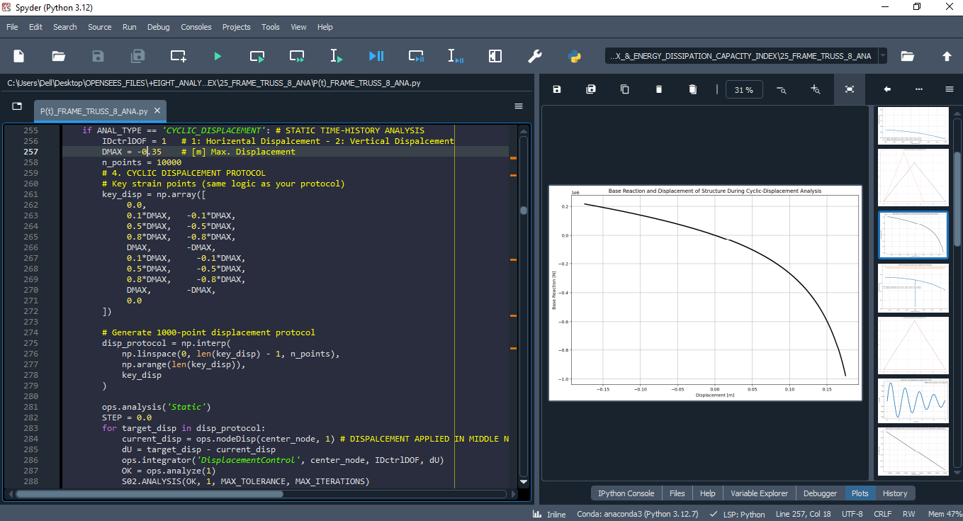

Slide 14
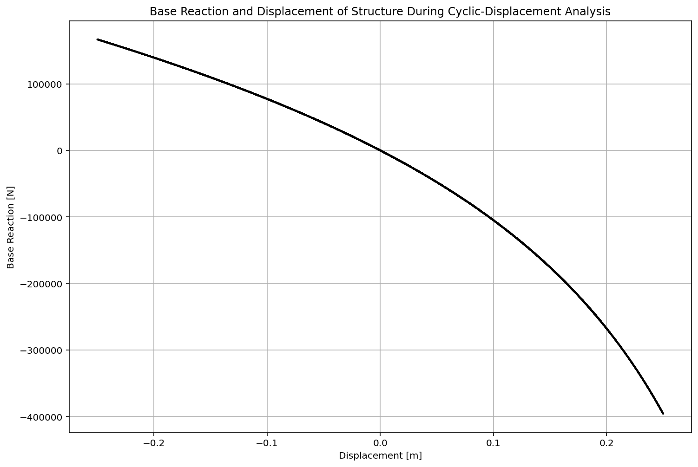

Slide 15
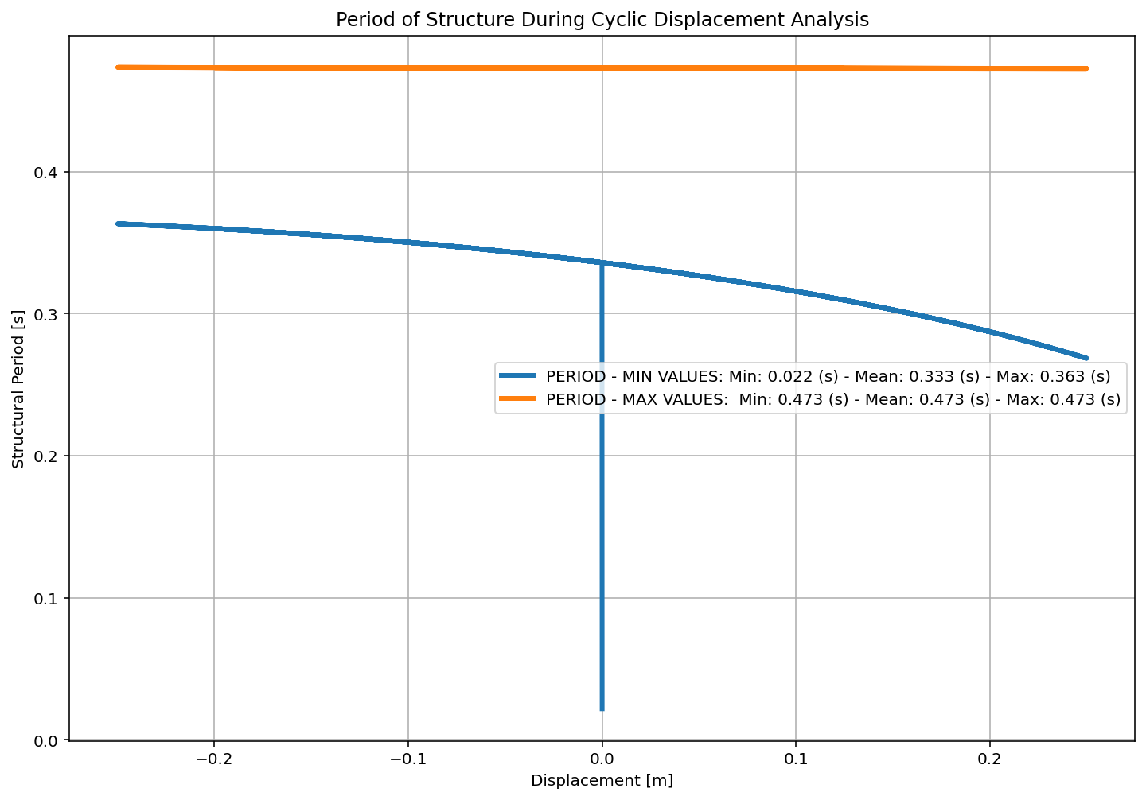

Slide 16
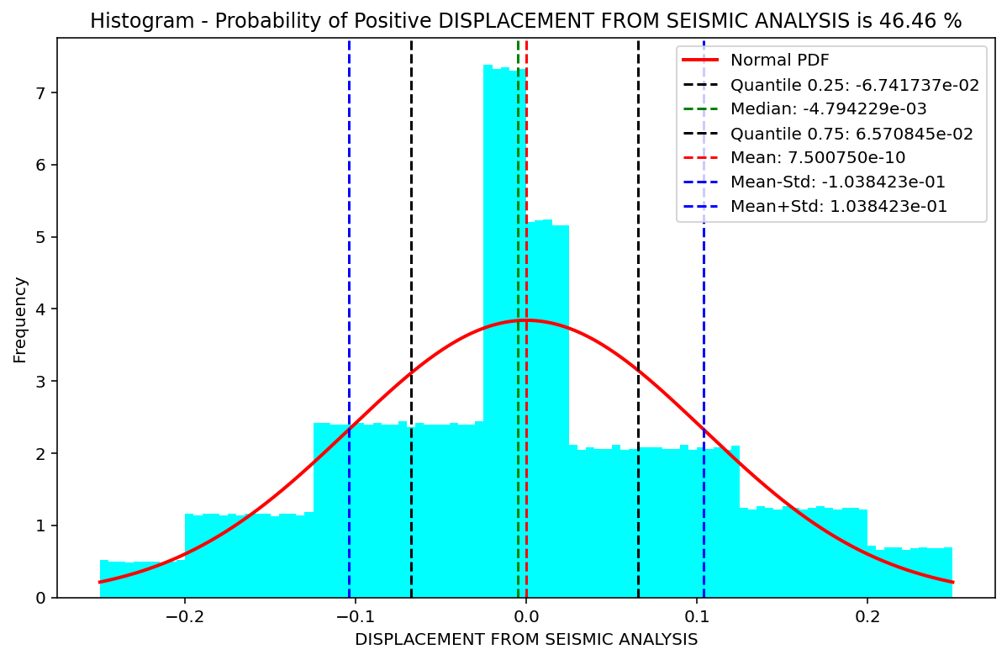

Slide 17
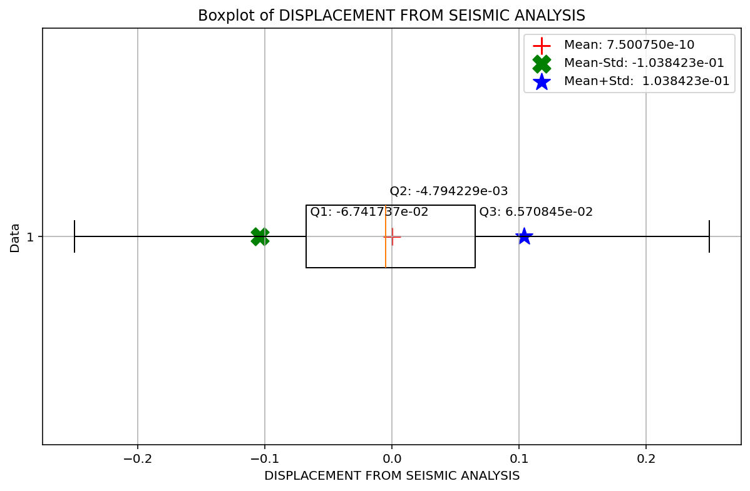

Slide 18
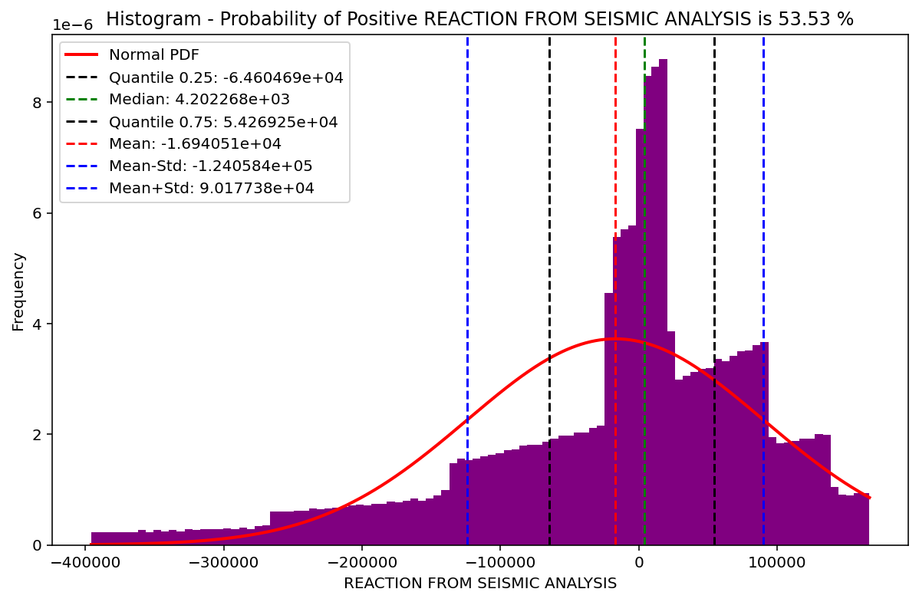

Slide 19
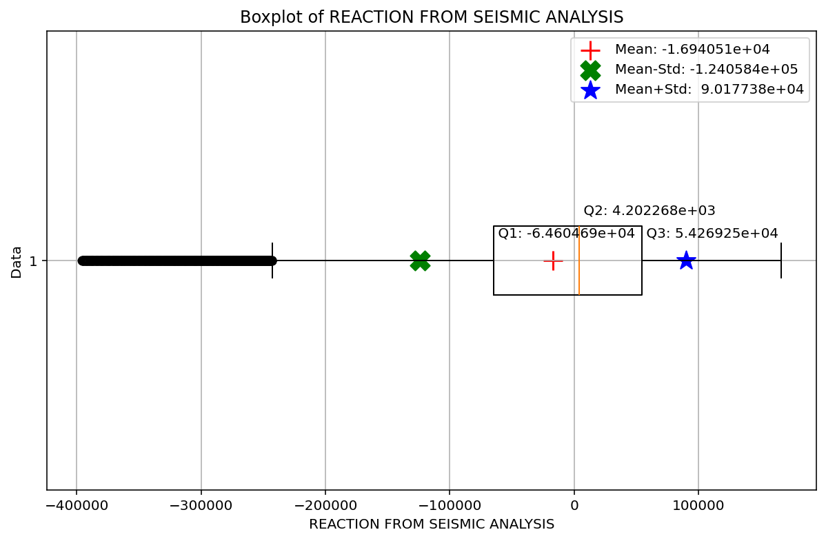

Slide 20
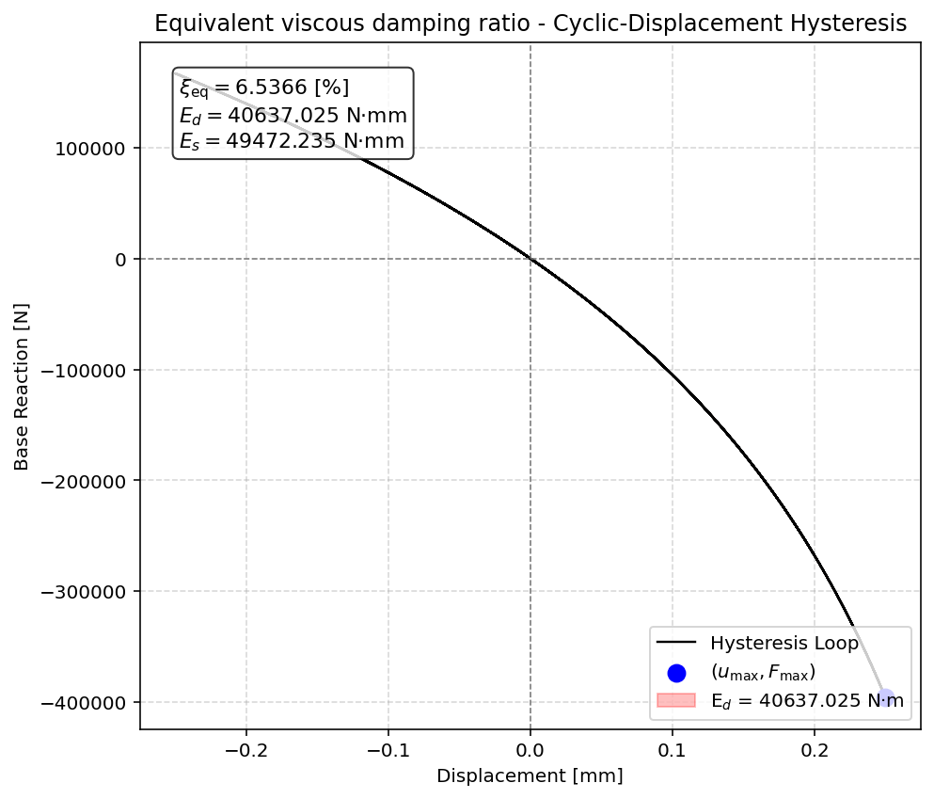

Slide 21


Slide 22
STATIC TIME-HISTORY WITH EXTERNAL TIME-DEPENDENT LOADING ANALYSIS

Slide 23
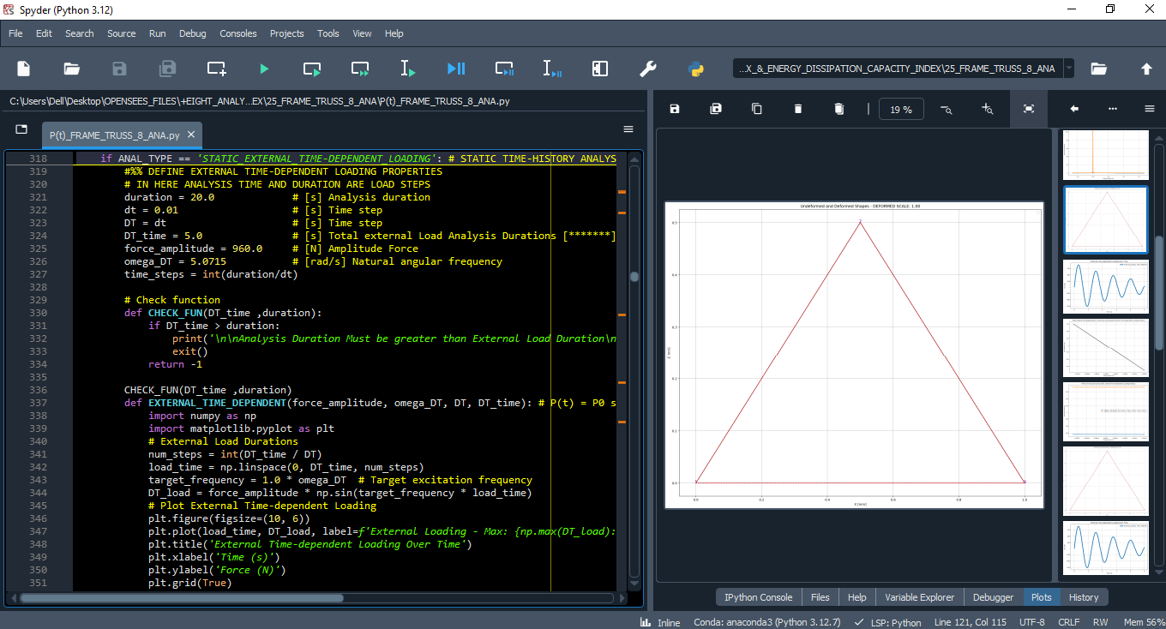

Slide 24
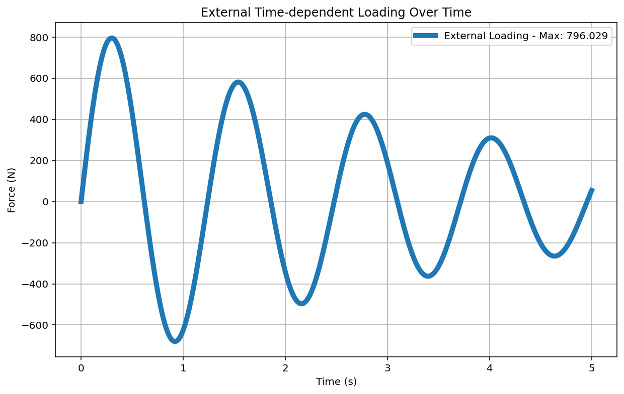

Slide 25
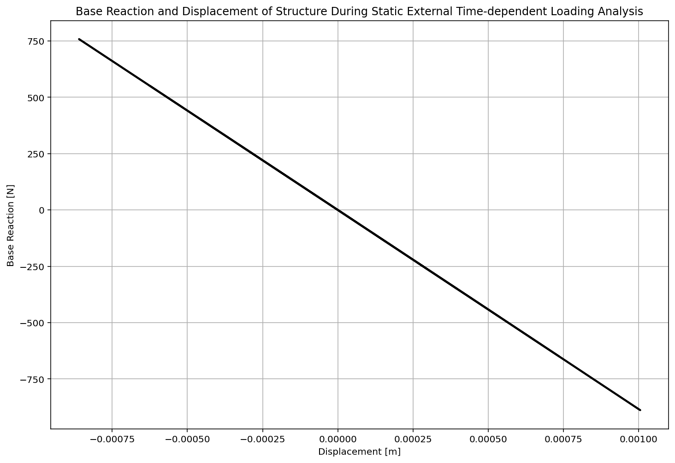

Slide 26
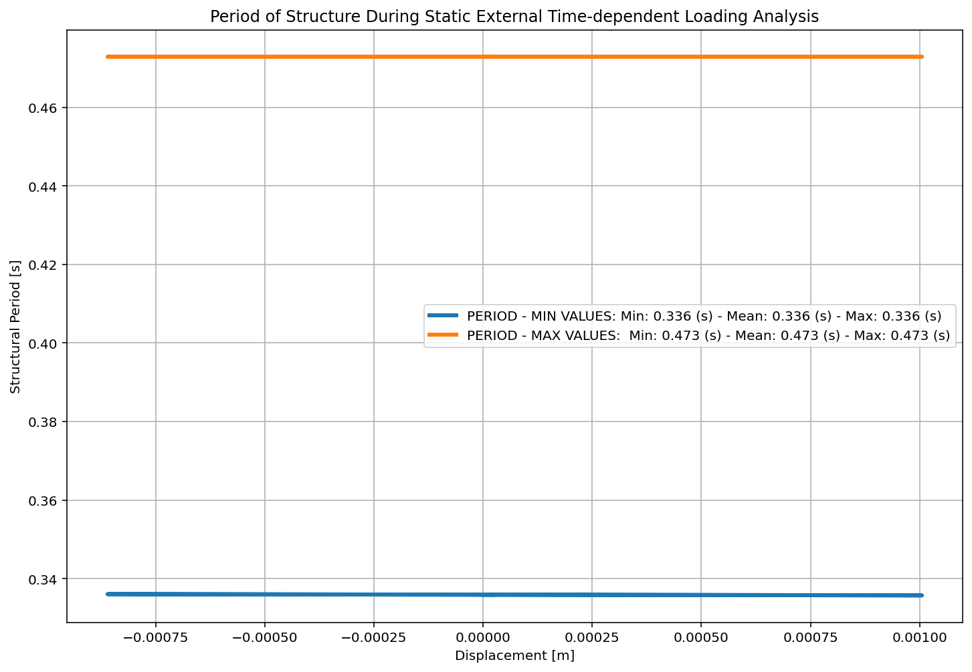

Slide 27
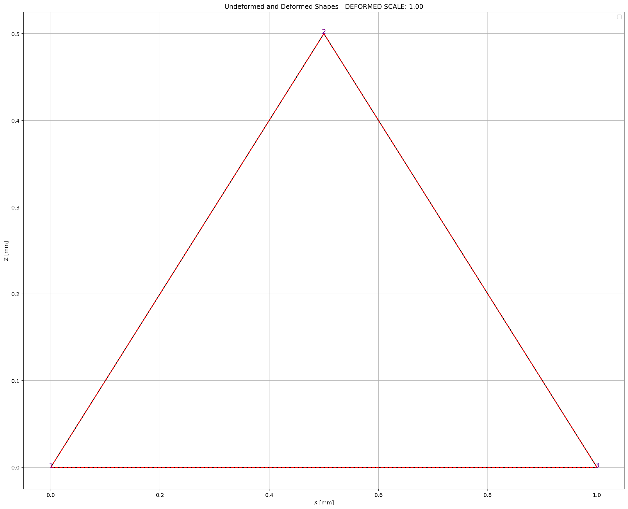

Slide 28
DYNAMIC TIME-HISTORY WITH EXTERNAL TIME-DEPENDENT LOADING ANALYSIS

Slide 29
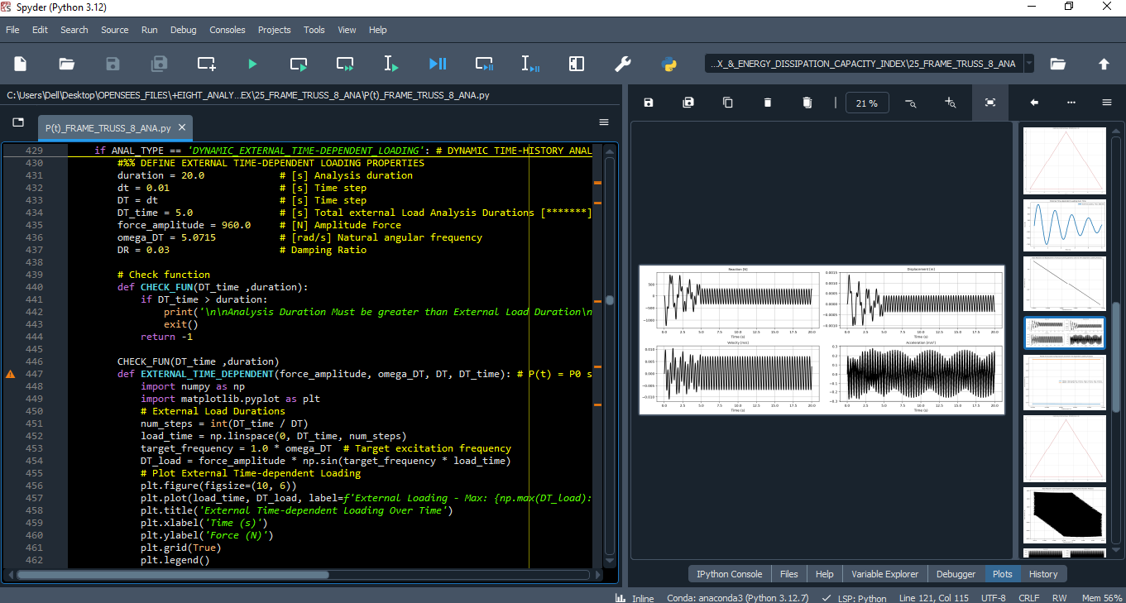

Slide 31
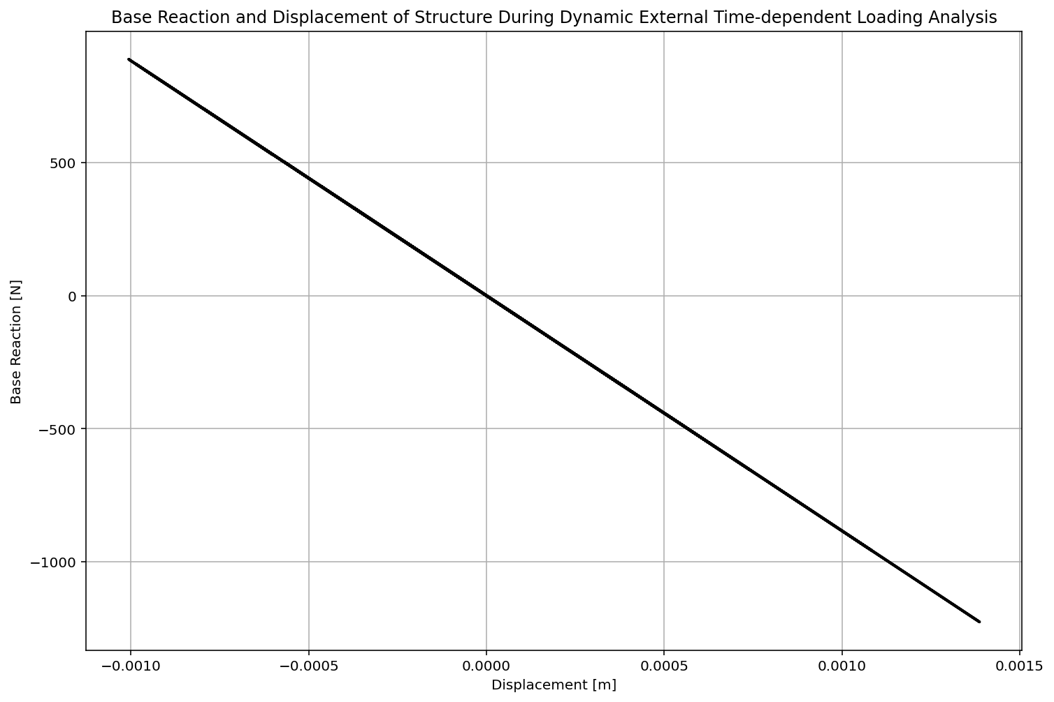

Slide 32
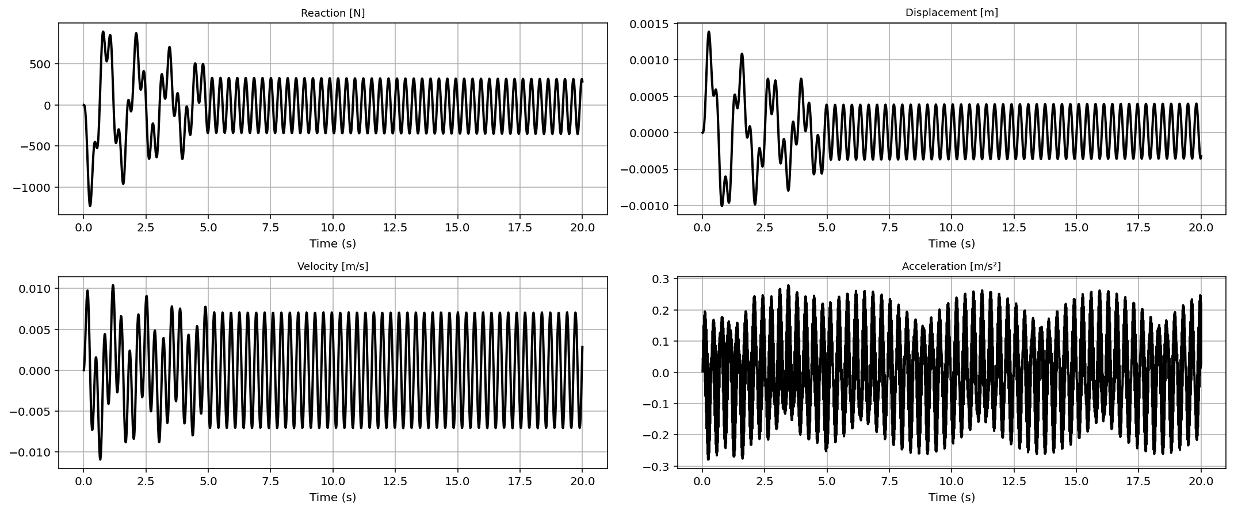

Slide 33
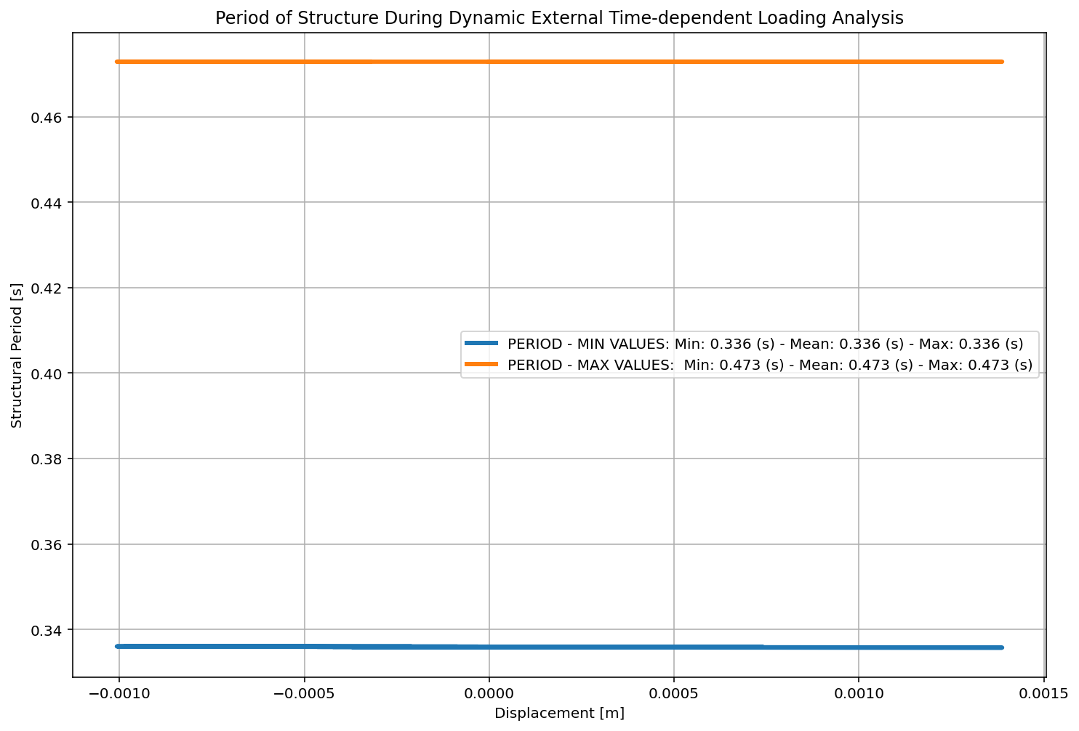

Slide 34
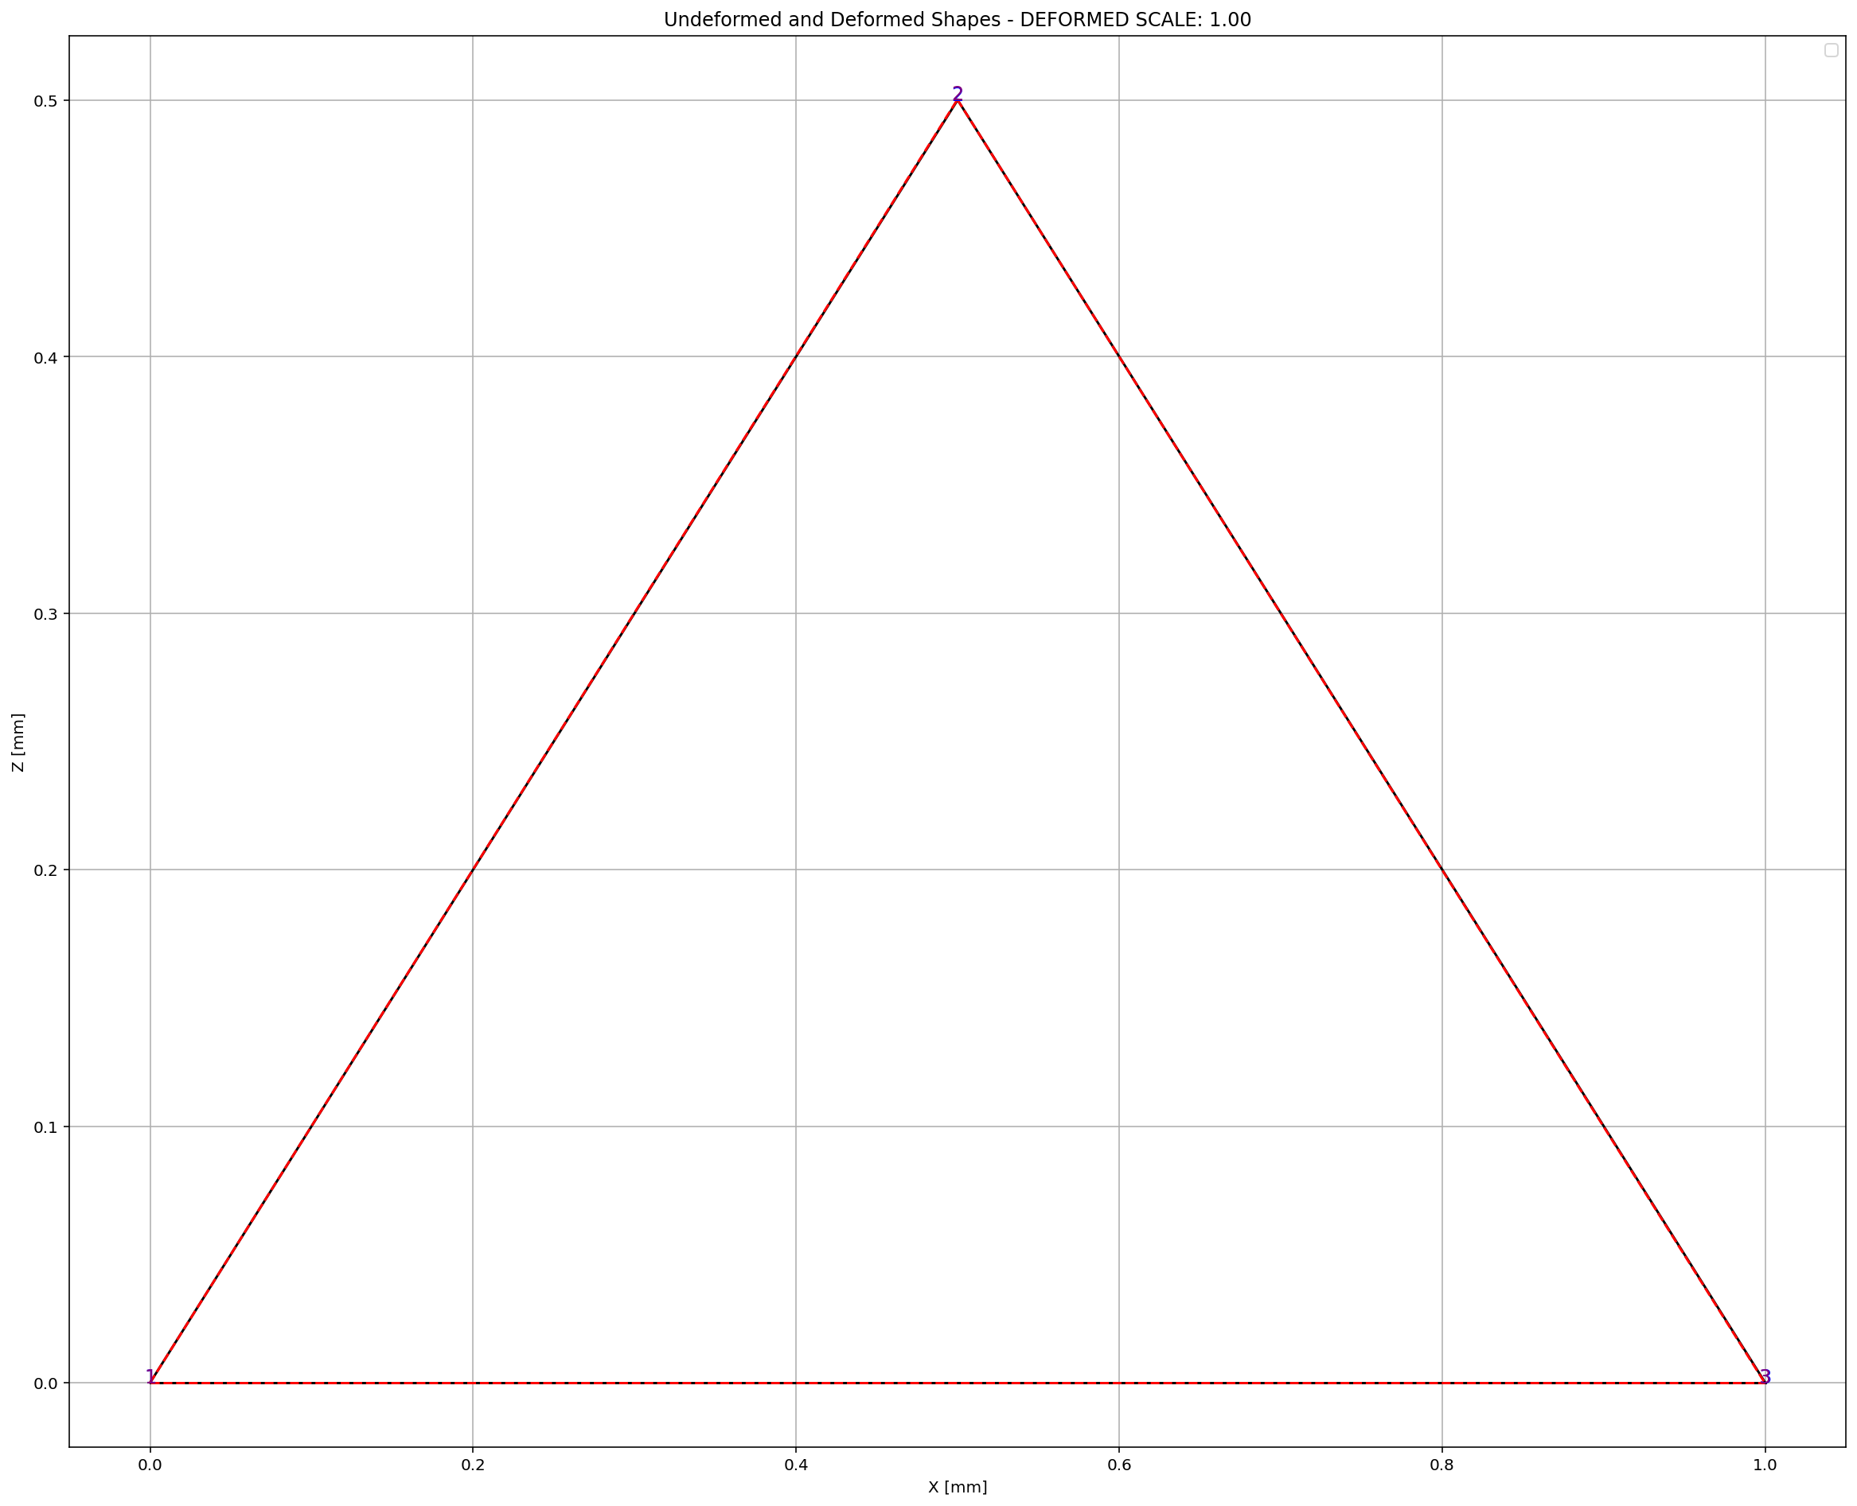

Slide 35
FREE-VIBRATION ANALYSIS

Slide 36
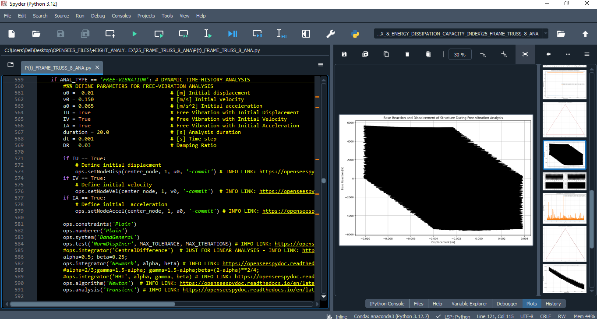

Slide 37
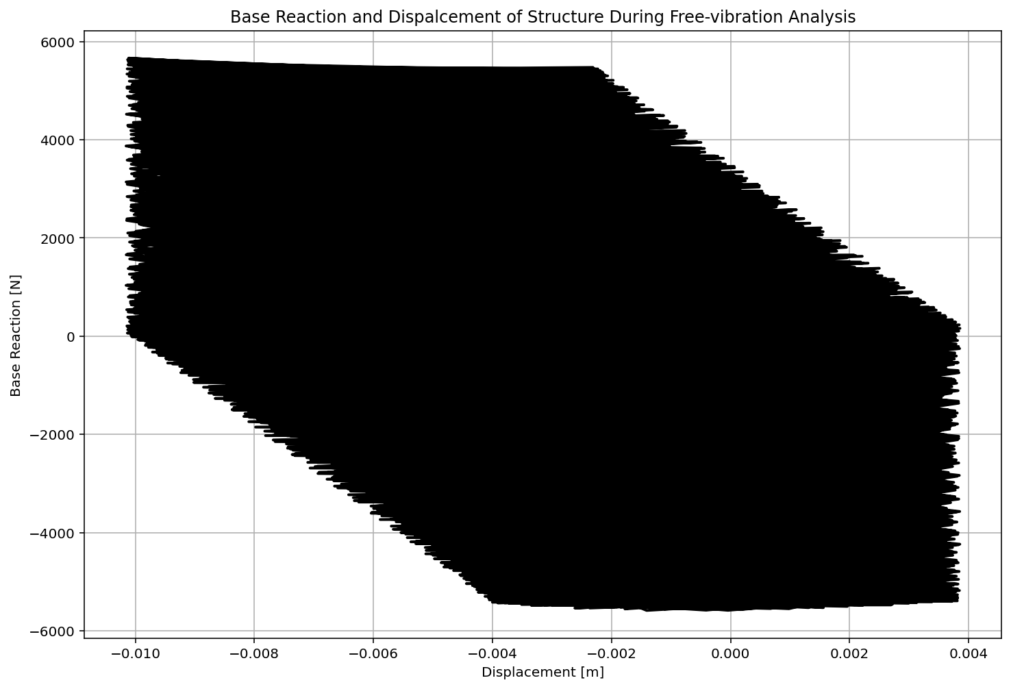

Slide 38
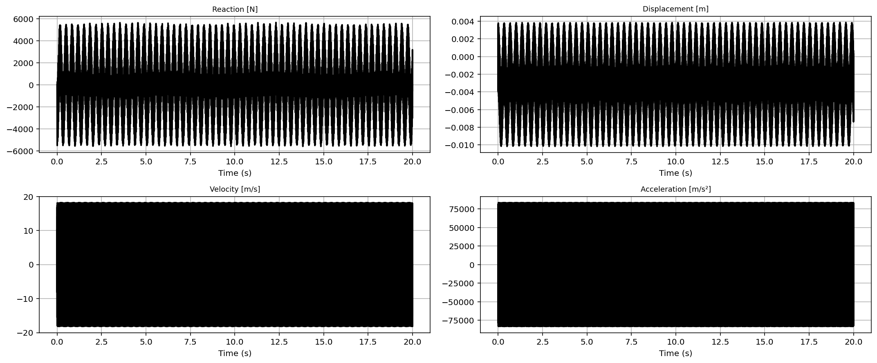

Slide 39
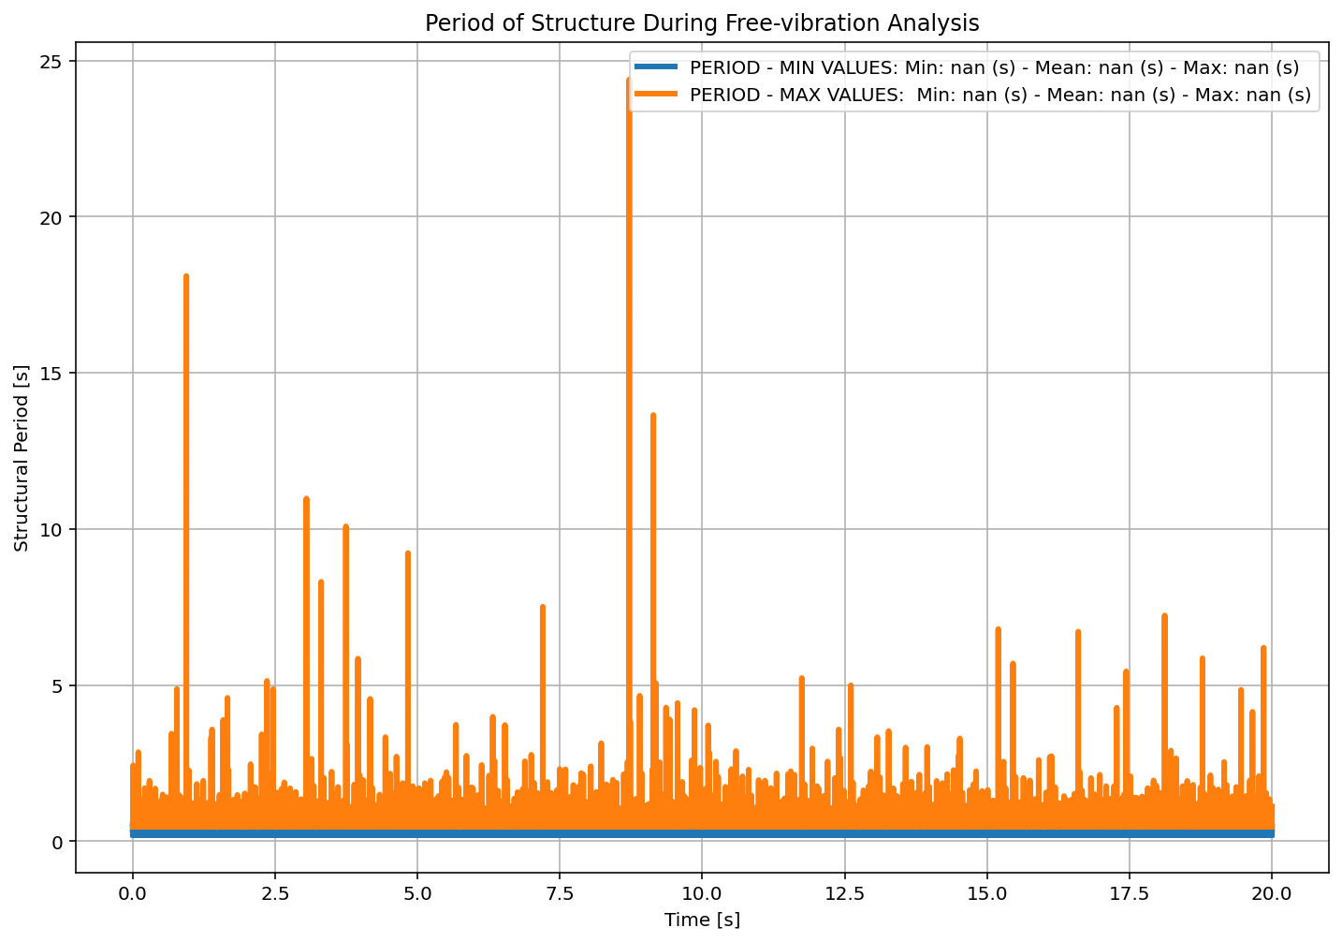

Slide 40
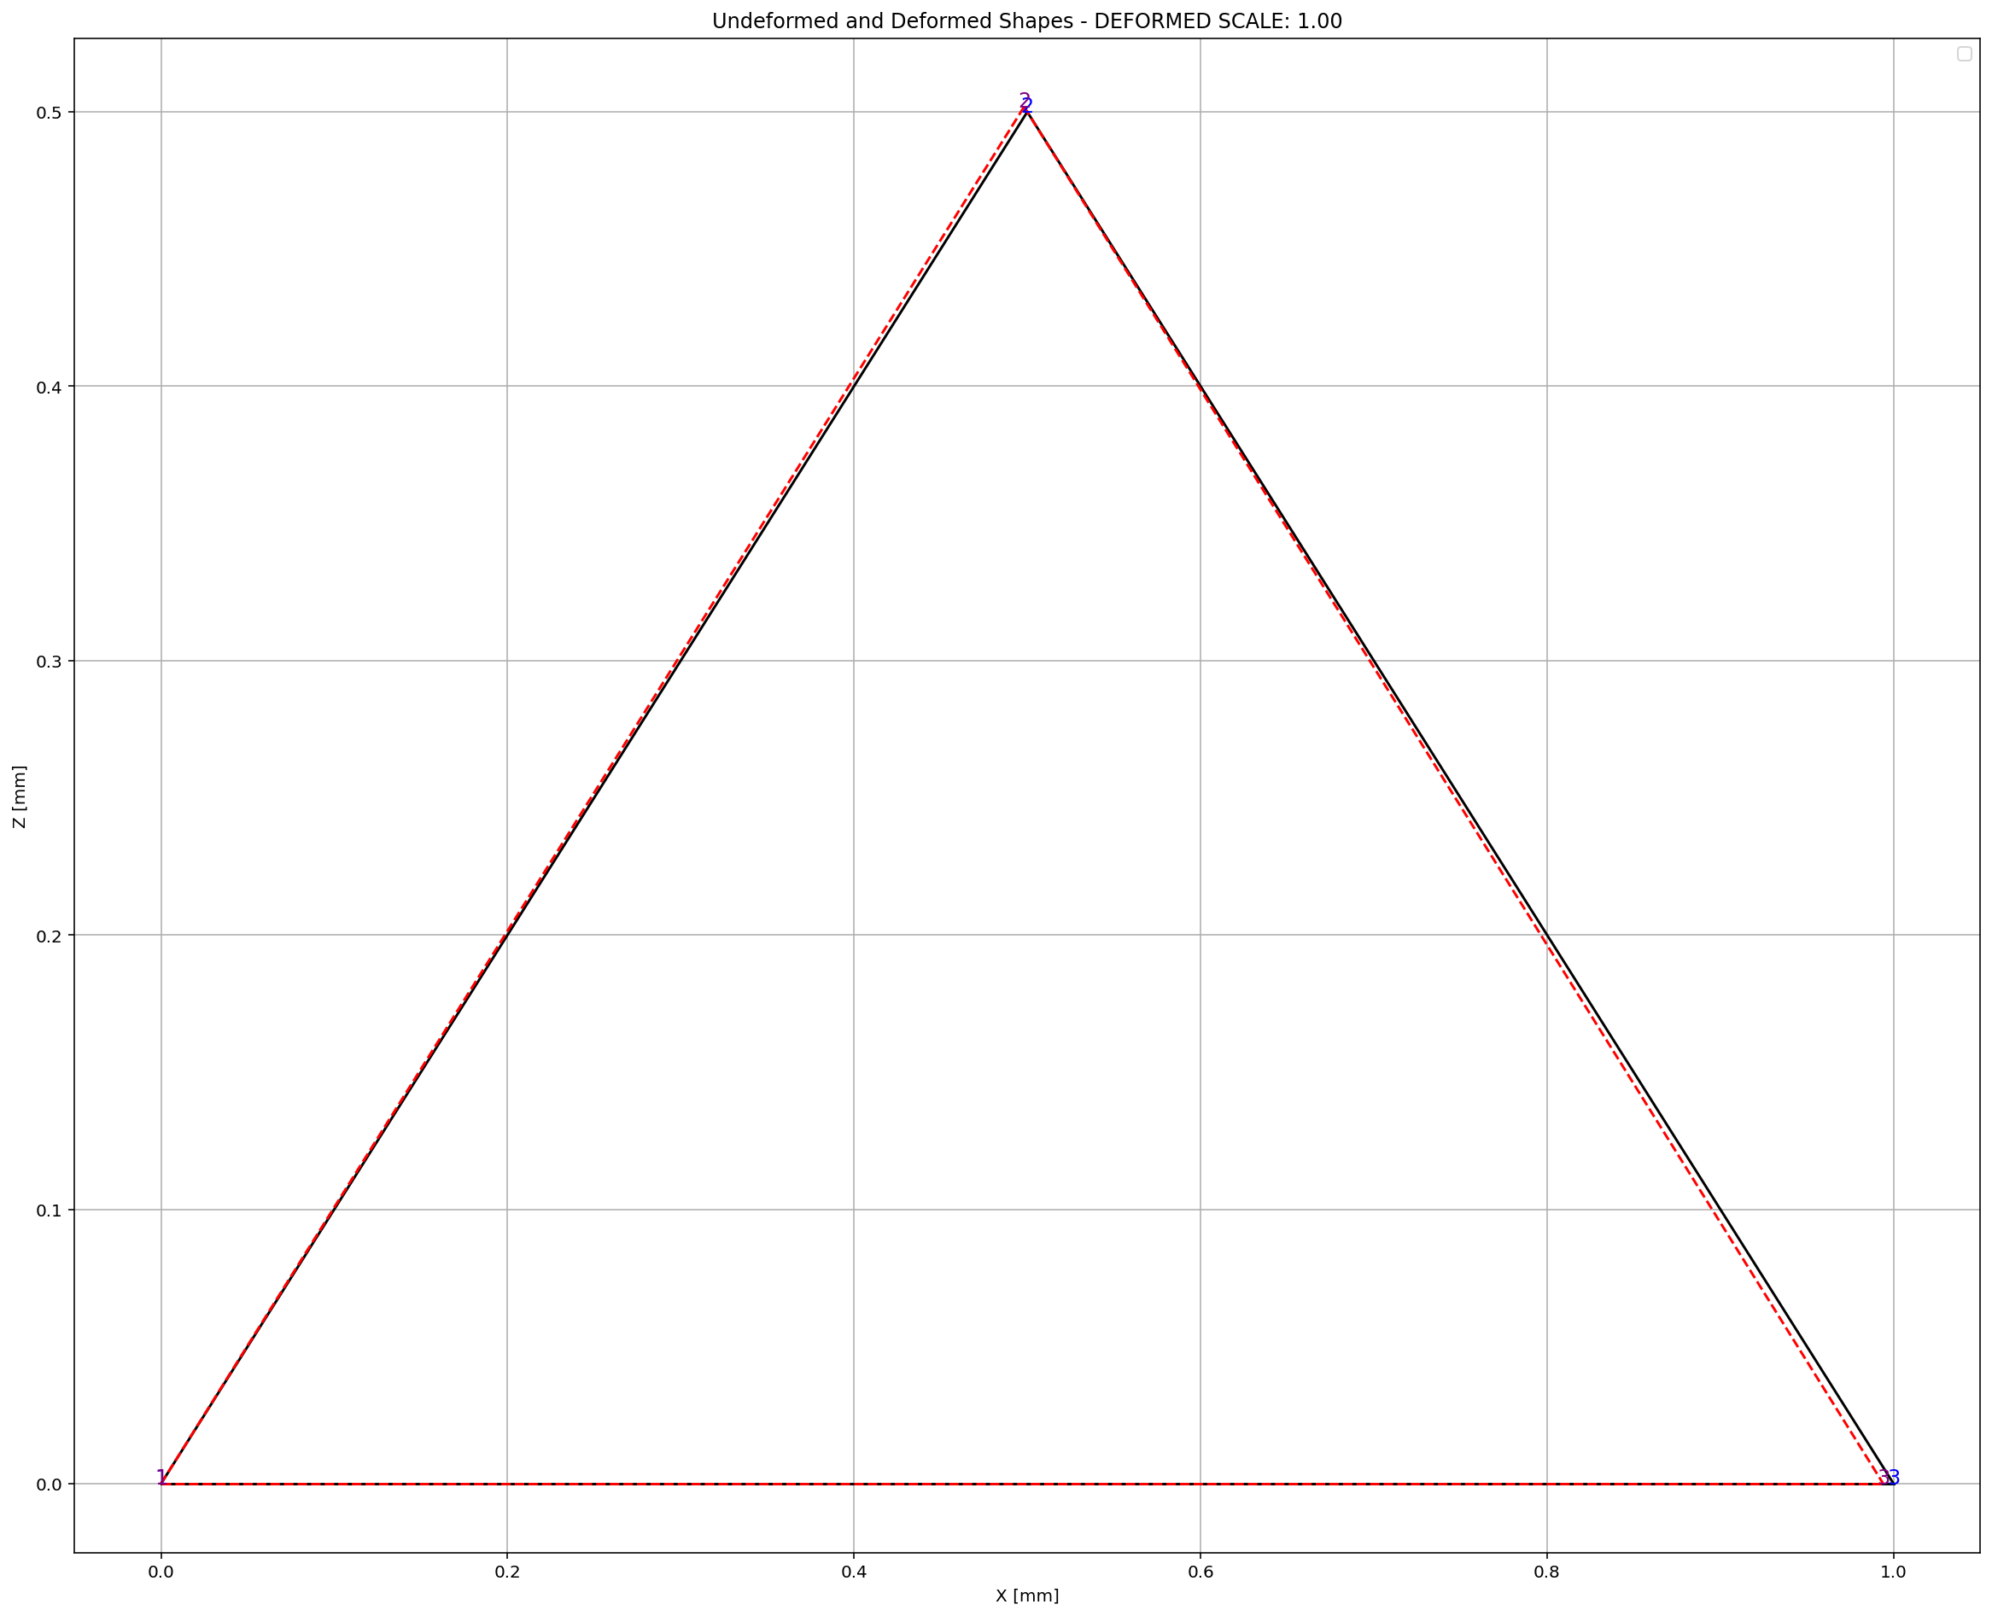

Slide 41
SEISMIC ANALYSIS

Slide 42
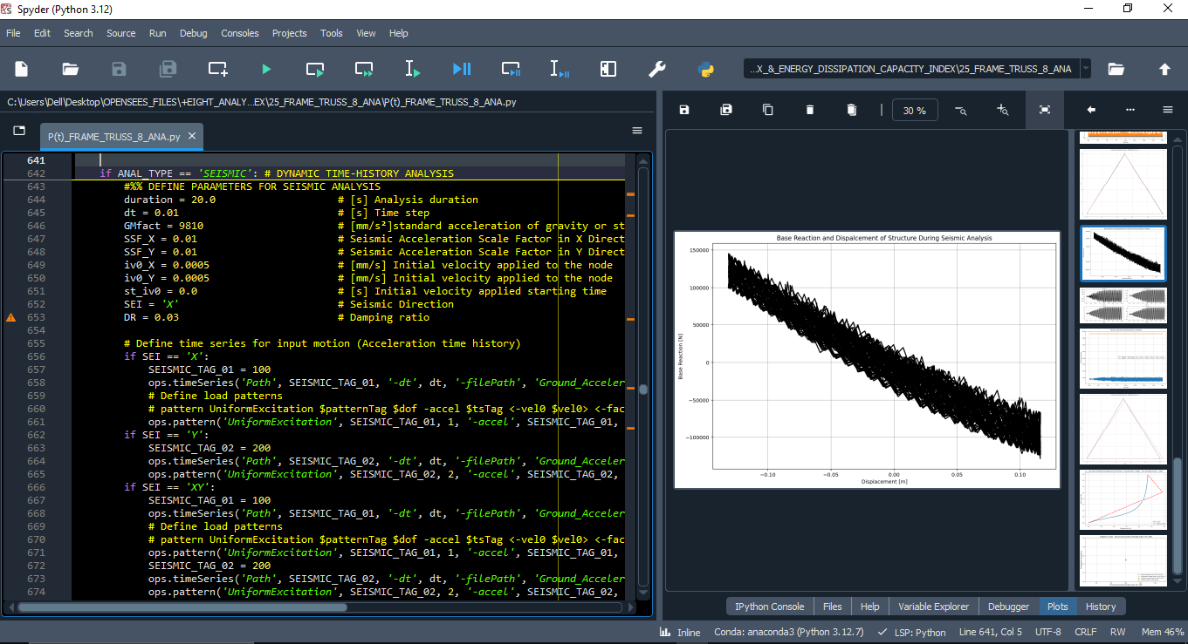

Slide 43
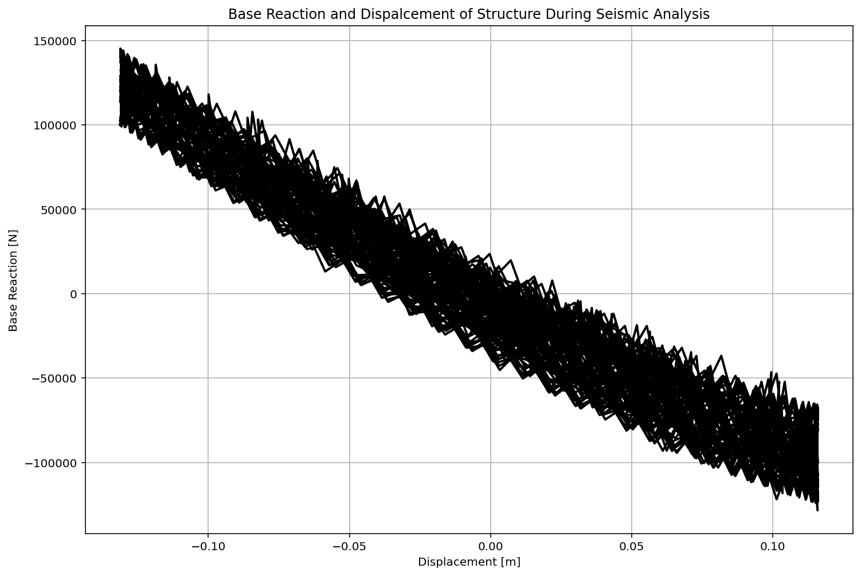

Slide 44
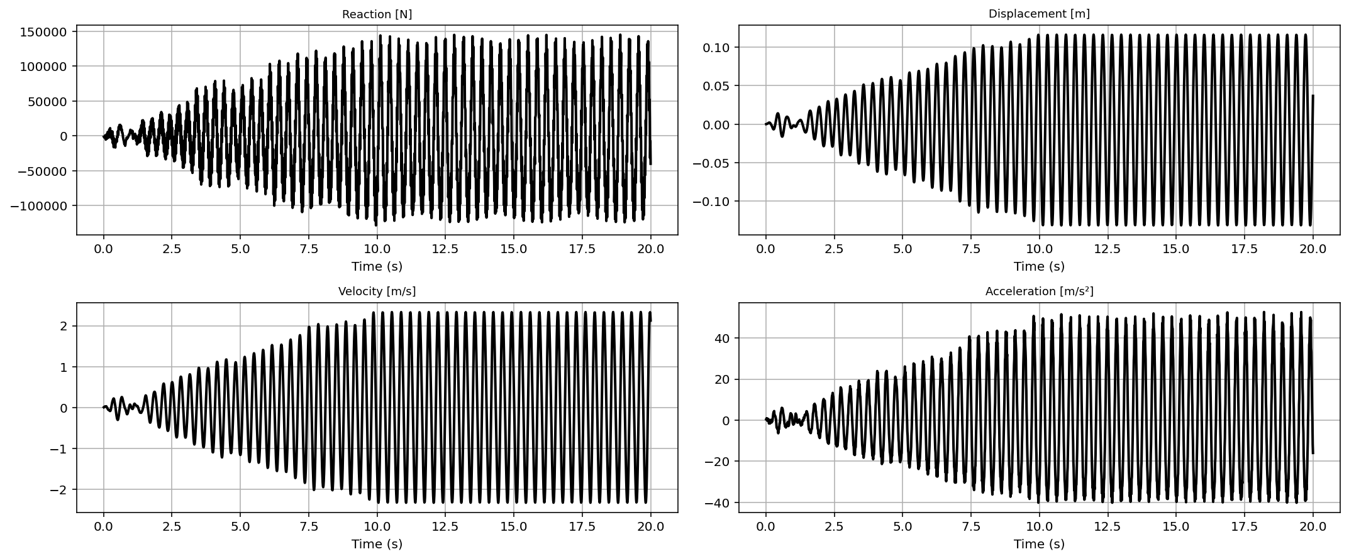

Slide 45
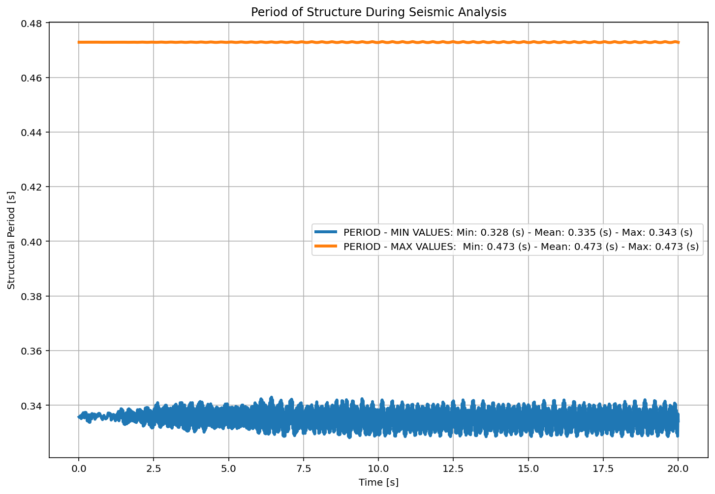

Slide 46
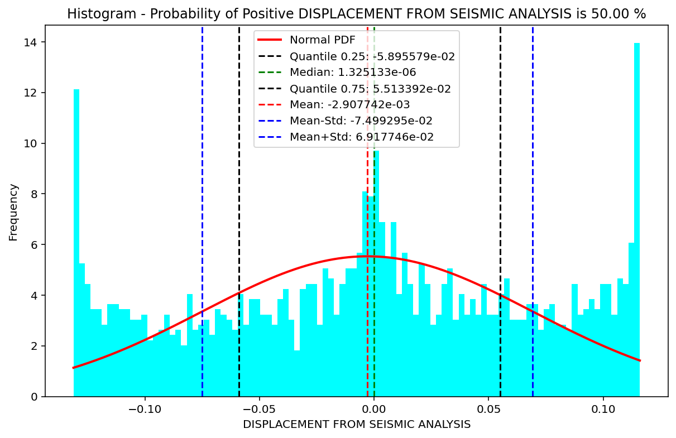

Slide 47
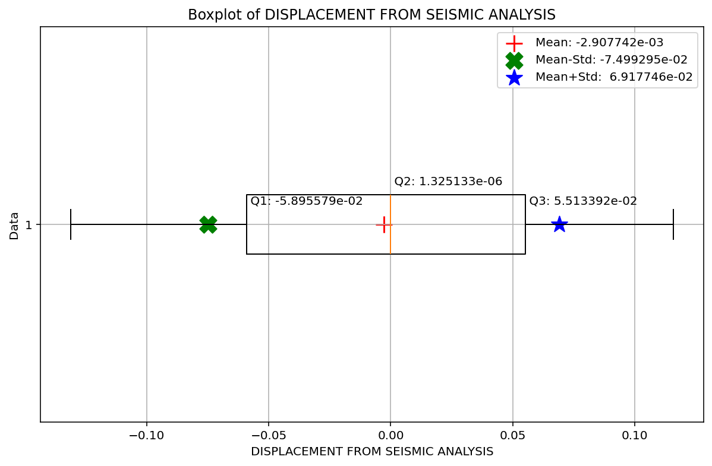

Slide 48
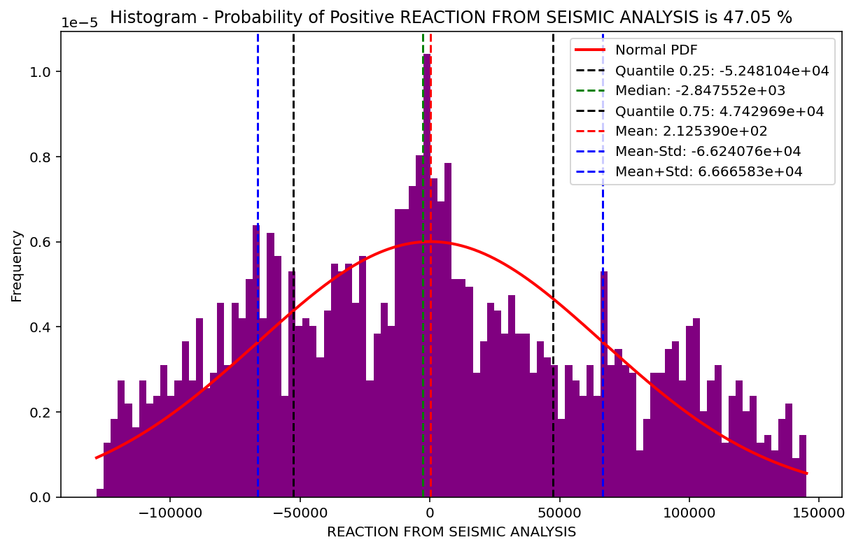

Slide 49
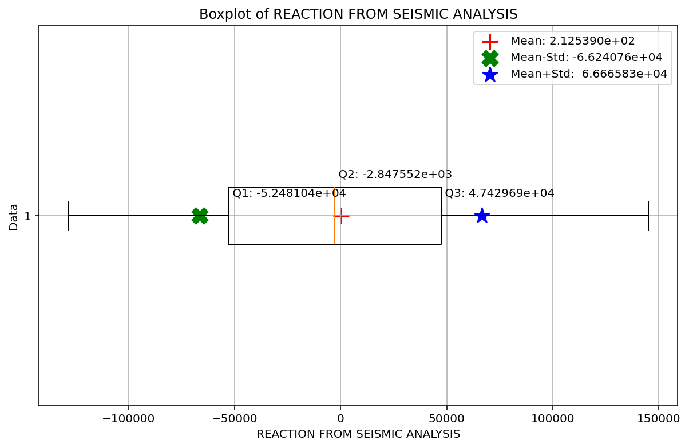

Slide 50
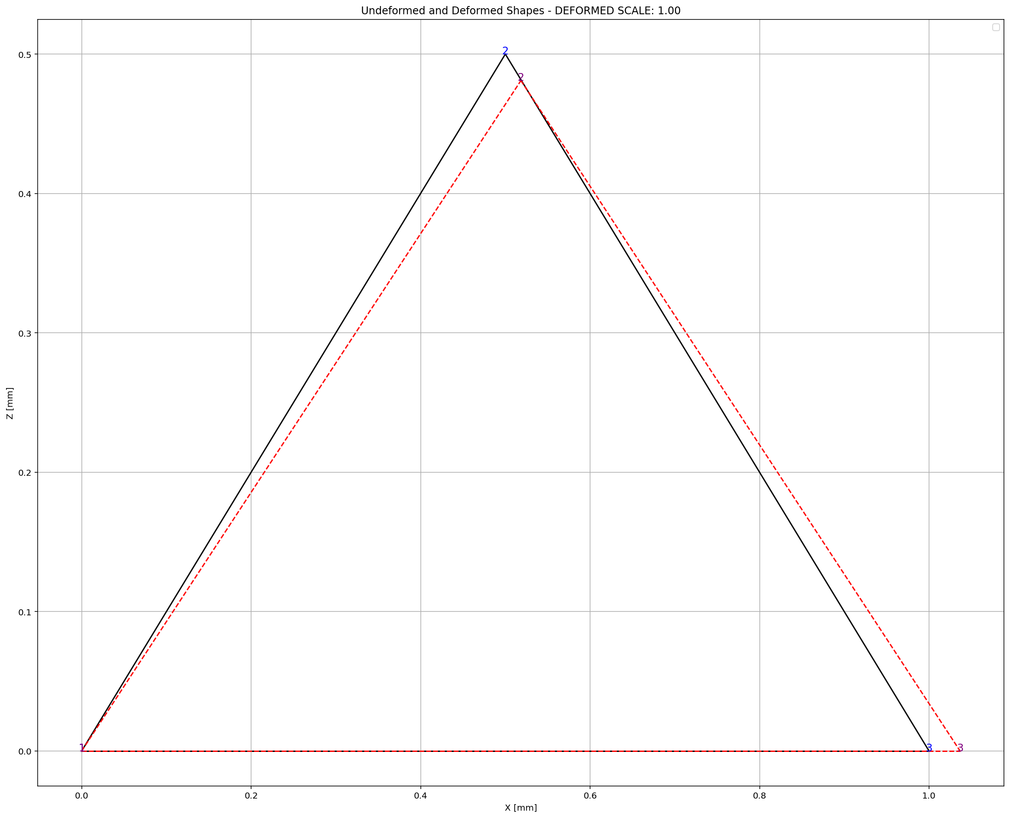

Slide 51
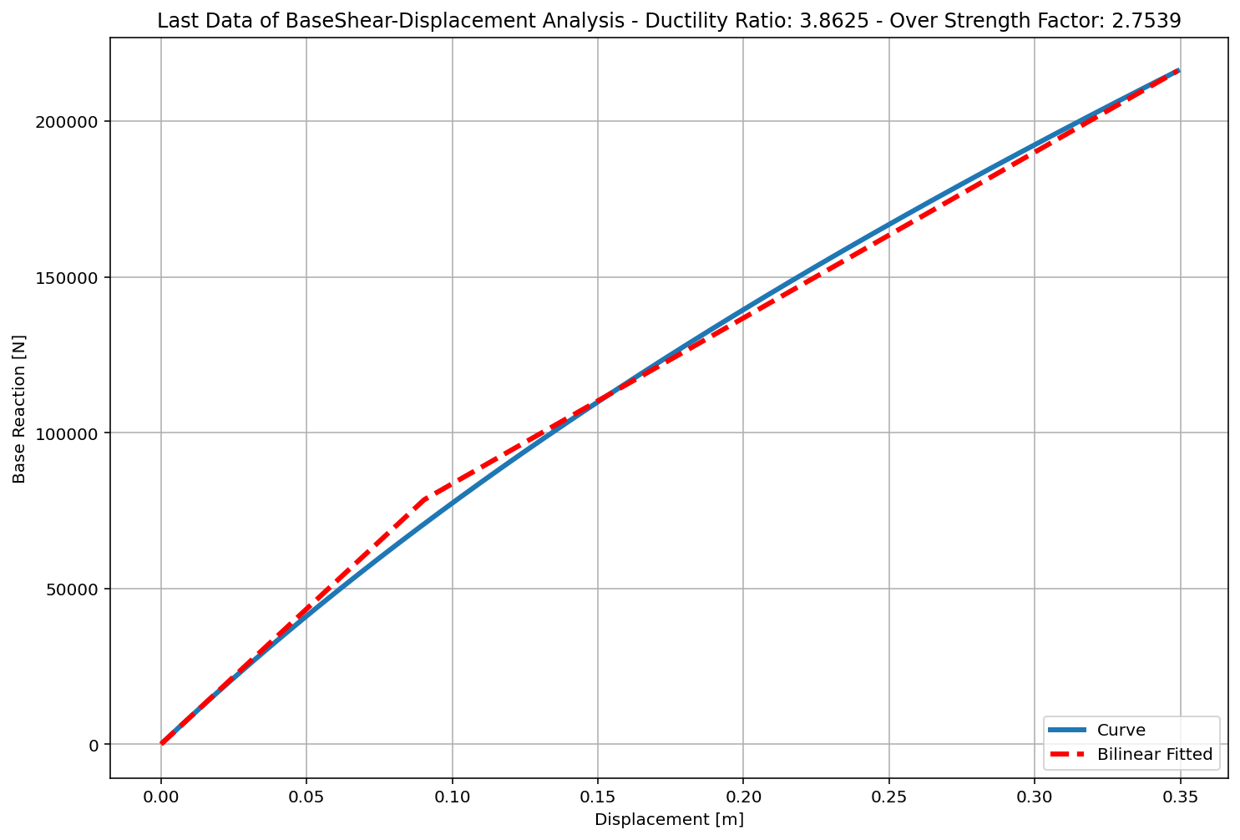

Slide 52
+==========================+
= Analysis curve fitted =
Disp Base Shear
----------------------------
[[0.00000000e+00 0.00000000e+00]
[9.03570300e-02 7.84853705e+04]
[3.49000000e-01 2.16143071e+05]]
+==========================+
+----------------------------------------------------+
Structure Elastic Stiffness : 868613.88
Structure Plastic Stiffness : 619321.12
Structure Tangent Stiffness : 532230.59
Structure Ductility Ratio : 3.86
Structure Over Strength Factor: 2.75
+----------------------------------------------------+
Over Strength Coefficient (Ω0): 2.7539
Displacement Ductility Ratio (μ): 3.8625
Ductility Coefficient (Rμ): 3.8625
Structural Behavior Coefficient (R): 10.6369
Structural Ductility Damage Index in X Direction: 15.7960 (%)

Slide 53
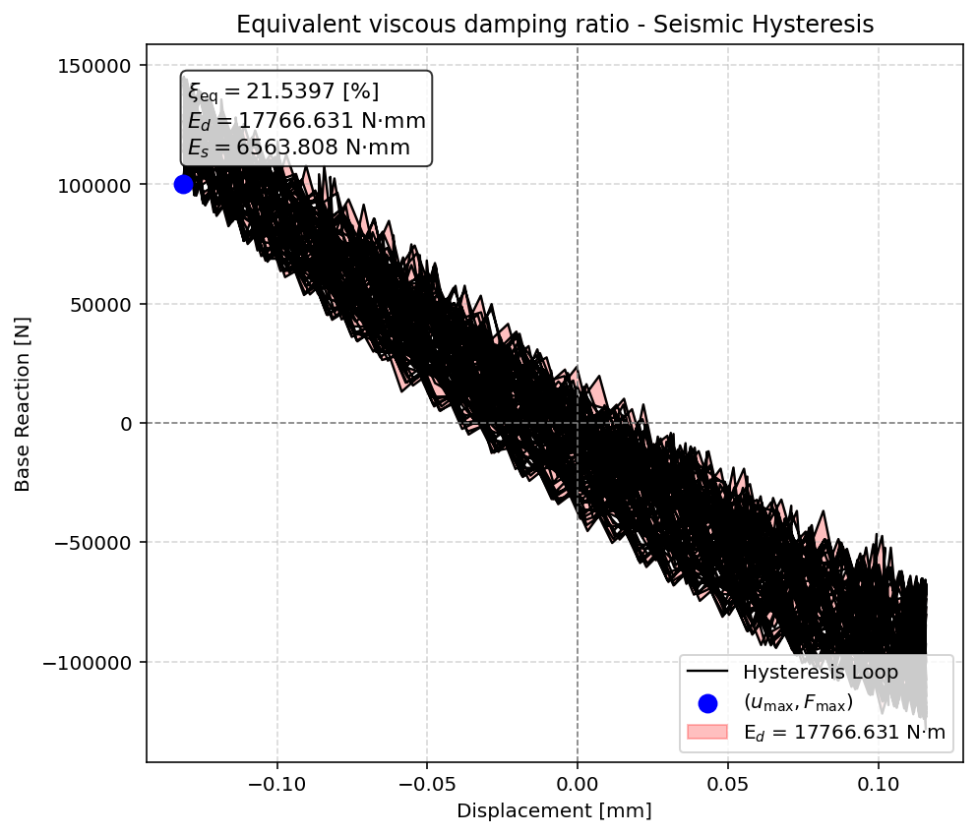

Slide 54
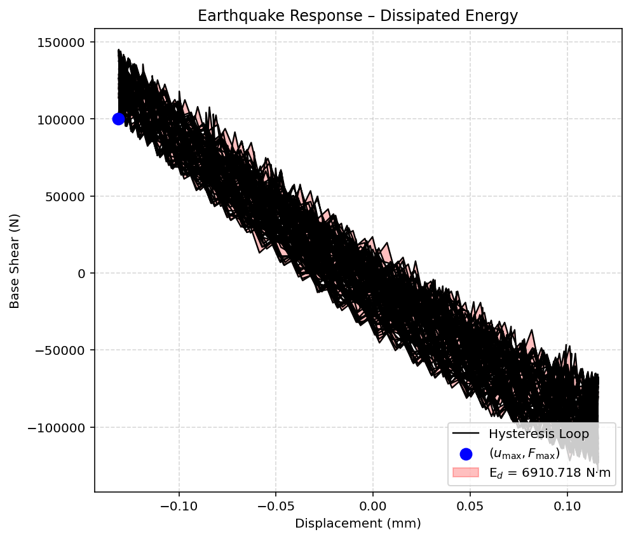

Slide 55
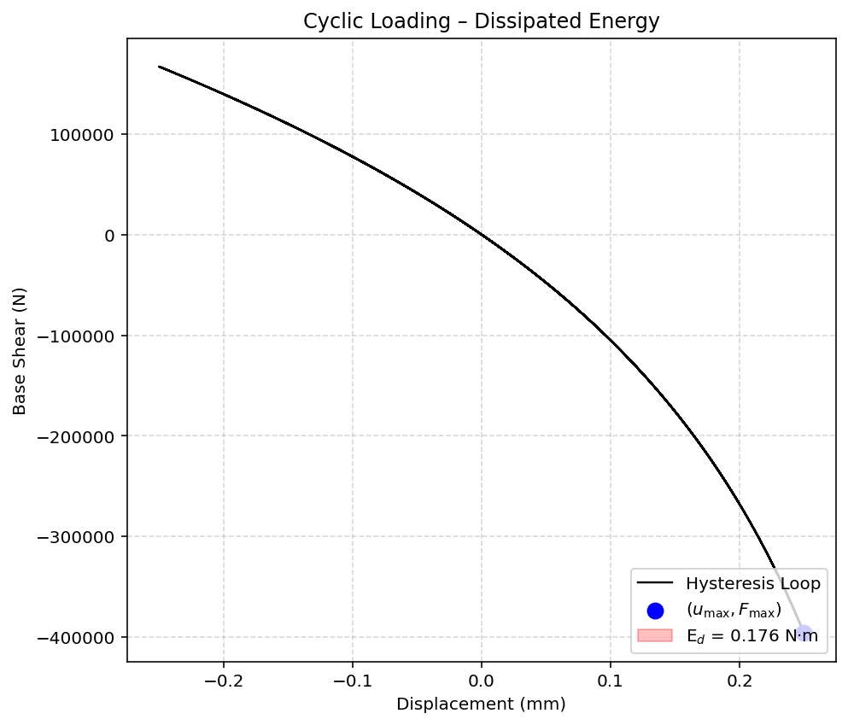

Slide 56
Dissipated Energy from Earthquake= 6910.72 N·mm
Dissipated Energy from Cyclic Displacement= 0.18 N·mm
FOR EVALUATION OF DISSIPATED ENERGY CAPACITY INDEX:
CHECK THE CYCLIC DISPLACEMENT ANALYSIS AND IF IT IS POSSIBLE
INCREASE THE DISPLACEMENT.

Slide 57
