Slide 1
>> IN THE NAME OF ALLAH, THE MOST GRACIOUS, THE MOST MERCIFUL <<
LEVERAGING PARALLEL COMPUTING IN OPENSEES TO SIMULATE GEOMETRIC AND MATERIAL NONLINEARITY IN MULTI-MODE POST-BUCKLING OF SEMI-RIGID STEEL COLUMNS
WRITTEN BY SALAR DELAVAR GHASHGHAEI (QASHQAI)

Slide 2
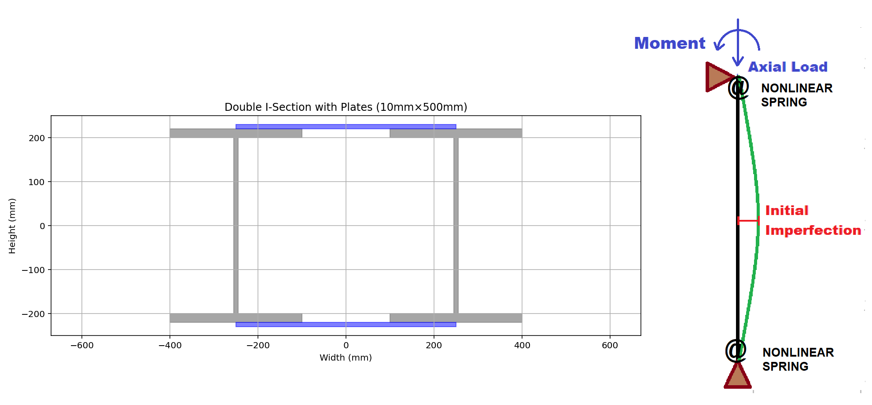

Slide 3
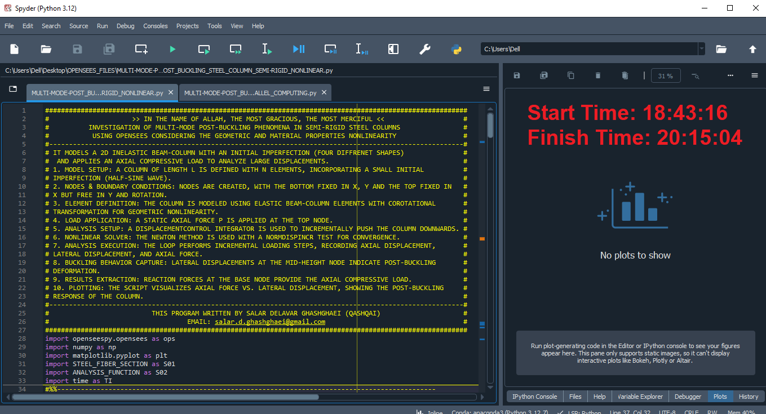
WITHOUT PARALLEL COMPUTING

Slide 4
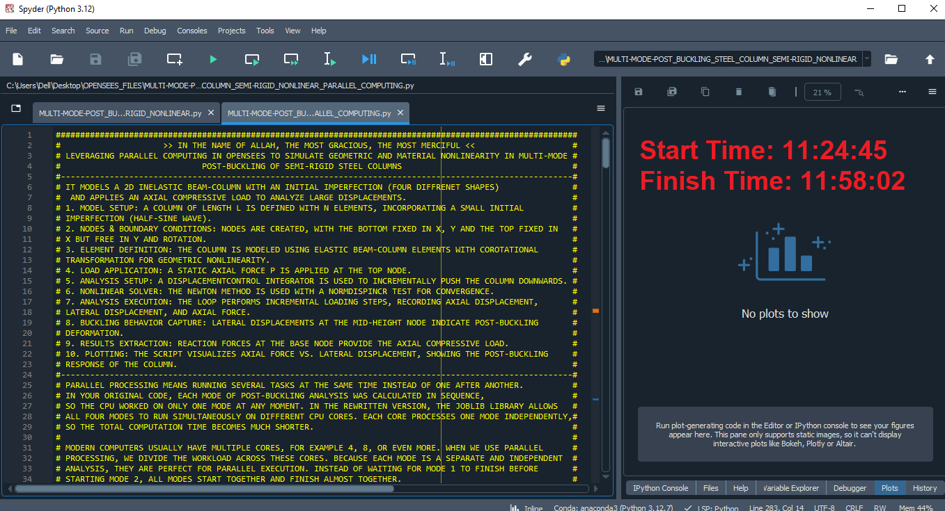
WITH PARALLEL COMPUTING

Slide 5
IN THIS ANALYSIS, USING PARALLEL COMPUTING (JOBLIB), WE CAN RUN THE CODE AT LEAST 8 TIMES FASTER

Slide 6
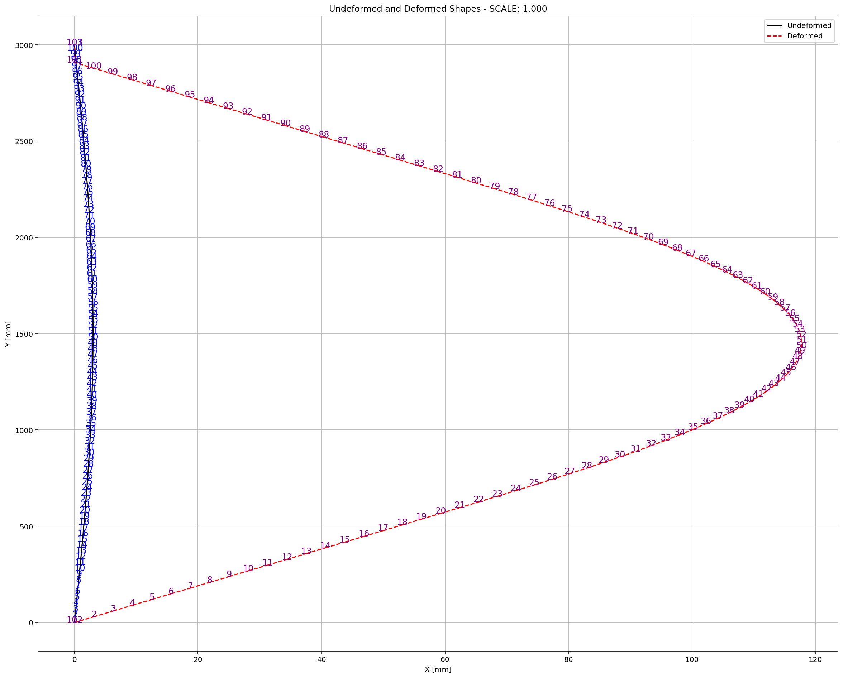

Slide 7
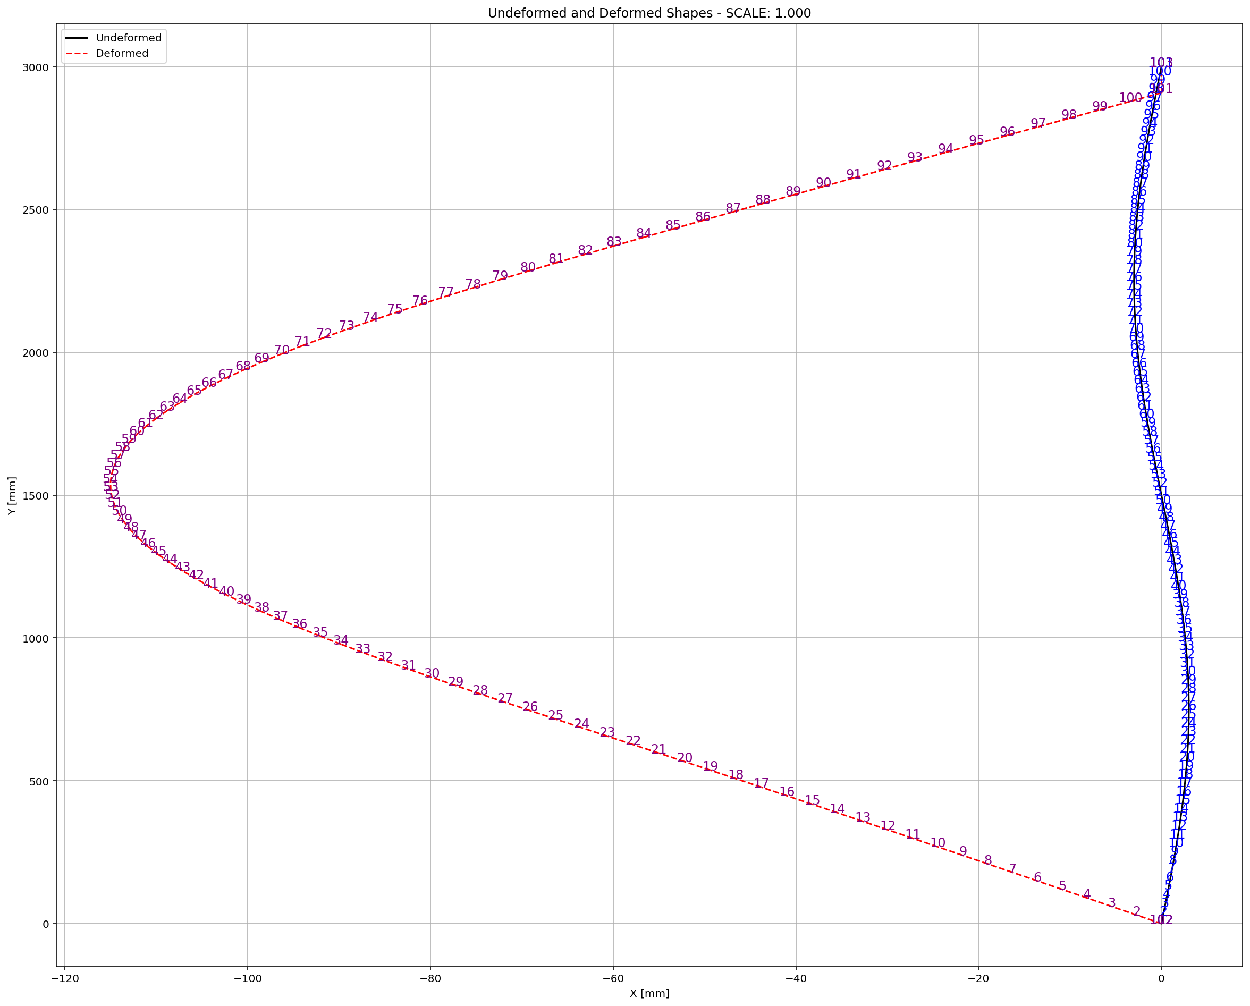

Slide 8
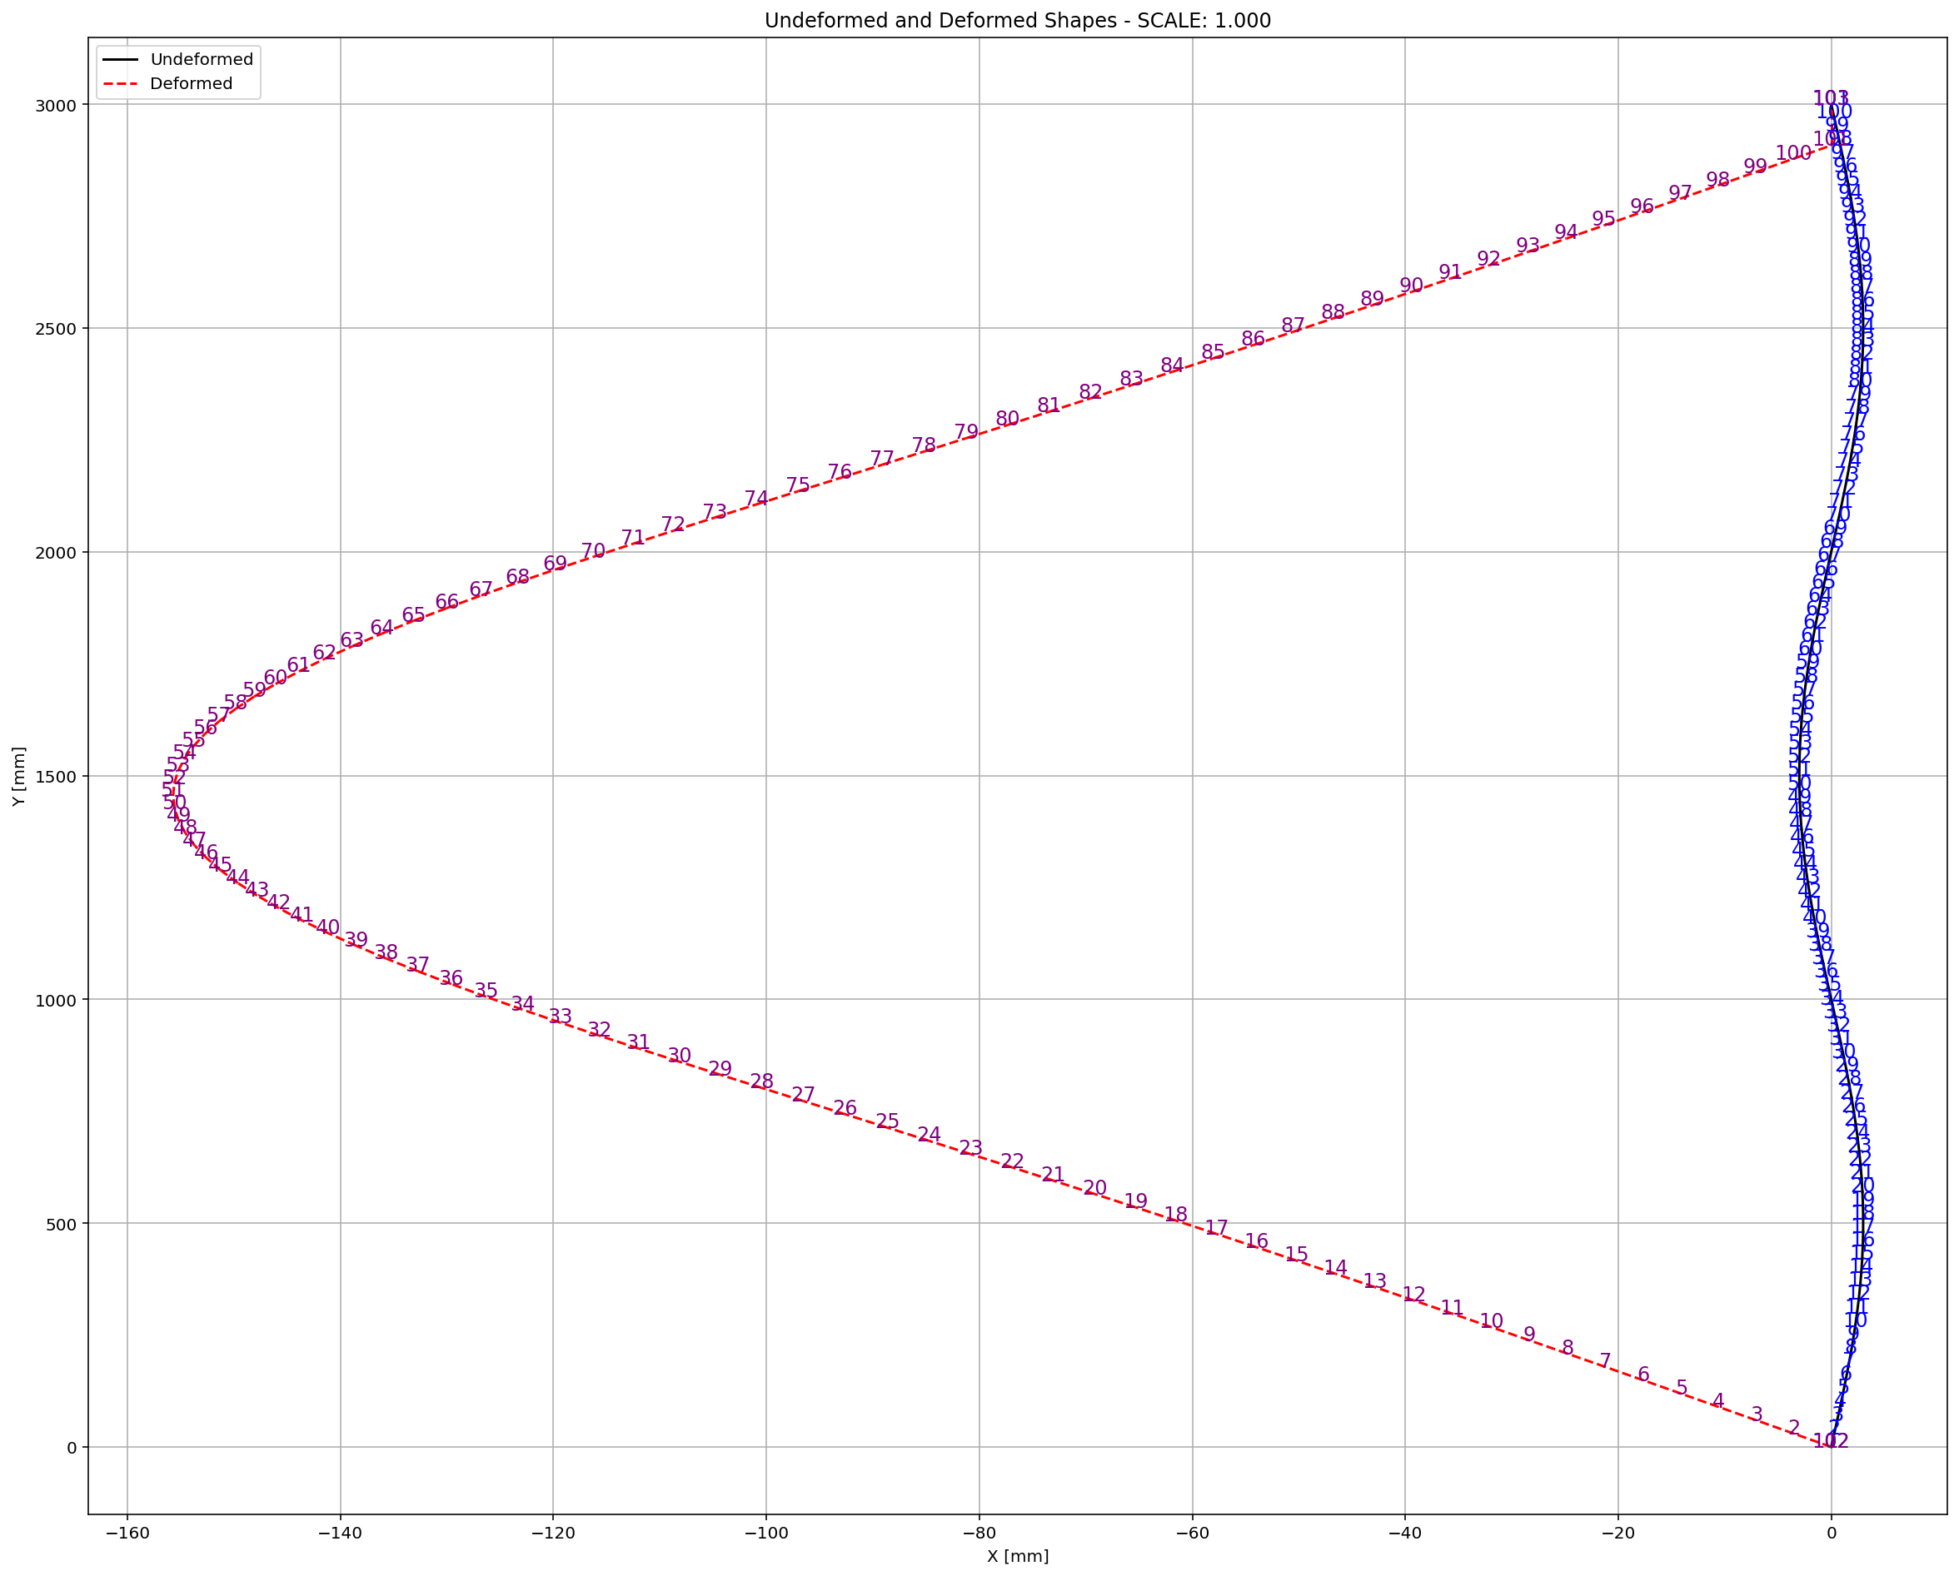

Slide 9
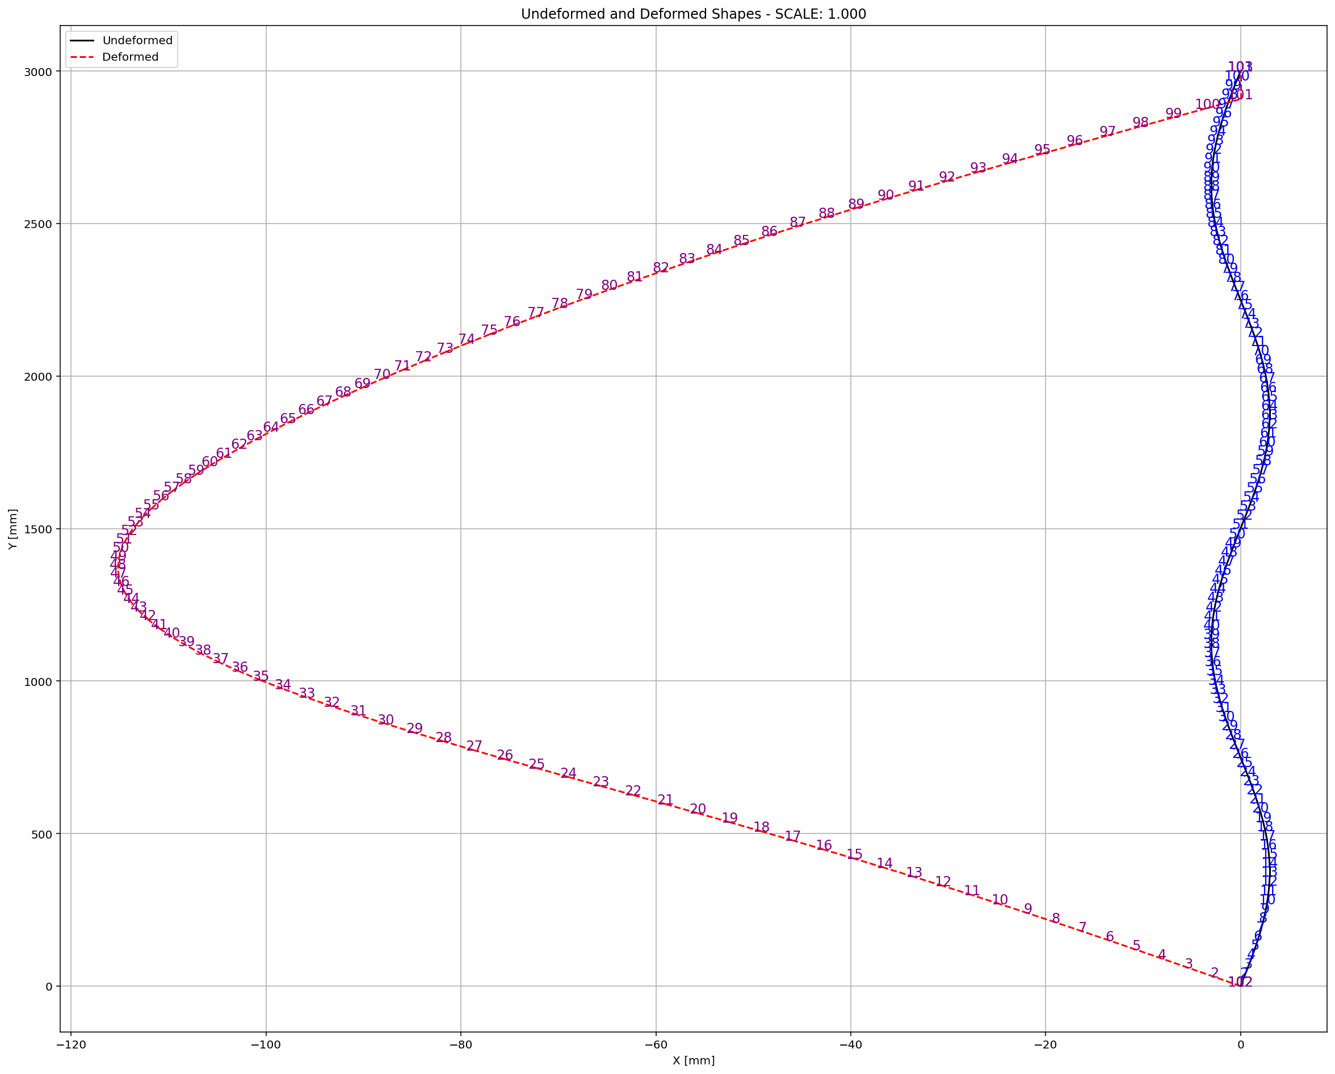

Slide 10
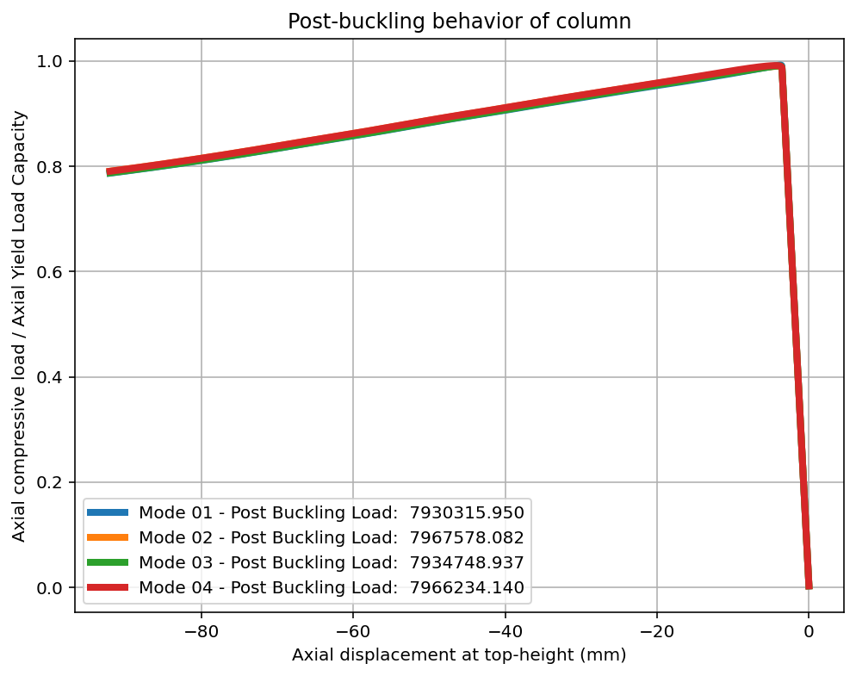

Slide 11
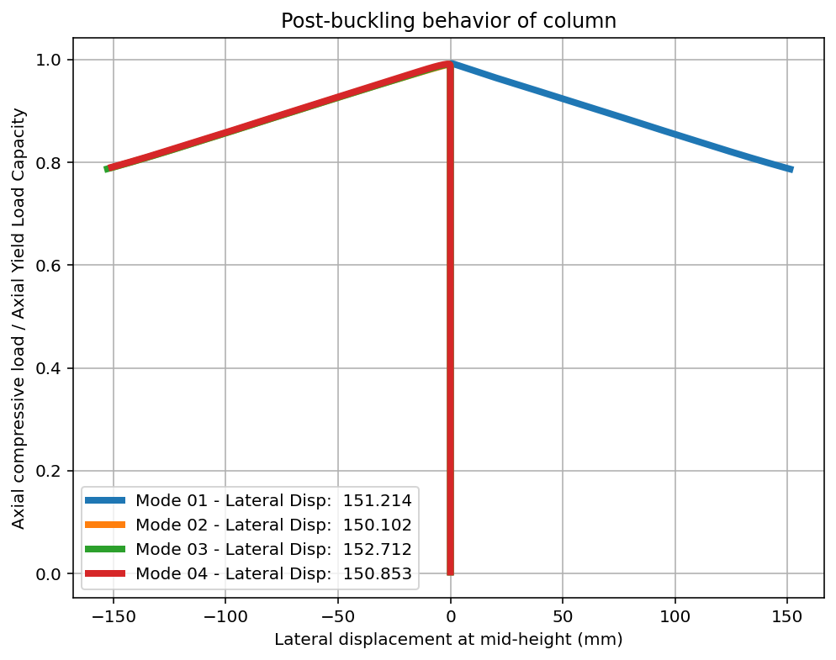

Slide 12
