Slide 1
>> IN THE NAME OF ALLAH, THE MOST GRACIOUS, THE MOST MERCIFUL <<
PARALLEL COMPUTING IN OPENSES FOR SCALABLE NONLINEAR DYNAMIC ANALYSIS: RESPONSE SPECTRA AND DUCTILITY DAMAGE INDEX ASSESSMENT UNDER 20 GROUND MOTIONS
WRITTEN BY SALAR DELAVAR GHASHGHAEI (QASHQAI)

Slide 2
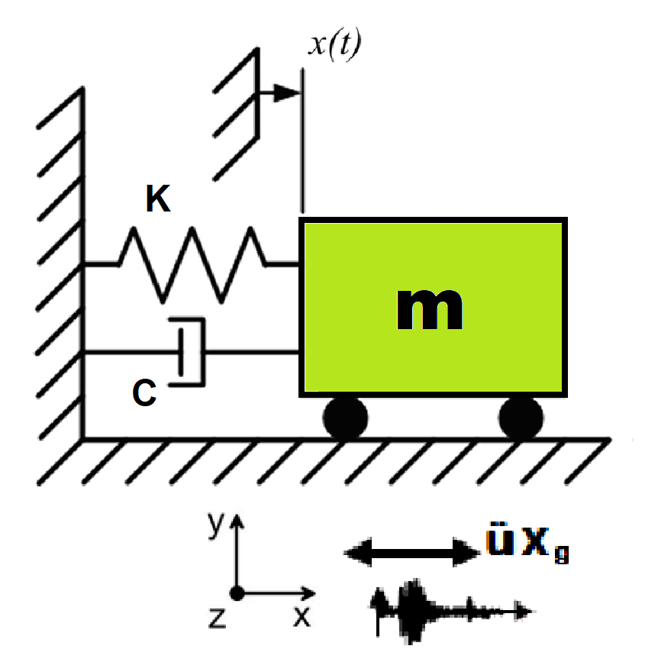
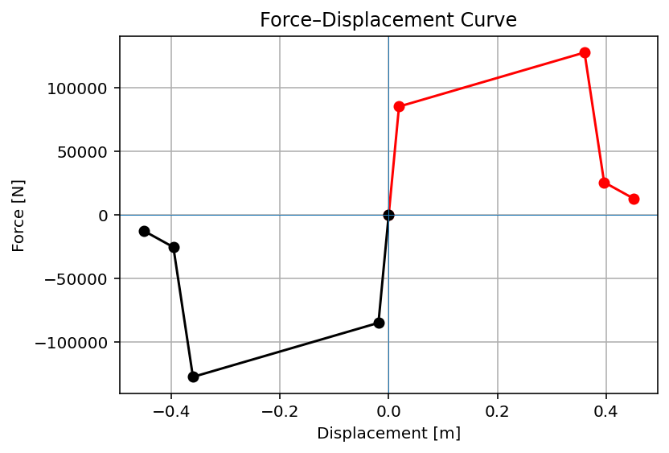

Slide 3
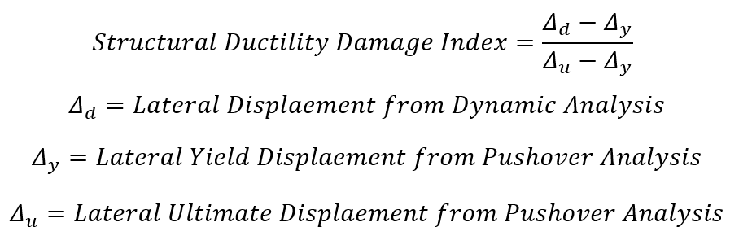

Slide 4
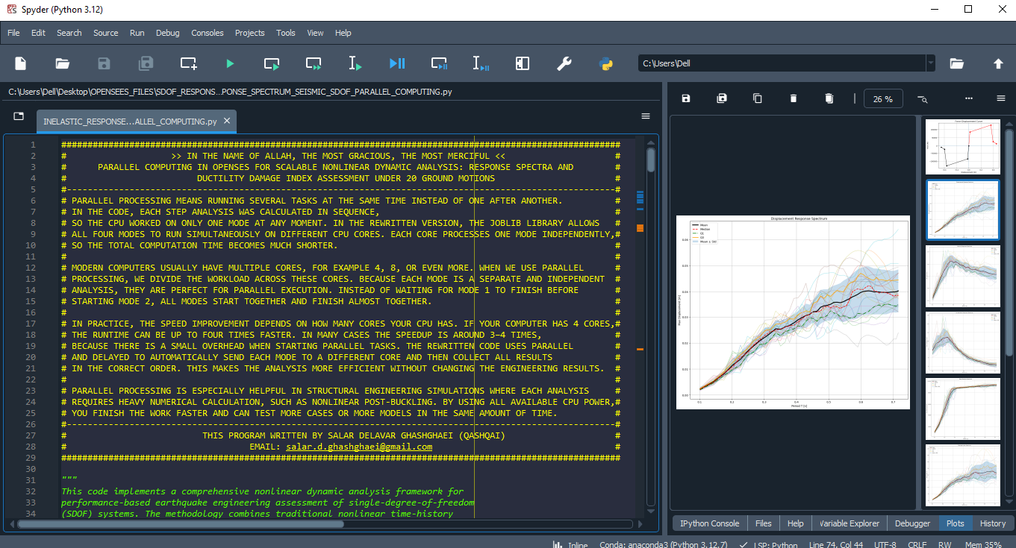

Slide 5
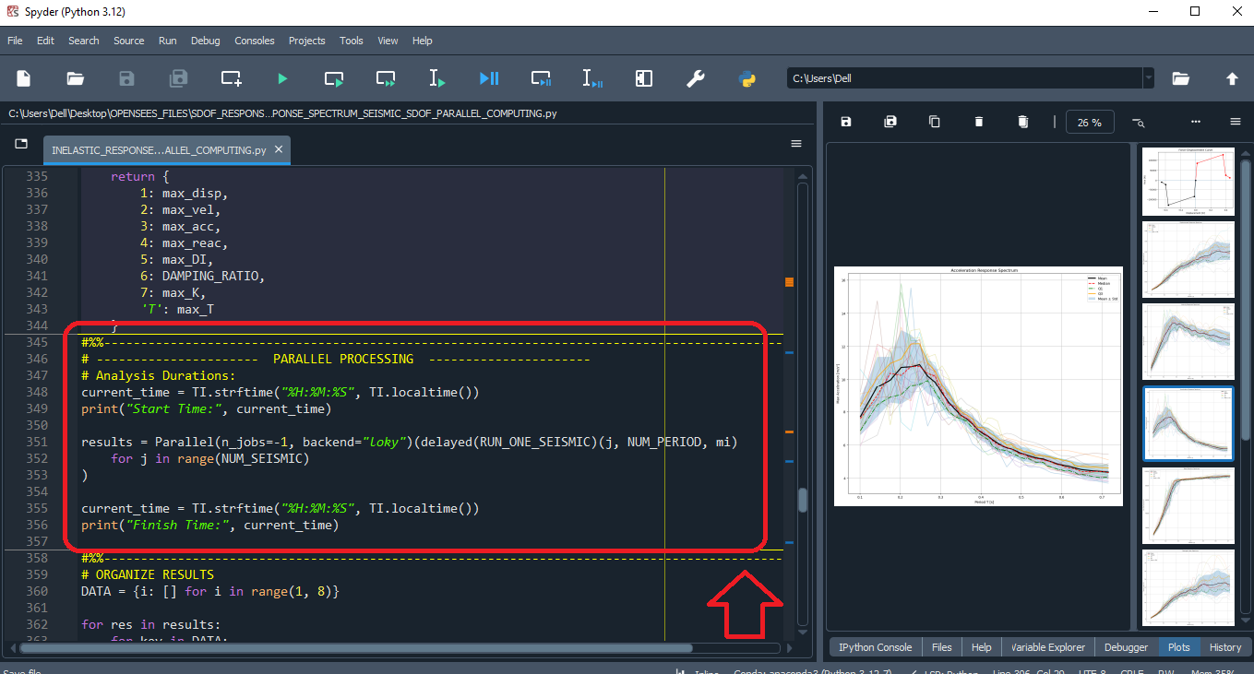

Slide 6
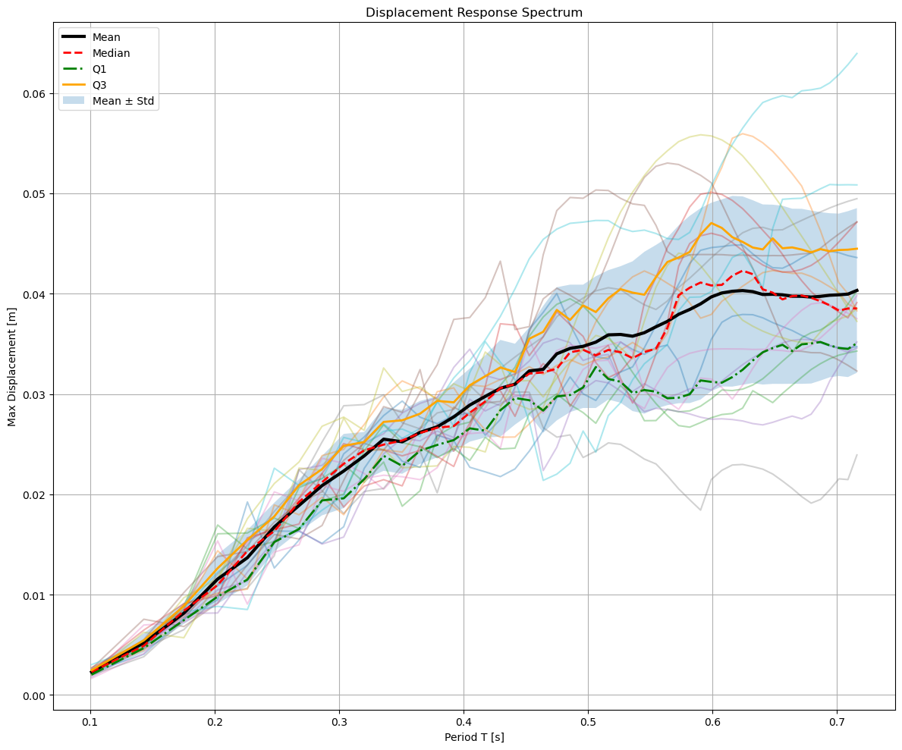

Slide 7
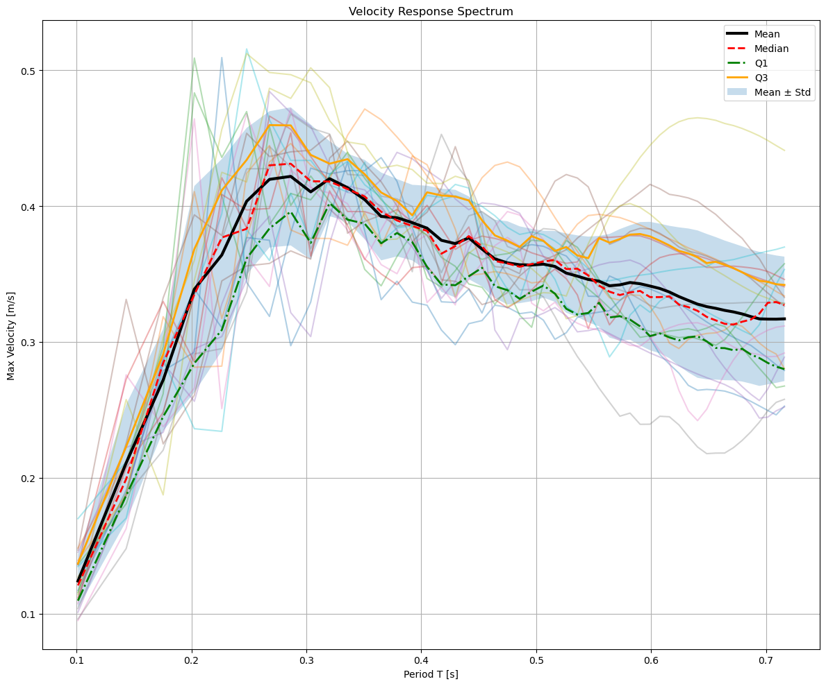

Slide 8
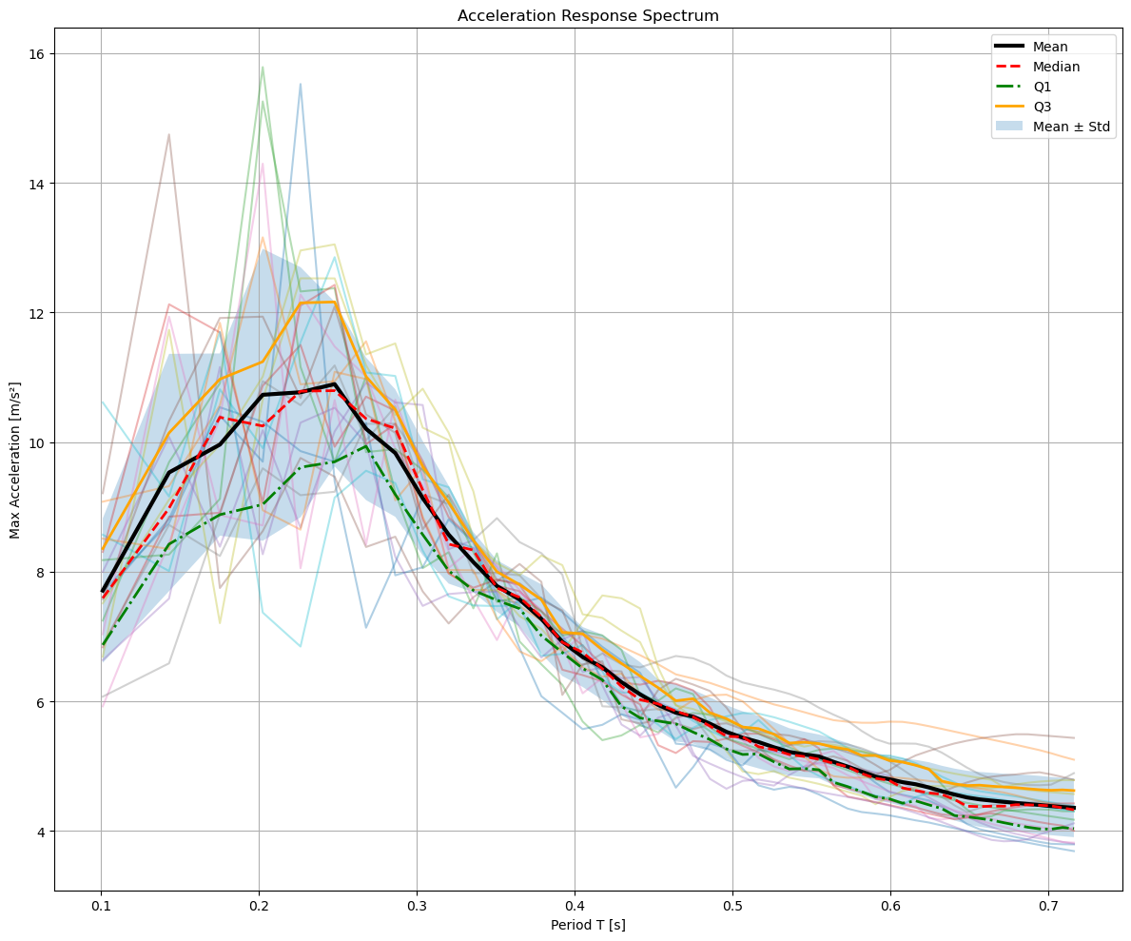

Slide 9
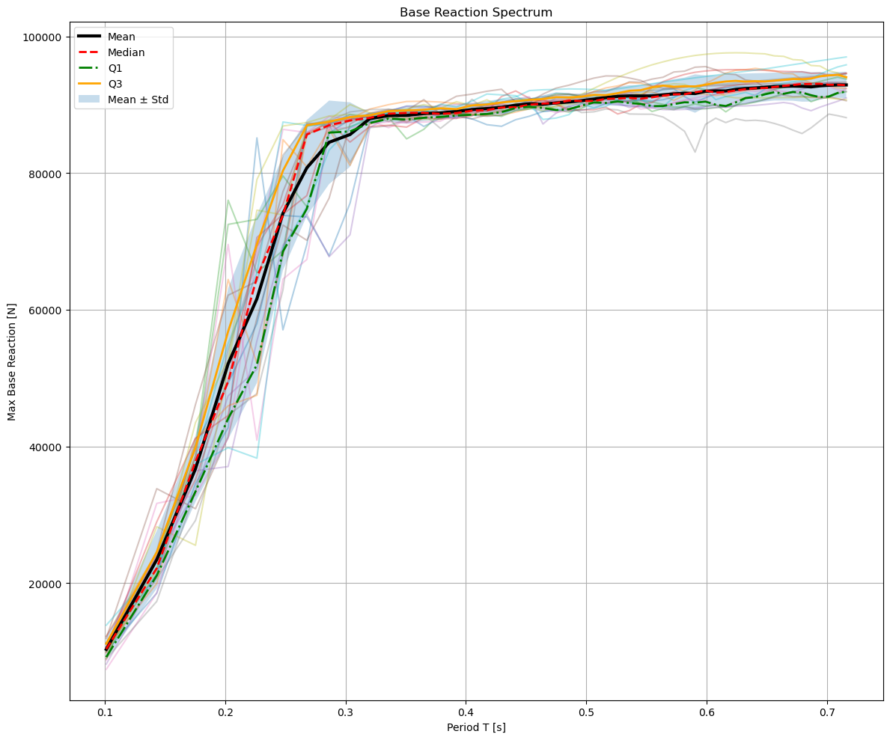

Slide 10
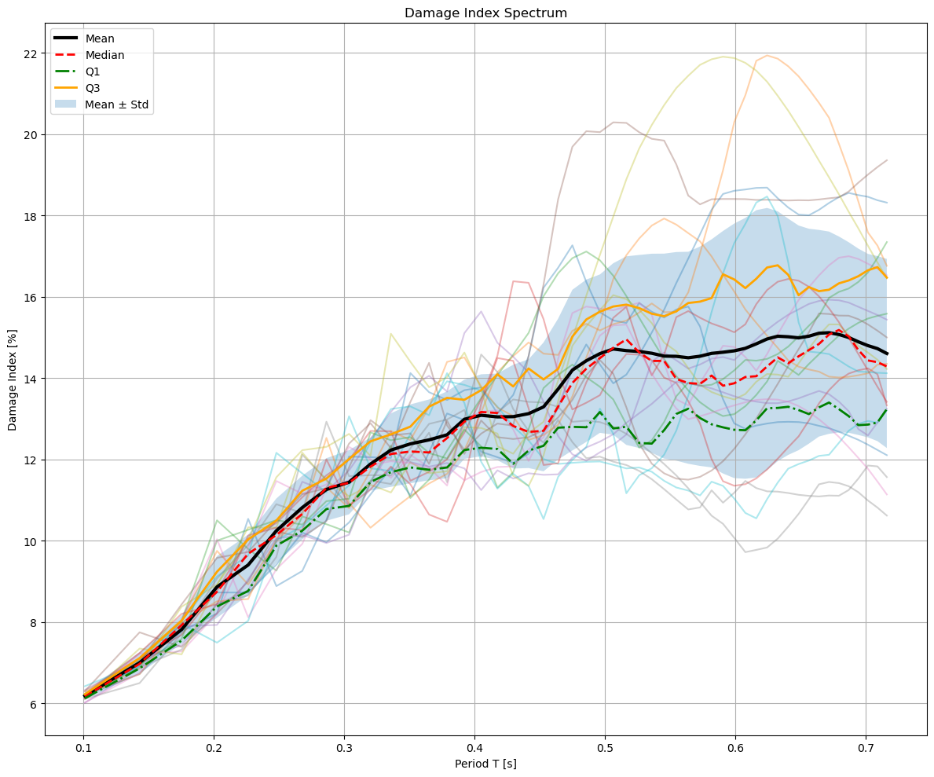

Slide 11
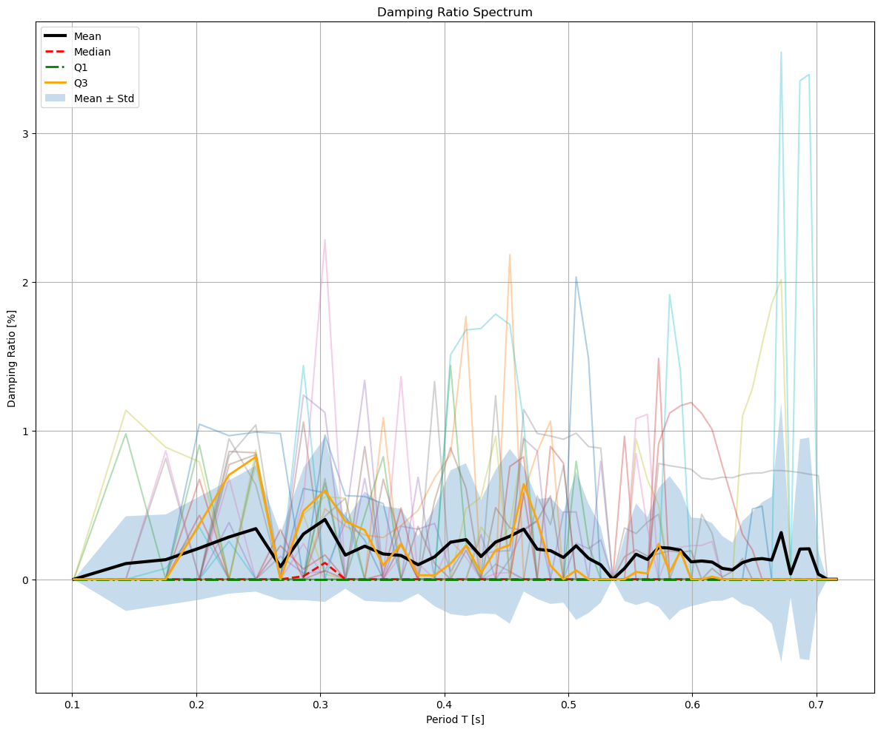

Slide 12
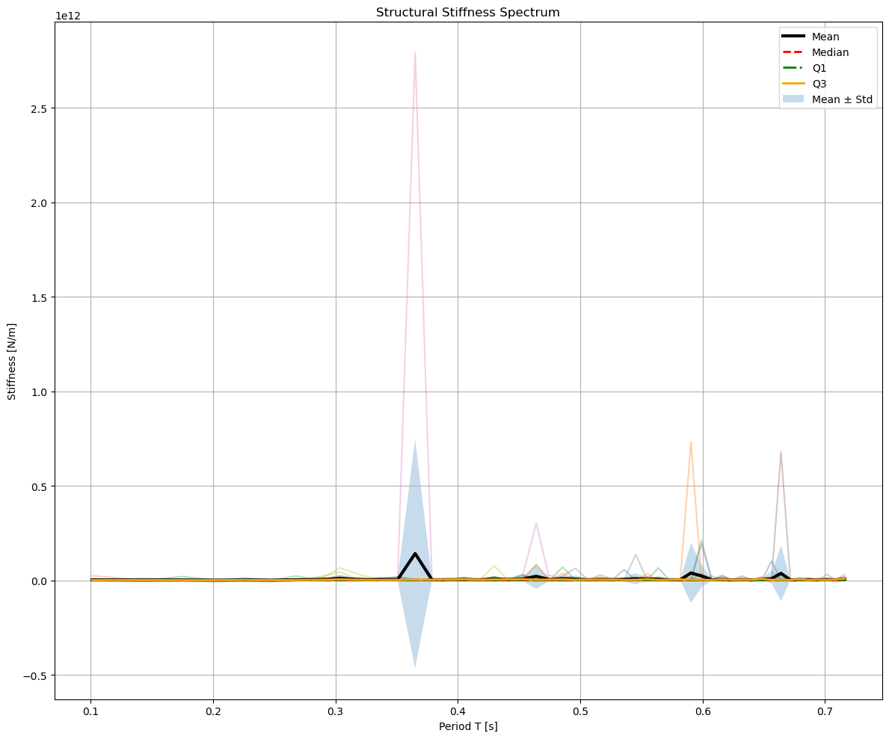

Slide 13
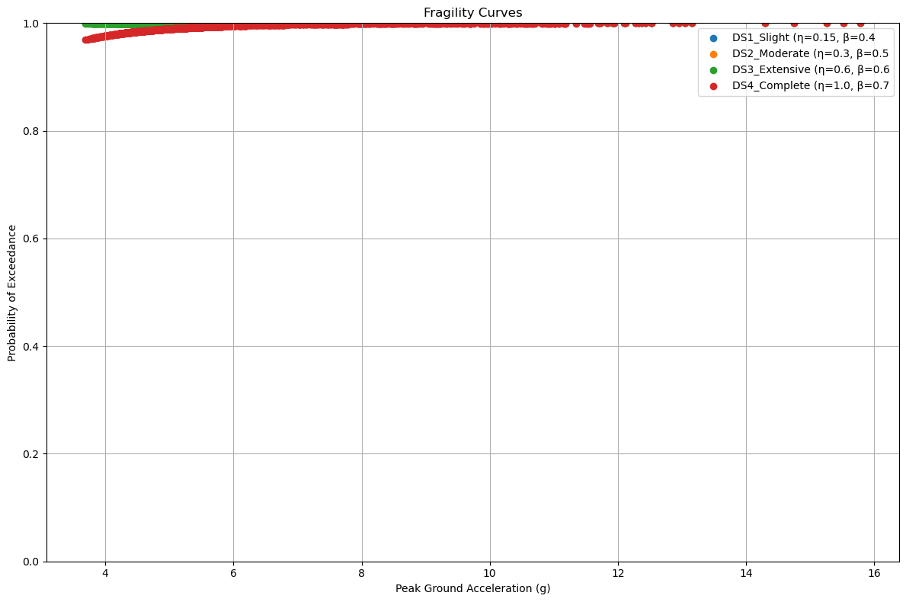

Slide 14
