Slide 1
>> IN THE NAME OF ALLAH, THE MOST GRACIOUS, THE MOST MERCIFUL <<
COMPREHENSIVE EVALUATION OF THE EQUIVALENT VISCOUS DAMPING RATIO OF A NONLINEAR MDOF SYSTEM UNDER MULTIPLE LOADING PROTOCOLS
THIS PROGRAM WRITTEN BY SALAR DELAVAR GHASHGHAEI (QASHQAI)

Slide 2
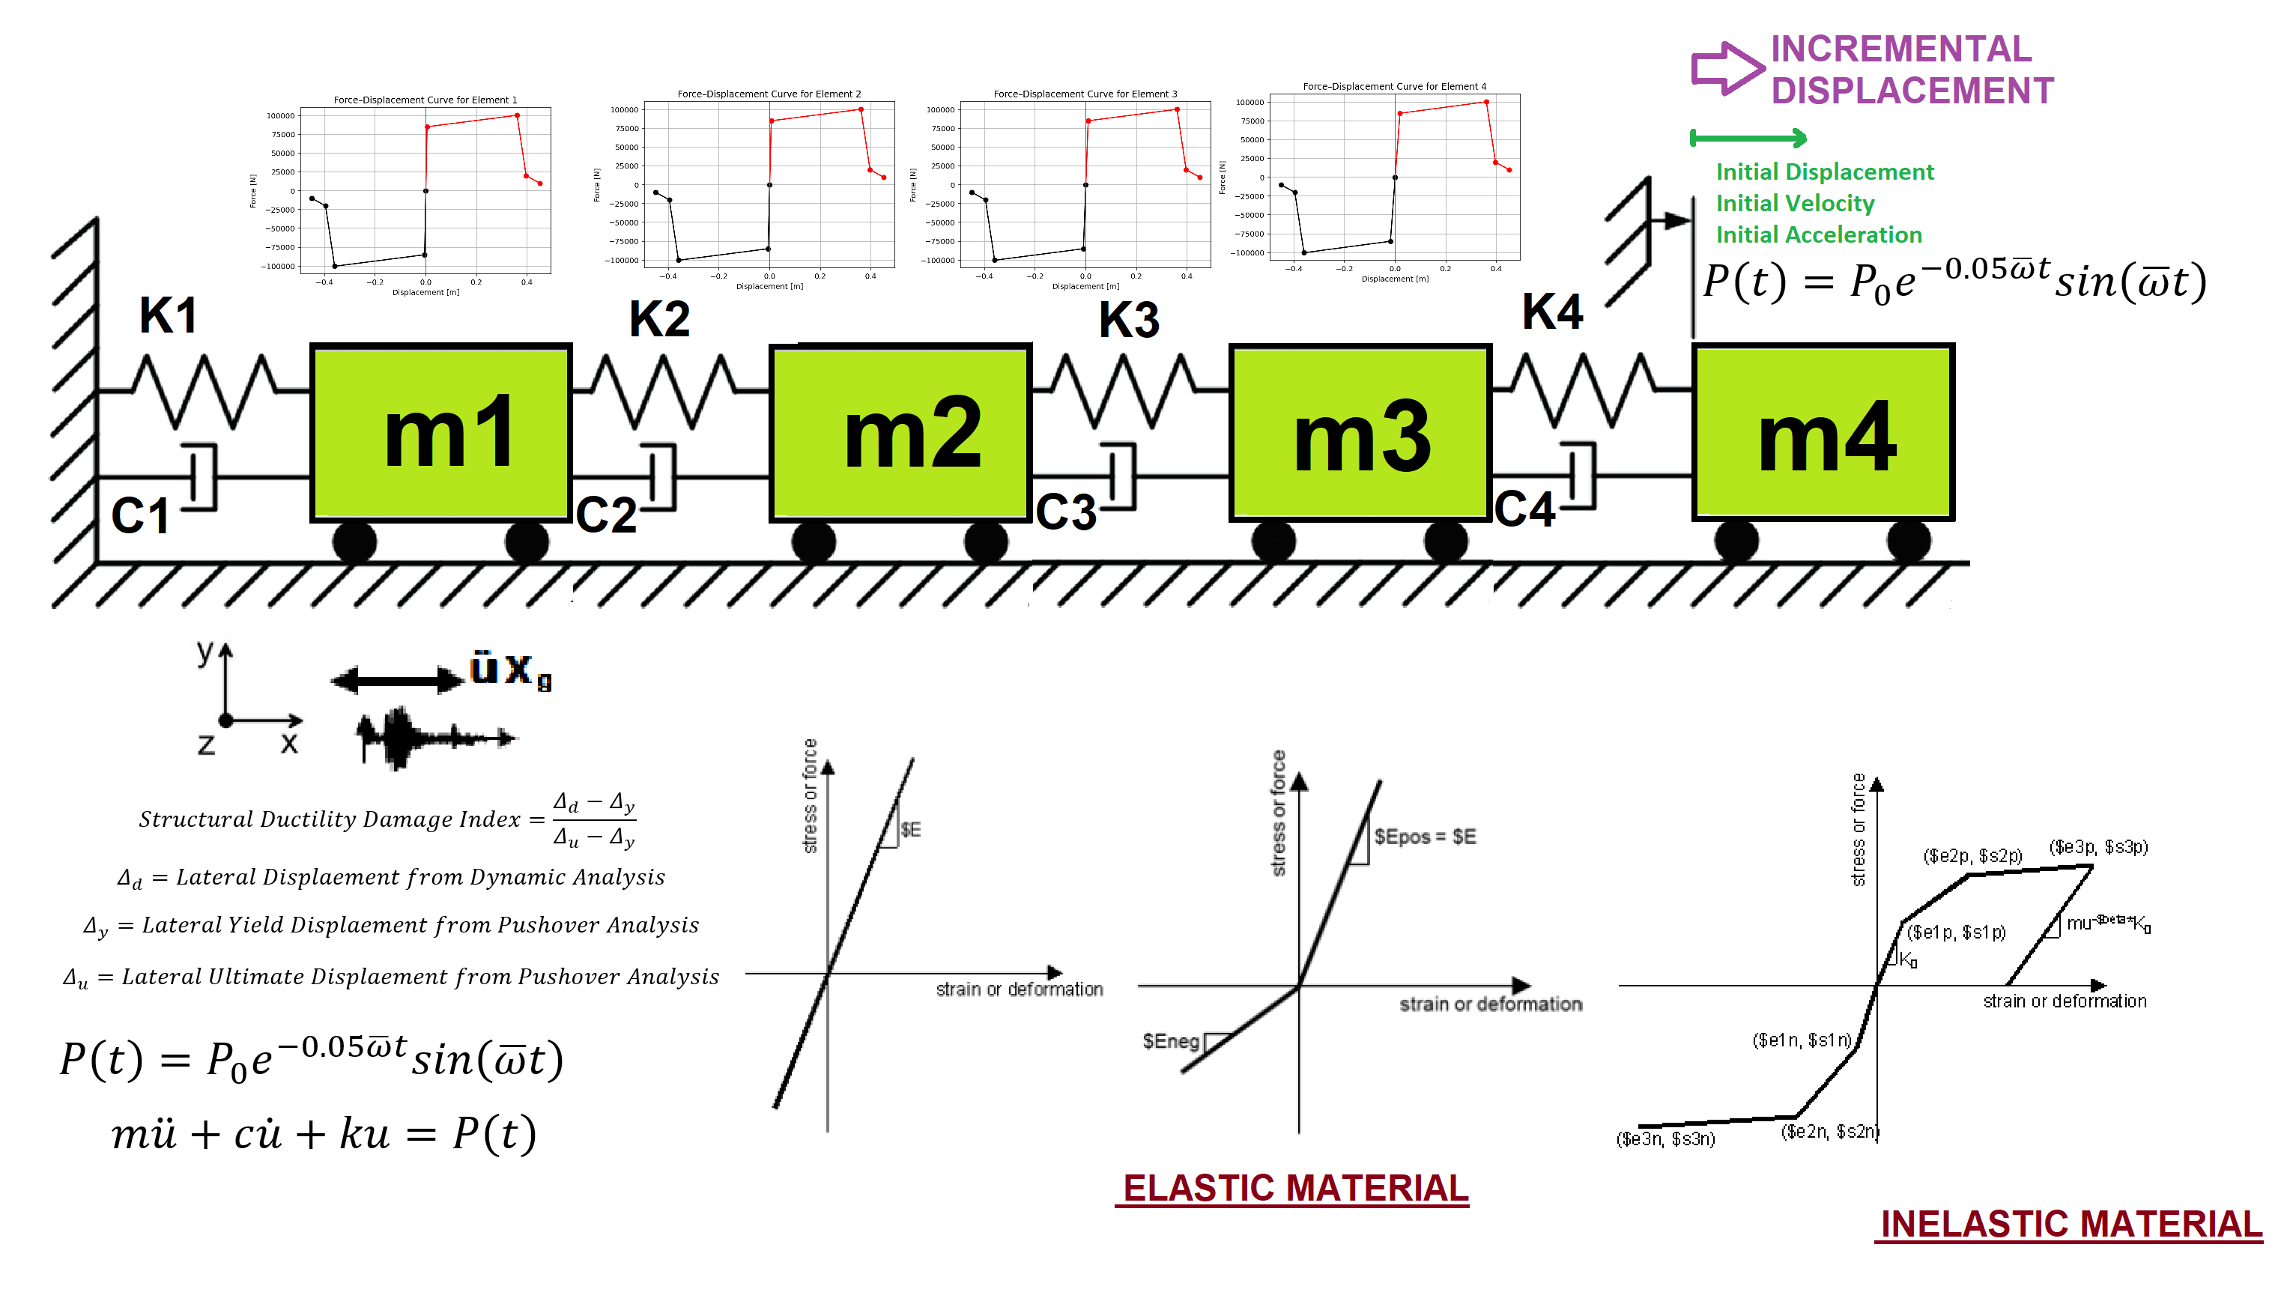

Slide 3
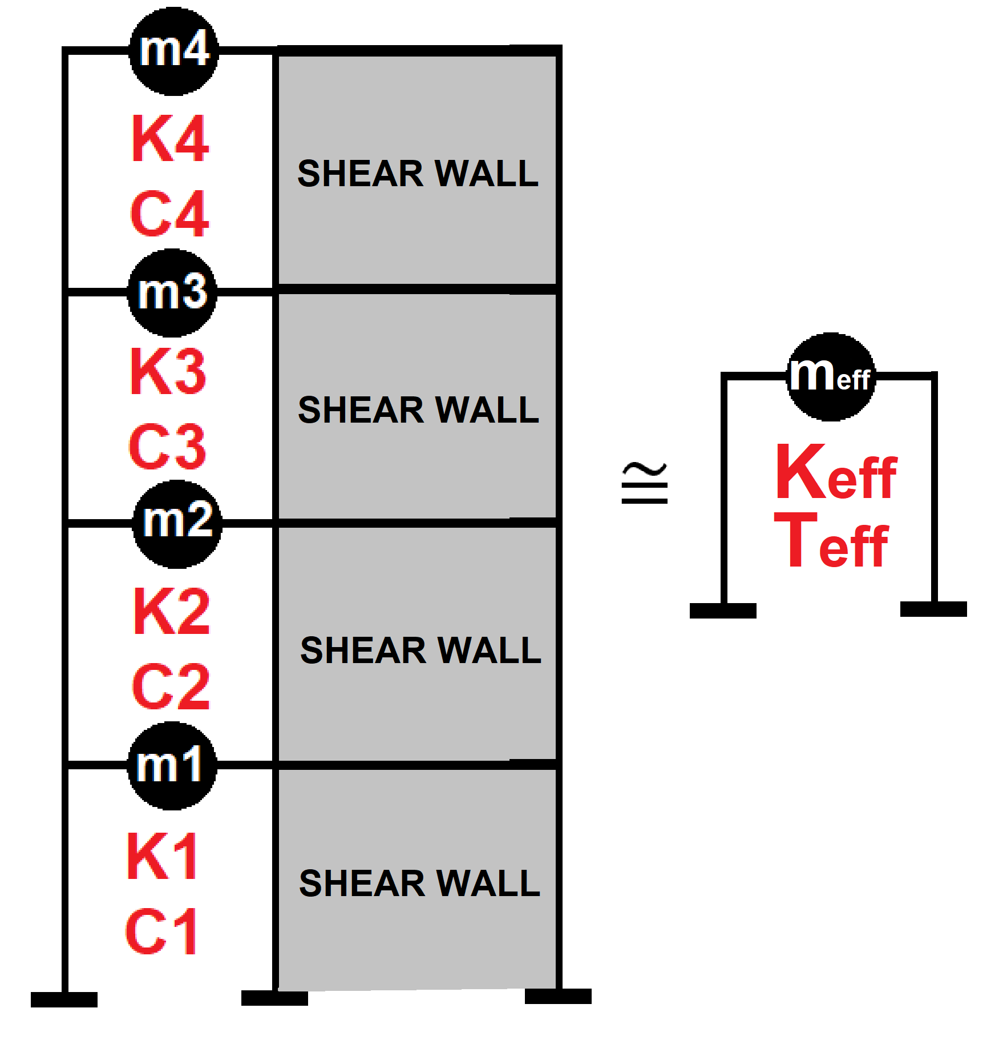

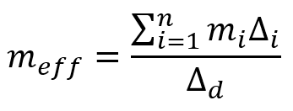
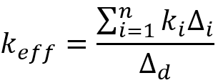
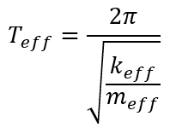
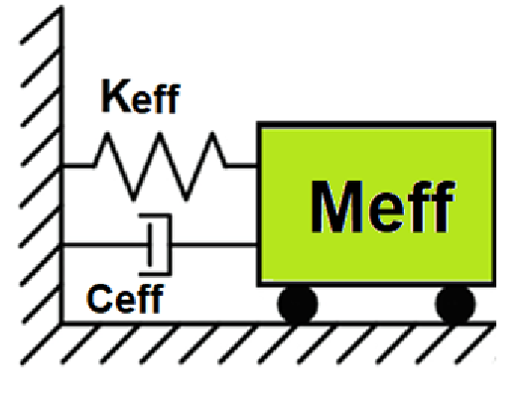
Displacement-based seismic analysis transformation,
converting a multi-degree-of-freedom (MDOF) system
into an equivalent single-degree-of-freedom (SDOF)
system for seismic assessment

Slide 4
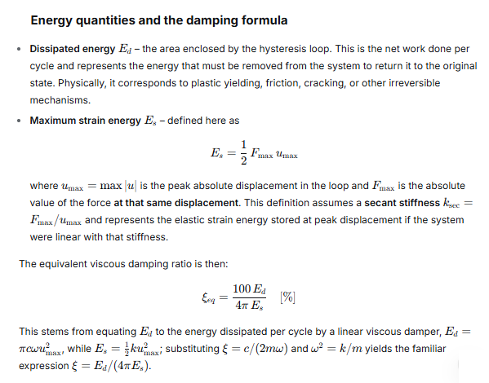

Slide 5
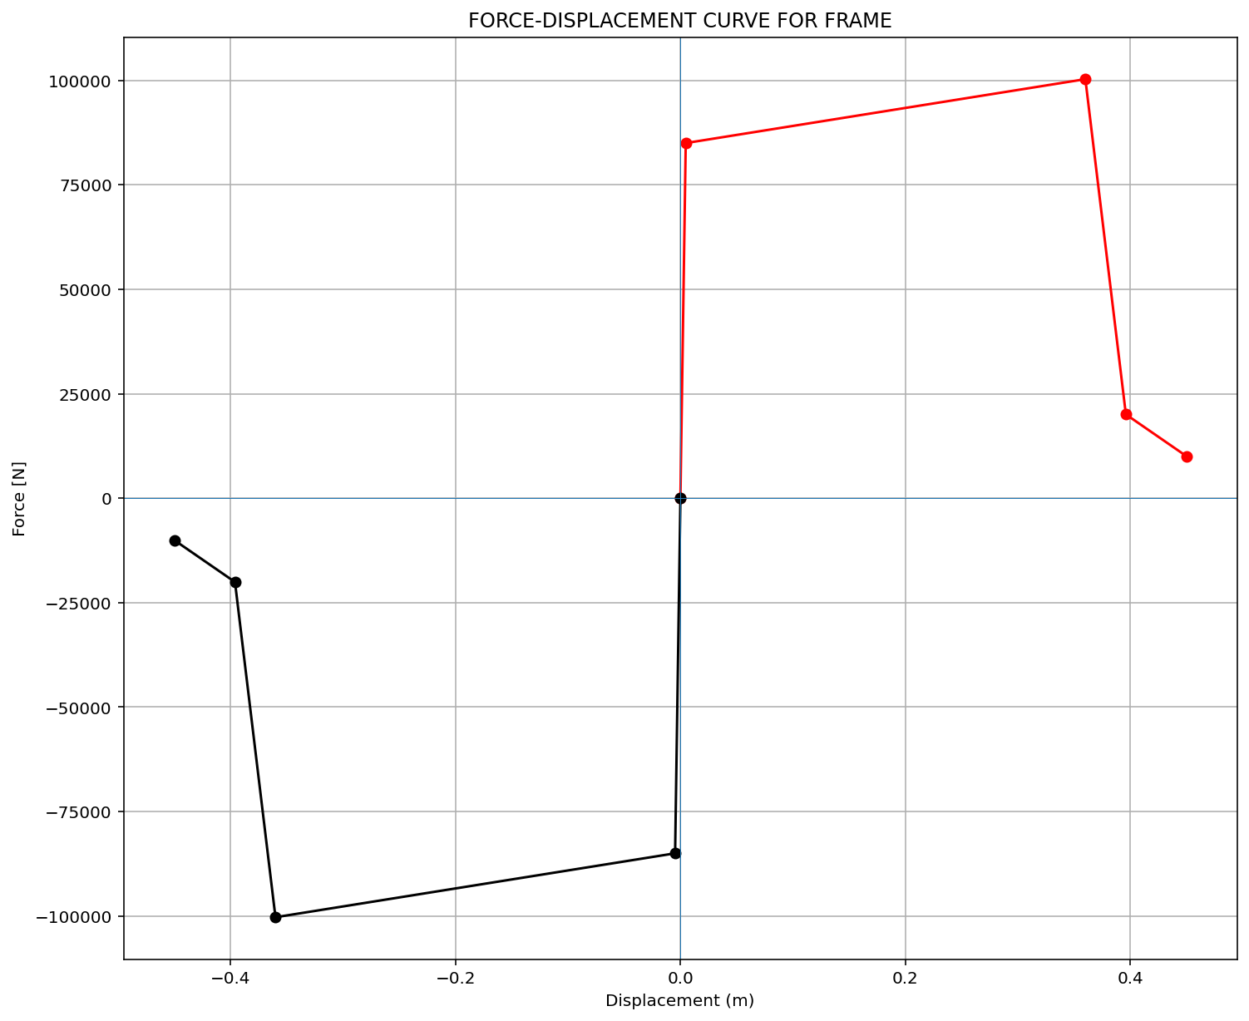

Slide 6
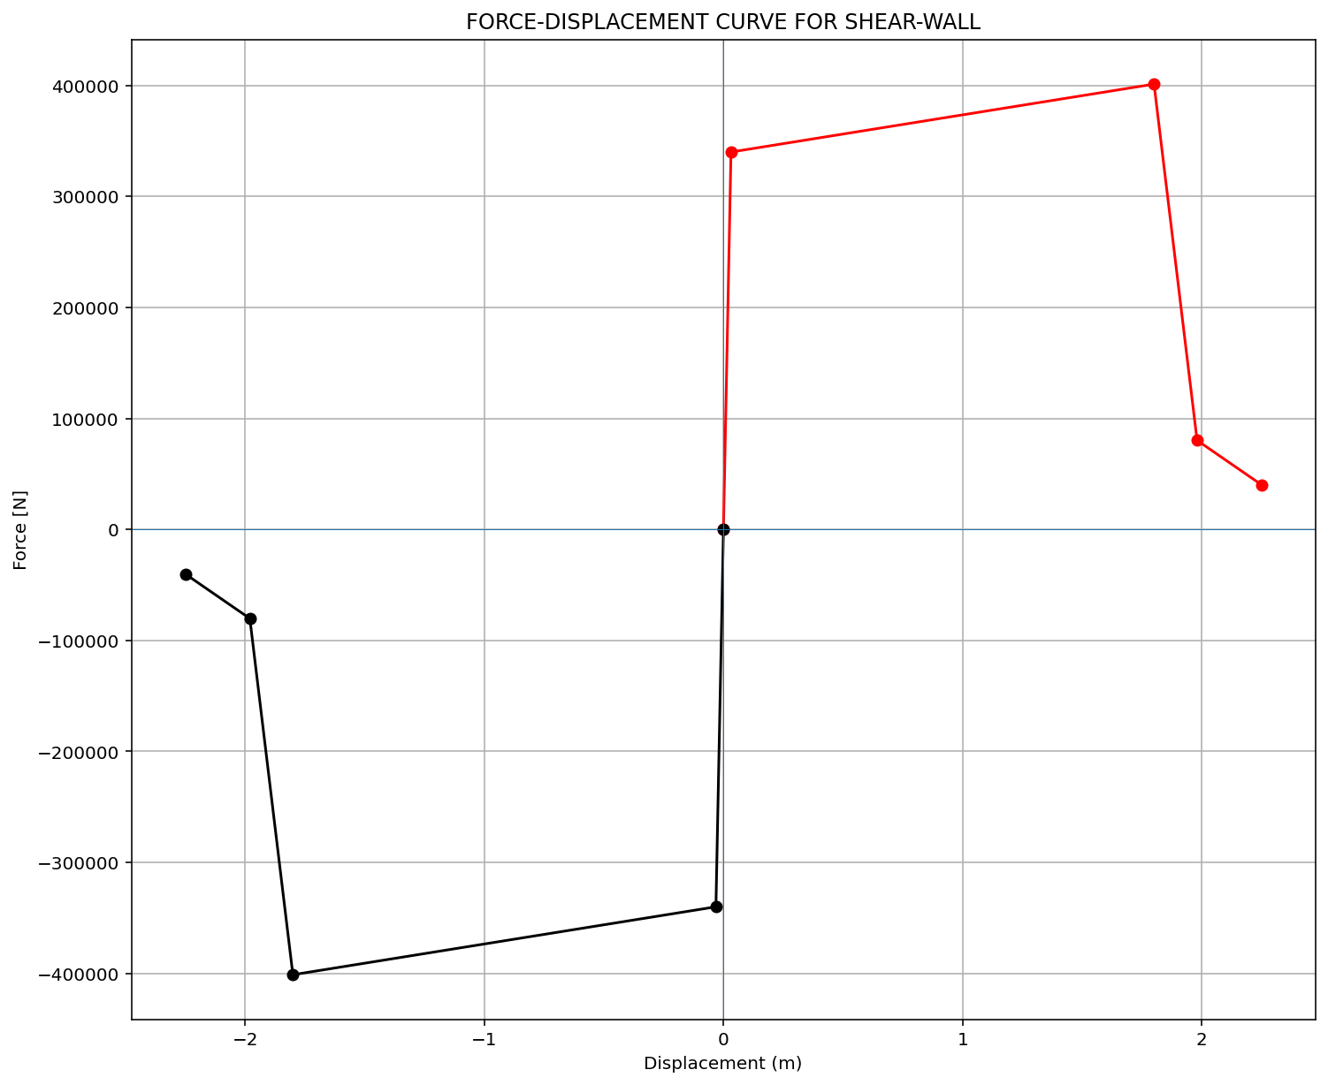

Slide 7
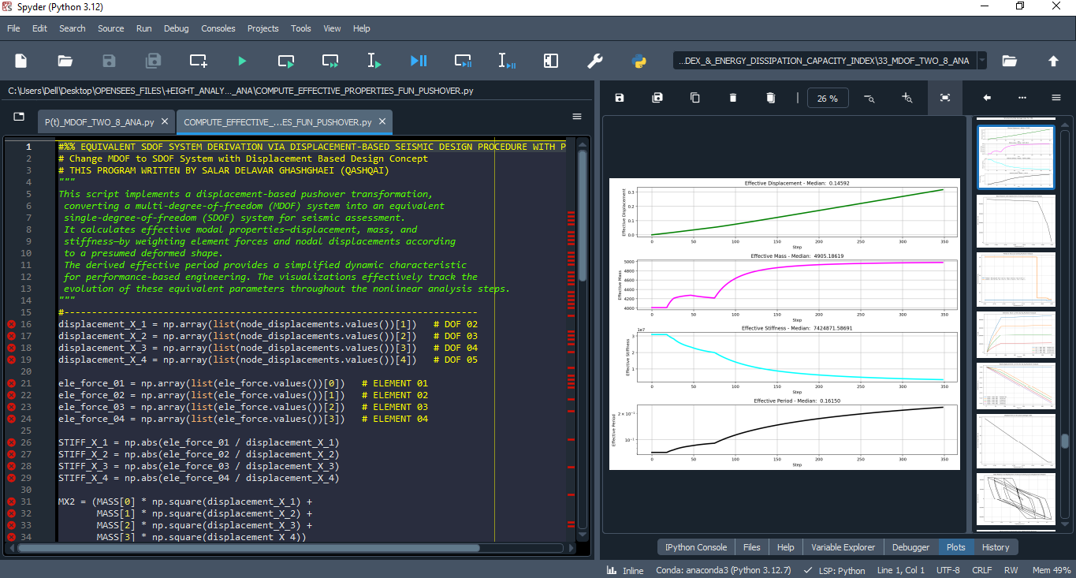

Slide 8
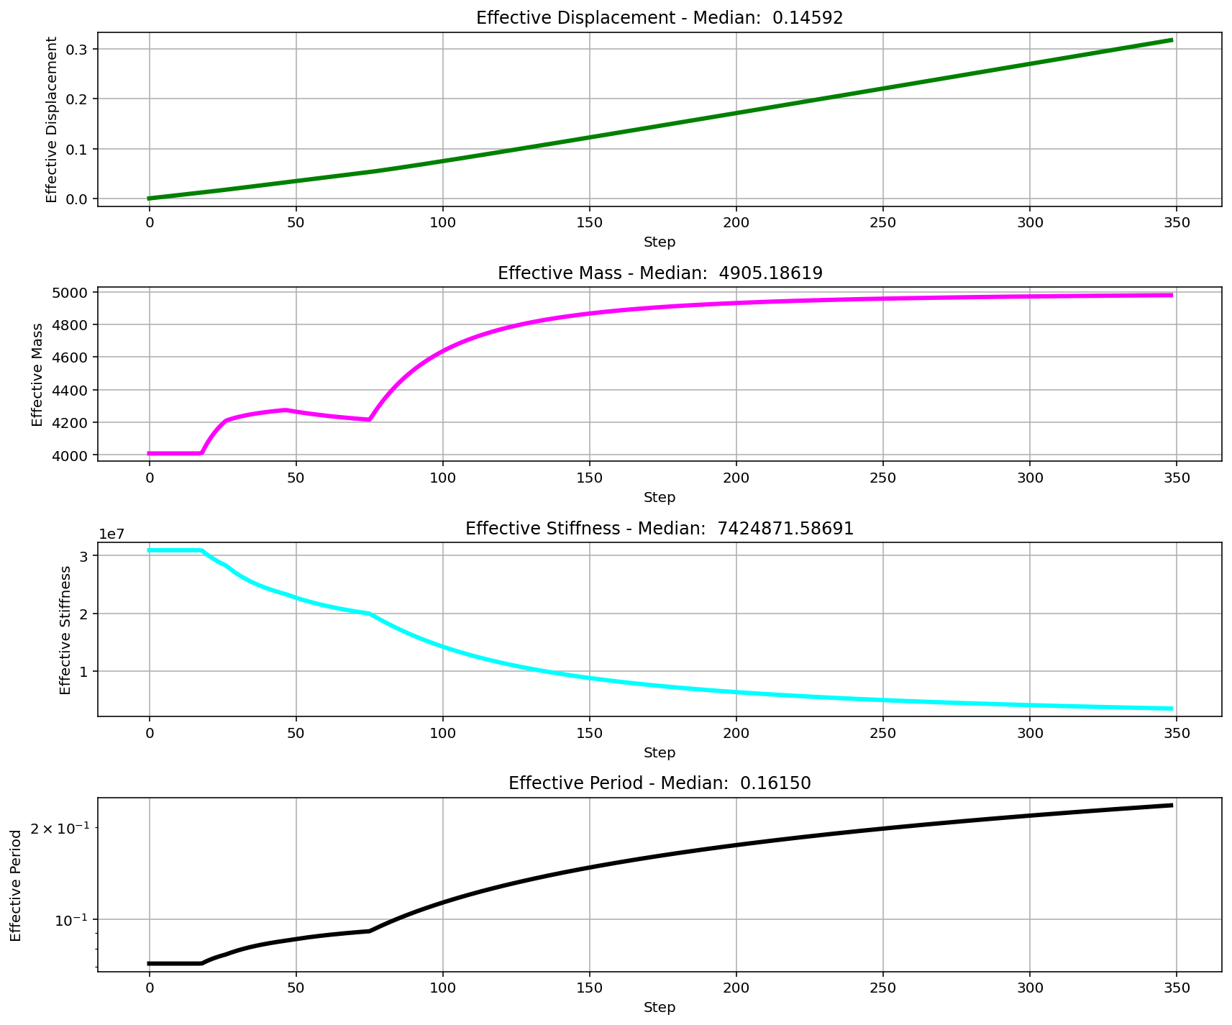

Slide 9
CYCLIC DISPLACEMENT ANALYSIS

Slide 10
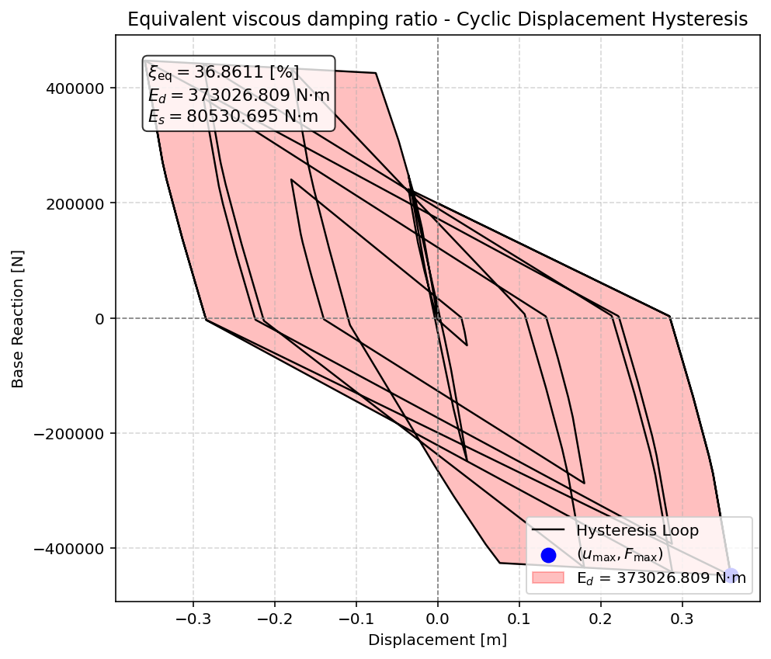

Slide 11
STATIC TIME-HISTORY WITH EXTERNAL TIME-DEPENDENT LOADING ANALYSIS

Slide 12
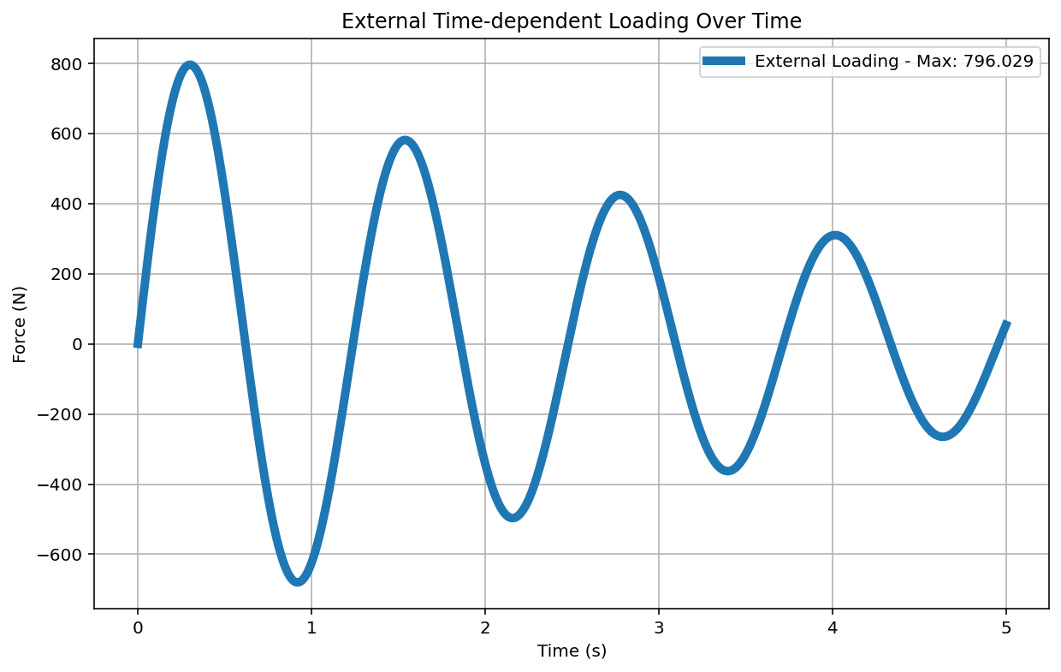

Slide 13
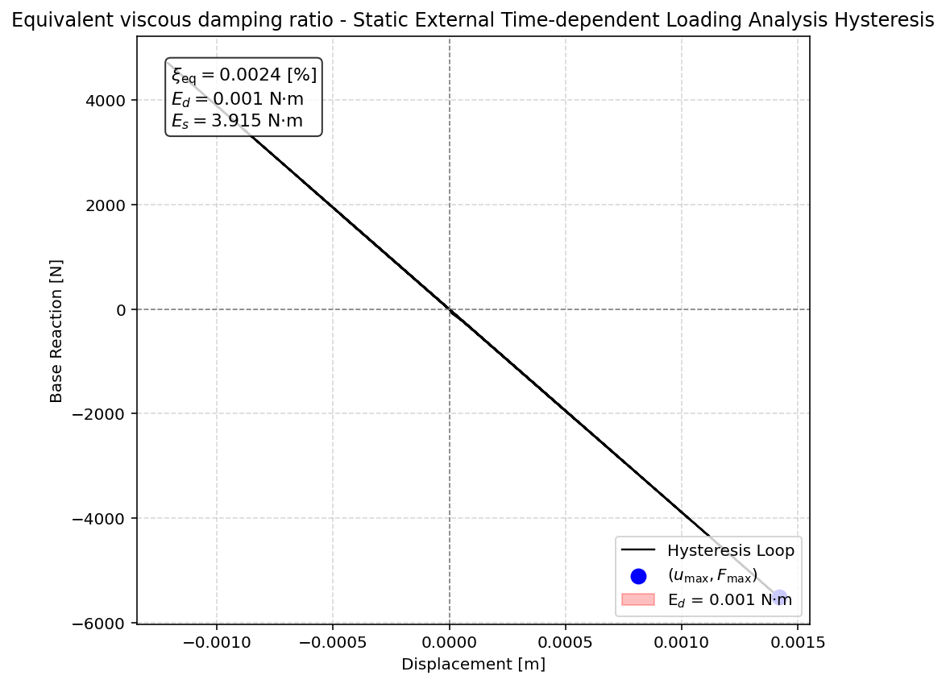

Slide 14
DYNAMIC TIME-HISTORY WITH EXTERNAL TIME-DEPENDENT LOADING ANALYSIS

Slide 16
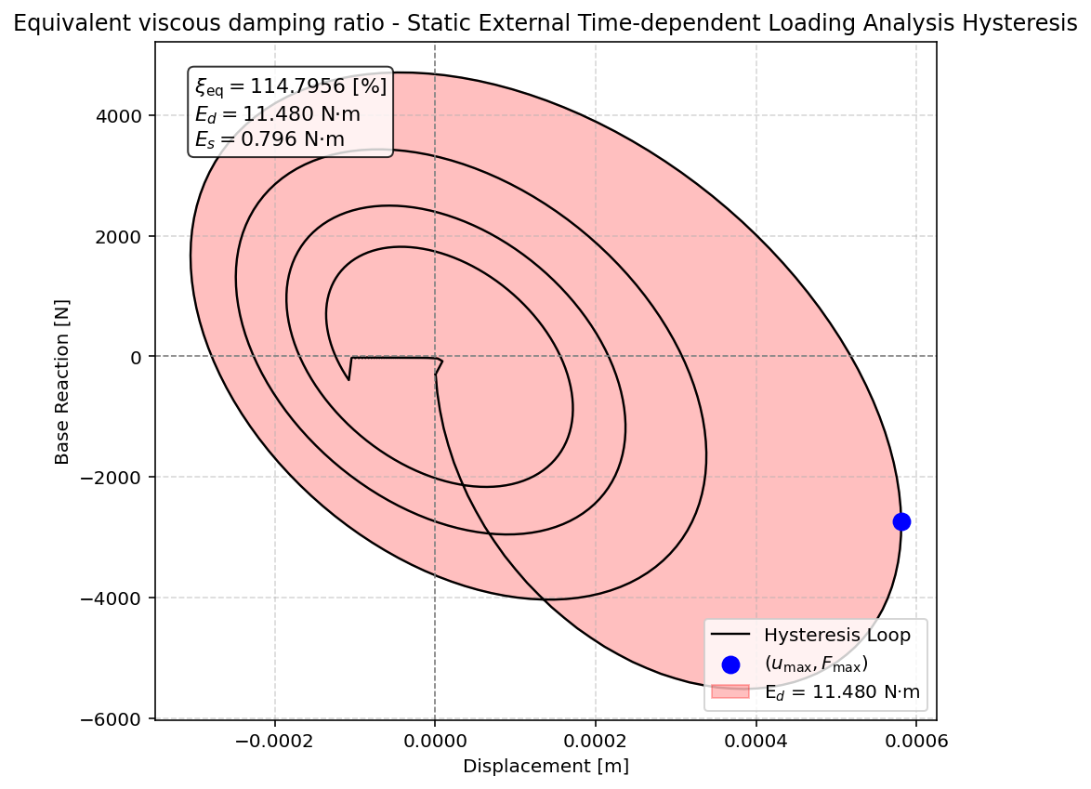

Slide 17
FREE-VIBRATION ANALYSIS

Slide 18
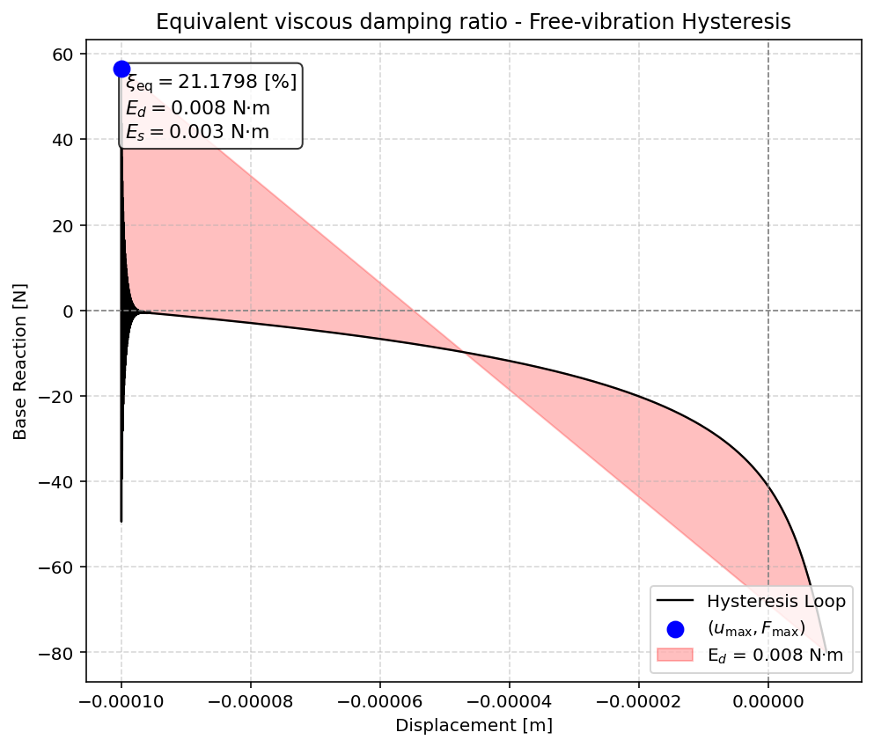

Slide 19
SEISMIC ANALYSIS

Slide 20
