Slide 1
>> IN THE NAME OF ALLAH, THE MOST GRACIOUS, THE MOST MERCIFUL <<
DETERMINATION OF OPTIMUM STRUCTURAL DUCTILITY RATIO FROM ENERGY DISSIPATION CAPACITY INDEX USING FINITE‑DIFFERENCE NEWTON ITERATION AND OPENSEES VIA 20 SEISMIC GROUND MOTIONS
THIS PROGRAM WRITTEN BY SALAR DELAVAR GHASHGHAEI (QASHQAI)

Slide 2
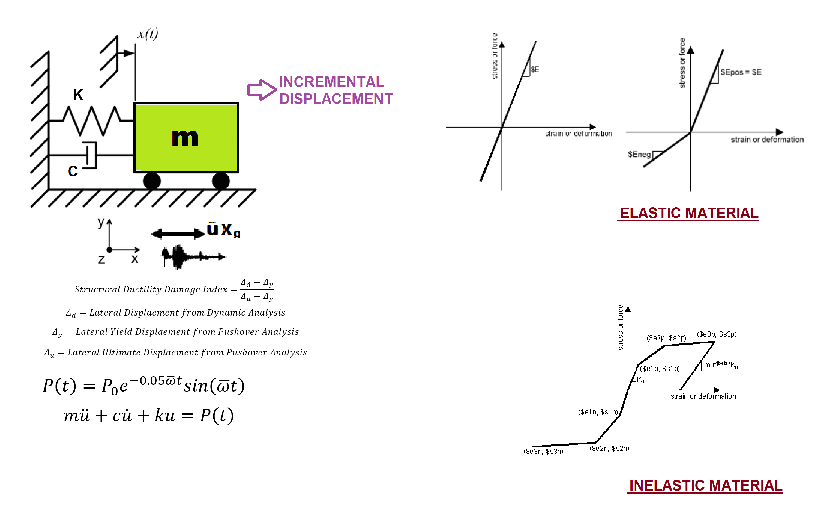

Slide 3
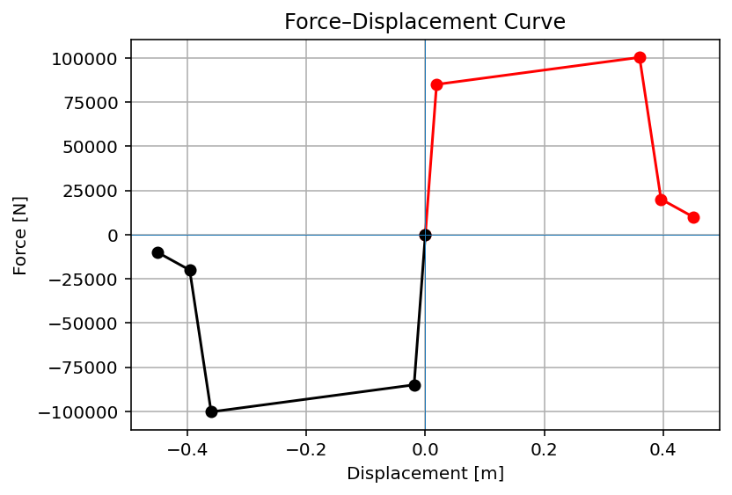

Slide 4
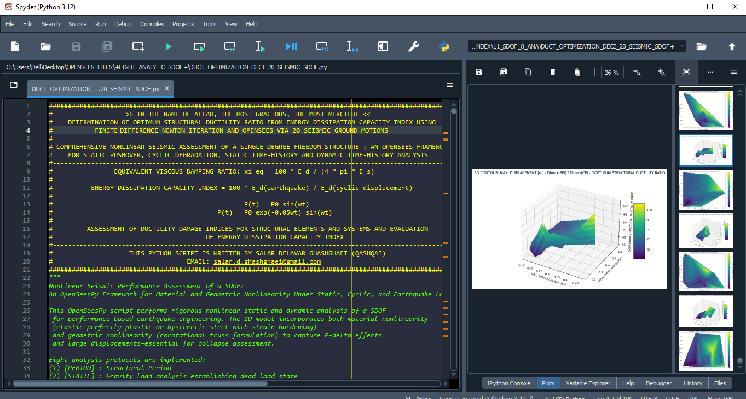

Slide 5
OPTIMIZATION PROBLEM FOR ENERGY DISSIPATION CAPACITY INDEX (EDCI)

Slide 6
Assume that a single-degree-of-freedom structure is subjected to nonlinear dynamic analysis
under twenty different ground motion records, and, by defining the amount of Energy Dissipation
Capacity Index as the objective, we aim to optimize the ductility of the structure using the
Newton–Raphson method. Therefore, with twenty different ground motion records, we calculate
different ductility ratios, and finally, we evaluate the results.

Slide 7
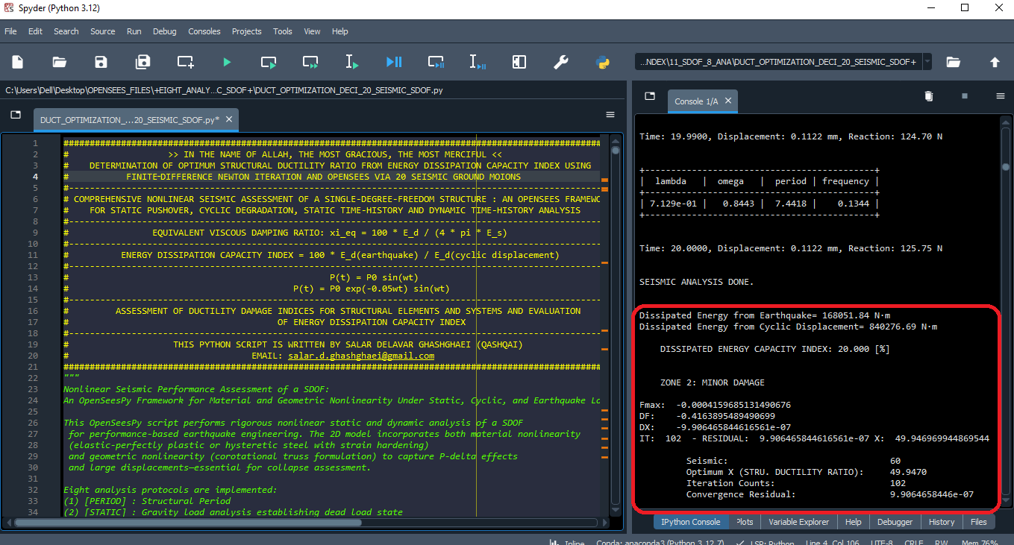

Slide 8
Dissipated Energy from Earthquake= 168051.84 N·m
Dissipated Energy from Cyclic Displacement= 840276.69 N·m
DISSIPATED ENERGY CAPACITY INDEX: 20.000 [%]
ZONE 2: MINOR DAMAGE
Fmax: -0.0004159685131490676
DF: -0.4163895489490699
DX: -9.906465844616561e-07
IT: 102 - RESIDUAL: 9.906465844616561e-07 X: 49.946969944869544
Seismic: 60
Optimum X (STRU. DUCTILITY RATIO): 49.9470
Iteration Counts: 102
Convergence Residual: 9.9064658446e-07
Total time (s): 1103.2188

Slide 9
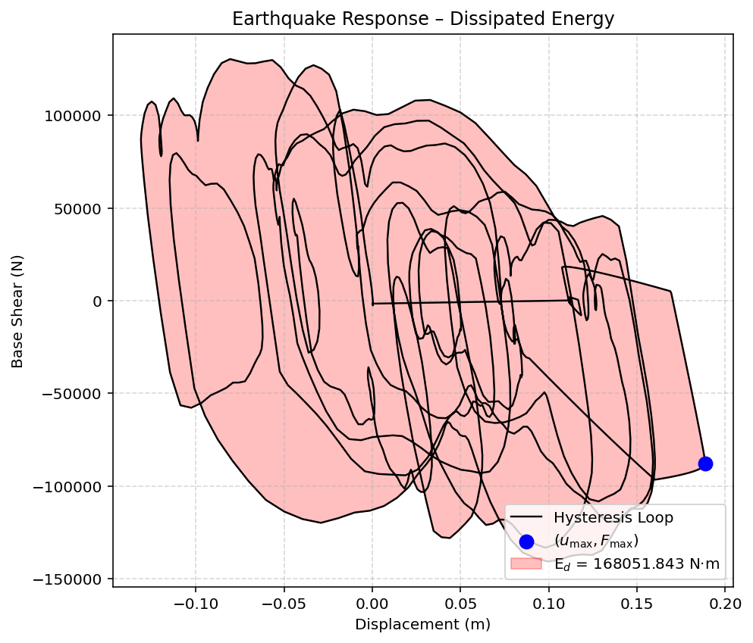

Slide 10
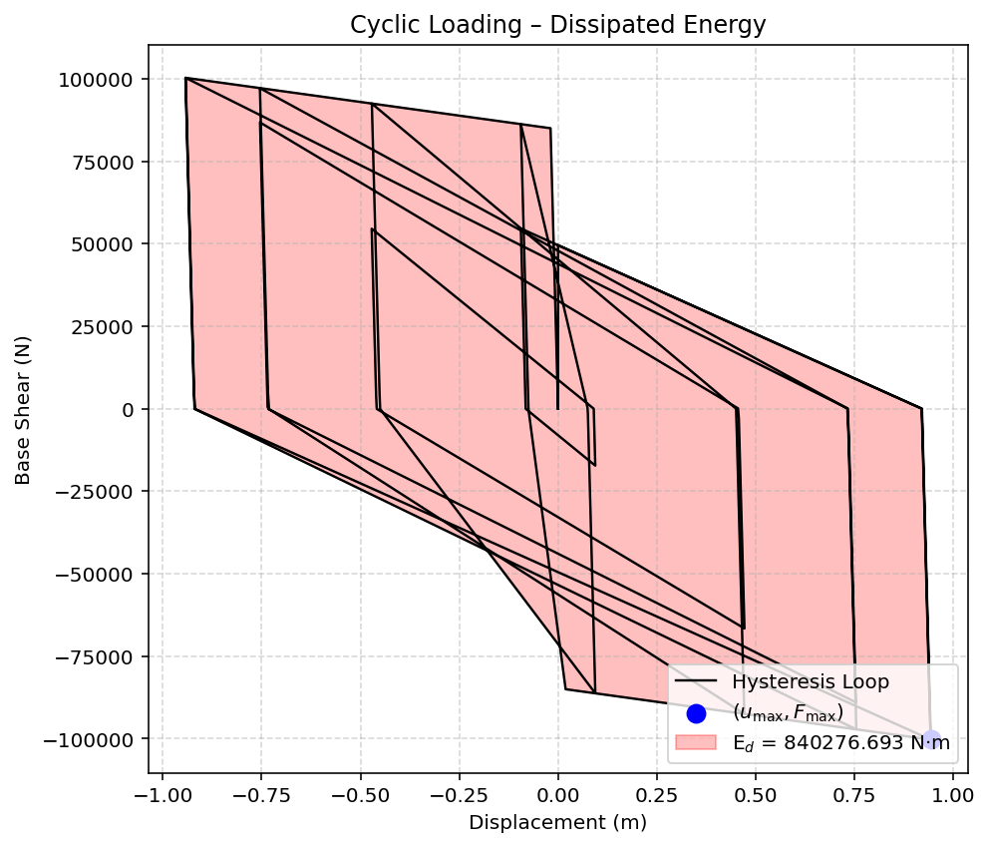

Slide 11
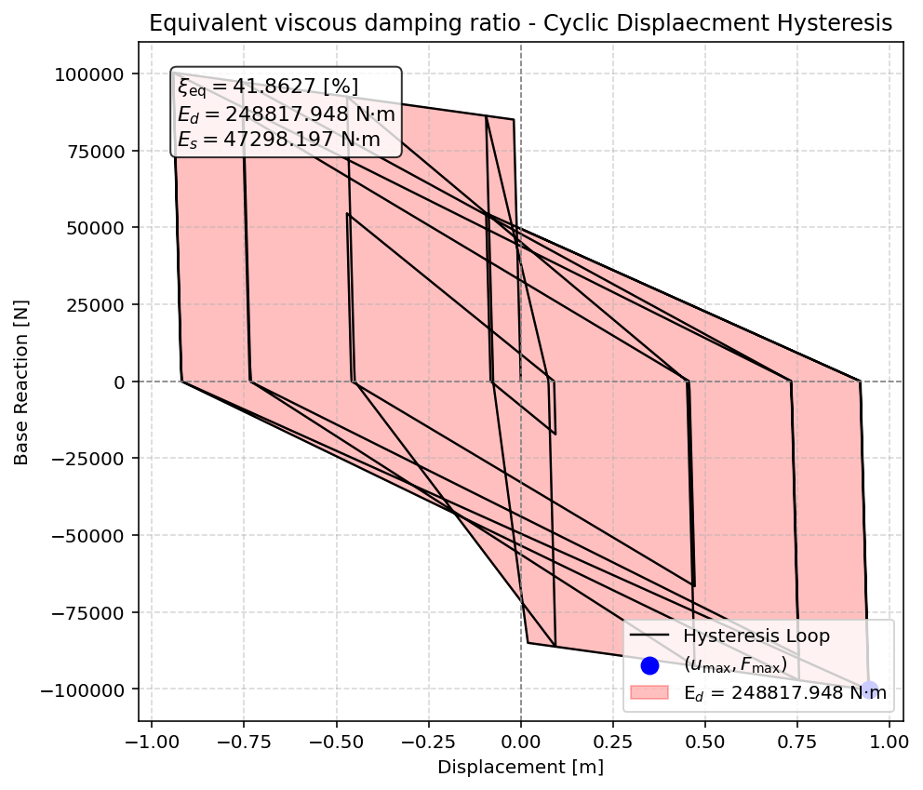

Slide 12
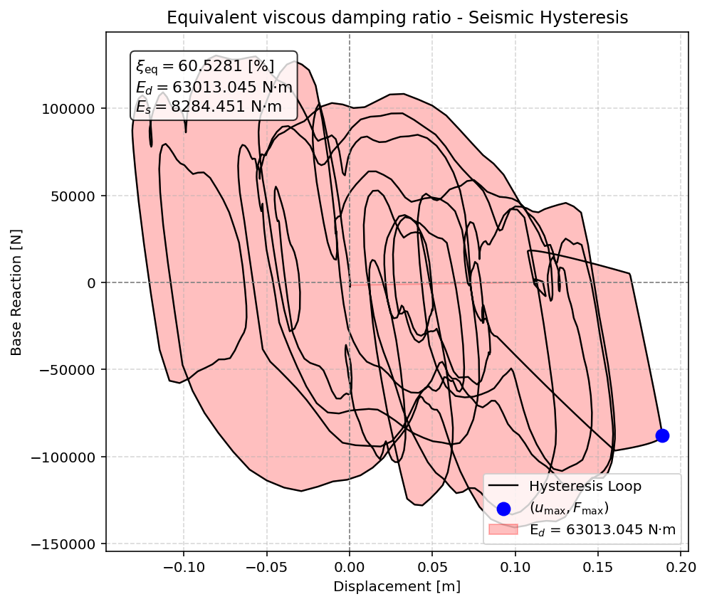

Slide 13
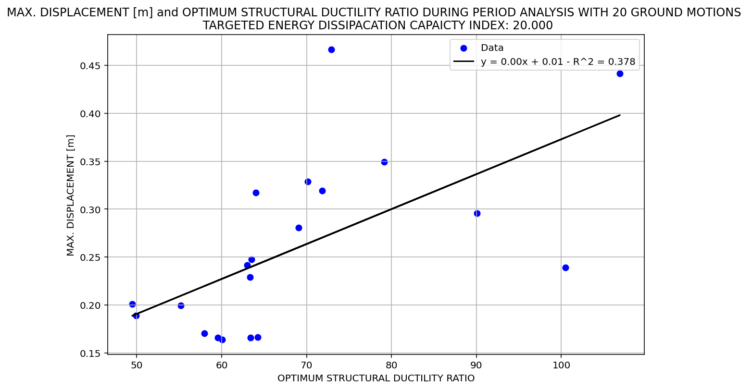

Slide 14
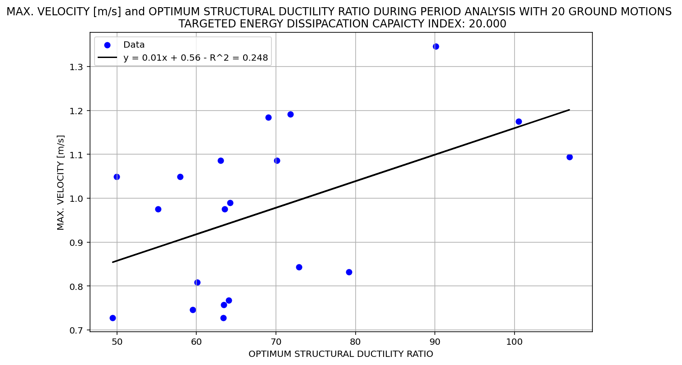

Slide 15
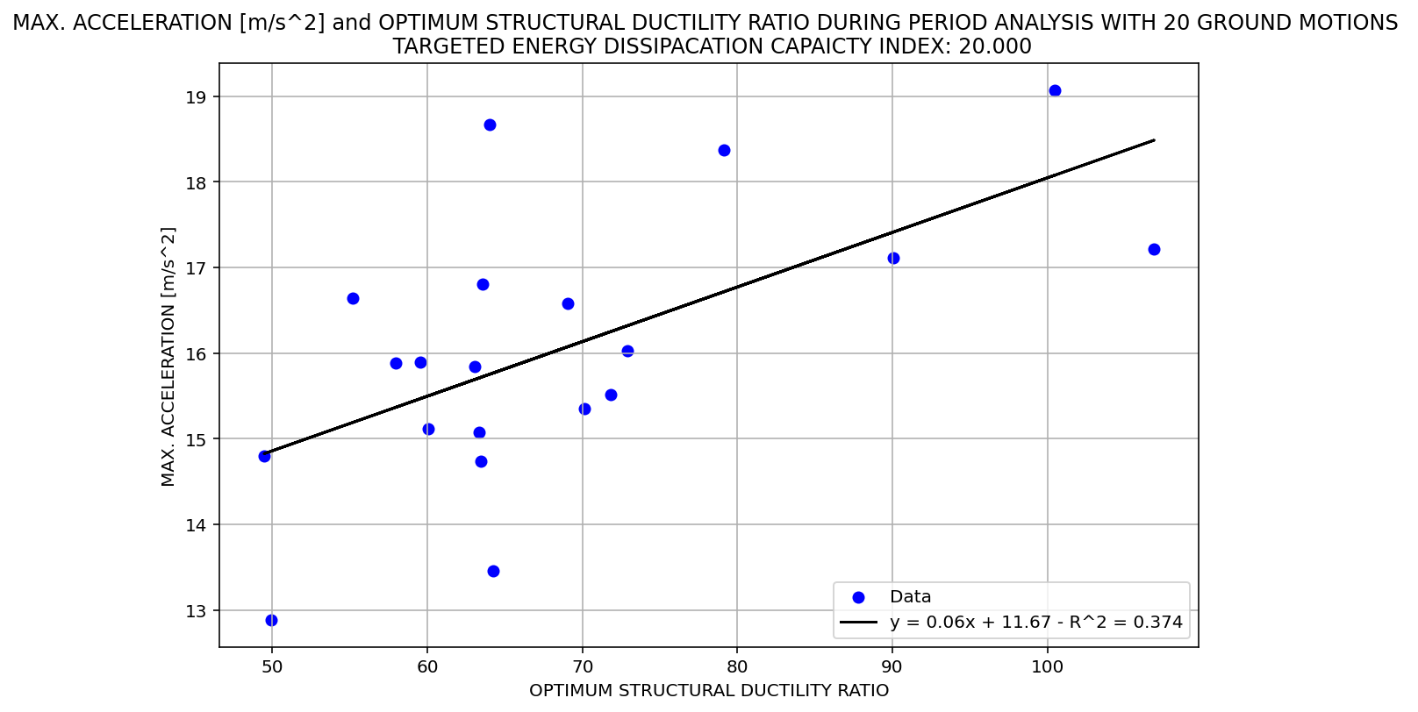

Slide 16
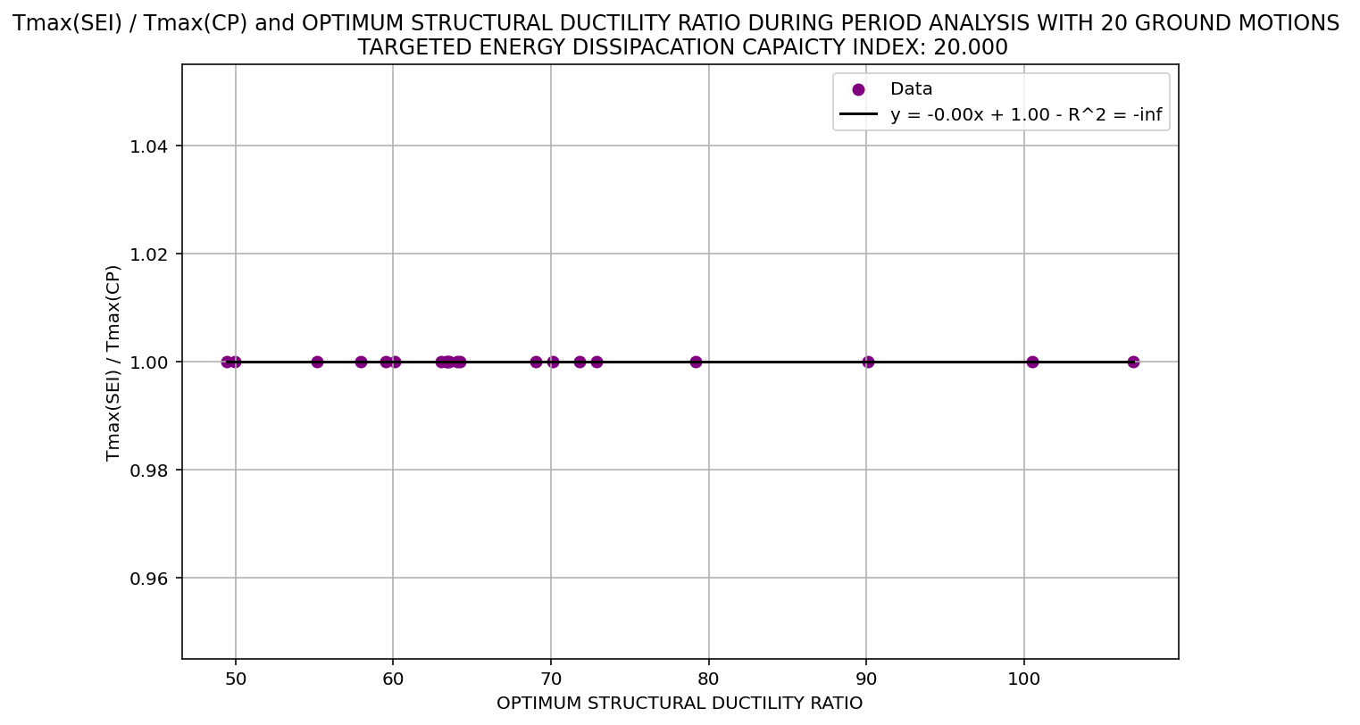

Slide 17
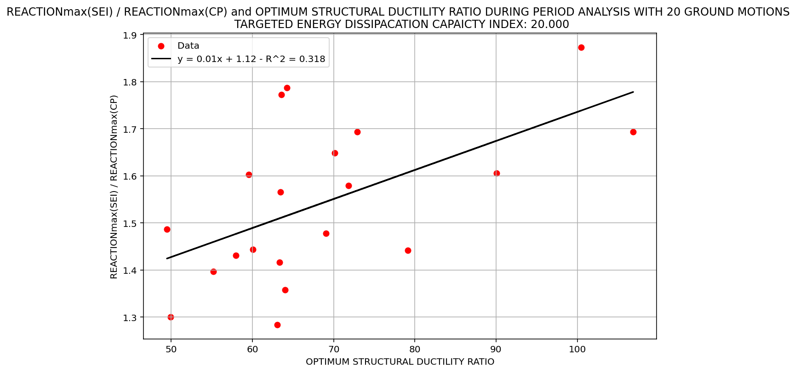

Slide 18
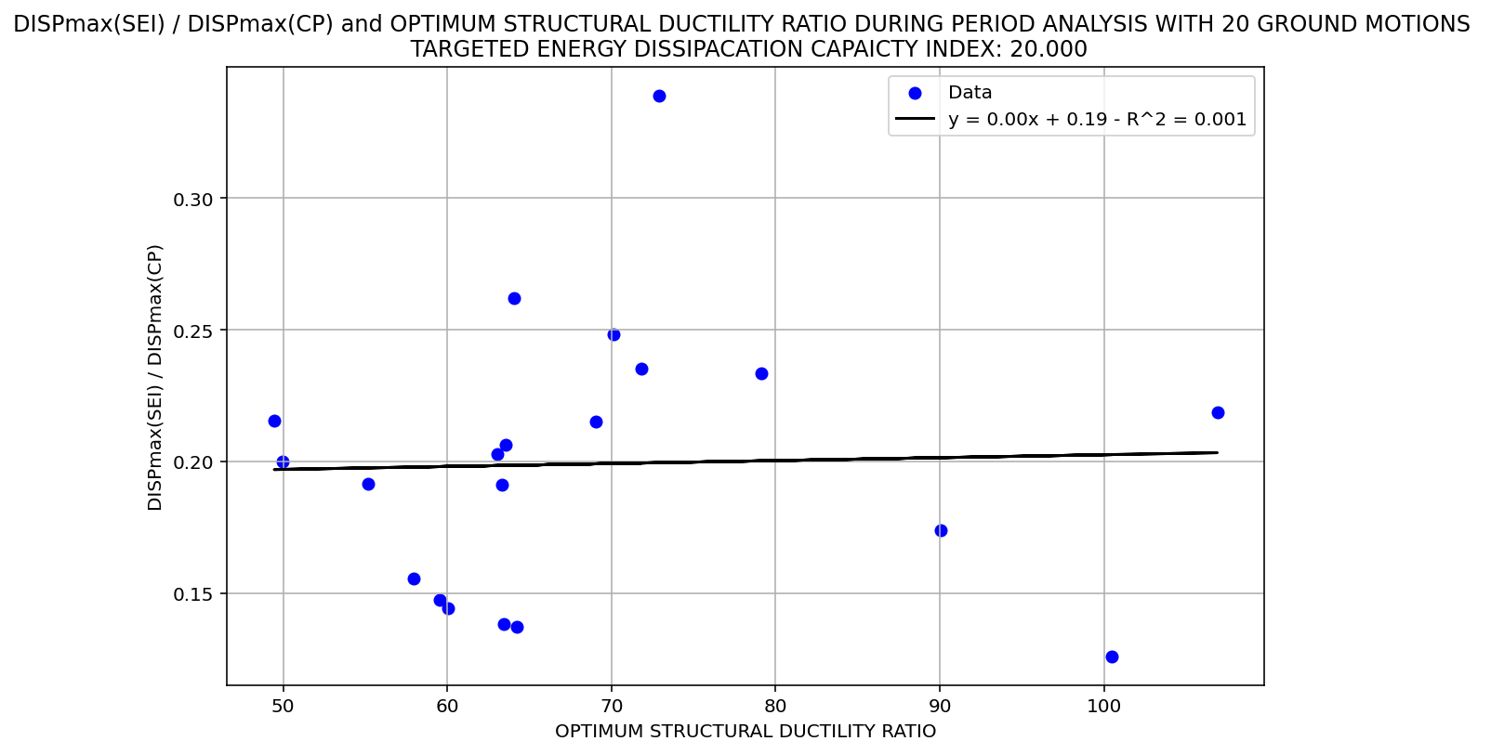

Slide 19
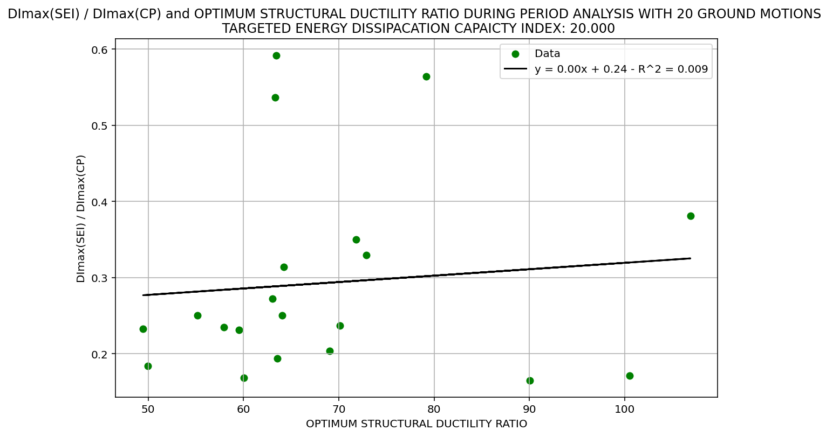

Slide 20
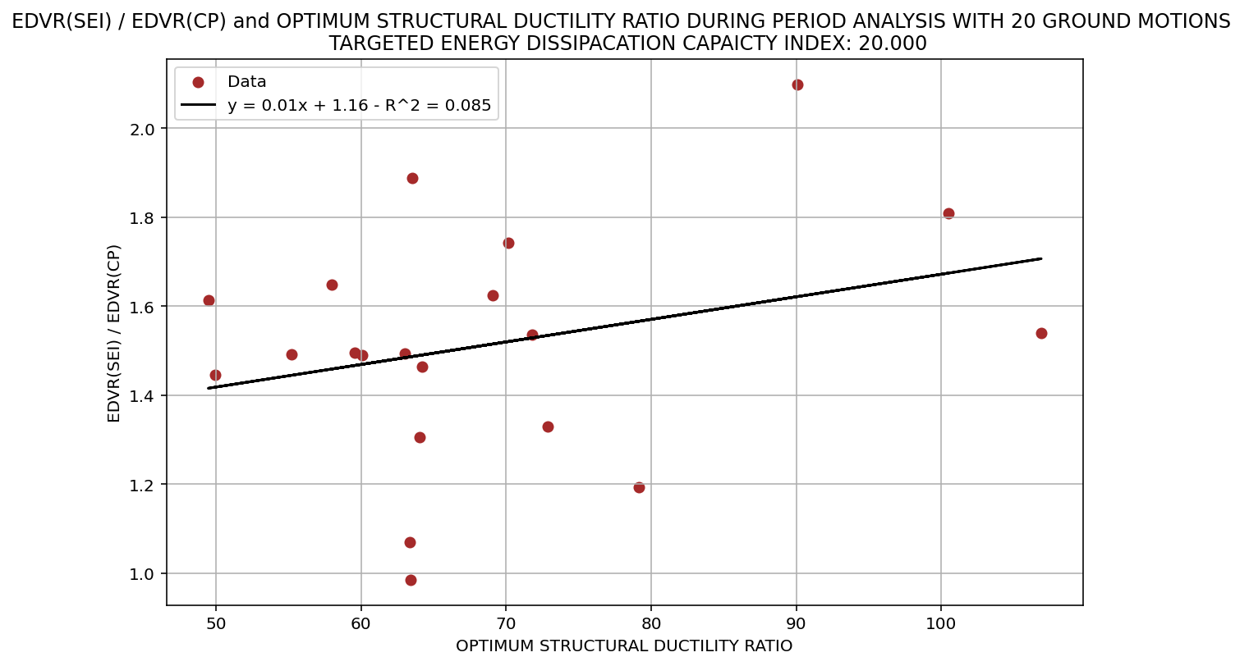

Slide 21
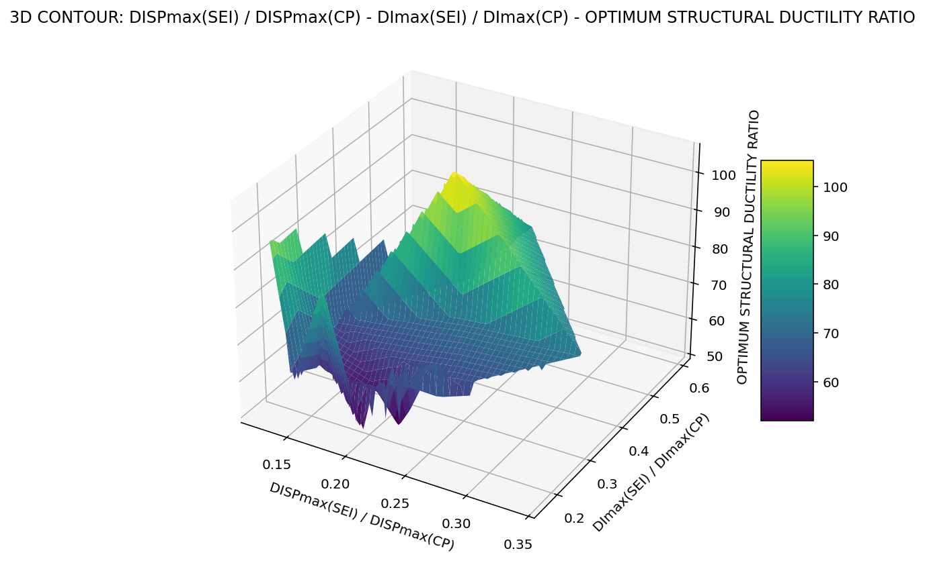

Slide 22
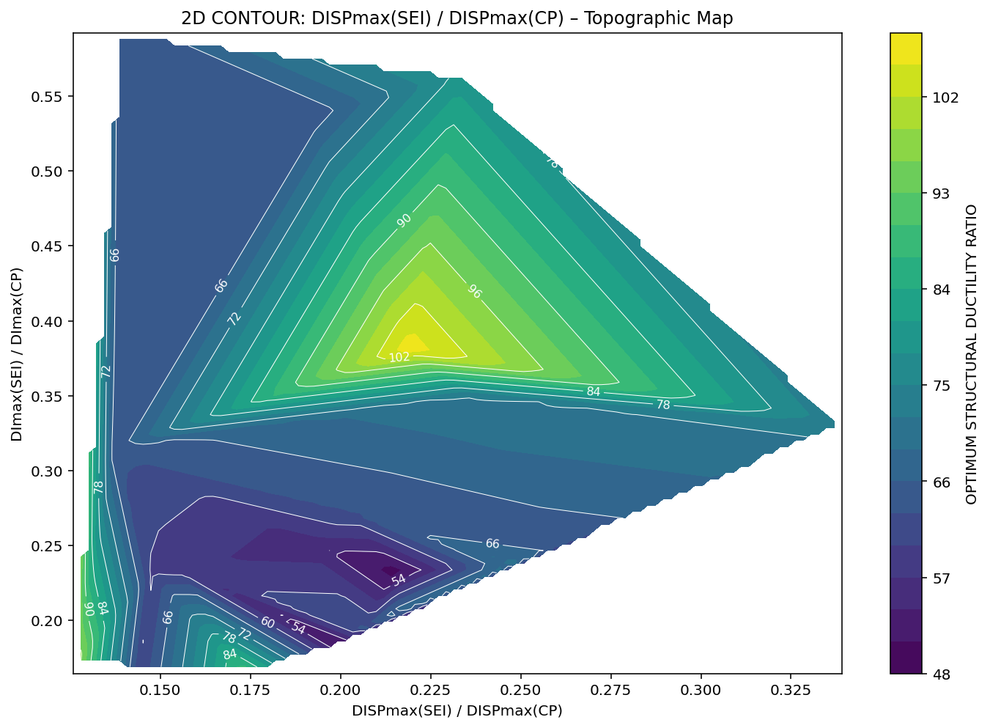

Slide 23
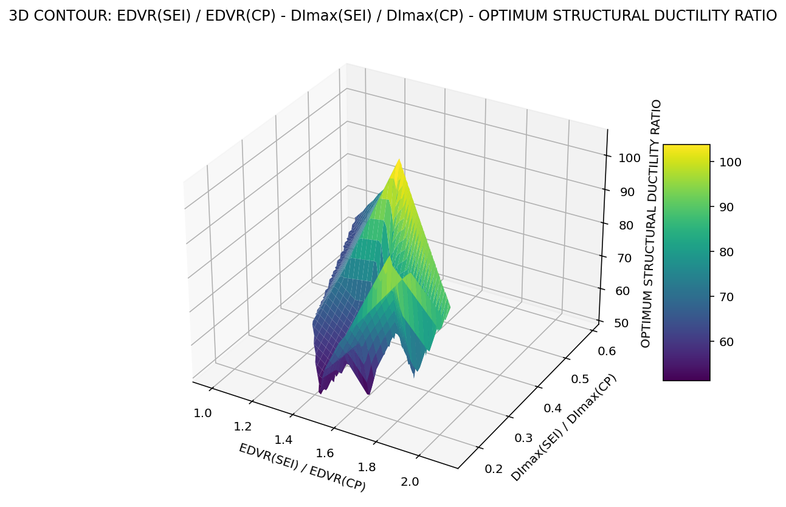

Slide 24
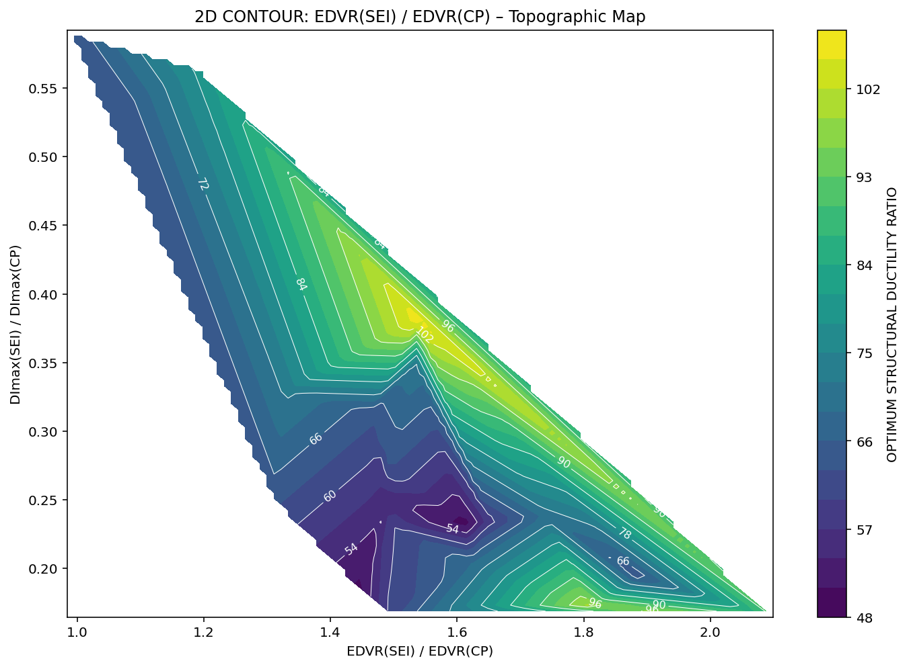

Slide 25
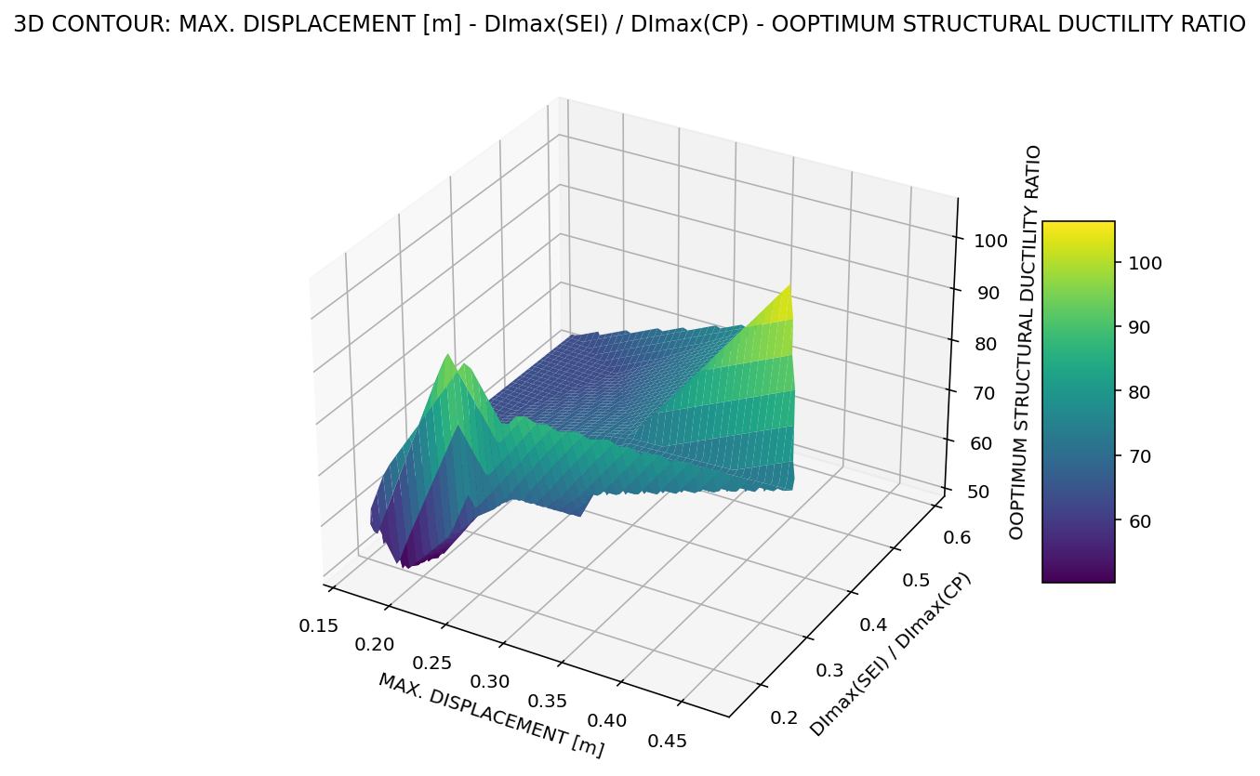

Slide 26
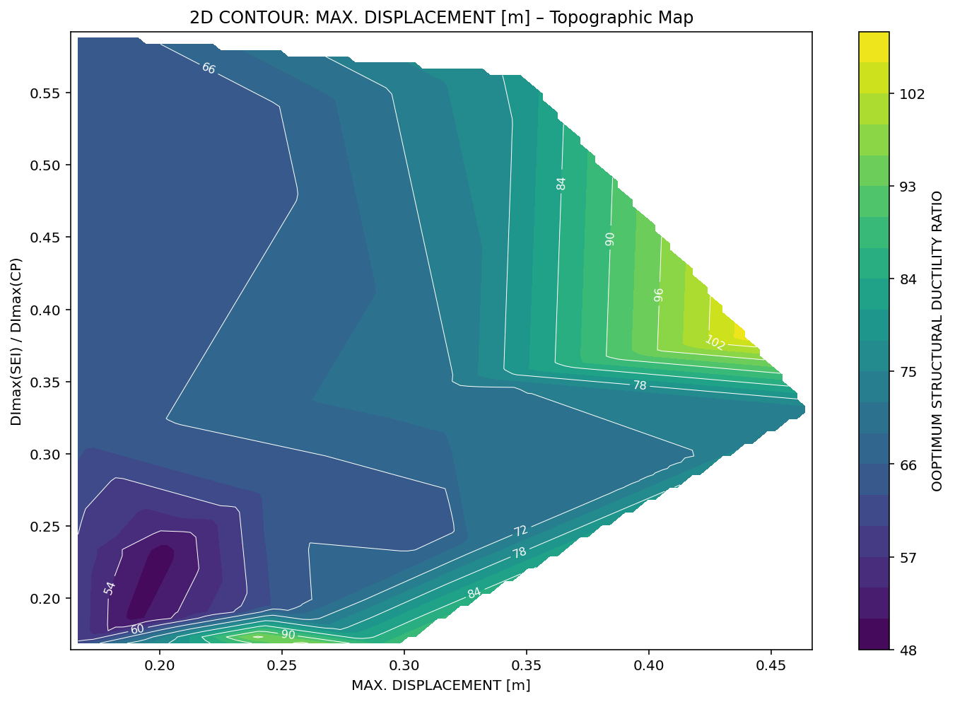

Slide 27
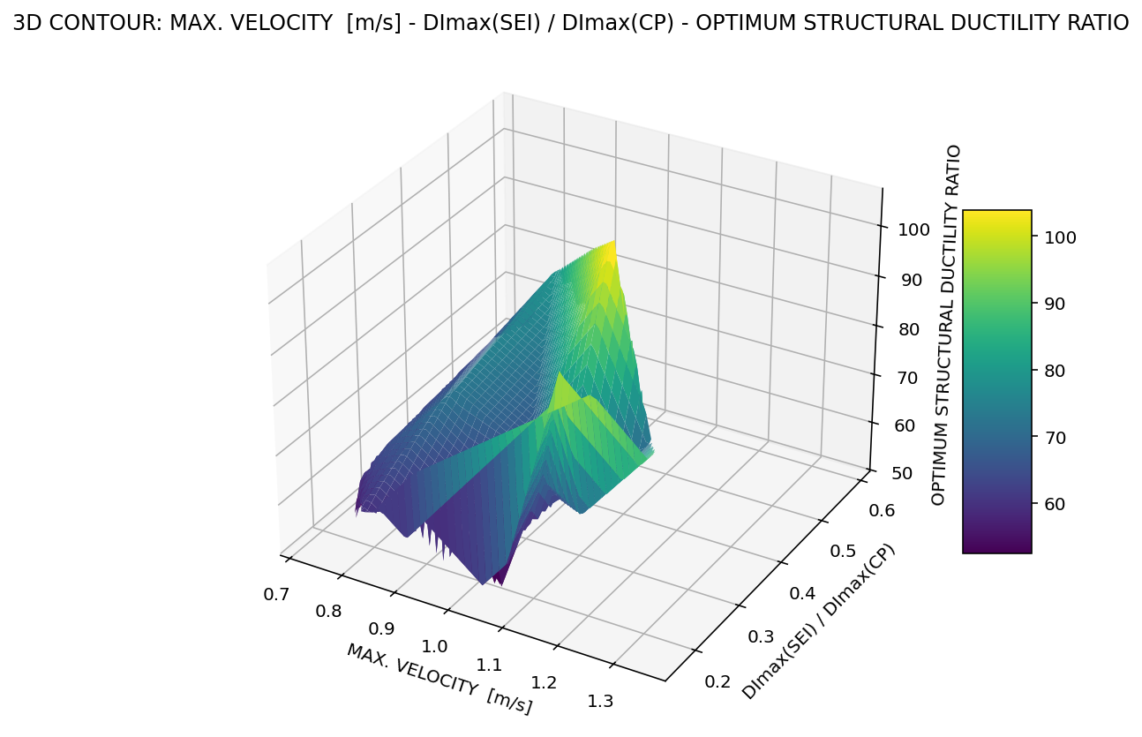

Slide 28
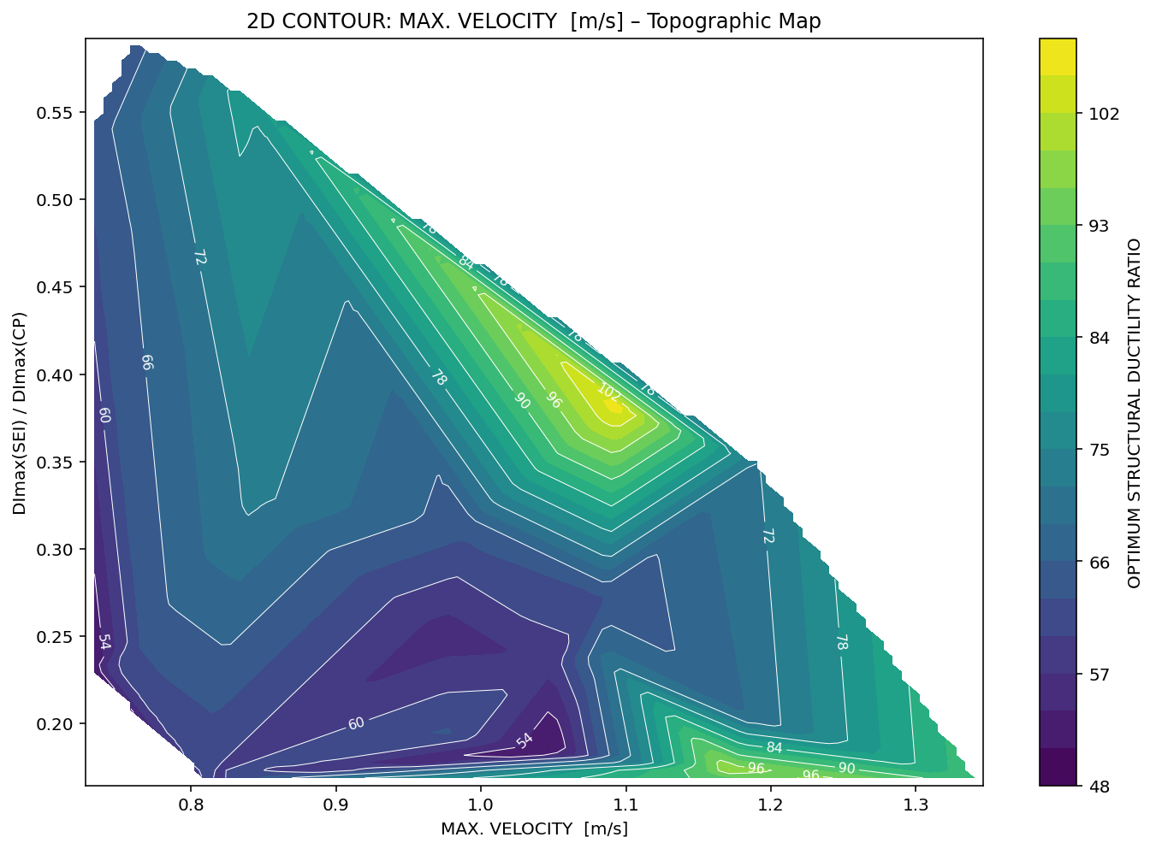

Slide 29
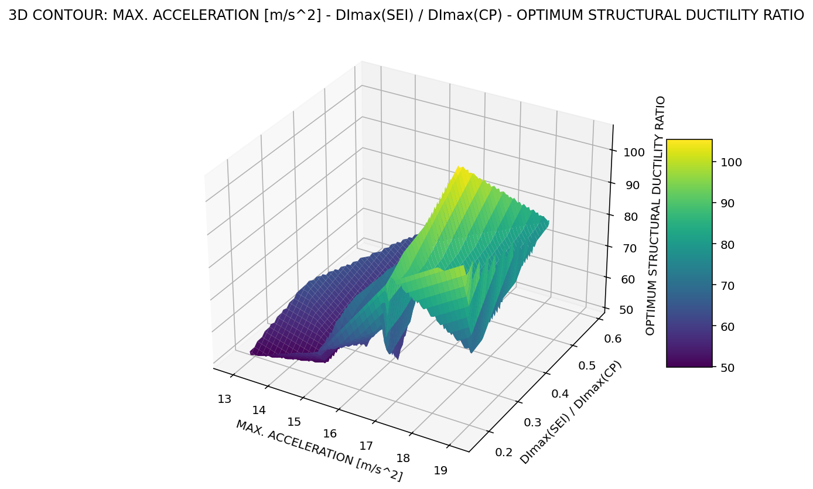

Slide 30
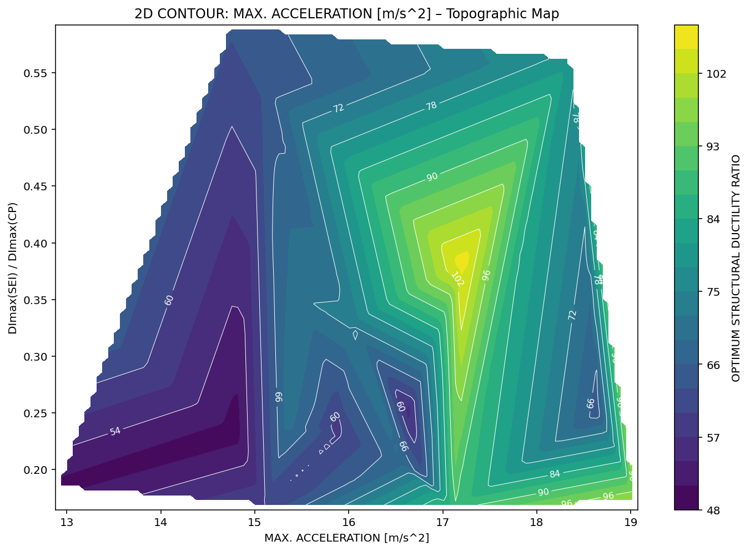

Slide 31
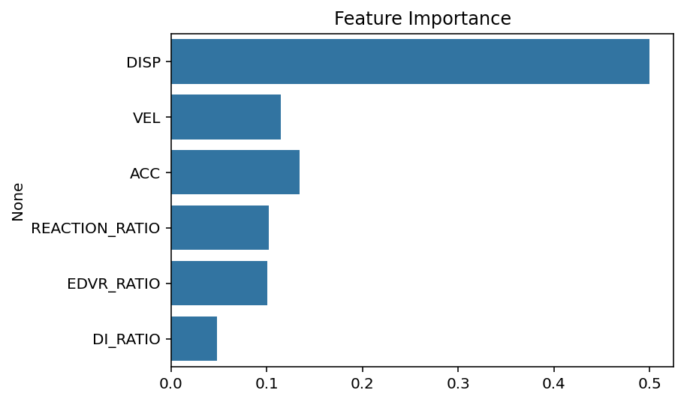

Slide 32
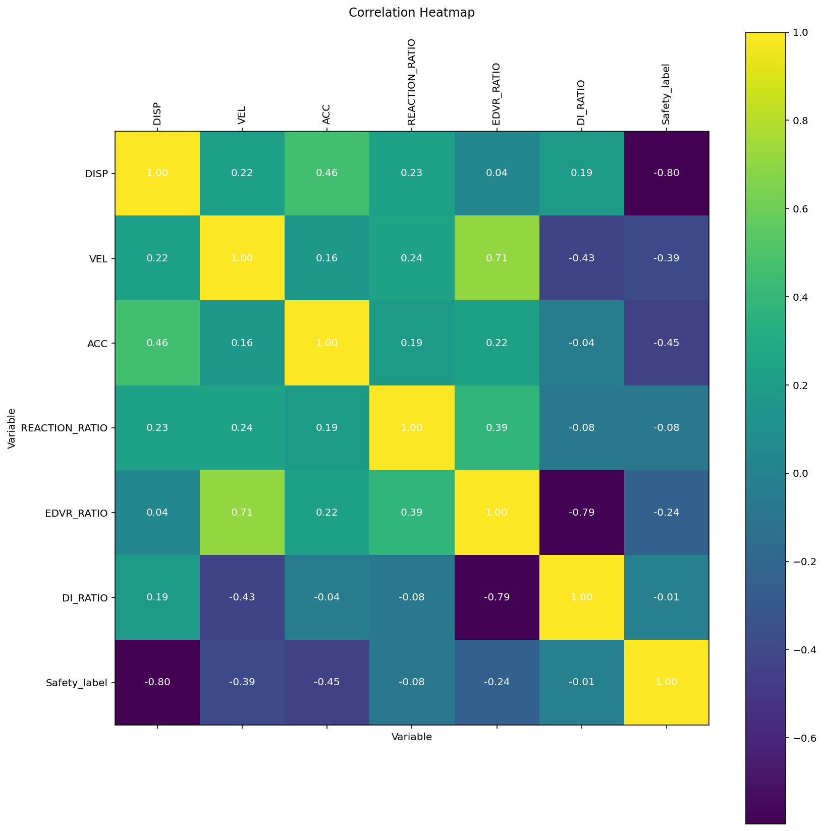

Slide 33
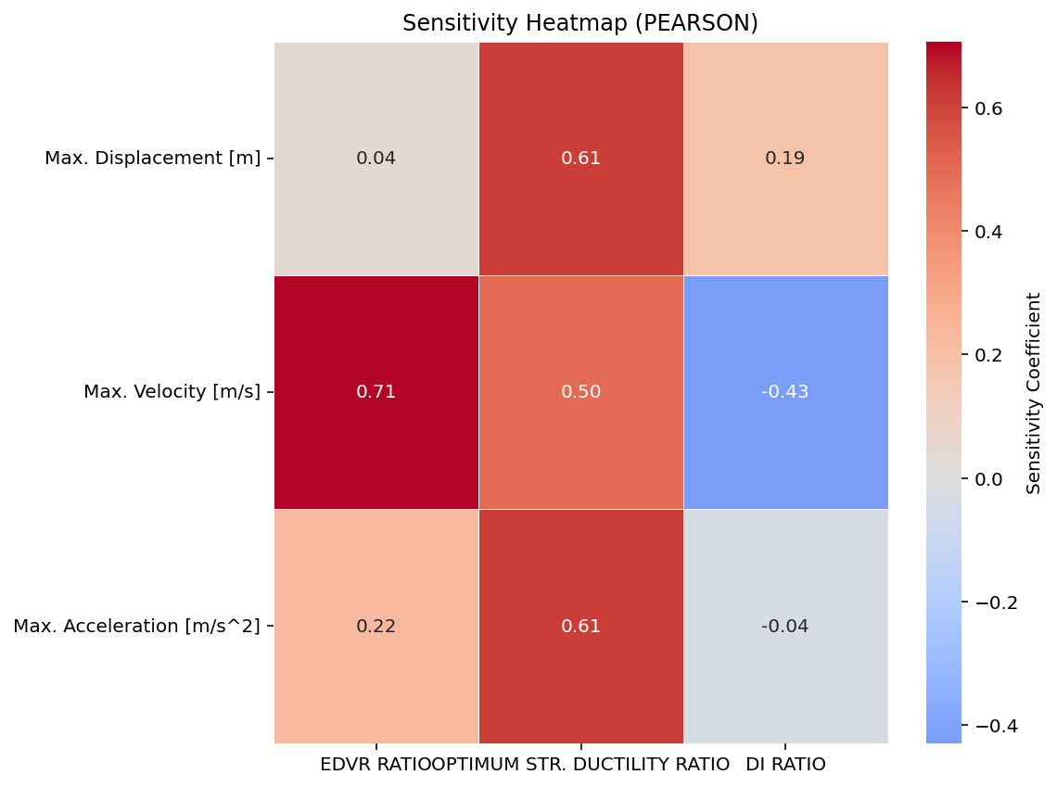

Slide 34
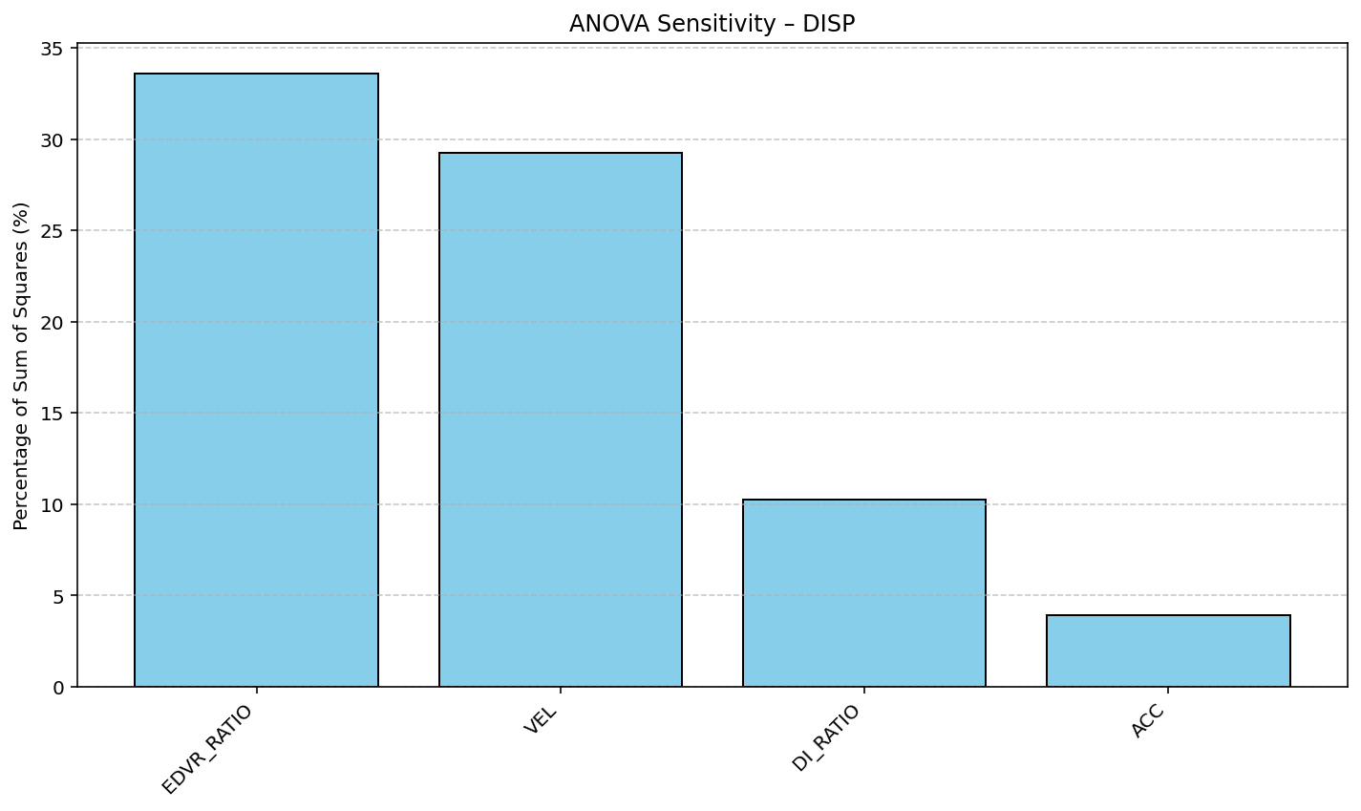

Slide 35
