Slide 1
>> IN THE NAME OF ALLAH, THE MOST GRACIOUS, THE MOST MERCIFUL <<
SENSITIVITY ANALYSIS OF SINGLE-DEGREE-FREEOM (SDOF) STRUCTURES USING FREE-VIBRATION:EFFECTS OF INITIAL DISPLACEMENT, MASS, STRCTURAL DUCTILITY RATIO AND OVER-STRENGTH FACTOR ON OUTPUT KEY PARAMETERS FROM NONLINEAR DYNAMIC ANALYSES USING PYTHON AND OPENSEES
(PARALLEL COMPUTING METHOD)
WRITTEN BY SALAR DELAVAR GHASHGHAEI (QASHQAI)

Slide 2
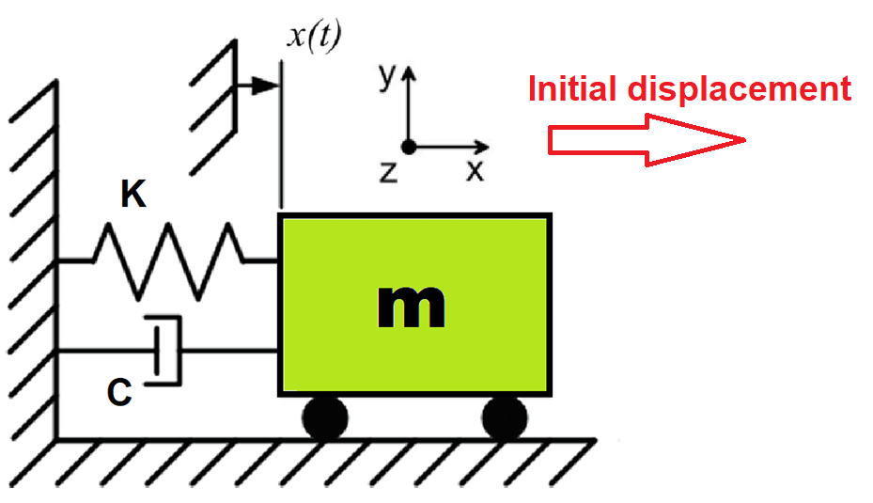

Slide 3
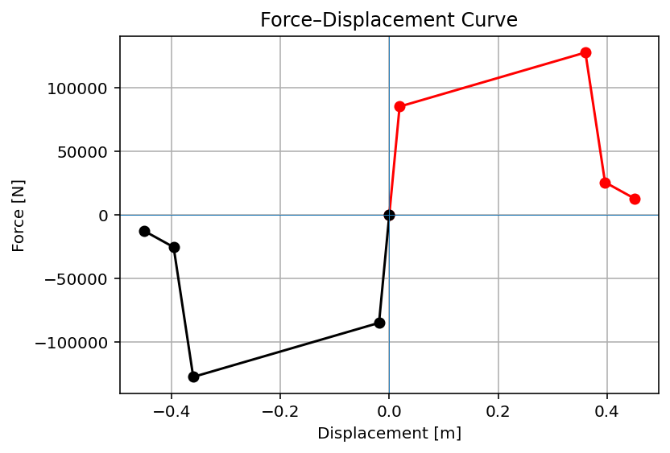

Slide 4
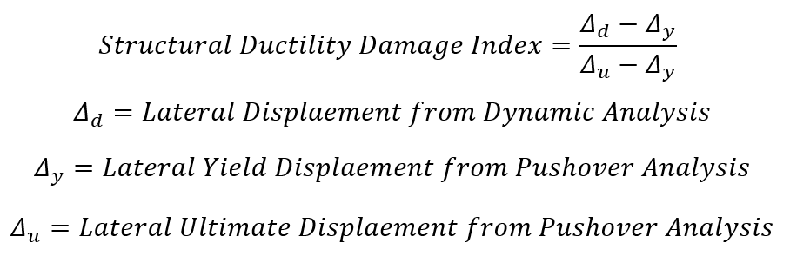

Slide 5
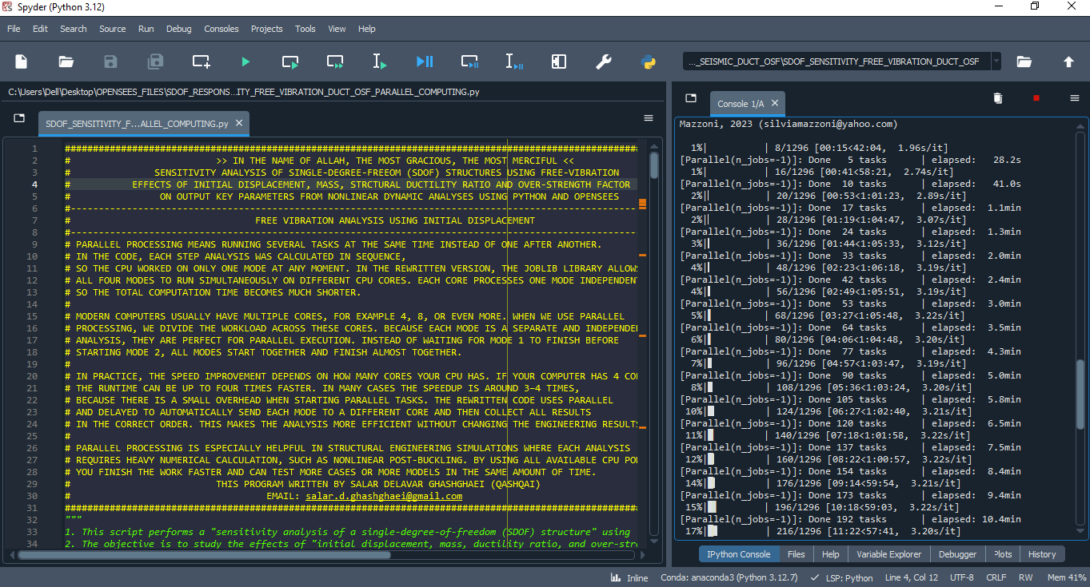

Slide 6
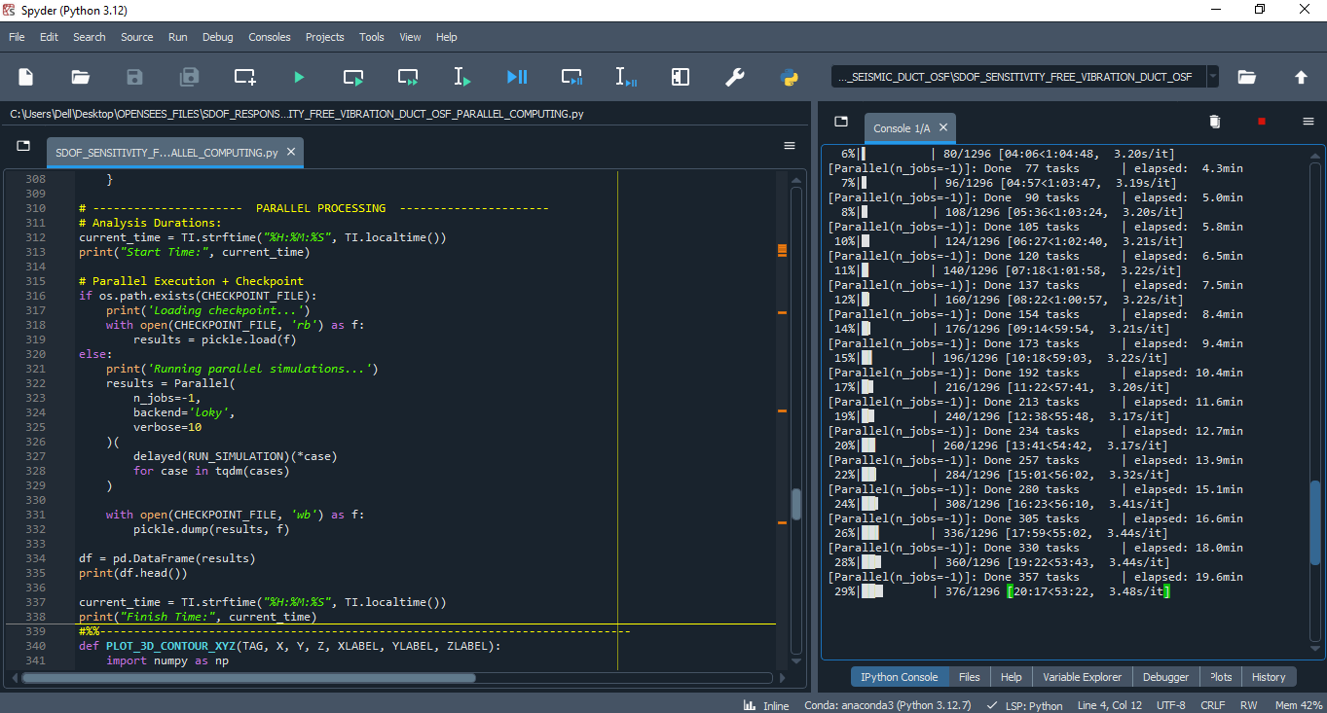

Slide 7
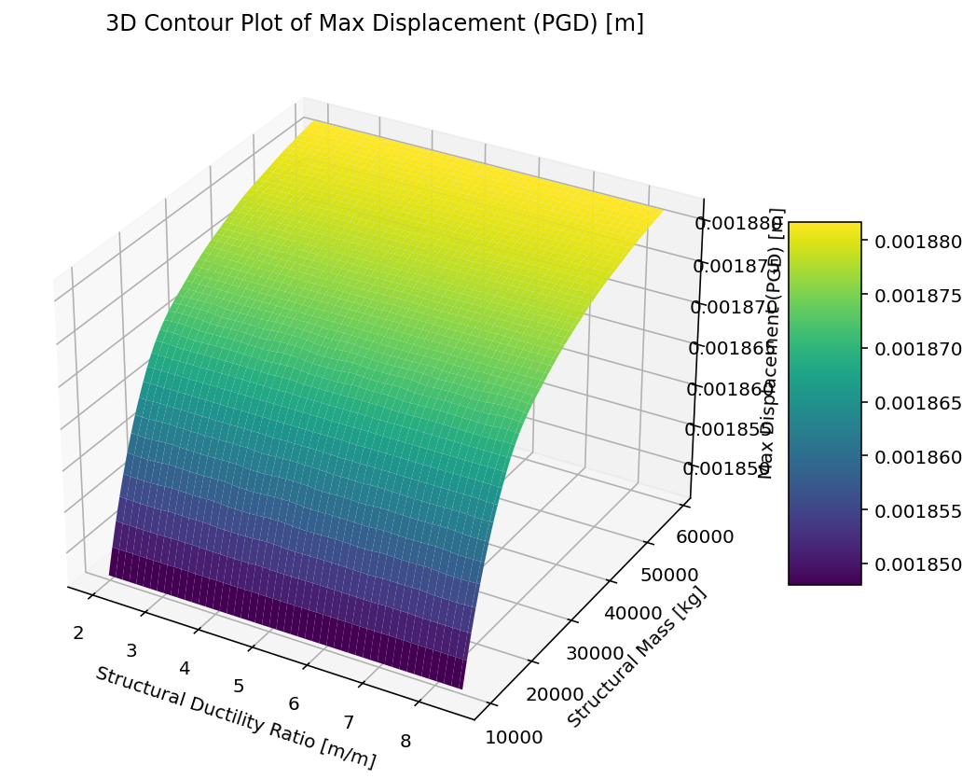

Slide 8
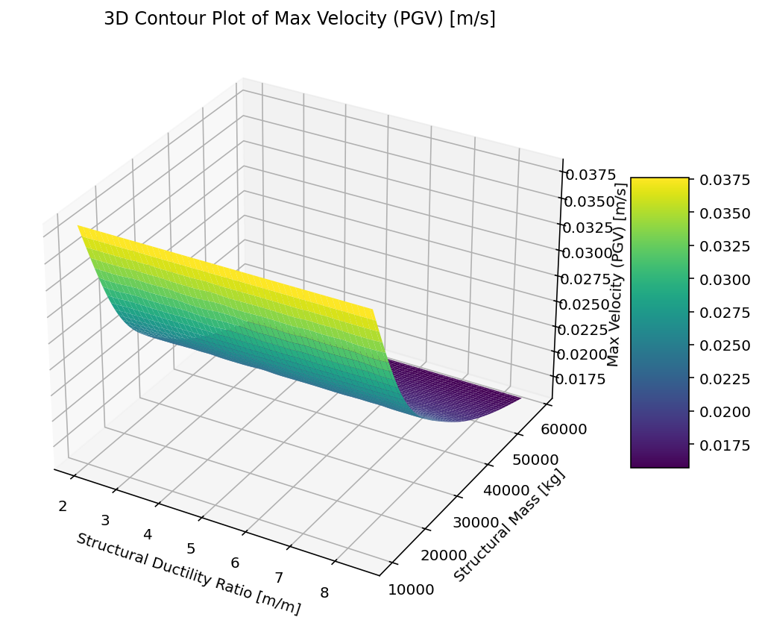

Slide 9
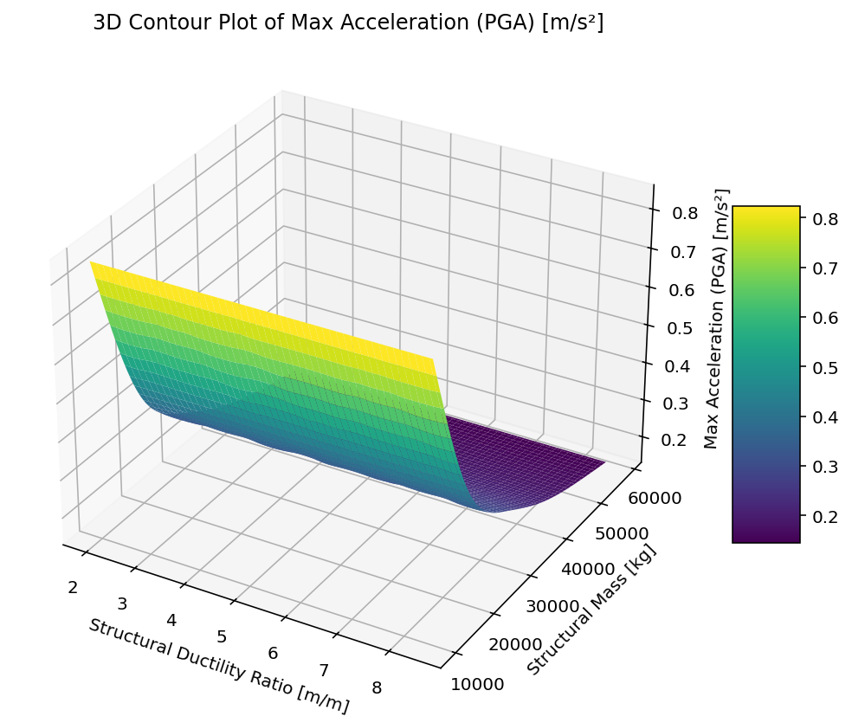

Slide 10
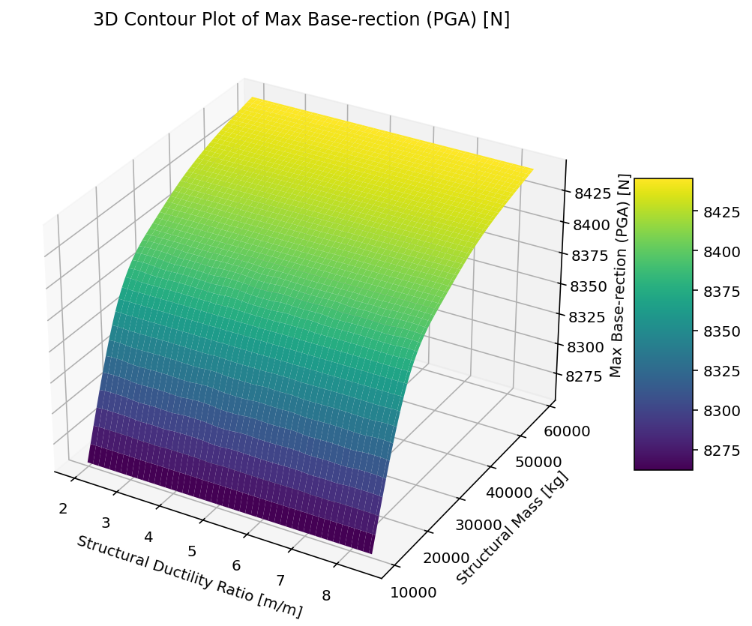

Slide 11
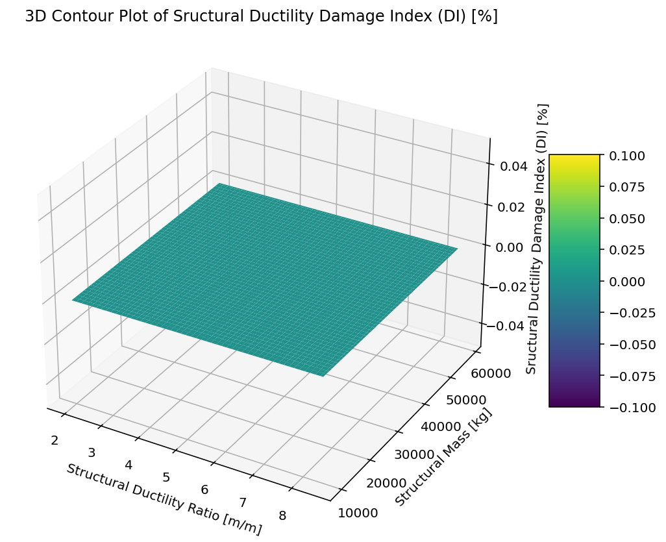

Slide 12
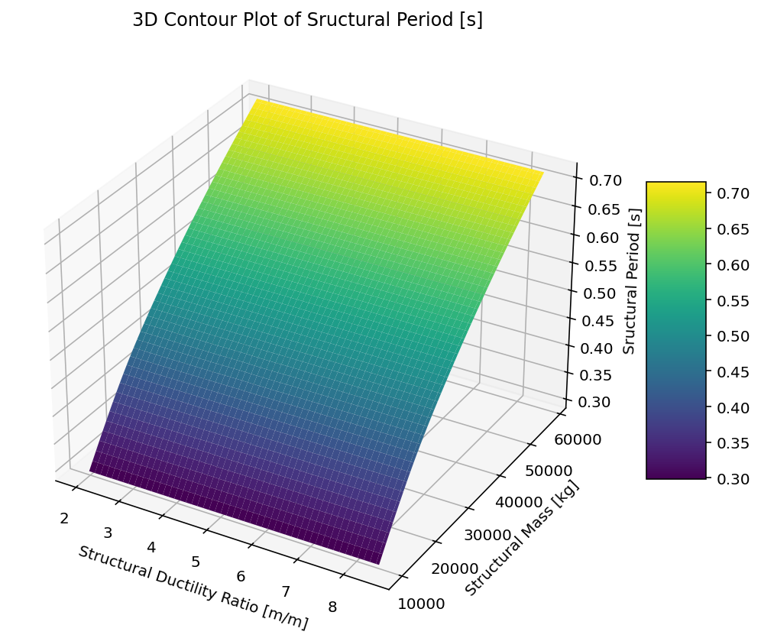

Slide 13
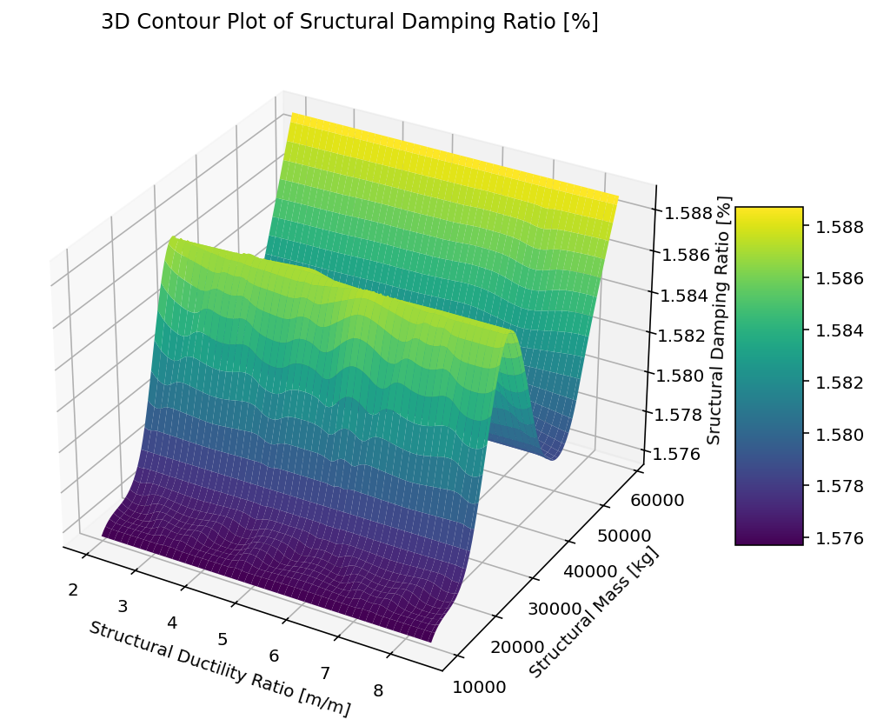

Slide 14
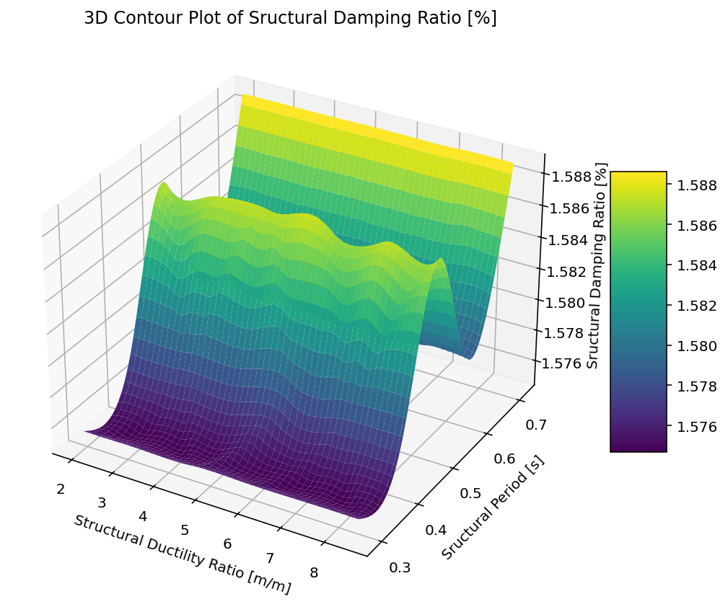

Slide 15
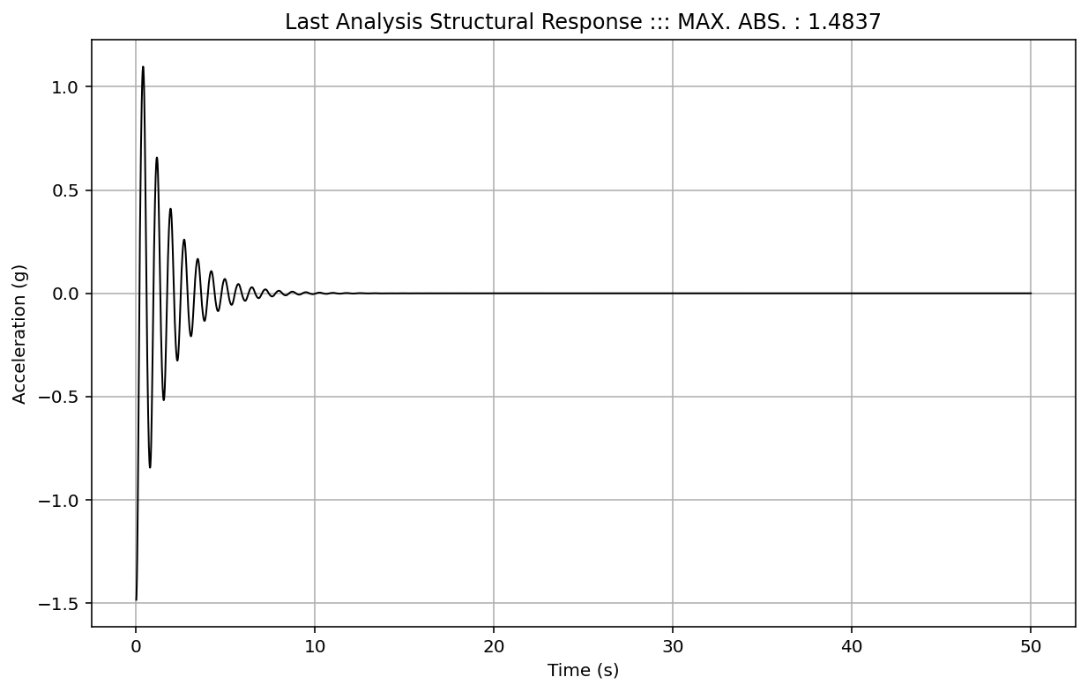

Slide 16
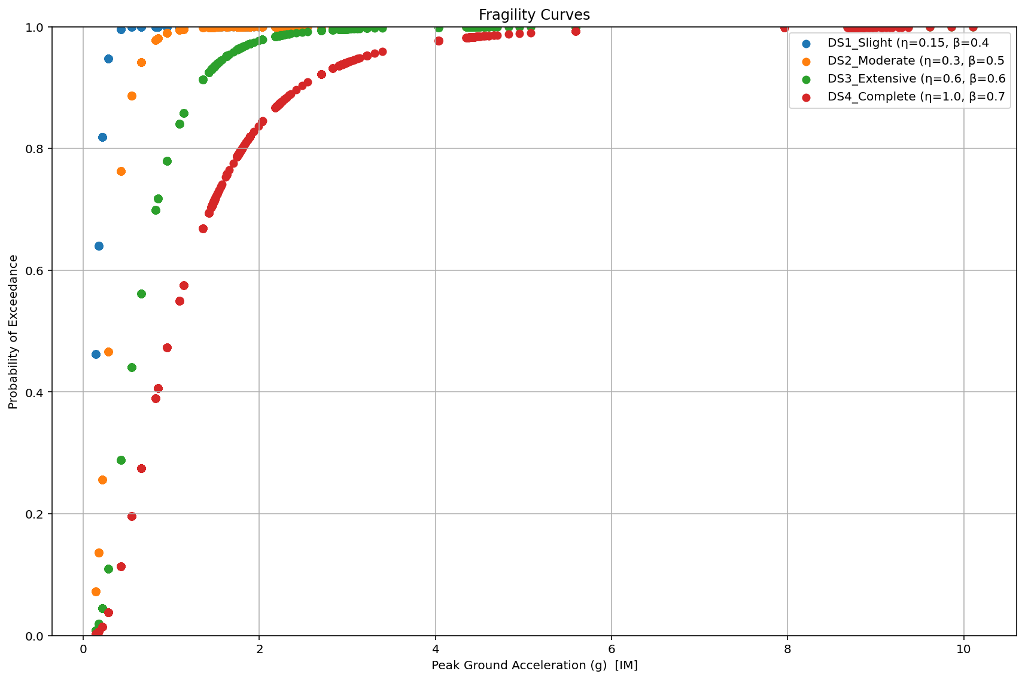

Slide 17
