Slide 1
>> IN THE NAME OF ALLAH, THE MOST GRACIOUS, THE MOST MERCIFUL <<
SENSITIVITY ANALYSIS OF CONCRETE FRAME BY CHANGING COLUMN REBAR DIAMETER AND CONFINEMENT ENHANCEMENT RATIO. USING OPENSEES FOR STRUCTURAL BEHAVIOR COEFFICIENT CALCULATION
WRITTEN BY SALAR DELAVAR GHASHGHAEI (QASHQAI)

Slide 2
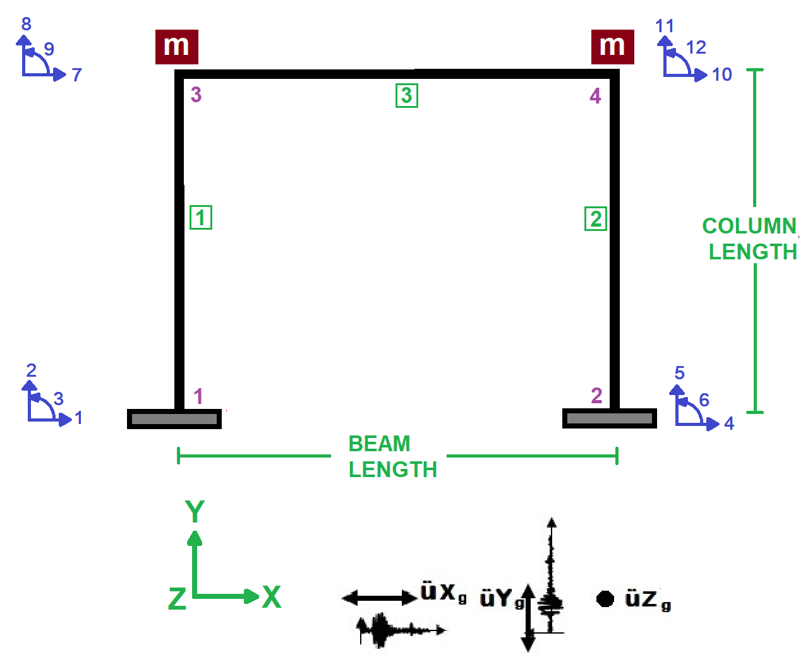

Slide 3
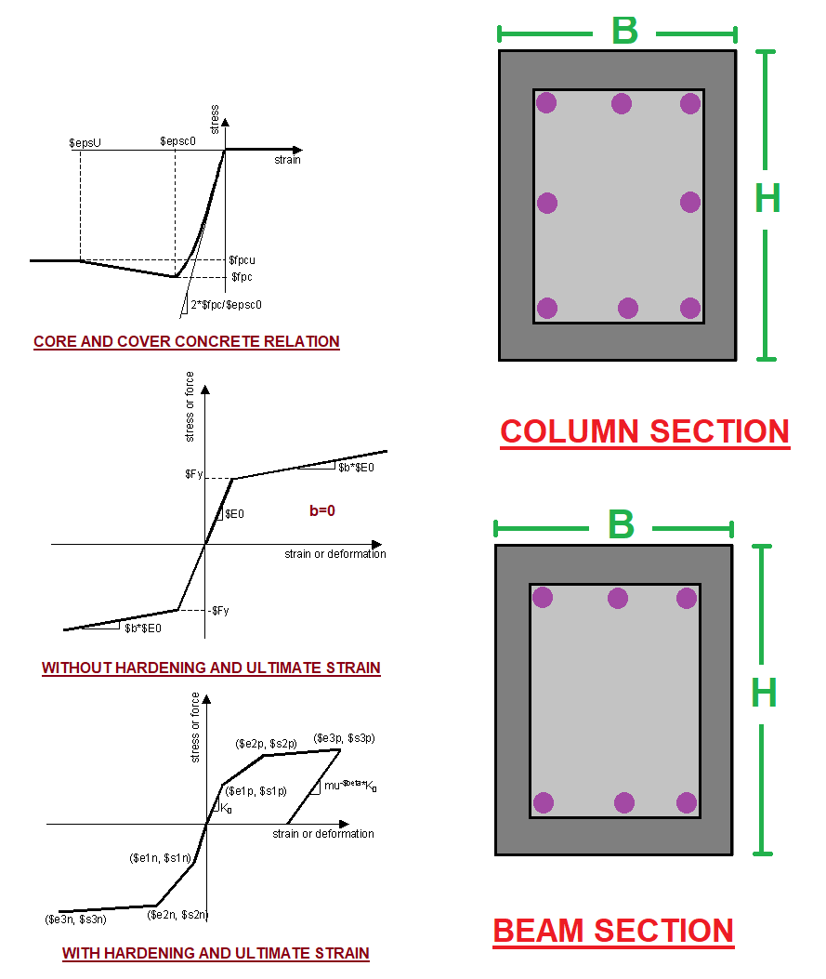

Slide 4
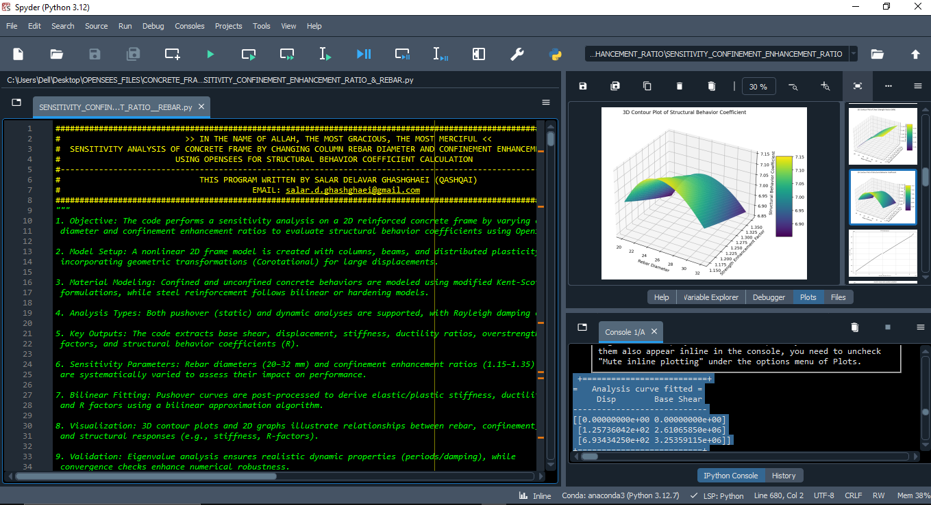

Slide 5
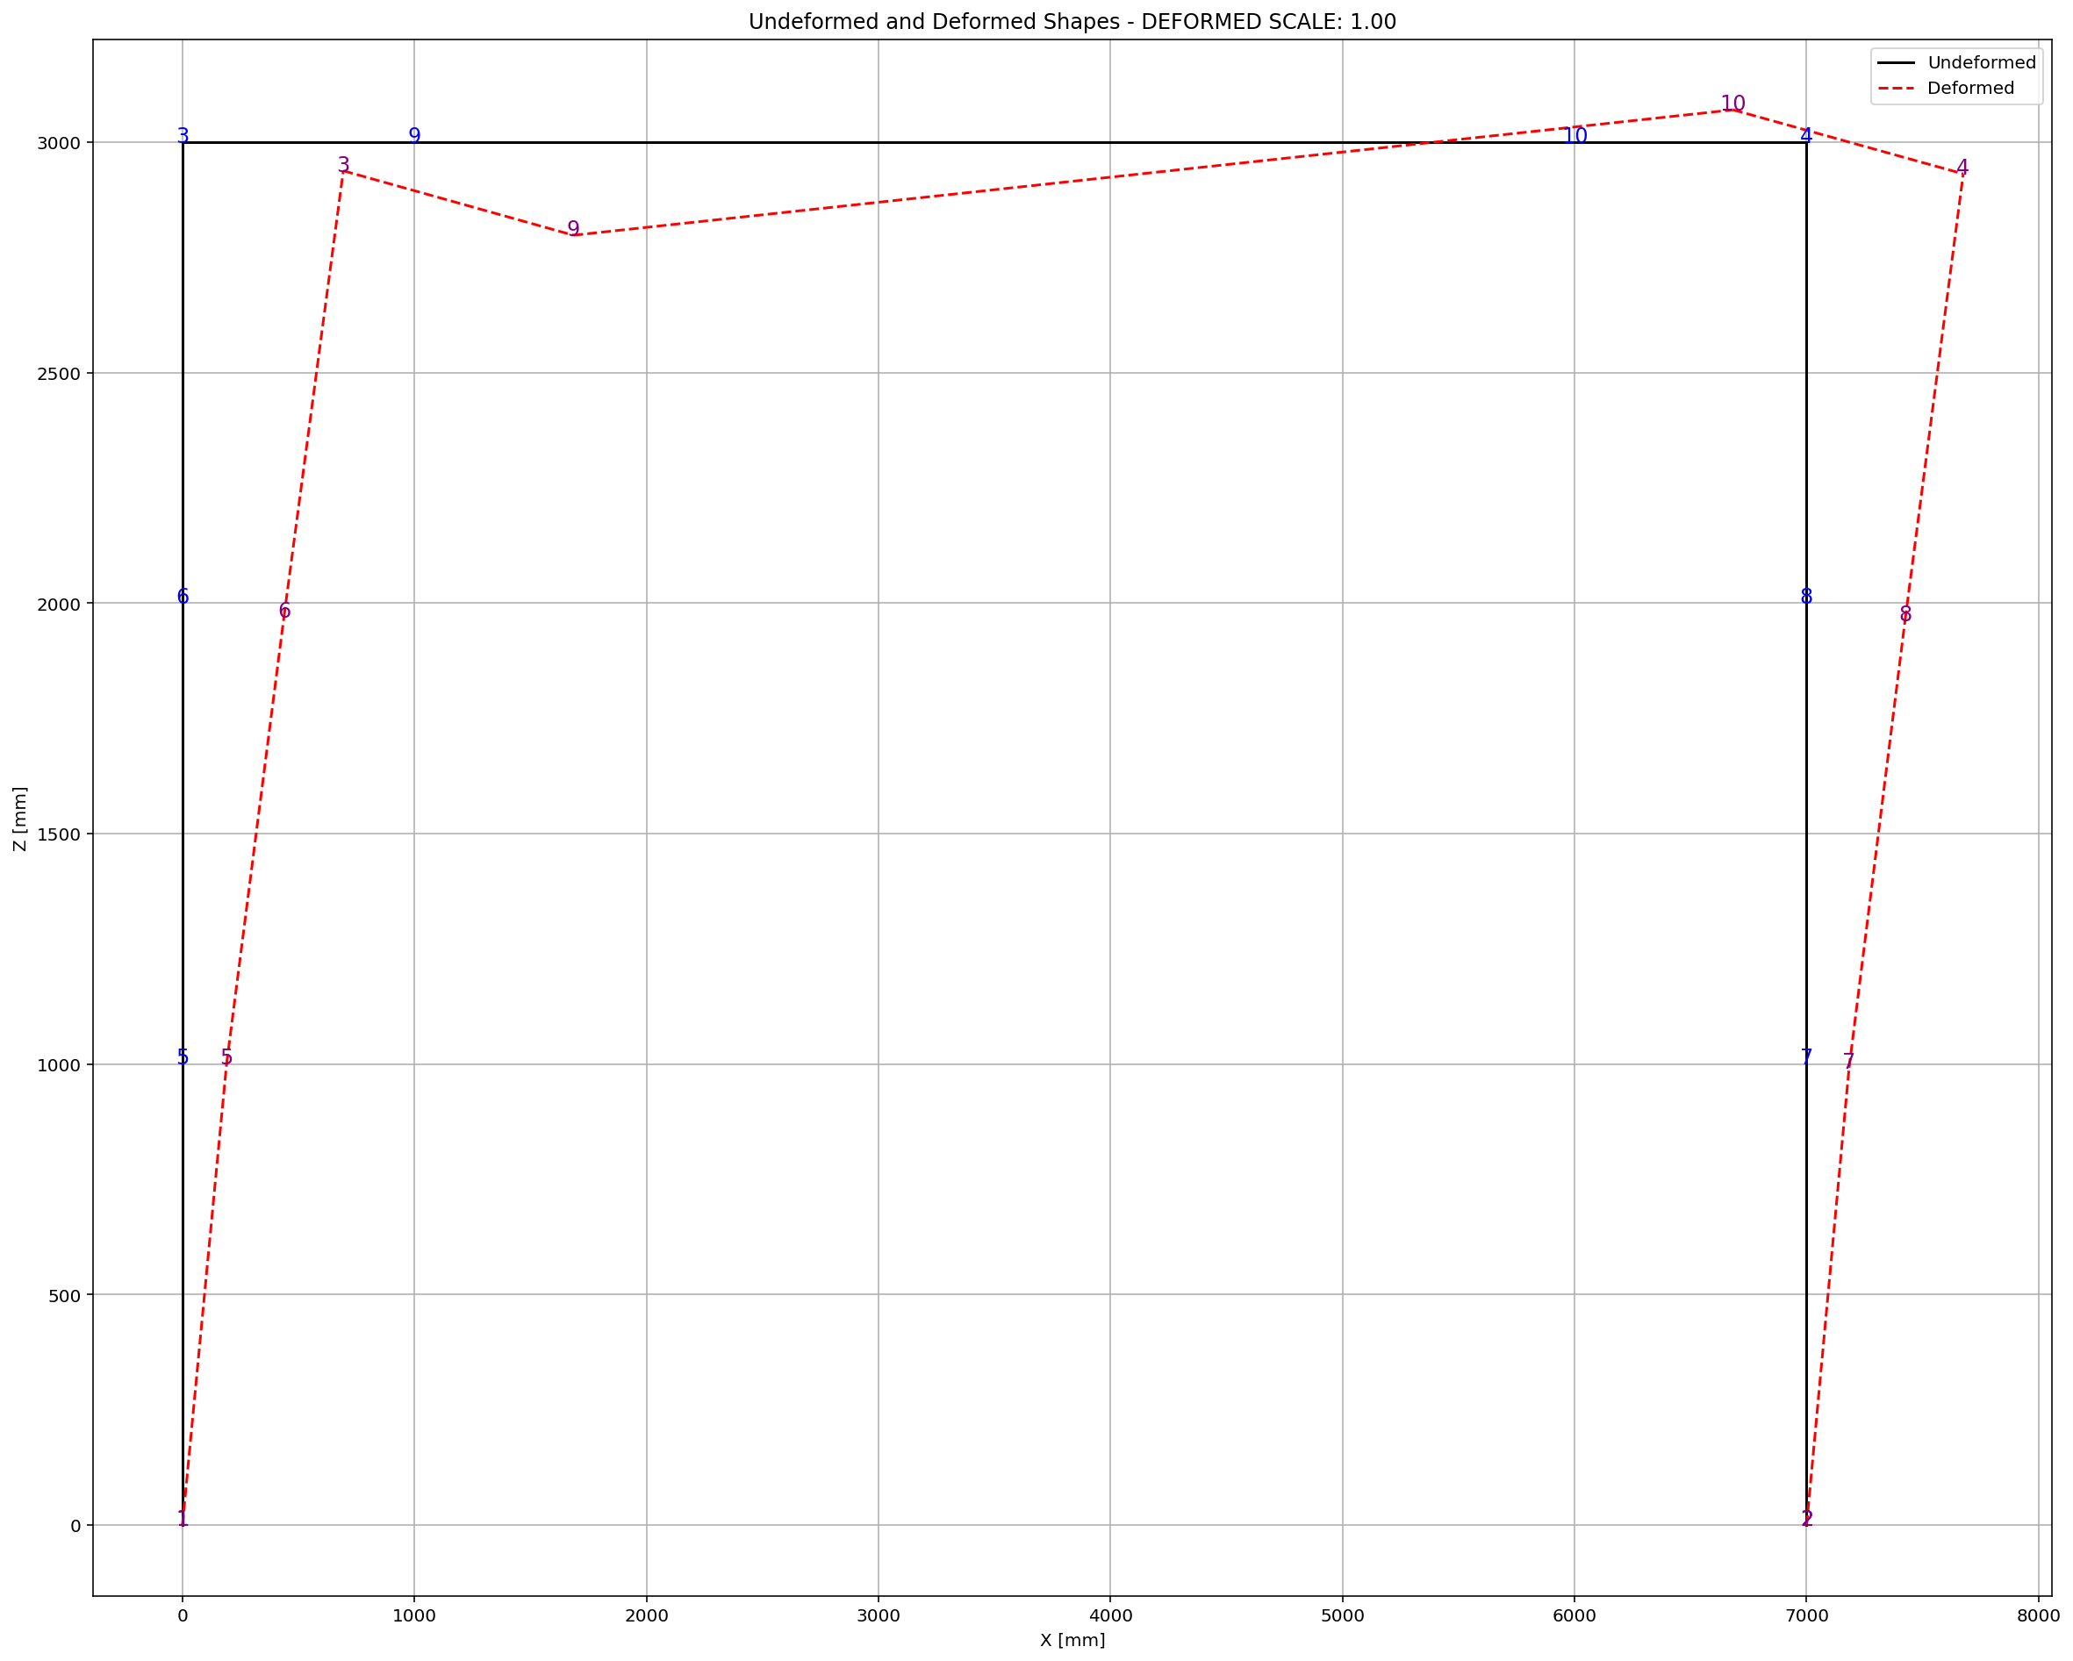

Slide 6
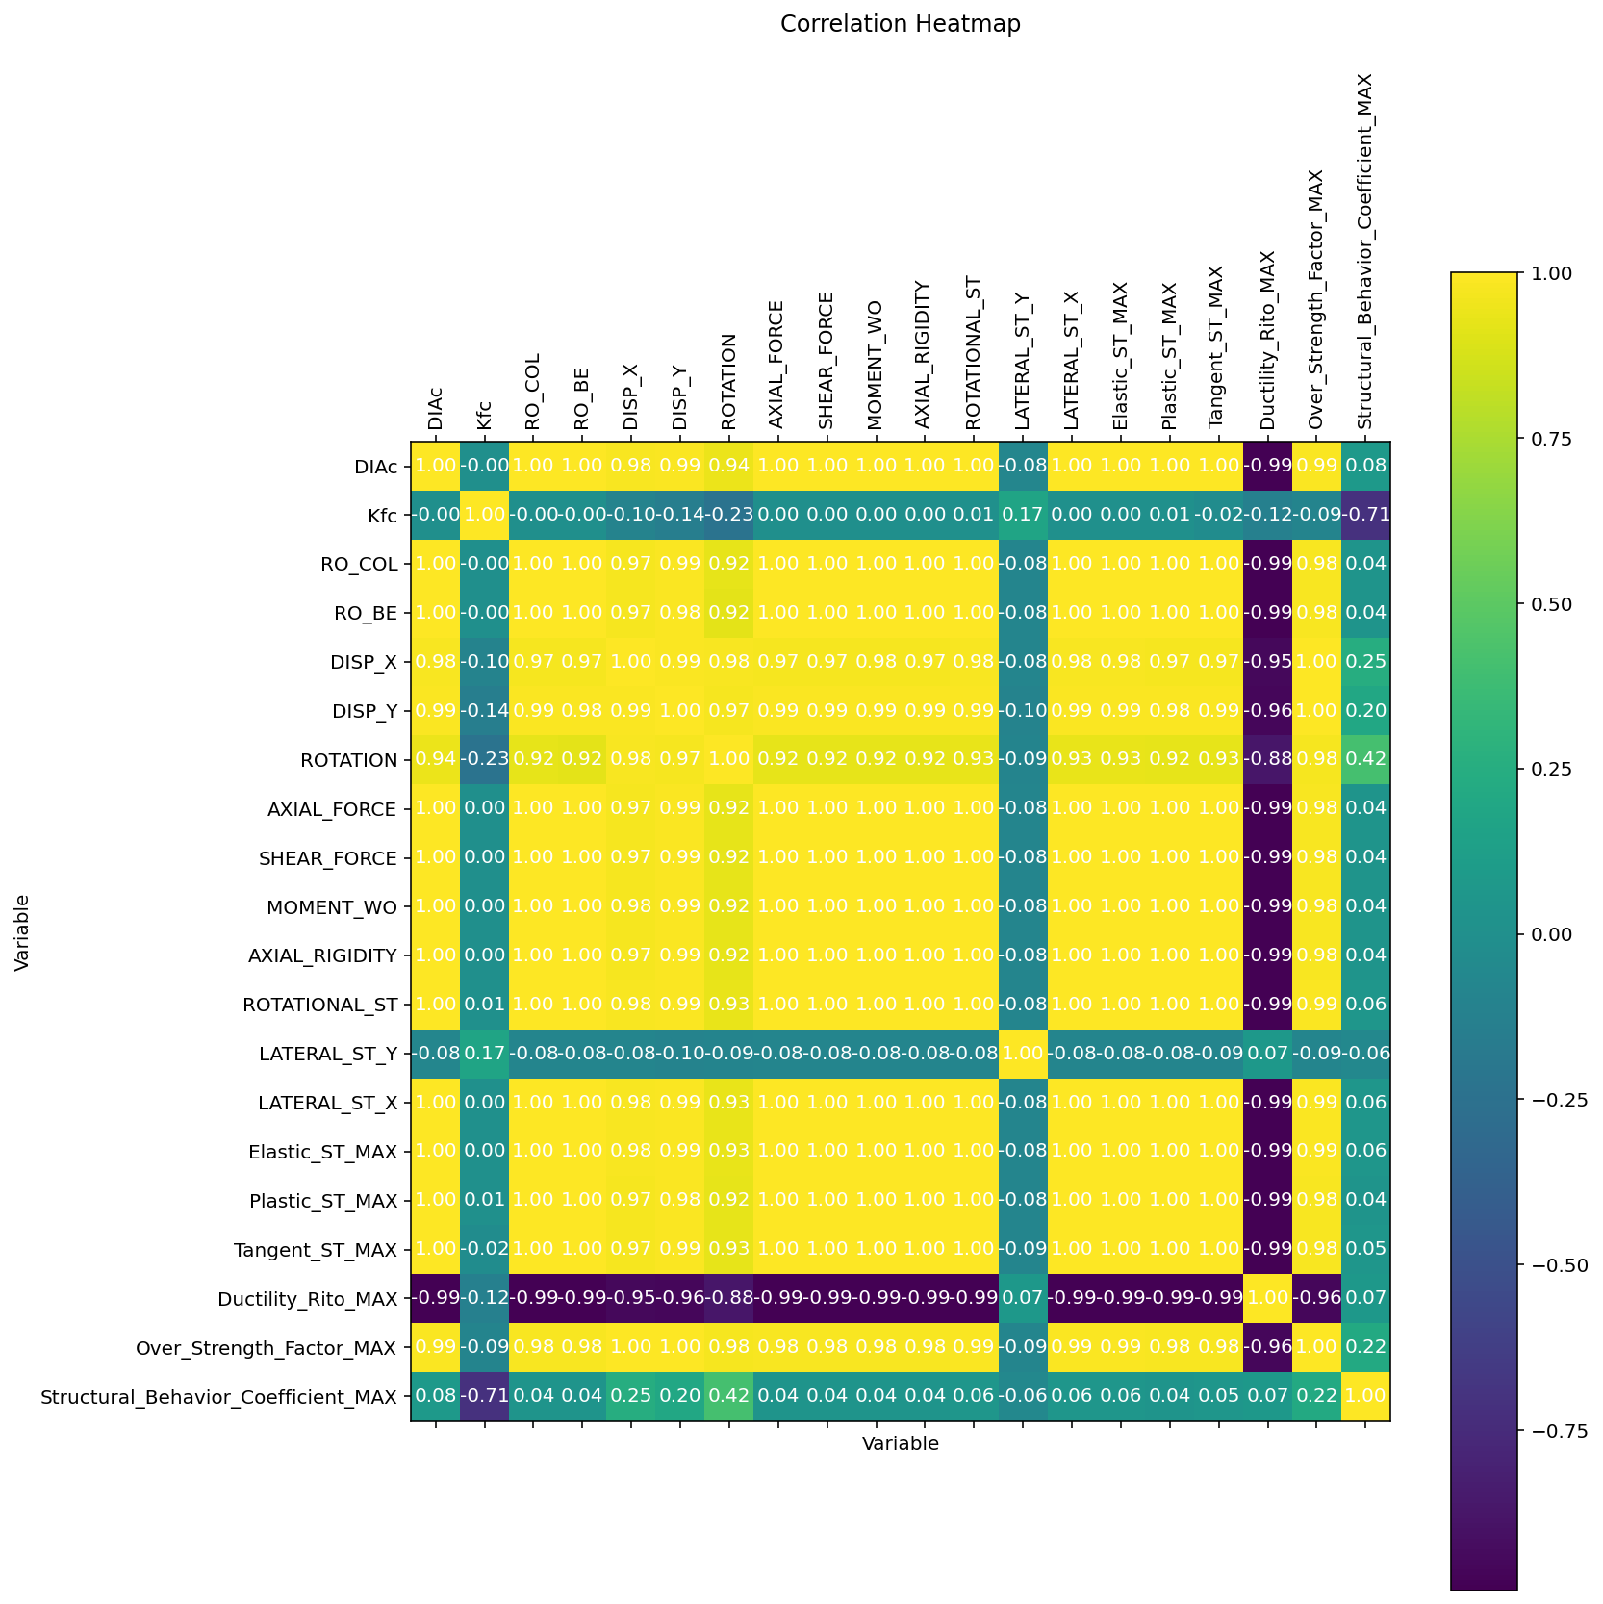

Slide 7
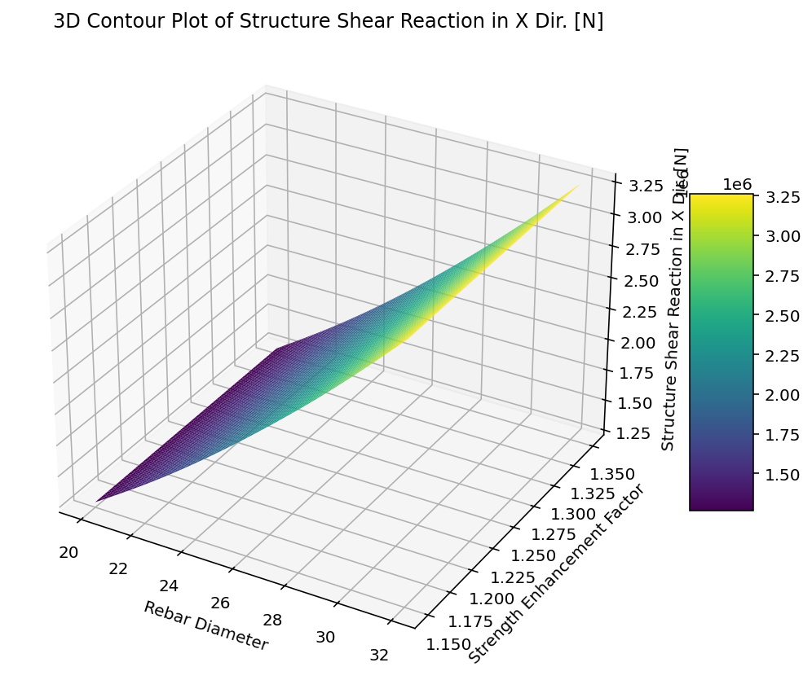

Slide 8


Slide 9
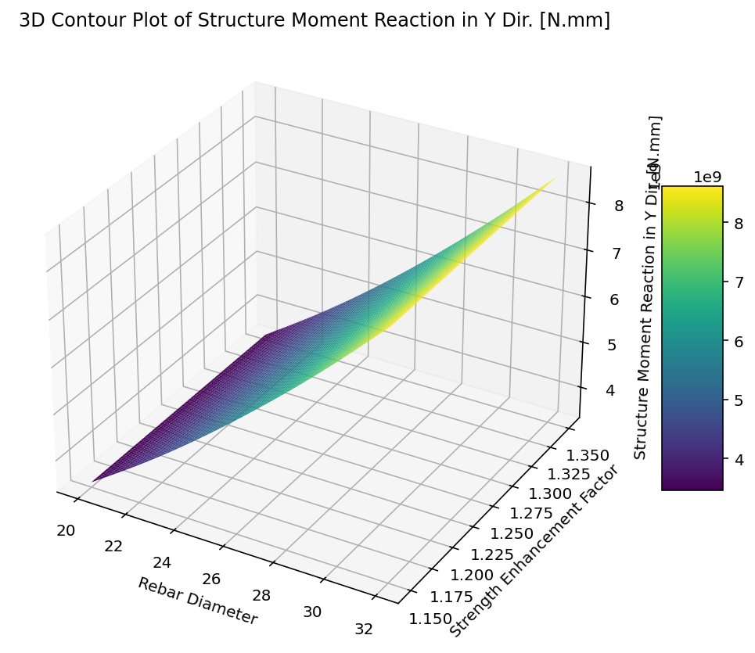

Slide 10
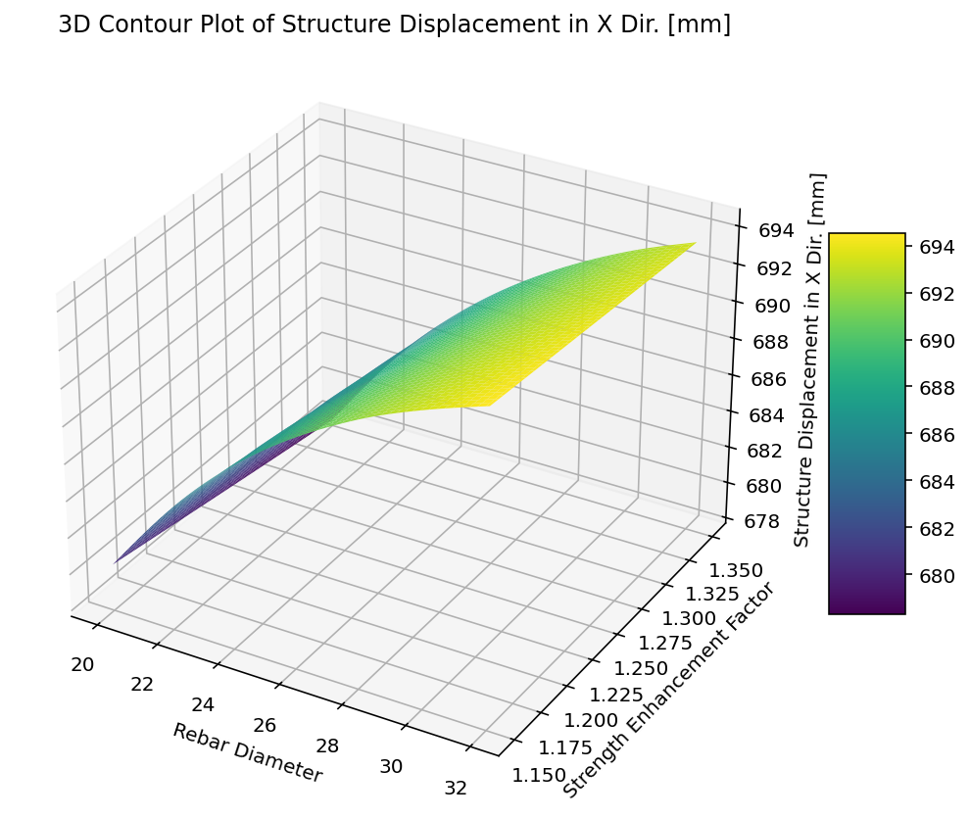

Slide 11
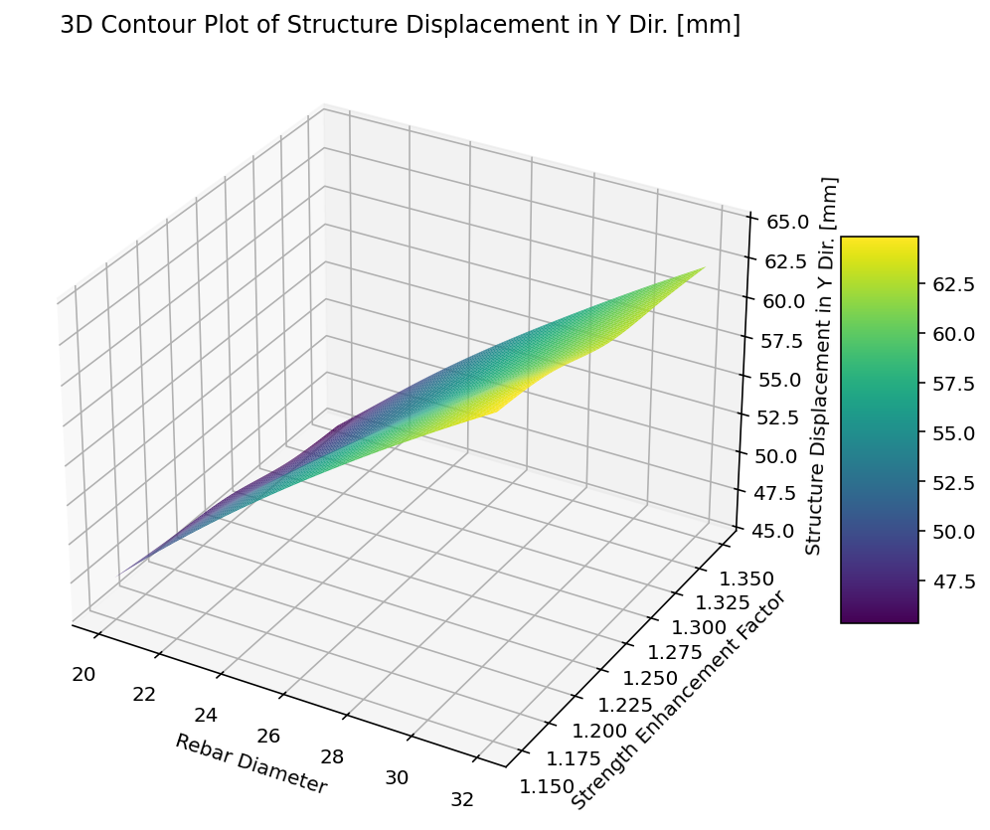

Slide 12
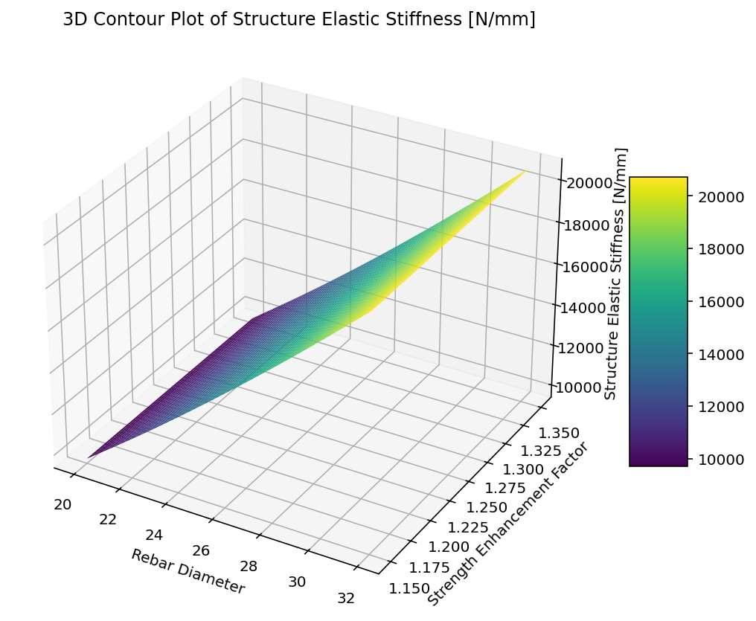

Slide 13
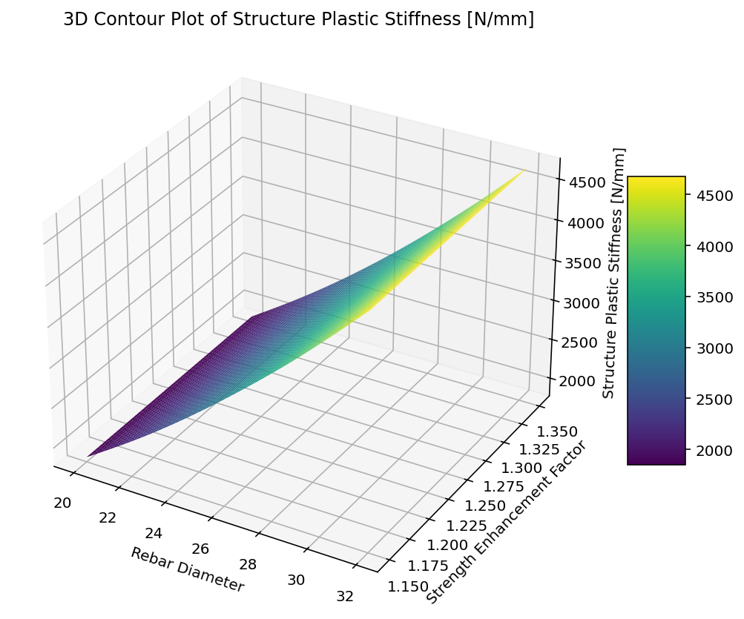

Slide 14
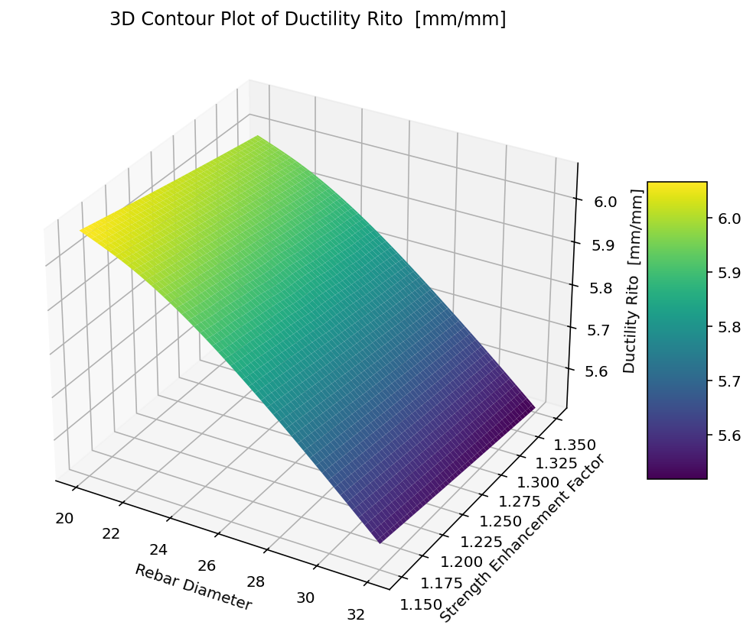

Slide 15
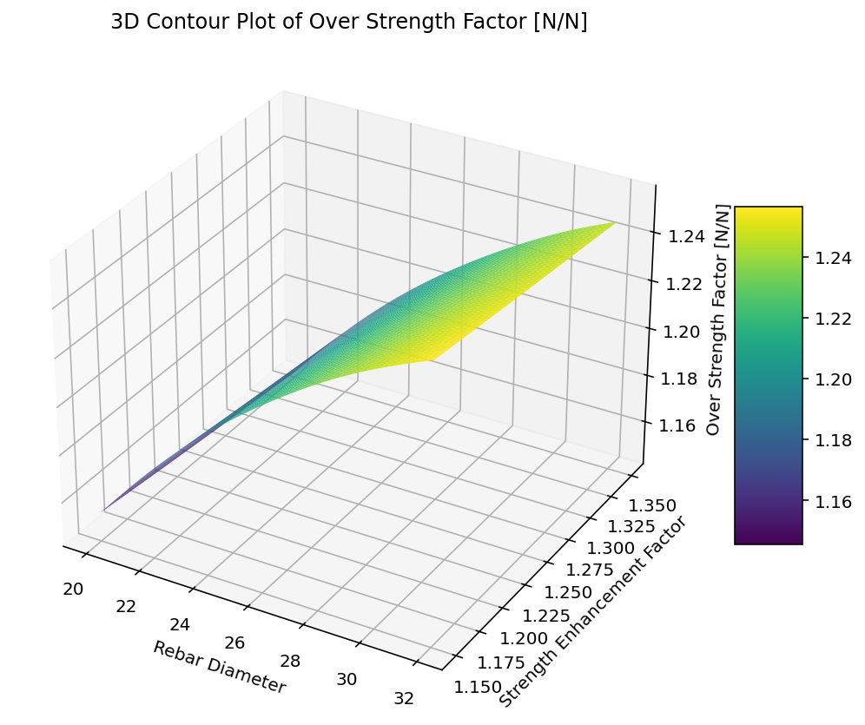

Slide 16
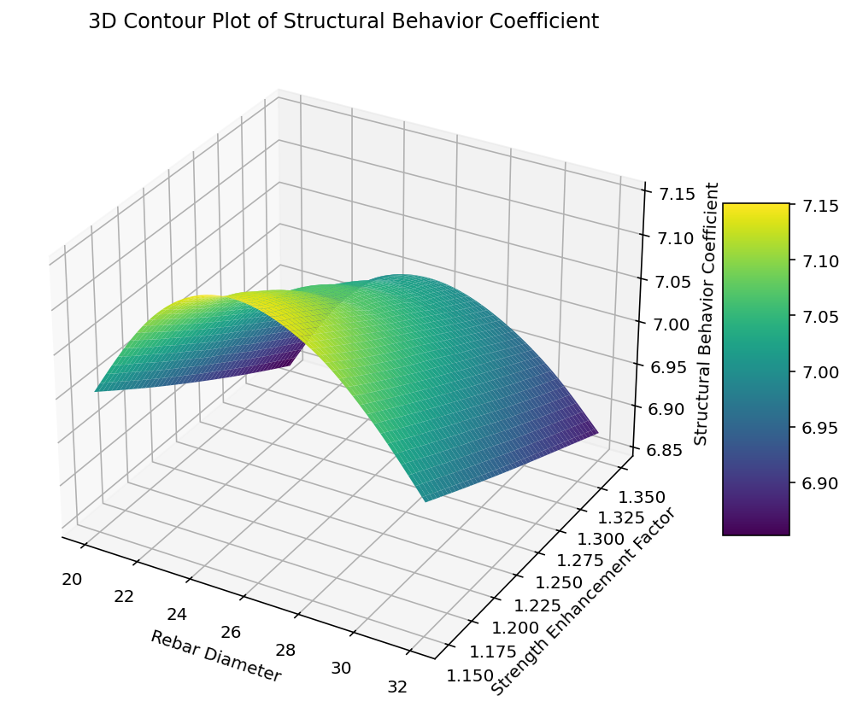

Slide 17
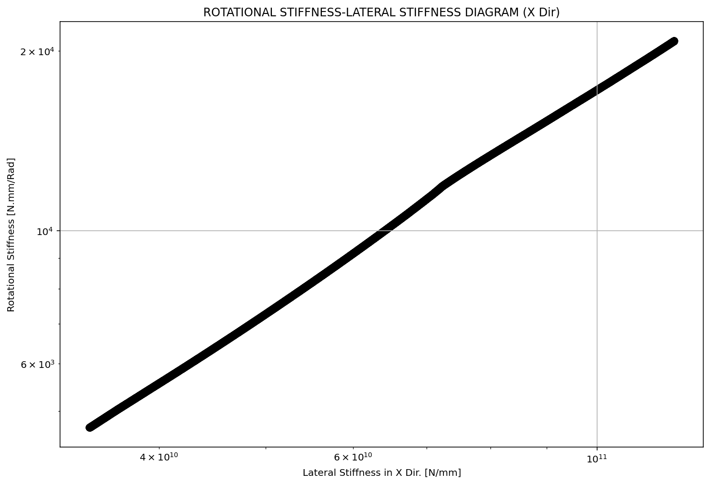

Slide 18
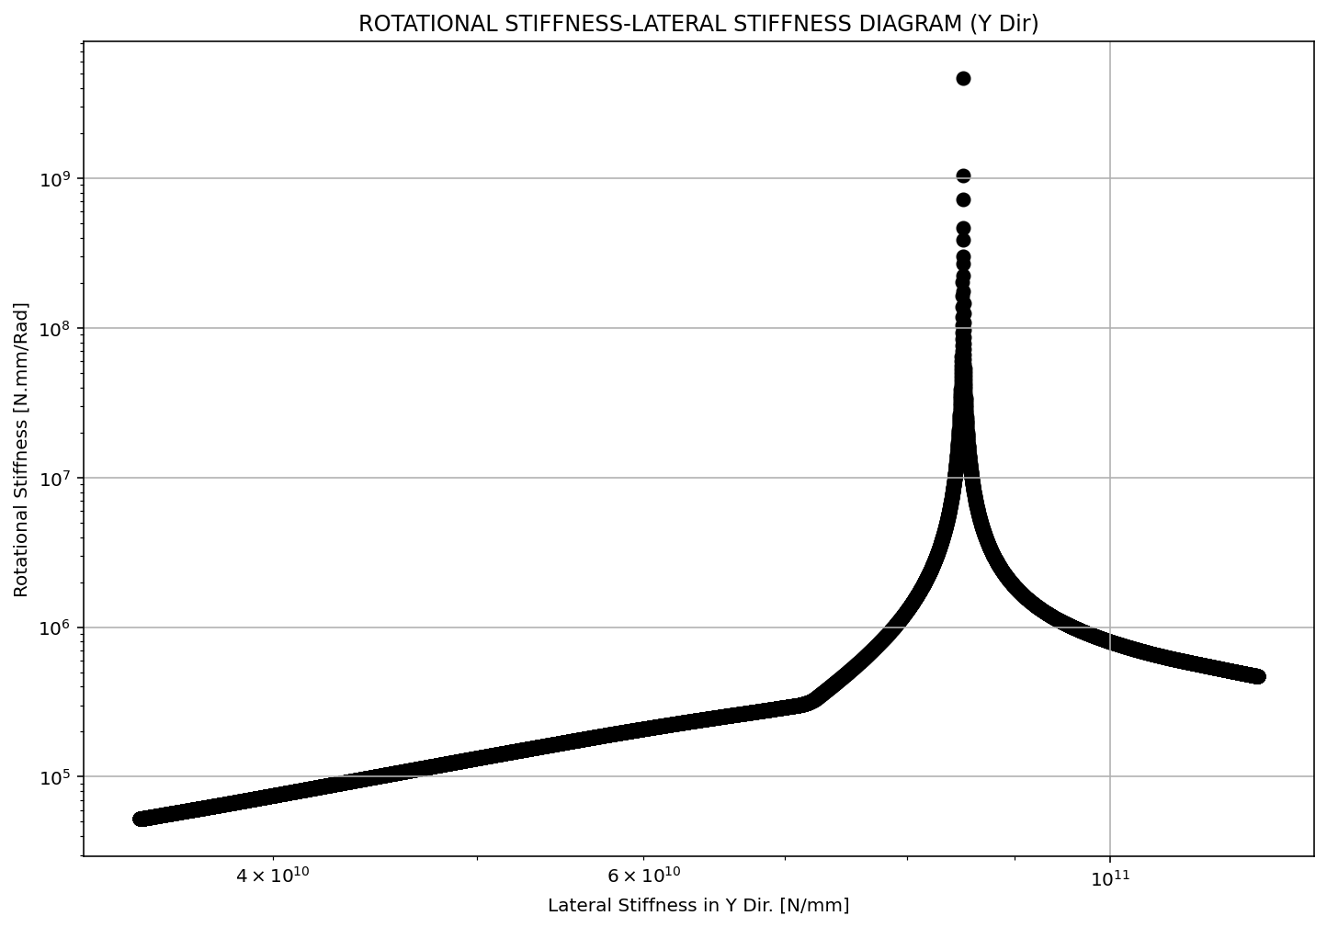

Slide 19
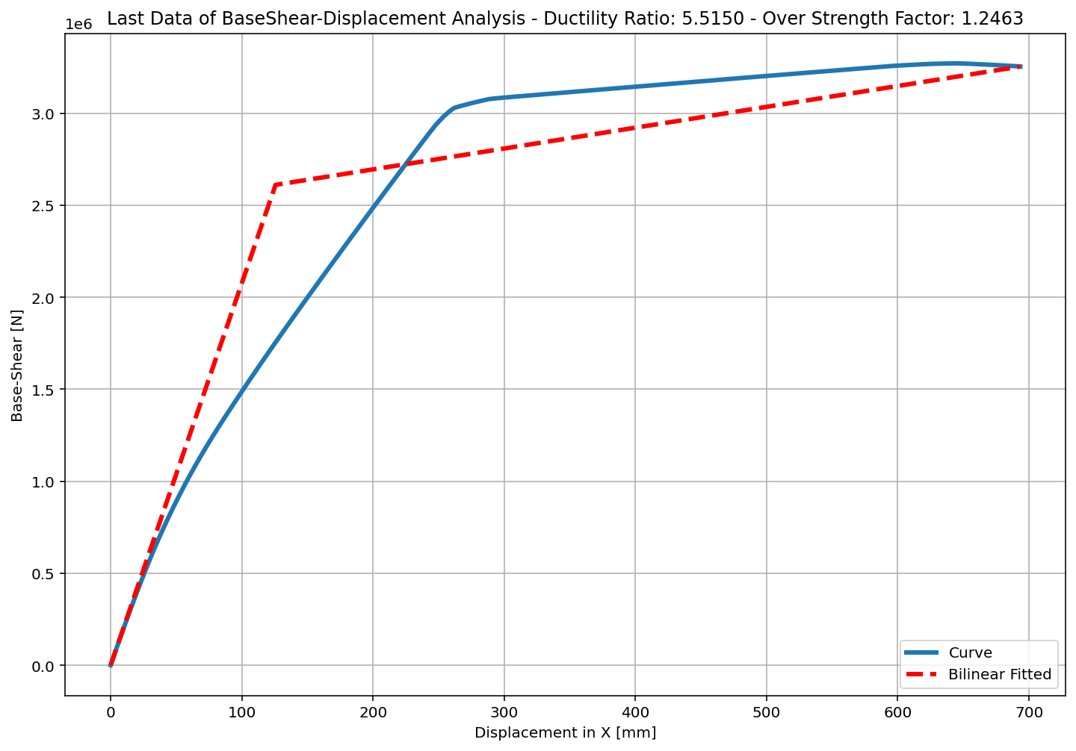
+==========================+
= Analysis curve fitted =
Disp Base Shear
----------------------------
[[0.00000000e+00 0.00000000e+00]
[1.25736042e+02 2.61065850e+06]
[6.93434250e+02 3.25359115e+06]]
+==========================+
+----------------------------------------------------+
Structure Elastic Stiffness : 20763.01
Structure Plastic Stiffness : 4692.00
Structure Tangent Stiffness : 1132.53
Structure Ductility Ratio : 5.51
Structure Over Strength Factor: 1.25
+----------------------------------------------------+
Over Strength Coefficient (Ω0): 1.2463
Displacement Ductility Ratio (μ): 5.5150
Ductility Coefficient (Rμ): 5.5150
Structural Behavior Coefficient (R): 6.8732

Slide 20
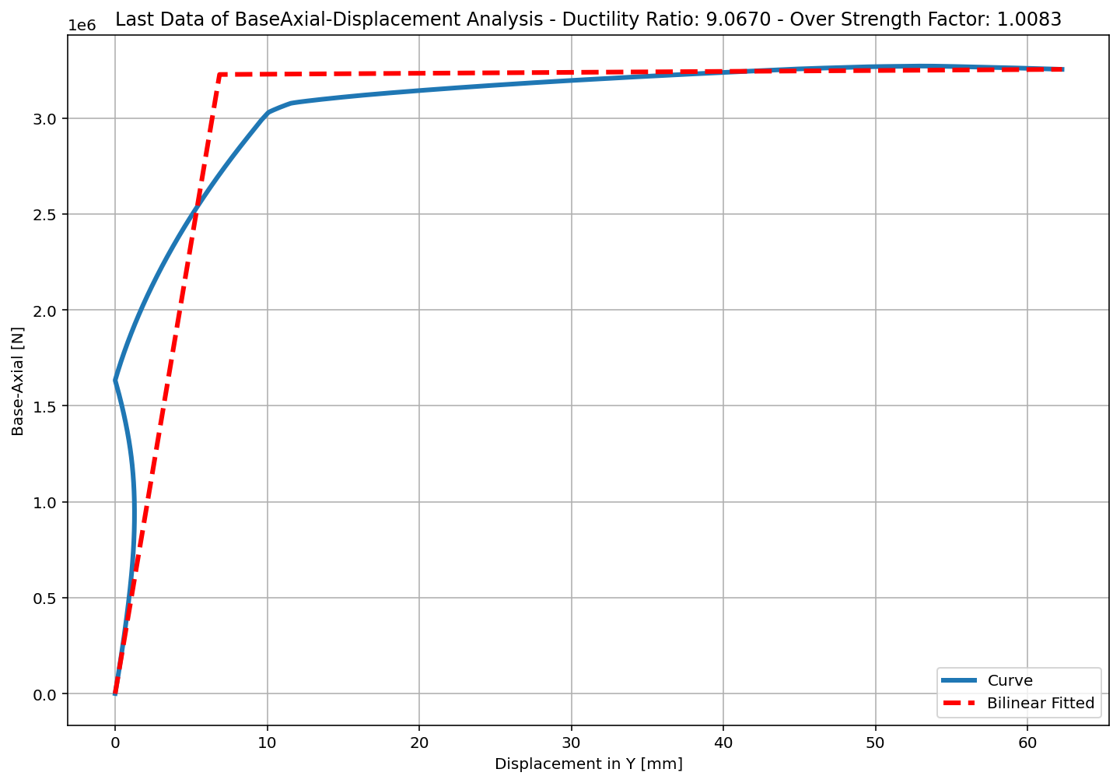
+==========================+
= Analysis curve fitted =
Disp Base Shear
----------------------------
[[0.00000000e+00 0.00000000e+00]
[6.86826626e+00 3.22686887e+06]
[6.22743759e+01 3.25359115e+06]]
+==========================+
+----------------------------------------------------+
Structure Elastic Stiffness : 469822.91
Structure Plastic Stiffness : 52246.07
Structure Tangent Stiffness : 482.30
Structure Ductility Ratio : 9.07
Structure Over Strength Factor: 1.01
+----------------------------------------------------+
Ductility Ratio: 1.4999
Over Strength Coefficient (Ω0): 1.0083
Displacement Ductility Ratio (μ): 9.0670
Ductility Coefficient (Rμ): 1.3747
Structural Behavior Coefficient (R): 1.3861

