Slide 1
IN THE NAME OF ALLAH
PROGRESSIVE COLLAPSE ANALYSIS OF CONCRETE FRAME.
EVALUATING STRAIN HARDENING AND ULTIMATE STRAIN CRITERIA USING OPENSEES.
DISPLACEMENT CONTROL
WRITTEN BY SALAR DELAVAR GHASHGHAEI (QASHQAI)

Slide 2
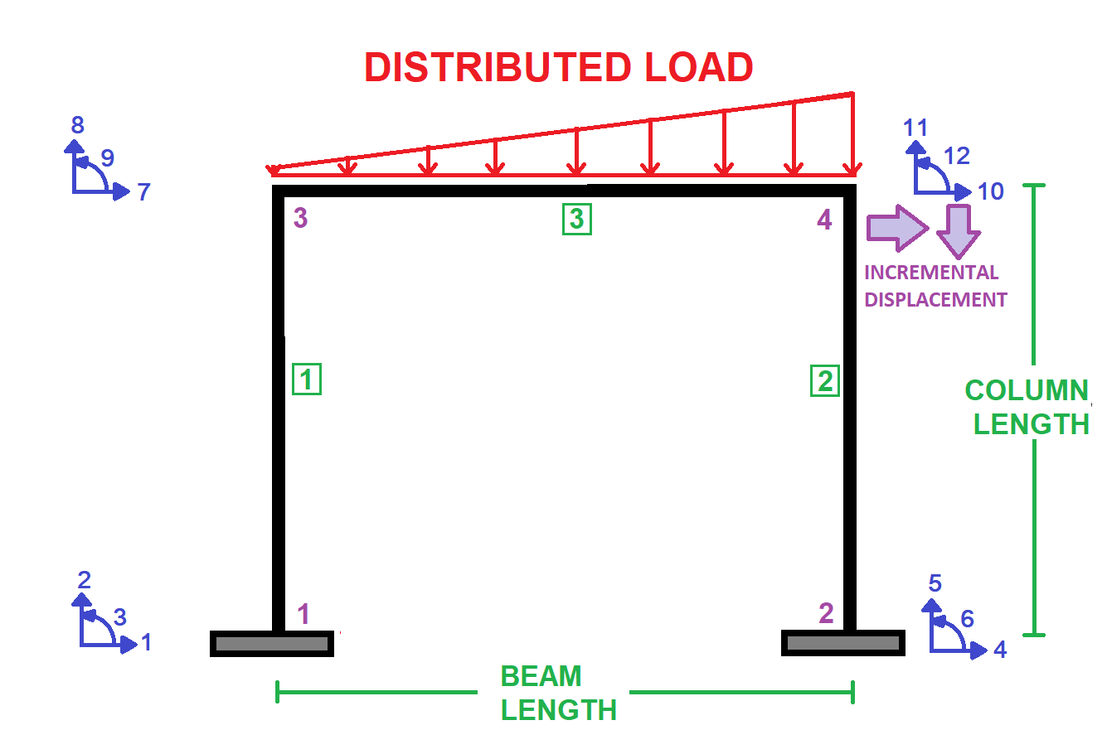

Slide 3
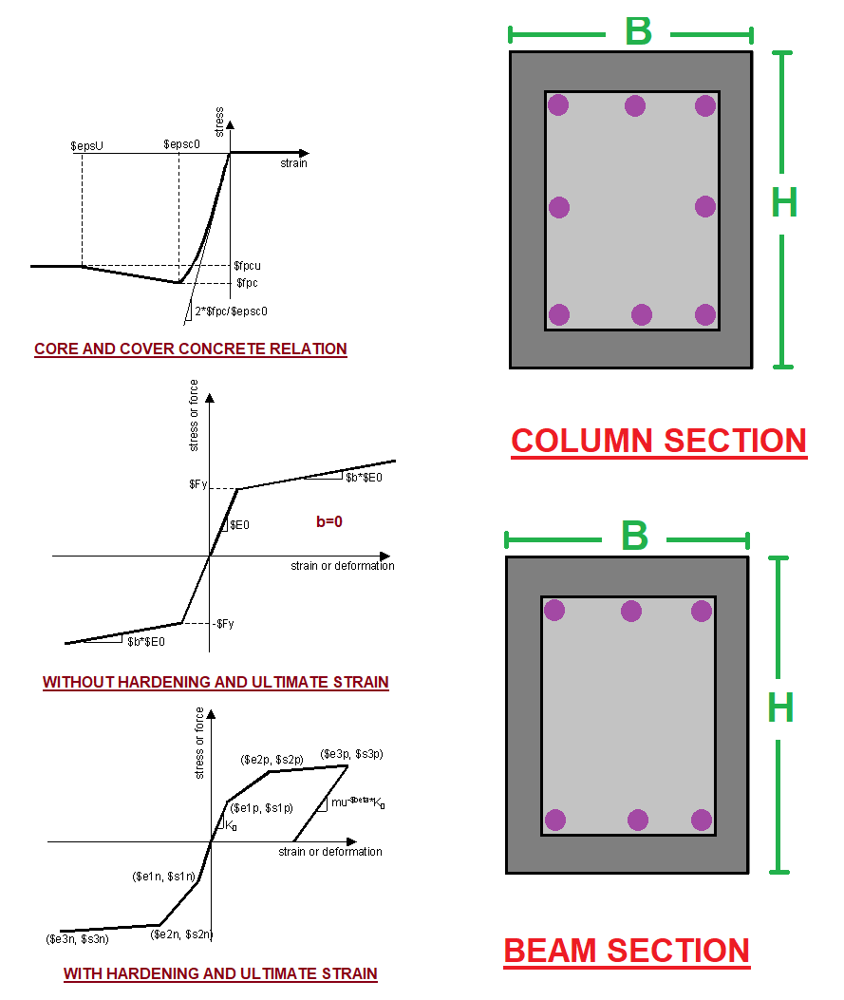

Slide 4
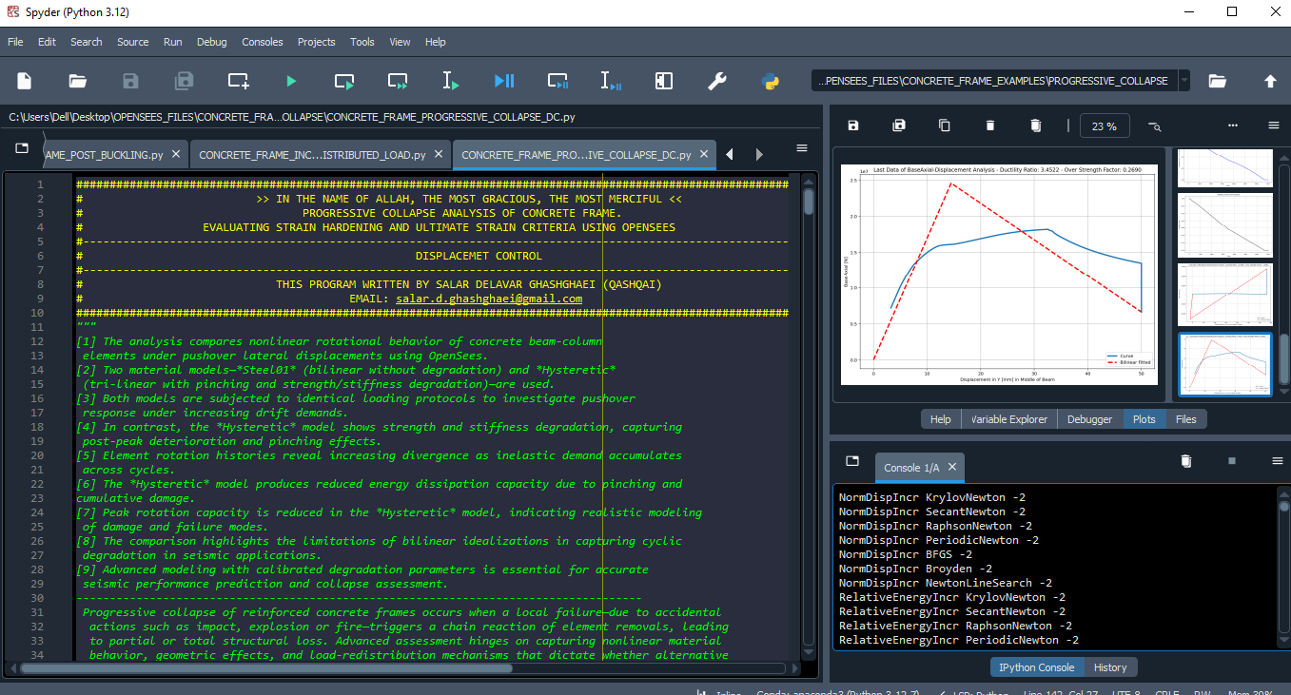

Slide 5
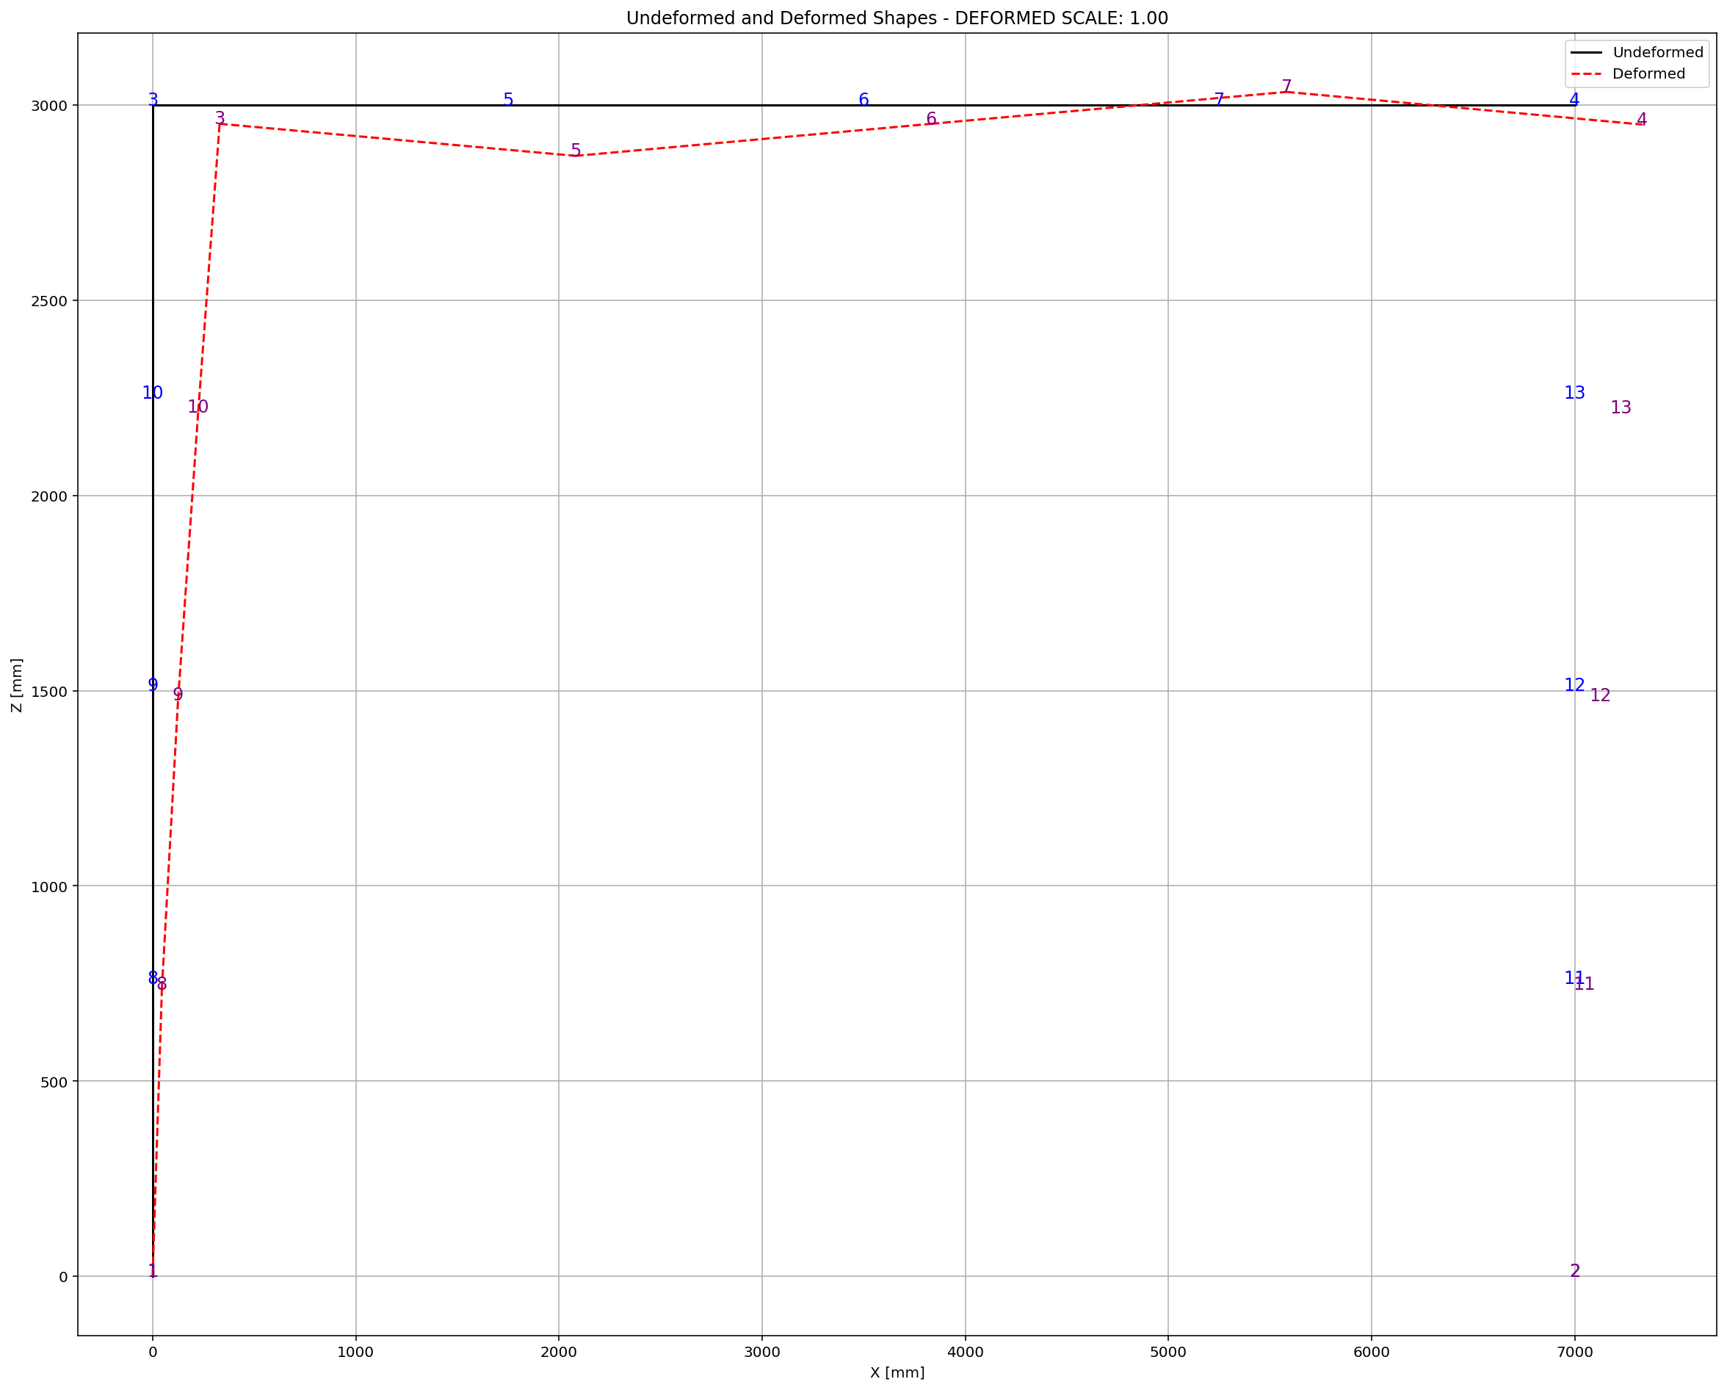

Slide 6
DISPLACEMENT CONTROL

Slide 7
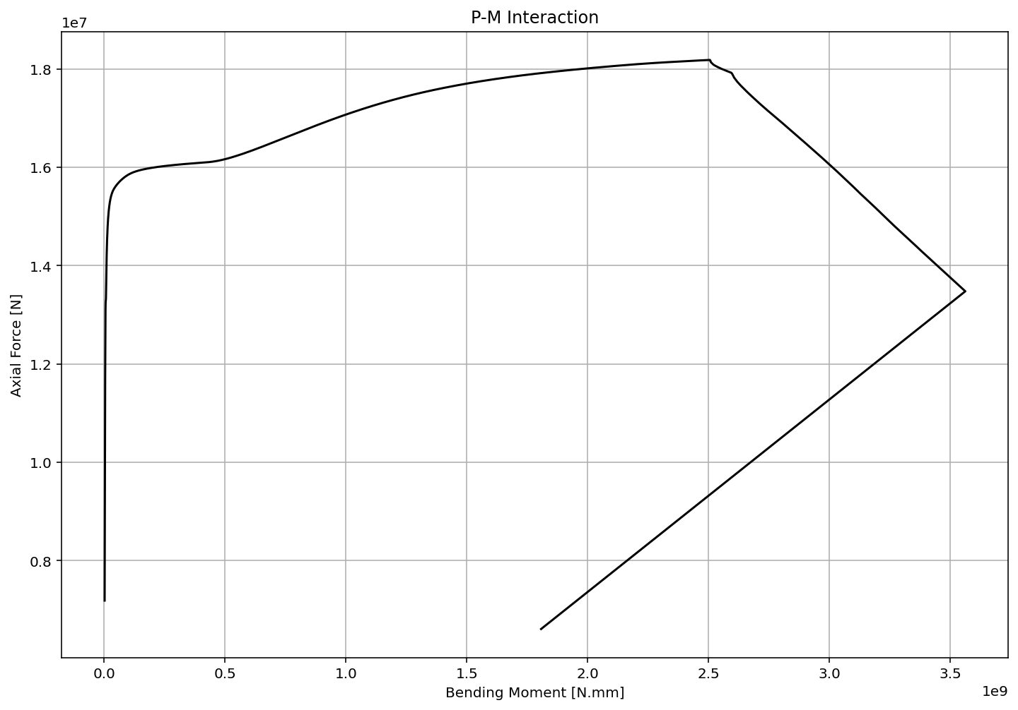

Slide 8
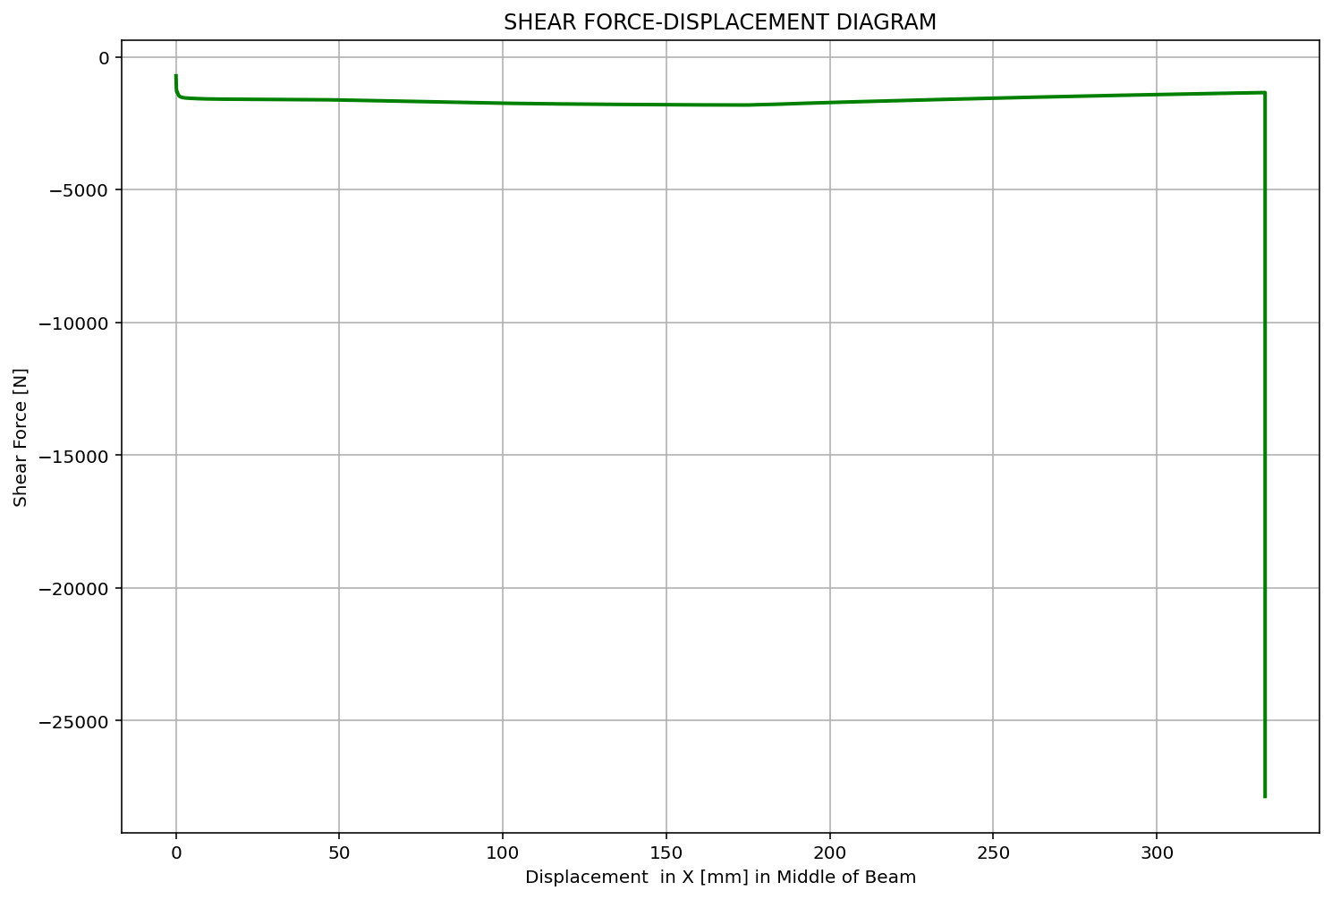

Slide 9
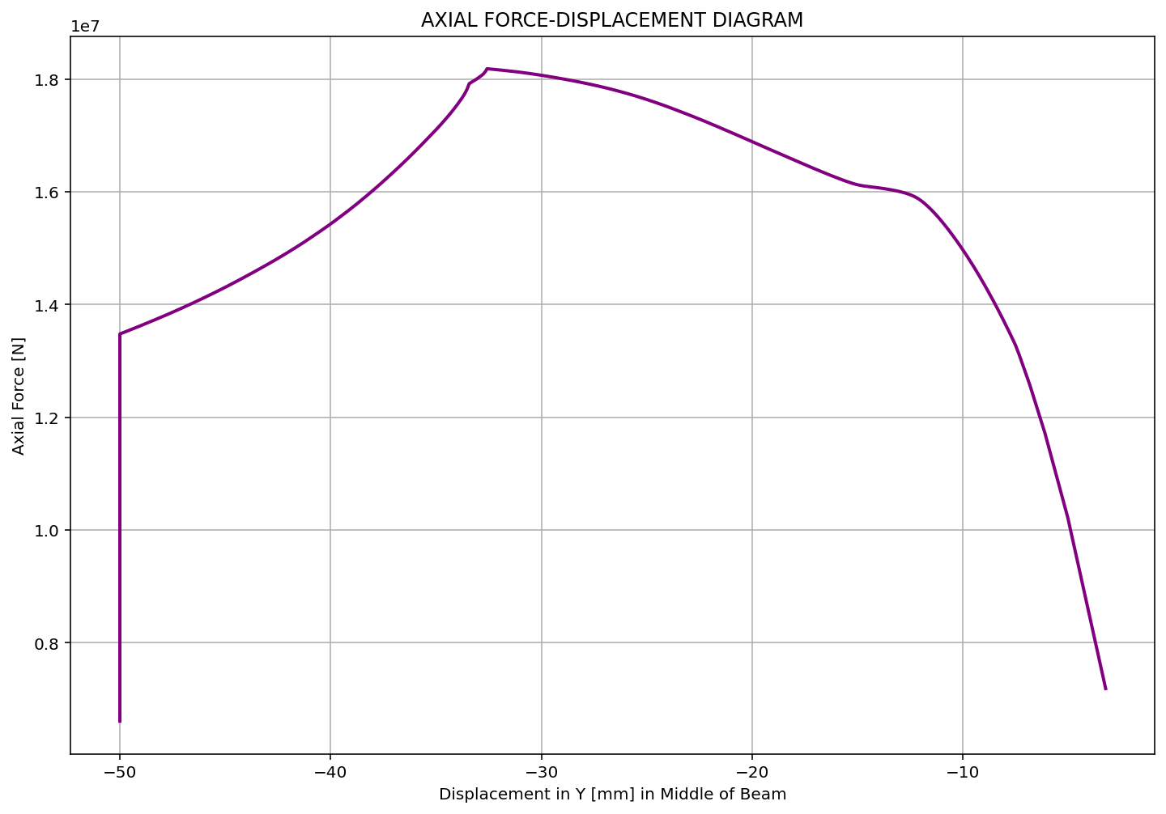

Slide 10
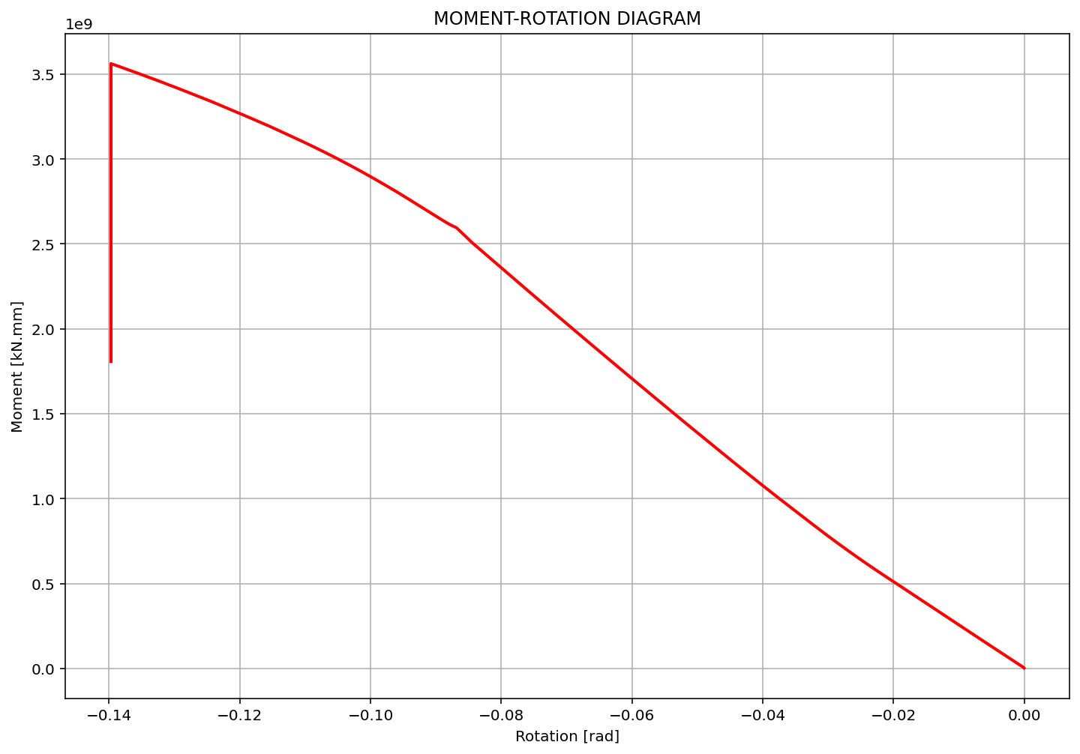

Slide 11
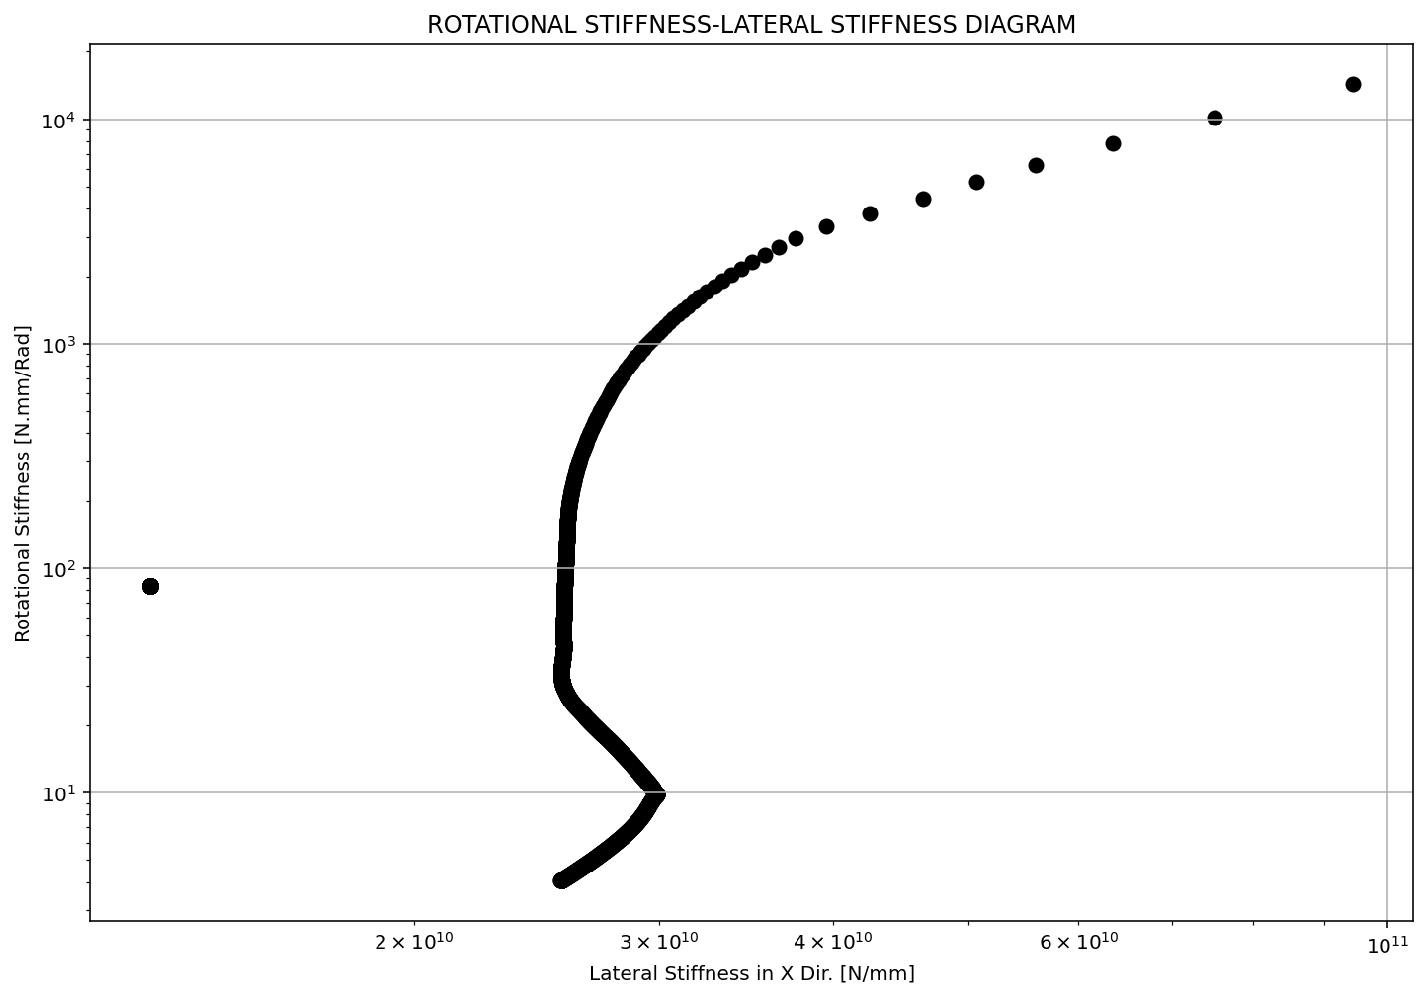

Slide 12
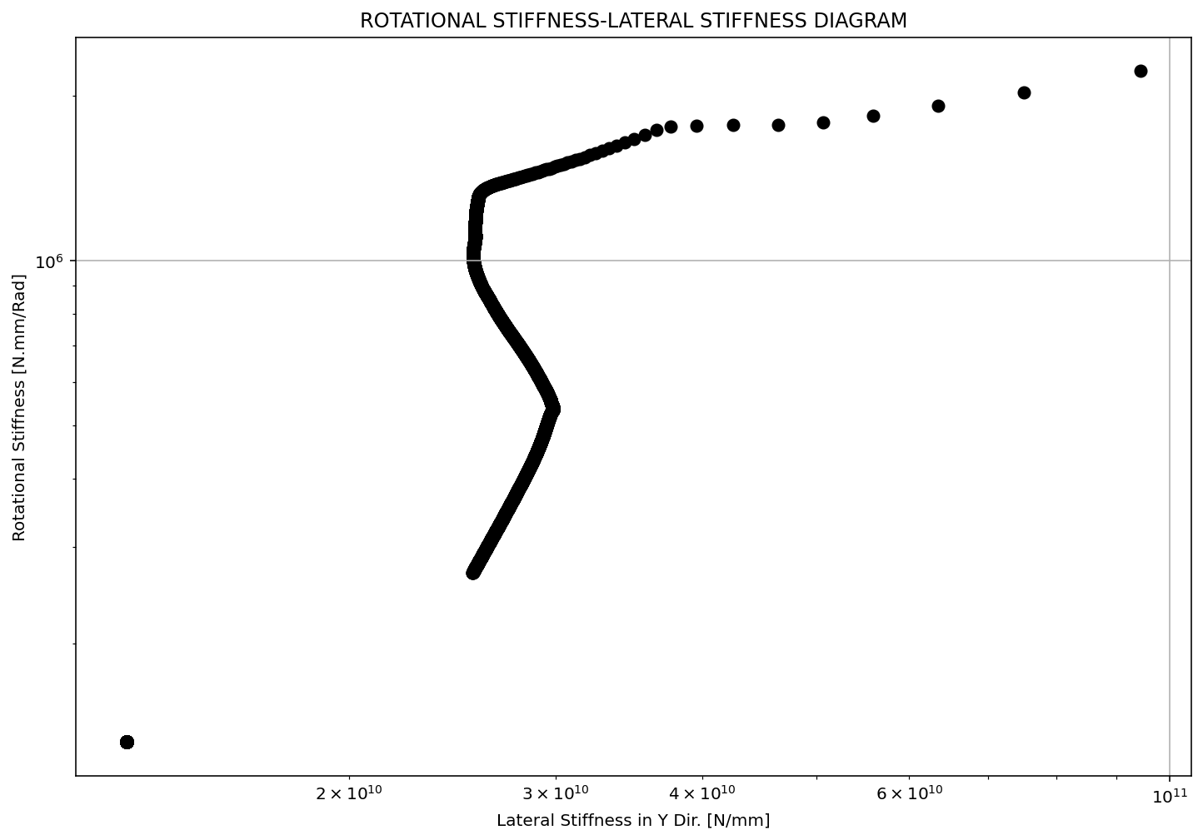

Slide 13
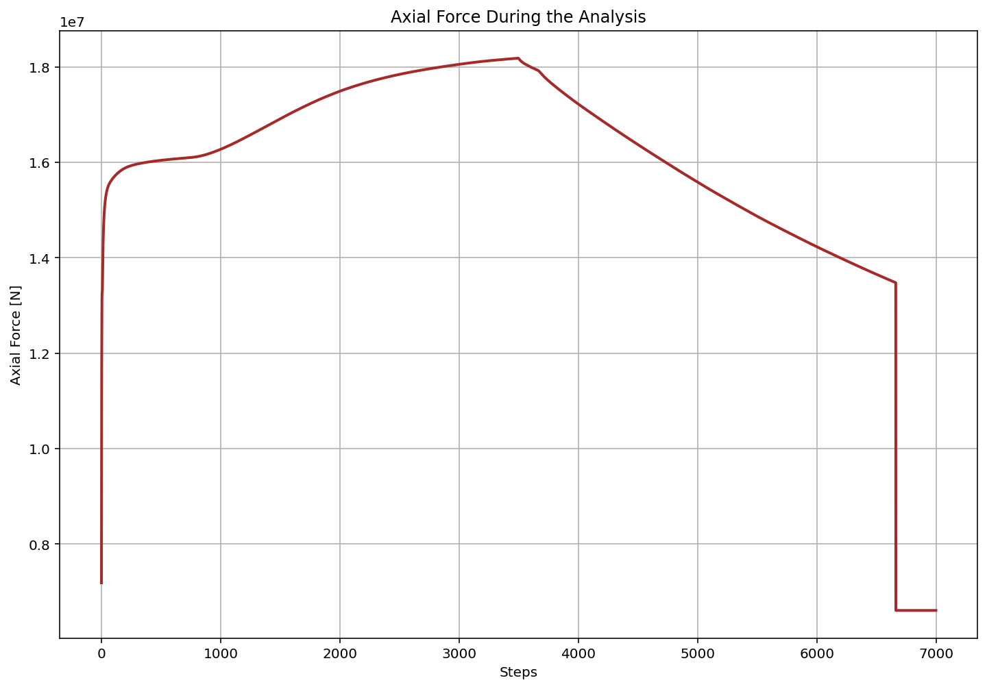

Slide 14
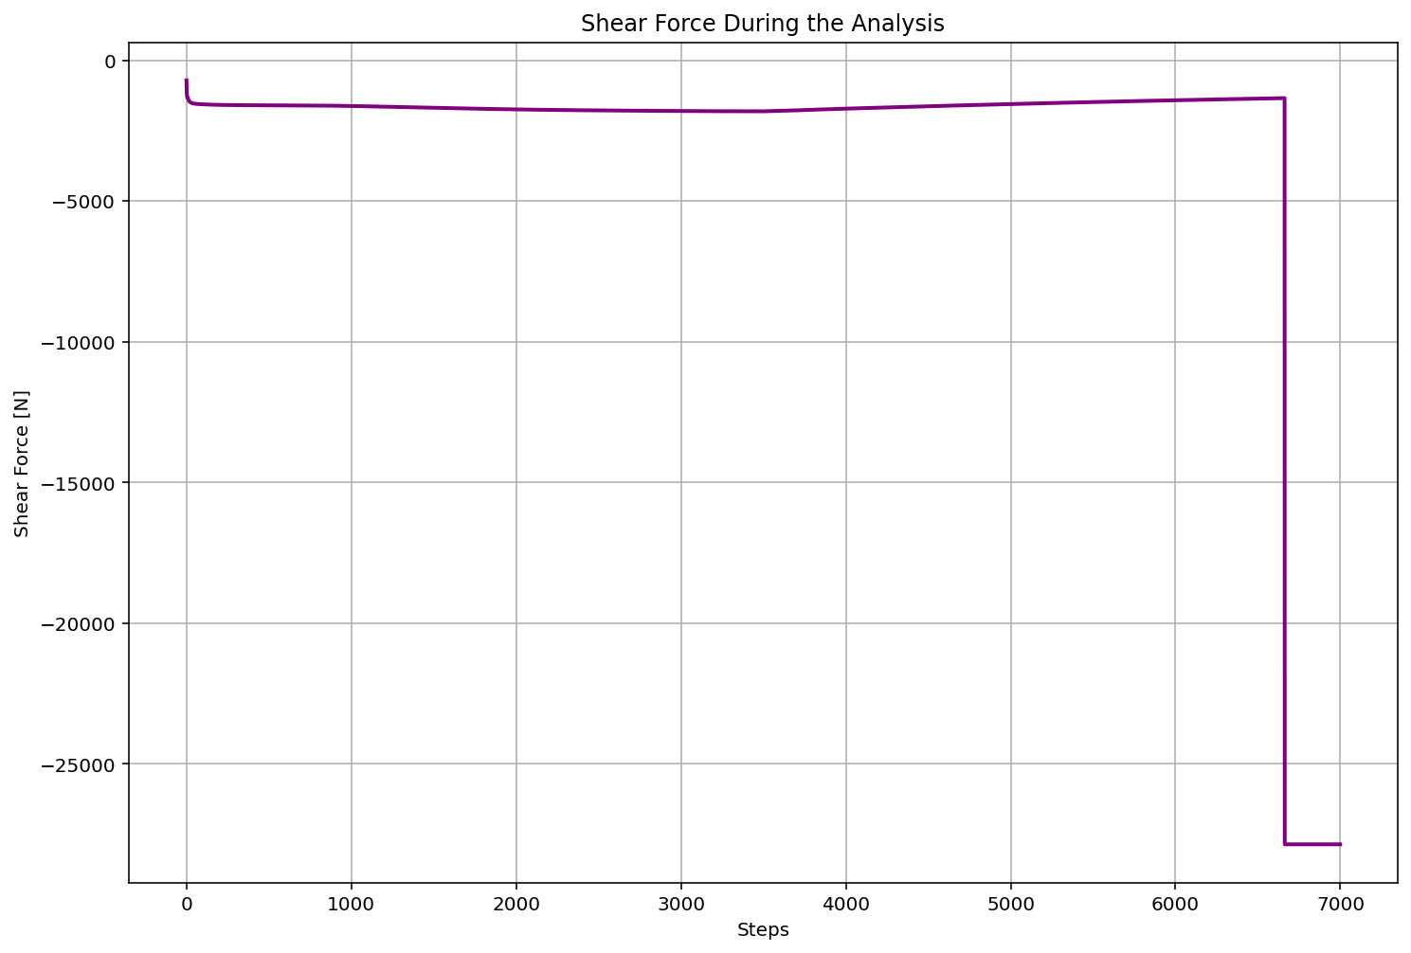

Slide 15
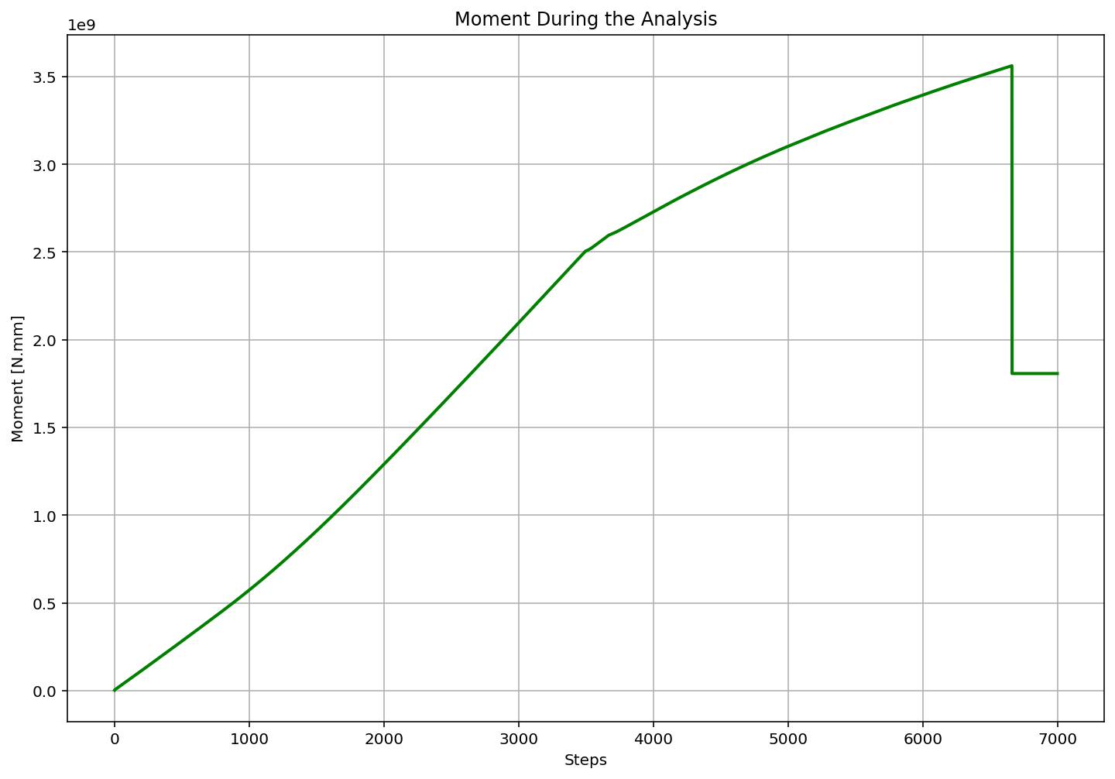

Slide 16
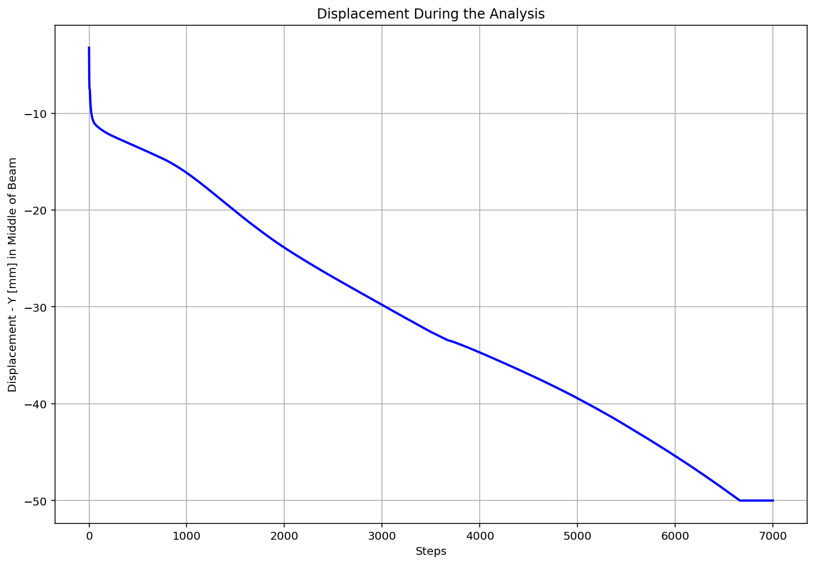

Slide 17
