Slide 1
>> IN THE NAME OF ALLAH, THE MOST GRACIOUS, THE MOST MERCIFUL <<
SOIL-FOUNDATION-STRUCTURE INTERACTION USING OPENSEES
SOIL-FOUNDATION INTERACTIONS SIMULATED WITH SIMPLE SPRINGS.
SOIL SPRINGS VALUES ARE NOT EXACT.
WRITTEN BY SALAR DELAVAR GHASHGHAEI (QASHQAI)

Slide 2
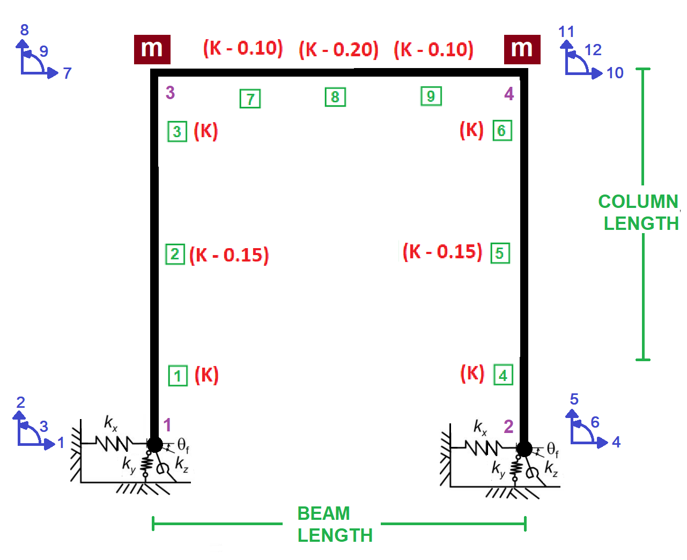

Slide 3
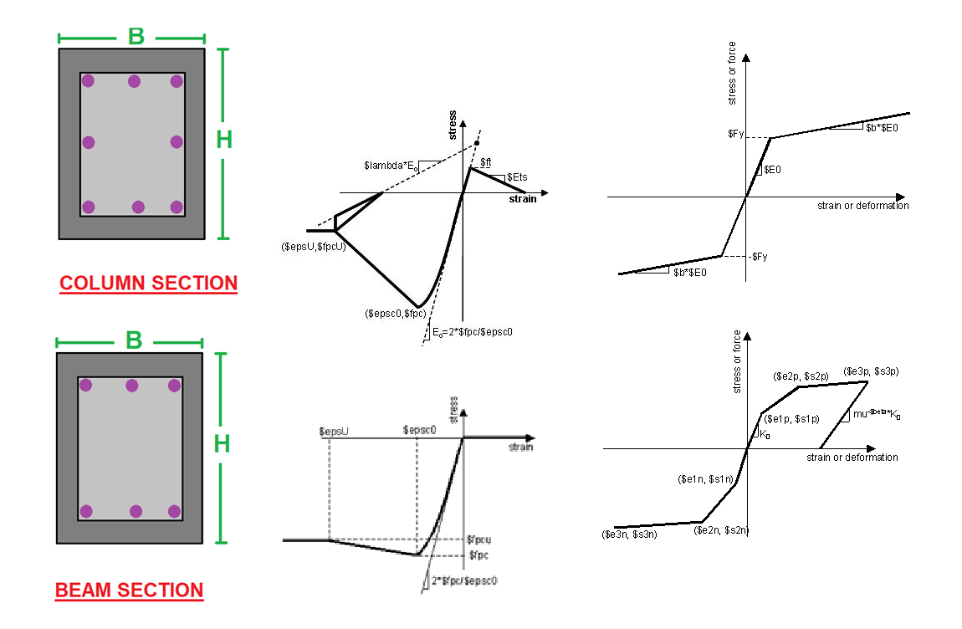

Slide 4
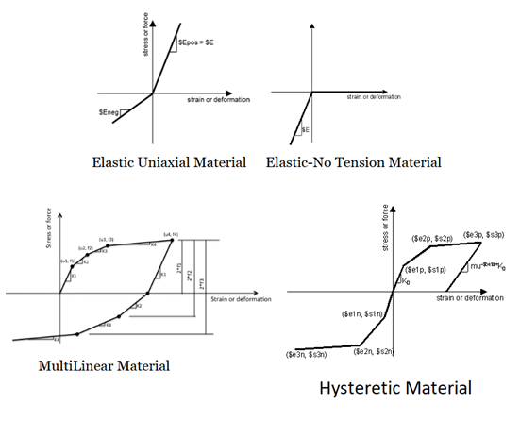

Slide 5
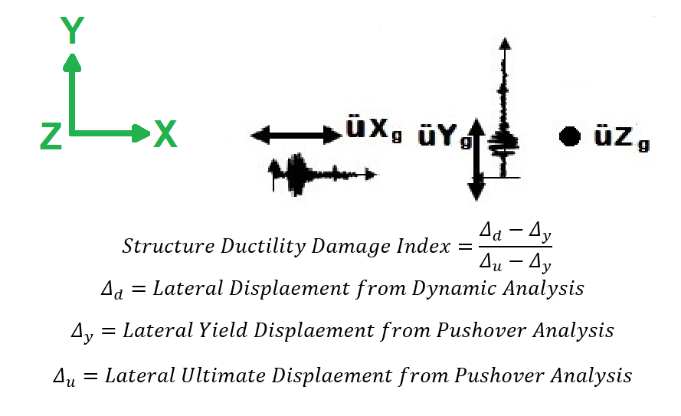

Slide 6
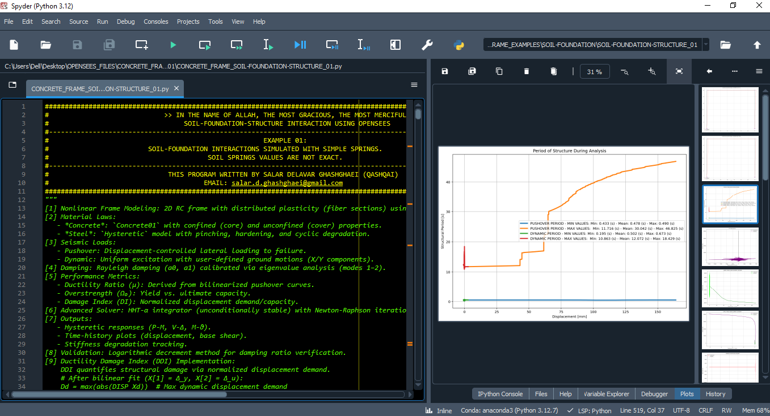

Slide 7
NONLINEAR STATIC ANALYSIS
(PUSHOVER)

Slide 8
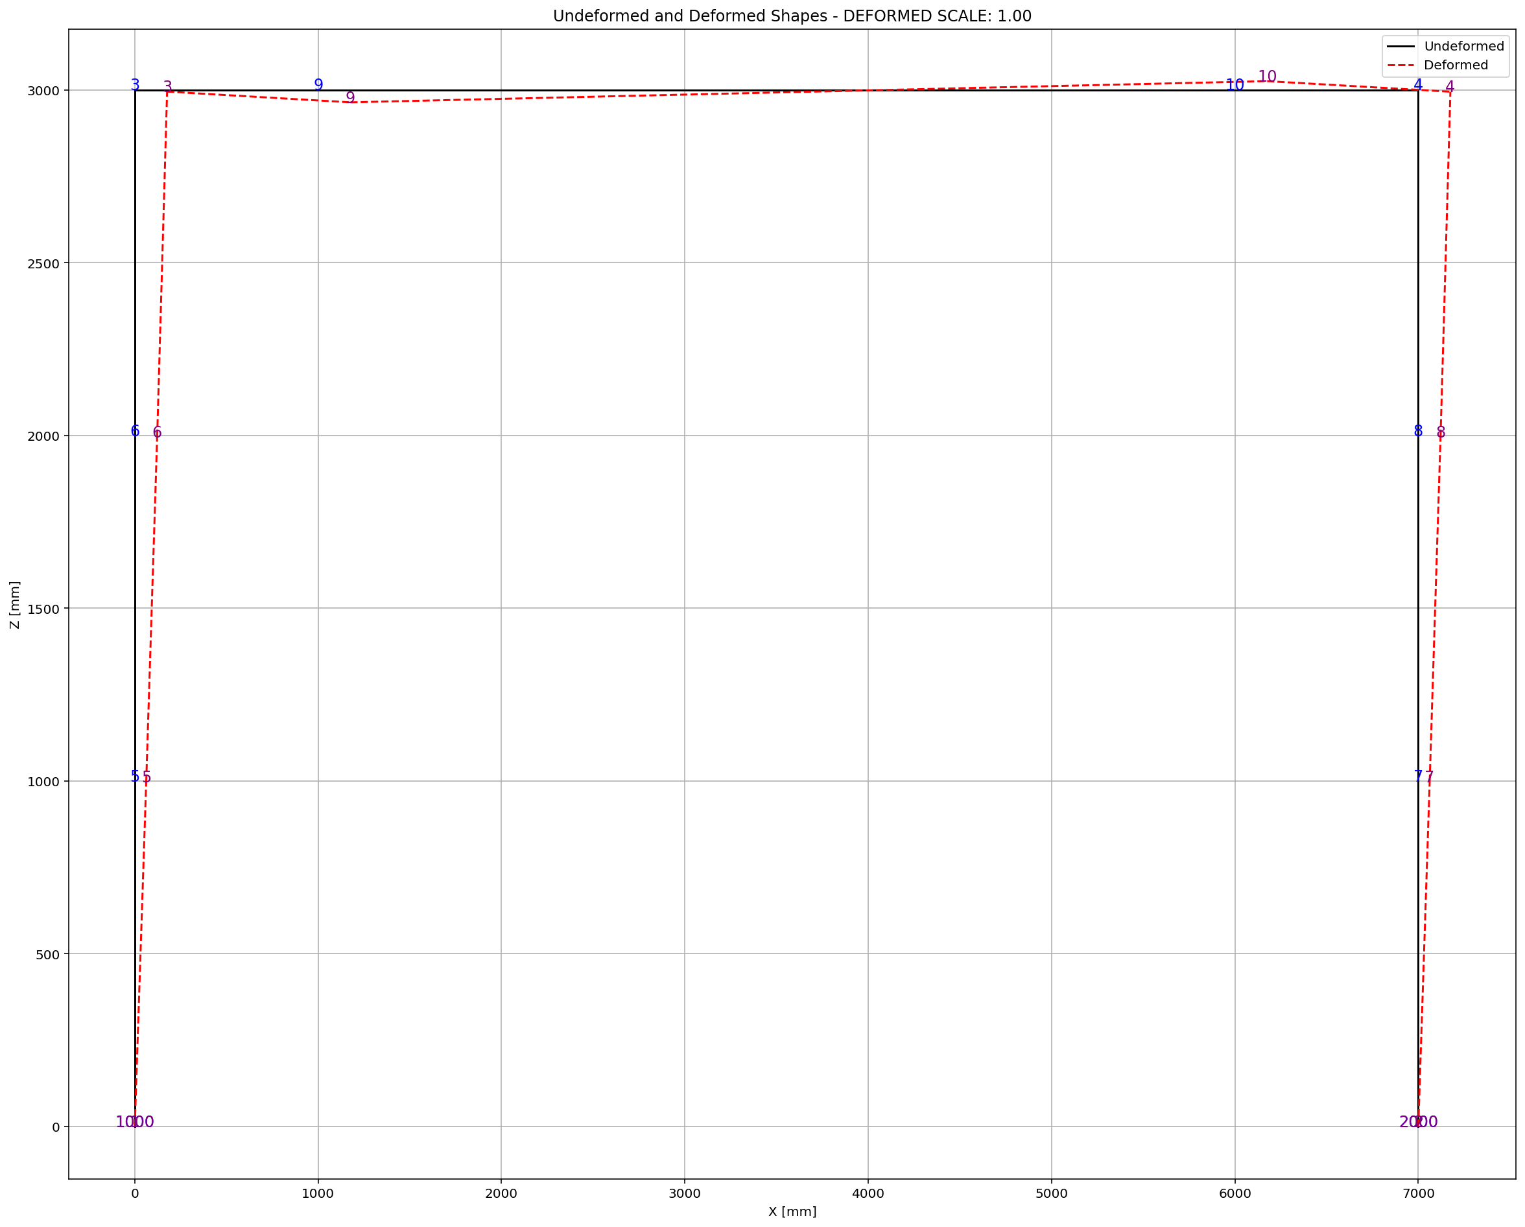

Slide 9
NONLINEAR DYNAMIC ANALYSIS

Slide 10
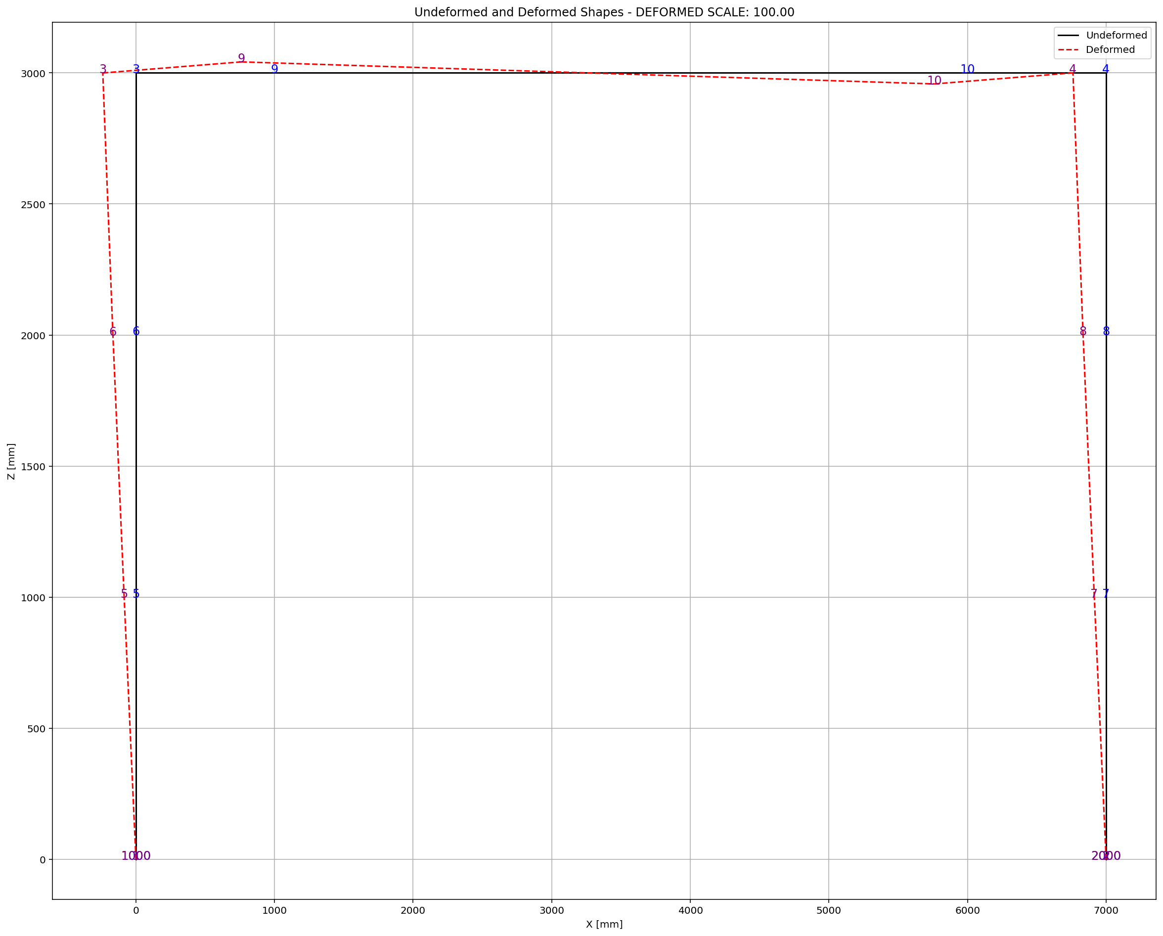

Slide 11
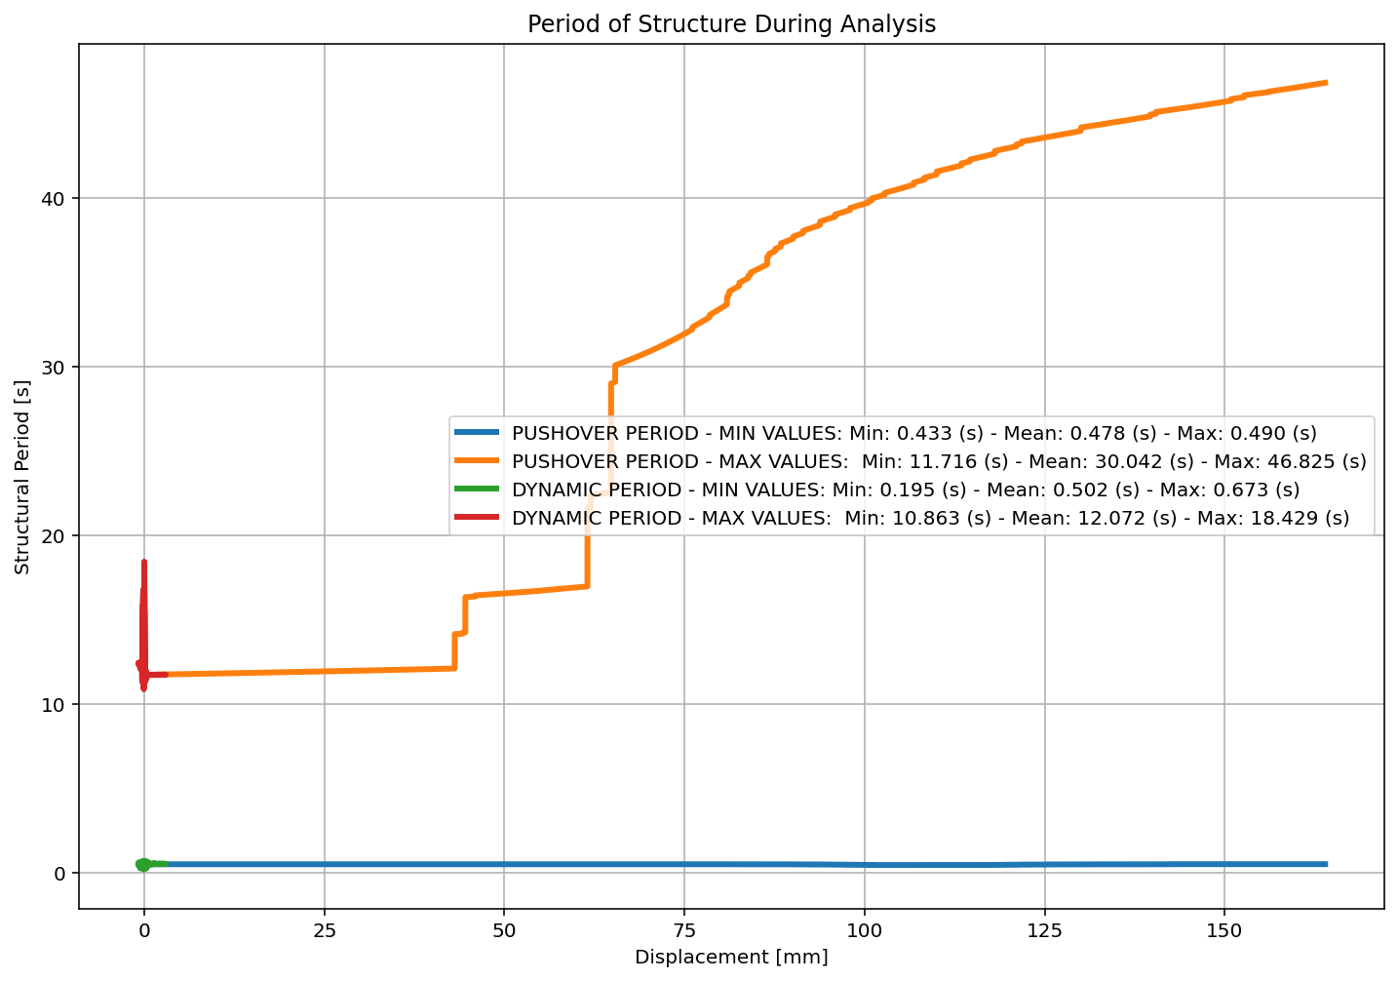

Slide 12
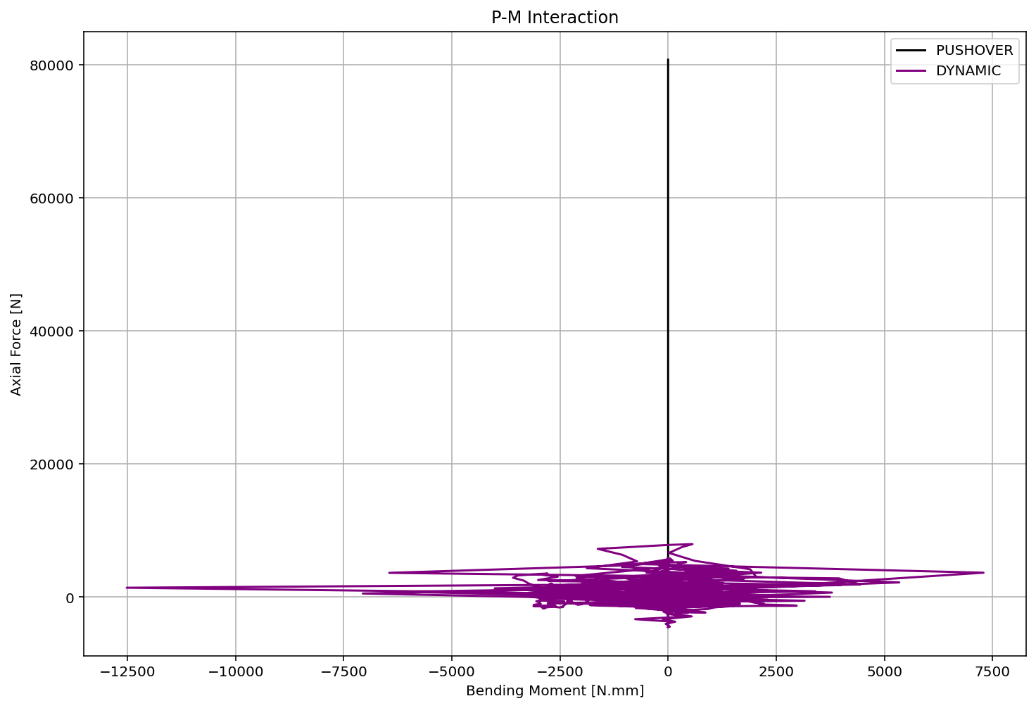

Slide 13
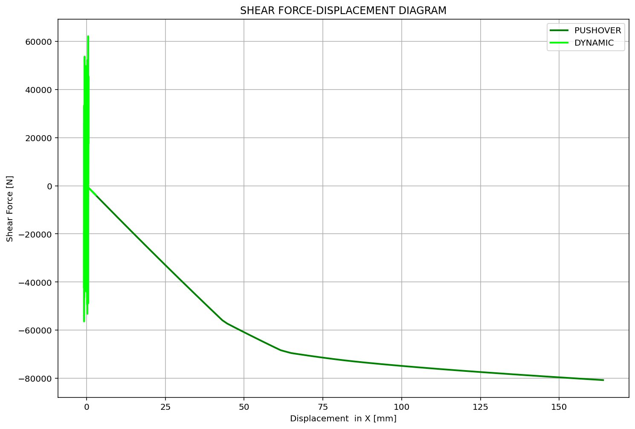

Slide 14
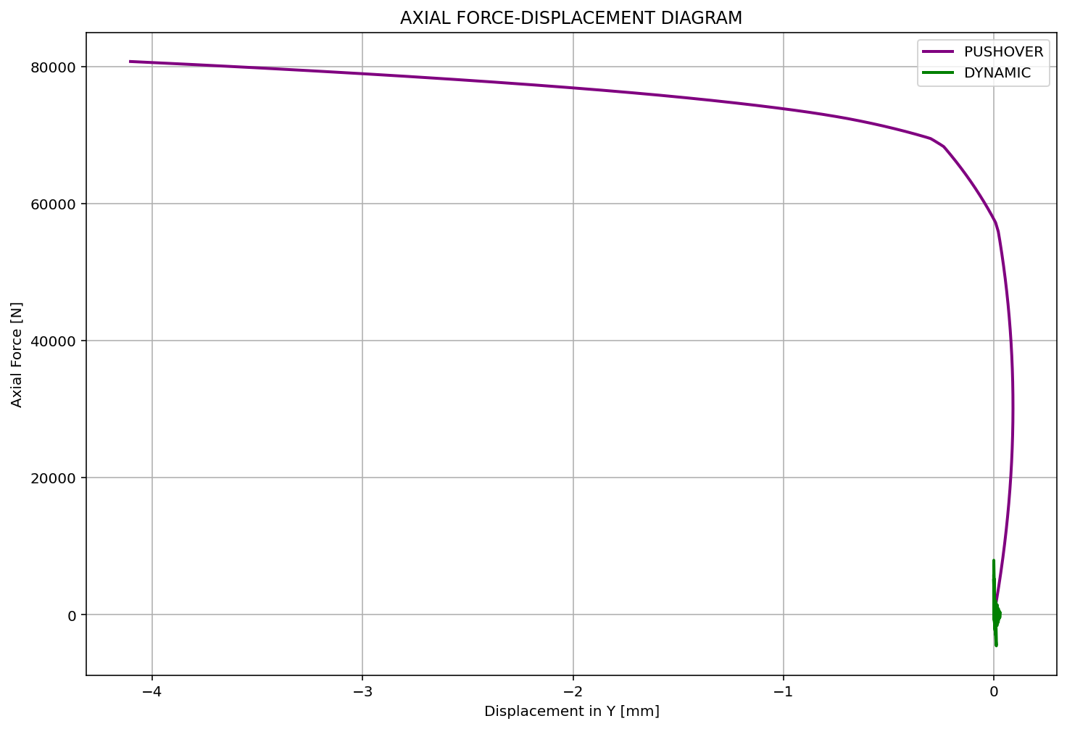

Slide 15
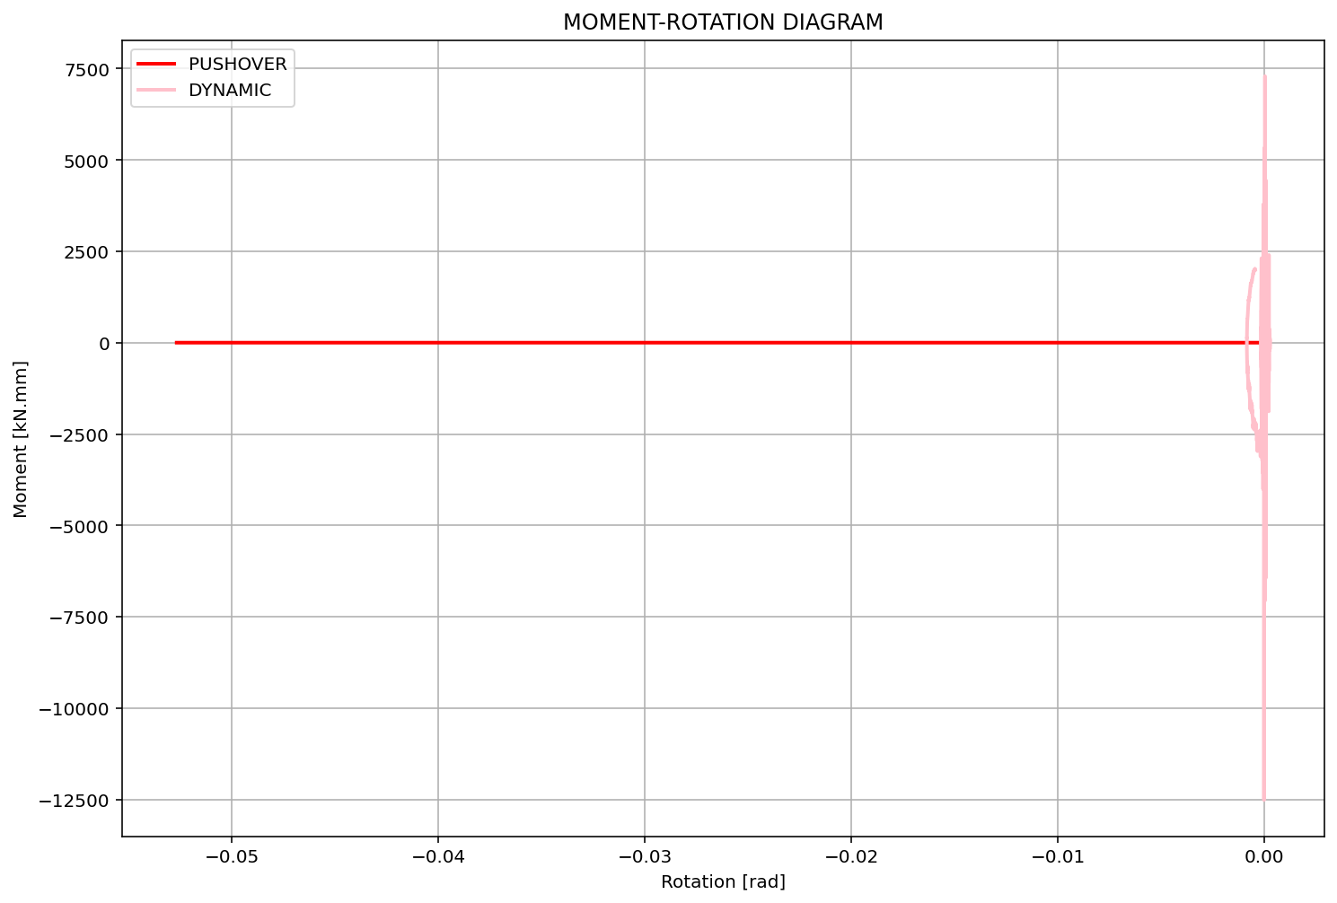

Slide 16
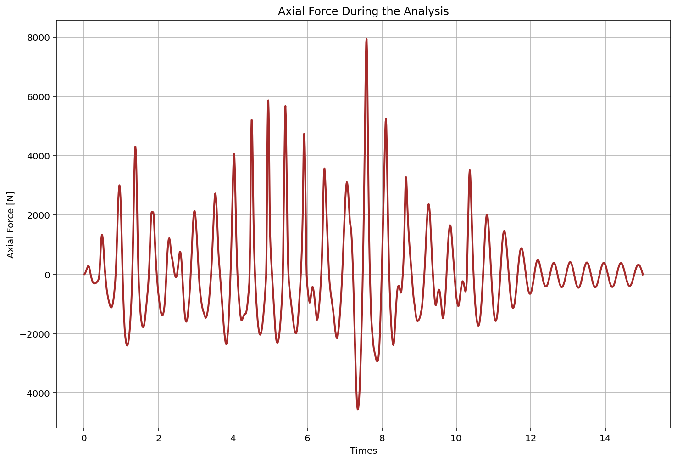

Slide 17
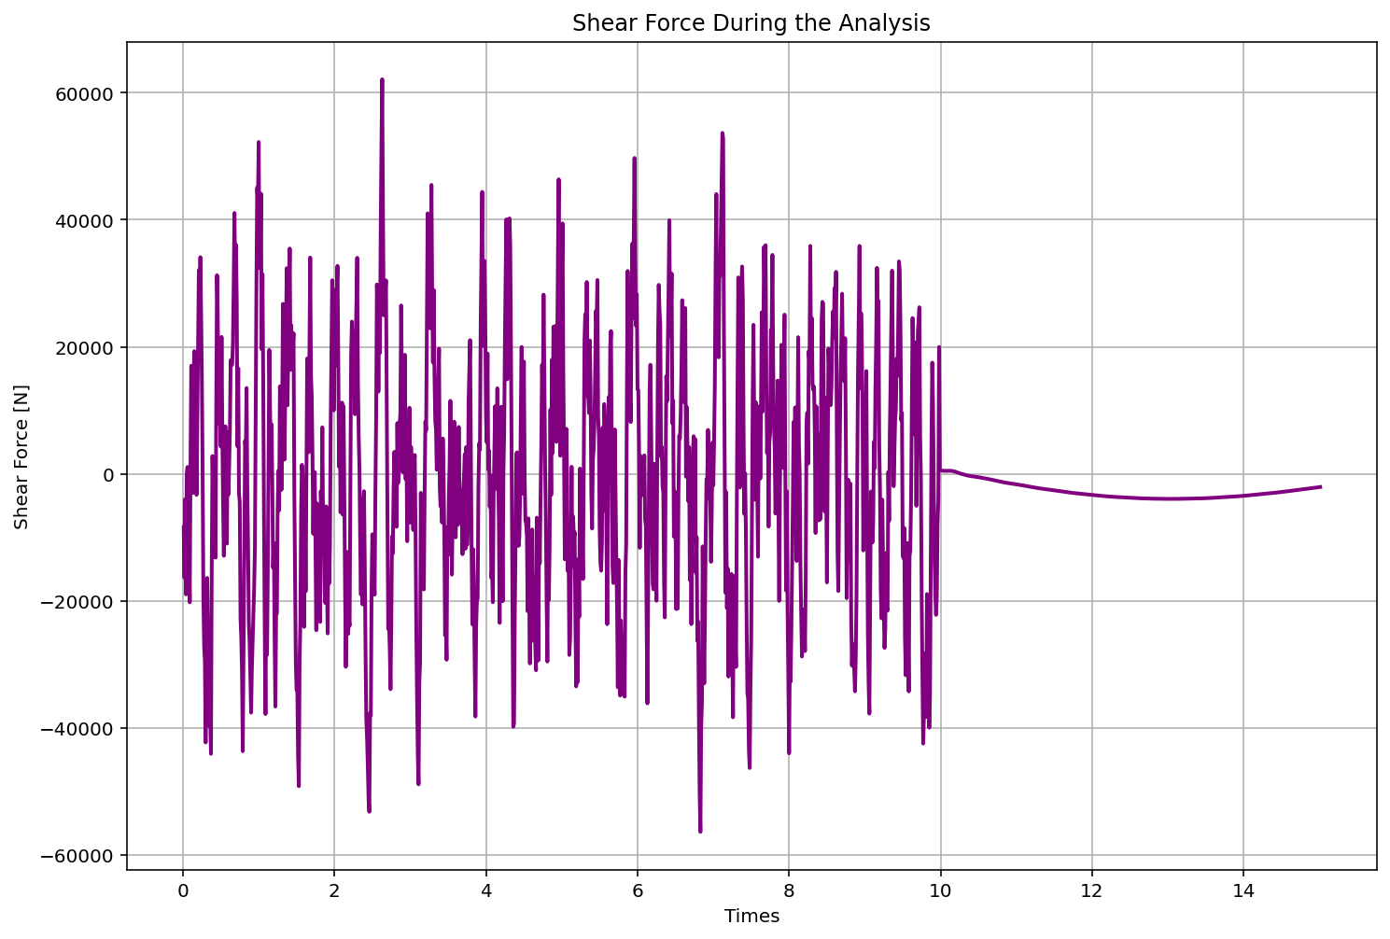

Slide 18
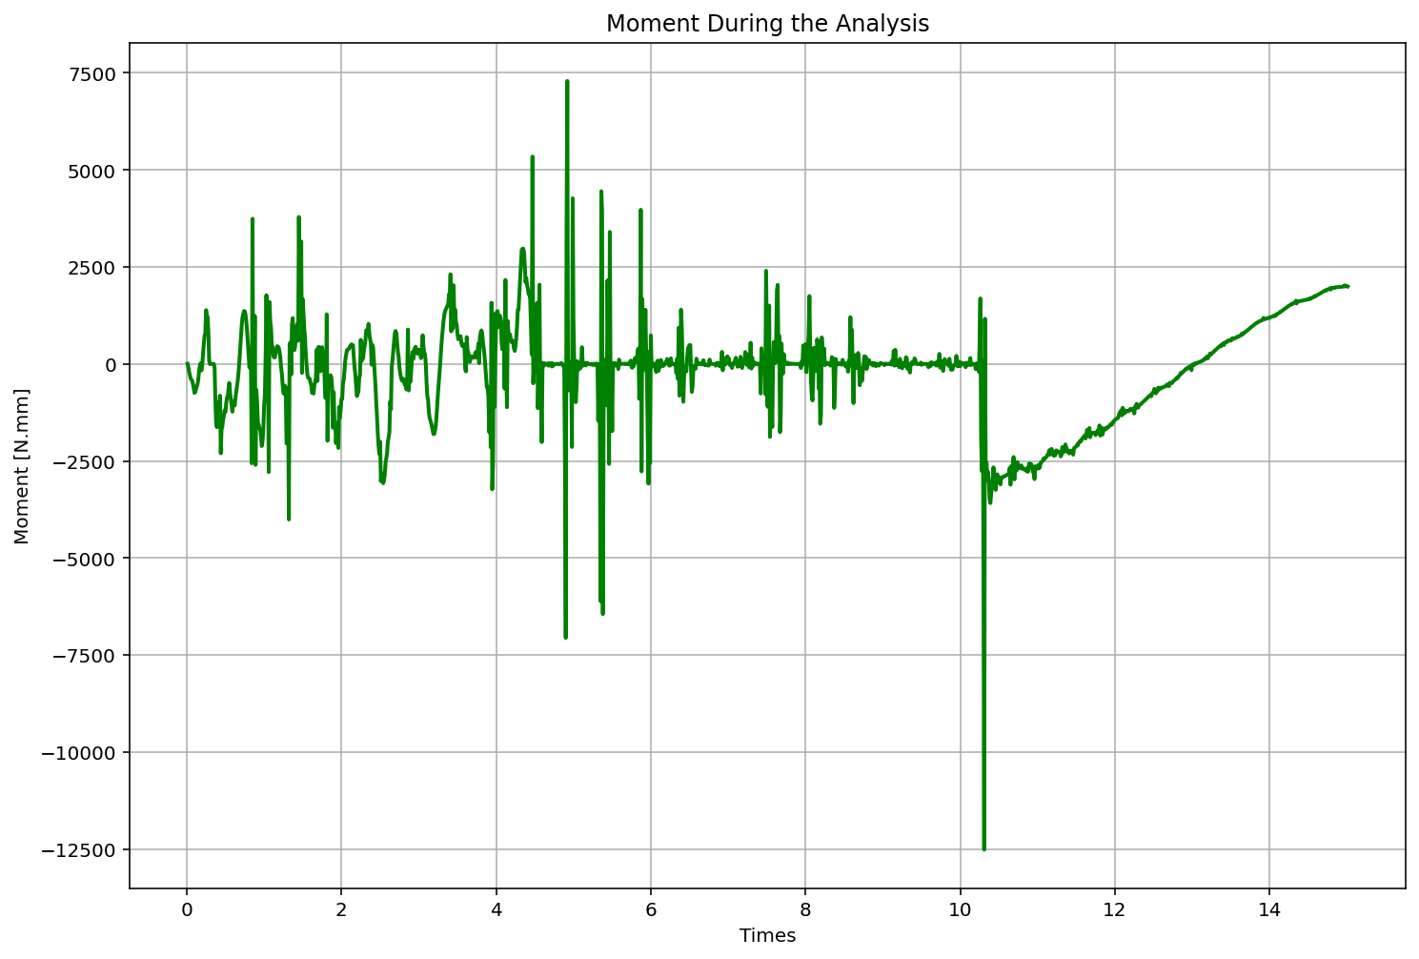

Slide 19
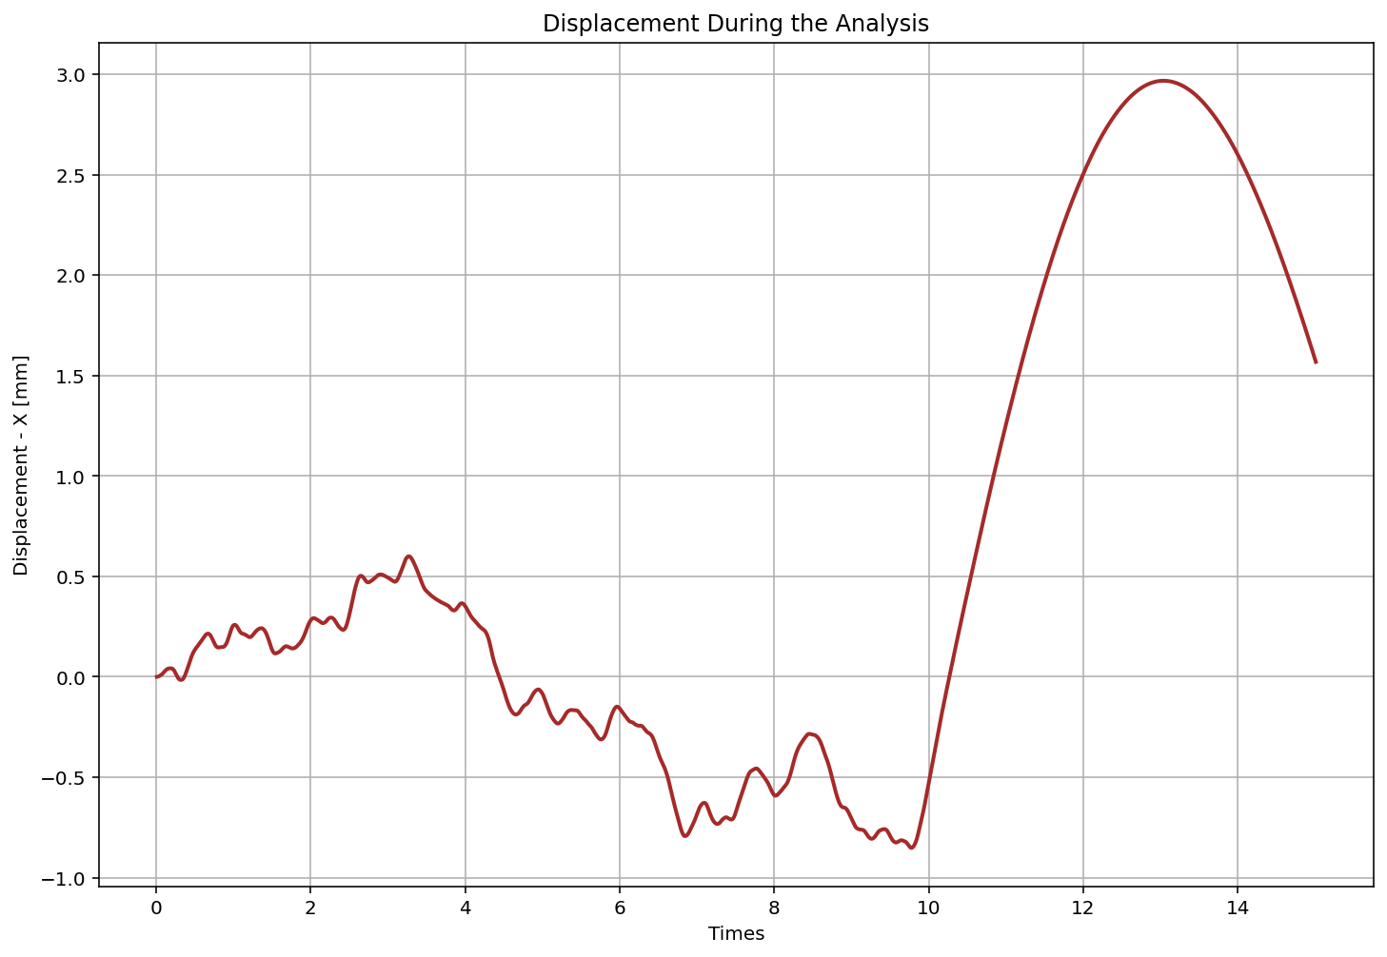

Slide 20
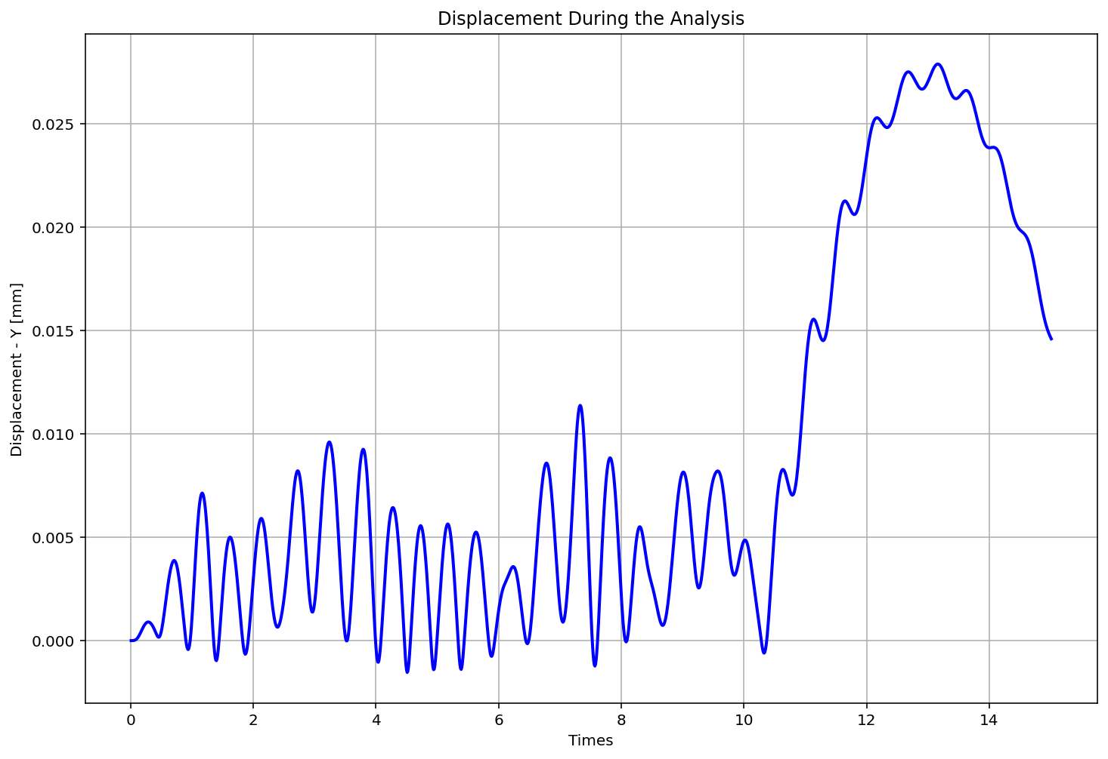

Slide 21
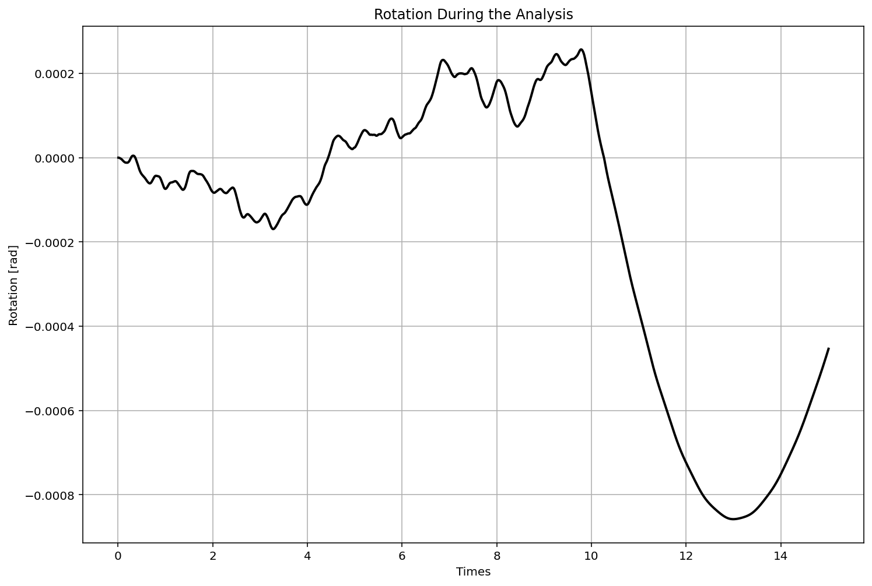

Slide 22
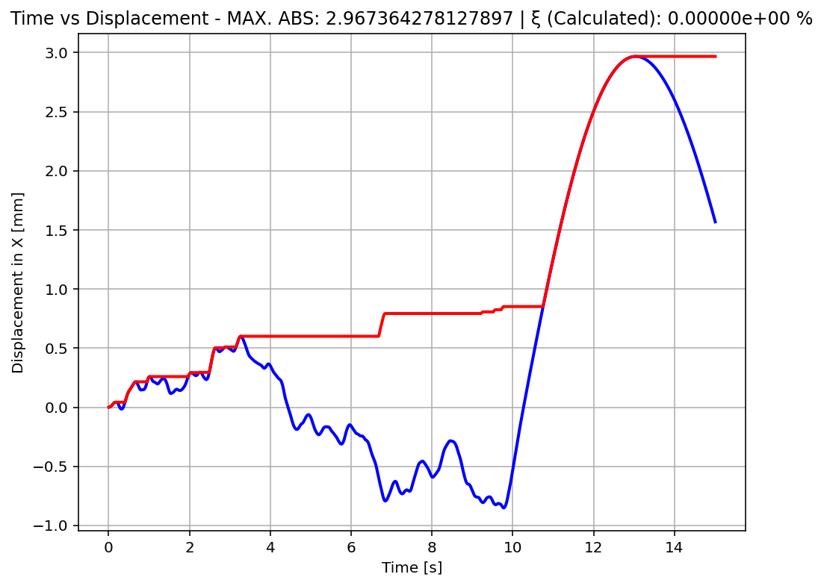

Slide 23
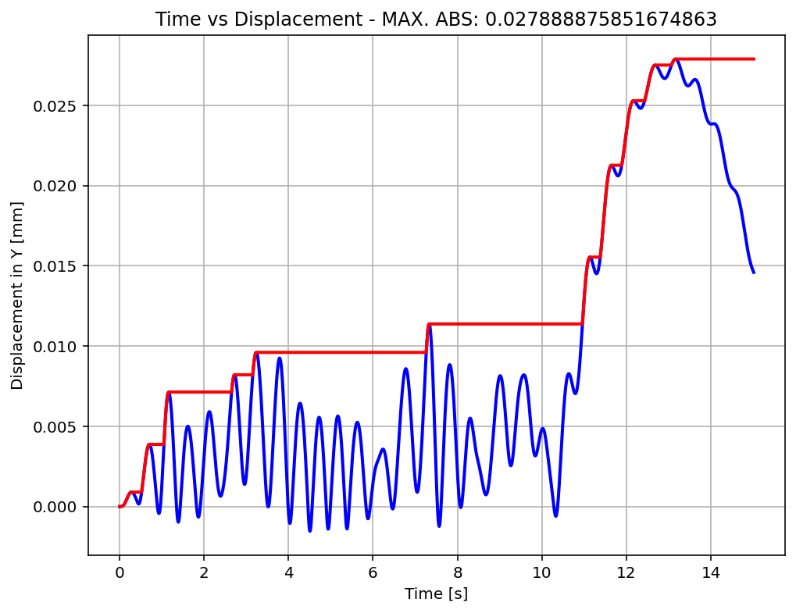

Slide 24
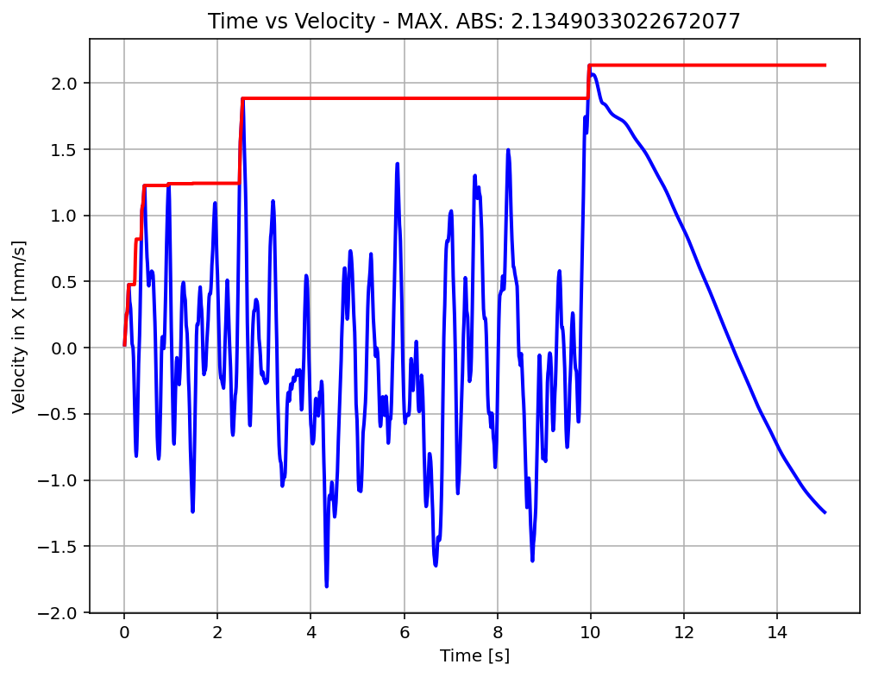

Slide 25
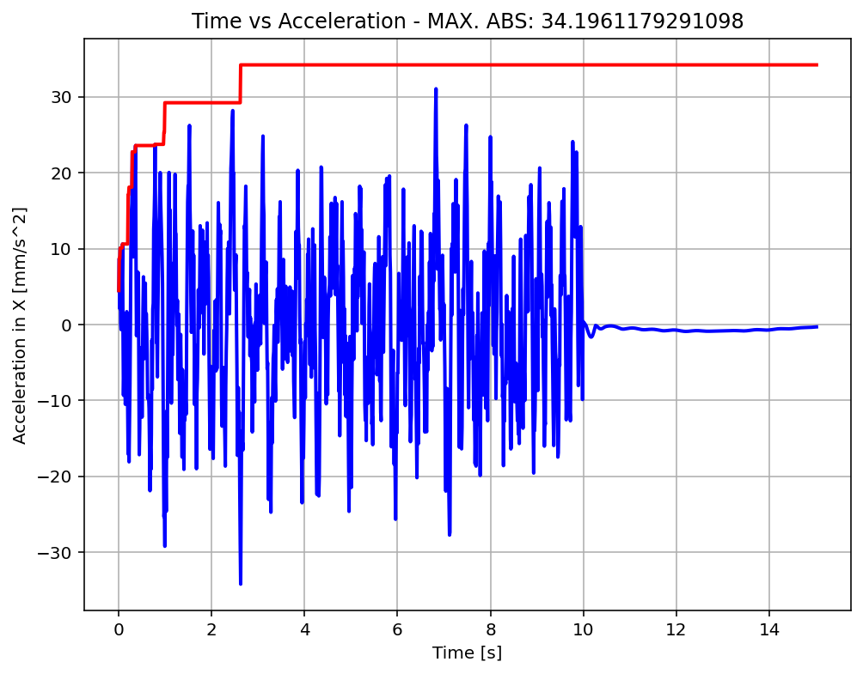

Slide 26
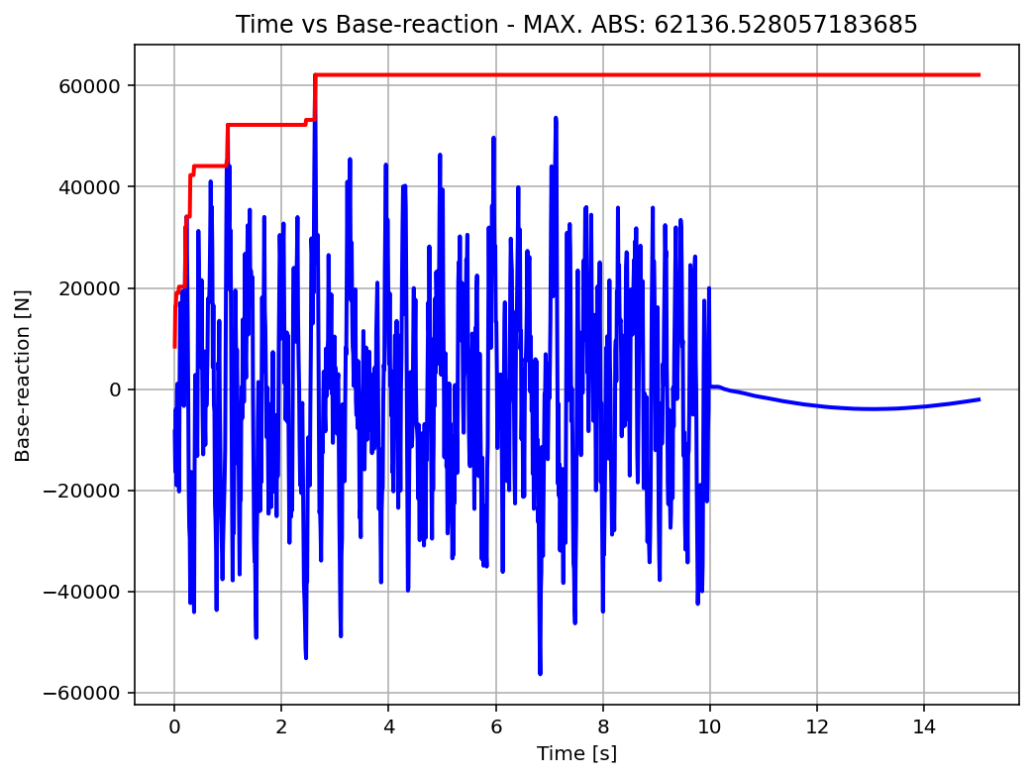

Slide 27
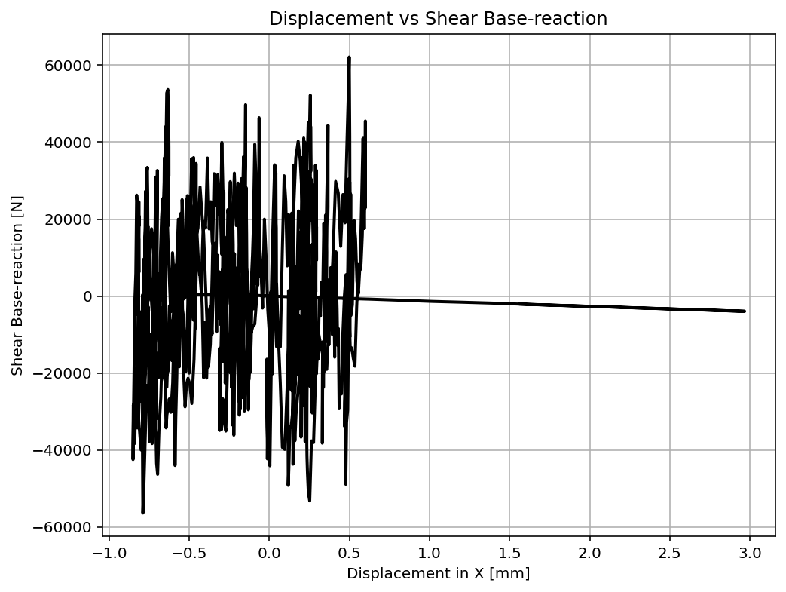

Slide 28
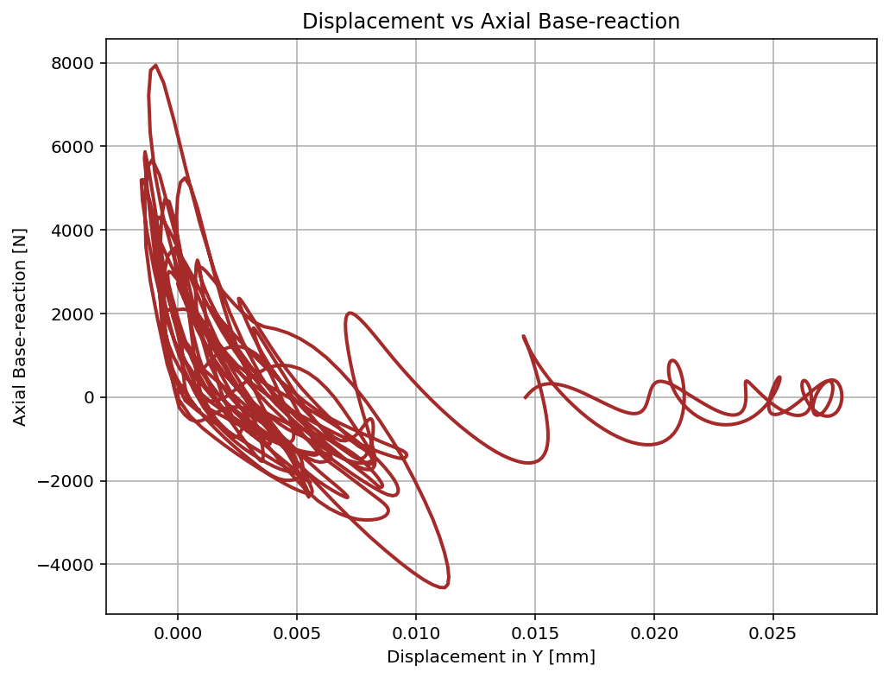

Slide 29
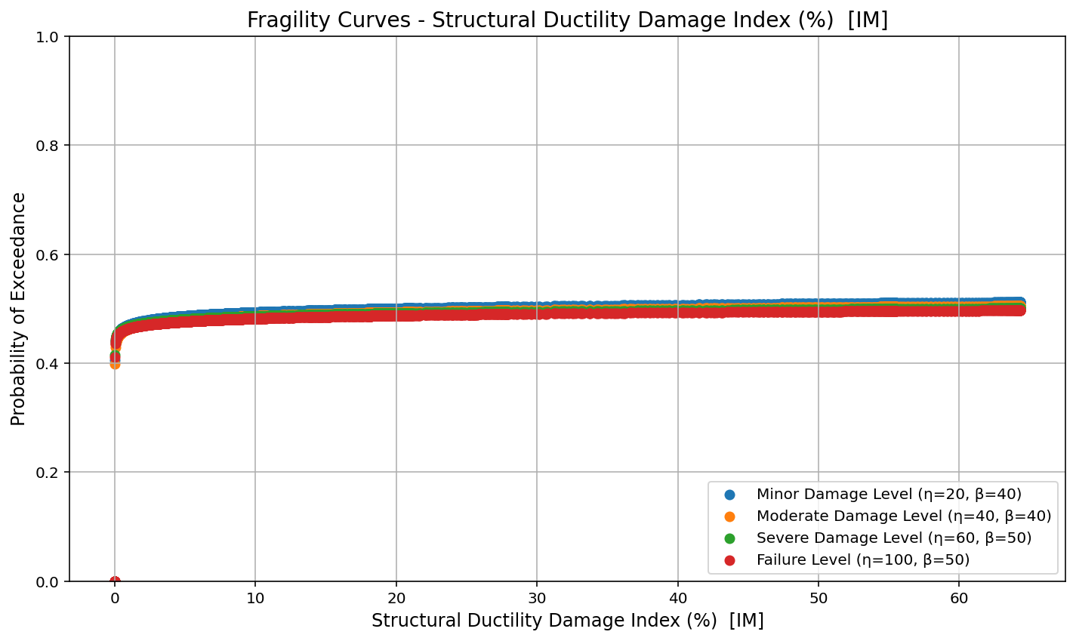

Slide 30
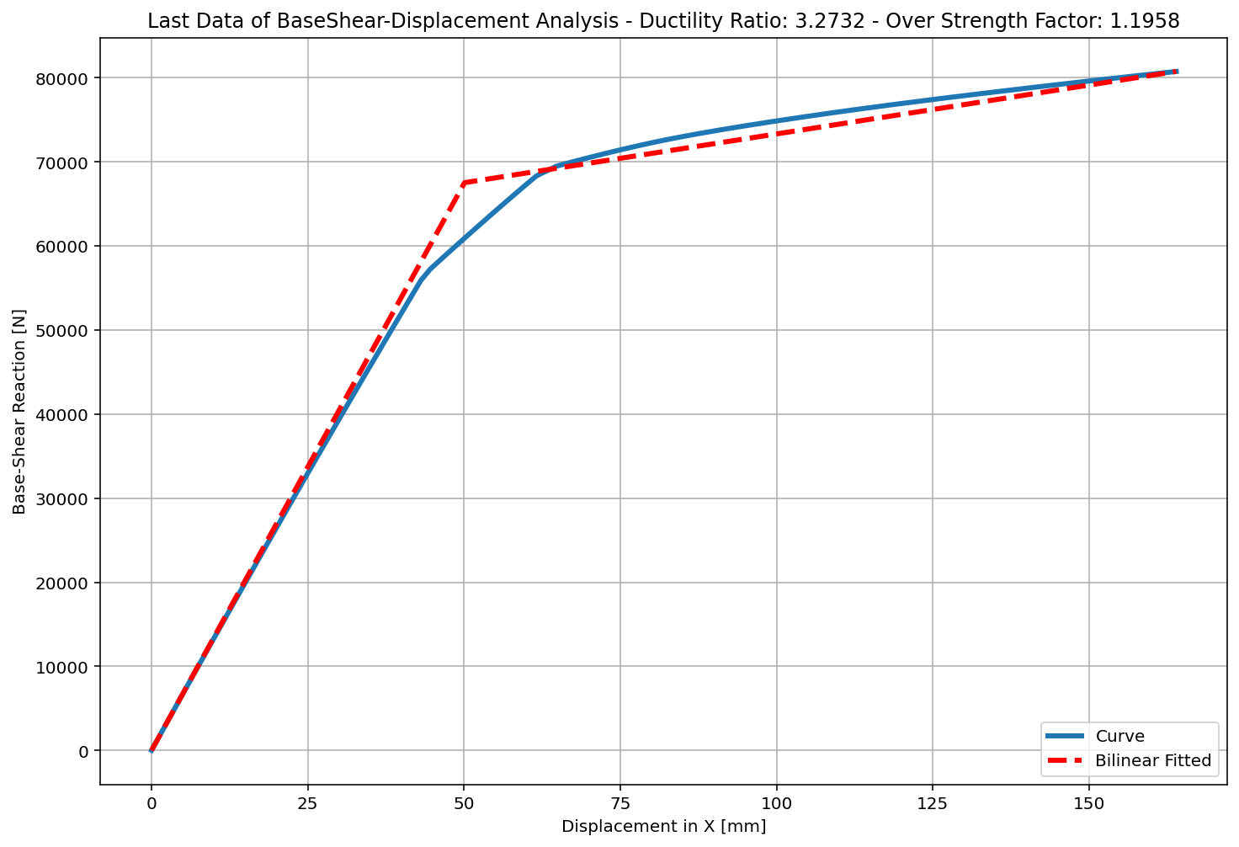
+==========================+
= Analysis curve fitted =
Disp Base Shear
----------------------------
[[0.00000000e+00 0.00000000e+00]
[5.00872349e+01 6.75315109e+04]
[1.63947529e+02 8.07560680e+04]]
+==========================+
+----------------------------------------------------+
Structure Elastic Stiffness : 1348.28
Structure Plastic Stiffness : 492.57
Structure Tangent Stiffness : 116.15
Structure Ductility Ratio : 3.27
Structure Over Strength Factor: 1.20
+----------------------------------------------------+
Over Strength Coefficient (Ω0): 1.1958
Displacement Ductility Ratio (μ): 3.2732
Ductility Coefficient (Rμ): 3.2732
Structural Behavior Coefficient (R): 3.9142
Structural Ductility Damage Index in X Direction: 2.1662 [%]

Slide 31
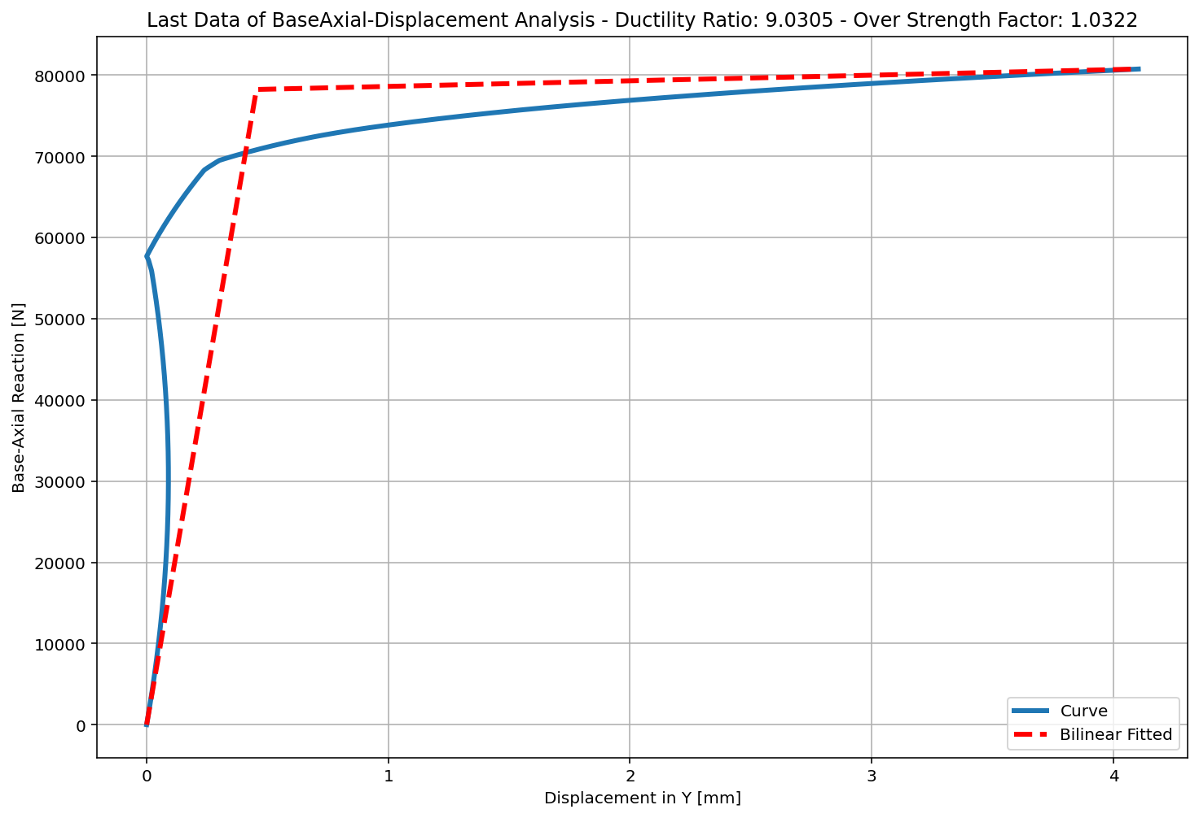
+==========================+
= Analysis curve fitted =
Disp Base Shear
----------------------------
[[0.00000000e+00 0.00000000e+00]
[4.54335712e-01 7.82383364e+04]
[4.10288891e+00 8.07560680e+04]]
+==========================+
+----------------------------------------------------+
Structure Elastic Stiffness : 172203.80
Structure Plastic Stiffness : 19682.73
Structure Tangent Stiffness : 690.06
Structure Ductility Ratio : 9.03
Structure Over Strength Factor: 1.03
+----------------------------------------------------+
Over Strength Coefficient (Ω0): 1.0322
Displacement Ductility Ratio (μ): 9.0305
Ductility Coefficient (Rμ): 9.0305
Structural Behavior Coefficient (R): 9.3211
Structural Ductility Damage Index in Y Direction: 0.6399 [%]

