Slide 1
IN THE NAME OF ALLAH, THE MOST GRACIOUS, THE MOST MERCIFUL
COMPARATIVE ANALYSIS OF AXIAL FORCE-MOMENT (P-M) INTERACTION BEHAVIOR IN CONFINED REINFORCED CONCRETE CROSS-SECTIONS: EVALUATING STRAIN HARDENING EFFECTS AND ULTIMATE STRAIN CRITERIA
WRITTEN BY SALAR DELAVAR GHASHGHAEI (QASHQAI)

Slide 2
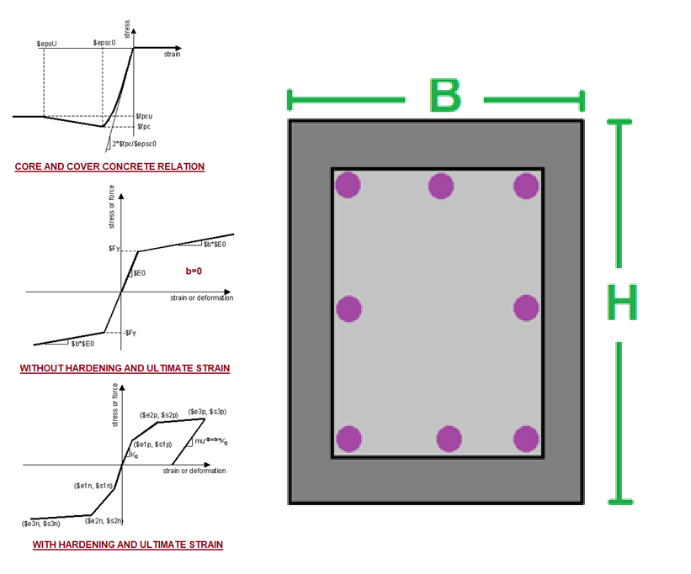

Slide 3
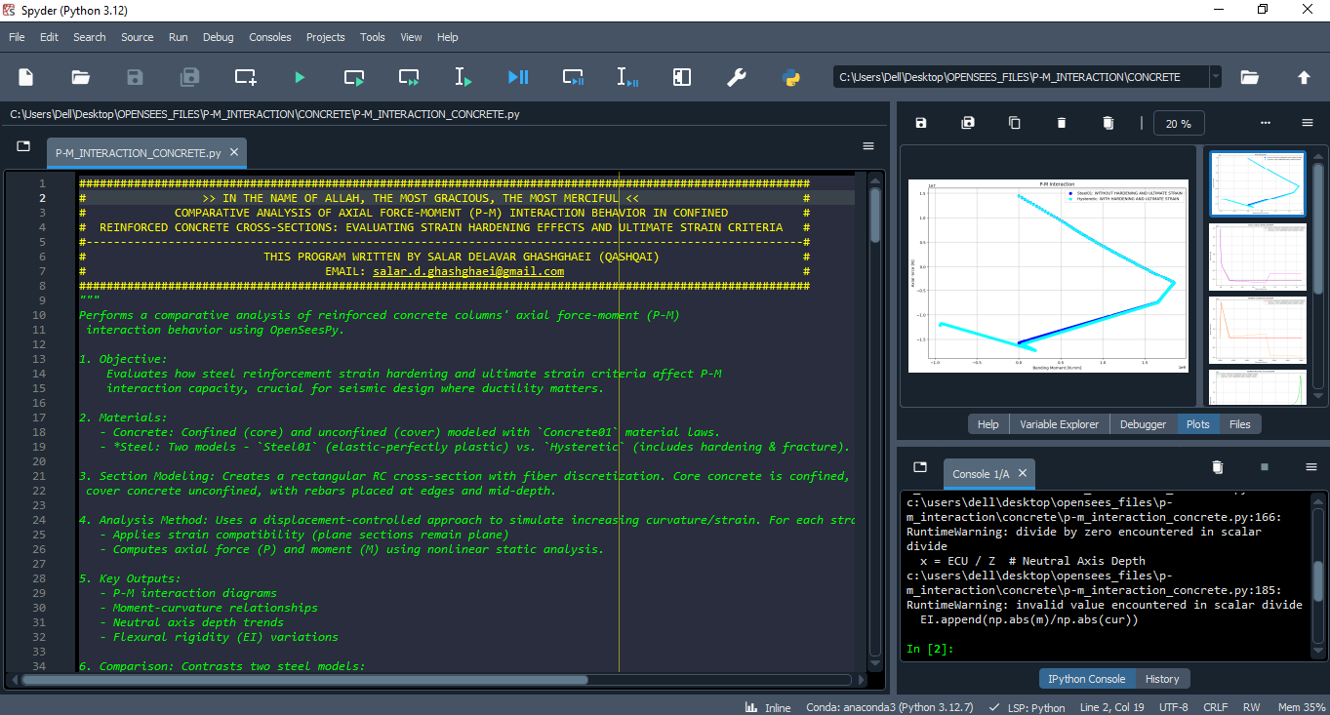

Slide 4
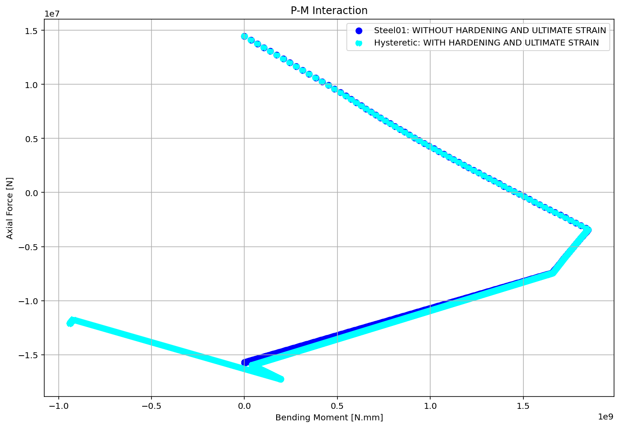

Slide 5
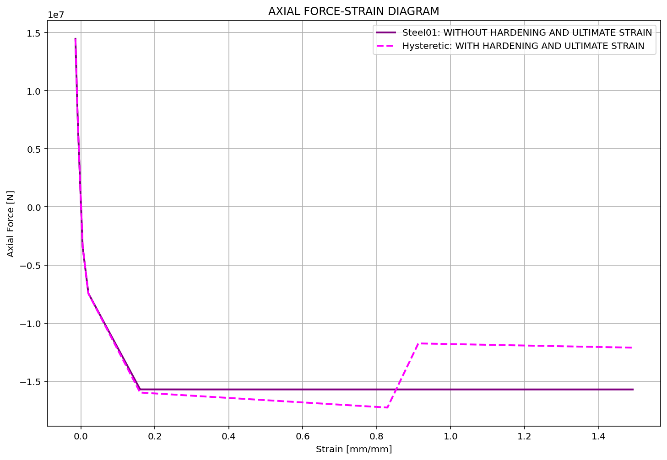

Slide 6
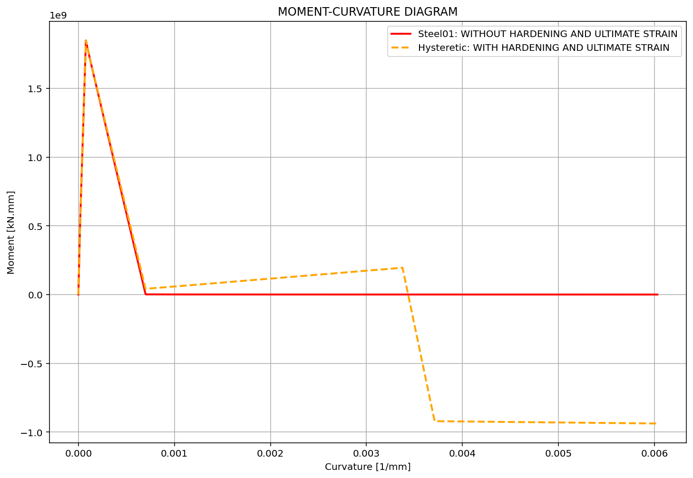
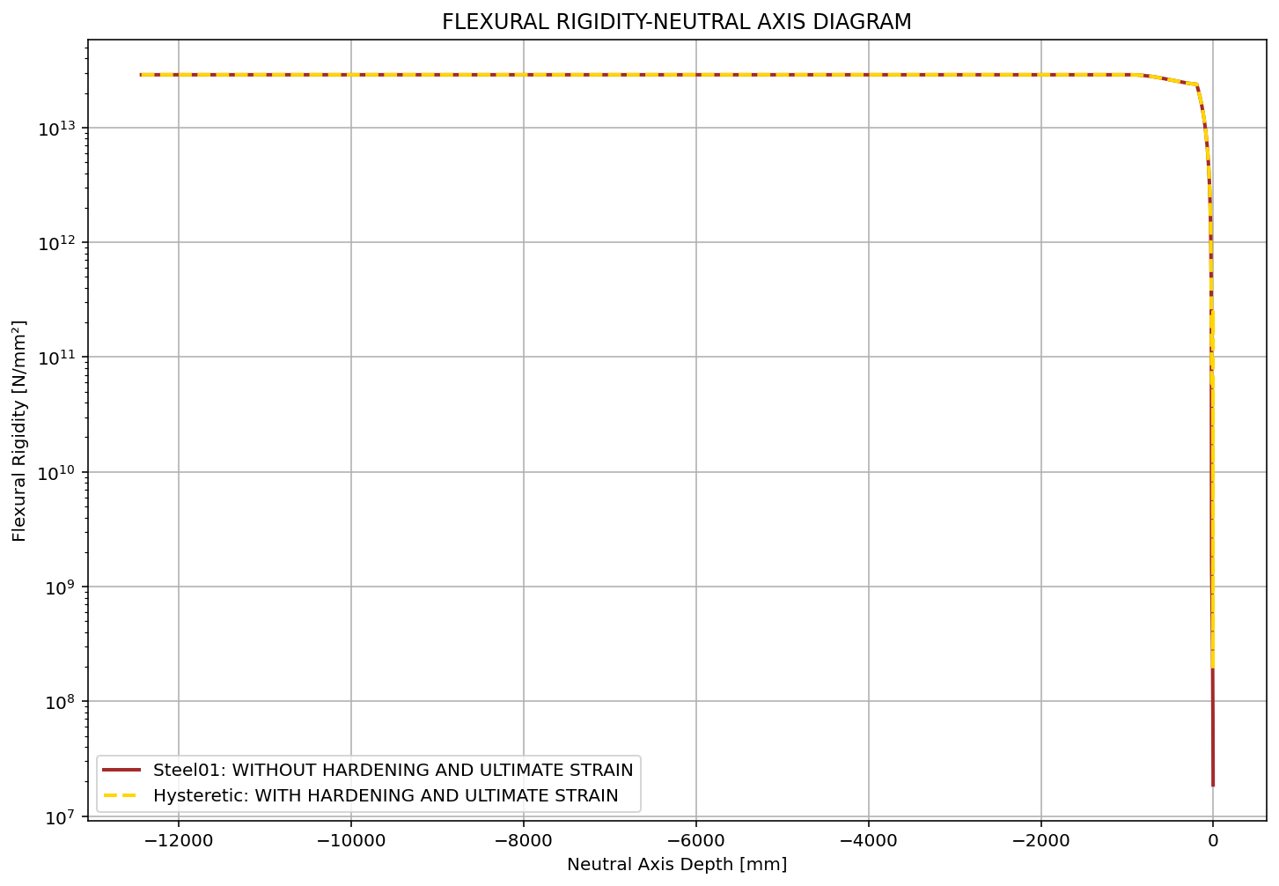

Slide 7
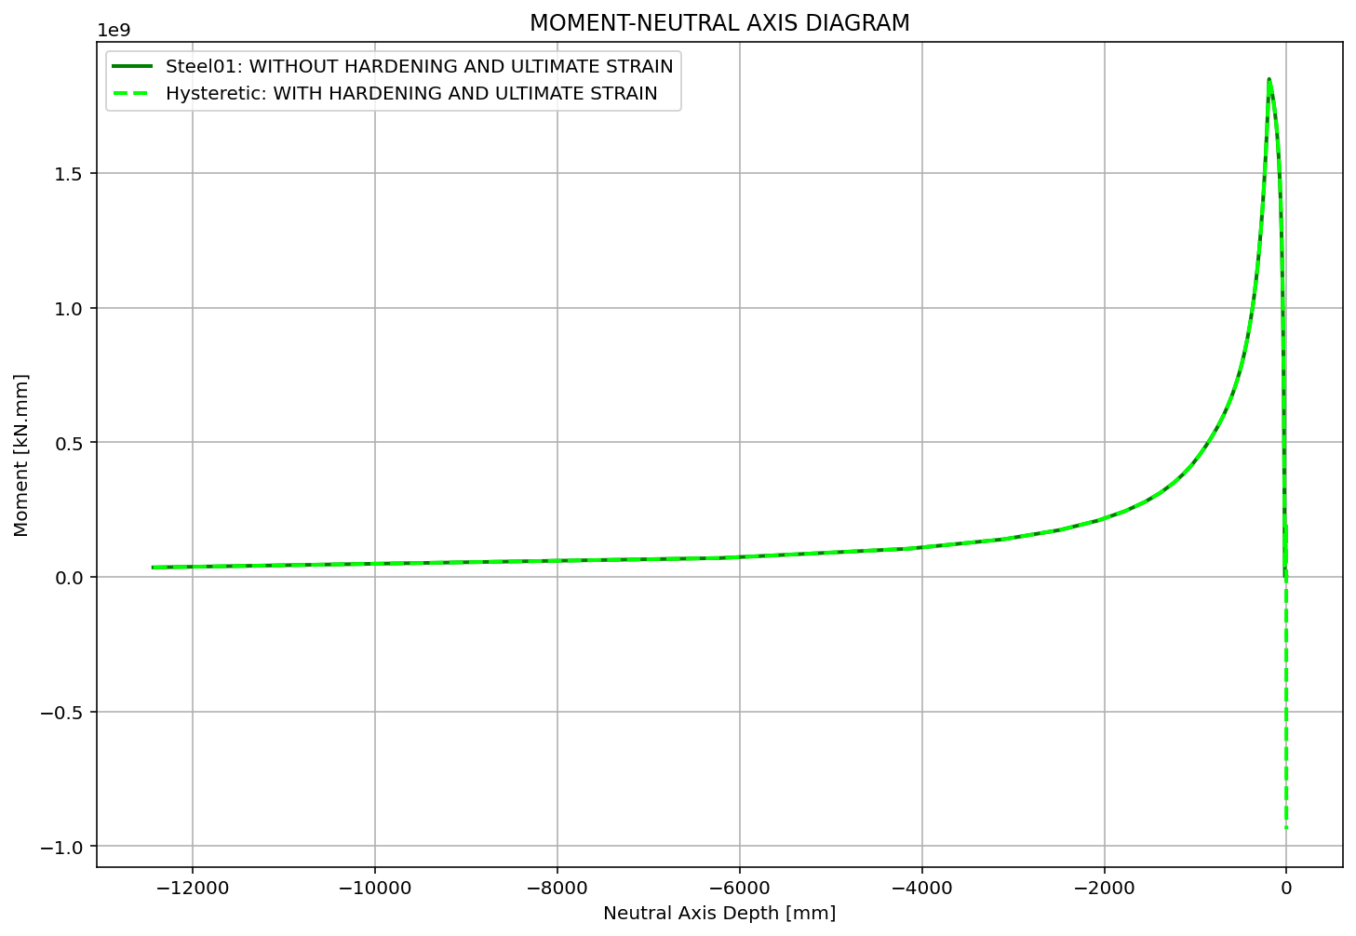

Slide 8
