Slide 1
>> IN THE NAME OF ALLAH, THE MOST GRACIOUS, THE MOST MERCIFUL <<
SENSITIVITY ANALYSIS BY CHANGING STRUCTURAL DAMPER STIFFNESS AND DAMPING RATIO USING OPENSEES
THIS PROGRAM WRITTEN BY SALAR DELAVAR GHASHGHAEI (QASHQAI)

Slide 2
Suppose we have an existing steel or concrete structure and wish to
enhance its seismic performance by adding supplemental dampers.
The goal is to increase the overall effective damping of the structural
system through the contribution of these devices. In this type of study a sensitivity analysis is carried out by varying key damper parameters; such as the elastic stiffness of the damper and its viscous damping coefficient in order to evaluate the resulting total damping of the structure. This total damping combines the inherent damping of the original structure and the additional damping provided by the dampers.

Slide 3
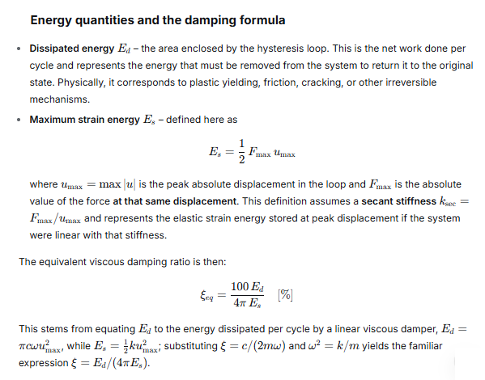

Slide 4
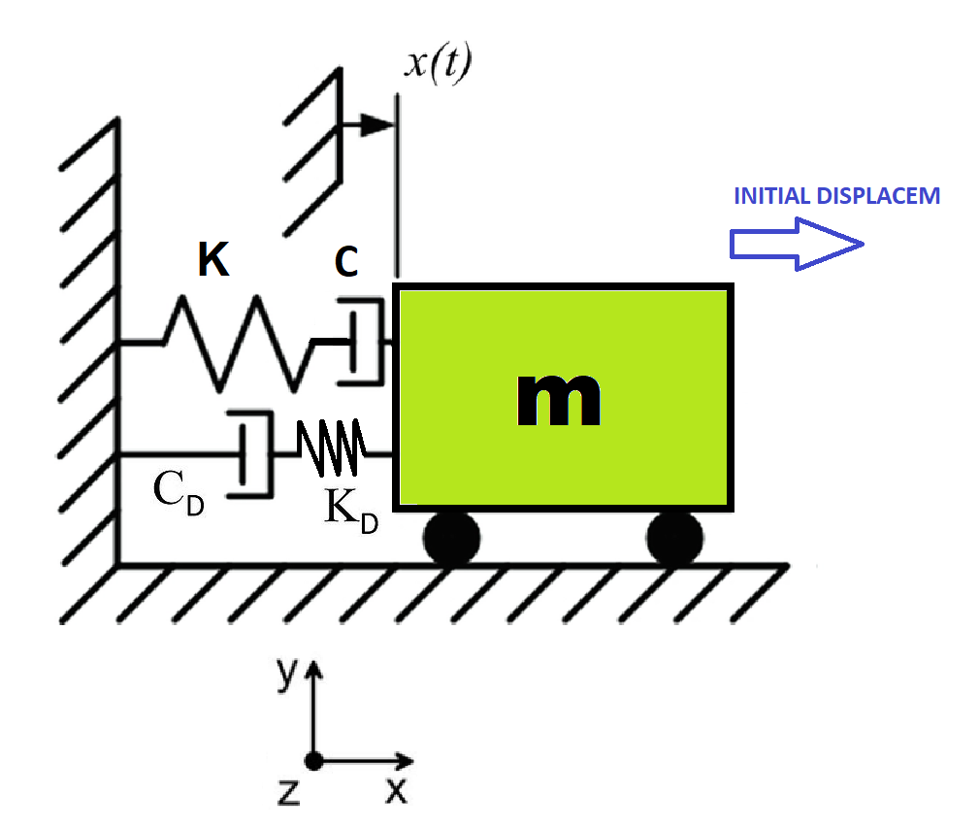

Slide 5
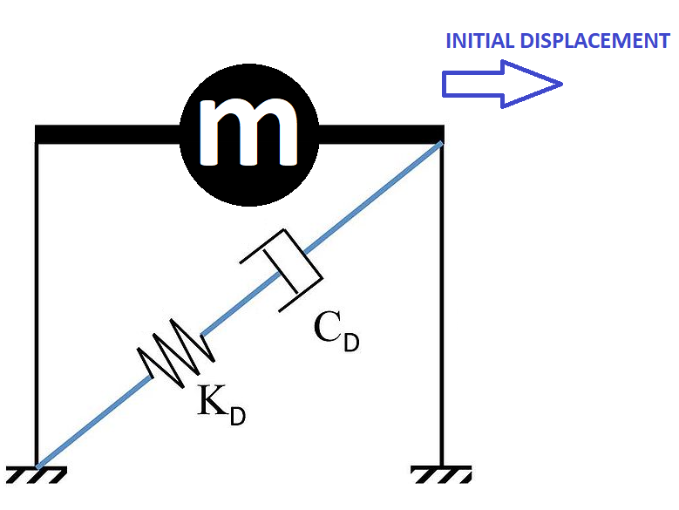

Slide 6
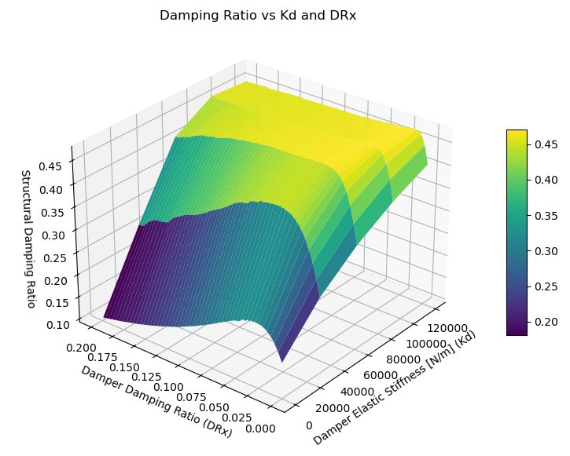

Slide 7
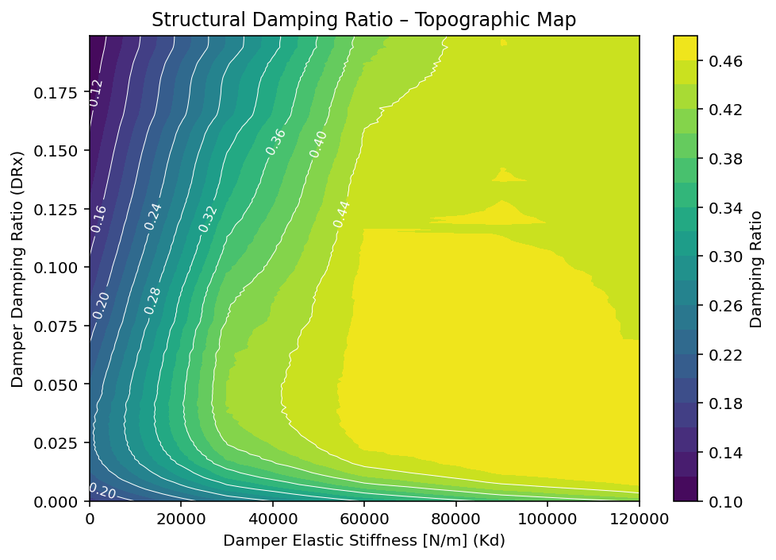

Slide 8
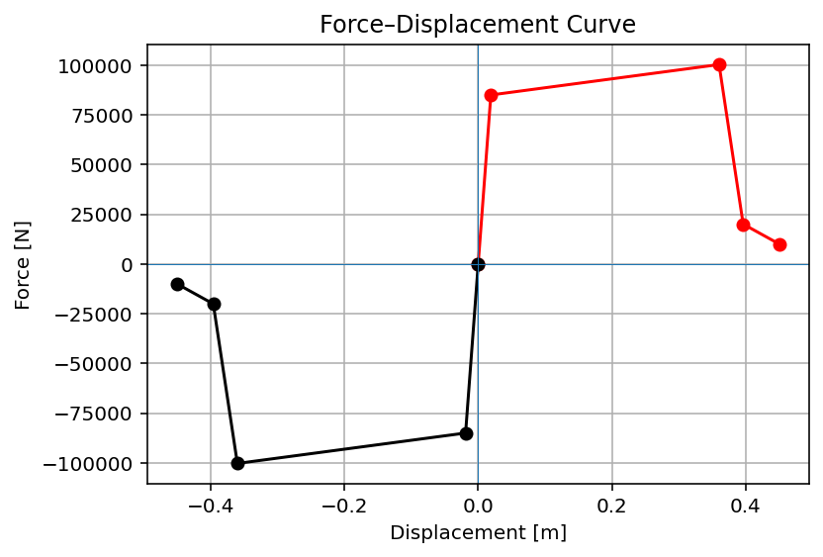

Slide 9
