Slide 1
>> IN THE NAME OF ALLAH, THE MOST GRACIOUS, THE MOST MERCIFUL <<
COMPREHENSIVE NONLINEAR SEISMIC ASSESSMENT OF A MULTI-DEGREE-FREEDOM (MDOF) STRUCTURE: AN OPENSEES FRAMEWORK FOR STATIC PUSHOVER, CYCLIC DEGRADATION, STATIC TIME-HISTORY AND DYNAMIC TIME-HISTORY ANALYSIS THIS PROGRAM IS WRITTEN BY SALAR DELAVAR GHASHGHAEI (QASHQAI)

Slide 2


Slide 3
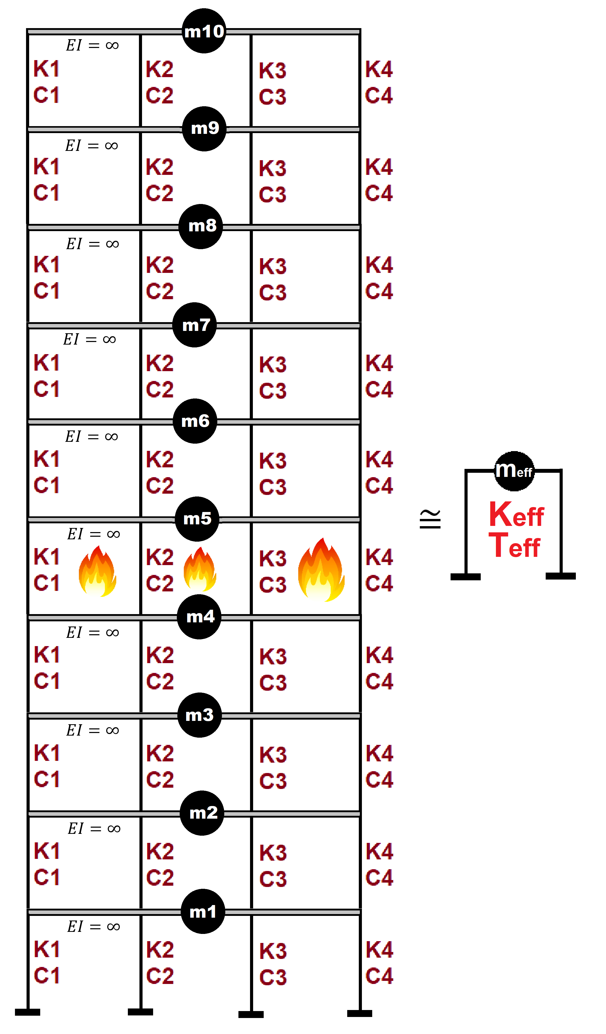

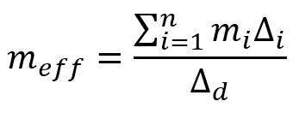
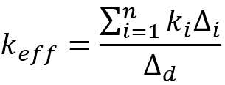
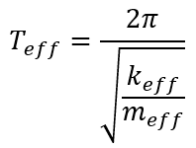
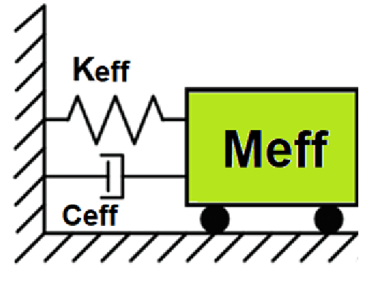
Displacement-based seismic analysis transformation,
converting a multi-degree-of-freedom (MDOF) system
into an equivalent single-degree-of-freedom (SDOF)
system for seismic assessment

Slide 4
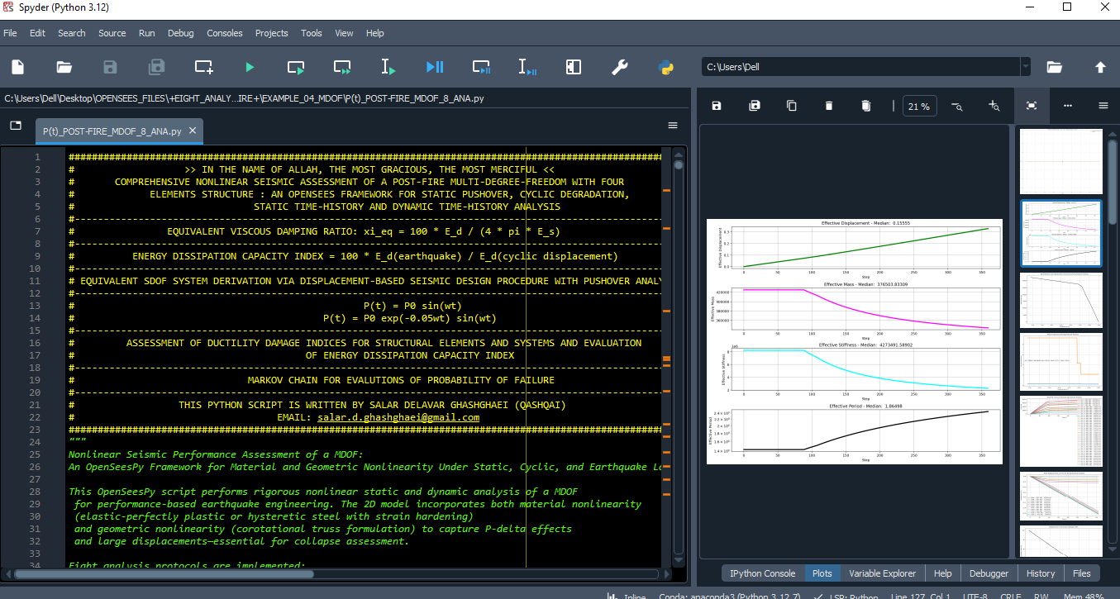

Slide 5
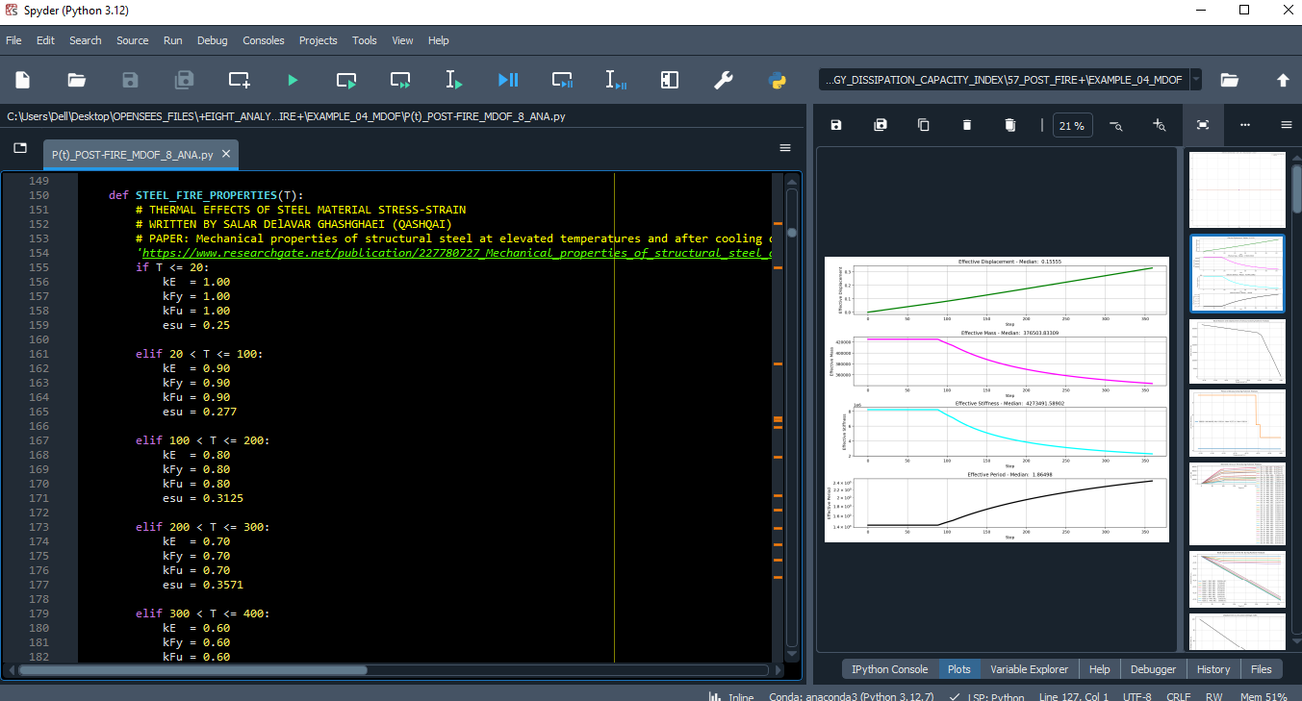
STEEL FIRE PROPERTIES

Slide 6
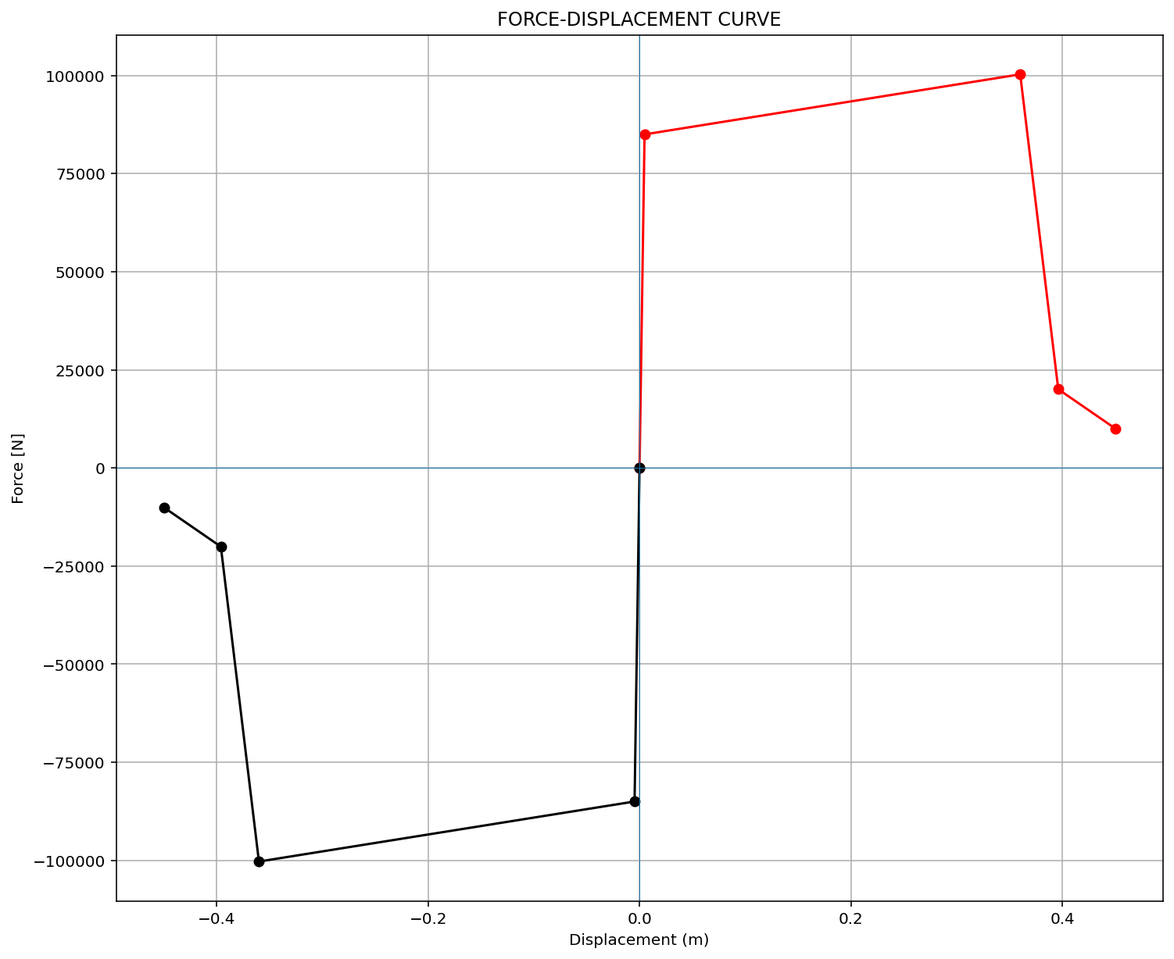
ELEMENT 01

Slide 7

ELEMENT 02

Slide 8
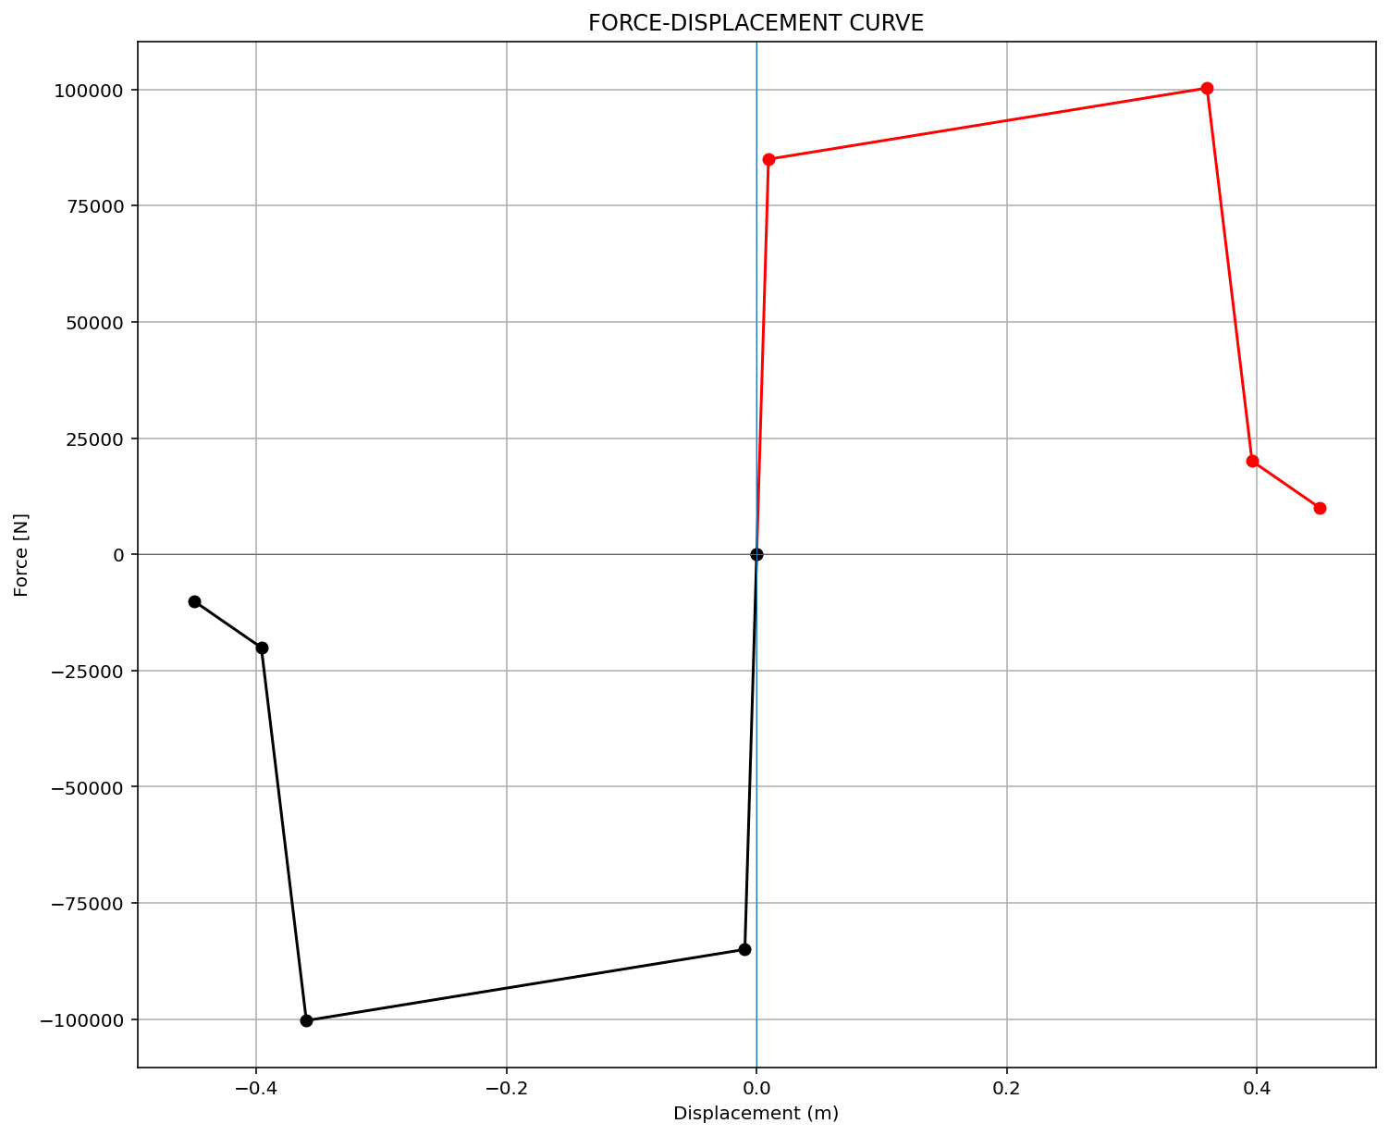
ELEMENT 03

Slide 9
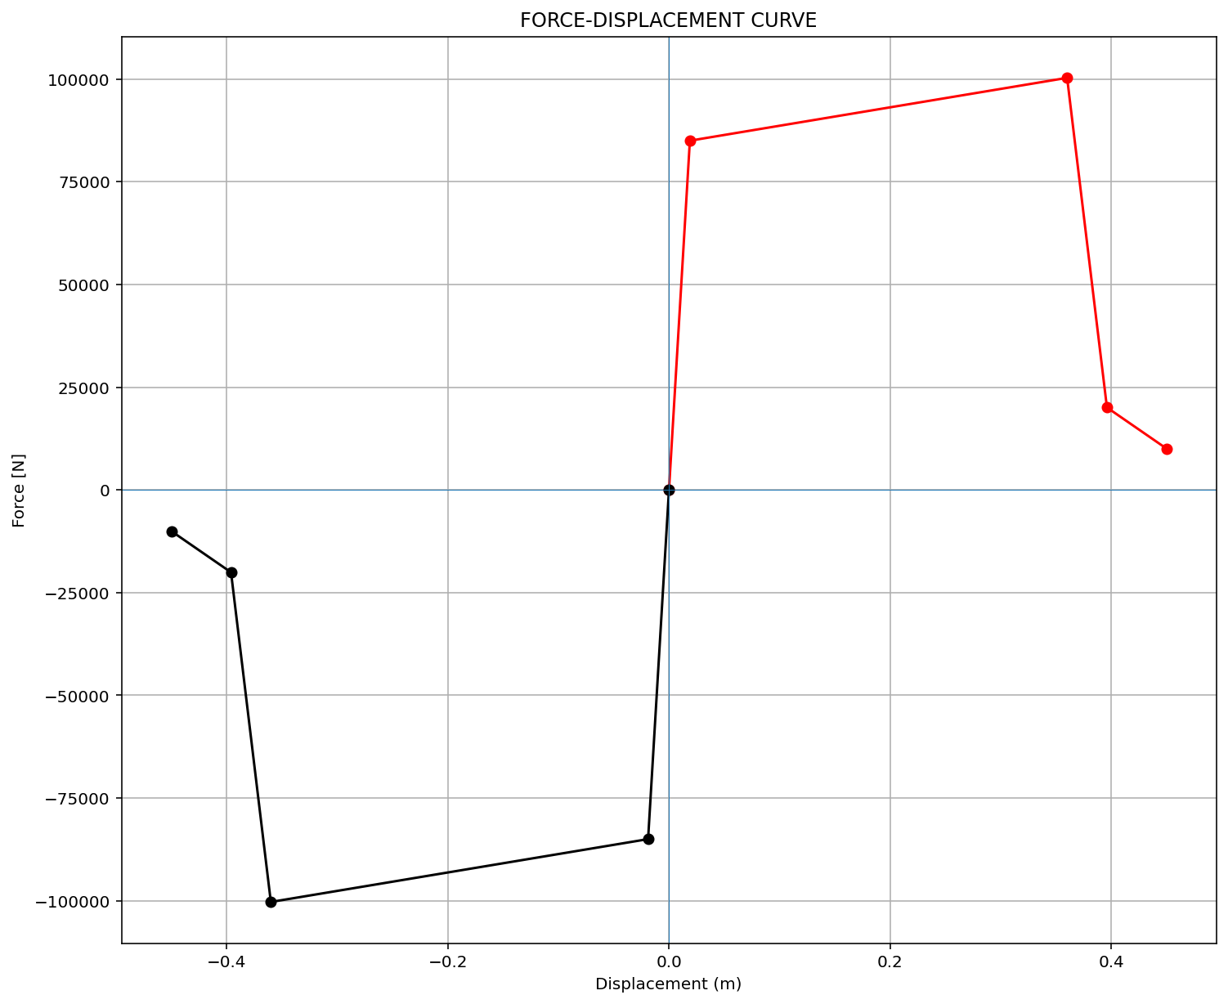
ELEMENT 04

Slide 10
STATIC ANALYSIS

Slide 11
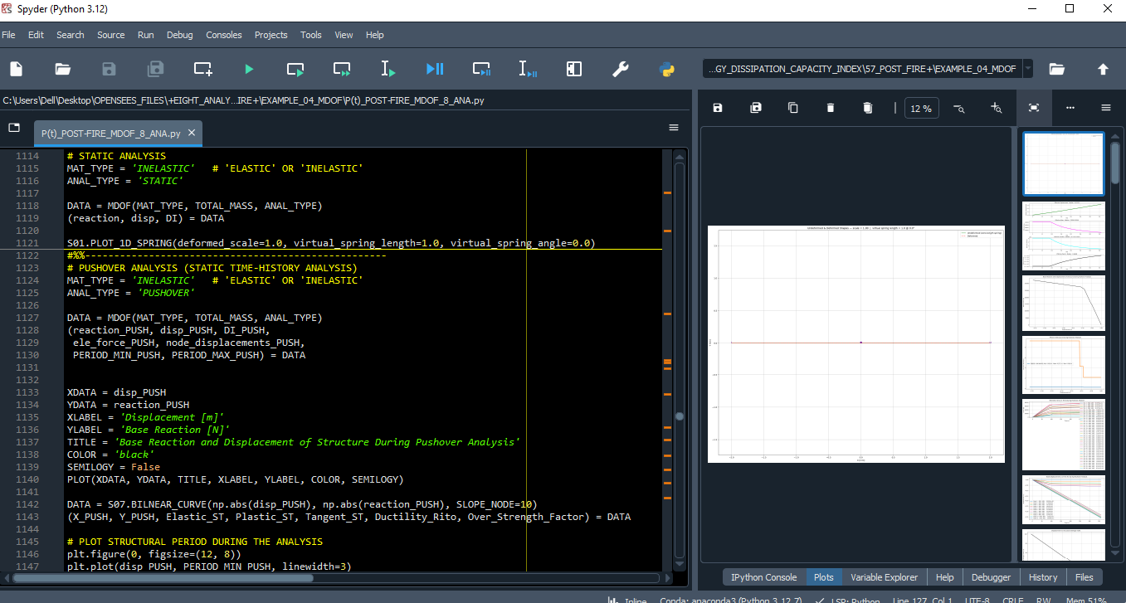

Slide 12
PUSHOVER ANALYSIS

Slide 13
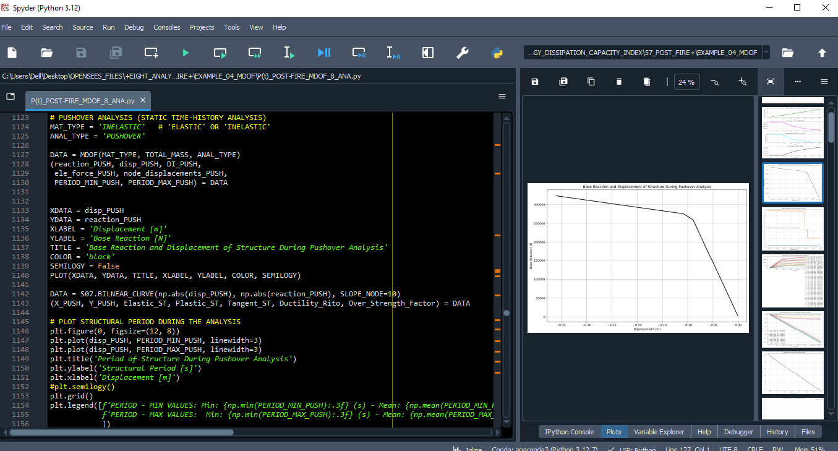

Slide 14
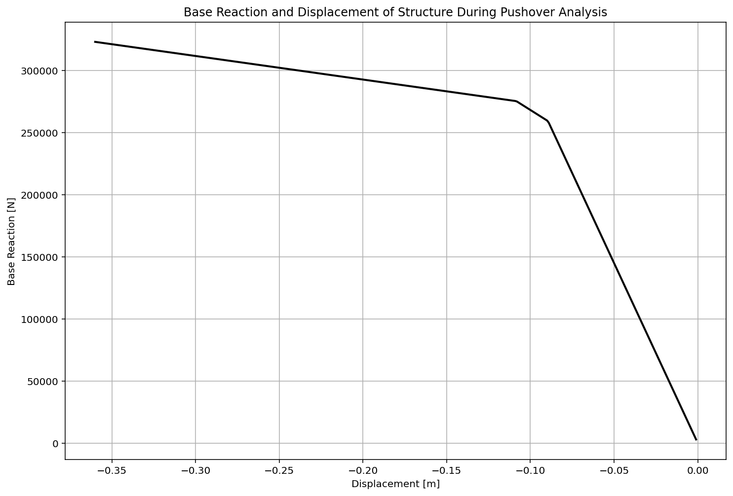

Slide 15
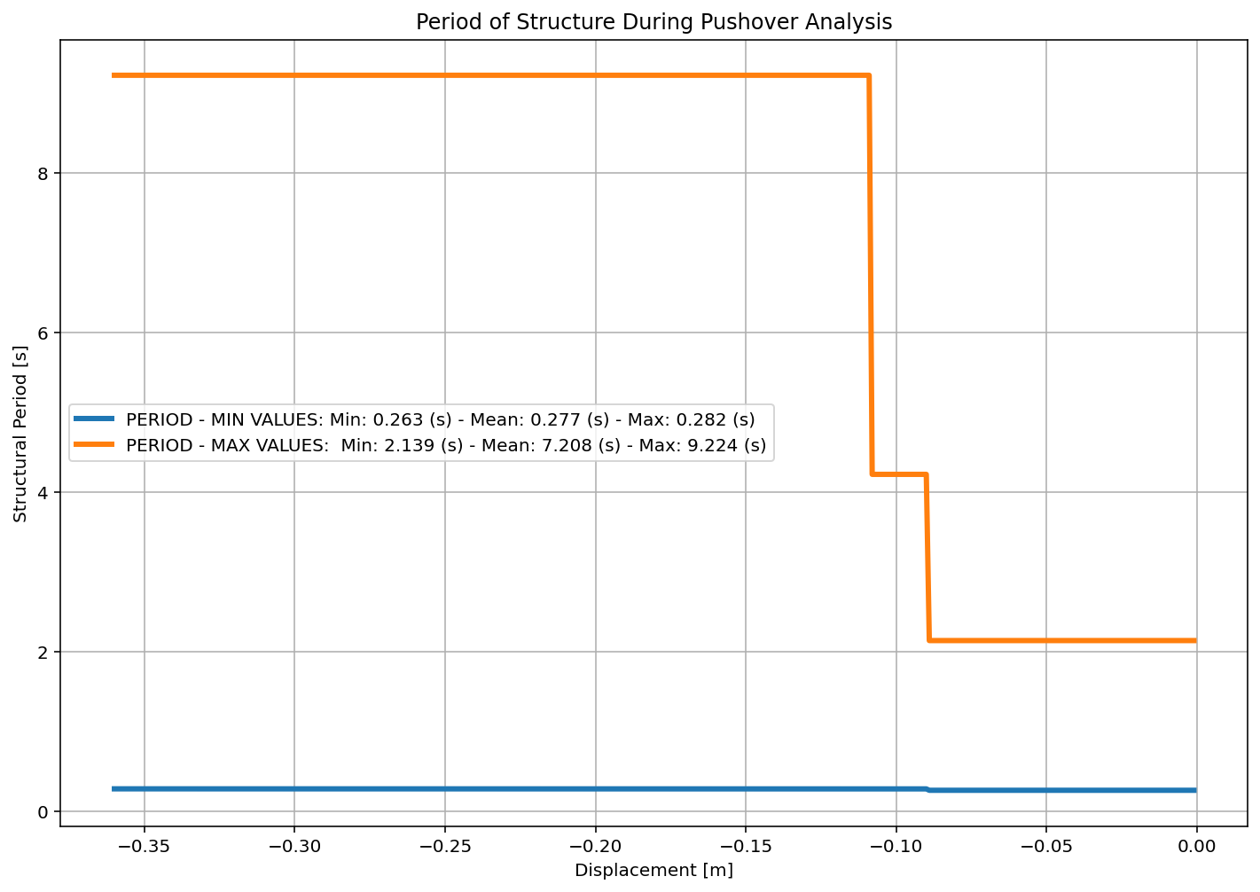

Slide 16
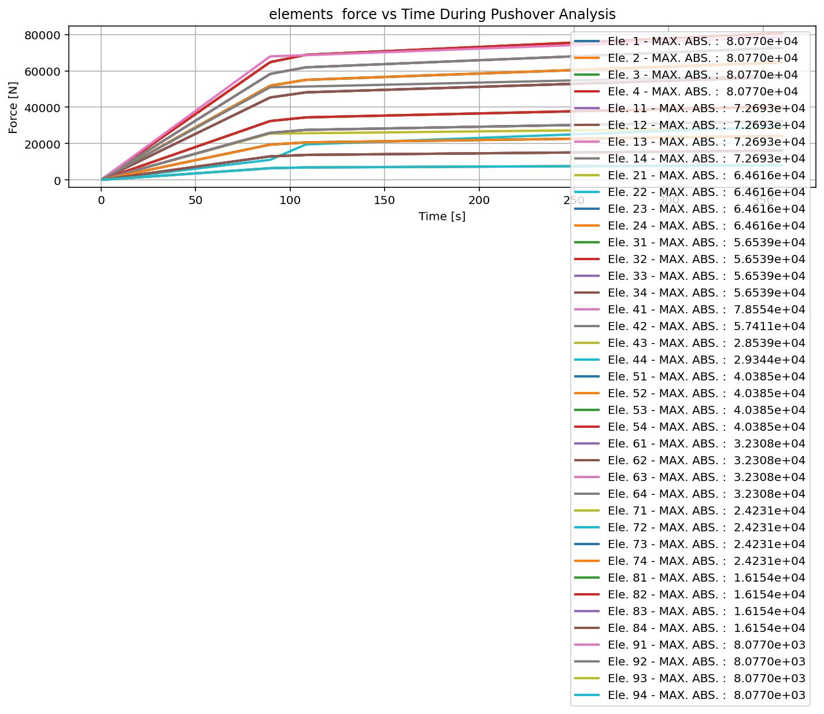

Slide 17
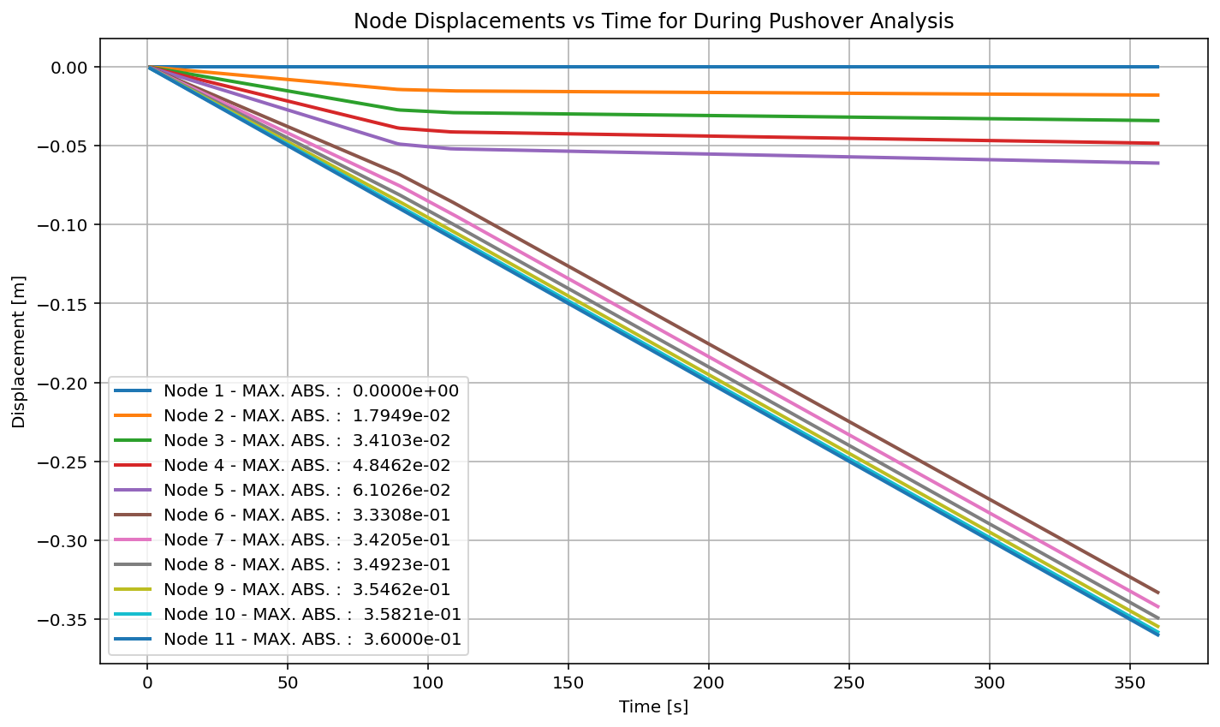

Slide 18
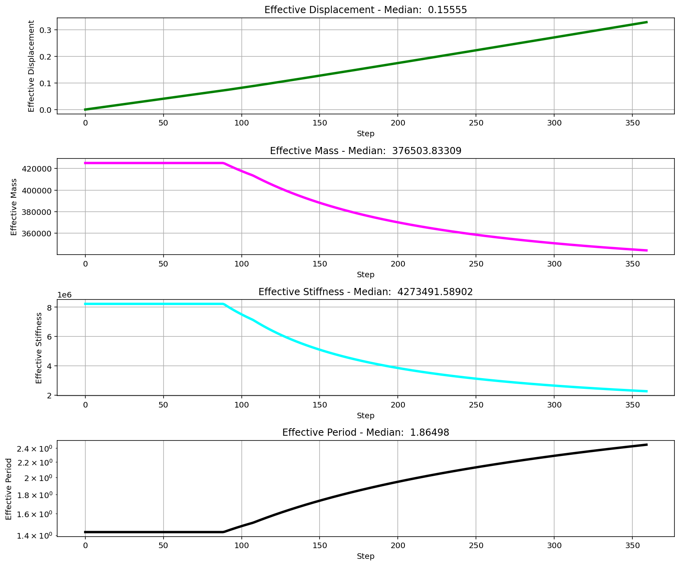

Slide 19
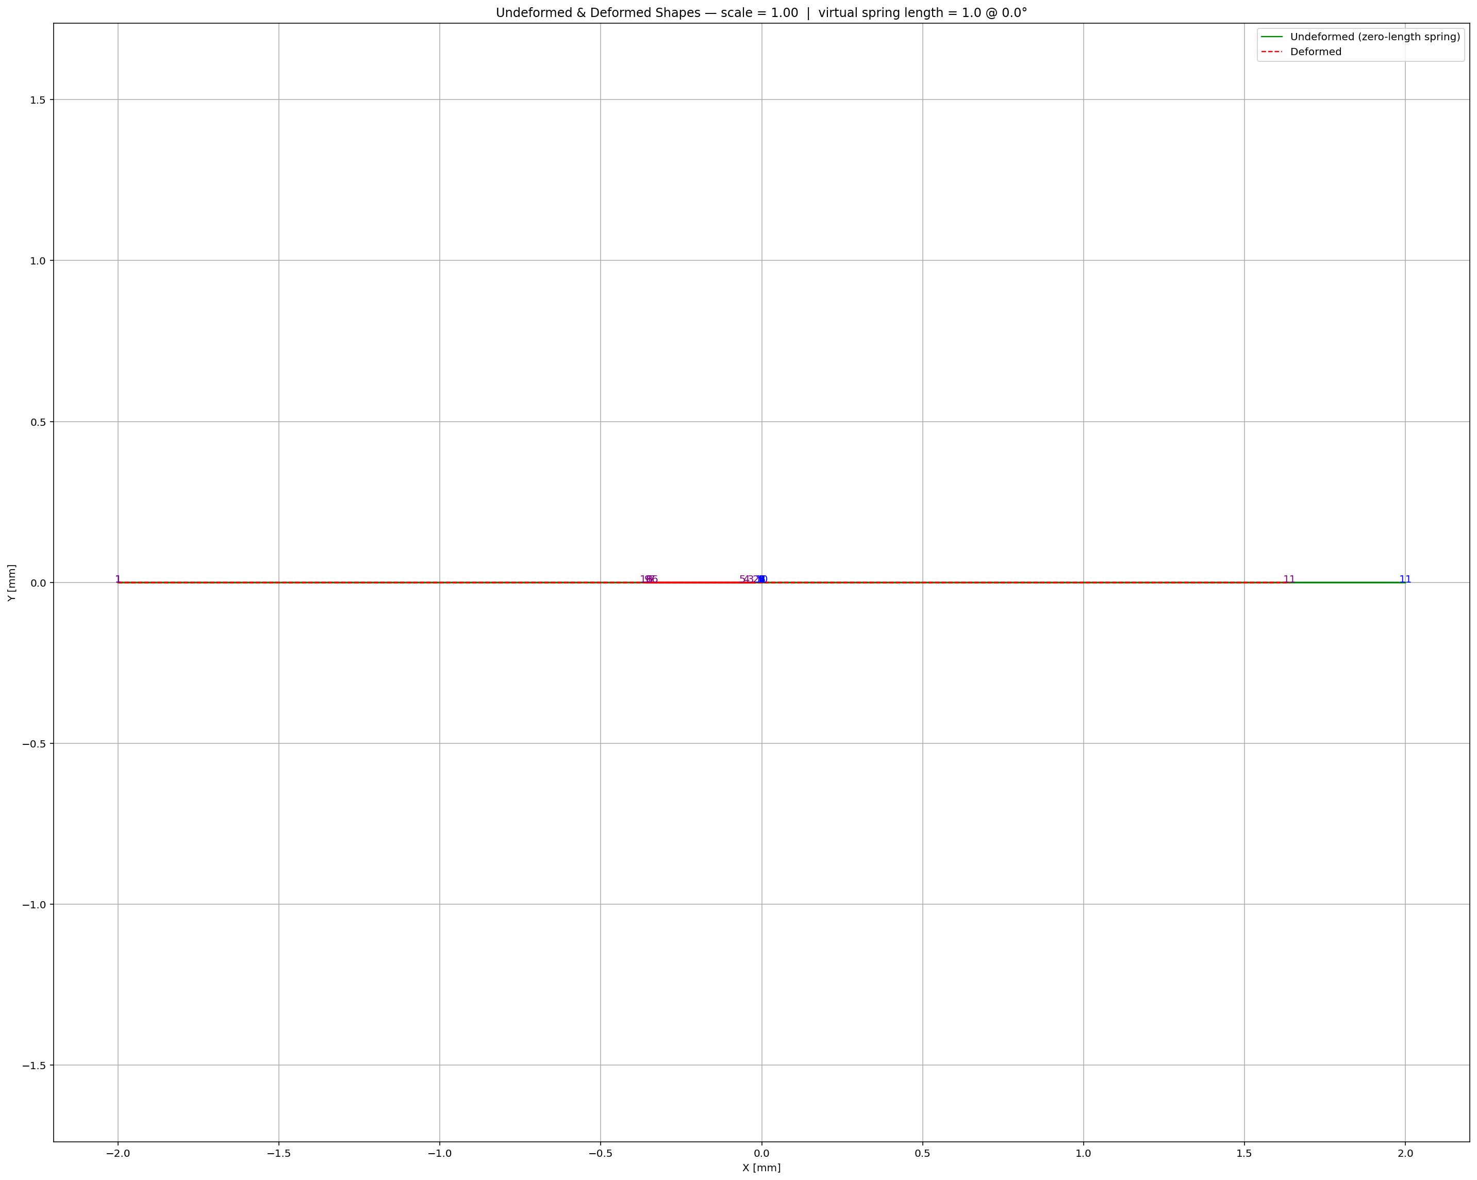

Slide 20
CYCLIC DISPLACEMENT ANALYSIS

Slide 21
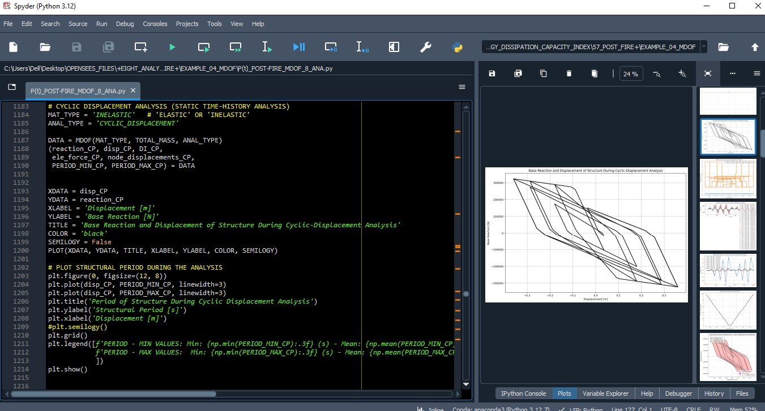

Slide 22
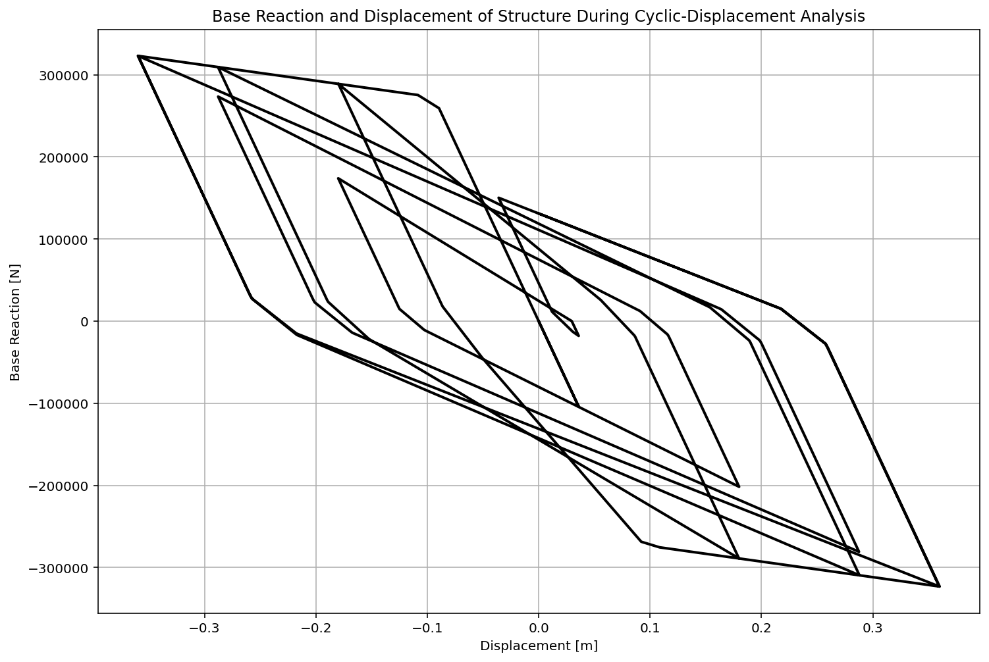

Slide 23
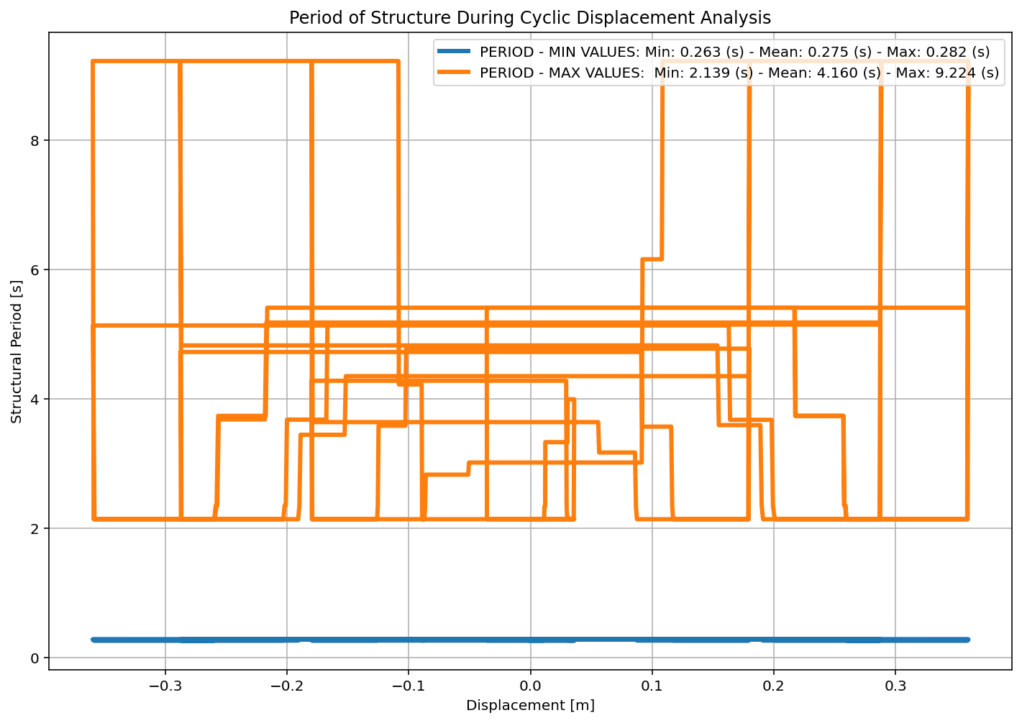

Slide 24
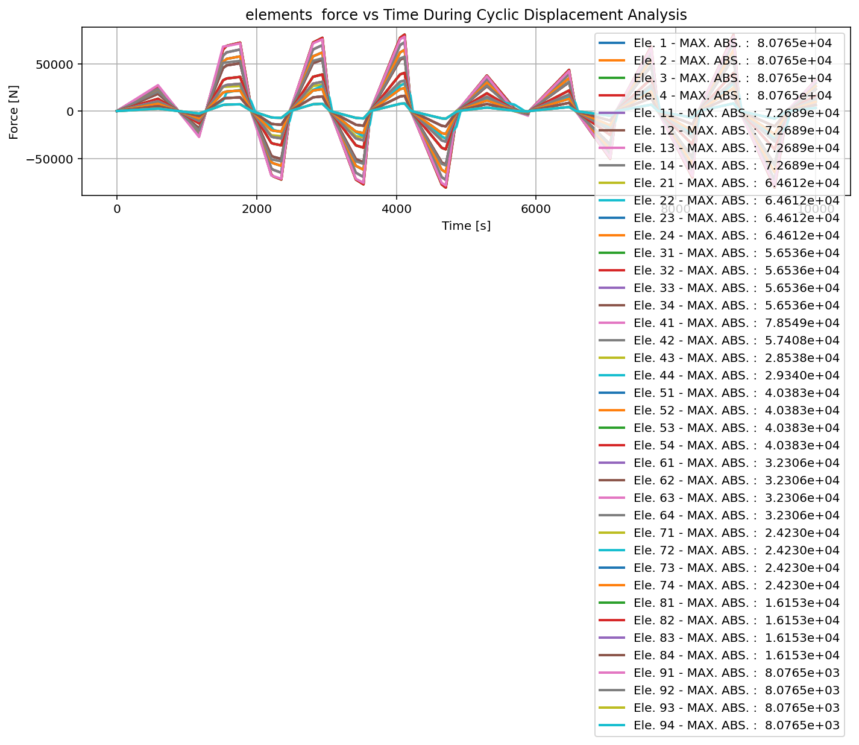

Slide 25
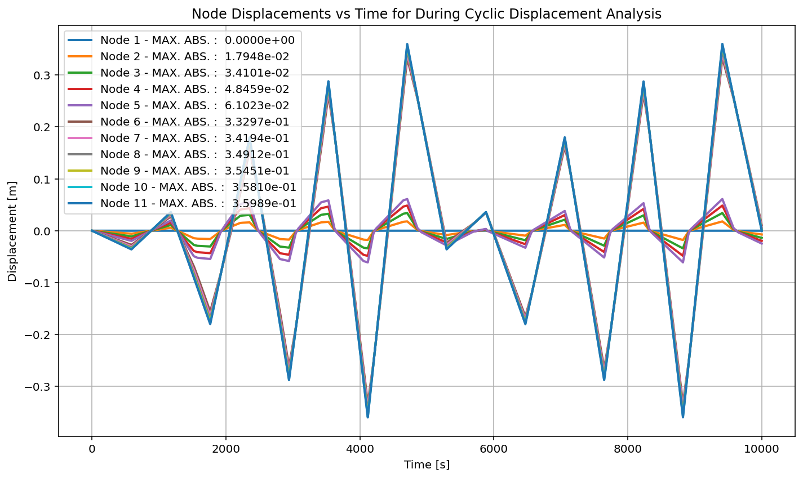

Slide 26
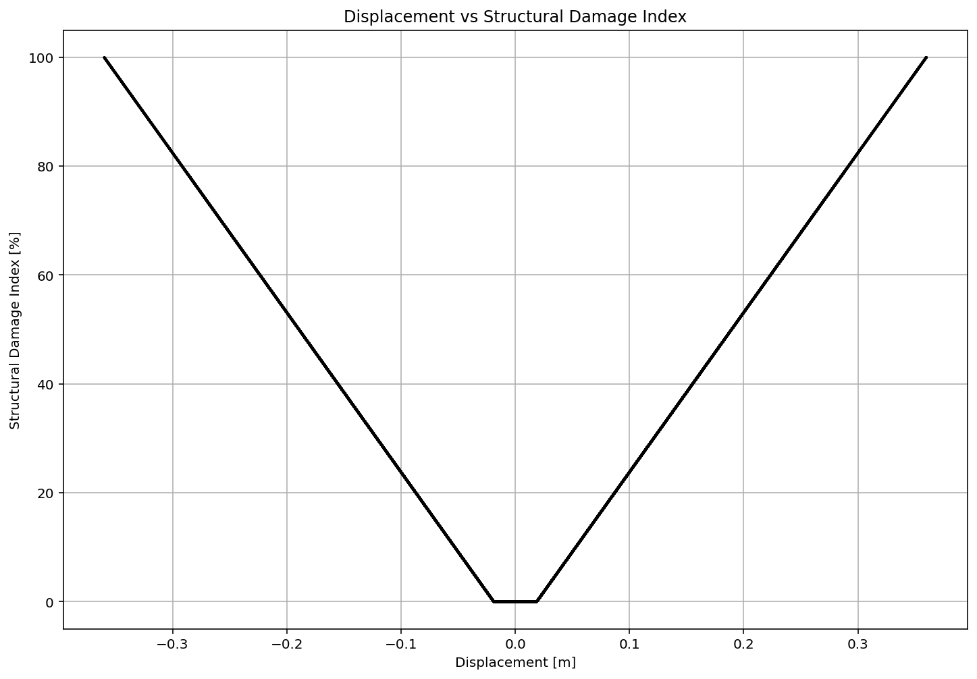

Slide 27
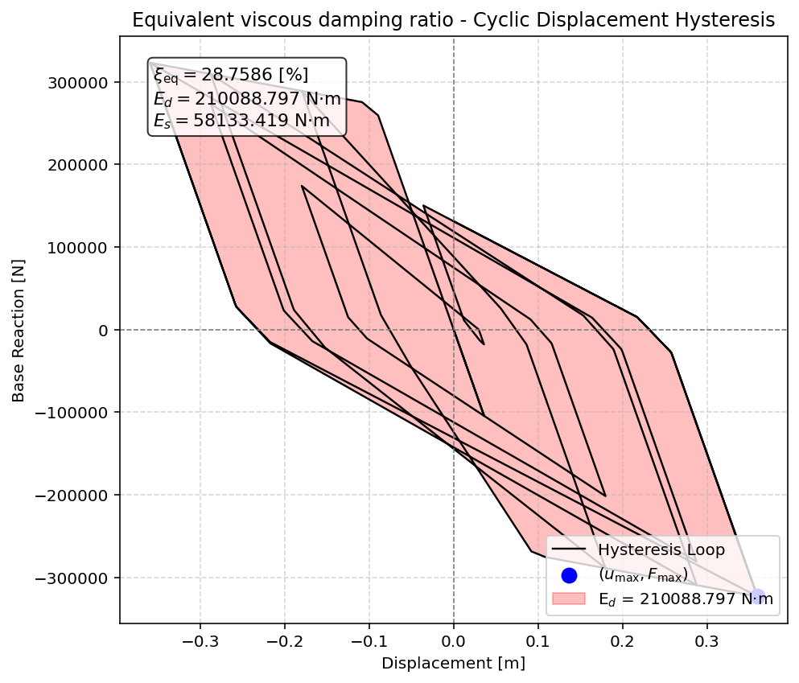

Slide 28
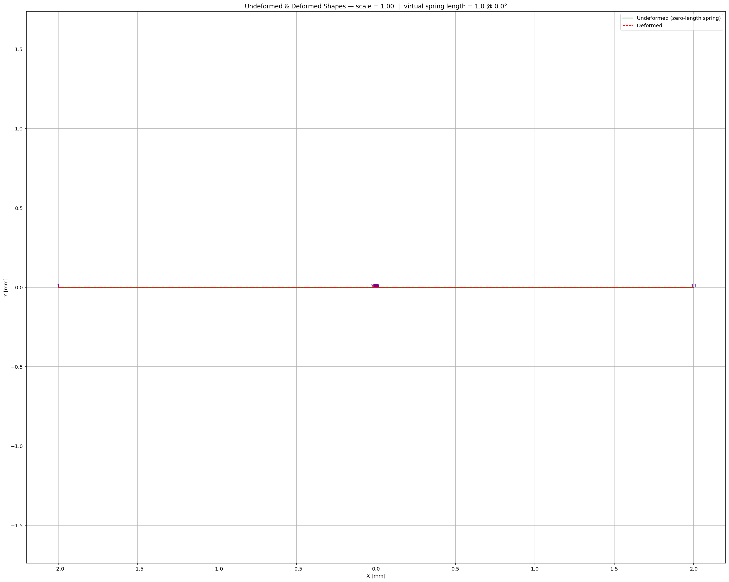

Slide 29
STATIC TIME-HISTORY WITH EXTERNAL TIME-DEPENDENT LOADING ANALYSIS

Slide 30
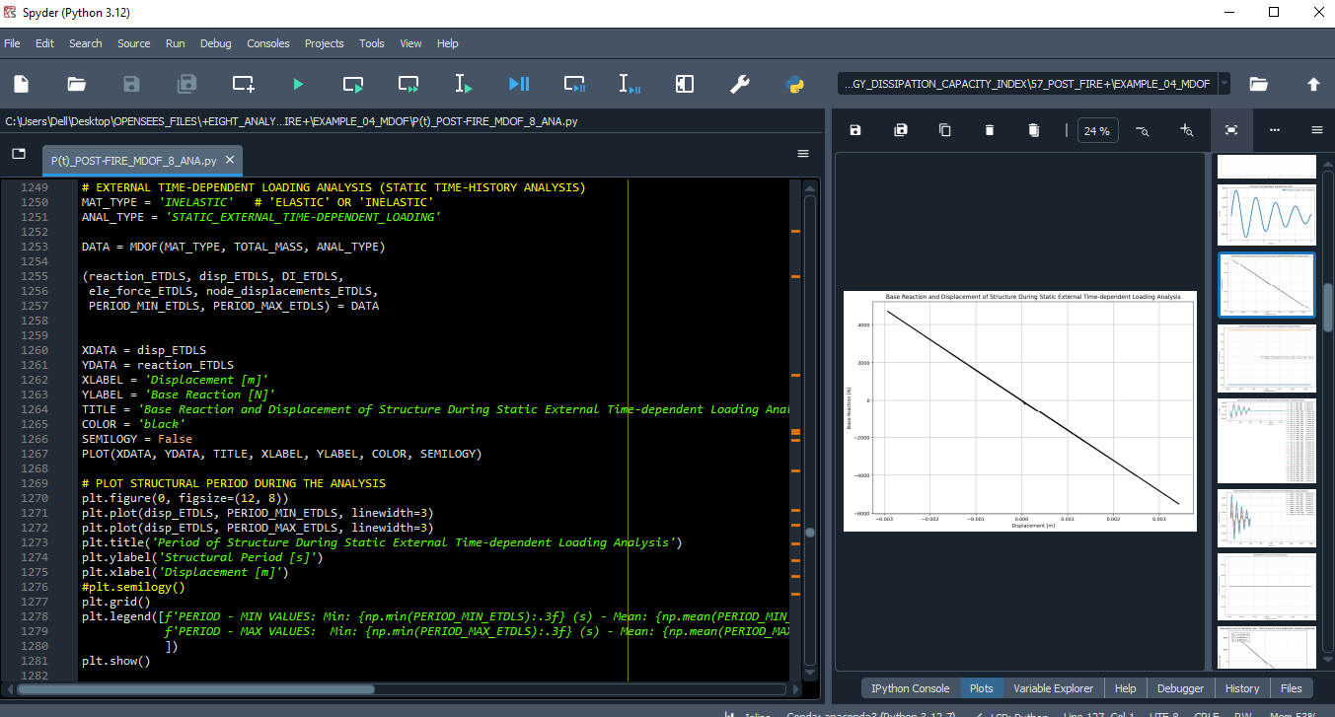

Slide 31
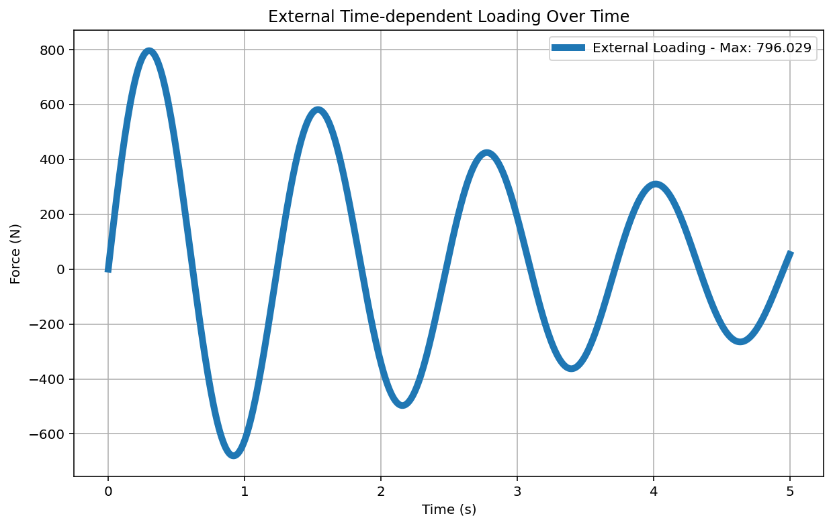

Slide 32
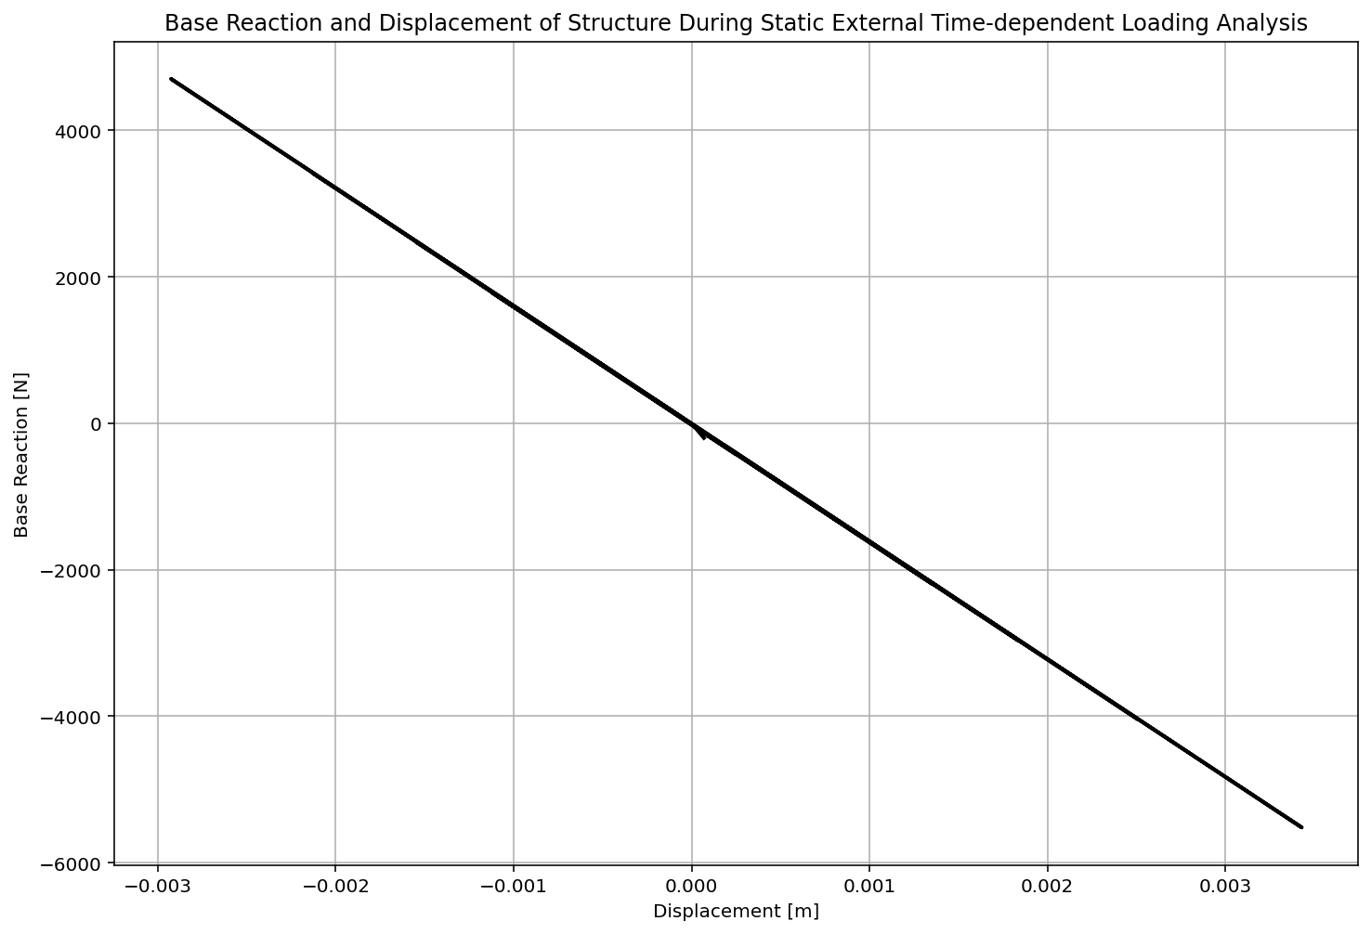

Slide 33
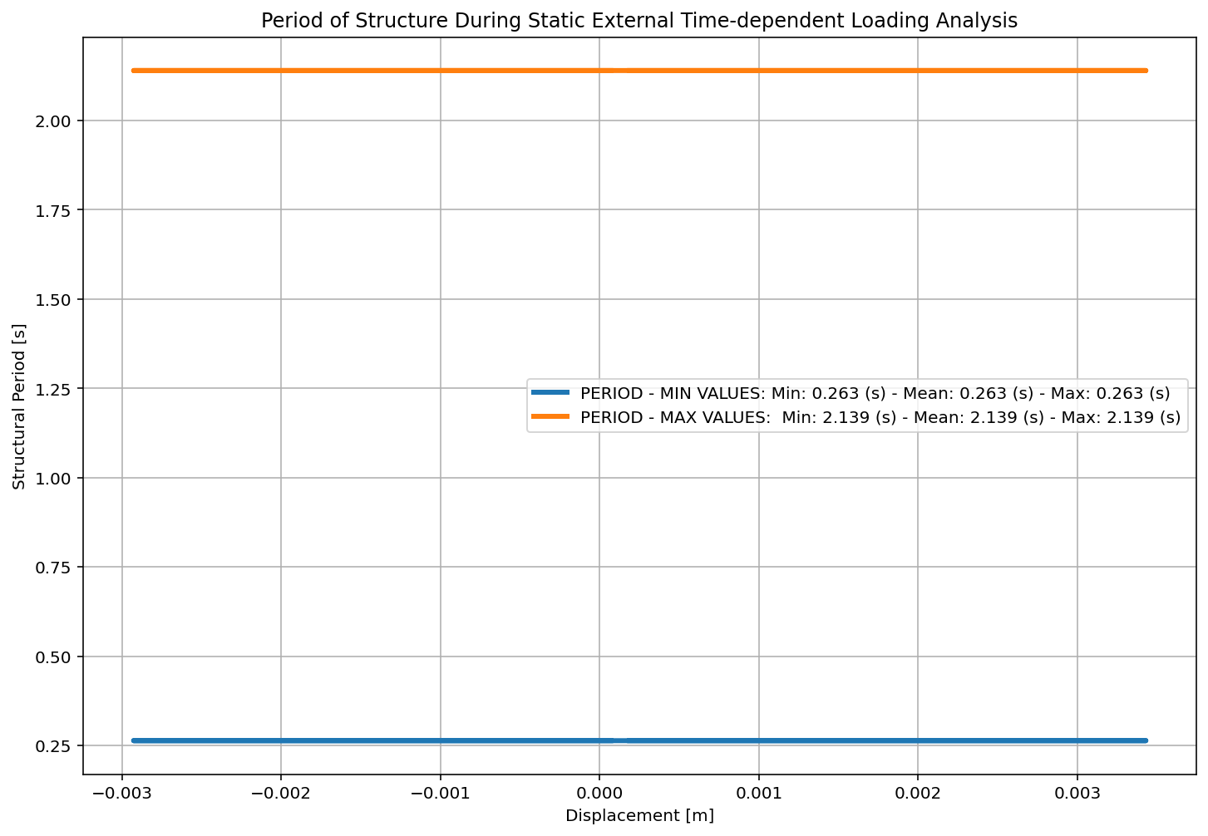

Slide 34
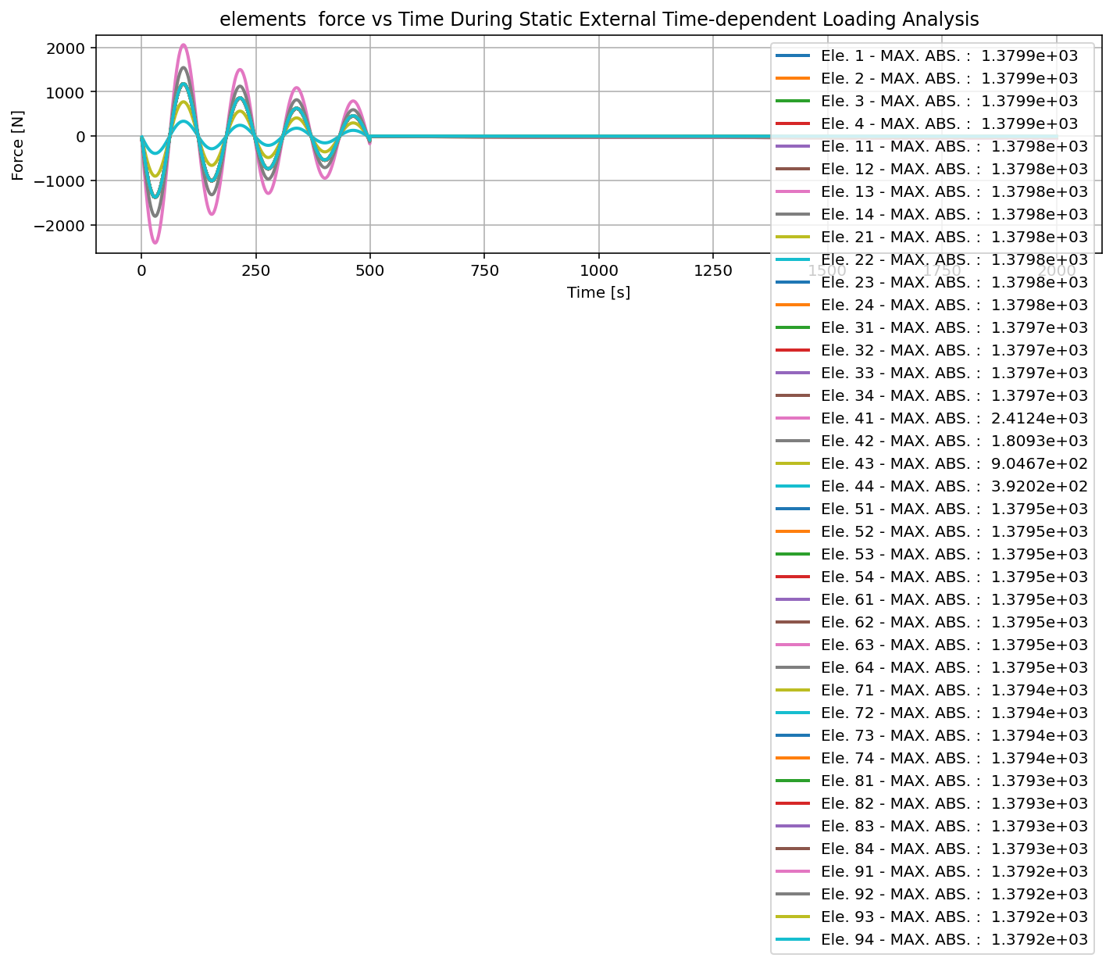

Slide 35
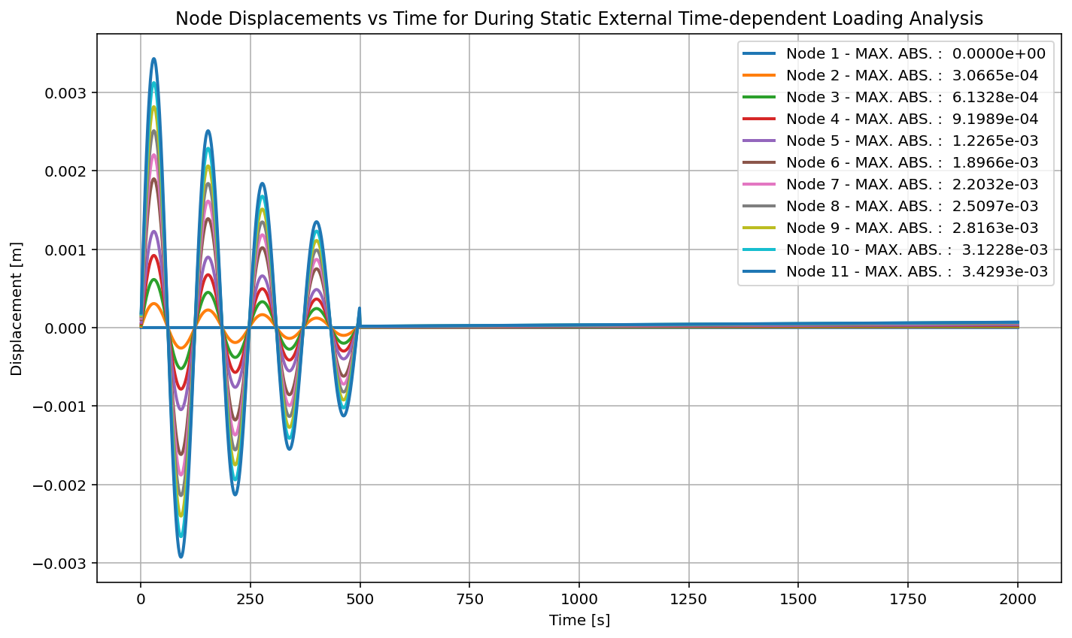

Slide 36
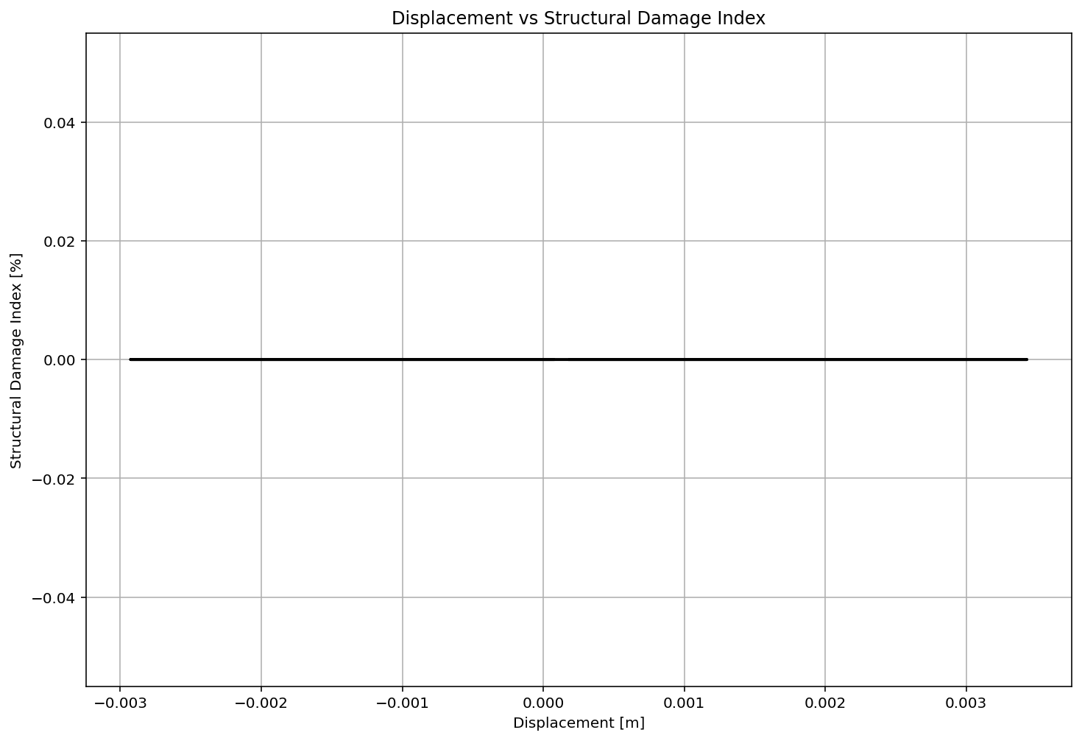

Slide 37
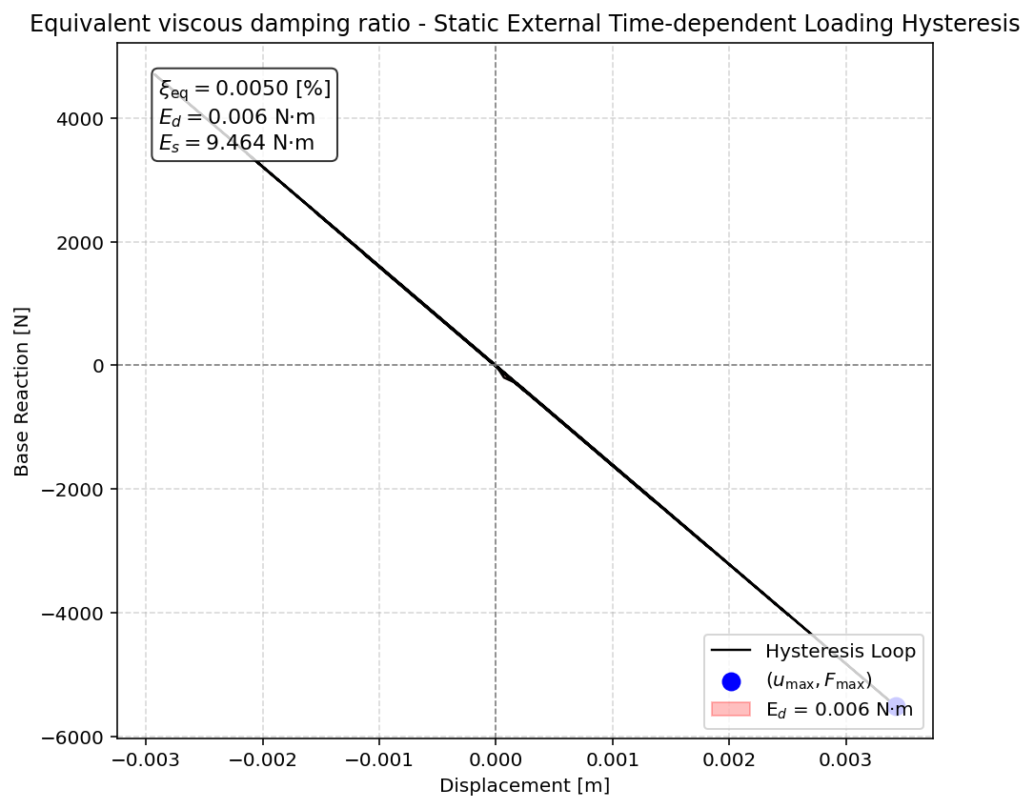

Slide 38
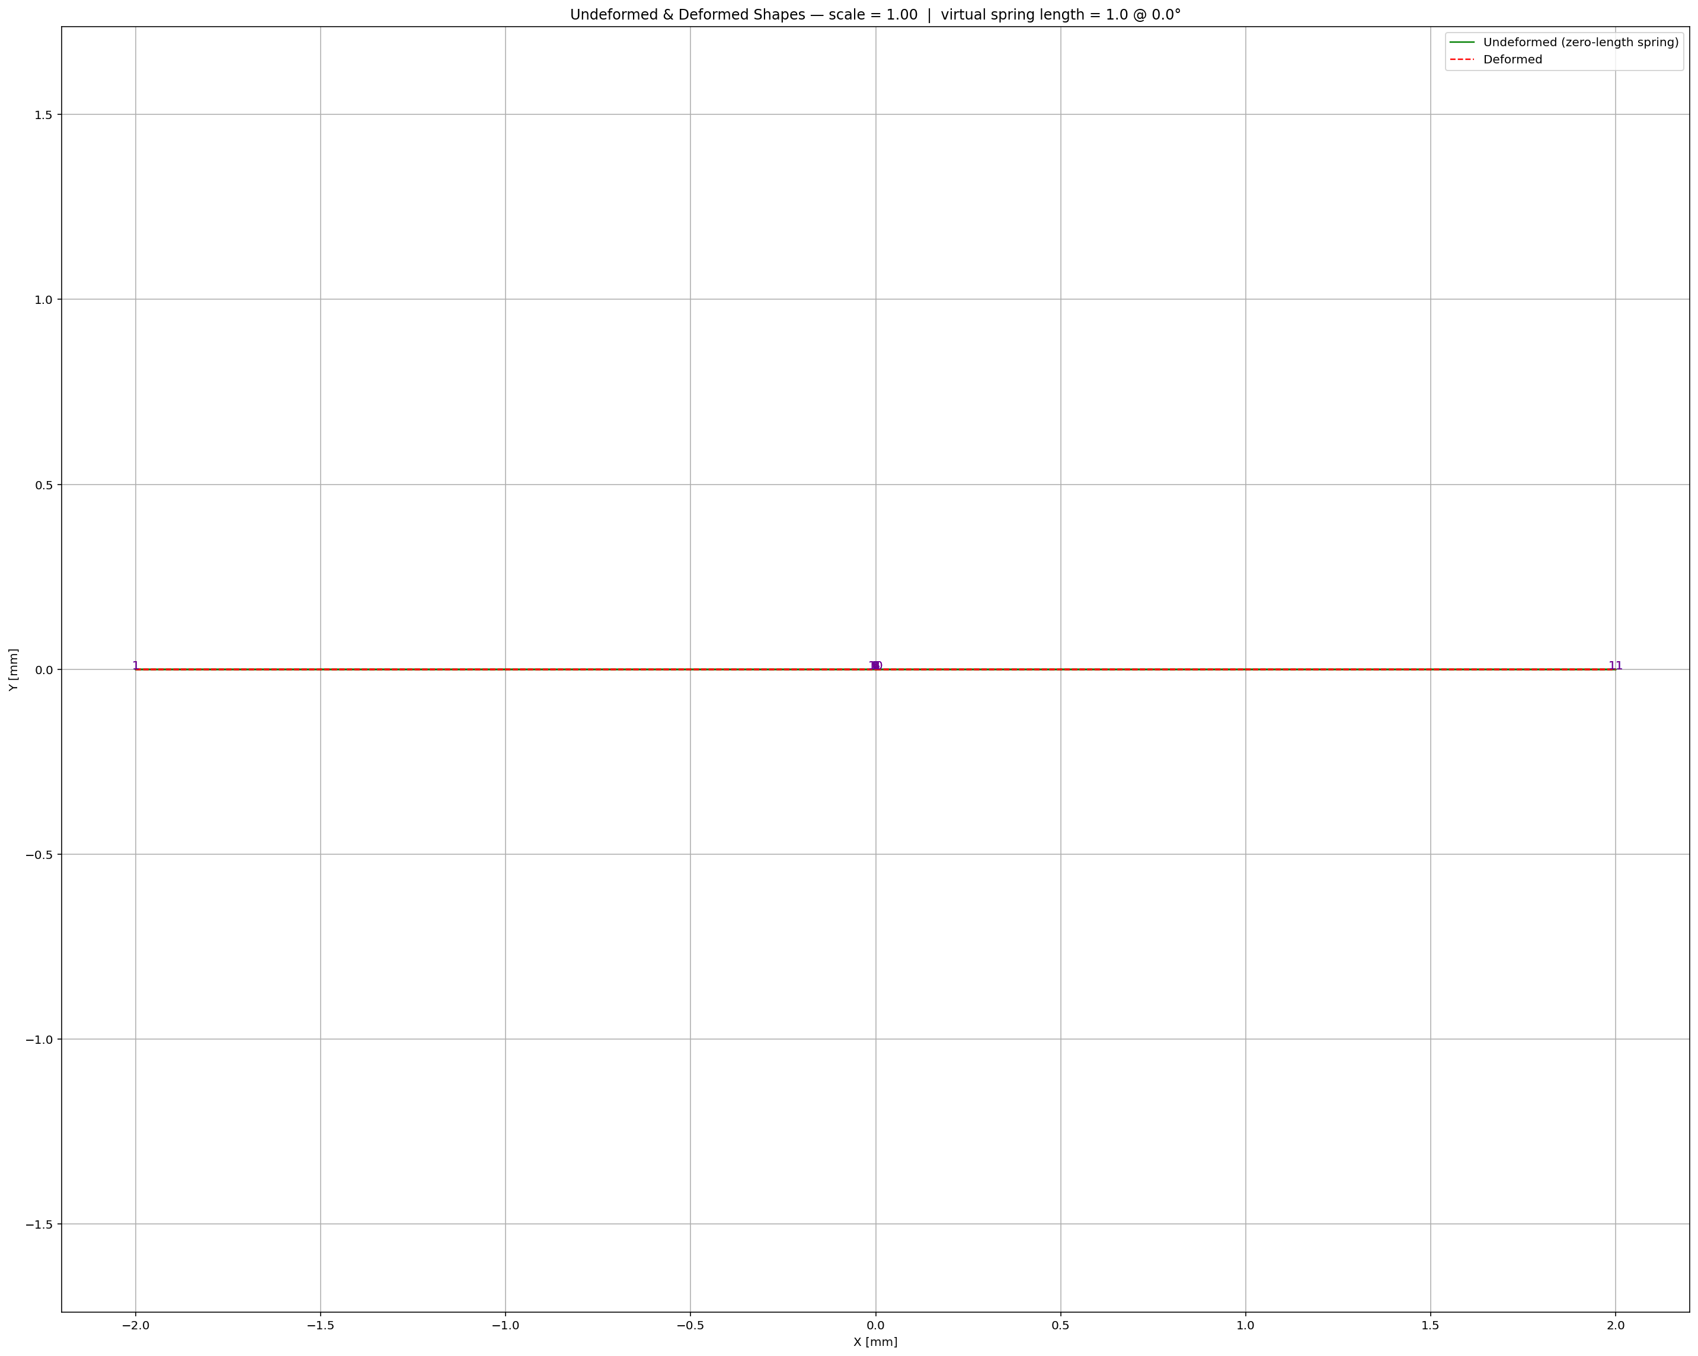

Slide 39
DYNAMIC TIME-HISTORY WITH EXTERNAL TIME-DEPENDENT LOADING ANALYSIS

Slide 40
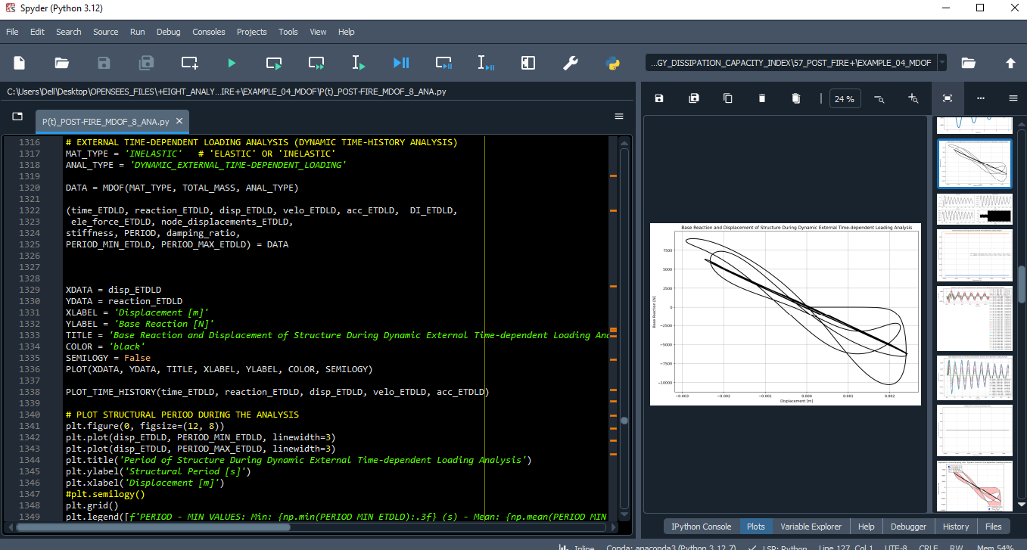

Slide 42
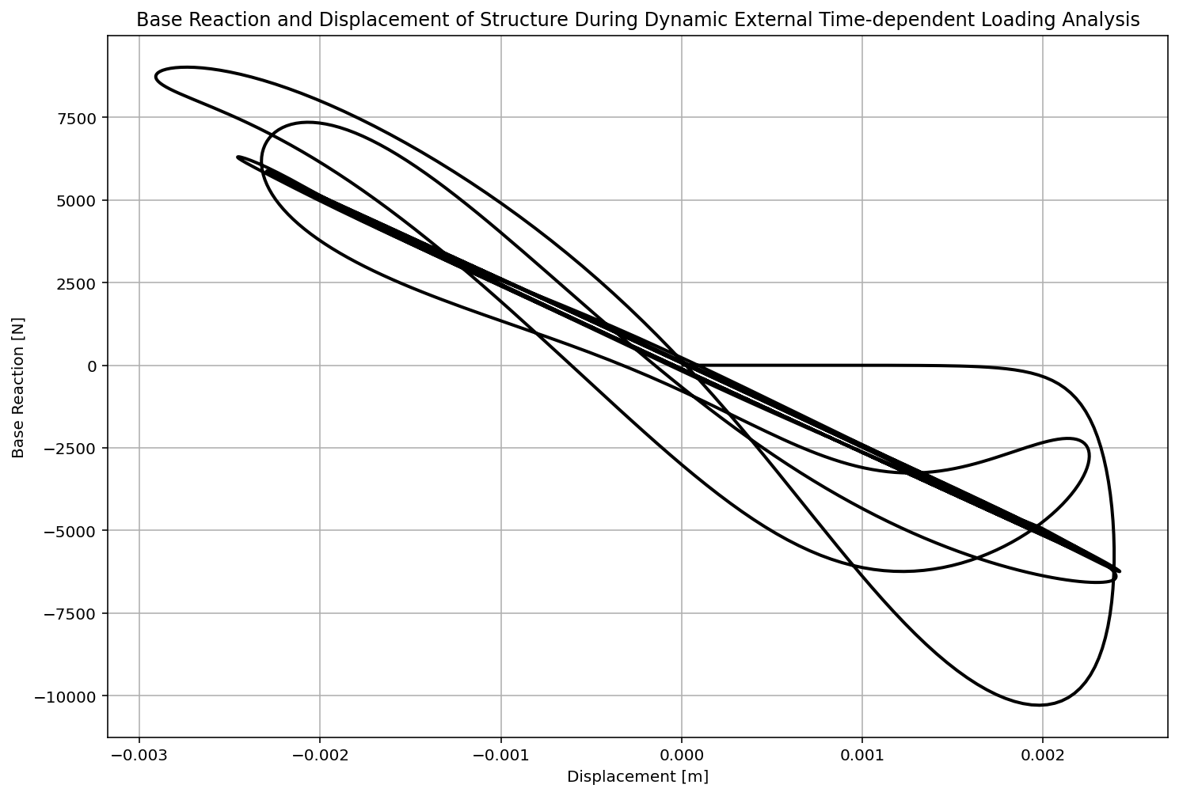

Slide 43
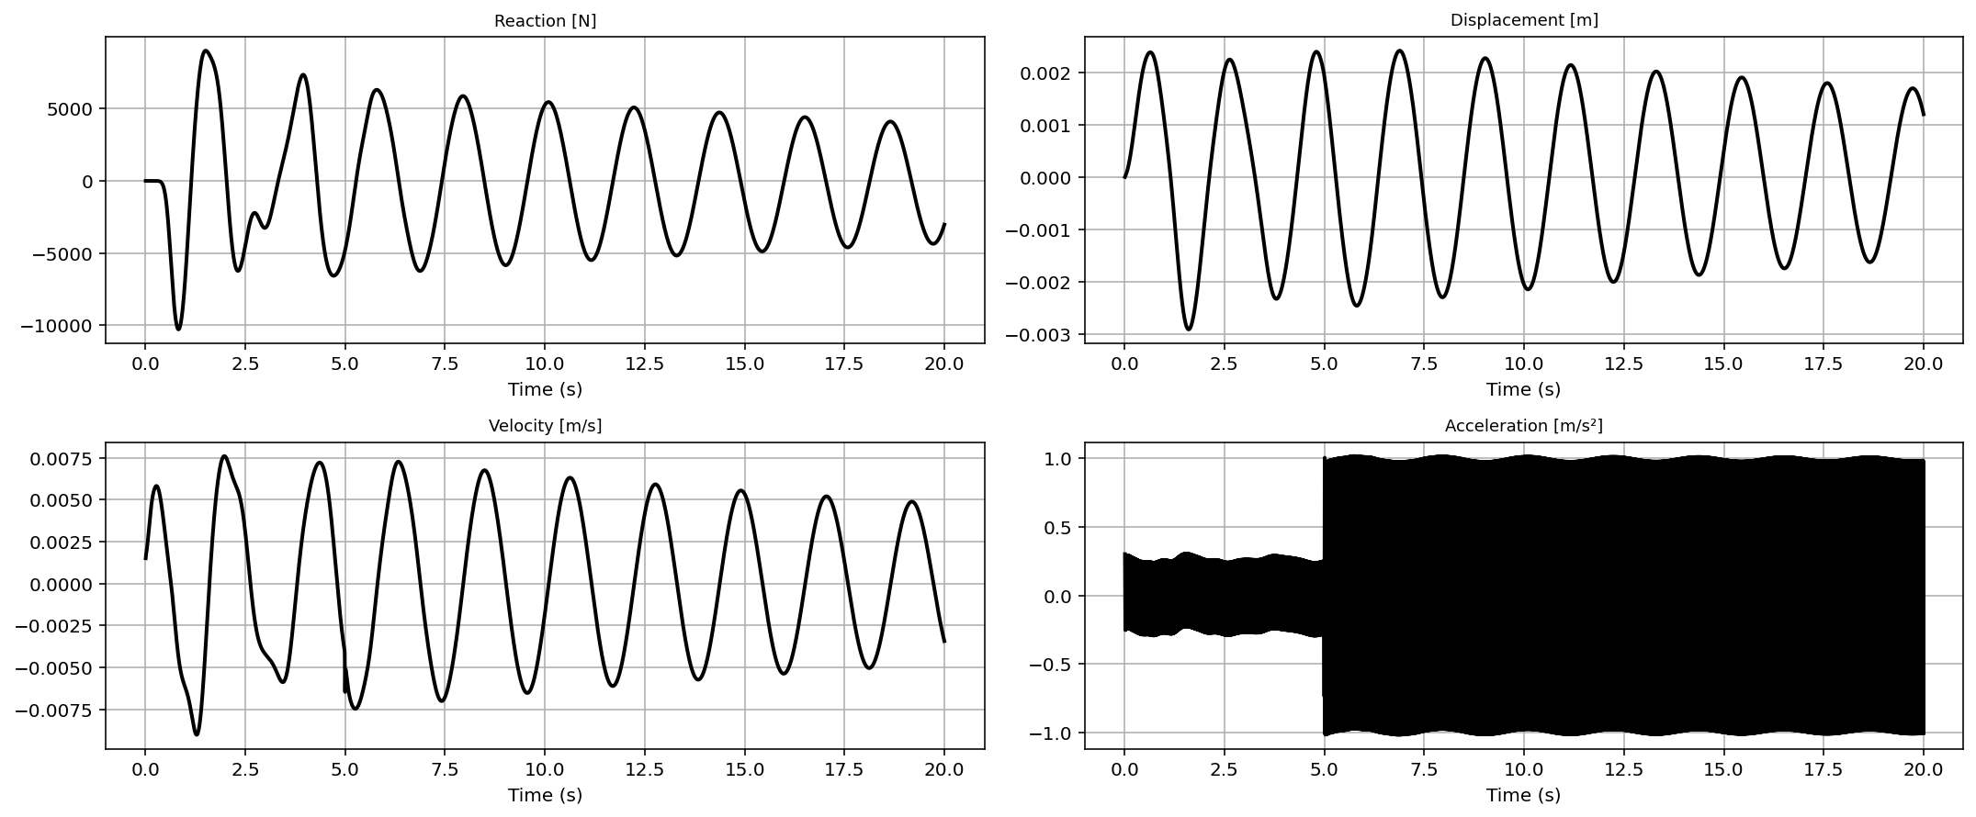

Slide 44
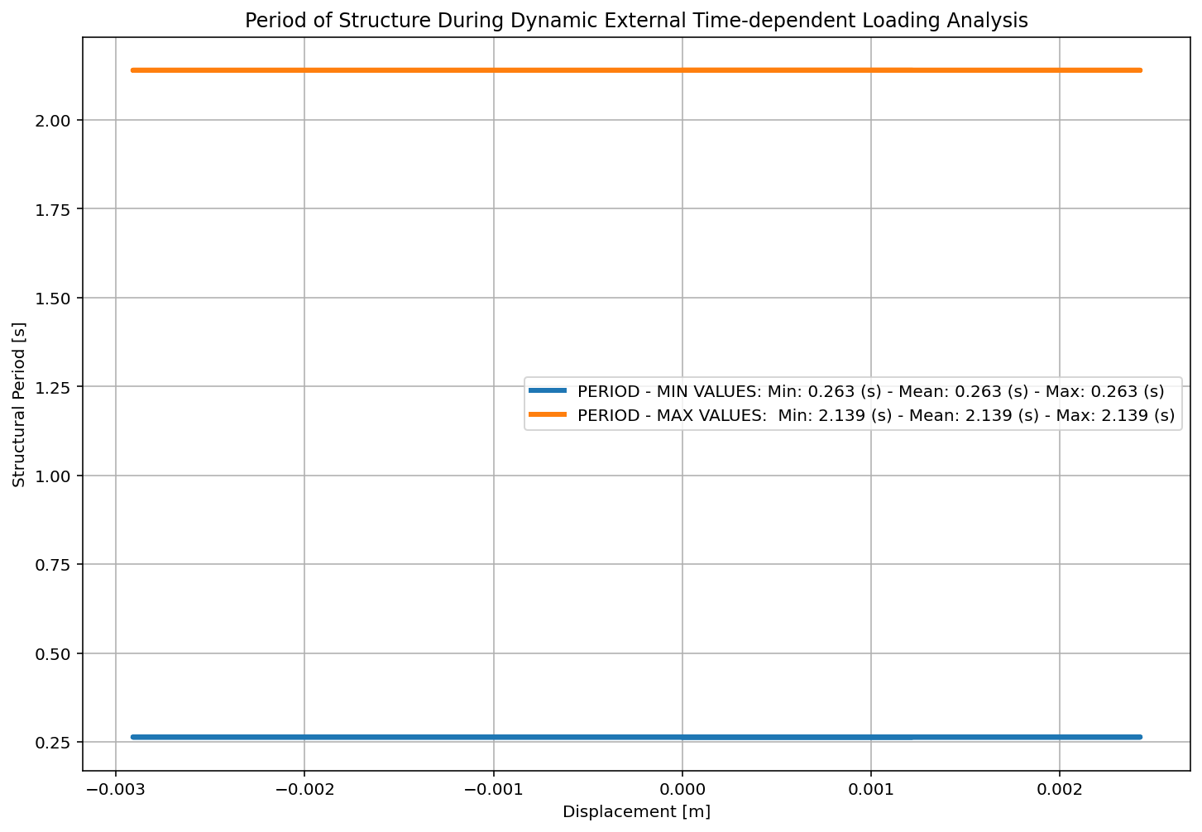

Slide 45
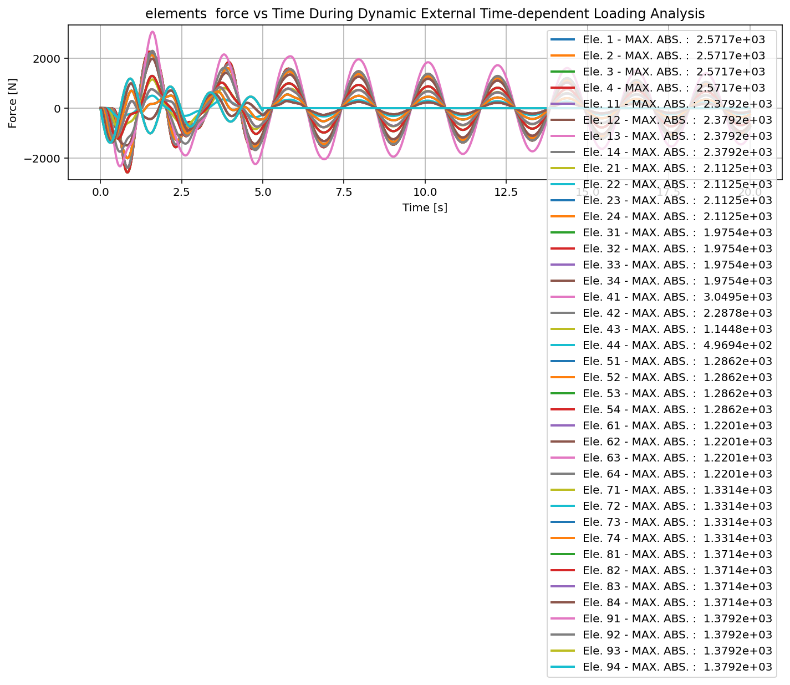

Slide 46
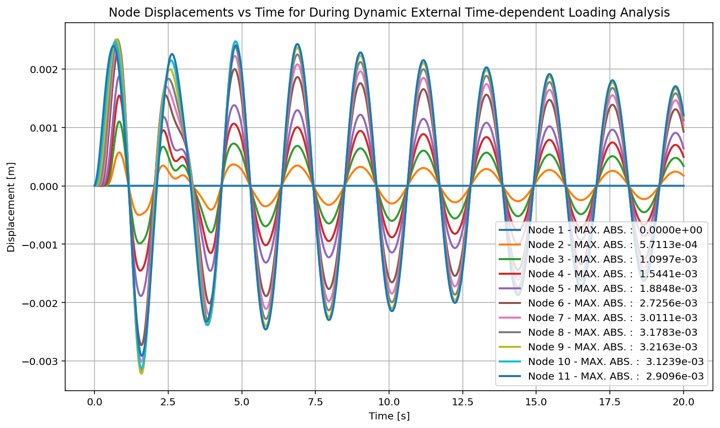

Slide 47


Slide 48
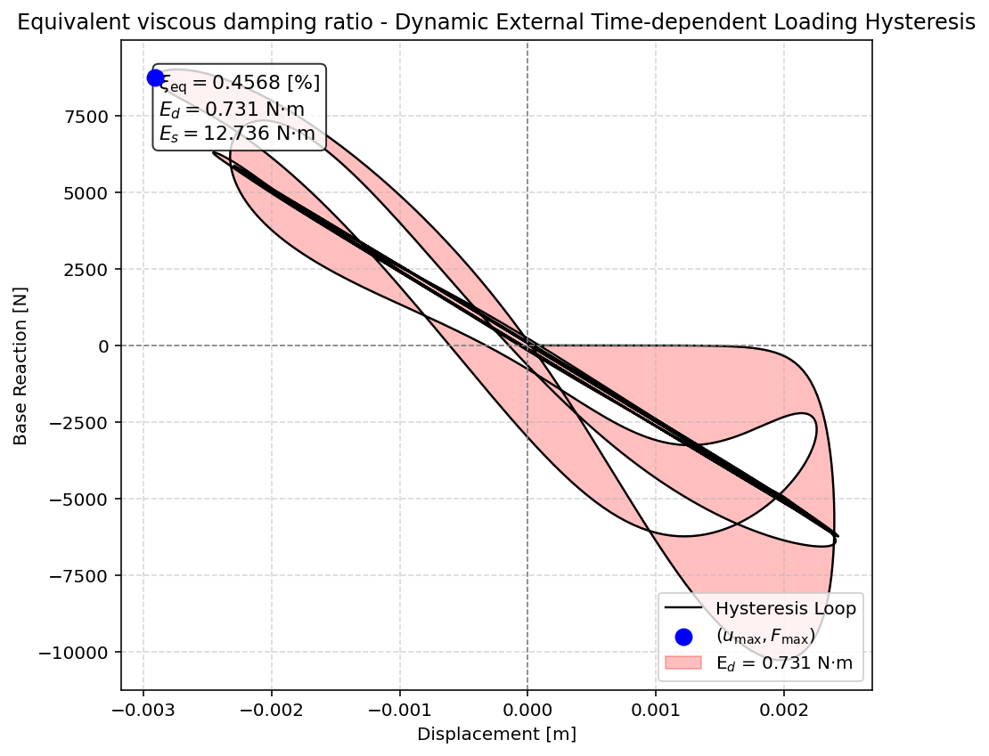

Slide 49


Slide 50
FREE-VIBRATION ANALYSIS

Slide 51
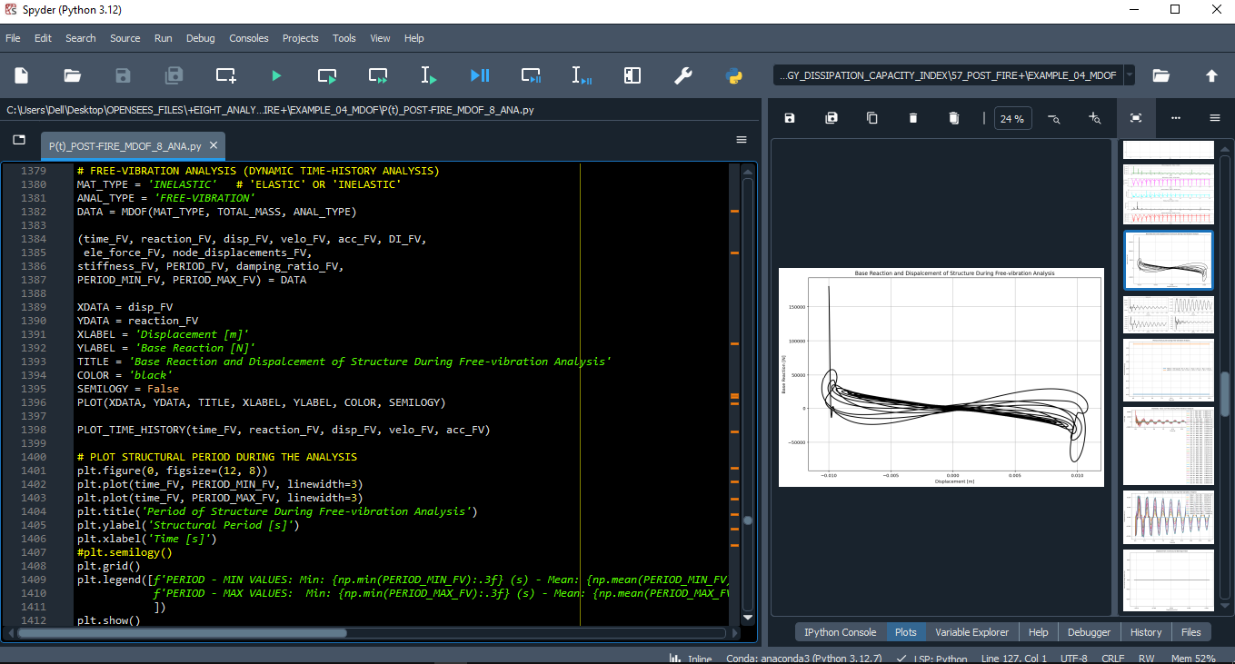

Slide 52
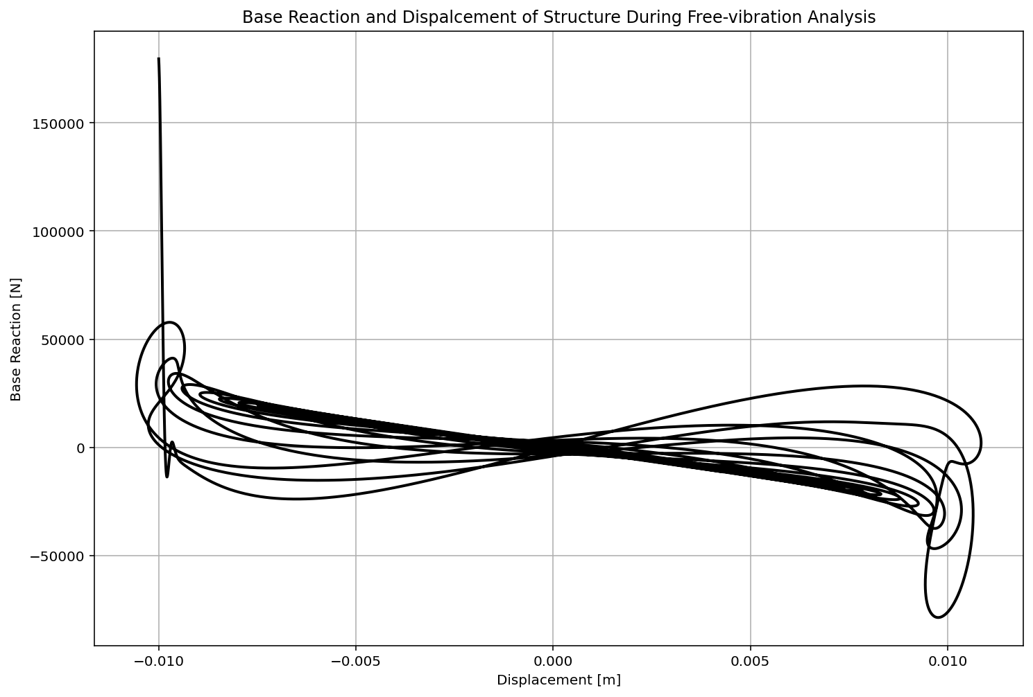

Slide 53
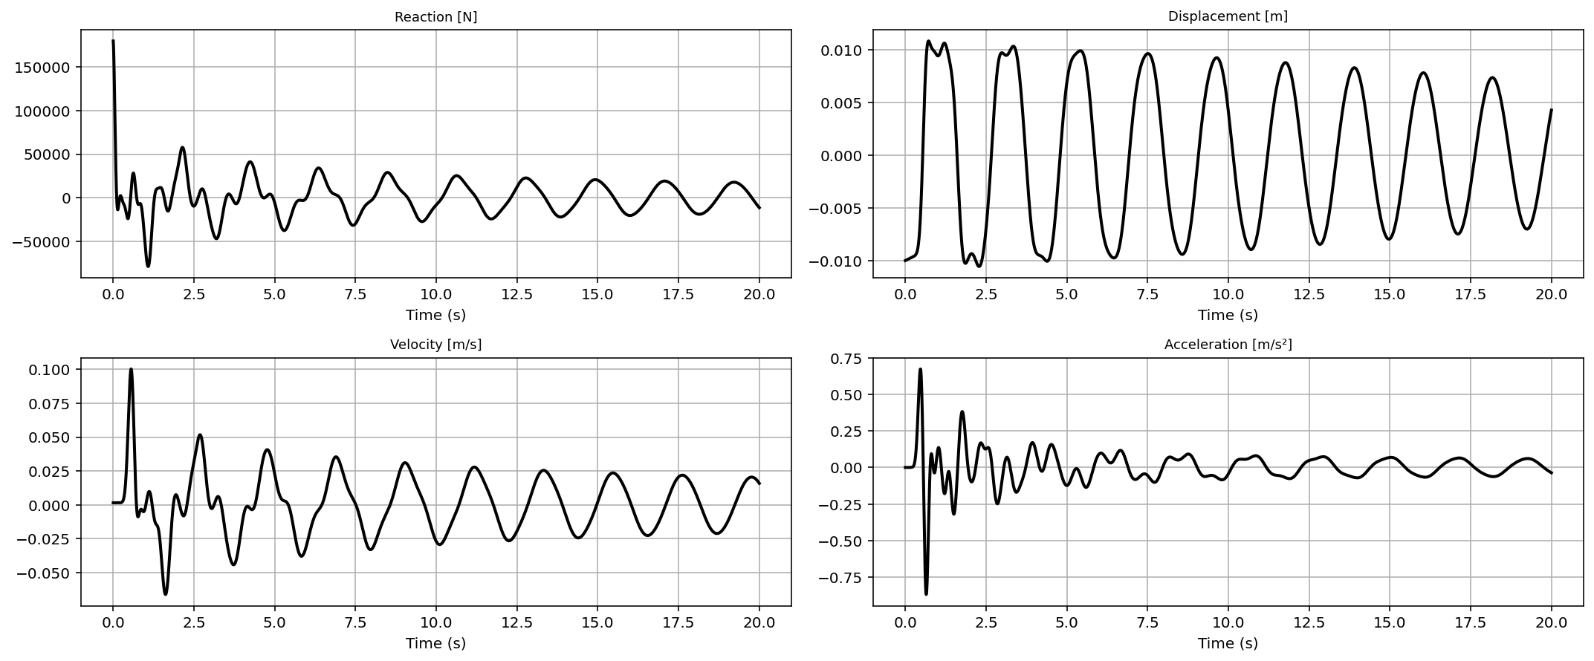

Slide 54
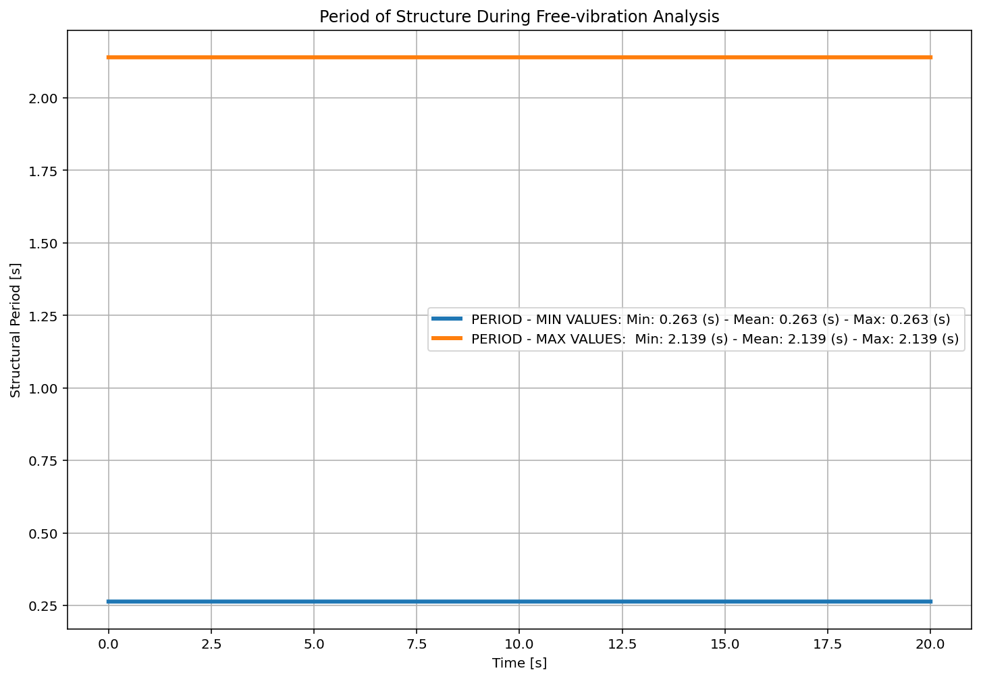

Slide 55
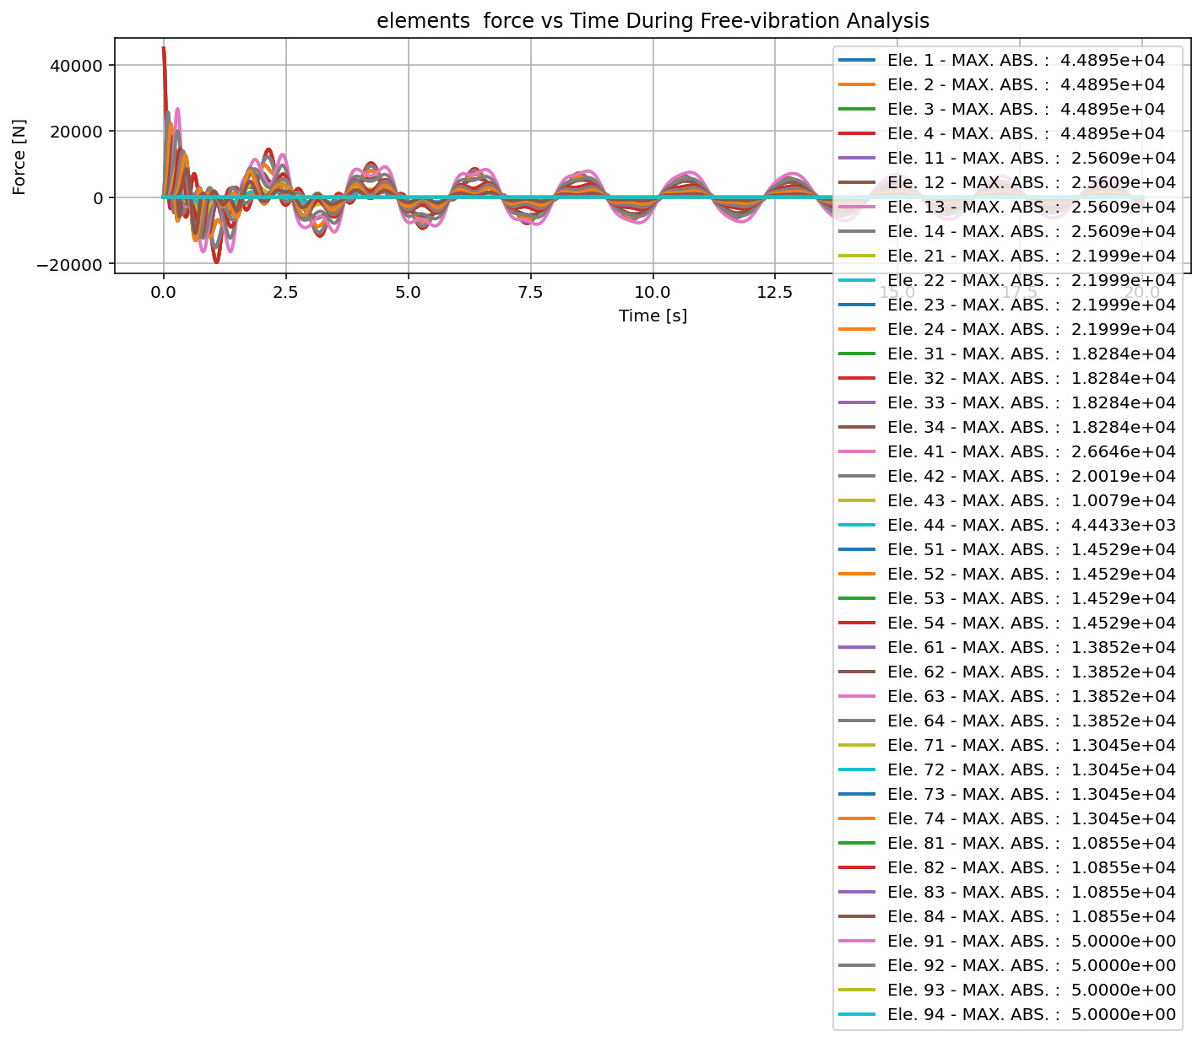

Slide 56
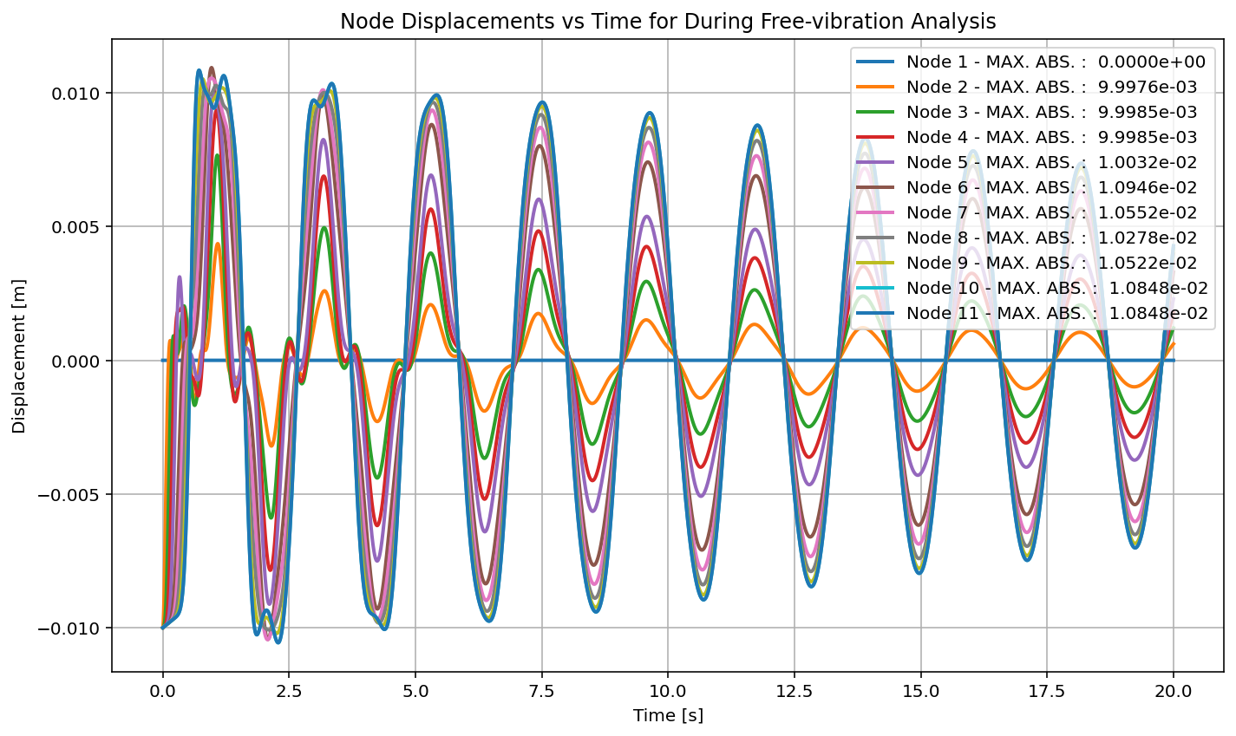

Slide 57
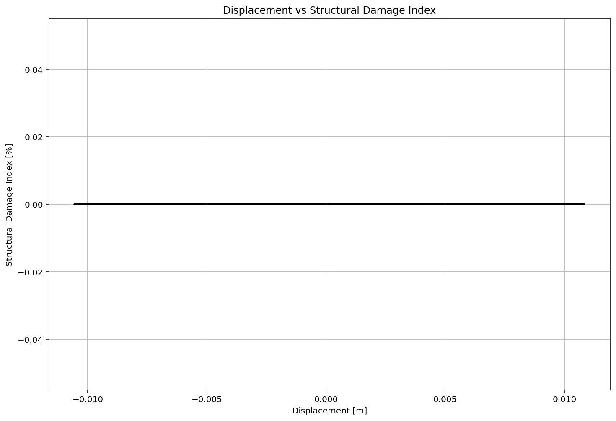

Slide 58
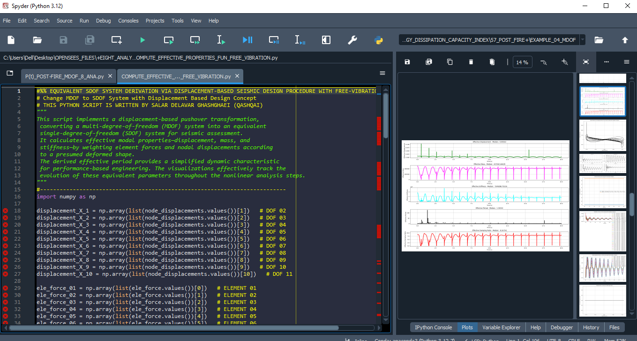

Slide 59



Slide 60


Slide 61


Slide 62


Slide 63


Slide 64


Slide 65
SEISMIC ANALYSIS

Slide 66


Slide 67


Slide 68


Slide 69


Slide 70


Slide 71


Slide 72


Slide 73


Slide 74


Slide 75


Slide 76


Slide 77


Slide 78


Slide 79


Slide 80
Dissipated Energy from Earthquake= 14513.74 N·m
Dissipated Energy from Cyclic Displacement= 652781.73 N·m
DISSIPATED ENERGY CAPACITY INDEX: 2.223 [%]
ZONE 1: VERY MINOR DAMAGE

Slide 81


Slide 82
+==========================+
= Analysis curve fitted =
Disp Base Shear
----------------------------
[[0.00000000e+00 0.00000000e+00]
[9.38225157e-02 2.71884725e+05]
[3.60000000e-01 3.23080863e+05]]
+==========================+
+----------------------------------------------------+
Structure Elastic Stiffness : 2897862.23
Structure Plastic Stiffness : 897446.84
Structure Tangent Stiffness : 192338.35
Structure Ductility Ratio : 3.84
Structure Over Strength Factor: 1.19
+----------------------------------------------------+
Over Strength Coefficient (Ω0): 1.1883
Displacement Ductility Ratio (μ): 3.8370
Ductility Coefficient (Rμ): 3.8370
Structural Behavior Coefficient (R): 4.5595
Structural Ductility Damage Index in X Direction: -12.0030 (%)

Slide 83


Slide 84


Slide 85


