Slide 1
>> IN THE NAME OF ALLAH, THE MOST GRACIOUS, THE MOST MERCIFUL <<
NONLINEAR PUSHOVER ANALYSIS OF A
NONPRISMATIC STEEL GABLE FRAME. MODELING OF NONPRISMATIC ELEMENT WITH MULTI PRISMATIC ELEMENTS USING OPENSEES.
WRITTEN BY SALAR DELAVAR GHASHGHAEI (QASHQAI)

Slide 2
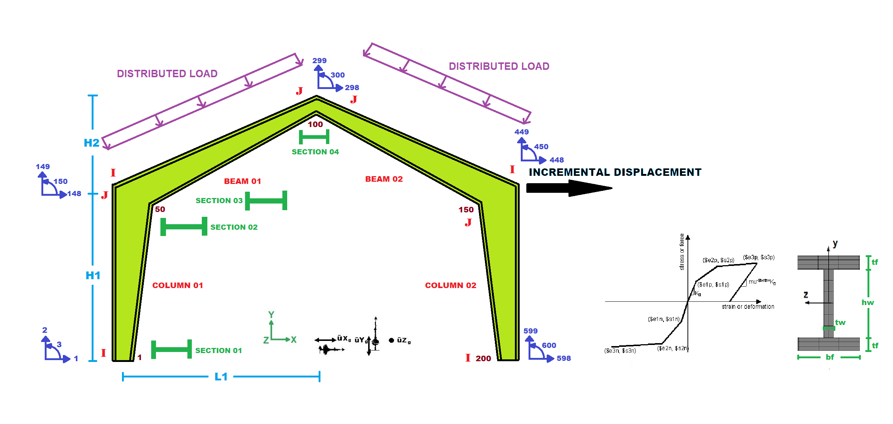

Slide 3
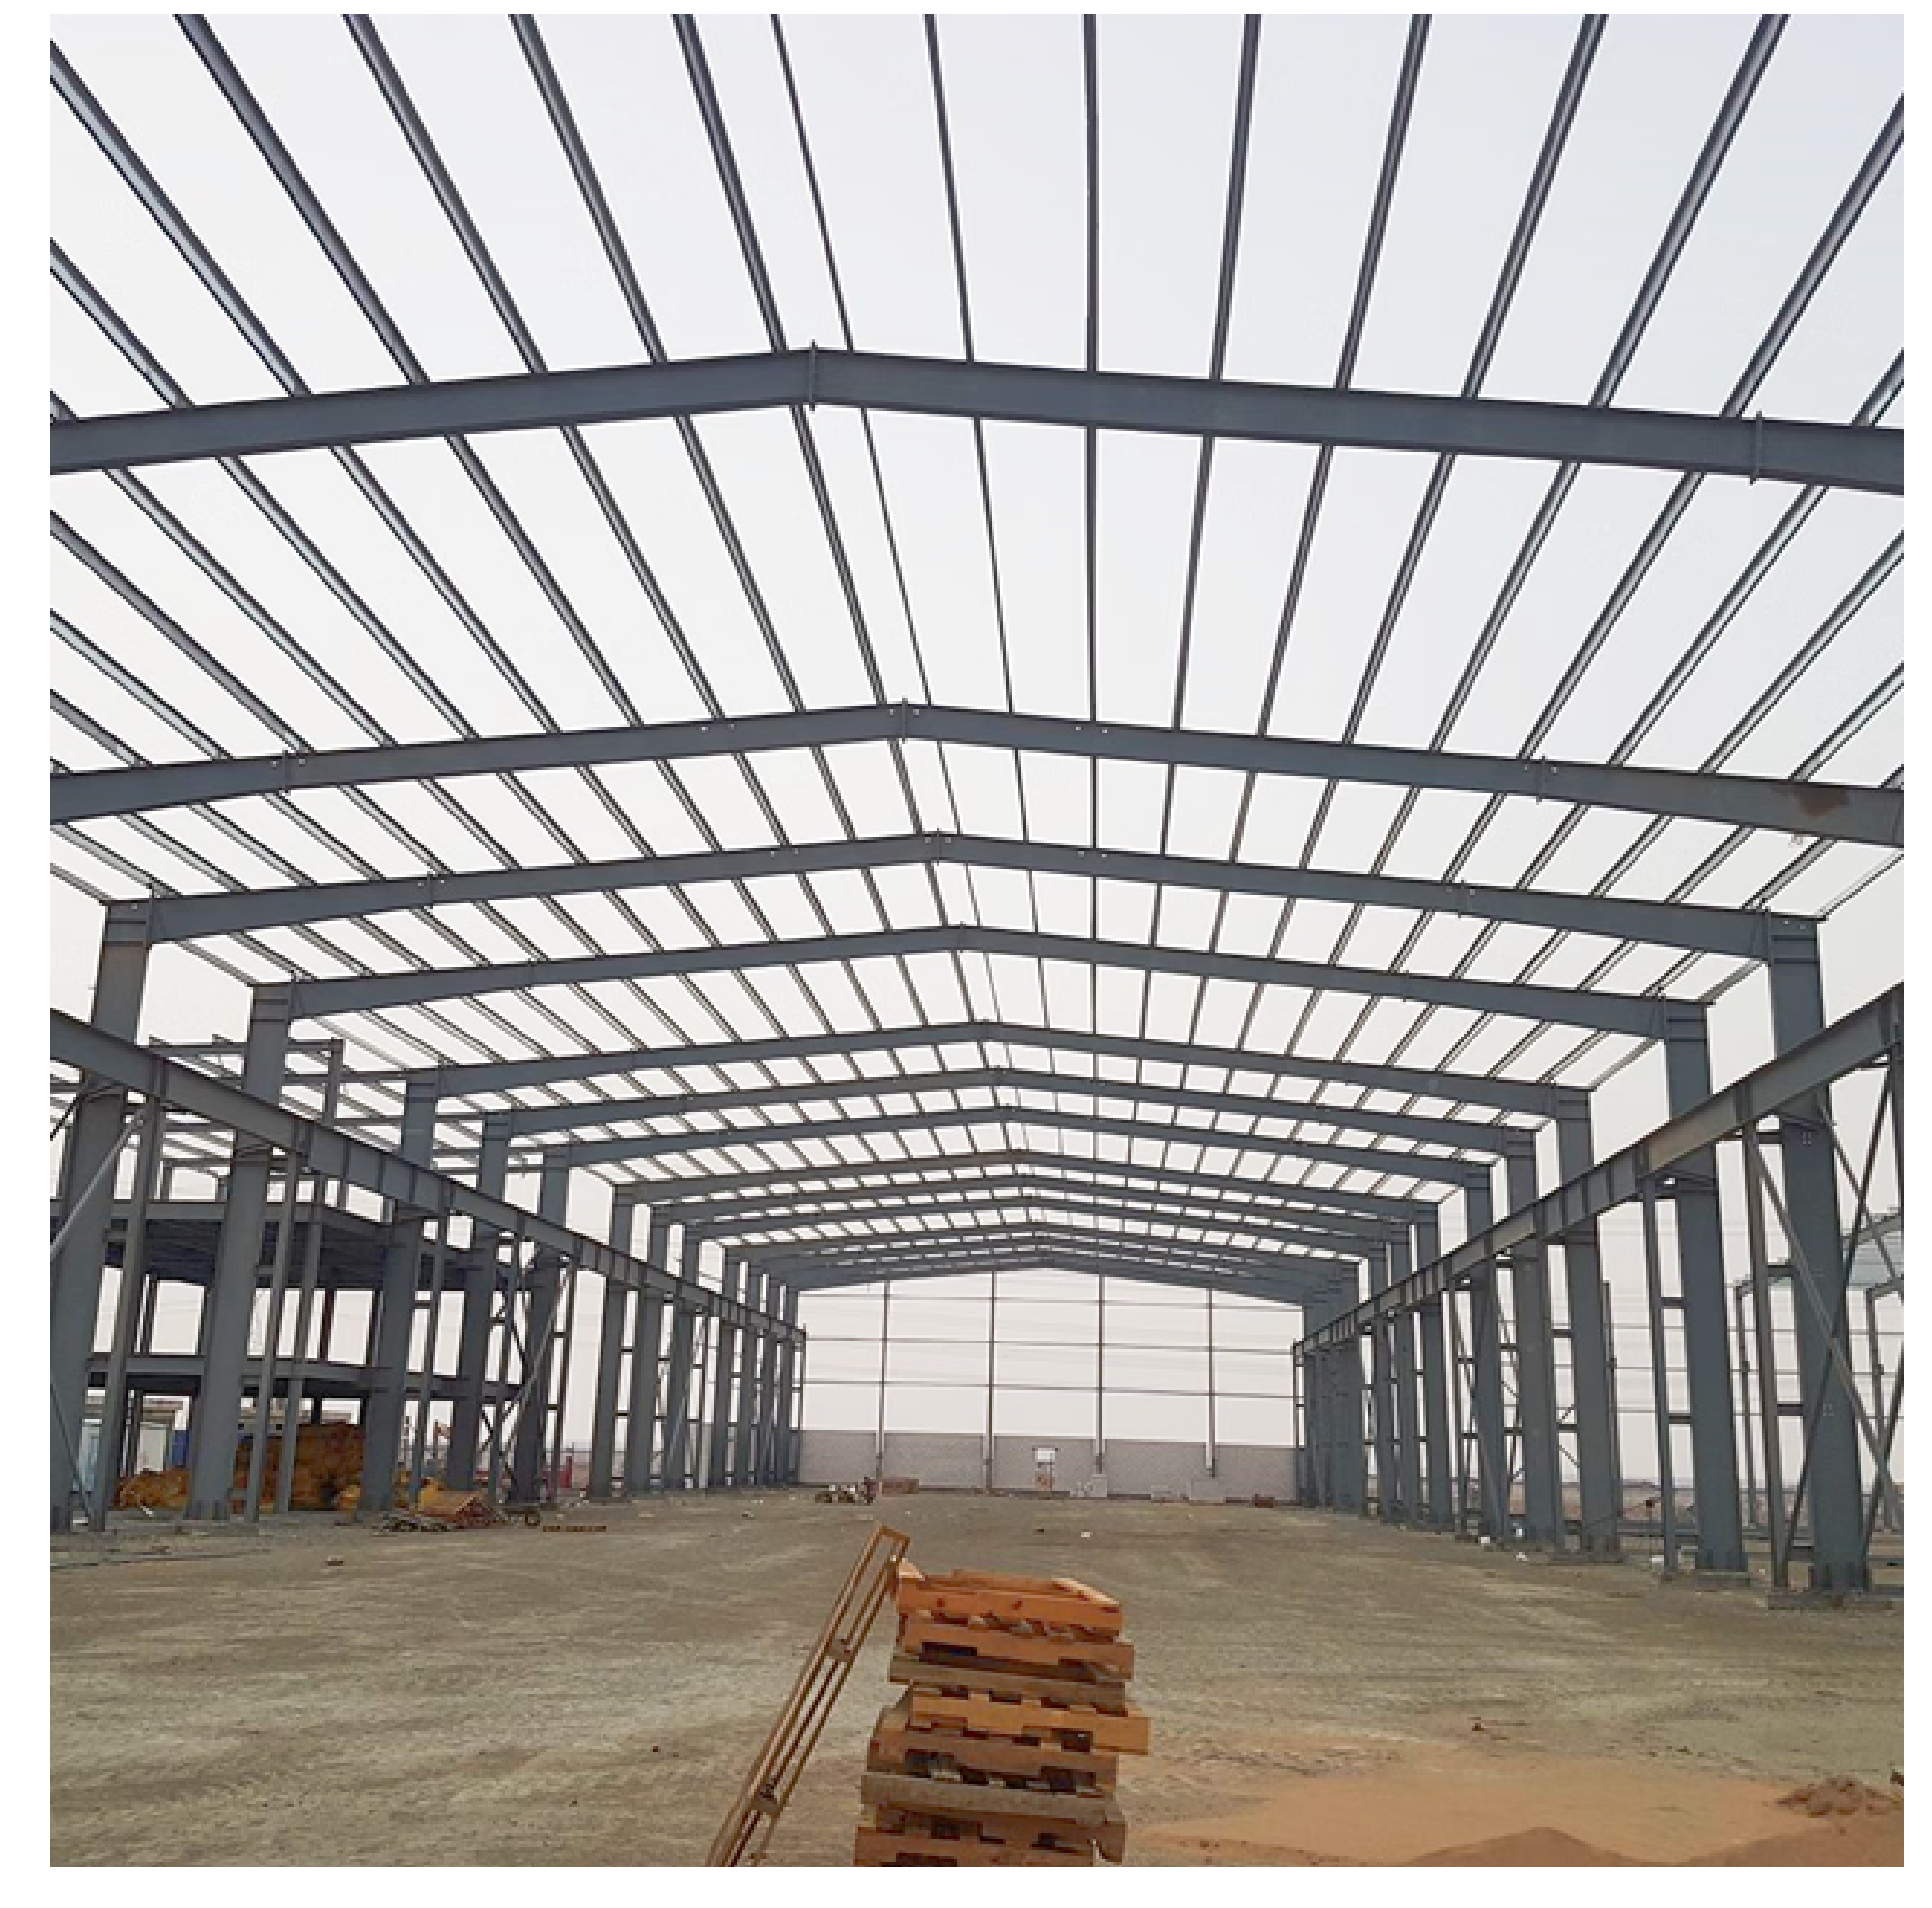

Slide 4
NONLINEAR PUSHOVER ANALYSIS OF A
NONPRISMATIC STEEL GABLE FRAME

Slide 5
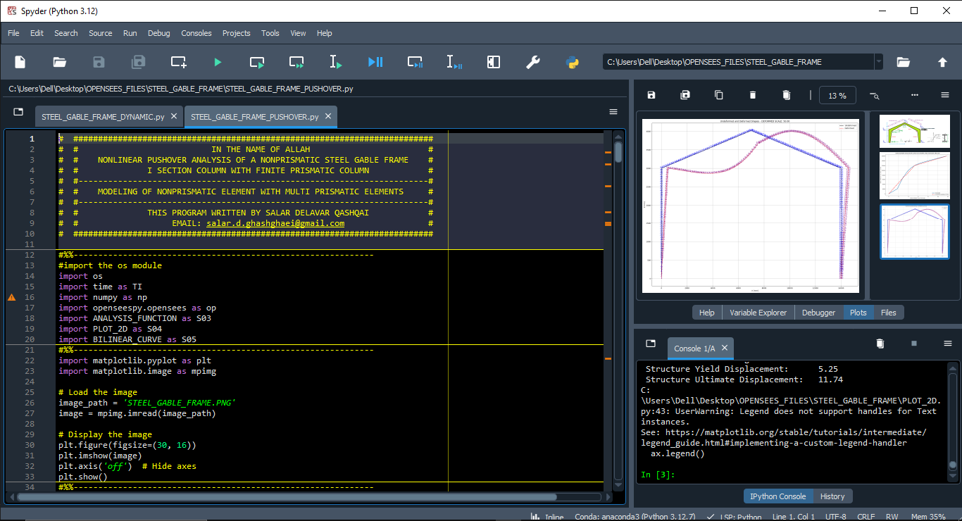

Slide 6
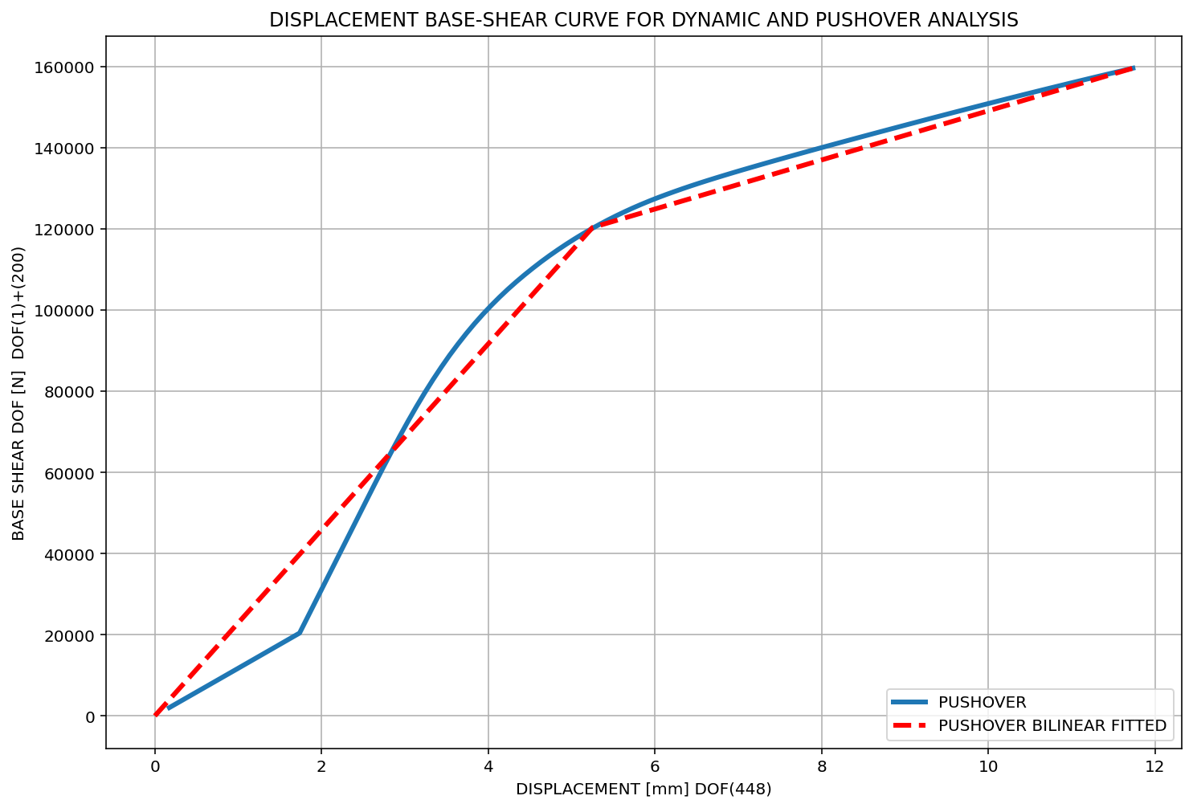
### STRUCTURAL PARAMETERS BASED ON ANALYSIS ###
==================================================== Structure Elastic Stiffness : 22917.41
Structure Plastic Stiffness : 13601.47
Structure Tangent Stiffness : 6053.57
Structure Ductility Ratio : 2.23
Structure Over Strength Factor: 1.33
Structure Yield Displacement: 5.25
Structure Ultimate Displacement: 11.74

Slide 7
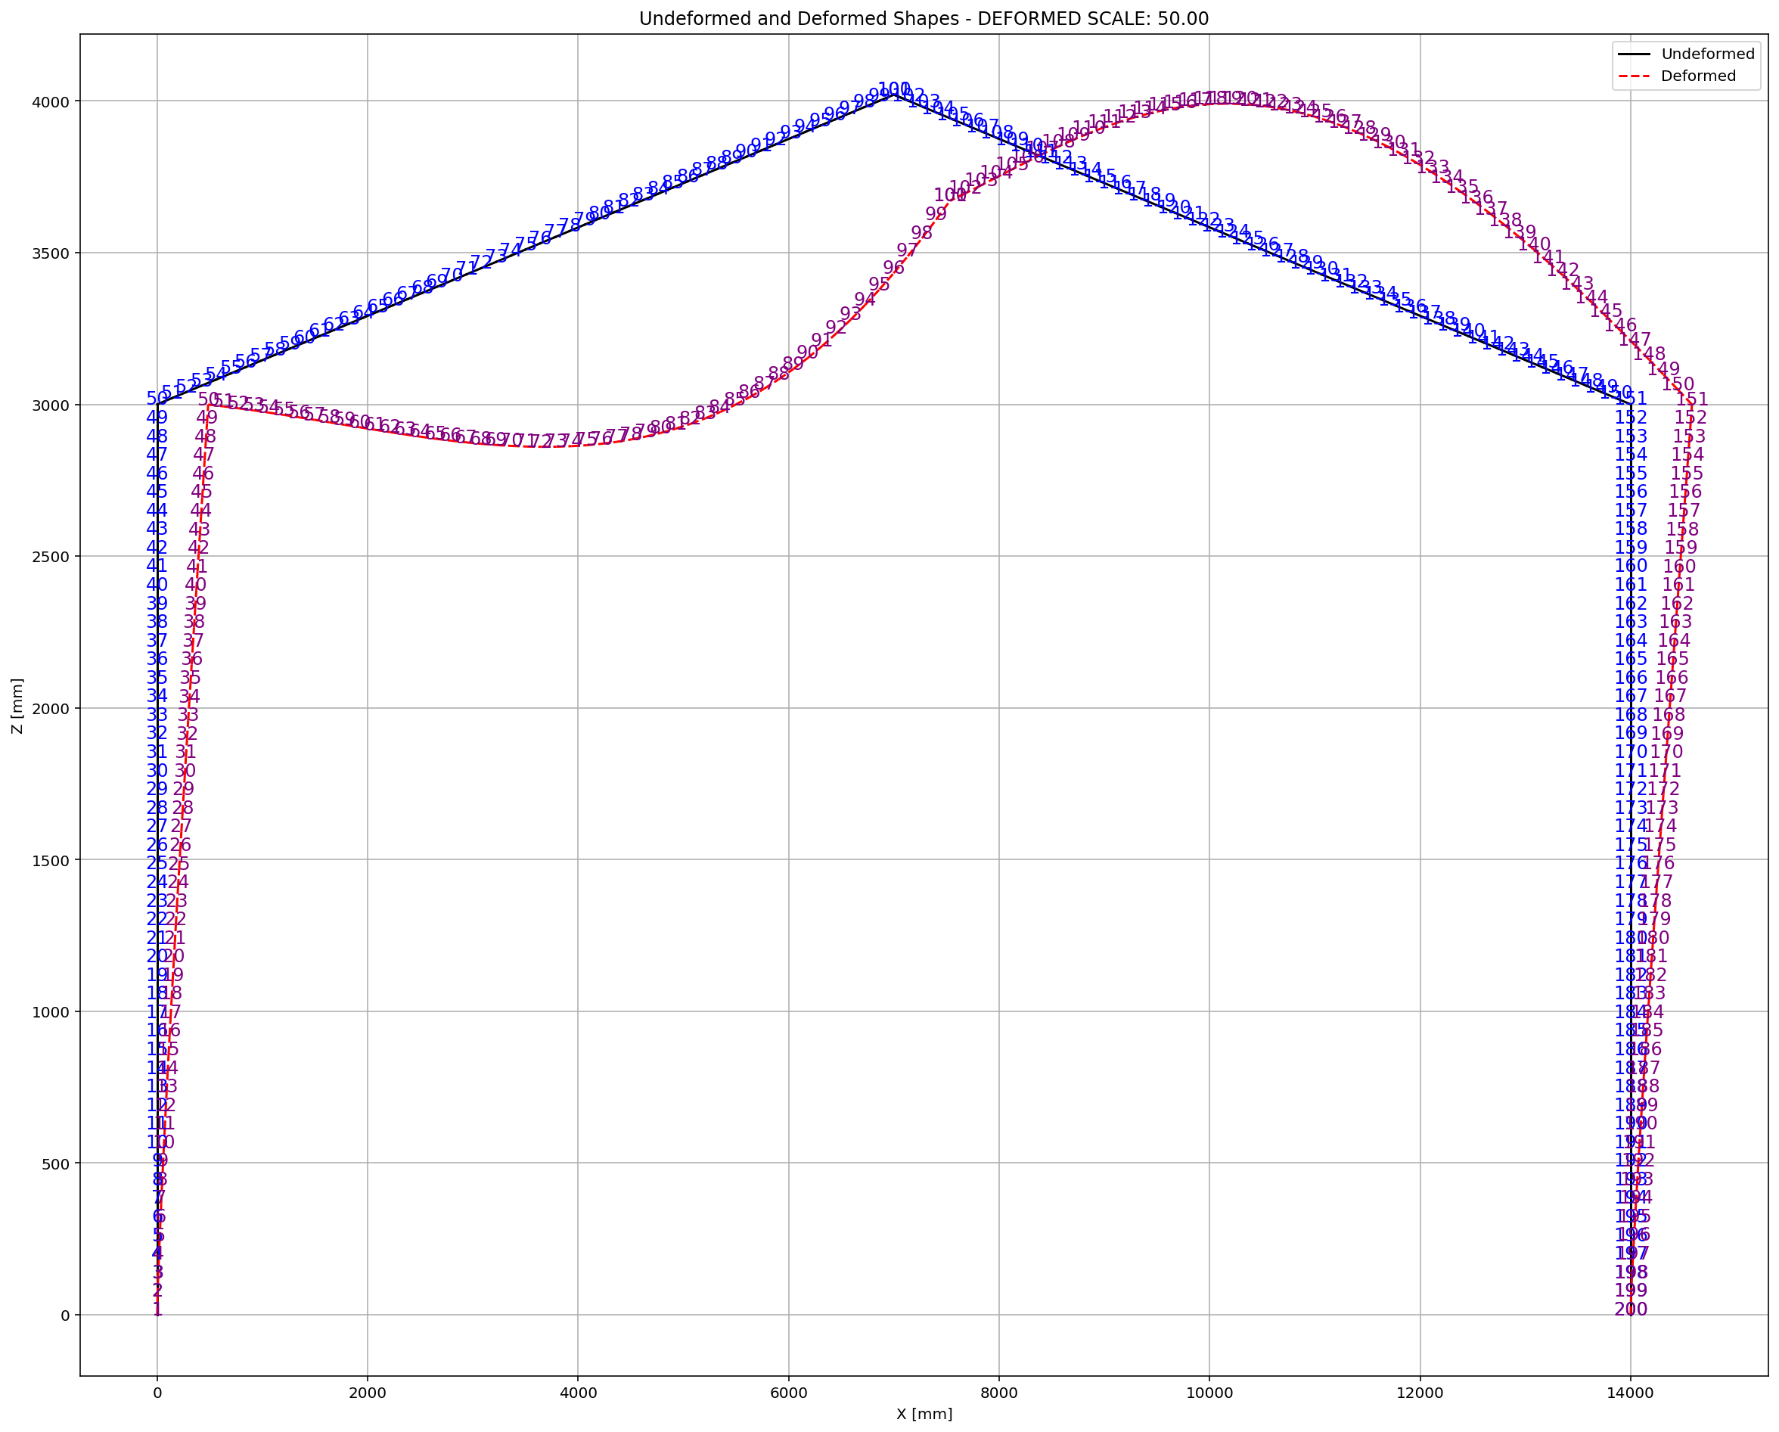

Slide 8
NONLINEAR DYNAMIC ANALYSIS OF A
NONPRISMATIC STEEL GABLE FRAME

Slide 9
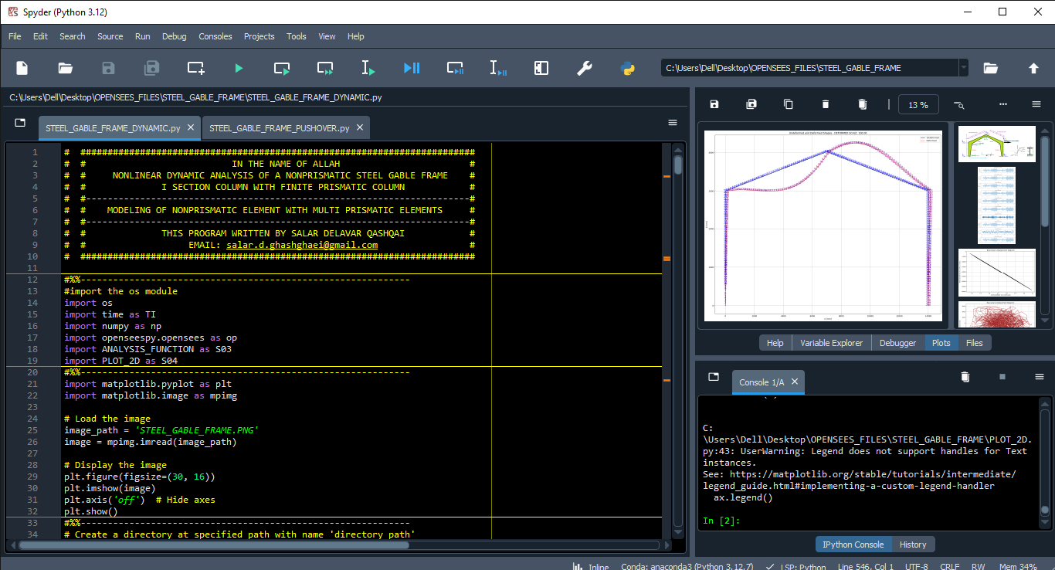

Slide 10
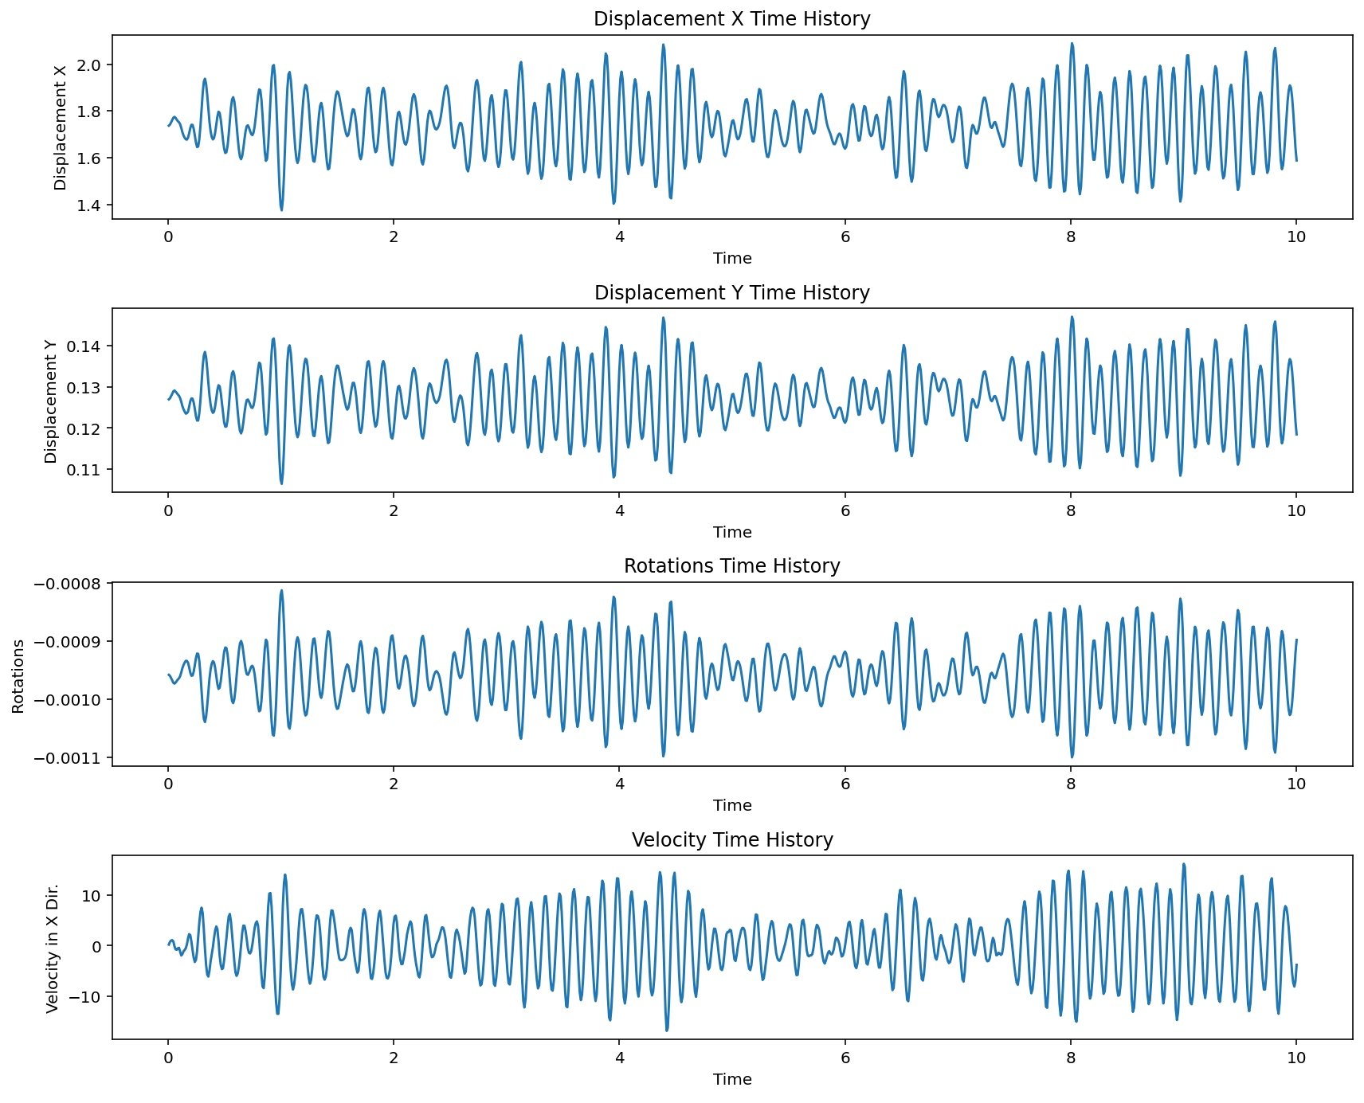

Slide 11
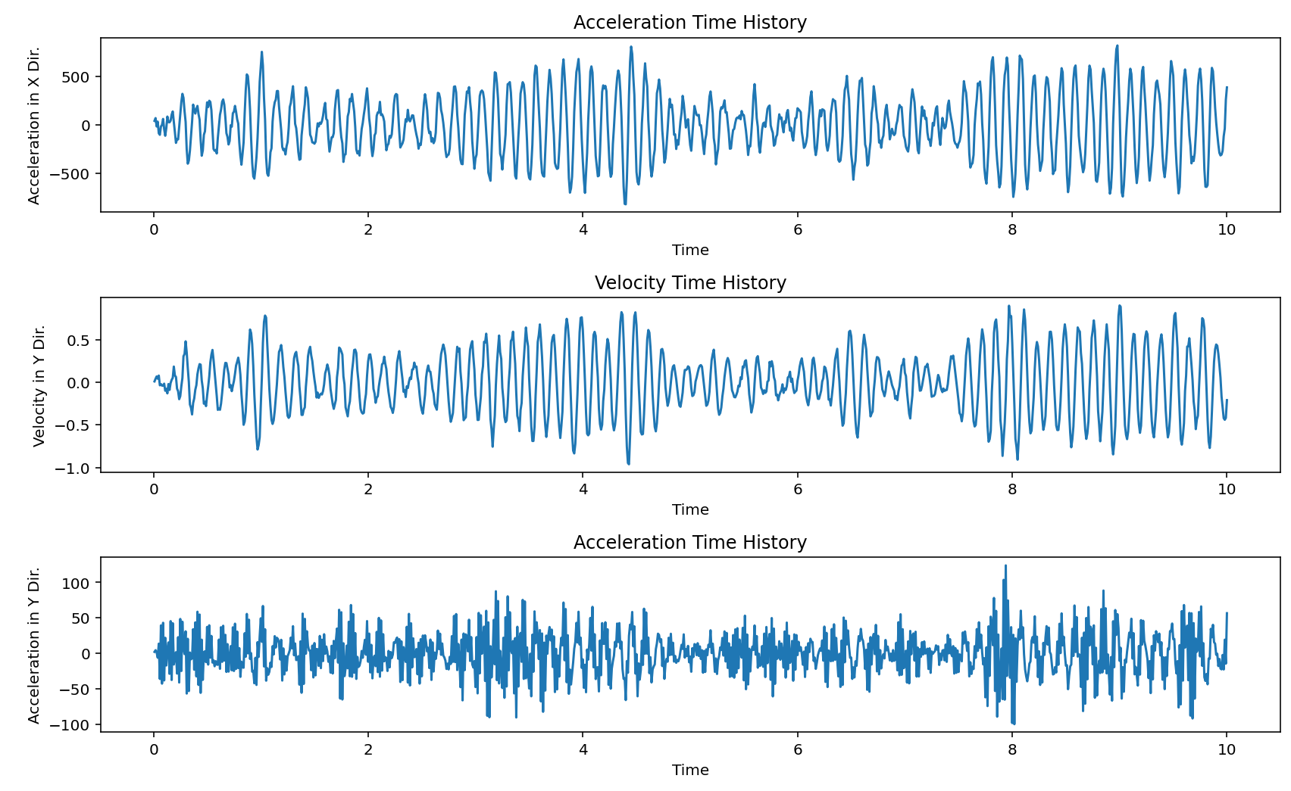

Slide 12
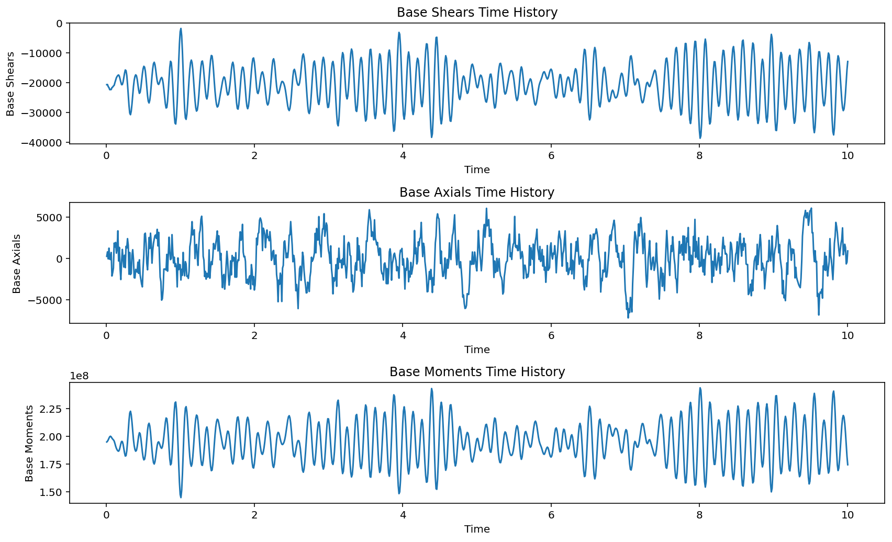

Slide 13
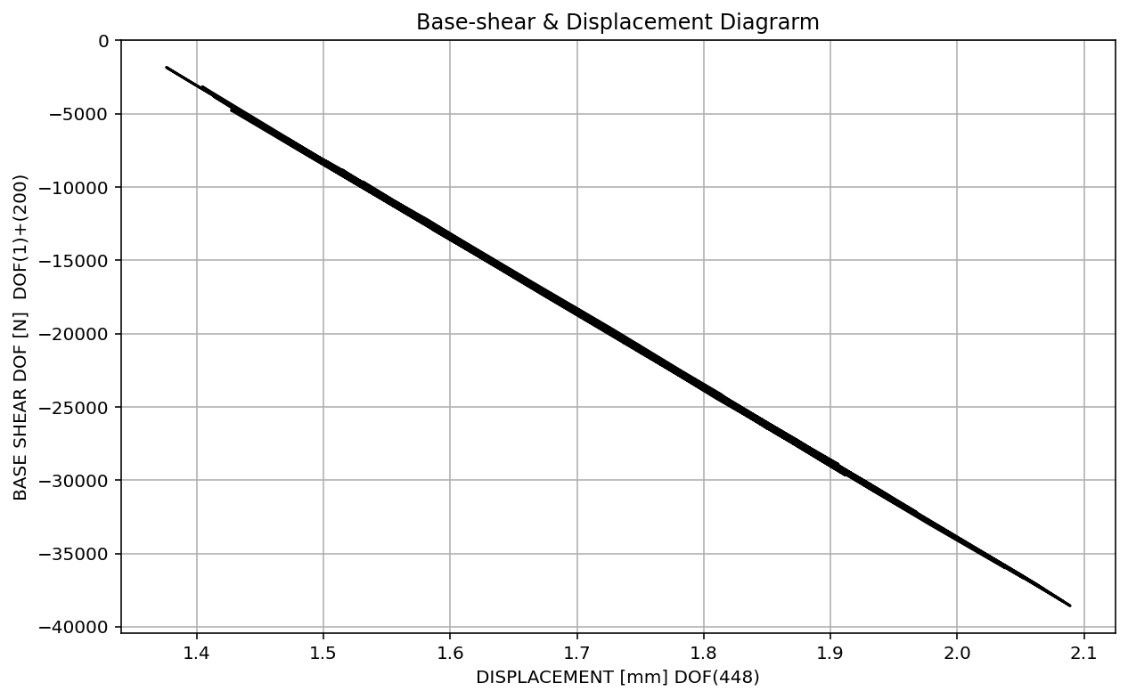

Slide 14
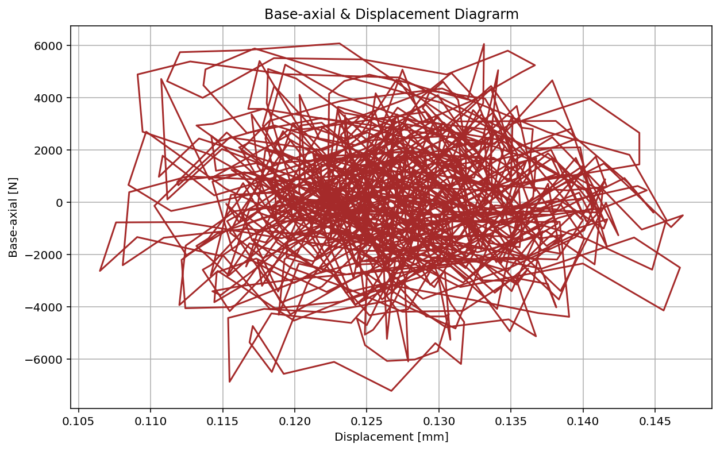

Slide 15
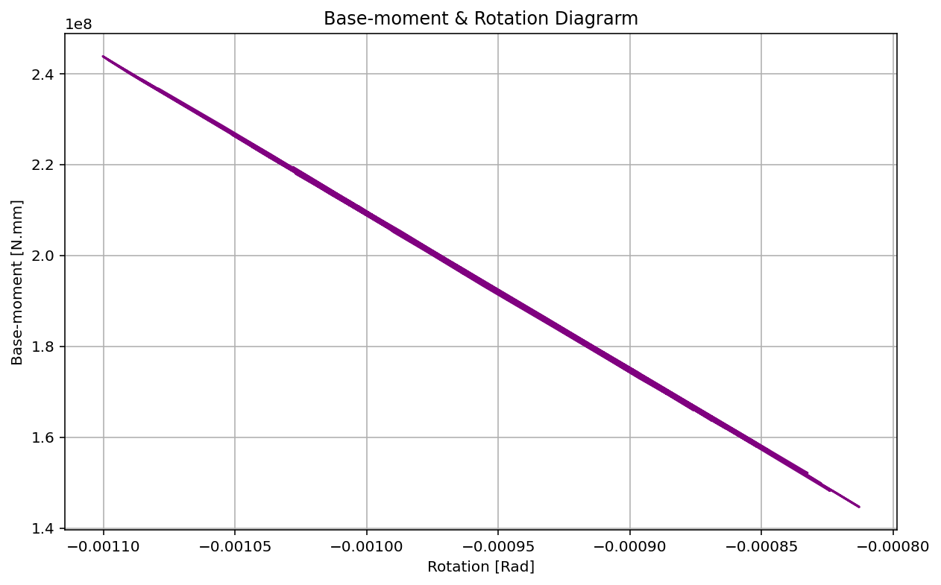

Slide 16
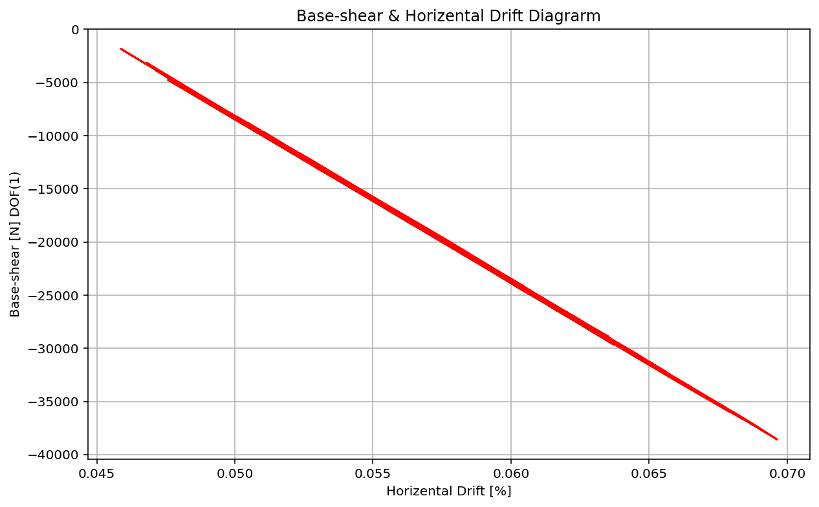

Slide 17
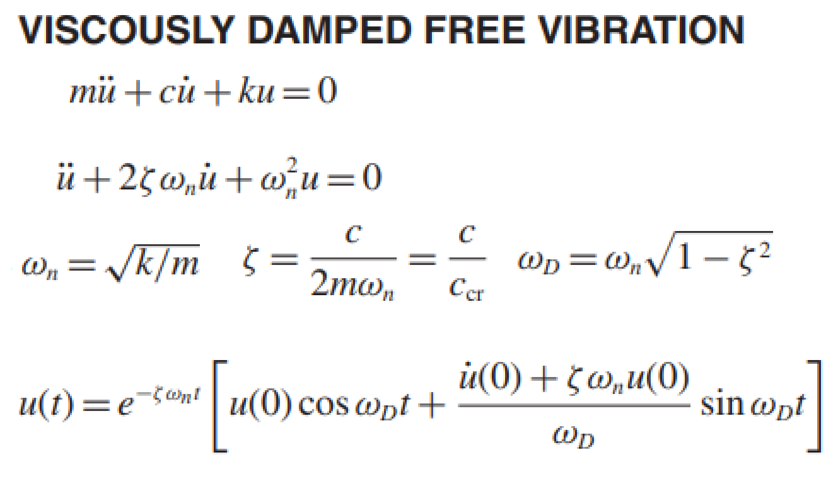
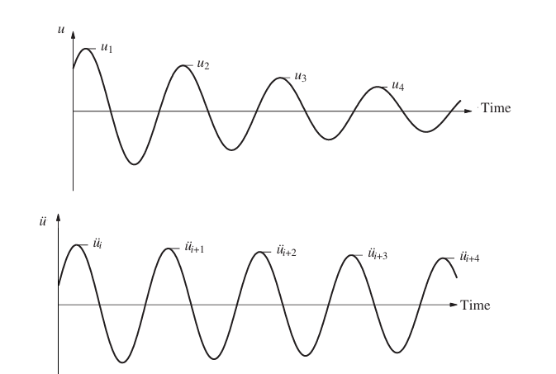
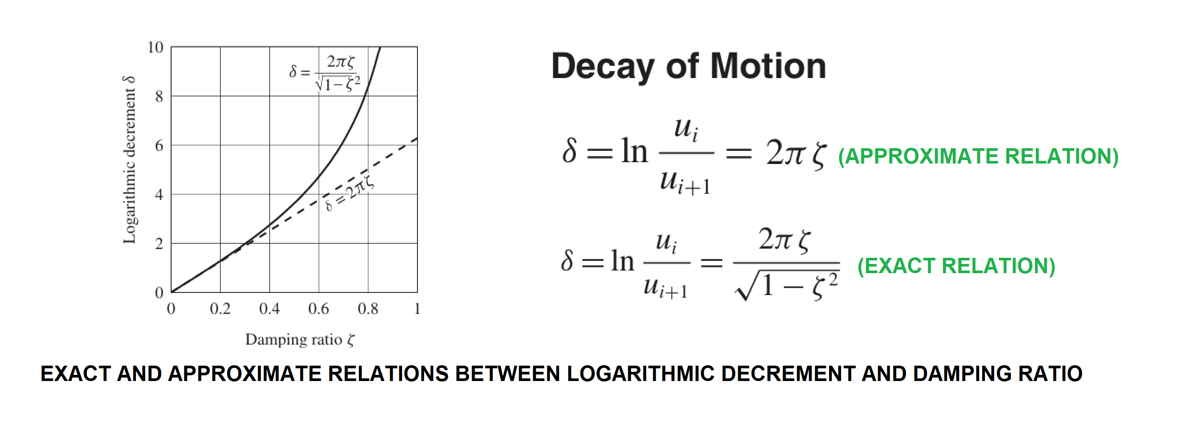
Exact Damping Ratio: 1.50494054e-04

Slide 18
