Slide 1
>> IN THE NAME OF ALLAH, THE MOST GRACIOUS, THE MOST MERCIFUL <<
COMPREHENSIVE NONLINEAR SEISMIC ASSESSMENT OF A COMPOSITE BEAM SECTION SIMPILY SUPPORTED : AN OPENSEES FRAMEWORK FOR STATIC PUSHOVER, CYCLIC DEGRADATION, STATIC TIME-HISTORY AND DYNAMIC TIME-HISTORY ANALYSIS
THIS PROGRAM IS WRITTEN BY SALAR DELAVAR GHASHGHAEI (QASHQAI)

Slide 2
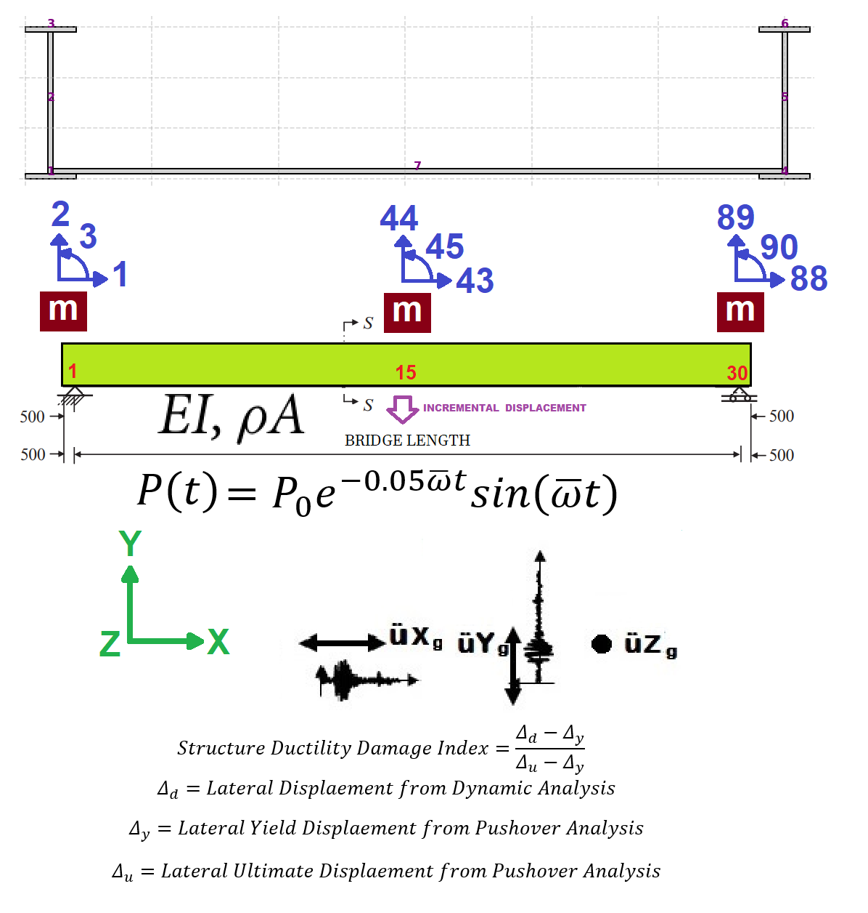
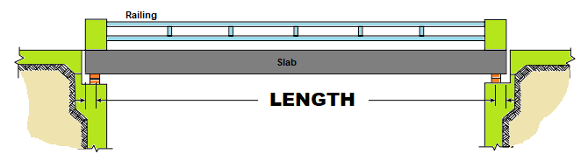

Slide 3
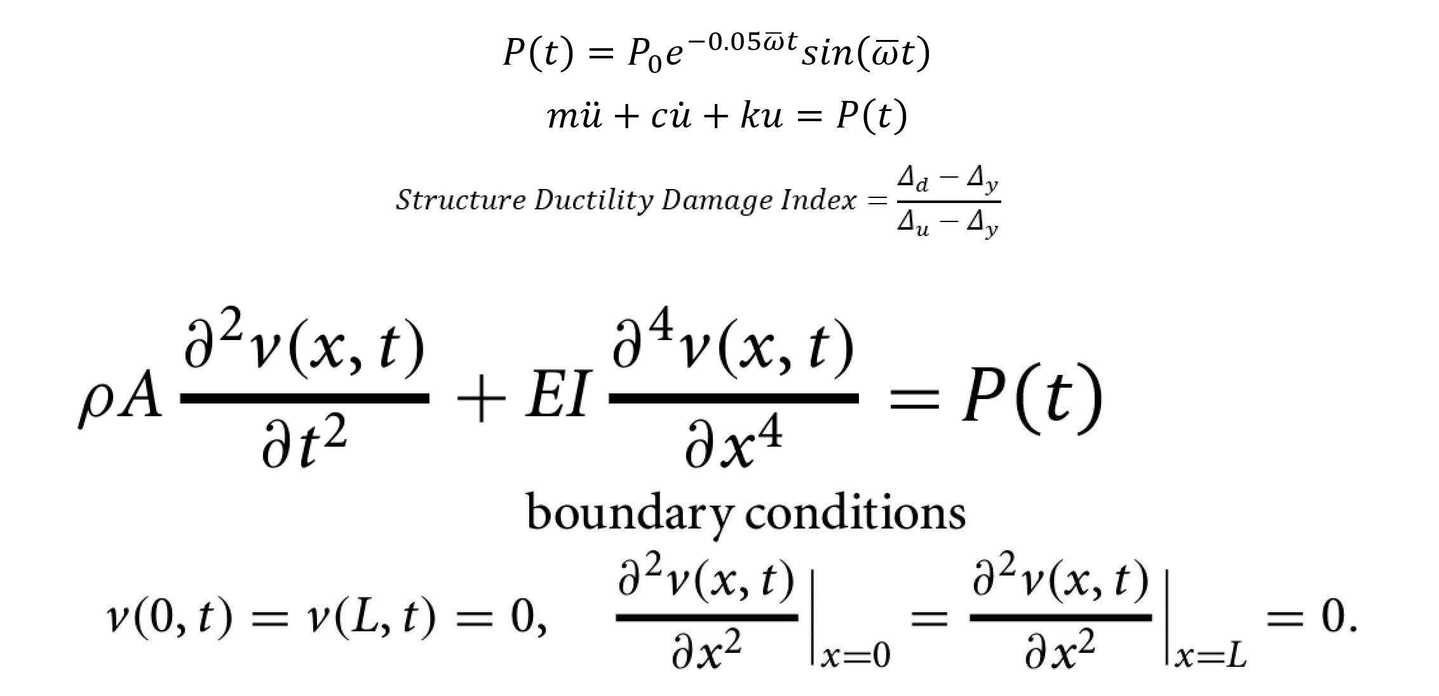

Slide 4


Slide 5


Slide 6


Slide 7
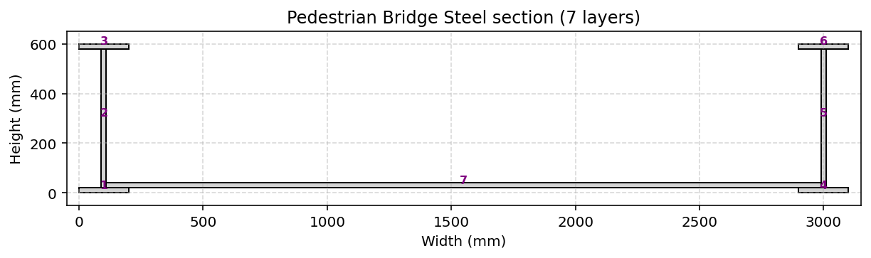

Slide 8
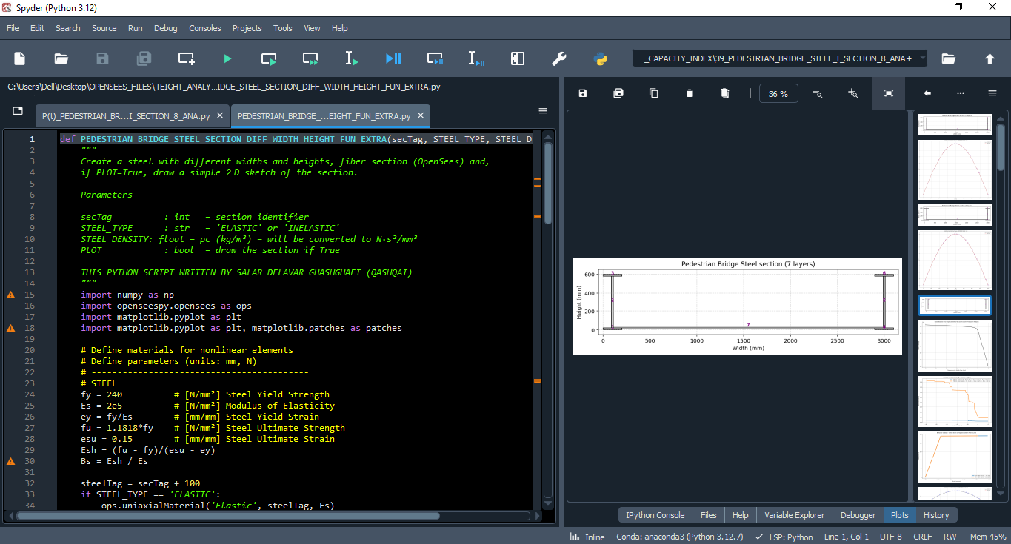

Slide 9
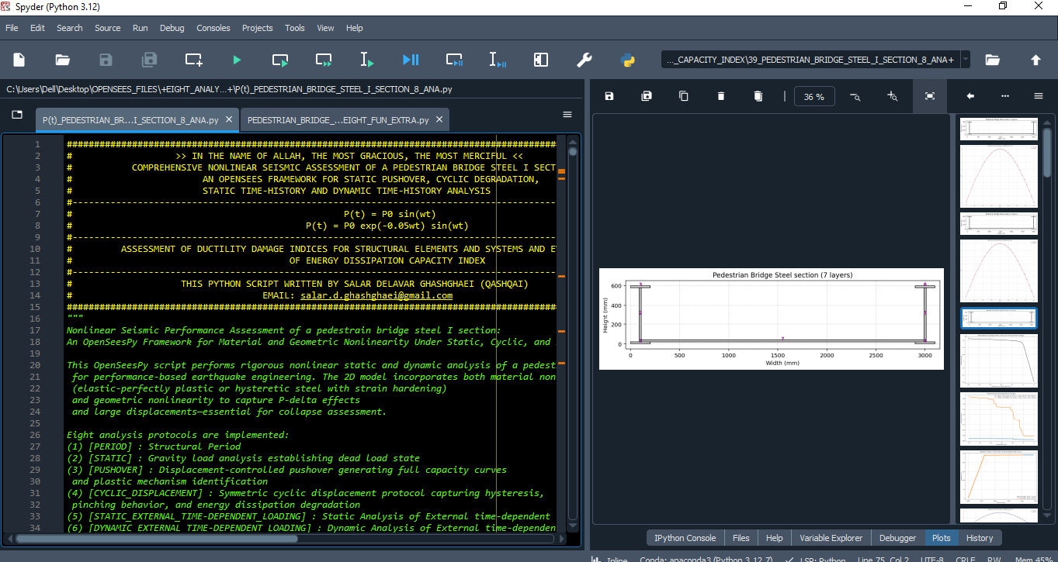

Slide 10
STATIC ANALYSIS

Slide 11
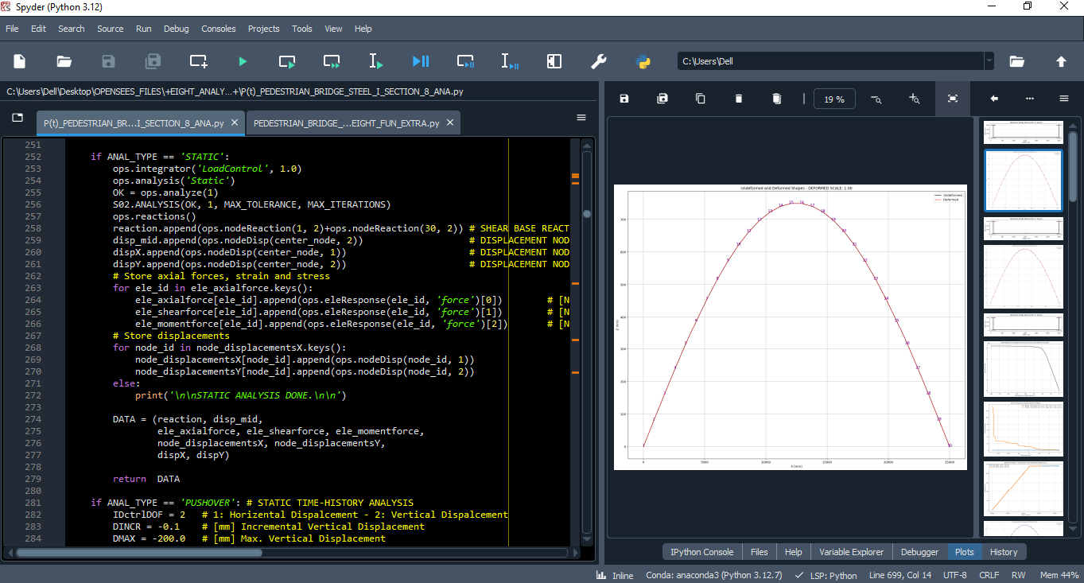

Slide 12
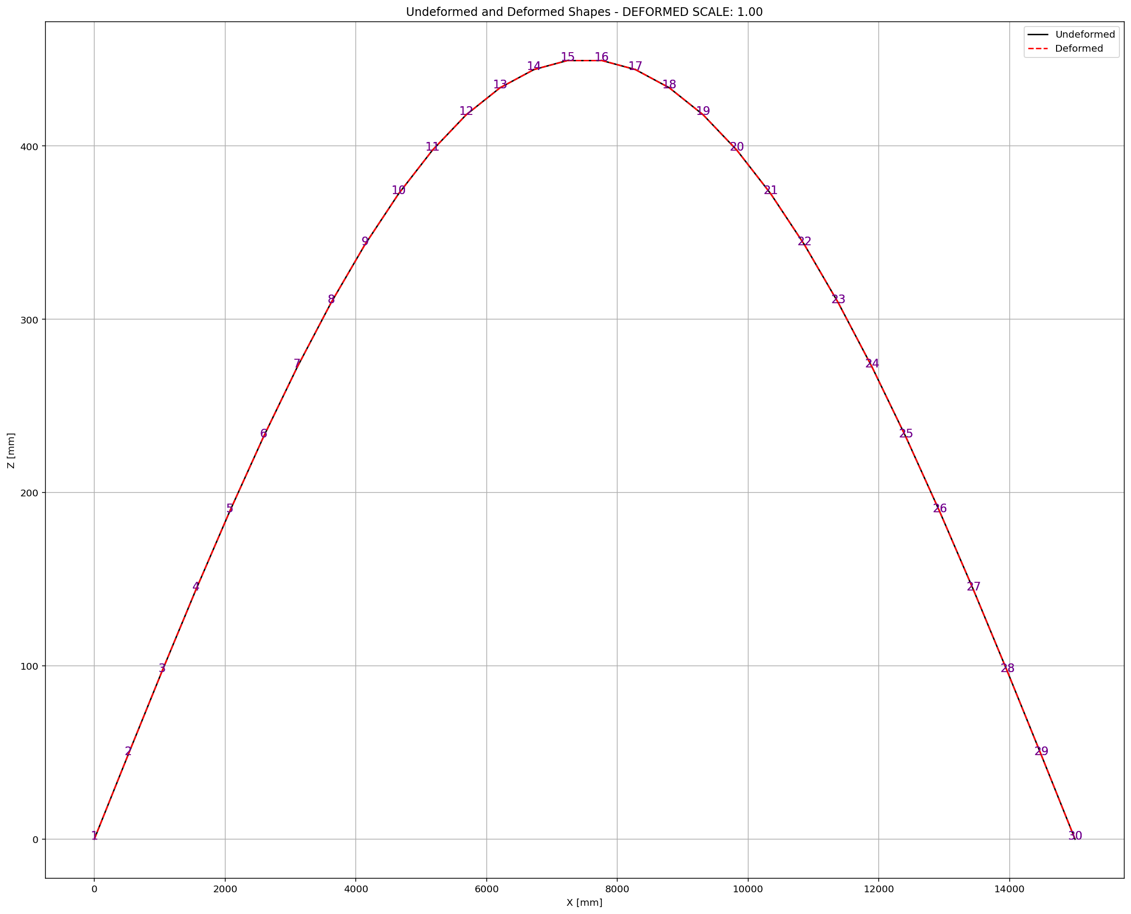

Slide 13
PUSHOVER ANALYSIS

Slide 14
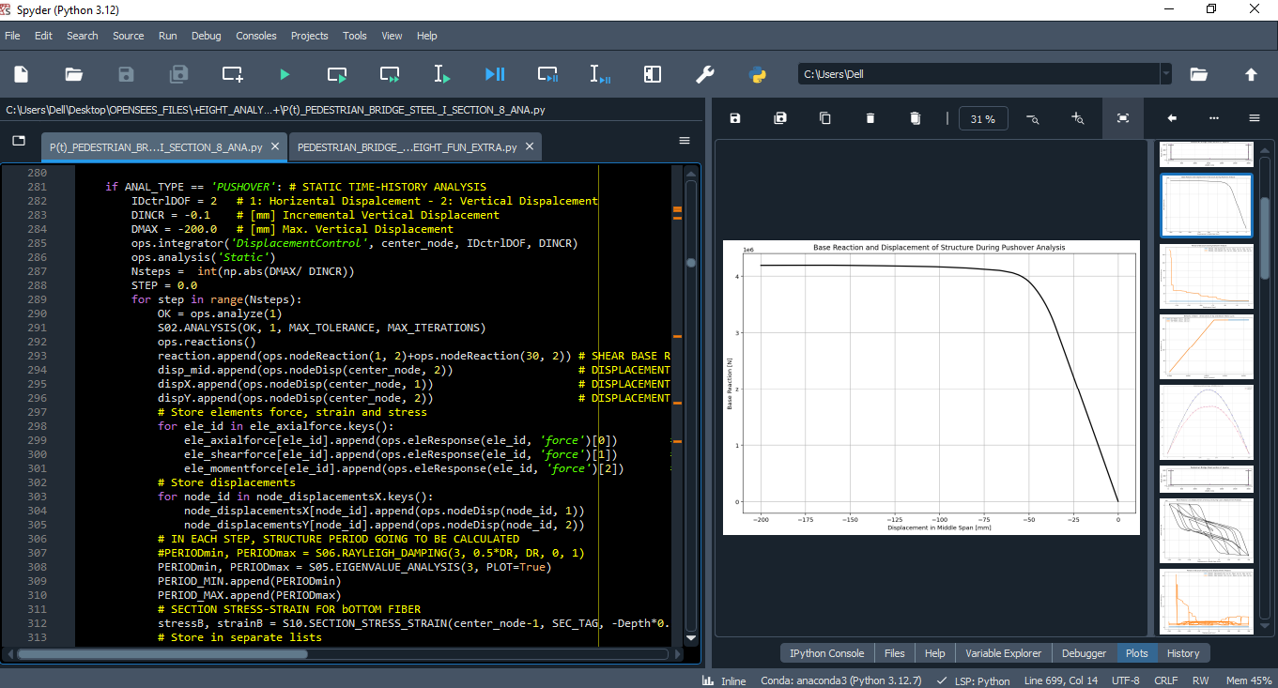

Slide 15
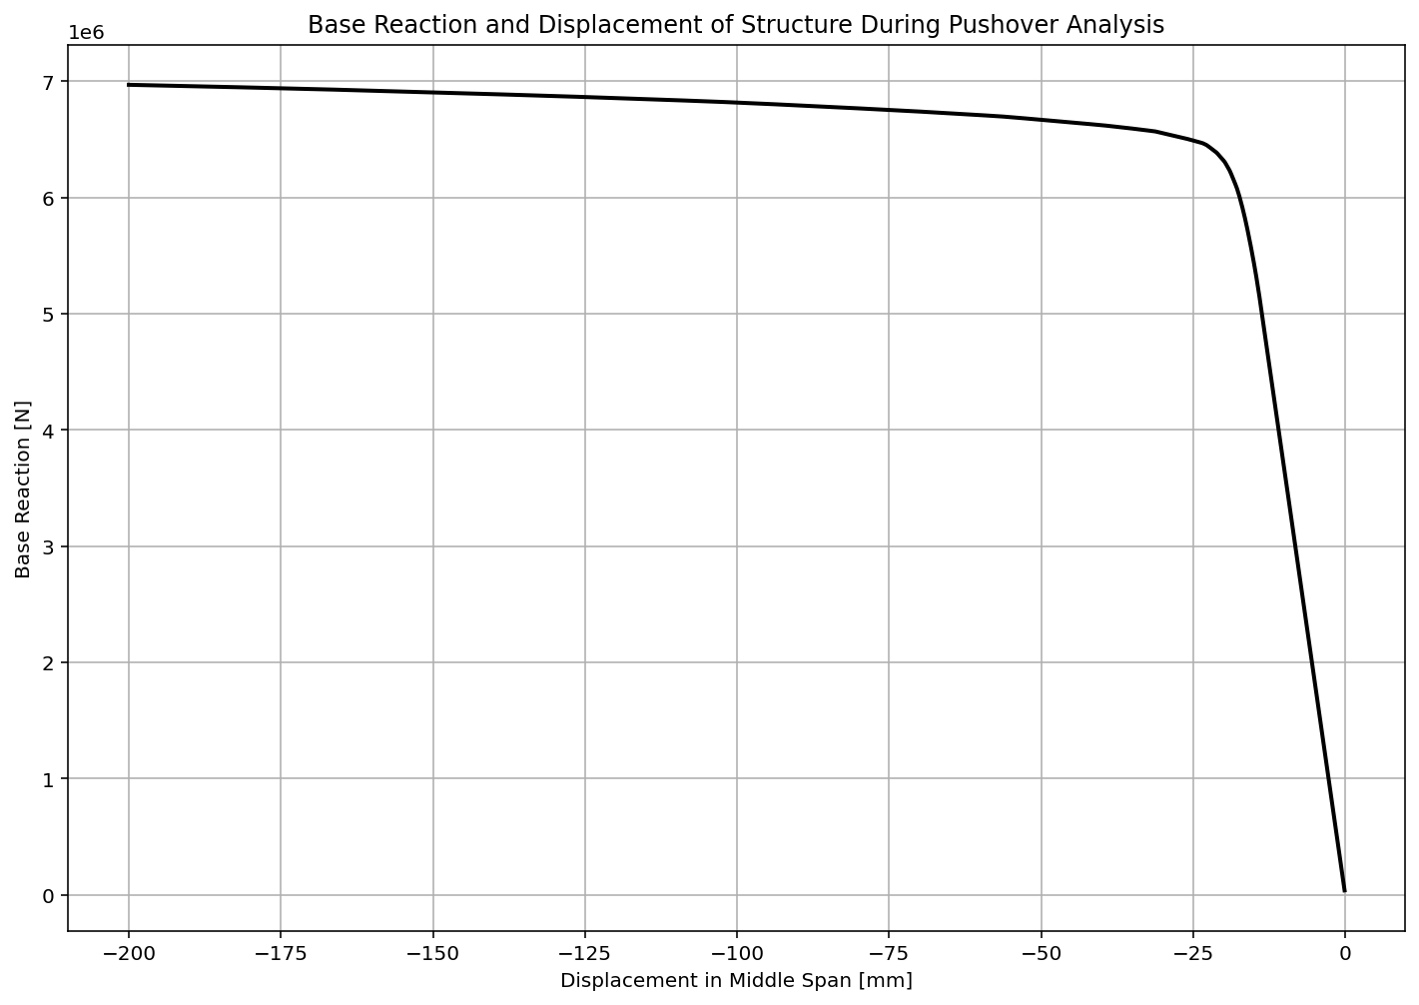

Slide 16
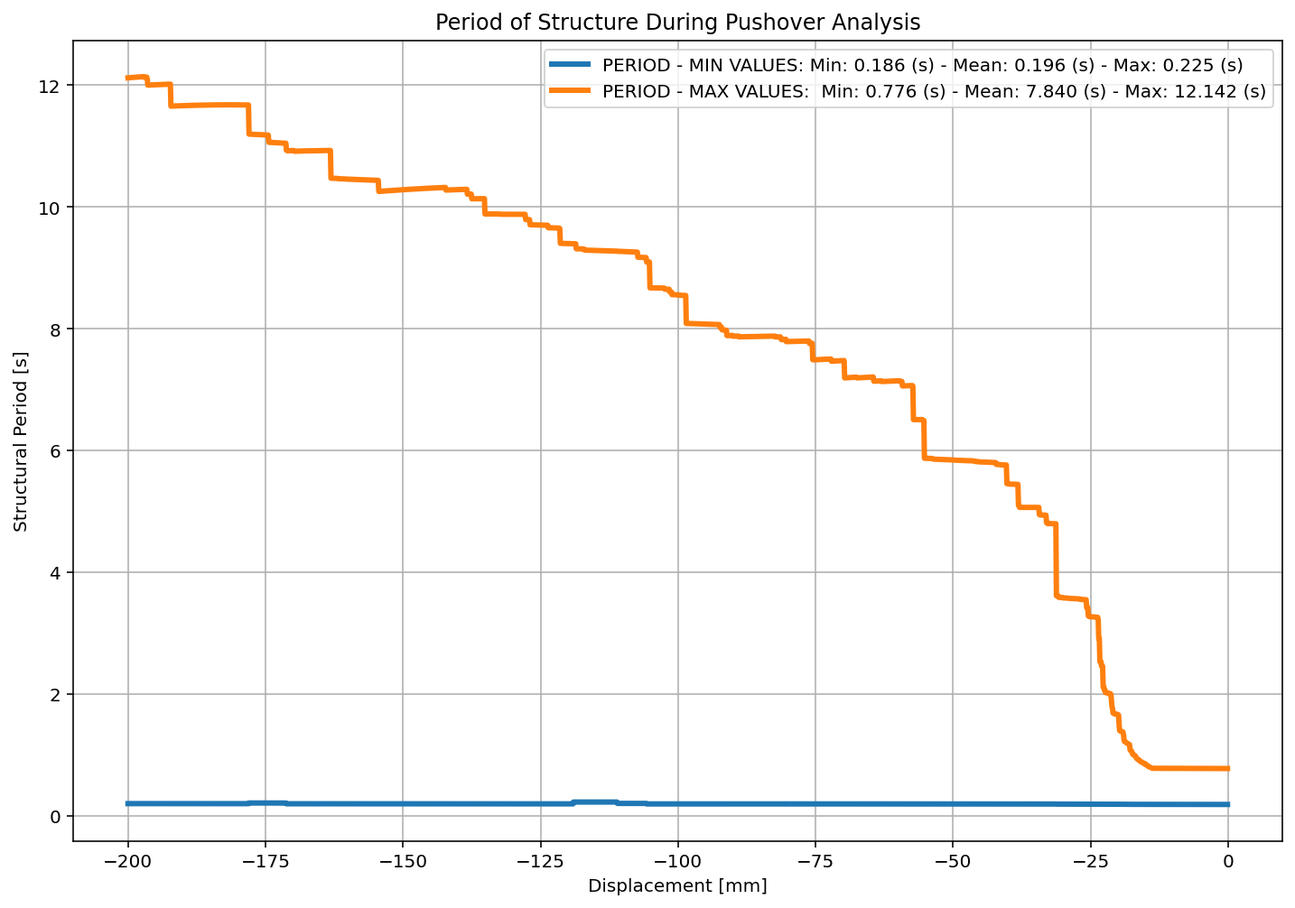

Slide 17
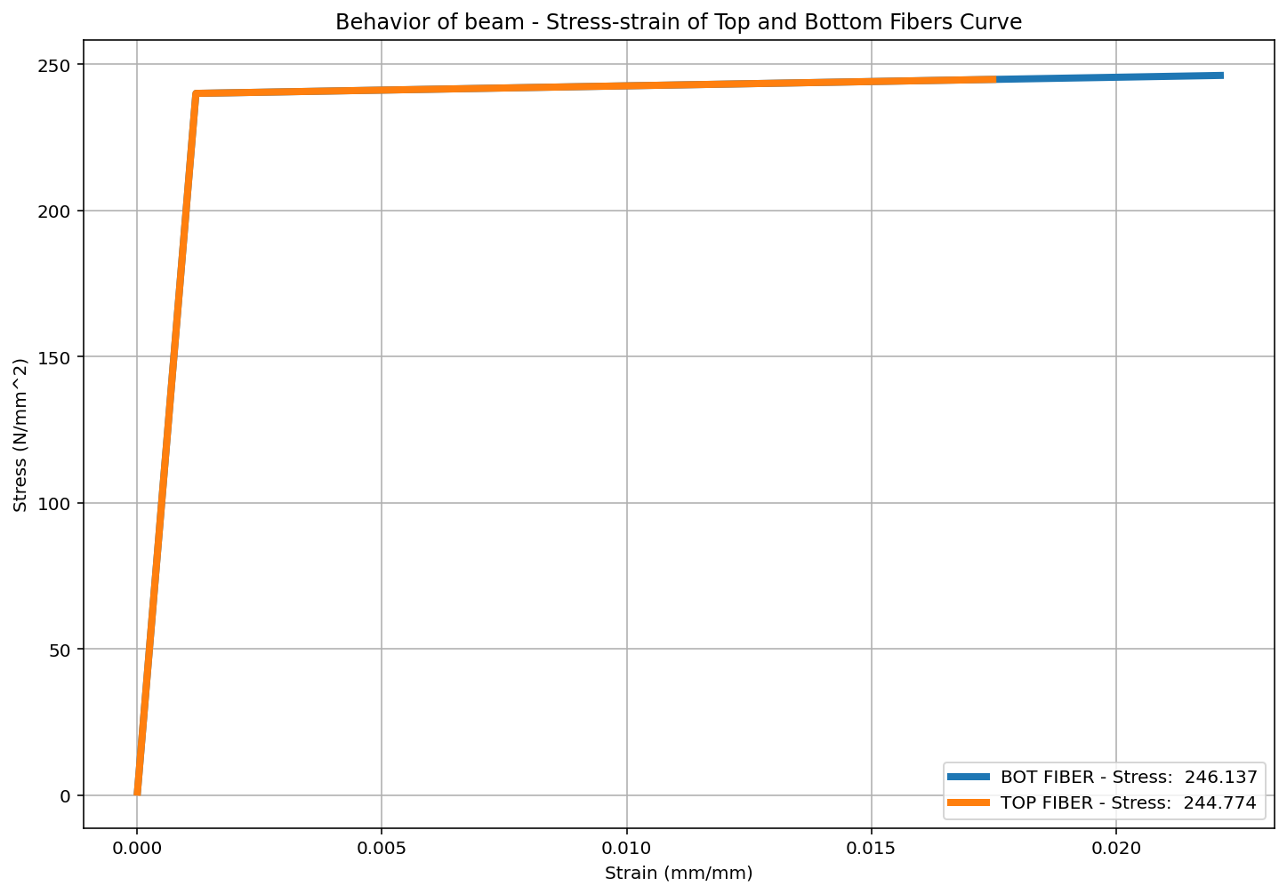

Slide 18
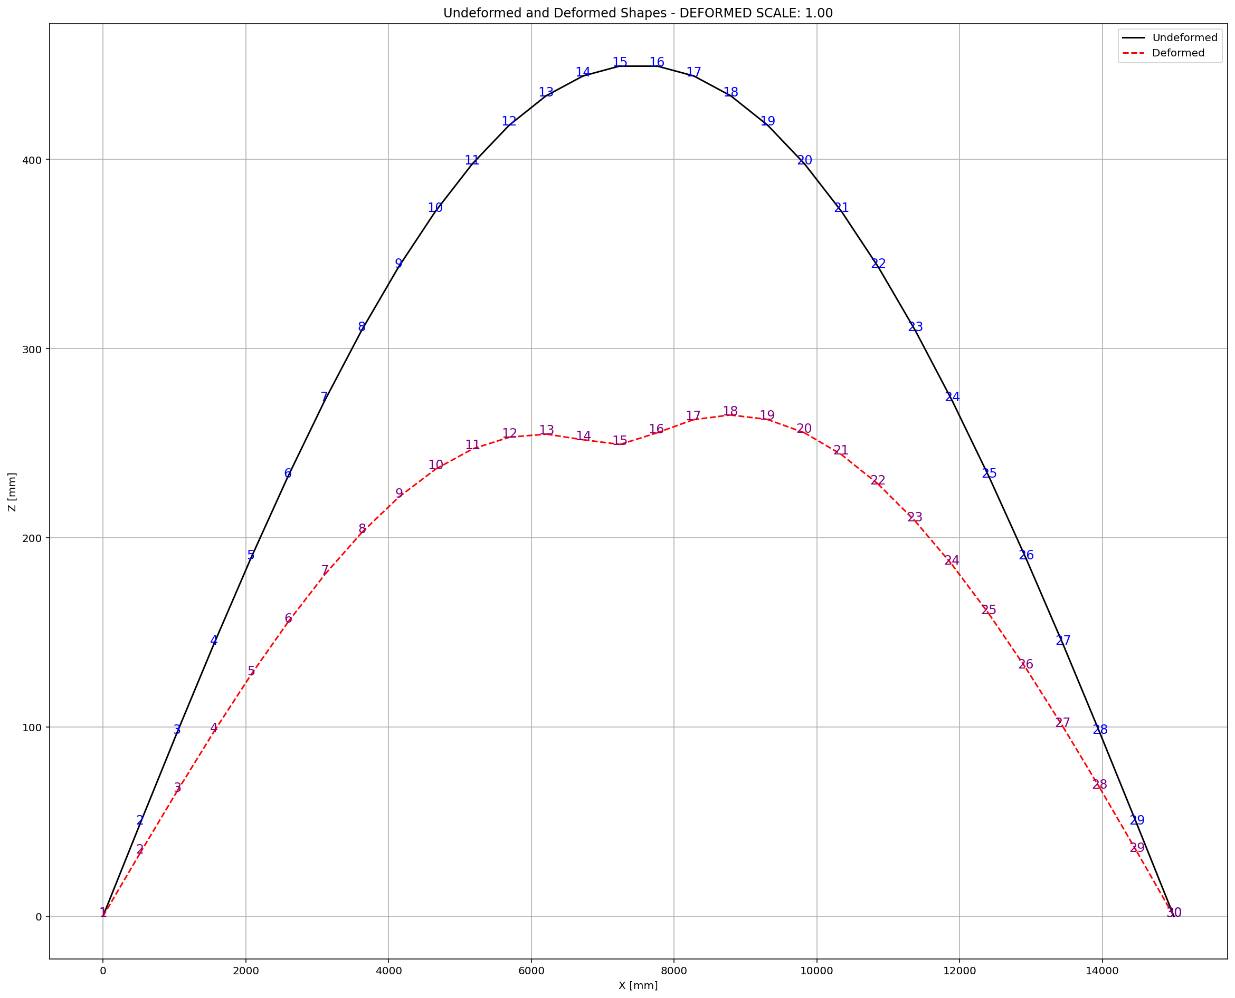

Slide 19
CYCLIC DISPLACEMENT ANALYSIS

Slide 20
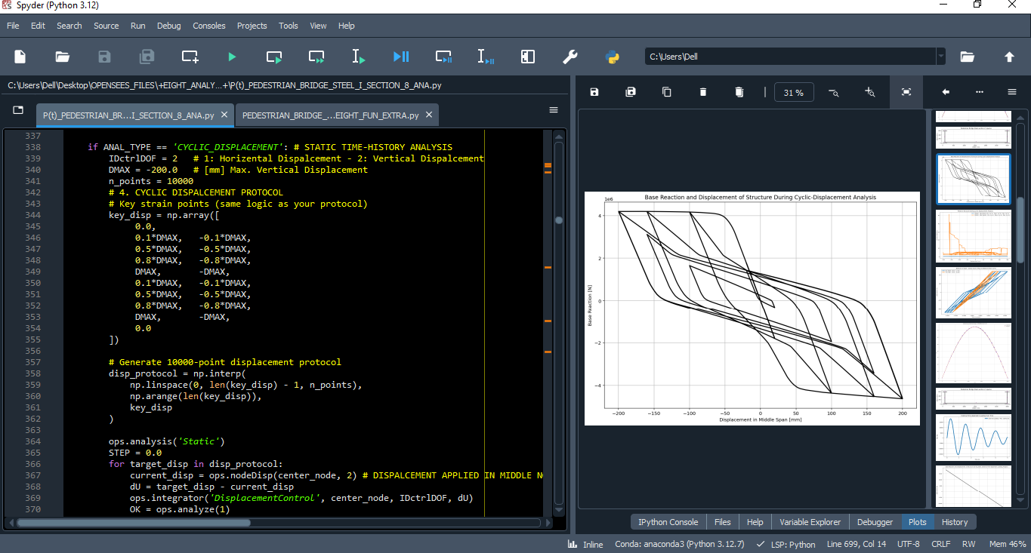

Slide 21
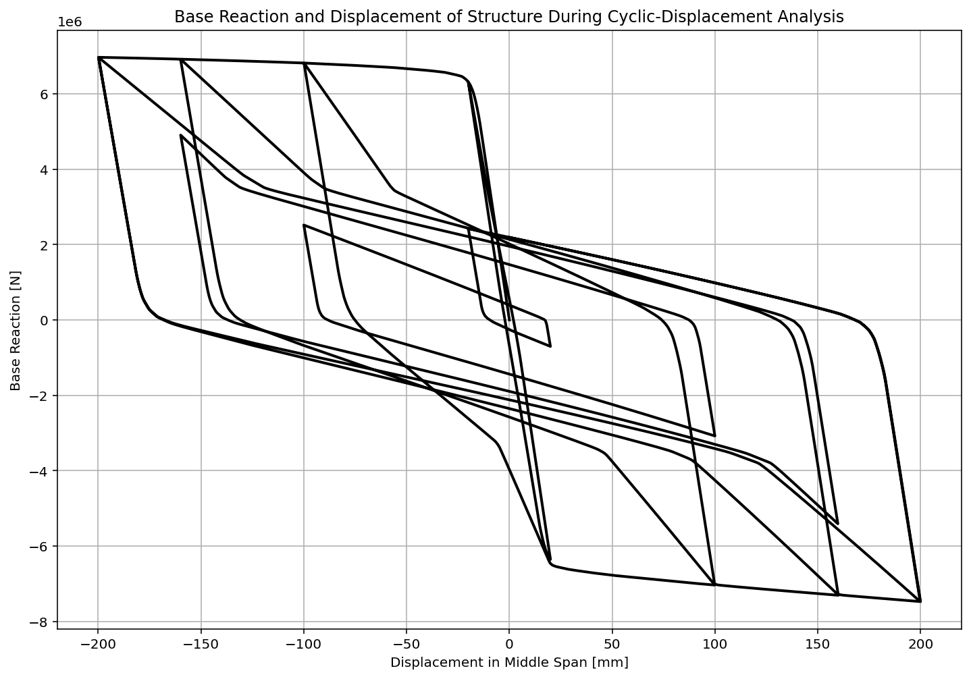

Slide 22
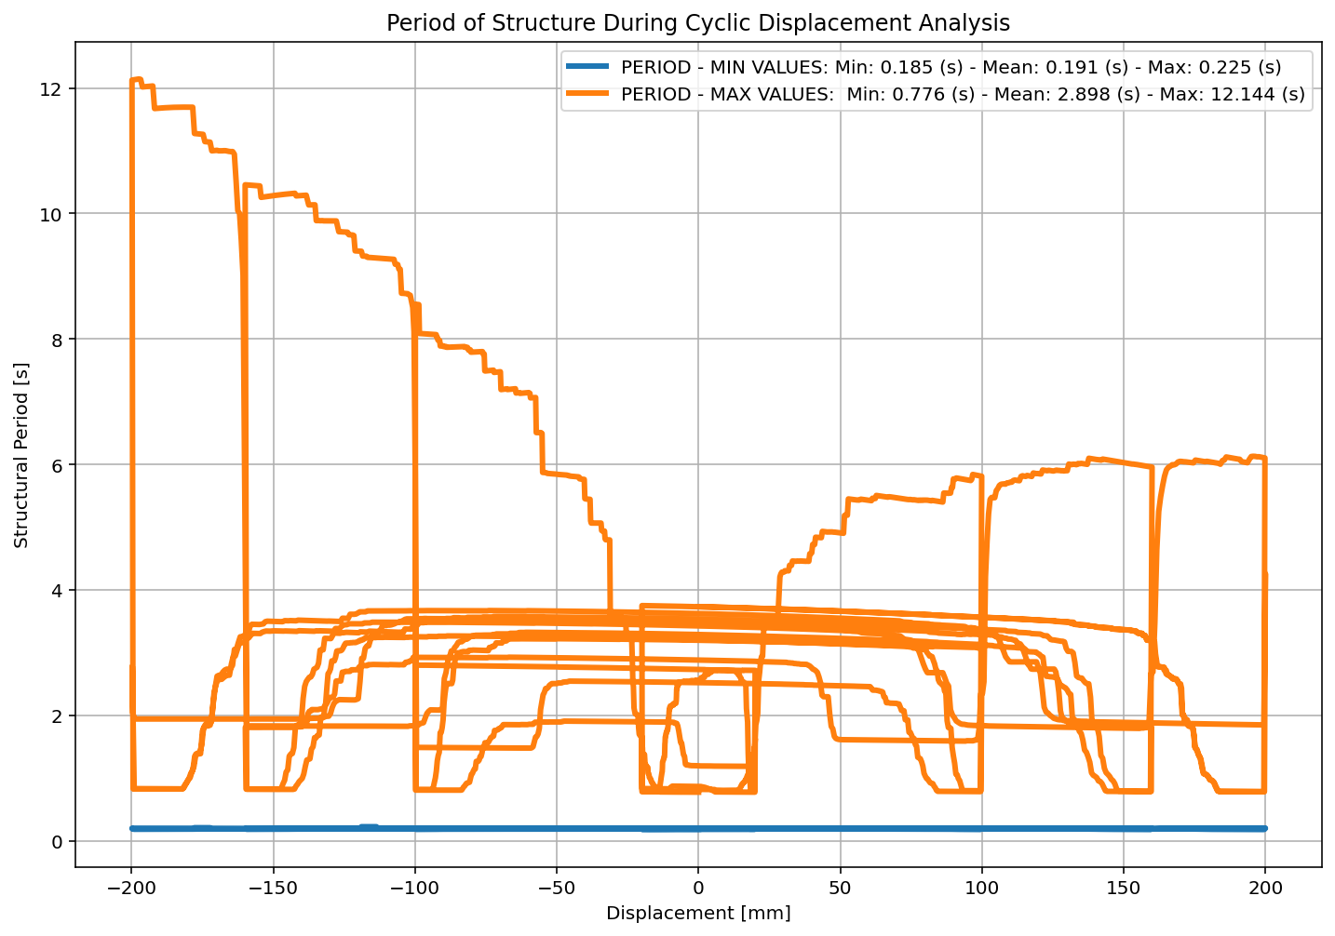

Slide 23
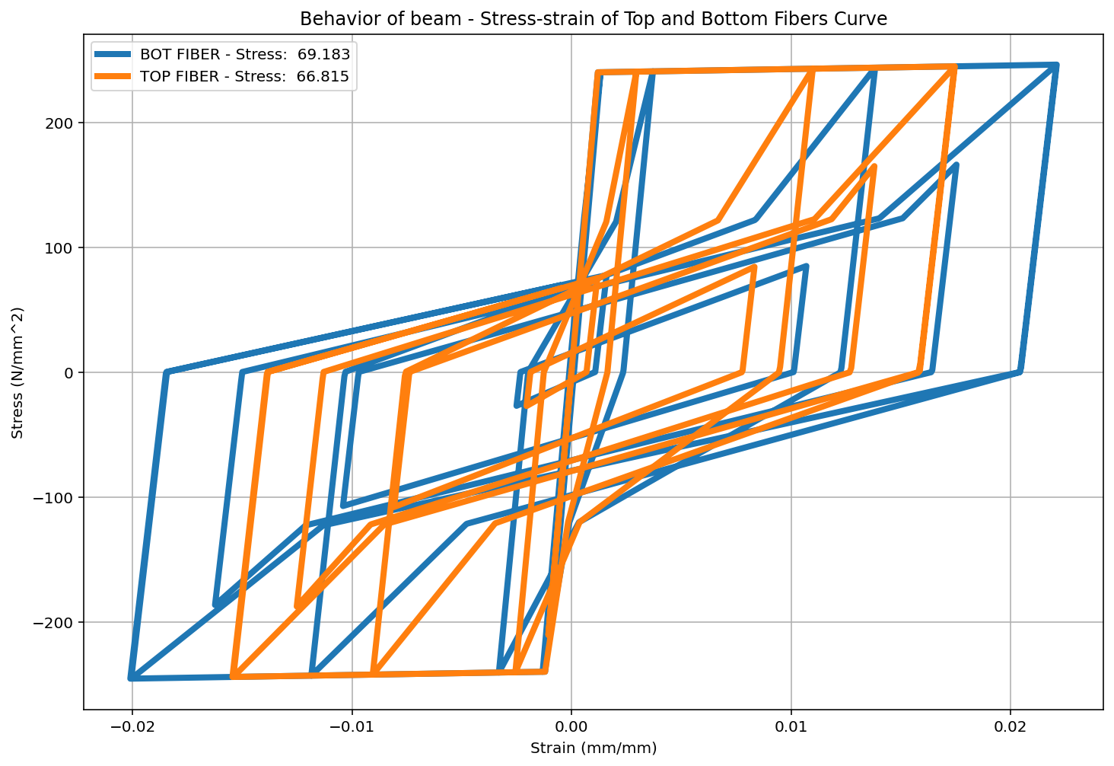

Slide 24
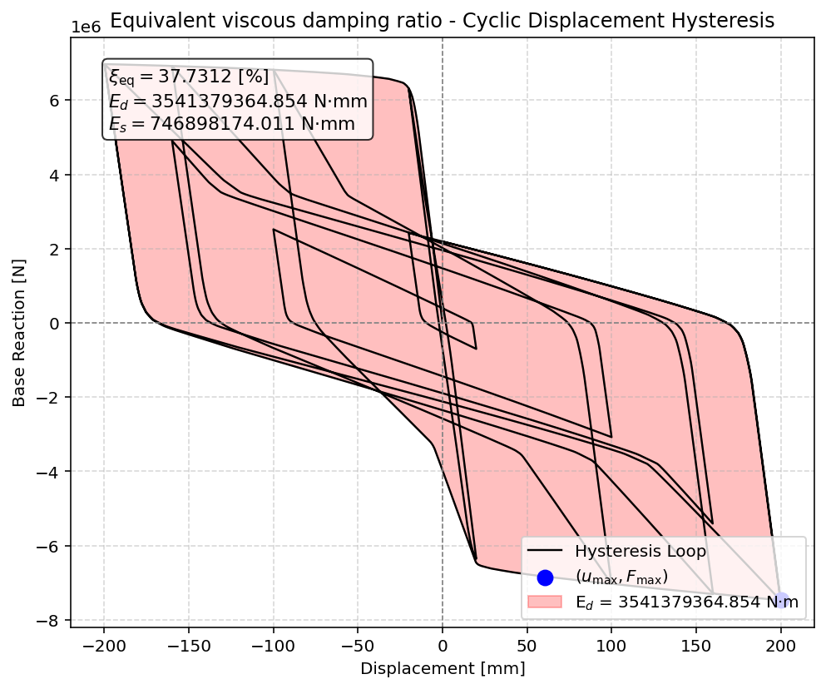

Slide 25
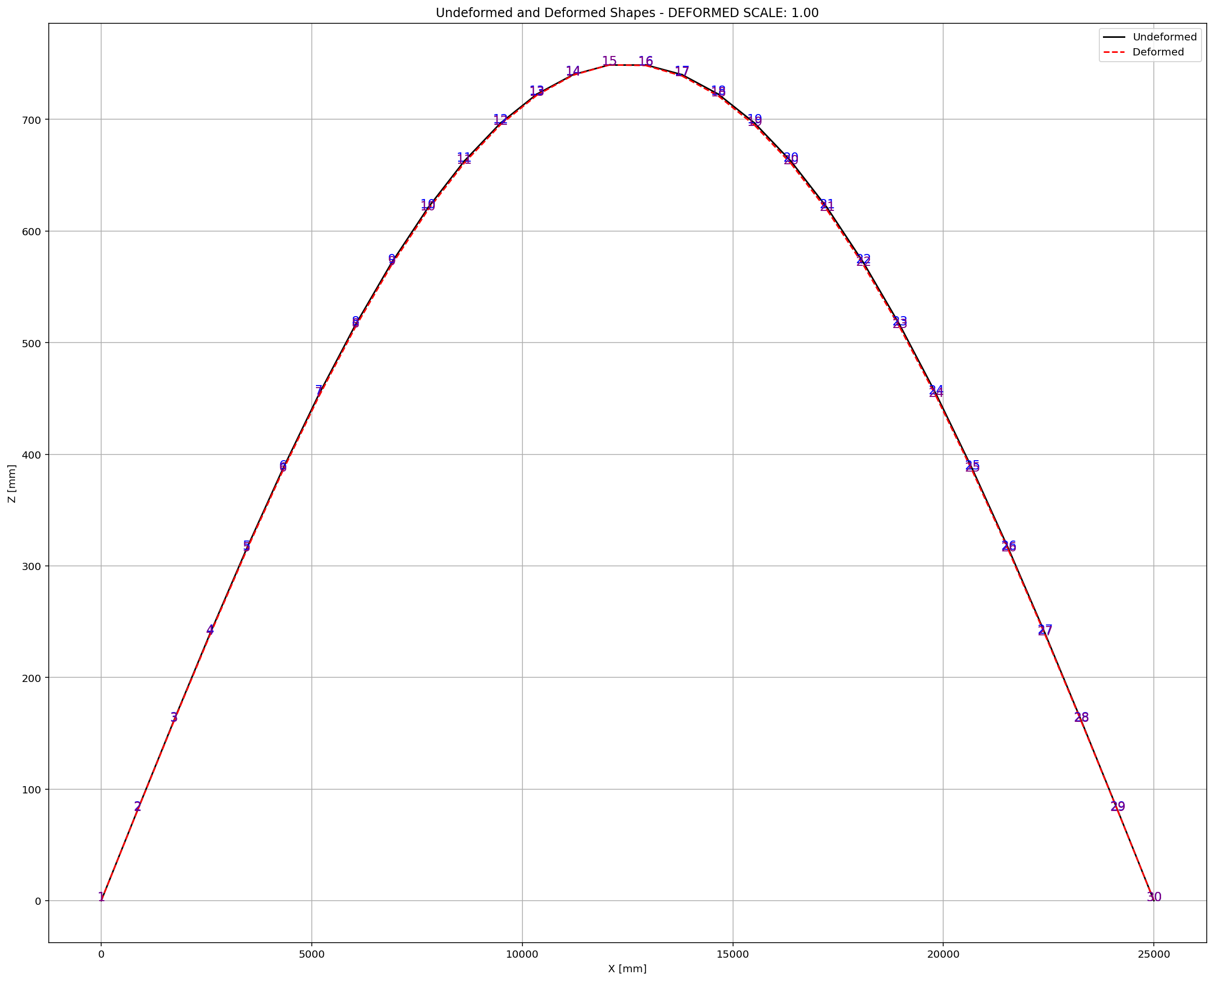

Slide 26
STATIC TIME-HISTORY WITH EXTERNAL TIME-DEPENDENT LOADING ANALYSIS

Slide 27
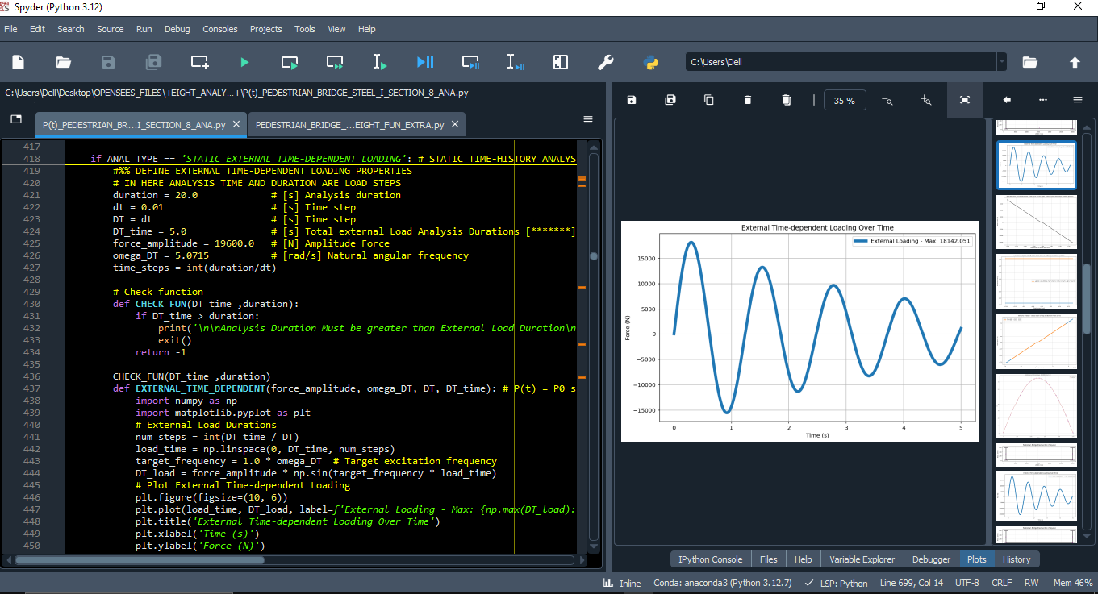

Slide 28
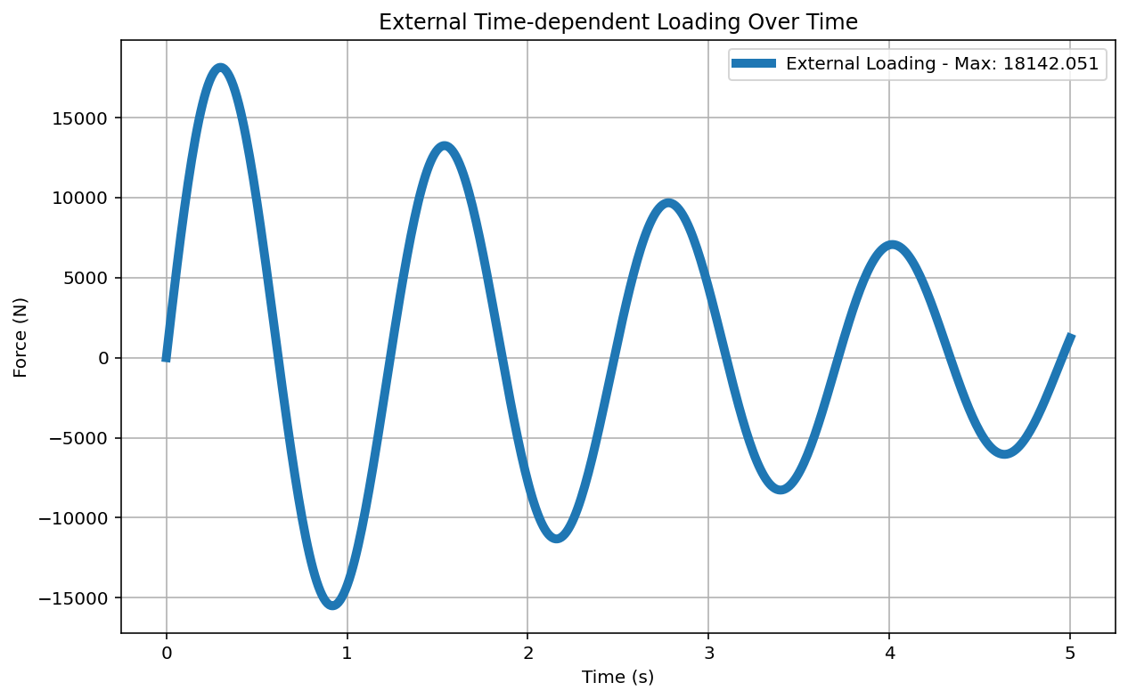

Slide 29
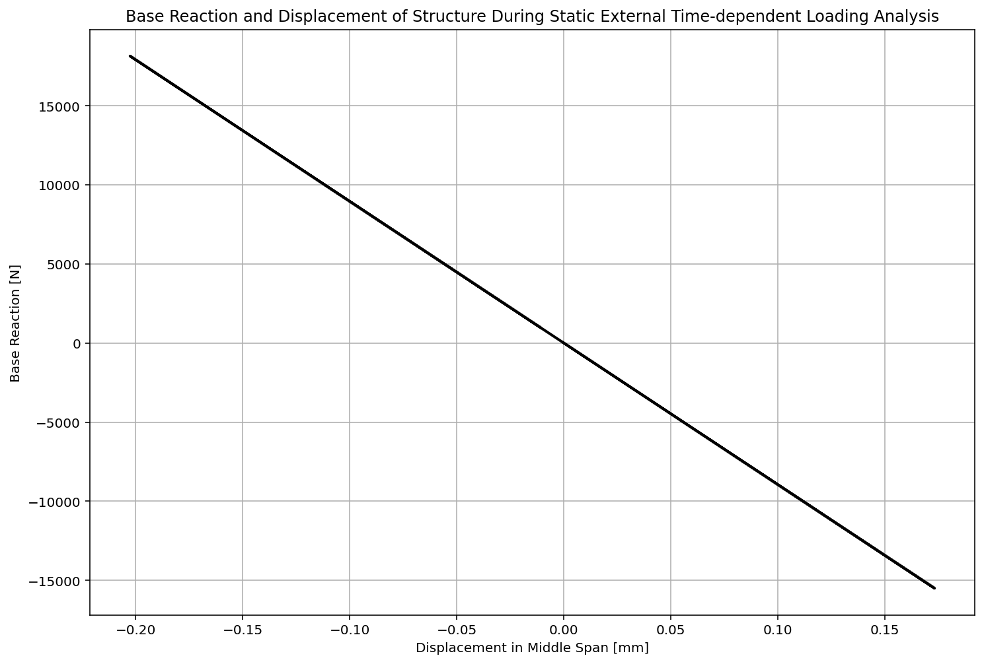

Slide 30
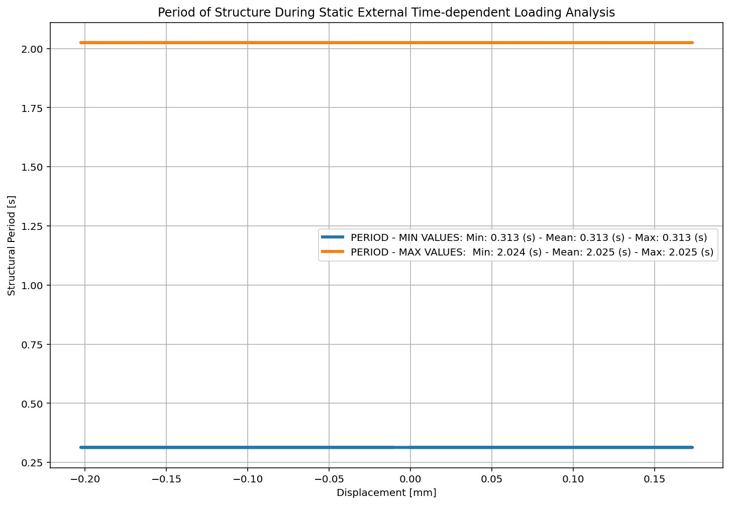

Slide 31
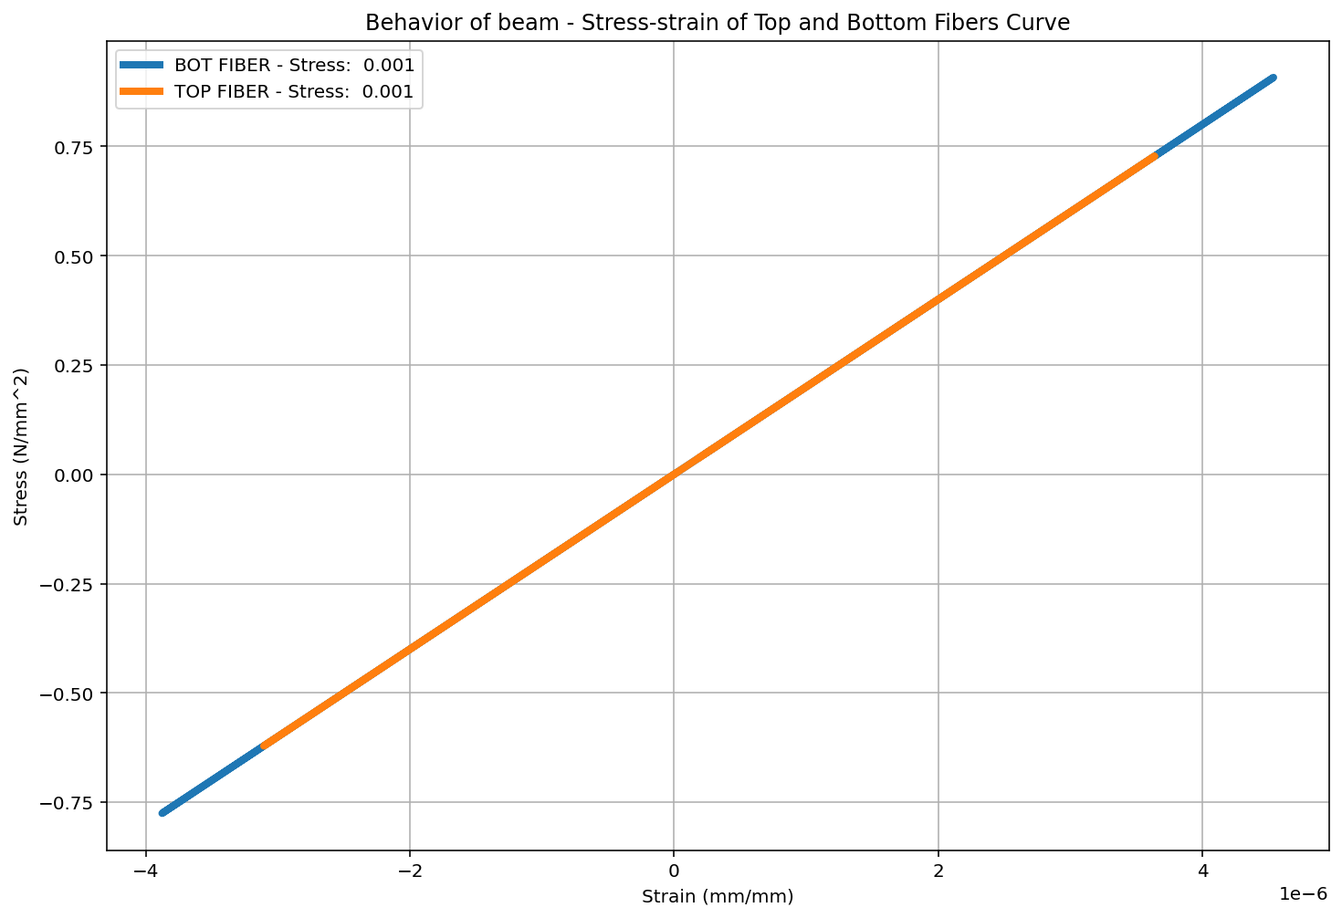

Slide 33
DYNAMIC TIME-HISTORY WITH EXTERNAL TIME-DEPENDENT LOADING ANALYSIS

Slide 34
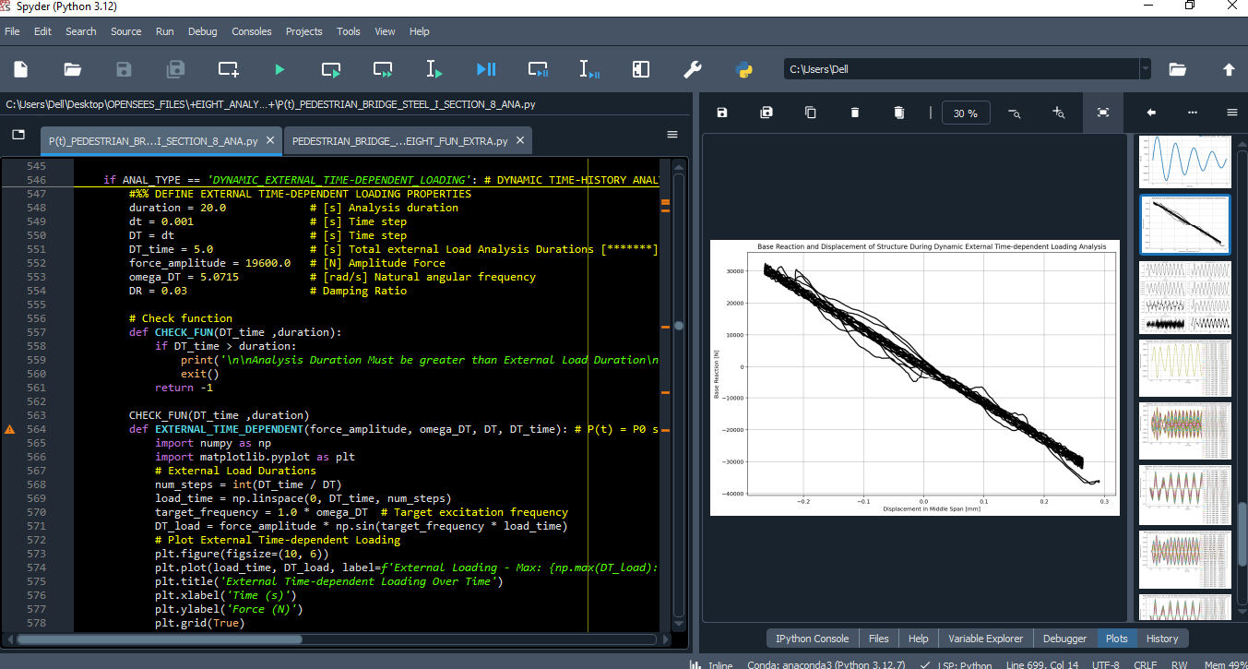

Slide 36
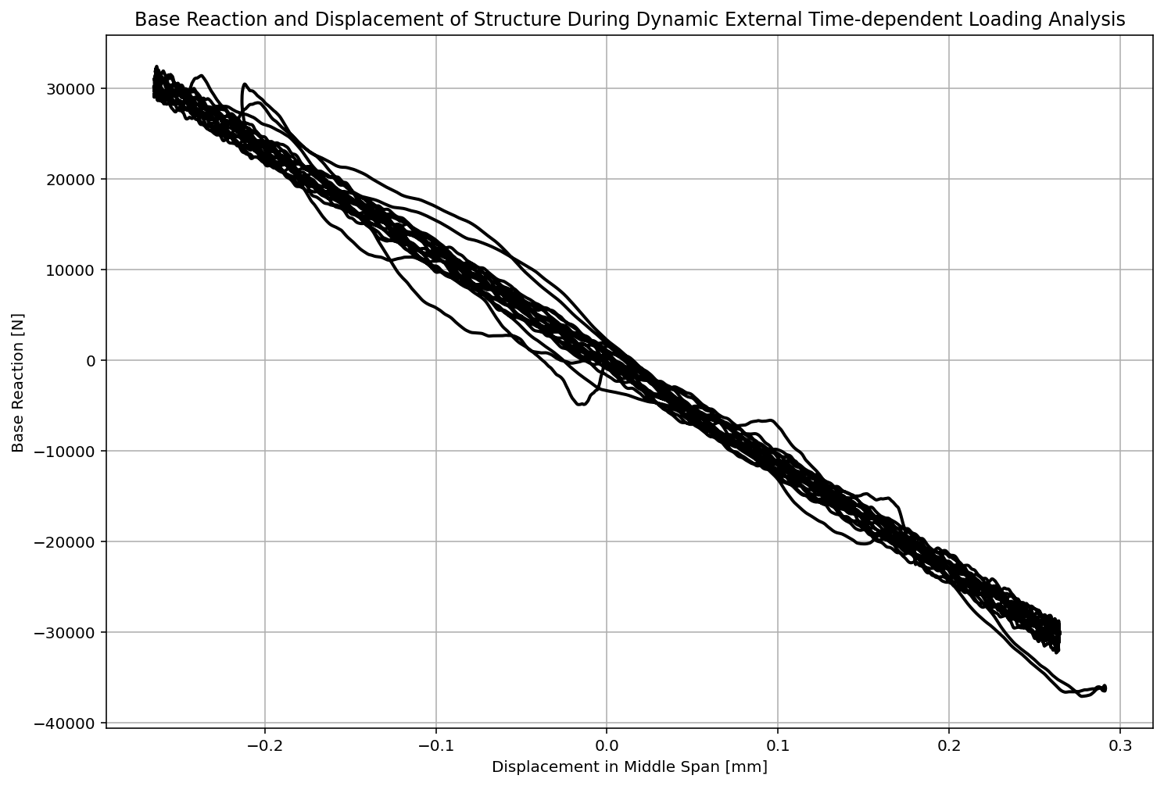

Slide 37
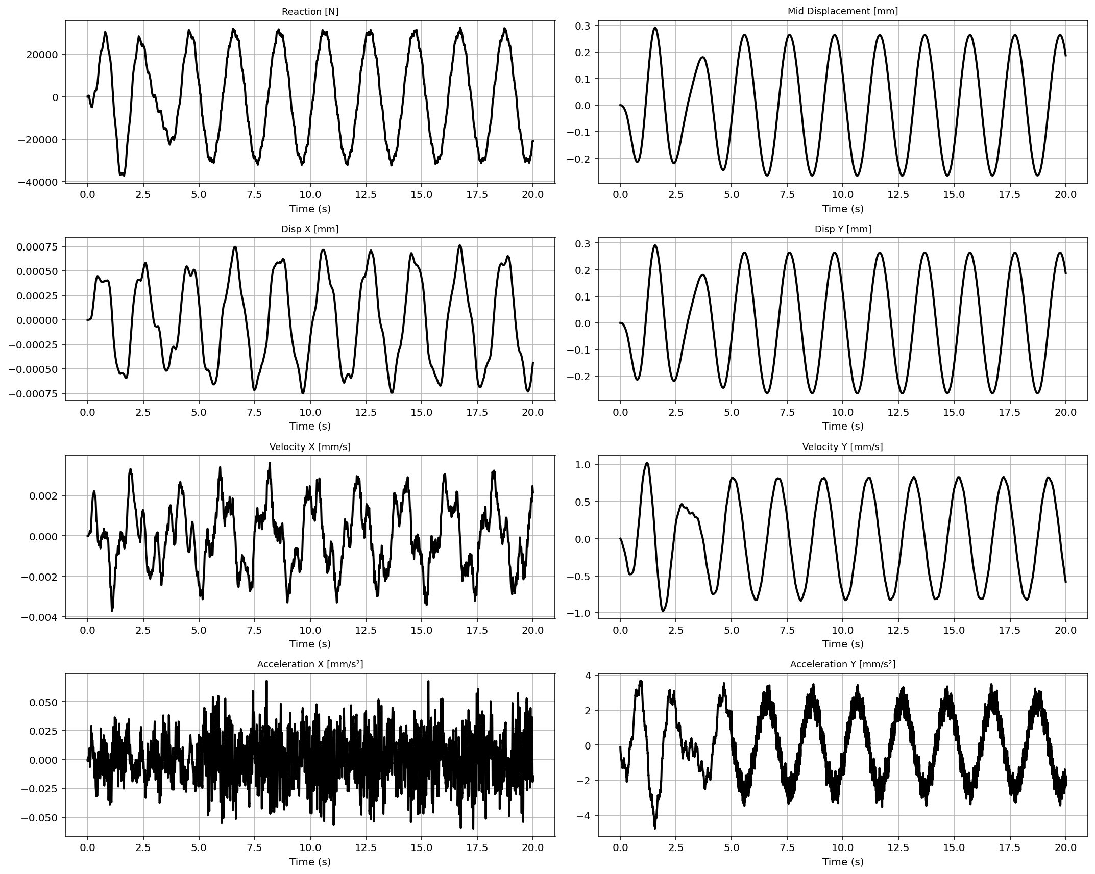

Slide 38
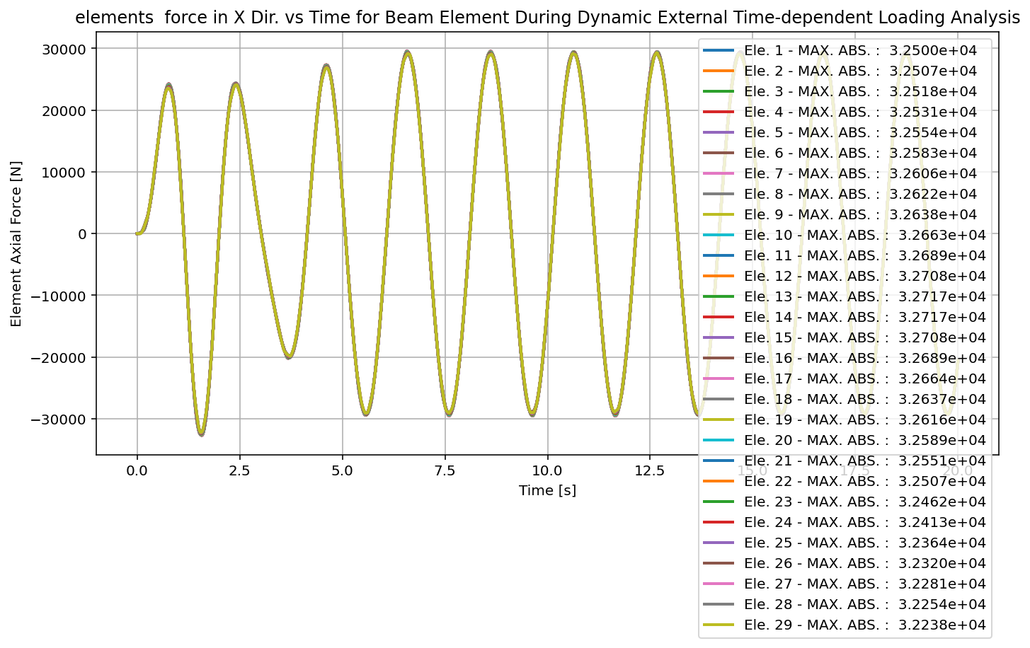

Slide 39
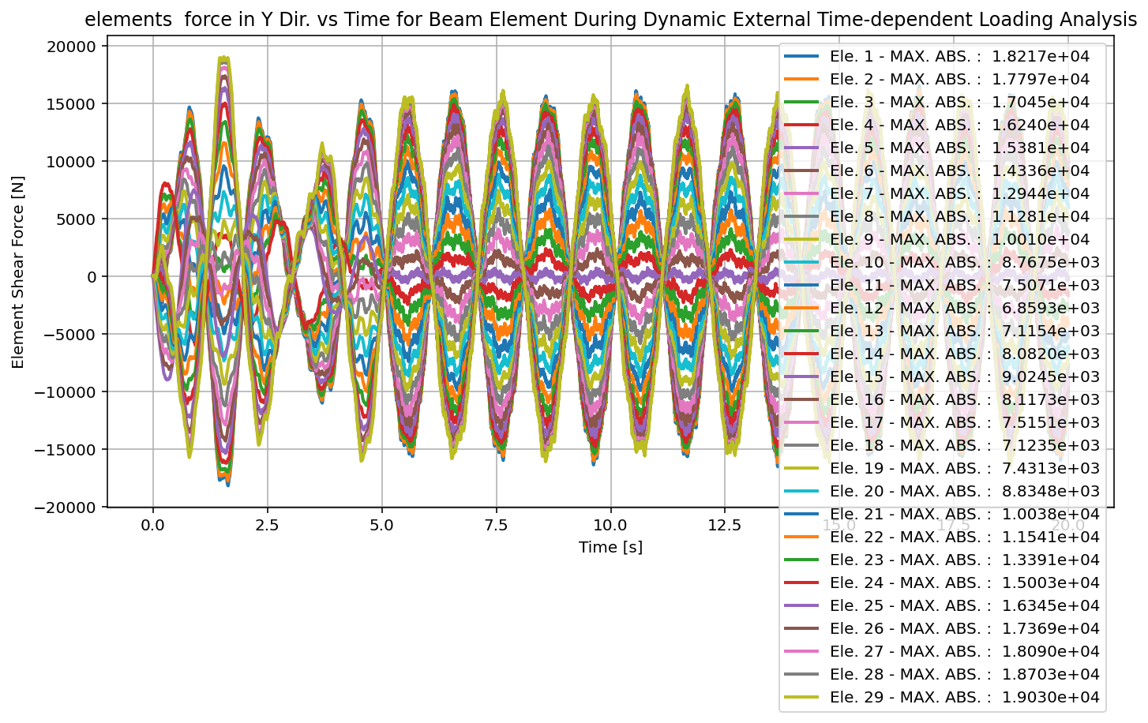

Slide 40
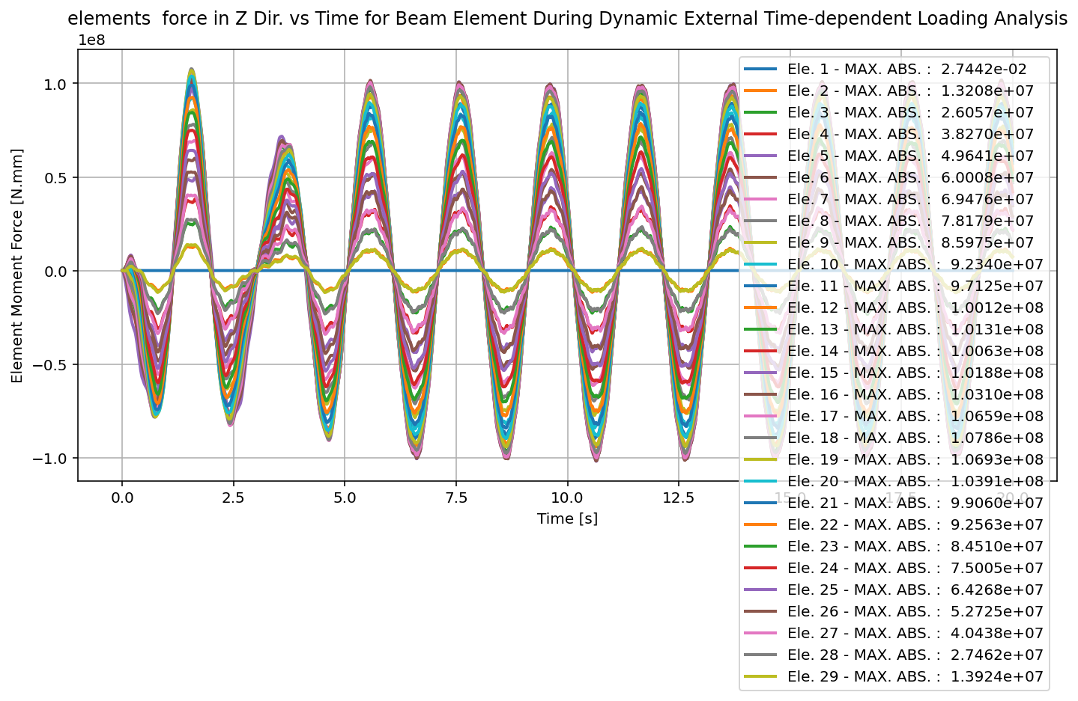

Slide 41
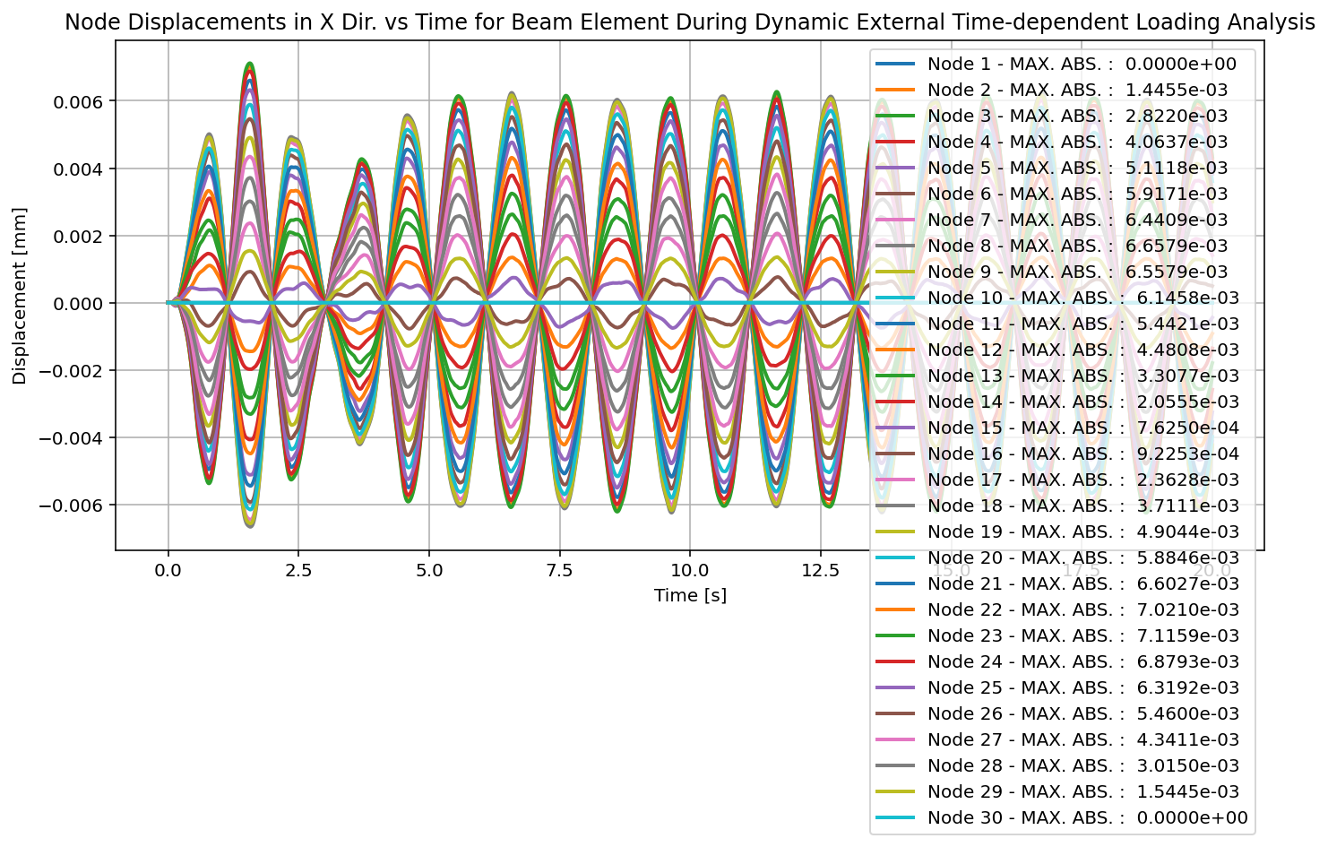

Slide 42
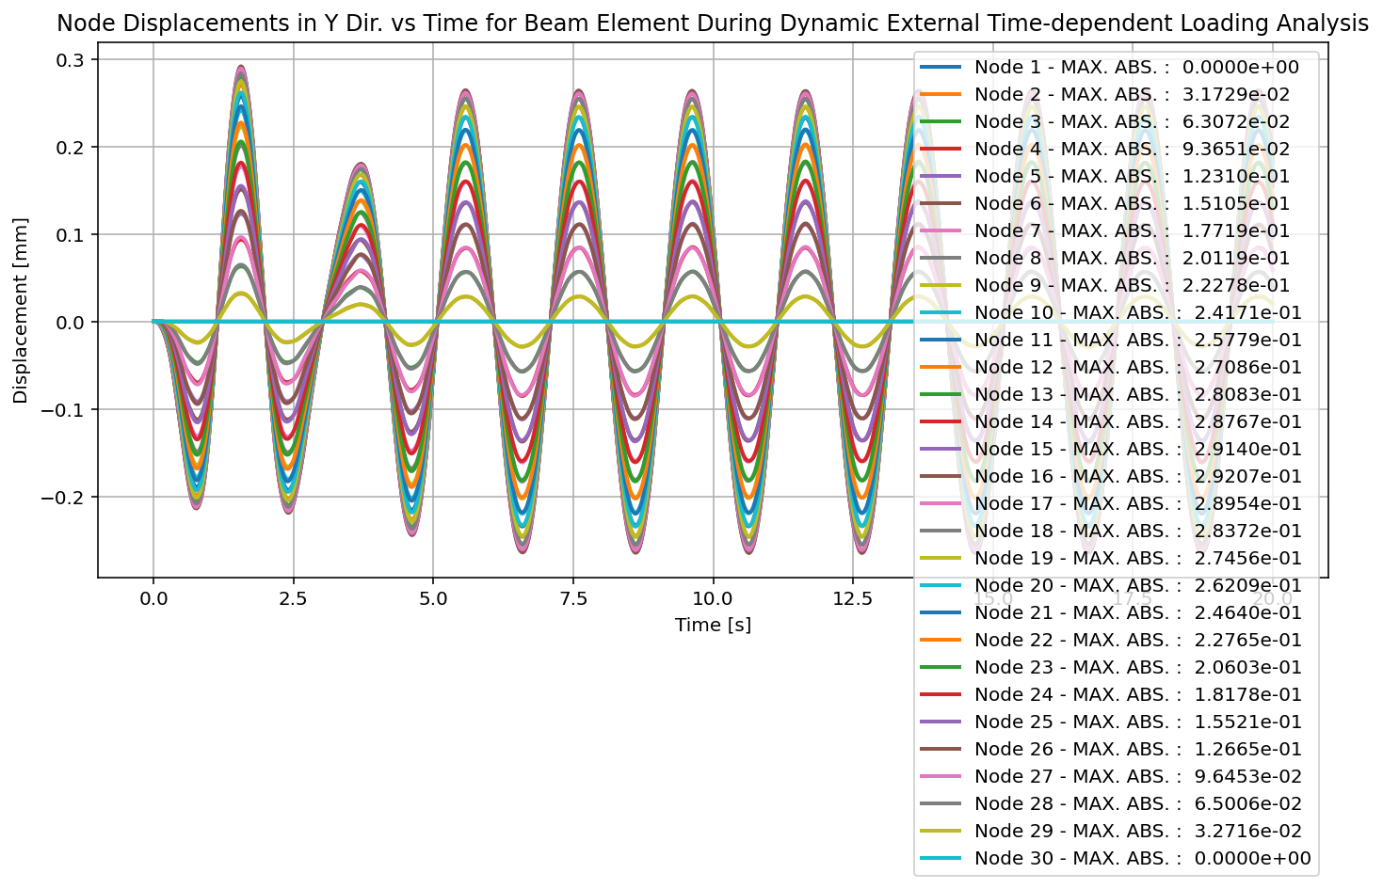

Slide 43


Slide 44
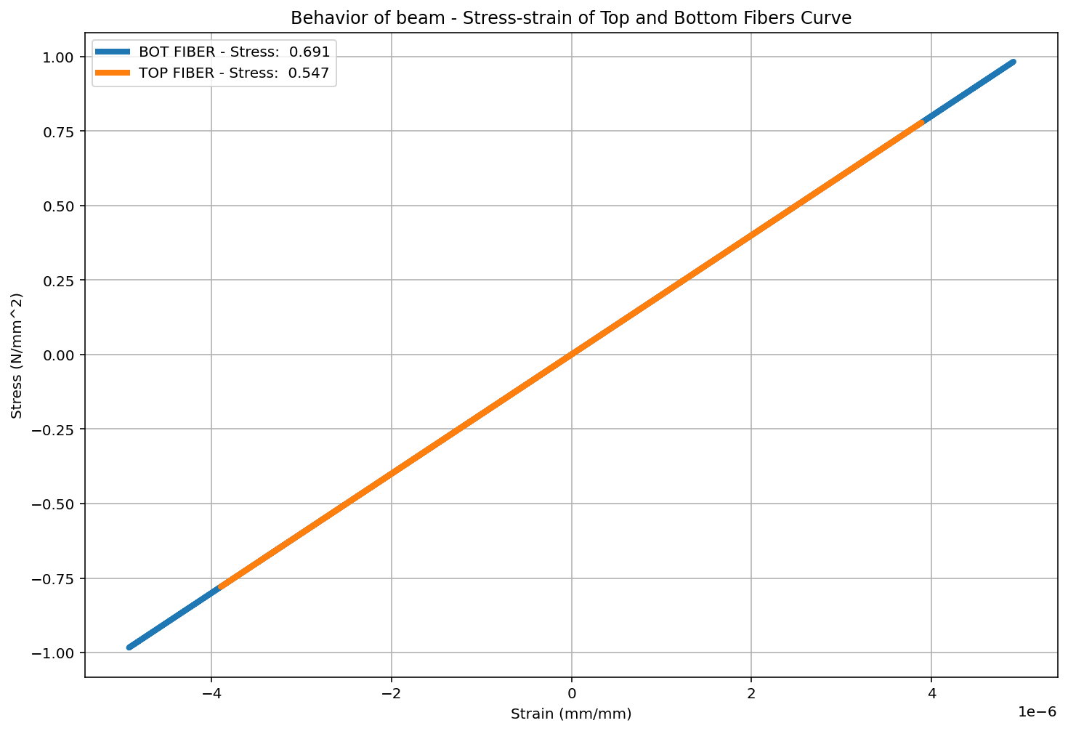

Slide 46
FREE-VIBRATION ANALYSIS

Slide 47
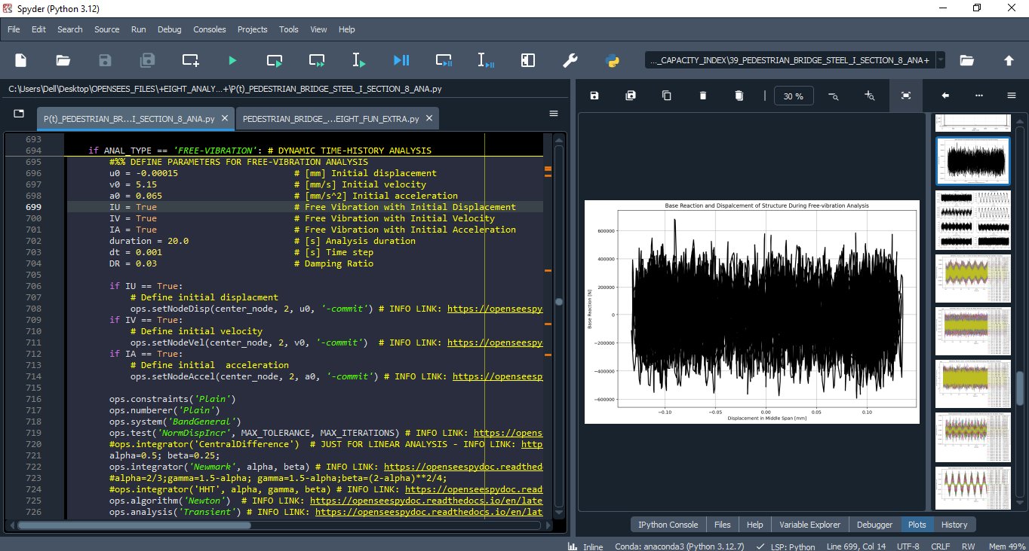

Slide 48
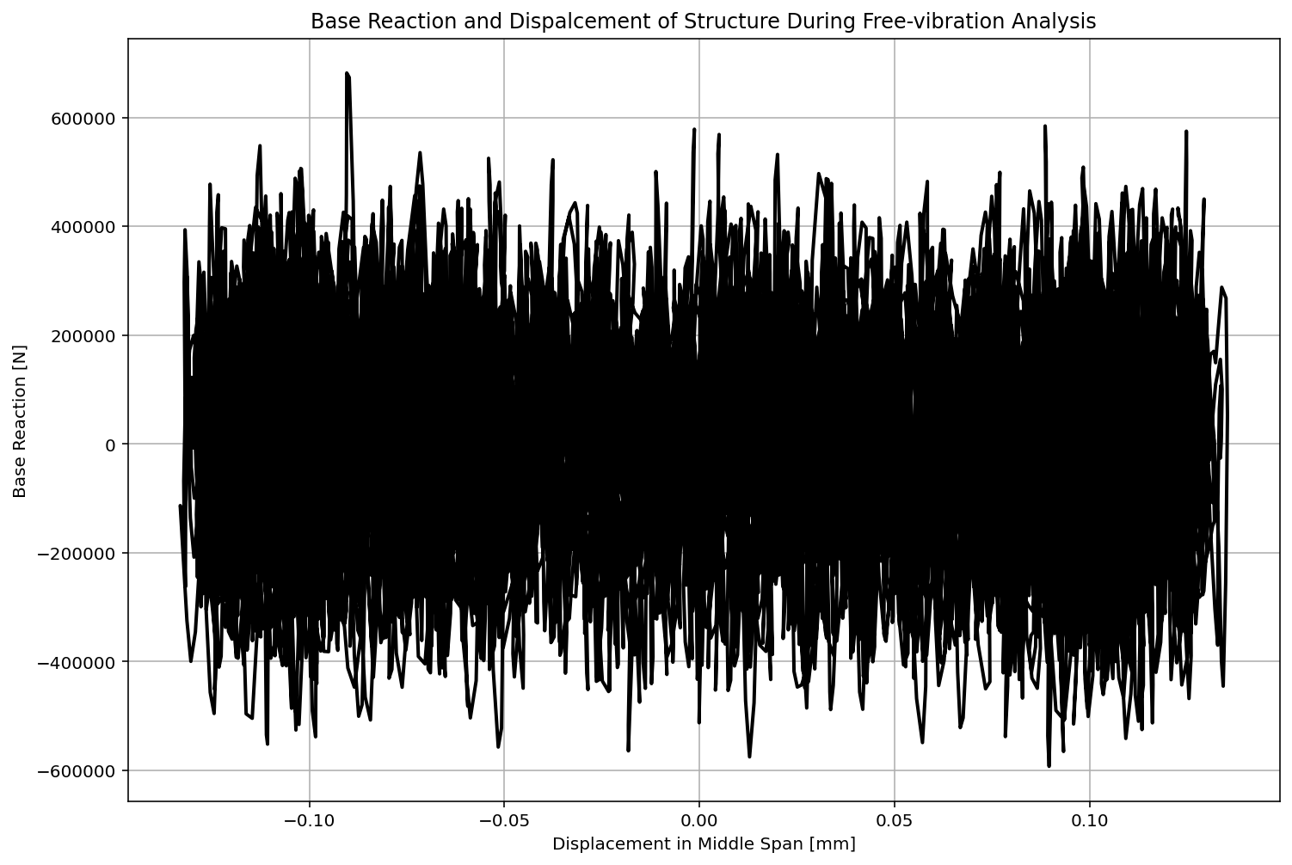

Slide 49
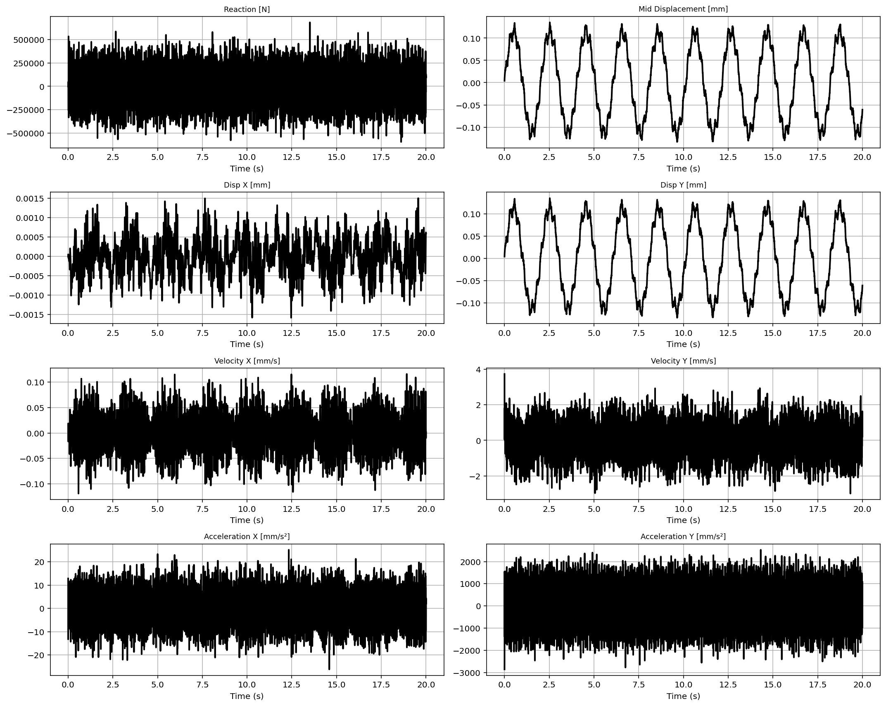

Slide 50
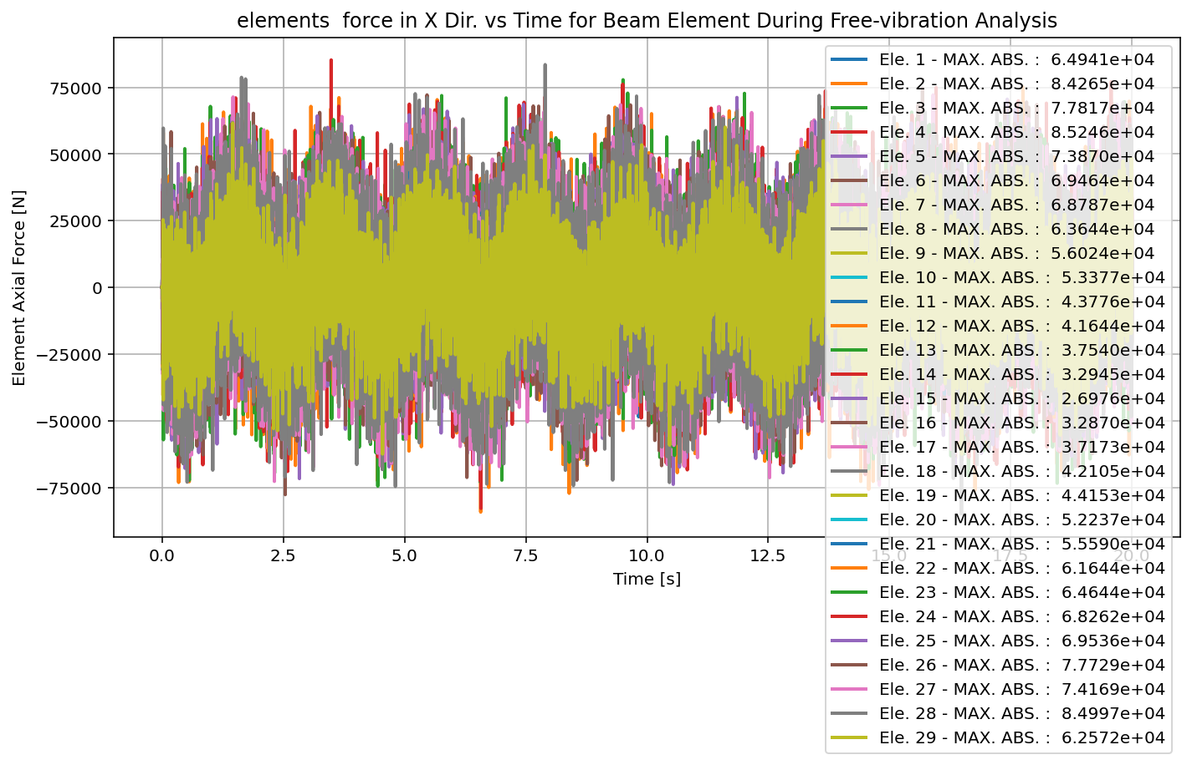

Slide 51


Slide 52
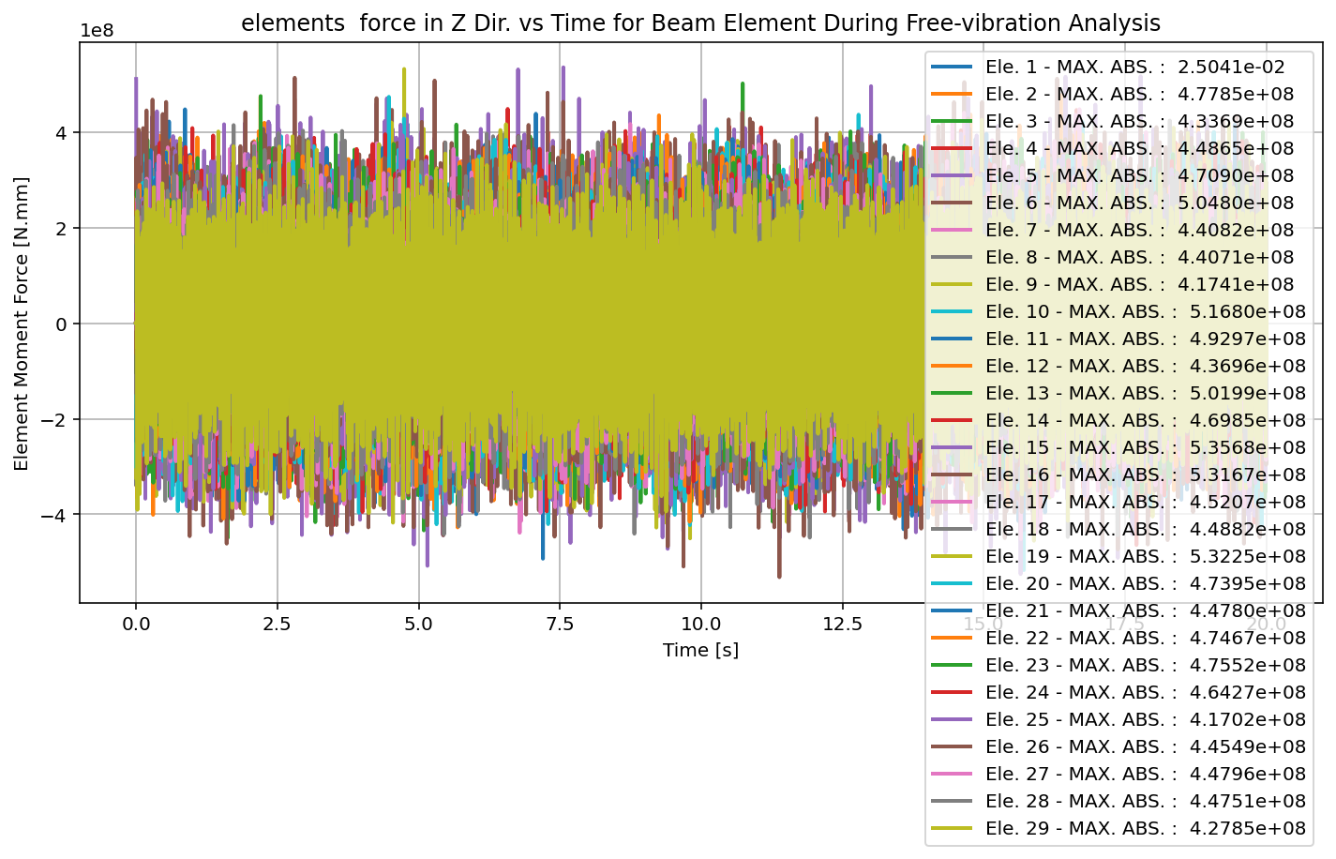

Slide 53
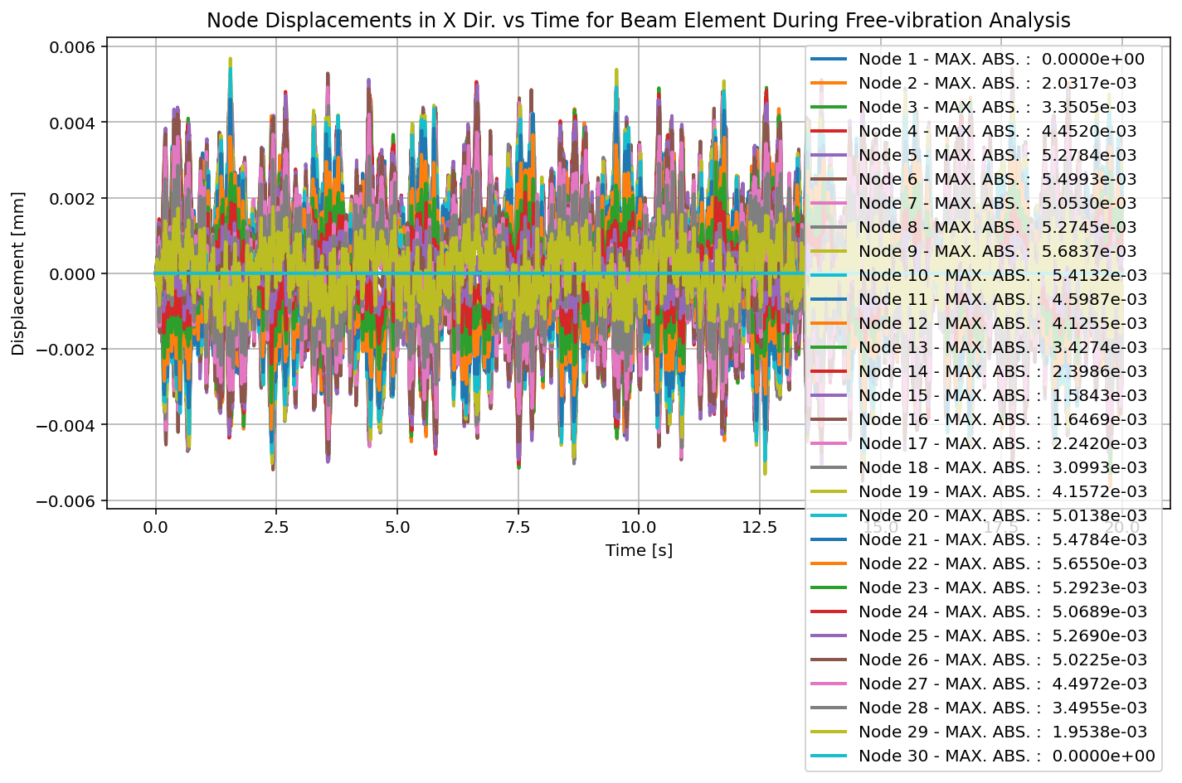

Slide 54
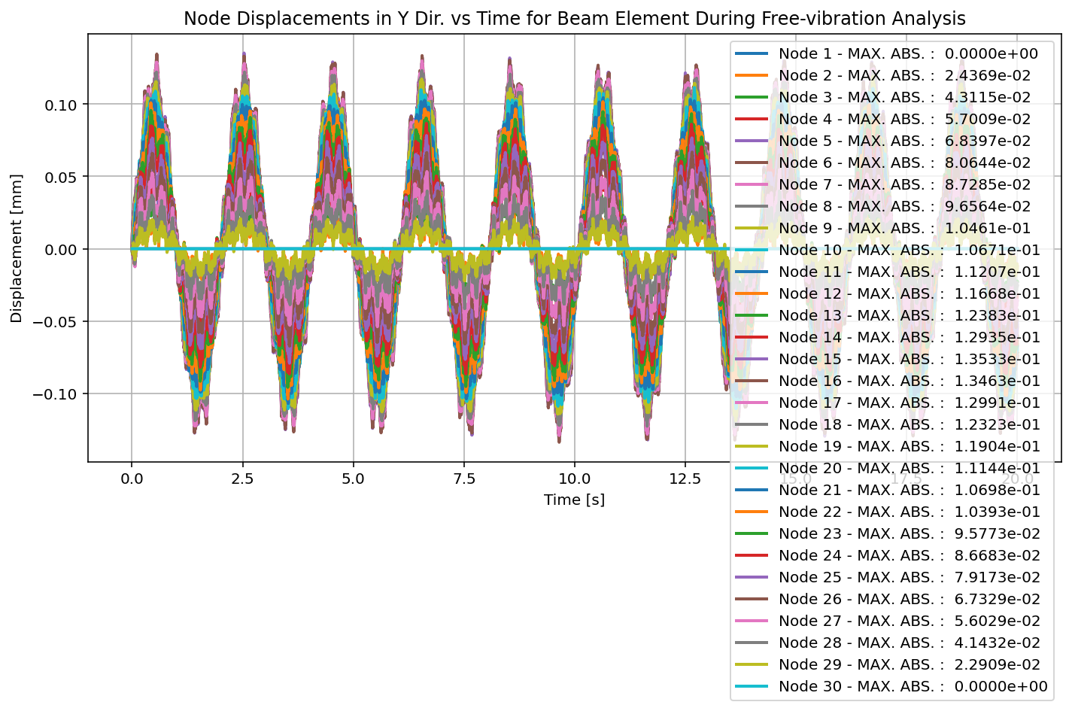

Slide 55
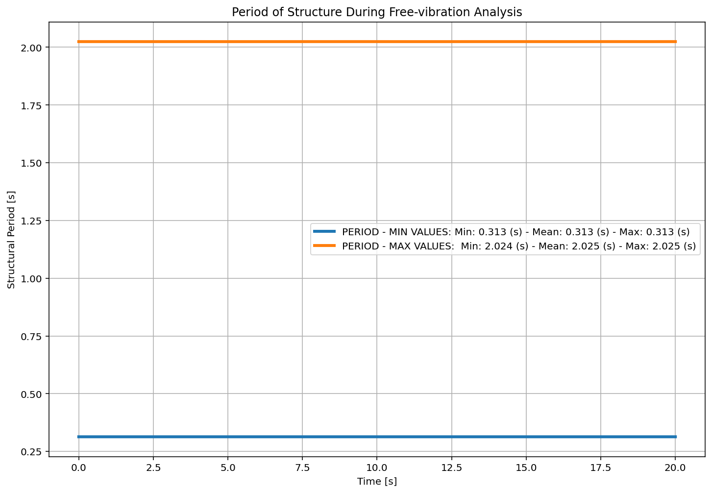

Slide 56
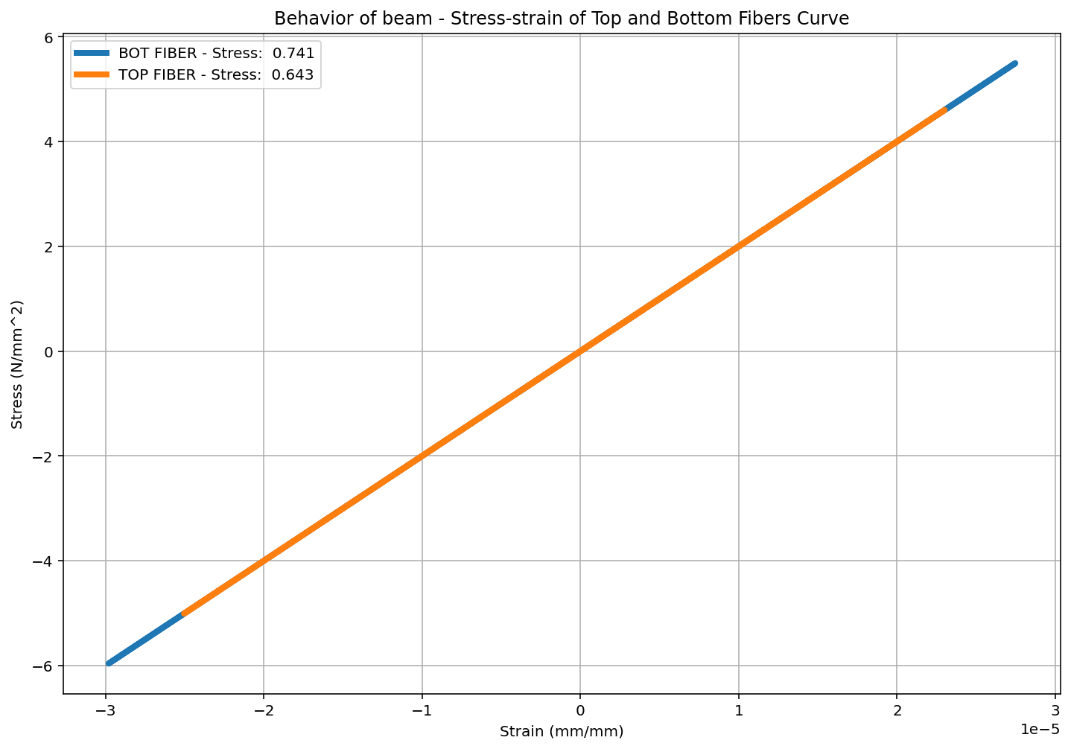

Slide 57
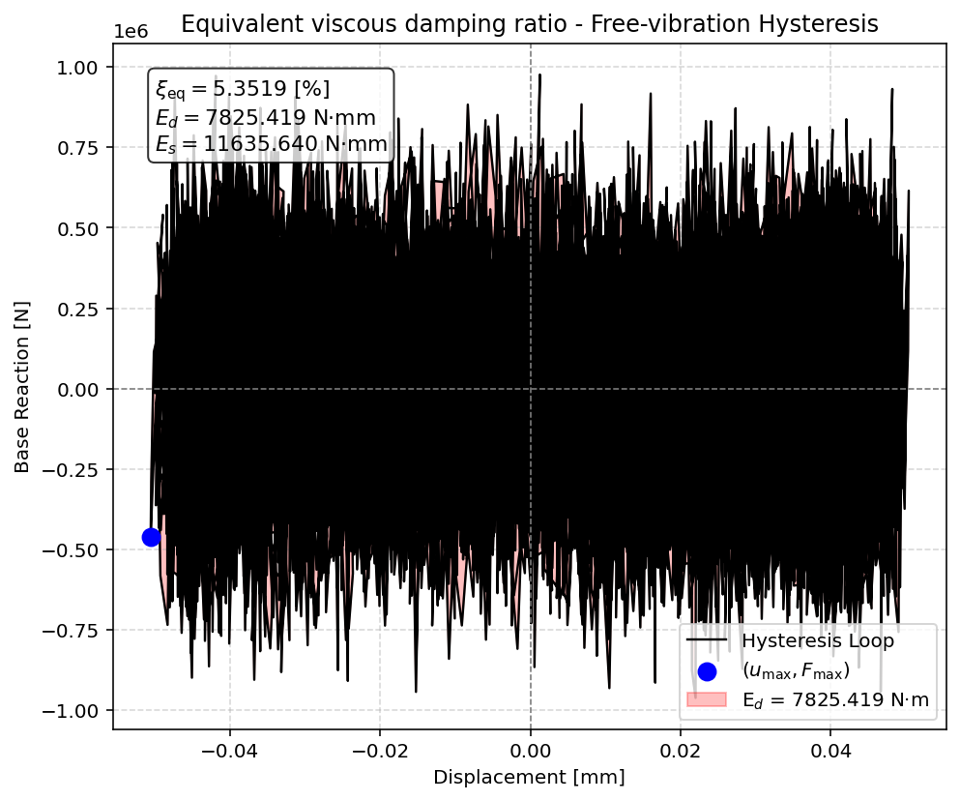

Slide 59
SEISMIC ANALYSIS

Slide 60
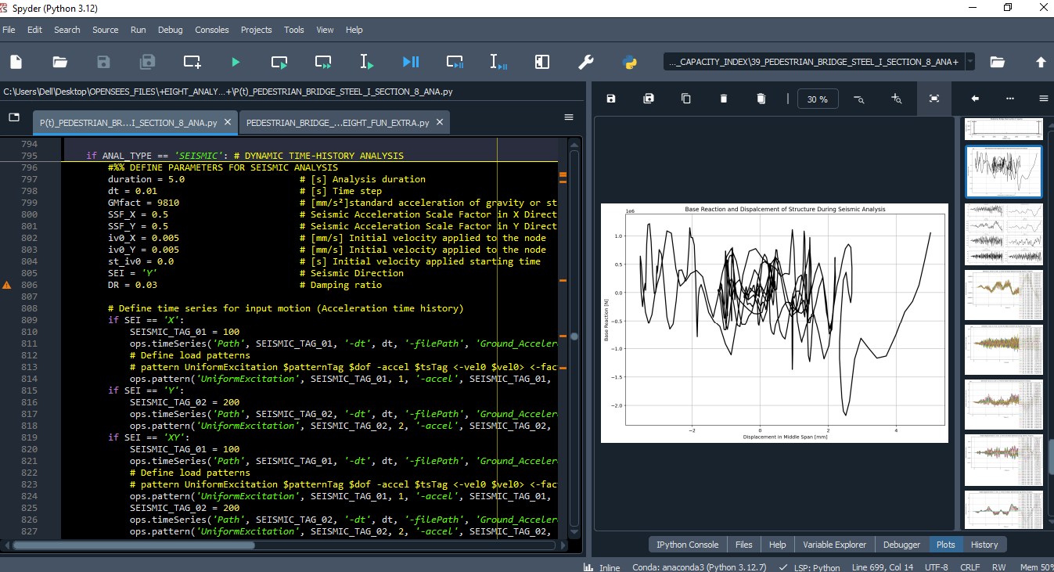

Slide 61
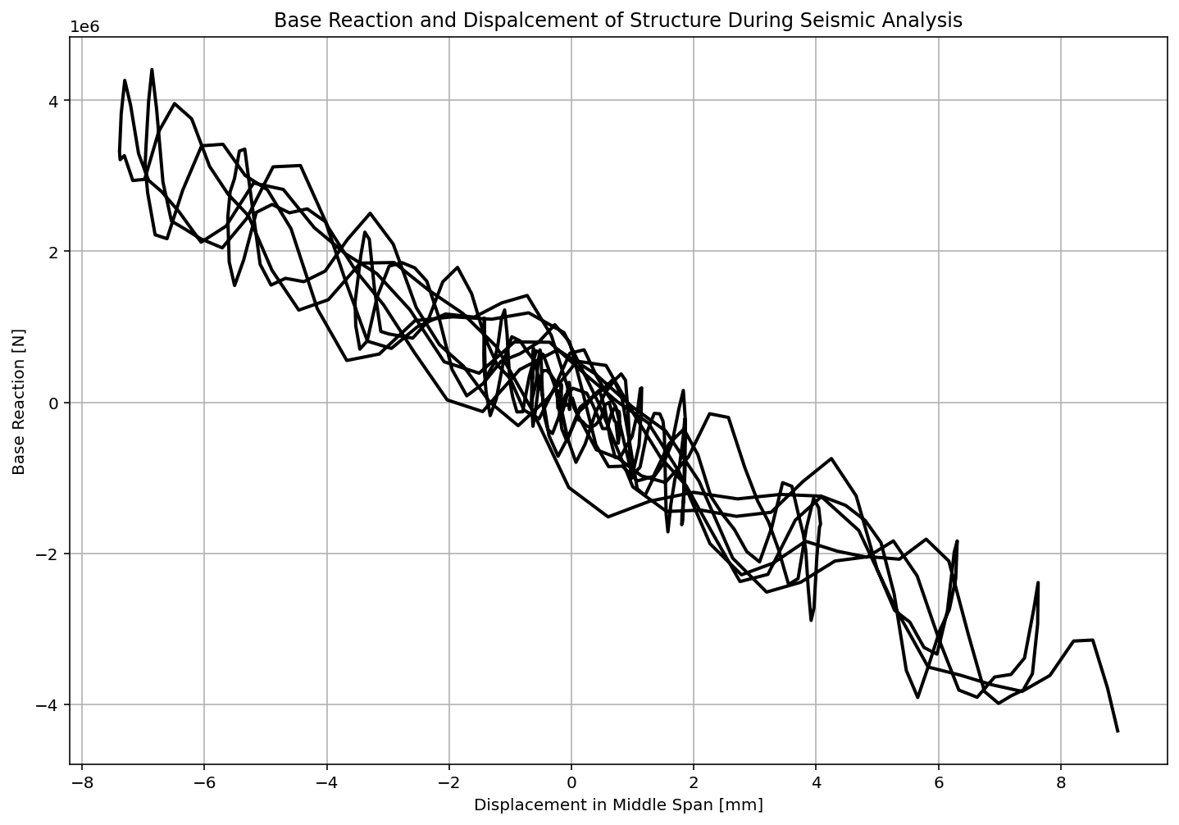

Slide 62
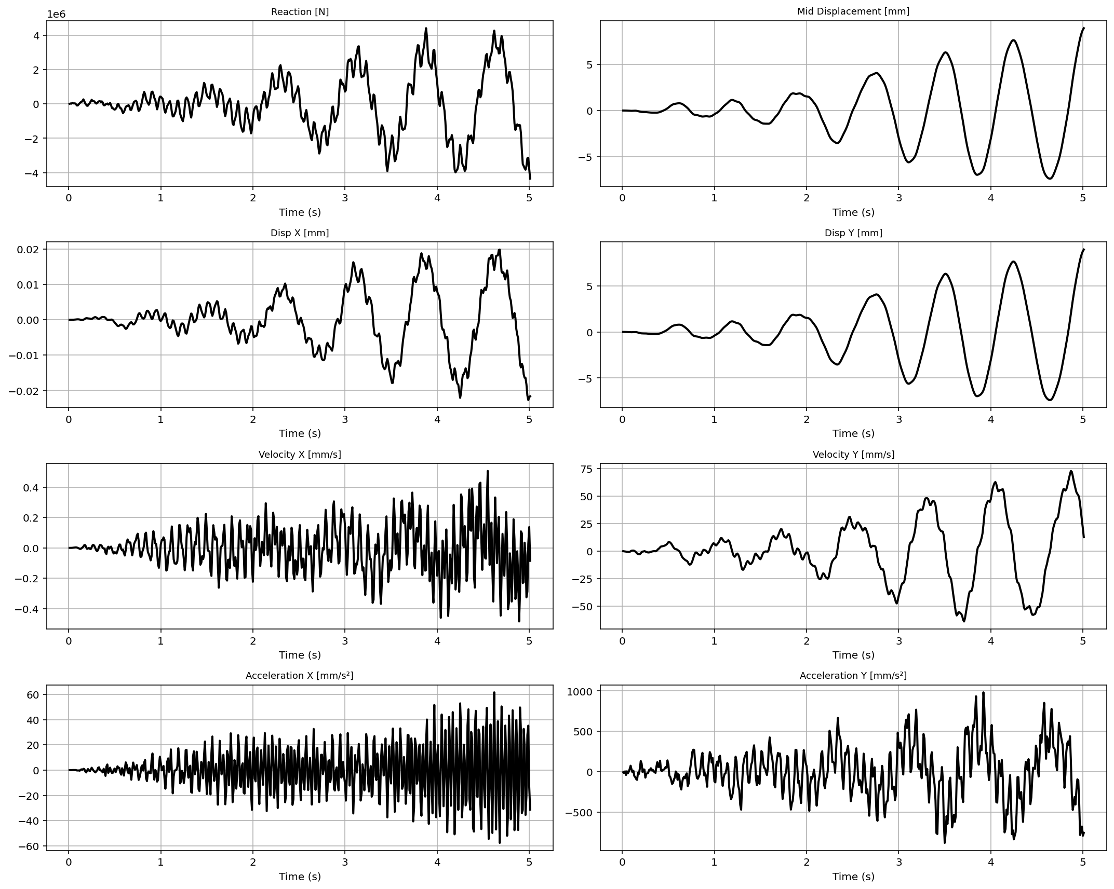

Slide 63
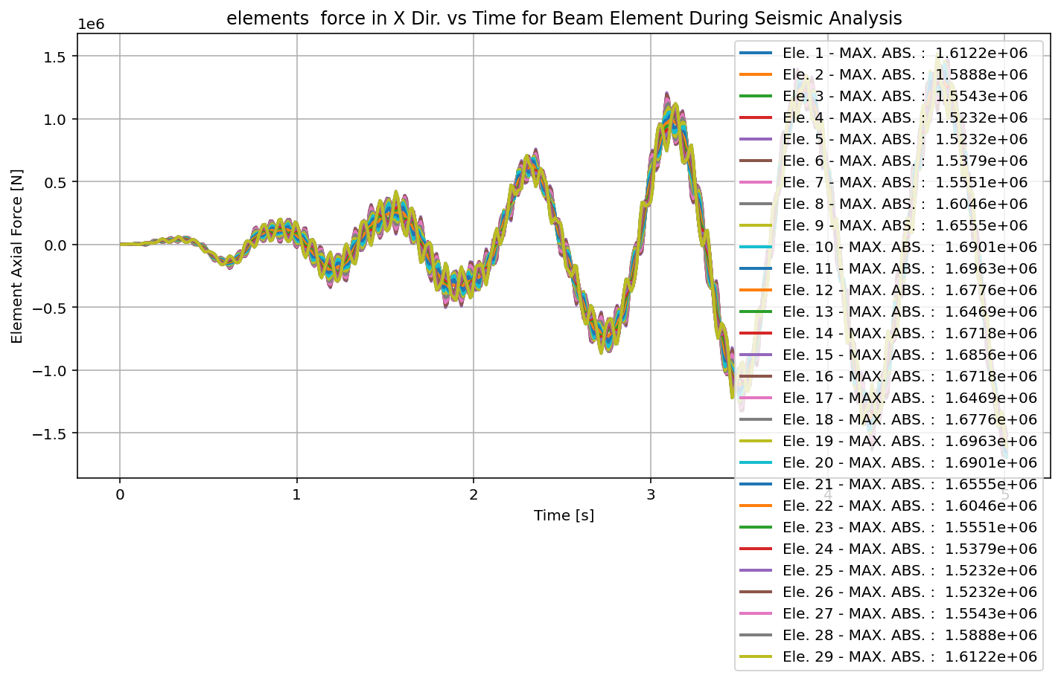

Slide 65
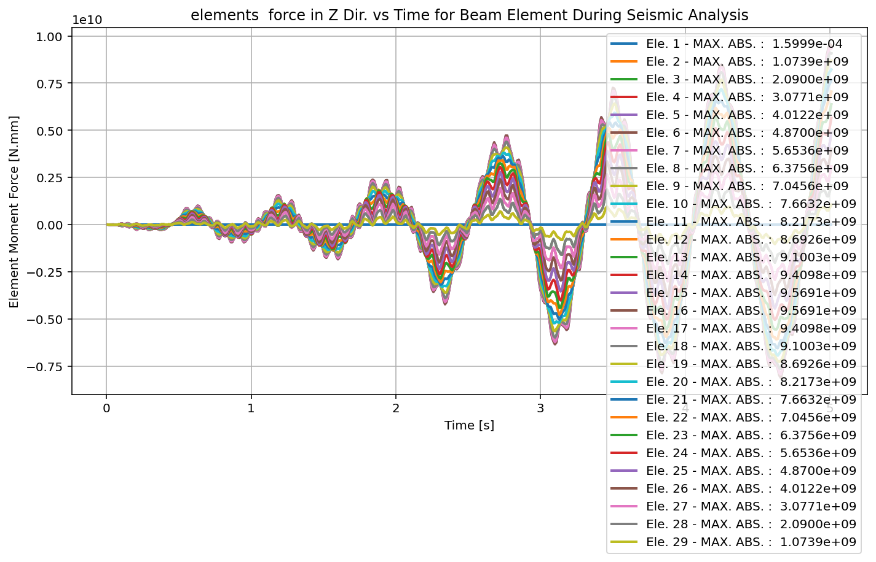

Slide 66
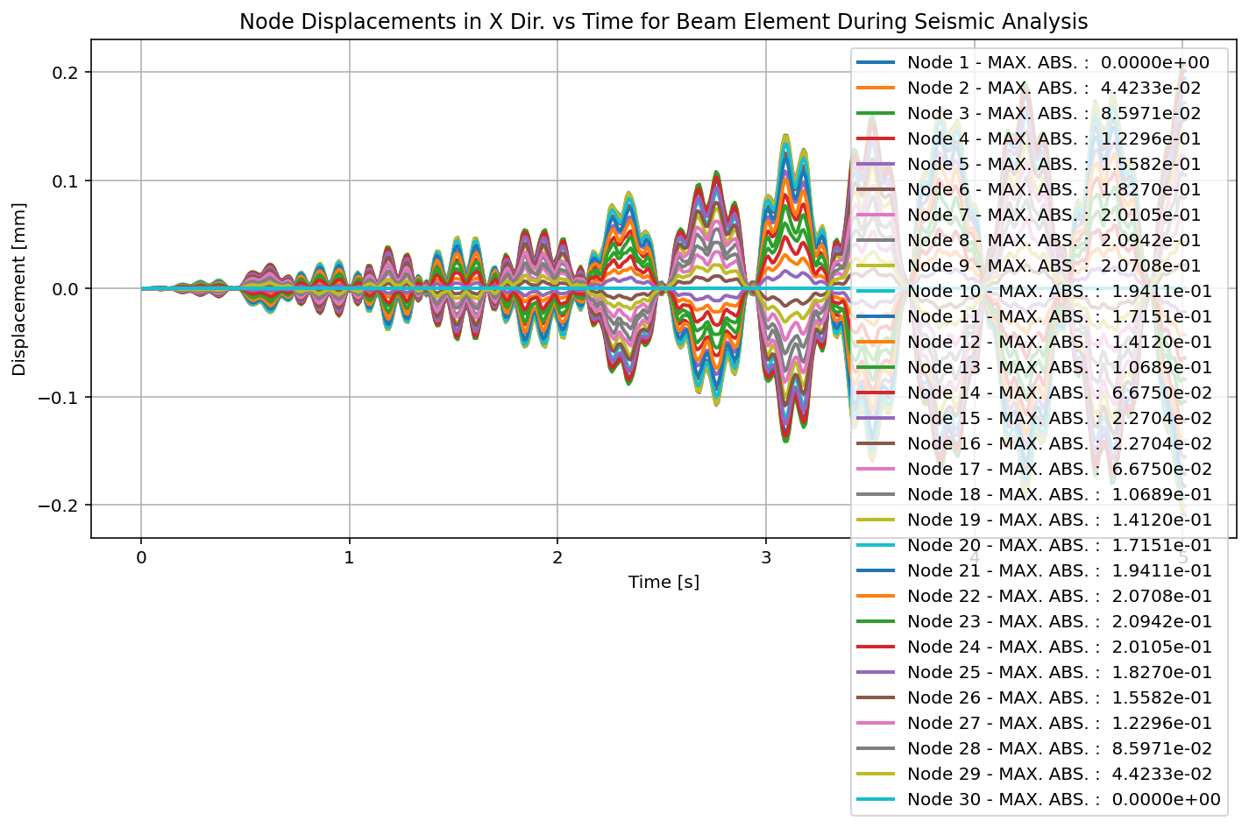

Slide 67
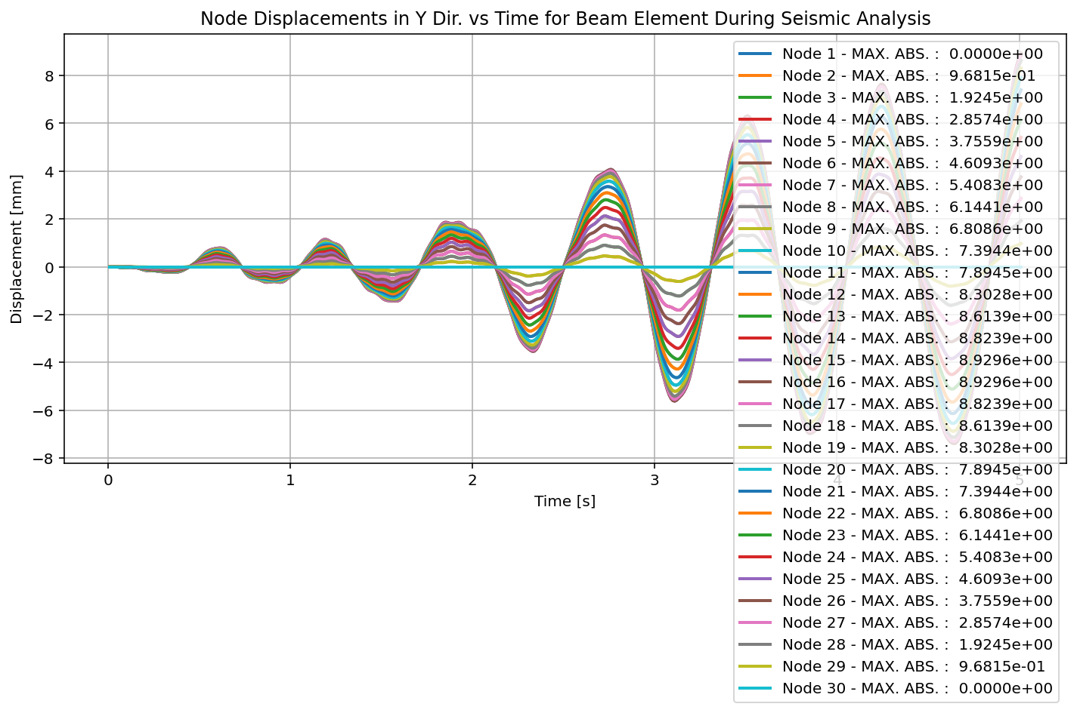

Slide 68


Slide 69


Slide 70


Slide 72


Slide 73
+==========================+
= Analysis curve fitted =
Disp Base Shear
----------------------------
[[0.00000000e+00 0.00000000e+00]
[4.56219262e+01 4.08222187e+06]
[2.00000000e+02 4.19196500e+06]]
+==========================+
+----------------------------------------------------+
Structure Elastic Stiffness : 89479.38
Structure Plastic Stiffness : 20959.82
Structure Tangent Stiffness : 710.87
Structure Ductility Ratio : 4.38
Structure Over Strength Factor: 1.03
+----------------------------------------------------+
Over Strength Coefficient (Ω0): 1.0269
Displacement Ductility Ratio (μ): 4.3839
Ductility Coefficient (Rμ): 4.3839
Structural Behavior Coefficient (R): 4.5017
Structural Ductility Damage Index in Y Direction: -26.3043 (%)

Slide 74


Slide 75


Slide 76
Dissipated Energy from Earthquake= 4178336.21 N·mm
Dissipated Energy from Cyclic Displacement= 8658710171.16 N·mm
DISSIPATED ENERGY CAPACITY INDEX: 0.048 [%]
ZONE 1: VERY MINOR DAMAGE

Slide 77


