Slide 1
>> IN THE NAME OF ALLAH, THE MOST GRACIOUS, THE MOST MERCIFUL <<
SENSITIVITY ANALYSIS OF SINGLE-DEGREE-FREEOM (SDOF) STRUCTURES USING FREE-VIBRATION EFFECTS OF INTIAL DISPLACEMENT, STRUCTURAL ELASTIC STIFFNESS, STRUCTURAL DUCTILITY RATIO AND OVER-STRENGTH FACTOR ON OUTPUT KEY PARAMETERS SUCH AS EQULIVALENT VISCOUS DAMPING RATIO FROM NONLINEAR DYNAMIC ANALYSES USING PYTHON AND OPENSEES
THIS PROGRAM WRITTEN BY SALAR DELAVAR GHASHGHAEI (QASHQAI)

Slide 2


Slide 3


Slide 4
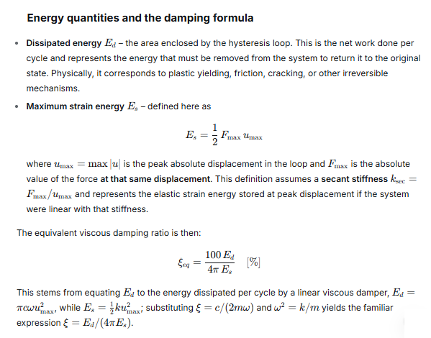

Slide 5
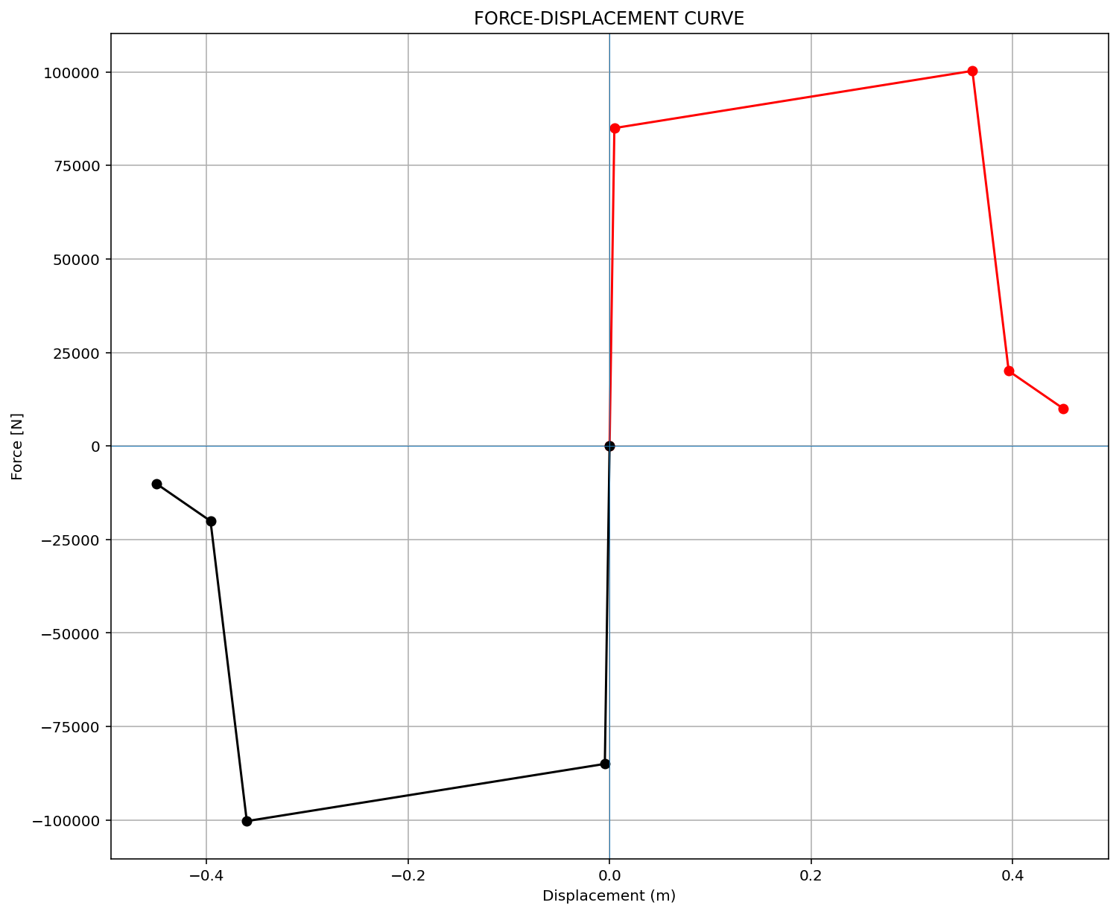
ELEMENT 01

Slide 6

ELEMENT 02

Slide 7
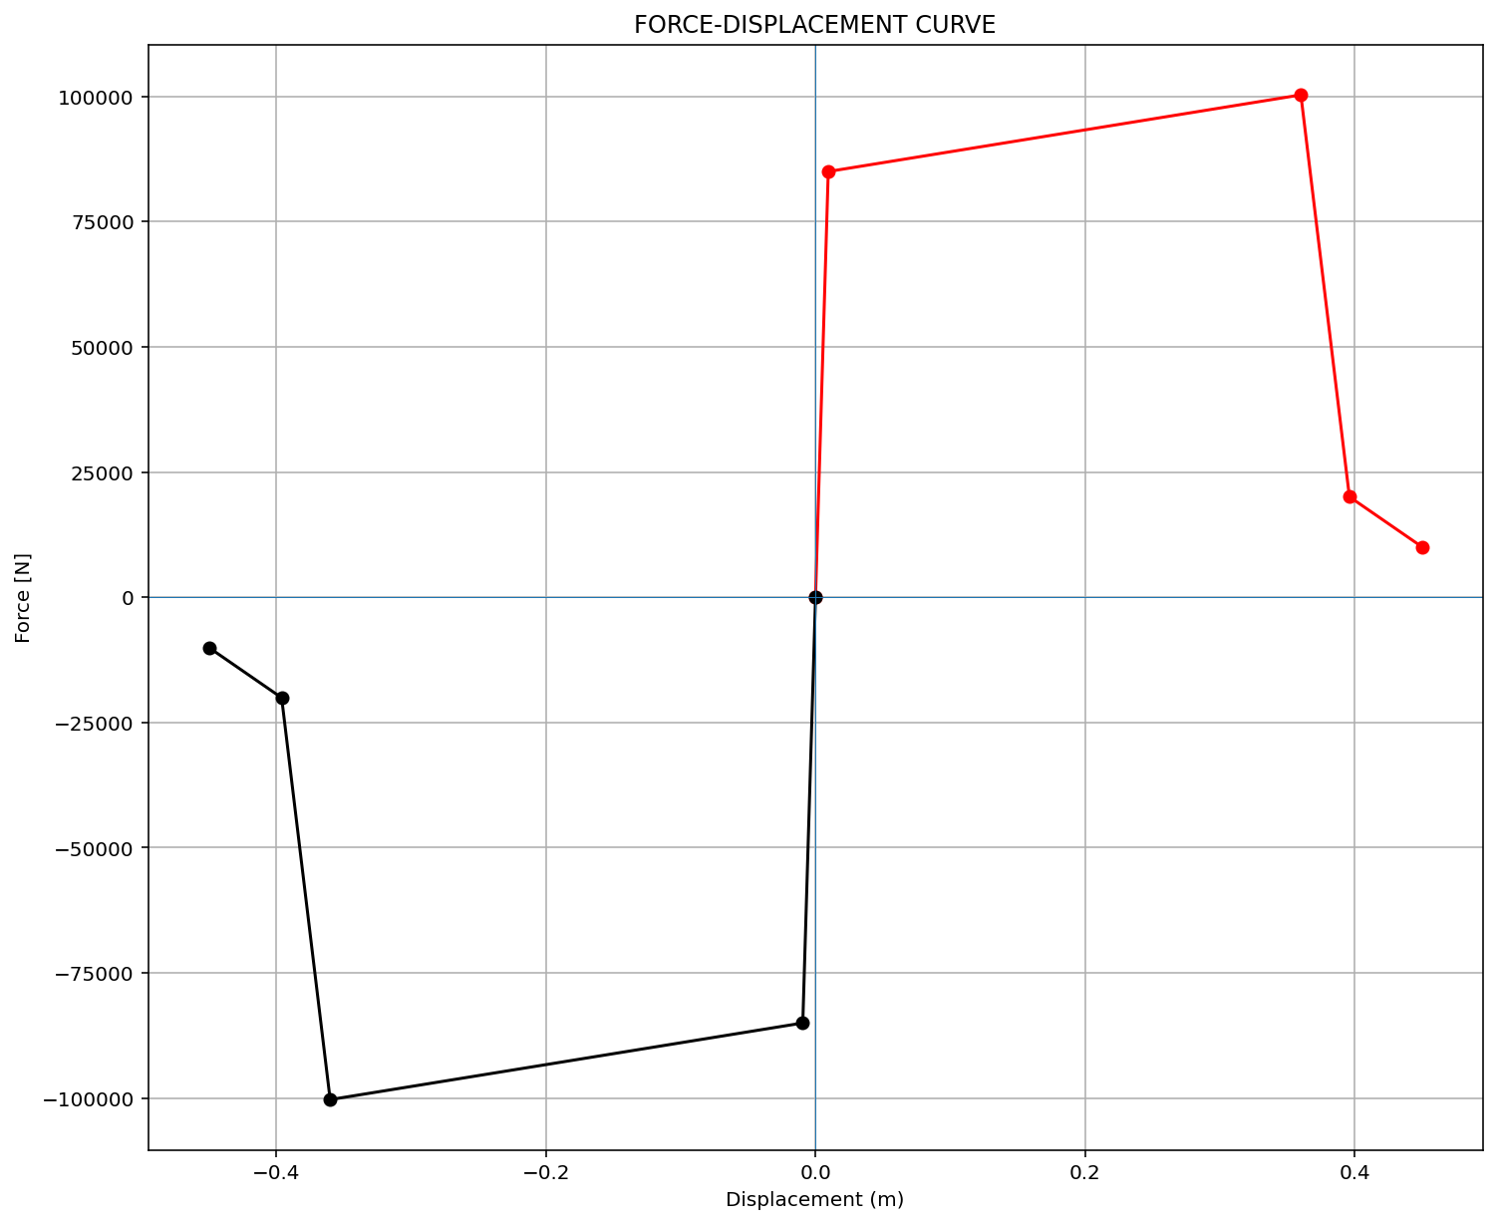
ELEMENT 03

Slide 8
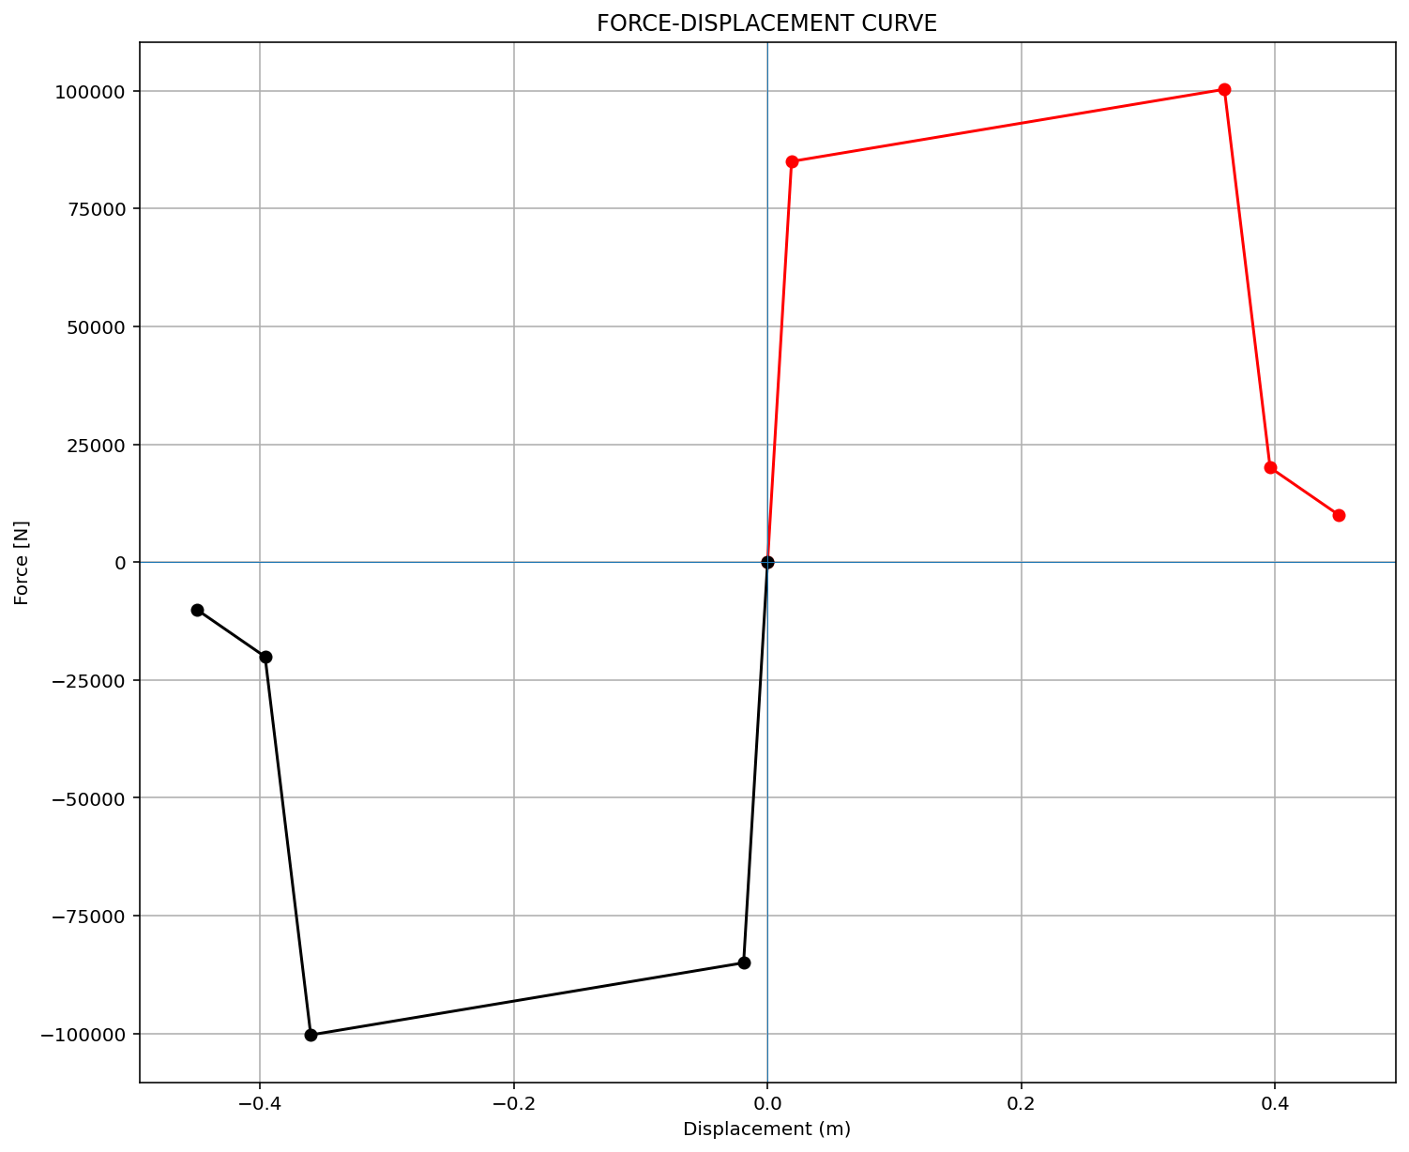
ELEMENT 04

Slide 9
FREE-VIBRATION ANALYSIS

Slide 10
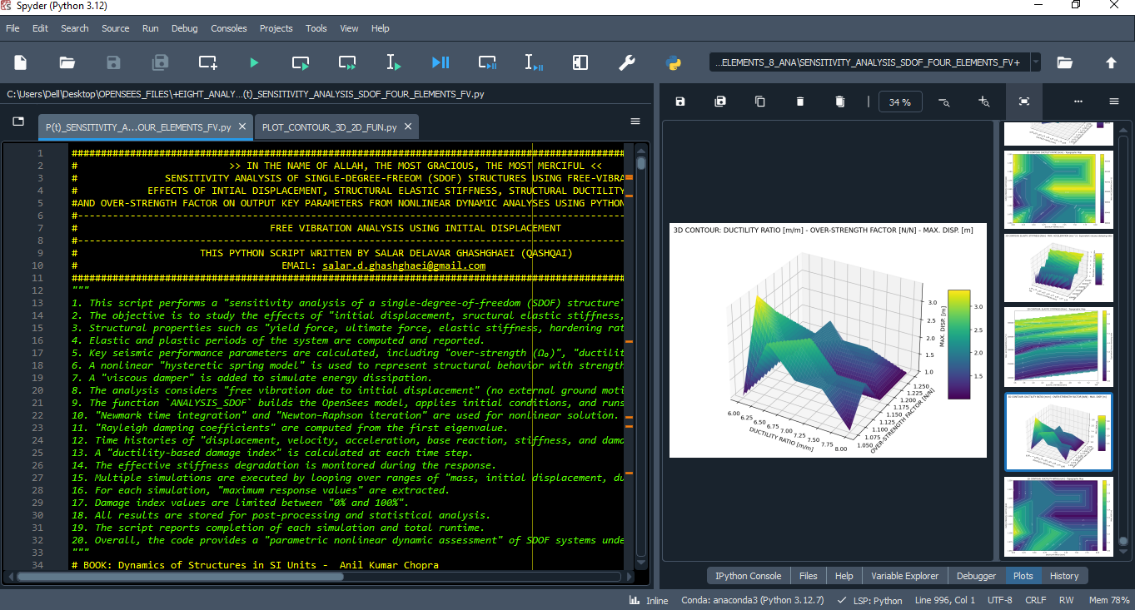

Slide 11
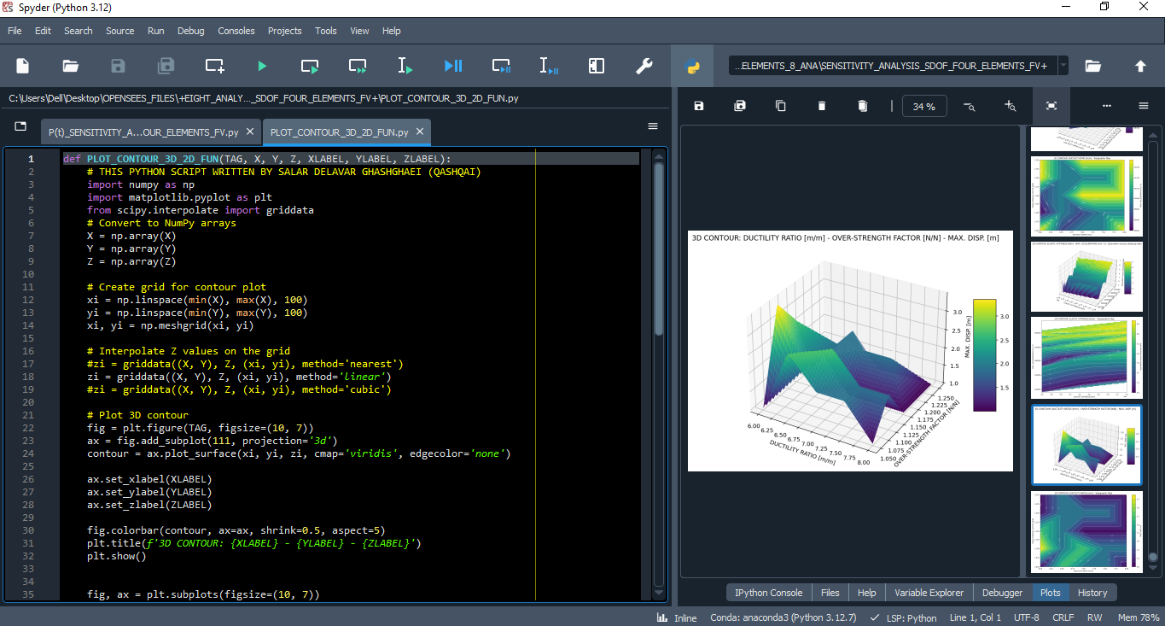

Slide 12
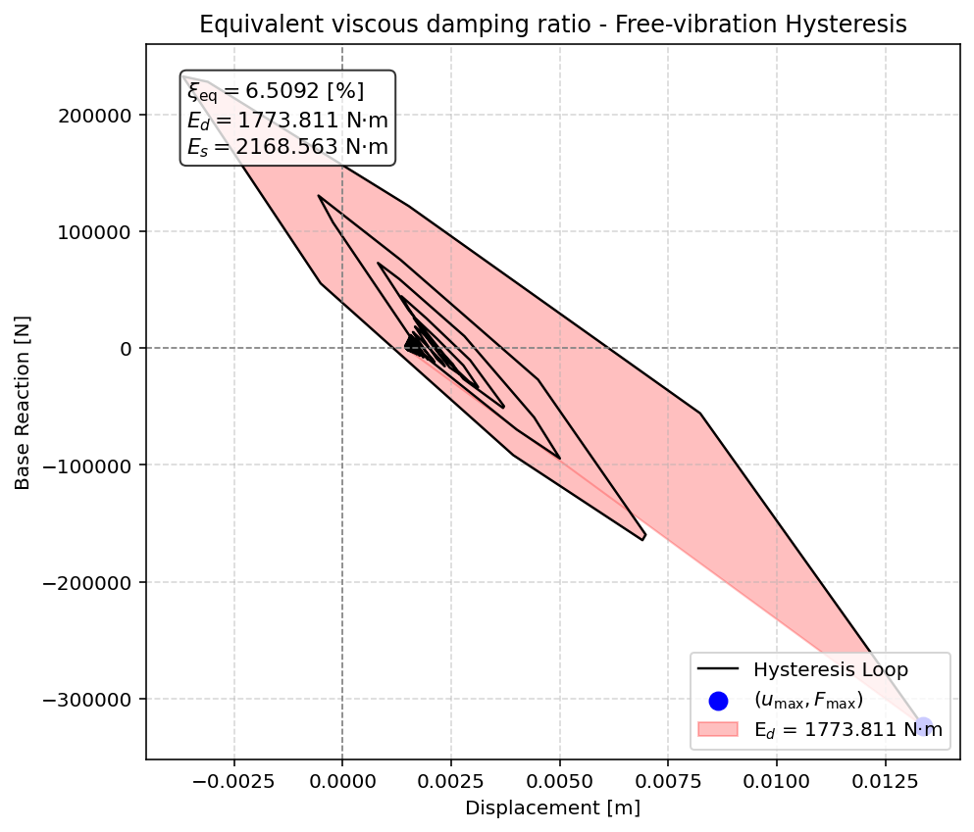

Slide 13
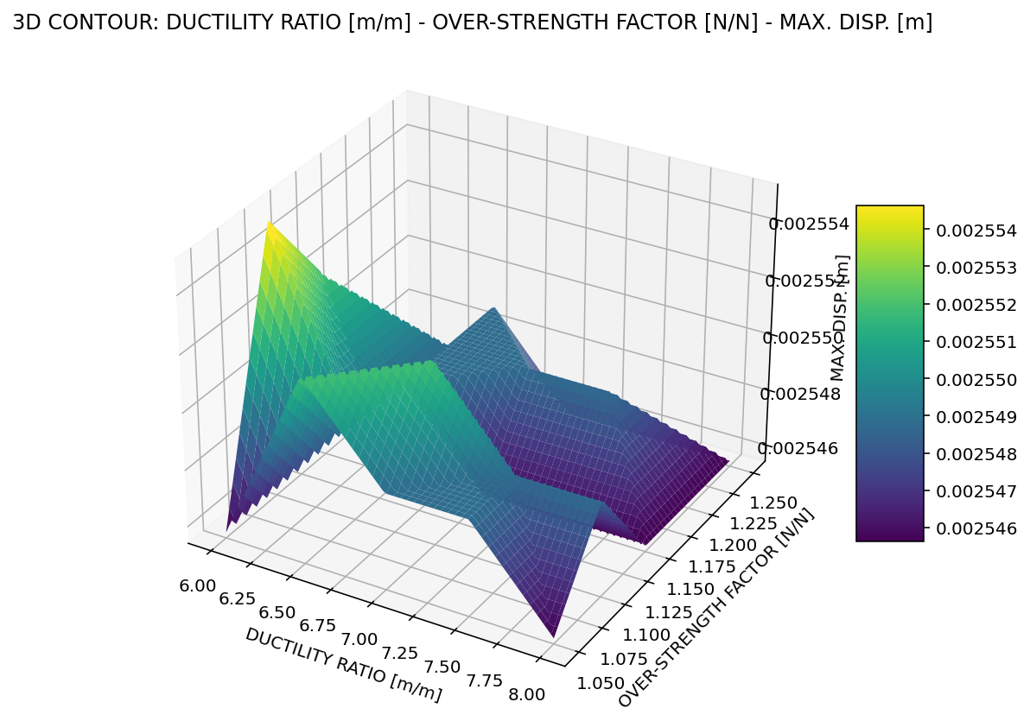

Slide 14
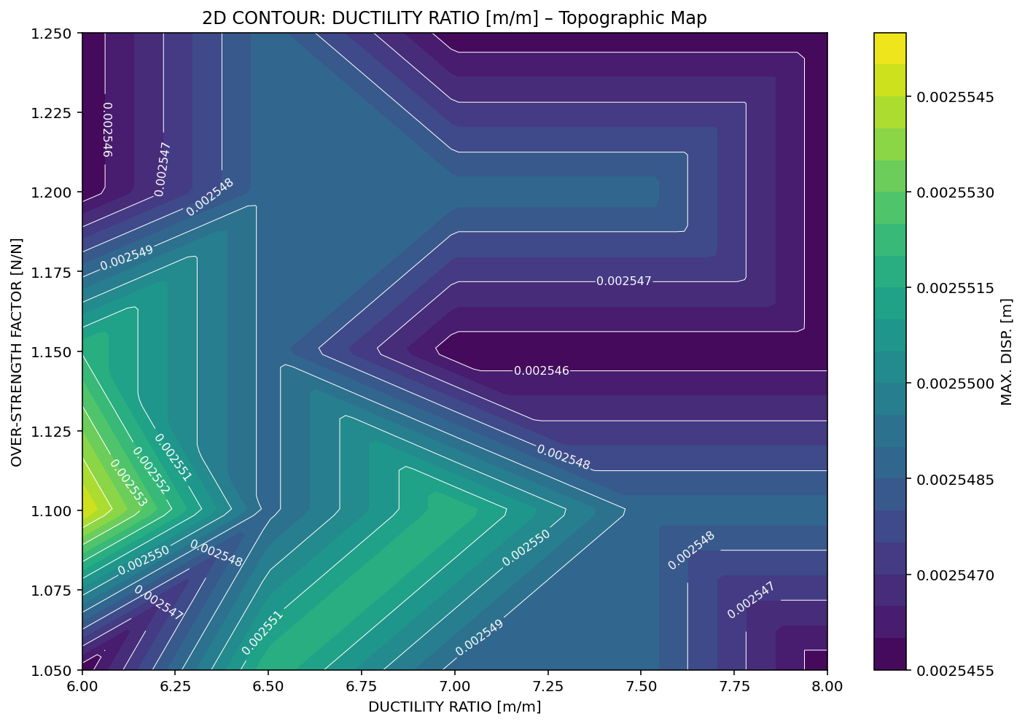

Slide 15
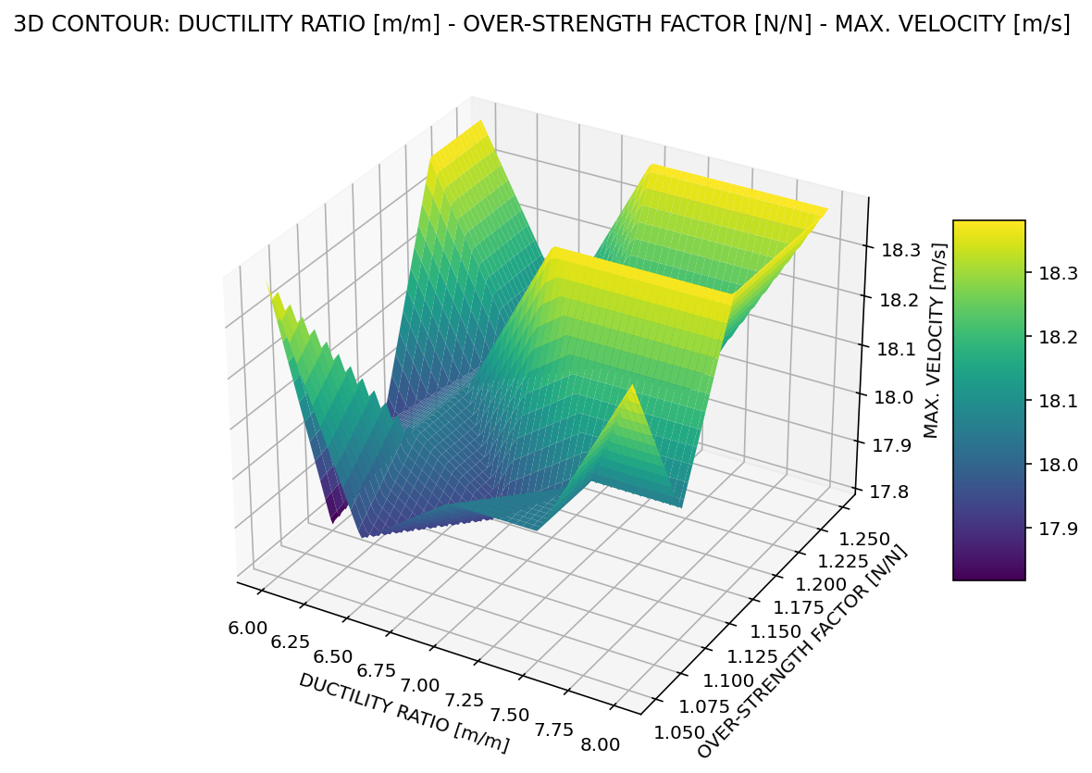

Slide 16
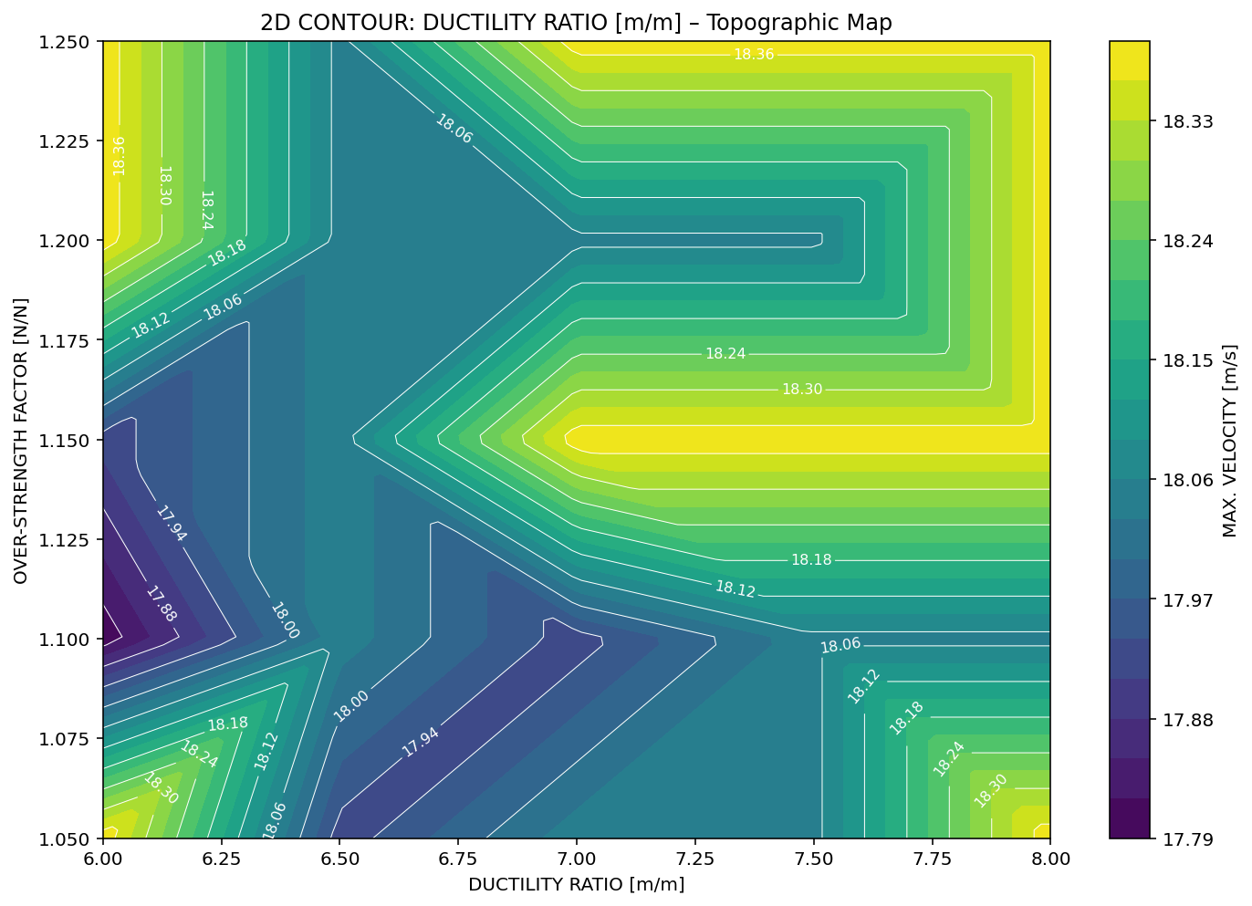

Slide 17
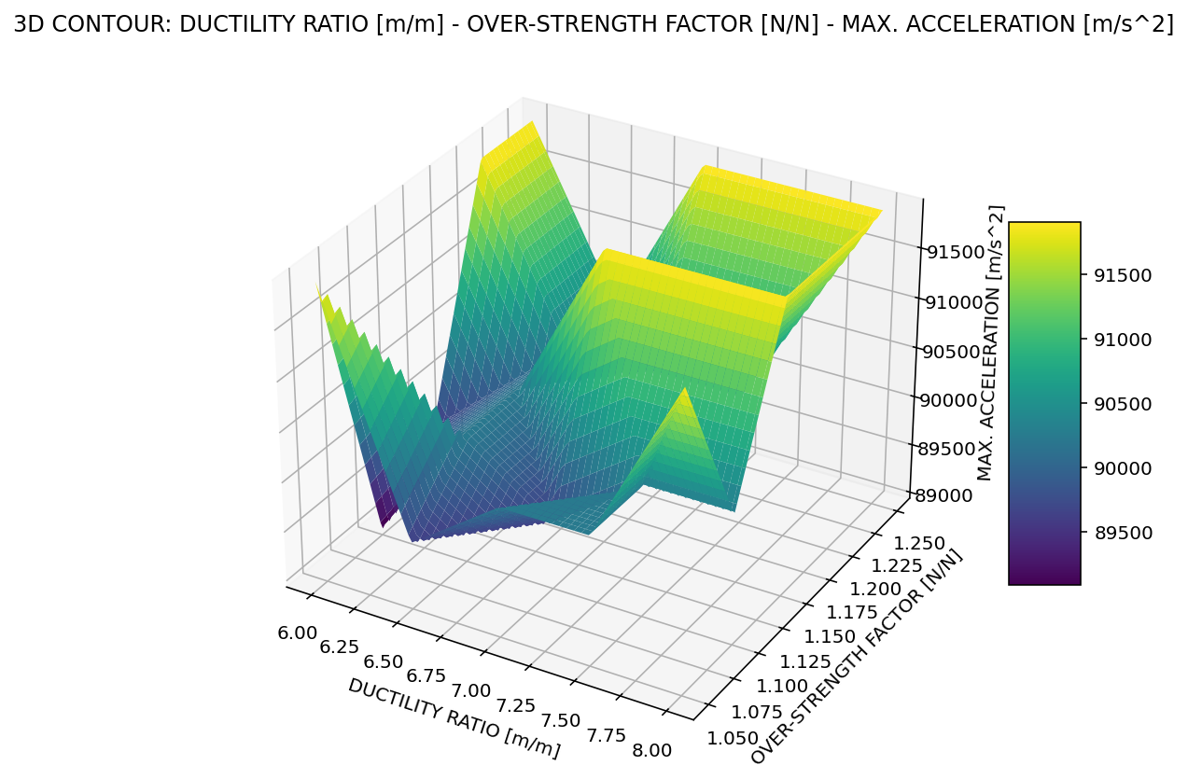

Slide 18
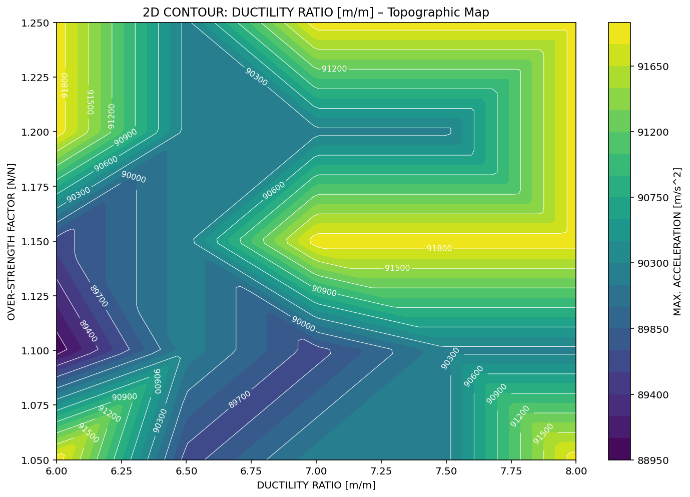

Slide 19
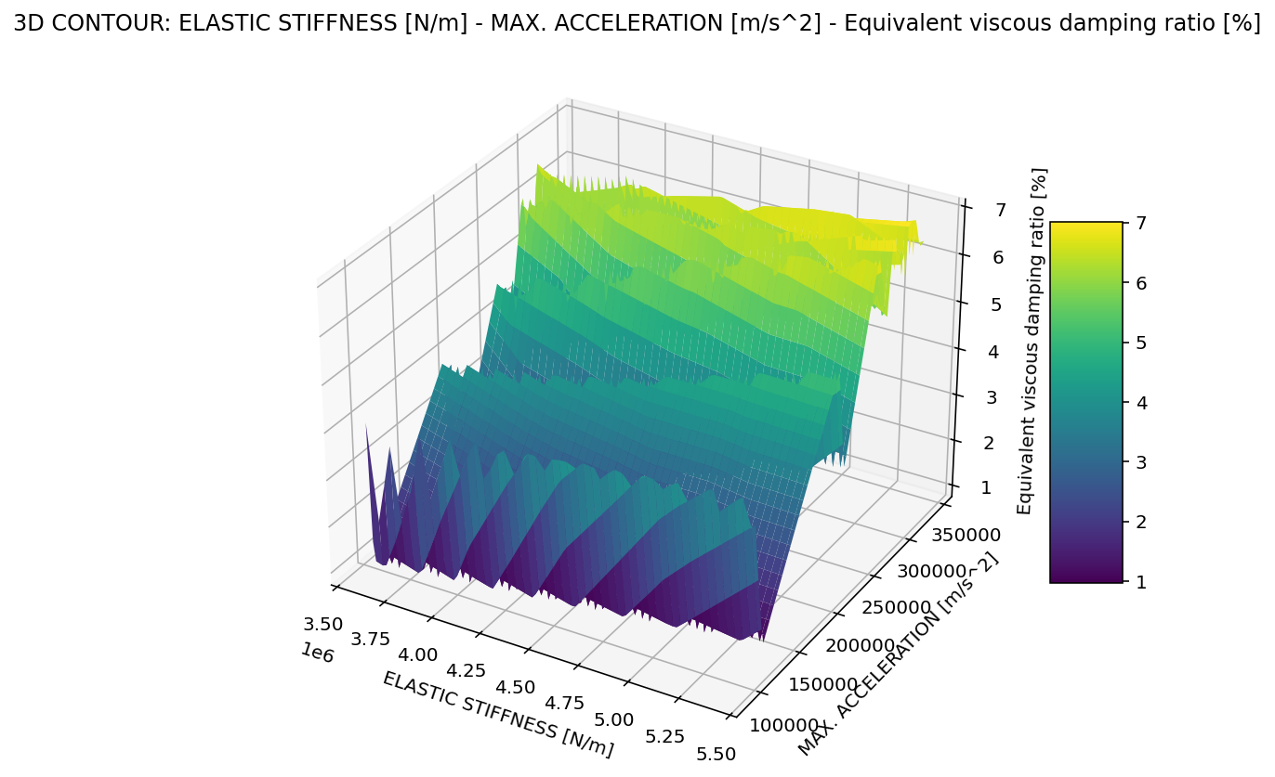

Slide 20
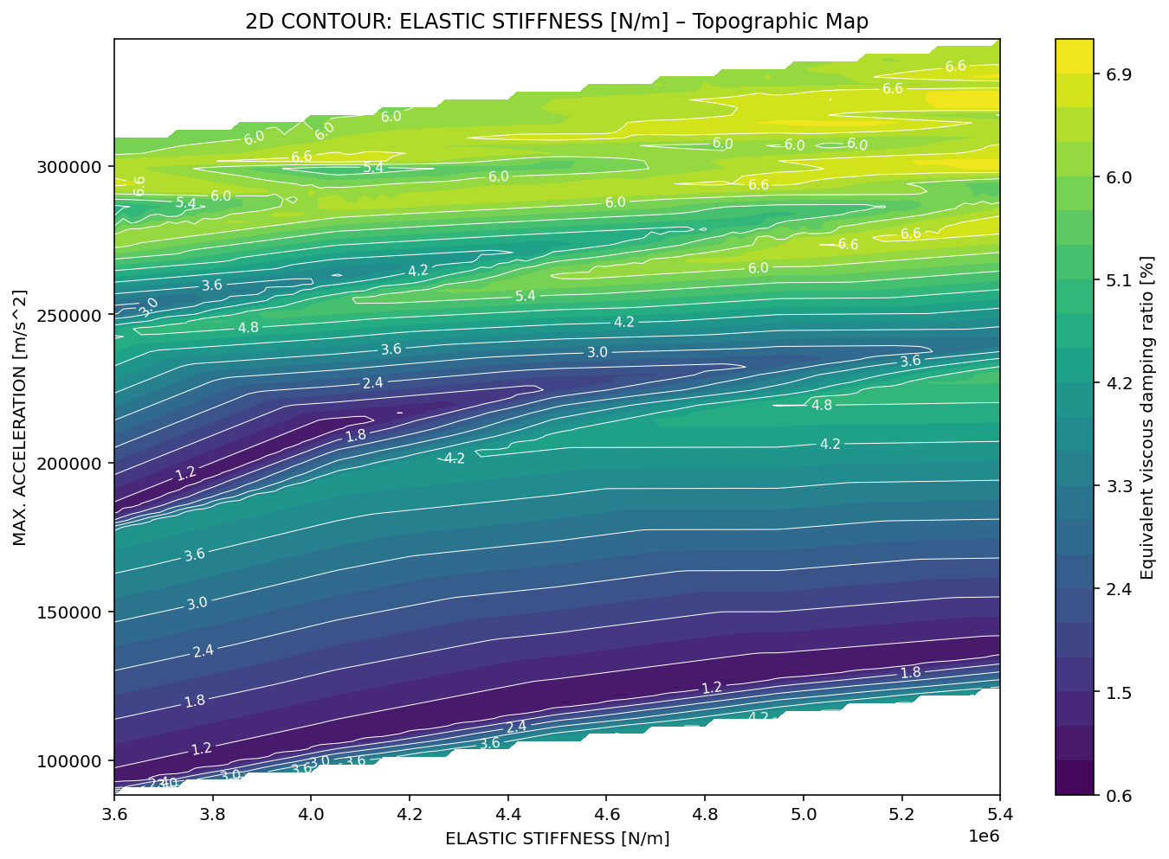

Slide 21
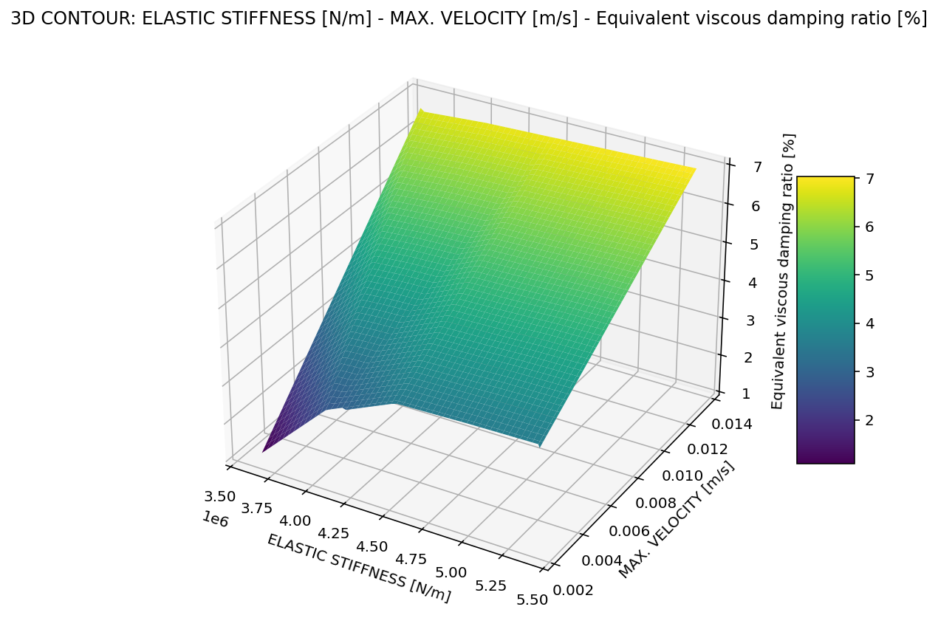

Slide 22
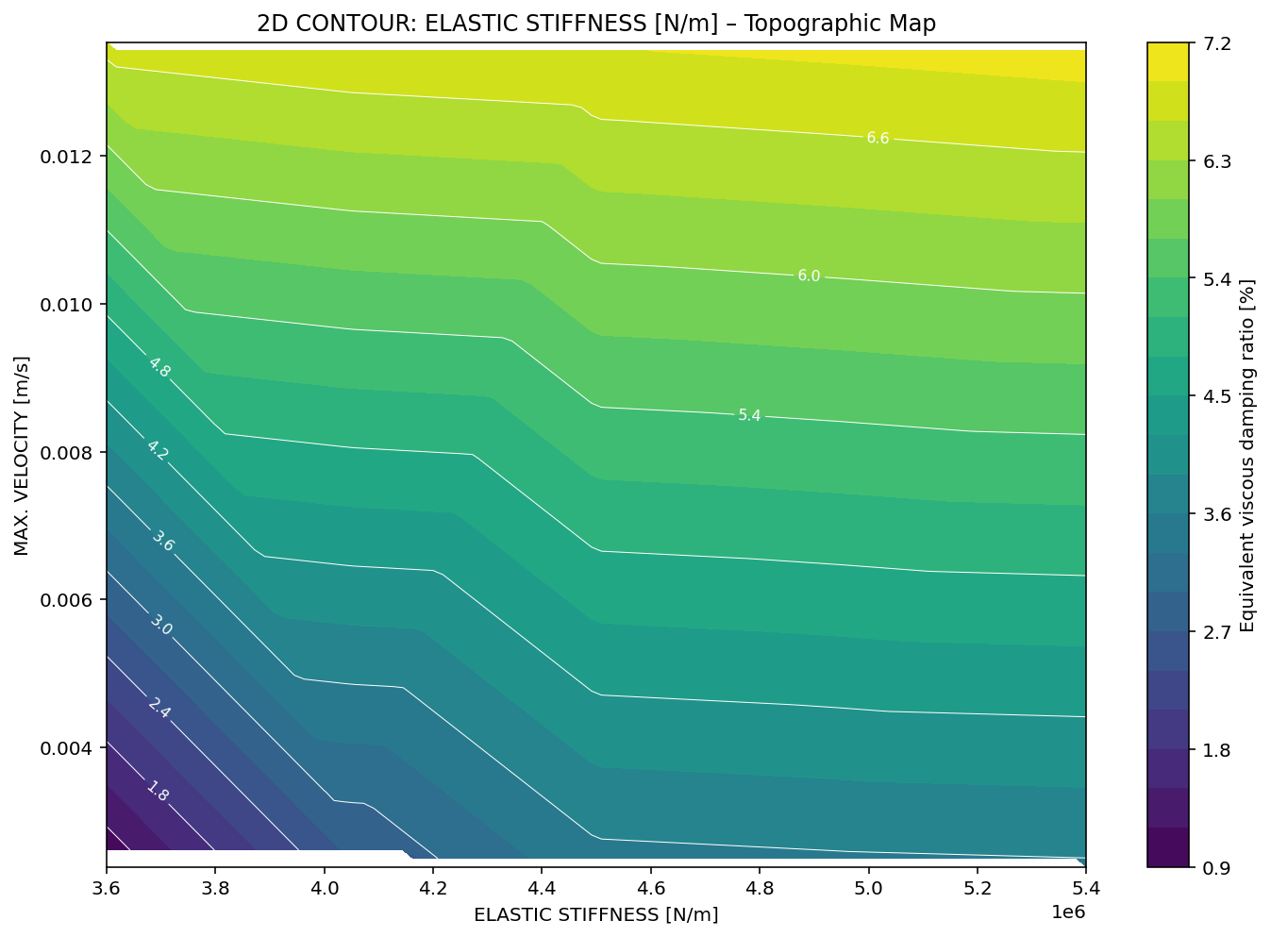

Slide 23
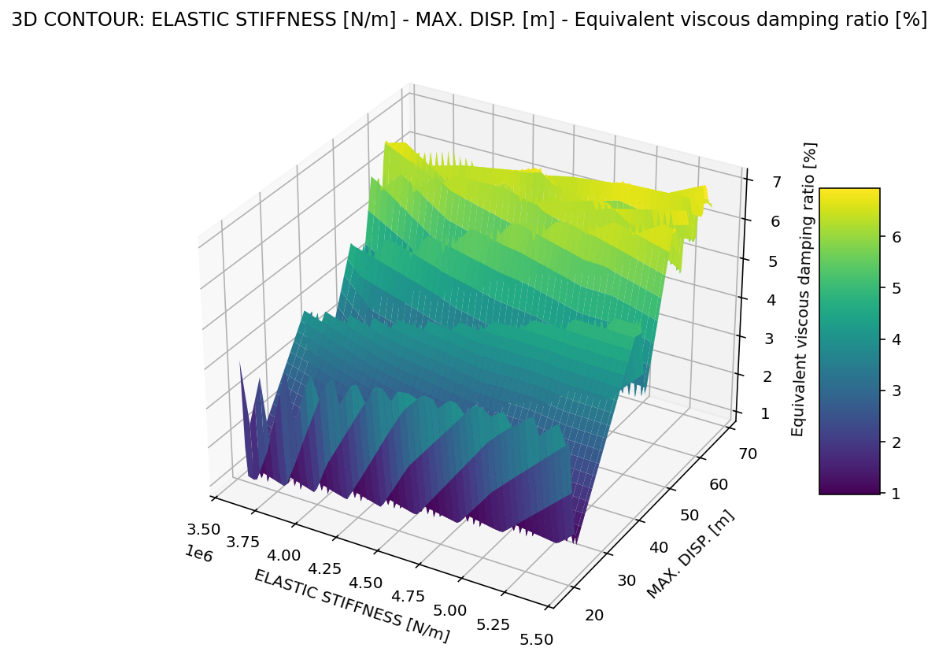

Slide 24
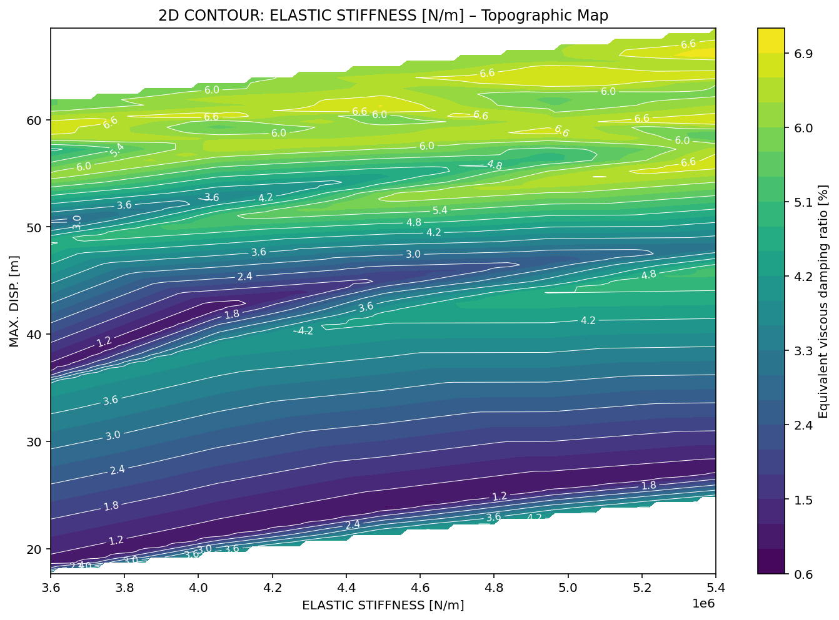

Slide 25
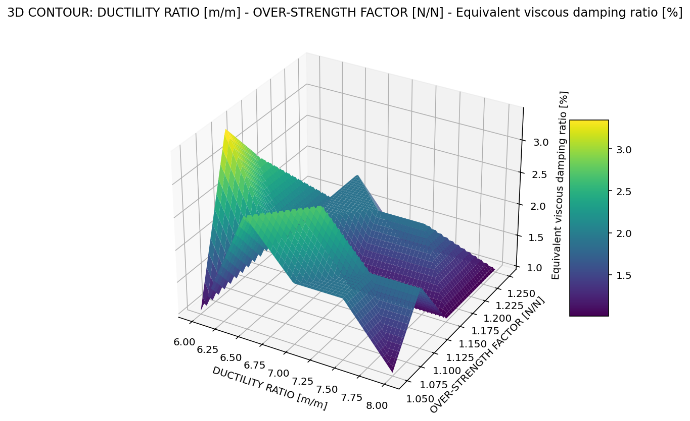

Slide 26
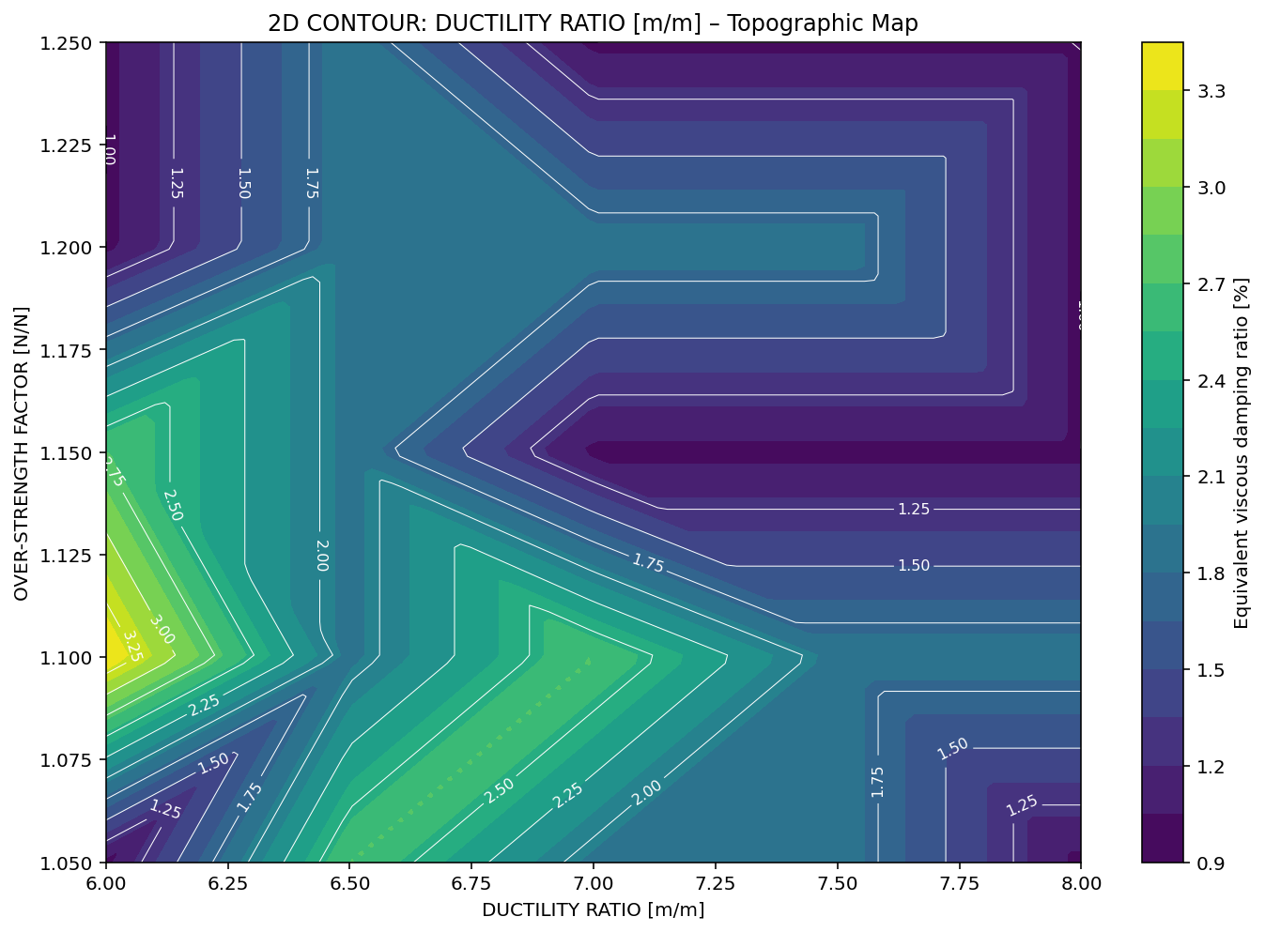

Slide 27
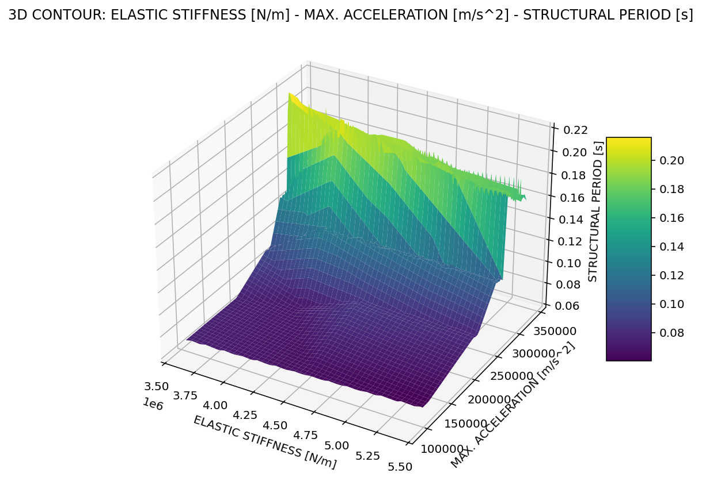

Slide 28
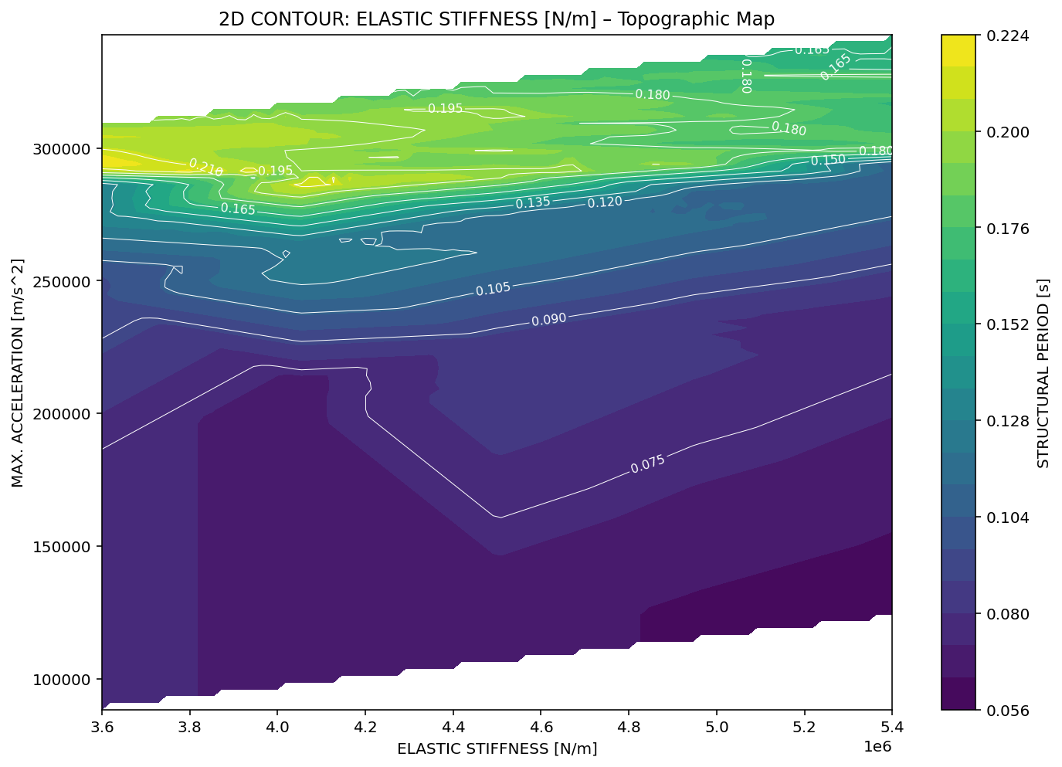

Slide 29
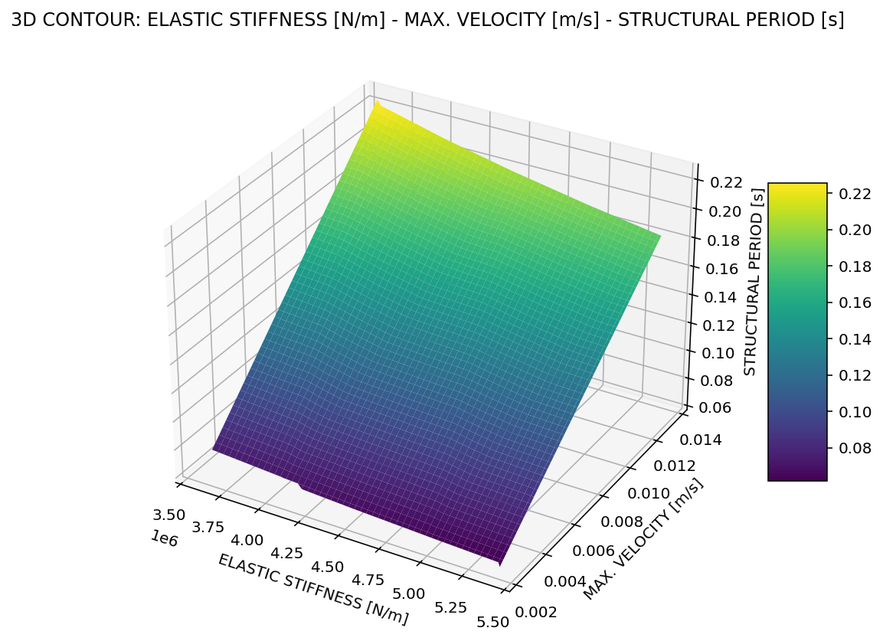

Slide 30
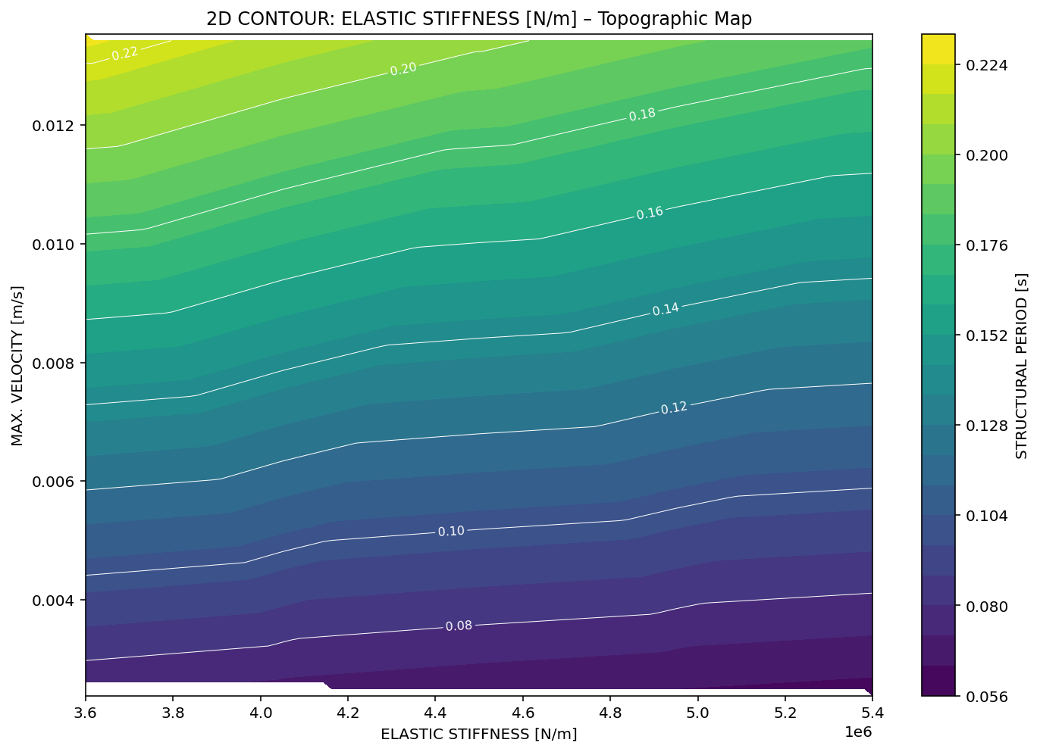

Slide 31
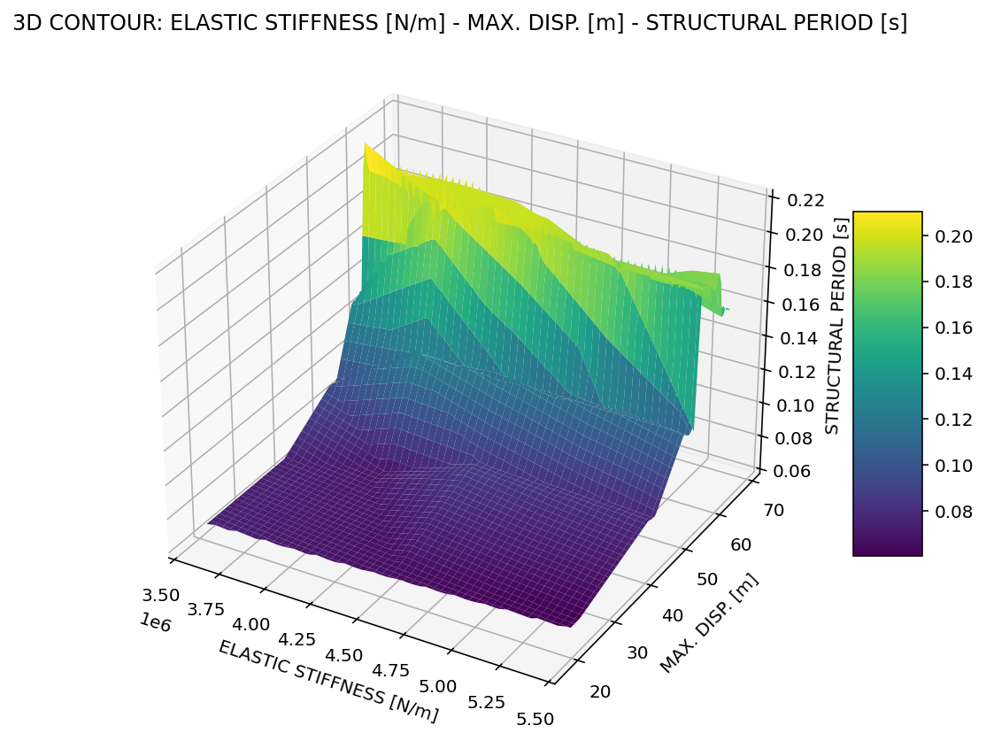

Slide 32
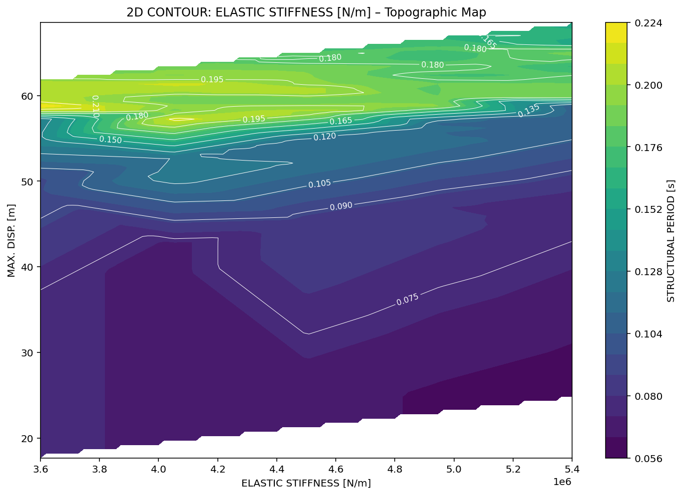

Slide 33
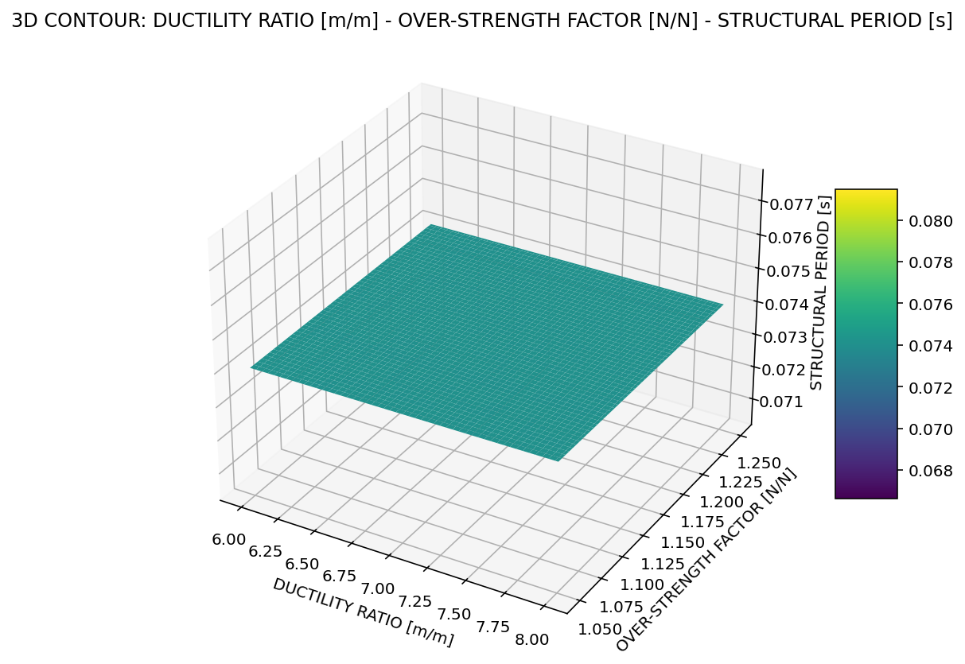

Slide 34
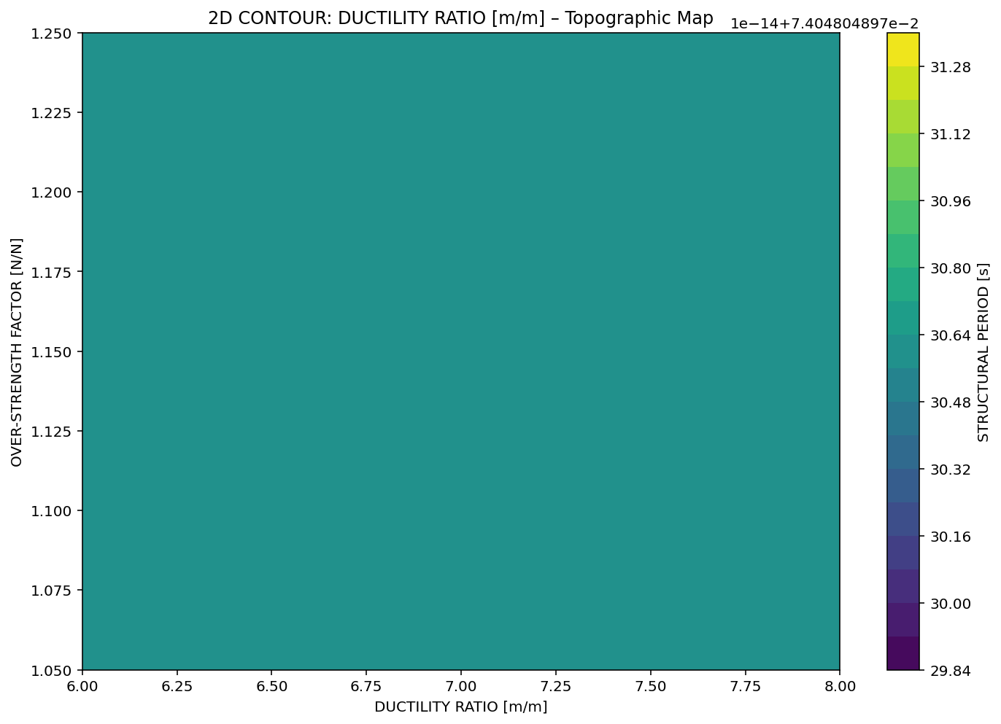

Slide 35
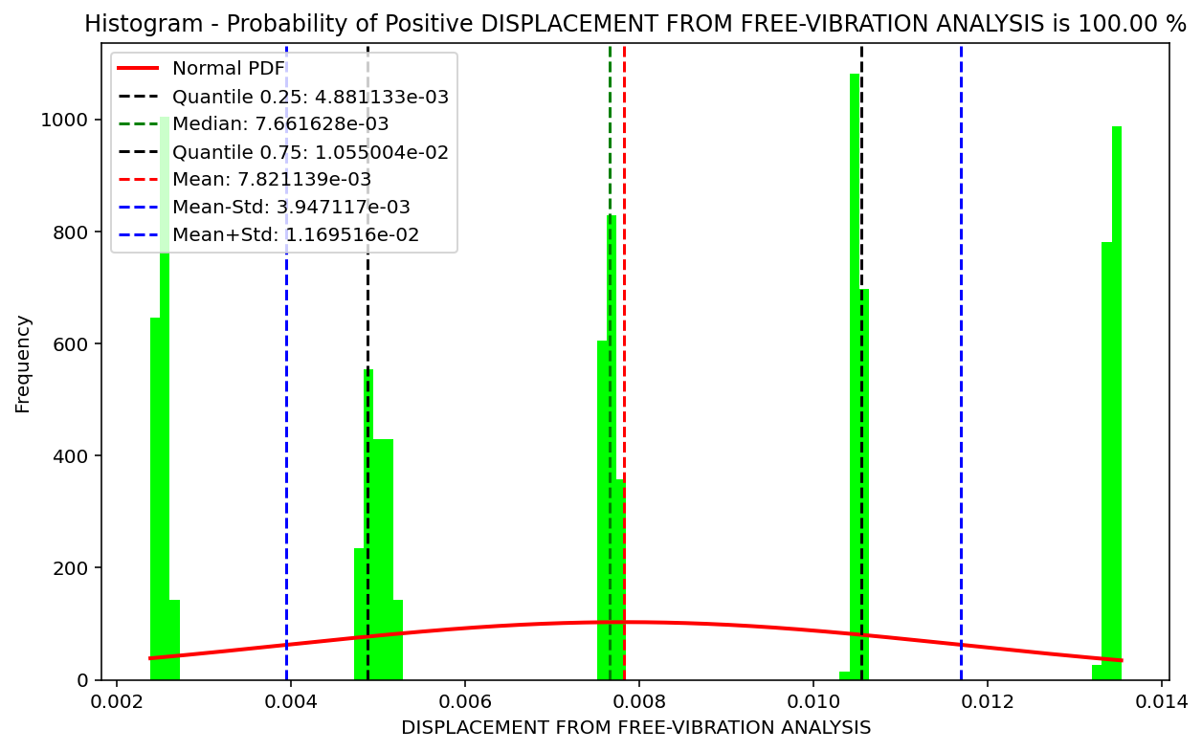

Slide 36
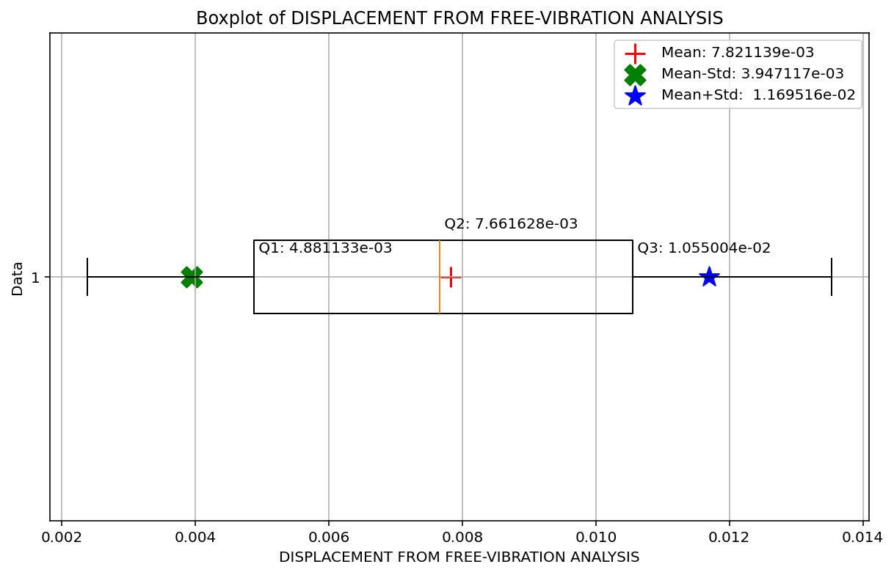

Slide 37
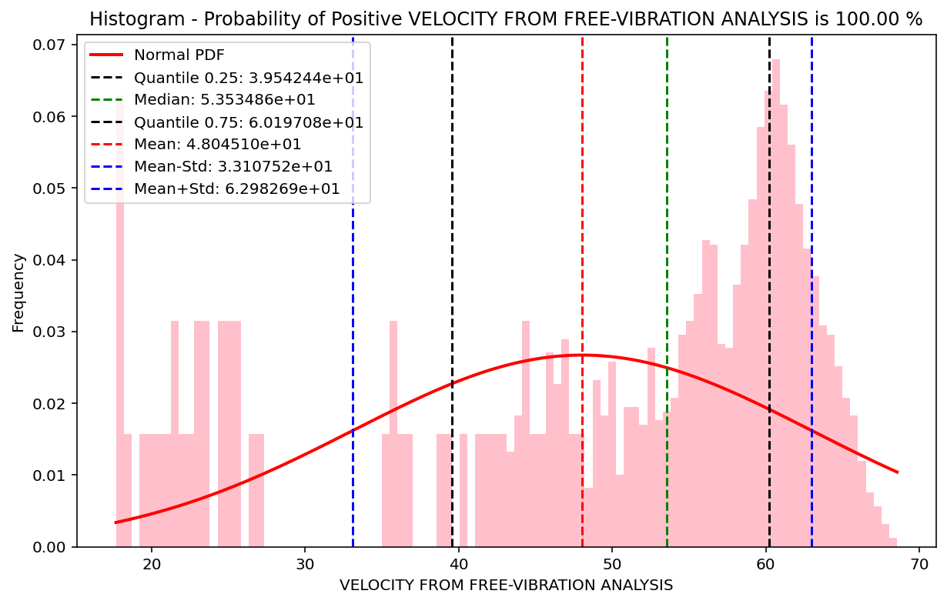

Slide 38
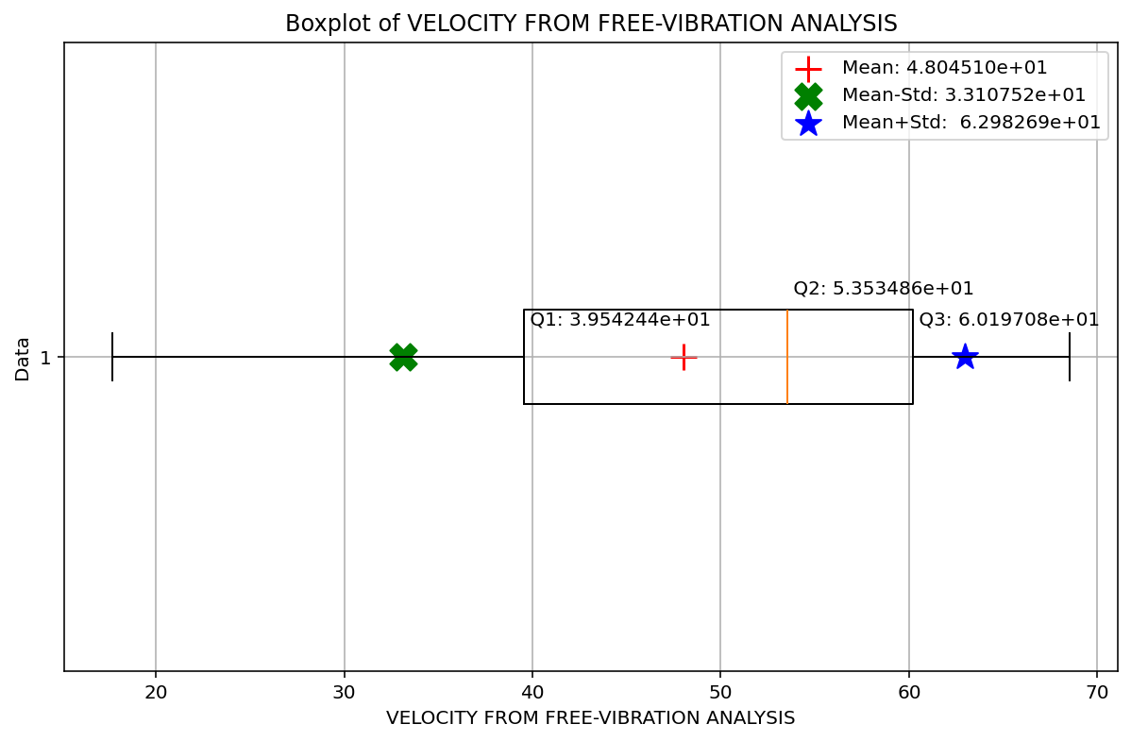

Slide 39
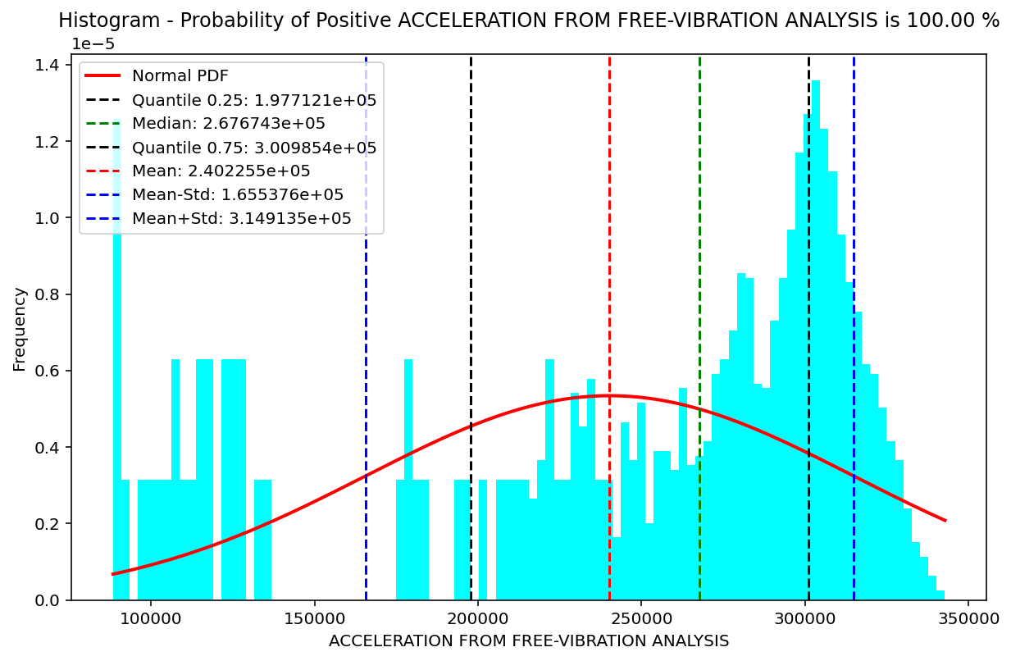

Slide 40
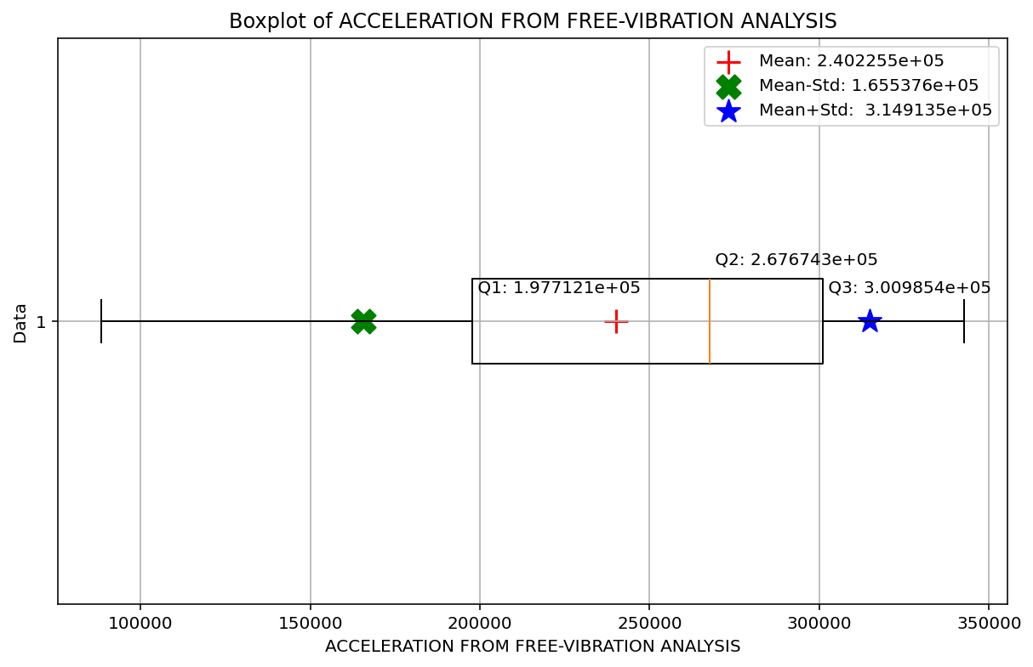

Slide 41
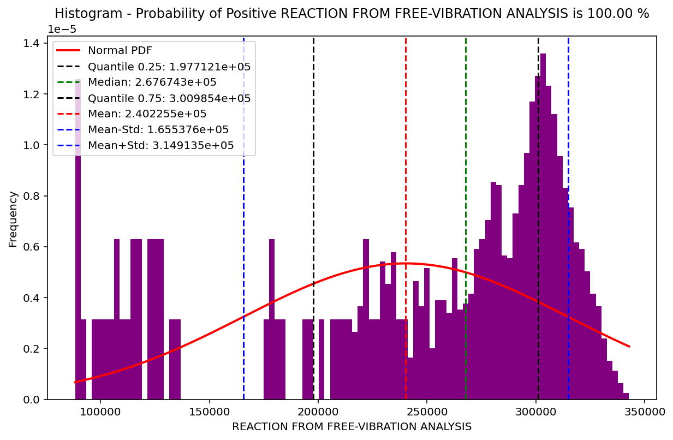

Slide 42
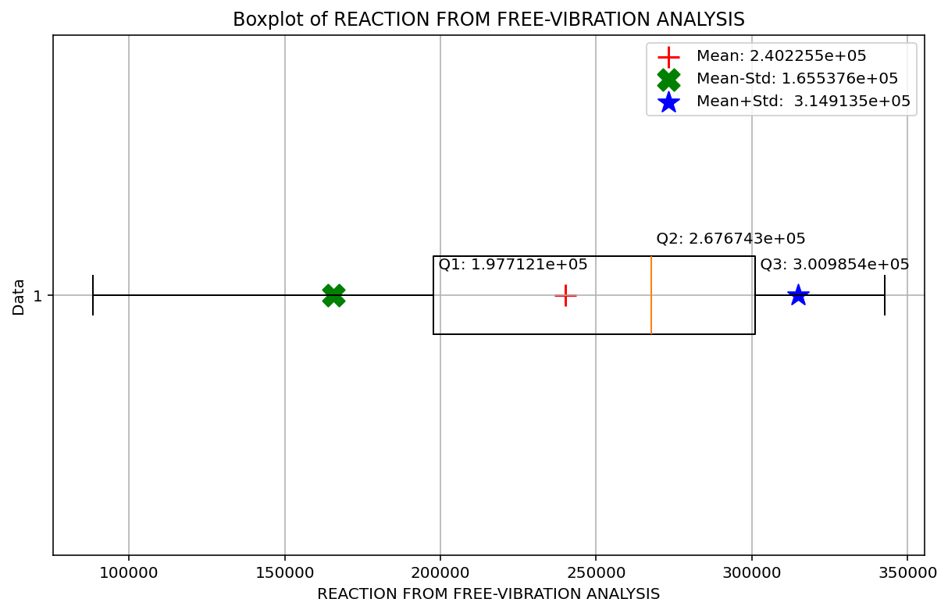

Slide 43
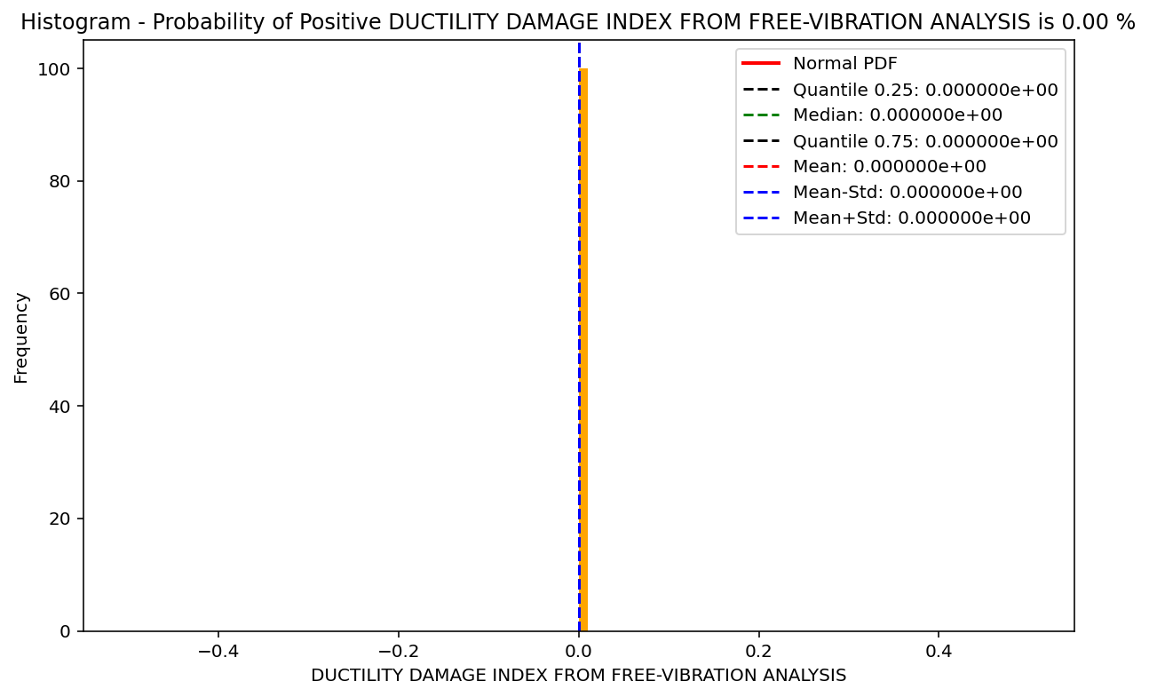

Slide 44
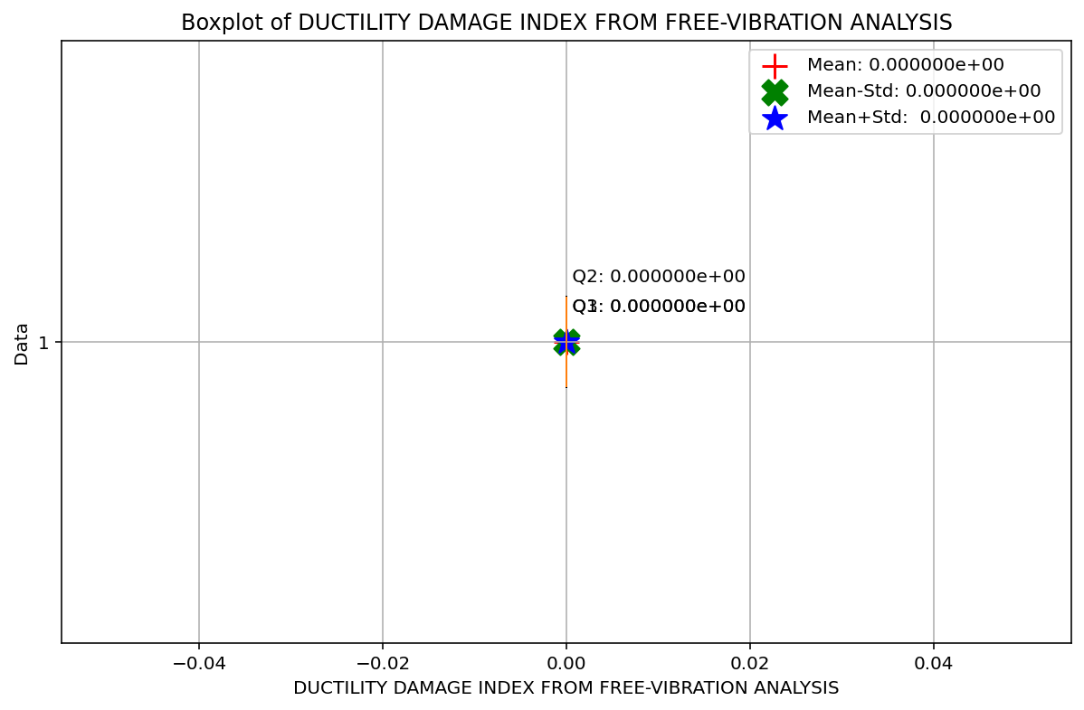

Slide 45
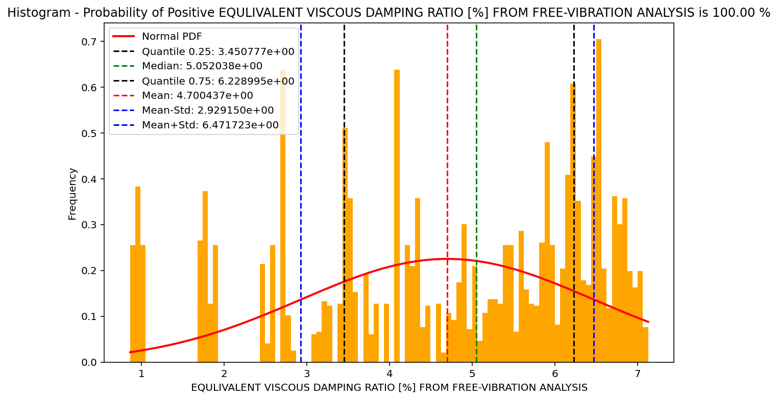

Slide 46
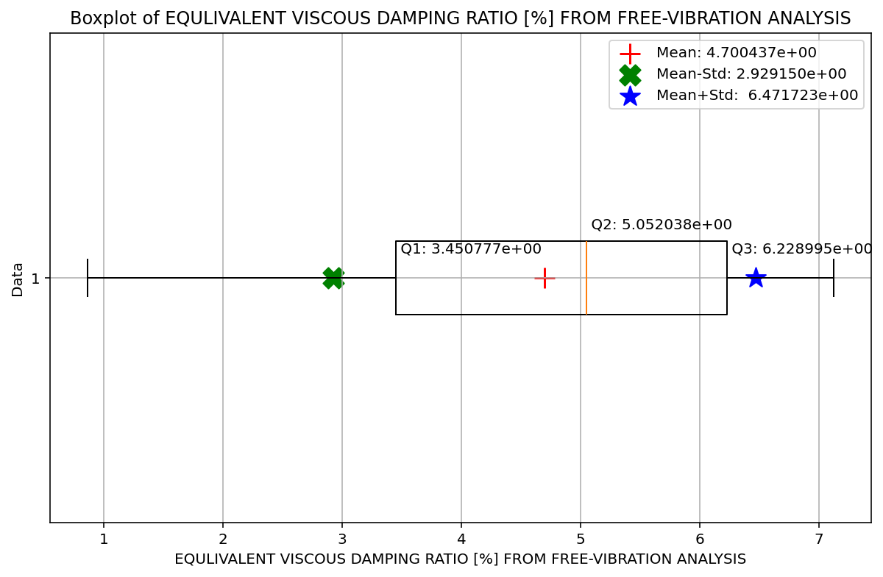

Slide 47
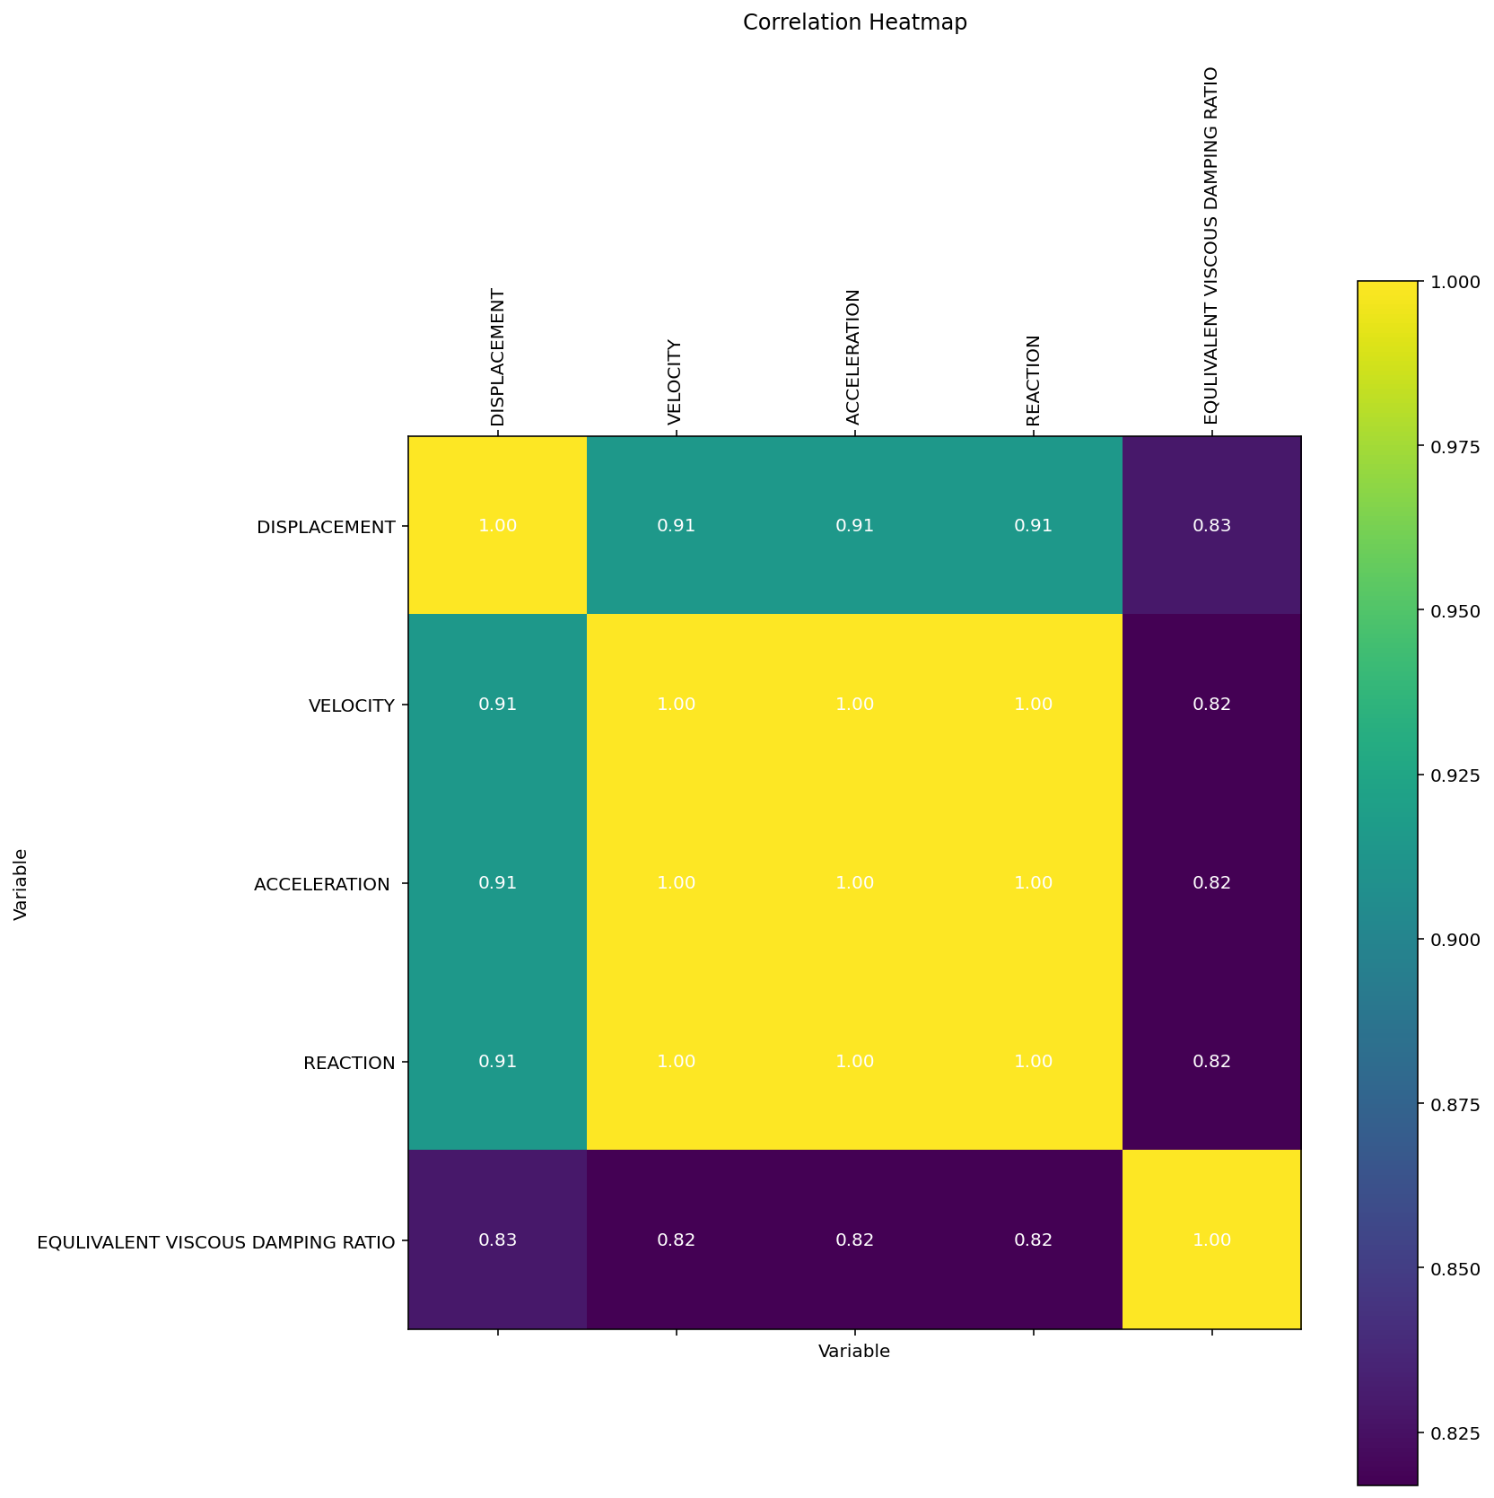

Slide 48
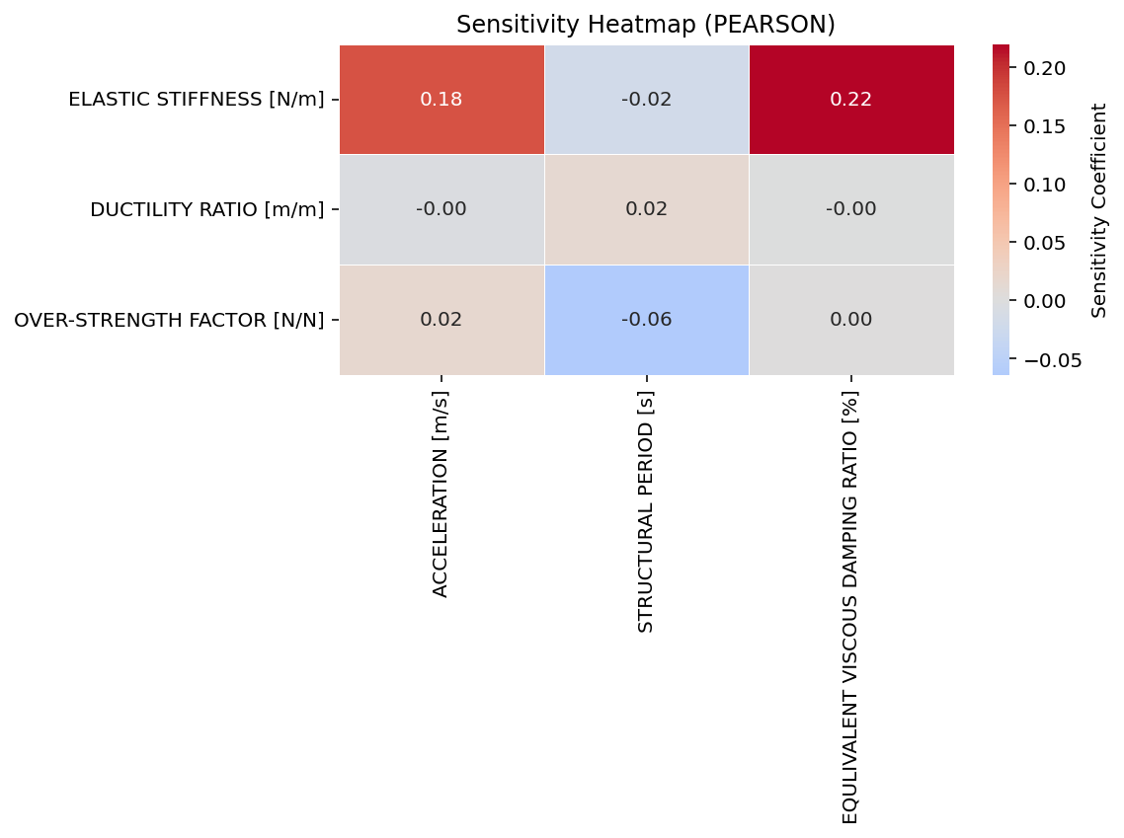

Slide 49
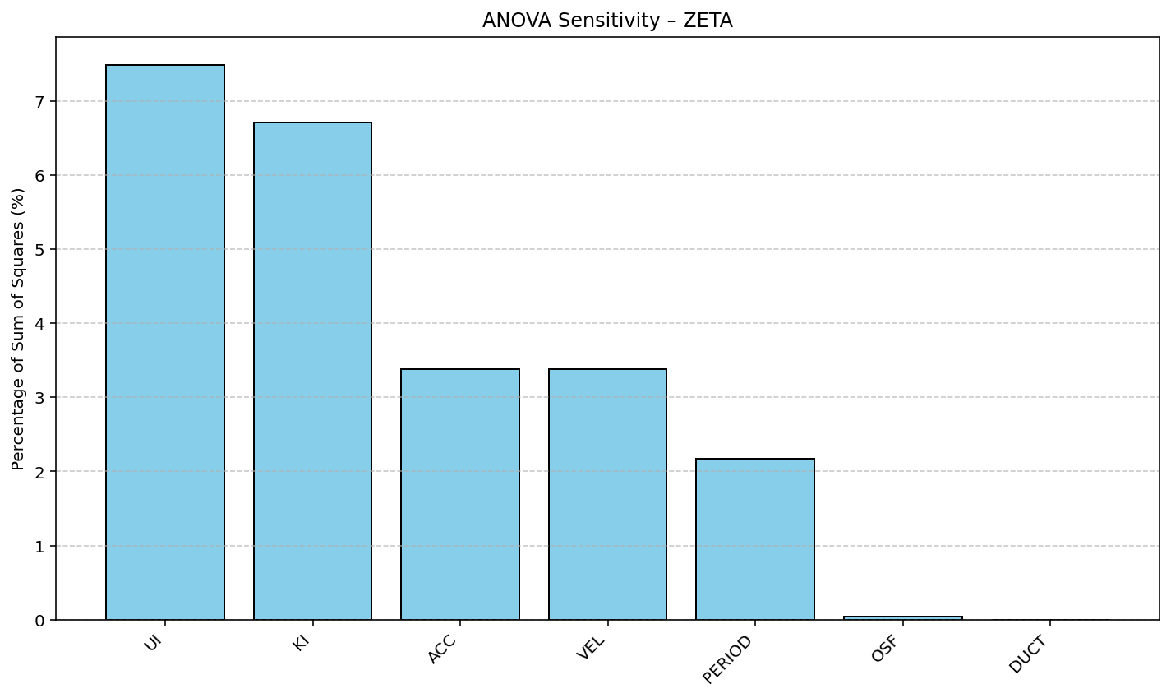

Slide 50
