Slide 1
IN THE NAME OF ALLAH
ASSESSMENTS OF THE STRUCTURAL DUCTILITY DAMAGE INDEX OF ULTRA-HIGH STRENGTH CONCRETE (UHSC) FRAME USING OPENSEES.
WRITTEN BY SALAR DELAVAR GHASHGHAEI (QASHQAI)

Slide 2
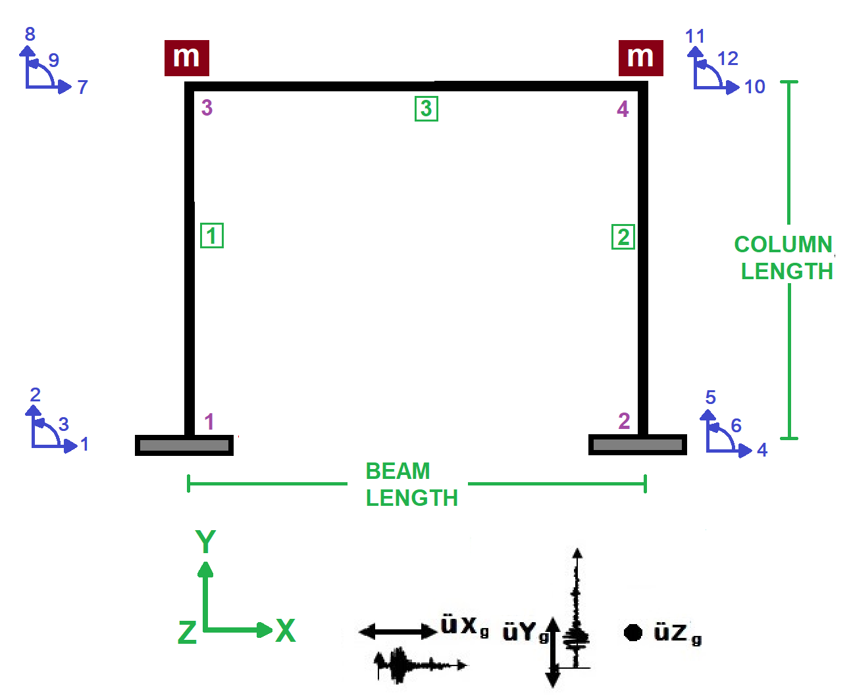

Slide 3
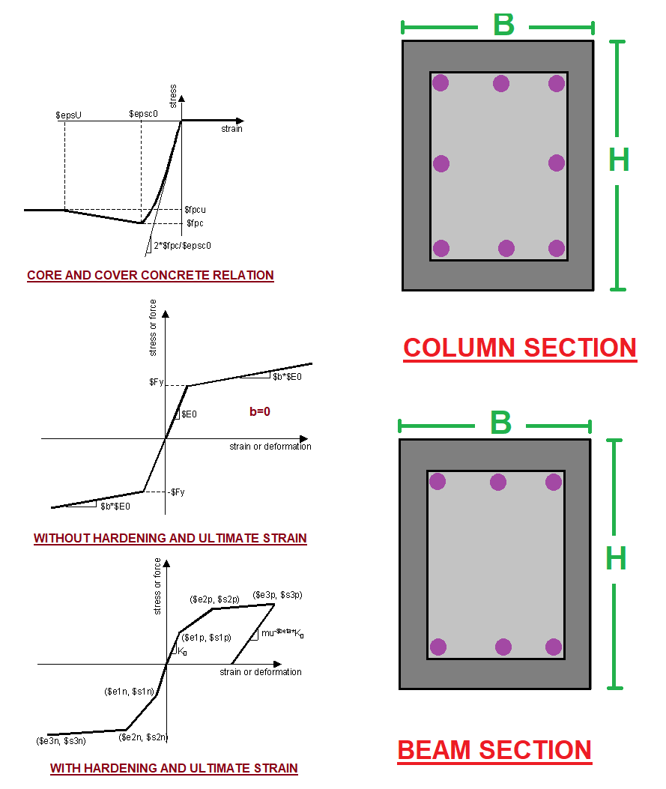

Slide 4
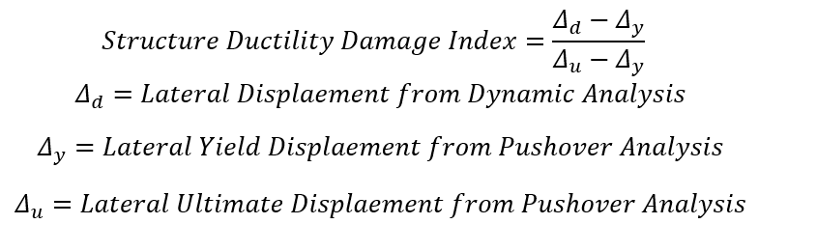

Slide 5
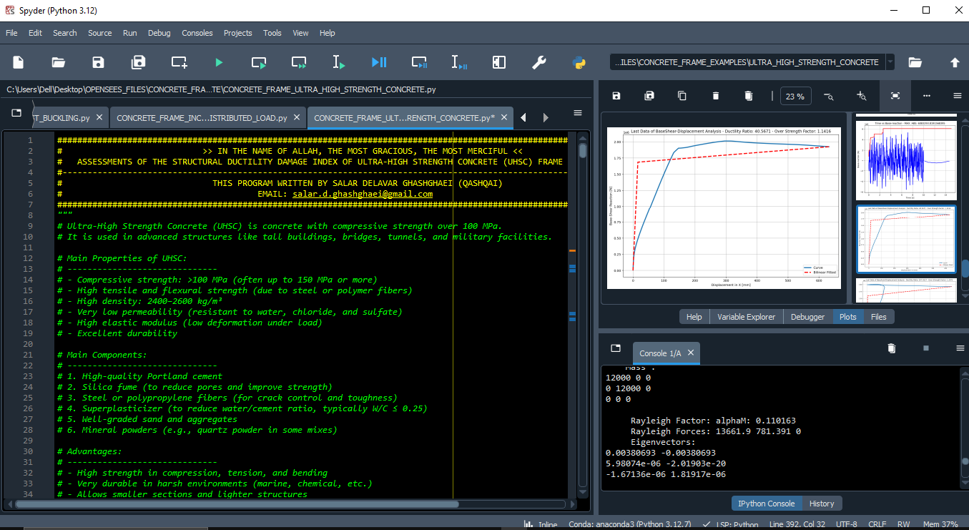

Slide 6
NONLINEAR STATIC ANALYSIS
(PUSHOVER)

Slide 7
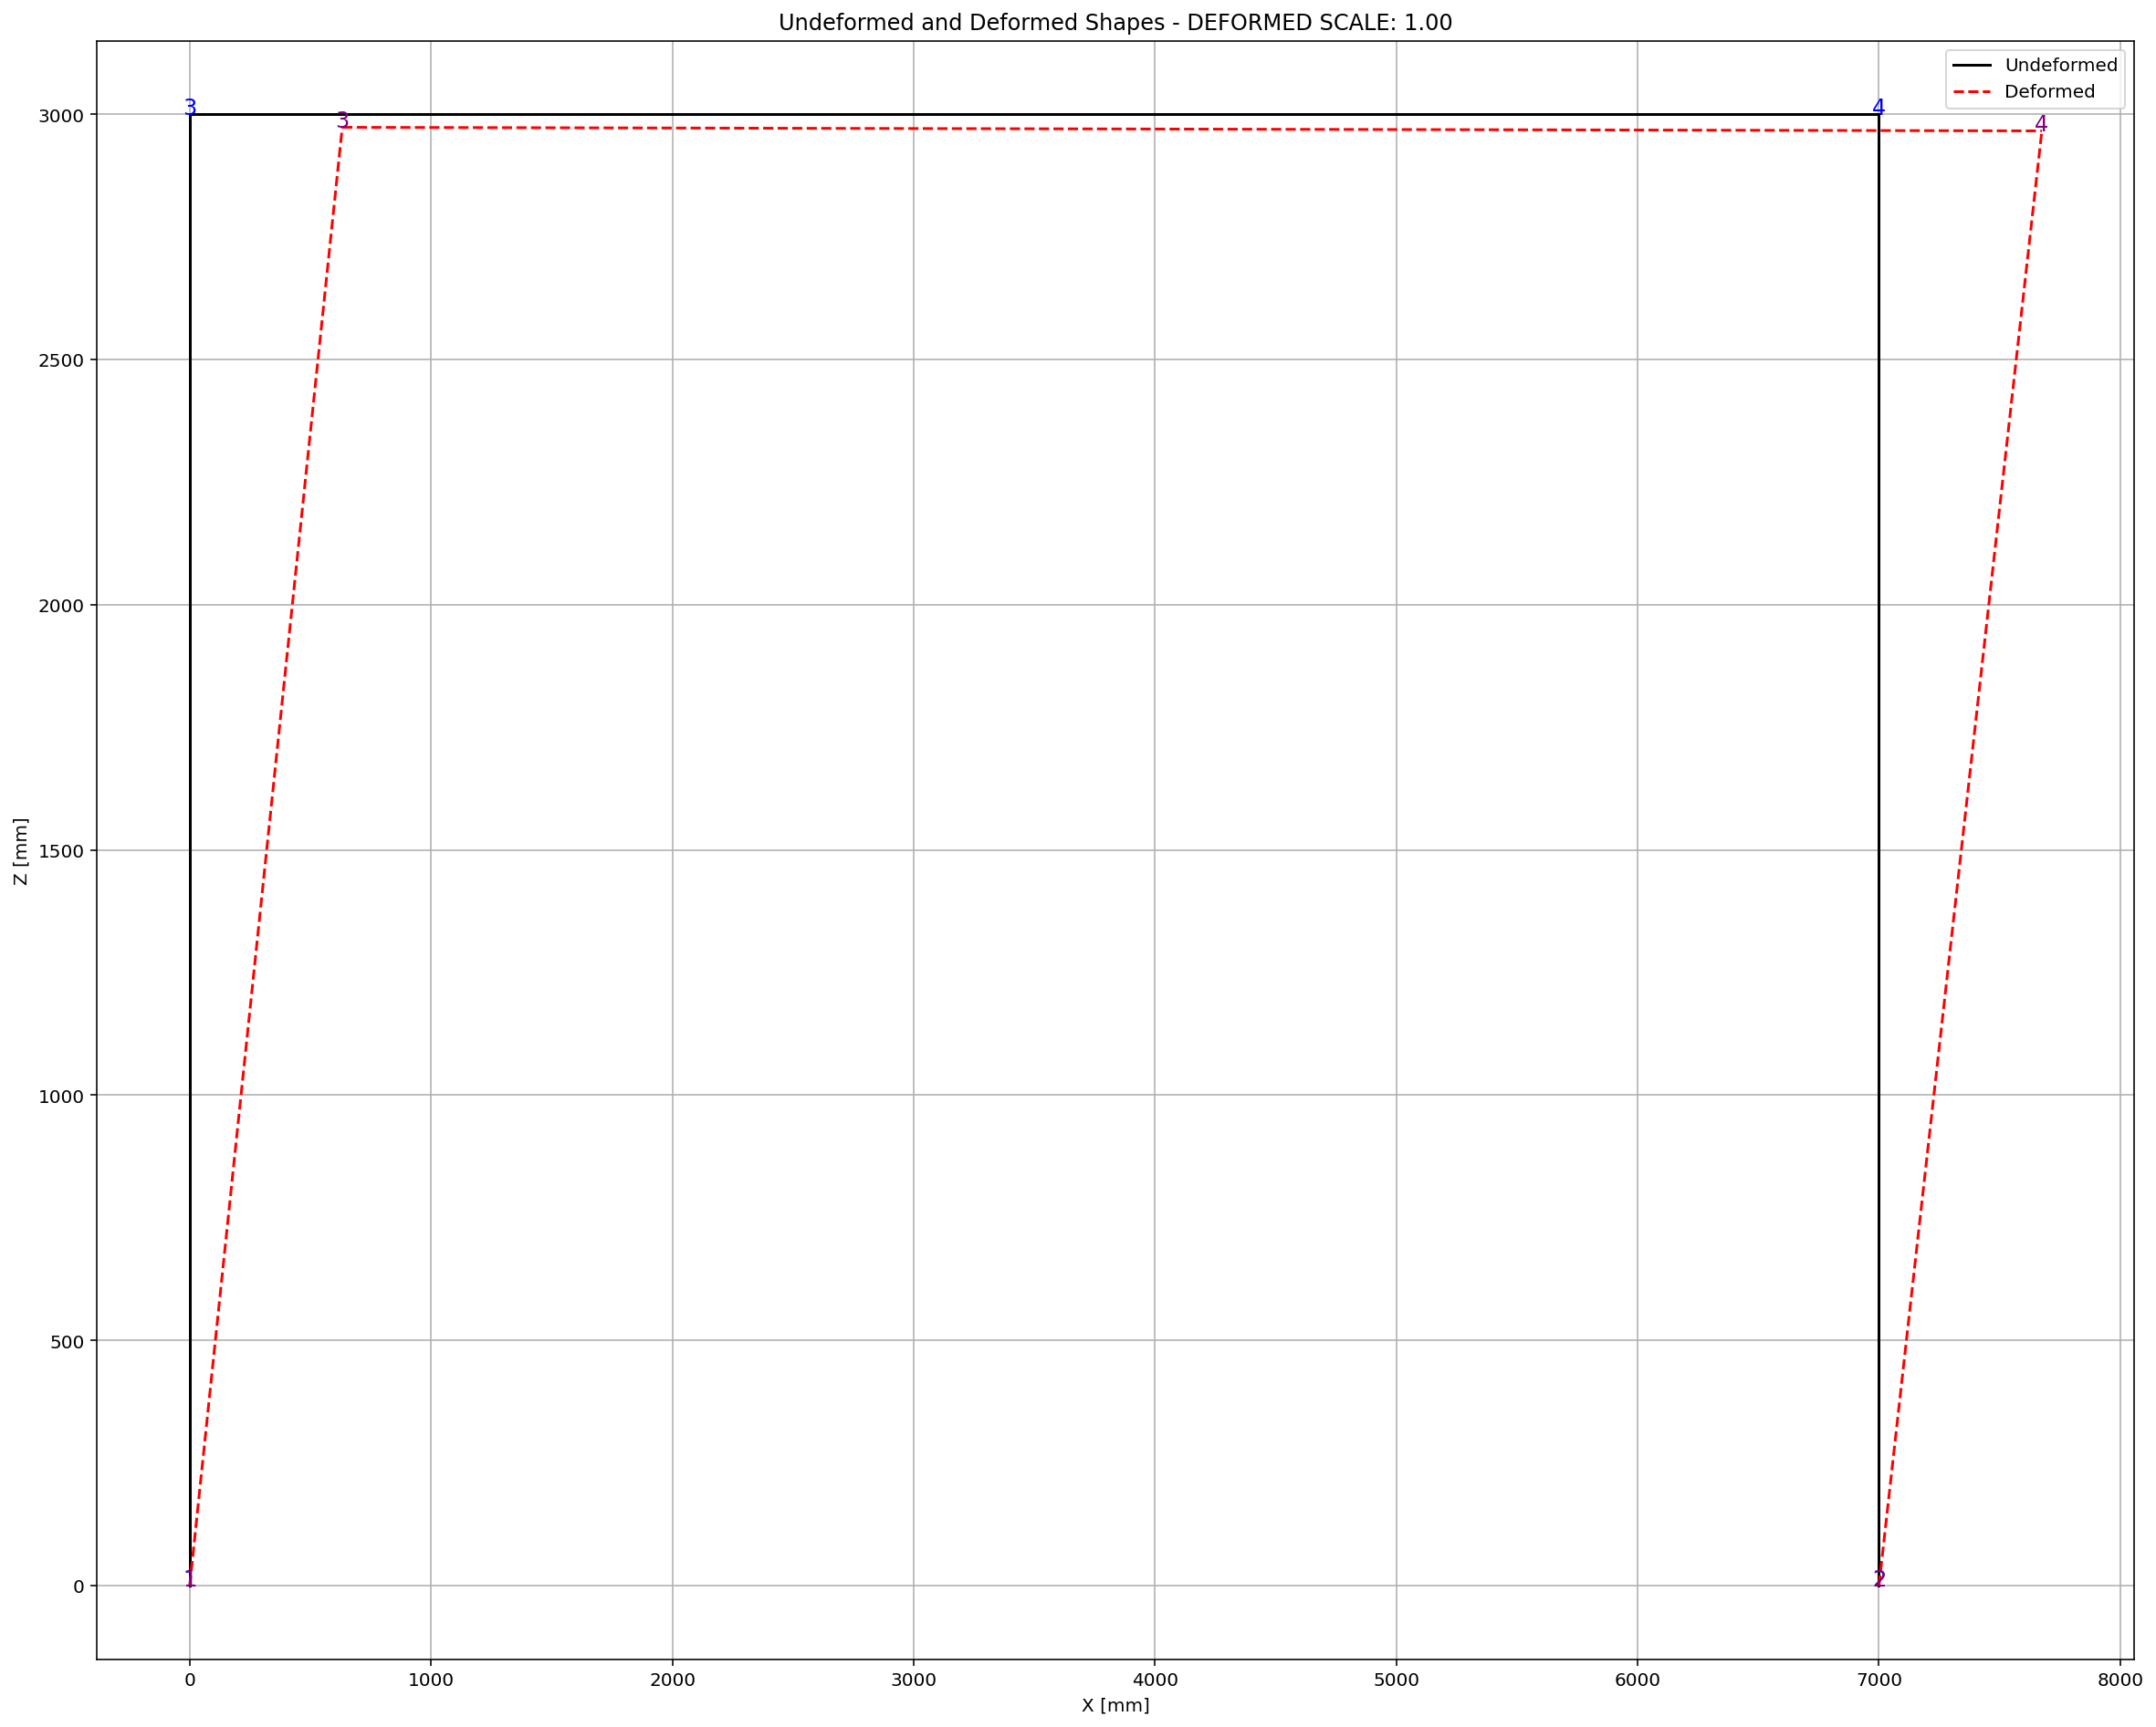

Slide 8
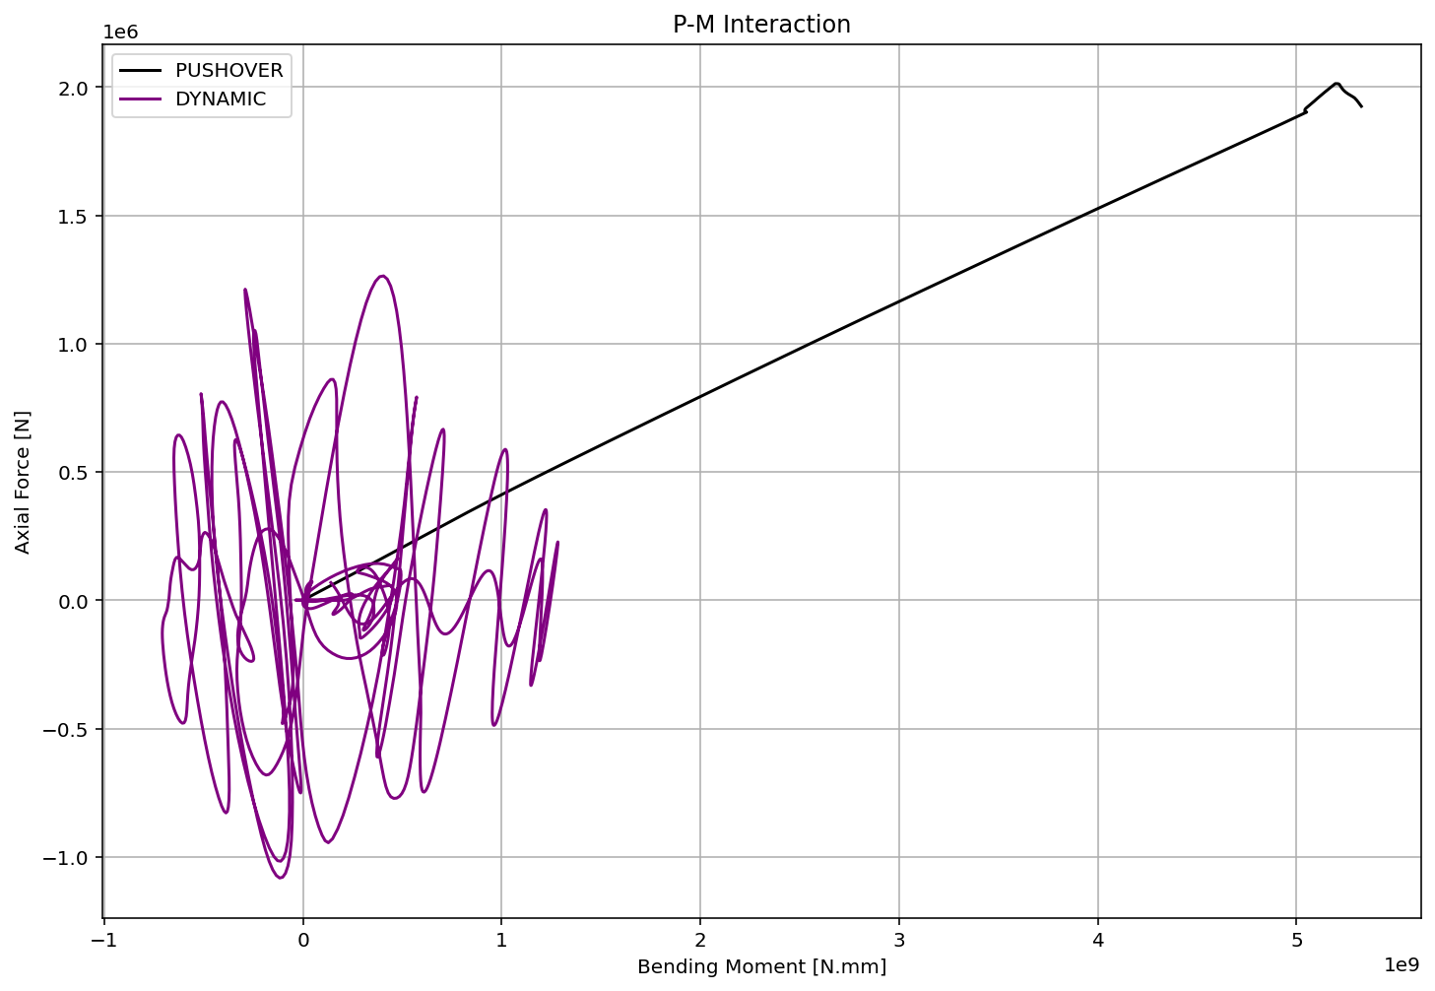

Slide 9
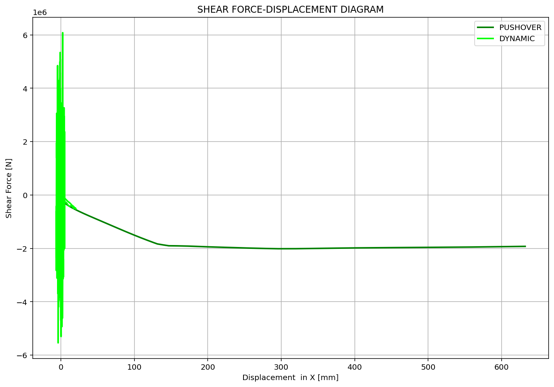

Slide 10
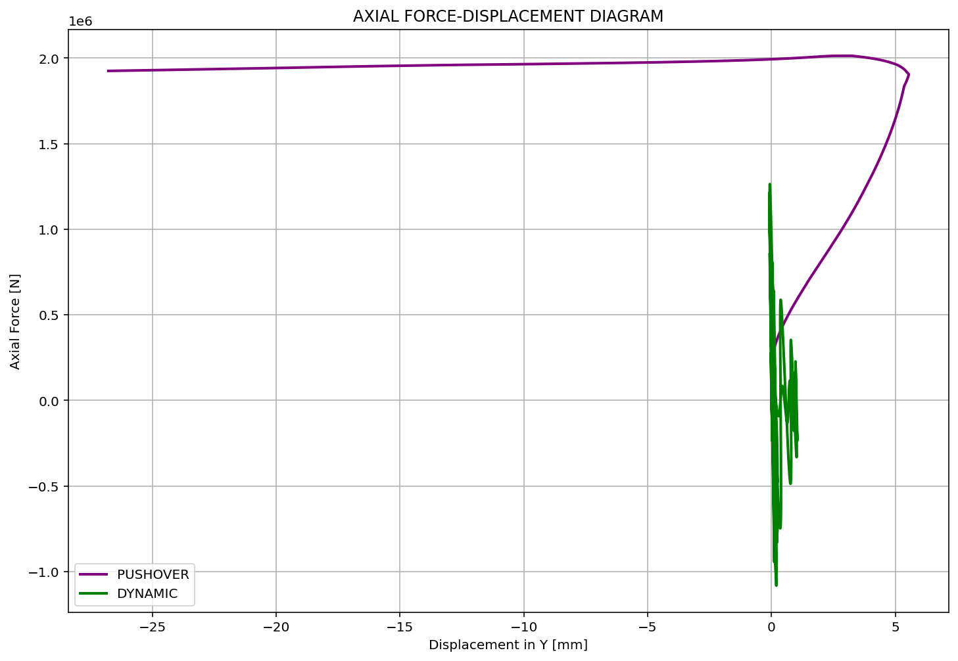

Slide 11
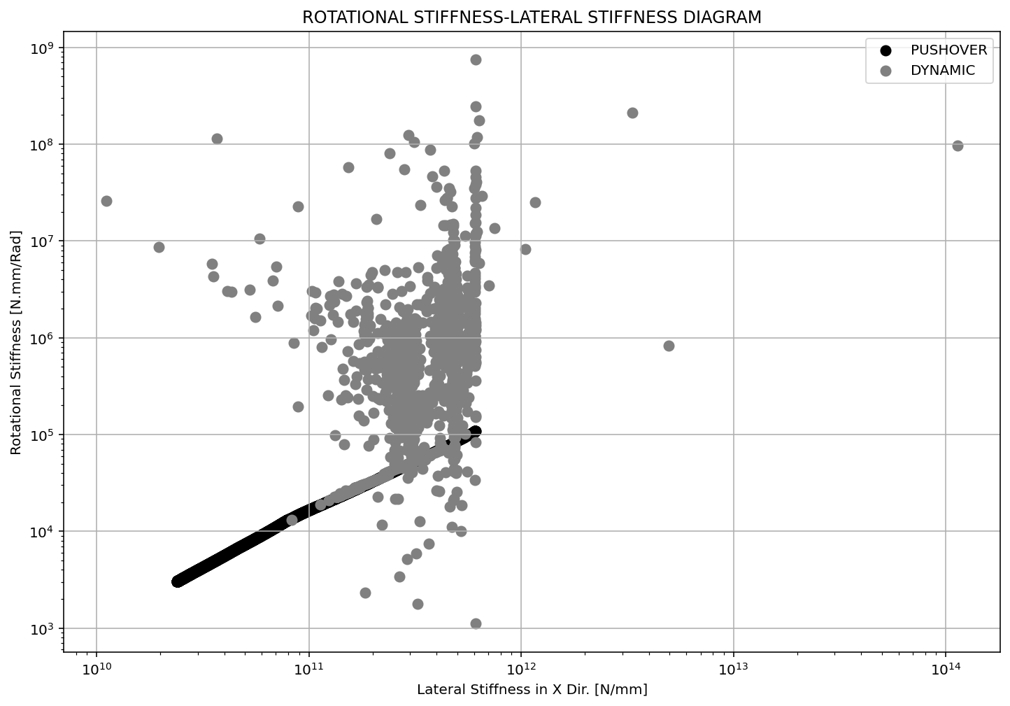

Slide 12
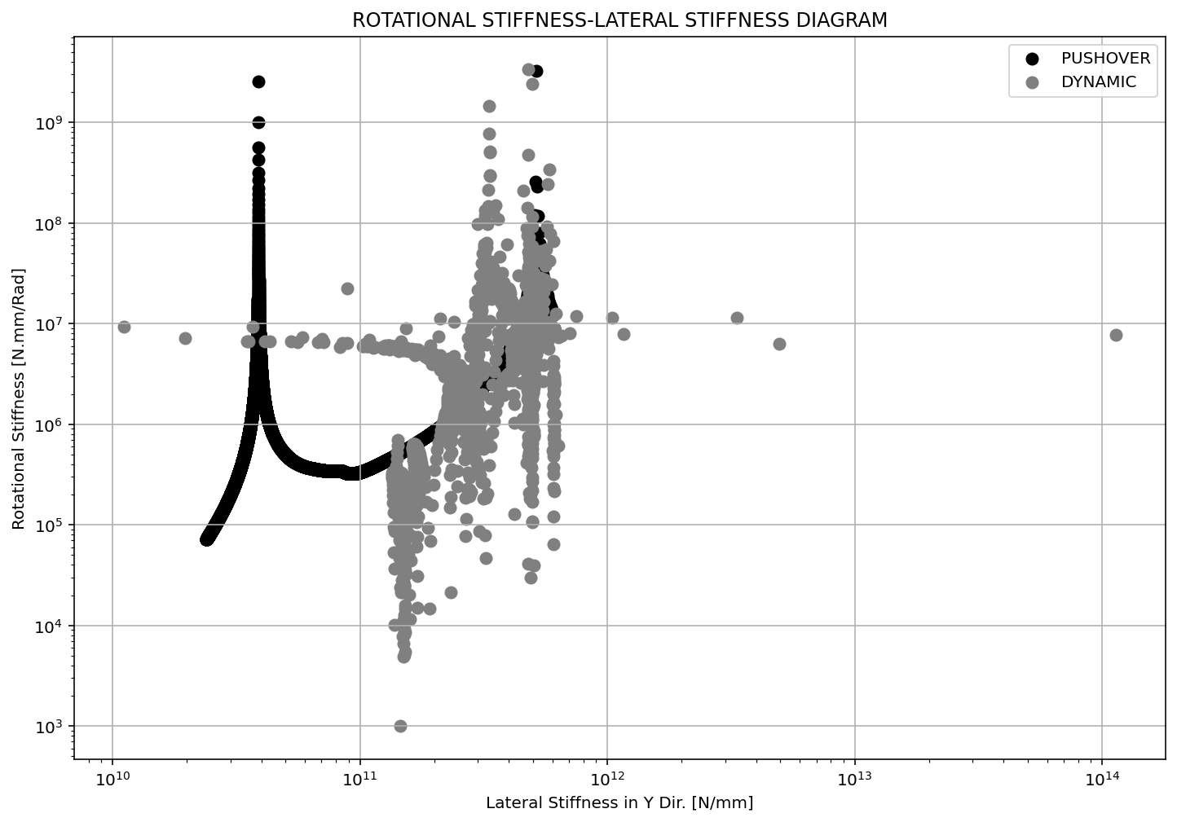

Slide 13
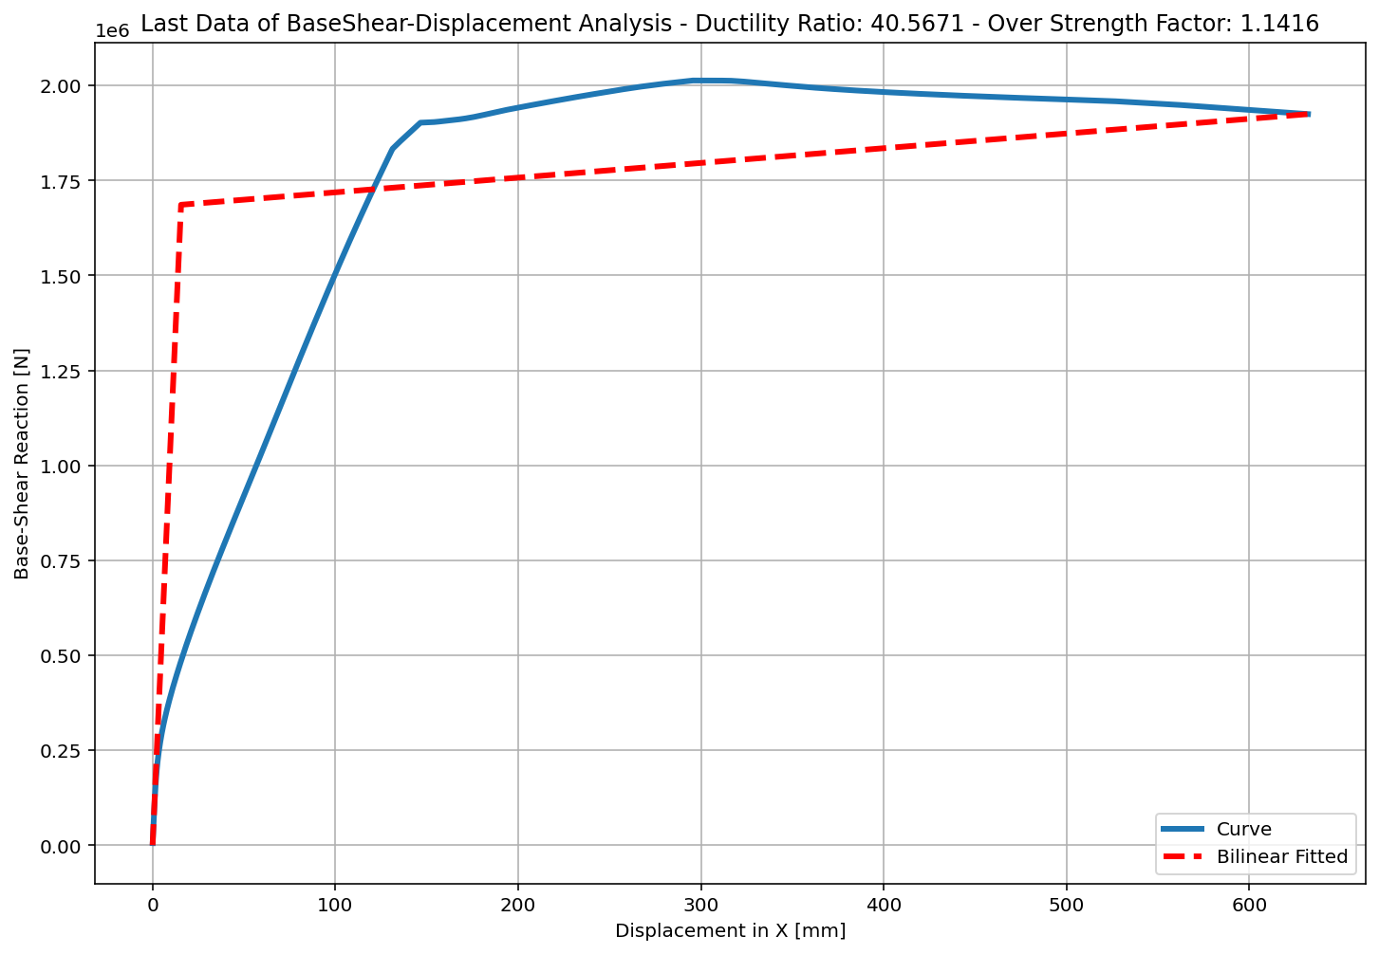
+==========================+
= Analysis curve fitted =
Disp Base Shear
----------------------------
[[0.00000000e+00 0.00000000e+00]
[1.55835723e+01 1.68594305e+06]
[6.32179891e+02 1.92460682e+06]]
+==========================+
+----------------------------------------------------+
Structure Elastic Stiffness : 108187.20
Structure Plastic Stiffness : 3044.40
Structure Tangent Stiffness : 387.07
Structure Ductility Ratio : 40.57
Structure Over Strength Factor: 1.14
+----------------------------------------------------+
Over Strength Coefficient (Ω0): 1.1416
Displacement Ductility Ratio (μ): 40.5671
Ductility Coefficient (Rμ): 40.5671
Structural Behavior Coefficient (R): 46.3098
Structural Ductility Damage Index in X Direction: 0.0076

Slide 14
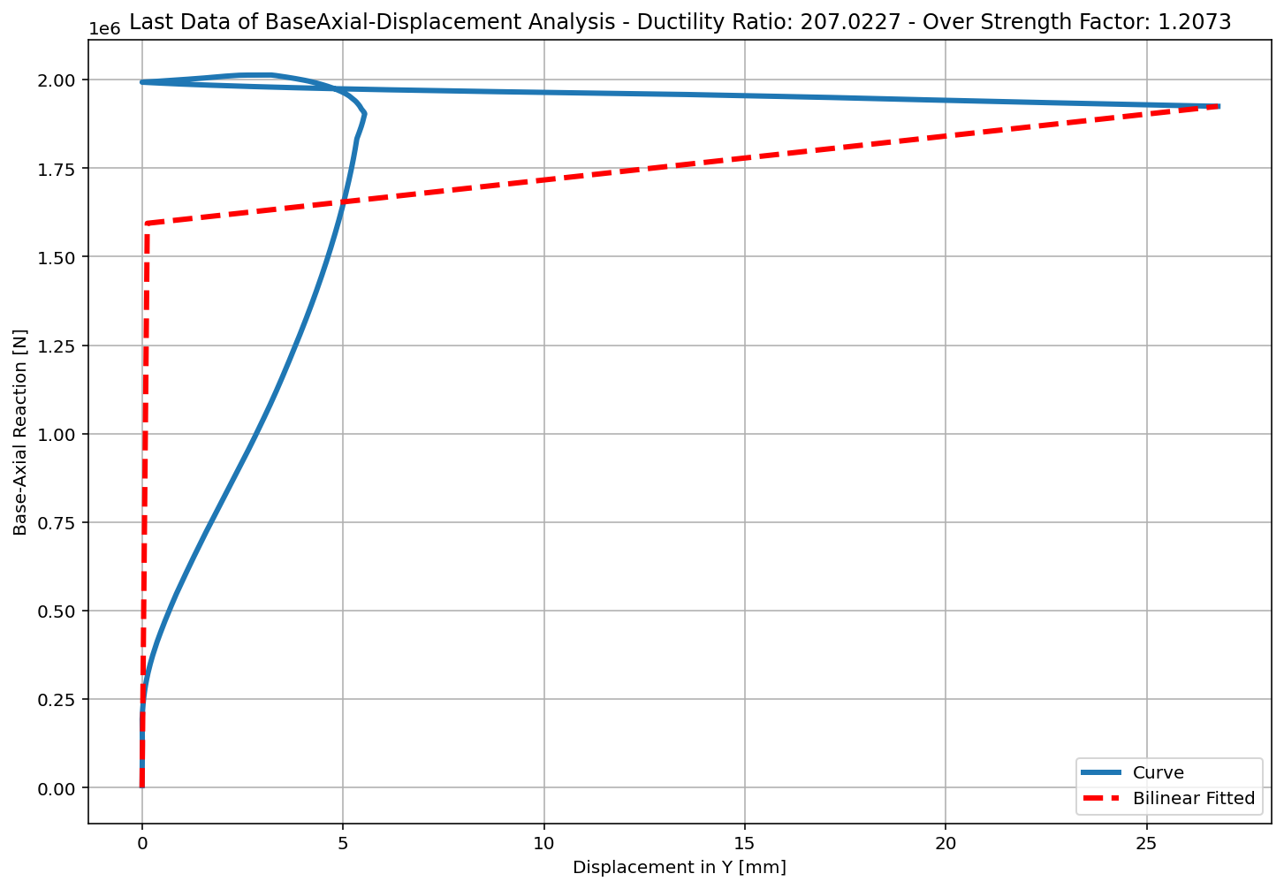
+==========================+
= Analysis curve fitted =
Disp Base Shear
----------------------------
[[0.00000000e+00 0.00000000e+00]
[1.29320525e-01 1.59412277e+06]
[2.67722849e+01 1.92460682e+06]]
+==========================+
+----------------------------------------------------+
Structure Elastic Stiffness : 12326912.32
Structure Plastic Stiffness : 71888.03
Structure Tangent Stiffness : 12404.18
Structure Ductility Ratio : 207.02
Structure Over Strength Factor: 1.21
+----------------------------------------------------+
Over Strength Coefficient (Ω0): 1.2073
Displacement Ductility Ratio (μ): 207.0227
Ductility Coefficient (Rμ): 207.0227
Structural Behavior Coefficient (R): 249.9414
Structural Ductility Damage Index in Y Direction: 0.0342

Slide 15
NONLINEAR DYNAMIC ANALYSIS

Slide 16
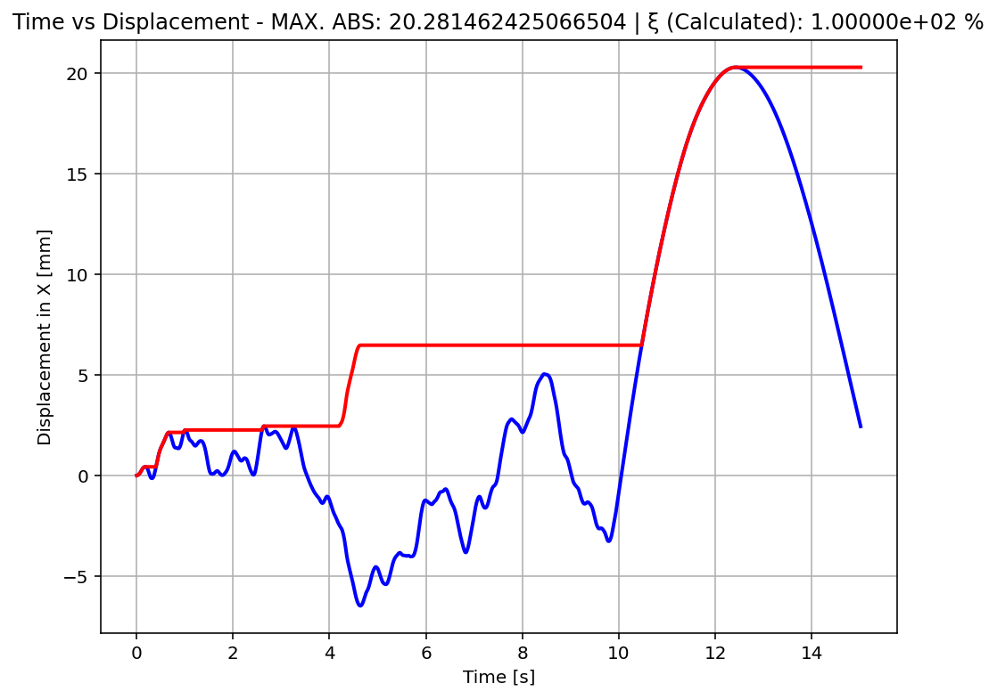

Slide 17
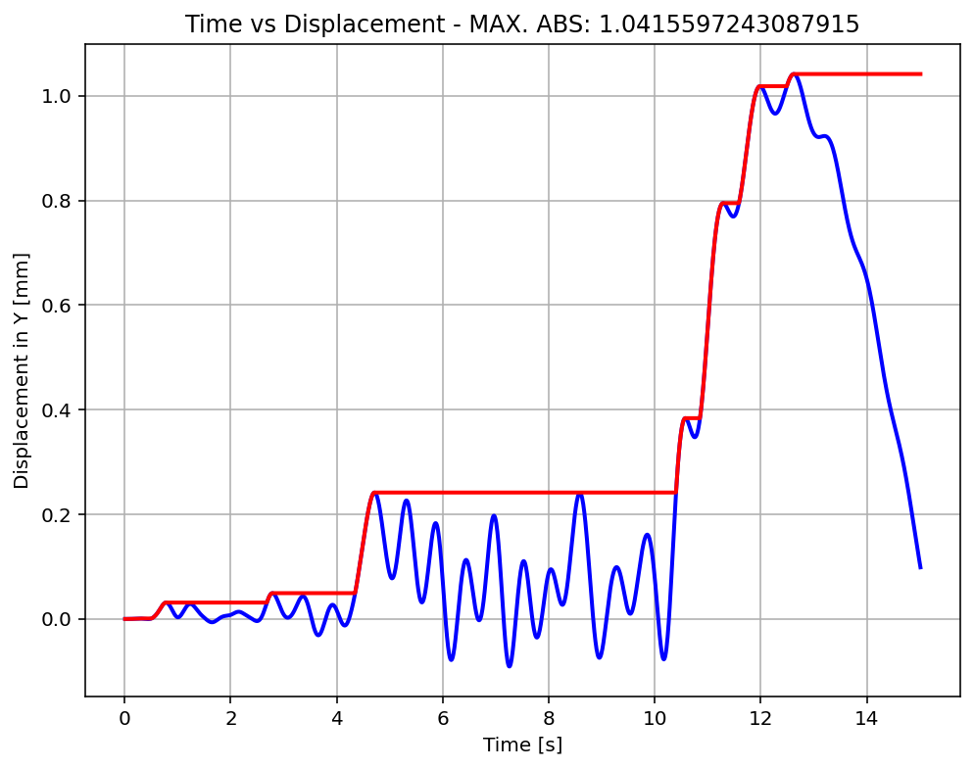

Slide 19
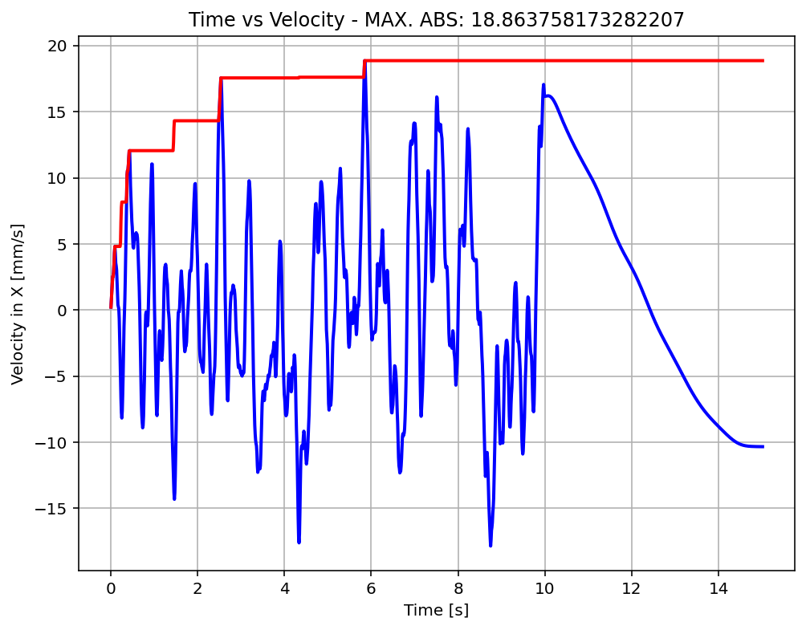

Slide 20
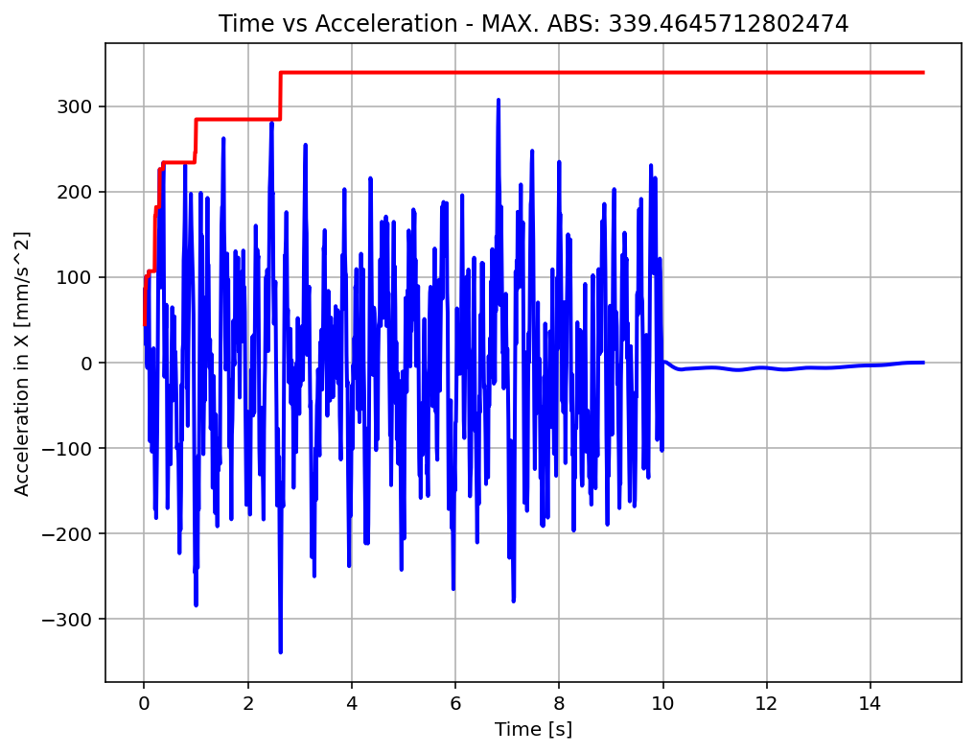

Slide 21
