Slide 1
>> IN THE NAME OF ALLAH, THE MOST GRACIOUS, THE MOST MERCIFUL <<
COMPARATIVE PUSHOVER ANALYSIS OF A MDOF STRUCTURE: ELASTIC VS INELASTIC RESPONSE USING OPENSEES
WRITTEN BY SALAR DELAVAR GHASHGHAEI (QASHQAI)

Slide 2
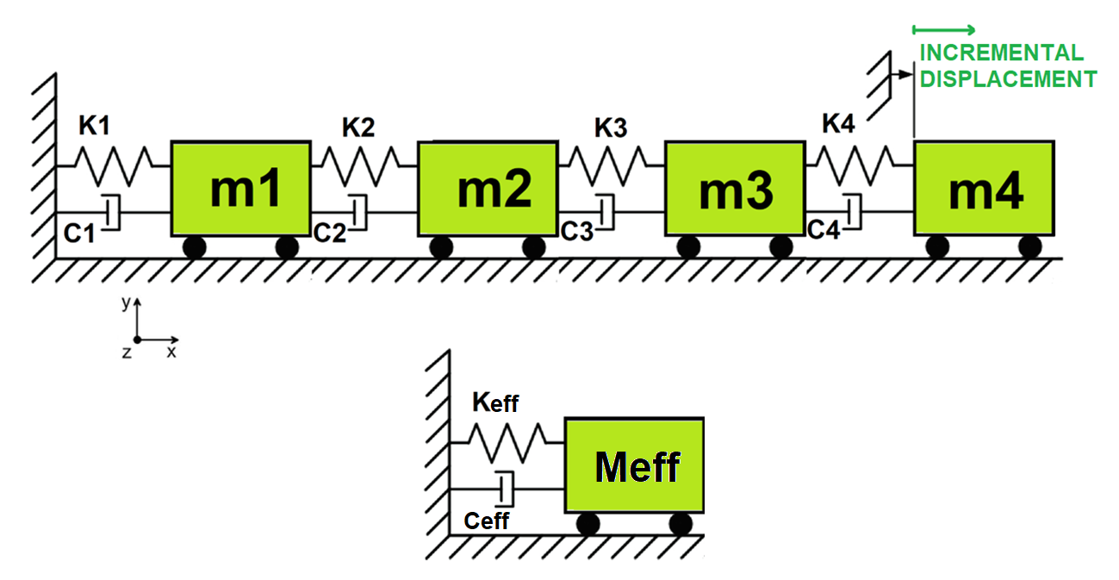

Slide 3
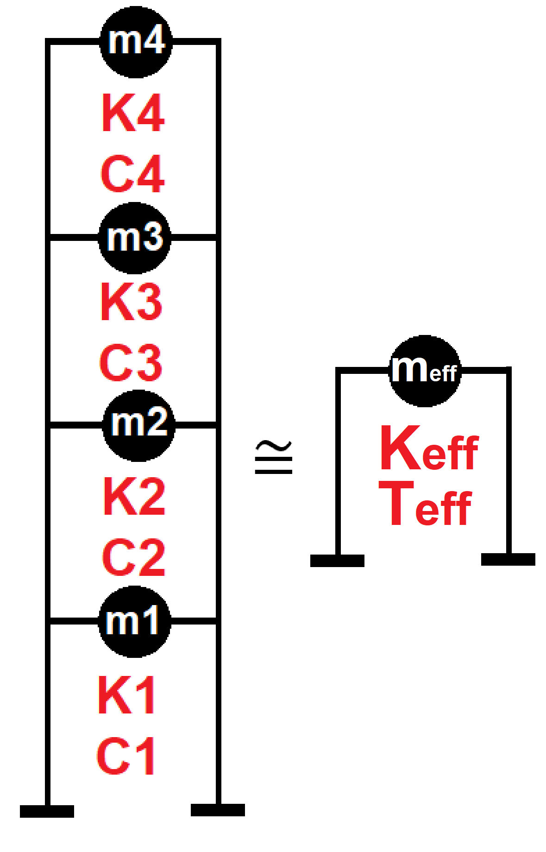

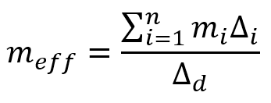
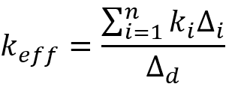
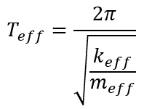
Displacement-based seismic analysis transformation,
converting a multi-degree-of-freedom (MDOF) system
into an equivalent single-degree-of-freedom (SDOF)
system for seismic assessment

Slide 4
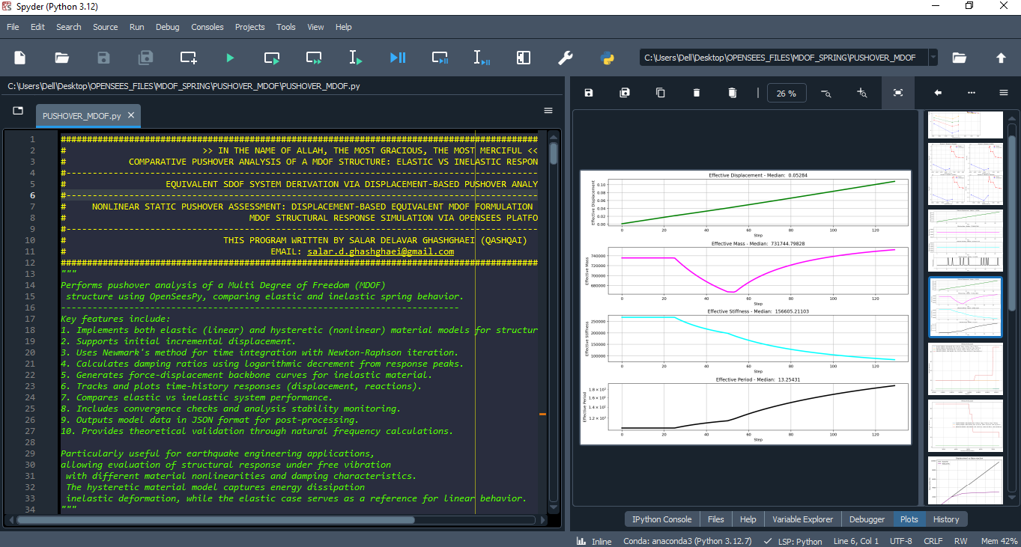

Slide 5
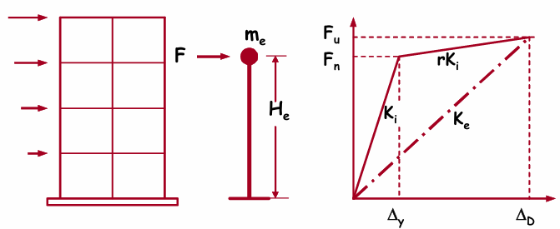
Structure Elastic Stiffness : 74942.52
Structure Plastic Stiffness : 23510.68
Structure Tangent Stiffness : 5012.99
Structure Ductility Ratio : 3.78
Structure Over Strength Factor: 1.19

Slide 6
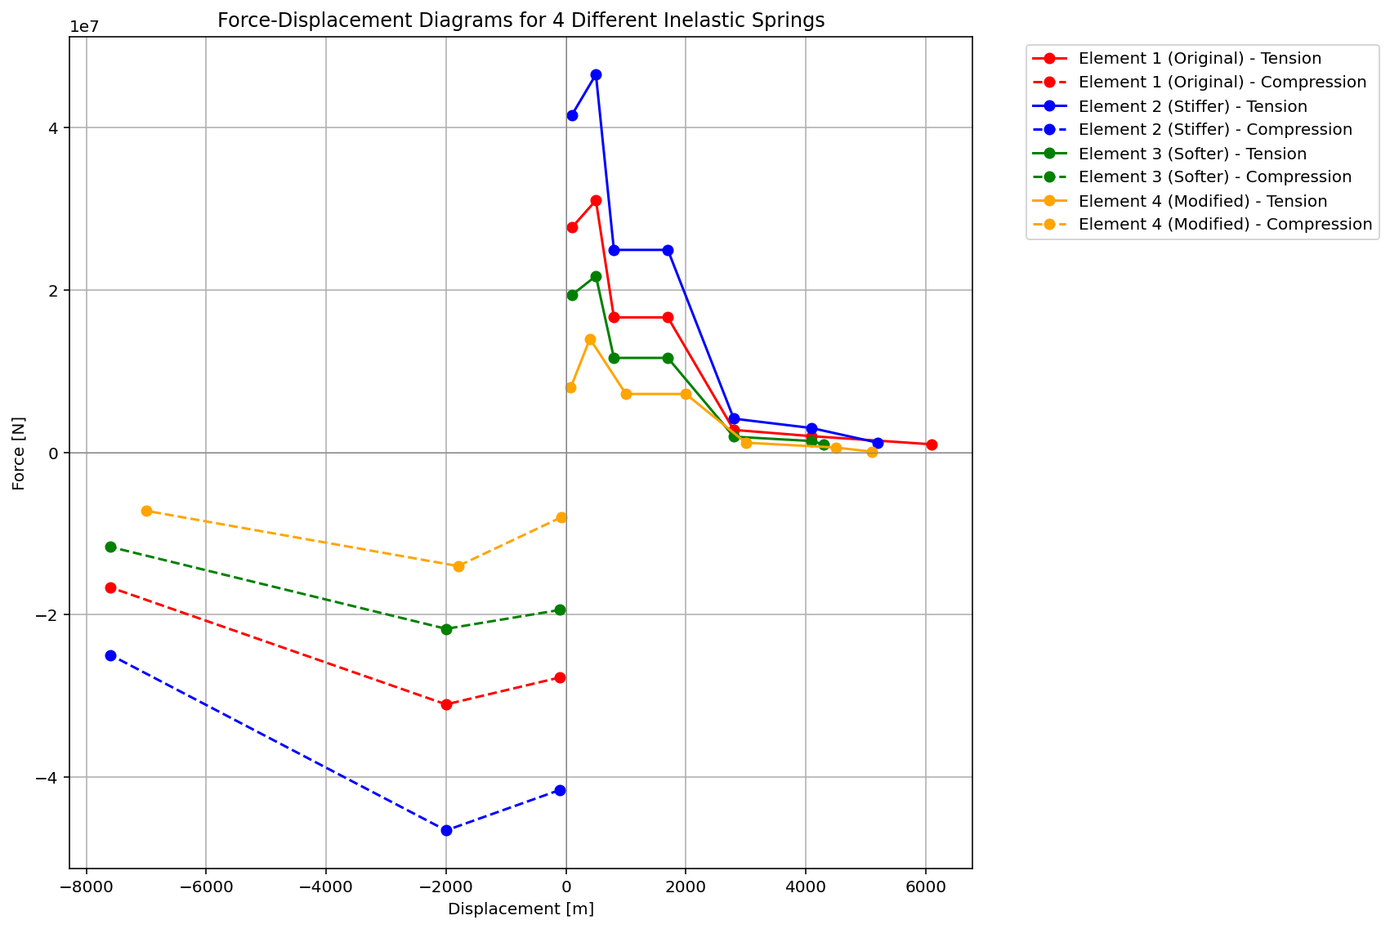

Slide 7
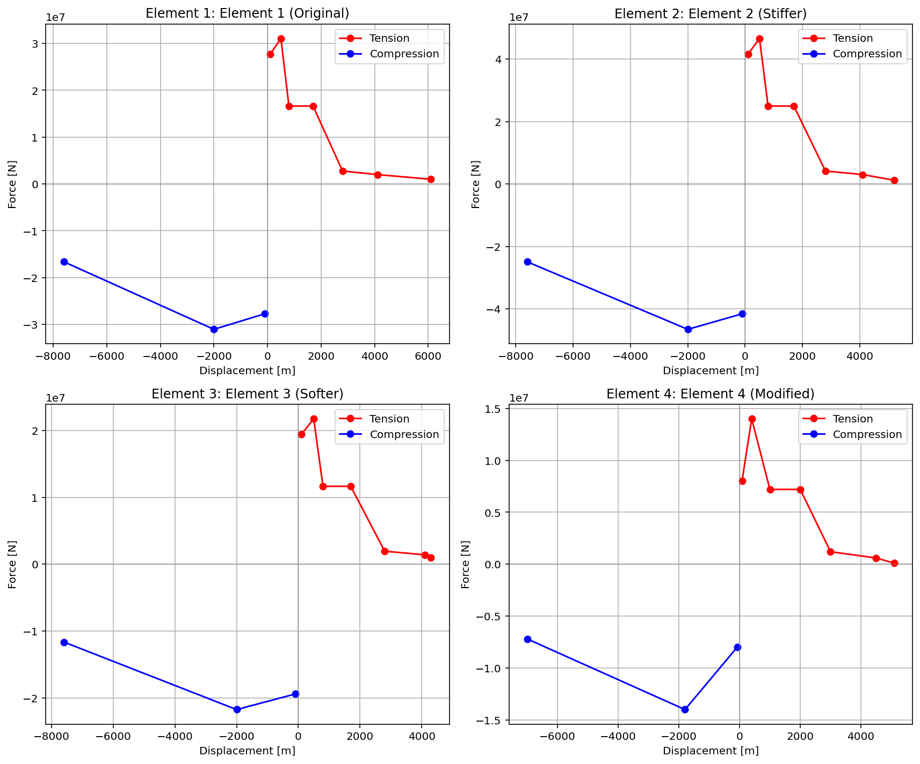

Slide 8
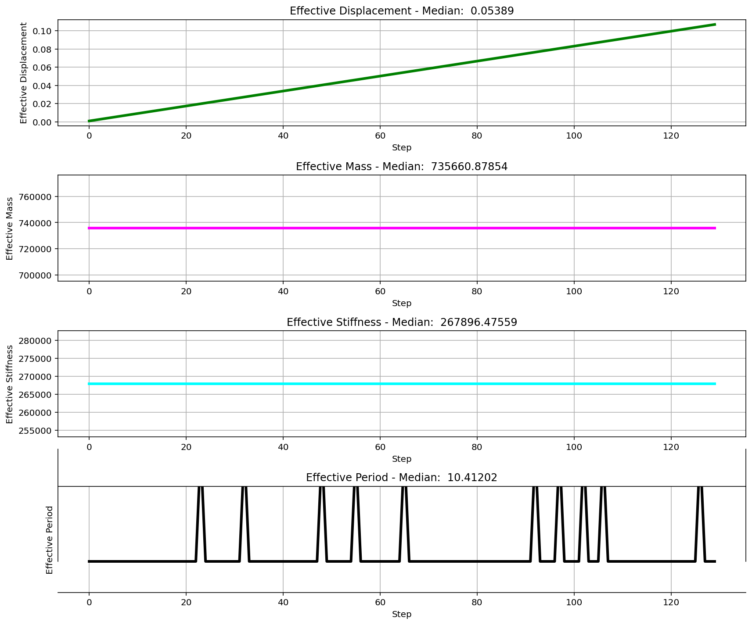

Slide 9
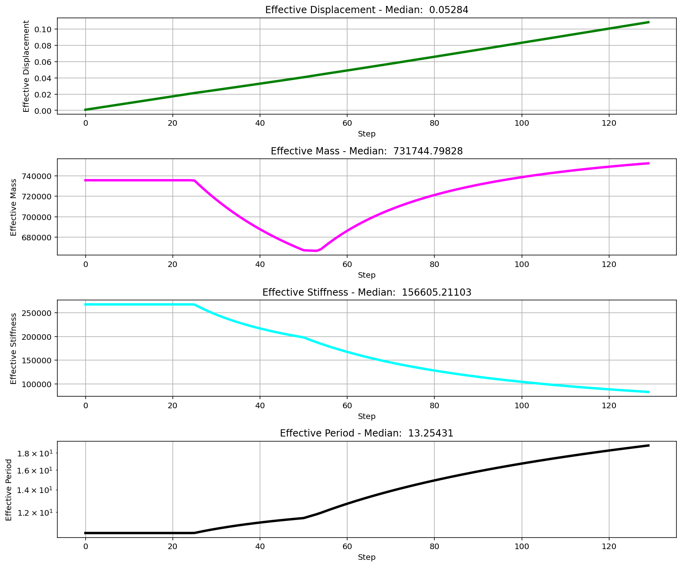

Slide 10
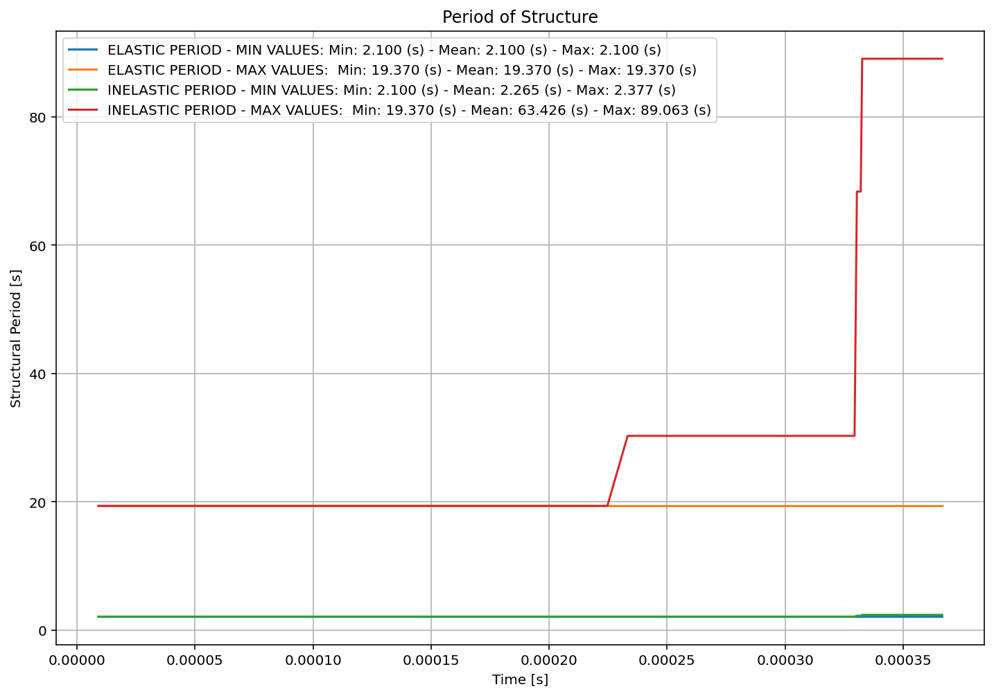

Slide 11
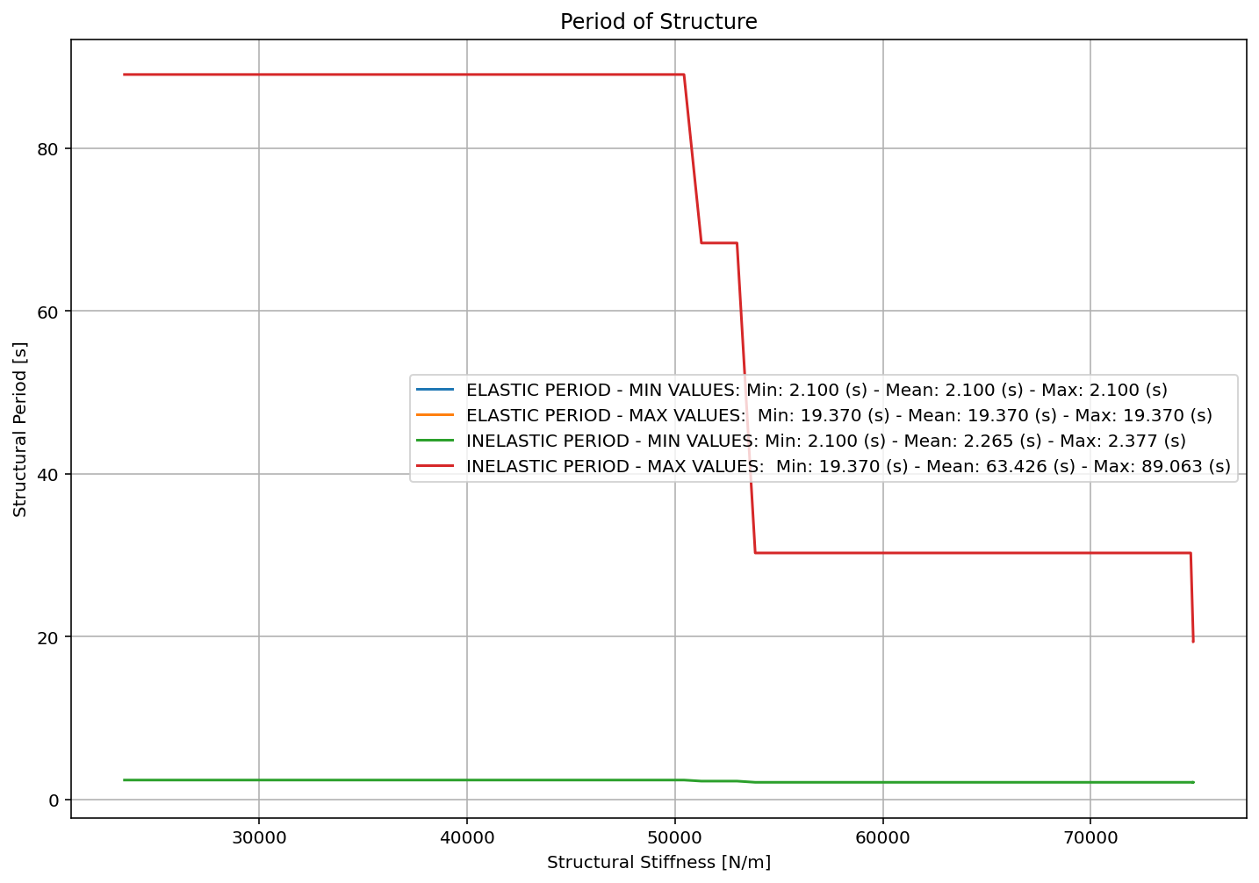

Slide 12
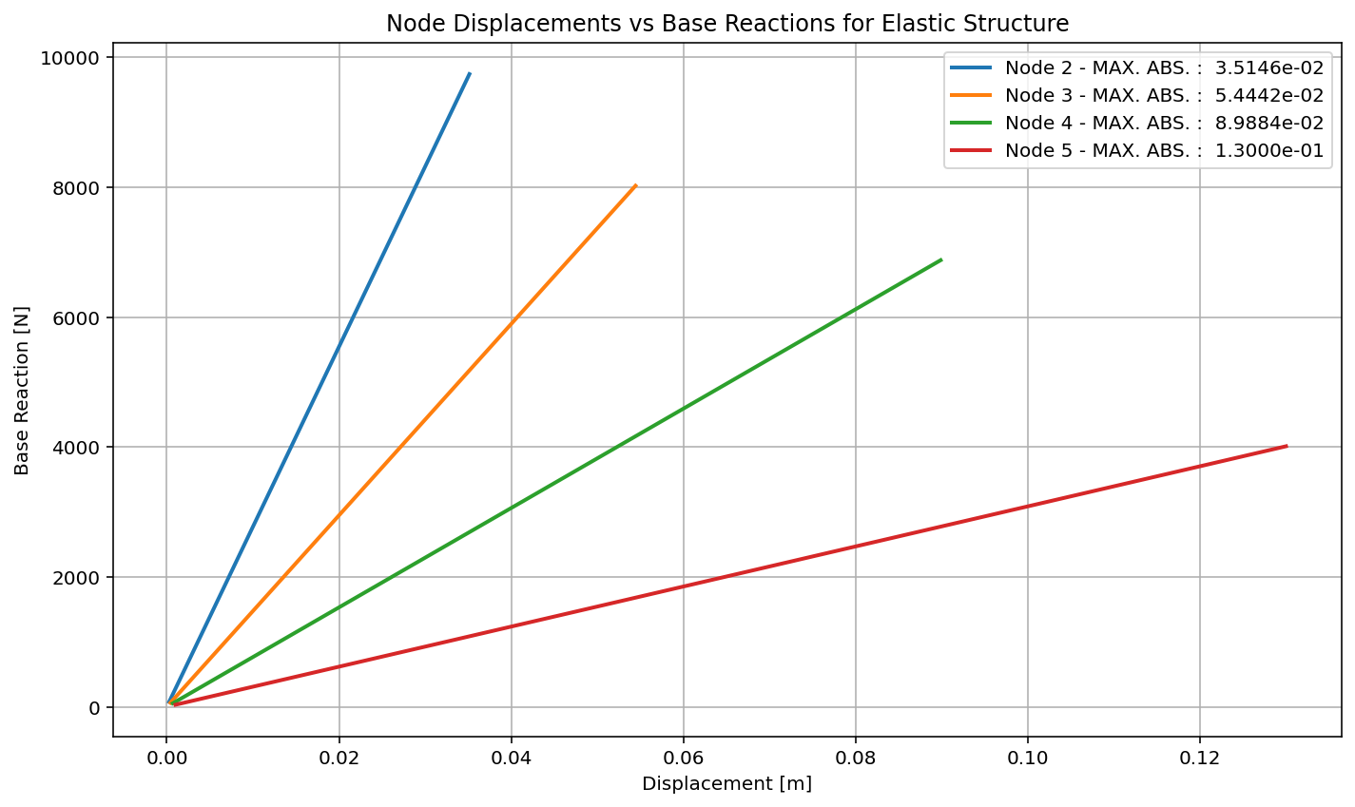

Slide 13
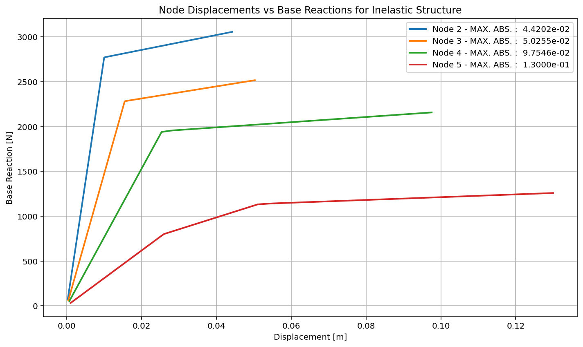

Slide 14
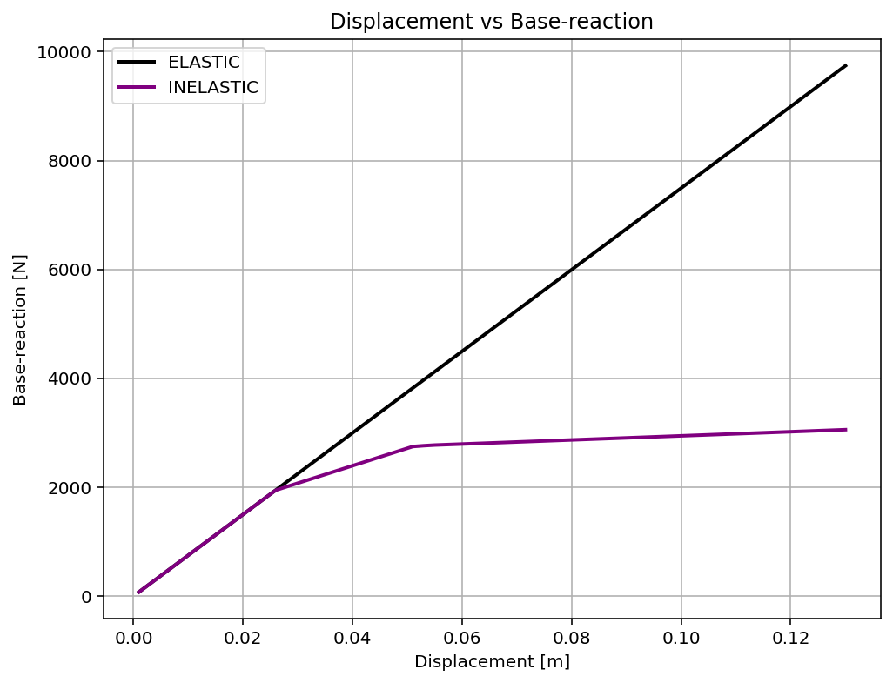

Slide 15
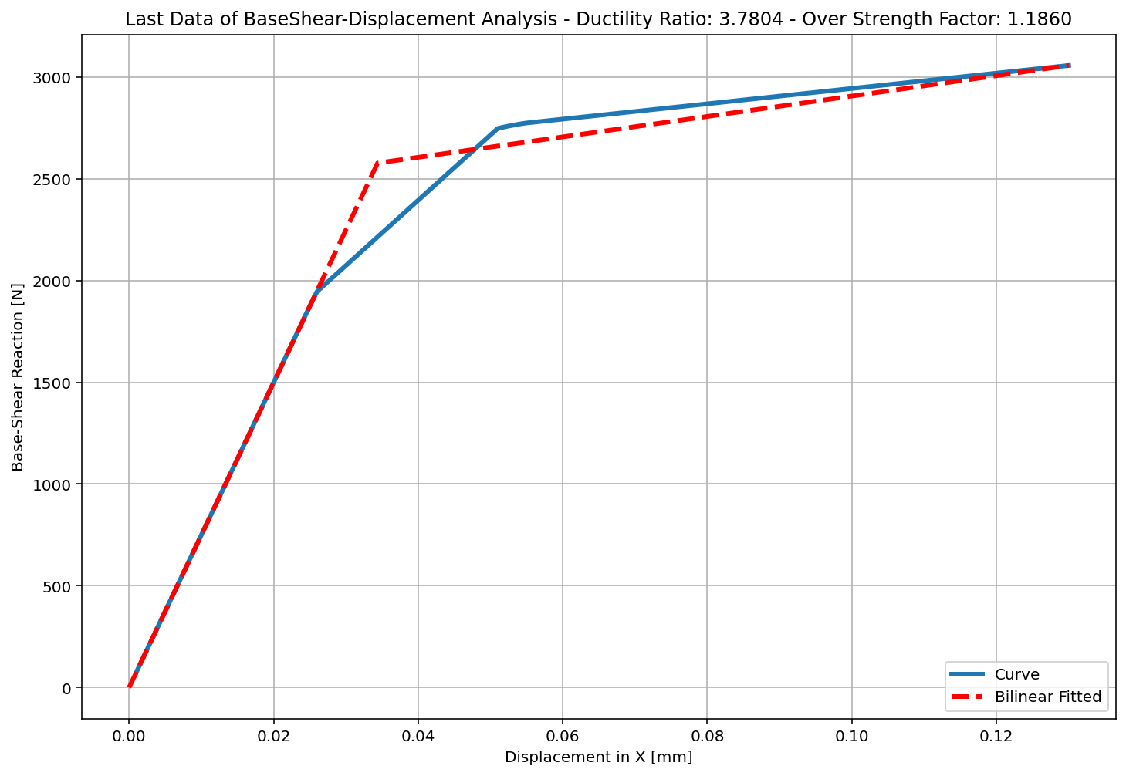
+==========================+
= Analysis curve fitted =
Disp Base Shear
----------------------------
[[0.00000000e+00 0.00000000e+00]
[3.43874631e-02 2.57708318e+03]
[1.30000000e-01 3.05638823e+03]]
+==========================+
+----------------------------------------------------+
Structure Elastic Stiffness : 74942.52
Structure Plastic Stiffness : 23510.68
Structure Tangent Stiffness : 5012.99
Structure Ductility Ratio : 3.78
Structure Over Strength Factor: 1.19
+----------------------------------------------------+
Over Strength Coefficient (Ω0): 1.1860
Displacement Ductility Ratio (μ): 3.7804
Ductility Coefficient (Rμ): 3.7804
Structural Behavior Coefficient (R): 4.4836

