Slide 1
IN THE NAME OF ALLAH
CREEP AND SHRINKAGE ANALYSIS OF CONCRETE FRAME. EVALUATING STRAIN HARDENING
AND ULTIMATE STRAIN CRITERIA USING OPENSEES AND CALCULATE STRUCTURAL BEHAVIOR COEFFICIENT
WRITTEN BY SALAR DELAVAR GHASHGHAEI (QASHQAI)

Slide 2
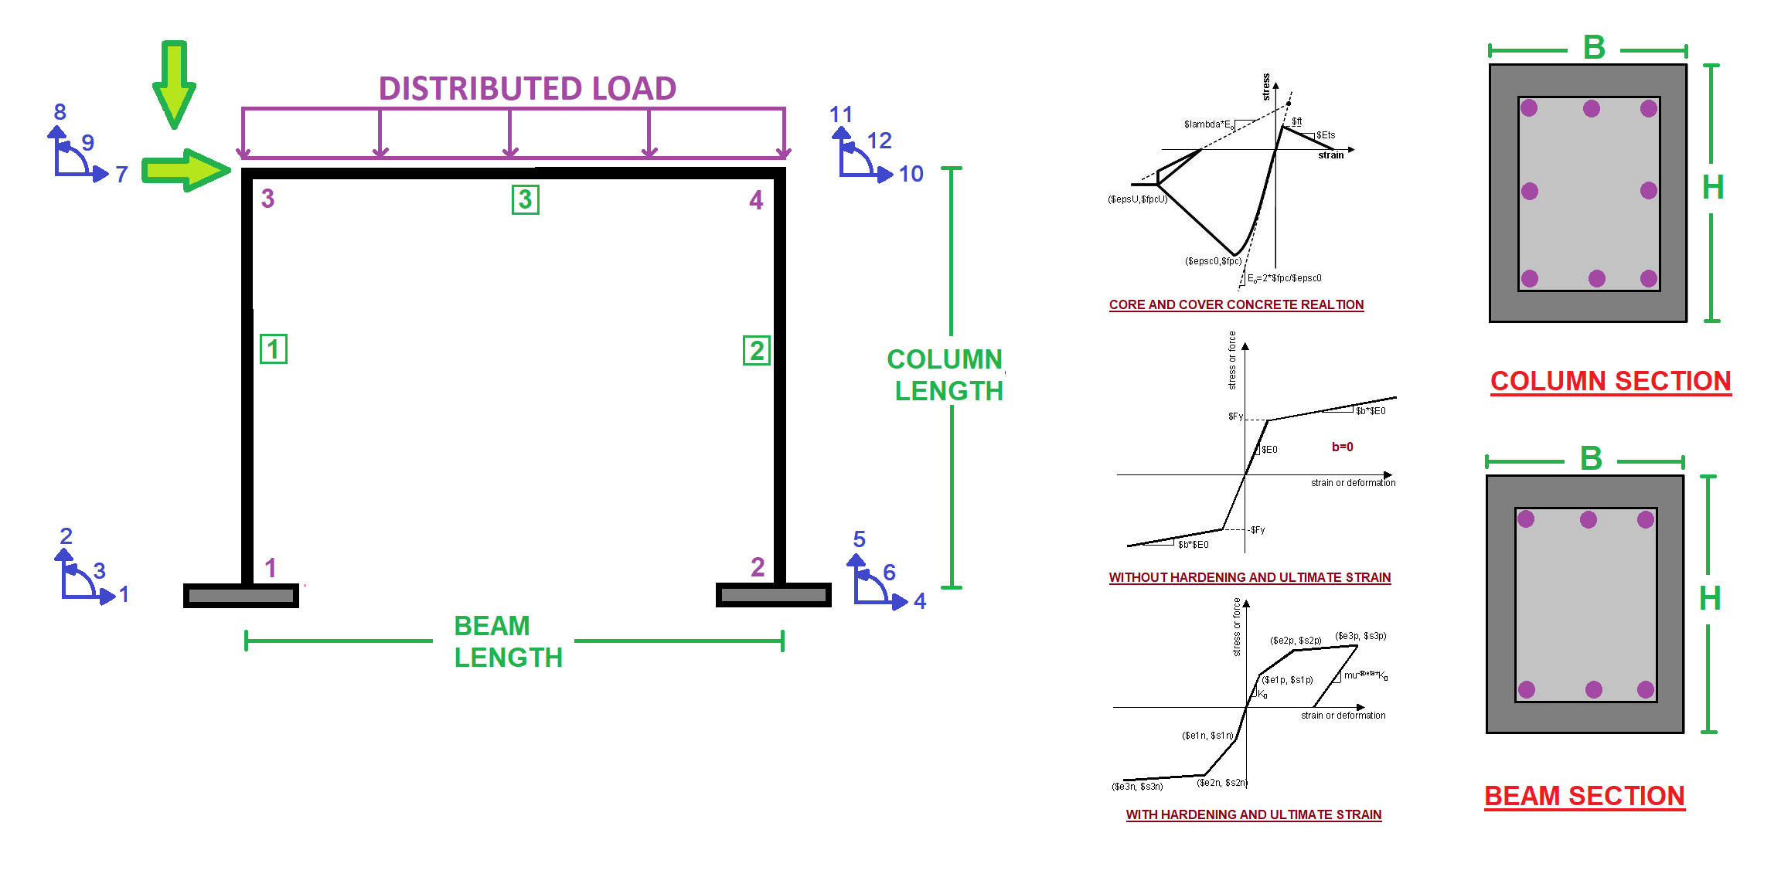

Slide 3
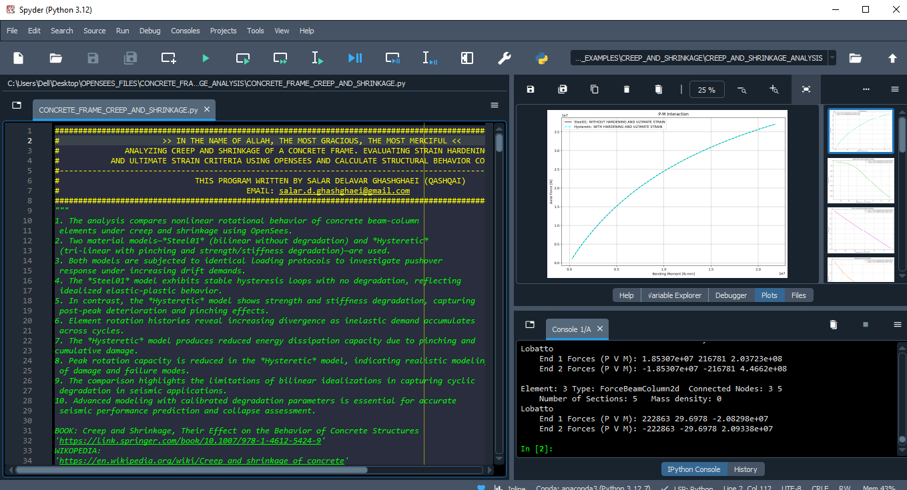

Slide 4
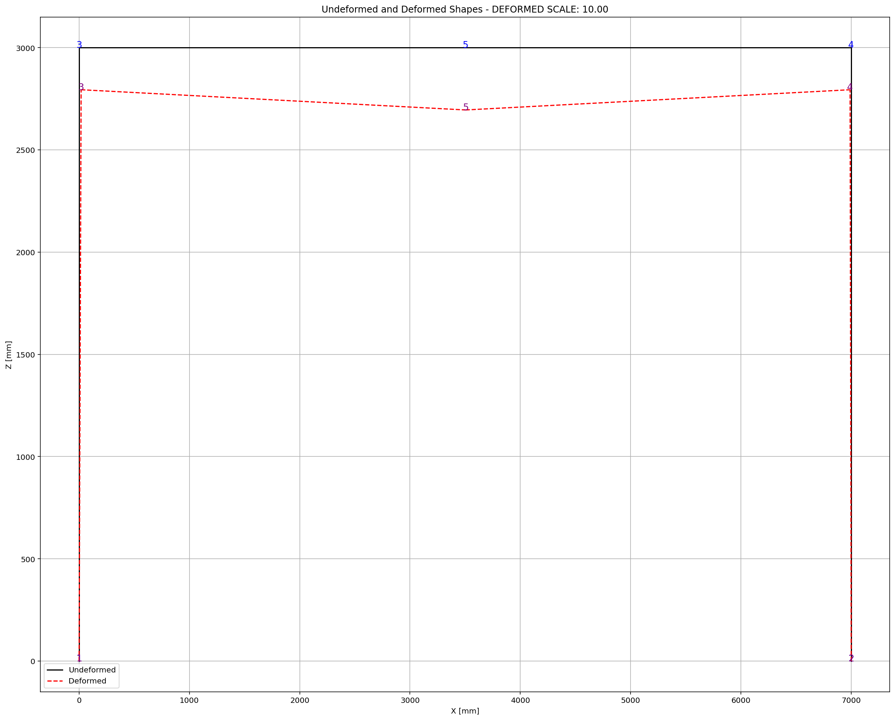

Slide 5
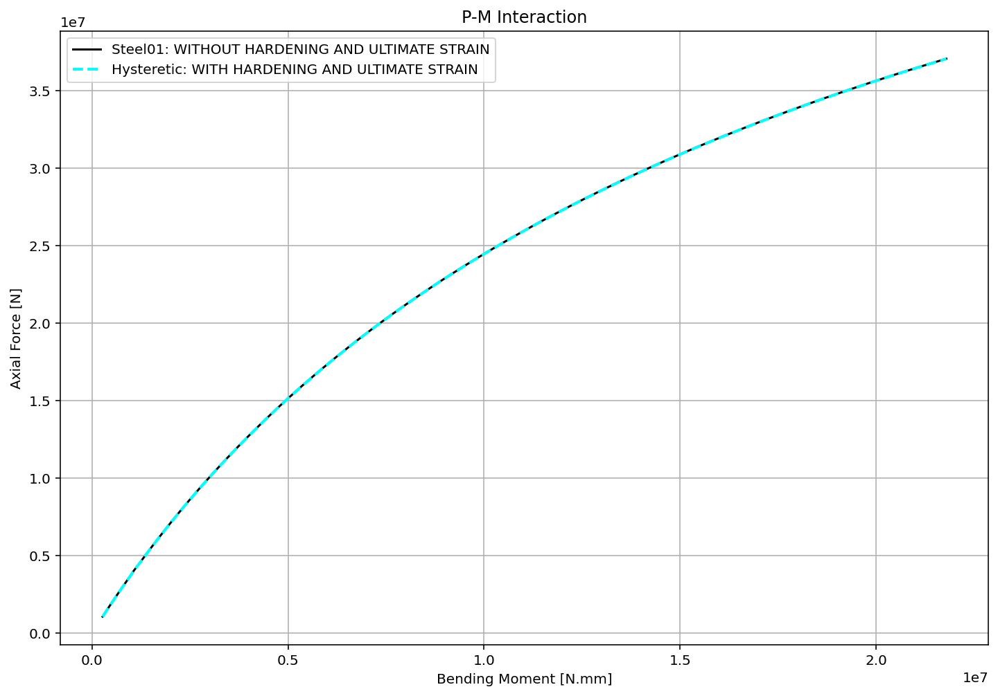

Slide 6
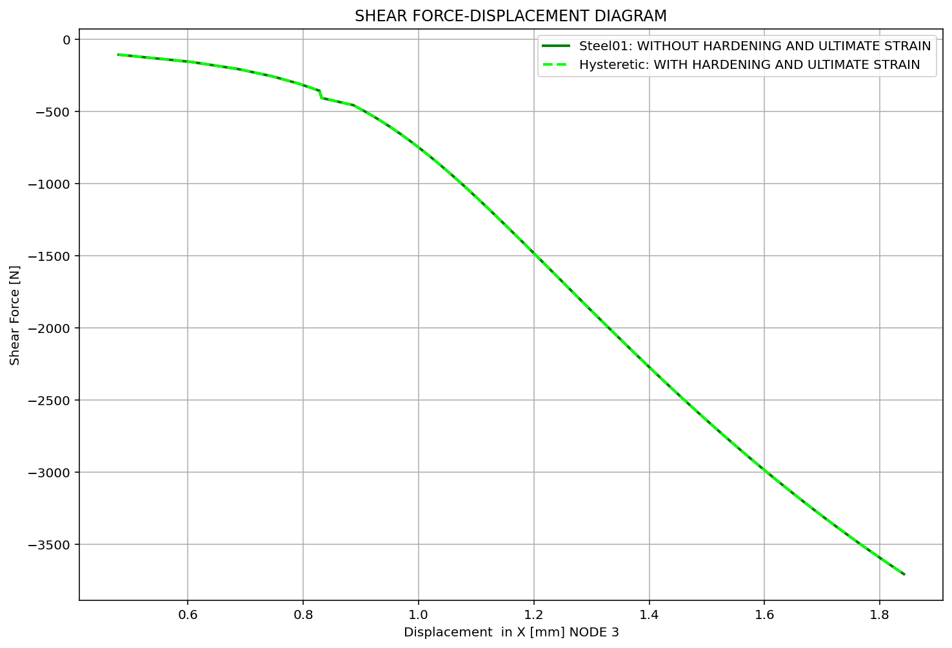

Slide 7
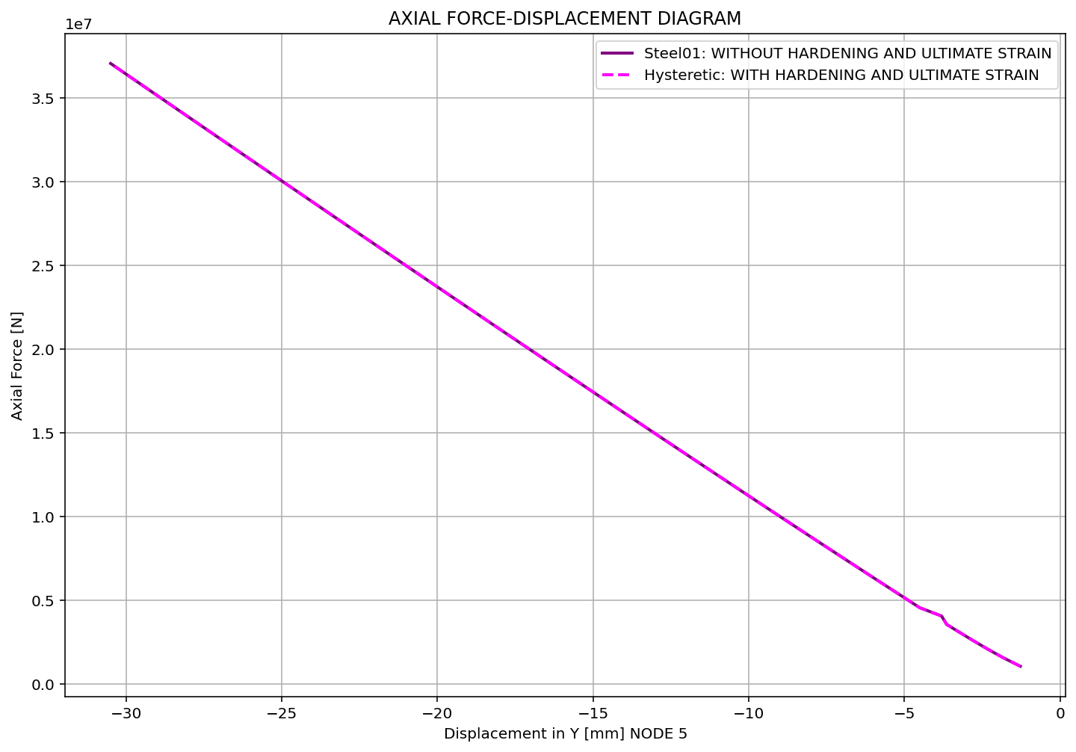

Slide 8
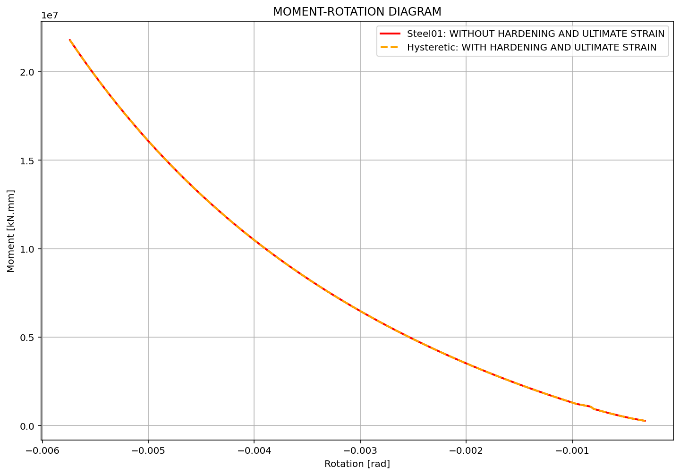

Slide 9
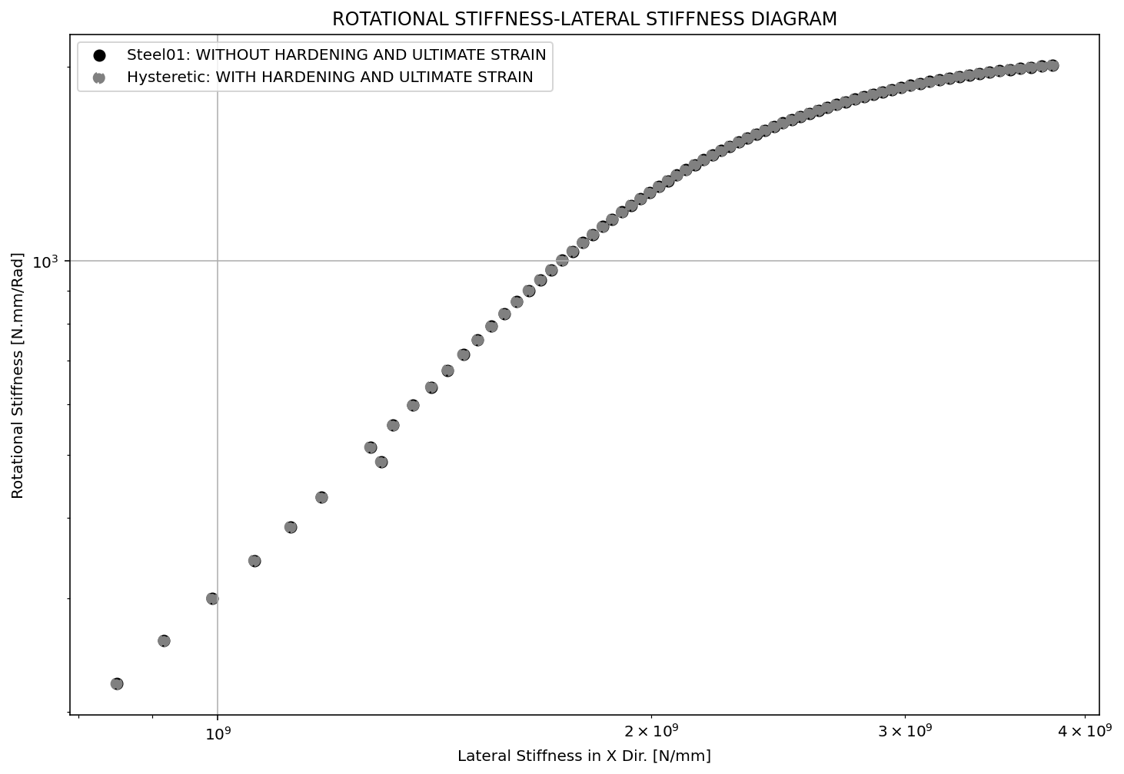

Slide 10
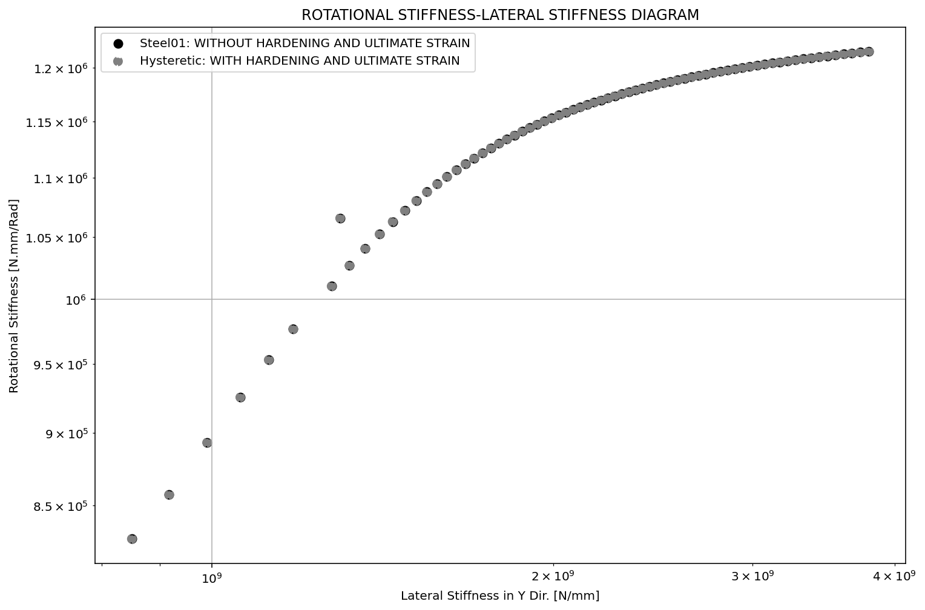

Slide 11
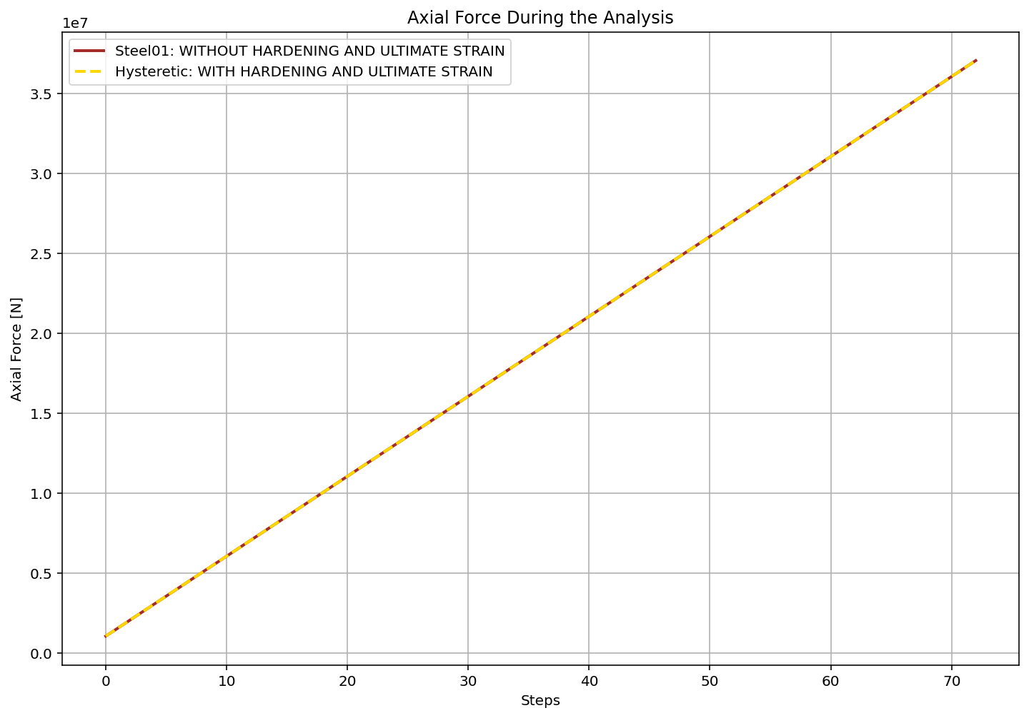

Slide 12
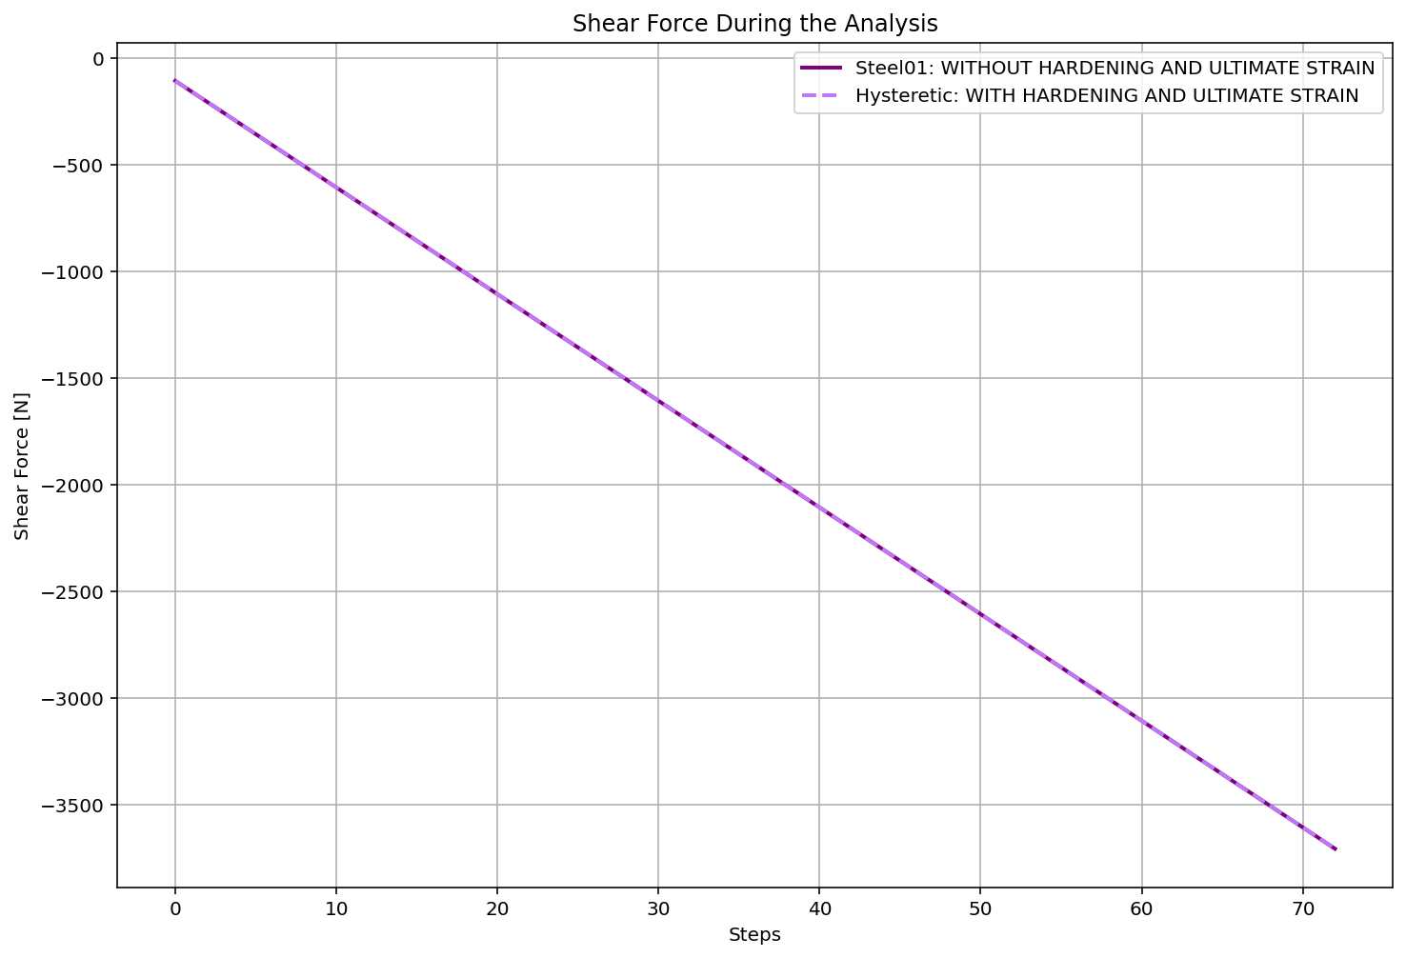

Slide 13
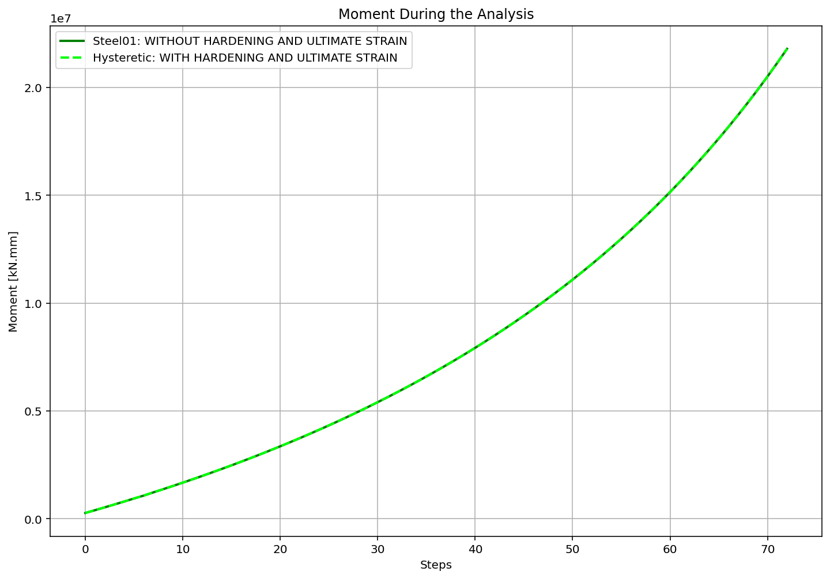

Slide 14
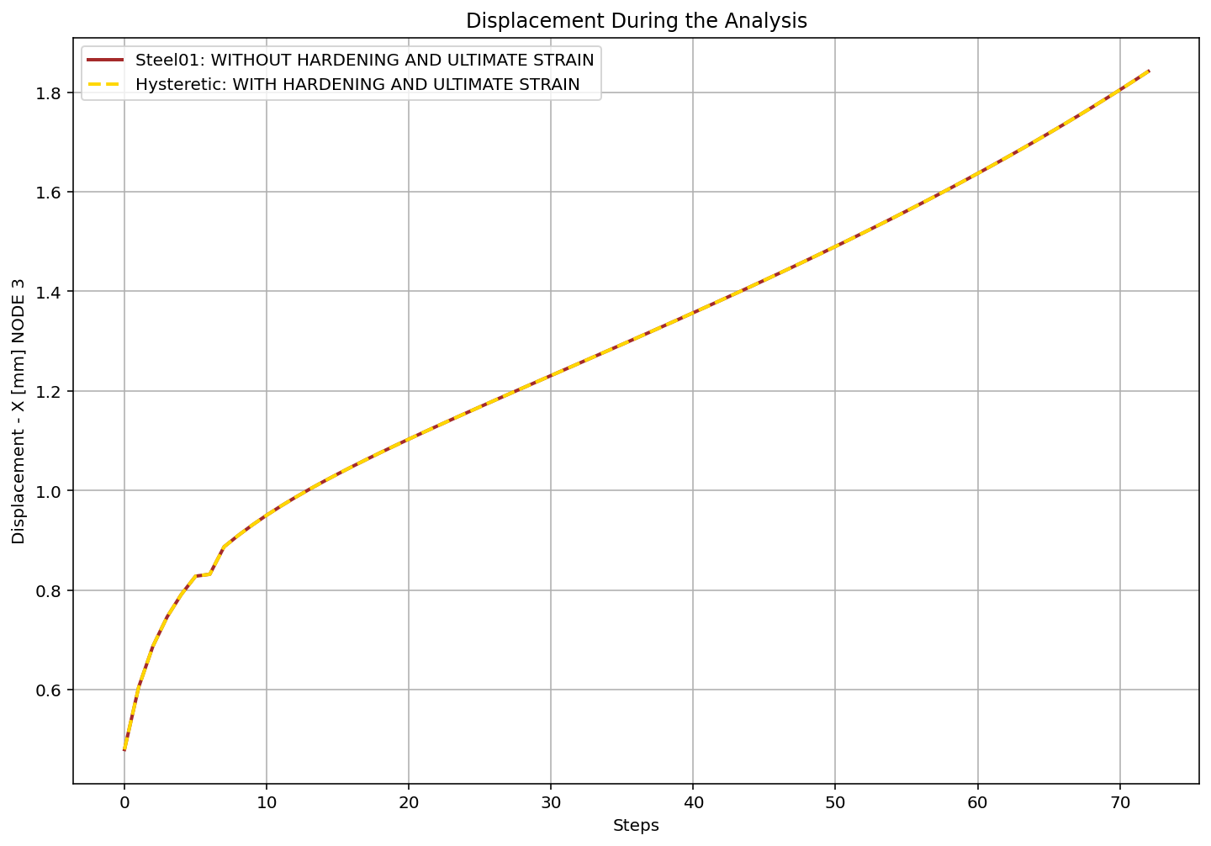

Slide 15
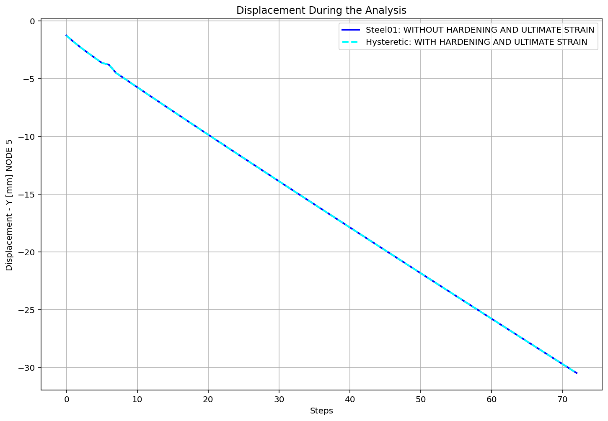

Slide 16
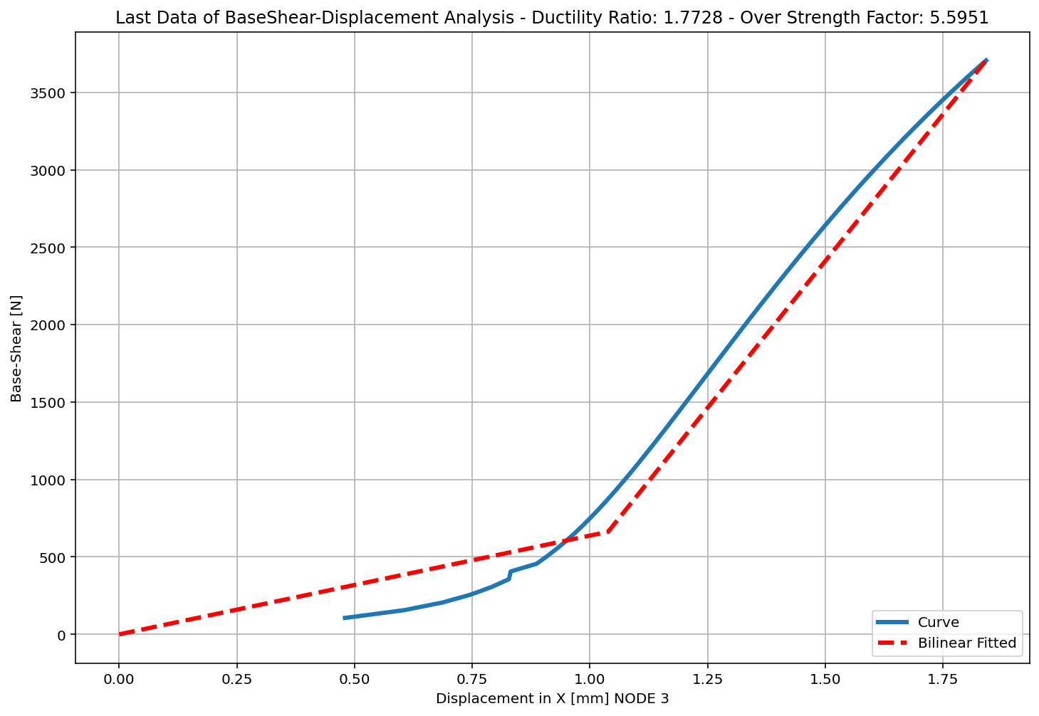

Slide 17
