Slide 1
IN THE NAME OF ALLAH, THE MOST GRACIOUS, THE MOST MERCIFUL
SEISMIC ANALYSIS OF CONCRETE FRAME. EVALUATING STRAIN HARDENING AND ULTIMATE STRAIN CRITERIA USING OPENSEES
WRITTEN BY SALAR DELAVAR GHASHGHAEI (QASHQAI)

Slide 2
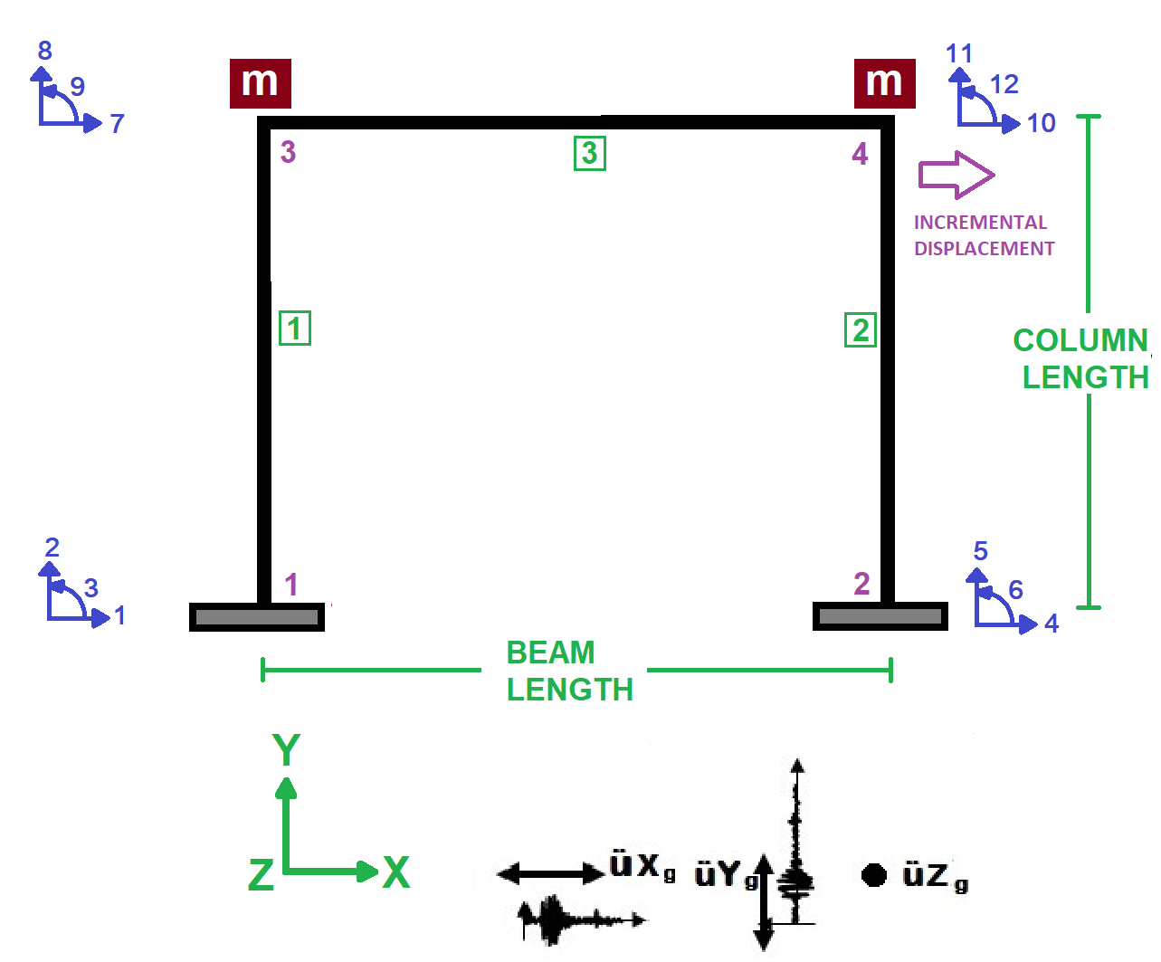

Slide 3
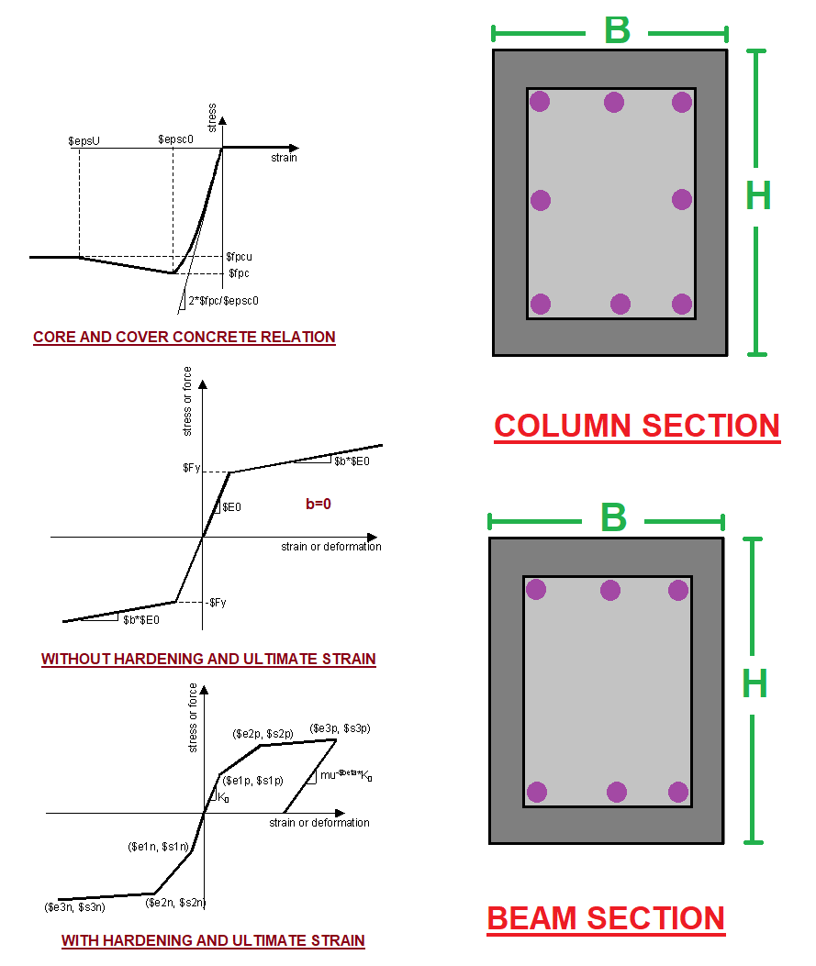

Slide 4
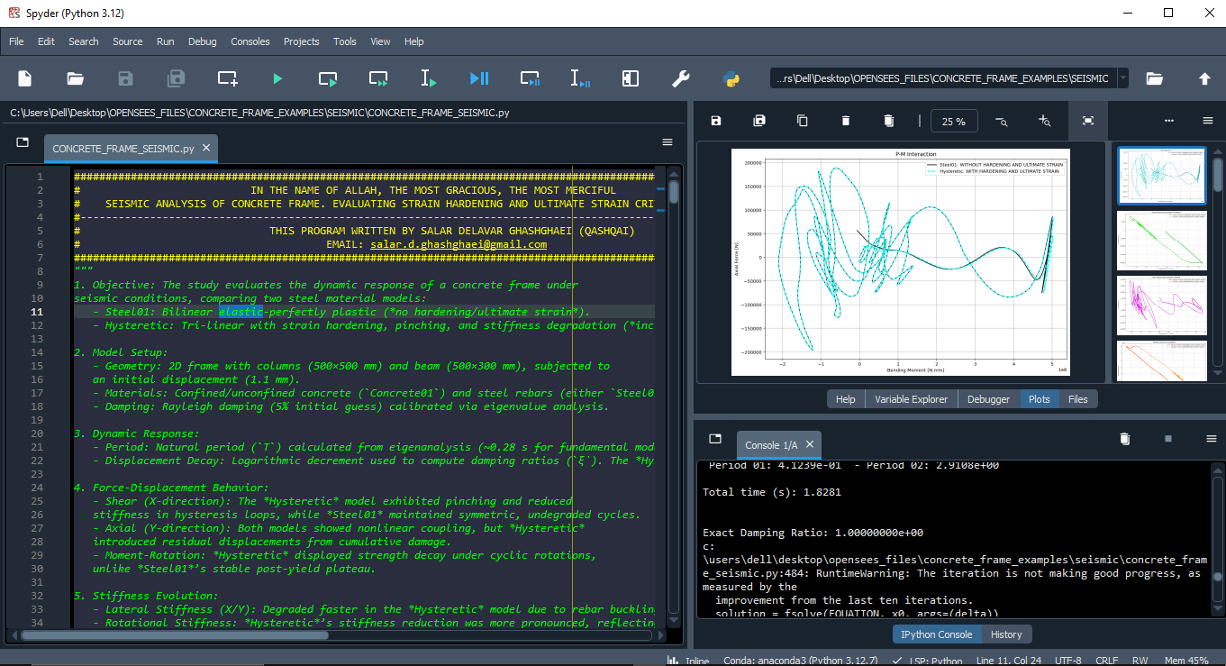

Slide 5
NONLINEAR DYNAMIC ANALYSIS

Slide 6
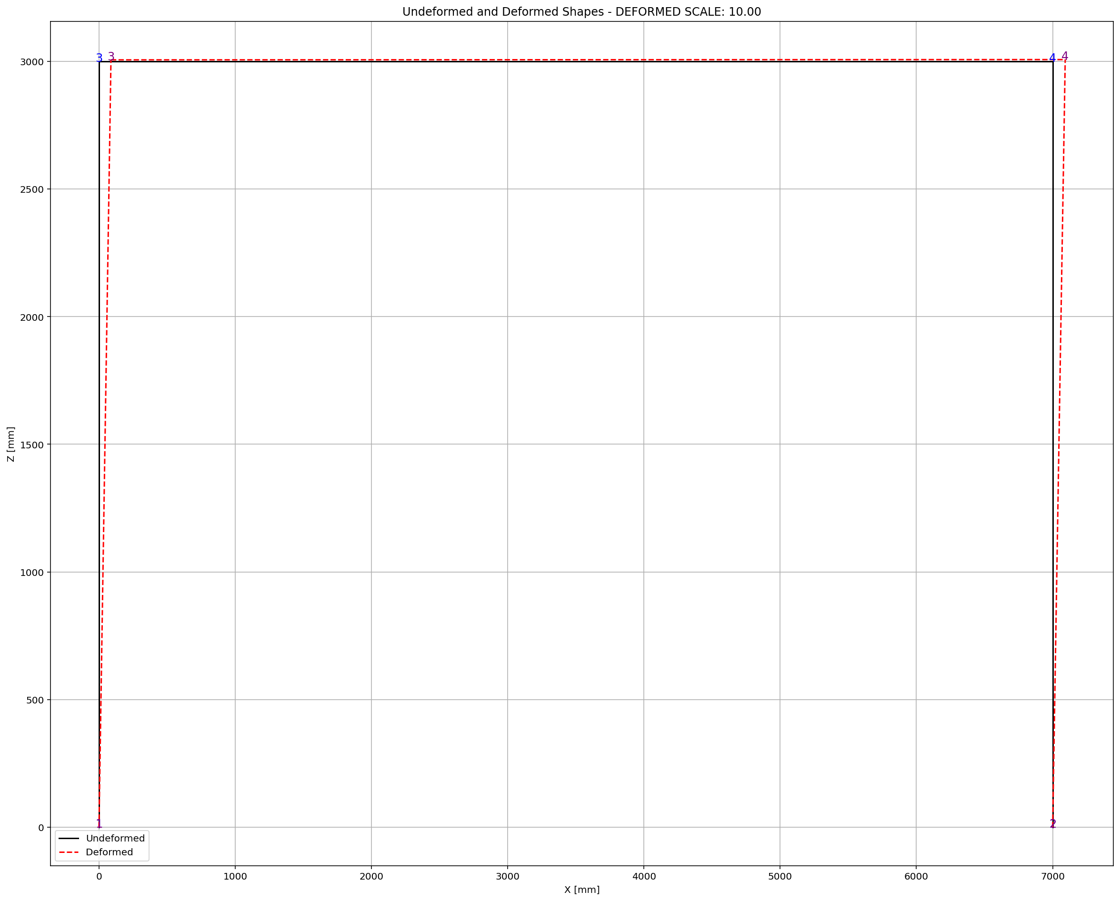

Slide 7
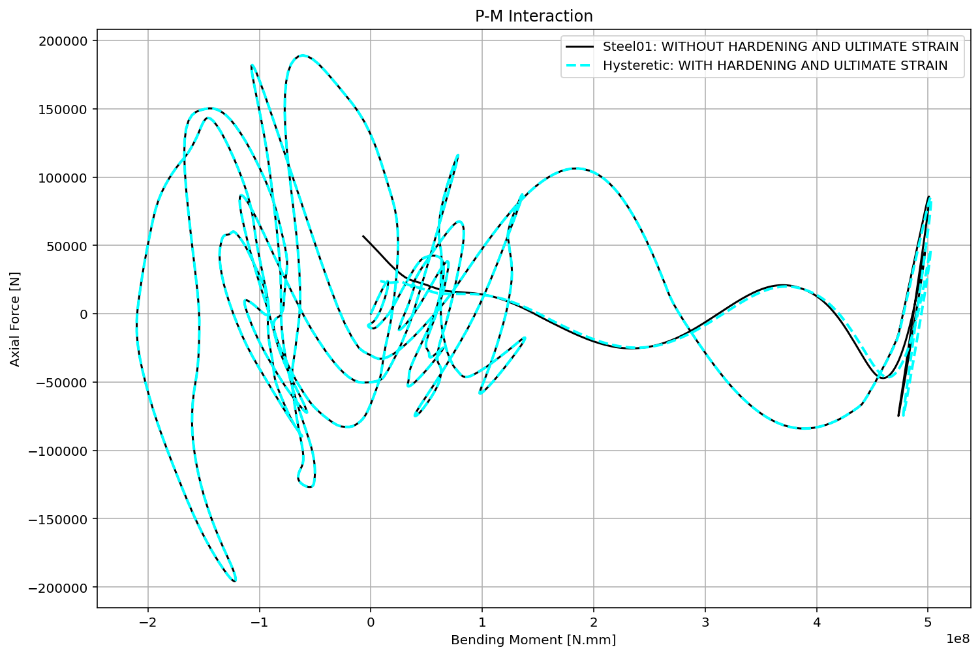

Slide 8
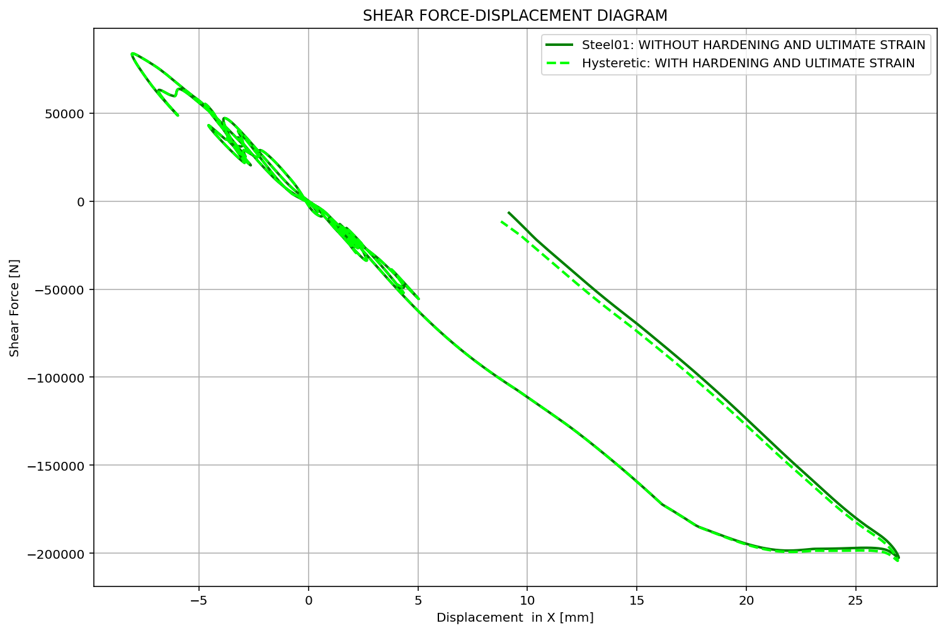

Slide 9
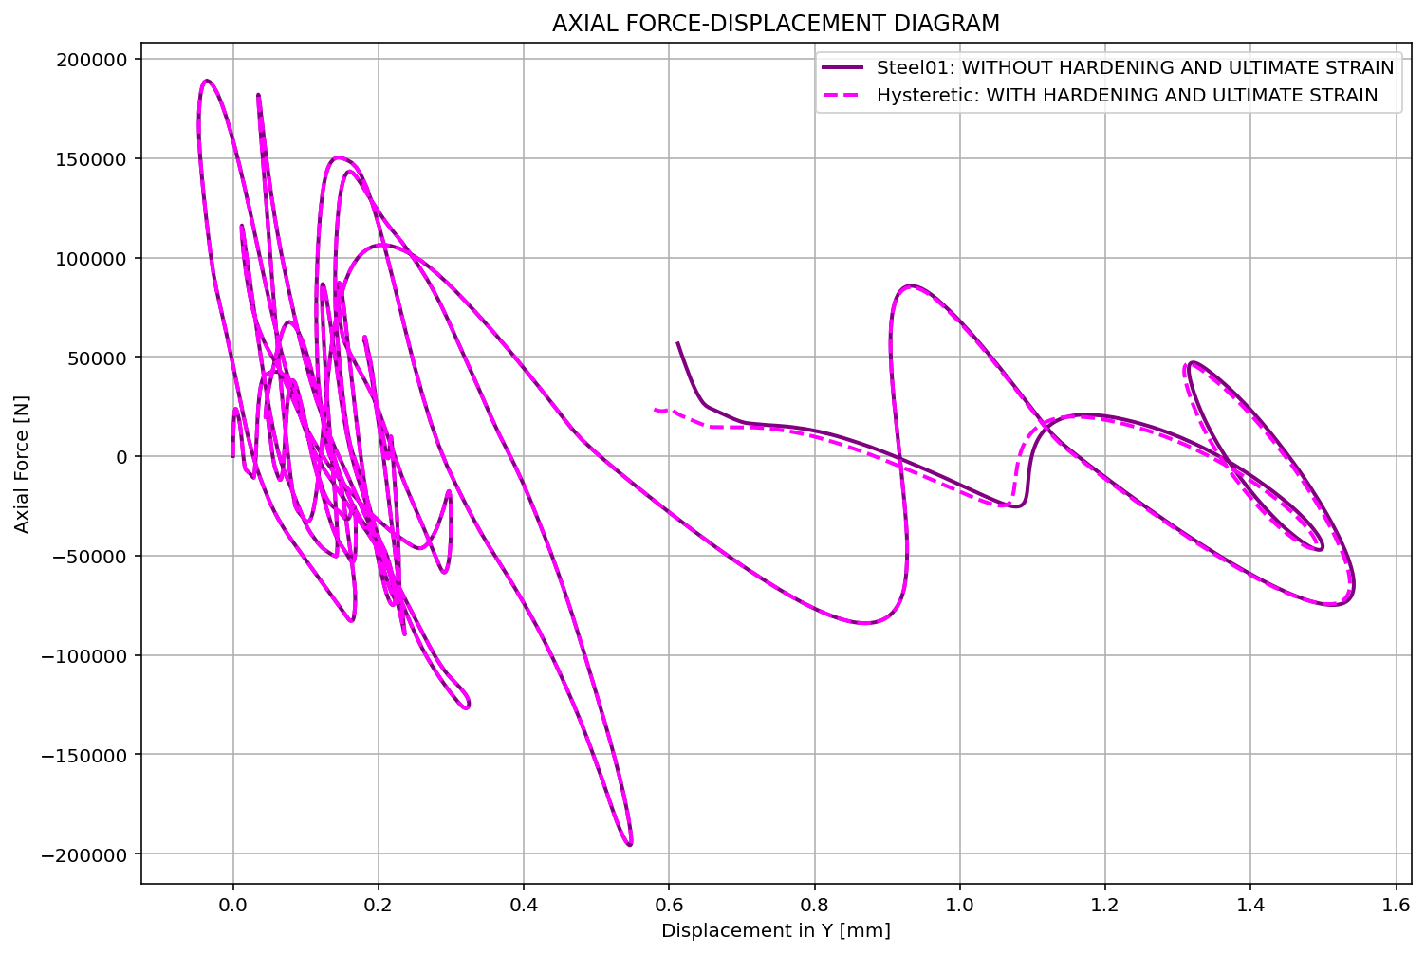

Slide 10
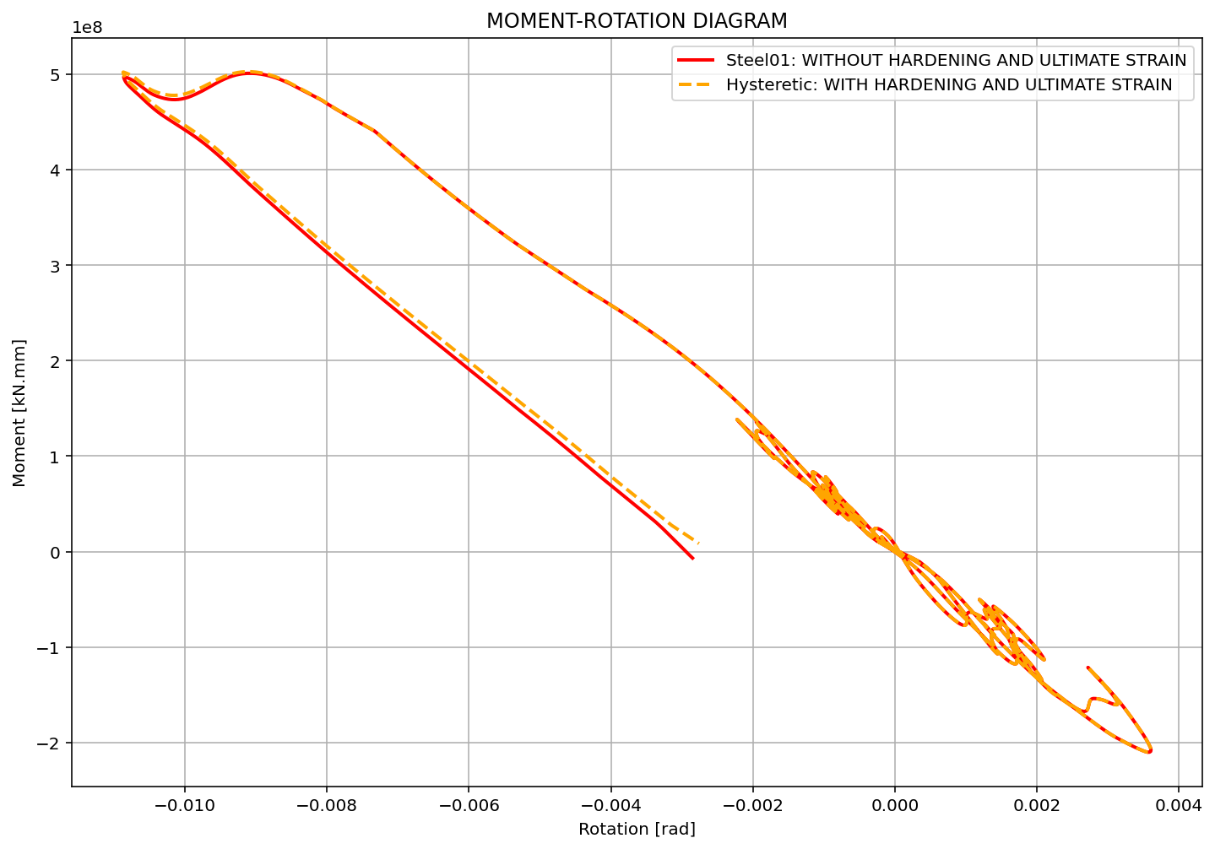

Slide 11
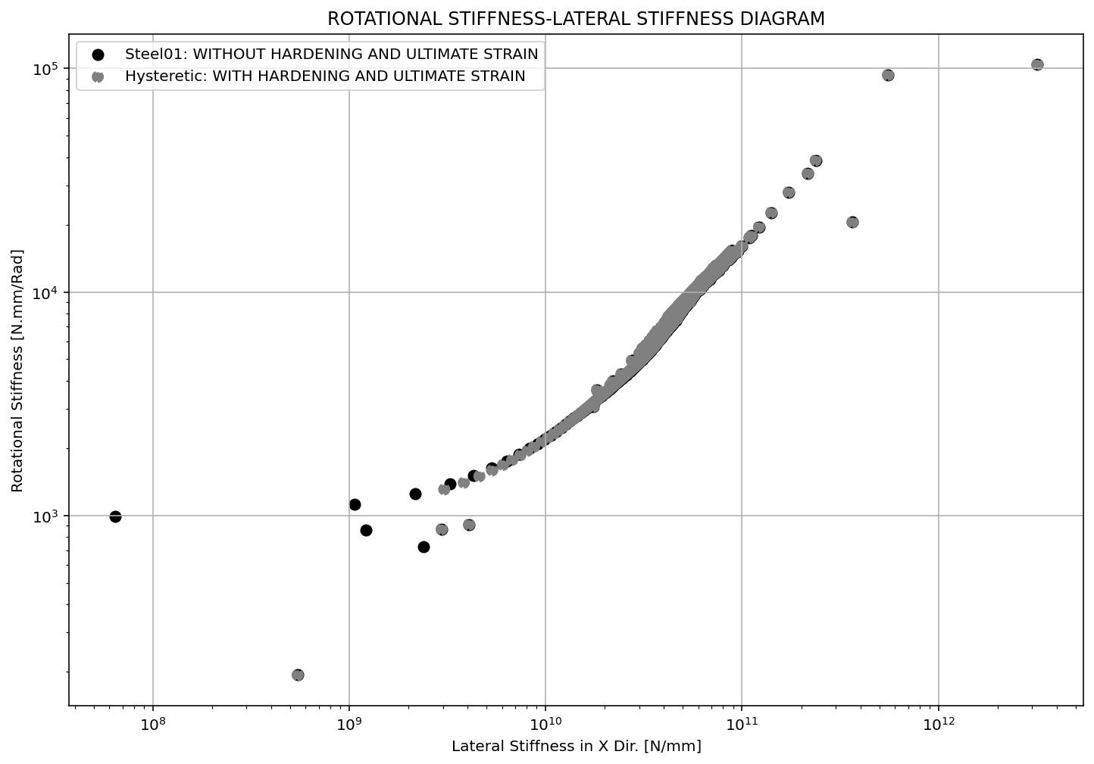

Slide 12
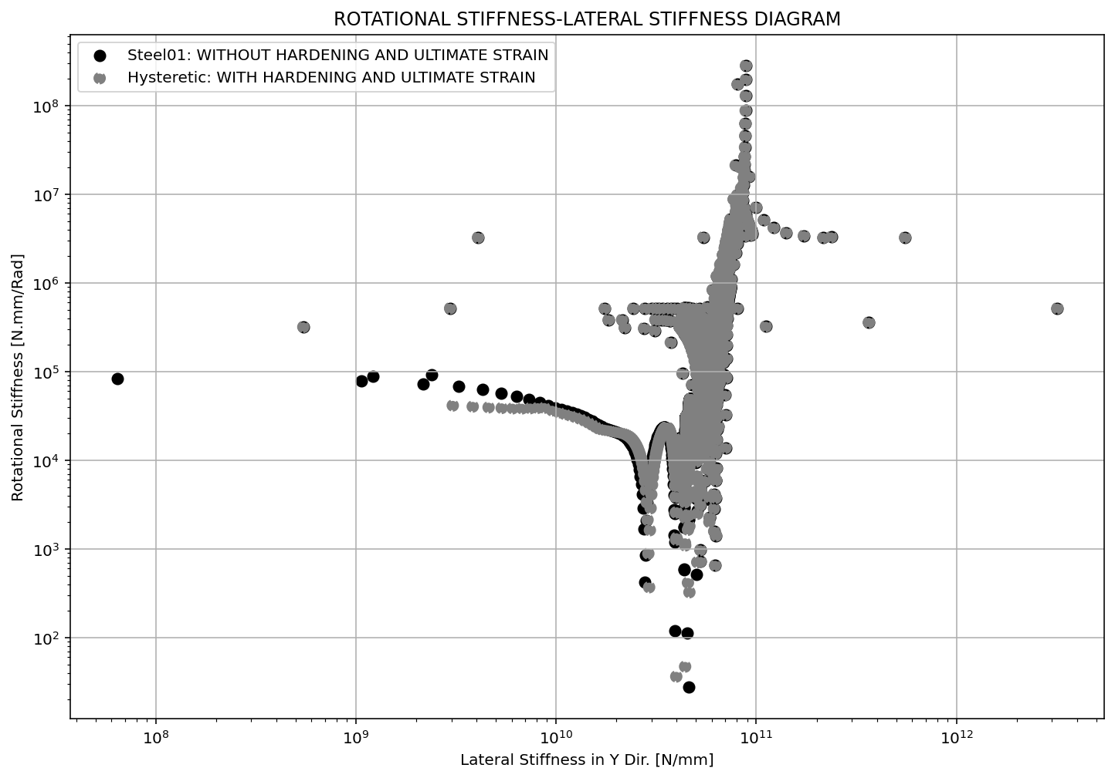

Slide 13
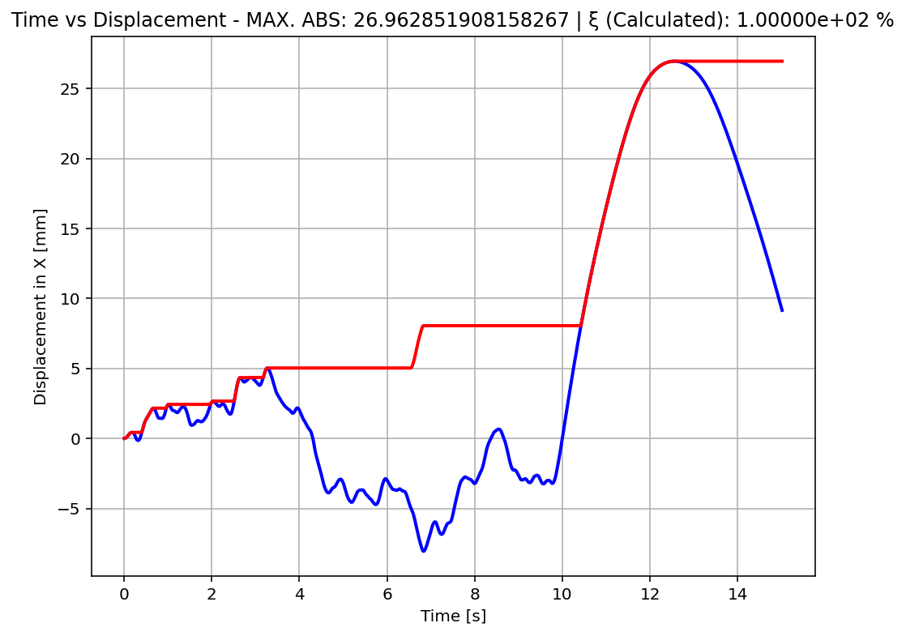

Slide 14
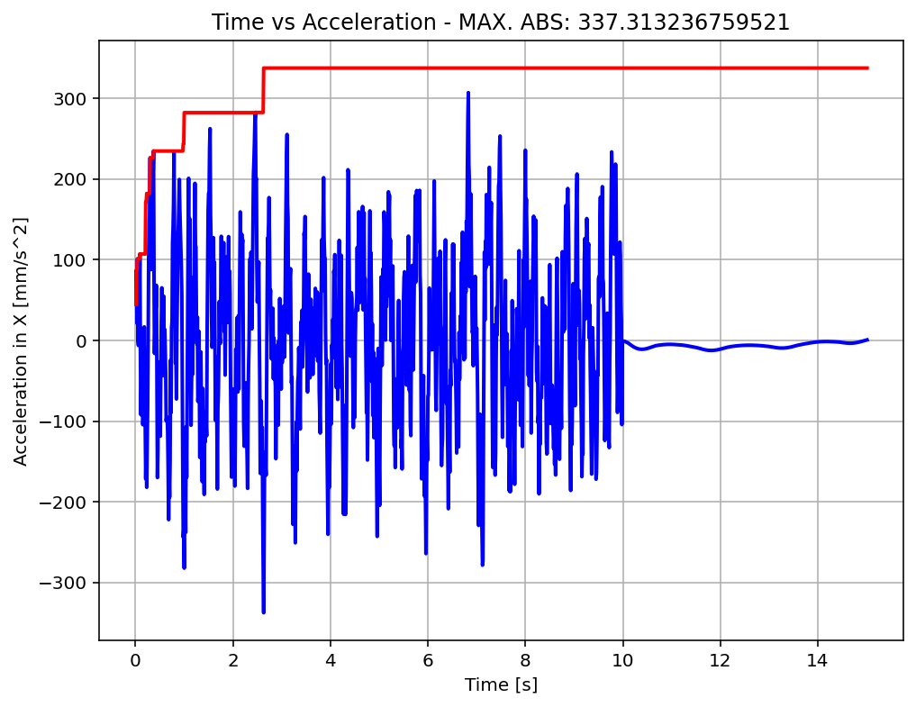
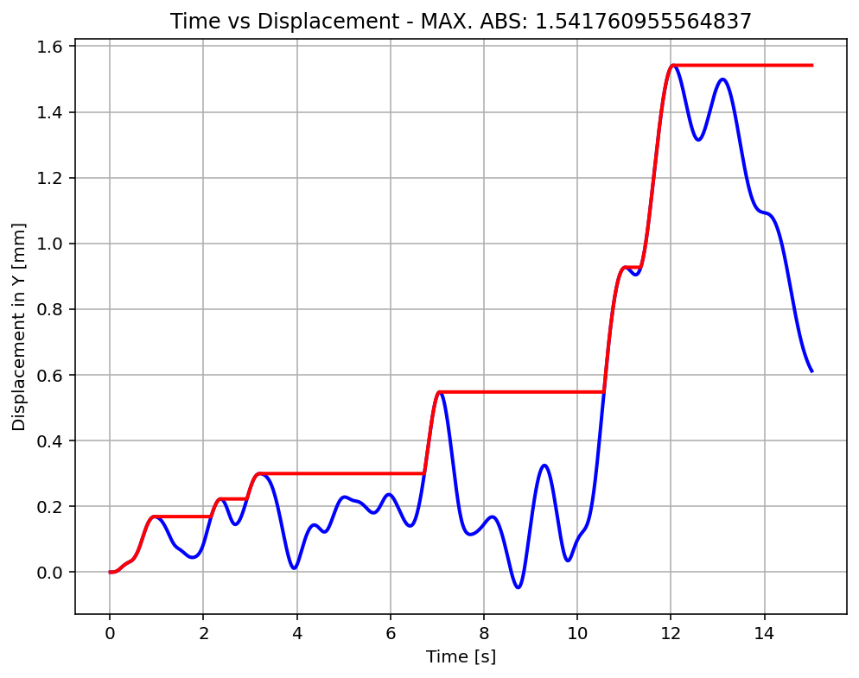

Slide 15
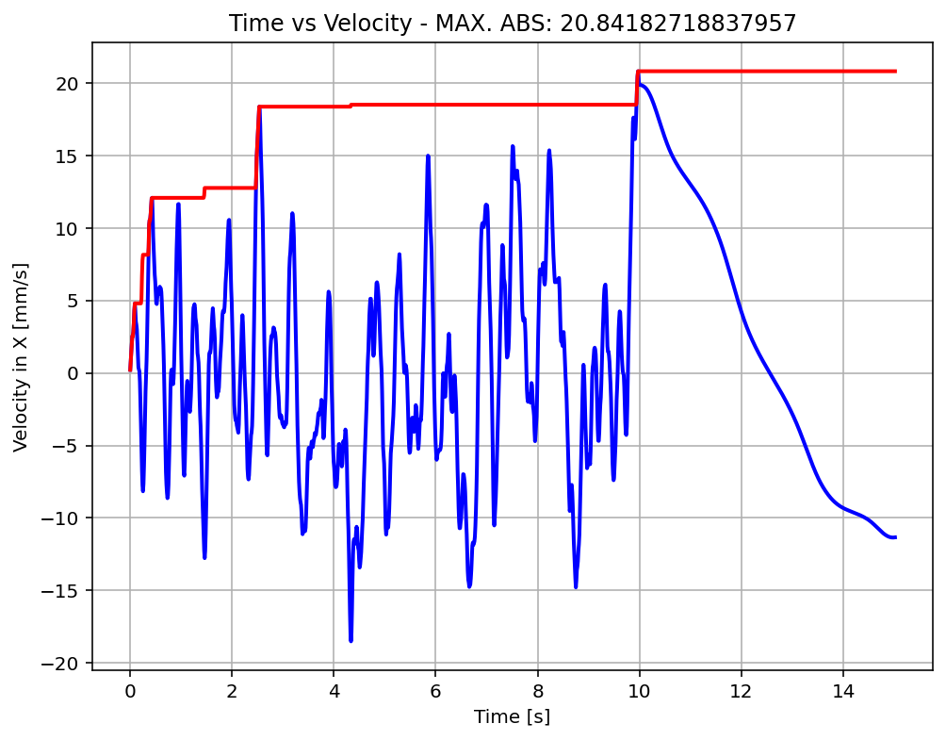

Slide 16
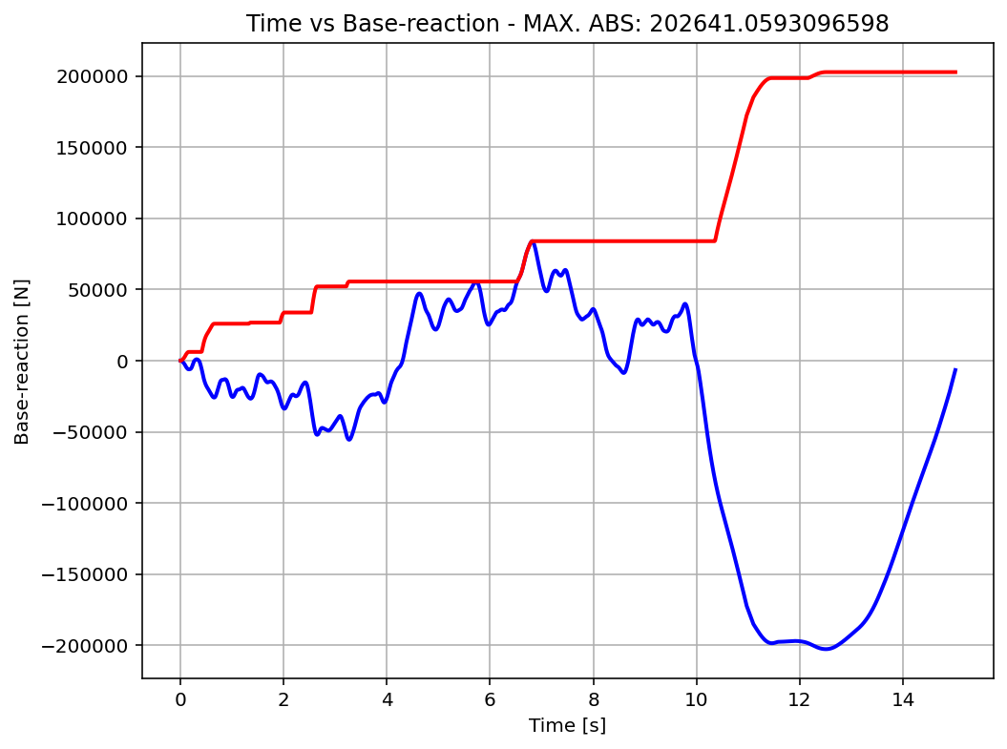

Slide 17
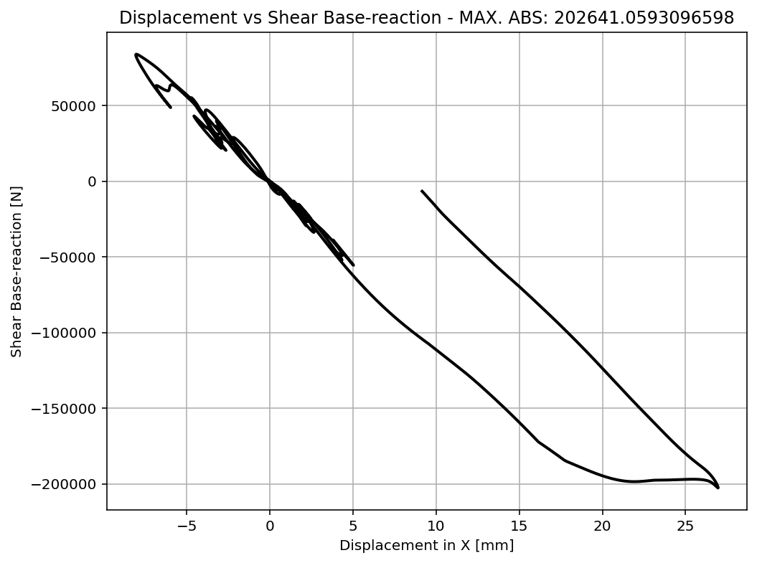

Slide 18
