Slide 1
>> IN THE NAME OF ALLAH, THE MOST GRACIOUS, THE MOST MERCIFUL <<
COMPREHENSIVE EVALUATION OF THE EQUIVALENT VISCOUS DAMPING RATIO OF A NONLINEAR SDOF SYSTEM UNDER MULTIPLE LOADING PROTOCOLS
THIS PROGRAM WRITTEN BY SALAR DELAVAR GHASHGHAEI (QASHQAI)

Slide 2
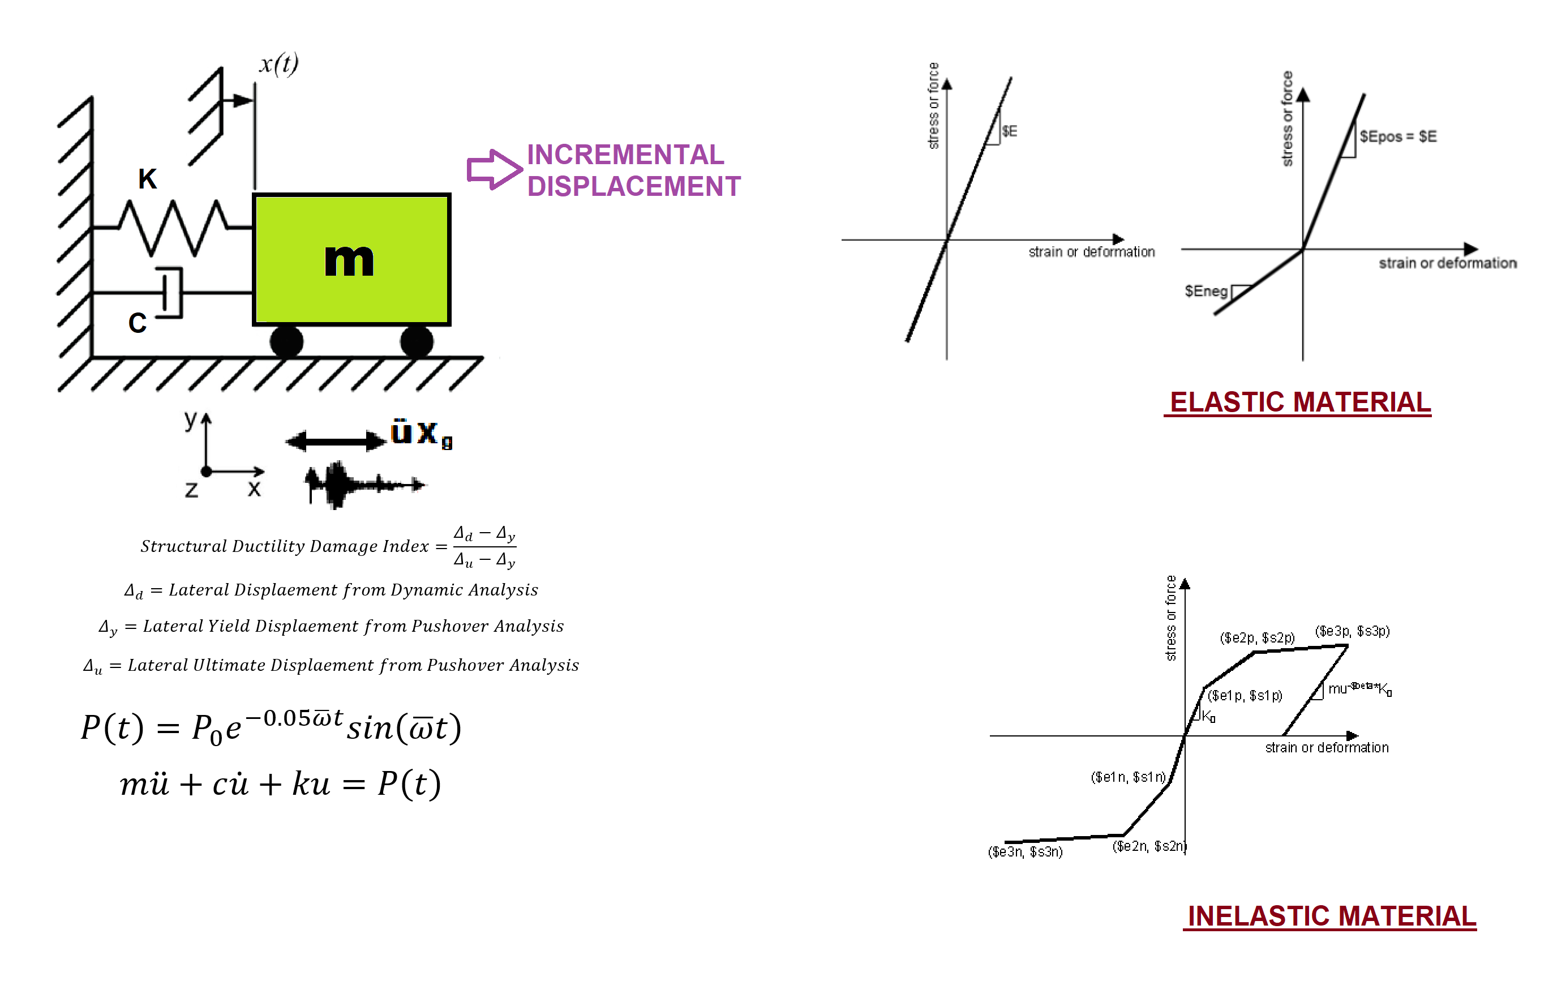

Slide 3
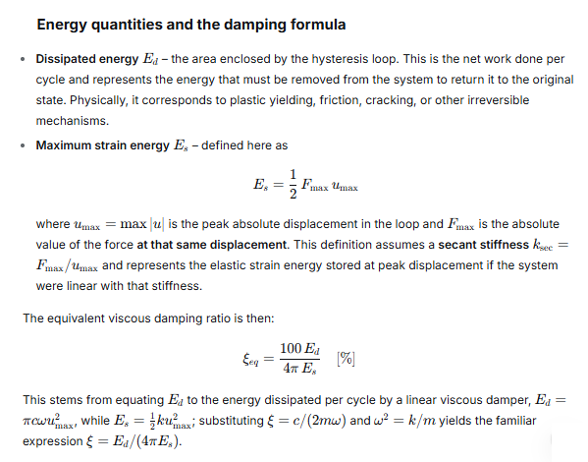

Slide 4
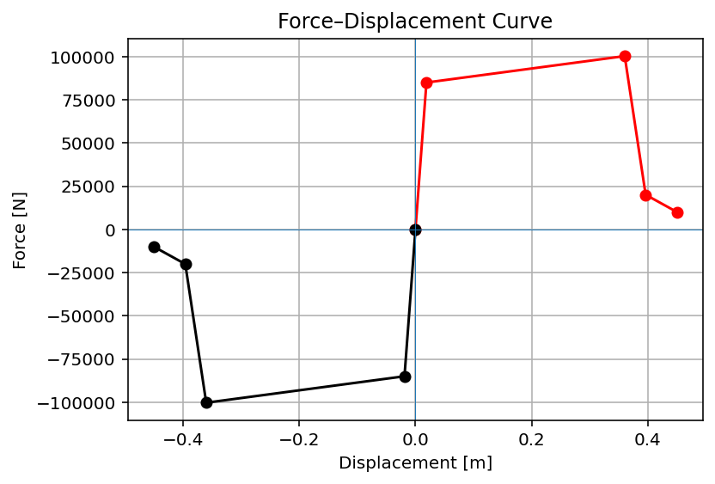

Slide 5
CYCLIC DISPLACEMENT ANALYSIS

Slide 6
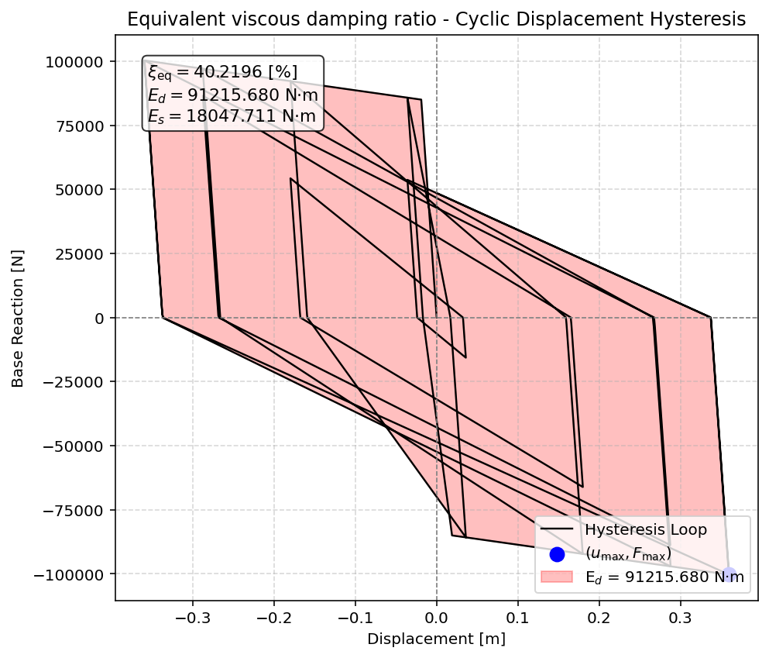

Slide 7
STATIC TIME-HISTORY WITH EXTERNAL TIME-DEPENDENT LOADING ANALYSIS

Slide 8
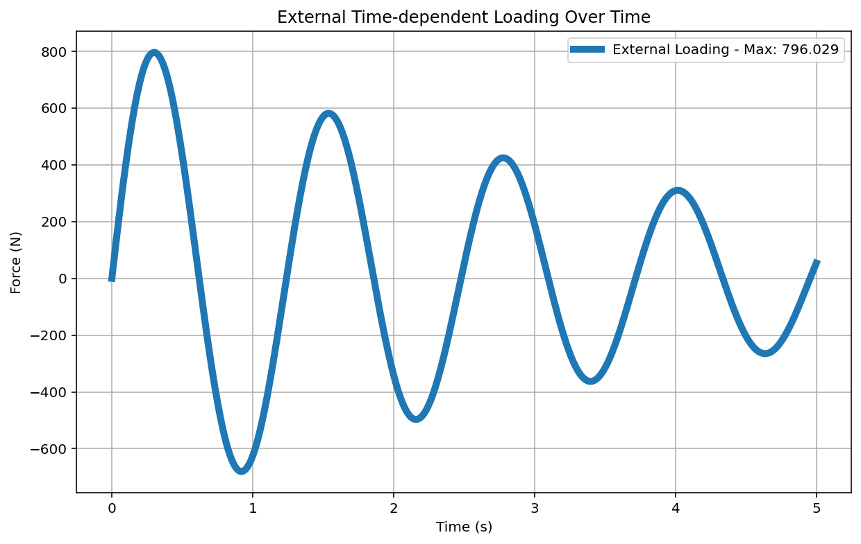

Slide 9
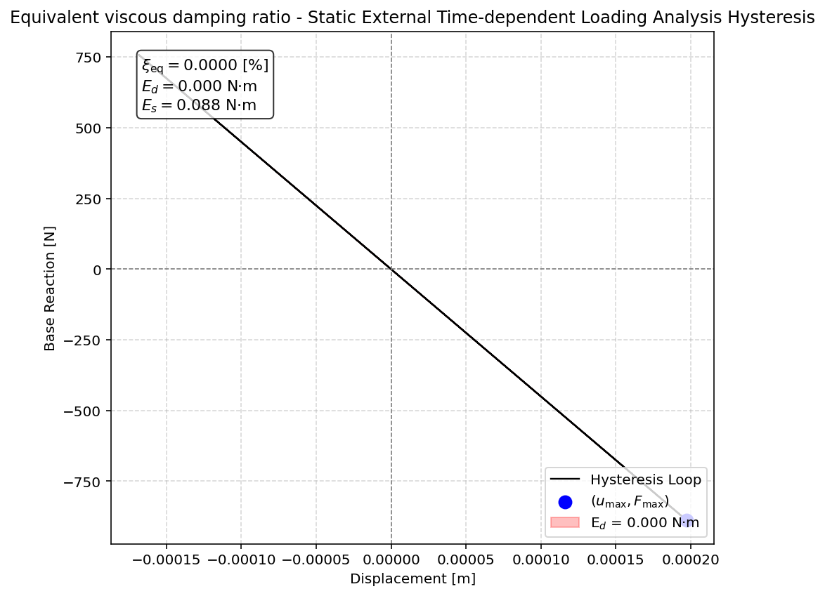

Slide 10
DYNAMIC TIME-HISTORY WITH EXTERNAL TIME-DEPENDENT LOADING ANALYSIS

Slide 12
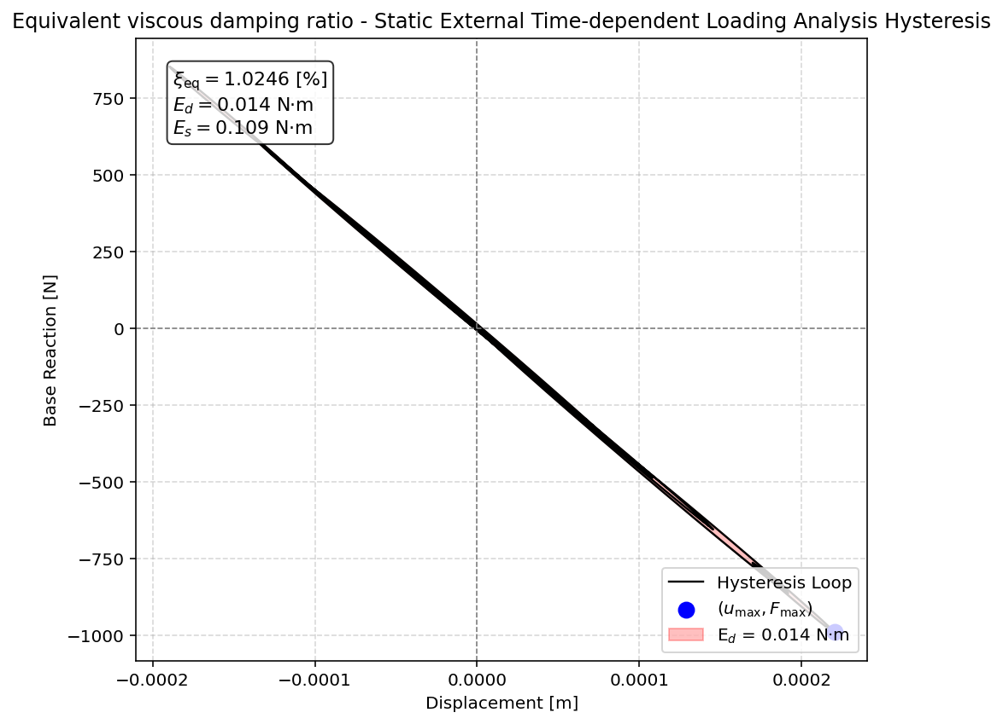

Slide 13
FREE-VIBRATION ANALYSIS

Slide 14
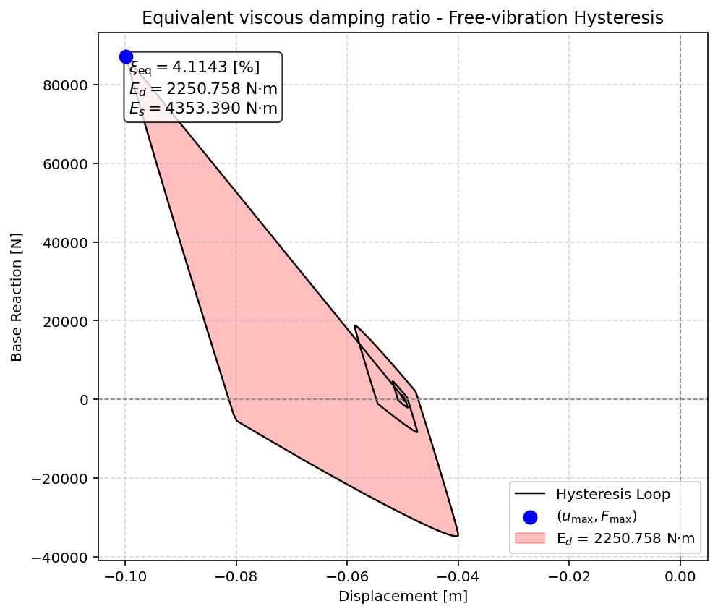

Slide 15
SEISMIC ANALYSIS

Slide 16
