Slide 1
IN THE NAME OF ALLAH
PUSHOVER AND DYNAMIC ANALYSIS OF CONCRETE COLUMNS WITH AXIAL AND ROTATIONAL SPRINGS FOR MODELING BEAM COLUMN JOINTS
THIS PROGRAM WRITTEN BY SALAR DELAVAR GHASHGHAEI (QASHQAI)

Slide 2
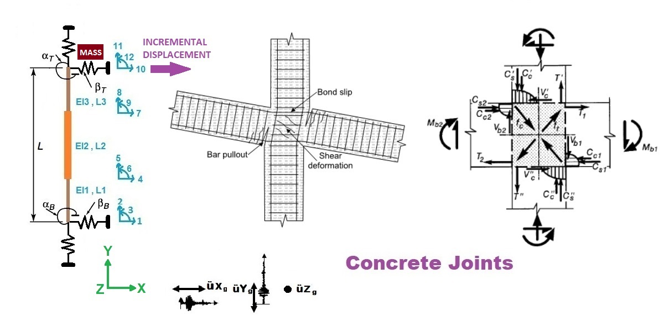

Slide 3
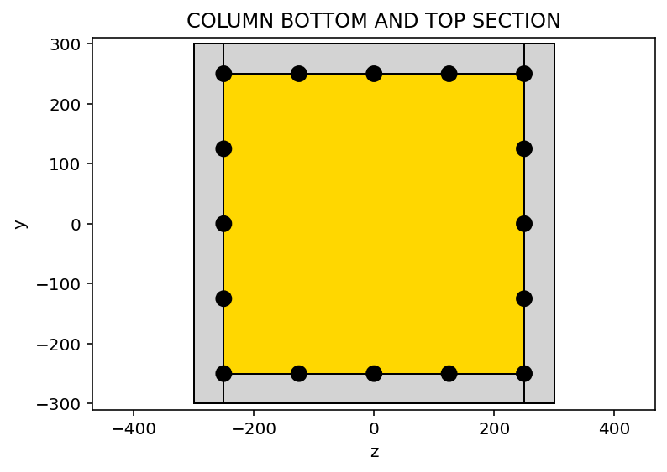
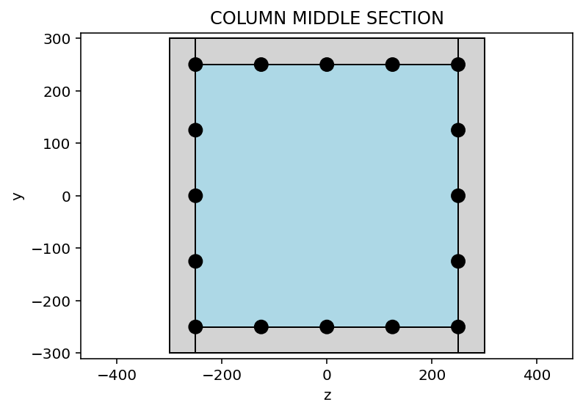

Slide 4
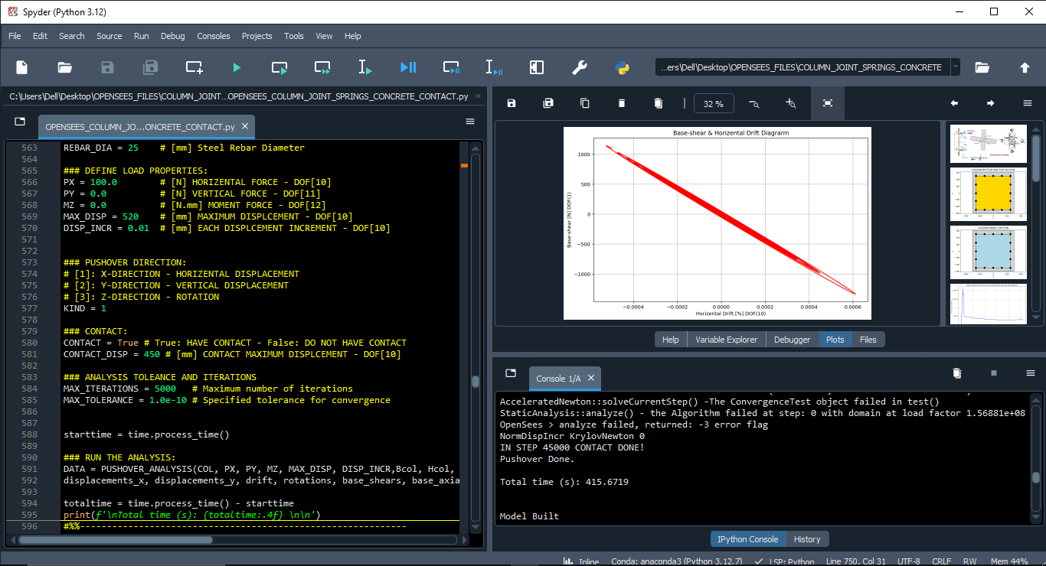

Slide 5
PUSHOVER ANALYSIS OF CONCRETE COLUMNS WITH AXIAL AND ROTATIONAL SPRINGS FOR MODELING BEAM COLUMN JOINTS

Slide 6
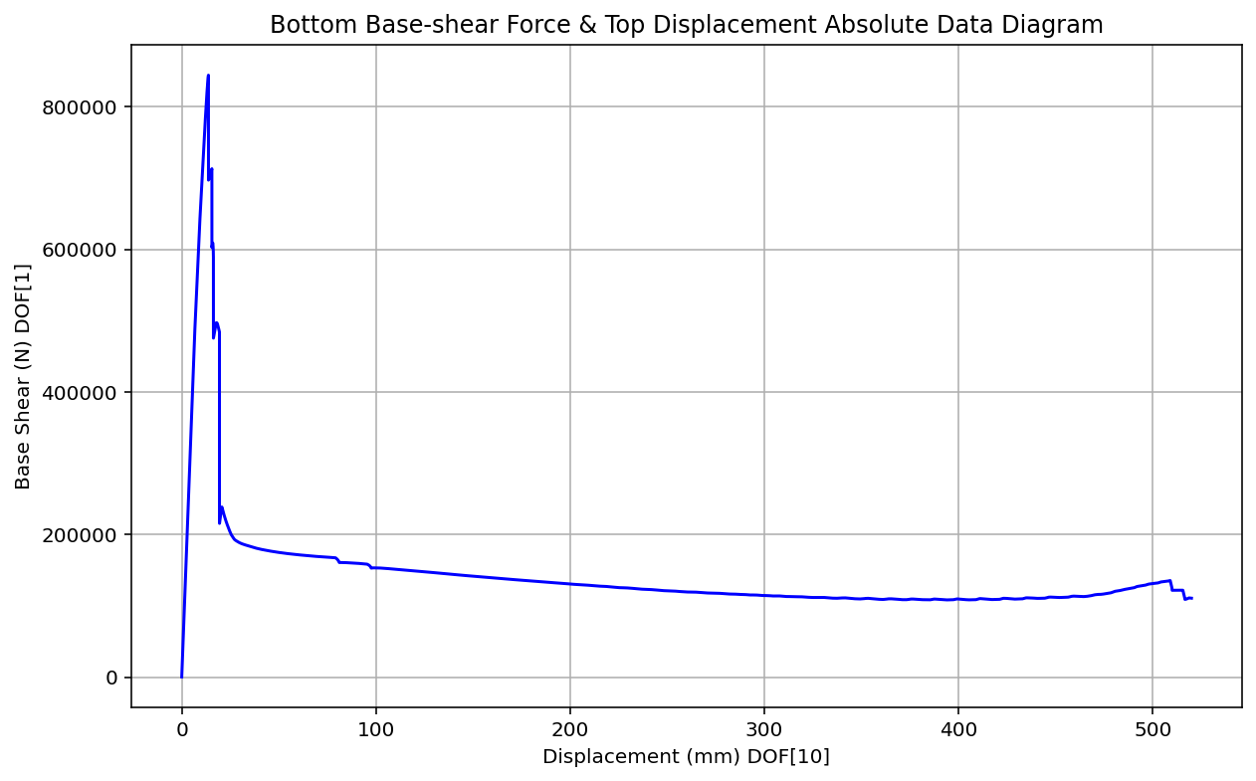

Slide 7
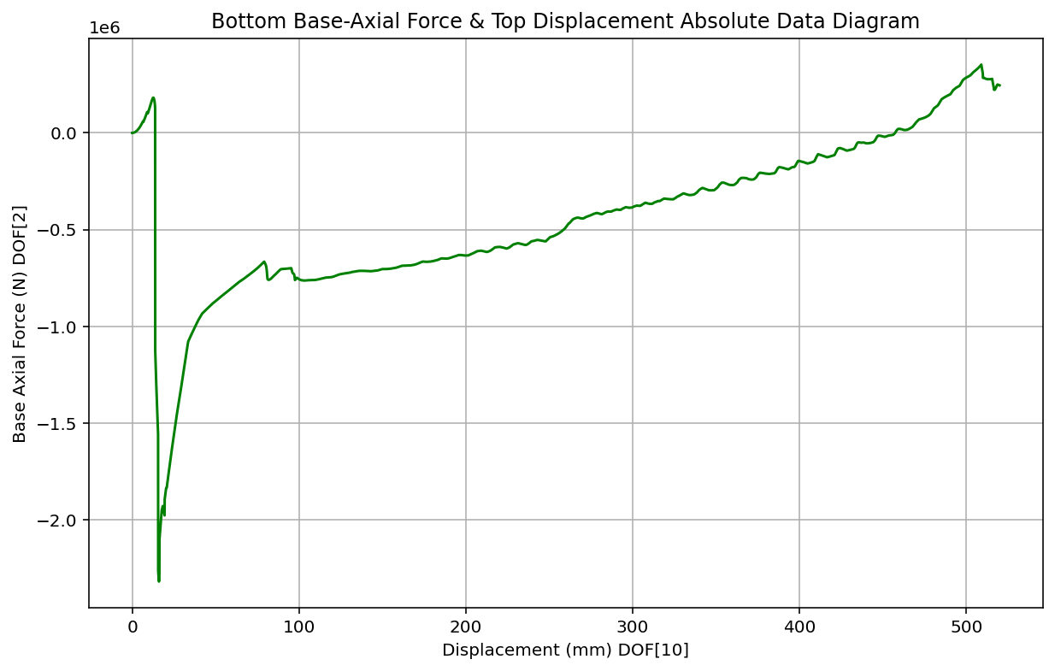

Slide 8
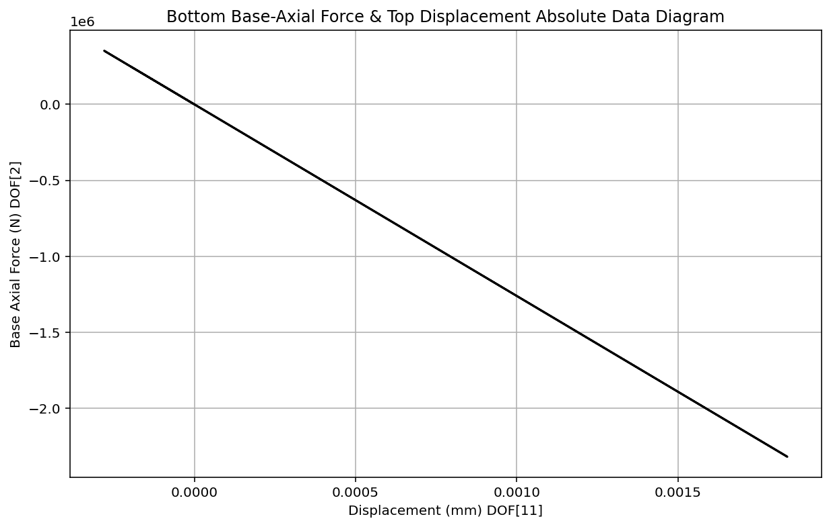

Slide 9
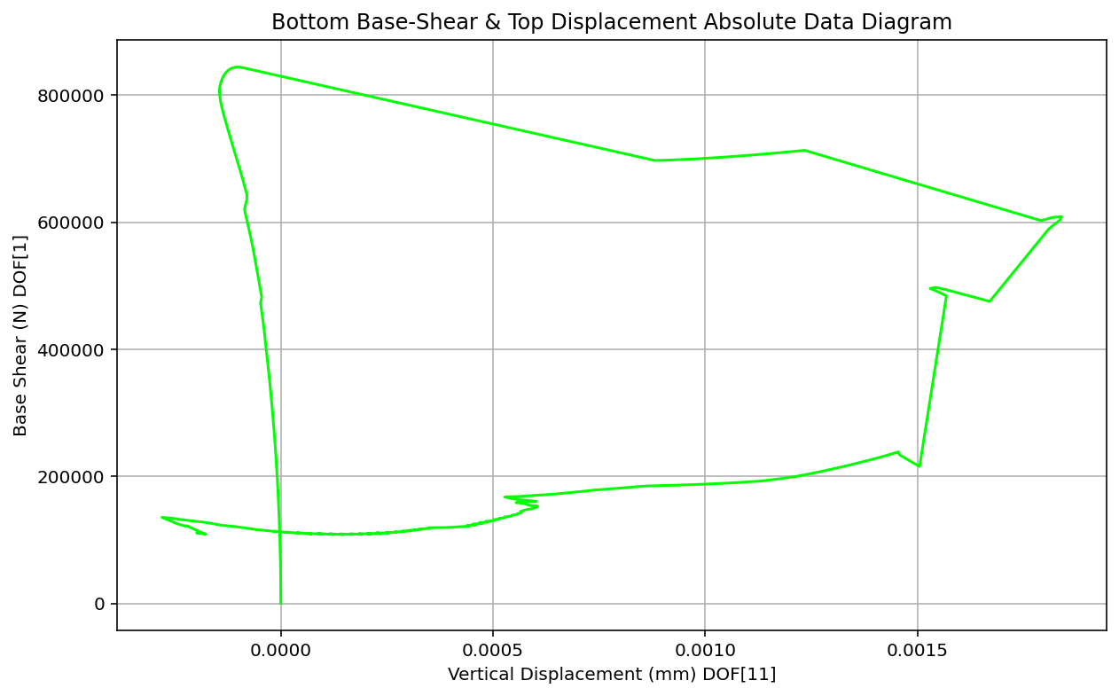

Slide 10
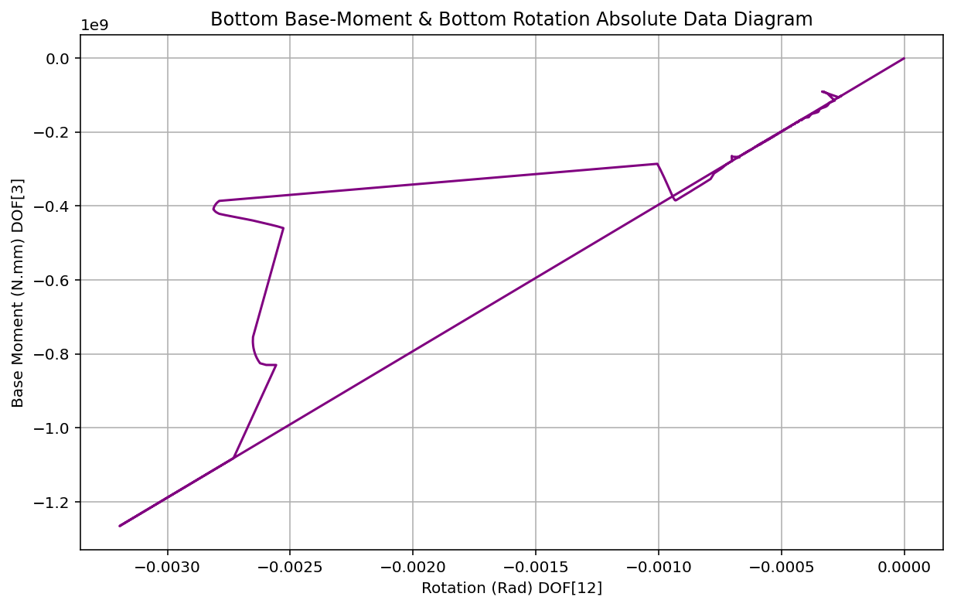

Slide 11
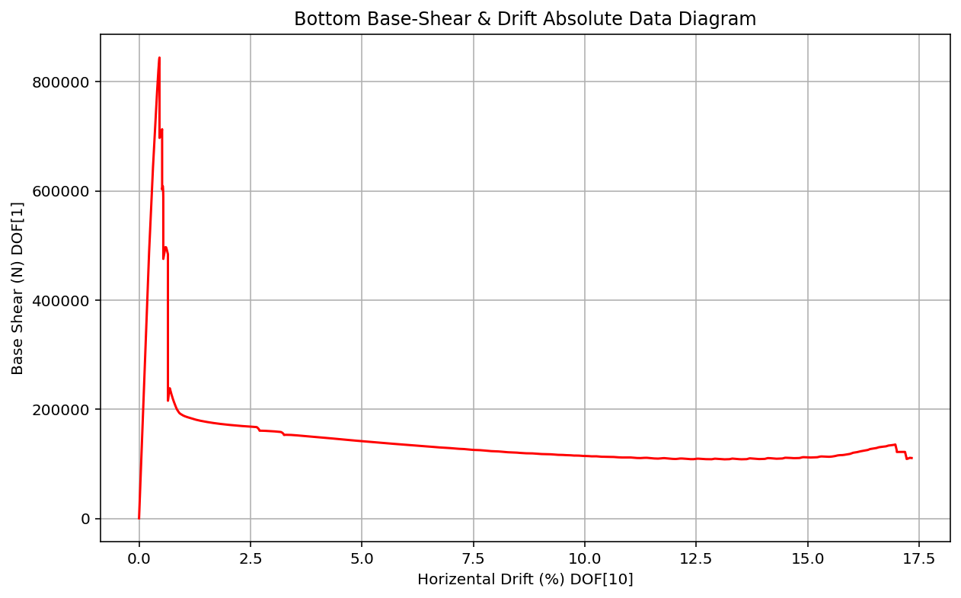

Slide 13
DYNAMIC ANALYSIS OF CONCRETE COLUMNS WITH AXIAL AND ROTATIONAL SPRINGS FOR MODELING BEAM COLUMN JOINTS

Slide 14
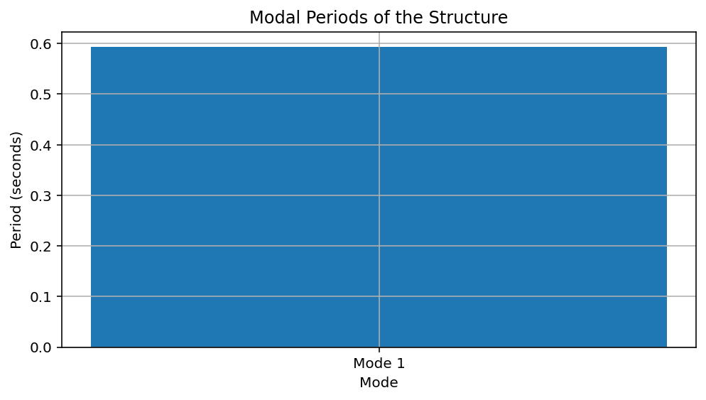
Period: 0.12475926338077073 (s)
Natural Frequency: 8.015436873396377 (Hz)

Slide 15
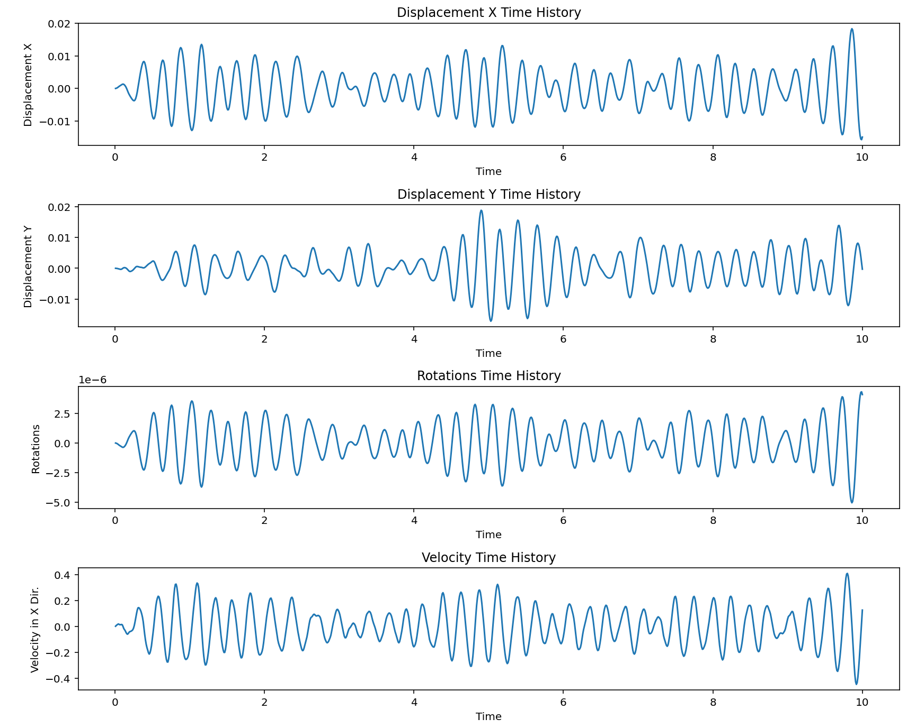

Slide 16
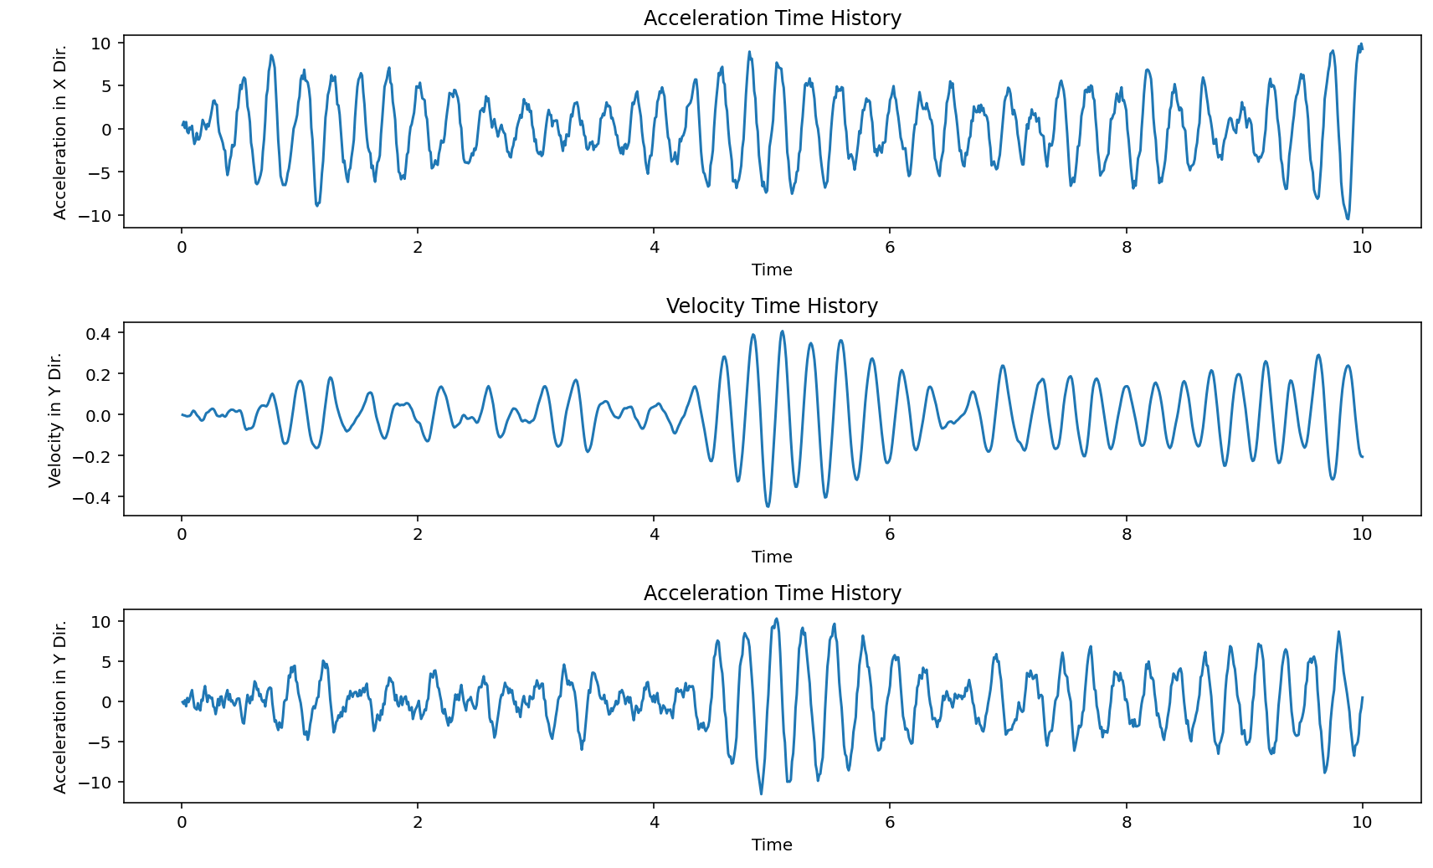

Slide 17
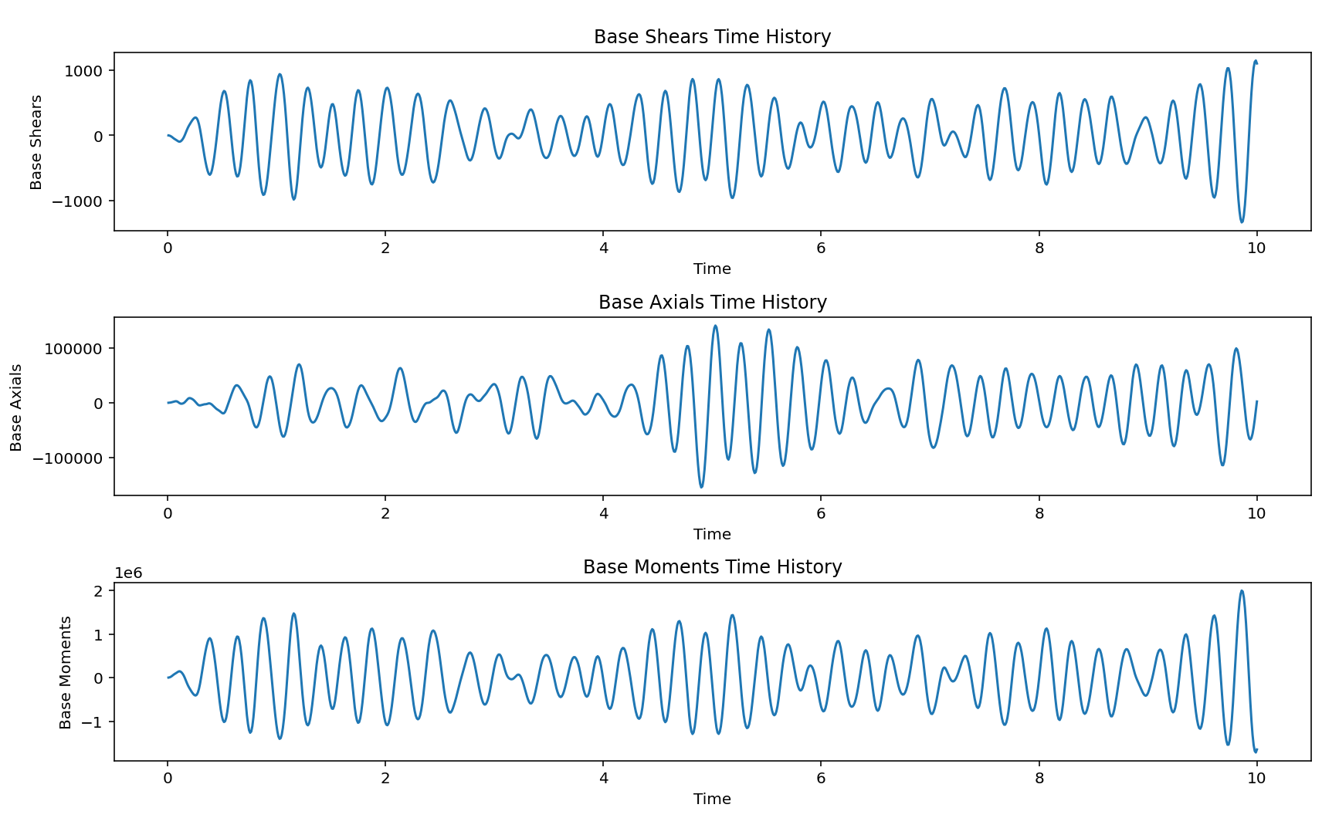

Slide 18
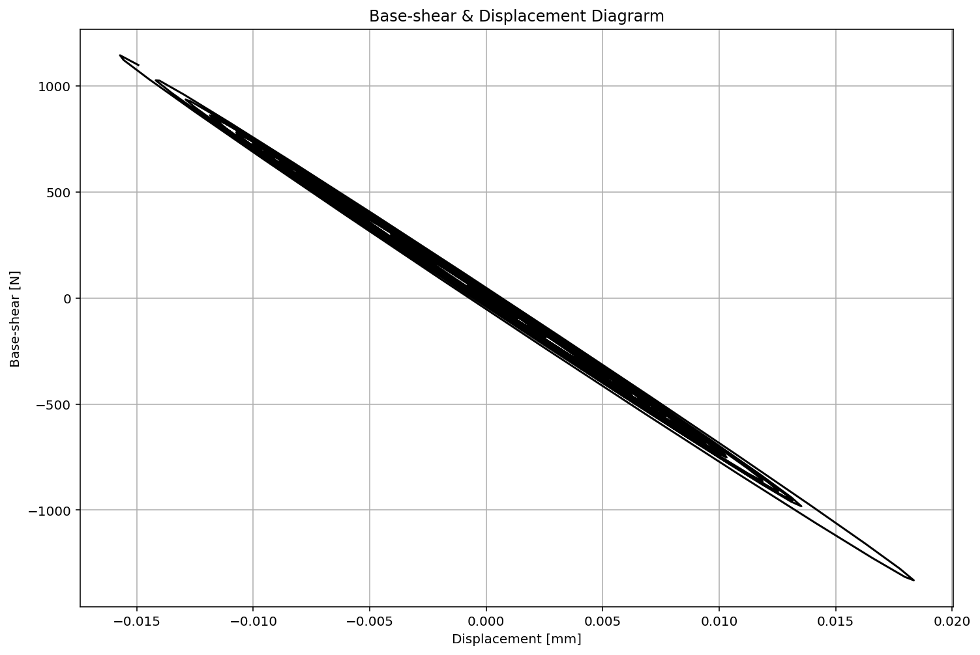

Slide 19
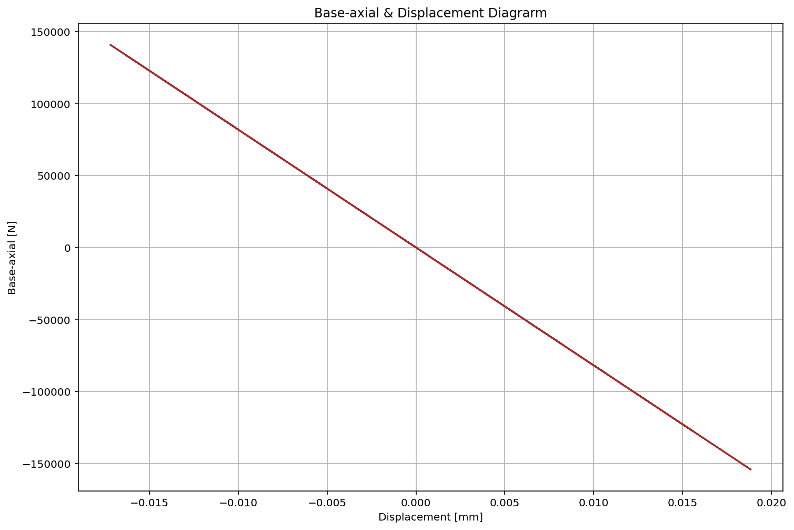

Slide 20
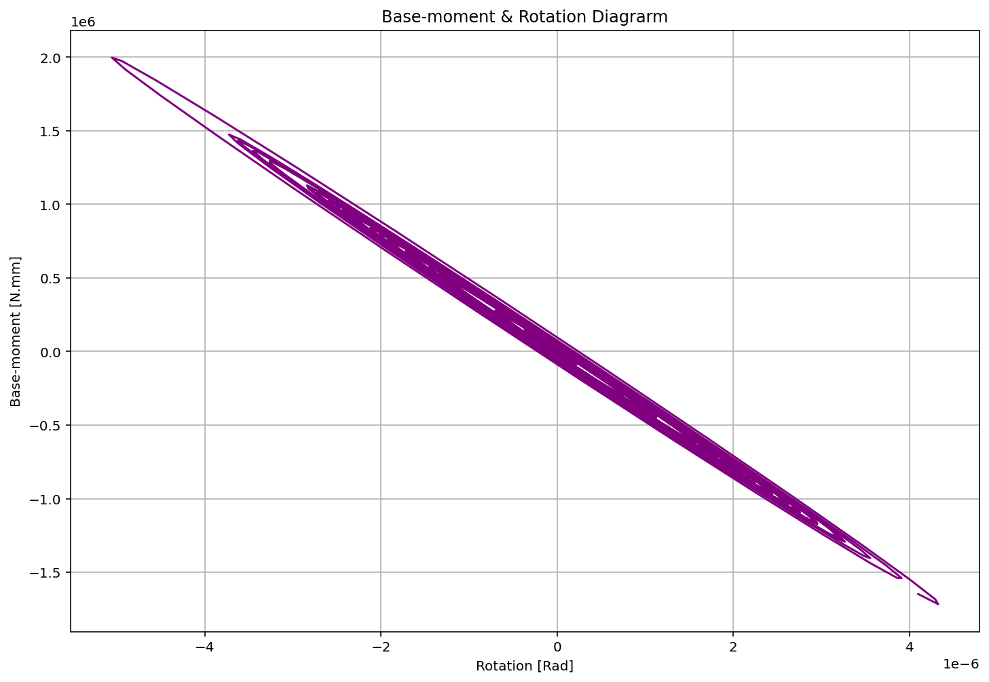

Slide 21
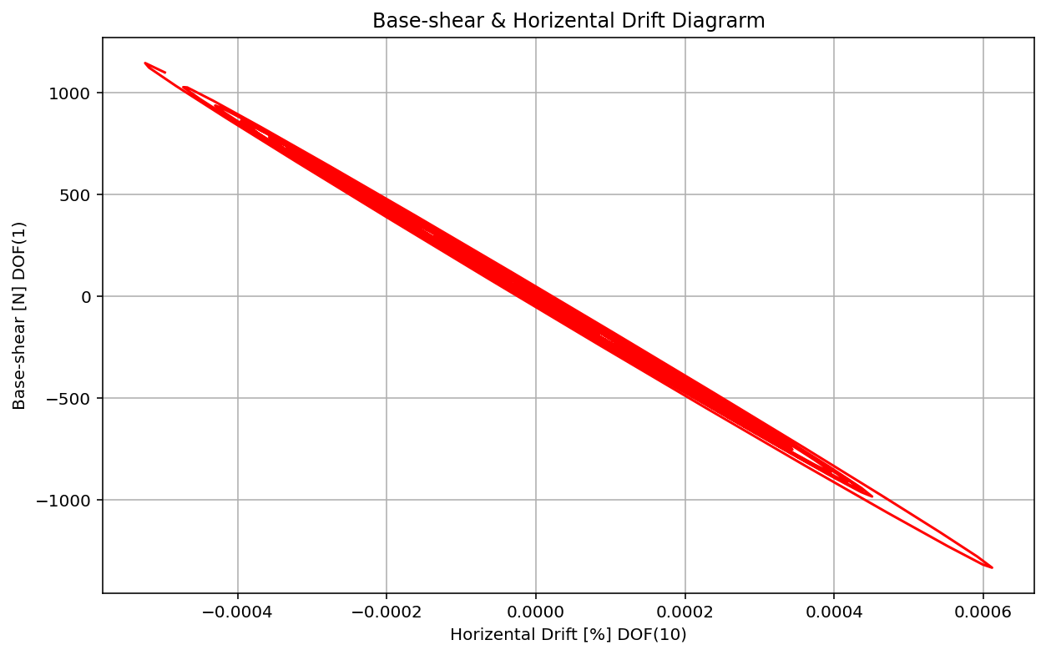

Slide 22
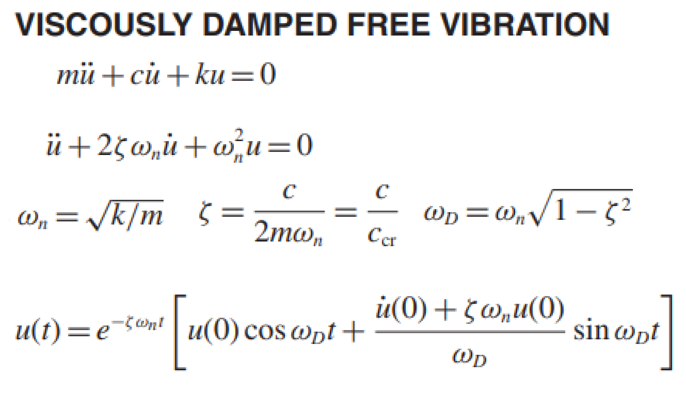
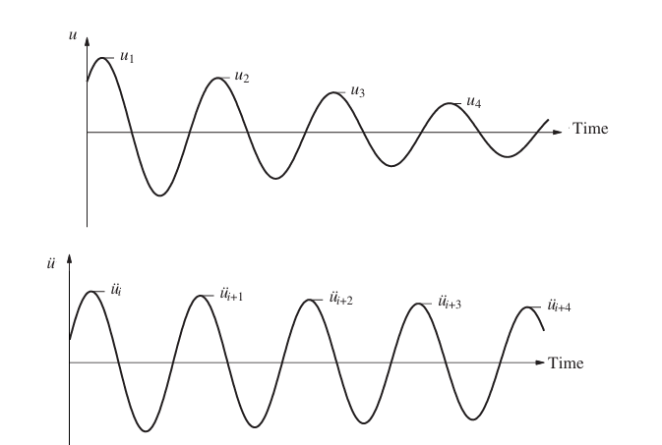
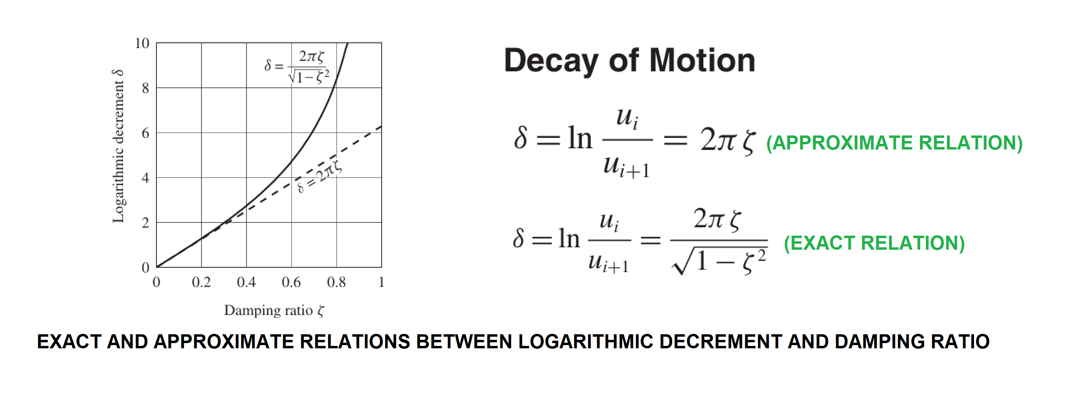
Exact Damping Ratio: 1.06798624e-02

