Slide 1
IN THE NAME OF ALLAH, THE MOST GRACIOUS, THE MOST MERCIFUL
ASSESSMENTS OF THE STRUCTURAL DUCTILITY DAMAGE INDEX OF CONCRETE FRAME USING OPENSEES
WRITTEN BY SALAR DELAVAR GHASHGHAEI (QASHQAI)

Slide 2
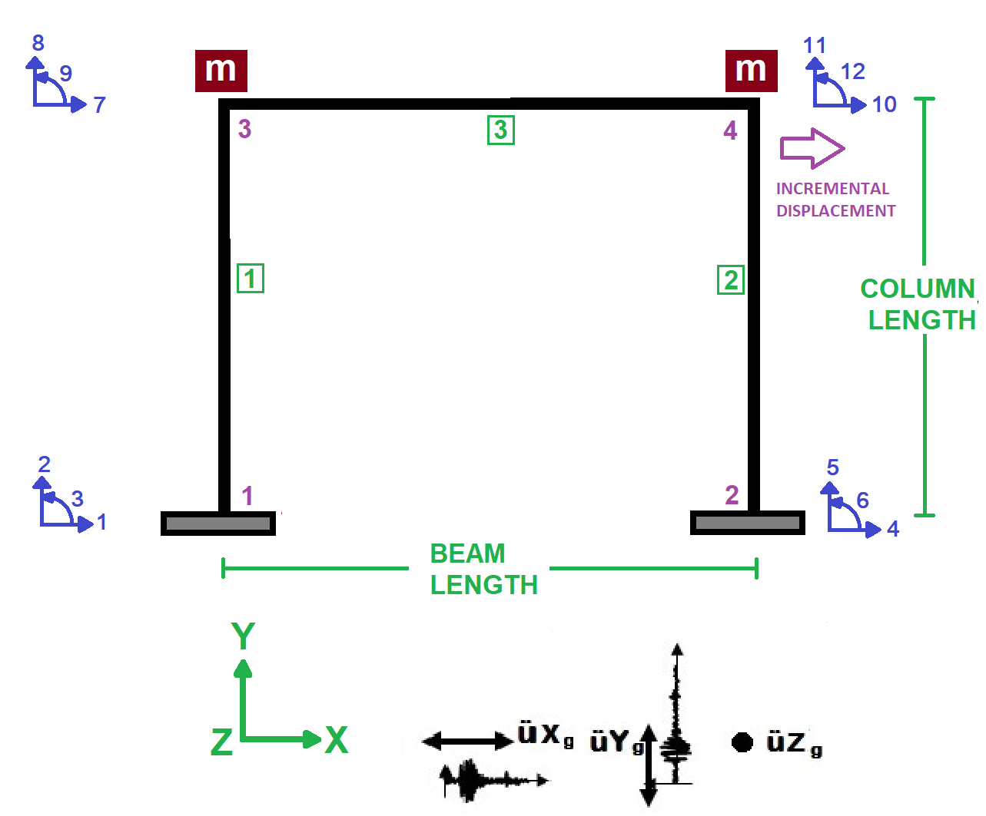

Slide 3
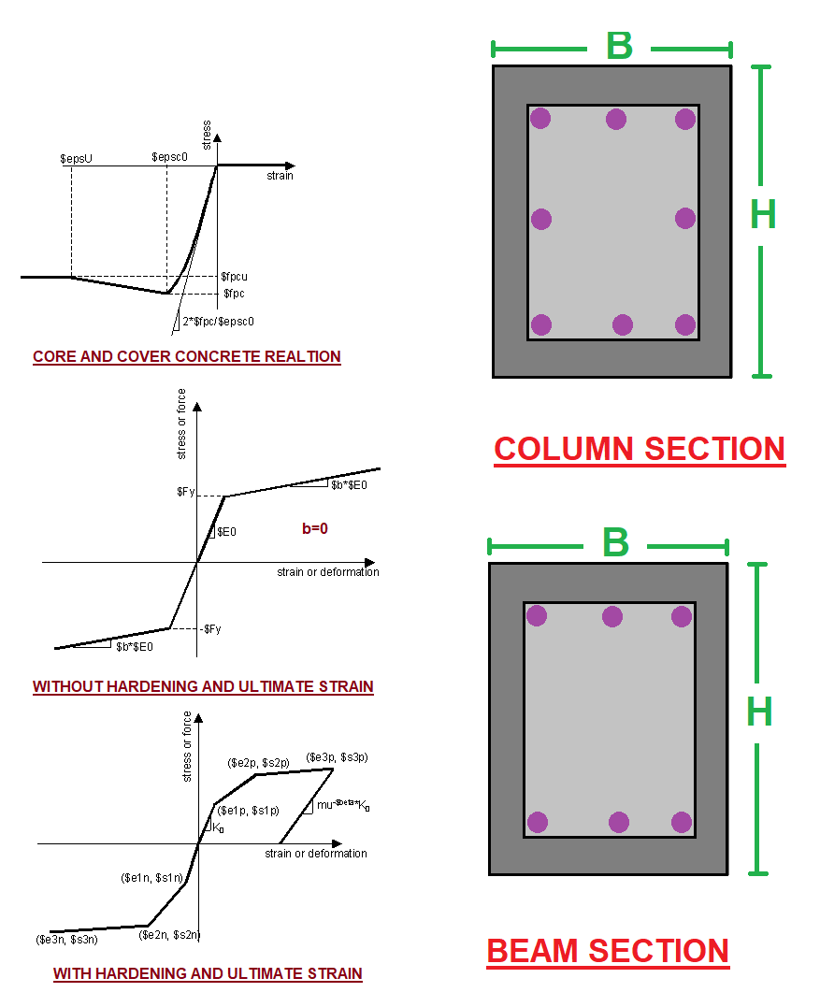

Slide 4
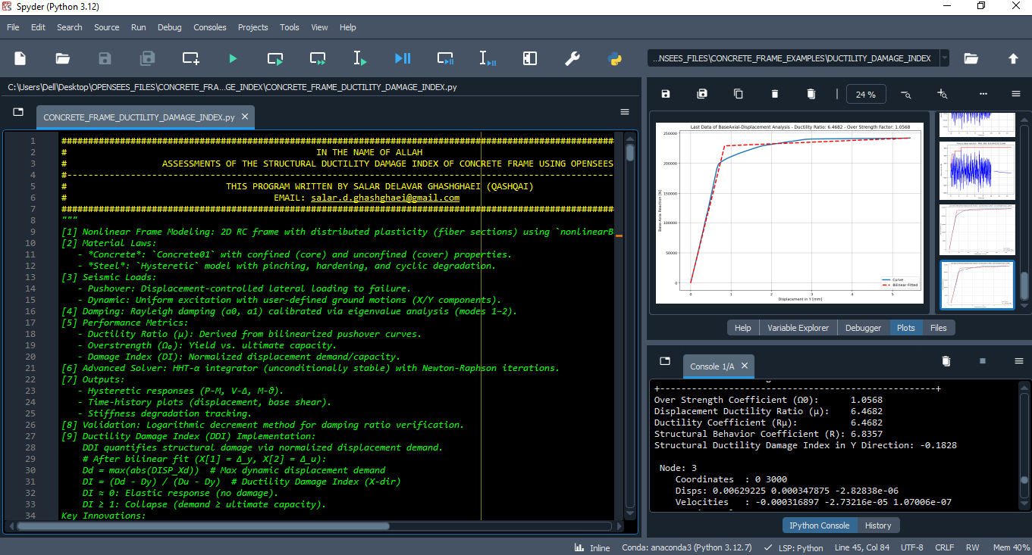

Slide 5
NONLINEAR STATIC ANALYSIS
(PUSHOVER)

Slide 6
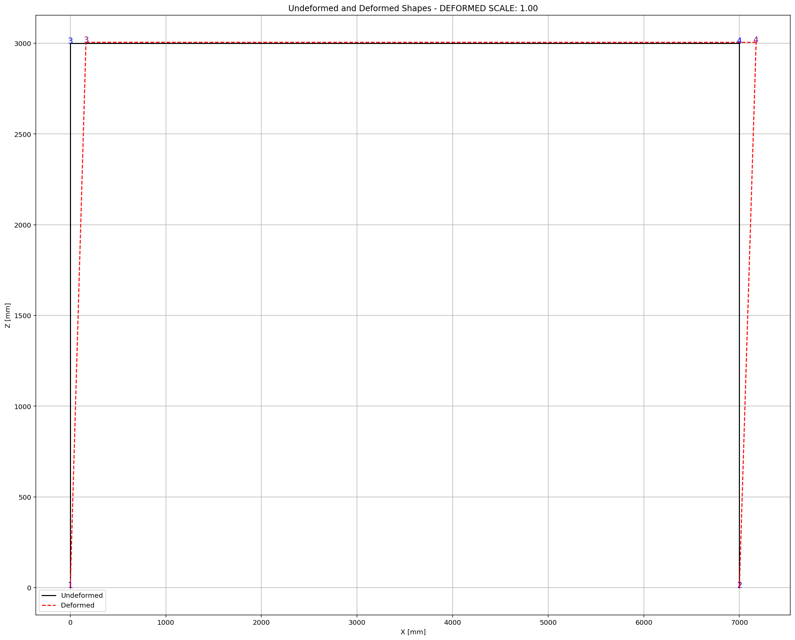

Slide 7
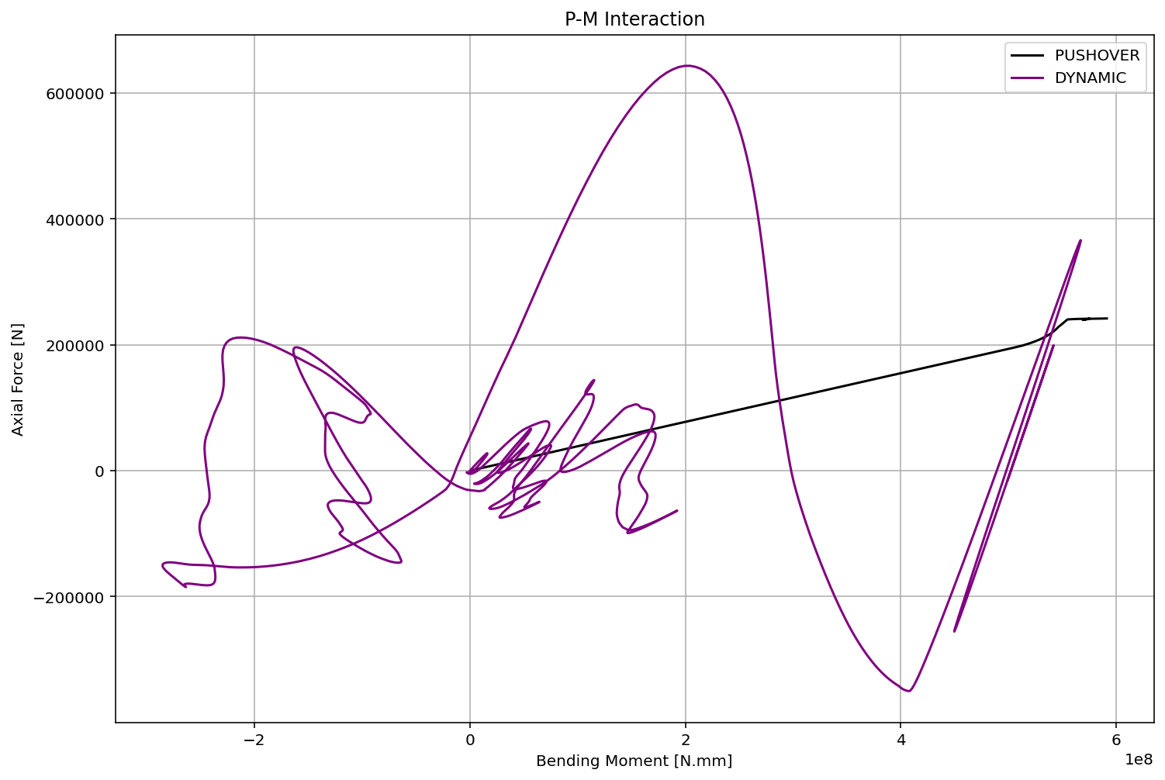

Slide 8
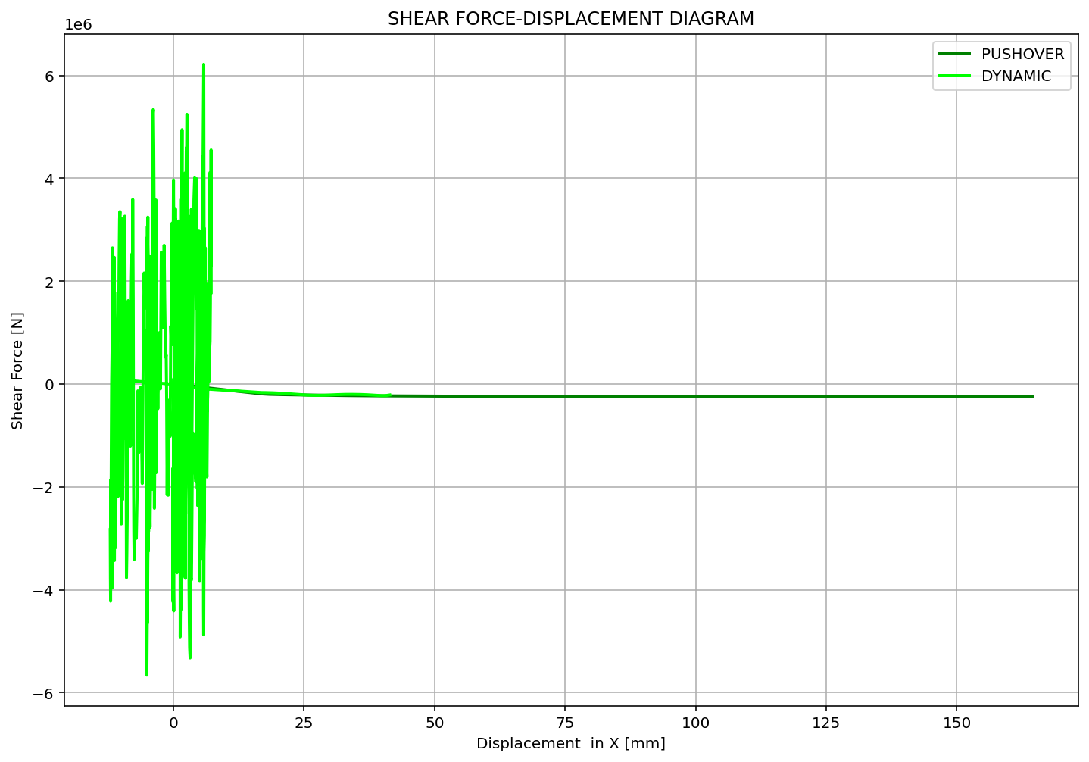

Slide 9
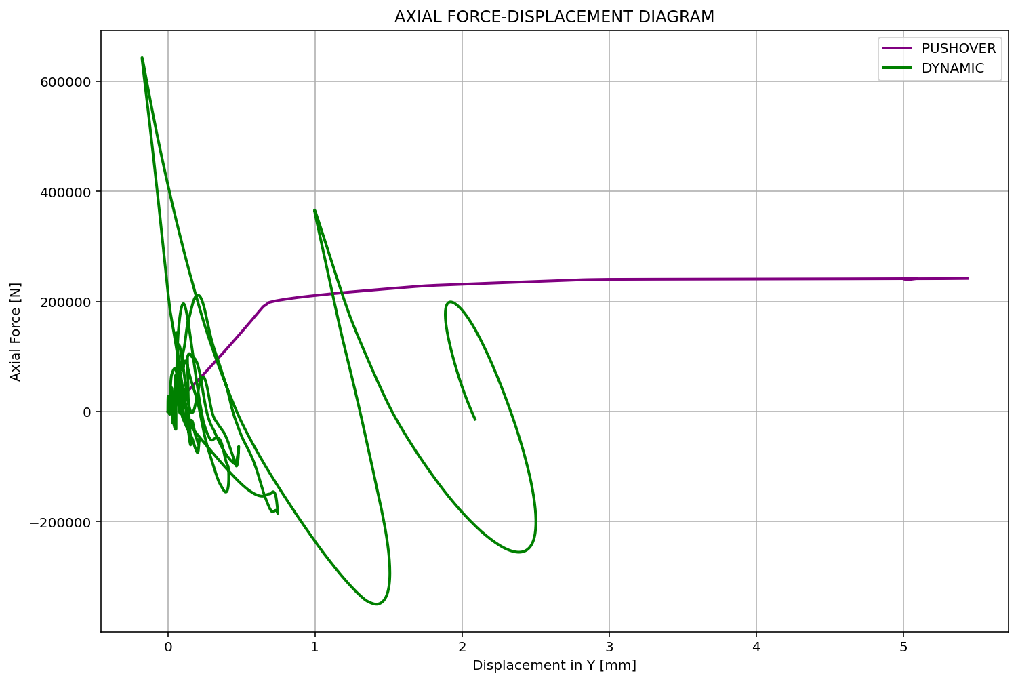

Slide 10
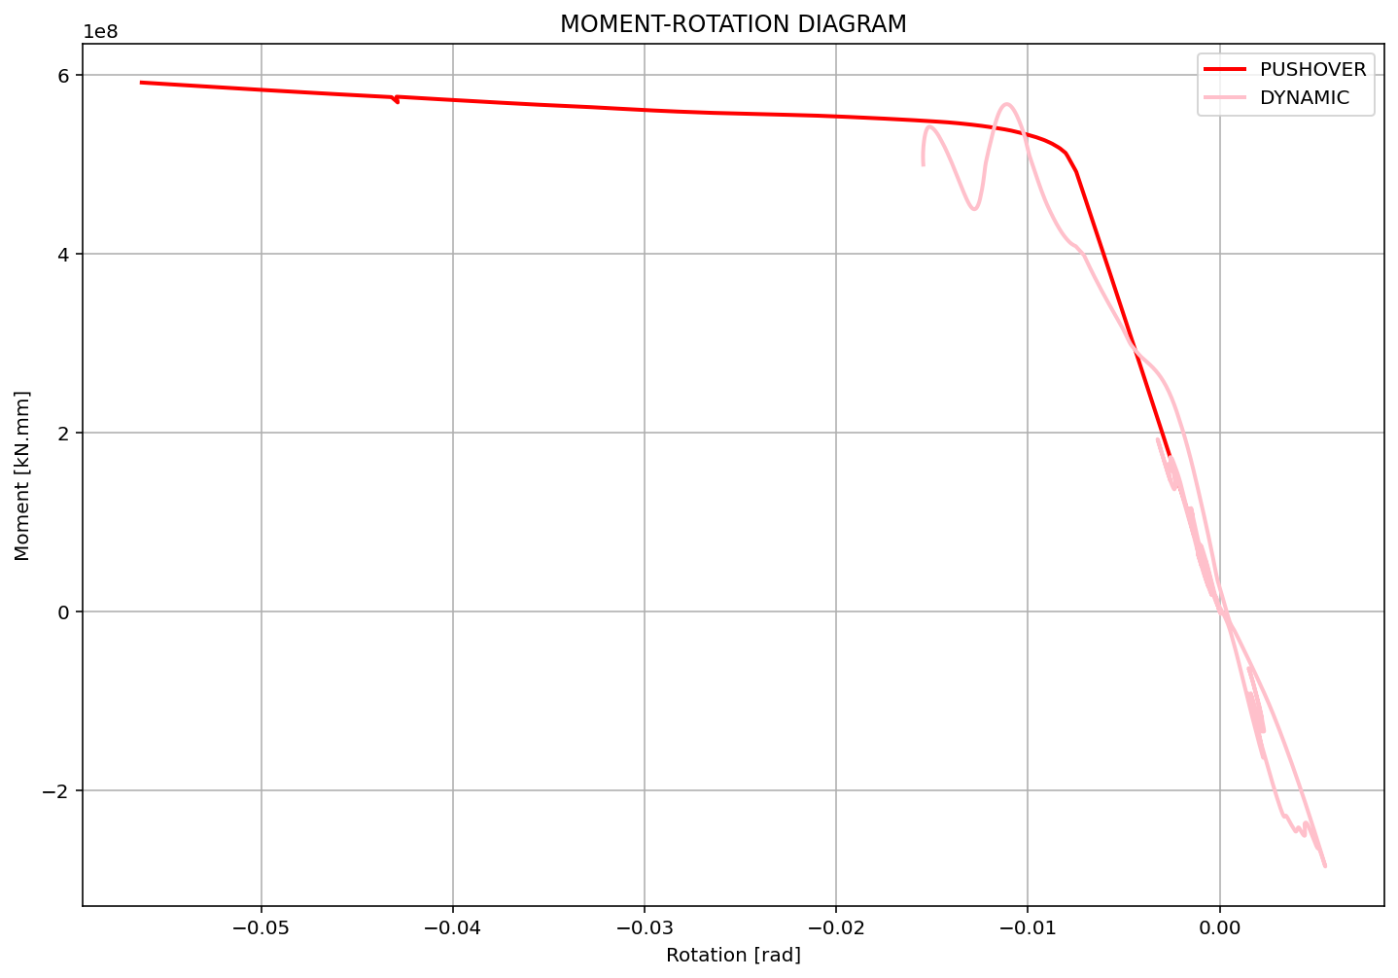

Slide 11
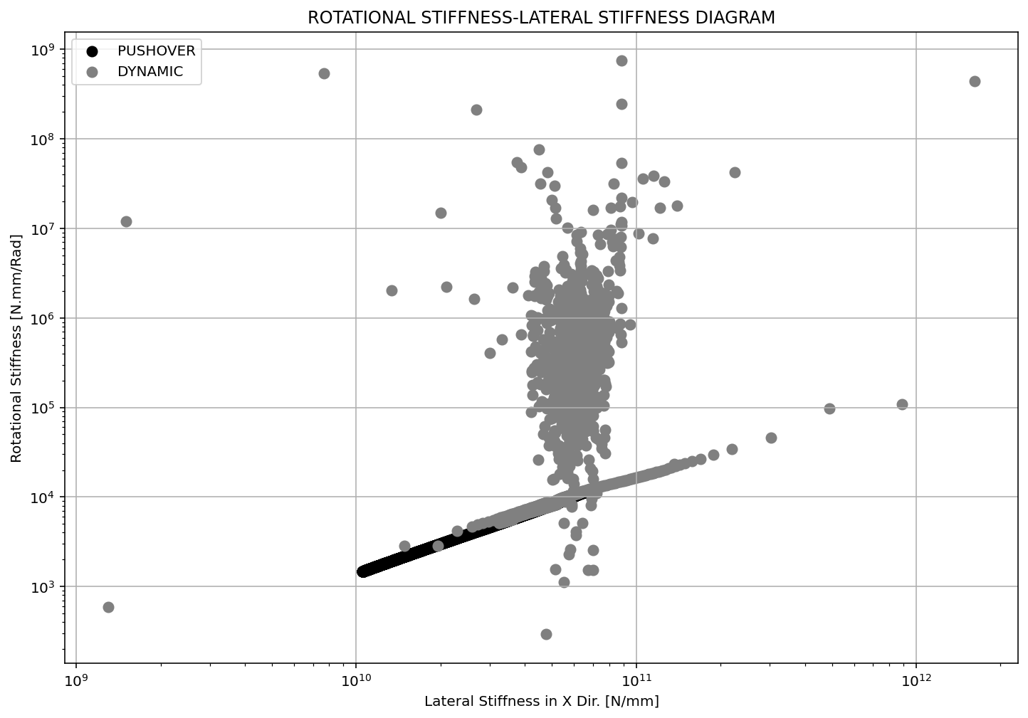

Slide 12
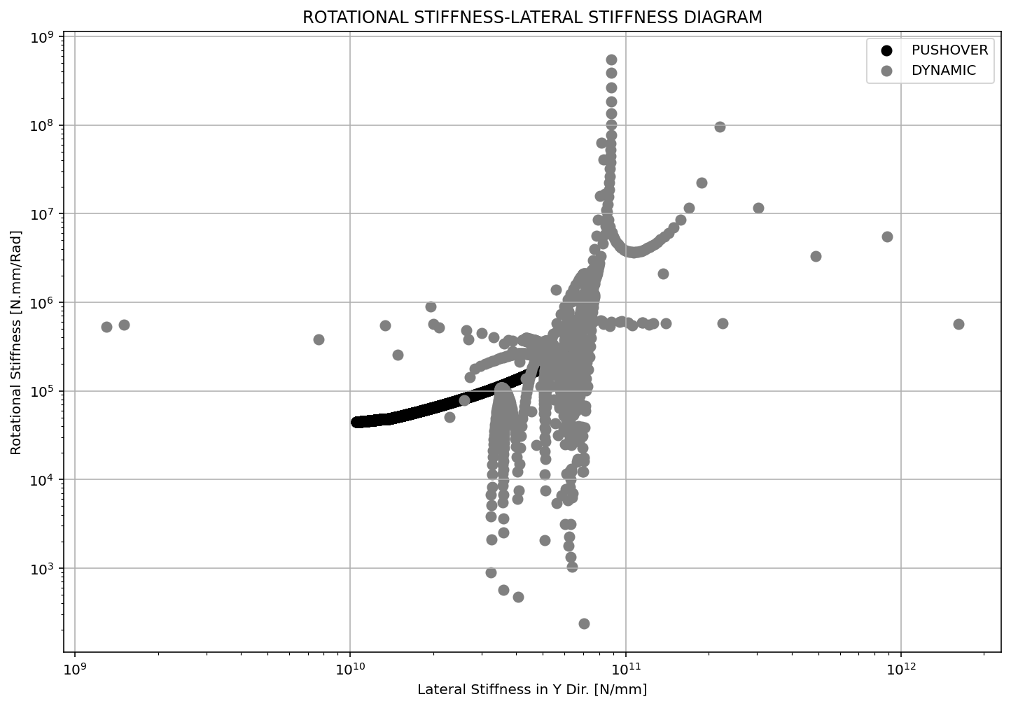

Slide 13
NONLINEAR DYNAMIC ANALYSIS

Slide 14
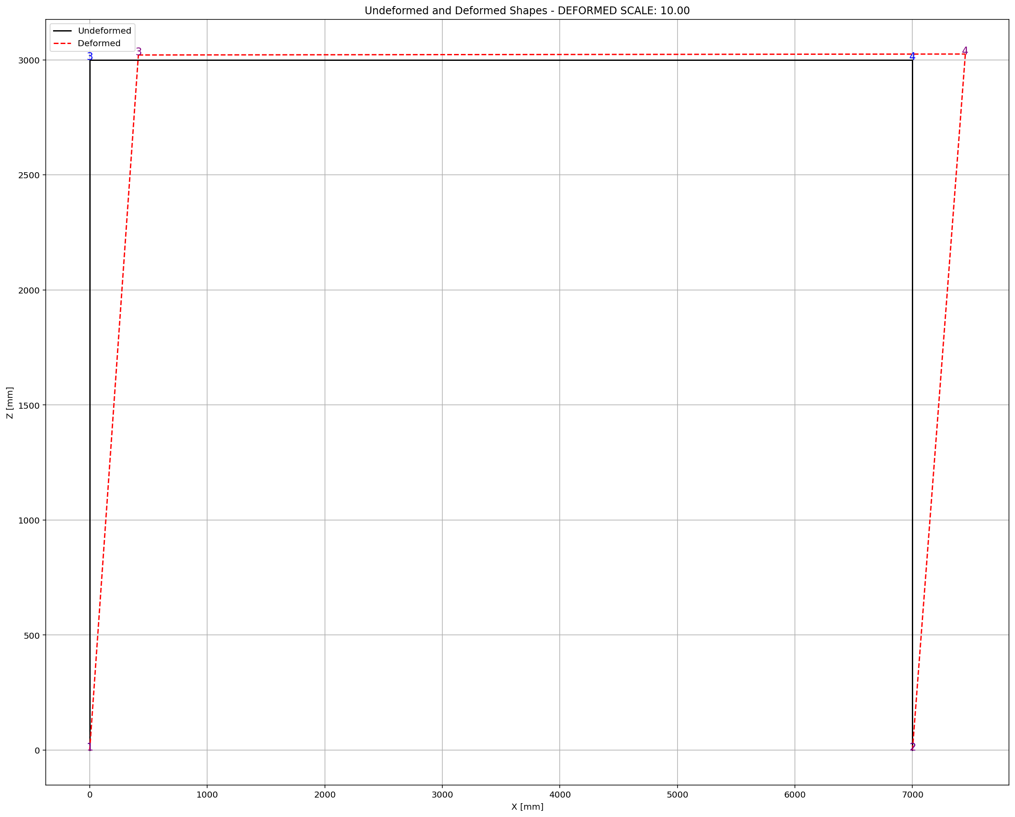

Slide 15
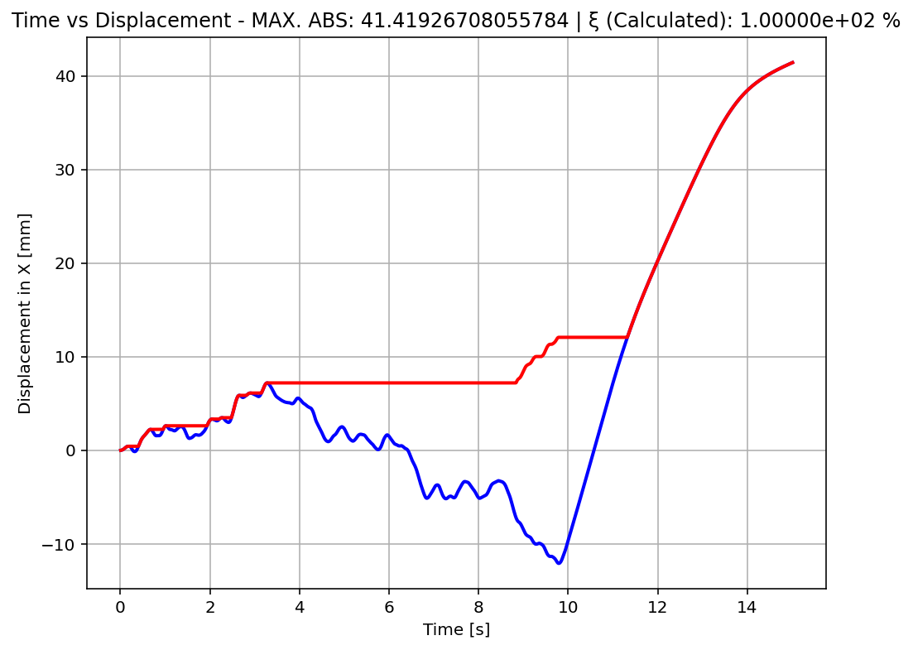

Slide 16
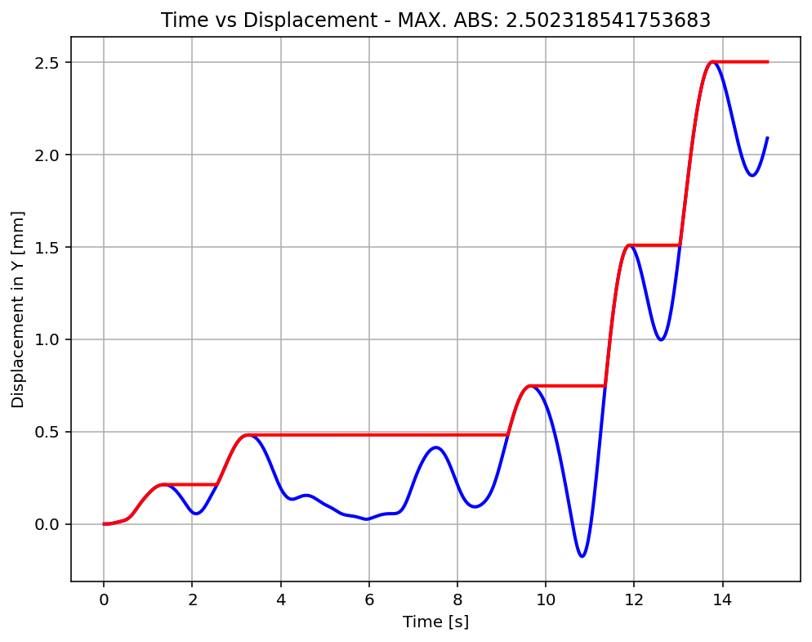

Slide 17
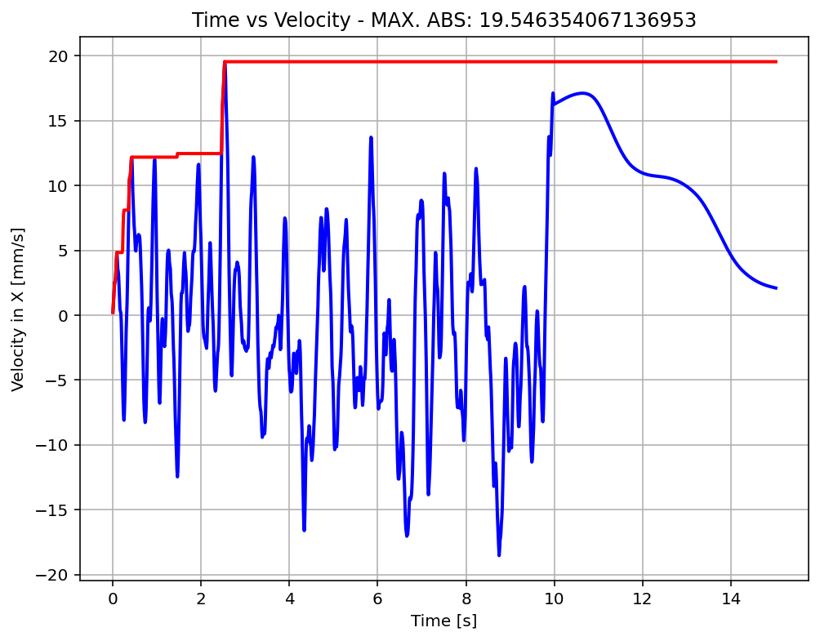

Slide 18
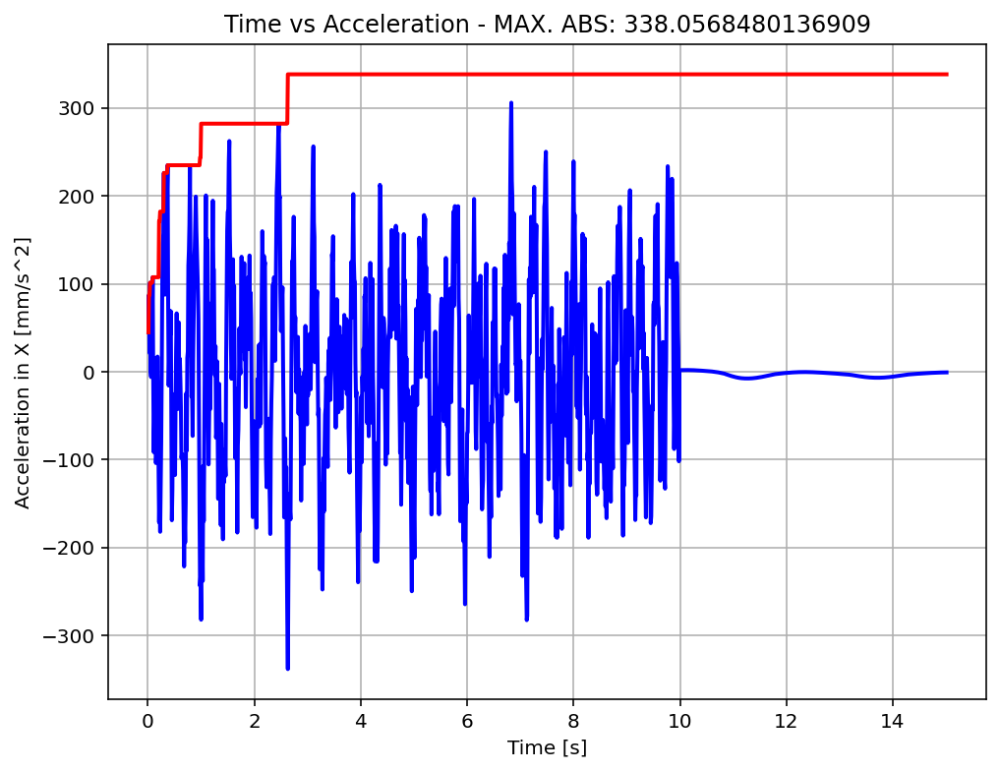

Slide 19
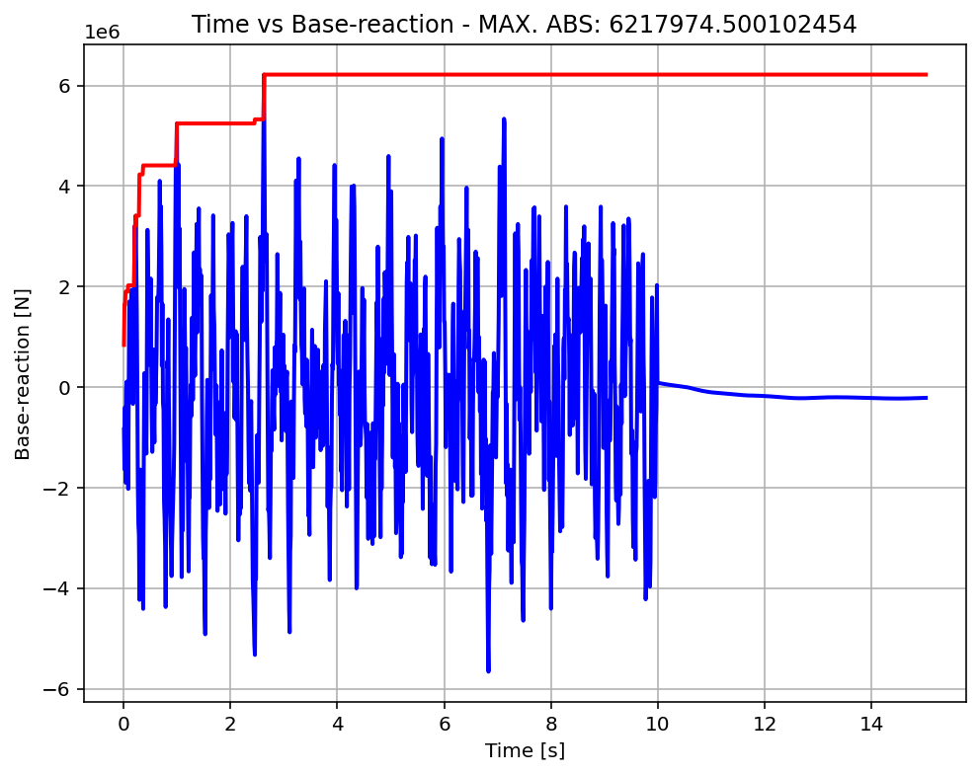

Slide 20
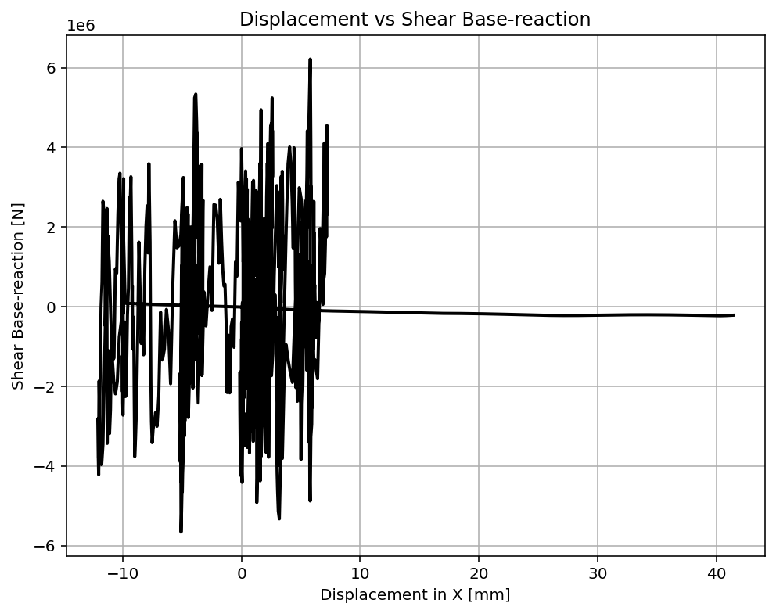

Slide 21
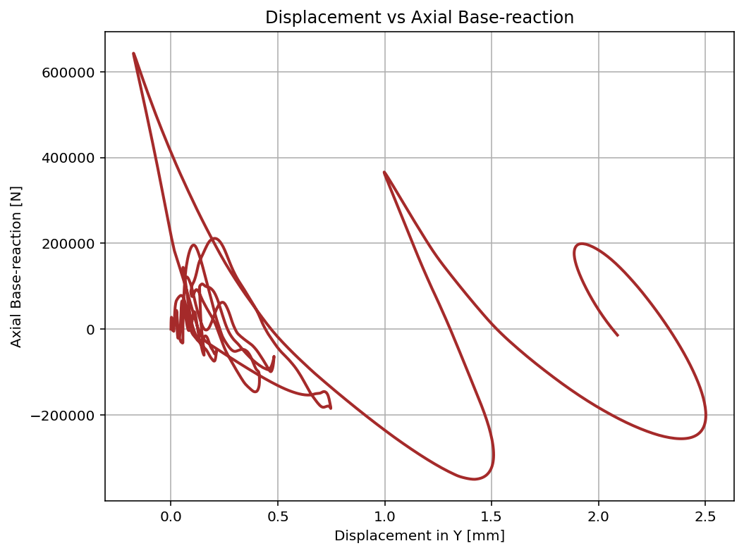

Slide 22
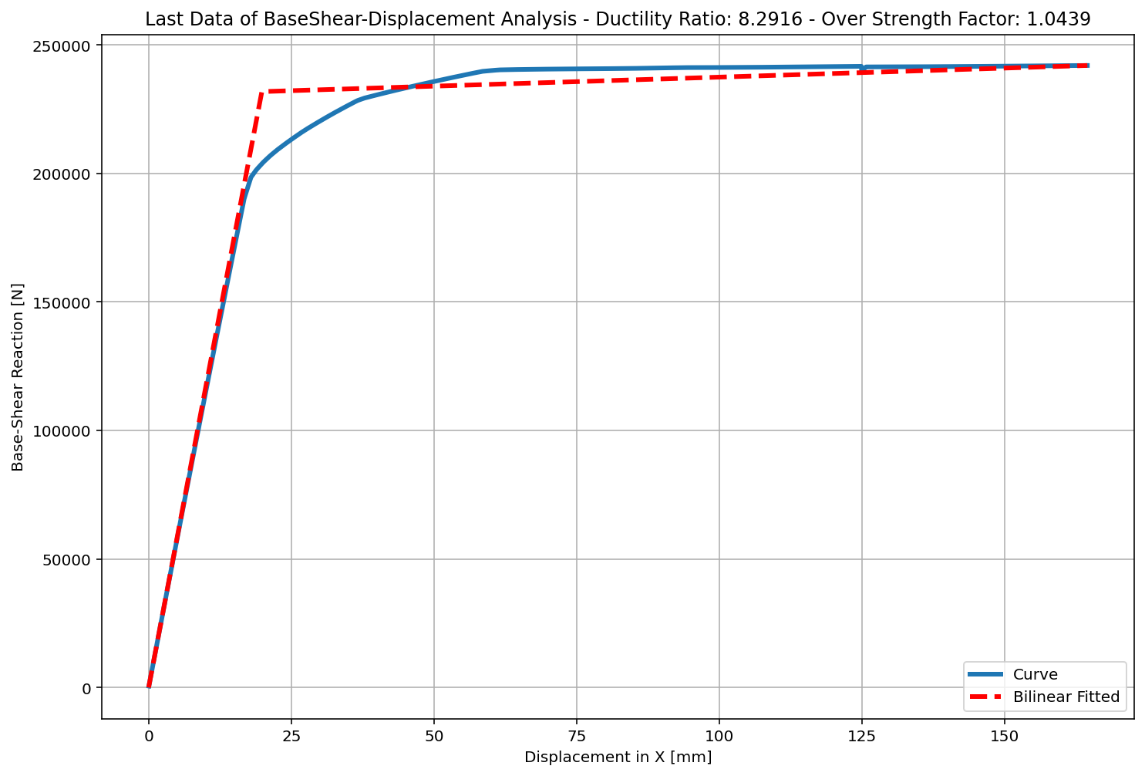
+==========================+
= Analysis curve fitted =
Disp Base Shear
----------------------------
[[0.00000000e+00 0.00000000e+00]
[1.98355134e+01 2.31825760e+05]
[1.64467417e+02 2.41992266e+05]]
+==========================+
+----------------------------------------------------+
Structure Elastic Stiffness : 11687.41
Structure Plastic Stiffness : 1471.37
Structure Tangent Stiffness : 70.29
Structure Ductility Ratio : 8.29
Structure Over Strength Factor: 1.04
+----------------------------------------------------+
Over Strength Coefficient (Ω0): 1.0439
Displacement Ductility Ratio (μ): 8.2916
Ductility Coefficient (Rμ): 8.2916
Structural Behavior Coefficient (R): 8.6552
Structural Ductility Damage Index in X Direction: 0.1492

Slide 23
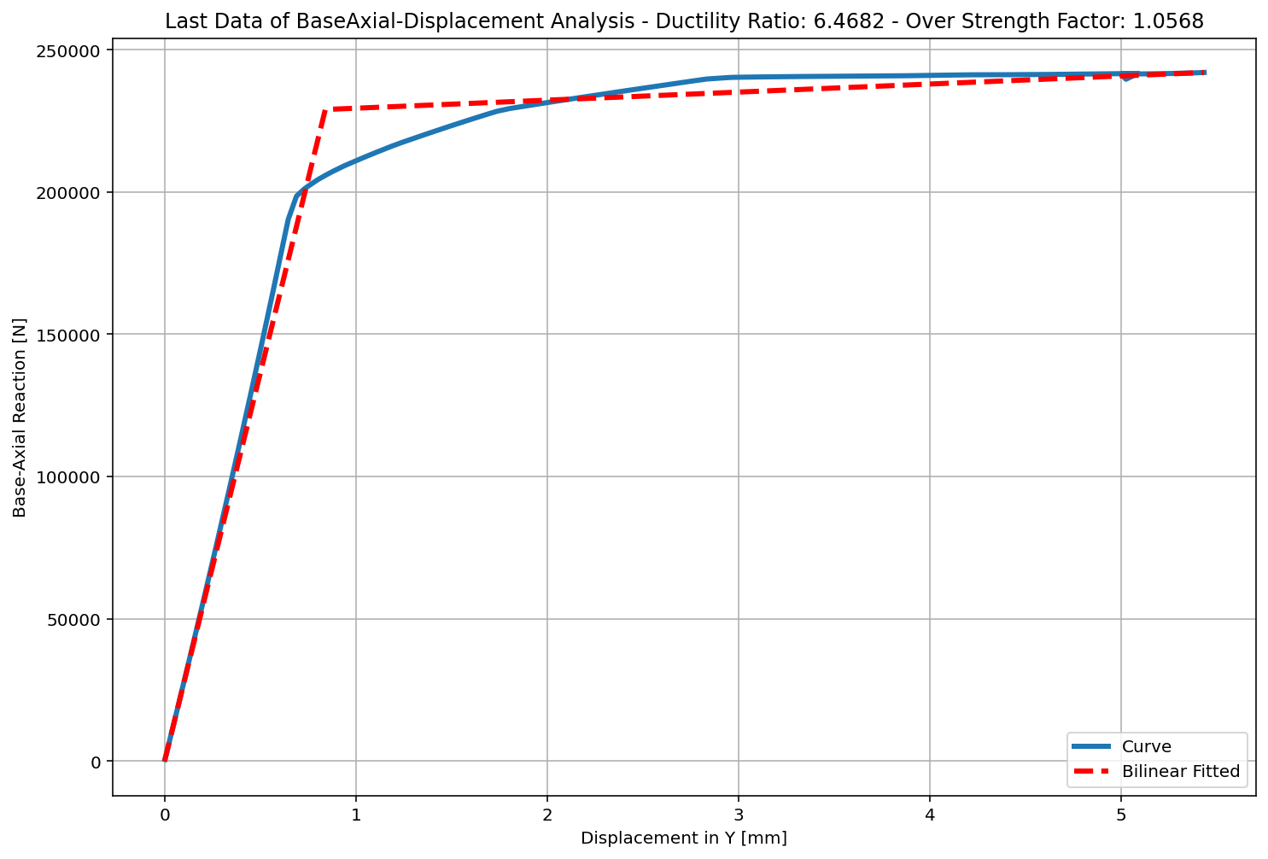
+==========================+
= Analysis curve fitted =
Disp Base Shear
----------------------------
[[0.00000000e+00 0.00000000e+00]
[8.40169209e-01 2.28982680e+05]
[5.43435779e+00 2.41992266e+05]]
+==========================+
+----------------------------------------------------+
Structure Elastic Stiffness : 272543.53
Structure Plastic Stiffness : 44530.06
Structure Tangent Stiffness : 2831.75
Structure Ductility Ratio : 6.47
Structure Over Strength Factor: 1.06
+----------------------------------------------------+
Over Strength Coefficient (Ω0): 1.0568
Displacement Ductility Ratio (μ): 6.4682
Ductility Coefficient (Rμ): 6.4682
Structural Behavior Coefficient (R): 6.8357
Structural Ductility Damage Index in Y Direction: 0.3618

