Slide 1
>> IN THE NAME OF ALLAH, THE MOST GRACIOUS, THE MOST MERCIFUL <<
COMPARATIVE FREE-VIBRATION AND PUSHOVER ANALYSIS OF AN SDOF SYSTEM: ELASTIC VERSUS INELASTIC RESPONSE WITH PARALLEL. SPRINGS FOR STRUCTURAL AND NON-STRUCTURAL ELEMENTS USING OPENSEES
WRITTEN BY SALAR DELAVAR GHASHGHAEI (QASHQAI)

Slide 2
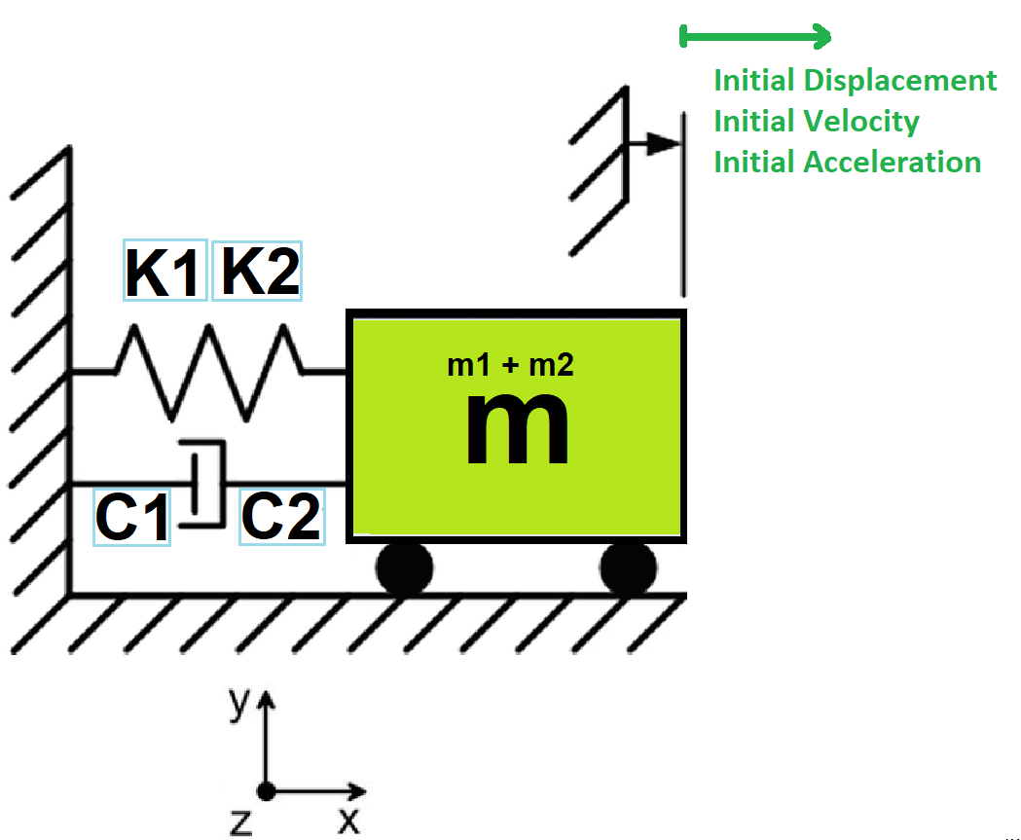

Slide 3
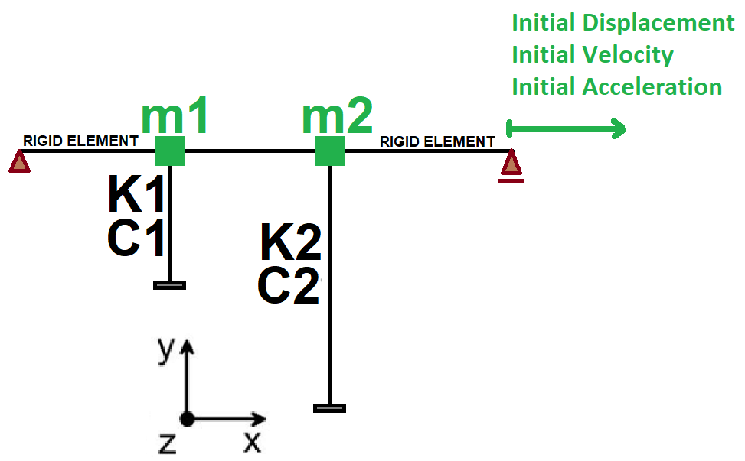

Slide 4
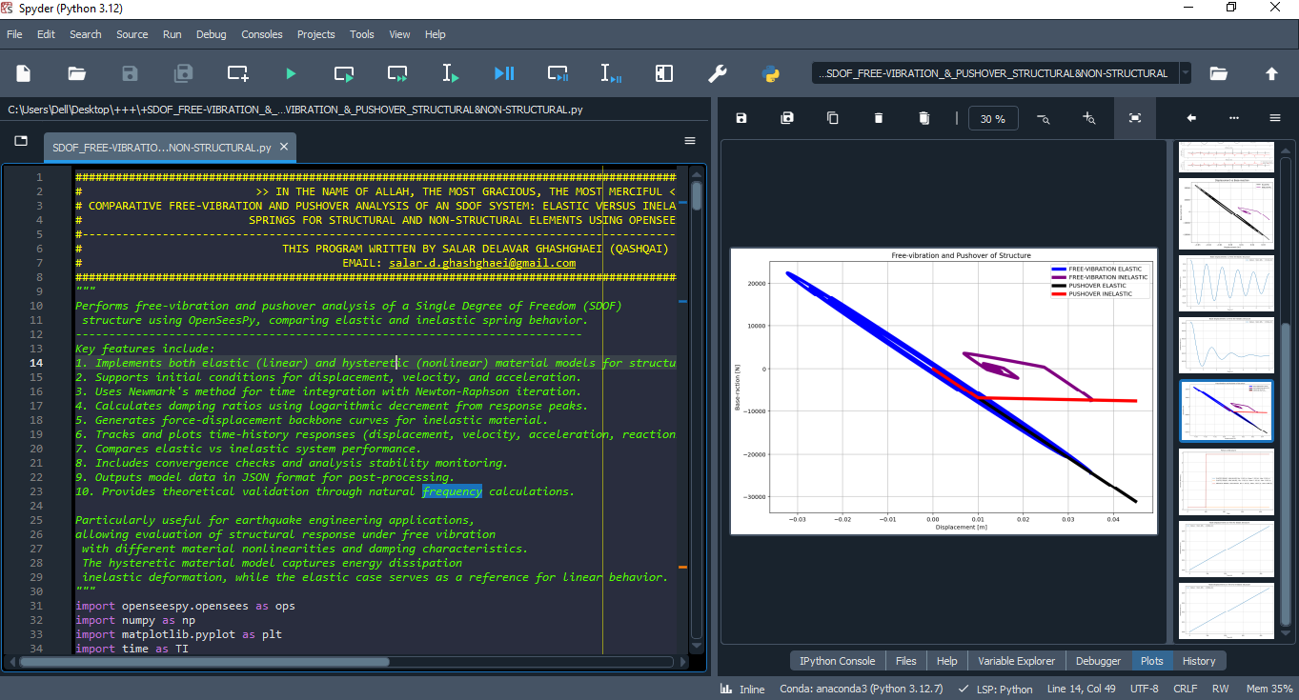

Slide 5
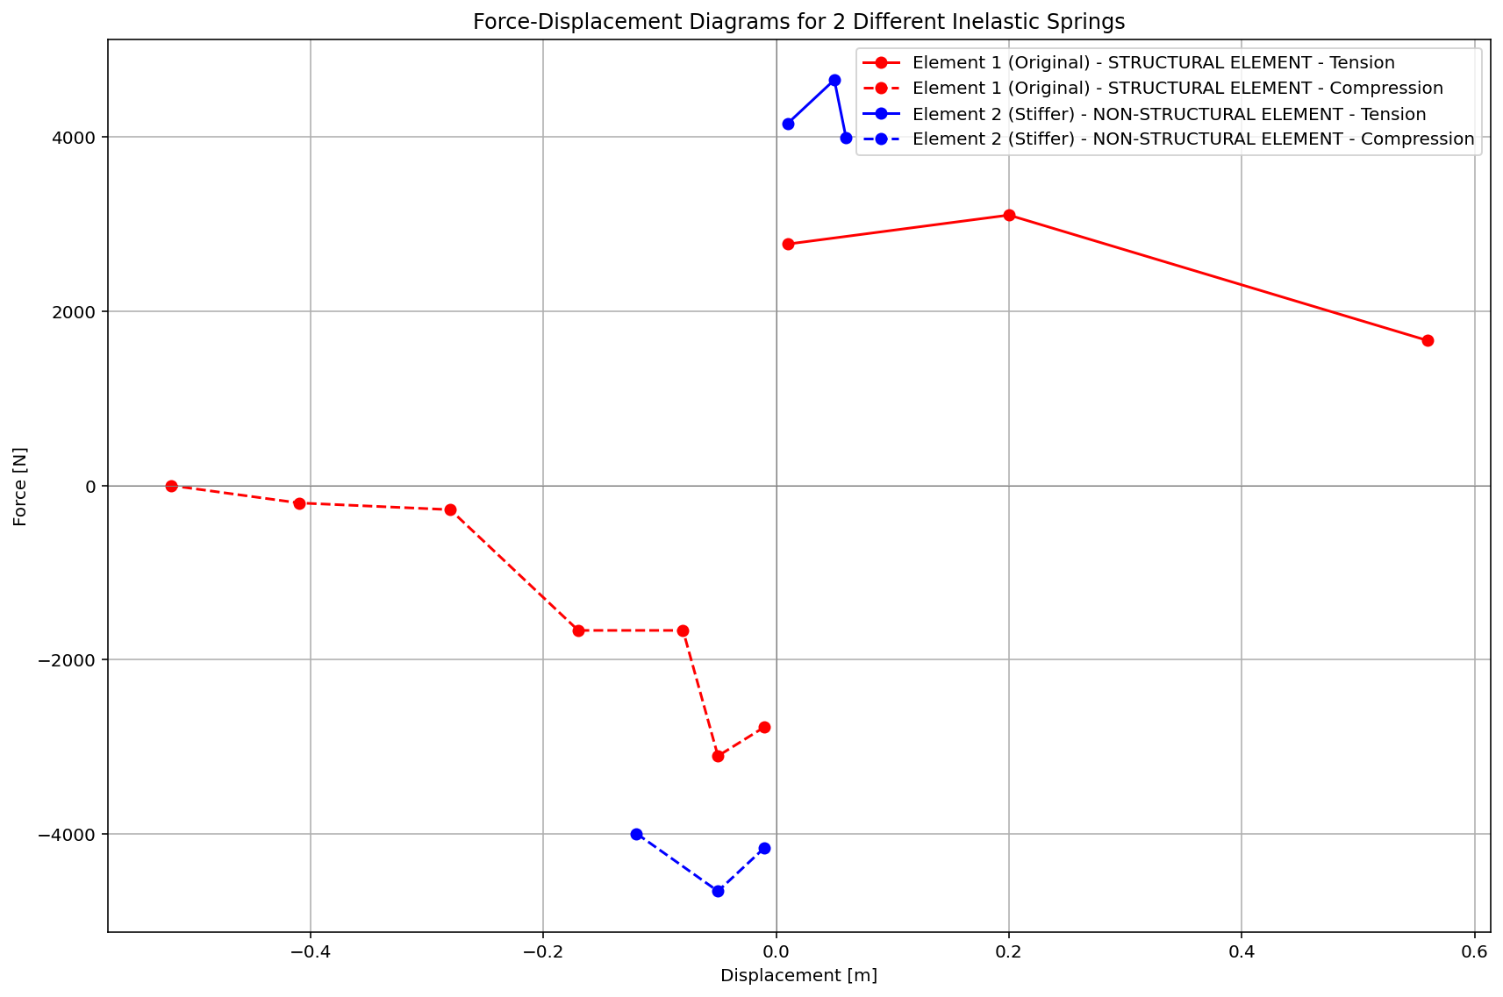

Slide 6
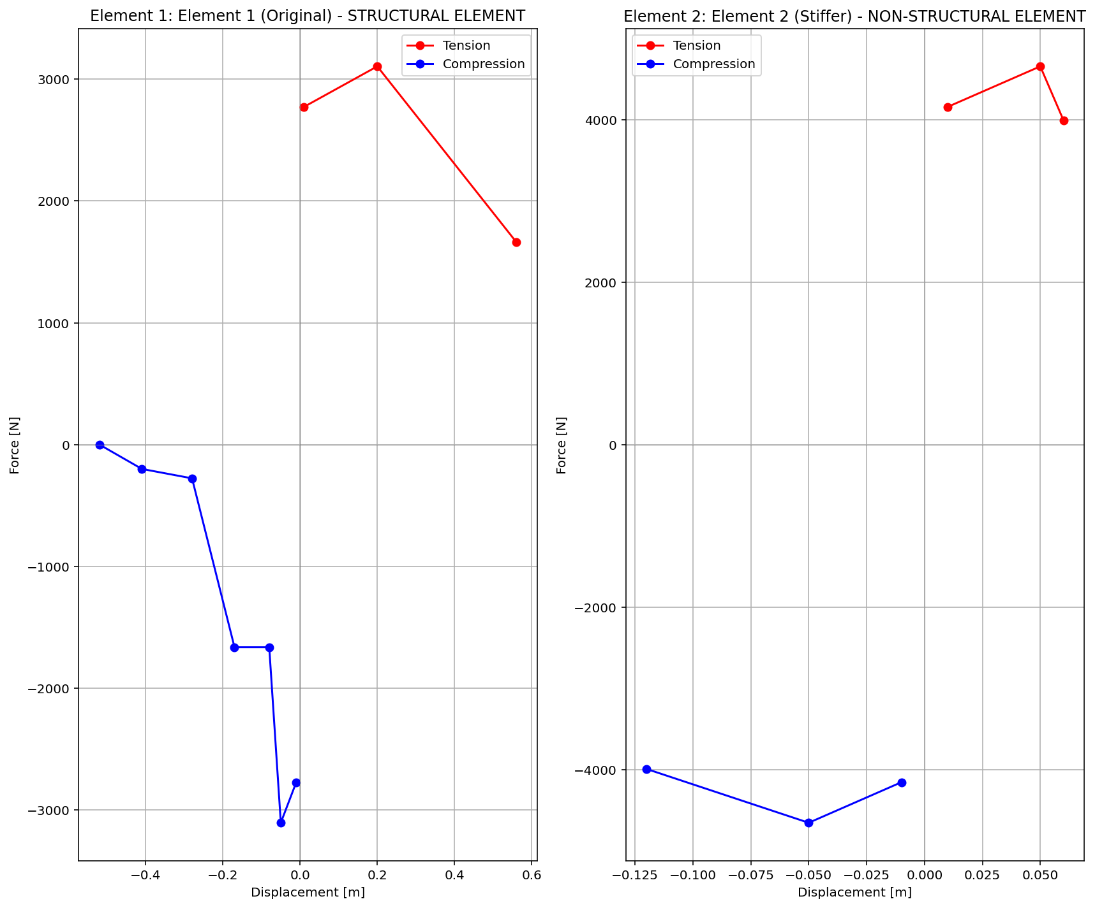

Slide 7
FREE-VIBRATION ANALYSIS

Slide 8
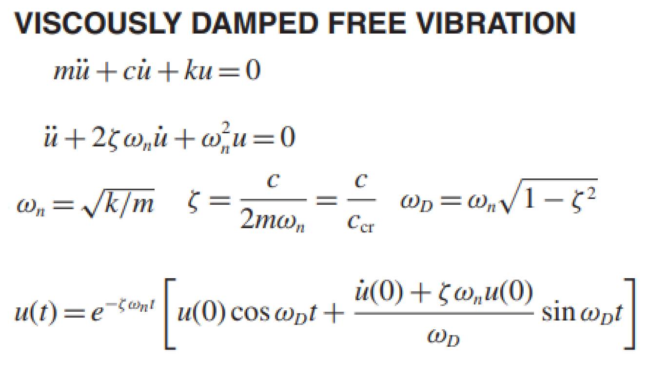
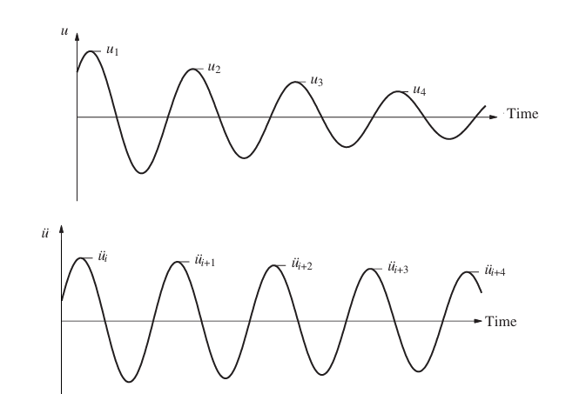
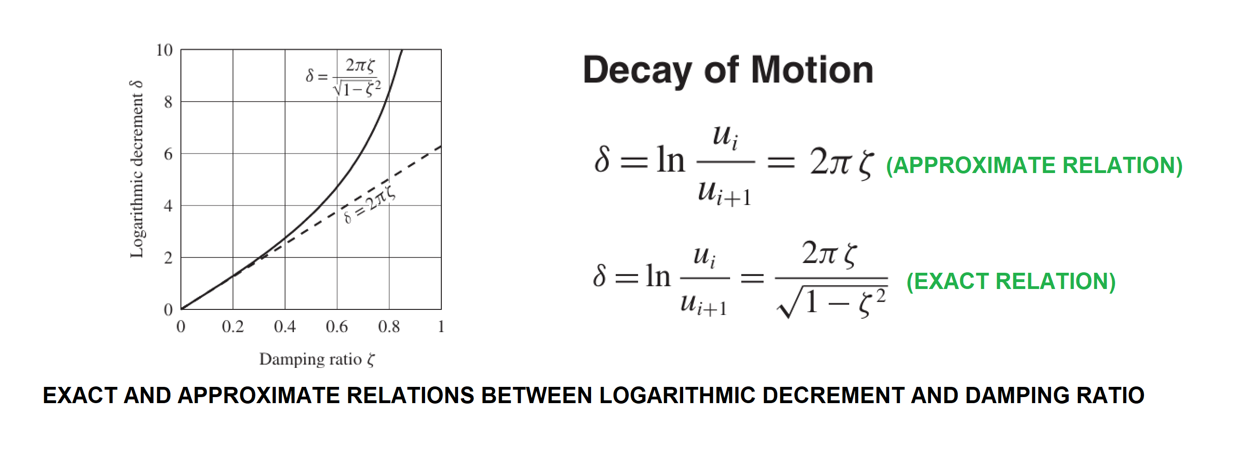

Slide 9
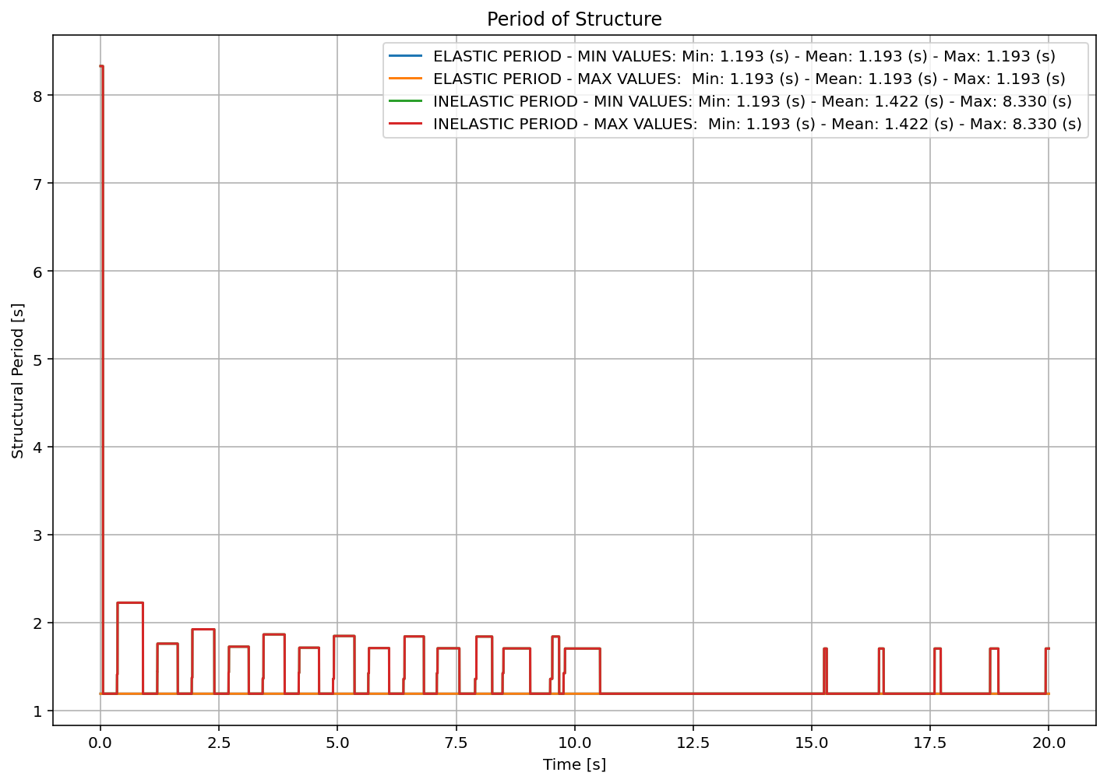

Slide 10
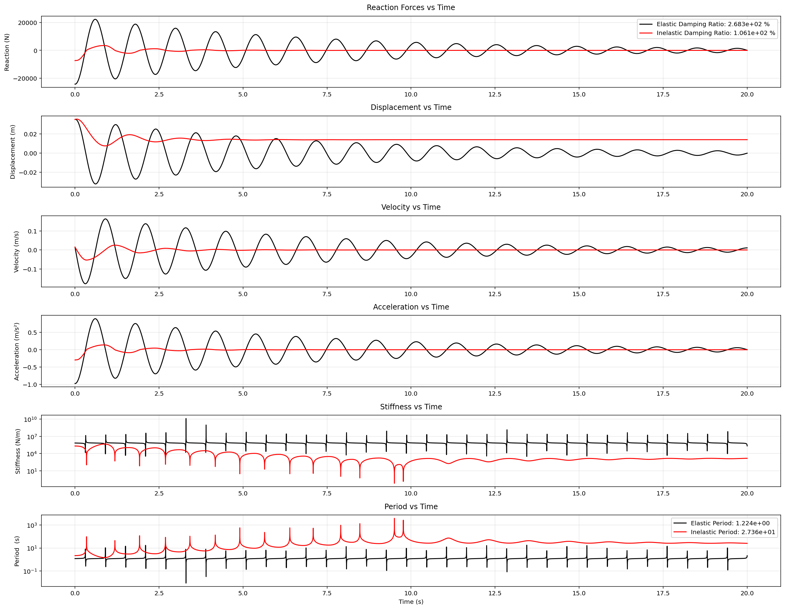

Slide 11
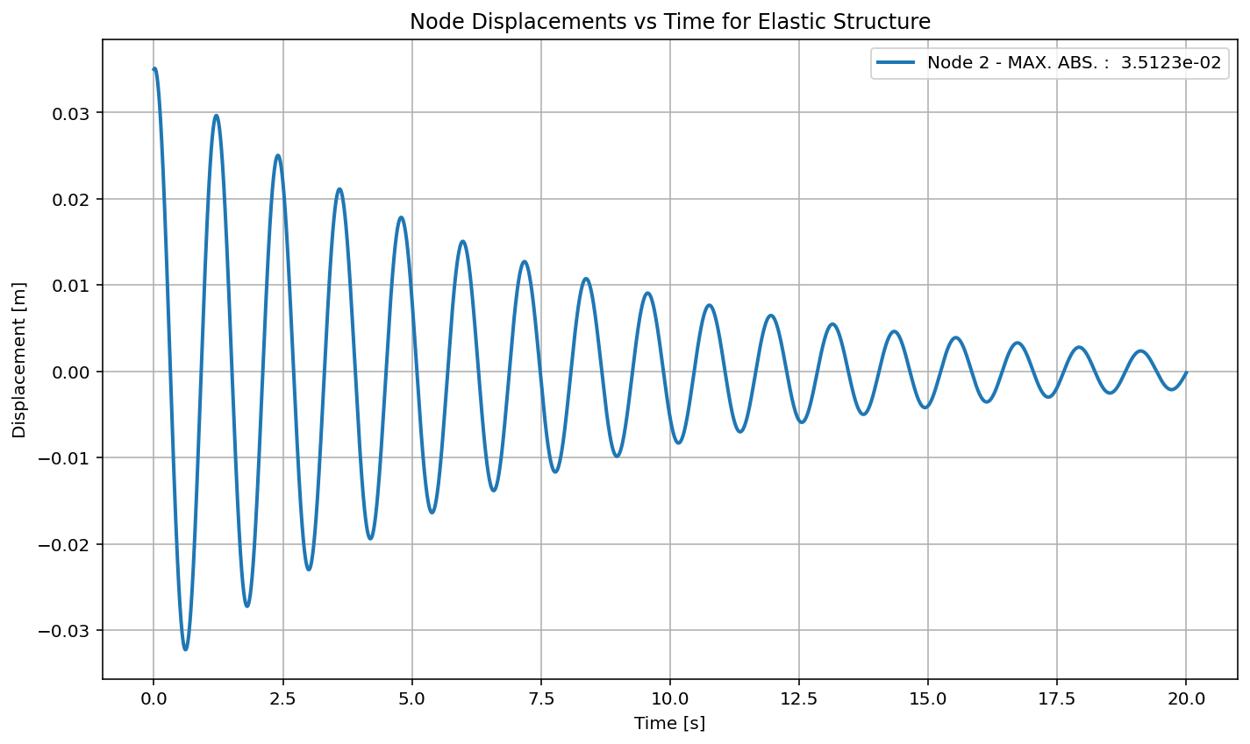

Slide 12
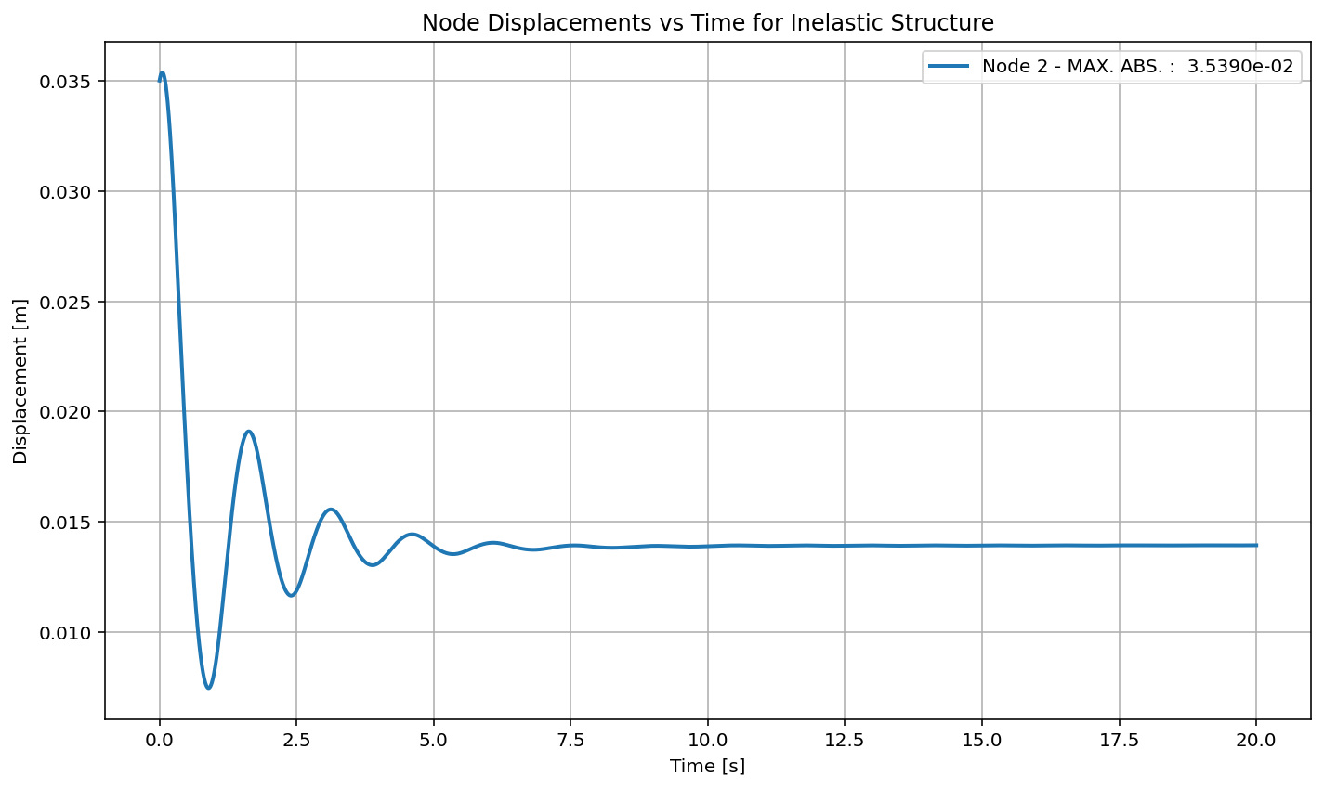

Slide 13
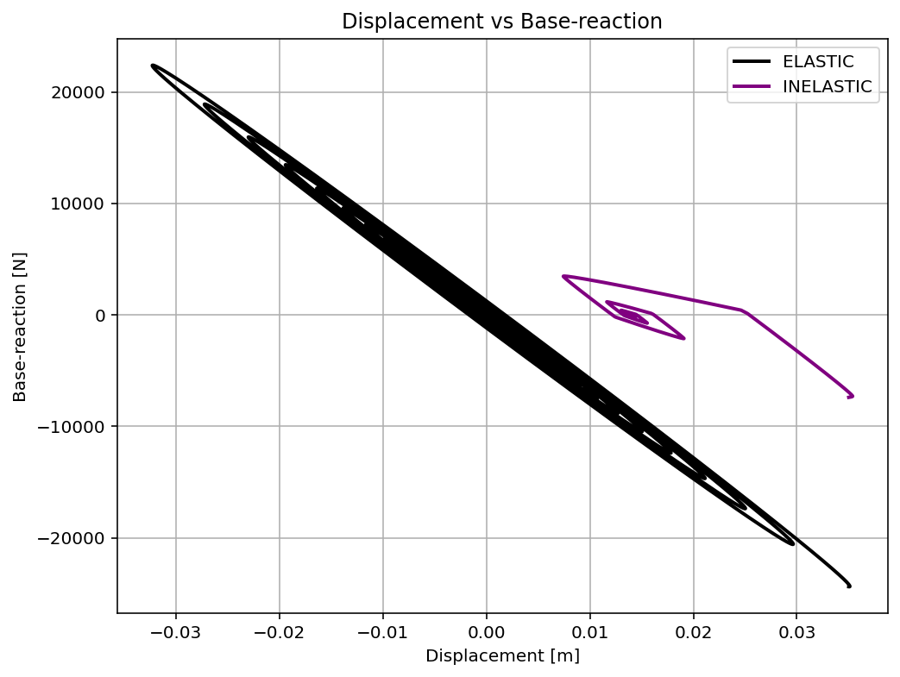

Slide 14
PUSHOVER ANALYSIS

Slide 15
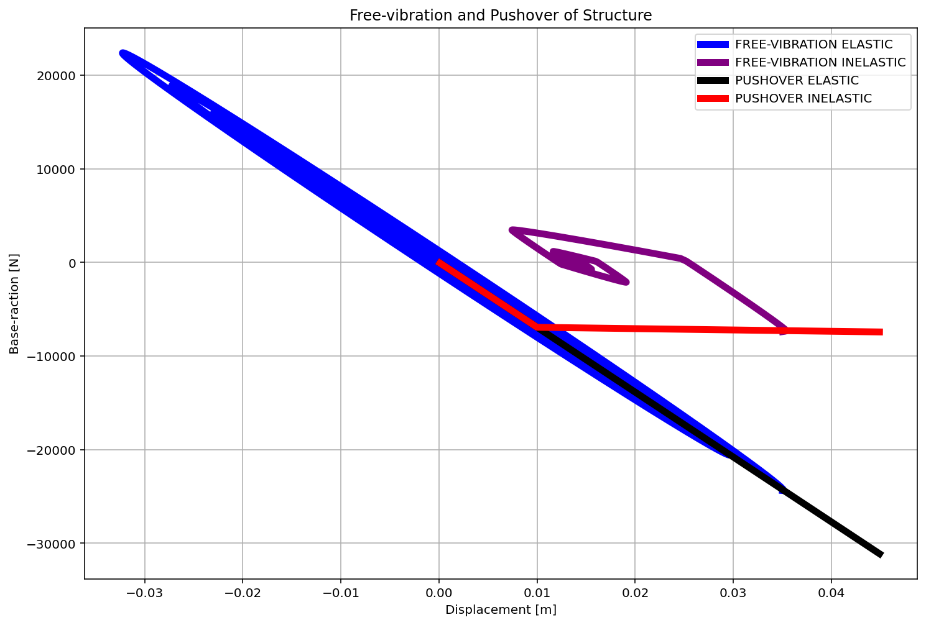

Slide 16
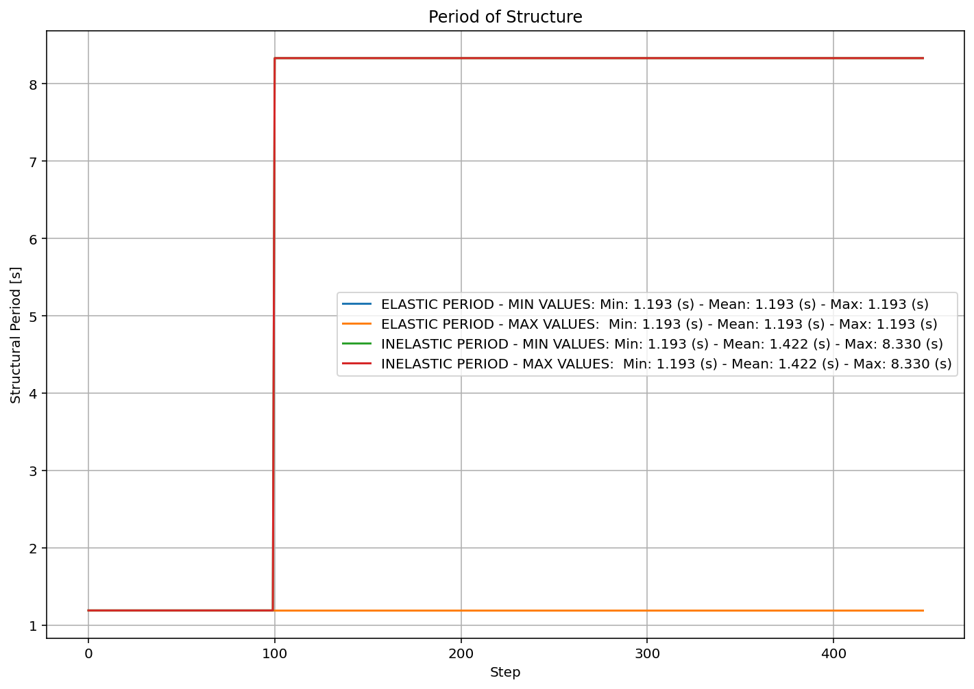

Slide 17
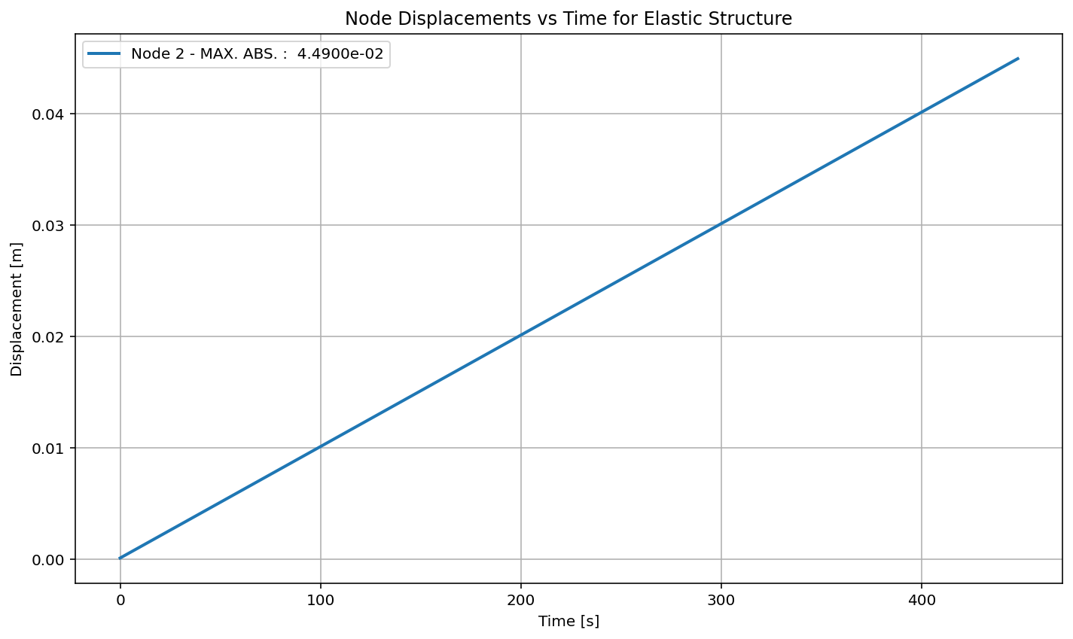

Slide 18


Slide 19
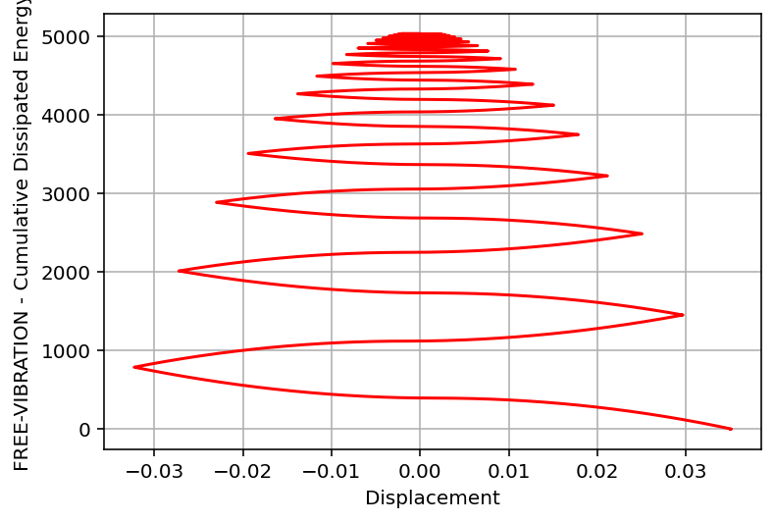

Slide 20
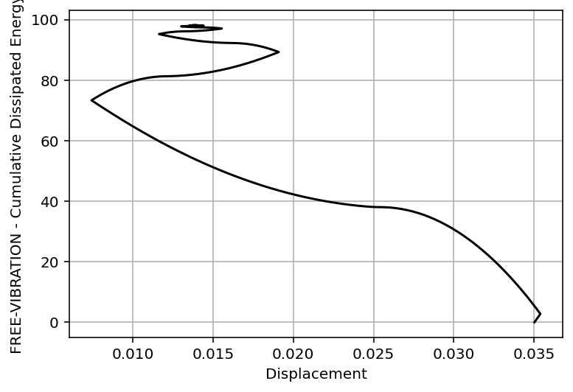

Slide 21
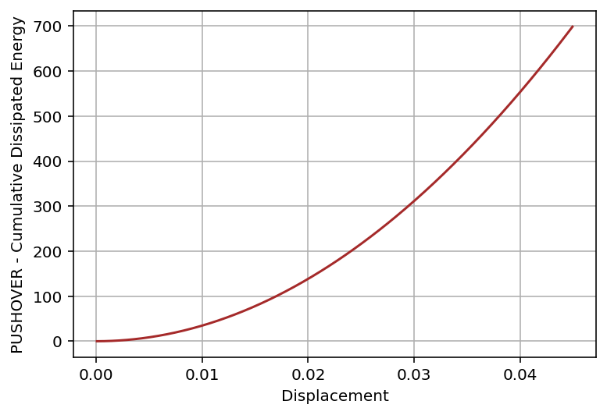

Slide 22
