Slide 1
>> IN THE NAME OF ALLAH, THE MOST GRACIOUS, THE MOST MERCIFUL <<
FREE-VIBRATION ANALYSIS OF SDOF STRUCTURE USING OPENSEES
WRITTEN BY SALAR DELAVAR GHASHGHAEI (QASHQAI)

Slide 2
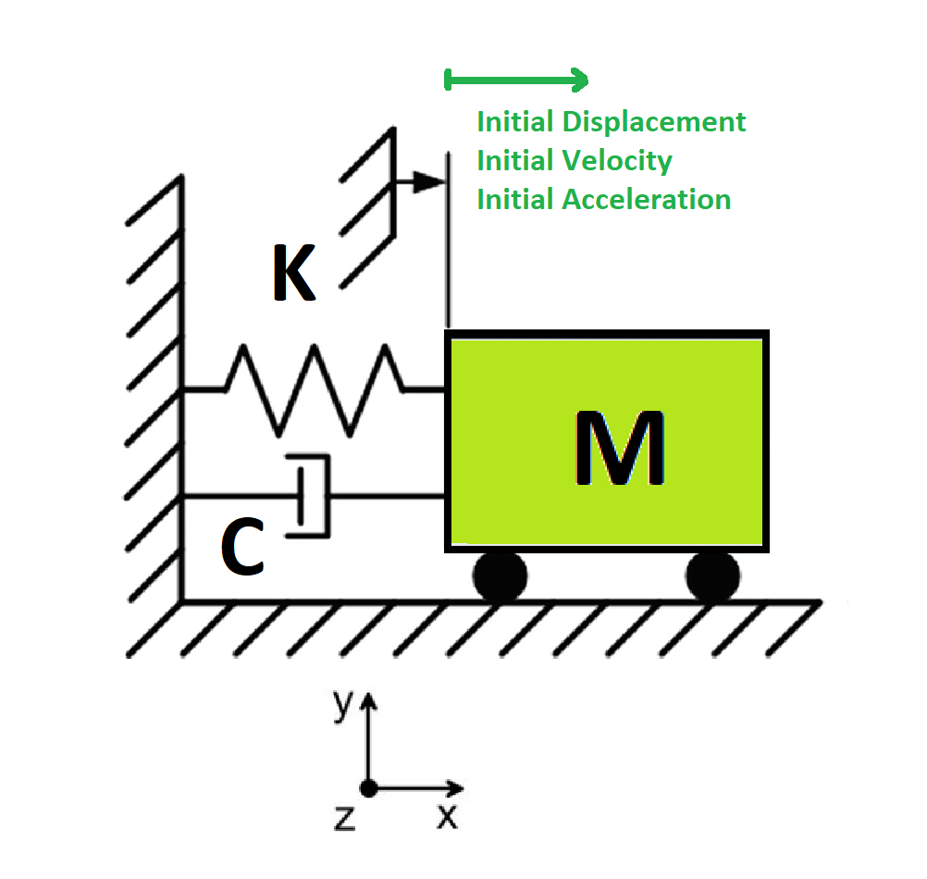

Slide 3
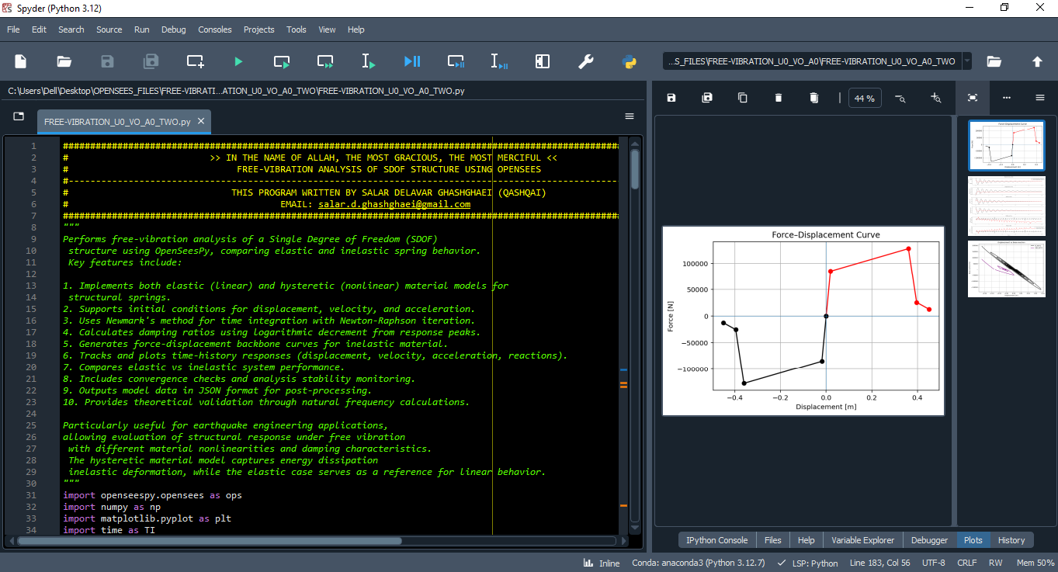

Slide 4
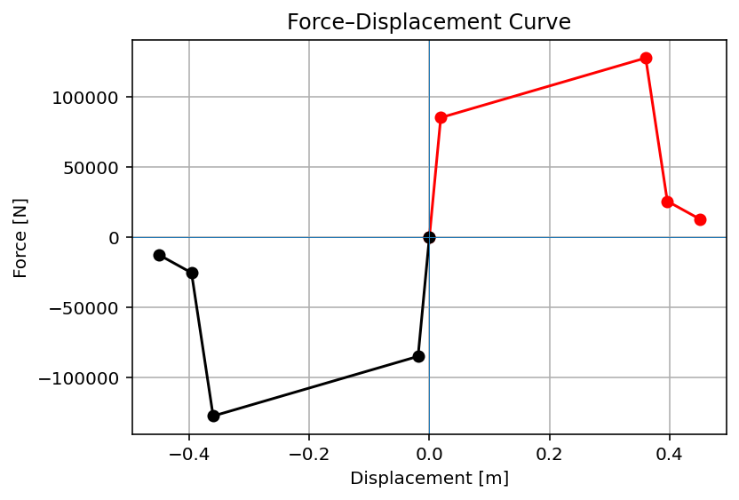

Slide 5
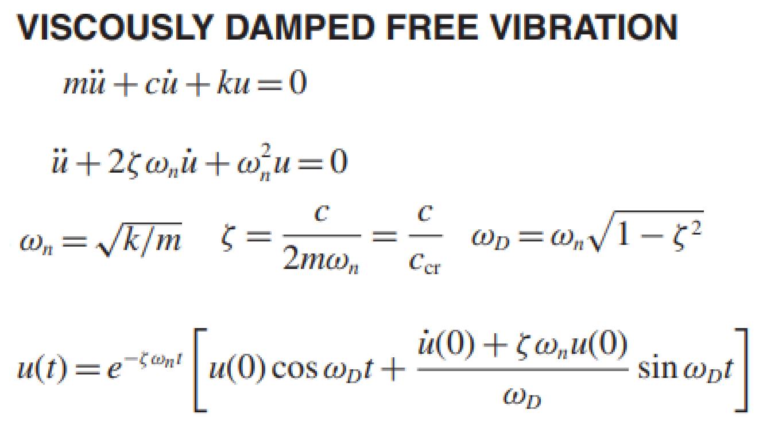
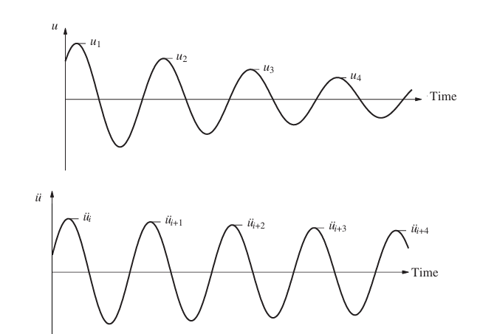
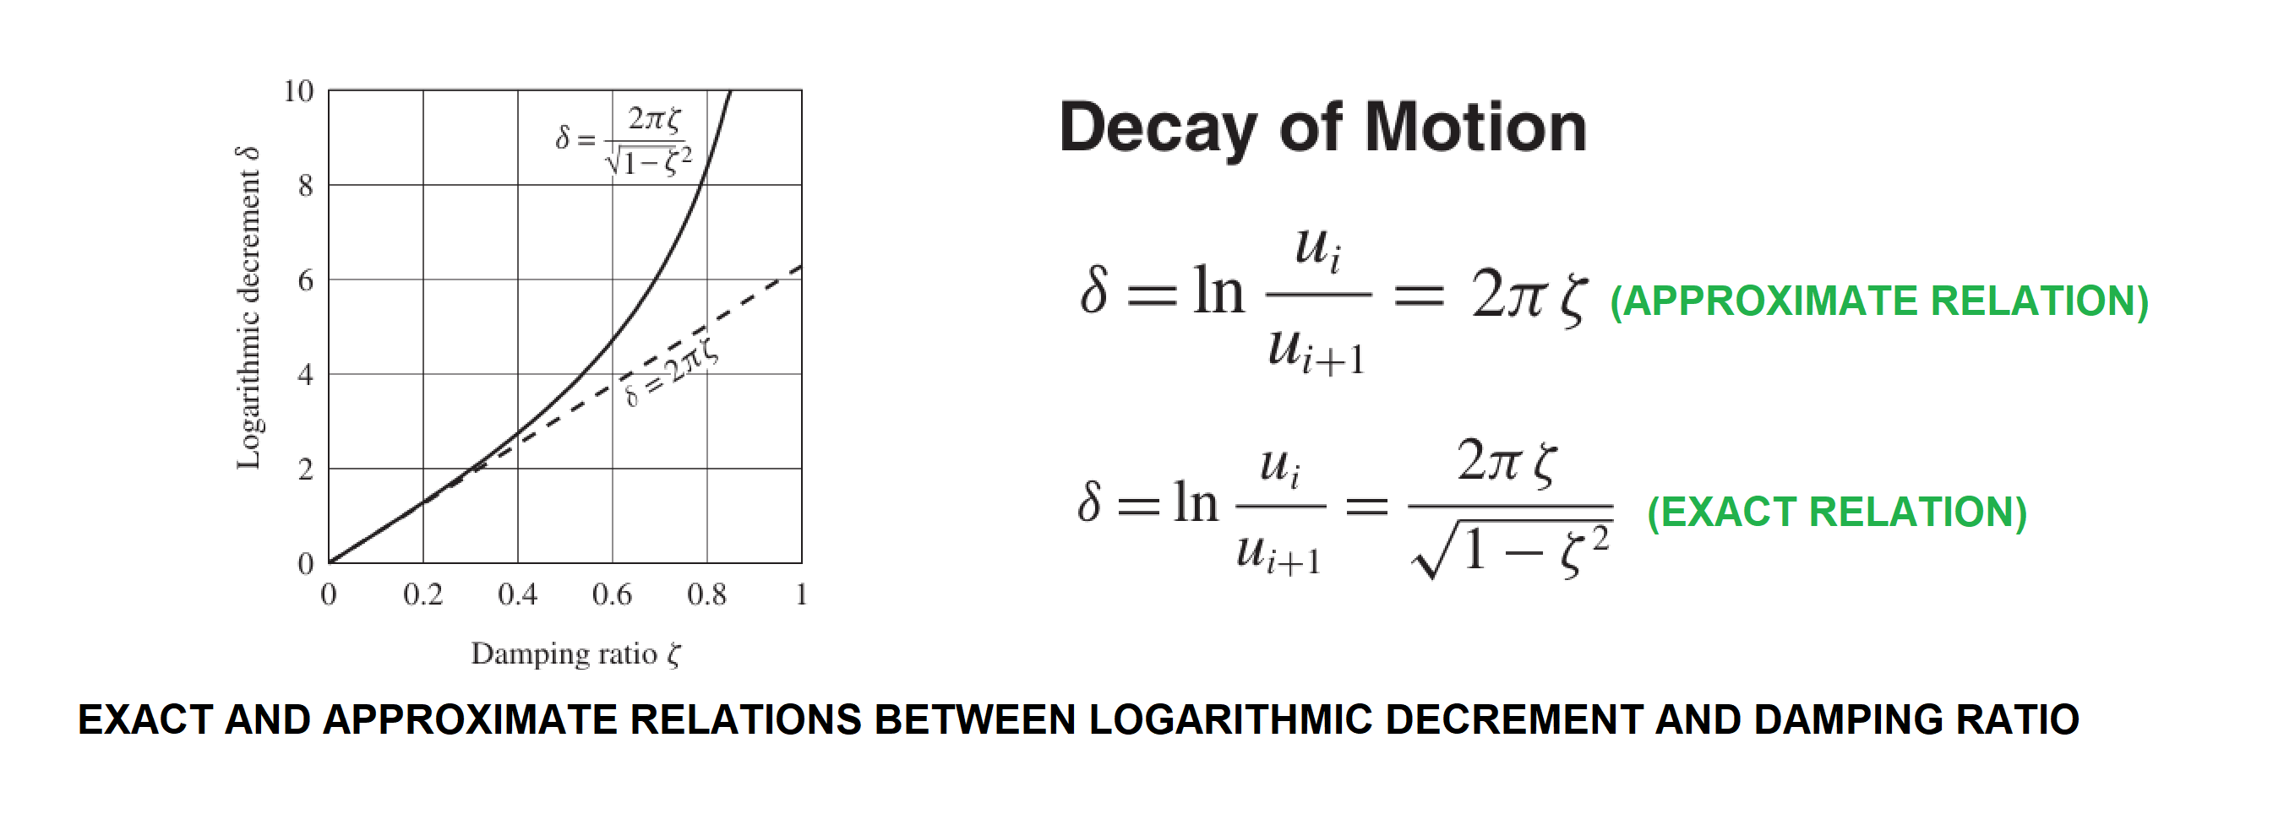

Slide 6
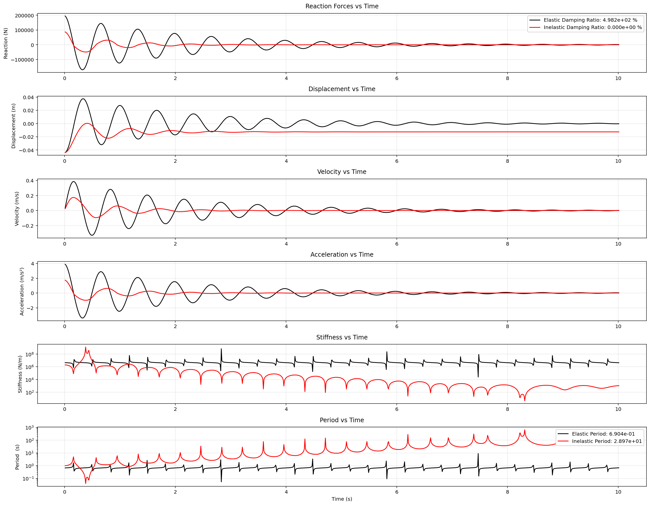

Slide 7
