Slide 1
>> IN THE NAME OF ALLAH, THE MOST GRACIOUS, THE MOST MERCIFUL <<
DETERMINATION OF OPTIMUM STRUCTURAL INITIAL ELASTIC STIFFNESS FROM STRUCTURAL PERIOD USING FINITE‑DIFFERENCE NEWTON ITERATION AND OPENSEES
THIS PYTHON SCRIPT IS WRITTEN BY SALAR DELAVAR GHASHGHAEI (QASHQAI)

Slide 2
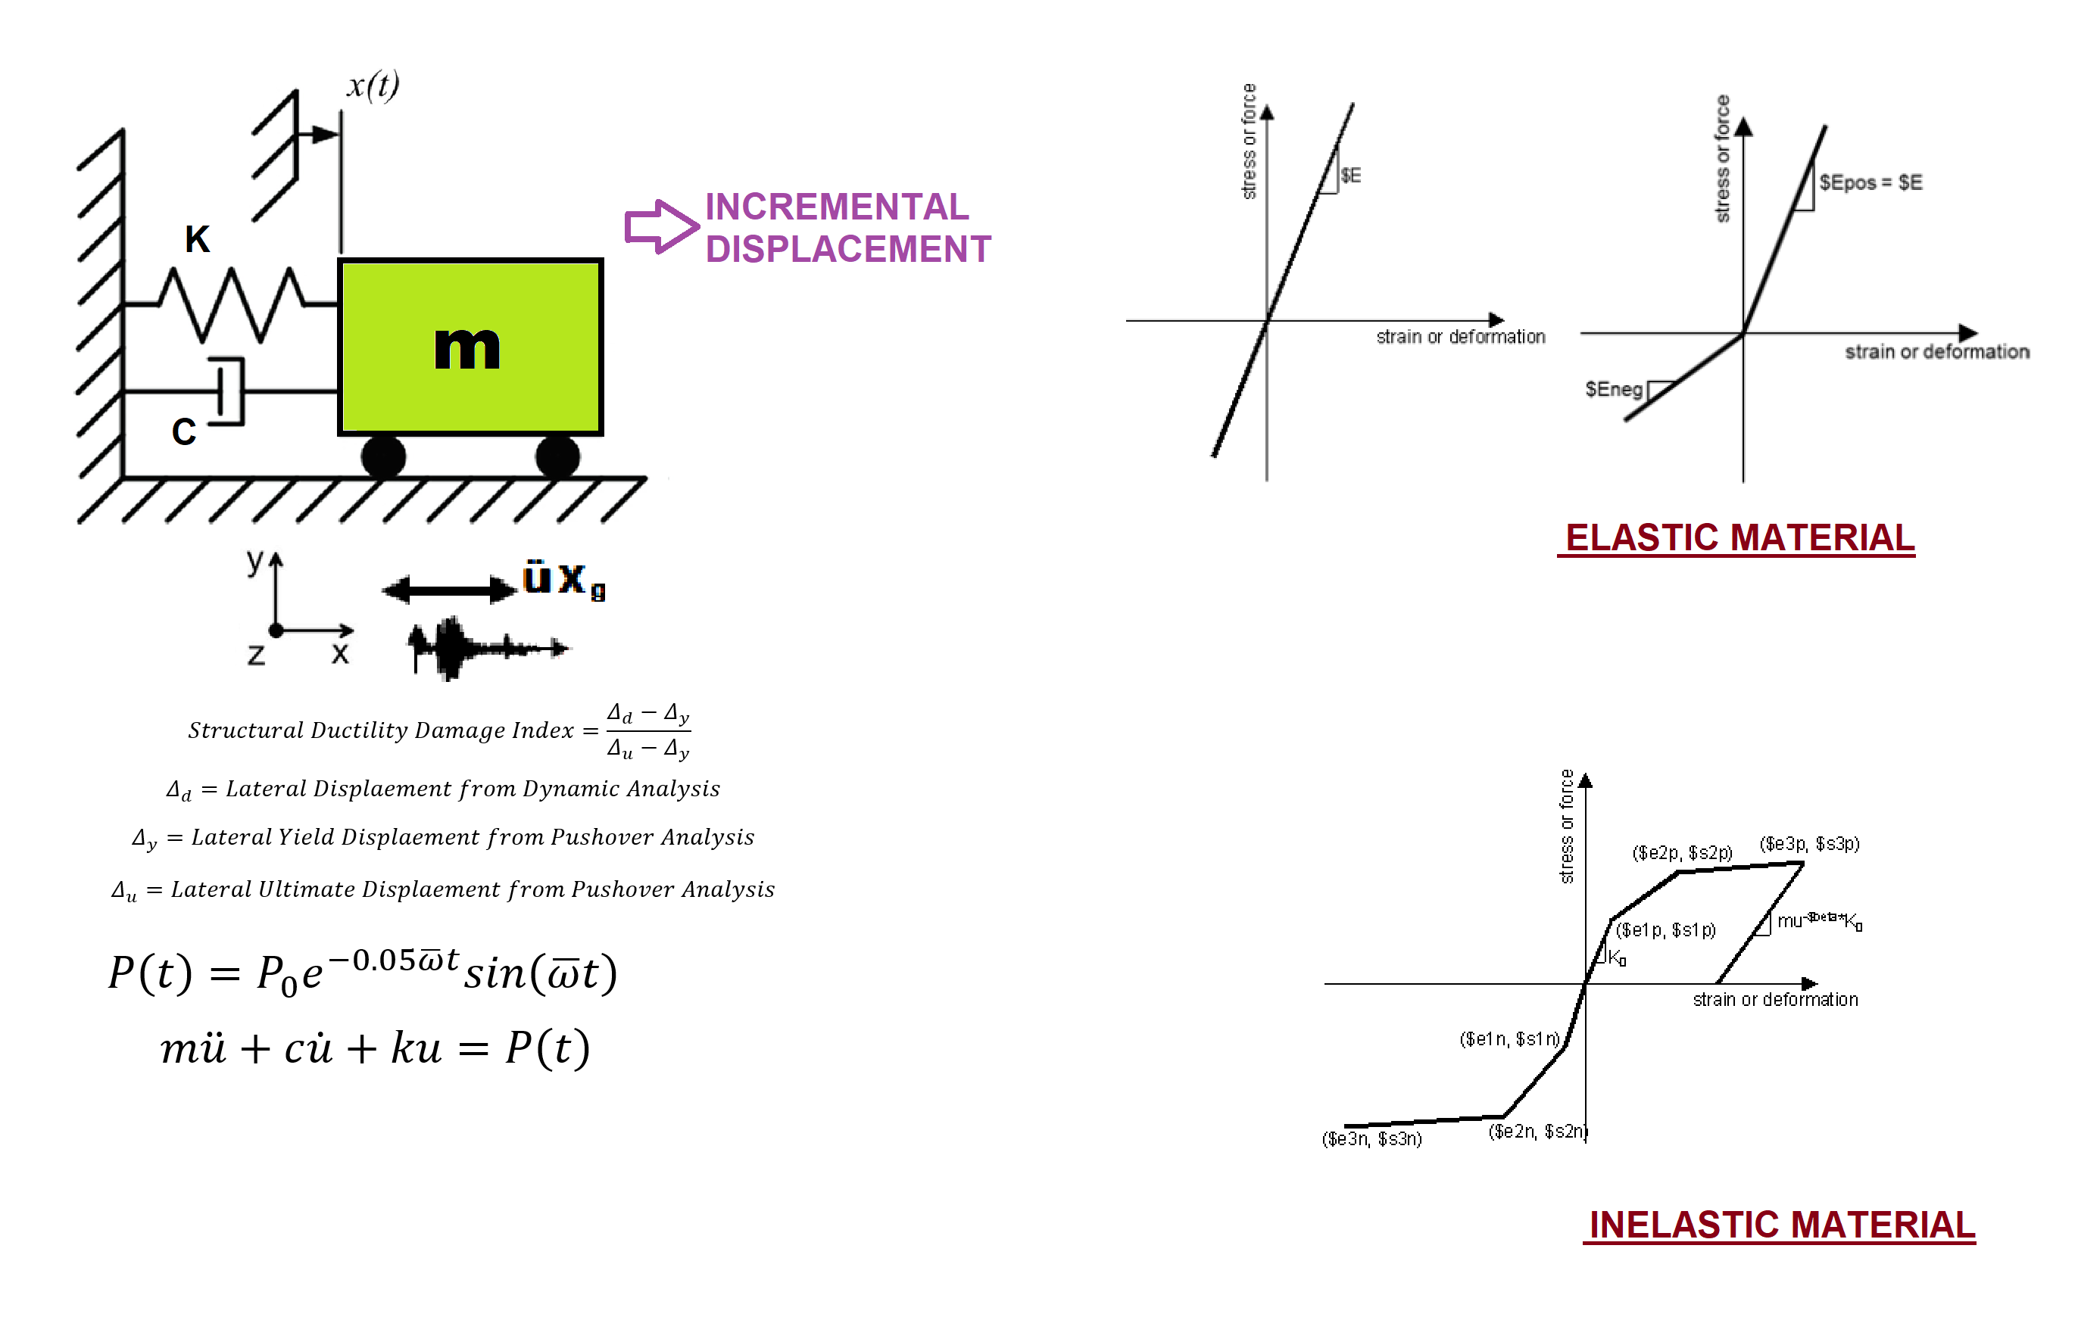

Slide 3
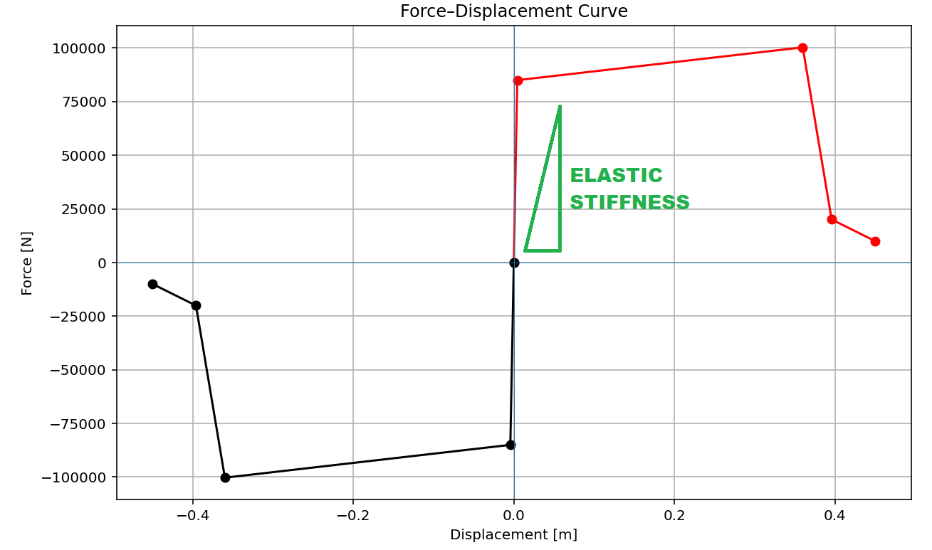

Slide 4
OPTIMIZATION PROBLEM FOR STRUCTURAL PERIOD BY CHANGING INTIAL ELASTIC STIFFNESS

Slide 5
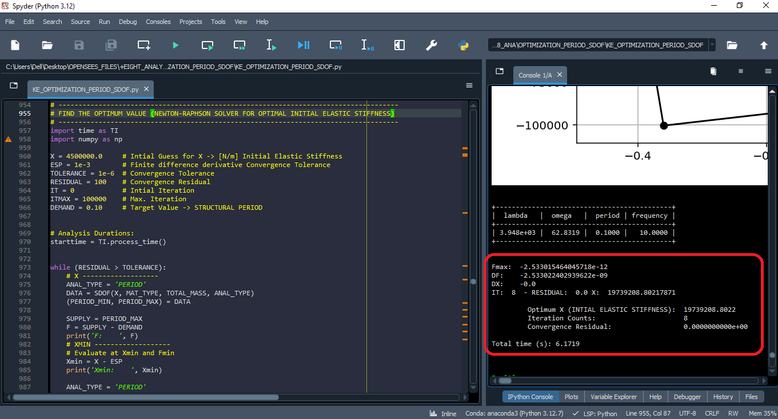

Slide 6
+--------------------------------------------+
| lambda | omega | period | frequency |
+--------------------------------------------+
| 3.948e+03 | 62.8319 | 0.1000 | 10.0000 |
+--------------------------------------------+
Fmax: -2.533015464045718e-12
DF: -2.533022402939622e-09
DX: -0.0
IT: 8 - RESIDUAL: 0.0 X: 19739208.80217871
Optimum X (INTIAL ELASTIC STIFFNESS): 19739208.8022
Iteration Counts: 8
Convergence Residual: 0.0000000000e+00
Total time (s): 6.1719

