Slide 1
>> IN THE NAME OF ALLAH, THE MOST GRACIOUS, THE MOST MERCIFUL <<
DETERMINATION OF OPTIMUM STRUCTURAL YIELD STRENGTH FROM ENERGY DISSIPATION CAPACITY INDEX USING FINITE‑DIFFERENCE NEWTON ITERATION AND OPENSEES
THIS PROGRAM WRITTEN BY SALAR DELAVAR GHASHGHAEI (QASHQAI)

Slide 2
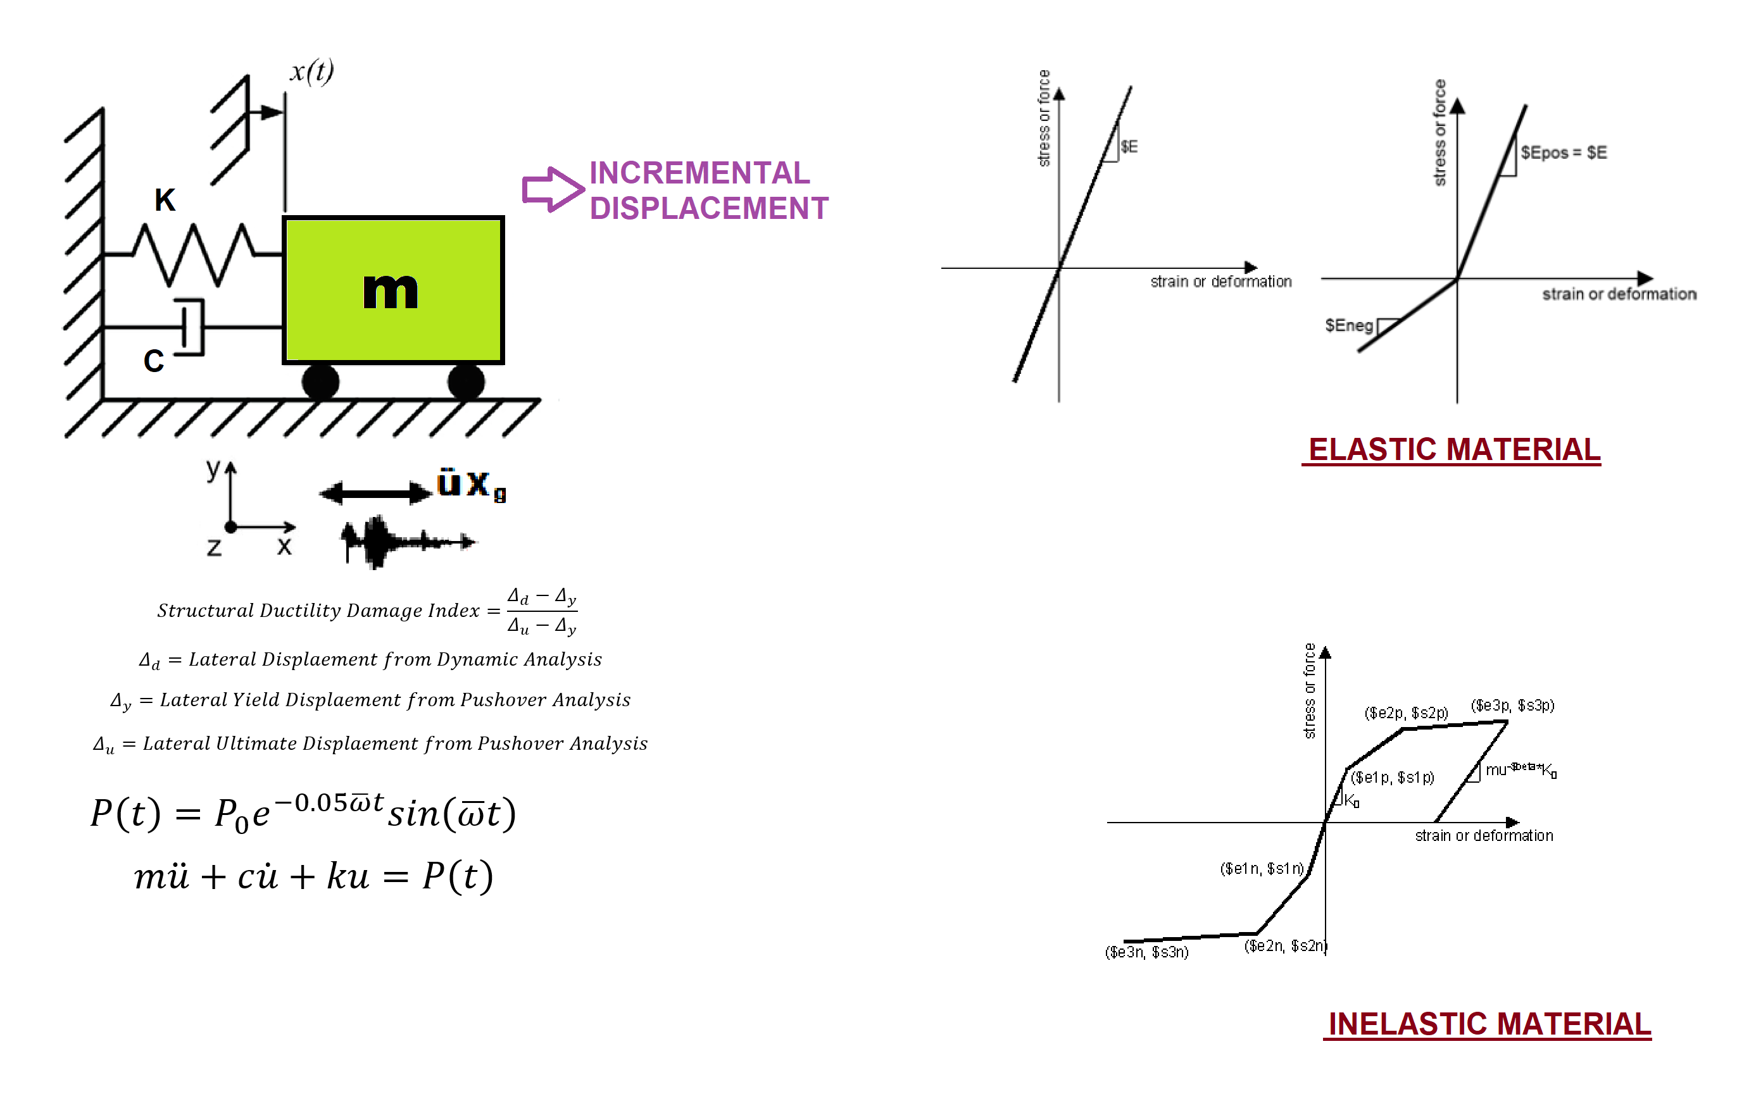

Slide 3
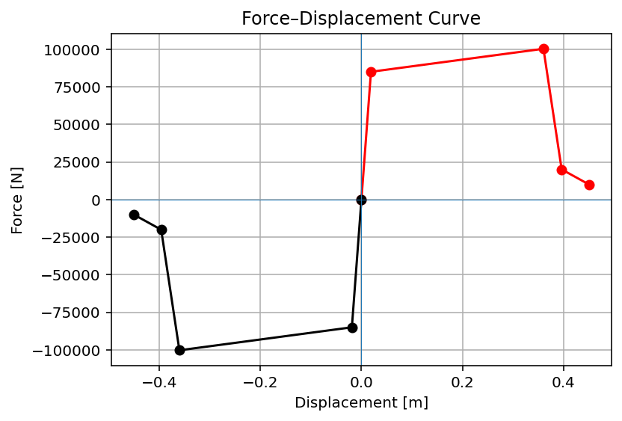

Slide 4
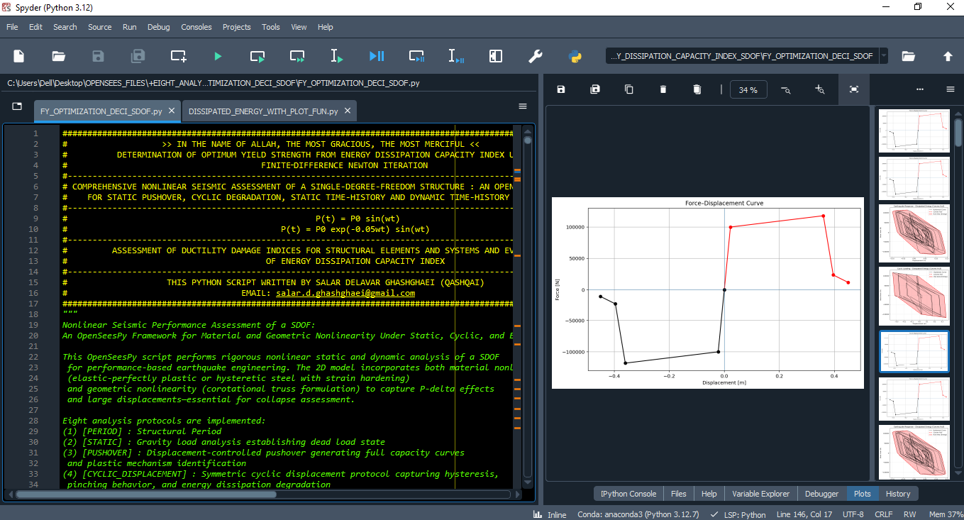

Slide 5
OPTIMIZATION PROBLEM FOR ENERGY DISSIPATION CAPACITY INDEX (EDCI)

Slide 6
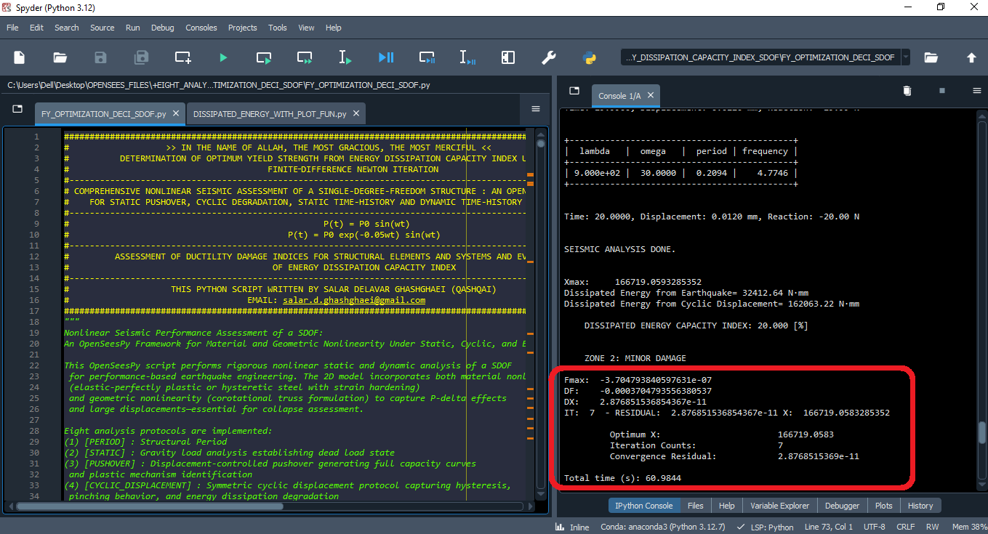

Slide 7
Dissipated Energy from Earthquake= 32412.64 N·m
Dissipated Energy from Cyclic Displacement= 162063.22 N·m
DISSIPATED ENERGY CAPACITY INDEX: 20.000 [%]
ZONE 2: MINOR DAMAGE
Fmax: -3.704793840597631e-07
DF: -0.0003704793556380537
DX: 2.876851536854367e-11
IT: 7 - RESIDUAL: 2.876851536854367e-11 X: 166719.0583285352
Optimum X (YIELD STRENGTH): 166719.0583
Iteration Counts: 7
Convergence Residual: 2.8768515369e-11

Slide 8
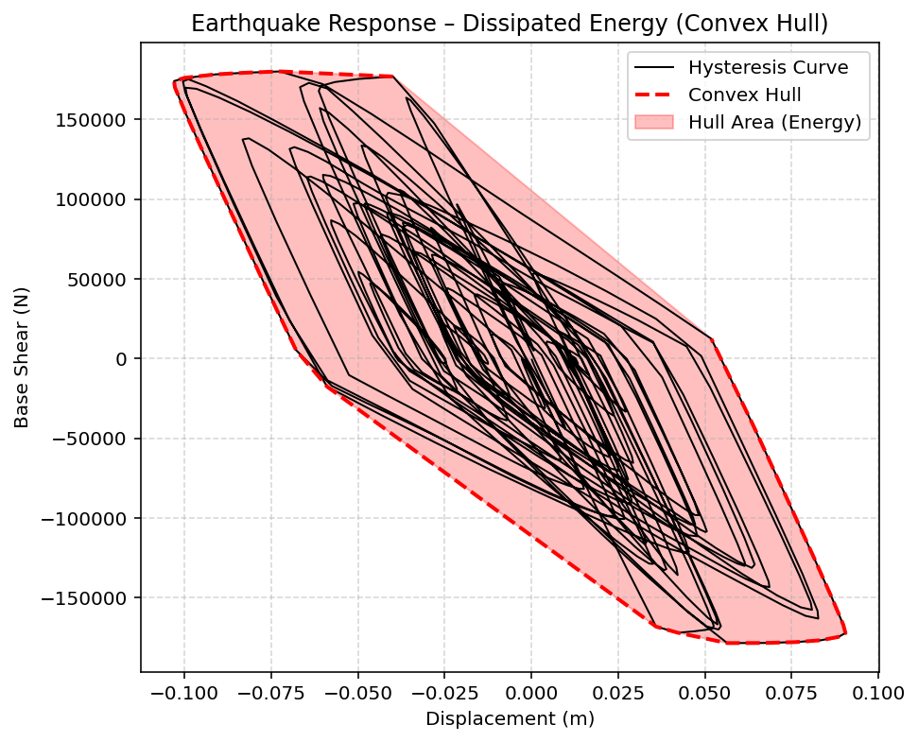

Slide 9
